Slide 1
The Locality Descriptor A Holistic Cross-Layer Abstraction to Express Data Locality in GPUs
ISCA 2018
Nandita Vijaykumar
Eiman Ebrahimi, Kevin Hsieh, Phillip B. Gibbons, Onur Mutlu

Slide 2
Data locality is critical to GPU performance
Core
Core
Core
Core
Memory
Memory
L1
L2
Core
Core
Memory
Memory
Memory
Cache Locality
NUMA Locality

Slide 3
Exploiting data locality in GPUs is a challenging and elusive feat…

Slide 4
…requiring a range of architectural techniques
Cache Management
CTA Scheduling
Data Placement
Data Prefetching
…

Slide 5
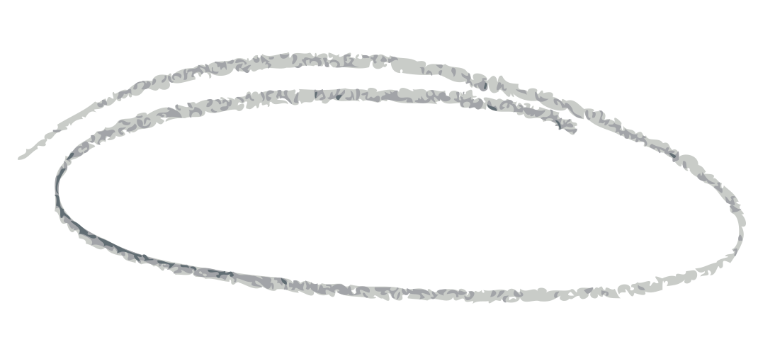
Furthermore…
A single technique is often insufficient
The required set of techniques depends on the program
Program B
Cache Management
CTA Scheduling
Program A
Data Placement
Data Prefetching
…

Slide 6
Challenging for the programmer/software
No easy access to many architectural techniques
Tedious and un-portable programming:
Bypass Cache Line A
Schedule Thread Block 2 at SM 1
…

Slide 7
Challenging for the architect
Hardware misses key program semantics required for optimization
Where to place data?
Which threads to schedule together?
Which data to bypass?

Slide 8
The Locality Descriptor
A hardware-software abstraction to express and exploit data locality
Connects locality semantics to the underlying
hardware techniques
Application
New software interface
Software
Locality Descriptor
Access to key program semantics
Hardware
Data Placement
Cache Management
CTA Scheduling
Data Prefetching
…

Slide 9
A Sneak Peak
Address Range
Data Structure
Locality Type
LocalityDescriptor ldesc();
LocalityDescriptor ldesc(A, len, INTER-THREAD, tile, loc, priority);
Tile Semantics
Locality
Semantics
Priority
Key Performance Results:
Leveraging Cache Locality: 26.6% on average (up to 46.6%)
Leveraging NUMA Locality: 53.7% (up to 2.8X)

Slide 10
The Locality Descriptor A Holistic Cross-Layer Abstraction to Express Data Locality in GPUs
ISCA 2018
Nandita Vijaykumar
Eiman Ebrahimi, Kevin Hsieh, Phillip B. Gibbons, Onur Mutlu

