Slide 1






Pythia
A Customizable Hardware Prefetching Framework Using Online Reinforcement Learning
Rahul Bera, Konstantinos Kanellopoulos, Anant V. Nori,
Taha Shahroodi, Sreenivas Subramoney, Onur Mutlu
Notes:
Hi I’m Rahul. Today, I will introduce Pythia.

Slide 2


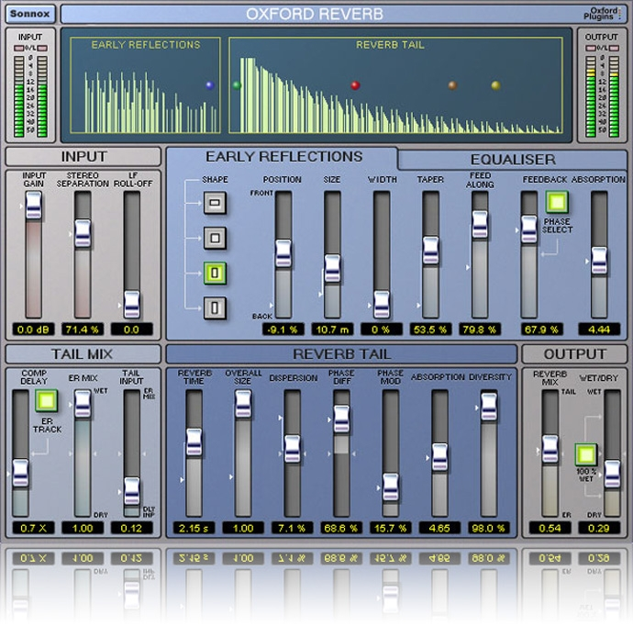


1
2
3
Mainly use one program context info. for prediction
Lack system awareness
Lack in-silicon customizability
Why prefetchers do not perform well?
Notes:
We analyze many prior prefetchers and observe three key shortcomings that significantly limits their performance.
[CLICK] First, they use mainly a single program context for prefetch prediction
[CLICK] Second, they lack system awareness
[CLICK] Third, they lack in-silicon customizability

Slide 3
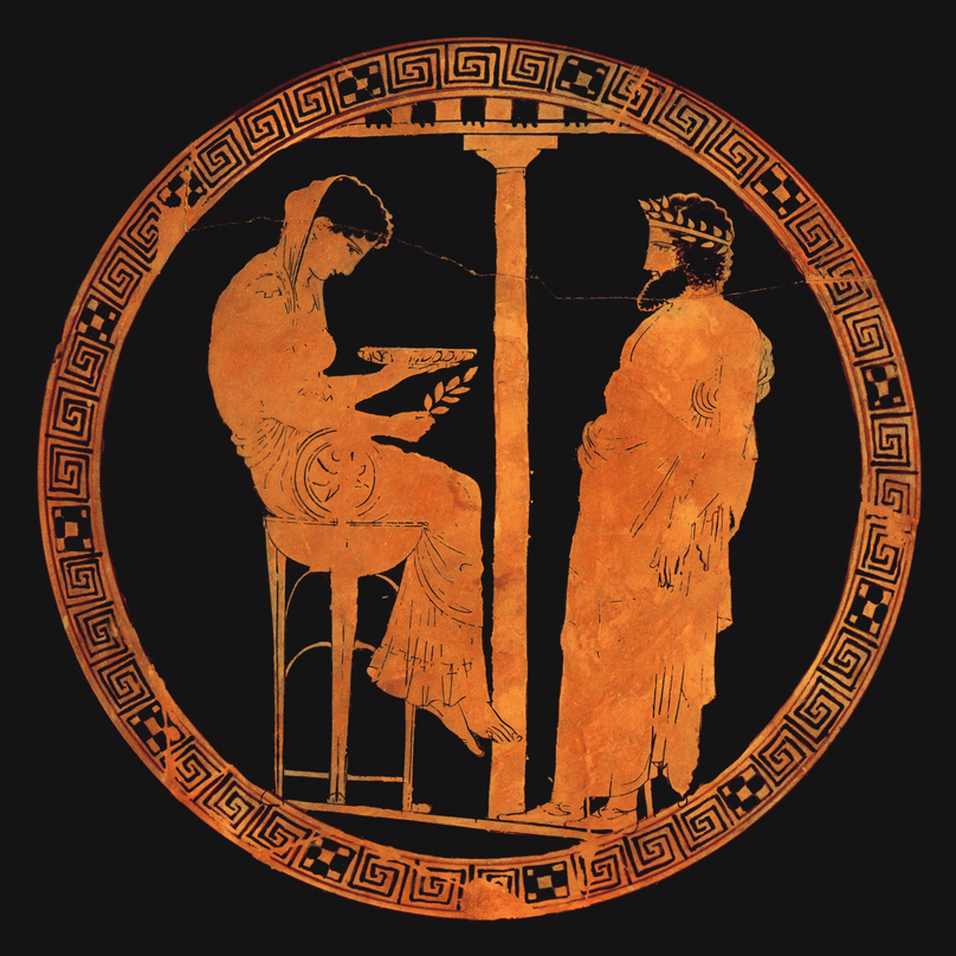


Pythia
Autonomously learns to prefetch using multiple program context information
and system-level feedback
In-silicon customizable to change program context information or prefetching objective on the fly
Notes:
To alleviate these challenges, we introduce Pythia that:
[CLICK] autonomously learns to prefetch using multiple program context information and system-level feedback
[CLICK] and can be customizable in silicon to alter the program context information or the objective of the prefetcher

Slide 4
Brief Overview of Pythia
Pythia formulates prefetching as a reinforcement learning problem
Notes:
Pythia formulates prefetching as a reinforcement learning problem where,
[CLICK] the prefetcher acts as the agent, ….

Slide 5
1
We evaluate Pythia using a wide-range of workloads
Pythia improves performance by
3.4% and 3.8% in single-core
7.7% and 9.6% in twelve-core
16.9% and 20.2% in memory bandwidth-constrained core
over state-of-the-art MLOP and Bingo prefetchers
2
We gain 7.8% more performance on top of basic Pythia configuration by simply customizing reward values for graph workloads
3
Realistic, practical implementation
No complex structures, only simple tables.
Only 1.03% area and 0.4% power of a desktop-class processor
Notes:
[CLICK] We extensively evaluate Pythia over a wide range of workloads and show that Pythia outperforms many state-of-the-art prefetcher over a wide range of system configuration.
[CLICK] We also show that by simple customization via configuration registers, Pythia can provide higher performance benefits for target workloads, without any changes to the underlying hardware.
[CLICK] Finally, Pythia proposes a realistic implementation of its RL algorithm that incurs a modest area and power overhead on top of a traditional processor.

Slide 6
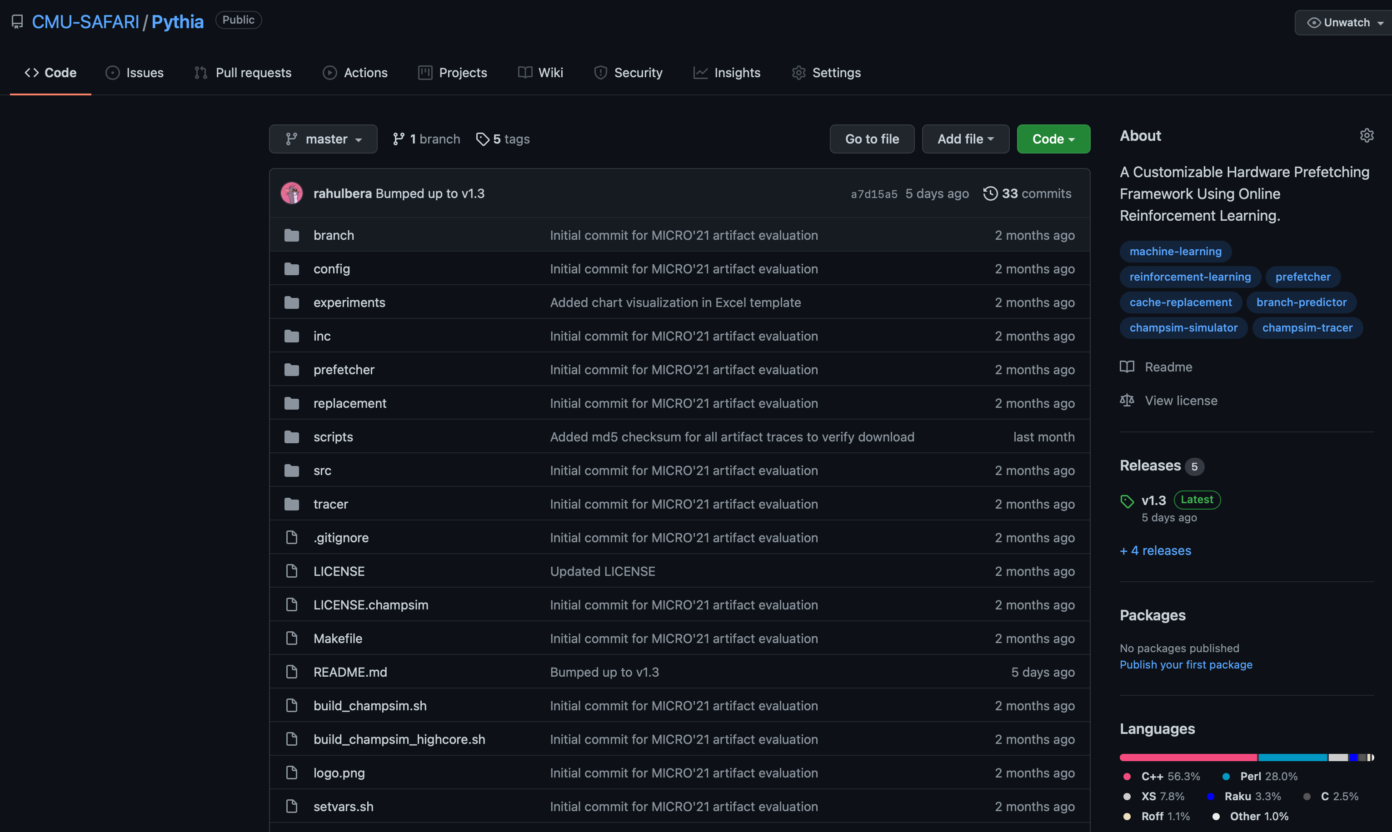
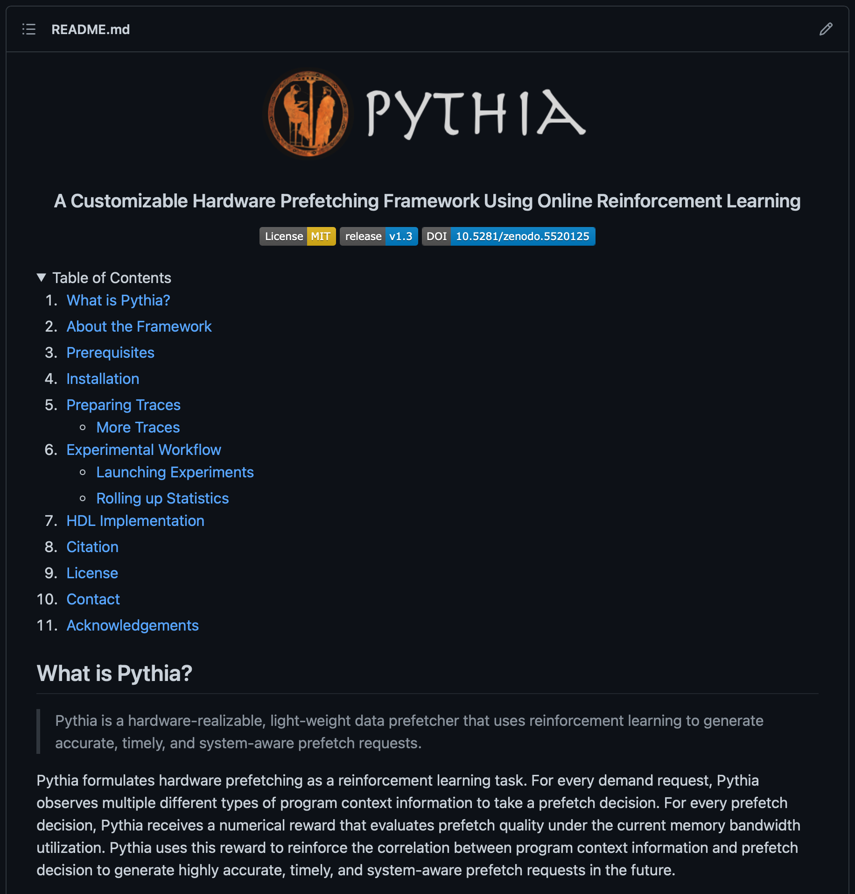
Pythia is Open-sourced
https://github.com/CMU-SAFARI/Pythia
MICRO’21 artifact evaluated
Champsim source code + Chisel modeling code
All traces used for evaluation
Notes:
Pythia is open-sourced and artifact evaluated.
All necessary source code and traces used for evaluation can be found online in our GitHub repository.

Slide 7
Pythia
A Customizable Hardware Prefetching Framework Using Online Reinforcement Learning
Rahul Bera, Konstantinos Kanellopoulos, Anant V. Nori,
Taha Shahroodi, Sreenivas Subramoney, Onur Mutlu
Session 9B, October 21, 8:00 PM CEST
Notes:
We invite everyone to attend our talk in Session 9B on 21st October.

