Slide 1
RowPress Amplifying Read Disturbance in Modern DRAM Chips
ISCA 2023 Session 2B: Monday 19 June, 2:15 PM EDT
Haocong Luo
Ataberk Olgun A. Giray Yağlıkçı Yahya Can Tuğrul
Steve Rhyner Meryem Banu Cavlak Joël Lindegger
Mohammad Sadrosadati Onur Mutlu
Notes:
Hello, I am Haocong Luo. I will be presenting our work, RowPress, amplifying read disturbance in modern DRAM chips

Slide 2
High-Level Summary
We demonstrate and analyze RowPress, a new read disturbance phenomenon that causes bitflips in real DRAM chips
We show that RowPress is different from the RowHammer vulnerability
We demonstrate RowPress using a user-level program on a real Intel system with real DRAM chips
We provide effective solutions to RowPress
Notes:
In this work, we demonstrate and analyze RowPress, a new read disturbance phenomenon that causes bitflips in real DRAM chips
[Click]
We show that RowPress is different from RowHammer
[Click]
demonstrate RowPress in a real system with a user-level program
[Click]
And provide effective solutions to mitigate RowPress

Slide 3
What is RowPress?
Keeping a DRAM row open for a long time causes bitflips in adjacent rows
These bitflips do NOT require many row activations
Only one activation is enough in some cases!
☞
Now, let's delve into some background and
see how this is different from RowHammer
Notes:
So, what is RowPress?
[Click]
RowPress is the read disturbance caused by keeping a DRAM row open for a long time, which induces bitflips in adjacent rows
[Click]
These bitflips do not require many row activations,
[Click]
and we find in some cases only one row activation is enough.
[Click]
Now, lets see how this is different from RowHammer

Slide 4
Read Disturbance in DRAM
Read disturbance in DRAM breaks memory isolation
Prominent example: RowHammer
DRAM Chip
Row 1
Row 1
Row 1
Victim Row
Row 2
Row 2
Row 2
Row 2
Row 2
Row 2
closed
open
open
Aggressor Row
closed
open
Row 3
Row 3
Row 3
Victim Row
Repeatedly opening (activating) and closing a DRAM row many times causes RowHammer bitflips in adjacent rows
Notes:
Read disturbance has significant system-level implications because it breaks memory isolation.
A prominent example of this is RowHammer, where repeatedly activating and closing a DRAM row many times causes RowHammer bitflips in adjacent rows

Slide 5
Are There Other Read-Disturb Issues in DRAM?
RowHammer is the only studied read-disturb phenomenon
Mitigations work by detecting high row activation count
What if there is another read-disturb phenomenon
that does NOT rely on high row activation count?
https://www.reddit.com/r/CrappyDesign/comments/arw0q8/now_this_this_is_poor_fencing/
Notes:
RowHammer is the only studied read-disturb effect, and various mitigations work by detecting high row activation count.
This raises the following question, what if there is another read-disturb phenomenon that does not rely on high activation count?

Slide 6
RowPress vs. RowHammer
Instead of using a high activation count,
☞ increase the time that the aggressor row stays open
RowHammer
Aggressor Row
Open
Close
36ns, 47K activations to induce bitflips
RowPress
Aggressor Row
Open
Close
7.8µs, only 5K activations to induce bitflips
We observe bitflips even with ONLY ONE activation in extreme cases where the row stays open for 30ms
Notes:
Instead of a high activation count, RowPress increases the time the that aggressor stays open.
Doing disturbs adjacent rows enough to cause bitflips without a very high activation count.
We observe bitflips even with only one activation in extreme cases.

Slide 7
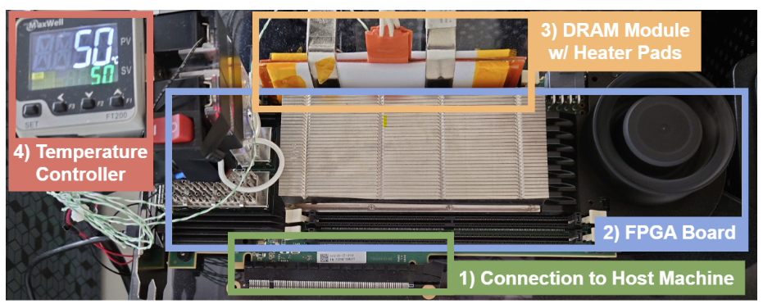
Real DRAM Chip Characterization (I)
FPGA-Based DDR4 Testing Infrastructure
Based on SoftMC [Hassan+, HPCA’17] and DRAM Bender [Olgun+, TCAD’23]
Fine-grained control over DRAM commands, timings, and temperature
Notes:
We use a FPGA based DDR4 testing infrastructure to characterize RowPress

Slide 8
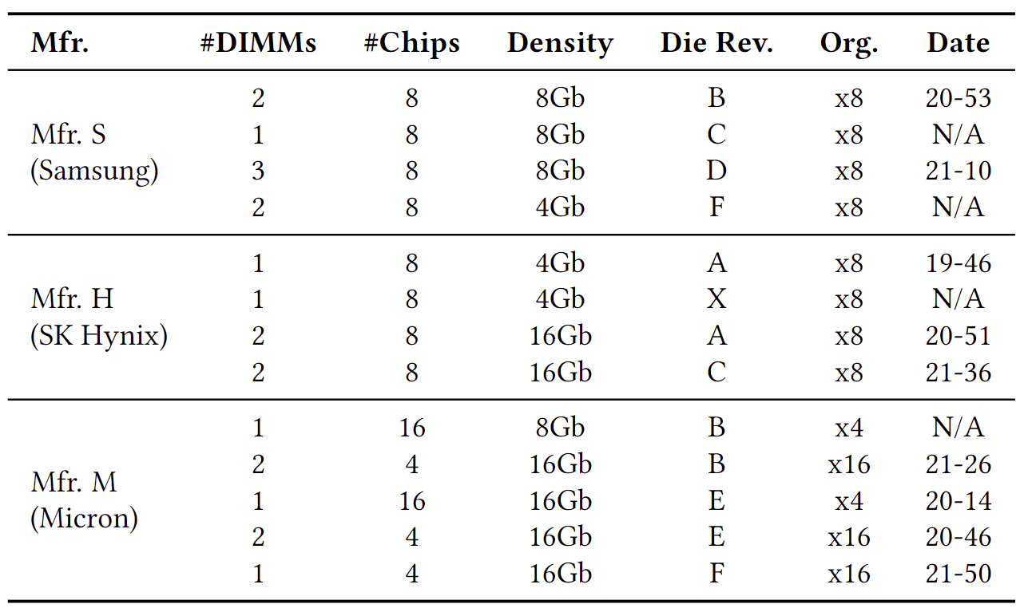
Real DRAM Chip Characterization (II)
DRAM Chips Tested
164 DDR4 chips from all 3 major DRAM manufacturers
Notes:
using DDR4 chips from all 3 major DRAM manufacturers

Slide 9
Major Takeaways from Real DRAM Chips
RowPress significantly amplifies DRAM’s vulnerability to read disturbance
RowPress has a different underlying error mechanism from RowHammer
Notes:
Our characterization yields the following two key takeaways

Slide 10
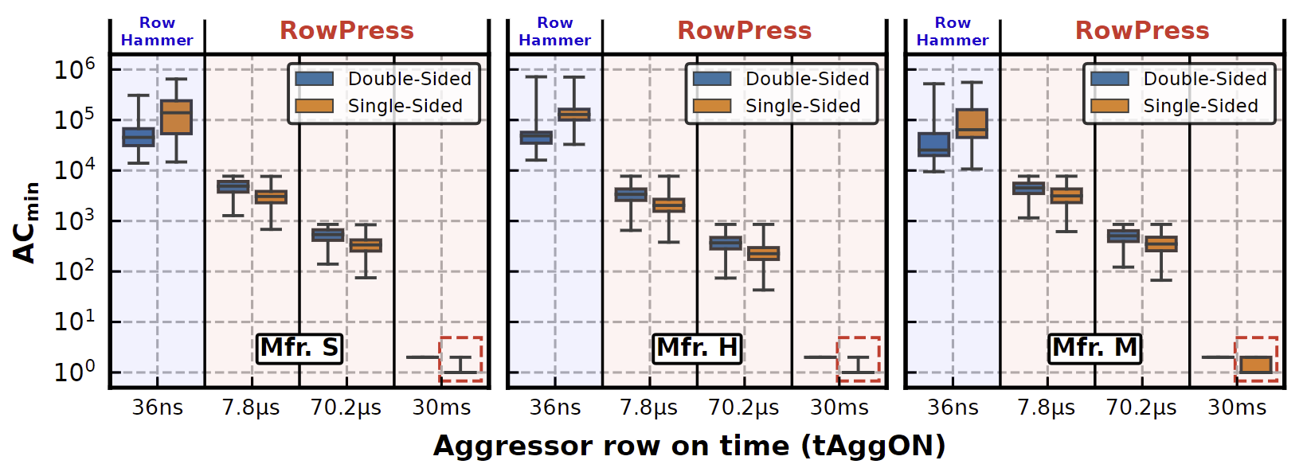
Key Characteristics of RowPress (I)
Amplifying Read Disturbance in DRAM
Reduces the minimum number of row activations needed to induce a bitflip (ACmin) by 1-2 orders of magnitude
In extreme cases, activating a row only once induces bitflips
Notes:
RowPress amplifies read disturbance because
First, it reduces the minimum number of row activations needed to induce a bitflip by 1-2 orders of magnitude
Second, in extreme cases, activating a row only once induces bitflips

Slide 11
Key Characteristics of RowPress (II)
Amplifying Read Disturbance in DRAM
Reduces the minimum number of row activations needed to induce a bitflip (ACmin) by 1-2 orders of magnitude
In extreme cases, activating a row only once induces bitflips
Gets worse as temperature increases
Different From RowHammer
Affects a different set of cells compared to RowHammer and retention failures
Behaves differently as access pattern and temperature changes compared to RowHammer
Notes:
Third, it gets worse as temperature increases
RowPress is different from RowHamer because it affects a different set of cells and behaves differently as access pattern and temperature changes

Slide 12
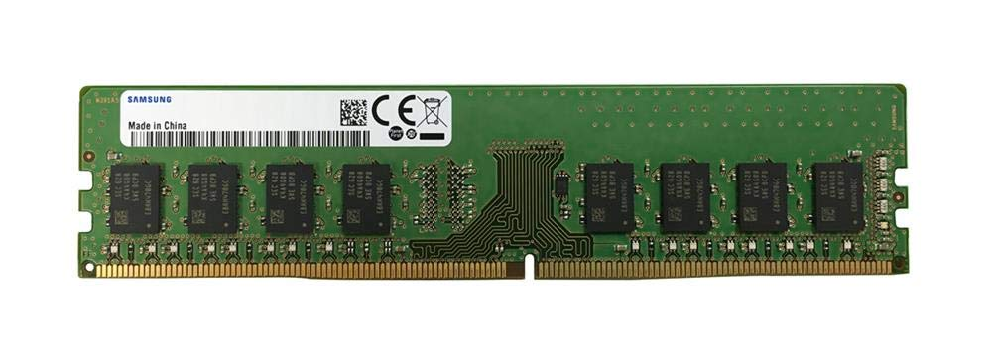
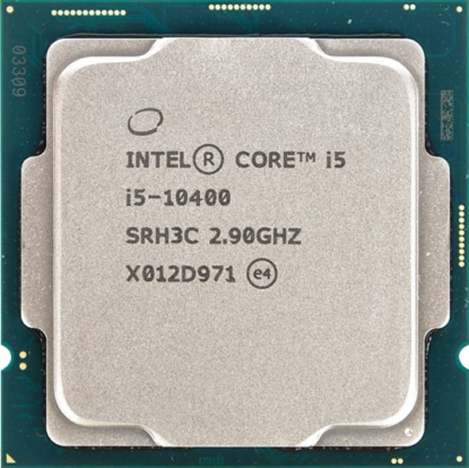
Real-System Demonstration (I)
Samsung DDR4 Module M378A2K43CB1-CTD
(Date Code: 20-10)
w/ TRR RowHammer Mitigation
Intel Core i5-10400 (Comet Lake)
Key Idea: A proof-of-concept RowPress program keeps a DRAM row open for a longer period by keeping on accessing different cache blocks in the row
Notes:
We demonstrate RowPress on a real system with a recent Intel processor and a Samsung DDR4 module with TRR rowhammer mitigation. The key idea is to keep a DRAM row open for a longer period by keeping accessing different cache blocks in the row.

Slide 13
Real-System Demonstration (II)
Key Idea: A proof-of-concept RowPress program keeps a DRAM row open for a longer period by keeping on accessing different cache blocks in the row
Leveraging RowPress, a user-level program
induces bitflips when RowHammer cannot
Notes:
Our results show that leveraing RowPress, a user-level program induces bitflips when RowHammer cannot, in the presence of on-die TRR RowHammer mitigation.

Slide 14
How to Avoid RowPress Bitflips
We propose a methodology to adapt existing RowHammer mitigations to also mitigate RowPress
Key Mechanisms:
Limit the maximum time that a row can stay open
Configure the RowHammer mitigation to account for the RowPress-induced reduction in the number of activations needed to cause bitflips
Our solutions mitigate RowPress at low additional performance overhead
Notes:
We propose a methodology to adapt existing RH mitigations to also mitigate RowPress.
The key mechanisms are,
first limit the maximum time that a row can stay open, and
second, configure the RowHammer mitigation to account for the RowPress induced reduction in the number of activations needed to cause bitflips. Our solutions mitigate RowPress at low additional performance overhead.

Slide 15
More Results
Many more results & analyses in the paper
6 major takeaways
19 major empirical observations
Fully open source and artifact evaluated
https://github.com/CMU-SAFARI/RowPress
Notes:
We have more results in the paper, and our work is fully open-source and artifact evaluated.

Slide 16
RowPress Amplifying Read Disturbance in Modern DRAM Chips
ISCA 2023 Session 2B: Monday 19 June, 2:15 PM EDT
Haocong Luo
Ataberk Olgun A. Giray Yağlıkçı Yahya Can Tuğrul
Steve Rhyner Meryem Banu Cavlak Joël Lindegger
Mohammad Sadrosadati Onur Mutlu
Notes:
Thank you for your attention, and I invite you to our full talk and paper for more details.

