Slide 1


The RowHammer Problem and Other Issues We May Face as Memory Becomes Denser
Onur Mutlu
onur.mutlu@inf.ethz.ch
https://people.inf.ethz.ch/omutlu
April 21, 2017
CFAED Workshop on Resilient Systems Keynote

Slide 2
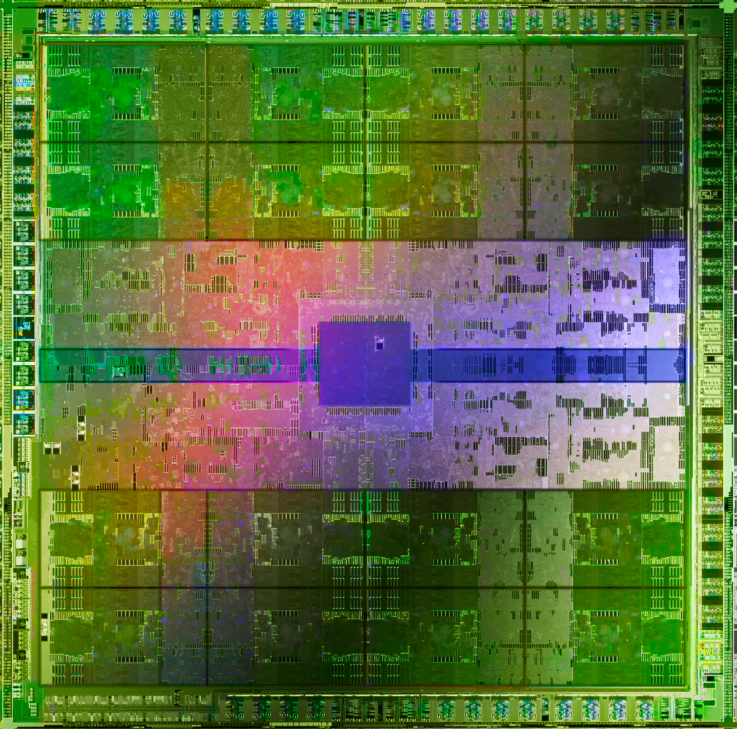
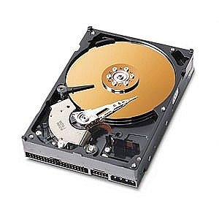
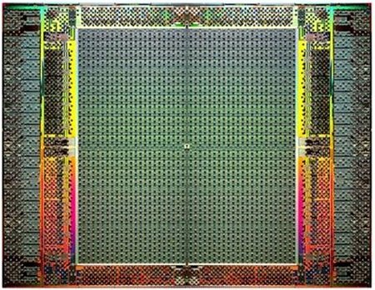
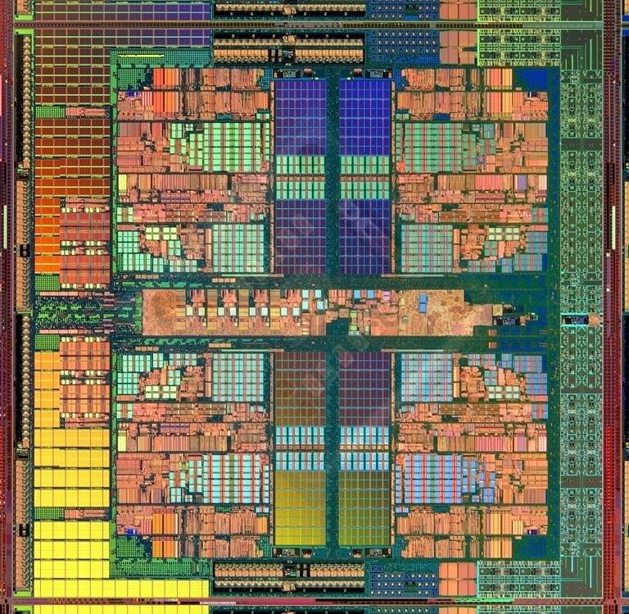
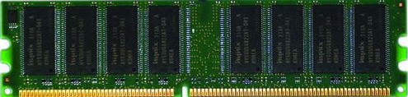
The Main Memory System
Main memory is a critical component of all computing systems: server, mobile, embedded, desktop, sensor
Main memory system must scale (in size, technology, efficiency, cost, and management algorithms) to maintain performance growth and technology scaling benefits
Processors
and caches
Main Memory
Storage (SSD/HDD)
GPUs
FPGAs

Slide 3
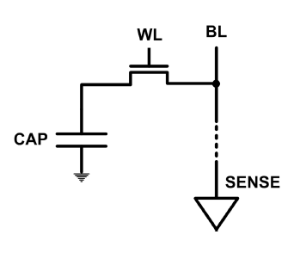
The DRAM Scaling Problem
DRAM stores charge in a capacitor (charge-based memory)
  Capacitor must be large enough for reliable sensing
  Access transistor should be large enough for low leakage and high retention time
  Scaling beyond 40-35nm (2013) is challenging [ITRS, 2009]
As DRAM cell becomes smaller, it becomes more vulnerable

Slide 4
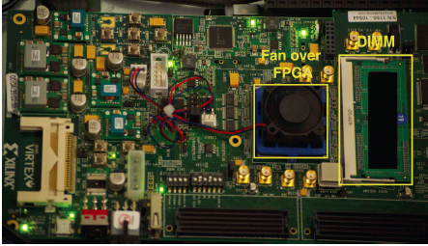
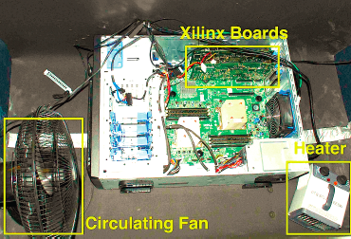
Testing DRAM Scaling Issues …
  An Experimental Study of Data Retention Behavior in Modern DRAM Devices: Implications for Retention Time Profiling Mechanisms (Liu et al., ISCA 2013)
  The Efficacy of Error Mitigation Techniques for DRAM Retention Failures: A Comparative Experimental Study
  (Khan et al., SIGMETRICS 2014)
  Flipping Bits in Memory Without Accessing Them: An Experimental Study of DRAM Disturbance Errors (Kim et al., ISCA 2014)
  Adaptive-Latency DRAM: Optimizing DRAM Timing for the Common-Case (Lee et al., HPCA 2015)
  AVATAR: A Variable-Retention-Time (VRT) Aware Refresh for DRAM Systems (Qureshi et al., DSN 2015)

Slide 5
Modern DRAM is Prone to Disturbance Errors
Row of Cells
Wordline
Row
Victim Row
Row
Hammered Row
V_{LOW}
Opened
V_{HIGH}
Closed
Row
Victim Row
Row
Repeatedly opening and closing a row enough times within a refresh interval induces disturbance errors in adjacent rows in most real DRAM chips you can buy today
Flipping Bits in Memory Without Accessing Them: An Experimental Study of DRAM Disturbance Errors, (Kim et al., ISCA 2014)

Slide 6
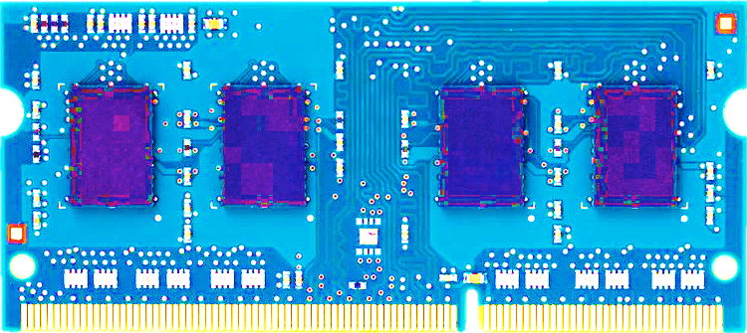
Most DRAM Modules Are Vulnerable
A company
B company
C company
86%
(37/43)
83%
(45/54)
88%
(28/32)
Up to
1.0×10⁷
errors
Up to
2.7×10⁶
errors
Up to
3.3×10⁵
errors
Flipping Bits in Memory Without Accessing Them: An Experimental Study of DRAM Disturbance Errors, (Kim et al., ISCA 2014)

Slide 7
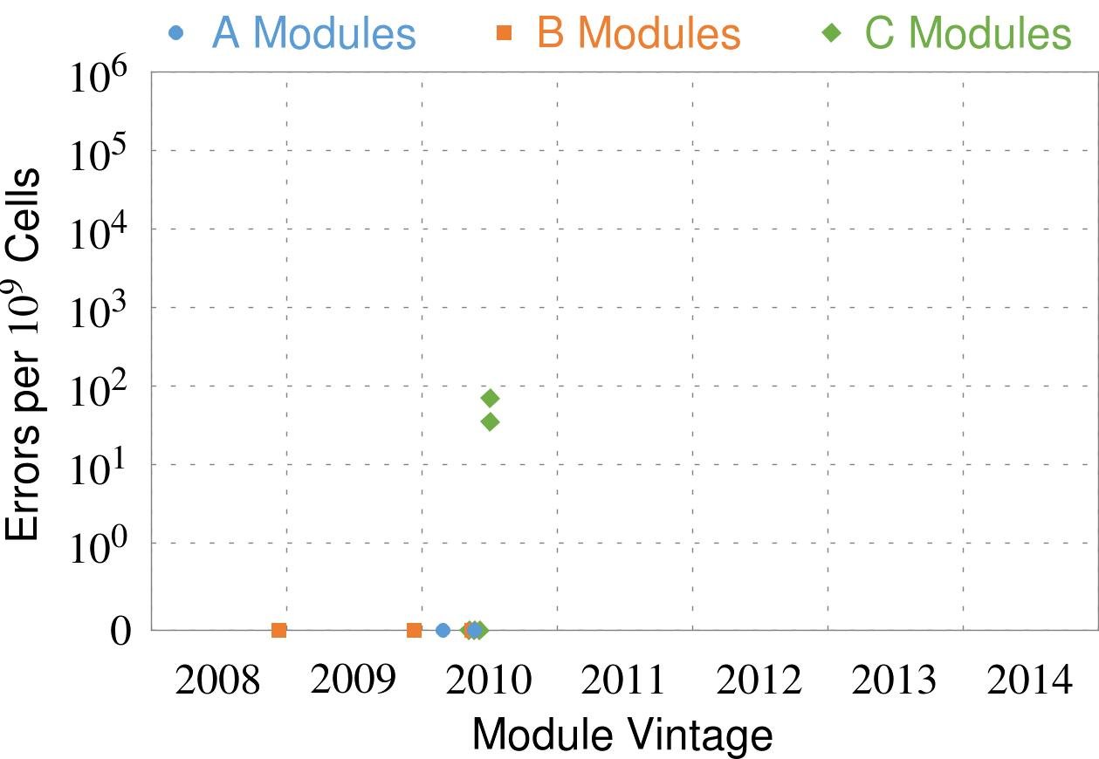
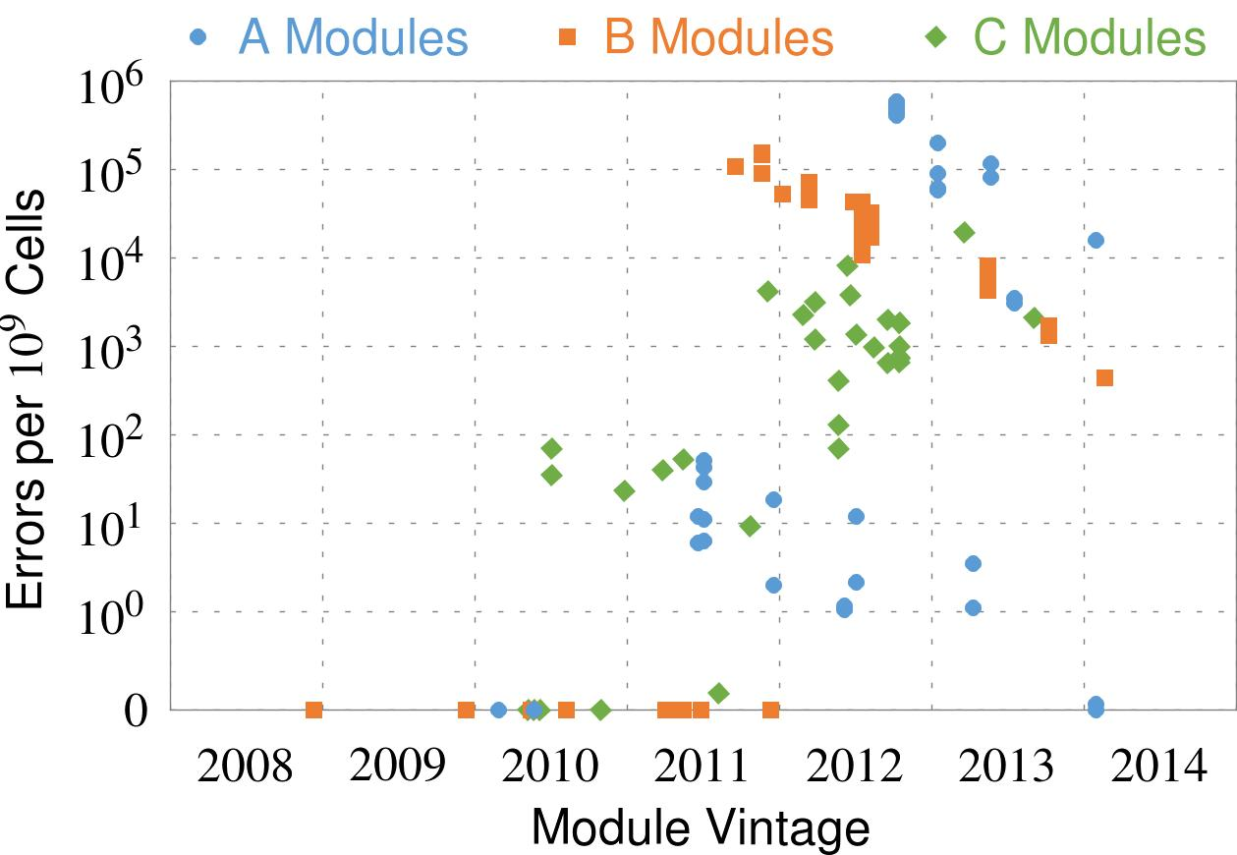
Recent DRAM Is More Vulnerable
First
Appearance
All modules from 2012–2013 are vulnerable
Notes:
In this figure, the x-axis is the module manufacture date. And the y-axis is the number of errors in a module, normalized to one billion cells. In 2008 and 2009, there are no errors. But, in 2010, we first start to see errors in C modules. After 2010, the errors start to proliferate. For A and B modules, we first start to see errors in 2011. In particular, all modules from 2012 and 2013 are vulnerable.

Slide 8
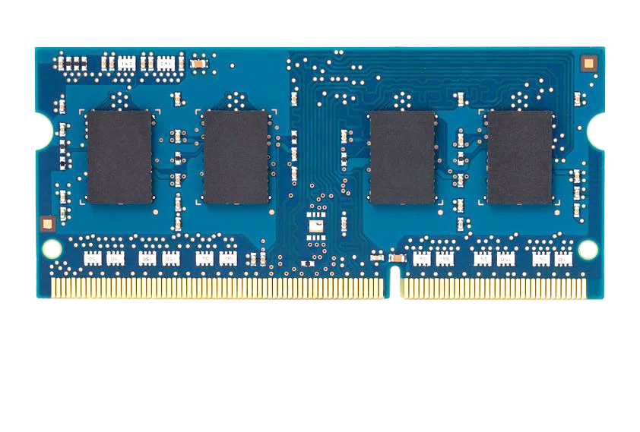
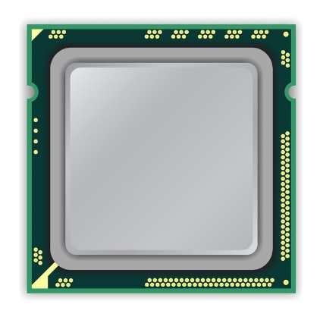
A Simple Program Can Induce Many Errors
CPU
DRAM Module
loop:
mov (X), %eax
mov (Y), %ebx
clflush (X)
clflush (Y)
mfence
jmp loop
X
Y
  Download from: https://github.com/CMU-SAFARI/rowhammer
Notes:
We demonstrate the errors on multiple x86 systems. Shown to the bottom-left is a “disturbance kernel”. When executed, it forces two rows to be opened and closed one after the other – over and over again. Consequently, it induces many errors in the module.

Slide 9
A Simple Program Can Induce Many Errors
CPU
DRAM Module
Avoid cache hits
  Flush X from cache
Avoid row hits to X
  Read Y in another row
X
Y
  Download from: https://github.com/CMU-SAFARI/rowhammer
Notes:
We demonstrate the errors on multiple x86 systems. Shown to the bottom-left is a “disturbance kernel”. When executed, it forces two rows to be opened and closed one after the other – over and over again. Consequently, it induces many errors in the module.

Slide 10
A Simple Program Can Induce Many Errors
CPU
DRAM Module
loop:
mov (X), %eax
mov (Y), %ebx
clflush (X)
clflush (Y)
mfence
jmp loop
X
Y
  Download from: https://github.com/CMU-SAFARI/rowhammer
Notes:
We demonstrate the errors on multiple x86 systems. Shown to the bottom-left is a “disturbance kernel”. When executed, it forces two rows to be opened and closed one after the other – over and over again. Consequently, it induces many errors in the module.

Slide 11
A Simple Program Can Induce Many Errors
CPU
DRAM Module
loop:
mov (X), %eax
mov (Y), %ebx
clflush (X)
clflush (Y)
mfence
jmp loop
X
Y
  Download from: https://github.com/CMU-SAFARI/rowhammer
Notes:
We demonstrate the errors on multiple x86 systems. Shown to the bottom-left is a “disturbance kernel”. When executed, it forces two rows to be opened and closed one after the other – over and over again. Consequently, it induces many errors in the module.

Slide 12
A Simple Program Can Induce Many Errors
CPU
DRAM Module
loop:
mov (X), %eax
mov (Y), %ebx
clflush (X)
clflush (Y)
mfence
jmp loop
X
Y
  Download from: https://github.com/CMU-SAFARI/rowhammer
Notes:
We demonstrate the errors on multiple x86 systems. Shown to the bottom-left is a “disturbance kernel”. When executed, it forces two rows to be opened and closed one after the other – over and over again. Consequently, it induces many errors in the module.

Slide 13
Observed Errors in Real Systems
A real reliability & security issue
In a more controlled environment, we can induce as many as ten million disturbance errors
CPU Architecture | Errors | Access-Rate
Intel Haswell (2013) | 22.9K | 12.3M/sec
Intel Ivy Bridge (2012) | 20.7K | 11.7M/sec
Intel Sandy Bridge (2011) | 16.1K | 11.6M/sec
AMD Piledriver (2012) | 59 | 6.1M/sec
Kim+, “Flipping Bits in Memory Without Accessing Them: An Experimental Study of DRAM Disturbance Errors,” ISCA 2014.
Notes:
When we executed the code on four different processors, all four of them yielded errors. Intel Haswell has the most errors, at 23 thousand, because it has the highest rate of accessing DRAM.
Later on, I’ll show that we can induce as many as ten million disturbance errors in a more controlled environment.
From this, we conclude that disturbance errors are a serious reliability issue.

Slide 14


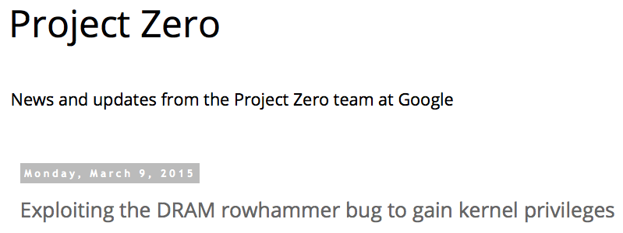
One Can Take Over an Otherwise-Secure System
Flipping Bits in Memory Without Accessing Them: An Experimental Study of DRAM Disturbance Errors (Kim et al., ISCA 2014)
Exploiting the DRAM rowhammer bug to gain kernel privileges (Seaborn, 2015)

Slide 15
RowHammer Security Attack Example
“Rowhammer” is a problem with some recent DRAM devices in which repeatedly accessing a row of memory can cause bit flips in adjacent rows (Kim et al., ISCA 2014).
  Flipping Bits in Memory Without Accessing Them: An Experimental Study of DRAM Disturbance Errors (Kim et al., ISCA 2014)
We tested a selection of laptops and found that a subset of them exhibited the problem.
We built two working privilege escalation exploits that use this effect.
  Exploiting the DRAM rowhammer bug to gain kernel privileges (Seaborn, 2015)
One exploit uses rowhammer-induced bit flips to gain kernel privileges on x86-64 Linux when run as an unprivileged userland process.
When run on a machine vulnerable to the rowhammer problem, the process was able to induce bit flips in page table entries (PTEs).
It was able to use this to gain write access to its own page table, and hence gain read-write access to all of physical memory.
Exploiting the DRAM rowhammer bug to gain kernel privileges (Seaborn, 2015)

Slide 16
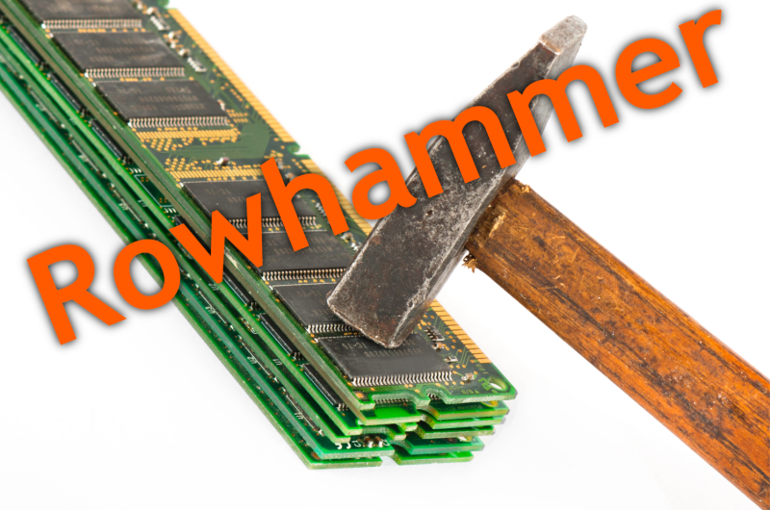
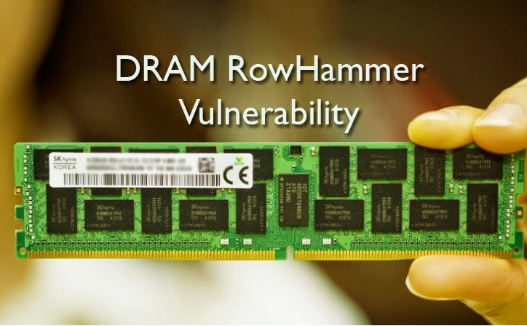
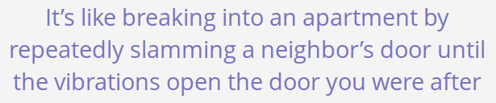
Security Implications
Notes:
Picture from the article:
http://thehackernews.com/2015/03/dram-rowhammer-vulnerability.html

Slide 17
Selected Readings on RowHammer (I)
Our first detailed study: Rowhammer analysis and solutions (June 2014)
  Yoongu Kim, Ross Daly, Jeremie Kim, Chris Fallin, Ji Hye Lee, Donghyuk Lee, Chris Wilkerson, Konrad Lai, and Onur Mutlu,
  "Flipping Bits in Memory Without Accessing Them: An Experimental Study of DRAM Disturbance Errors"
  Proceedings of the 41st International Symposium on Computer Architecture (ISCA), Minneapolis, MN, June 2014. [Slides (pptx) (pdf)] [Lightning Session Slides (pptx) (pdf)] [Source Code and Data]
Our Source Code to Induce Errors in Modern DRAM Chips (June 2014)
  https://github.com/CMU-SAFARI/rowhammer
Google Project Zero’s Attack to Take Over a System (March 2015)
  Exploiting the DRAM rowhammer bug to gain kernel privileges (Seaborn+, 2015)
  https://github.com/google/rowhammer-test
  Double-sided Rowhammer

Slide 18
Selected Readings on RowHammer (II)
Remote RowHammer Attacks via JavaScript (July 2015)
  http://arxiv.org/abs/1507.06955
  https://github.com/IAIK/rowhammerjs
  Gruss et al., DIMVA 2016.
  CLFLUSH-free Rowhammer
  “A fully automated attack that requires nothing but a website with JavaScript to trigger faults on remote hardware.”
  “We can gain unrestricted access to systems of website visitors.”
ANVIL: Software-Based Protection Against Next-Generation Rowhammer Attacks (March 2016)
  http://dl.acm.org/citation.cfm?doid=2872362.2872390
  Aweke et al., ASPLOS 2016
  CLFLUSH-free Rowhammer
  Software based monitoring for rowhammer detection

Slide 19
Selected Readings on RowHammer (III)
Flip Feng Shui: Hammering a Needle in the Software Stack (August 2016)
  https://www.usenix.org/system/files/conference/usenixsecurity16/sec16_paper_razavi.pdf
  Razavi et al., USENIX Security 2016.
  Combines memory deduplication and RowHammer
  “A malicious VM can gain unauthorized access to a co-hosted VM running OpenSSH.”
  Breaks OpenSSH public key authentication
Drammer: Deterministic Rowhammer Attacks on Mobile Platforms (October 2016)
  http://dl.acm.org/citation.cfm?id=2976749.2978406
  Van Der Veen et al., CCS 2016
  Can take over an ARM-based Android system deterministically
  Exploits predictable physical memory allocator behavior
    Can deterministically place security-sensitive data (e.g., page table) in an attacker-chosen, vulnerable location in memory

Slide 20

More Security Implications
Rowhammer.js: A Remote Software-Induced Fault Attack in JavaScript
Source: https://lab.dsst.io/32c3-slides/7197.html

Slide 21

More Security Implications
Drammer: Deterministic Rowhammer Attacks on Mobile Platforms
Source: https://fossbytes.com/drammer-rowhammer-attack-android-root-devices/

Slide 22

More Security Implications?

Slide 23
Root Causes of Disturbance Errors
Cause 1: Electromagnetic coupling
  Toggling the wordline voltage briefly increases the voltage of adjacent wordlines
  Slightly opens adjacent rows → Charge leakage
Cause 2: Conductive bridges
Cause 3: Hot-carrier injection
Confirmed by at least one manufacturer
Notes:
Why do the errors occur? We see three possible causes.
First, there could electromagnetic coupling between adjacent wordlines. When the voltage of one is toggled, it could briefly increase the voltage of the other and facilitate the leakage of charge.
Two other possibilities are conductive bridges and hot-carrier injection.
At least one manufacturer confirmed that these three could play a role in the disturbance errors we see them today.

Slide 24
Experimental DRAM Testing Infrastructure
  An Experimental Study of Data Retention Behavior in Modern DRAM Devices: Implications for Retention Time Profiling Mechanisms (Liu et al., ISCA 2013)
  The Efficacy of Error Mitigation Techniques for DRAM Retention Failures: A Comparative Experimental Study
  (Khan et al., SIGMETRICS 2014)
  Flipping Bits in Memory Without Accessing Them: An Experimental Study of DRAM Disturbance Errors (Kim et al., ISCA 2014)
  Adaptive-Latency DRAM: Optimizing DRAM Timing for the Common-Case (Lee et al., HPCA 2015)
  AVATAR: A Variable-Retention-Time (VRT) Aware Refresh for DRAM Systems (Qureshi et al., DSN 2015)

Slide 25
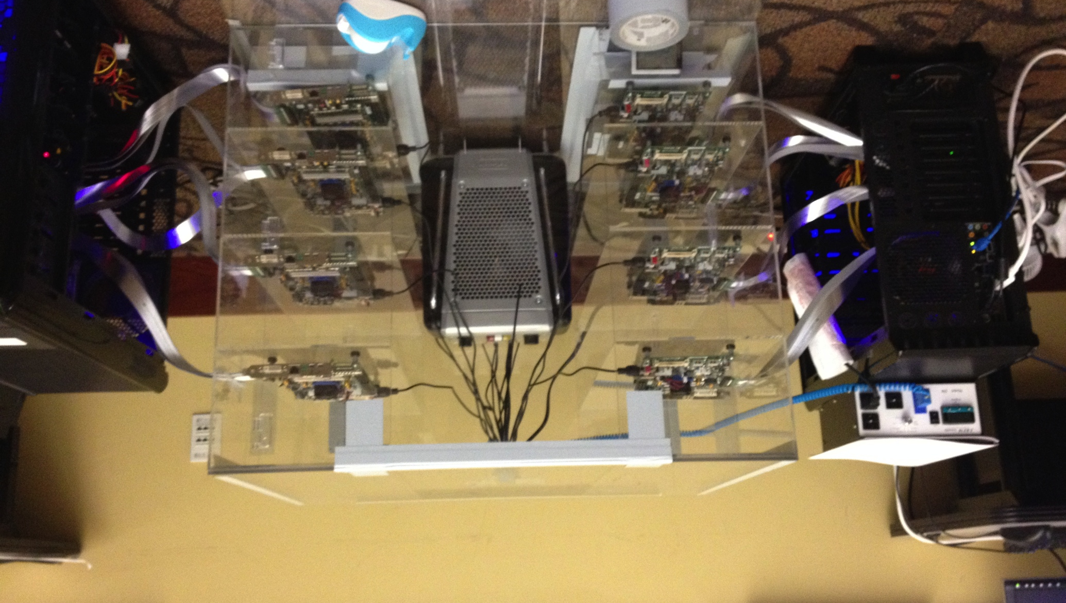
Experimental DRAM Testing Infrastructure
Temperature
Controller
FPGAs
Heater
FPGAs
PC
  Kim+, “Flipping Bits in Memory Without Accessing Them: An Experimental Study of DRAM Disturbance Errors,” ISCA 2014.

Slide 26
RowHammer Characterization Results
Most Modules Are at Risk
Errors vs. Vintage
Error = Charge Loss
Adjacency: Aggressor & Victim
Sensitivity Studies
Other Results in Paper
Solution Space
Flipping Bits in Memory Without Accessing Them: An Experimental Study of DRAM Disturbance Errors, (Kim et al., ISCA 2014)
Notes:
Now I will present the characterization results, one-by-one.
First, I show that most modules are at risk. Second, I show the number of errors in a module as a function of the manufacture date. Third, I show that the errors are symptomatic of charge loss. Fourth, I show that an aggressor induces errors in adjacent rows. Fifth, I show several sensitivity studies. And, finally, I briefly describe other results in the paper.

Slide 27
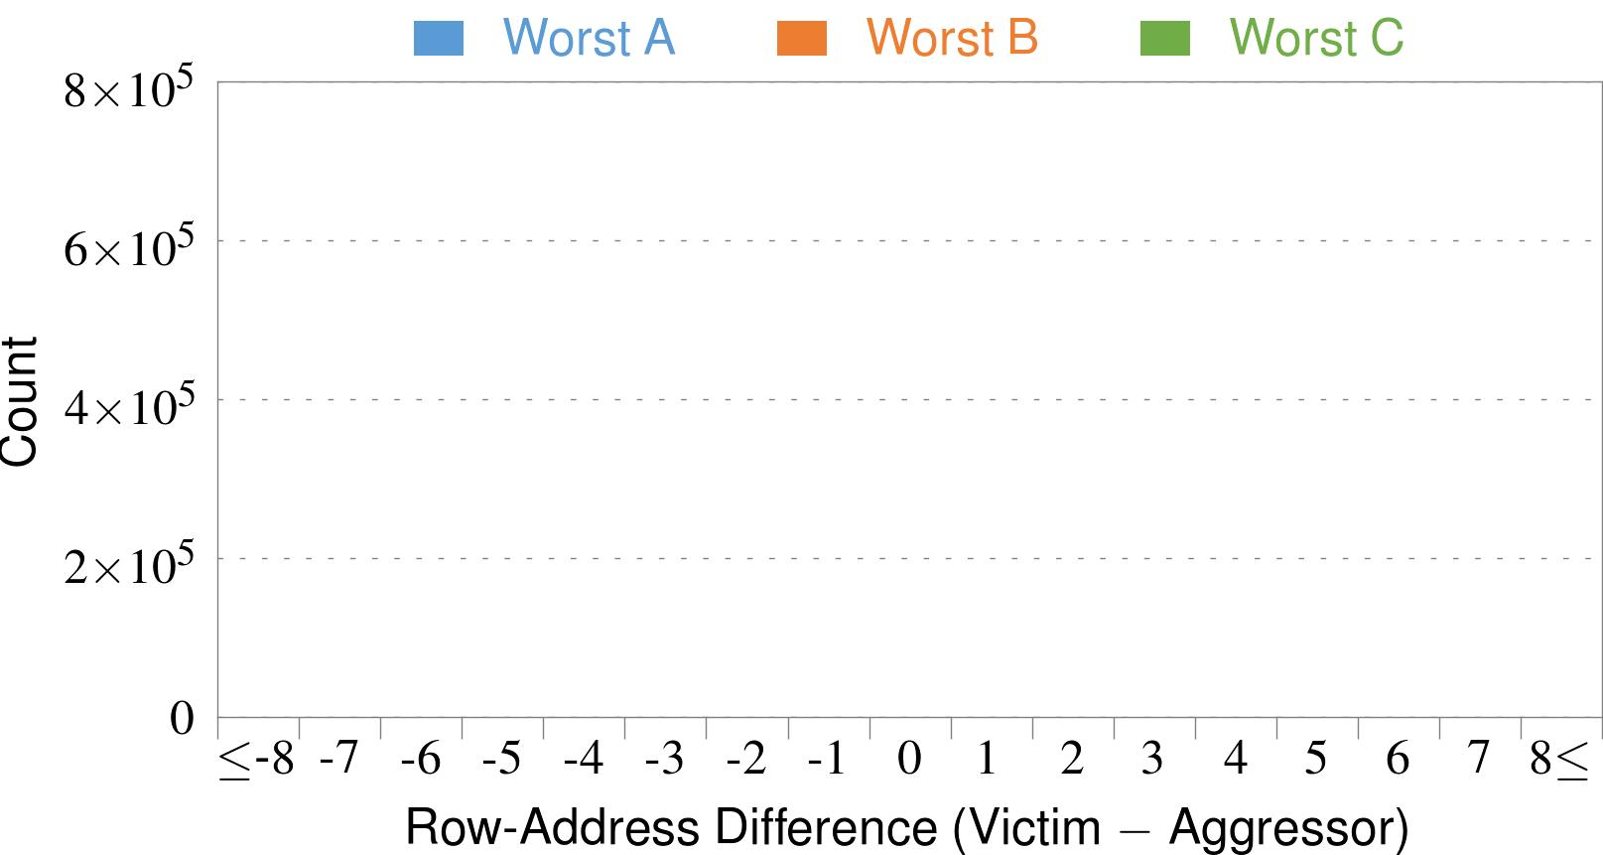
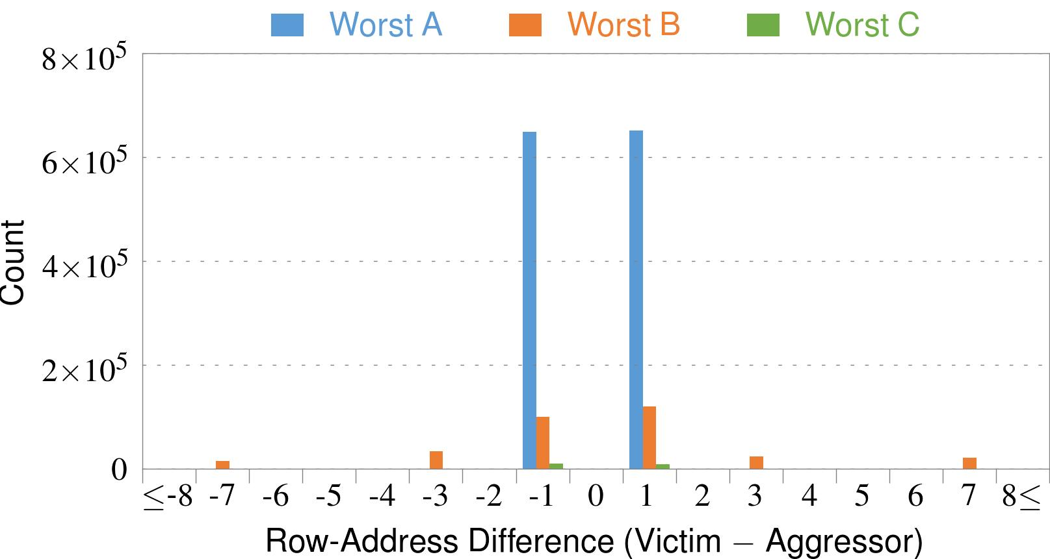
4. Adjacency: Aggressor & Victim
Adjacent
Adjacent
Adjacent
Non-Adjacent
Non-Adjacent
Note: For three modules with the most errors (only first bank)
Most aggressors & victims are adjacent
Notes:
In this figure, the x-axis is the row-address difference between an aggressor and its victims. And the y-axis is the number of victim-aggressor pairs that correspond to the row-address difference. For all three modules, we see strong peaks at plus/minus 1. This implies that aggressors and victims have consecutive row-addresses, in other words, they are adjacent.
However, the figure also shows some victims that are not adjacent to the aggressor. We believe this could be caused by two reasons. First, depending on the mapping, two rows that are physically adjacent within the DRAM chip may not have consecutive row-addresses. Second, fault rows are often re-mapped to spare rows that may reside on a different portion of the DRAM chip.
Nevertheless, we conclude that the vast majority of aggressors & victims are adjacent.

Slide 28
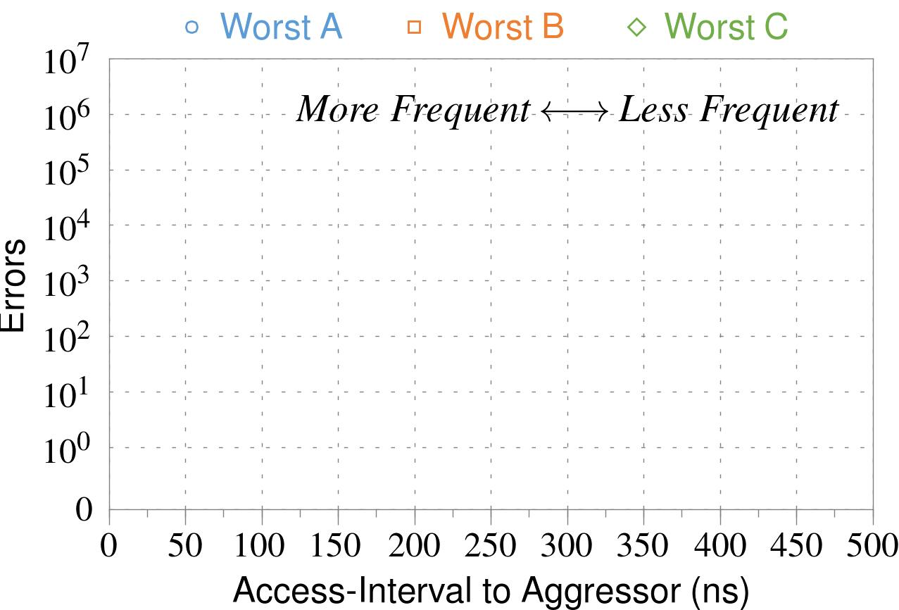
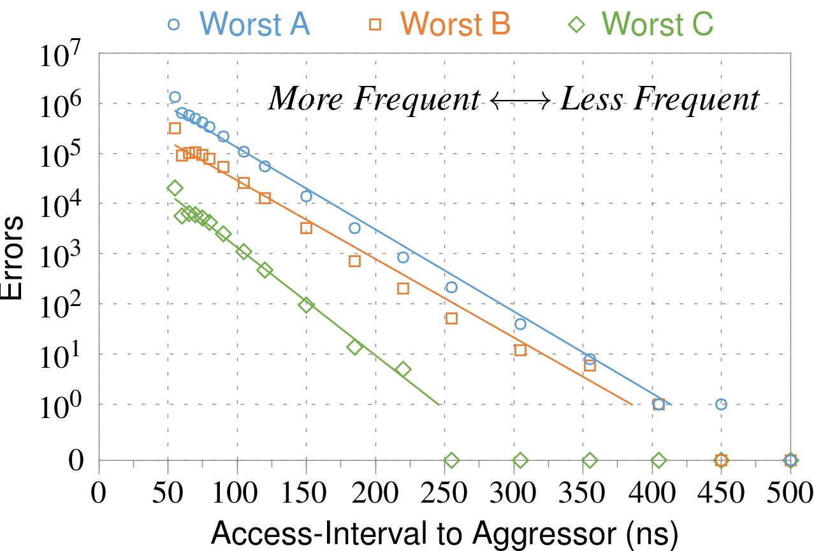
❶ Access Interval (Aggressor)
Not Allowed
500ns
55ns
Note: For three modules with the most errors (only first bank)
Less frequent accesses → Fewer errors
Notes:
In this figure, the x-axis is the interval at which we access the aggressor. And the y-axis is the number of errors. To comply with the DRAM standard, we employ a default value of 55ns in our experiments. However, as we increase the access-interval, we see that the number of errors decreases. In particular, at 500ns, there are no errors for all three modules.
From this, we conclude that less frequent accesses induce fewer errors.

Slide 29
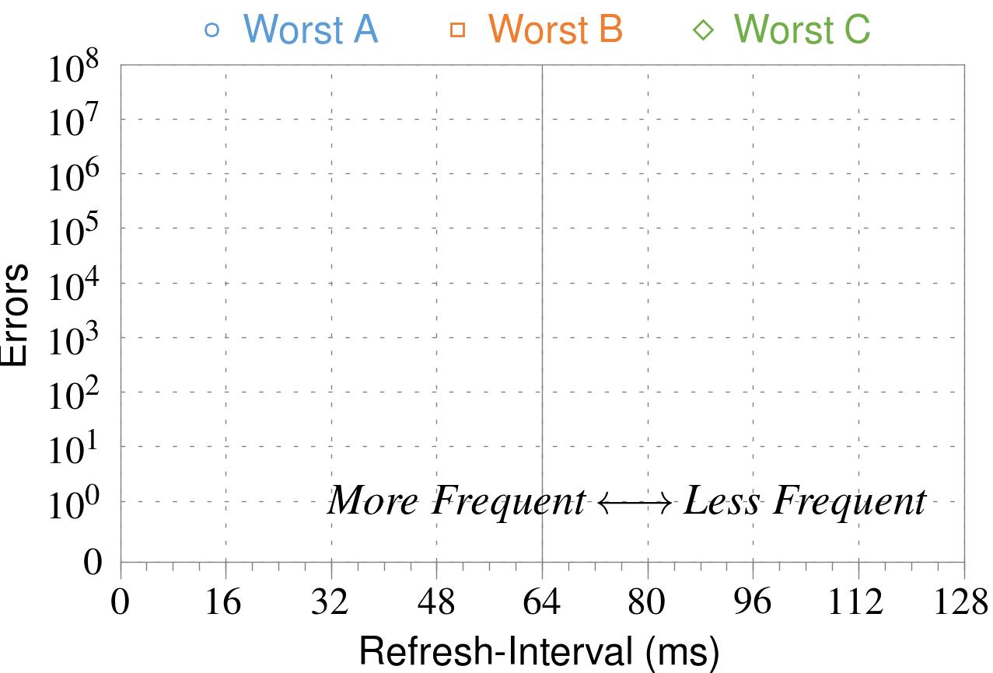
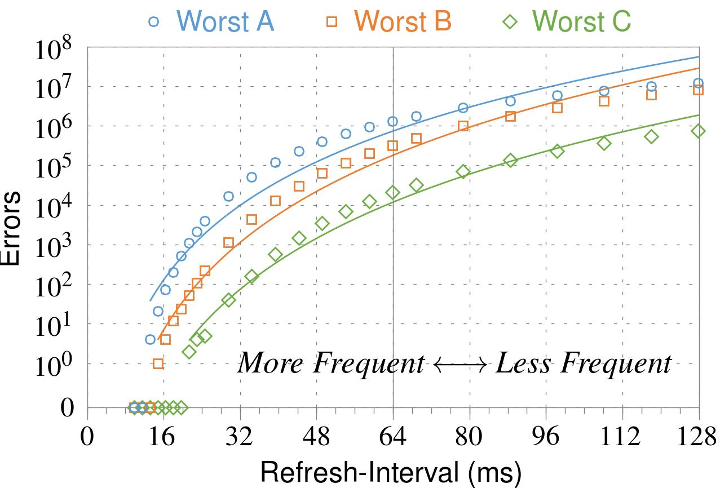
❷ Refresh Interval
~7x frequent
64ms
Note: Using three modules with the most errors (only first bank)
More frequent refreshes → Fewer errors
Notes:
In this figure, the x-axis is the refresh-interval. And the y-axis is the number of errors. To comply with the DRAM standard, we employ a default value of 64ms in our experiments. However, as we decrease the refresh-interval, we see that the number of errors decreases. In particular, when the refresh is shortened by 7x, there are no errors for all three modules.
From this, we conclude that more frequent accesses induce fewer errors.

Slide 30
❸ Data Pattern
Solid
RowStripe
111111
111111
111111
000000
111111
111111
10x Errors
111111
000000
~Solid
~RowStripe
000000
000000
000000
111111
000000
000000
000000
111111
Errors affected by data stored in other cells
Notes:
We tested the modules with four different data-patterns: Solid, inverse Solid, RowStripe, and inverse RowStripe. Solid and inverse Solid give us full coverage since each cell is tested with both 1s and 0s. And the same applies to RowStripe and its inverse.
However, we found that the rowstripe pattern had 10 times as more errors than the solid pattern. We also tested many other data-patterns, including random, but found RowStripe to induce the most errors.
Therefore, we conclude that errors are affected by data stored in other cells due to differences in coupling effects between the cells.

Slide 31
6. Other Results (in Paper)
Victim Cells ≠ Weak Cells (i.e., leaky cells)
  Almost no overlap between them
Errors not strongly affected by temperature
  Default temperature: 50°C
  At 30°C and 70°C, number of errors changes <15%
Errors are repeatable
  Across ten iterations of testing, >70% of victim cells had errors in every iteration
Notes:
First, we show that victim cells are not weak cells, which are cells that are inherently leaky. According to our experiments, we saw almost no overlap between them.
Second, we show that errors are not strongly affected by temperature. In all of the tests so far, we set the temperature to 50 degrees Celsius. But even when we changed the temperature by 20 degrees, the number of errors changed by less than 15 percent.
Third, we show that errors are repeatable. Across ten iterations of testing, more than 70% of victim cells had errors in every iteration.

Slide 32
6. Other Results (in Paper) cont’d
As many as 4 errors per cache-line
  Simple ECC (e.g., SECDED) cannot prevent all errors
Number of cells & rows affected by aggressor
  Victims cells per aggressor: ≤110
  Victims rows per aggressor: ≤9
Cells affected by two aggressors on either side
  Very small fraction of victim cells (<100) have an error when either one of the aggressors is toggled
Notes:
Fourth, we show that there are as many as four errors per cacheline. From this, we conclude that simple ECC schemes (for example, SECDED) cannot prevent all errors.
Fifth, we show that the number of cells & rows affected by an aggressor can be as high as 110 or 9, respectively.
Lastly, we show that a very small fraction of victim cells experience an error when either one of the aggressors is toggled.

Slide 33
Some Potential Solutions
Cost
Make better DRAM chips
Power, Performance
Refresh frequently
Cost, Power
Sophisticated ECC
Cost, Power, Complexity
Access counters
Notes:
Here is a list of four potential solutions to disturbance errors: making better DRAM chips, refreshing more frequently, employing sophisticated ECC schemes, and using hardware counters to track the number of accesses to different rows.
However, all of these solutions incur a large overhead in terms cost, power, performance, and/or complexity.

Slide 34
Naive Solutions
❶ Throttle accesses to same row
  Limit access-interval: ≥500ns
  Limit number of accesses: ≤128K (=64ms/500ns)
❷ Refresh more frequently
  Shorten refresh-interval by ~7x
Both naive solutions introduce significant overhead in performance and power
Notes:
Based on what we learned from the sensitivity studies, there are two naive solutions that immediately present themselves.
First, we can throttle accesses to the same row. If the access-interval is greater than 500ns, I showed how errors are not induced. We can achieve the same effect by limiting the maximum number of accesses to the same row to be less than 128K, within a refresh interval.
Second, we can refresh the module more frequently. If the refresh-interval is shortened by 7x, I showed how errors can be prevented.
However, both naive solutions introduce significant overhead in both performance and power. Later on, I will propose a much more efficient solution.

Slide 35
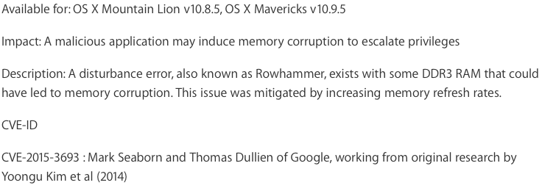
Apple’s Patch for RowHammer
https://support.apple.com/en-gb/HT204934
HP and Lenovo released similar patches

Slide 36
Our Solution
PARA: Probabilistic Adjacent Row Activation
Key Idea
  After closing a row, we activate (i.e., refresh) one of its neighbors with a low probability: p = 0.005
Reliability Guarantee
  When p=0.005, errors in one year: 9.4×10⁻¹⁴
  By adjusting the value of p, we can vary the strength of protection against errors
Notes:
We provide a more efficient solution, called PARA, which stands for probabilistic adjacent row activation.
The key idea is thus: after closing a row, we activate (i.e., refresh) one of its neighbors with a low probability, for example, p equal to 0.005.
PARA provides a strong reliability guarantee even under the worst-case access patterns to DRAM. When we set p to 0.005, the expected number of errors in one year is 9.4 times 10 to the negative 14. This probability is much lower the failure rate of other hardware components, for example, the hard-disk drive.
And by adjusting the value of p, PARA can provide an arbitrarily strong-degree of protection against errors.

Slide 37
Advantages of PARA
PARA refreshes rows infrequently
  Low power
  Low performance-overhead
    Average slowdown: 0.20% (for 29 benchmarks)
    Maximum slowdown: 0.75%
PARA is stateless
  Low cost
  Low complexity
PARA is an effective and low-overhead solution to prevent disturbance errors
Notes:
PARA has many advantages. Since it refreshes row infrequently, it has low power and low performance-overhead. Simulated across 29 benchmarks, we saw an average of only 0.2% slowdown and a maximum of only 0.75% slowdown.
In addition, due to its stateless nature, PARA has low cost and complexity.
Therefore, PARA is an effective and low-overhead solution to prevent disturbance errors.

Slide 38
Requirements for PARA
If implemented in DRAM chip
  Enough slack in timing parameters
  Plenty of slack today:
    Lee et al., “Adaptive-Latency DRAM: Optimizing DRAM Timing for the Common Case,” HPCA 2015.
    Chang et al., “Understanding Latency Variation in Modern DRAM Chips,” SIGMETRICS 2016.
    Lee et al., “Design-Induced Latency Variation in Modern DRAM Chips,” SIGMETRICS 2017.
    Chang et al., “Understanding Reduced-Voltage Operation in Modern DRAM Devices,” SIGMETRICS 2017.
If implemented in memory controller
  Better coordination between memory controller and DRAM
  Memory controller should know which rows are physically adjacent

Slide 39
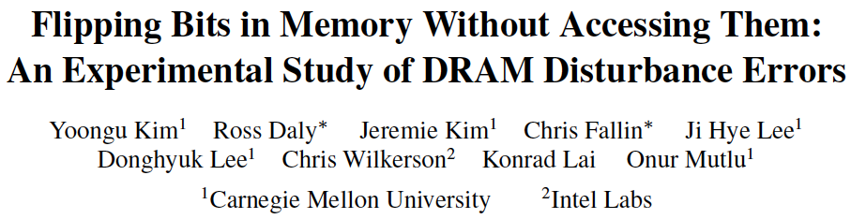
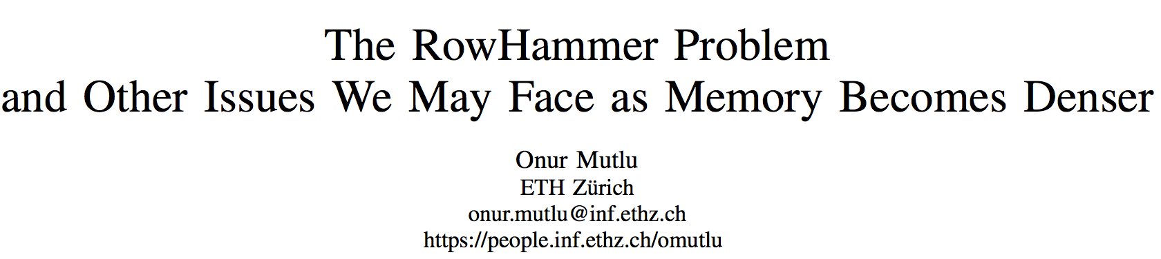
More on RowHammer Analysis
https://people.inf.ethz.ch/omutlu/pub/rowhammer-and-other-memory-issues_date17.pdf

Slide 40
Future of Main Memory
DRAM is becoming less reliable → more vulnerable

Slide 41
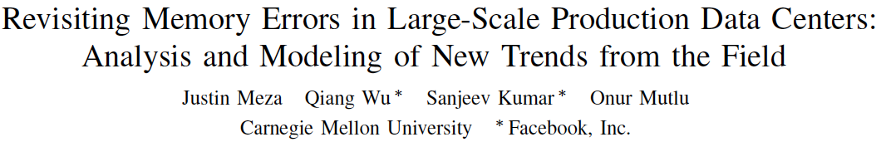
Large-Scale Failure Analysis of DRAM Chips
Analysis and modeling of memory errors found in all of Facebook’s server fleet
Justin Meza, Qiang Wu, Sanjeev Kumar, and Onur Mutlu,
"Revisiting Memory Errors in Large-Scale Production Data Centers: Analysis and Modeling of New Trends from the Field"
Proceedings of the 45th Annual IEEE/IFIP International Conference on Dependable Systems and Networks (DSN), Rio de Janeiro, Brazil, June 2015.
[Slides (pptx) (pdf)] [DRAM Error Model]

Slide 42
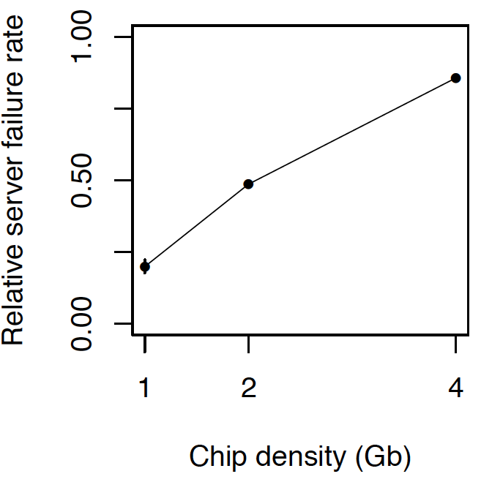
DRAM Reliability Reducing
Intuition:
quadratic
increase in
capacity

Slide 43
Future of Main Memory
DRAM is becoming less reliable → more vulnerable
Due to difficulties in DRAM scaling, other problems may also appear (or they may be going unnoticed)
Some errors may already be slipping into the field
  Read disturb errors (Rowhammer)
  Retention errors
  Read errors, write errors
  …
These errors can also pose security vulnerabilities

Slide 44
DRAM Data Retention Time Failures
Determining the data retention time of a cell/row is getting more difficult
Retention failures may already be slipping into the field

Slide 45
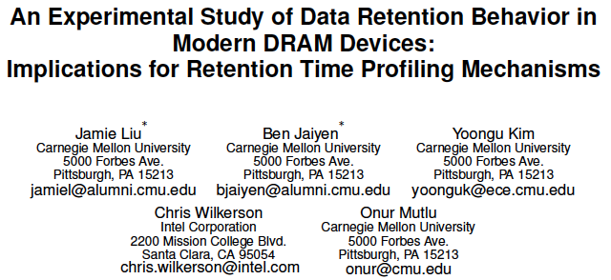
Analysis of Data Retention Failures [ISCA’13]

Slide 46
Two Challenges to Retention Time Profiling
Data Pattern Dependence (DPD) of retention time
Variable Retention Time (VRT) phenomenon

Slide 47
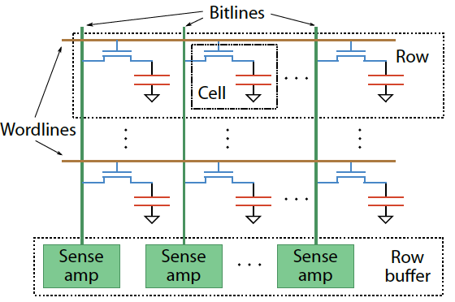
Two Challenges to Retention Time Profiling
Challenge 1: Data Pattern Dependence (DPD)
  Retention time of a DRAM cell depends on its value and the values of cells nearby it
  When a row is activated, all bitlines are perturbed simultaneously

Slide 48
Data Pattern Dependence
Electrical noise on the bitline affects reliable sensing of a DRAM cell
The magnitude of this noise is affected by values of nearby cells via
  Bitline-bitline coupling → electrical coupling between adjacent bitlines
  Bitline-wordline coupling → electrical coupling between each bitline and the activated wordline
Retention time of a cell depends on data patterns stored in nearby cells
→ need to find the worst data pattern to find worst-case retention time
→ this pattern is location dependent
Notes:
If a cell has lost enough charge, this noise can be large enough to cause a failure on a read
(normally, there is enough noise margin to tolerate the coupling noise)

Slide 49
Two Challenges to Retention Time Profiling
Challenge 2: Variable Retention Time (VRT)
  Retention time of a DRAM cell changes randomly over time
    a cell alternates between multiple retention time states
  Leakage current of a cell changes sporadically due to a charge trap in the gate oxide of the DRAM cell access transistor
  When the trap becomes occupied, charge leaks more readily from the transistor’s drain, leading to a short retention time
    Called Trap-Assisted Gate-Induced Drain Leakage
  This process appears to be a random process [Kim+ IEEE TED’11]
  Worst-case retention time depends on a random process
    → need to find the worst case despite this

Slide 50
Modern DRAM Retention Time Distribution
NEWER
NEWER
OLDER
OLDER
Newer device families have more weak cells than older ones
Likely a result of technology scaling

Slide 51
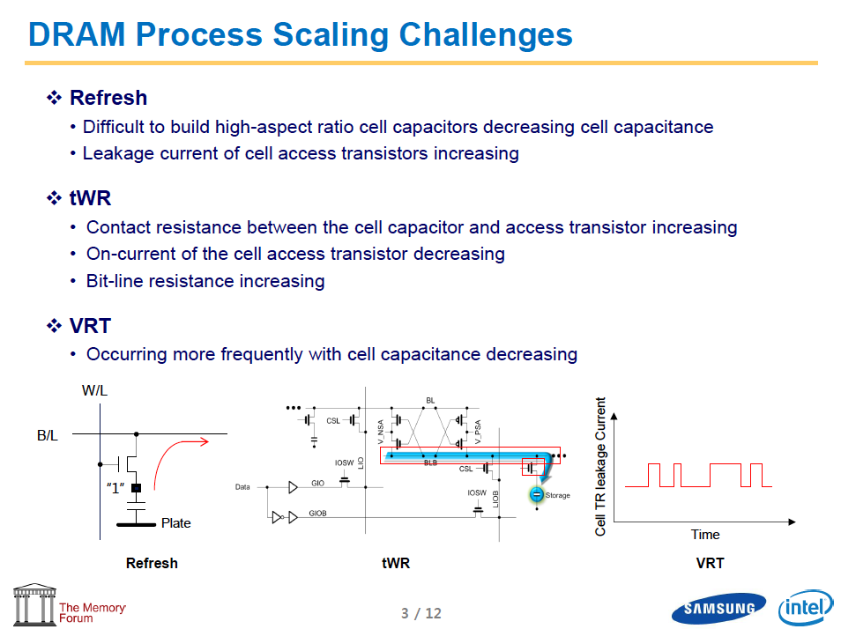
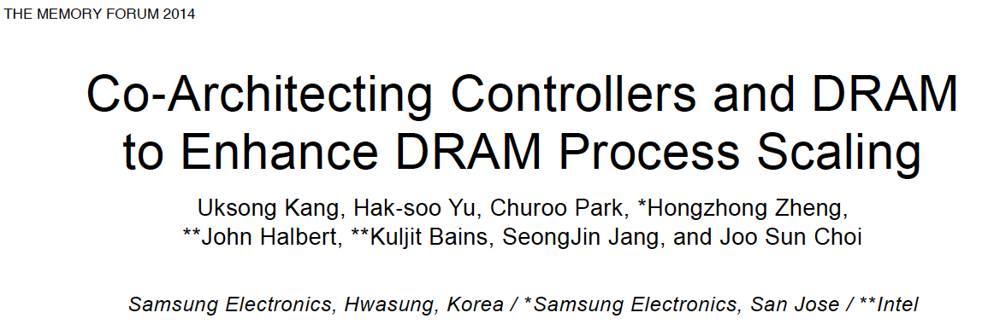
Industry Is Writing Papers About It, Too

Slide 52
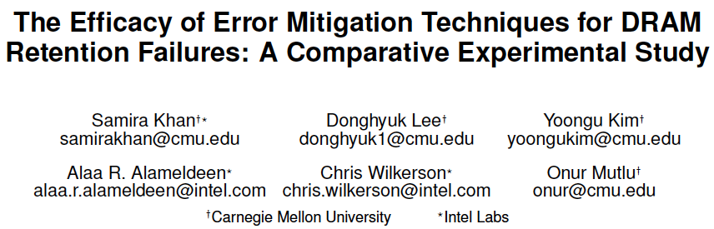
Mitigation of Retention Issues [SIGMETRICS’14]

Slide 53
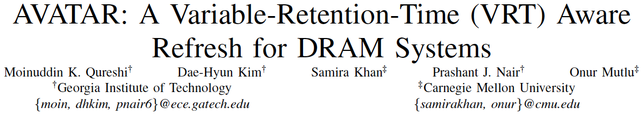
Handling Variable Retention Time [DSN’15]

Slide 54
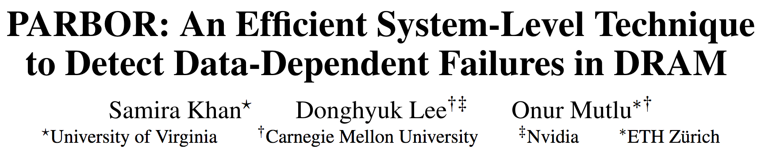
Handling Data-Dependent Failures [DSN’16]

Slide 55
How Do We Keep Memory Secure?
DRAM
Flash memory
Emerging Technologies
  Phase Change Memory
  STT-MRAM
  RRAM, memristors
  …

Slide 56
How Do We Keep Memory Secure?
Understand: Solid methodologies for failure modeling and discovery
  Modeling based on real device data – small scale and large scale
Architect: Principled co-architecting of system and memory
  Good partitioning of duties across the stack
Design & Test: Principled electronic design, automation, testing
  High coverage and good interaction with system reliability methods

Slide 57
Understand with Experiments (DRAM)
Temperature
Controller
FPGAs
Heater
FPGAs
PC
  Kim+, “Flipping Bits in Memory Without Accessing Them: An Experimental Study of DRAM Disturbance Errors,” ISCA 2014.

Slide 58
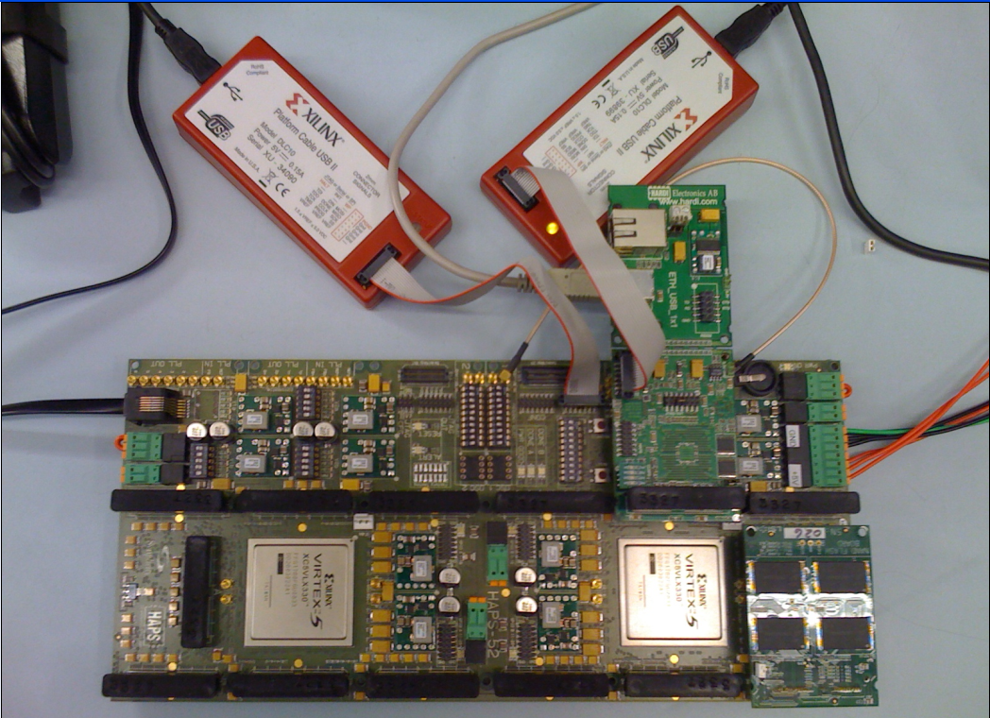
Understand with Experiments (Flash)
USB Daughter Board
USB Jack
HAPS-52 Mother Board
Virtex-II Pro
(USB controller)
1x-nm
NAND Flash
Virtex-V FPGA
(NAND Controller)
[DATE 2012, ICCD 2012, DATE 2013, ITJ 2013, ICCD 2013, SIGMETRICS 2014, HPCA 2015, DSN 2015, MSST 2015, JSAC 2016, HPCA 2017, DFRWS 2017]
NAND Daughter Board

Slide 59

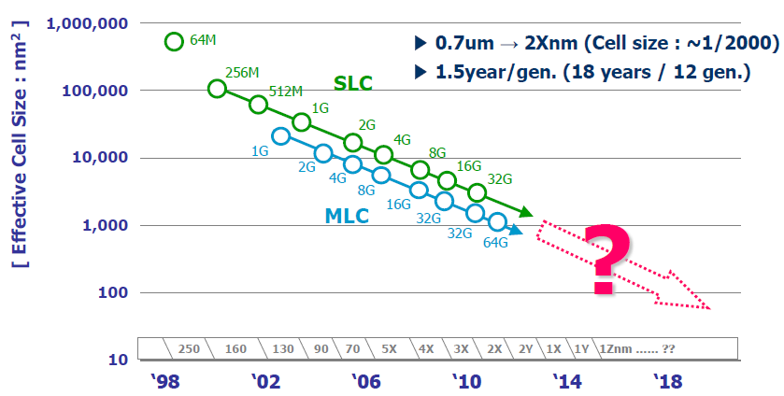
Evolution of NAND Flash Memory
CMOS scaling
More bits per Cell
Seaung Suk Lee, “Emerging Challenges in NAND Flash Technology”, Flash Summit 2011 (Hynix)
Flash memory is widening its range of applications
  Portable consumer devices, laptop PCs and enterprise servers

Slide 60
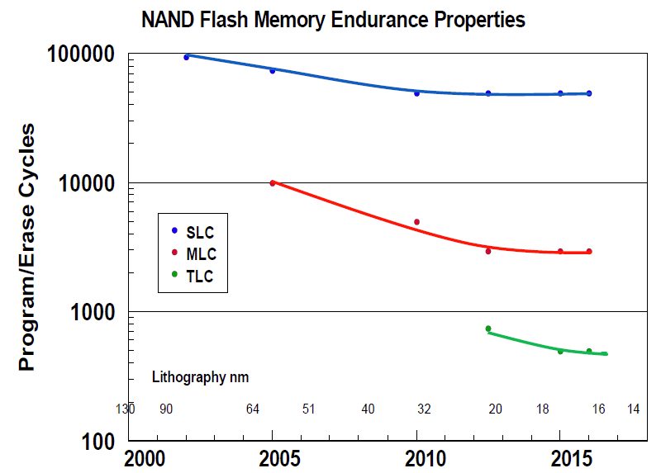
Flash Challenges: Reliability and Endurance
P/E cycles (provided)
A few thousand
P/E cycles (required)
Writing
the full capacity
of the drive
10 times per day
for 5 years
(STEC)
> 50k P/E cycles
E. Grochowski et al., “Future technology challenges for NAND flash and HDD products”, Flash Memory Summit 2012

Slide 61
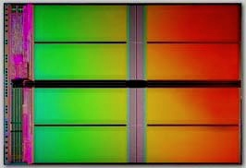
NAND Flash Memory is Increasingly Noisy
Write
Noisy NAND
Read

Slide 62
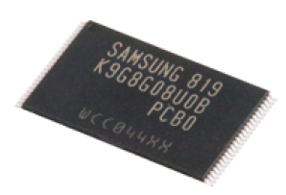
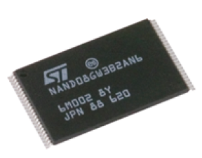
Future NAND Flash-based Storage Architecture
Memory
Signal
Processing
Raw Bit
Error Rate
Uncorrectable
BER < 10⁻¹⁵
Noisy
Error
Correction
Lower
High
Better
Our Goals:
Build reliable error models for NAND flash memory
Design efficient reliability mechanisms based on the model

Slide 63
NAND Flash Error Model
Write
Noisy NAND
Read
Experimentally characterize and model dominant errors
Cai et al., “Error Patterns in MLC NAND Flash Memory: Measurement, Characterization, and Analysis””, DATE 2012
Luo et al., “Enabling Accurate and Practical Online Flash Channel Modeling for Modern MLC NAND Flash Memory”, JSAC 2016
Write
Erase block
Program page
Neighbor page prog/read (c-to-c interference)
Read
Retention
Cai et al., “Threshold voltage distribution in MLC NAND Flash Memory: Characterization, Analysis, and Modeling”, DATE 2013
Cai et al., “Vulnerabilities in MLC NAND Flash Memory Programming: Experimental Analysis, Exploits, and Mitigation Techniques”, HPCA 2017
Cai et al., “Program Interference in MLC NAND Flash Memory: Characterization, Modeling, and Mitigation”, ICCD 2013
Cai et al., “Neighbor-Cell Assisted Error Correction in MLC NAND Flash Memories”, SIGMETRICS 2014
Cai et al., “Read Disturb Errors in MLC NAND Flash Memory: Characterization and Mitigation”, DSN 2015
Cai et al., “Flash Correct-and-Refresh: Retention-aware error management for increased flash memory lifetime”, ICCD 2012
Cai et al., “Error Analysis and Retention-Aware Error Management for NAND Flash Memory, ITJ 2013
Cai et al., “Data Retention in MLC NAND Flash Memory: Characterization, Optimization and Recovery" , HPCA 2015

Slide 64
Our Goals and Approach
Goals:
  Understand error mechanisms and develop reliable predictive models for MLC NAND flash memory errors
  Develop efficient error management techniques to mitigate errors and improve flash reliability and endurance
Approach:
  Solid experimental analyses of errors in real MLC NAND flash memory → drive the understanding and models
  Understanding, models, and creativity → drive the new techniques

Slide 65
Experimental Testing Platform
USB Daughter Board
USB Jack
HAPS-52 Mother Board
Virtex-II Pro
(USB controller)
1x-nm
NAND Flash
Virtex-V FPGA
(NAND Controller)
[DATE 2012, ICCD 2012, DATE 2013, ITJ 2013, ICCD 2013, SIGMETRICS 2014, HPCA 2015, DSN 2015, MSST 2015, JSAC 2016, HPCA 2017, DFRWS 2017]
NAND Daughter Board
Cai et al., FPGA-based Solid-State Drive prototyping platform, FCCM 2011.

Slide 66
NAND Flash Error Types
Four types of errors [Cai+, DATE 2012]
Caused by common flash operations
  Read errors
  Erase errors
  Program (interference) errors
Caused by flash cell losing charge over time
  Retention errors
    Whether an error happens depends on required retention time
    Especially problematic in MLC flash because threshold voltage window to determine stored value is smaller

Slide 67
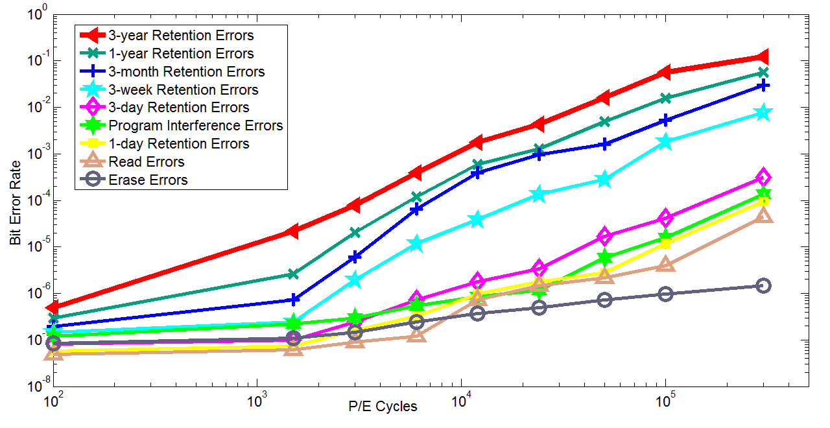
Observations: Flash Error Analysis
retention errors
Raw Bit Error Rate
P/E Cycles
Raw bit error rate increases exponentially with P/E cycles
Retention errors are dominant (>99% for 1-year ret. time)
Retention errors increase with retention time requirement
Cai et al., Error Patterns in MLC NAND Flash Memory, DATE 2012.

Slide 68
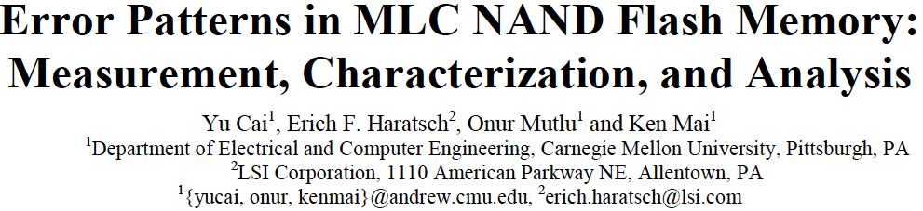
More on Flash Error Analysis
Yu Cai, Erich F. Haratsch, Onur Mutlu, and Ken Mai,
"Error Patterns in MLC NAND Flash Memory: Measurement, Characterization, and Analysis"
Proceedings of the Design, Automation, and Test in Europe Conference (DATE), Dresden, Germany, March 2012. Slides (ppt)

Slide 69
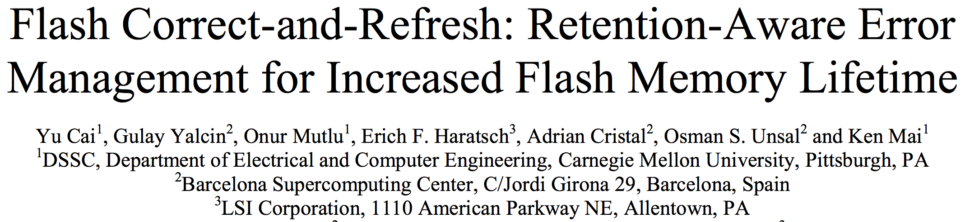
Solution to Retention Errors
Refresh periodically
Change the period based on P/E cycle wearout
  Refresh more often at higher P/E cycles
Use a combination of in-place and remapping-based refresh

Slide 70
One Issue: Read Disturb in Flash Memory
All scaled memories are prone to read disturb errors

Slide 71

NAND Flash Memory Background
Flash Memory
Page 0
Read
Block 0
Page 256
……
Page M
Block 1
Block N
Page 1
Page 257
Page M+1
Pass
Page 2
Page 258
Page M+2
Pass
……
……
……
…
Page 255
Pass
Page 511
Page M+255
Flash Controller
Notes:
When we read from one page in a block, we apply a high voltage to all the other pages in the same block. We will explain why later

Slide 72
Flash Cell Array
Row
Block X
Page Y
Column
Sense Amplifiers
Sense Amplifiers
Notes:
Now, let’s zoom in to a single block of flash memory, which consists of an array of flash pages.
Each flash page is written to flash cells located in the same row.
Each row of cells are controlled by the same horizontal wire.
Each column of cells are connected in series with a sense amplifier at the bottom.

Slide 73
Flash Cell
Drain
Floating Gate
Gate
V_{th} = 2.5 V
Source
Floating Gate Transistor
(Flash Cell)
Notes:
Now let’s zoom in again to look at a single flash cell, or, it can also be called, a floating gate transistor.

Slide 74
Flash Read
V_{read} = 2.5 V
V_{th} = 2 V
V_{read} = 2.5 V
V_{th} = 3 V
Gate
1
0
Notes:
Now, if we have two flash cells programmed to different threshold voltages, 2V and 3V, we can distinguish them with a read voltage of 2.5V.
When we apply 2.5V to the gate, since the read voltage is higher than the threshold voltage, …
Now if we look back at this example, we can see that the threshold voltage of each flash cell actually represents the value being stored.

Slide 75
Flash Pass-Through
V_{pass} = 5 V
V_{th} = 2 V
V_{pass} = 5 V
V_{th} = 3 V
Gate
1
1
Notes:
But, for the same cells, when we apply a high voltage to them, regardless of the threshold voltage, any cell will be passed-through.
So we call this voltage pass-through voltage or Vpass

Slide 76
Read from Flash Cell Array
V_{pass} = 5.0 V
Pass (5V)
3.0V
3.8V
3.9V
4.8V
Page 1
V_{read} = 2.5 V
Read (2.5V)
3.5V
2.9V
2.4V
2.1V
Page 2
V_{pass} = 5.0 V
Pass (5V)
2.2V
4.3V
4.6V
1.8V
Page 3
V_{pass} = 5.0 V
Pass (5V)
3.5V
2.3V
1.9V
4.3V
Page 4
Correct values for page 2:
0
0
1
1
Notes:
Now, let’s look at an example array of flash cells.
In this example, we make up threshold voltage numbers for each cell.
Let’s say we want to read from the second page in this array.
So we apply a read voltage of 2.5 V to the second page
And since all the other pages are connected in series, we apply a high pass-through voltage of 5 V to the other pages.
As we can see, the high pass through voltage switches on all the flash pages being passed-through, allowing the sense amplifier to read the values stored in the second page.
In this case, the correct values …

Slide 77
Read Disturb Problem: “Weak Programming” Effect
Pass (5V)
3.0V
3.8V
3.9V
4.8V
Page 1
Pass (5V)
3.5V
2.9V
2.4V
2.1V
Page 2
Read (2.5V)
2.2V
4.3V
4.6V
1.8V
Page 3
Pass (5V)
3.5V
2.3V
1.9V
4.3V
Page 4
Repeatedly read page 3 (or any page other than page 2)
Notes:
However, the high pass through voltage can generate read disturb problem, which we will introduce now.
When we want to read page 3, instead of page 2, this high pass through voltage now needs to be applied on the 2nd page.
When we repeatedly read page 3, the pass through voltage induces a weak programming effect on the second page.

Slide 78
Read Disturb Problem: “Weak Programming” Effect
V_{pass} = 5.0 V
3.0V
3.8V
3.9V
4.8V
Page 1
V_{read} = 2.5 V
3.5V
2.9V
2.4V
2.6V
2.1V
Page 2
V_{pass} = 5.0 V
2.2V
4.3V
4.6V
1.8V
Page 3
V_{pass} = 5.0 V
3.5V
2.3V
1.9V
4.3V
Page 4
Incorrect values from page 2:
0
0
0
1
High pass-through voltage induces “weak-programming” effect
Notes:
As the weak programming effect accumulates, the threshold voltage of each flash cell increases, and the threshold voltage state of a cell can be altered.
In this case, when we read page 2 again, we will read incorrect values from page 2, 0001
Flash vendors conservatively set this pass-through voltage to a high voltage.
However, we find in the paper that it is unnecessary to set to this high, and that reducing this voltage by just a bit will reduce read disturb errors significantly in the future.

Slide 79
Executive Summary
Read disturb errors limit flash memory lifetime today
  Apply a high pass-through voltage (V_{pass}) to multiple pages on a read
  Repeated application of V_{pass} can alter stored values in unread pages
We characterize read disturb on real NAND flash chips
  Slightly lowering V_{pass} greatly reduces read disturb errors
  Some flash cells are more prone to read disturb
Technique 1: Mitigate read disturb errors online
  V_{pass} Tuning dynamically finds and applies a lowered V_{pass} per block
  Flash memory lifetime improves by 21%
Technique 2: Recover after failure to prevent data loss
  Read Disturb Oriented Error Recovery (RDR) selectively corrects cells more susceptible to read disturb errors
  Reduces raw bit error rate (RBER) by up to 36%
Notes:
When we read data from one page, we have to apply a high voltage to multiple other flash pages that are connected to this page, and we call this high pass-through voltage.
Over time this high pass-through voltage can alter the values stored in unread flash pages. We call this a read disturb error.
For the first time in open literature, we characterize read disturb on real NAND flash chips, and show that read disturb errors exist in today’s flash chips and is expected to increase in the future.
We make two key observations from the characterization.
Using our characterization, we develop two techniques that can help flash memory tolerate such read disturb errors.

Slide 80
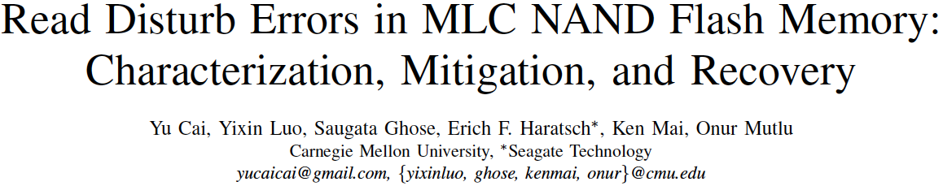
More on Flash Read Disturb Errors
Yu Cai, Yixin Luo, Saugata Ghose, Erich F. Haratsch, Ken Mai, and Onur Mutlu,
"Read Disturb Errors in MLC NAND Flash Memory: Characterization and Mitigation"
Proceedings of the 45th Annual IEEE/IFIP International Conference on Dependable Systems and Networks (DSN), Rio de Janeiro, Brazil, June 2015.

Slide 81
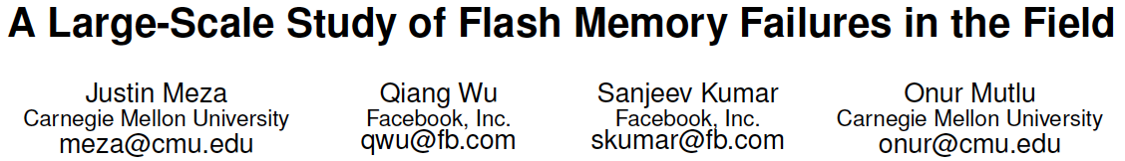
Large-Scale Flash SSD Error Analysis
First large-scale field study of flash memory errors
Justin Meza, Qiang Wu, Sanjeev Kumar, and Onur Mutlu,
"A Large-Scale Study of Flash Memory Errors in the Field"
Proceedings of the ACM International Conference on Measurement and Modeling of Computer Systems (SIGMETRICS), Portland, OR, June 2015.
[Slides (pptx) (pdf)] [Coverage at ZDNet] [Coverage on The Register] [Coverage on TechSpot] [Coverage on The Tech Report]

Slide 82
Another Time: NAND Flash Vulnerabilities
Onur Mutlu,
"Error Analysis and Management for MLC NAND Flash Memory"
Technical talk at Flash Memory Summit 2014 (FMS), Santa Clara, CA, August 2014. Slides (ppt) (pdf)
Cai+, “Error Patterns in MLC NAND Flash Memory: Measurement, Characterization, and Analysis,” DATE 2012.
Cai+, “Flash Correct-and-Refresh: Retention-Aware Error Management for Increased Flash Memory Lifetime,” ICCD 2012.
Cai+, “Threshold Voltage Distribution in MLC NAND Flash Memory: Characterization, Analysis and Modeling,” DATE 2013.
Cai+, “Error Analysis and Retention-Aware Error Management for NAND Flash Memory,” Intel Technology Journal 2013.
Cai+, “Program Interference in MLC NAND Flash Memory: Characterization, Modeling, and Mitigation,” ICCD 2013.
Cai+, “Neighbor-Cell Assisted Error Correction for MLC NAND Flash Memories,” SIGMETRICS 2014.
Cai+,”Data Retention in MLC NAND Flash Memory: Characterization, Optimization and Recovery,” HPCA 2015.
Cai+, “Read Disturb Errors in MLC NAND Flash Memory: Characterization and Mitigation,” DSN 2015.
Luo+, “WARM: Improving NAND Flash Memory Lifetime with Write-hotness Aware Retention Management,” MSST 2015.
Meza+, “A Large-Scale Study of Flash Memory Errors in the Field,” SIGMETRICS 2015.
Luo+, “Enabling Accurate and Practical Online Flash Channel Modeling for Modern MLC NAND Flash Memory,” IEEE JSAC 2016.
Cai+, “Vulnerabilities in MLC NAND Flash Memory Programming: Experimental Analysis, Exploits, and Mitigation Techniques,” HPCA 2017.
Fukami+, “Improving the Reliability of Chip-Off Forensic Analysis of NAND Flash Memory Devices,” DFRWS EU 2017.

Slide 83
Flash Memory Programming Vulnerabilities
https://people.inf.ethz.ch/omutlu/pub/flash-memory-programming-vulnerabilities_hpca17.pdf

Slide 84
Summary
Memory reliability is reducing
Reliability issues open up security vulnerabilities
  Very hard to defend against
Rowhammer is an example
  Its implications on system security research are tremendous & exciting
Good news: We have a lot more to do.
Understand: Solid methodologies for failure modeling and discovery
  Modeling based on real device data – small scale and large scale
Architect: Principled co-architecting of system and memory
  Good partitioning of duties across the stack
Design & Test: Principled electronic design, automation, testing
  High coverage and good interaction with system reliability methods

Slide 85
The RowHammer Problem and Other Issues We May Face as Memory Becomes Denser
Onur Mutlu
onur.mutlu@inf.ethz.ch
https://people.inf.ethz.ch/omutlu
April 21, 2017
CFAED Workshop on Resilient Systems Keynote

Slide 86
More on DRAM Data Retention

Slide 87
DRAM Refresh
DRAM capacitor charge leaks over time
The memory controller needs to refresh each row periodically to restore charge
  Activate each row every N ms
  Typical N = 64 ms
Downsides of refresh
-- Energy consumption: Each refresh consumes energy
  -- Performance degradation: DRAM rank/bank unavailable while refreshed
  -- QoS/predictability impact: (Long) pause times during refresh
  -- Refresh rate limits DRAM capacity scaling

Slide 88
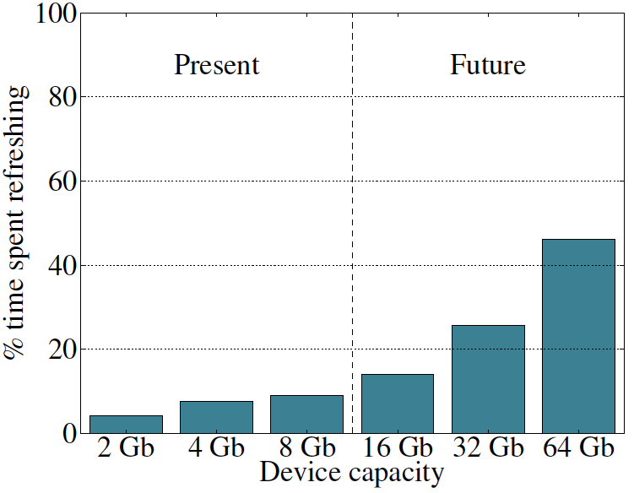
Refresh Overhead: Performance
46%
8%
Liu et al., “RAIDR: Retention-Aware Intelligent DRAM Refresh,” ISCA 2012.

Slide 89
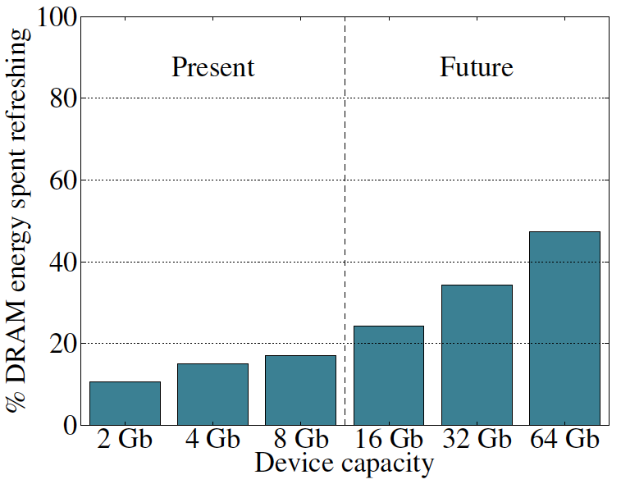
Refresh Overhead: Energy
47%
15%
Liu et al., “RAIDR: Retention-Aware Intelligent DRAM Refresh,” ISCA 2012.

Slide 90
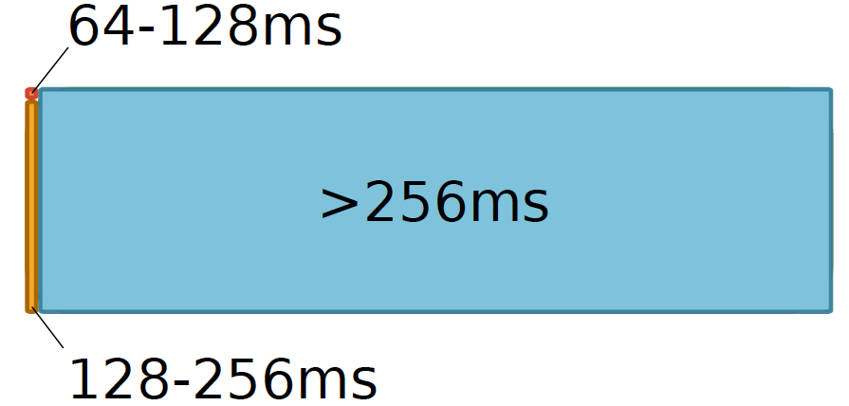
Retention Time Profile of DRAM

Slide 91


RAIDR: Eliminating Unnecessary Refreshes
Observation: Most DRAM rows can be refreshed much less often without losing data [Kim+, EDL’09][Liu+ ISCA’13]
Key idea: Refresh rows containing weak cells
more frequently, other rows less frequently
  1. Profiling: Profile retention time of all rows
  2. Binning: Store rows into bins by retention time in memory controller
  Efficient storage with Bloom Filters (only 1.25KB for 32GB memory)
  3. Refreshing: Memory controller refreshes rows in different bins at different rates
Results: 8-core, 32GB, SPEC, TPC-C, TPC-H
  74.6% refresh reduction @ 1.25KB storage
  ~16%/20% DRAM dynamic/idle power reduction
  ~9% performance improvement
  Benefits increase with DRAM capacity
Liu et al., “RAIDR: Retention-Aware Intelligent DRAM Refresh,” ISCA 2012.

Slide 92
More Detail

Slide 93
RowHammer in Popular Sites and Press
https://en.wikipedia.org/wiki/Row_hammer
https://twitter.com/hashtag/rowhammer?f=realtime
http://www.rowhammer.com/
http://www.zdnet.com/article/flipping-dram-bits-maliciously/
http://www.infoworld.com/article/2894497/security/rowhammer-hardware-bug-threatens-to-smashnotebook-
http://www.zdnet.com/article/rowhammer-dram-flaw-could-be-widespread-says-google/
http://arstechnica.com/security/2015/03/cutting-edge-hack-gives-super-user-status-by-exploiting-dramweakness/
https://www.youtube.com/watch?v=H63dUfGBpxE
http://www.wired.com/2015/03/google-hack-dram-memory-electric-leaks/
https://www.grc.com/sn/sn-498-notes.pdf
…

Slide 94
Recap: The DRAM Scaling Problem

Slide 95

DRAM Retention Failure Analysis
Jamie Liu, Ben Jaiyen, Yoongu Kim, Chris Wilkerson, and Onur Mutlu,
"An Experimental Study of Data Retention Behavior in Modern DRAM Devices: Implications for Retention Time Profiling Mechanisms"
Proceedings of the 40th International Symposium on Computer Architecture (ISCA), Tel-Aviv, Israel, June 2013. Slides (ppt) Slides (pdf)

Slide 96
Towards an Online Profiling System
Key Observations:
Testing alone cannot detect all possible failures
Combination of ECC and other mitigation techniques is much more effective
  But degrades performance
Testing can help to reduce the ECC strength
  Even when starting with a higher strength ECC
Khan+, “The Efficacy of Error Mitigation Techniques for DRAM Retention Failures: A Comparative Experimental Study,” SIGMETRICS 2014.
Notes:
Our high-level design for online profiling system is based to thee key observations:

Slide 97


Towards an Online Profiling System
Initially Protect DRAM
with Strong ECC
Periodically Test
Parts of DRAM
1
2
Test
ECC
Test
Test
Mitigate errors and
reduce ECC
3
Run tests periodically after a short interval
at smaller regions of memory
Notes:
Based on these observations, we propose that in an online profiling system,

Slide 98

Online Mitigating of DRAM Failures
Samira Khan, Donghyuk Lee, Yoongu Kim, Alaa Alameldeen, Chris Wilkerson, and Onur Mutlu,
"The Efficacy of Error Mitigation Techniques for DRAM Retention Failures: A Comparative Experimental Study"
Proceedings of the ACM International Conference on Measurement and Modeling of Computer Systems (SIGMETRICS), Austin, TX, June 2014. [Slides (pptx) (pdf)] [Poster (pptx) (pdf)] [Full data sets]

Slide 99
Memory Errors in Facebook Fleet
Analysis and modeling of memory errors found in all of Facebook’s server fleet
Justin Meza, Qiang Wu, Sanjeev Kumar, and Onur Mutlu,
"Revisiting Memory Errors in Large-Scale Production Data Centers: Analysis and Modeling of New Trends from the Field"
Proceedings of the 45th Annual IEEE/IFIP International Conference on Dependable Systems and Networks (DSN), Rio de Janeiro, Brazil, June 2015.
[Slides (pptx) (pdf)] [DRAM Error Model]

Slide 100
Findings
Error/failure occurrence
New
reliability
trends
Page offlining
at scale
Technology
scaling
Modeling errors
Architecture &
workload

Slide 101

Findings
Error/failure occurrence
New
reliability
trends
Page offlining
at scale
Technology
scaling
Errors follow a power-law distribution and a large number of errors occur due to sockets/channels
Modeling errors
Architecture &
workload
Notes:
Unlike popularly believed, memory errors are not isolated events and can bombard a server, creating a kind of denial of service attack.

Slide 102

Findings
Error/failure occurrence
New
reliability
trends
We find that newer cell fabrication technologies have higher failure rates
Page offlining
at scale
Technology
scaling
Modeling errors
Architecture &
workload

Slide 103
Findings
Error/failure occurrence
New
reliability
trends
Chips per DIMM, transfer width, and workload type (not necessarily CPU/memory utilization) affect reliability
Page offlining
at scale
Technology
scaling
Modeling errors
Architecture &
workload

Slide 104
Findings
Error/failure occurrence
New
reliability
trends
Page offlining
at scale
Technology
scaling
We have made publicly available a statistical model for assessing server memory reliability
Modeling errors
Architecture &
workload

Slide 105
Findings
Error/failure occurrence
New
reliability
trends
First large-scale study of page offlining; real-world limitations of technique
Page offlining
at scale
Technology
scaling
Modeling errors
Architecture &
workload

Slide 106

Server error rate
Notes:
- Correctable errors occur relatively commonly and affect around 2% of servers each month.

Slide 107

Memory error distribution

Slide 108

Memory error distribution
Decreasing
hazard
rate

Slide 109
Errors in Flash Memory (I)
Retention noise study and management
  Yu Cai, Gulay Yalcin, Onur Mutlu, Erich F. Haratsch, Adrian Cristal, Osman Unsal, and Ken Mai, Flash Correct-and-Refresh: Retention-Aware Error Management for Increased Flash Memory Lifetime, ICCD 2012.
  Yu Cai, Yixin Luo, Erich F. Haratsch, Ken Mai, and Onur Mutlu, Data Retention in MLC NAND Flash Memory: Characterization, Optimization and Recovery, HPCA 2015.
  Yixin Luo, Yu Cai, Saugata Ghose, Jongmoo Choi, and Onur Mutlu, WARM: Improving NAND Flash Memory Lifetime with Write-hotness Aware Retention Management, MSST 2015.
Flash-based SSD prototyping and testing platform
  Yu Cai, Erich F. Haratsh, Mark McCartney, Ken Mai, FPGA-based solid-state drive prototyping platform, FCCM 2011.

Slide 110
Errors in Flash Memory (II)
Overall flash error analysis
  Yu Cai, Erich F. Haratsch, Onur Mutlu, and Ken Mai, Error Patterns in MLC NAND Flash Memory: Measurement, Characterization, and Analysis, DATE 2012.
  Yu Cai, Gulay Yalcin, Onur Mutlu, Erich F. Haratsch, Adrian Cristal, Osman Unsal, and Ken Mai, Error Analysis and Retention-Aware Error Management for NAND Flash Memory, ITJ 2013.
Program and erase noise study
  Yu Cai, Erich F. Haratsch, Onur Mutlu, and Ken Mai, Threshold Voltage Distribution in MLC NAND Flash Memory: Characterization, Analysis and Modeling, DATE 2013.

Slide 111
Errors in Flash Memory (III)
5. Cell-to-cell interference characterization and tolerance
  Yu Cai, Onur Mutlu, Erich F. Haratsch, and Ken Mai, Program Interference in MLC NAND Flash Memory: Characterization, Modeling, and Mitigation, ICCD 2013.
  Yu Cai, Gulay Yalcin, Onur Mutlu, Erich F. Haratsch, Osman Unsal, Adrian Cristal, and Ken Mai, Neighbor-Cell Assisted Error Correction for MLC NAND Flash Memories, SIGMETRICS 2014.
  6. Read disturb noise study
  Yu Cai, Yixin Luo, Saugata Ghose, Erich F. Haratsch, Ken Mai, and Onur Mutlu,
  Read Disturb Errors in MLC NAND Flash Memory: Characterization and Mitigation, DSN 2015.
7. Flash errors in the field
  Justin Meza, Qiang Wu, Sanjeev Kumar, and Onur Mutlu, A Large-Scale Study of Flash Memory Errors in the Field, SIGMETRICS 2015.

Slide 112

More on Flash Retention Errors
Yu Cai, Yixin Luo, Erich F. Haratsch, Ken Mai, and Onur Mutlu,
"Data Retention in MLC NAND Flash Memory: Characterization, Optimization and Recovery"
Proceedings of the 21st International Symposium on High-Performance Computer Architecture (HPCA), Bay Area, CA, February 2015.
[Slides (pptx) (pdf)]

Slide 113
More on Flash Read Disturb Errors
Yu Cai, Yixin Luo, Saugata Ghose, Erich F. Haratsch, Ken Mai, and Onur Mutlu,
"Read Disturb Errors in MLC NAND Flash Memory: Characterization and Mitigation"
Proceedings of the 45th Annual IEEE/IFIP International Conference on Dependable Systems and Networks (DSN), Rio de Janeiro, Brazil, June 2015.

Slide 114
More on Flash Error Analysis
Yu Cai, Erich F. Haratsch, Onur Mutlu, and Ken Mai,
"Error Patterns in MLC NAND Flash Memory: Measurement, Characterization, and Analysis"
Proceedings of the Design, Automation, and Test in Europe Conference (DATE), Dresden, Germany, March 2012. Slides (ppt)

Slide 115

More Detail on Flash Error Analysis
Yu Cai, Gulay Yalcin, Onur Mutlu, Erich F. Haratsch, Adrian Cristal, Osman Unsal, and Ken Mai,
"Error Analysis and Retention-Aware Error Management for NAND Flash Memory"
Intel Technology Journal (ITJ) Special Issue on Memory Resiliency, Vol. 17, No. 1, May 2013.

Slide 116
Google’s RowHammer Attack
The following slides are from Mark Seaborn and Thomas Dullien’s BlackHat 2015 talk
https://www.blackhat.com/docs/us-15/materials/us-15-Seaborn-Exploiting-The-DRAM-Rowhammer-Bug-To-Gain-Kernel-Privileges.pdf

Slide 117

This slide is from Mark Seaborn and Thomas Dullien’s BlackHat 2015 talk
https://www.blackhat.com/docs/us-15/materials/us-15-Seaborn-Exploiting-The-DRAM-Rowhammer-Bug-To-Gain-Kernel-Privileges.pdf

Slide 118

This slide is from Mark Seaborn and Thomas Dullien’s BlackHat 2015 talk
https://www.blackhat.com/docs/us-15/materials/us-15-Seaborn-Exploiting-The-DRAM-Rowhammer-Bug-To-Gain-Kernel-Privileges.pdf

Slide 119

This slide is from Mark Seaborn and Thomas Dullien’s BlackHat 2015 talk
https://www.blackhat.com/docs/us-15/materials/us-15-Seaborn-Exploiting-The-DRAM-Rowhammer-Bug-To-Gain-Kernel-Privileges.pdf

Slide 120

This slide is from Mark Seaborn and Thomas Dullien’s BlackHat 2015 talk
https://www.blackhat.com/docs/us-15/materials/us-15-Seaborn-Exploiting-The-DRAM-Rowhammer-Bug-To-Gain-Kernel-Privileges.pdf

Slide 121

This slide is from Mark Seaborn and Thomas Dullien’s BlackHat 2015 talk
https://www.blackhat.com/docs/us-15/materials/us-15-Seaborn-Exploiting-The-DRAM-Rowhammer-Bug-To-Gain-Kernel-Privileges.pdf

Slide 122

This slide is from Mark Seaborn and Thomas Dullien’s BlackHat 2015 talk
https://www.blackhat.com/docs/us-15/materials/us-15-Seaborn-Exploiting-The-DRAM-Rowhammer-Bug-To-Gain-Kernel-Privileges.pdf

Slide 123

This slide is from Mark Seaborn and Thomas Dullien’s BlackHat 2015 talk
https://www.blackhat.com/docs/us-15/materials/us-15-Seaborn-Exploiting-The-DRAM-Rowhammer-Bug-To-Gain-Kernel-Privileges.pdf

Slide 124

This slide is from Mark Seaborn and Thomas Dullien’s BlackHat 2015 talk
https://www.blackhat.com/docs/us-15/materials/us-15-Seaborn-Exploiting-The-DRAM-Rowhammer-Bug-To-Gain-Kernel-Privileges.pdf

Slide 125

This slide is from Mark Seaborn and Thomas Dullien’s BlackHat 2015 talk
https://www.blackhat.com/docs/us-15/materials/us-15-Seaborn-Exploiting-The-DRAM-Rowhammer-Bug-To-Gain-Kernel-Privileges.pdf

Slide 126

This slide is from Mark Seaborn and Thomas Dullien’s BlackHat 2015 talk
https://www.blackhat.com/docs/us-15/materials/us-15-Seaborn-Exploiting-The-DRAM-Rowhammer-Bug-To-Gain-Kernel-Privileges.pdf

Slide 127

This slide is from Mark Seaborn and Thomas Dullien’s BlackHat 2015 talk
https://www.blackhat.com/docs/us-15/materials/us-15-Seaborn-Exploiting-The-DRAM-Rowhammer-Bug-To-Gain-Kernel-Privileges.pdf

Slide 128

This slide is from Mark Seaborn and Thomas Dullien’s BlackHat 2015 talk
https://www.blackhat.com/docs/us-15/materials/us-15-Seaborn-Exploiting-The-DRAM-Rowhammer-Bug-To-Gain-Kernel-Privileges.pdf

Slide 129


Slide 130

This slide is from Mark Seaborn and Thomas Dullien’s BlackHat 2015 talk
https://www.blackhat.com/docs/us-15/materials/us-15-Seaborn-Exploiting-The-DRAM-Rowhammer-Bug-To-Gain-Kernel-Privileges.pdf

Slide 131

This slide is from Mark Seaborn and Thomas Dullien’s BlackHat 2015 talk
https://www.blackhat.com/docs/us-15/materials/us-15-Seaborn-Exploiting-The-DRAM-Rowhammer-Bug-To-Gain-Kernel-Privileges.pdf

