Slide 1



Intelligent Architectures for
Intelligent Machines
Onur Mutlu
omutlu@gmail.com
https://people.inf.ethz.ch/omutlu
12 January 2021
SNU NPRC Seminar

Slide 2
The Problem
Computing
is Bottlenecked by Data

Slide 3
Data is Key for AI, ML, Genomics, …
Important workloads are all data intensive
They require rapid and efficient processing of large amounts of data
Data is increasing
  We can generate more than we can process

Slide 4
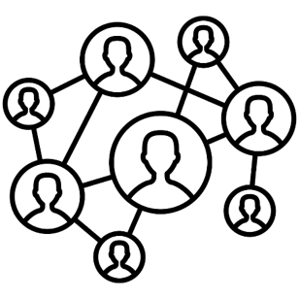



Data is Key for Future Workloads
In-memory Databases
[Mao+, EuroSys’12;
Clapp+ (Intel), IISWC’15]
Graph/Tree Processing
[Xu+, IISWC’12; Umuroglu+, FPL’15]
In-Memory Data Analytics
[Clapp+ (Intel), IISWC’15;
Awan+, BDCloud’15]
Datacenter Workloads
[Kanev+ (Google), ISCA’15]

Slide 5
Data Overwhelms Modern Machines
In-memory Databases
[Mao+, EuroSys’12;
Clapp+ (Intel), IISWC’15]
Graph/Tree Processing
[Xu+, IISWC’12; Umuroglu+, FPL’15]
Data → performance & energy bottleneck
In-Memory Data Analytics
[Clapp+ (Intel), IISWC’15;
Awan+, BDCloud’15]
Datacenter Workloads
[Kanev+ (Google), ISCA’15]

Slide 6








Data is Key for Future Workloads
  Chrome
TensorFlow Mobile
    Google’s web browser
Google’s machine learning framework
  Video Playback
  Video Capture
Google’s video codec
Google’s video codec
Notes:
In this work, we take a look at widely-used google consumer workloads, to figure out the major sources of energy consumption.
We look at Google Chrome web brower. We take a look at Tensorflow, Google’s machine learning framework, and we also take a look at two important video related workloads, video playback and video capture, both rely on Google’s vp9 codec technology.

Slide 7
Data Overwhelms Modern Machines
  Chrome
TensorFlow Mobile
    Google’s web browser
Google’s machine learning framework
Data → performance & energy bottleneck
  Video Playback
  Video Capture
Google’s video codec
Google’s video codec
Notes:
In this work, we take a look at widely-used google consumer workloads, to figure out the major sources of energy consumption.
We look at Google Chrome web brower. We take a look at Tensorflow, Google’s machine learning framework, and we also take a look at two important video related workloads, video playback and video capture, both rely on Google’s vp9 codec technology.

Slide 8
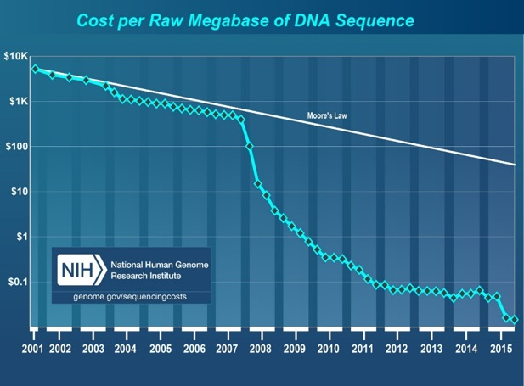
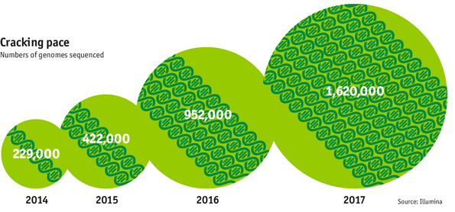

Data is Key for Future Workloads
development of high-throughput sequencing (HTS) technologies
Number of Genomes Sequenced
http://www.economist.com/news/21631808-so-much-genetic-data-so-many-uses-genes-unzipped
Notes:
However, since the development of high throughput sequencing (HTS) technologies, the cost of genome sequencing has fallen off a cliff (<< 1,000$) making it viable for almost everyone's use.

Slide 9

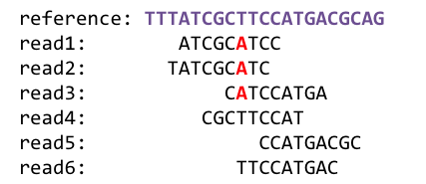
1
Sequencing
Genome Analysis
Read Mapping
2
Data → performance & energy bottleneck
Variant Calling
Scientific Discovery
3
4
Notes:
Genome analysis starts with sequencing random short DNA fragments of copies of the original molecule.
Unfortunately, these reads lack information about their order and which part of genome they are originated from.
Hence the second step is to map these reads to a long reference genome.

Slide 10
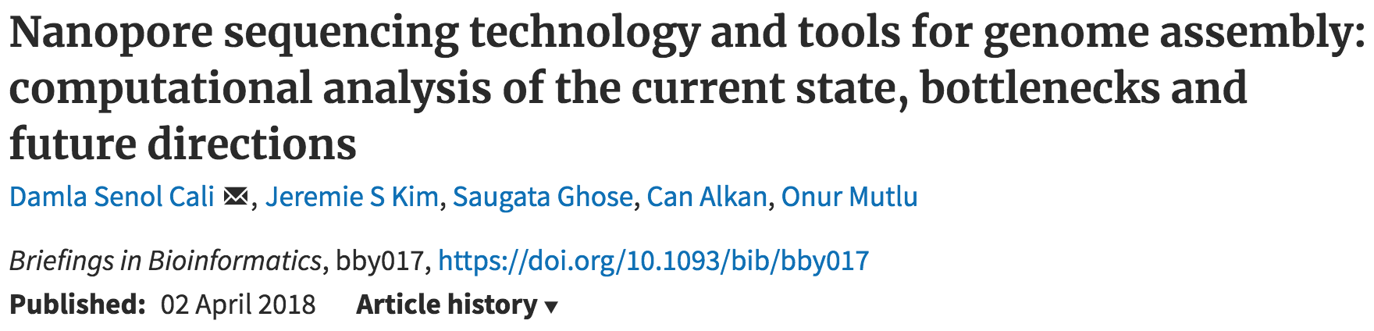
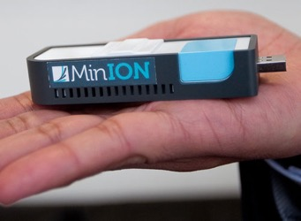
New Genome Sequencing Technologies
Oxford Nanopore MinION
Senol Cali+, “Nanopore Sequencing Technology and Tools for Genome
Assembly: Computational Analysis of the Current State, Bottlenecks
and Future Directions,” Briefings in Bioinformatics, 2018.
[Open arxiv.org version]

Slide 11
New Genome Sequencing Technologies
Oxford Nanopore MinION
Senol Cali+, “Nanopore Sequencing Technology and Tools for Genome
Assembly: Computational Analysis of the Current State, Bottlenecks
and Future Directions,” Briefings in Bioinformatics, 2018.
[Preliminary arxiv.org version]
Data → performance & energy bottleneck

Slide 12
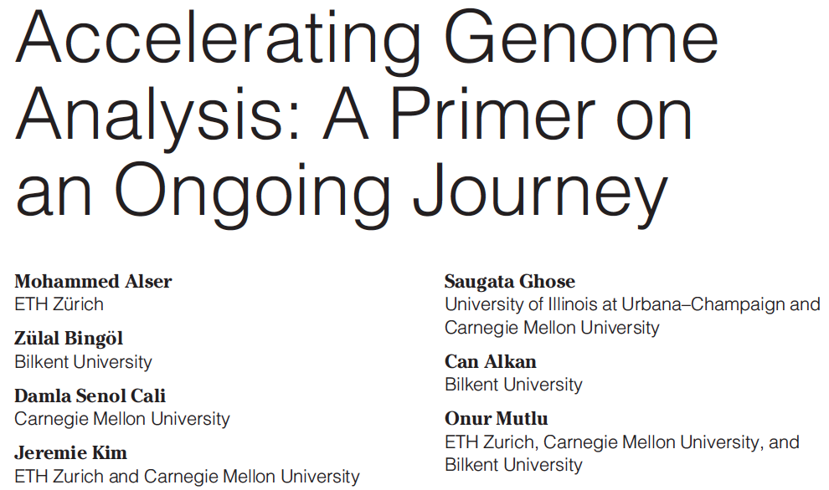
Accelerating Genome Analysis
Mohammed Alser, Zulal Bingol, Damla Senol Cali, Jeremie Kim, Saugata Ghose, Can Alkan, and Onur Mutlu,
"Accelerating Genome Analysis: A Primer on an Ongoing Journey"
IEEE Micro (IEEE MICRO), Vol. 40, No. 5, pages 65-75, September/October 2020.
[Slides (pptx)(pdf)]
[Talk Video (1 hour 2 minutes)]

Slide 13
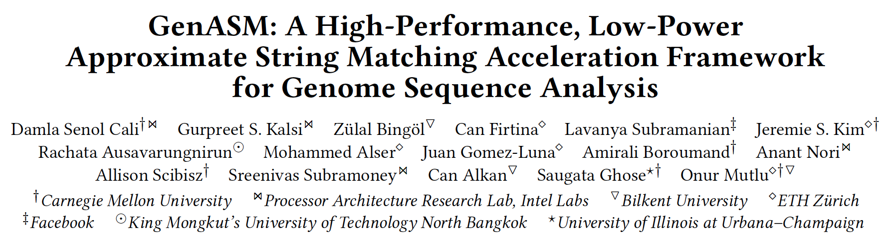
GenASM Framework [MICRO 2020]
Damla Senol Cali, Gurpreet S. Kalsi, Zulal Bingol, Can Firtina, Lavanya Subramanian, Jeremie S. Kim, Rachata Ausavarungnirun, Mohammed Alser, Juan Gomez-Luna, Amirali Boroumand, Anant Nori, Allison Scibisz, Sreenivas Subramoney, Can Alkan, Saugata Ghose, and Onur Mutlu,
"GenASM: A High-Performance, Low-Power Approximate String Matching Acceleration Framework for Genome Sequence Analysis"
Proceedings of the 53rd International Symposium on Microarchitecture (MICRO), Virtual, October 2020.
[Lighting Talk Video (1.5 minutes)]
[Lightning Talk Slides (pptx) (pdf)]
[Talk Video (18 minutes)]
[Slides (pptx) (pdf)]

Slide 14
Data Overwhelms Modern Machines …
Storage/memory capability
Communication capability
Computation capability
Greatly impacts robustness, energy, performance, cost

Slide 15
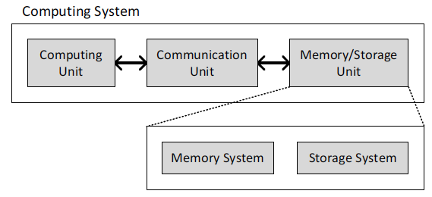
A Computing System
Three key components
Computation
Communication
Storage/memory
Burks, Goldstein, von Neumann, “Preliminary discussion of the
logical design of an electronic computing instrument,” 1946.
Image source: https://lbsitbytes2010.wordpress.com/2013/03/29/john-von-neumann-roll-no-15/

Slide 16
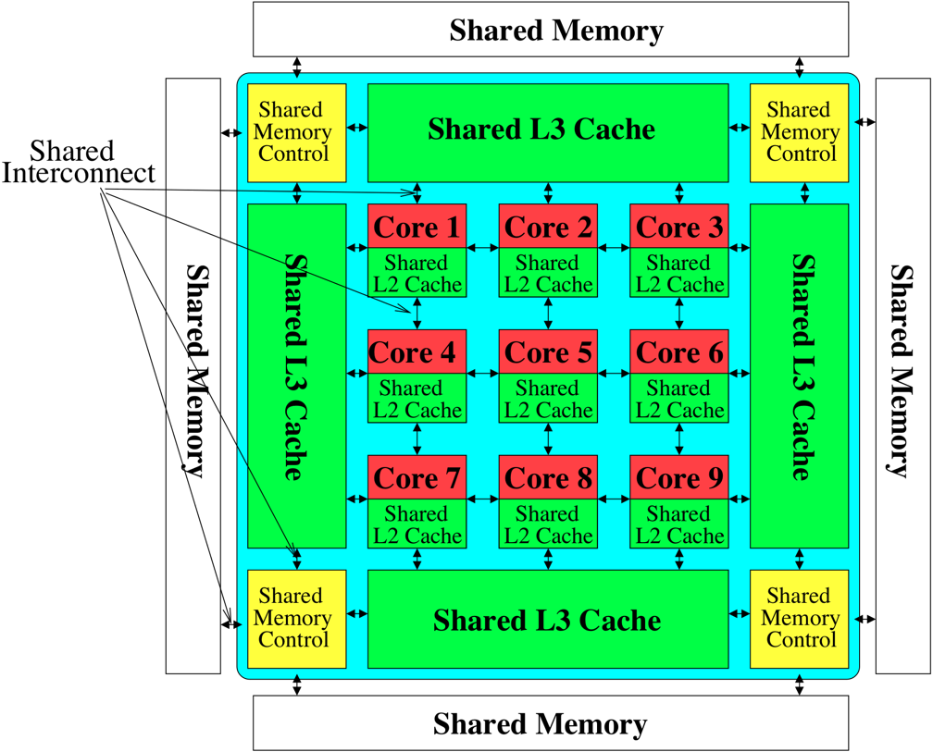
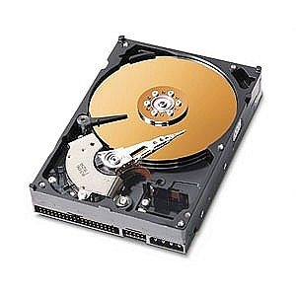
Perils of Processor-Centric Design
Most of the system is dedicated to storing and moving data

Slide 17
Data Overwhelms Modern Machines
  Chrome
TensorFlow Mobile
    Google’s web browser
Google’s machine learning framework
Data → performance & energy bottleneck
  Video Playback
  Video Capture
Google’s video codec
Google’s video codec
Notes:
In this work, we take a look at widely-used google consumer workloads, to figure out the major sources of energy consumption.
We look at Google Chrome web brower. We take a look at Tensorflow, Google’s machine learning framework, and we also take a look at two important video related workloads, video playback and video capture, both rely on Google’s vp9 codec technology.

Slide 18
Data Movement Overwhelms Modern Machines
Amirali Boroumand, Saugata Ghose, Youngsok Kim, Rachata Ausavarungnirun, Eric Shiu, Rahul Thakur, Daehyun Kim, Aki Kuusela, Allan Knies, Parthasarathy Ranganathan, and Onur Mutlu,
"Google Workloads for Consumer Devices: Mitigating Data Movement Bottlenecks"
Proceedings of the 23rd International Conference on Architectural Support for Programming Languages and Operating Systems (ASPLOS), Williamsburg, VA, USA, March 2018.
62.7% of the total system energy
is spent on data movement

Slide 19
Axiom
An Intelligent Architecture
Handles Data Well

Slide 20
How to Handle Data Well
Ensure data does not overwhelm the components
  via intelligent algorithms
  via intelligent architectures
  via whole system designs: algorithm-architecture-devices
Take advantage of vast amounts of data and metadata
  to improve architectural & system-level decisions
Understand and exploit properties of (different) data
  to improve algorithms & architectures in various metrics

Slide 21
Corollaries: Architectures Today …
Architectures are terrible at dealing with data
  Designed to mainly store and move data vs. to compute
  They are processor-centric as opposed to data-centric
Architectures are terrible at taking advantage of vast amounts of data (and metadata) available to them
  Designed to make simple decisions, ignoring lots of data
  They make human-driven decisions vs. data-driven decisions
Architectures are terrible at knowing and exploiting different properties of application data
  Designed to treat all data as the same
  They make component-aware decisions vs. data-aware

Slide 22
Data-Centric (Memory-Centric) Architectures

Slide 23
Data-Centric Architectures: Properties
Process data where it resides (where it makes sense)
  Processing in and near memory structures
Low-latency and low-energy data access
  Low latency memory
  Low energy memory
Low-cost data storage and processing
  High capacity memory at low cost: hybrid memory, compression
Intelligent data management
  Intelligent controllers handling robustness, security, cost

Slide 24
Processing Data
Where It Makes Sense

Slide 25
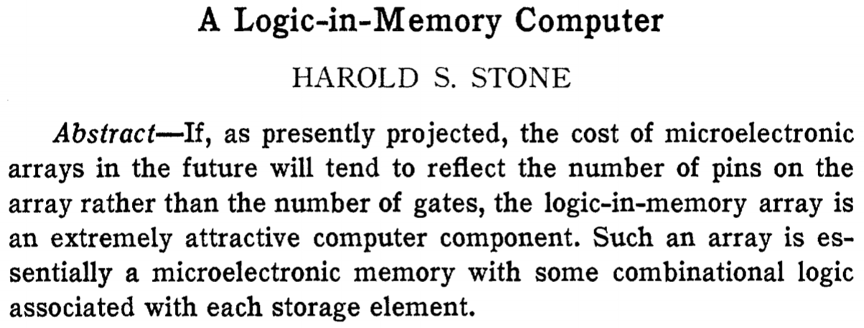
Processing in/near Memory: An Old Idea
Stone, “A Logic-in-Memory Computer,” IEEE TC 1970.

Slide 26
Why In-Memory Computation Today?
Push from Technology
  DRAM Scaling at jeopardy
  → Controllers close to DRAM
  → Industry open to new memory architectures

Slide 27
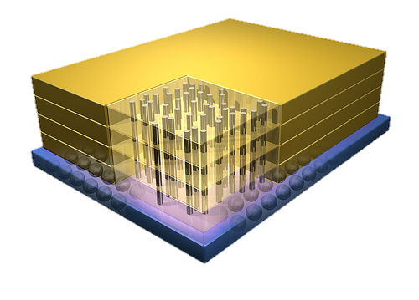


Why In-Memory Computation Today?
Push from Technology
  DRAM Scaling at jeopardy
  → Controllers close to DRAM
  → Industry open to new memory architectures

Slide 28
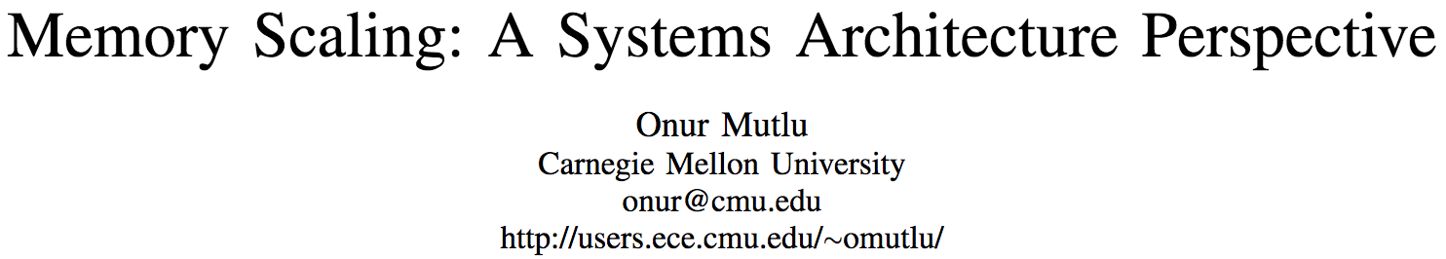
Memory Scaling Issues Were Real
Onur Mutlu,
"Memory Scaling: A Systems Architecture Perspective"
Proceedings of the 5th International Memory Workshop (IMW), Monterey, CA, May 2013. Slides (pptx) (pdf)
EETimes Reprint
https://people.inf.ethz.ch/omutlu/pub/memory-scaling_memcon13.pdf

Slide 29
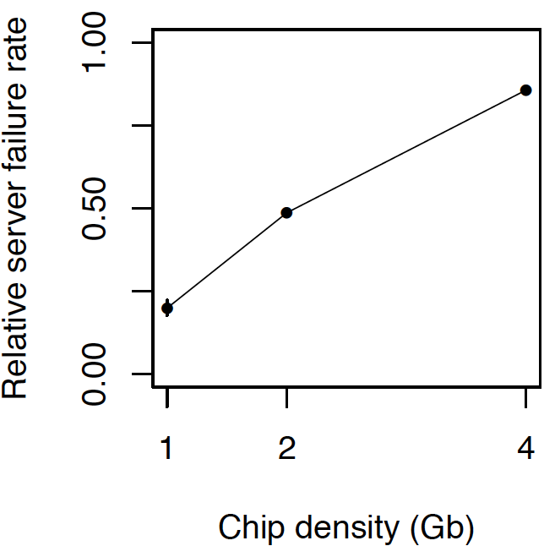
As Memory Scales, It Becomes Unreliable
Data from all of Facebook’s servers worldwide
Meza+, “Revisiting Memory Errors in Large-Scale Production Data Centers,” DSN’15.
Intuition:
quadratic
increase in
capacity

Slide 30
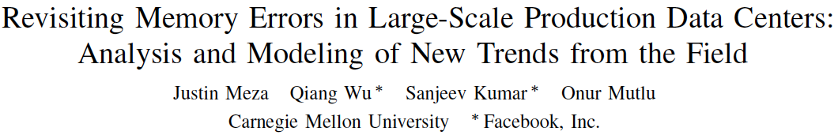
Large-Scale Failure Analysis of DRAM Chips
Analysis and modeling of memory errors found in all of Facebook’s server fleet
Justin Meza, Qiang Wu, Sanjeev Kumar, and Onur Mutlu,
"Revisiting Memory Errors in Large-Scale Production Data Centers: Analysis and Modeling of New Trends from the Field"
Proceedings of the 45th Annual IEEE/IFIP International Conference on Dependable Systems and Networks (DSN), Rio de Janeiro, Brazil, June 2015.
[Slides (pptx) (pdf)] [DRAM Error Model]

Slide 31
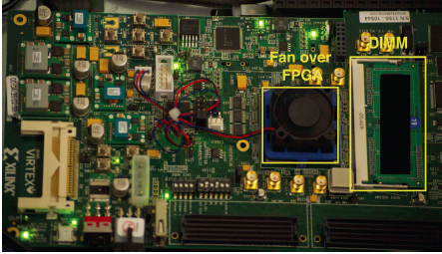
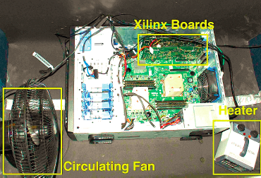
Infrastructures to Understand Such Issues
  An Experimental Study of Data Retention Behavior in Modern DRAM Devices: Implications for Retention Time Profiling Mechanisms (Liu et al., ISCA 2013)
  The Efficacy of Error Mitigation Techniques for DRAM Retention Failures: A Comparative Experimental Study
  (Khan et al., SIGMETRICS 2014)
  Flipping Bits in Memory Without Accessing Them: An Experimental Study of DRAM Disturbance Errors (Kim et al., ISCA 2014)
  Adaptive-Latency DRAM: Optimizing DRAM Timing for the Common-Case (Lee et al., HPCA 2015)
  AVATAR: A Variable-Retention-Time (VRT) Aware Refresh for DRAM Systems (Qureshi et al., DSN 2015)

Slide 32
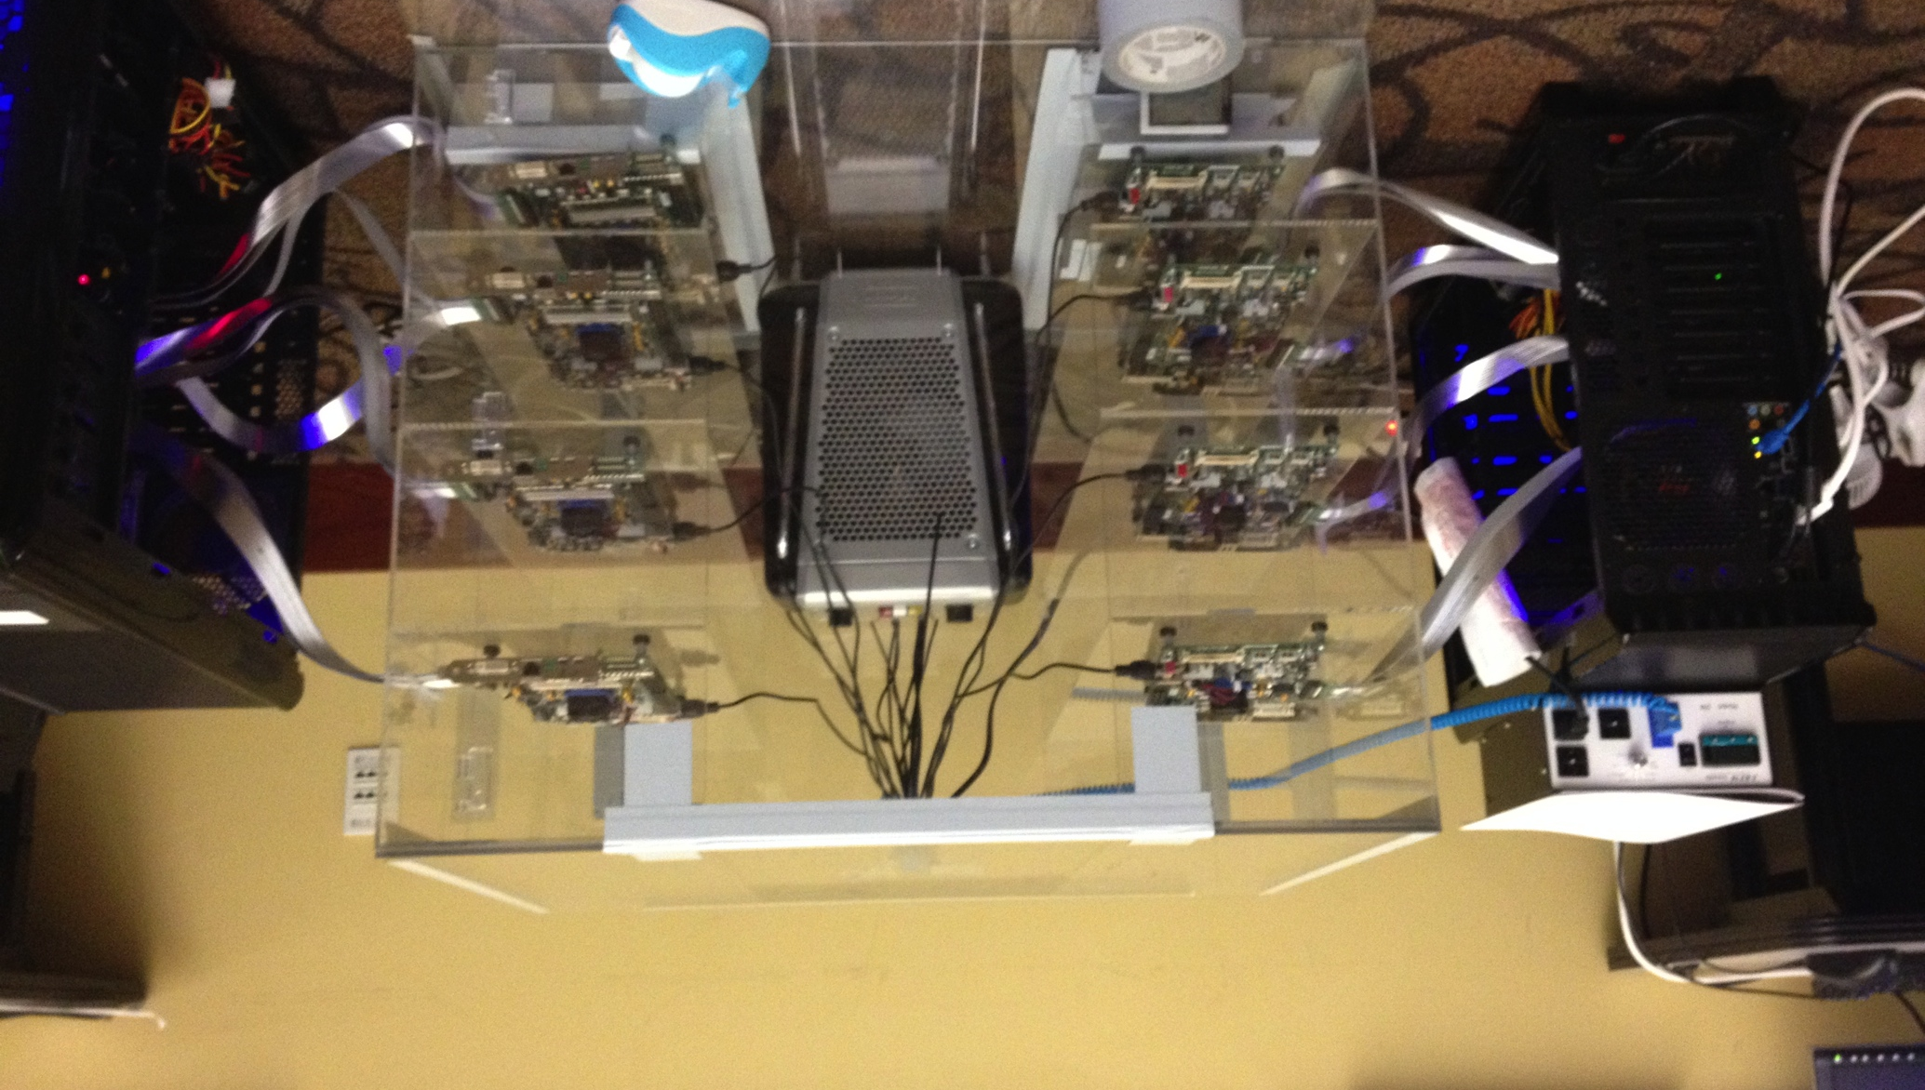
Infrastructures to Understand Such Issues
Temperature
Controller
FPGAs
Heater
FPGAs
PC
  Kim+, “Flipping Bits in Memory Without Accessing Them: An Experimental Study of DRAM Disturbance Errors,” ISCA 2014.

Slide 33
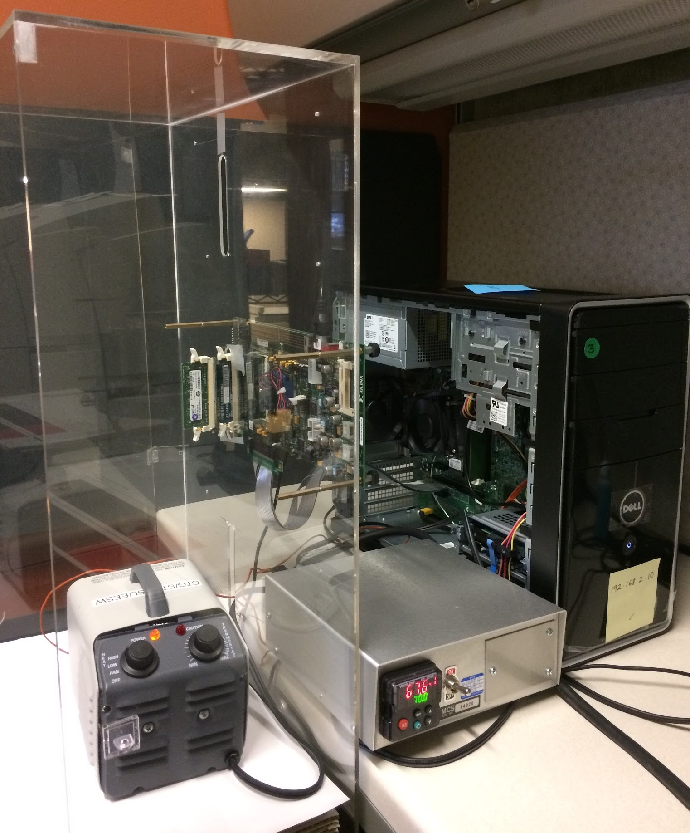
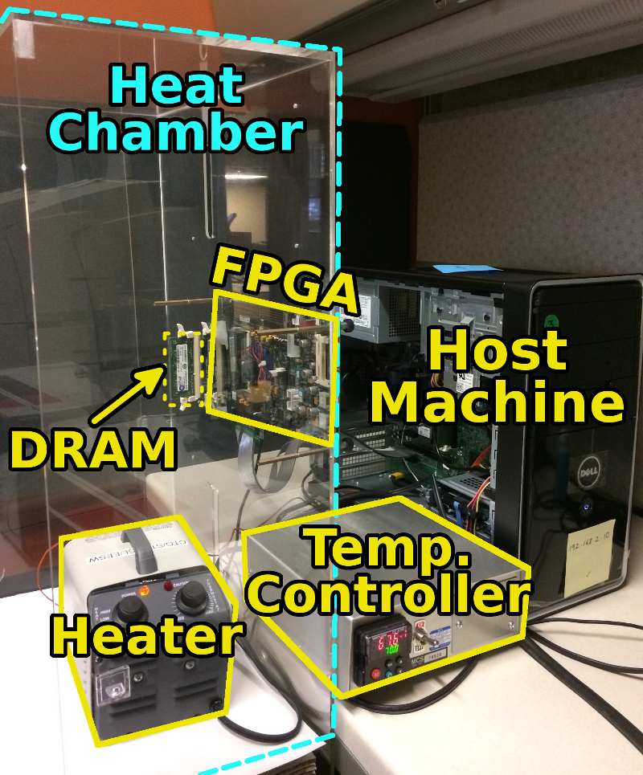
SoftMC: Open Source DRAM Infrastructure
Hasan Hassan et al., “SoftMC: A Flexible and Practical Open-Source Infrastructure for Enabling Experimental DRAM Studies,” HPCA 2017.
Flexible
Easy to Use (C++ API)
Open-source
github.com/CMU-SAFARI/SoftMC

Slide 34
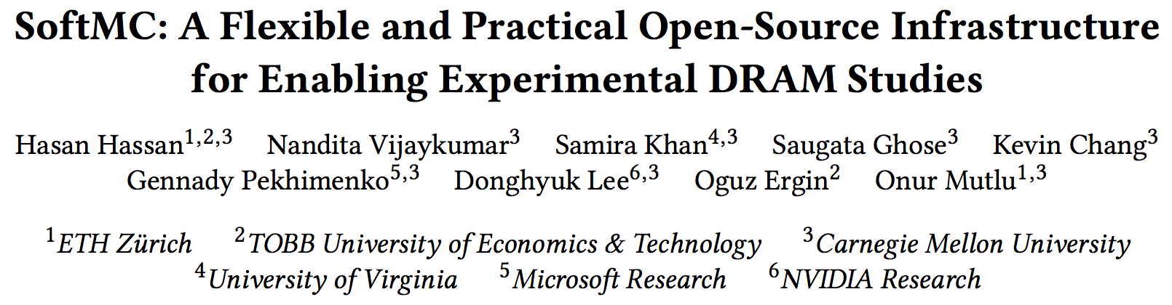
SoftMC
https://github.com/CMU-SAFARI/SoftMC

Slide 35
A Curious Discovery [Kim et al., ISCA 2014]
One can
predictably induce errors
in most DRAM memory chips

Slide 36
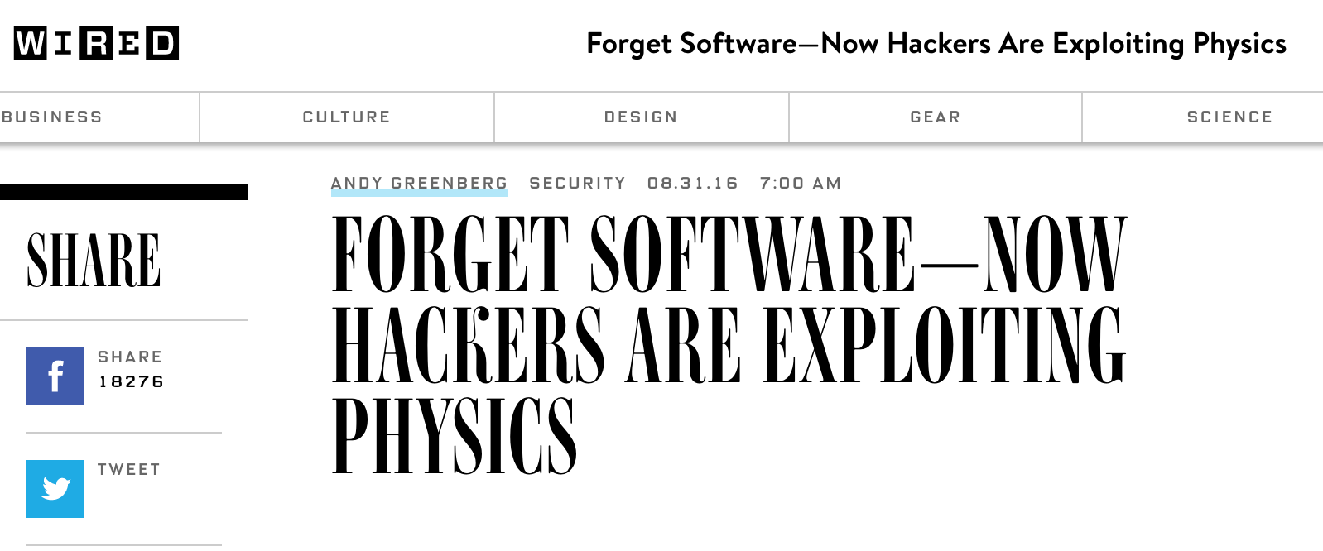
The Story of RowHammer
One can predictably induce bit flips in commodity DRAM chips
  >80% of the tested DRAM chips are vulnerable
First example of how a simple hardware failure mechanism can create a widespread system security vulnerability

Slide 37
Modern DRAM is Prone to Disturbance Errors
Row of Cells
Wordline
Row
Victim Row
Row
Hammered Row
V_{LOW}
Opened
V_{HIGH}
Closed
Row
Victim Row
Row
Repeatedly reading a row enough times (before memory gets refreshed) induces disturbance errors in adjacent rows in most real DRAM chips you can buy today
Flipping Bits in Memory Without Accessing Them: An Experimental Study of DRAM Disturbance Errors, (Kim et al., ISCA 2014)

Slide 38
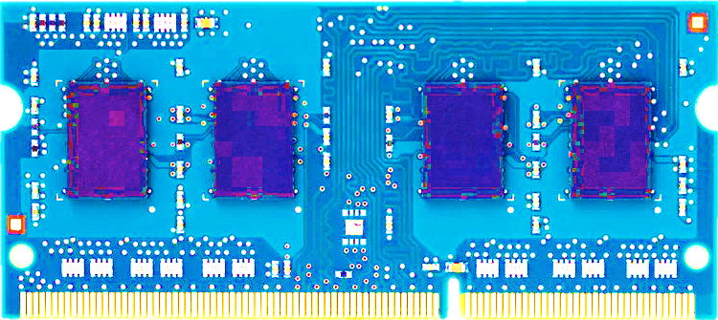
Most DRAM Modules Are Vulnerable
A company
B company
C company
86%
(37/43)
83%
(45/54)
88%
(28/32)
Up to
1.0×10⁷
errors
Up to
2.7×10⁶
errors
Up to
3.3×10⁵
errors
Flipping Bits in Memory Without Accessing Them: An Experimental Study of DRAM Disturbance Errors, (Kim et al., ISCA 2014)

Slide 39
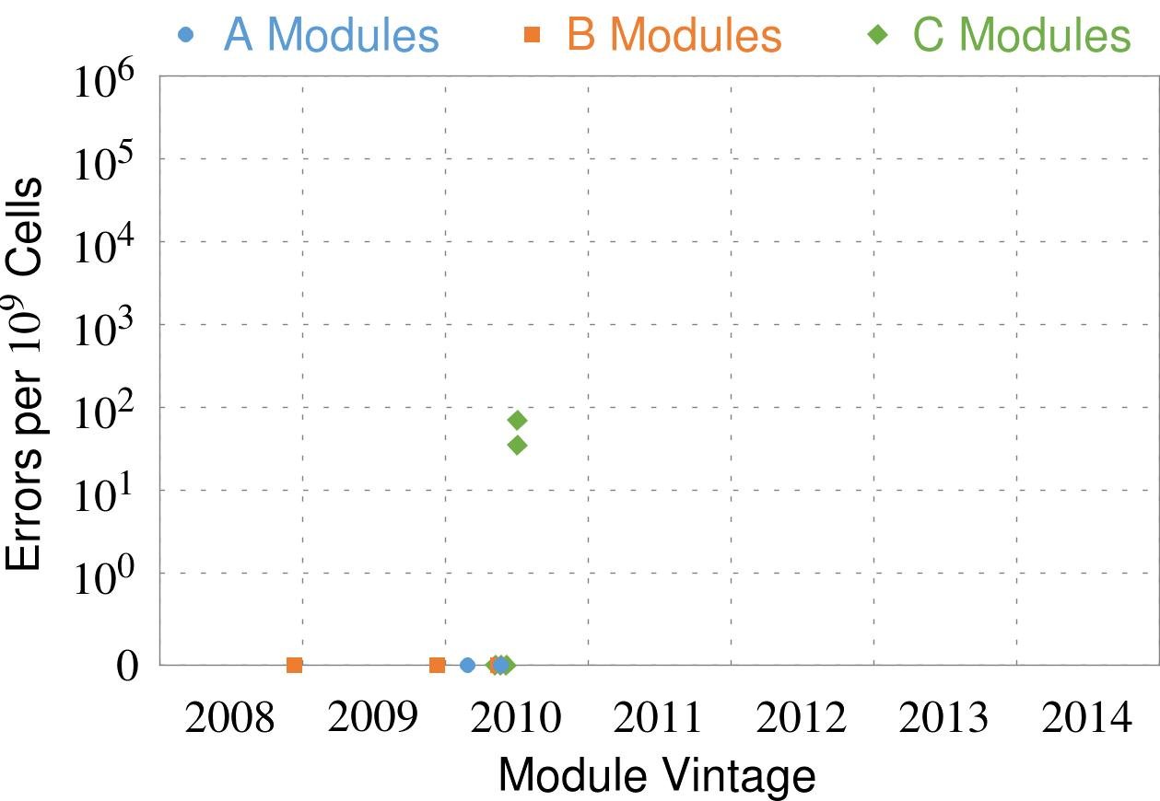
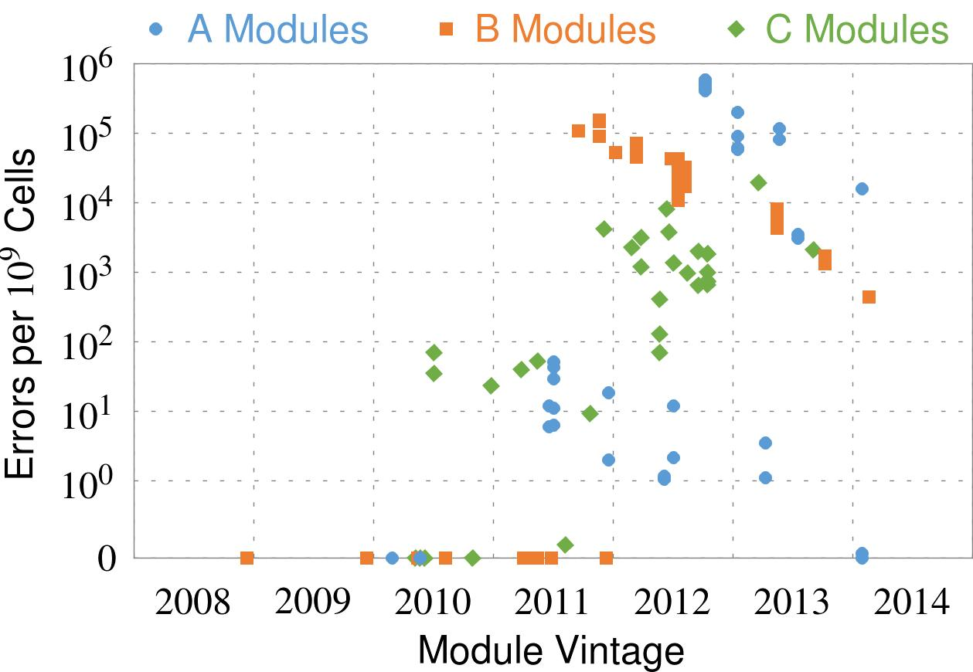
Recent DRAM Is More Vulnerable
First
Appearance
All modules from 2012–2013 are vulnerable
Notes:
In this figure, the x-axis is the module manufacture date. And the y-axis is the number of errors in a module, normalized to one billion cells. In 2008 and 2009, there are no errors. But, in 2010, we first start to see errors in C modules. After 2010, the errors start to proliferate. For A and B modules, we first start to see errors in 2011. In particular, all modules from 2012 and 2013 are vulnerable.

Slide 40


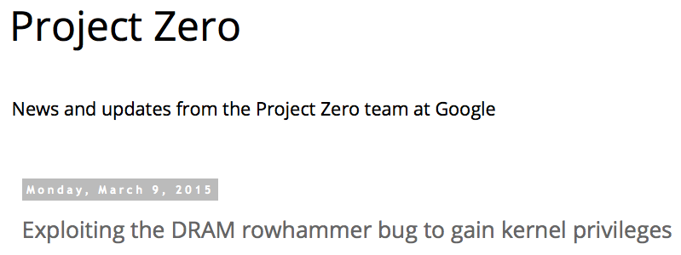
One Can Take Over an Otherwise-Secure System
Flipping Bits in Memory Without Accessing Them: An Experimental Study of DRAM Disturbance Errors (Kim et al., ISCA 2014)
Exploiting the DRAM rowhammer bug to gain kernel privileges (Seaborn, 2015)

Slide 41
The Push from Circuits and Devices
Main Memory Needs
Intelligent Controllers

Slide 42
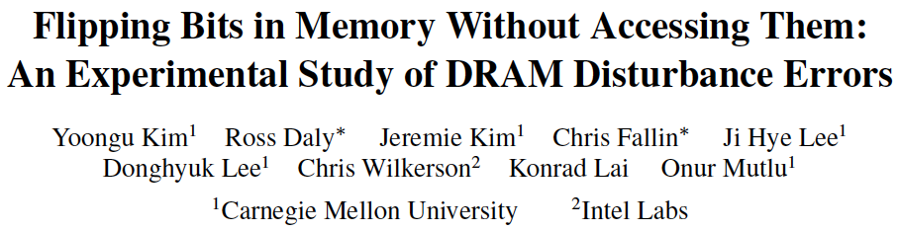
Memory Scaling Issues Are Real
Yoongu Kim, Ross Daly, Jeremie Kim, Chris Fallin, Ji Hye Lee, Donghyuk Lee, Chris Wilkerson, Konrad Lai, and Onur Mutlu,
"Flipping Bits in Memory Without Accessing Them: An Experimental Study of DRAM Disturbance Errors"
Proceedings of the 41st International Symposium on Computer Architecture (ISCA), Minneapolis, MN, June 2014.
[Slides (pptx) (pdf)] [Lightning Session Slides (pptx) (pdf)] [Source Code and Data]

Slide 43
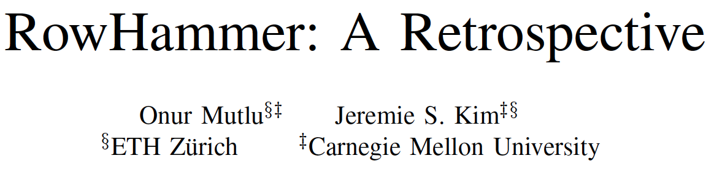
Memory Scaling Issues Are Real
Onur Mutlu and Jeremie Kim,
"RowHammer: A Retrospective"
IEEE Transactions on Computer-Aided Design of Integrated Circuits and Systems (TCAD) Special Issue on Top Picks in Hardware and Embedded Security, 2019.
[Preliminary arXiv version]

Slide 44
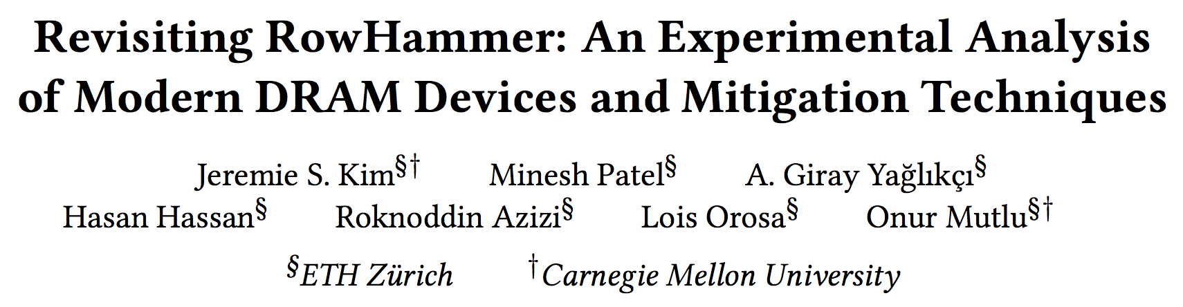
RowHammer in 2020 (I)
Jeremie S. Kim, Minesh Patel, A. Giray Yaglikci, Hasan Hassan, Roknoddin Azizi, Lois Orosa, and Onur Mutlu,
"Revisiting RowHammer: An Experimental Analysis of Modern Devices and Mitigation Techniques"
Proceedings of the 47th International Symposium on Computer Architecture (ISCA), Valencia, Spain, June 2020.
[Slides (pptx) (pdf)]
[Lightning Talk Slides (pptx) (pdf)]
[Talk Video (20 minutes)]
[Lightning Talk Video (3 minutes)]

Slide 45
Key Takeaways from 1580 Chips
Chips of newer DRAM technology nodes are more vulnerable to RowHammer
There are chips today whose weakest cells fail after only 4800 hammers
Chips of newer DRAM technology nodes can exhibit RowHammer bit flips 1) in more rows and 2) farther away from the victim row.
Existing mitigation mechanisms are not effective
Notes:
To reiterate our three key takeaways from our experimental characterization, we find that
[CLICK] First, chips of newer DRAM technology nodes are more vulnerable to RowHammer
[CLICK] Second, there are chips today whose weakest cells fail after only 4800 hammers
[CLICK] Third, chips of newer DRAM technology nodes can exhibit RowHammer bit flips in more rows and farther away from the victim row
================

Slide 46
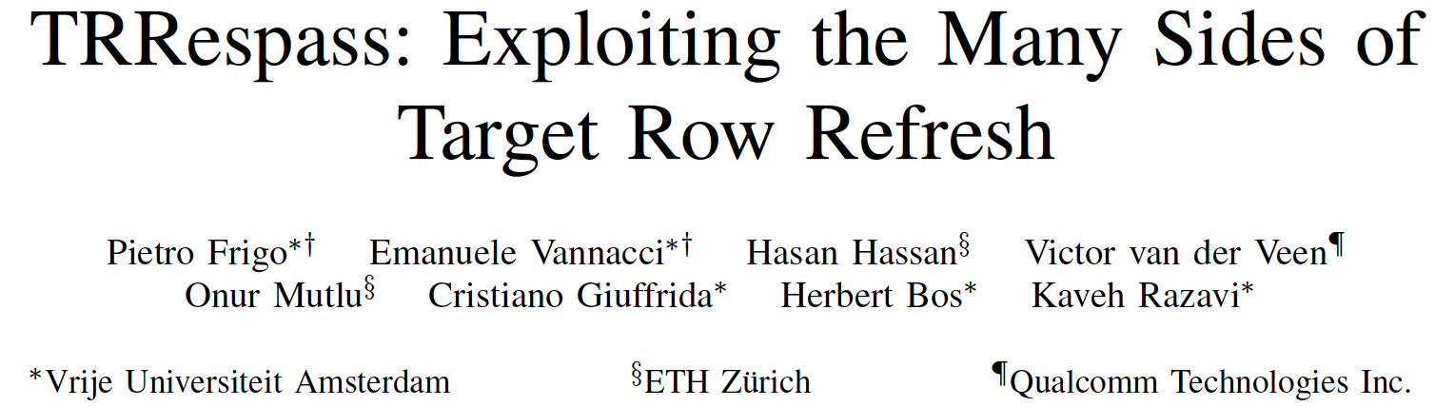
RowHammer in 2020 (II)
Pietro Frigo, Emanuele Vannacci, Hasan Hassan, Victor van der Veen, Onur Mutlu, Cristiano Giuffrida, Herbert Bos, and Kaveh Razavi,
"TRRespass: Exploiting the Many Sides of Target Row Refresh"
Proceedings of the 41st IEEE Symposium on Security and Privacy (S&P), San Francisco, CA, USA, May 2020.
[Slides (pptx) (pdf)]
[Talk Video (17 minutes)]
[Source Code]
[Web Article]
Best paper award.

Slide 47
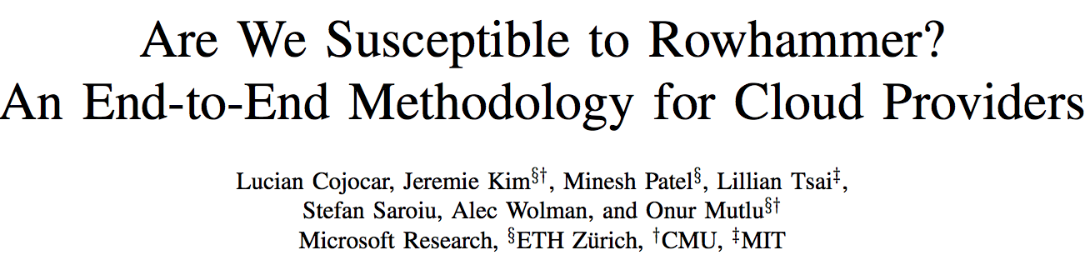
RowHammer in 2020 (III)
Lucian Cojocar, Jeremie Kim, Minesh Patel, Lillian Tsai, Stefan Saroiu, Alec Wolman, and Onur Mutlu,
"Are We Susceptible to Rowhammer? An End-to-End Methodology for Cloud Providers"
Proceedings of the 41st IEEE Symposium on Security and Privacy (S&P), San Francisco, CA, USA, May 2020.
[Slides (pptx) (pdf)]
[Talk Video (17 minutes)]

Slide 48
The Push from Circuits and Devices
Main Memory Needs
Intelligent Controllers

Slide 49
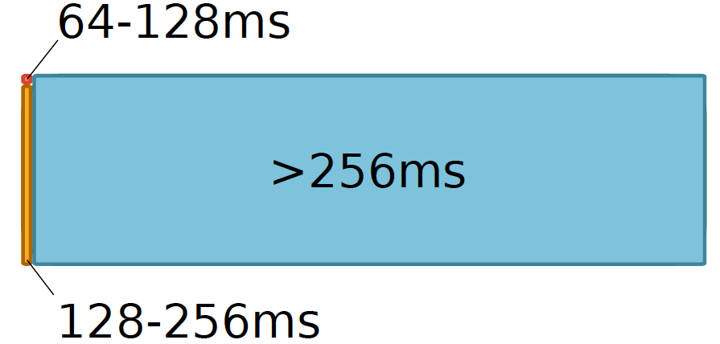
Data Retention in Memory [Liu et al., ISCA 2013]
Retention Time Profile of DRAM looks like this:
Location dependent
Stored value pattern dependent
Time dependent

Slide 50
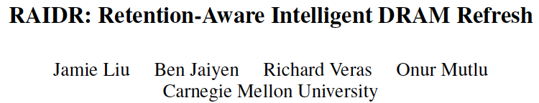
More on DRAM Refresh (I)
Jamie Liu, Ben Jaiyen, Richard Veras, and Onur Mutlu,
"RAIDR: Retention-Aware Intelligent DRAM Refresh"
Proceedings of the 39th International Symposium on Computer Architecture (ISCA), Portland, OR, June 2012. Slides (pdf)

Slide 51
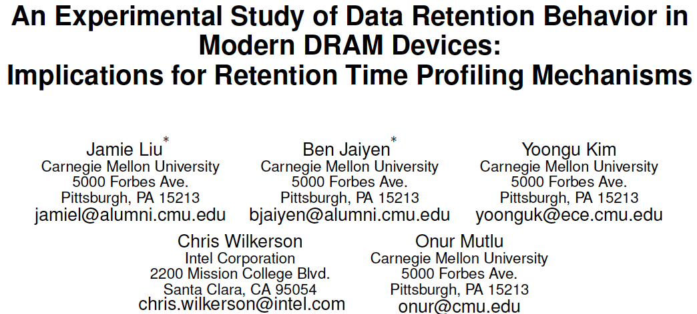
More on DRAM Refresh (II)
Jamie Liu, Ben Jaiyen, Yoongu Kim, Chris Wilkerson, and Onur Mutlu,
"An Experimental Study of Data Retention Behavior in Modern DRAM Devices: Implications for Retention Time Profiling Mechanisms"
Proceedings of the 40th International Symposium on Computer Architecture (ISCA), Tel-Aviv, Israel, June 2013. Slides (ppt) Slides (pdf)

Slide 52
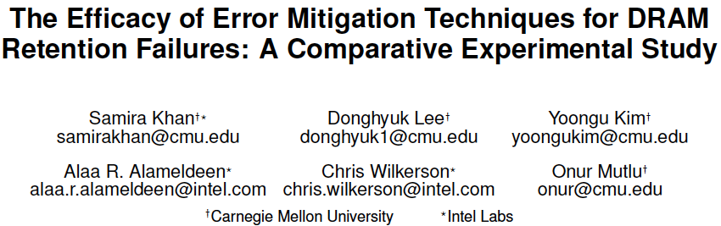
More on DRAM Refresh (III)
Samira Khan, Donghyuk Lee, Yoongu Kim, Alaa Alameldeen, Chris Wilkerson, and Onur Mutlu,
"The Efficacy of Error Mitigation Techniques for DRAM Retention Failures: A Comparative Experimental Study"
Proceedings of the ACM International Conference on Measurement and Modeling of Computer Systems (SIGMETRICS), Austin, TX, June 2014. [Slides (pptx) (pdf)] [Poster (pptx) (pdf)] [Full data sets]

Slide 53
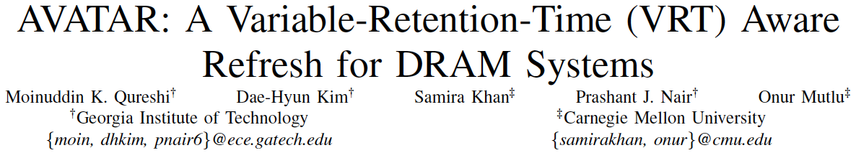
More on DRAM Refresh (IV)
Moinuddin Qureshi, Dae Hyun Kim, Samira Khan, Prashant Nair, and Onur Mutlu,
"AVATAR: A Variable-Retention-Time (VRT) Aware Refresh for DRAM Systems"
Proceedings of the 45th Annual IEEE/IFIP International Conference on Dependable Systems and Networks (DSN), Rio de Janeiro, Brazil, June 2015.
[Slides (pptx) (pdf)]

Slide 54
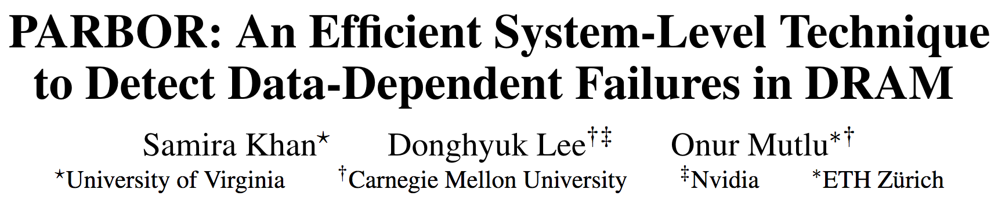
More on DRAM Refresh (V)
Samira Khan, Donghyuk Lee, and Onur Mutlu,
"PARBOR: An Efficient System-Level Technique to Detect Data-Dependent Failures in DRAM"
Proceedings of the 45th Annual IEEE/IFIP International Conference on Dependable Systems and Networks (DSN), Toulouse, France, June 2016.
[Slides (pptx) (pdf)]

Slide 55
More on DRAM Refresh (VI)
Samira Khan, Chris Wilkerson, Zhe Wang, Alaa R. Alameldeen, Donghyuk Lee, and Onur Mutlu,
"Detecting and Mitigating Data-Dependent DRAM Failures by Exploiting Current Memory Content"
Proceedings of the 50th International Symposium on Microarchitecture (MICRO), Boston, MA, USA, October 2017.
[Slides (pptx) (pdf)] [Lightning Session Slides (pptx) (pdf)] [Poster (pptx) (pdf)]

Slide 56
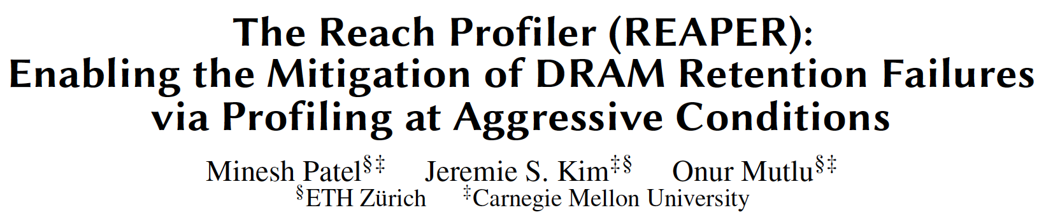
More on DRAM Refresh (VII)
Minesh Patel, Jeremie S. Kim, and Onur Mutlu,
"The Reach Profiler (REAPER): Enabling the Mitigation of DRAM Retention Failures via Profiling at Aggressive Conditions"
Proceedings of the 44th International Symposium on Computer Architecture (ISCA), Toronto, Canada, June 2017.
[Slides (pptx) (pdf)]
[Lightning Session Slides (pptx) (pdf)]
First experimental analysis of (mobile) LPDDR4 chips
Analyzes the complex tradeoff space of retention time profiling
Idea: enable fast and robust profiling at higher refresh intervals & temperatures

Slide 57
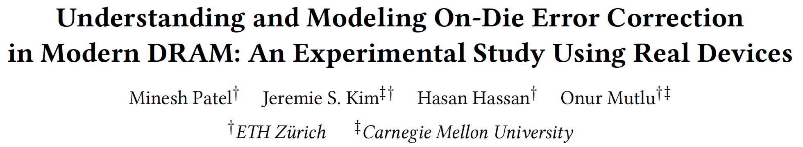
More on DRAM Refresh (VIII)
Minesh Patel, Jeremie S. Kim, Hasan Hassan, and Onur Mutlu,
"Understanding and Modeling On-Die Error Correction in Modern DRAM: An Experimental Study Using Real Devices"
Proceedings of the 49th Annual IEEE/IFIP International Conference on Dependable Systems and Networks (DSN), Portland, OR, USA, June 2019.
[Slides (pptx) (pdf)]
[Talk Video (26 minutes)]
[Full Talk Lecture (29 minutes)]
[Source Code for EINSim, the Error Inference Simulator]
Best paper award.

Slide 58
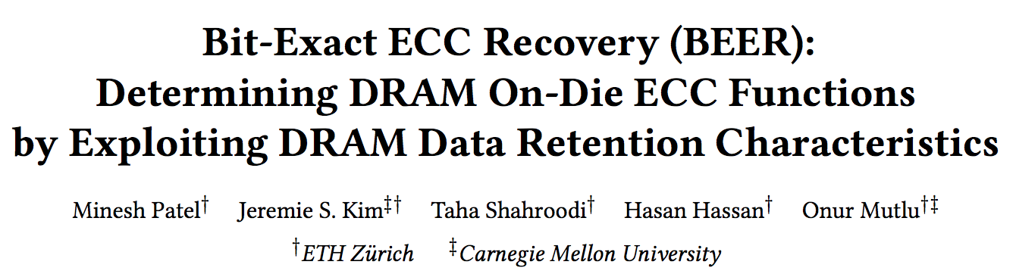
More on DRAM Refresh (IX)
Minesh Patel, Jeremie S. Kim, Taha Shahroodi, Hasan Hassan, and Onur Mutlu,
"Bit-Exact ECC Recovery (BEER): Determining DRAM On-Die ECC Functions by Exploiting DRAM Data Retention Characteristics"
Proceedings of the 53rd International Symposium on Microarchitecture (MICRO), Virtual, October 2020.
[Slides (pptx) (pdf)]
[Lightning Talk Slides (pptx) (pdf)]
[Talk Video (15 minutes)]
[Lightning Talk Video (1.5 minutes)]
Best paper award.

Slide 59
The Push from Circuits and Devices
Main Memory Needs
Intelligent Controllers

Slide 60
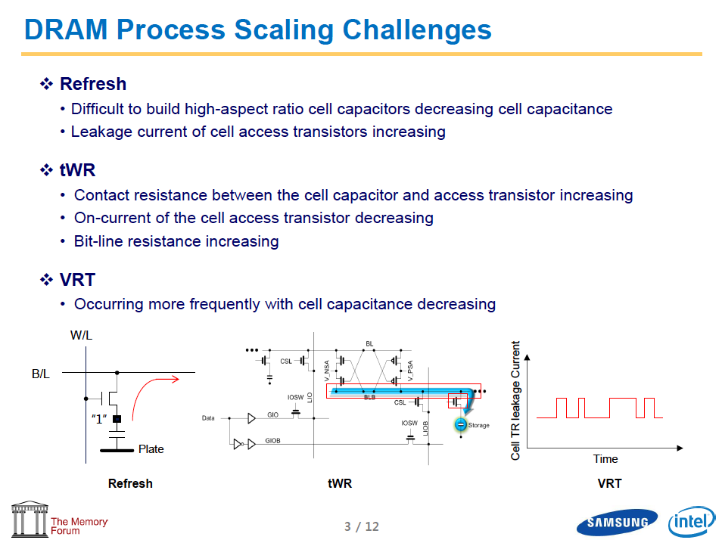
Industry Is Writing Papers About It, Too

Slide 61
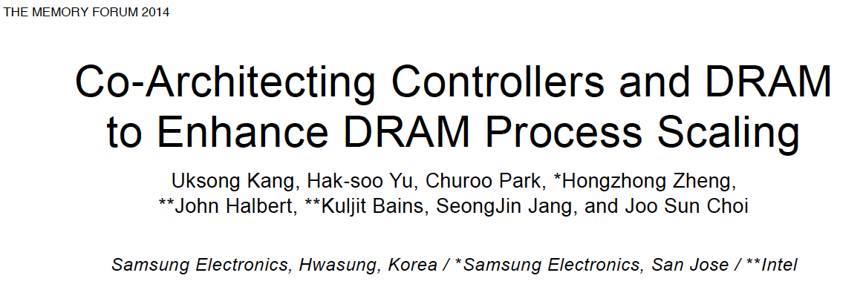
Call for Intelligent Memory Controllers

Slide 62
Hybrid Memory Systems
CPU
Meza+, “Enabling Efficient and Scalable Hybrid Memories,” IEEE Comp. Arch. Letters, 2012.
Yoon, Meza et al., “Row Buffer Locality Aware Caching Policies for Hybrid Memories,” ICCD 2012 Best Paper Award.
DRAMCtrl
PCM Ctrl
DRAM
Technology X (e.g., PCM)
Fast, durable
Small,
leaky, volatile,
high-cost
Large, non-volatile, low-cost
Slow, wears out, high active energy
Hardware/software manage data allocation and movement
to achieve the best of multiple technologies

Slide 63
The Push from Circuits and Devices
Main Memory Needs
Intelligent Controllers

Slide 64
Why In-Memory Computation Today?
Push from Technology
  DRAM Scaling at jeopardy
  → Controllers close to DRAM
  → Industry open to new memory architectures
Pull from Systems and Applications
  Data access is a major system and application bottleneck
  Systems are energy limited
  Data movement much more energy-hungry than computation

Slide 65
Three Key Systems Trends
1. Data access is a major bottleneck
  Applications are increasingly data hungry
2. Energy consumption is a key limiter
3. Data movement energy dominates compute
  Especially true for off-chip to on-chip movement

Slide 66
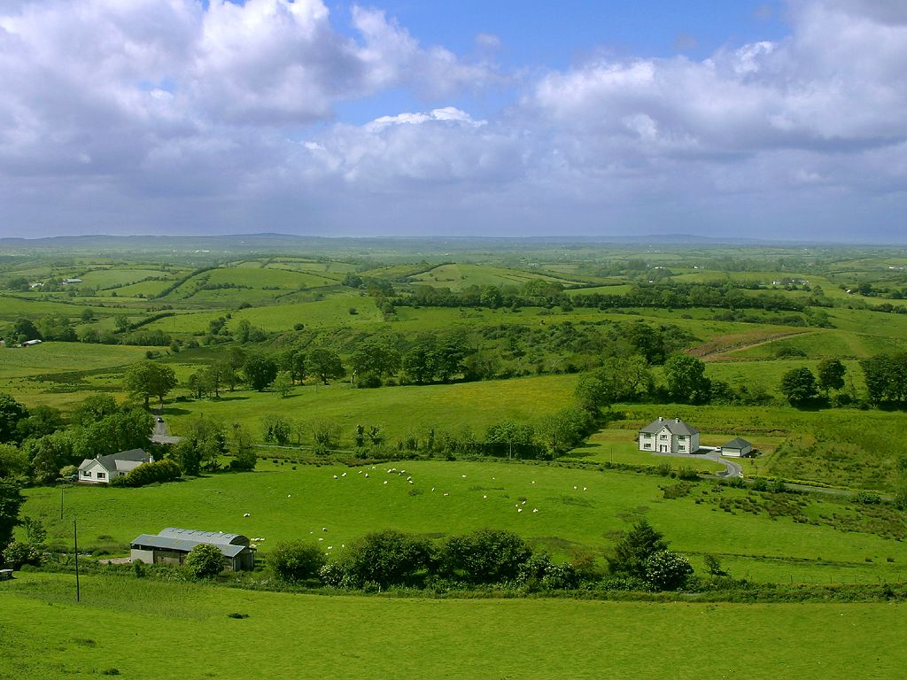
Do We Want This?
Source: V. Milutinovic

Slide 67
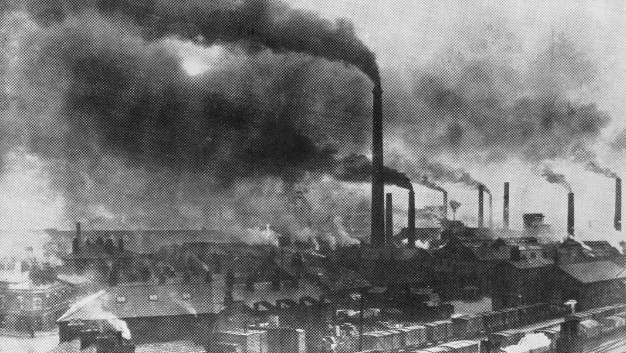
Or This?
Source: V. Milutinovic

Slide 68
Challenge and Opportunity for Future
High Performance,
Energy Efficient,
Sustainable

Slide 69
The Problem
Data access is the major performance and energy bottleneck
Our current
design principles
cause great energy waste
(and great performance loss)

Slide 70
The Problem
Processing of data
is performed
far away from the data

Slide 71
A Computing System
Three key components
Computation
Communication
Storage/memory
Burks, Goldstein, von Neumann, “Preliminary discussion of the
logical design of an electronic computing instrument,” 1946.
Image source: https://lbsitbytes2010.wordpress.com/2013/03/29/john-von-neumann-roll-no-15/

Slide 72
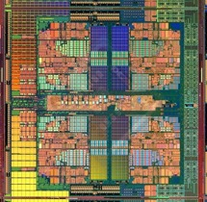

A Computing System
Three key components
Computation
Communication
Storage/memory
Burks, Goldstein, von Neumann, “Preliminary discussion of the
logical design of an electronic computing instrument,” 1946.
Image source: https://lbsitbytes2010.wordpress.com/2013/03/29/john-von-neumann-roll-no-15/

Slide 73
Today’s Computing Systems
Are overwhelmingly processor centric
All data processed in the processor → at great system cost
Processor is heavily optimized and is considered the master
Data storage units are dumb and are largely unoptimized (except for some that are on the processor die)

Slide 74
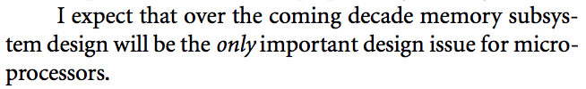
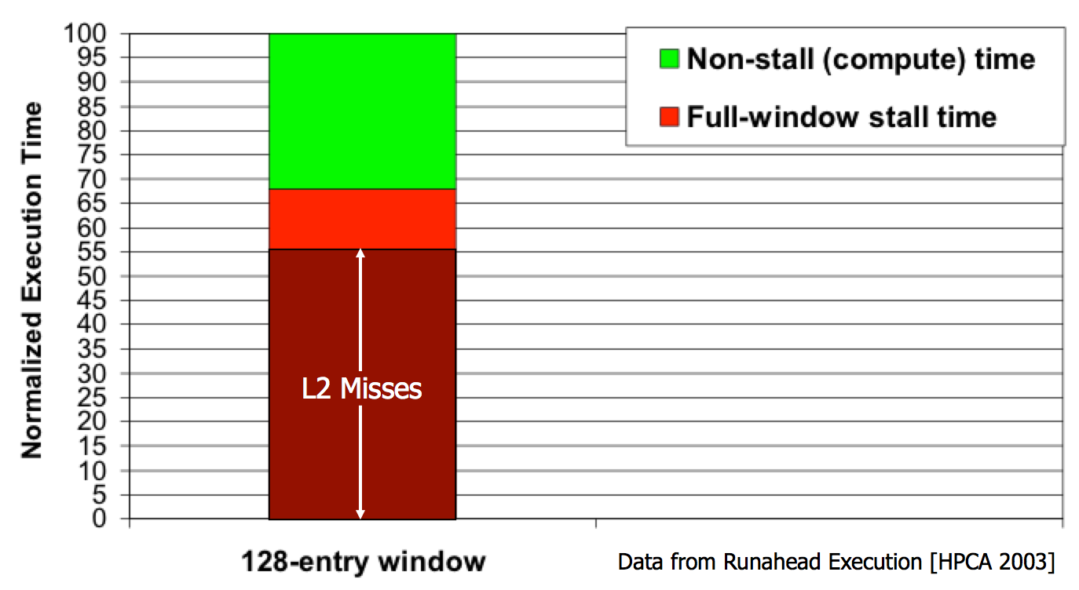
Yet …
“It’s the Memory, Stupid!” (Richard Sites, MPR, 1996)
Mutlu+, “Runahead Execution: An Alternative to Very Large Instruction Windows for Out-of-Order Processors,” HPCA 2003.

Slide 75
The Performance Perspective
Onur Mutlu, Jared Stark, Chris Wilkerson, and Yale N. Patt,
"Runahead Execution: An Alternative to Very Large Instruction Windows for Out-of-order Processors"
Proceedings of the 9th International Symposium on High-Performance Computer Architecture (HPCA), pages 129-140, Anaheim, CA, February 2003. Slides (pdf)

Slide 76
The Performance Perspective (Today)
All of Google’s Data Center Workloads (2015):
Kanev+, “Profiling a Warehouse-Scale Computer,” ISCA 2015.

Slide 77
The Performance Perspective (Today)
All of Google’s Data Center Workloads (2015):
Kanev+, “Profiling a Warehouse-Scale Computer,” ISCA 2015.

Slide 78
Perils of Processor-Centric Design
Grossly-imbalanced systems
  Processing done only in one place
  Everything else just stores and moves data: data moves a lot
  → Energy inefficient
  → Low performance
  → Complex
Overly complex and bloated processor (and accelerators)
  To tolerate data access from memory
  Complex hierarchies and mechanisms
  → Energy inefficient
  → Low performance
  → Complex

Slide 79
Perils of Processor-Centric Design
Most of the system is dedicated to storing and moving data

Slide 80
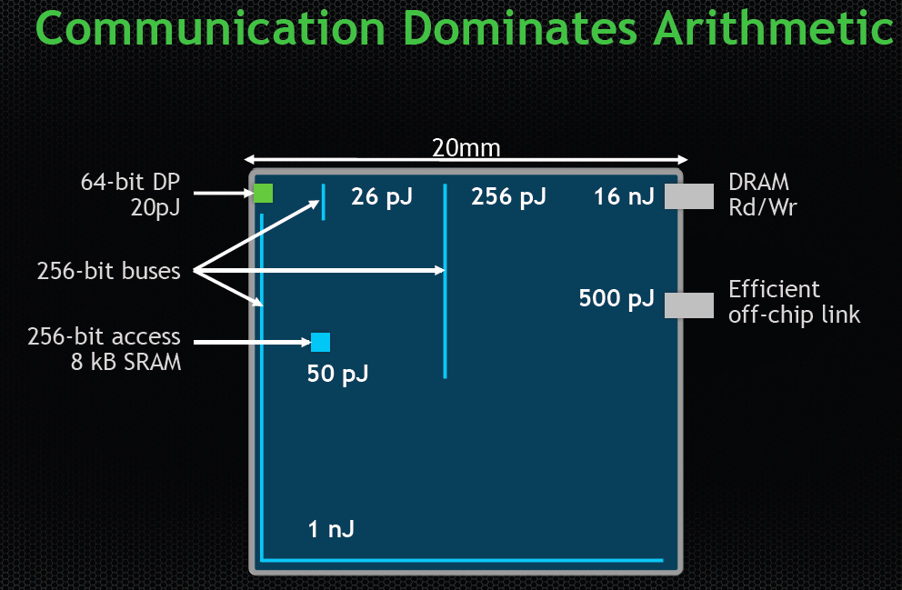
The Energy Perspective
Dally, HiPEAC 2015

Slide 81
Data Movement vs. Computation Energy
Dally, HiPEAC 2015
A memory access consumes ~100-1000X
the energy of a complex addition

Slide 82
Data Movement vs. Computation Energy
Data movement is a major system energy bottleneck
  Comprises 41% of mobile system energy during web browsing [2]
  Costs ~115 times as much energy as an ADD operation [1, 2]
[1]: Reducing data Movement Energy via Online Data Clustering and Encoding (MICRO’16)
[2]: Quantifying the energy cost of data movement for emerging smart phone workloads on mobile platforms (IISWC’14)

Slide 83
Energy Waste in Mobile Devices
Amirali Boroumand, Saugata Ghose, Youngsok Kim, Rachata Ausavarungnirun, Eric Shiu, Rahul Thakur, Daehyun Kim, Aki Kuusela, Allan Knies, Parthasarathy Ranganathan, and Onur Mutlu,
"Google Workloads for Consumer Devices: Mitigating Data Movement Bottlenecks"
Proceedings of the 23rd International Conference on Architectural Support for Programming Languages and Operating Systems (ASPLOS), Williamsburg, VA, USA, March 2018.
62.7% of the total system energy
is spent on data movement

Slide 84
We Do Not Want to Move Data!
Dally, HiPEAC 2015
A memory access consumes ~100-1000X
the energy of a complex addition

Slide 85
We Need A Paradigm Shift To …
Enable computation with minimal data movement
Compute where it makes sense (where data resides)
Make computing architectures more data-centric

Slide 86
Goal: Processing Inside Memory
Many questions … How do we design the:
  compute-capable memory & controllers?
  processor chip and in-memory units?
  software and hardware interfaces?
  system software, compilers, languages?
  algorithms and theoretical foundations?
Memory
Processor
Core
Database
Graphs
Media
Cache
Query
Interconnect
Problem
Results
Algorithm
Program/Language
System Software
SW/HW Interface
Micro-architecture
Logic
Devices
Electrons

Slide 87
Processing in Memory:
Two Approaches
1. Minimally changing memory chips
2. Exploiting 3D-stacked memory

Slide 88
Approach 1: Minimally Changing Memory
DRAM has great capability to perform bulk data movement and computation internally with small changes
  Can exploit internal connectivity to move data
  Can exploit analog computation capability
  …
Examples: RowClone, In-DRAM AND/OR, Gather/Scatter DRAM
  RowClone: Fast and Efficient In-DRAM Copy and Initialization of Bulk Data (Seshadri et al., MICRO 2013)
  Fast Bulk Bitwise AND and OR in DRAM (Seshadri et al., IEEE CAL 2015)
  Gather-Scatter DRAM: In-DRAM Address Translation to Improve the Spatial Locality of Non-unit Strided Accesses (Seshadri et al., MICRO 2015)
  "Ambit: In-Memory Accelerator for Bulk Bitwise Operations Using Commodity DRAM Technology” (Seshadri et al., MICRO 2017)

Slide 89

Starting Simple: Data Copy and Initialization
  memmove & memcpy: 5% cycles in Google’s datacenter [Kanev+ ISCA’15]
000000000000000
Zero initialization
(e.g., security)
Forking
Checkpointing
Many more
VM Cloning
Deduplication
Page Migration

Slide 90
Today’s Systems: Bulk Data Copy
1) High latency
Memory
3) Cache pollution
L3
CPU
L2
L1
MC
2) High bandwidth utilization
4) Unwanted data movement
1046ns, 3.6uJ (for 4KB page copy via DMA)

Slide 91
Future Systems: In-Memory Copy
3) No cache pollution
1) Low latency
Memory
L3
CPU
L2
L1
MC
2) Low bandwidth utilization
4) No unwanted data movement
1046ns, 3.6uJ
→ 90ns, 0.04uJ

Slide 92
RowClone: In-DRAM Row Copy
Idea: Two consecutive ACTivates
4 Kbytes
Negligible HW cost
Step 1: Activate row A
Step 2: Activate row B
Transfer row
DRAM subarray
Transfer
row
Row Buffer (4 Kbytes)
8 bits
Data Bus
Notes:
copy

Slide 93
RowClone: Latency and Energy Savings
11.6x
74x
Seshadri et al., “RowClone: Fast and Efficient In-DRAM Copy and Initialization of Bulk Data,” MICRO 2013.

Slide 94
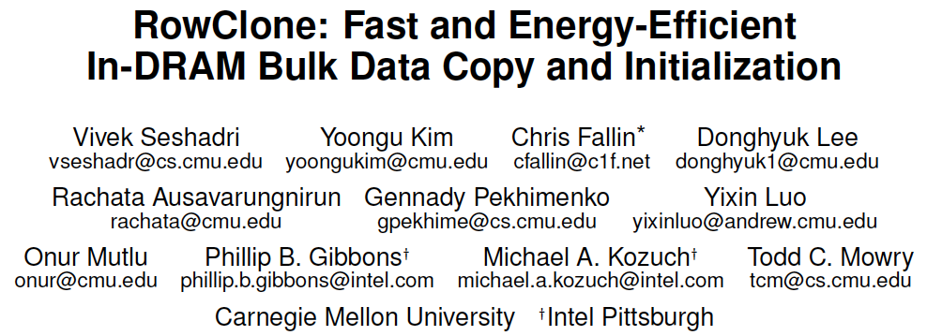
More on RowClone
Vivek Seshadri, Yoongu Kim, Chris Fallin, Donghyuk Lee, Rachata Ausavarungnirun, Gennady Pekhimenko, Yixin Luo, Onur Mutlu, Michael A. Kozuch, Phillip B. Gibbons, and Todd C. Mowry,
"RowClone: Fast and Energy-Efficient In-DRAM Bulk Data Copy and Initialization"
Proceedings of the 46th International Symposium on Microarchitecture (MICRO), Davis, CA, December 2013. [Slides (pptx) (pdf)] [Lightning Session Slides (pptx) (pdf)] [Poster (pptx) (pdf)]

Slide 95
RowClone Extensions and Follow-Up Work
Can this be improved to do faster inter-subarray copy?
  Yes, see LISA [Chang et al., HPCA 2016]
Can we enable data movement at smaller granularities within a bank?
  Yes, see FIGARO [Wang et al., MICRO 2020]
Can this be improved to do better inter-bank copy?
  Yes, see Network-on-Memory [CAL 2020]
Can similar ideas and DRAM properties be used to perform computation on data?
  Yes, see Ambit [Seshadri et al., CAL 2015, MICRO 2017]

Slide 96
LISA: Increasing Connectivity in DRAM
Kevin K. Chang, Prashant J. Nair, Saugata Ghose, Donghyuk Lee, Moinuddin K. Qureshi, and Onur Mutlu,
"Low-Cost Inter-Linked Subarrays (LISA): Enabling Fast Inter-Subarray Data Movement in DRAM"
Proceedings of the 22nd International Symposium on High-Performance Computer Architecture (HPCA), Barcelona, Spain, March 2016.
[Slides (pptx) (pdf)]
[Source Code]

Slide 97

FIGARO: Fine-Grained In-DRAM Copy
Yaohua Wang, Lois Orosa, Xiangjun Peng, Yang Guo, Saugata Ghose, Minesh Patel, Jeremie S. Kim, Juan Gómez Luna, Mohammad Sadrosadati, Nika Mansouri Ghiasi, and Onur Mutlu,
"FIGARO: Improving System Performance via Fine-Grained In-DRAM Data Relocation and Caching"
Proceedings of the 53rd International Symposium on Microarchitecture (MICRO), Virtual, October 2020.

Slide 98

Network-On-Memory: Fast Inter-Bank Copy
Seyyed Hossein SeyyedAghaei Rezaei, Mehdi Modarressi, Rachata Ausavarungnirun, Mohammad Sadrosadati, Onur Mutlu, and Masoud Daneshtalab,
"NoM: Network-on-Memory for Inter-Bank Data Transfer in Highly-Banked Memories"
IEEE Computer Architecture Letters (CAL), to appear in 2020.

Slide 99
Memory as an Accelerator
CPU
core
CPU
core
mini-CPU
core
GPU
(throughput)
core
GPU
(throughput)
core
video
core
GPU
(throughput)
core
GPU
(throughput)
core
CPU
core
CPU
core
Memory
imaging
core
LLC
Specialized
compute-capability
in memory
Memory Controller
Memory Bus
Memory similar to a “conventional” accelerator

Slide 100
In-Memory Bulk Bitwise Operations
We can support in-DRAM COPY, ZERO, AND, OR, NOT, MAJ
At low cost
Using analog computation capability of DRAM
  Idea: activating multiple rows performs computation
30-60X performance and energy improvement
  Seshadri+, “Ambit: In-Memory Accelerator for Bulk Bitwise Operations Using Commodity DRAM Technology,” MICRO 2017.
New memory technologies enable even more opportunities
  Memristors, resistive RAM, phase change mem, STT-MRAM, …
  Can operate on data with minimal movement

Slide 101
In-DRAM AND/OR: Triple Row Activation
½V_{DD}
½V_{DD}+δ
V_{DD}
A
Final State
AB + BC + AC
B
C
C(A + B) + ~C(AB)
dis
en
0
½V_{DD}
Seshadri+, “Fast Bulk Bitwise AND and OR in DRAM”, IEEE CAL 2015.

Slide 102
In-DRAM Bulk Bitwise AND/OR Operation
BULKAND A, B → C
Semantics: Perform a bitwise AND of two rows A and B and store the result in row C
R0 – reserved zero row, R1 – reserved one row
D1, D2, D3 – Designated rows for triple activation
1. RowClone A into D1
2. RowClone B into D2
3. RowClone R0 into D3
4. ACTIVATE D1,D2,D3
5. RowClone Result into C

Slide 103

In-DRAM NOT: Dual Contact Cell
Idea:
Feed the
negated value
in the sense amplifier
into a special row
Seshadri+, “Ambit: In-Memory Accelerator for Bulk Bitwise Operations using Commodity DRAM Technology,” MICRO 2017.

Slide 104
Ambit vs. DDR3: Performance and Energy
32X
35X
Seshadri+, “Ambit: In-Memory Accelerator for Bulk Bitwise Operations using Commodity DRAM Technology,” MICRO 2017.

Slide 105
Bulk Bitwise Operations in Workloads
[1] Li and Patel, BitWeaving, SIGMOD 2013
[2] Goodwin+, BitFunnel, SIGIR 2017

Slide 106
Performance: Bitmap Index on Ambit
>5.4-6.6X Performance Improvement
Seshadri+, “Ambit: In-Memory Accelerator for Bulk Bitwise Operations using Commodity DRAM Technology,” MICRO 2017.

Slide 107
Performance: BitWeaving on Ambit
>4-12X Performance Improvement
Seshadri+, “Ambit: In-Memory Accelerator for Bulk Bitwise Operations using Commodity DRAM Technology,” MICRO 2017.

Slide 108

More on In-DRAM Bulk AND/OR
Vivek Seshadri, Kevin Hsieh, Amirali Boroumand, Donghyuk Lee, Michael A. Kozuch, Onur Mutlu, Phillip B. Gibbons, and Todd C. Mowry,
"Fast Bulk Bitwise AND and OR in DRAM"
IEEE Computer Architecture Letters (CAL), April 2015.

Slide 109
More on Ambit
Vivek Seshadri et al., “Ambit: In-Memory Accelerator for Bulk Bitwise Operations Using Commodity DRAM Technology,” MICRO 2017.

Slide 110

In-DRAM Bulk Bitwise Execution
Vivek Seshadri and Onur Mutlu,
"In-DRAM Bulk Bitwise Execution Engine"
Invited Book Chapter in Advances in Computers, to appear in 2020.
[Preliminary arXiv version]

Slide 111

Coming Up…

Slide 112

RowClone & Bitwise Ops in Real DRAM Chips
https://parallel.princeton.edu/papers/micro19-gao.pdf

Slide 113

Pinatubo: RowClone and Bitwise Ops in PCM
https://cseweb.ucsd.edu/~jzhao/files/Pinatubo-dac2016.pdf

Slide 114
Processing in Memory:
Two Approaches
1. Minimally changing memory chips
2. Exploiting 3D-stacked memory

Slide 115
Opportunity: 3D-Stacked Logic+Memory
Memory
Logic
Other “True 3D” technologies
under development

Slide 116
DRAM Landscape (circa 2015)
  Kim+, “Ramulator: A Flexible and Extensible DRAM Simulator”, IEEE CAL 2015.

Slide 117
Two Key Questions in 3D-Stacked PIM
What are the performance and energy benefits of using 3D-stacked memory as a coarse-grained accelerator?
  By changing the entire system
  By performing simple function offloading
What is the minimal processing-in-memory support we can provide?
  With minimal changes to system and programming

Slide 118




Graph Processing
Large graphs are everywhere (circa 2015)
Scalable large-scale graph processing is challenging
36 Million
Wikipedia Pages
1.4 Billion
Facebook Users
300 Million
Twitter Users
30 Billion
Instagram Photos

Slide 119
Key Bottlenecks in Graph Processing
for (v: graph.vertices) {
for (w: v.successors) {
w.next_rank += weight * v.rank;
}
}
1. Frequent random memory accesses
v
&w
w.rank
w.next_rank
w.edges
weight * v.rank
w
…
2. Little amount of computation

Slide 120
Tesseract System for Graph Processing
Interconnected set of 3D-stacked memory+logic chips with simple cores
Host Processor
Memory
Memory-Mapped
Accelerator Interface
(Noncacheable, Physically Addressed)
Logic
In-Order Core
DRAM Controller
…
…
LP
PF Buffer
Crossbar Network
…
MTP
…
Message Queue
NI
Ahn+, “A Scalable Processing-in-Memory Accelerator for Parallel Graph Processing” ISCA 2015.

Slide 121
Tesseract System for Graph Processing
Host Processor
Memory
Memory-Mapped
Accelerator Interface
(Noncacheable, Physically Addressed)
Logic
In-Order Core
DRAM Controller
…
…
Communications via
Remote Function Calls
LP
PF Buffer
Crossbar Network
…
MTP
…
Message Queue
NI

Slide 122
Tesseract System for Graph Processing
Host Processor
Memory
Memory-Mapped
Accelerator Interface
(Noncacheable, Physically Addressed)
Logic
Prefetching
In-Order Core
DRAM Controller
…
…
LP
PF Buffer
Crossbar Network
…
MTP
…
Message Queue
NI

Slide 123
Evaluated Systems
DDR3-OoO
HMC-OoO
HMC-MC
Tesseract
32 Tesseract Cores
8 OoO
4GHz
8 OoO
4GHz
8 OoO
4GHz
8 OoO
4GHz
128
In-Order
2GHz
128
In-Order
2GHz
8 OoO
4GHz
8 OoO
4GHz
8 OoO
4GHz
8 OoO
4GHz
128
In-Order
2GHz
128
In-Order
2GHz
102.4GB/s
640GB/s
640GB/s
8TB/s
Ahn+, “A Scalable Processing-in-Memory Accelerator for Parallel Graph Processing” ISCA 2015.

Slide 124
Tesseract Graph Processing Performance
>13X Performance Improvement
On five graph processing algorithms
Ahn+, “A Scalable Processing-in-Memory Accelerator for Parallel Graph Processing” ISCA 2015.

Slide 125
Tesseract Graph Processing Performance

Slide 126
Tesseract Graph Processing System Energy
> 8X Energy Reduction
Ahn+, “A Scalable Processing-in-Memory Accelerator for Parallel Graph Processing” ISCA 2015.

Slide 127

More on Tesseract
Junwhan Ahn, Sungpack Hong, Sungjoo Yoo, Onur Mutlu, and Kiyoung Choi,
"A Scalable Processing-in-Memory Accelerator for Parallel Graph Processing"
Proceedings of the 42nd International Symposium on Computer Architecture (ISCA), Portland, OR, June 2015.
[Slides (pdf)] [Lightning Session Slides (pdf)]

Slide 128
Two Key Questions in 3D-Stacked PIM
What are the performance and energy benefits of using 3D-stacked memory as a coarse-grained accelerator?
  By changing the entire system
  By performing simple function offloading
What is the minimal processing-in-memory support we can provide?
  With minimal changes to system and programming

Slide 129
PIM on Mobile Devices
Amirali Boroumand, Saugata Ghose, Youngsok Kim, Rachata Ausavarungnirun, Eric Shiu, Rahul Thakur, Daehyun Kim, Aki Kuusela, Allan Knies, Parthasarathy Ranganathan, and Onur Mutlu,
"Google Workloads for Consumer Devices: Mitigating Data Movement Bottlenecks"
Proceedings of the 23rd International Conference on Architectural Support for Programming Languages and Operating Systems (ASPLOS), Williamsburg, VA, USA, March 2018.

Slide 130




Consumer Devices
Consumer devices are everywhere!
Energy consumption is
a first-class concern in consumer devices
Notes:
Consumer devices like tablets smartphone and wearable are now everywhere and used by billions of people.
One of the major challenge in these devices is battery limitation which makes the energy consumption a critical concern …

Slide 131
Four Important Workloads
  Chrome
TensorFlow Mobile
    Google’s web browser
Google’s machine learning framework
  Video Playback
  Video Capture
Google’s video codec
Google’s video codec
Notes:
In this work, we take a look at widely-used google consumer workloads, to figure out the major sources of energy consumption.
We look at Google Chrome web brower. We take a look at Tensorflow, Google’s machine learning framework, and we also take a look at two important video related workloads, video playback and video capture, both rely on Google’s vp9 codec technology.

Slide 132
Energy Cost of Data Movement
1st key observation: 62.7% of the total system energy is spent on data movement
Data Movement
SoC
DRAM
CPU
L2
CPU
L1
CPU
CPU
Compute Unit
Processing-In-Memory (PIM)
  Potential solution: move computation close to data
  Challenge: limited area and energy budget
Notes:
Throughout our analysis, we make a key observation that out of all sources of energy consumption, data movement is a major contributor to the total system energy. We find that across all of the workloads, on average around 62.7% of total system energy is spent on data movement.
One way to reduce data movement cost is to move computation close to data, or …
One potential solution to address this cost it do move computation close to data, or in other words, do procesing in memory. However, the challenge is that these devices.
One potential solution to mitigate data movement cost and reduce total system energy is to execute data-movement heavy portions of application close to data, or in other words, do processing in memory. However, consumer devices are extermely limited in terms of area and power budget. So the question is can we move part of the data movement heavy portion given the limited area and energy budget. Our

Slide 133
Simple PIM on Mobile Workloads
  2nd key observation: a significant fraction of the
  data movement often comes from simple functions
We can design lightweight logic to implement
these simple functions in memory
Small embedded
low-power core
Small fixed-function accelerators
PIM Core
PIM Accelerator
PIM Accelerator
PIM Accelerator
  Offloading to PIM logic reduces energy and
  execution time, on average, by 55.4% and 54.2%
Notes:
To figure out if we can use processing in memory, we dig deeper into our analysis and we make another key observation that majority of data movement often comes form simple functions and pritmitives. We find that these simple function can be implemented in memory as either a small embedded core, or group of small fixed function accelerators. Our result shows that offloading these function to PIM logic can significantly reduce data movement for each function and reduce energy on average around 55% and improve perforamcne around 54%.
our PIM core can reduce significant portion of data movement, reduce enregy by 49.1% for each function and improve performance up to 2.2X. While using group of fixed function accelerator reduce energy by 55.4% and improve performance by up to 2.5X.
Or use Saugata’s approach : Reduces total system energy by an average of 55.4%
Reduces execution time by an average of 54.2%
Our result show that both of them can significantly reduce the data movement for each function.
Feedback: talk about result more
Don’t talk about specific detail like MemCopy, MemSet stuff like that
Main take away: data movement come from simple functions that are simple enough to implement in PIM
We find that these functions and primitves can be implemented as PIM logic using either (1) a small low-power general-purpose embedded core or (2) a group of small fixed-function accelerators (PIM accelerators). Our Analysis shows that both are cost-feasible to use in consumer devices. We find that they eliminate a significant fraction of dat amovement, and reduce energy consumption for each of these operation on average by 49 and 55%.

Slide 134
Workload Analysis
  Chrome
TensorFlow Mobile
    Google’s web browser
Google’s machine learning framework
  Video Playback
  Video Capture
Google’s video codec
Google’s video codec
Notes:
In this work, we take a look at widely-used google consumer workloads, to figure out the major sources of energy consumption.
We look at Google Chrome web brower. We take a look at Tensorflow, Google’s machine learning framework, and we also take a look at two important video related workloads, video playback and video capture, both rely on Google’s vp9 codec technology.

Slide 135


TensorFlow Mobile
Inference
Prediction
57.3% of the inference energy is spent on
data movement
54.4% of the data movement energy comes from
packing/unpacking and quantization

Slide 136
Packing
Matrix
Packing
Packed Matrix
Reorders elements of matrices to minimize
cache misses during matrix multiplication
Up to 40% of the
inference energy and 31% of
inference execution time
Packing’s data movement accounts for up to
35.3% of the inference energy
A simple data reorganization process
that requires simple arithmetic

Slide 137
Quantization
floating point
Quantization
integer
Converts 32-bit floating point to 8-bit integers to improve inference execution time and energy consumption
Up to 16.8% of the inference energy
and 16.1% of
inference execution time
Majority of quantization energy comes from
data movement
A simple data conversion operation that requires shift, addition, and multiplication operations

Slide 138
Normalized Energy
Chrome Browser
TensorFlow Mobile
Video Playback and Capture
PIM core and PIM accelerator reduce
energy consumption on average by 49.1% and 55.4%
Notes:
We make another obsrevation that using PIM accelerator provide limited energy reduction over PIM core, for some of these workloads, such as texture tiling. This is becase these kernels are data intensive and have low ocmputational compleity, and as a result, using fixed function accelerator does not provide significant energy reduction over the PIM core.

Slide 139
Normalized Runtime
Chrome Browser
Video Playback and Capture
TensorFlow Mobile
Offloading these kernels to PIM core and PIM accelerator reduces program runtime on average by 44.6% and 54.2%
Notes:
PIM-Core and PIM-Acc significantly outperform CPU-Only across all kernels, improving performance by … This perfomance benefit come from higher bandwidth and lower access latency of 3D-stacked memory, because all of these kernels are data intensive.
Performance improvement of PIM-acc over PIM-core differes across different workloads. In some cases such as Texture Tiling, the performance improvement of PIM-Acc over PIM-Core is limited by the low computational complexity of these two kernels. But there are other cases, such as compression that benefit significantly from using PIM-Acc over PIM-Core in terms of performance, because these kernels are more compute-intensive and less data-intensive compared to texture tiling and.

Slide 140
More on PIM for Mobile Devices
Amirali Boroumand, Saugata Ghose, Youngsok Kim, Rachata Ausavarungnirun, Eric Shiu, Rahul Thakur, Daehyun Kim, Aki Kuusela, Allan Knies, Parthasarathy Ranganathan, and Onur Mutlu,
"Google Workloads for Consumer Devices: Mitigating Data Movement Bottlenecks"
Proceedings of the 23rd International Conference on Architectural Support for Programming Languages and Operating Systems (ASPLOS), Williamsburg, VA, USA, March 2018.
[Slides (pptx) (pdf)] [Lightning Session Slides (pptx) (pdf)] [Poster (pptx) (pdf)]
[Lightning Talk Video (2 minutes)]
[Full Talk Video (21 minutes)]

Slide 141

Truly Distributed GPU Processing with PIM?
3D-stacked memory
(memory stack)
SM (Streaming Multiprocessor)
Logic layer
Logic layer SM
Main GPU
Crossbar switch
Vault Ctrl
….
Vault Ctrl

Slide 142

Accelerating GPU Execution with PIM (I)
Kevin Hsieh, Eiman Ebrahimi, Gwangsun Kim, Niladrish Chatterjee, Mike O'Connor, Nandita Vijaykumar, Onur Mutlu, and Stephen W. Keckler,
"Transparent Offloading and Mapping (TOM): Enabling Programmer-Transparent Near-Data Processing in GPU Systems"
Proceedings of the 43rd International Symposium on Computer Architecture (ISCA), Seoul, South Korea, June 2016.
[Slides (pptx) (pdf)]
[Lightning Session Slides (pptx) (pdf)]

Slide 143

Accelerating GPU Execution with PIM (II)
Ashutosh Pattnaik, Xulong Tang, Adwait Jog, Onur Kayiran, Asit K. Mishra, Mahmut T. Kandemir, Onur Mutlu, and Chita R. Das,
"Scheduling Techniques for GPU Architectures with Processing-In-Memory Capabilities"
Proceedings of the 25th International Conference on Parallel Architectures and Compilation Techniques (PACT), Haifa, Israel, September 2016.

Slide 144

Accelerating Linked Data Structures
Kevin Hsieh, Samira Khan, Nandita Vijaykumar, Kevin K. Chang, Amirali Boroumand, Saugata Ghose, and Onur Mutlu,
"Accelerating Pointer Chasing in 3D-Stacked Memory: Challenges, Mechanisms, Evaluation"
Proceedings of the 34th IEEE International Conference on Computer Design (ICCD), Phoenix, AZ, USA, October 2016.

Slide 145

Accelerating Dependent Cache Misses
Milad Hashemi, Khubaib, Eiman Ebrahimi, Onur Mutlu, and Yale N. Patt,
"Accelerating Dependent Cache Misses with an Enhanced Memory Controller"
Proceedings of the 43rd International Symposium on Computer Architecture (ISCA), Seoul, South Korea, June 2016.
[Slides (pptx) (pdf)]
[Lightning Session Slides (pptx) (pdf)]

Slide 146

Accelerating Runahead Execution
Milad Hashemi, Onur Mutlu, and Yale N. Patt,
"Continuous Runahead: Transparent Hardware Acceleration for Memory Intensive Workloads"
Proceedings of the 49th International Symposium on Microarchitecture (MICRO), Taipei, Taiwan, October 2016.
[Slides (pptx) (pdf)] [Lightning Session Slides (pdf)] [Poster (pptx) (pdf)]

Slide 147

Accelerating Climate Modeling
Gagandeep Singh, Dionysios Diamantopoulos, Christoph Hagleitner, Juan Gómez-Luna, Sander Stuijk, Onur Mutlu, and Henk Corporaal,
"NERO: A Near High-Bandwidth Memory Stencil Accelerator for Weather Prediction Modeling"
Proceedings of the 30th International Conference on Field-Programmable Logic and Applications (FPL), Gothenburg, Sweden, September 2020.
[Slides (pptx) (pdf)]
[Lightning Talk Slides (pptx) (pdf)]
[Talk Video (23 minutes)]
Nominated for the Stamatis Vassiliadis Memorial Award.

Slide 148
Accelerating Approximate String Matching
Damla Senol Cali, Gurpreet S. Kalsi, Zulal Bingol, Can Firtina, Lavanya Subramanian, Jeremie S. Kim, Rachata Ausavarungnirun, Mohammed Alser, Juan Gomez-Luna, Amirali Boroumand, Anant Nori, Allison Scibisz, Sreenivas Subramoney, Can Alkan, Saugata Ghose, and Onur Mutlu,
"GenASM: A High-Performance, Low-Power Approximate String Matching Acceleration Framework for Genome Sequence Analysis"
Proceedings of the 53rd International Symposium on Microarchitecture (MICRO), Virtual, October 2020.
[Lighting Talk Video (1.5 minutes)]
[Lightning Talk Slides (pptx) (pdf)]
[Talk Video (18 minutes)]
[Slides (pptx) (pdf)]

Slide 149

Accelerating Time Series Analysis
Ivan Fernandez, Ricardo Quislant, Christina Giannoula, Mohammed Alser, Juan Gómez-Luna, Eladio Gutiérrez, Oscar Plata, and Onur Mutlu,
"NATSA: A Near-Data Processing Accelerator for Time Series Analysis"
Proceedings of the 38th IEEE International Conference on Computer Design (ICCD), Virtual, October 2020.

Slide 150
Two Key Questions in 3D-Stacked PIM
What are the performance and energy benefits of using 3D-stacked memory as a coarse-grained accelerator?
  By changing the entire system
  By performing simple function offloading
What is the minimal processing-in-memory support we can provide?
  With minimal changes to system and programming

Slide 151
PEI: PIM-Enabled Instructions (Ideas)
Goal: Develop mechanisms to get the most out of near-data processing with minimal cost, minimal changes to the system, no changes to the programming model
Key Idea 1: Expose each PIM operation as a cache-coherent, virtually-addressed host processor instruction (called PEI) that operates on only a single cache block
  e.g., __pim_add(&w.next_rank, value) → pim.add r1, (r2)
  No changes sequential execution/programming model
  No changes to virtual memory
  Minimal changes to cache coherence
  No need for data mapping: Each PEI restricted to a single memory module
Key Idea 2: Dynamically decide where to execute a PEI (i.e., the host processor or PIM accelerator) based on simple locality characteristics and simple hardware predictors
  Execute each operation at the location that provides the best performance

Slide 152

PEI: PIM-Enabled Instructions (Example)
for (v: graph.vertices) {
value = weight * v.rank;
for (w: v.successors) {
__pim_add(&w.next_rank, value);
}
}
pfence();
pim.add r1, (r2)
pfence
Executed either in memory or in the processor: dynamic decision
  Low-cost locality monitoring for a single instruction
Cache-coherent, virtually-addressed, single cache block only
Atomic between different PEIs
Not atomic with normal instructions (use pfence for ordering)

Slide 153

PEI: Initial Evaluation Results
Initial evaluations with 10 emerging data-intensive workloads
  Large-scale graph processing
  In-memory data analytics
  Machine learning and data mining
  Three input sets (small, medium, large) for each workload to analyze the impact of data locality
Pin-based cycle-level x86-64 simulation
  Performance Improvement and Energy Reduction:
    47% average speedup with large input data sets
    32% speedup with small input data sets
    25% avg. energy reduction in a single node with large input data sets

Slide 154
PEI Performance Delta: Large Data Sets
(Large Inputs, Baseline: Host-Only)
47% Performance
Improvement

Slide 155
PEI Energy Consumption
25% Energy
Reduction
Host-Only
PIM-Only
Locality-Aware

Slide 156

Simpler PIM: PIM-Enabled Instructions
Junwhan Ahn, Sungjoo Yoo, Onur Mutlu, and Kiyoung Choi,
"PIM-Enabled Instructions: A Low-Overhead, Locality-Aware Processing-in-Memory Architecture"
Proceedings of the 42nd International Symposium on Computer Architecture (ISCA), Portland, OR, June 2015.
[Slides (pdf)] [Lightning Session Slides (pdf)]

Slide 157
Eliminating the Adoption Barriers
How to Enable Adoption of Processing in Memory

Slide 158
Barriers to Adoption of PIM
1. Functionality of and applications & software for PIM
2. Ease of programming (interfaces and compiler/HW support)
3. System support: coherence & virtual memory
4. Runtime and compilation systems for adaptive scheduling, data mapping, access/sharing control
5. Infrastructures to assess benefits and feasibility
All can be solved with change of mindset

Slide 159
We Need to Revisit the Entire Stack
Problem
Algorithm
Program/Language
System Software
SW/HW Interface
Micro-architecture
Logic
Devices
Electrons
We can get there step by step

Slide 160

PIM Review and Open Problems
Onur Mutlu, Saugata Ghose, Juan Gomez-Luna, and Rachata Ausavarungnirun,
"A Modern Primer on Processing in Memory"
Invited Book Chapter in Emerging Computing: From Devices to Systems - Looking Beyond Moore and Von Neumann, Springer, to be published in 2021.
https://arxiv.org/pdf/1903.03988.pdf

Slide 161

PIM Review and Open Problems (II)
Saugata Ghose, Amirali Boroumand, Jeremie S. Kim, Juan Gomez-Luna, and Onur Mutlu,
"Processing-in-Memory: A Workload-Driven Perspective"
Invited Article in IBM Journal of Research & Development, Special Issue on Hardware for Artificial Intelligence, to appear in November 2019.
[Preliminary arXiv version]
https://arxiv.org/pdf/1907.12947.pdf

Slide 162
UPMEM Processing-in-DRAM Engine (2019)
Processing in DRAM Engine
Includes standard DIMM modules, with a large number of DPU processors combined with DRAM chips.
Replaces standard DIMMs
  DDR4 R-DIMM modules
    8GB+128 DPUs (16 PIM chips)
    Standard 2x-nm DRAM process
  Large amounts of compute & memory bandwidth
https://www.anandtech.com/show/14750/hot-chips-31-analysis-inmemory-processing-by-upmem
https://www.upmem.com/video-upmem-presenting-its-true-processing-in-memory-solution-hot-chips-2019/

Slide 163
Key Challenge 1: Code Mapping
Challenge 1: Which operations should be executed in memory vs. in CPU?
?
3D-stacked memory
(memory stack)
SM (Streaming Multiprocessor)
?
Logic layer
Logic layer SM
Main GPU
Crossbar switch
Vault Ctrl
….
Vault Ctrl

Slide 164
Key Challenge 2: Data Mapping
Challenge 2: How should data be mapped to different 3D memory stacks?
3D-stacked memory
(memory stack)
SM (Streaming Multiprocessor)
Logic layer
Logic layer SM
Main GPU
Crossbar switch
Vault Ctrl
….
Vault Ctrl

Slide 165
How to Do the Code and Data Mapping?
Kevin Hsieh, Eiman Ebrahimi, Gwangsun Kim, Niladrish Chatterjee, Mike O'Connor, Nandita Vijaykumar, Onur Mutlu, and Stephen W. Keckler,
"Transparent Offloading and Mapping (TOM): Enabling Programmer-Transparent Near-Data Processing in GPU Systems"
Proceedings of the 43rd International Symposium on Computer Architecture (ISCA), Seoul, South Korea, June 2016.
[Slides (pptx) (pdf)]
[Lightning Session Slides (pptx) (pdf)]

Slide 166
How to Schedule Code? (I)
Ashutosh Pattnaik, Xulong Tang, Adwait Jog, Onur Kayiran, Asit K. Mishra, Mahmut T. Kandemir, Onur Mutlu, and Chita R. Das,
"Scheduling Techniques for GPU Architectures with Processing-In-Memory Capabilities"
Proceedings of the 25th International Conference on Parallel Architectures and Compilation Techniques (PACT), Haifa, Israel, September 2016.

Slide 167
How to Schedule Code? (II)
Milad Hashemi, Khubaib, Eiman Ebrahimi, Onur Mutlu, and Yale N. Patt,
"Accelerating Dependent Cache Misses with an Enhanced Memory Controller"
Proceedings of the 43rd International Symposium on Computer Architecture (ISCA), Seoul, South Korea, June 2016.
[Slides (pptx) (pdf)]
[Lightning Session Slides (pptx) (pdf)]

Slide 168
How to Schedule Code? (III)
Milad Hashemi, Onur Mutlu, and Yale N. Patt,
"Continuous Runahead: Transparent Hardware Acceleration for Memory Intensive Workloads"
Proceedings of the 49th International Symposium on Microarchitecture (MICRO), Taipei, Taiwan, October 2016.
[Slides (pptx) (pdf)] [Lightning Session Slides (pdf)] [Poster (pptx) (pdf)]

Slide 169

How to Maintain Coherence? (I)
Amirali Boroumand, Saugata Ghose, Minesh Patel, Hasan Hassan, Brandon Lucia, Kevin Hsieh, Krishna T. Malladi, Hongzhong Zheng, and Onur Mutlu,
"LazyPIM: An Efficient Cache Coherence Mechanism for Processing-in-Memory"
IEEE Computer Architecture Letters (CAL), June 2016.

Slide 170

How to Maintain Coherence? (II)
Amirali Boroumand, Saugata Ghose, Minesh Patel, Hasan Hassan, Brandon Lucia, Kevin Hsieh, Krishna T. Malladi, Hongzhong Zheng, and Onur Mutlu,
"CoNDA: Efficient Cache Coherence Support for Near-Data Accelerators"
Proceedings of the 46th International Symposium on Computer Architecture (ISCA), Phoenix, AZ, USA, June 2019.

Slide 171
How to Support Virtual Memory?
Kevin Hsieh, Samira Khan, Nandita Vijaykumar, Kevin K. Chang, Amirali Boroumand, Saugata Ghose, and Onur Mutlu,
"Accelerating Pointer Chasing in 3D-Stacked Memory: Challenges, Mechanisms, Evaluation"
Proceedings of the 34th IEEE International Conference on Computer Design (ICCD), Phoenix, AZ, USA, October 2016.

Slide 172
How to Design Data Structures for PIM?
Zhiyu Liu, Irina Calciu, Maurice Herlihy, and Onur Mutlu,
"Concurrent Data Structures for Near-Memory Computing"
Proceedings of the 29th ACM Symposium on Parallelism in Algorithms and Architectures (SPAA), Washington, DC, USA, July 2017.
[Slides (pptx) (pdf)]

Slide 173

Simulation Infrastructures for PIM
Ramulator extended for PIM
  Flexible and extensible DRAM simulator
  Can model many different memory standards and proposals
  Kim+, “Ramulator: A Flexible and Extensible DRAM Simulator”, IEEE CAL 2015.
  https://github.com/CMU-SAFARI/ramulator-pim
  https://github.com/CMU-SAFARI/ramulator
  [Source Code for Ramulator-PIM]

Slide 174

Performance & Energy Models for PIM
Gagandeep Singh, Juan Gomez-Luna, Giovanni Mariani, Geraldo F. Oliveira, Stefano Corda, Sander Stujik, Onur Mutlu, and Henk Corporaal,
"NAPEL: Near-Memory Computing Application Performance Prediction via Ensemble Learning"
Proceedings of the 56th Design Automation Conference (DAC), Las Vegas, NV, USA, June 2019.
[Slides (pptx) (pdf)]
[Poster (pptx) (pdf)]
[Source Code for Ramulator-PIM]

Slide 175
Challenge and Opportunity for Future
Computing Architectures
with
Minimal Data Movement

Slide 176
Corollaries: Architectures Today …
Architectures are terrible at dealing with data
  Designed to mainly store and move data vs. to compute
  They are processor-centric as opposed to data-centric
Architectures are terrible at taking advantage of vast amounts of data (and metadata) available to them
  Designed to make simple decisions, ignoring lots of data
  They make human-driven decisions vs. data-driven decisions
Architectures are terrible at knowing and exploiting different properties of application data
  Designed to treat all data as the same
  They make component-aware decisions vs. data-aware

Slide 177
Exploiting Data to Design Intelligent Architectures

Slide 178
System Architecture Design Today
Human-driven
  Humans design the policies (how to do things)
Many (too) simple, short-sighted policies all over the system
No automatic data-driven policy learning
(Almost) no learning: cannot take lessons from past actions
Can we design
fundamentally intelligent architectures?

Slide 179
An Intelligent Architecture
Data-driven
  Machine learns the “best” policies (how to do things)
Sophisticated, workload-driven, changing, far-sighted policies
Automatic data-driven policy learning
All controllers are intelligent data-driven agents
How do we start?

Slide 180
Self-Optimizing
Memory Controllers

Slide 181
Memory Controller
How to schedule requests to maximize system performance?
Resolves memory contention by scheduling requests
Core
Core
Memory Controller
Memory
Core
Core

Slide 182
Why are Memory Controllers Difficult to Design?
Need to obey DRAM timing constraints for correctness
  There are many (50+) timing constraints in DRAM
  tWTR: Minimum number of cycles to wait before issuing a read command after a write command is issued
  tRC: Minimum number of cycles between the issuing of two consecutive activate commands to the same bank
  …
Need to keep track of many resources to prevent conflicts
  Channels, banks, ranks, data bus, address bus, row buffers, …
Need to handle DRAM refresh
Need to manage power consumption
Need to optimize performance & QoS (in the presence of constraints)
  Reordering is not simple
  Fairness and QoS needs complicates the scheduling problem
…

Slide 183

Many Memory Timing Constraints
From Lee et al., “DRAM-Aware Last-Level Cache Writeback: Reducing Write-Caused Interference in Memory Systems,” HPS Technical Report, April 2010.

Slide 184

Many Memory Timing Constraints
Kim et al., “A Case for Exploiting Subarray-Level Parallelism (SALP) in DRAM,” ISCA 2012.
Lee et al., “Tiered-Latency DRAM: A Low Latency and Low Cost DRAM Architecture,” HPCA 2013.

Slide 185
Memory Controller Design Is Becoming More Difficult
CPU
CPU
CPU
CPU
GPU
HWA
HWA
Shared Cache
DRAM and Hybrid Memory Controllers
DRAM and Hybrid Memories
Heterogeneous agents: CPUs, GPUs, and HWAs
Main memory interference between CPUs, GPUs, HWAs
Many timing constraints for various memory types
Many goals at the same time: performance, fairness, QoS, energy efficiency, …

Slide 186
Reality and Dream
Reality: It difficult to design a policy that maximizes performance, QoS, energy-efficiency, …
  Too many things to think about
  Continuously changing workload and system behavior
Dream: Wouldn’t it be nice if the DRAM controller automatically found a good scheduling policy on its own?

Slide 187
Self-Optimizing DRAM Controllers
Problem: DRAM controllers are difficult to design
  It is difficult for human designers to design a policy that can adapt itself very well to different workloads and different system conditions
Idea: A memory controller that adapts its scheduling policy to workload behavior and system conditions using machine learning.
Observation: Reinforcement learning maps nicely to memory control.
Design: Memory controller is a reinforcement learning agent
  It dynamically and continuously learns and employs the best scheduling policy to maximize long-term performance.
Ipek+, “Self Optimizing Memory Controllers: A Reinforcement Learning Approach,” ISCA 2008.

Slide 188

Self-Optimizing DRAM Controllers
Engin Ipek, Onur Mutlu, José F. Martínez, and Rich Caruana,
"Self Optimizing Memory Controllers: A Reinforcement Learning Approach"
Proceedings of the 35th International Symposium on Computer Architecture (ISCA), pages 39-50, Beijing, China, June 2008.
Goal: Learn to choose actions to maximize r₀ + γr₁ + γ²r₂ + … ( 0 ≤ γ < 1)

Slide 189

Self-Optimizing DRAM Controllers
Dynamically adapt the memory scheduling policy via interaction with the system at runtime
  Associate system states and actions (commands) with long term reward values: each action at a given state leads to a learned reward
  Schedule command with highest estimated long-term reward value in each state
  Continuously update reward values for <state, action> pairs based on feedback from system

Slide 190

Self-Optimizing DRAM Controllers
Engin Ipek, Onur Mutlu, José F. Martínez, and Rich Caruana,
"Self Optimizing Memory Controllers: A Reinforcement Learning Approach"
Proceedings of the 35th International Symposium on Computer Architecture (ISCA), pages 39-50, Beijing, China, June 2008.

Slide 191
States, Actions, Rewards
Reward function
  +1 for scheduling Read and Write commands
  0 at all other times
  Goal is to maximize long-term data bus utilization
State attributes
  Number of reads, writes, and load misses in transaction queue
  Number of pending writes and ROB heads waiting for referenced row
  Request’s relative ROB order
Actions
  Activate
  Write
  Read - load miss
  Read - store miss
  Precharge - pending
  Precharge - preemptive
  NOP

Slide 192


Performance Results
Large, robust performance improvements
over many human-designed policies

Slide 193
Self Optimizing DRAM Controllers
+ Continuous learning in the presence of changing environment
+ Reduced designer burden in finding a good scheduling policy. Designer specifies:
1) What system variables might be useful
2) What target to optimize, but not how to optimize it
-- How to specify different objectives? (e.g., fairness, QoS, …)
-- Hardware complexity?
-- Design mindset and flow

Slide 194

More on Self-Optimizing DRAM Controllers
Engin Ipek, Onur Mutlu, José F. Martínez, and Rich Caruana,
"Self Optimizing Memory Controllers: A Reinforcement Learning Approach"
Proceedings of the 35th International Symposium on Computer Architecture (ISCA), pages 39-50, Beijing, China, June 2008.

Slide 195
An Intelligent Architecture
Data-driven
  Machine learns the “best” policies (how to do things)
Sophisticated, workload-driven, changing, far-sighted policies
Automatic data-driven policy learning
All controllers are intelligent data-driven agents
We need to rethink design
(of all controllers)

Slide 196
Challenge and Opportunity for Future
Self-Optimizing
(Data-Driven)
Computing Architectures

Slide 197
Corollaries: Architectures Today …
Architectures are terrible at dealing with data
  Designed to mainly store and move data vs. to compute
  They are processor-centric as opposed to data-centric
Architectures are terrible at taking advantage of vast amounts of data (and metadata) available to them
  Designed to make simple decisions, ignoring lots of data
  They make human-driven decisions vs. data-driven decisions
Architectures are terrible at knowing and exploiting different properties of application data
  Designed to treat all data as the same
  They make component-aware decisions vs. data-aware

Slide 198
Data-Aware Architectures
A data-aware architecture understands what it can do with and to each piece of data
It makes use of different properties of data to improve performance, efficiency and other metrics
  Compressibility
  Approximability
  Locality
  Sparsity
  Criticality for Computation X
  Access Semantics
  …

Slide 199

One Problem: Limited Expressiveness

Slide 200

A Solution: More Expressive Interfaces

Slide 201

Expressive (Memory) Interfaces
Nandita Vijaykumar, Abhilasha Jain, Diptesh Majumdar, Kevin Hsieh, Gennady Pekhimenko, Eiman Ebrahimi, Nastaran Hajinazar, Phillip B. Gibbons and Onur Mutlu,
"A Case for Richer Cross-layer Abstractions: Bridging the Semantic Gap with Expressive Memory"
Proceedings of the 45th International Symposium on Computer Architecture (ISCA), Los Angeles, CA, USA, June 2018.
[Slides (pptx) (pdf)] [Lightning Talk Slides (pptx) (pdf)]
[Lightning Talk Video]

Slide 202

X-MeM Aids Many Optimizations

Slide 203

Expressive (Memory) Interfaces for GPUs
Nandita Vijaykumar, Eiman Ebrahimi, Kevin Hsieh, Phillip B. Gibbons and Onur Mutlu,
"The Locality Descriptor: A Holistic Cross-Layer Abstraction to Express Data Locality in GPUs"
Proceedings of the 45th International Symposium on Computer Architecture (ISCA), Los Angeles, CA, USA, June 2018.
[Slides (pptx) (pdf)] [Lightning Talk Slides (pptx) (pdf)]
[Lightning Talk Video]

Slide 204
An Example: Hybrid Memory Management
SoC
Meza+, “Enabling Efficient and Scalable Hybrid Memories,” IEEE Comp. Arch. Letters, 2012.
Yoon+, “Row Buffer Locality Aware Caching Policies for Hybrid Memories,” ICCD 2012 Best Paper Award.
DRAMCtrl
PCM Ctrl
DRAM
Phase Change Memory (or Tech. X)
Fast, durable
Small,
leaky, volatile,
high-cost
Large, non-volatile, low-cost
Slow, wears out, high active energy
Hardware/software manage data allocation and movement
to achieve the best of multiple technologies

Slide 205

An Example: Heterogeneous-Reliability Memory
Yixin Luo, Sriram Govindan, Bikash Sharma, Mark Santaniello, Justin Meza, Aman Kansal, Jie Liu, Badriddine Khessib, Kushagra Vaid, and Onur Mutlu,
"Characterizing Application Memory Error Vulnerability to Optimize Data Center Cost via Heterogeneous-Reliability Memory"
Proceedings of the 44th Annual IEEE/IFIP International Conference on Dependable Systems and Networks (DSN), Atlanta, GA, June 2014. [Summary] [Slides (pptx) (pdf)] [Coverage on ZDNet]

Slide 206

Exploiting Memory Error Tolerance with Hybrid Memory Systems
Heterogeneous-Reliability Memory [DSN 2014]
Vulnerable data
Vulnerable data
Tolerant data
Tolerant data
Reliable memory
Low-cost memory
Vulnerable data
  On Microsoft’s Web Search workload
  Reduces server hardware cost by 4.7 %
  Achieves single server availability target of 99.90 %
ECC protected
Well-tested chips
Tolerant data
NoECC or Parity
Less-tested chips
Notes:
As we have shown earlier, either across or within applications, our characterization can identify data that are vulnerable to memory errors and data that are tolerant to memory errors.
To exploit this observation, we would like to map these different data onto different memory modules according to their memory error tolerance.
As an example here, we map vulnerable data to reliable memory to improve reliability, and map tolerant data to low-cost less-reliable memory to exploit its tolerance and lower the cost. We call this mechanism heterogeneous-reliability memory, HRM.
Reliable memory consists of … Low cost memory consists of …
As we will show later, HRM allows us to use weaker error protection in memory, and enables the use of less-tested memory chips to lower the cost of the memory system, while still achieving reasonable single-server reliability target.

Slide 207
More on Heterogeneous-Reliability Memory
Yixin Luo, Sriram Govindan, Bikash Sharma, Mark Santaniello, Justin Meza, Aman Kansal, Jie Liu, Badriddine Khessib, Kushagra Vaid, and Onur Mutlu,
"Characterizing Application Memory Error Vulnerability to Optimize Data Center Cost via Heterogeneous-Reliability Memory"
Proceedings of the 44th Annual IEEE/IFIP International Conference on Dependable Systems and Networks (DSN), Atlanta, GA, June 2014. [Summary] [Slides (pptx) (pdf)] [Coverage on ZDNet]

Slide 208
Another Example: EDEN for DNNs
Deep Neural Network evaluation is very DRAM-intensive (especially for large networks)
1. Some data and layers in DNNs are very tolerant to errors
2. Reduce DRAM latency and voltage on such data and layers
3. While still achieving a user-specified DNN accuracy target by making training DRAM-error-aware
Data-aware management of DRAM latency and voltage for Deep Neural Network Inference

Slide 209

Example DNN Data Type to DRAM Mapping
Mapping example of ResNet-50:
<8% BER
<5% BER
<6% BER
4
2
3
<2% BER
1
Map more error-tolerant DNN layers
to DRAM partitions with lower voltage/latency
4 DRAM partitions with different error rates
Notes:
In contrast, using a DRAM chip partitioned into four voltage domains can use a many-to-four DNN to DRAM mapping, using four different voltage values with error rates indicated by the yellow, red, green, and blue lines

Slide 210

EDEN: Data-Aware Efficient DNN Inference
Skanda Koppula, Lois Orosa, A. Giray Yaglikci, Roknoddin Azizi, Taha Shahroodi, Konstantinos Kanellopoulos, and Onur Mutlu,
"EDEN: Enabling Energy-Efficient, High-Performance Deep Neural Network Inference Using Approximate DRAM"
Proceedings of the 52nd International Symposium on Microarchitecture (MICRO), Columbus, OH, USA, October 2019.
[Lightning Talk Slides (pptx) (pdf)]
[Lightning Talk Video (90 seconds)]

Slide 211

SMASH: SW/HW Indexing Acceleration
Konstantinos Kanellopoulos, Nandita Vijaykumar, Christina Giannoula, Roknoddin Azizi, Skanda Koppula, Nika Mansouri Ghiasi, Taha Shahroodi, Juan Gomez-Luna, and Onur Mutlu,
"SMASH: Co-designing Software Compression and Hardware-Accelerated Indexing for Efficient Sparse Matrix Operations"
Proceedings of the 52nd International Symposium on Microarchitecture (MICRO), Columbus, OH, USA, October 2019.
[Slides (pptx) (pdf)]
[Lightning Talk Slides (pptx) (pdf)]
[Poster (pptx) (pdf)]
[Lightning Talk Video (90 seconds)]
[Full Talk Lecture (30 minutes)]

Slide 212

Data-Aware Virtual Memory Framework
Nastaran Hajinazar, Pratyush Patel, Minesh Patel, Konstantinos Kanellopoulos, Saugata Ghose, Rachata Ausavarungnirun, Geraldo Francisco de Oliveira Jr., Jonathan Appavoo, Vivek Seshadri, and Onur Mutlu,
"The Virtual Block Interface: A Flexible Alternative to the Conventional Virtual Memory Framework"
Proceedings of the 47th International Symposium on Computer Architecture (ISCA), Virtual, June 2020.
[Slides (pptx) (pdf)]
[Lightning Talk Slides (pptx) (pdf)]
[ARM Research Summit Poster (pptx) (pdf)]
[Talk Video (26 minutes)]
[Lightning Talk Video (3 minutes)]
[Lecture Video (43 minutes)]

Slide 213
Challenge and Opportunity for Future
Data-Aware
(Expressive)
Computing Architectures

Slide 214
Concluding Remarks

Slide 215
Recap: Corollaries: Architectures Today …
Architectures are terrible at dealing with data
  Designed to mainly store and move data vs. to compute
  They are processor-centric as opposed to data-centric
Architectures are terrible at taking advantage of vast amounts of data (and metadata) available to them
  Designed to make simple decisions, ignoring lots of data
  They make human-driven decisions vs. data-driven decisions
Architectures are terrible at knowing and exploiting different properties of application data
  Designed to treat all data as the same
  They make component-aware decisions vs. data-aware

Slide 216
Concluding Remarks
It is time to design principled system architectures to solve the data handling (i.e., memory/storage) problem
Design complete systems to be truly balanced, high-performance, and energy-efficient → intelligent architectures
  Data-centric, data-driven, data-aware
Enable computation capability inside and close to memory
This can
  Lead to orders-of-magnitude improvements
  Enable new applications & computing platforms
  Enable better understanding of nature
  …
Notes:
Perhaps we have taken processor-centric system design a bit too far

Slide 217
Architectures for Intelligent Machines
Data-centric
Data-driven
Data-aware

Slide 218

Source: http://spectrum.ieee.org/image/MjYzMzAyMg.jpeg

Slide 219
We Need to Revisit the Entire Stack
Problem
Algorithm
Program/Language
System Software
SW/HW Interface
Micro-architecture
Logic
Devices
Electrons
We can get there step by step

Slide 220
We Need to Exploit Good Principles
Data-centric system design
All components intelligent
Better cross-layer communication, better interfaces
Better-than-worst-case design
Heterogeneity
Flexibility, adaptability
Open minds

Slide 221
PIM Review and Open Problems
Onur Mutlu, Saugata Ghose, Juan Gomez-Luna, and Rachata Ausavarungnirun,
"A Modern Primer on Processing in Memory"
Invited Book Chapter in Emerging Computing: From Devices to Systems - Looking Beyond Moore and Von Neumann, Springer, to be published in 2021.
https://arxiv.org/pdf/1903.03988.pdf

Slide 222
PIM Review and Open Problems (II)
Saugata Ghose, Amirali Boroumand, Jeremie S. Kim, Juan Gomez-Luna, and Onur Mutlu,
"Processing-in-Memory: A Workload-Driven Perspective"
Invited Article in IBM Journal of Research & Development, Special Issue on Hardware for Artificial Intelligence, to appear in November 2019.
[Preliminary arXiv version]
https://arxiv.org/pdf/1907.12947.pdf

Slide 223
A Longer Version of This Talk
Onur Mutlu,
"Memory-Centric Computing Systems"
Invited Tutorial at 66th International Electron Devices Meeting (IEDM), Virtual, 12 December 2020.
[Slides (pptx) (pdf)]
[Executive Summary Slides (pptx) (pdf)]
[Tutorial Video (1 hour 51 minutes)]
[Executive Summary Video (2 minutes)]
[Abstract and Bio]
[Related Keynote Paper from VLSI-DAT 2020]
[Related Review Paper on Processing in Memory]
https://www.youtube.com/watch?v=H3sEaINPBOE

Slide 224
Funding Acknowledgments
Alibaba, AMD, ASML, Google, Facebook, Hi-Silicon, HP Labs, Huawei, IBM, Intel, Microsoft, Nvidia, Oracle, Qualcomm, Rambus, Samsung, Seagate, VMware
NSF
NIH
GSRC
SRC
CyLab

Slide 225
Acknowledgments
My current and past students and postdocs
  Rachata Ausavarungnirun, Abhishek Bhowmick, Amirali Boroumand, Rui Cai, Yu Cai, Kevin Chang, Saugata Ghose, Kevin Hsieh, Tyler Huberty, Ben Jaiyen, Samira Khan, Jeremie Kim, Yoongu Kim, Yang Li, Jamie Liu, Lavanya Subramanian, Donghyuk Lee, Yixin Luo, Justin Meza, Gennady Pekhimenko, Vivek Seshadri, Lavanya Subramanian, Nandita Vijaykumar, HanBin Yoon, Jishen Zhao, …
My collaborators
  Can Alkan, Chita Das, Phil Gibbons, Sriram Govindan, Norm Jouppi, Mahmut Kandemir, Mike Kozuch, Konrad Lai, Ken Mai, Todd Mowry, Yale Patt, Moinuddin Qureshi, Partha Ranganathan, Bikash Sharma, Kushagra Vaid, Chris Wilkerson, …

Slide 226

Acknowledgments
Think BIG, Aim HIGH!
https://safari.ethz.ch

Slide 227


Onur Mutlu’s SAFARI Research Group
Computer architecture, HW/SW, systems, bioinformatics, security, memory
https://safari.ethz.ch/safari-newsletter-january-2021/
38+ Researchers
Think BIG, Aim HIGH!
https://safari.ethz.ch

Slide 228

SAFARI Newsletter April 2020 Edition
https://safari.ethz.ch/safari-newsletter-january-2021/

Slide 229

SAFARI Newsletter January 2021 Edition
https://safari.ethz.ch/safari-newsletter-january-2021/

Slide 230
Intelligent Architectures for
Intelligent Machines
Onur Mutlu
omutlu@gmail.com
https://people.inf.ethz.ch/omutlu
12 January 2021
SNU NPRC Seminar

Slide 231
Backup Slides

Slide 232

A Quote from A Famous Architect
“architecture […] based upon principle, and not upon precedent”

Slide 233

Precedent-Based Design?
“architecture […] based upon principle, and not upon precedent”

Slide 234

Principled Design
“architecture […] based upon principle, and not upon precedent”

Slide 235


Slide 236


The Overarching Principle

Slide 237

Another Example: Precedent-Based Design
Source: http://cookiemagik.deviantart.com/art/Train-station-207266944

Slide 238

Principled Design
Source: By Toni_V, CC BY-SA 2.0, https://commons.wikimedia.org/w/index.php?curid=4087256

Slide 239


Another Principled Design
Source: By Martín Gómez Tagle - Lisbon, Portugal, CC BY-SA 3.0, https://commons.wikimedia.org/w/index.php?curid=13764903
Source: http://www.arcspace.com/exhibitions/unsorted/santiago-calatrava/

Slide 240

Another Principled Design
Source: CC BY-SA 3.0, https://commons.wikimedia.org/w/index.php?curid=172107

Slide 241


Principle Applied to Another Structure
Source: By 準建築人手札網站 Forgemind ArchiMedia - Flickr: IMG_2489.JPG, CC BY 2.0,
https://commons.wikimedia.org/w/index.php?curid=31493356, https://en.wikipedia.org/wiki/Santiago_Calatrava
Source: https://www.dezeen.com/2016/08/29/santiago-calatrava-oculus-world-trade-center-transportation-hub-new-york-photographs-hufton-crow/

Slide 242


The Overarching Principle

Slide 243
Overarching Principles for Computing?
Source: http://spectrum.ieee.org/image/MjYzMzAyMg.jpeg

Slide 244
Readings, Videos, Reference Materials

Slide 245

A Bit About Myself
Onur Mutlu
  Full Professor @ ETH Zurich, since September 2015
  Strecker Professor @ Carnegie Mellon University ECE/CS, 2009-2016, 2016-…
  PhD from UT-Austin, worked at Google, VMware, Microsoft Research, Intel, AMD
  https://people.inf.ethz.ch/omutlu/
  omutlu@gmail.com (Best way to reach me)
  https://people.inf.ethz.ch/omutlu/projects.htm
Research and Teaching in:
  Computer architecture, computer systems, hardware security, bioinformatics
  Memory and storage systems
  Hardware security, safety, predictability
  Fault tolerance
  Hardware/software cooperation
  Architectures for bioinformatics, health, medicine
  …

Slide 246
Related Overview Talks
https://www.youtube.com/onurmutlulectures
Future Computing Architectures
  https://www.youtube.com/watch?v=kgiZlSOcGFM&list=PL5Q2soXY2Zi8D_5MGV6EnXEJHnV2YFBJl&index=1
Enabling In-Memory Computation
  https://www.youtube.com/watch?v=njX_14584Jw&list=PL5Q2soXY2Zi8D_5MGV6EnXEJHnV2YFBJl&index=16
Accelerating Genome Analysis
  https://www.youtube.com/watch?v=hPnSmfwu2-A&list=PL5Q2soXY2Zi8D_5MGV6EnXEJHnV2YFBJl&index=9
Rethinking Memory System Design
  https://www.youtube.com/watch?v=F7xZLNMIY1E&list=PL5Q2soXY2Zi8D_5MGV6EnXEJHnV2YFBJl&index=3
Intelligent Architectures for Intelligent Machines
  https://www.youtube.com/watch?v=n8Aj_A0WSg8&list=PL5Q2soXY2Zi8D_5MGV6EnXEJHnV2YFBJl&index=22

Slide 247
Accelerated Memory Course (~6.5 hours)
ACACES 2018
  Memory Systems and Memory-Centric Computing Systems
  Taught by Onur Mutlu July 9-13, 2018
  ~6.5 hours of lectures
Website for the Course including Videos, Slides, Papers
  https://people.inf.ethz.ch/omutlu/acaces2018.html
  https://www.youtube.com/playlist?list=PL5Q2soXY2Zi-HXxomthrpDpMJm05P6J9x
All Papers are at:
  https://people.inf.ethz.ch/omutlu/projects.htm
  Final lecture notes and readings (for all topics)

Slide 248
Longer Memory Course (~18 hours)
Tu Wien 2019
  Memory Systems and Memory-Centric Computing Systems
  Taught by Onur Mutlu June 12-19, 2019
  ~18 hours of lectures
Website for the Course including Videos, Slides, Papers
  https://safari.ethz.ch/memory_systems/TUWien2019
  https://www.youtube.com/playlist?list=PL5Q2soXY2Zi_gntM55VoMlKlw7YrXOhbl
All Papers are at:
  https://people.inf.ethz.ch/omutlu/projects.htm
  Final lecture notes and readings (for all topics)

Slide 249
An Interview on Research and Education
Computing Research and Education (@ ISCA 2019)
  https://www.youtube.com/watch?v=8ffSEKZhmvo&list=PL5Q2soXY2Zi_4oP9LdL3cc8G6NIjD2Ydz
Maurice Wilkes Award Speech (10 minutes)
  https://www.youtube.com/watch?v=tcQ3zZ3JpuA&list=PL5Q2soXY2Zi8D_5MGV6EnXEJHnV2YFBJl&index=15

Slide 250

Reference Overview Paper I
Onur Mutlu, Saugata Ghose, Juan Gomez-Luna, and Rachata Ausavarungnirun,
"Processing Data Where It Makes Sense: Enabling In-Memory Computation"
Invited paper in Microprocessors and Microsystems (MICPRO), June 2019.
[arXiv version]
https://arxiv.org/pdf/1903.03988.pdf

Slide 251
Reference Overview Paper II
Saugata Ghose, Amirali Boroumand, Jeremie S. Kim, Juan Gomez-Luna, and Onur Mutlu,
"Processing-in-Memory: A Workload-Driven Perspective"
Invited Article in IBM Journal of Research & Development, Special Issue on Hardware for Artificial Intelligence, to appear in November 2019.
[Preliminary arXiv version]
https://arxiv.org/pdf/1907.12947.pdf

Slide 252

Reference Overview Paper III
Saugata Ghose, Kevin Hsieh, Amirali Boroumand, Rachata Ausavarungnirun, Onur Mutlu,
"Enabling the Adoption of Processing-in-Memory: Challenges, Mechanisms, Future Research Directions"
Invited Book Chapter, to appear in 2018.
[Preliminary arxiv.org version]
https://arxiv.org/pdf/1802.00320.pdf

Slide 253

Reference Overview Paper IV
Onur Mutlu and Lavanya Subramanian,
"Research Problems and Opportunities in Memory Systems"
Invited Article in Supercomputing Frontiers and Innovations (SUPERFRI), 2014/2015.
https://people.inf.ethz.ch/omutlu/pub/memory-systems-research_superfri14.pdf

Slide 254

Reference Overview Paper V
Onur Mutlu,
"The RowHammer Problem and Other Issues We May Face as Memory Becomes Denser"
Invited Paper in Proceedings of the Design, Automation, and Test in Europe Conference (DATE), Lausanne, Switzerland, March 2017.
[Slides (pptx) (pdf)]
https://people.inf.ethz.ch/omutlu/pub/rowhammer-and-other-memory-issues_date17.pdf

Slide 255
Reference Overview Paper VI
Onur Mutlu,
"Memory Scaling: A Systems Architecture Perspective"
Technical talk at MemCon 2013 (MEMCON), Santa Clara, CA, August 2013. [Slides (pptx) (pdf)]
[Video] [Coverage on StorageSearch]
https://people.inf.ethz.ch/omutlu/pub/memory-scaling_memcon13.pdf

Slide 256

Reference Overview Paper VII
Proceedings of the IEEE, Sept. 2017
https://arxiv.org/pdf/1706.08642

Slide 257
Reference Overview Paper VIII
Onur Mutlu and Jeremie Kim,
"RowHammer: A Retrospective"
IEEE Transactions on Computer-Aided Design of Integrated Circuits and Systems (TCAD) Special Issue on Top Picks in Hardware and Embedded Security, 2019.
[Preliminary arXiv version]

Slide 258
Related Videos and Course Materials (I)
Undergraduate Digital Design & Computer Architecture Course Lecture Videos (2020, 2019, 2018, 2017, 2015, 2014, 2013)
Undergraduate Digital Design & Computer Architecture Course Materials (2020, 2019, 2018, 2015, 2014, 2013)
Graduate Computer Architecture Course Lecture Videos (2019, 2018, 2017, 2015, 2013)
Graduate Computer Architecture Course Materials (2019, 2018, 2017, 2015, 2013)
Parallel Computer Architecture Course Materials (Lecture Videos)

Slide 259
Related Videos and Course Materials (II)
Seminar in Computer Architecture Course Lecture Videos (Spring 2020, Fall 2019, Spring 2019, 2018)
Seminar in Computer Architecture Course Materials (Spring 2020, Fall 2019, Spring 2019, 2018)
Memory Systems Course Lecture Videos (Sept 2019, July 2019, June 2019, October 2018)
Memory Systems Short Course Lecture Materials (Sept 2019, July 2019, June 2019, October 2018)
ACACES Summer School Memory Systems Course Lecture Videos (2018, 2013)
ACACES Summer School Memory Systems Course Materials (2018, 2013)

Slide 260
Some Open Source Tools (I)
Rowhammer – Program to Induce RowHammer Errors
  https://github.com/CMU-SAFARI/rowhammer
Ramulator – Fast and Extensible DRAM Simulator
  https://github.com/CMU-SAFARI/ramulator
MemSim – Simple Memory Simulator
  https://github.com/CMU-SAFARI/memsim
NOCulator – Flexible Network-on-Chip Simulator
  https://github.com/CMU-SAFARI/NOCulator
SoftMC – FPGA-Based DRAM Testing Infrastructure
  https://github.com/CMU-SAFARI/SoftMC
Other open-source software from my group
  https://github.com/CMU-SAFARI/
  http://www.ece.cmu.edu/~safari/tools.html

Slide 261
Some Open Source Tools (II)
MQSim – A Fast Modern SSD Simulator
  https://github.com/CMU-SAFARI/MQSim
Mosaic – GPU Simulator Supporting Concurrent Applications
  https://github.com/CMU-SAFARI/Mosaic
IMPICA – Processing in 3D-Stacked Memory Simulator
  https://github.com/CMU-SAFARI/IMPICA
SMLA – Detailed 3D-Stacked Memory Simulator
  https://github.com/CMU-SAFARI/SMLA
HWASim – Simulator for Heterogeneous CPU-HWA Systems
  https://github.com/CMU-SAFARI/HWASim
Other open-source software from my group
  https://github.com/CMU-SAFARI/
  http://www.ece.cmu.edu/~safari/tools.html

Slide 262

More Open Source Tools (III)
A lot more open-source software from my group
  https://github.com/CMU-SAFARI/
  http://www.ece.cmu.edu/~safari/tools.html

Slide 263



Slide 264
Referenced Papers and Talks
All are available at
  https://people.inf.ethz.ch/omutlu/projects.htm
  http://scholar.google.com/citations?user=7XyGUGkAAAAJ&hl=en
  https://www.youtube.com/onurmutlulectures

Slide 265
An Interview on Research and Education
Computing Research and Education (@ ISCA 2019)
  https://www.youtube.com/watch?v=8ffSEKZhmvo&list=PL5Q2soXY2Zi_4oP9LdL3cc8G6NIjD2Ydz
Maurice Wilkes Award Speech (10 minutes)
  https://www.youtube.com/watch?v=tcQ3zZ3JpuA&list=PL5Q2soXY2Zi8D_5MGV6EnXEJHnV2YFBJl&index=15

Slide 266
Low-Latency Memory

Slide 267

Workload-DRAM Interaction Analysis
Saugata Ghose, Tianshi Li, Nastaran Hajinazar, Damla Senol Cali, and Onur Mutlu,
"Demystifying Workload–DRAM Interactions: An Experimental Study"
Proceedings of the ACM International Conference on Measurement and Modeling of Computer Systems (SIGMETRICS), Phoenix, AZ, USA, June 2019.
[Preliminary arXiv Version]
[Abstract]
[Slides (pptx) (pdf)]

Slide 268
Why Study Workload–DRAM Interactions?
Manufacturers are developing many new types of DRAM
  DRAM limits performance, energy improvements:
  new types may overcome some limitations
  Memory systems now serve a very diverse set of applications:
  can no longer take a one-size-fits-all approach
So which DRAM type works best with which application?
  Difficult to understand intuitively due to the complexity of the interaction
  Can’t be tested methodically on real systems: new type needs a new CPU
We perform a wide-ranging experimental study to uncover
the combined behavior of workloads and DRAM types
  115 prevalent/emerging applications and multiprogrammed workloads
  9 modern DRAM types: DDR3, DDR4, GDDR5, HBM, HMC, LPDDR3, LPDDR4, Wide I/O, Wide I/O 2

Slide 269
Modern DRAM Types: Comparison to DDR3
DRAM Type | Banks per Rank | Bank Groups | 3D-Stacked | Low-Power
DDR3 | 8
DDR4 | 16 | ✓
GDDR5 | 16 | ✓
HBM High-Bandwidth Memory | 16 |  | ✓
HMC Hybrid Memory Cube | 256 |  | ✓
Wide I/O | 4 |  | ✓ | ✓
Wide I/O 2 | 8 |  | ✓ | ✓
LPDDR3 | 8 |  |  | ✓
LPDDR4 | 16 |  |  | ✓
DRAM Type | Banks per Rank | Bank Groups | 3D-Stacked | Low-Power
DDR3 | 8
DDR4 | 16 | ✓
GDDR5 | 16 | ✓
HBM High-Bandwidth Memory | 16 |  | ✓
HMC Hybrid Memory Cube | 256 |  | ✓
Wide I/O | 4 |  | ✓ | ✓
Wide I/O 2 | 8 |  | ✓ | ✓
LPDDR3 | 8 |  |  | ✓
LPDDR4 | 16 |  |  | ✓
Bank groups
3D-stacked DRAM
Bank Group
Bank Group
Bank
Bank
Bank
Bank
increased latency
increased area/power
memory channel
high bandwidth with
Through-Silicon
Vias (TSVs)
narrower rows, higher latency
Memory
Layers
dedicated Logic Layer

Slide 270
4. Need for Lower Access Latency: Performance
New DRAM types often increase access latency in order to provide more banks, higher throughput
Many applications can’t make up for the increased latency
  Especially true of common OS routines (e.g., file I/O, process forking)
  A variety of desktop/scientific, server/cloud, GPGPU applications
Several applications don’t benefit from more parallelism

Slide 271
Key Takeaways
DRAM latency remains a critical bottleneck for
many applications
Bank parallelism is not fully utilized by a wide variety
of applications
Spatial locality continues to provide significant performance benefits if it is exploited by the memory subsystem
For some classes of applications, low-power memory
can provide energy savings without sacrificing
significant performance

Slide 272
Conclusion
Manufacturers are developing many new types of DRAM
  DRAM limits performance, energy improvements:
  new types may overcome some limitations
  Memory systems now serve a very diverse set of applications:
  can no longer take a one-size-fits-all approach
  Difficult to intuitively determine which DRAM–workload pair works best
We perform a wide-ranging experimental study to uncover
the combined behavior of workloads, DRAM types
  115 prevalent/emerging applications and multiprogrammed workloads
  9 modern DRAM types
12 key observations on DRAM–workload behavior
Open-source tools: https://github.com/CMU-SAFARI/ramulator
Full paper: https://arxiv.org/pdf/1902.07609

Slide 273
The Memory Latency Problem
High memory latency is a significant limiter of system performance and energy-efficiency
It is becoming increasingly so with higher memory contention in multi-core and heterogeneous architectures
  Exacerbating the bandwidth need
  Exacerbating the QoS problem
It increases processor design complexity due to the mechanisms incorporated to tolerate memory latency

Slide 274
Retrospective: Conventional Latency Tolerance Techniques
Caching [initially by Wilkes, 1965]
  Widely used, simple, effective, but inefficient, passive
  Not all applications/phases exhibit temporal or spatial locality
Prefetching [initially in IBM 360/91, 1967]
  Works well for regular memory access patterns
  Prefetching irregular access patterns is difficult, inaccurate, and hardware-intensive
Multithreading [initially in CDC 6600, 1964]
  Works well if there are multiple threads
  Improving single thread performance using multithreading hardware is an ongoing research effort
Out-of-order execution [initially by Tomasulo, 1967]
  Tolerates cache misses that cannot be prefetched
  Requires extensive hardware resources for tolerating long latencies
None of These
Fundamentally Reduce
Memory Latency

Slide 275
Two Major Sources of Latency Inefficiency
Modern DRAM is not designed for low latency
  Main focus is cost-per-bit (capacity)
Modern DRAM latency is determined by worst case conditions and worst case devices
  Much of memory latency is unnecessary
Our Goal: Reduce Memory Latency at the Source of the Problem

Slide 276

Why is Memory Latency High?
DRAM latency: Delay as specified in DRAM standards
  Doesn’t reflect true DRAM device latency
Imperfect manufacturing process → latency variation
High standard latency chosen to increase yield
DRAM A
DRAM B
DRAM C
Standard
Latency
Manufacturing
Variation
Low
High
DRAM Latency
Notes:
To understand the latency problem, we need to go into what defines latency.
DRAM latency is the total amnt of time that the underlying hw operations need <> to retrieve data.
The DRAM standards define a single fixed time for how long these ops should take in every DRAM chip.
However, this defined delay doesn’t actually reflect the latency of the individual DRAMs.
<Timeline illustration>
Because the manufacturing process is imperfect, it introduces variation in the production chips, resulting in latency variation across different chips.
This simple illustartion shows the difference b/w the average latency across 3 different dram chips, to convey the point of latency variation.
It’s important to note that not only does latency variation exists <across> chips, but also <inside> each dram chip itself.
<Blue standard>
Since we don’t want to throw away the chips with high variation, we tolerate them.
The simple way is to <slow> down the acceptable latency so that the majority of chips can all work reliably under this high standard latency.
as we can see, the high standard latency is a result of a trade-off made for higher DRAM production yield.
---
<> Operative word

Slide 277
Adaptive-Latency DRAM
Key idea
  Optimize DRAM timing parameters online
Two components
  DRAM manufacturer provides multiple sets of reliable DRAM timing parameters at different temperatures for each DIMM
  System monitors DRAM temperature & uses appropriate DRAM timing parameters
reliable DRAM timing parameters
DRAM temperature
Lee+, “Adaptive-Latency DRAM: Optimizing DRAM Timing for the Common-Case,” HPCA 2015.

Slide 278

Infrastructures to Understand Such Issues
Temperature
Controller
FPGAs
Heater
FPGAs
PC
  Kim+, “Flipping Bits in Memory Without Accessing Them: An Experimental Study of DRAM Disturbance Errors,” ISCA 2014.

Slide 279


SoftMC: Open Source DRAM Infrastructure
Hasan Hassan et al., “SoftMC: A Flexible and Practical Open-Source Infrastructure for Enabling Experimental DRAM Studies,” HPCA 2017.
Flexible
Easy to Use (C++ API)
Open-source
github.com/CMU-SAFARI/SoftMC

Slide 280
SoftMC
https://github.com/CMU-SAFARI/SoftMC

Slide 281
Latency Reduction Summary of 115 DIMMs
Latency reduction for read & write (55°C)
  Read Latency: 32.7%
  Write Latency: 55.1%
Latency reduction for each timing parameter (55°C)
  Sensing: 17.3%
  Restore: 37.3% (read), 54.8% (write)
  Precharge: 35.2%
Lee+, “Adaptive-Latency DRAM: Optimizing DRAM Timing for the Common-Case,” HPCA 2015.

Slide 282
AL-DRAM: Real-System Performance
Average
Improvement
14.0%
10.4%
Performance Improvement
2.9%
all-35-workload
AL-DRAM provides high performance on
memory-intensive workloads

Slide 283
Reducing Latency Also Reduces Energy
AL-DRAM reduces DRAM power consumption
Major reason: reduction in row activation time

Slide 284

More on Adaptive-Latency DRAM
Donghyuk Lee, Yoongu Kim, Gennady Pekhimenko, Samira Khan, Vivek Seshadri, Kevin Chang, and Onur Mutlu,
"Adaptive-Latency DRAM: Optimizing DRAM Timing for the Common-Case"
Proceedings of the 21st International Symposium on High-Performance Computer Architecture (HPCA), Bay Area, CA, February 2015.
[Slides (pptx) (pdf)] [Full data sets]

Slide 285
Tackling the Fixed Latency Mindset
Reliable operation latency is actually very heterogeneous
  Across temperatures, chips, parts of a chip, voltage levels, …
Idea: Dynamically find out and use the lowest latency one can reliably access a memory location with
  Adaptive-Latency DRAM [HPCA 2015]
  Flexible-Latency DRAM [SIGMETRICS 2016]
  Design-Induced Variation-Aware DRAM [SIGMETRICS 2017]
  Voltron [SIGMETRICS 2017]
  DRAM Latency PUF [HPCA 2018]
  DRAM Latency True Random Number Generator [HPCA 2019]
  ...
We would like to find sources of latency heterogeneity and exploit them to minimize latency (or create other benefits)

Slide 286

Analysis of Latency Variation in DRAM Chips
Kevin Chang, Abhijith Kashyap, Hasan Hassan, Samira Khan, Kevin Hsieh, Donghyuk Lee, Saugata Ghose, Gennady Pekhimenko, Tianshi Li, and Onur Mutlu,
"Understanding Latency Variation in Modern DRAM Chips: Experimental Characterization, Analysis, and Optimization"
Proceedings of the ACM International Conference on Measurement and Modeling of Computer Systems (SIGMETRICS), Antibes Juan-Les-Pins, France, June 2016.
[Slides (pptx) (pdf)]
[Source Code]

Slide 287

Design-Induced Latency Variation in DRAM
Donghyuk Lee, Samira Khan, Lavanya Subramanian, Saugata Ghose, Rachata Ausavarungnirun, Gennady Pekhimenko, Vivek Seshadri, and Onur Mutlu,
"Design-Induced Latency Variation in Modern DRAM Chips: Characterization, Analysis, and Latency Reduction Mechanisms"
Proceedings of the ACM International Conference on Measurement and Modeling of Computer Systems (SIGMETRICS), Urbana-Champaign, IL, USA, June 2017.

Slide 288

Solar-DRAM: Exploiting Spatial Variation
Jeremie S. Kim, Minesh Patel, Hasan Hassan, and Onur Mutlu,
"Solar-DRAM: Reducing DRAM Access Latency by Exploiting the Variation in Local Bitlines"
Proceedings of the 36th IEEE International Conference on Computer Design (ICCD), Orlando, FL, USA, October 2018.

Slide 289

DRAM Latency PUFs
Jeremie S. Kim, Minesh Patel, Hasan Hassan, and Onur Mutlu,
"The DRAM Latency PUF: Quickly Evaluating Physical Unclonable Functions by Exploiting the Latency-Reliability Tradeoff in Modern DRAM Devices"
Proceedings of the 24th International Symposium on High-Performance Computer Architecture (HPCA), Vienna, Austria, February 2018.
[Lightning Talk Video]
[Slides (pptx) (pdf)] [Lightning Session Slides (pptx) (pdf)]

Slide 290

DRAM Latency True Random Number Generator
Jeremie S. Kim, Minesh Patel, Hasan Hassan, Lois Orosa, and Onur Mutlu,
"D-RaNGe: Using Commodity DRAM Devices to Generate True Random Numbers with Low Latency and High Throughput"
Proceedings of the 25th International Symposium on High-Performance Computer Architecture (HPCA), Washington, DC, USA, February 2019.

Slide 291

ChargeCache: Exploiting Access Patterns
Hasan Hassan, Gennady Pekhimenko, Nandita Vijaykumar, Vivek Seshadri, Donghyuk Lee, Oguz Ergin, and Onur Mutlu,
"ChargeCache: Reducing DRAM Latency by Exploiting Row Access Locality"
Proceedings of the 22nd International Symposium on High-Performance Computer Architecture (HPCA), Barcelona, Spain, March 2016.
[Slides (pptx) (pdf)]
[Source Code]

Slide 292

Exploiting Subarray Level Parallelism
Yoongu Kim, Vivek Seshadri, Donghyuk Lee, Jamie Liu, and Onur Mutlu,
"A Case for Exploiting Subarray-Level Parallelism (SALP) in DRAM"
Proceedings of the 39th International Symposium on Computer Architecture (ISCA), Portland, OR, June 2012. Slides (pptx)

Slide 293

Tiered-Latency DRAM
Donghyuk Lee, Yoongu Kim, Vivek Seshadri, Jamie Liu, Lavanya Subramanian, and Onur Mutlu,
"Tiered-Latency DRAM: A Low Latency and Low Cost DRAM Architecture"
Proceedings of the 19th International Symposium on High-Performance Computer Architecture (HPCA), Shenzhen, China, February 2013. Slides (pptx)

Slide 294
LISA: Low-cost Inter-linked Subarrays
Kevin K. Chang, Prashant J. Nair, Saugata Ghose, Donghyuk Lee, Moinuddin K. Qureshi, and Onur Mutlu,
"Low-Cost Inter-Linked Subarrays (LISA): Enabling Fast Inter-Subarray Data Movement in DRAM"
Proceedings of the 22nd International Symposium on High-Performance Computer Architecture (HPCA), Barcelona, Spain, March 2016.
[Slides (pptx) (pdf)]
[Source Code]

Slide 295

The CROW Substrate for DRAM
Hasan Hassan, Minesh Patel, Jeremie S. Kim, A. Giray Yaglikci, Nandita Vijaykumar, Nika Mansourighiasi, Saugata Ghose, and Onur Mutlu,
"CROW: A Low-Cost Substrate for Improving DRAM Performance, Energy Efficiency, and Reliability"
Proceedings of the 46th International Symposium on Computer Architecture (ISCA), Phoenix, AZ, USA, June 2019.

Slide 296
CROW: The Copy Row Substrate
[ISCA 2019]

Slide 297

Challenges of DRAM Scaling
1
access latency
2
refresh overhead
3
exposure to vulnerabilities
Notes:
DRAM offers high memory capacity at low cost.
However, process technology scaling introduces three key challenges to DRAM [CLICK]
First, high DRAM access latency is a bottleneck for improving system performance and energy efficiency. [CLICK]
Second, as the number of cells in a DRAM chip increase, DRAM refresh overheads incur more performance and energy overheads. [CLICK]
Third, as process technology shrinks, DRAM cells become smaller and get closer to each other. The increasing interference between cells exposes DRAM to vulnerabilities such as RowHammer, which reduce DRAM reliability.

Slide 298
Conventional DRAM
DRAM Subarray
sense amplifier
Notes:
Conventional DRAM chip is composed of multiple subarrays. DRAM cells in a subarray are organized as two-dimensional array.
To access a cell, a DRAM row has to be activated. [CLICK] A row activation results in loading the row’s data into the sense amplifiers, where read and write operations can be performed.

Slide 299
Copy Row DRAM (CROW)
DRAM Subarray
Row copy
Multiple row activation
sense amplifier
Notes:
To address the scaling challenges of conventional DRAM, we propose a flexible substrate which we call CROW.
CROW slightly modifies the DRAM subarray by introducing copy rows in addition to the regular rows in conventional DRAM. The copy rows have their own address decoders and they can be activated independently from the regular rows.
The CROW substrate enables two key operations. [CLICK]
First, it enables duplicating an entire regular row to a copy row within the subarray. This operation is simply performed by following a regular row activation with a copy row activation. [CLICK]
Second, CROW enables simultaneously activating a regular row and a copy row. If the two rows contain the same data, this operation results in low latency activation. This is because two rows share more charge with the sense amplifiers and as a result the sense amplifiers operate faster.

Slide 300
Use Cases of CROW
CROW-cache
  reduces access latency
CROW-ref
  reduces DRAM refresh overhead
A mechanism for protecting against RowHammer
weak
strong
Notes:
The CROW substrate is flexible and can be used to enable a variety of mechanisms.
In this work, we discuss and evaluate two mechanisms. First, [CLICK] CROW-cache enables low-latency access to the most recently activated regular rows in every subarray. To do so, [CLICK] CROW-cache
makes a copy of the activated regular row into an available copy row. During a subsequent access to the same regular row, [CLICK] CROW-cache simultaneously activates both the regular and copy row to reduce activation latency.
[CLICK]
Second, CROW-ref mitigates DRAM refresh overhead by avoiding storing any data in retention-weak rows such that the entire DRAM chip can use a longer refresh interval. [CLICK] CROW-ref simply remaps weak regular DRAM rows to strong copy rows and the memory controller activates the corresponding copy row instead of the weak regular row.
Please come to my talk to learn more about these mechanisms.
[CLICK]
In the talk, we will also briefly discuss a third mechanism for mitigating RowHammer errors.
We hope future work exploits CROW to devise more use cases.

Slide 301
Key Results
  CROW-cache + CROW-ref
    20% speedup
    22% less DRAM energy
  Hardware Overhead
    0.5% DRAM chip area
    1.6% DRAM capacity
    11.3 KiB memory controller storage
Notes:
CROW-cache and CROW-ref are complementary to each other. Averaged across 20 four-core memory intensive workloads, the combination of CROW-cache and CROW-ref improves performance by 20.0% and reduces DRAM energy by 22%.
[CLICK]
CROW provides such performance and energy benefits with a small hardware overhead in the DRAM chip and the memory controller.

Slide 302
More on CROW
Hasan Hassan, Minesh Patel, Jeremie S. Kim, A. Giray Yaglikci, Nandita Vijaykumar, Nika Mansourighiasi, Saugata Ghose, and Onur Mutlu,
"CROW: A Low-Cost Substrate for Improving DRAM Performance, Energy Efficiency, and Reliability"
Proceedings of the 46th International Symposium on Computer Architecture (ISCA), Phoenix, AZ, USA, June 2019.
[Slides (pptx) (pdf)]
[Lightning Talk Slides (pptx) (pdf)]
[Poster (pptx) (pdf)]
[Lightning Talk Video (3 minutes)]
[Full Talk Video (16 minutes)]
[Source Code for CROW (Ramulator and Circuit Modeling)]

Slide 303

CLR-DRAM: Capacity-Latency Reconfigurability
Haocong Luo, Taha Shahroodi, Hasan Hassan, Minesh Patel, A. Giray Yaglikci, Lois Orosa, Jisung Park, and Onur Mutlu,
"CLR-DRAM: A Low-Cost DRAM Architecture Enabling Dynamic Capacity-Latency Trade-Off"
Proceedings of the 47th International Symposium on Computer Architecture (ISCA), Valencia, Spain, June 2020.
[Slides (pptx) (pdf)]
[Lightning Talk Slides (pptx) (pdf)]
[Talk Video (20 minutes)]
[Lightning Talk Video (3 minutes)]

Slide 304
CLR-DRAM: Capacity-Latency Reconfigurable DRAM [ISCA 2020]

Slide 305



CLR-DRAM:
A Low-Cost DRAM Architecture
Enabling Dynamic Capacity-Latency Trade-off
Haocong Luo Taha Shahroodi Hasan Hassan Minesh Patel
A. Giray Yaglıkçı Lois Orosa Jisung Park Onur Mutlu
Notes:
Hello, my name is Haocong. I will be presenting CLR-DRAM, a low cost DRAM architecture that enables a dynamic capacity-latency trade-off.

Slide 306

Motivation & Goal
Workloads and systems have varying main memory capacity and latency demands.
Existing commodity DRAM makes static capacity-latency trade-off at design time.
Systems miss opportunities to improve performance by adapting to changes in main memory capacity and latency demands.
Goal: Design a low-cost DRAM architecture that can be dynamically configured to have high capacity or low latency at a fine granularity (i.e., at the granularity of a row).
DRAM Row X
DRAM Row X
High Storage Capacity
Low Latency
Notes:
[Click] This work is motivated by the fact that workloads and systems have varying main memory capacity and latency demands.
[Click] However, commodity DRAM, as the prevalent technology for the main memory, makes a static capacity-latency trade-off at design-time.
[Click] As a result, existing systems miss opportunities to improve performance by adapting to changes in main memory capacity and latency demands.
[Click] Therefore, our goal is to enable a dynamic DRAM capacity-latency trade-off at a fine granularity (that is, a single DRAM row), as shown pictorially in this figure.

Slide 307
CLR-DRAM (Capacity-Latency-Reconfigurable DRAM)
CLR-DRAM (Capacity-Latency-Reconfigurable DRAM):
  A low cost DRAM architecture that enables a single DRAM row to dynamically switch between max-capacity mode or high-performance mode.
Key Idea:
Dynamically configure the connections between DRAM cells and sense amplifiers in the density-optimized open-bitline architecture.
SA1
SA1
Type 1
Type 2
Each bitline is
connected to only one SA
bitline mode
select transistors
A
B
A
B
Type 2
Type 1
SA2
SA2
Open-bitline (Baseline)
CLR-DRAM
Notes:
[Click] To this end, we propose CLR-DRAM, which stands for capacity-latency reconfigurable DRAM.
CLR-DRAM is a low cost DRAM architecture that enables a single DRAM row to dynamically switch between either max-capacity or high-performance mode.
[Click] The key idea of CLR-DRAM is to enable dynamic configurability of the connections between DRAM cells and sense amplifiers in the [Click] density-optimized open-bitline architecture, which is shown on the left.
[Click] To do so, CLR-DRAM, which is shown on the right, adds two types of small isolation transistors, called Type 1 and Type 2 bitline mode select transistors to enhance the connectivity between DRAM cells and sense amplifiers.

Slide 308
CLR-DRAM (Capacity-Latency-Reconfigurable DRAM)
Max-capacity mode
High-performance mode
SA1
SA
SA1
Type 1
Type 2
Type 1
Type 2
mimics the cell-to-SA connections as in the open-bitline architecture
coupled cells
coupled
sense amplifiers
A
B
A
B
A
B
A
A
Type 2
Type 1
Type 2
Type 1
SA2
SA
SA2
The same storage capacity as the conventional open-bitline architecture
Reduced latency and refresh overhead via coupled cell/SA operation
Notes:
[Click] For a row to operate in max-capacity mode, CLR-DRAM enables Type 1 and disables Type 2 bitline mode select transistors to mimic exactly the same cell-to-SA connections as in the open-bitline architecture.
[Click] Doing so enables every single DRAM cell and its sense amplifier in a max-capacity row to operate individually, achieving the same storage capacity as a row in the conventional density-optimized open-bitline architecture.
[Click] For a row to operate in high-performance mode, CLR-DRAM enables both types of bitline mode select transistors to enable two kinds of coupled operations simultaneously.
[Click] First, two adjacent DRAM cells in a row are coupled to operate as a single logical cell because they are connected to both ports of the same sense amplifier.
[Click] Second, two sense amplifiers, which originally served the two adjacent cells individually, are now coupled to operate as a single logical sense amplifier because the logical cell is connected to both the two sense amplifiers.
[Click] A high-performance mode row has reduced access latency and refresh overhead via these coupled cell and sense amplifier operations.

Slide 309

Key Results
DRAM Latency Reduction:
  Activation latency (tRCD) by 60.1%
  Restoration latency (tRAS) by 64.2%
  Precharge latency (tRP) by 46.4%
  Write-recovery latency (tWR) by 35.2%
System-level Benefits:
  Performance improvement: 18.6%
  DRAM energy reduction: 29.7%
  DRAM refresh energy reduction: 66.1%
Max-capacity
High-performance
We hope that CLR-DRAM can be exploited to develop more flexible systems that can adapt to the diverse and changing DRAM capacity and latency demands of workloads.
Notes:
[Click] Our SPICE simulations show that CLR-DRAM significantly reduces all four major DRAM access latencies, ranging from 35.2% to 64.2%
[Click] Our system level evaluation shows that CLR-DRAM improves system performance by 18.6%, saves DRAM energy by 29.7% and reduces DRAM refresh energy by 66.1%.
[Click] We hope that CLR-DRAM can be exploited to develop more flexible systems that can adapt to the diverse and changing DRAM capacity and latency demands of workloads.

Slide 310
More on CLR-DRAM
Haocong Luo, Taha Shahroodi, Hasan Hassan, Minesh Patel, A. Giray Yaglikci, Lois Orosa, Jisung Park, and Onur Mutlu,
"CLR-DRAM: A Low-Cost DRAM Architecture Enabling Dynamic Capacity-Latency Trade-Off"
Proceedings of the 47th International Symposium on Computer Architecture (ISCA), Valencia, Spain, June 2020.
[Slides (pptx) (pdf)]
[Lightning Talk Slides (pptx) (pdf)]
[Talk Video (20 minutes)]
[Lightning Talk Video (3 minutes)]

Slide 311

Reducing Refresh Latency
Anup Das, Hasan Hassan, and Onur Mutlu,
"VRL-DRAM: Improving DRAM Performance via Variable Refresh Latency"
Proceedings of the 55th Design Automation Conference (DAC), San Francisco, CA, USA, June 2018.

Slide 312

Parallelizing Refreshes and Accesses
Kevin Chang, Donghyuk Lee, Zeshan Chishti, Alaa Alameldeen, Chris Wilkerson, Yoongu Kim, and Onur Mutlu,
"Improving DRAM Performance by Parallelizing Refreshes with Accesses"
Proceedings of the 20th International Symposium on High-Performance Computer Architecture (HPCA), Orlando, FL, February 2014. [Summary] [Slides (pptx) (pdf)]

Slide 313
Eliminating Refreshes
Jamie Liu, Ben Jaiyen, Richard Veras, and Onur Mutlu,
"RAIDR: Retention-Aware Intelligent DRAM Refresh"
Proceedings of the 39th International Symposium on Computer Architecture (ISCA), Portland, OR, June 2012. Slides (pdf)

Slide 314

Analysis of Latency-Voltage in DRAM Chips
Kevin Chang, A. Giray Yaglikci, Saugata Ghose, Aditya Agrawal, Niladrish Chatterjee, Abhijith Kashyap, Donghyuk Lee, Mike O'Connor, Hasan Hassan, and Onur Mutlu,
"Understanding Reduced-Voltage Operation in Modern DRAM Devices: Experimental Characterization, Analysis, and Mechanisms"
Proceedings of the ACM International Conference on Measurement and Modeling of Computer Systems (SIGMETRICS), Urbana-Champaign, IL, USA, June 2017.

Slide 315

VAMPIRE DRAM Power Model
Saugata Ghose, A. Giray Yaglikci, Raghav Gupta, Donghyuk Lee, Kais Kudrolli, William X. Liu, Hasan Hassan, Kevin K. Chang, Niladrish Chatterjee, Aditya Agrawal, Mike O'Connor, and Onur Mutlu,
"What Your DRAM Power Models Are Not Telling You: Lessons from a Detailed Experimental Study"
Proceedings of the ACM International Conference on Measurement and Modeling of Computer Systems (SIGMETRICS), Irvine, CA, USA, June 2018.
[Abstract]
[POMACS Journal Version (same content, different format)]
[Slides (pptx) (pdf)]
[VAMPIRE DRAM Power Model]

Slide 316
Takeaway I
We Can Reduce
Memory Latency
with Change of Mindset

Slide 317
Takeaway II
Main Memory Needs
Intelligent Controllers
to Reduce Latency

