Slide 1
(Intelligent) Architectures for Intelligent Machines
Onur Mutlu
omutlu@gmail.com
https://people.inf.ethz.ch/omutlu
15 April 2019
Mubadala-SRC AI Hardware Systems Forum Keynote Talk

Slide 2
The Problem
Computing
is Bottlenecked by Data

Slide 3
Data is Key for AI, ML, Genomics, …
Important workloads are all data intensive
They require rapid and efficient processing of large amounts of data
Data is increasing
We can generate more than we can process

Slide 4
Data is Key for Future Workloads
In-memory Databases
[Mao+, EuroSys’12; Clapp+ (Intel), IISWC’15]
Graph/Tree Processing
[Xu+, IISWC’12; Umuroglu+, FPL’15]
In-Memory Data Analytics
[Clapp+ (Intel), IISWC’15;
Awan+, BDCloud’15]
Datacenter Workloads [Kanev+ (Google), ISCA’15]

Slide 5
Data Overwhelms Modern Machines
In-memory Databases
[Mao+, EuroSys’12; Clapp+ (Intel), IISWC’15]
Graph/Tree Processing
[Xu+, IISWC’12; Umuroglu+, FPL’15]
Data → performance & energy bottleneck
In-Memory Data Analytics
[Clapp+ (Intel), IISWC’15;
Awan+, BDCloud’15]
Datacenter Workloads [Kanev+ (Google), ISCA’15]

Slide 6
Data is Key for Future Workloads
Chrome
TensorFlow Mobile
Google’s web browser
Google’s machine learning framework
Video Playback
Video Capture
Google’s video codec
Google’s video codec
Notes:
In this work, we take a look at widely-used google consumer workloads, to figure out the major sources of energy consumption.
We look at Google Chrome web brower. We take a look at Tensorflow, Google’s machine learning framework, and we also take a look at two important video related workloads, video playback and video capture, both rely on Google’s vp9 codec technology.

Slide 7
Data Overwhelms Modern Machines
Chrome
TensorFlow Mobile
Google’s web browser
Google’s machine learning framework
Data → performance & energy bottleneck
Video Playback
Video Capture
Google’s video codec
Google’s video codec
Notes:
In this work, we take a look at widely-used google consumer workloads, to figure out the major sources of energy consumption.
We look at Google Chrome web brower. We take a look at Tensorflow, Google’s machine learning framework, and we also take a look at two important video related workloads, video playback and video capture, both rely on Google’s vp9 codec technology.

Slide 8
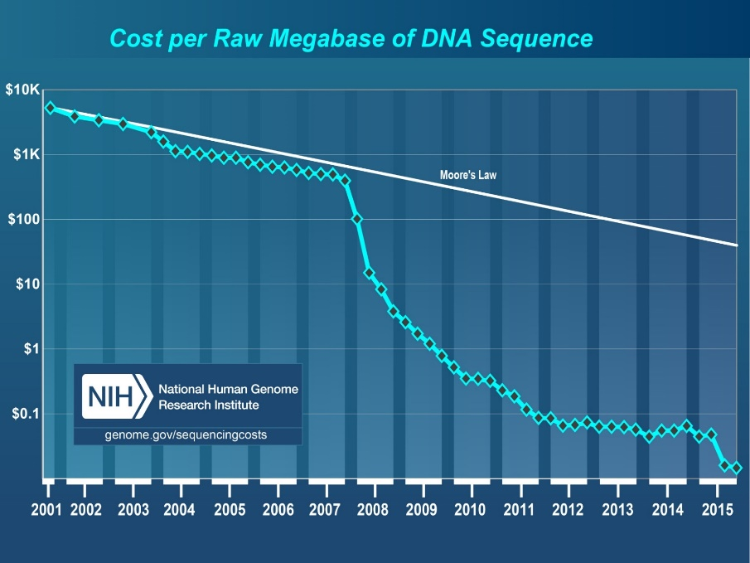
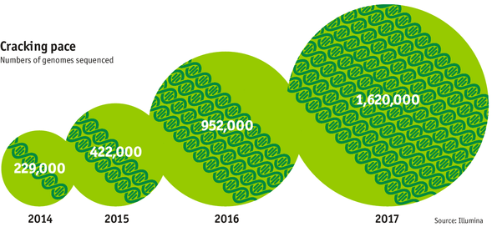
Data is Key for Future Workloads
development of high-throughput sequencing (HTS) technologies
Number of Genomes Sequenced
http://www.economist.com/news/21631808-so-much-genetic-data-so-many-uses-genes-unzipped
Notes:
However, since the development of high throughput sequencing (HTS) technologies, the cost of genome sequencing has fallen off a cliff (<< 1,000$) making it viable for almost everyone's use.

Slide 9
1
Sequencing
Genome Analysis
Read Mapping
2
Data → performance & energy bottleneck
Variant Calling
Scientific Discovery
3
4
Notes:
Genome analysis starts with sequencing random short DNA fragments of copies of the original molecule.
Unfortunately, these reads lack information about their order and which part of genome they are originated from.
Hence the second step is to map these reads to a long reference genome.

Slide 10
New Genome Sequencing Technologies
Oxford Nanopore MinION
Senol Cali+, “Nanopore Sequencing Technology and Tools for Genome
Assembly: Computational Analysis of the Current State, Bottlenecks
and Future Directions,” Briefings in Bioinformatics, 2018.
[Preliminary arxiv.org version]
Data → performance & energy bottleneck

Slide 11
Data Overwhelms Modern Machines …
Storage/memory capability
Communication capability
Computation capability

Slide 12
A Computing System
Three key components
Computation
Communication
Storage/memory
Burks, Goldstein, von Neumann, “Preliminary discussion of the
logical design of an electronic computing instrument,” 1946.
Image source: https://lbsitbytes2010.wordpress.com/2013/03/29/john-von-neumann-roll-no-15/

Slide 13
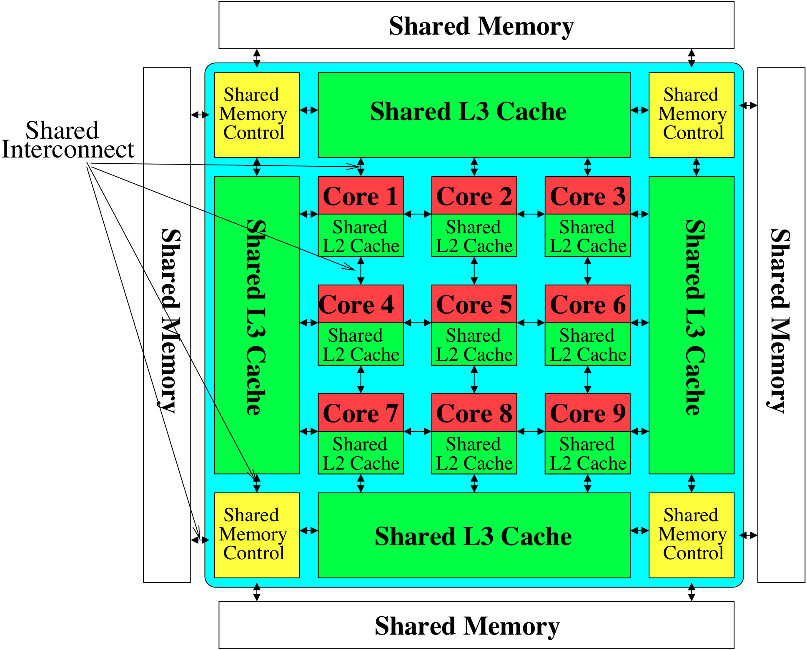
Perils of Processor-Centric Design
Most of the system is dedicated to storing and moving data

Slide 14
Data Overwhelms Modern Machines
Chrome
TensorFlow Mobile
Google’s web browser
Google’s machine learning framework
Data → performance & energy bottleneck
Video Playback
Video Capture
Google’s video codec
Google’s video codec
Notes:
In this work, we take a look at widely-used google consumer workloads, to figure out the major sources of energy consumption.
We look at Google Chrome web brower. We take a look at Tensorflow, Google’s machine learning framework, and we also take a look at two important video related workloads, video playback and video capture, both rely on Google’s vp9 codec technology.

Slide 15
Data Movement Overwhelms Modern Machines
Amirali Boroumand, Saugata Ghose, Youngsok Kim, Rachata Ausavarungnirun, Eric Shiu, Rahul Thakur, Daehyun Kim, Aki Kuusela, Allan Knies, Parthasarathy Ranganathan, and Onur Mutlu, "Google Workloads for Consumer Devices: Mitigating Data Movement Bottlenecks" Proceedings of the 23rd International Conference on Architectural Support for Programming Languages and Operating Systems (ASPLOS), Williamsburg, VA, USA, March 2018.
62.7% of the total system energy
is spent on data movement

Slide 16
Axiom
An Intelligent Architecture
Handles Data Well

Slide 17
How to Handle Data Well
Ensure data does not overwhelm the components
via intelligent algorithms
via intelligent architectures
via whole system designs: algorithm-architecture-devices
Take advantage of vast amounts of data and metadata
to improve architectural & system-level decisions
Understand and exploit properties of (different) data
to improve algorithms & architectures in various metrics
…

Slide 18
Corollaries: Architectures Today …
Architectures are terrible at dealing with data
Designed to mainly store and move data vs. to compute
They are processor-centric as opposed to data-centric
Architectures are terrible at taking advantage of vast amounts of data (and metadata) available to them
Designed to make simple decisions, ignoring lots of data
They make human-driven decisions vs. data-driven decisions
Architectures are terrible at knowing and exploiting different properties of application data
Designed to treat all data as the same
They make component-aware decisions vs. data-aware

Slide 19
Processing Data Where It Makes Sense

Slide 20
Three Key Systems Trends
1. Data access is a major bottleneck
Applications are increasingly data hungry
2. Energy consumption is a key limiter
3. Data movement energy dominates compute
Especially true for off-chip to on-chip movement

Slide 21
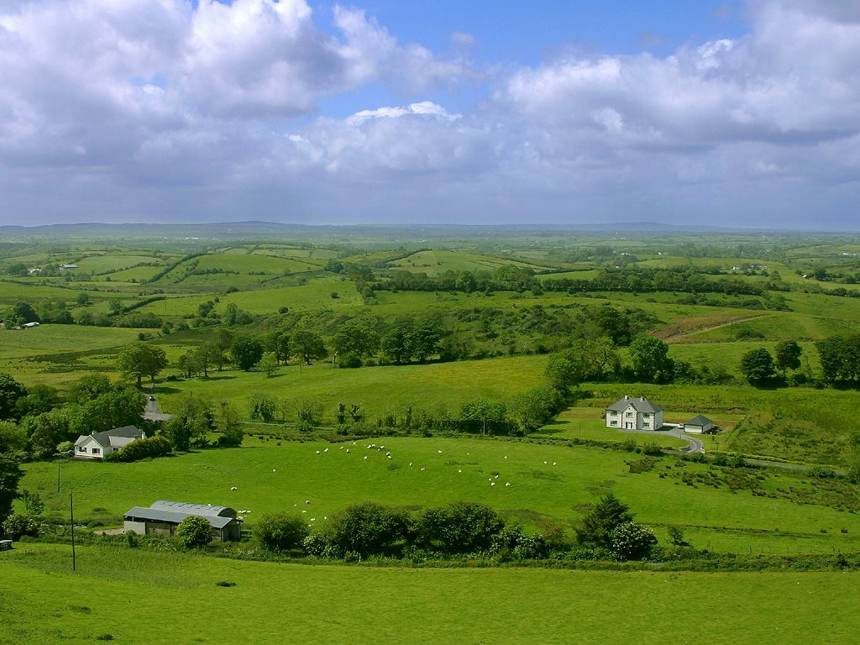
Do We Want This?
Source: V. Milutinovic

Slide 22
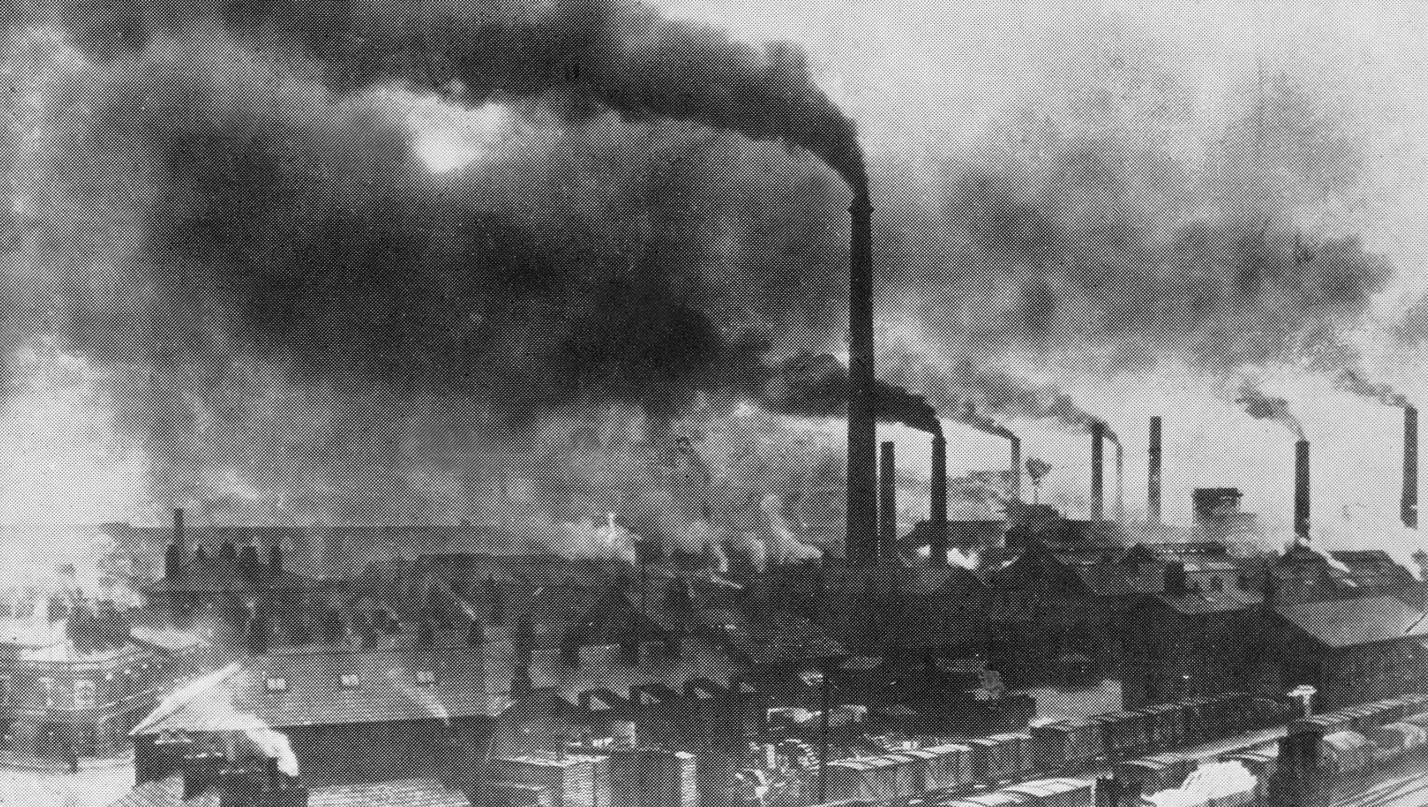
Or This?
Source: V. Milutinovic

Slide 23
Challenge and Opportunity for Future
High Performance,
Energy Efficient,
Sustainable

Slide 24
The Problem
Data access is the major performance and energy bottleneck
Our current
design principles
cause great energy waste
(and great performance loss)

Slide 25
The Problem
Processing of data
is performed
far away from the data

Slide 26
A Computing System
Three key components
Computation
Communication
Storage/memory
Burks, Goldstein, von Neumann, “Preliminary discussion of the
logical design of an electronic computing instrument,” 1946.
Image source: https://lbsitbytes2010.wordpress.com/2013/03/29/john-von-neumann-roll-no-15/

Slide 27
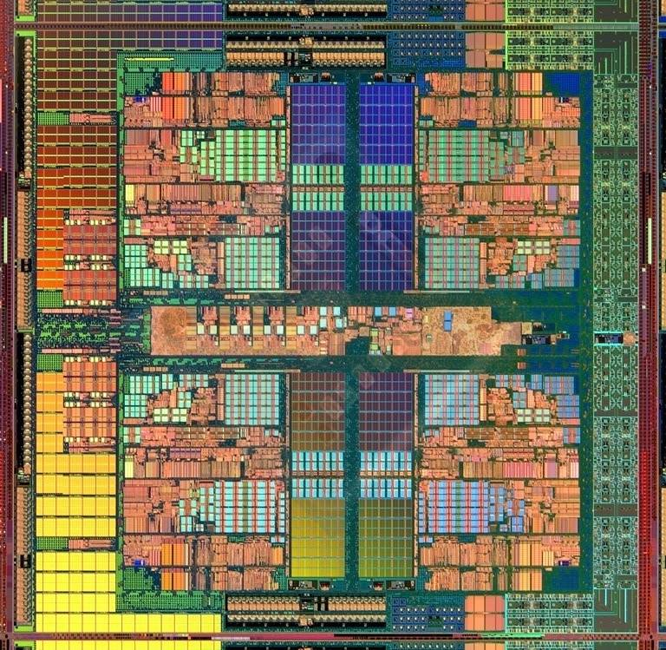
A Computing System
Three key components
Computation
Communication
Storage/memory
Burks, Goldstein, von Neumann, “Preliminary discussion of the
logical design of an electronic computing instrument,” 1946.
Image source: https://lbsitbytes2010.wordpress.com/2013/03/29/john-von-neumann-roll-no-15/

Slide 28
Today’s Computing Systems
Are overwhelmingly processor centric
All data processed in the processor → at great system cost
Processor is heavily optimized and is considered the master
Data storage units are dumb and are largely unoptimized (except for some that are on the processor die)

Slide 29
Yet …
“It’s the Memory, Stupid!” (Richard Sites, MPR, 1996)
Mutlu+, “Runahead Execution: An Alternative to Very Large Instruction Windows for Out-of-Order Processors,” HPCA 2003.

Slide 30
The Performance Perspective
Onur Mutlu, Jared Stark, Chris Wilkerson, and Yale N. Patt, "Runahead Execution: An Alternative to Very Large Instruction Windows for Out-of-order Processors" Proceedings of the 9th International Symposium on High-Performance Computer Architecture (HPCA), pages 129-140, Anaheim, CA, February 2003. Slides (pdf)

Slide 31
The Performance Perspective (Today)
All of Google’s Data Center Workloads (2015):
Kanev+, “Profiling a Warehouse-Scale Computer,” ISCA 2015.

Slide 32
The Performance Perspective (Today)
All of Google’s Data Center Workloads (2015):
Kanev+, “Profiling a Warehouse-Scale Computer,” ISCA 2015.

Slide 33
Perils of Processor-Centric Design
Grossly-imbalanced systems
Processing done only in one place
Everything else just stores and moves data: data moves a lot
→ Energy inefficient
→ Low performance
→ Complex
Overly complex and bloated processor (and accelerators)
To tolerate data access from memory
Complex hierarchies and mechanisms
→ Energy inefficient
→ Low performance
→ Complex

Slide 34
Perils of Processor-Centric Design
Most of the system is dedicated to storing and moving data

Slide 35
The Energy Perspective
Dally, HiPEAC 2015

Slide 36
Data Movement vs. Computation Energy
Dally, HiPEAC 2015
A memory access consumes ~1000X
the energy of a complex addition

Slide 37
Data Movement vs. Computation Energy
Data movement is a major system energy bottleneck
Comprises 41% of mobile system energy during web browsing [2]
Costs ~115 times as much energy as an ADD operation [1, 2]
[1]: Reducing data Movement Energy via Online Data Clustering and Encoding (MICRO’16)
[2]: Quantifying the energy cost of data movement for emerging smart phone workloads on mobile platforms (IISWC’14)

Slide 38
Energy Waste in Mobile Devices
Amirali Boroumand, Saugata Ghose, Youngsok Kim, Rachata Ausavarungnirun, Eric Shiu, Rahul Thakur, Daehyun Kim, Aki Kuusela, Allan Knies, Parthasarathy Ranganathan, and Onur Mutlu, "Google Workloads for Consumer Devices: Mitigating Data Movement Bottlenecks" Proceedings of the 23rd International Conference on Architectural Support for Programming Languages and Operating Systems (ASPLOS), Williamsburg, VA, USA, March 2018.
62.7% of the total system energy
is spent on data movement

Slide 39
We Do Not Want to Move Data!
Dally, HiPEAC 2015
A memory access consumes ~1000X
the energy of a complex addition

Slide 40
We Need A Paradigm Shift To …
Enable computation with minimal data movement
Compute where it makes sense (where data resides)
Make computing architectures more data-centric

Slide 41
Goal: Processing Inside Memory
Many questions … How do we design the:
compute-capable memory & controllers?
processor chip and in-memory units?
software and hardware interfaces?
system software and languages?
algorithms?
Memory
Processor
Core
Database
Graphs
Media
Cache
Query
Interconnect
Problem
Results
Algorithm
Program/Language
System Software
SW/HW Interface
Micro-architecture
Logic
Devices
Electrons

Slide 42
Why In-Memory Computation Today?
Push from Technology
DRAM Scaling at jeopardy
→ Controllers close to DRAM
→ Industry open to new memory architectures

Slide 43
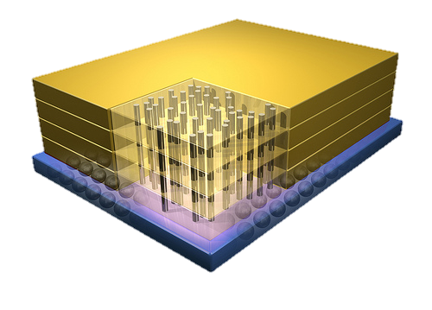
Why In-Memory Computation Today?
Push from Technology
DRAM Scaling at jeopardy
→ Controllers close to DRAM
→ Industry open to new memory architectures

Slide 44
Why In-Memory Computation Today?
Push from Technology
DRAM Scaling at jeopardy
→ Controllers close to DRAM
→ Industry open to new memory architectures
Pull from Systems and Applications
Data access is a major system and application bottleneck
Systems are energy limited
Data movement much more energy-hungry than computation

Slide 45
Processing in Memory: Two Approaches
1. Minimally changing memory chips
2. Exploiting 3D-stacked memory

Slide 46
Approach 1: Minimally Changing DRAM
DRAM has great capability to perform bulk data movement and computation internally with small changes
Can exploit internal connectivity to move data
Can exploit analog computation capability
…
Examples: RowClone, In-DRAM AND/OR, Gather/Scatter DRAM
RowClone: Fast and Efficient In-DRAM Copy and Initialization of Bulk Data (Seshadri et al., MICRO 2013)
Fast Bulk Bitwise AND and OR in DRAM (Seshadri et al., IEEE CAL 2015)
Gather-Scatter DRAM: In-DRAM Address Translation to Improve the Spatial Locality of Non-unit Strided Accesses (Seshadri et al., MICRO 2015)
"Ambit: In-Memory Accelerator for Bulk Bitwise Operations Using Commodity DRAM Technology” (Seshadri et al., MICRO 2017)

Slide 47
Starting Simple: Data Copy and Initialization
memmove & memcpy: 5% cycles in Google’s datacenter [Kanev+ ISCA’15]
000000000000000
Zero initialization
(e.g., security)
Forking
Checkpointing
Many more
VM Cloning
Deduplication
Page Migration

Slide 48
Today’s Systems: Bulk Data Copy
1) High latency
Memory
3) Cache pollution
L3
CPU
L2
L1
MC
2) High bandwidth utilization
4) Unwanted data movement
1046ns, 3.6uJ (for 4KB page copy via DMA)

Slide 49
Future Systems: In-Memory Copy
3) No cache pollution
1) Low latency
Memory
L3
CPU
L2
L1
MC
2) Low bandwidth utilization
4) No unwanted data movement
1046ns, 3.6uJ
→ 90ns, 0.04uJ

Slide 50
RowClone: In-DRAM Row Copy
Idea: Two consecutive ACTivates
4 Kbytes
Negligible HW cost
Step 1: Activate row A
Step 2: Activate row B
Transfer row
DRAM subarray
Transfer
row
Row Buffer (4 Kbytes)
8 bits
Data Bus
Notes:
copy

Slide 51
RowClone: Latency and Energy Savings
11.6x
74x
Seshadri et al., “RowClone: Fast and Efficient In-DRAM Copy and Initialization of Bulk Data,” MICRO 2013.

Slide 52
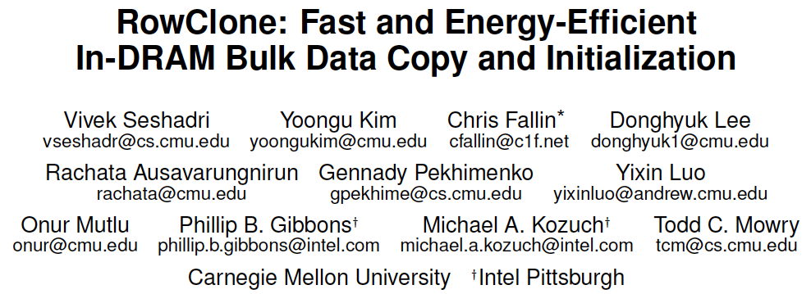
More on RowClone
Vivek Seshadri, Yoongu Kim, Chris Fallin, Donghyuk Lee, Rachata Ausavarungnirun, Gennady Pekhimenko, Yixin Luo, Onur Mutlu, Michael A. Kozuch, Phillip B. Gibbons, and Todd C. Mowry, "RowClone: Fast and Energy-Efficient In-DRAM Bulk Data Copy and Initialization" Proceedings of the 46th International Symposium on Microarchitecture (MICRO), Davis, CA, December 2013. [Slides (pptx) (pdf)] [Lightning Session Slides (pptx) (pdf)] [Poster (pptx) (pdf)]

Slide 53
Memory as an Accelerator
CPU
core
CPU
core
mini-CPU
core
GPU
(throughput)
core
GPU
(throughput)
core
video
core
GPU
(throughput)
core
GPU
(throughput)
core
CPU
core
CPU
core
Memory
imaging
core
LLC
Specialized
compute-capability
in memory
Memory Controller
Memory Bus
Memory similar to a “conventional” accelerator

Slide 54
In-Memory Bulk Bitwise Operations
We can support in-DRAM COPY, ZERO, AND, OR, NOT, MAJ
At low cost
Using analog computation capability of DRAM
Idea: activating multiple rows performs computation
30-60X performance and energy improvement
Seshadri+, “Ambit: In-Memory Accelerator for Bulk Bitwise Operations Using Commodity DRAM Technology,” MICRO 2017.
New memory technologies enable even more opportunities
Memristors, resistive RAM, phase change mem, STT-MRAM, …
Can operate on data with minimal movement

Slide 55
In-DRAM AND/OR: Triple Row Activation
½V_{DD}
½V_{DD}+δ
V_{DD}
A
Final State
AB + BC + AC
B
C
C(A + B) + ~C(AB)
dis
en
0
½V_{DD}
Seshadri+, “Fast Bulk Bitwise AND and OR in DRAM”, IEEE CAL 2015.

Slide 56
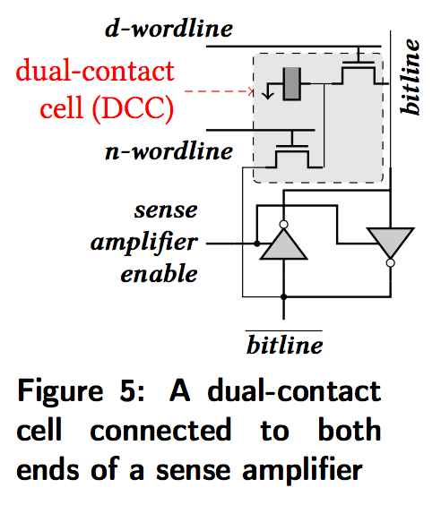
In-DRAM NOT: Dual Contact Cell
Idea:
Feed the
negated value
in the sense amplifier
into a special row
Seshadri+, “Ambit: In-Memory Accelerator for Bulk Bitwise Operations using Commodity DRAM Technology,” MICRO 2017.

Slide 57
Ambit vs. DDR3: Performance and Energy
32X
35X
Seshadri+, “Ambit: In-Memory Accelerator for Bulk Bitwise Operations using Commodity DRAM Technology,” MICRO 2017.

Slide 58
Bulk Bitwise Operations in Workloads
[1] Li and Patel, BitWeaving, SIGMOD 2013
[2] Goodwin+, BitFunnel, SIGIR 2017

Slide 59
Performance: Bitmap Index on Ambit
Seshadri+, “Ambit: In-Memory Accelerator for Bulk Bitwise Operations using Commodity DRAM Technology,” MICRO 2017.

Slide 60
Performance: BitWeaving on Ambit
>4-12X Performance Improvement
Seshadri+, “Ambit: In-Memory Accelerator for Bulk Bitwise Operations using Commodity DRAM Technology,” MICRO 2017.

Slide 61
More on Ambit
Vivek Seshadri et al., “Ambit: In-Memory Accelerator for Bulk Bitwise Operations Using Commodity DRAM Technology,” MICRO 2017.

Slide 62
Processing in Memory: Two Approaches
1. Minimally changing memory chips
2. Exploiting 3D-stacked memory

Slide 63
Opportunity: 3D-Stacked Logic+Memory
Memory
Logic
Other “True 3D” technologies
under development

Slide 64
DRAM Landscape (circa 2015)
Kim+, “Ramulator: A Flexible and Extensible DRAM Simulator”, IEEE CAL 2015.

Slide 65
Two Key Questions in 3D-Stacked PIM
What are the performance and energy benefits of using 3D-stacked memory as a coarse-grained accelerator?
By changing the entire system
By performing simple function offloading
What is the minimal processing-in-memory support we can provide?
With minimal changes to system and programming

Slide 66
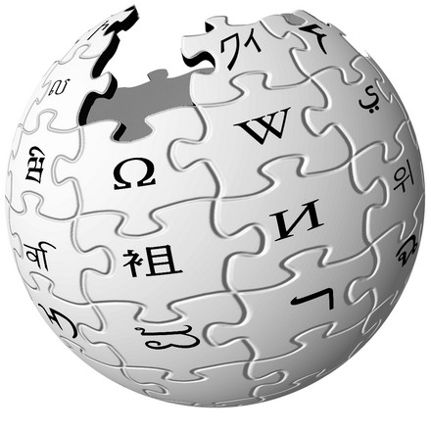
Graph Processing
Large graphs are everywhere (circa 2015)
Scalable large-scale graph processing is challenging
36 Million
Wikipedia Pages
1.4 Billion
Facebook Users
300 Million
Twitter Users
30 Billion
Instagram Photos

Slide 67
Key Bottlenecks in Graph Processing
for (v: graph.vertices) {
for (w: v.successors) {
w.next_rank += weight * v.rank;
}
}
1. Frequent random memory accesses
v
&w
w.rank
w.next_rank
w.edges
weight * v.rank
w
…
2. Little amount of computation

Slide 68
Tesseract System for Graph Processing
Interconnected set of 3D-stacked memory+logic chips with simple cores
Host Processor
Memory
Memory-Mapped
Accelerator Interface
(Noncacheable, Physically Addressed)
Logic
In-Order Core
DRAM Controller
…
…
LP
PF Buffer
Crossbar Network
…
MTP
…
Message Queue
NI
Ahn+, “A Scalable Processing-in-Memory Accelerator for Parallel Graph Processing” ISCA 2015.

Slide 69
Tesseract System for Graph Processing
Host Processor
Memory
Memory-Mapped
Accelerator Interface
(Noncacheable, Physically Addressed)
Logic
In-Order Core
DRAM Controller
…
…
Communications via Remote Function Calls
LP
PF Buffer
Crossbar Network
…
MTP
…
Message Queue
NI

Slide 70
Tesseract System for Graph Processing
Host Processor
Memory
Memory-Mapped
Accelerator Interface
(Noncacheable, Physically Addressed)
Logic
Prefetching
In-Order Core
DRAM Controller
…
…
LP
PF Buffer
Crossbar Network
…
MTP
…
Message Queue
NI

Slide 71
Evaluated Systems
DDR3-OoO
HMC-OoO
HMC-MC
Tesseract
32 Tesseract Cores
8 OoO
4GHz
8 OoO
4GHz
8 OoO
4GHz
8 OoO
4GHz
128 In-Order
2GHz
128 In-Order
2GHz
8 OoO
4GHz
8 OoO
4GHz
8 OoO
4GHz
8 OoO
4GHz
128 In-Order
2GHz
128 In-Order
2GHz
102.4GB/s
640GB/s
640GB/s
8TB/s
Ahn+, “A Scalable Processing-in-Memory Accelerator for Parallel Graph Processing” ISCA 2015.

Slide 72
Tesseract Graph Processing Performance
>13X Performance Improvement
On five graph processing algorithms
Ahn+, “A Scalable Processing-in-Memory Accelerator for Parallel Graph Processing” ISCA 2015.

Slide 73
Tesseract Graph Processing Performance

Slide 74
Tesseract Graph Processing System Energy
> 8X Energy Reduction
Ahn+, “A Scalable Processing-in-Memory Accelerator for Parallel Graph Processing” ISCA 2015.

Slide 75
More on Tesseract
Junwhan Ahn, Sungpack Hong, Sungjoo Yoo, Onur Mutlu, and Kiyoung Choi, "A Scalable Processing-in-Memory Accelerator for Parallel Graph Processing" Proceedings of the 42nd International Symposium on Computer Architecture (ISCA), Portland, OR, June 2015. [Slides (pdf)] [Lightning Session Slides (pdf)]

Slide 76
Two Key Questions in 3D-Stacked PIM
What are the performance and energy benefits of using 3D-stacked memory as a coarse-grained accelerator?
By changing the entire system
By performing simple function offloading
What is the minimal processing-in-memory support we can provide?
With minimal changes to system and programming

Slide 77
PIM on Mobile Devices
Amirali Boroumand, Saugata Ghose, Youngsok Kim, Rachata Ausavarungnirun, Eric Shiu, Rahul Thakur, Daehyun Kim, Aki Kuusela, Allan Knies, Parthasarathy Ranganathan, and Onur Mutlu, "Google Workloads for Consumer Devices: Mitigating Data Movement Bottlenecks" Proceedings of the 23rd International Conference on Architectural Support for Programming Languages and Operating Systems (ASPLOS), Williamsburg, VA, USA, March 2018.

Slide 78
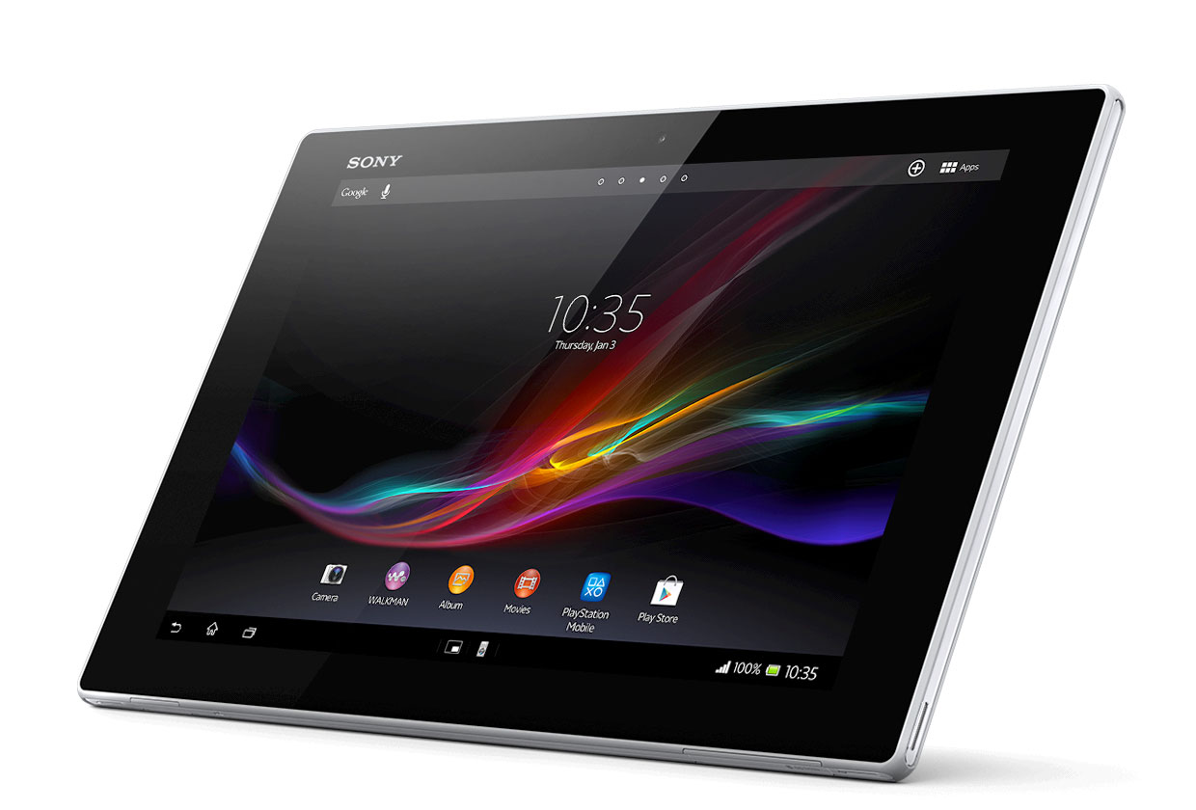
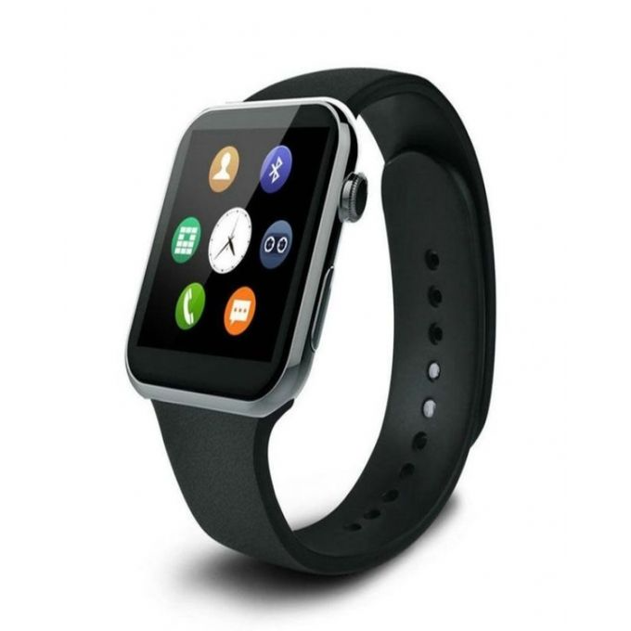
Consumer Devices
Consumer devices are everywhere!
Energy consumption is a first-class concern in consumer devices
Notes:
Consumer devices like tablets smartphone and wearable are now everywhere and used by billions of people.
One of the major challenge in these devices is battery limitation which makes the energy consumption a critical concern …

Slide 79
Popular Google Consumer Workloads
Chrome
TensorFlow Mobile
Google’s web browser
Google’s machine learning framework
Video Playback
Video Capture
Google’s video codec
Google’s video codec
Notes:
In this work, we take a look at widely-used google consumer workloads, to figure out the major sources of energy consumption.
We look at Google Chrome web brower. We take a look at Tensorflow, Google’s machine learning framework, and we also take a look at two important video related workloads, video playback and video capture, both rely on Google’s vp9 codec technology.

Slide 80
Energy Cost of Data Movement
1st key observation: 62.7% of the total system energy is spent on data movement
Data Movement
SoC
DRAM
CPU
L2
CPU
L1
CPU
CPU
Compute Unit
Processing-In-Memory (PIM)
Potential solution: move computation close to data
Challenge: limited area and energy budget
Notes:
Throughout our analysis, we make a key observation that out of all sources of energy consumption, data movement is a major contributor to the total system energy. We find that across all of the workloads, on average around 62.7% of total system energy is spent on data movement.
One way to reduce data movement cost is to move computation close to data, or …
One potential solution to address this cost it do move computation close to data, or in other words, do procesing in memory. However, the challenge is that these devices.
One potential solution to mitigate data movement cost and reduce total system energy is to execute data-movement heavy portions of application close to data, or in other words, do processing in memory. However, consumer devices are extermely limited in terms of area and power budget. So the question is can we move part of the data movement heavy portion given the limited area and energy budget. Our

Slide 81
Using PIM to Reduce Data Movement
2nd key observation: a significant fraction of the data movement often comes from simple functions
We can design lightweight logic to implement these simple functions in memory
Small embedded low-power core
Small fixed-function accelerators
PIM Core
PIM Accelerator
PIM Accelerator
PIM Accelerator
Offloading to PIM logic reduces energy and improves performance, on average, by 55.4% and 54.2%
Notes:
To figure out if we can use processing in memory, we dig deeper into our analysis and we make another key observation that majority of data movement often comes form simple functions and pritmitives. We find that these simple function can be implemented in memory as either a small embedded core, or group of small fixed function accelerators. Our result shows that offloading these function to PIM logic can significantly reduce data movement for each function and reduce energy on average around 55% and improve perforamcne around 54%.
our PIM core can reduce significant portion of data movement, reduce enregy by 49.1% for each function and improve performance up to 2.2X. While using group of fixed function accelerator reduce energy by 55.4% and improve performance by up to 2.5X.
Or use Saugata’s approach : Reduces total system energy by an average of 55.4%
Reduces execution time by an average of 54.2%
Our result show that both of them can significantly reduce the data movement for each function.
Feedback: talk about result more
Don’t talk about specific detail like MemCopy, MemSet stuff like that
Main take away: data movement come from simple functions that are simple enough to implement in PIM
We find that these functions and primitves can be implemented as PIM logic using either (1) a small low-power general-purpose embedded core or (2) a group of small fixed-function accelerators (PIM accelerators). Our Analysis shows that both are cost-feasible to use in consumer devices. We find that they eliminate a significant fraction of dat amovement, and reduce energy consumption for each of these operation on average by 49 and 55%.

Slide 82
Workload Analysis
Chrome
TensorFlow Mobile
Google’s web browser
Google’s machine learning framework
Video Playback
Video Capture
Google’s video codec
Google’s video codec
Notes:
In this work, we take a look at widely-used google consumer workloads, to figure out the major sources of energy consumption.
We look at Google Chrome web brower. We take a look at Tensorflow, Google’s machine learning framework, and we also take a look at two important video related workloads, video playback and video capture, both rely on Google’s vp9 codec technology.

Slide 83
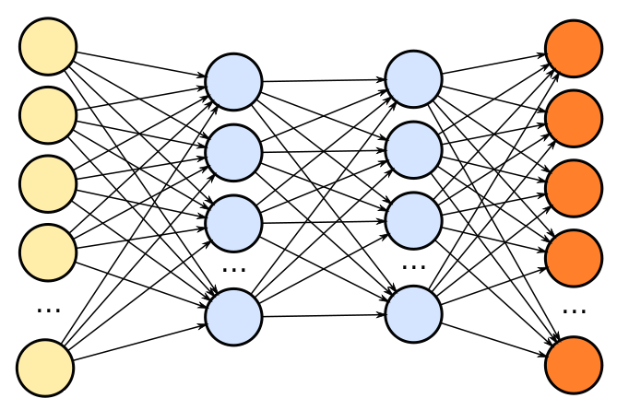
TensorFlow Mobile
Inference
Prediction
57.3% of the inference energy is spent on data movement
54.4% of the data movement energy comes from packing/unpacking and quantization

Slide 84
Packing
Matrix
Packing
Packed Matrix
Reorders elements of matrices to minimize cache misses during matrix multiplication
Up to 40% of the inference energy and 31% of inference execution time
Packing’s data movement accounts for up to 35.3% of the inference energy
A simple data reorganization process that requires simple arithmetic

Slide 85
Quantization
floating point
Quantization
integer
Converts 32-bit floating point to 8-bit integers to improve inference execution time and energy consumption
Up to 16.8% of the inference energy and 16.1% of inference execution time
Majority of quantization energy comes from data movement
A simple data conversion operation that requires shift, addition, and multiplication operations

Slide 86
Normalized Energy
Chrome Browser
TensorFlow Mobile
Video Playback and Capture
PIM core and PIM accelerator reduce energy consumption on average by 49.1% and 55.4%
Notes:
We make another obsrevation that using PIM accelerator provide limited energy reduction over PIM core, for some of these workloads, such as texture tiling. This is becase these kernels are data intensive and have low ocmputational compleity, and as a result, using fixed function accelerator does not provide significant energy reduction over the PIM core.

Slide 87
Normalized Runtime
Chrome Browser
Video Playback and Capture
TensorFlow Mobile
Offloading these kernels to PIM core and PIM accelerator improves performance on average by 44.6% and 54.2%
Notes:
PIM-Core and PIM-Acc significantly outperform CPU-Only across all kernels, improving performance by … This perfomance benefit come from higher bandwidth and lower access latency of 3D-stacked memory, because all of these kernels are data intensive.
Performance improvement of PIM-acc over PIM-core differes across different workloads. In some cases such as Texture Tiling, the performance improvement of PIM-Acc over PIM-Core is limited by the low computational complexity of these two kernels. But there are other cases, such as compression that benefit significantly from using PIM-Acc over PIM-Core in terms of performance, because these kernels are more compute-intensive and less data-intensive compared to texture tiling and.

Slide 88
More on PIM for Mobile Devices
Amirali Boroumand, Saugata Ghose, Youngsok Kim, Rachata Ausavarungnirun, Eric Shiu, Rahul Thakur, Daehyun Kim, Aki Kuusela, Allan Knies, Parthasarathy Ranganathan, and Onur Mutlu, "Google Workloads for Consumer Devices: Mitigating Data Movement Bottlenecks" Proceedings of the 23rd International Conference on Architectural Support for Programming Languages and Operating Systems (ASPLOS), Williamsburg, VA, USA, March 2018.
62.7% of the total system energy
is spent on data movement

Slide 89
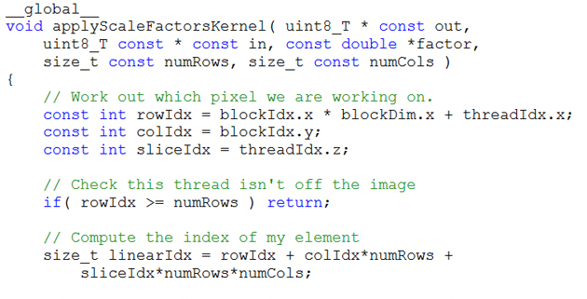
Truly Distributed GPU Processing with PIM?
3D-stacked memory
(memory stack)
SM (Streaming Multiprocessor)
Logic layer
Logic layer SM
Main GPU
Crossbar switch
Vault Ctrl
….
Vault Ctrl

Slide 90
Accelerating GPU Execution with PIM (I)
Kevin Hsieh, Eiman Ebrahimi, Gwangsun Kim, Niladrish Chatterjee, Mike O'Connor, Nandita Vijaykumar, Onur Mutlu, and Stephen W. Keckler, "Transparent Offloading and Mapping (TOM): Enabling Programmer-Transparent Near-Data Processing in GPU Systems" Proceedings of the 43rd International Symposium on Computer Architecture (ISCA), Seoul, South Korea, June 2016. [Slides (pptx) (pdf)] [Lightning Session Slides (pptx) (pdf)]

Slide 91
Accelerating GPU Execution with PIM (II)
Ashutosh Pattnaik, Xulong Tang, Adwait Jog, Onur Kayiran, Asit K. Mishra, Mahmut T. Kandemir, Onur Mutlu, and Chita R. Das, "Scheduling Techniques for GPU Architectures with Processing-In-Memory Capabilities" Proceedings of the 25th International Conference on Parallel Architectures and Compilation Techniques (PACT), Haifa, Israel, September 2016.

Slide 92
Eliminating the Adoption Barriers
How to Enable Adoption of Processing in Memory

Slide 93
Barriers to Adoption of PIM
1. Functionality of and applications for PIM
2. Ease of programming (interfaces and compiler/HW support)
3. System support: coherence & virtual memory
4. Runtime systems for adaptive scheduling, data mapping, access/sharing control
5. Infrastructures to assess benefits and feasibility

Slide 94
We Need to Revisit the Entire Stack
Problem
Algorithm
Program/Language
System Software
SW/HW Interface
Micro-architecture
Logic
Devices
Electrons

Slide 95
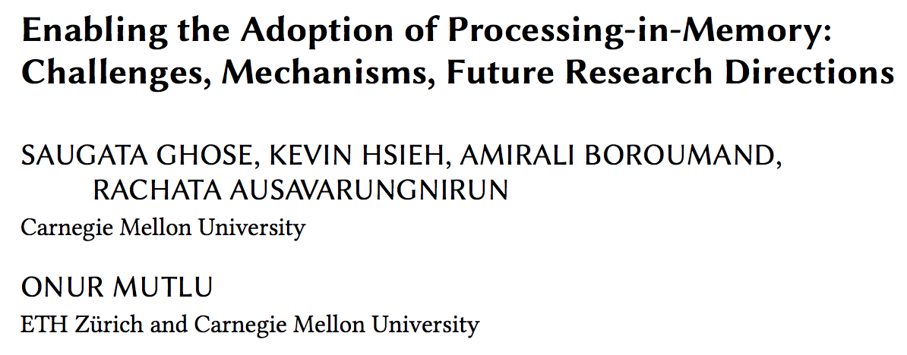
Open Problems: PIM Adoption
Saugata Ghose, Kevin Hsieh, Amirali Boroumand, Rachata Ausavarungnirun, Onur Mutlu, "Enabling the Adoption of Processing-in-Memory: Challenges, Mechanisms, Future Research Directions" Invited Book Chapter, to appear in 2018. [Preliminary arxiv.org version]
https://arxiv.org/pdf/1802.00320.pdf

Slide 96
PIM Review and Open Problems
Onur Mutlu, Saugata Ghose, Juan Gomez-Luna, and Rachata Ausavarungnirun, "Processing Data Where It Makes Sense: Enabling In-Memory Computation" Invited paper in Microprocessors and Microsystems (MICPRO), June 2019. [arXiv version]
https://arxiv.org/pdf/1903.03988.pdf

Slide 97
Challenge and Opportunity for Future
Computing Architectures
with
Minimal Data Movement

Slide 98
Corollaries: Architectures Today …
Architectures are terrible at dealing with data
Designed to mainly store and move data vs. to compute
They are processor-centric as opposed to data-centric
Architectures are terrible at taking advantage of vast amounts of data (and metadata) available to them
Designed to make simple decisions, ignoring lots of data
They make human-driven decisions vs. data-driven decisions
Architectures are terrible at knowing and exploiting different properties of application data
Designed to treat all data as the same
They make component-aware decisions vs. data-aware

Slide 99
Exploiting Data to Design Intelligent Architectures

Slide 100
System Architecture Design Today
Human-driven
Humans design the policies (how to do things)
Many (too) simple, short-sighted policies all over the system
No automatic data-driven policy learning
(Almost) no learning: cannot take lessons from past actions
Can we design
fundamentally intelligent architectures?

Slide 101
An Intelligent Architecture
Data-driven
Machine learns the “best” policies (how to do things)
Sophisticated, workload-driven, changing, far-sighted policies
Automatic data-driven policy learning
All controllers are intelligent data-driven agents
How do we start?

Slide 102
Self-Optimizing Memory Controllers

Slide 103
Memory Controller
How to schedule requests to maximize system performance?
Resolves memory contention by scheduling requests
Core
Core
Memory Controller
Memory
Core
Core

Slide 104
Why are Memory Controllers Difficult to Design?
Need to obey DRAM timing constraints for correctness
There are many (50+) timing constraints in DRAM
tWTR: Minimum number of cycles to wait before issuing a read command after a write command is issued
tRC: Minimum number of cycles between the issuing of two consecutive activate commands to the same bank
…
Need to keep track of many resources to prevent conflicts
Channels, banks, ranks, data bus, address bus, row buffers, …
Need to handle DRAM refresh
Need to manage power consumption
Need to optimize performance & QoS (in the presence of constraints)
Reordering is not simple
Fairness and QoS needs complicates the scheduling problem
…

Slide 105
Many Memory Timing Constraints
From Lee et al., “DRAM-Aware Last-Level Cache Writeback: Reducing Write-Caused Interference in Memory Systems,” HPS Technical Report, April 2010.

Slide 106
Many Memory Timing Constraints
Kim et al., “A Case for Exploiting Subarray-Level Parallelism (SALP) in DRAM,” ISCA 2012.
Lee et al., “Tiered-Latency DRAM: A Low Latency and Low Cost DRAM Architecture,” HPCA 2013.

Slide 107
Memory Controller Design Is Becoming More Difficult
CPU
CPU
CPU
CPU
GPU
HWA
HWA
Shared Cache
DRAM and Hybrid Memory Controllers
DRAM and Hybrid Memories
Heterogeneous agents: CPUs, GPUs, and HWAs
Main memory interference between CPUs, GPUs, HWAs
Many timing constraints for various memory types
Many goals at the same time: performance, fairness, QoS, energy efficiency, …

Slide 108
Reality and Dream
Reality: It difficult to design a policy that maximizes performance, QoS, energy-efficiency, …
Too many things to think about
Continuously changing workload and system behavior
Dream: Wouldn’t it be nice if the DRAM controller automatically found a good scheduling policy on its own?

Slide 109
Self-Optimizing DRAM Controllers
Problem: DRAM controllers are difficult to design
It is difficult for human designers to design a policy that can adapt itself very well to different workloads and different system conditions
Idea: A memory controller that adapts its scheduling policy to workload behavior and system conditions using machine learning.
Observation: Reinforcement learning maps nicely to memory control.
Design: Memory controller is a reinforcement learning agent
It dynamically and continuously learns and employs the best scheduling policy to maximize long-term performance.
Ipek+, “Self Optimizing Memory Controllers: A Reinforcement Learning Approach,” ISCA 2008.

Slide 110
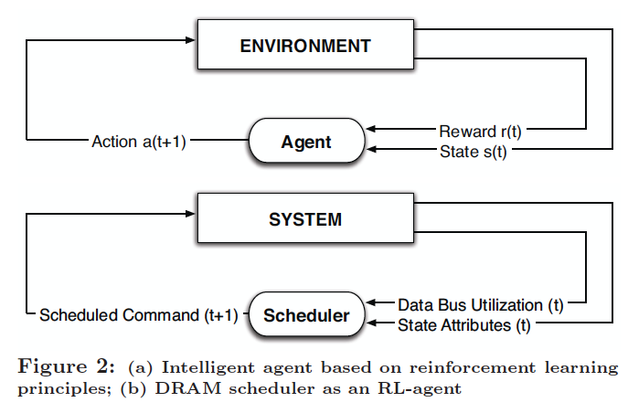
Self-Optimizing DRAM Controllers
Engin Ipek, Onur Mutlu, José F. Martínez, and Rich Caruana, "Self Optimizing Memory Controllers: A Reinforcement Learning Approach" Proceedings of the 35th International Symposium on Computer Architecture (ISCA), pages 39-50, Beijing, China, June 2008.
Goal: Learn to choose actions to maximize r₀ + γr₁ + γ²r₂ + … ( 0 ≤ γ < 1)

Slide 111
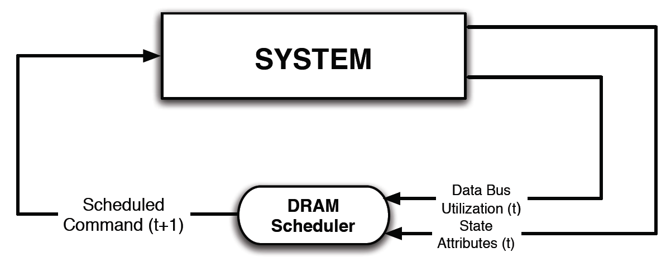
Self-Optimizing DRAM Controllers
Dynamically adapt the memory scheduling policy via interaction with the system at runtime
Associate system states and actions (commands) with long term reward values: each action at a given state leads to a learned reward
Schedule command with highest estimated long-term reward value in each state
Continuously update reward values for <state, action> pairs based on feedback from system

Slide 112
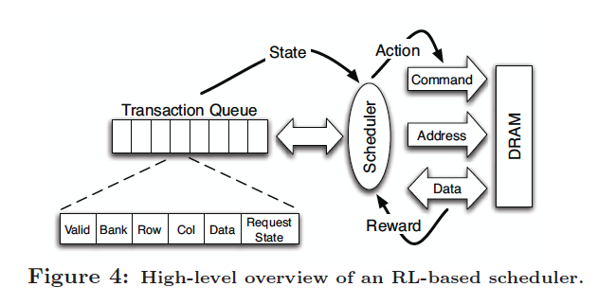
Self-Optimizing DRAM Controllers
Engin Ipek, Onur Mutlu, José F. Martínez, and Rich Caruana, "Self Optimizing Memory Controllers: A Reinforcement Learning Approach" Proceedings of the 35th International Symposium on Computer Architecture (ISCA), pages 39-50, Beijing, China, June 2008.

Slide 113
States, Actions, Rewards
Reward function
+1 for scheduling Read and Write commands
0 at all other times
Goal is to maximize long-term data bus utilization
State attributes
Number of reads, writes, and load misses in transaction queue
Number of pending writes and ROB heads waiting for referenced row
Request’s relative ROB order
Actions
Activate
Write
Read - load miss
Read - store miss
Precharge - pending
Precharge - preemptive
NOP

Slide 114
Performance Results
Large, robust performance improvements over many human-designed policies

Slide 115
Self Optimizing DRAM Controllers
+ Continuous learning in the presence of changing environment
+ Reduced designer burden in finding a good scheduling policy. Designer specifies:
1) What system variables might be useful
2) What target to optimize, but not how to optimize it
-- How to specify different objectives? (e.g., fairness, QoS, …)
-- Hardware complexity?
-- Design mindset and flow

Slide 116
More on Self-Optimizing DRAM Controllers
Engin Ipek, Onur Mutlu, José F. Martínez, and Rich Caruana, "Self Optimizing Memory Controllers: A Reinforcement Learning Approach" Proceedings of the 35th International Symposium on Computer Architecture (ISCA), pages 39-50, Beijing, China, June 2008.

Slide 117
An Intelligent Architecture
Data-driven
Machine learns the “best” policies (how to do things)
Sophisticated, workload-driven, changing, far-sighted policies
Automatic data-driven policy learning
All controllers are intelligent data-driven agents
We need to rethink design
(of all controllers)

Slide 118
Challenge and Opportunity for Future
Self-Optimizing
(Data-Driven)
Computing Architectures

Slide 119
Corollaries: Architectures Today …
Architectures are terrible at dealing with data
Designed to mainly store and move data vs. to compute
They are processor-centric as opposed to data-centric
Architectures are terrible at taking advantage of vast amounts of data (and metadata) available to them
Designed to make simple decisions, ignoring lots of data
They make human-driven decisions vs. data-driven decisions
Architectures are terrible at knowing and exploiting different properties of application data
Designed to treat all data as the same
They make component-aware decisions vs. data-aware

Slide 120
Data-Aware Architectures
A data-aware architecture understands what it can do with and to each piece of data
It makes use of different properties of data to improve performance, efficiency and other metrics
Compressibility
Approximability
Locality
Sparsity
Criticality for Computation X
Access Semantics
…

Slide 121
One Problem: Limited Interfaces

Slide 122
A Solution: More Expressive Interfaces

Slide 123
Expressive (Memory) Interfaces
Nandita Vijaykumar, Abhilasha Jain, Diptesh Majumdar, Kevin Hsieh, Gennady Pekhimenko, Eiman Ebrahimi, Nastaran Hajinazar, Phillip B. Gibbons and Onur Mutlu, "A Case for Richer Cross-layer Abstractions: Bridging the Semantic Gap with Expressive Memory" Proceedings of the 45th International Symposium on Computer Architecture (ISCA), Los Angeles, CA, USA, June 2018. [Slides (pptx) (pdf)] [Lightning Talk Slides (pptx) (pdf)] [Lightning Talk Video]

Slide 124
An Example: Heterogeneous-Reliability Memory
Yixin Luo, Sriram Govindan, Bikash Sharma, Mark Santaniello, Justin Meza, Aman Kansal, Jie Liu, Badriddine Khessib, Kushagra Vaid, and Onur Mutlu, "Characterizing Application Memory Error Vulnerability to Optimize Data Center Cost via Heterogeneous-Reliability Memory" Proceedings of the 44th Annual IEEE/IFIP International Conference on Dependable Systems and Networks (DSN), Atlanta, GA, June 2014. [Summary] [Slides (pptx) (pdf)] [Coverage on ZDNet]

Slide 125
Exploiting Memory Error Tolerance with Hybrid Memory Systems
Heterogeneous-Reliability Memory [DSN 2014]
Vulnerable data
Vulnerable data
Tolerant data
Tolerant data
Reliable memory
Low-cost memory
Vulnerable data
On Microsoft’s Web Search workload
Reduces server hardware cost by 4.7 %
Achieves single server availability target of 99.90 %
ECC protected
Well-tested chips
Tolerant data
NoECC or Parity
Less-tested chips
Notes:
As we have shown earlier, either across or within applications, our characterization can identify data that are vulnerable to memory errors and data that are tolerant to memory errors.
To exploit this observation, we would like to map these different data onto different memory modules according to their memory error tolerance.
As an example here, we map vulnerable data to reliable memory to improve reliability, and map tolerant data to low-cost less-reliable memory to exploit its tolerance and lower the cost. We call this mechanism heterogeneous-reliability memory, HRM.
Reliable memory consists of … Low cost memory consists of …
As we will show later, HRM allows us to use weaker error protection in memory, and enables the use of less-tested memory chips to lower the cost of the memory system, while still achieving reasonable single-server reliability target.

Slide 126
Another Example: EDEN
Deep Neural Network evaluation is very DRAM-intensive (for large networks)
1. Some data and layers in DNNs are very tolerant to errors
2. We can reduce DRAM latency and voltage on such data and layers (intermediate feature maps and weights)
3. While still achieving a user-specified DNN accuracy target
Data-aware management of DRAM latency and voltage

Slide 127
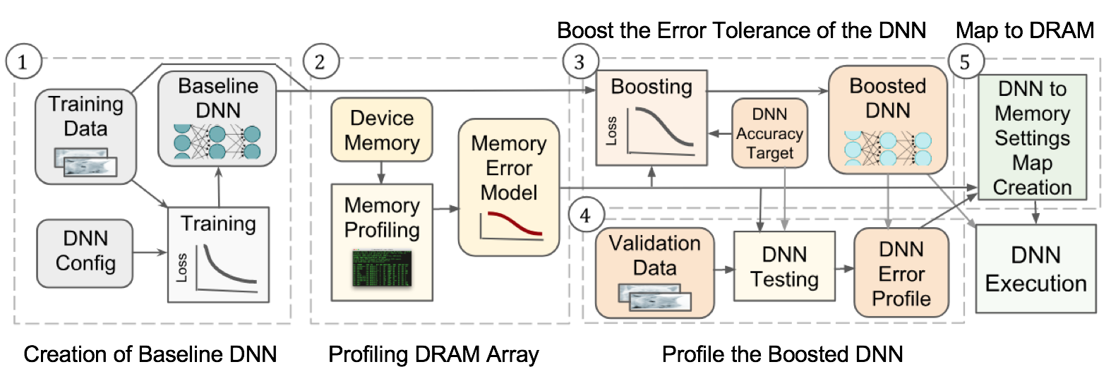
EDEN Flow

Slide 128
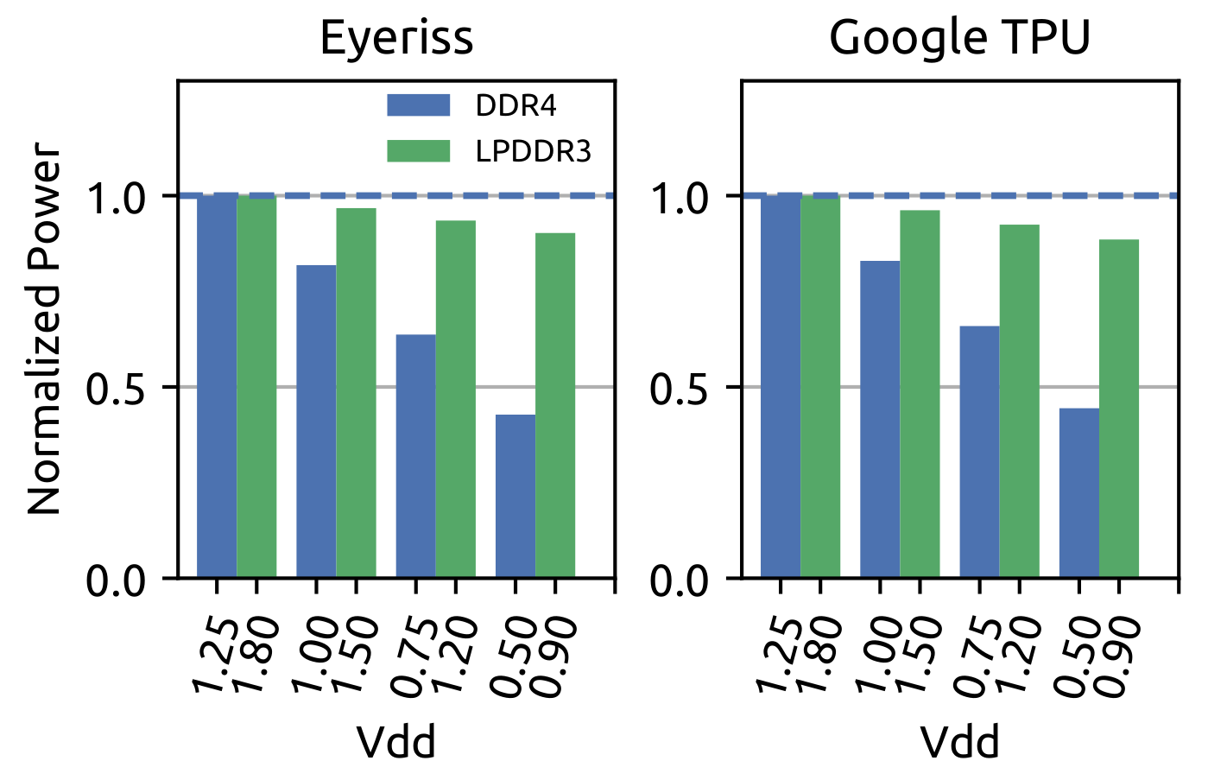
EDEN Power, Performance, Accuracy
~15-20% power savings, 8% perf improvement, <1% accuracy loss

Slide 129
Challenge and Opportunity for Future
Data-Aware
(Expressive)
Computing Architectures

Slide 130
Recap: Corollaries: Architectures Today …
Architectures are terrible at dealing with data
Designed to mainly store and move data vs. to compute
They are processor-centric as opposed to data-centric
Architectures are terrible at taking advantage of vast amounts of data (and metadata) available to them
Designed to make simple decisions, ignoring lots of data
They make human-driven decisions vs. data-driven decisions
Architectures are terrible at knowing and exploiting different properties of application data
Designed to treat all data as the same
They make component-aware decisions vs. data-aware

Slide 131
Architectures for Intelligent Machines
Data-centric
Data-driven
Data-aware

Slide 132
Source: http://spectrum.ieee.org/image/MjYzMzAyMg.jpeg

Slide 133
We Need to Revisit the Entire Stack
Problem
Algorithm
Program/Language
System Software
SW/HW Interface
Micro-architecture
Logic
Devices
Electrons

Slide 134
(Intelligent) Architectures for Intelligent Machines
Onur Mutlu
omutlu@gmail.com
https://people.inf.ethz.ch/omutlu
15 April 2019
Mubadala-SRC AI Hardware Systems Forum Keynote Talk

Slide 135
Concluding Remarks
It is time to design principled system architectures to solve the data handling problem
Design complete systems to be truly balanced, high-performance, and energy-efficient → intelligent architectures
Data-centric, data-driven, data-aware
This can
Lead to orders-of-magnitude improvements
Enable new applications & computing platforms
Enable better understanding of nature
…
Notes:
Perhaps we have taken processor-centric system design a bit too far

Slide 136
Backup Slides

Slide 137
More on Processing in Memory

Slide 138
Performance: In-DRAM Bitwise Operations
Seshadri+, “Ambit: In-Memory Accelerator for Bulk Bitwise Operations using Commodity DRAM Technology,” MICRO 2017.

Slide 139
Energy of In-DRAM Bitwise Operations
Seshadri+, “Ambit: In-Memory Accelerator for Bulk Bitwise Operations using Commodity DRAM Technology,” MICRO 2017.

Slide 140
Example Data Structure: Bitmap Index
Alternative to B-tree and its variants
Efficient for performing range queries and joins
Many bitwise operations to perform a query
age < 18
18 < age < 25
25 < age < 60
age > 60
Bitmap 1
Bitmap 2
Bitmap 3
Bitmap 4

Slide 141
More on In-DRAM Bulk AND/OR
Vivek Seshadri, Kevin Hsieh, Amirali Boroumand, Donghyuk Lee, Michael A. Kozuch, Onur Mutlu, Phillip B. Gibbons, and Todd C. Mowry, "Fast Bulk Bitwise AND and OR in DRAM" IEEE Computer Architecture Letters (CAL), April 2015.

Slide 142
Effect of Bandwidth & Programming Model
HMC-MC Bandwidth (640GB/s)
Tesseract Bandwidth (8TB/s)
Programming Model
Bandwidth
(No Prefetching)

Slide 143
Google Workloads for Consumer Devices: Mitigating Data Movement Bottlenecks
Amirali Boroumand
Saugata Ghose, Youngsok Kim, Rachata Ausavarungnirun,
Eric Shiu, Rahul Thakur, Daehyun Kim, Aki Kuusela, Allan Knies, Parthasarathy Ranganathan, Onur Mutlu

Slide 144
Quantization
floating point
Quantization
integer
Converts 32-bit floating point to 8-bit integers to improve inference execution time and energy consumption
Based on our analysis, we conclude that:
Both functions are good candidates for PIM execution
It is feasible to implement them in PIM logic
Up to 16.8% of the inference energy and 16.1% of inference execution time
Majority of quantization energy comes from data movement
A simple data conversion operation that requires shift, addition, and multiplication operations

Slide 145
Evaluation Methodology
System Configuration (gem5 Simulator)
SoC: 4 OoO cores, 8-wide issue, 64 kB L1cache, 2MB L2 cache
PIM Core: 1 core per vault, 1-wide issue, 4-wide SIMD, 32kB L1 cache
3D-Stacked Memory: 2GB cube, 16 vaults per cube
Internal Bandwidth: 256GB/S
Off-Chip Channel Bandwidth: 32 GB/s
Baseline Memory: LPDDR3, 2GB, FR-FCFS scheduler
We study each target in isolation and emulate each separately and run them in our simulator
Notes:
and then analyzing the benefit of PIM in our simulator

Slide 146
Google Workloads for Consumer Devices: Mitigating Data Movement Bottlenecks
Amirali Boroumand
Saugata Ghose, Youngsok Kim, Rachata Ausavarungnirun,
Eric Shiu, Rahul Thakur, Daehyun Kim, Aki Kuusela, Allan Knies, Parthasarathy Ranganathan, Onur Mutlu
ASPLOS 2018
Notes:
Please drop by our talk during session 1 if you would like to learn more about data movement in Google workloads.

Slide 147
Truly Distributed GPU Processing with PIM?
3D-stacked memory
(memory stack)
SM (Streaming Multiprocessor)
Logic layer
Logic layer SM
Main GPU
Crossbar switch
Vault Ctrl
….
Vault Ctrl

Slide 148
Accelerating GPU Execution with PIM (I)
Kevin Hsieh, Eiman Ebrahimi, Gwangsun Kim, Niladrish Chatterjee, Mike O'Connor, Nandita Vijaykumar, Onur Mutlu, and Stephen W. Keckler, "Transparent Offloading and Mapping (TOM): Enabling Programmer-Transparent Near-Data Processing in GPU Systems" Proceedings of the 43rd International Symposium on Computer Architecture (ISCA), Seoul, South Korea, June 2016. [Slides (pptx) (pdf)] [Lightning Session Slides (pptx) (pdf)]

Slide 149
Accelerating GPU Execution with PIM (II)
Ashutosh Pattnaik, Xulong Tang, Adwait Jog, Onur Kayiran, Asit K. Mishra, Mahmut T. Kandemir, Onur Mutlu, and Chita R. Das, "Scheduling Techniques for GPU Architectures with Processing-In-Memory Capabilities" Proceedings of the 25th International Conference on Parallel Architectures and Compilation Techniques (PACT), Haifa, Israel, September 2016.

Slide 150
Accelerating Linked Data Structures
Kevin Hsieh, Samira Khan, Nandita Vijaykumar, Kevin K. Chang, Amirali Boroumand, Saugata Ghose, and Onur Mutlu, "Accelerating Pointer Chasing in 3D-Stacked Memory: Challenges, Mechanisms, Evaluation" Proceedings of the 34th IEEE International Conference on Computer Design (ICCD), Phoenix, AZ, USA, October 2016.

Slide 151
Accelerating Dependent Cache Misses
Milad Hashemi, Khubaib, Eiman Ebrahimi, Onur Mutlu, and Yale N. Patt, "Accelerating Dependent Cache Misses with an Enhanced Memory Controller" Proceedings of the 43rd International Symposium on Computer Architecture (ISCA), Seoul, South Korea, June 2016. [Slides (pptx) (pdf)] [Lightning Session Slides (pptx) (pdf)]

Slide 152
Two Key Questions in 3D-Stacked PIM
What are the performance and energy benefits of using 3D-stacked memory as a coarse-grained accelerator?
By changing the entire system
By performing simple function offloading
What is the minimal processing-in-memory support we can provide?
With minimal changes to system and programming

Slide 153
PIM-Enabled Instructions
Junwhan Ahn, Sungjoo Yoo, Onur Mutlu, and Kiyoung Choi, "PIM-Enabled Instructions: A Low-Overhead, Locality-Aware Processing-in-Memory Architecture" Proceedings of the 42nd International Symposium on Computer Architecture (ISCA), Portland, OR, June 2015. [Slides (pdf)] [Lightning Session Slides (pdf)]

Slide 154
PEI: PIM-Enabled Instructions (Ideas)
Goal: Develop mechanisms to get the most out of near-data processing with minimal cost, minimal changes to the system, no changes to the programming model
Key Idea 1: Expose each PIM operation as a cache-coherent, virtually-addressed host processor instruction (called PEI) that operates on only a single cache block
e.g., __pim_add(&w.next_rank, value) → pim.add r1, (r2)
No changes sequential execution/programming model
No changes to virtual memory
Minimal changes to cache coherence
No need for data mapping: Each PEI restricted to a single memory module
Key Idea 2: Dynamically decide where to execute a PEI (i.e., the host processor or PIM accelerator) based on simple locality characteristics and simple hardware predictors
Execute each operation at the location that provides the best performance

Slide 155
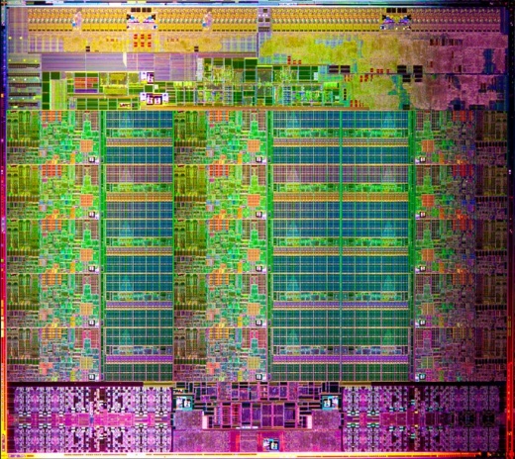
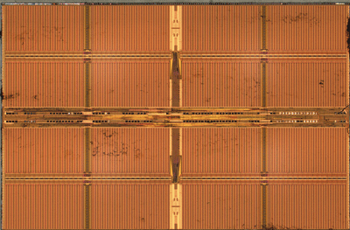
Simple PIM Operations as ISA Extensions (II)
for (v: graph.vertices) {
value = weight * v.rank;
for (w: v.successors) {
w.next_rank += value;
}
}
Host Processor
Main Memory
w.next_rank
w.next_rank
w.next_rank
w.next_rank
64 bytes in
64 bytes out
Conventional Architecture

Slide 156
Simple PIM Operations as ISA Extensions (III)
for (v: graph.vertices) {
value = weight * v.rank;
for (w: v.successors) {
__pim_add(&w.next_rank, value);
}
}
pim.add r1, (r2)
Host Processor
Main Memory
value
w.next_rank
w.next_rank
8 bytes in
0 bytes out
In-Memory Addition

Slide 157
Always Executing in Memory? Not A Good Idea
Increased
Memory Bandwidth Consumption
Caching very effective
Reduced Memory Bandwidth
Consumption due to
In-Memory Computation
More Vertices

Slide 158
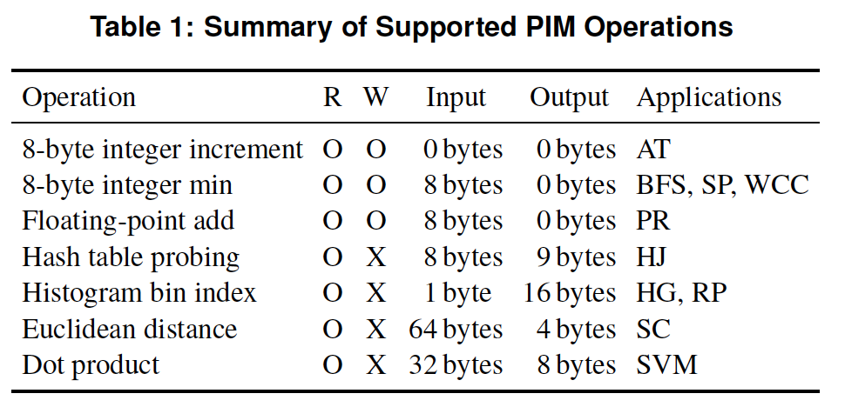
PEI: PIM-Enabled Instructions (Example)
for (v: graph.vertices) {
value = weight * v.rank;
for (w: v.successors) {
__pim_add(&w.next_rank, value);
}
}
pfence();
pim.add r1, (r2)
pfence
Executed either in memory or in the processor: dynamic decision
Low-cost locality monitoring for a single instruction
Cache-coherent, virtually-addressed, single cache block only
Atomic between different PEIs
Not atomic with normal instructions (use pfence for ordering)

Slide 159
Example (Abstract) PEI uArchitecture
Host Processor
3D-stacked Memory
Out-Of-Order Core
Last-Level Cache
DRAM Controller
L1 Cache
PCU
L2 Cache
PCU (PEI Computation Unit)
DRAM Controller
PCU
Network
HMC Controller
PMU (PEI
Mgmt Unit)
…
PIM Directory
Locality Monitor
DRAM Controller
PCU
Example PEI uArchitecture

Slide 160
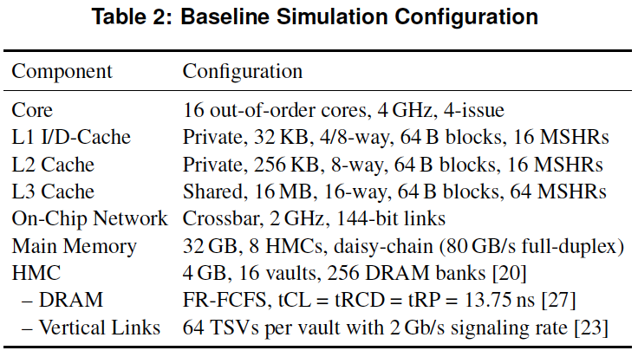
PEI: Initial Evaluation Results
Initial evaluations with 10 emerging data-intensive workloads
Large-scale graph processing
In-memory data analytics
Machine learning and data mining
Three input sets (small, medium, large) for each workload to analyze the impact of data locality
Pin-based cycle-level x86-64 simulation
Performance Improvement and Energy Reduction:
47% average speedup with large input data sets
32% speedup with small input data sets
25% avg. energy reduction in a single node with large input data sets

Slide 161
Simpler PIM: PIM-Enabled Instructions
Junwhan Ahn, Sungjoo Yoo, Onur Mutlu, and Kiyoung Choi, "PIM-Enabled Instructions: A Low-Overhead, Locality-Aware Processing-in-Memory Architecture" Proceedings of the 42nd International Symposium on Computer Architecture (ISCA), Portland, OR, June 2015. [Slides (pdf)] [Lightning Session Slides (pdf)]

Slide 162
Automatic Code and Data Mapping
Kevin Hsieh, Eiman Ebrahimi, Gwangsun Kim, Niladrish Chatterjee, Mike O'Connor, Nandita Vijaykumar, Onur Mutlu, and Stephen W. Keckler, "Transparent Offloading and Mapping (TOM): Enabling Programmer-Transparent Near-Data Processing in GPU Systems" Proceedings of the 43rd International Symposium on Computer Architecture (ISCA), Seoul, South Korea, June 2016. [Slides (pptx) (pdf)] [Lightning Session Slides (pptx) (pdf)]

Slide 163
Automatic Offloading of Critical Code
Milad Hashemi, Khubaib, Eiman Ebrahimi, Onur Mutlu, and Yale N. Patt, "Accelerating Dependent Cache Misses with an Enhanced Memory Controller" Proceedings of the 43rd International Symposium on Computer Architecture (ISCA), Seoul, South Korea, June 2016. [Slides (pptx) (pdf)] [Lightning Session Slides (pptx) (pdf)]

Slide 164
Automatic Offloading of Prefetch Mechanisms
Milad Hashemi, Onur Mutlu, and Yale N. Patt, "Continuous Runahead: Transparent Hardware Acceleration for Memory Intensive Workloads" Proceedings of the 49th International Symposium on Microarchitecture (MICRO), Taipei, Taiwan, October 2016. [Slides (pptx) (pdf)] [Lightning Session Slides (pdf)] [Poster (pptx) (pdf)]

Slide 165
Efficient Automatic Data Coherence Support
Amirali Boroumand, Saugata Ghose, Minesh Patel, Hasan Hassan, Brandon Lucia, Kevin Hsieh, Krishna T. Malladi, Hongzhong Zheng, and Onur Mutlu, "LazyPIM: An Efficient Cache Coherence Mechanism for Processing-in-Memory" IEEE Computer Architecture Letters (CAL), June 2016.

Slide 166
Eliminating the Adoption Barriers
How to Enable Adoption of Processing in Memory

Slide 167
Barriers to Adoption of PIM
1. Functionality of and applications for PIM
2. Ease of programming (interfaces and compiler/HW support)
3. System support: coherence & virtual memory
4. Runtime systems for adaptive scheduling, data mapping, access/sharing control
5. Infrastructures to assess benefits and feasibility

Slide 168
We Need to Revisit the Entire Stack
Problem
Algorithm
Program/Language
System Software
SW/HW Interface
Micro-architecture
Logic
Devices
Electrons

Slide 169
Open Problems: PIM Adoption
Saugata Ghose, Kevin Hsieh, Amirali Boroumand, Rachata Ausavarungnirun, Onur Mutlu, "Enabling the Adoption of Processing-in-Memory: Challenges, Mechanisms, Future Research Directions" Invited Book Chapter, to appear in 2018. [Preliminary arxiv.org version]
https://arxiv.org/pdf/1802.00320.pdf

Slide 170
Open Problems: PIM Adoption
Onur Mutlu, Saugata Ghose, Juan Gomez-Luna, and Rachata Ausavarungnirun, "Processing Data Where It Makes Sense: Enabling In-Memory Computation" Invited paper in Microprocessors and Microsystems (MICPRO), June 2019. [arXiv version]

Slide 171
Readings, Videos, Reference Materials

Slide 172
Accelerated Memory Course (~6.5 hours)
ACACES 2018
Memory Systems and Memory-Centric Computing Systems
Taught by Onur Mutlu July 9-13, 2018
~6.5 hours of lectures
Website for the Course including Videos, Slides, Papers
https://people.inf.ethz.ch/omutlu/acaces2018.html
https://www.youtube.com/playlist?list=PL5Q2soXY2Zi-HXxomthrpDpMJm05P6J9x
All Papers are at:
https://people.inf.ethz.ch/omutlu/projects.htm
Final lecture notes and readings (for all topics)

Slide 173
Reference Overview Paper I
Onur Mutlu, Saugata Ghose, Juan Gomez-Luna, and Rachata Ausavarungnirun, "Processing Data Where It Makes Sense: Enabling In-Memory Computation" Invited paper in Microprocessors and Microsystems (MICPRO), June 2019. [arXiv version]
https://arxiv.org/pdf/1903.03988.pdf

Slide 174
Reference Overview Paper II
Saugata Ghose, Kevin Hsieh, Amirali Boroumand, Rachata Ausavarungnirun, Onur Mutlu, "Enabling the Adoption of Processing-in-Memory: Challenges, Mechanisms, Future Research Directions" Invited Book Chapter, to appear in 2018. [Preliminary arxiv.org version]
https://arxiv.org/pdf/1802.00320.pdf

Slide 175
Reference Overview Paper III
Onur Mutlu and Lavanya Subramanian, "Research Problems and Opportunities in Memory Systems" Invited Article in Supercomputing Frontiers and Innovations (SUPERFRI), 2014/2015.
https://people.inf.ethz.ch/omutlu/pub/memory-systems-research_superfri14.pdf

Slide 176
Reference Overview Paper IV
Onur Mutlu, "The RowHammer Problem and Other Issues We May Face as Memory Becomes Denser" Invited Paper in Proceedings of the Design, Automation, and Test in Europe Conference (DATE), Lausanne, Switzerland, March 2017. [Slides (pptx) (pdf)]
https://people.inf.ethz.ch/omutlu/pub/rowhammer-and-other-memory-issues_date17.pdf

Slide 177
Reference Overview Paper V
Onur Mutlu, "Memory Scaling: A Systems Architecture Perspective" Technical talk at MemCon 2013 (MEMCON), Santa Clara, CA, August 2013. [Slides (pptx) (pdf)] [Video] [Coverage on StorageSearch]
https://people.inf.ethz.ch/omutlu/pub/memory-scaling_memcon13.pdf

Slide 178
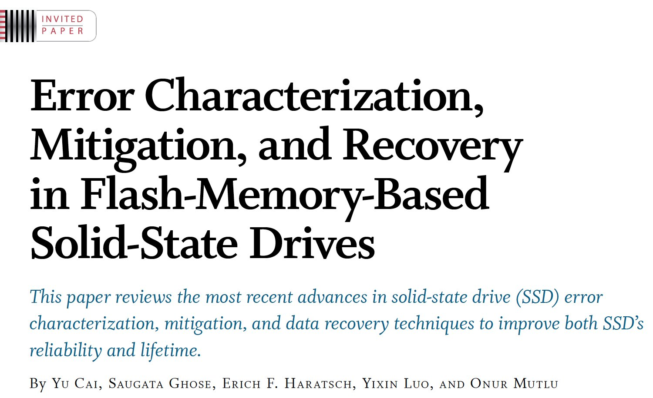
Reference Overview Paper VI
Proceedings of the IEEE, Sept. 2017
https://arxiv.org/pdf/1706.08642

Slide 179
Related Videos and Course Materials (I)
Undergraduate Computer Architecture Course Lecture Videos (2015, 2014, 2013)
Undergraduate Computer Architecture Course Materials (2015, 2014, 2013)
Graduate Computer Architecture Course Lecture Videos (2018, 2017, 2015, 2013)
Graduate Computer Architecture Course Materials (2018, 2017, 2015, 2013)
Parallel Computer Architecture Course Materials (Lecture Videos)

Slide 180
Related Videos and Course Materials (II)
Freshman Digital Circuits and Computer Architecture Course Lecture Videos (2018, 2017)
Freshman Digital Circuits and Computer Architecture Course Materials (2018)
Memory Systems Short Course Materials
(Lecture Video on Main Memory and DRAM Basics)

Slide 181
Some Open Source Tools (I)
Rowhammer – Program to Induce RowHammer Errors
https://github.com/CMU-SAFARI/rowhammer
Ramulator – Fast and Extensible DRAM Simulator
https://github.com/CMU-SAFARI/ramulator
MemSim – Simple Memory Simulator
https://github.com/CMU-SAFARI/memsim
NOCulator – Flexible Network-on-Chip Simulator
https://github.com/CMU-SAFARI/NOCulator
SoftMC – FPGA-Based DRAM Testing Infrastructure
https://github.com/CMU-SAFARI/SoftMC
Other open-source software from my group
https://github.com/CMU-SAFARI/
http://www.ece.cmu.edu/~safari/tools.html

Slide 182
Some Open Source Tools (II)
MQSim – A Fast Modern SSD Simulator
https://github.com/CMU-SAFARI/MQSim
Mosaic – GPU Simulator Supporting Concurrent Applications
https://github.com/CMU-SAFARI/Mosaic
IMPICA – Processing in 3D-Stacked Memory Simulator
https://github.com/CMU-SAFARI/IMPICA
SMLA – Detailed 3D-Stacked Memory Simulator
https://github.com/CMU-SAFARI/SMLA
HWASim – Simulator for Heterogeneous CPU-HWA Systems
https://github.com/CMU-SAFARI/HWASim
Other open-source software from my group
https://github.com/CMU-SAFARI/
http://www.ece.cmu.edu/~safari/tools.html

Slide 183
More Open Source Tools (III)
A lot more open-source software from my group
https://github.com/CMU-SAFARI/
http://www.ece.cmu.edu/~safari/tools.html

Slide 184
Referenced Papers
All are available at
https://people.inf.ethz.ch/omutlu/projects.htm
http://scholar.google.com/citations?user=7XyGUGkAAAAJ&hl=en
https://people.inf.ethz.ch/omutlu/acaces2018.html

