Slide 1
PIM-Enabled Instructions: A Low-Overhead, Locality-Aware PIM Architecture
Junwhan Ahn, Sungjoo Yoo, Onur Mutlu⁺, and Kiyoung Choi
Seoul National University
⁺Carnegie Mellon University

Slide 2
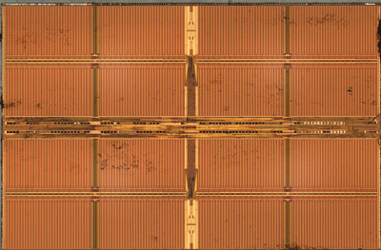
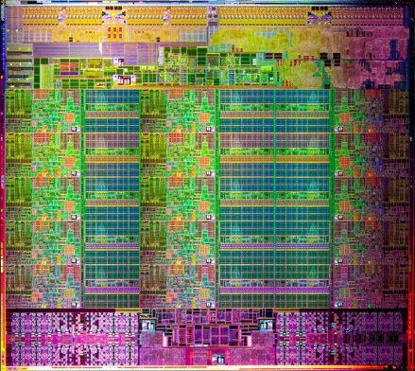
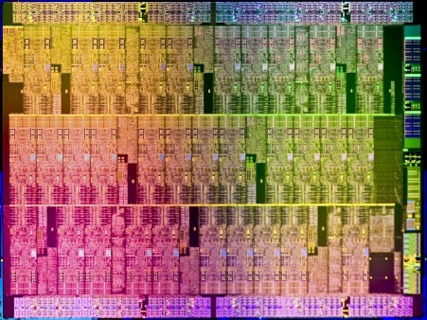
Challenges in Processing-in-Memory
Cost-effectiveness
Programming Model
Coherence & VM
Host Processor
Host Processor
Thread
Thread
Thread
Thread
Thread
Thread
Thread
Thread
Thread
DRAM die
Thread
Thread
Thread
C
4
Thread
Thread
Thread
Thread
Thread
Thread
Thread
Thread
Thread
Thread
Thread
Thread
Thread
Thread
Thread
Thread
Thread
Thread
Thread
Thread
Thread
Thread
Thread
Thread
Thread
Thread
Thread
5
Thread
C
Thread
Thread
Thread
Thread
Thread
Thread
Thread
Thread
Thread
Thread
Thread
Thread
Thread
Complex Logic
In-Memory Processors
DRAM die

Slide 3
PIM-Enabled Instructions
Our direction: simple PIM operations as ISA extension
Simple: low-overhead implementation
ISA extension: No changes to existing programming models
One more thing: locality-aware dynamic PIM execution
Adaptation between host-side and memory-side execution
Evaluation highlight
47% speedup over conventional systems in large inputs
32% speedup over PIM-only systems in small inputs
Impact of data locality, energy efficiency, and more…
Session 6A: Memory Systems I (10:20~10:45)

