Slide 1





EasyDRAM An FPGA-based Infrastructure for Fast and Accurate End-to-End Evaluation of Emerging DRAM Techniques
Oğuzhan Canpolat Ataberk Olgun David Novo Oğuz Ergin Onur Mutlu
https://arxiv.org/abs/2506.10441
Notes:
Hello everyone. I am Ataberk and I am excited to present our work EasyDRAM to you. EasyDRAM is an
FPGA-based infrastructure for fast and accurate end-to-end evaluation of emerging DRAM techniques.
I’m the second author. The first author unfortunately cannot be here due to a personal conflict.

Slide 2
EasyDRAM Summary
Motivation
Numerous DRAM techniques improve computing system throughput, reliability, and computing capabilities
Evaluating them require invasive changes across the compute stack
Existing FPGA-based evaluation platforms require hardware design expertise and do not accurately model modern systems
Goal: Develop a configurable framework (EasyDRAM) that allows fast and accurate evaluation of emerging DRAM techniques using real DRAM chips
Key Ideas of EasyDRAM
Easy to use (C++) programmable memory controller implemented in FPGA
System state advanced to respect modern clock frequency ratios between processor and DRAM
Case Studies
In-DRAM row-copy (RowClone) provides 15.0x speedup over CPU-based copy for copy-heavy microbenchmarks
DRAM access latency reduction (SolarDRAM) improves end-to-end system performance by 2.8% avg. across PolyBench workloads
Notes:
I’ll start with a summary.
[CLICK] There are numerous DRAM techniques that can improve system throughput, reliability, and computing capabilities
[CLICK] and evaluating these require invasive changes across the compute stack.
[CLICK] An FPGA-based platform is a good basis to build on to evaluate DRAM techniques, but they require deep hardware design expertise and they do not accurately model modern systems.
[CLICK] Our goal is to develop a configurable FPGA-based framework, one which overcomes the shortcomings of prior work, to evaluate DRAM techniques using real DRAM chips.
[CLICK] EasyDRAM is built with two key ideas. First, we implement a C++ programmable memory controller in the FPGA **to open the evaluation platform to architects and designers who lack hardware design expertise.**
[CLICK] Second, we develop a new technique that advances modeled system state in a way that respects modern clock frequency ratios between the processor and DRAM to enable accurate evaluation.
[CLICK] To demonstrate EasyDRAM’s ease of use and accurate evaluation capability, we conduct two case studies. We show that in-DRAM row copy using RowClone provides 15X speedup over CPU-based copy for copy-heavy microbenchmarks. This is still a high speedup but it is significantly smaller than what an inaccurate FPGA-based evaluation platform reports.
[CLICK] We show end-to-end system performance benefits for DRAM access latency reduction using workloads from the PolyBench benchmark suite.

Slide 3
Talk Outline
Background
Motivation
EasyDRAM
Case Studies
Conclusion
Notes:
Here is the outline for this talk

Slide 4
Talk Outline
Background
Motivation
EasyDRAM
Case Studies
Conclusion
Notes:
I’ll start with some DRAM background

Slide 5
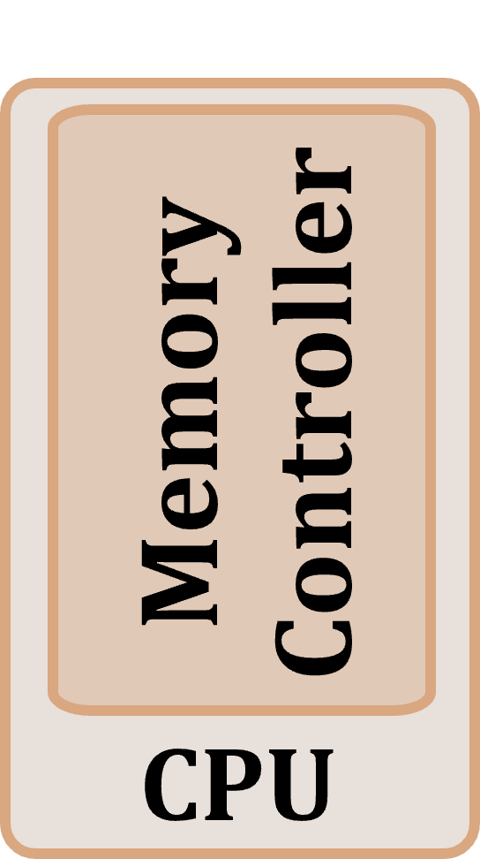
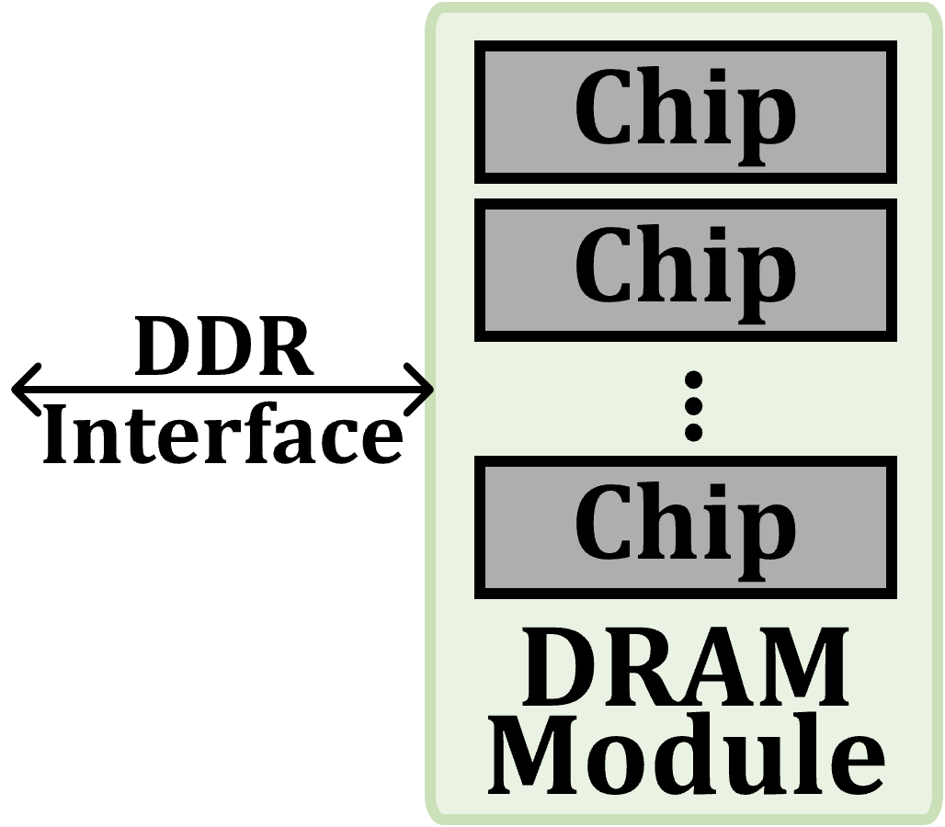
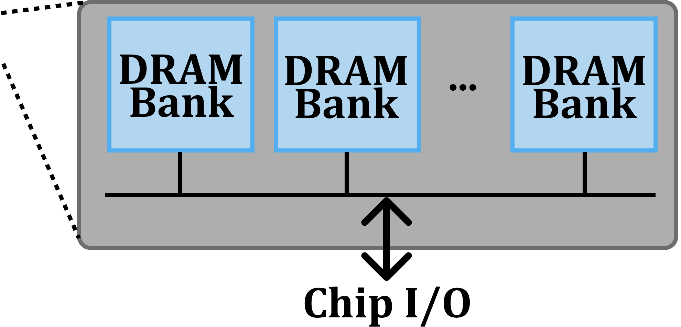
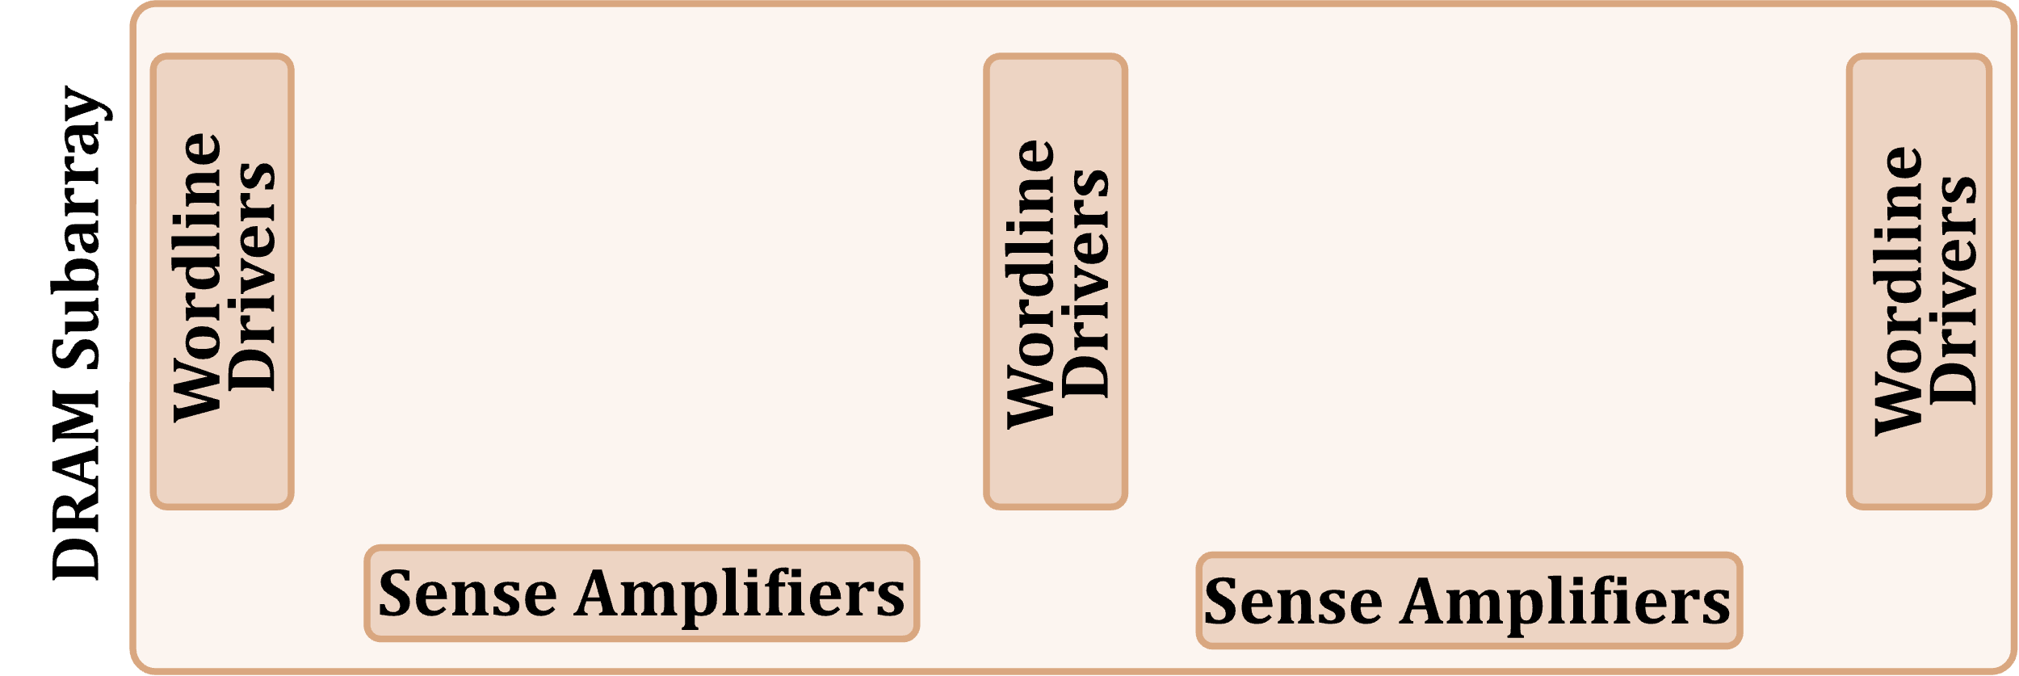
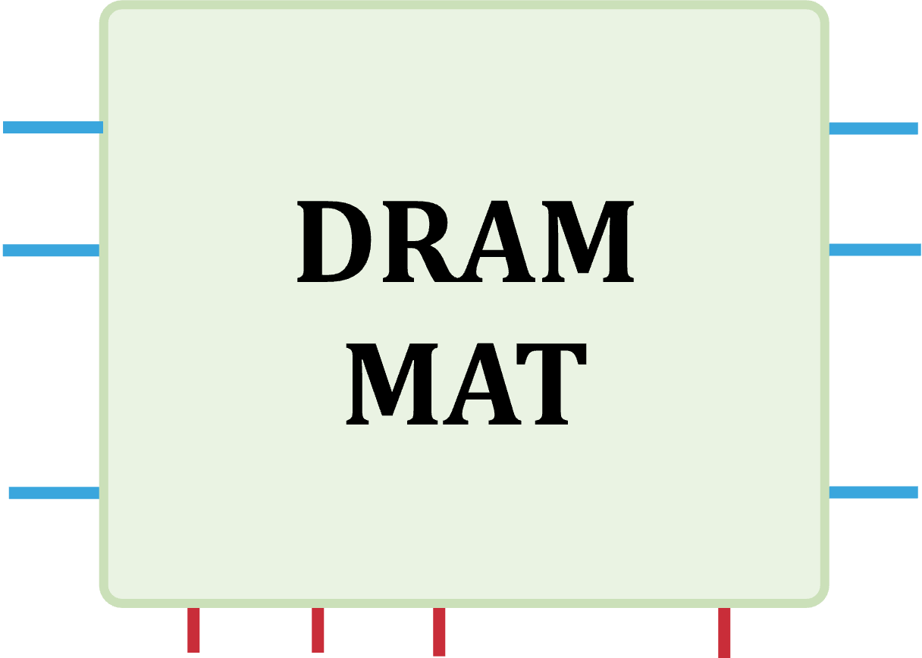
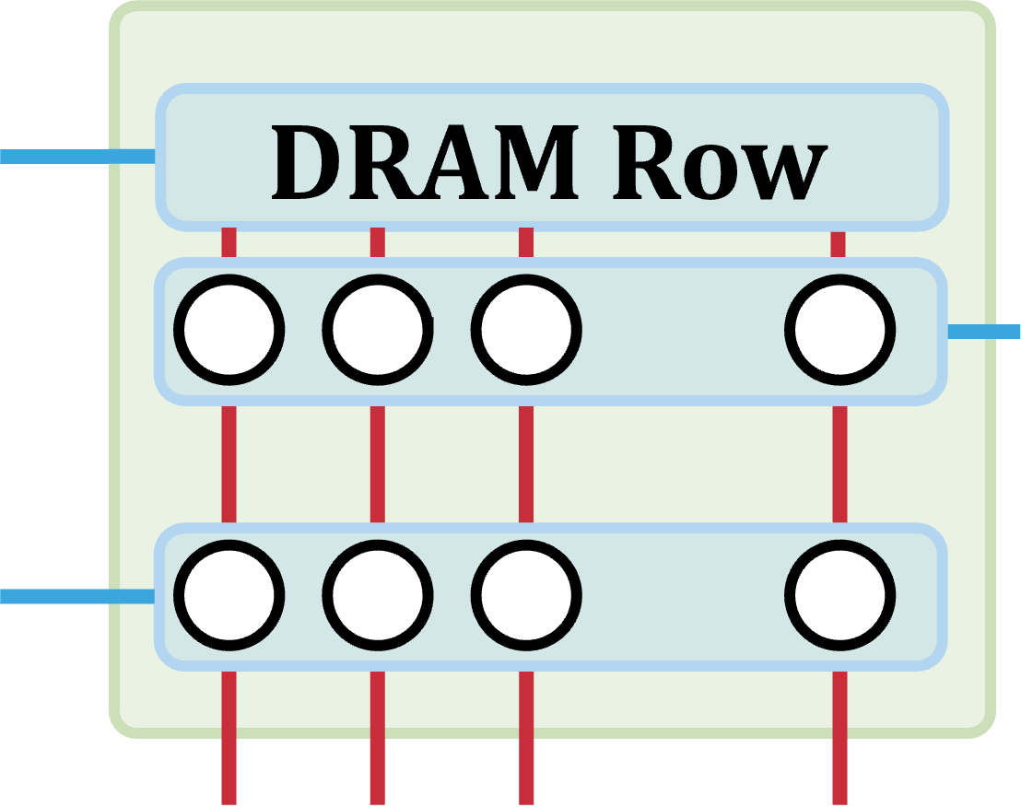
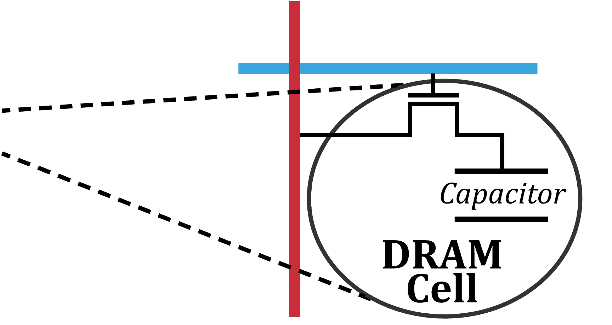
DRAM Organization
…
…
…
Notes:
In a typical computing system the processor’s memory controller
[CLICK] communicates with a set of DRAM chips within a DRAM module through a memory channel.
[CLICK] Each DRAM chip contains multiple banks that share a common chip I/O interface.
[CLICK] DRAM banks are organized into subarrays that consists of a set of wordline drivers and sense amplifiers
[CLICK] Subarrays are partitioned into DRAM MATs which are collections of DRAM cells that are separated from each other by wordline drivers.
[CLICK] DRAM cells are laid out onto a two-dimensional array of wordlines and bitlines within
a DRAM MAT. A row of DRAM cells is a DRAM row.
[CLICK] Here is a simplified diagram of a DRAM cell.

Slide 6
DRAM Operation
Cache line
…
Wordline Drivers
…
…
…
…
…
Sense Amplifiers
Sense Amplifiers
Sense Amplifiers
READ
READ
READ
READ
READ
READ
(Activation Latency)
(Access Latency)
(Precharge Latency)
DRAM Command Sequence
ACT R0
RD
RD
RD
PRE R0
ACT R1
RD
RD
RD
time
[Kim+ HPCA’19]
Notes:
Now we will look at how DRAM operates at the scope of a single subarray.
[CLICK] Because memory controllers typically access DRAM cells in the granularity of a cache line or a cache block we combine consecutive DRAM cells to form cache lines in this diagram.
[CLICK] On the bottom we have a timeline of DRAM commands.
[CLICK] First, we activate the first row to [CLICK] copy its cache lines to the sense amplifiers
[CLICK] At this point we can read data [CLICK] in cache line granularity from the sense [CLICK] amplifiers by sending READ commands
[CLICK] To access another row, we must first precharge the DRAM bank which closes the open DRAM row and sets the bitline voltage to half Vdd.
[CLICK] We can now activate the [CLICK] second row before [CLICK] [CLICK] [CLICK] reading data from it.
[CLICK] To ensure correct operation, we must obey certain timing parameters that define intervals between DRAM command pairs.
Three important timing parameters are tRAS, tRP, and tRCD
[CLICK] tRAS dictates the amount of time we need to wait between successive activate and precharge commands
[CLICK] Successive precharge and activate commands must be separated on the command bus by at least a tRP amount of time.
[CLICK] Successive activate and read commands must be separated by a tRCD amount of time.

Slide 7
DRAM Techniques
DRAM techniques violate standard timing parameters to improve latency and computing capabilities of DRAM
Many examples
In-DRAM bulk data copy and initialization (RowClone [MICRO’13])
Bulk bitwise operations (Ambit [MICRO’17])
DRAM access latency reduction (e.g., SolarDRAM [ICCD’18])
Retention-aware intelligent refresh (e.g., RAIDR [ISCA’12])
Random number generation (e.g., QUAC-TRNG [ISCA’21])
…
Notes:
These timing parameters can be violated to improve the latency and computing capabilities of DRAM. We refer to techniques that do so as DRAM techniques.
[CLICK] Various examples of DRAM techniques exist in the literature.
=====
Add proper references

Slide 8
DRAM Techniques
DRAM techniques violate standard timing parameters to improve latency and computing capabilities of DRAM
Many examples
In-DRAM bulk data copy and initialization (RowClone [MICRO’13])
Bulk bitwise operations (Ambit [MICRO’17])
DRAM access latency reduction (e.g., SolarDRAM [ICCD’18])
Retention-aware intelligent refresh (e.g., RAIDR [ISCA’12])
Random number generation (e.g., QUAC-TRNG [ISCA’21])
…
Notes:
We study in-DRAM bulk data copy and initialization using RowClone and DRAM access latency reduction using SolarDRAM in our work.
[CLICK] I’ll quickly give the key idea of each of these starting with RowClone.

Slide 9
Row-Copy: Key Idea (RowClone)
s
r
c
r
o
w
s
d
s
r
c
t
r
r
o
o
w
w
s
r
c
r
o
w
Sense Amplifiers

1. Source row to sense amplifiers
?
2. Sense amplifiers to destination row
[Seshadri+ MICRO’13]
Notes:
The diagram shows a simplified view of a DRAM subarray with a set of DRAM rows and sense amplifiers. To copy the orange source row to the gray destination row:
[CLICK] First, we copy the source row to row buffer
[CLICK] Second, we move the data from the sense amplifiers to the destination row
[CLICK] Current DRAM chips already support the first step of this operation. We can use activate commands to copy the source row to the destination row
[CLICK] I will describe how we can move data back from the sense amplifiers to the destination row later in my presentation but the key idea of RowClone is quite simple

Slide 10
DRAM Techniques
DRAM techniques violate standard timing parameters to improve latency and computing capabilities of DRAM
Many examples
In-DRAM bulk data copy and initialization (RowClone [MICRO’13])
Bulk bitwise operations (Ambit [MICRO’17])
DRAM access latency reduction (e.g., SolarDRAM [ICCD’18])
Retention-aware intelligent refresh (e.g., RAIDR [ISCA’12])
Random number generation (e.g., QUAC-TRNG [ISCA’21])
…
Notes:
DRAM access latency reduction is relatively simple as well.

Slide 11
DRAM Accesses and Failures
wordline
Guardband
Strong
(fast)
V_{dd}
access
transistor
V_{min}
Weak
(slow)
Ready to Access
Voltage Level
Process variation during manufacturing results in cells having unique behavior
bitline
Bitline Voltage
Bitline Charge Sharing
capacitor
Sense Amplifier
0.5 V_{dd}
Time
ACTIVATE
SA Enable
READ
t_{RCD}
[Kim+ HPCA’18]
Notes:
To explain access latency reduction better, I’ll first describe DRAM access failures.
[CLICK] This is a sketch of a DRAM cell and we will inspect the voltage on the bitline.
[CLICK][CLICK] The x-axis shows time and the y-axis shows the voltage on the bitline.
[CLICK] Initially the bitline is kept at Vdd/2.
[CLICK] When the wordline is driven high or activated, the capacitor begins to share charge with the bitline. The sense amplifier is then enabled and [CLICK] the voltage differential on the bitline is amplified to an I/O readable value.
[CLICK] In order to ensure correctness of operation, the memory controller can only read data tRCD time after the activation. [CLICK] We could read this data earlier, when it reaches a readable voltage threshold (Vmin), [CLICK] but we want to make sure that there is enough guardband such that other cells that may be [CLICK] weaker due to process variation will not fail when accessed tRCD time after activation.
[CLICK] We highlight and refer to varying degrees of strengths of cells in terms of how early they reach the readable voltage threshold.

Slide 12
DRAM Accesses and Failures
wordline
Strong
(fast)
V_{dd}
access
transistor
V_{min}
Weak
(slow)
Ready to Access
Voltage Level
bitline
Weaker cells have a higher probability to fail because they are slower
Bitline Voltage
capacitor
SA
0.5 V_{dd}
Time
ACTIVATE
SA Enable
READ
t_{RCD}
[Kim+ HPCA’18]
Notes:
If we are to read with a [CLICK] tRCD reduced below manufacturer-recommended values, [CLICK] we begin to induce failures in the weaker cell. We refer to these failures as access failures.

Slide 13
DRAM Access Latency Reduction: Key Idea
Stronger cells can be reliably accessed with a reduced t_{RCD}
wordline
Strong
(fast)
V_{dd}
access
transistor
V_{min}
Weak
(slow)
Ready to Access
Voltage Level
bitline
Bitline Voltage
capacitor
SA
0.5 V_{dd}
Time
ACTIVATE
SA Enable
READ
t_{RCD}
[Kim+ HPCA’18]
Notes:
On the flip side, some strong cells can be reliably accessed with a reduced access latency. The key idea of access latency reduction is to identify these cells and access them with a reduced tRCD timing parameter.

Slide 14
Talk Outline
Background
Motivation
EasyDRAM
Case Studies
Conclusion
Notes:
We’ve seen some DRAM technique. Let’s now see what it takes to properly evaluate them.

Slide 15

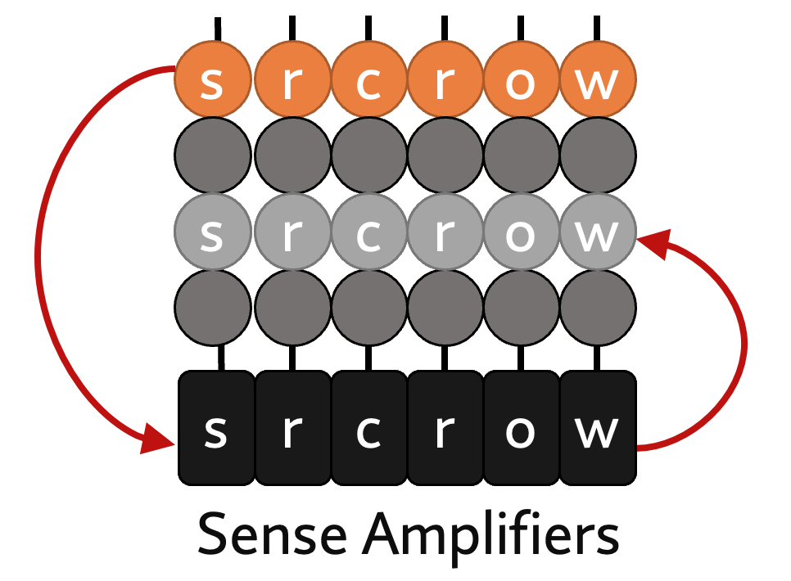
System Support for DRAM Techniques
Application
bulk data initialization
Program/Language
System Software
bridge the gap
SW/HW Interface
Micro-architecture
Logic
Devices
Electrons
Evaluating the benefits of DRAM techniques requires modifications across the stack
Notes:
This is a classic view of the computing stack ranging from application at the top to electrons at the bottom.
[CLICK] Many applications require bulk data initialization and [CLICK] can significantly benefit from dedicated support for it by DRAM, for example, using RowClone.
[CLICK] However, evaluating benefits of DRAM techniques requires modifications across the stack
[CLICK] and some evaluation platforms actually help bridge this gap, such as…

Slide 16
FPGA-Based Evaluation Platforms
Good basis for evaluating DRAM techniques
Interface with real DRAM chips
Relatively short end-to-end execution time
Requires hardware design expertise
Disproportionally low CPU clock frequency
https://arxiv.org/pdf/2506.10441
Notes:
… FPGA-based evaluation platforms. These provide a good basis for evaluating DRAM techniques because
[CLICK] They provide the user with a low-level interface to real DRAM chips
[CLICK] and they are relatively fast, such that we can practically evaluate a workload end-to-end
But, [CLICK] today’s FPGA-based platforms require hardware design expertise to study new DRAM techniques and
[CLICK] FPGA implementations of computing systems typically have a disproportionately low CPU clock frequency
I will elaborate on these two weaknesses shortly.
[CLICK] I just want to mention that we have a more comprehensive analysis of strengths and weaknesses of a broader variety of prior work in our paper.

Slide 17
FPGA-Based Evaluation Platforms
Good basis for evaluating DRAM techniques
Interface with real DRAM chips
Relatively short end-to-end execution time
Requires hardware design expertise
Disproportionally low CPU clock frequency
https://arxiv.org/pdf/2506.10441
Notes:
Let’s start with the first weakness.

Slide 18

Hardware Design Expertise Requirement
Implementing DRAM techniques requires memory controller modifications
Deep hardware design expertise to reason about
Design clock frequency
Design area and hardware utilization
Functional correctness
Debugging
Barrier to entry for many researchers and designers
Notes:
To implement a new DRAM technique, we must modify the memory controller design.
[CLICK] This requires deep hardware design expertise to reason about
[CLICKx3 as you talk] many important hardware design aspects
[CLICK] The hardware design expertise poses a barrier to entry for many researchers and system designers.

Slide 19
FPGA-Based Evaluation Platforms
Good basis for evaluating DRAM techniques
Interface with real DRAM chips
Relatively short end-to-end execution time
Requires hardware design expertise
Disproportionally low CPU clock frequency
https://arxiv.org/pdf/2506.10441
Notes:
Continuing with the *second* weakness…

Slide 20
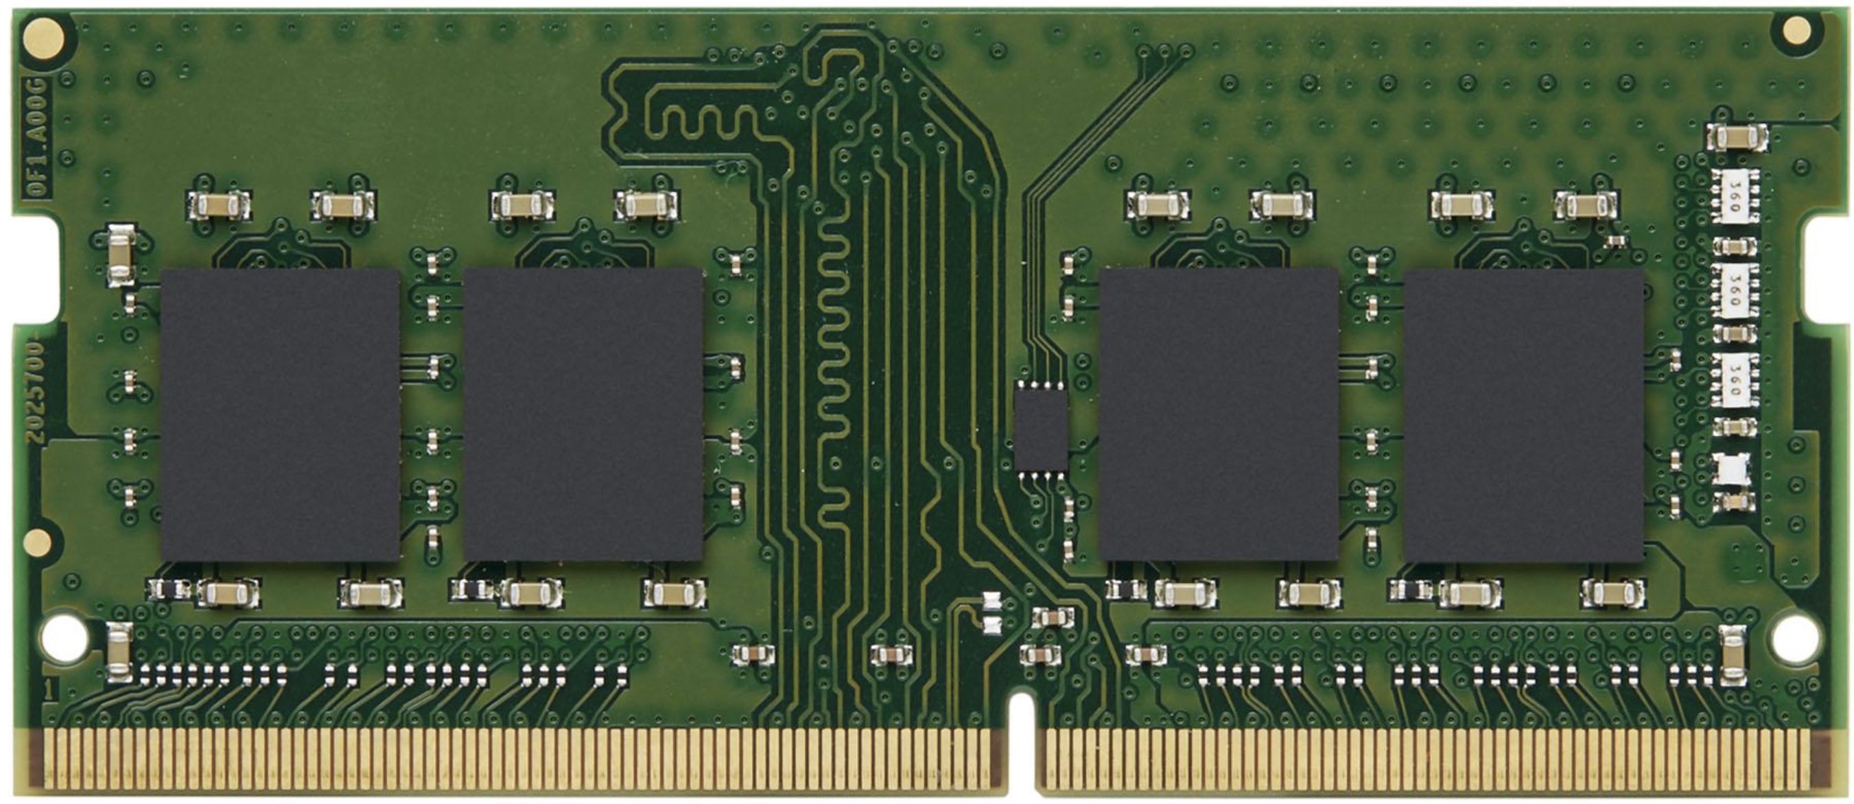
Disproportionately Low CPU Clock Frequency
Clock frequency 4~6 GHz
50~200 MHz
CPU
CPU
Integrated Circuit
FPGA Implementation
1~4 GHz
1~4 GHz
DRAM
DRAM
Notes:
We observe that in a typical computing system with [CLICK] DRAM-based main memory, the CPU [CLICKx2] clock frequency is around 4-6 GHz and DRAM clock frequency is between 1 to 4 GHz.
[CLICK] If we implement this CPU in an FPGA, it is very likely that we will not be able to clock it at very high clock frequency.
[CLICK] But the DRAM attached to this CPU is still clocked at relatively high clock frequency.
=====
Why not high clock frequency? FPGAs have a low upper bound clock freq. It requires a ton of effort to reach that upper bound and maybe even impossible for general logic to do.

Slide 21
The Clock Frequency is Discrepant
50~200 MHz
1~4 GHz
CPU
DRAM
FPGA Implementation
Limits evaluation accuracy and skews the results
Notes:
This clock frequency discrepancy [CLICK] limits evaluation accuracy and skews performance results

Slide 22
Problem
FPGA-based platforms
are difficult to modify
&
yield inaccurate system performance results
when used for DRAM technique evaluation
Notes:
To summarize, FPGA-based platforms are a good candidate for evaluating DRAM techniques, but they are difficult to modify
and [CLICK] they yield inaccurate system performance results

Slide 23
Our Goal
Enable rapid and accurate end-to-end evaluation of DRAM techniques
without needing deep hardware design expertise
Notes:
Our goal is to enable rapid and accurate, end-to-end, evaluation of DRAM techniques
[CLICK] without requiring deep hardware design expertise

Slide 24
Talk Outline
Background
Motivation
EasyDRAM
Case Studies
Conclusion
Notes:
Let’s see how EasyDRAM achieves this goal

Slide 25
EasyDRAM Key Ideas
Evaluate DRAM techniques using real DRAM chips
without requiring deep hardware design expertise
with accurate system performance results
1
Programmable memory controller
C++ program defines memory controller
Program runs on a RISC-V core
2
“Time Scaling” technique
Split hardware components to emulation domains
Control clock of each domain to match expectations
Notes:
We want to evaluate DRAM techniques using real DRAM chips
[CLICK] firstly without requiring deep hardware design expertise
[CLICK] and our key idea in providing this is to implement a software-programmable memory controller that runs the user’s C++ model of the memory controller in [CLICK] RISC-V core in the FPGA
[CLICK] and secondly we want to evaluate DRAM techniques accurately,
[CLICK] so we implement a technique that we call time scaling, which, at a very high level splits hardware components to multiple emulation domains
[CLICK] and controls the clock of each domain to match the behavior expected of a modern system.
To better explain these key ideas, I will describe each with examples later in the slides

Slide 26
EasyDRAM Overview
EasyDRAM
Programmable Memory Controller
data
1
Processing System (cores, caches, etc.)
DRAM interface
Time Scaling
clock control
2
Notes:
Here is an overview of EasyDRAM.

Slide 27
EasyDRAM Overview
EasyDRAM
Programmable Memory Controller
data
1
Processing System (cores, caches, etc.)
DRAM interface
Time Scaling
clock control
2
Notes:
I’ll start by describing the programmable memory controller

Slide 28
Programmable Memory Controller
Fully-programmable general-purpose processor instead of a conventional RTL memory controller
while (request_queue_is_empty());
Request req = receive_memory_request();
auto pa = req.physical_address;
auto dram_address = translate_address(pa);
response = issue_read(dram_address);
send_response(req);
C++ Memory Controller Program
Notes:
It really is a general-purpose processor that runs a memory controller model program instead of a conventional RTL memory controller.
[CLICK] Here is a very simple toy example of a memory controller program.

Slide 29
Programmable Memory Controller
Fully-programmable general-purpose processor instead of a conventional RTL memory controller
while (request_queue_is_empty());
Request req = receive_memory_request();
auto pa = req.physical_address;
auto dram_address = translate_address(pa);
response = issue_read(dram_address);
send_response(req);
1
wait for memory request to arrive
Notes:
This first line is waiting for a memory request to arrive

Slide 30
Programmable Memory Controller
Fully-programmable general-purpose processor instead of a conventional RTL memory controller
while (request_queue_is_empty());
Request req = receive_memory_request();
auto pa = req.physical_address;
auto dram_address = translate_address(pa);
response = issue_read(dram_address);
send_response(req);
2
process request to find DRAM address
Notes:
Then we process the request to find the DRAM row bank column address it targets

Slide 31
Programmable Memory Controller
Fully-programmable general-purpose processor instead of a conventional RTL memory controller
while (request_queue_is_empty());
Request req = receive_memory_request();
auto pa = req.physical_address;
auto dram_address = translate_address(pa);
response = issue_read(dram_address);
send_response(req);
3
issue request to DRAM and respond
Notes:
And finally we issue the DRAM commands needed to serve the request and then respond to the processing system.

Slide 32
Programmable Memory Controller
while (request_queue_is_empty());
Request req = receive_memory_request();
auto pa = req.physical_address;
auto dram_address = translate_address(pa);
response = issue_read(dram_address);
send_response(req);
Provides an easy means to perform low-level memory controller operations
Notes:
All of this is to show that the programmable memory controller [CLICK] provides an easy means to perform low-level memory controller operations

Slide 33
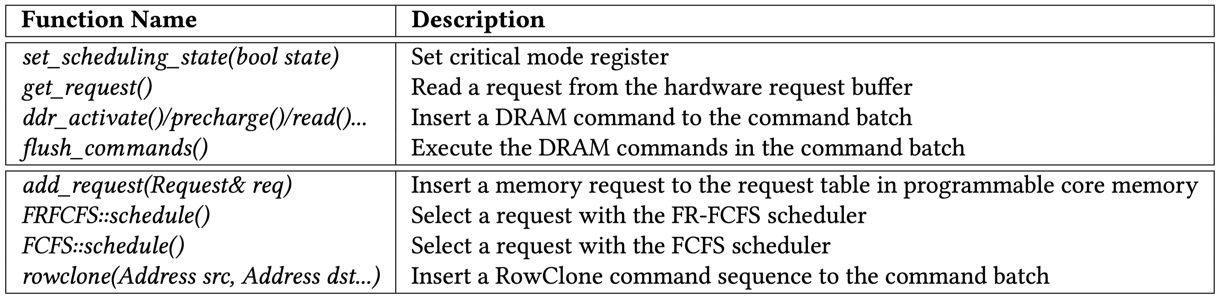
Programmable Memory Controller
while (request_queue_is_empty());
Request req = receive_memory_request();
auto pa = req.physical_address;
auto dram_address = translate_address(pa);
response = issue_read(dram_address);
send_response(req);
https://arxiv.org/pdf/2506.10441
Provides an easy means to perform low-level memory controller operations
Notes:
And you can find more elaborate example functions we provide to ease memory controller design in our paper

Slide 34
Using a Programmable Memory Controller in an FPGA-based System is Challenging
C++ Memory Controller Program
Executes many instructions to simulate one memory controller clock cycle (i.e., is slow)
1
Cannot issue DRAM commands at nanosecond granularity
2
The processor experiences lengthier stalls waiting for memory than in a real system
Notes:
Implementing the memory controller as a C++ program running on a general-purpose core introduces additional challenges for DRAM technique evaluation primarily because
[CLICK] the core executes many instructions to simulate one memory controller clock cycle, in other words, it is a slow memory controller and it creates two issues
[CLICK] first, we cannot issue DRAM commands at nanosecond granularity, which we need, to violate DRAM timing parameters
[CLICK] second, because the memory controller takes so long to process commands, the processor experiences very length stalls waiting for memory

Slide 35
Recall: Clock Frequency Discrepancy
50~200 MHz
1~4 GHz
CPU
DRAM
FPGA Implementation
Limits evaluation accuracy and skews the results
Notes:
All in all, this limits evaluation accuracy and skews results

Slide 36
Another View of EasyDRAM
Memory Controller Clock Frequency
0.1~1 MHz
50~200 MHz
1~4 GHz
EasyDRAM
Programmable Memory Controller
data
1
Processing System (cores, caches, etc.)
DRAM interface
Time Scaling
clock control
2
Notes:
Another way to look at this problem is to see the memory controller [CLICK] as if it were operating at 100 KHz to 1 MHz clock frequency.

Slide 37
Another View of EasyDRAM
Memory Controller Clock Frequency
0.1~1 MHz
50~200 MHz
1~4 GHz
EasyDRAM
Programmable Memory Controller
data
1
Processing System (cores, caches, etc.)
DRAM interface
Time Scaling
clock control
2
1
Cannot issue DRAM commands at nanosecond granularity
Notes:
We will look at how we fix this first issue of not being able to issue DRAM commands at nanosecond granularity.

Slide 38
EasyDRAM Issues DRAM Commands at Nanosecond Granularity
Key idea: Issue DRAM commands in batches
Slow clock
Fast clock
Programmable Memory Controller
Specialized Logic
CMD3
CMD1
CMD4
CMD2
CMD1
CMD2
CMD3
CMD4
time
Notes:
The key idea is quite simple, we batch the requests
[CLICK] The programmable core has a relatively slow clock frequency
[CLICK] and DRAM has a relatively fast clock frequency
[CLICK] on the bottom we have a timeline of commands issued from the memory controller and to DRAM [CLICKx4] The memory controller slowly collects multiple DRAM commands in a batch and precisely specifies the delay between each command

Slide 39
EasyDRAM Issues DRAM Commands at Nanosecond Granularity
Key idea: Issue DRAM commands in batches
Slow clock
Fast clock
Programmable Memory Controller
CMD1
Specialized Logic
CMD2
CMD3
CMD4
CMD1
CMD2
CMD3
CMD4
CMD1
CMD2
CMD3
CMD4
time
Notes:
[CLICK] The specialized logic rapidly issues this command batch strictly obeying the specified delays between each command to DRAM.

Slide 40
EasyDRAM Issues DRAM Commands at Nanosecond Granularity
Key idea: Issue DRAM commands in batches
Slow clock
Fast clock
Programmable Memory Controller
Specialized Logic
heavily reuses
DRAM Bender DDR3/4 and HBM2 Testing Infrastructure
*Olgun et al., "DRAM Bender: An Extensible and Versatile FPGA-Based Infrastructure to Easily Test State-of-the-Art DRAM Chips,” TCAD, 2023. [GitHub: https://github.com/CMU-SAFARI/DRAM-Bender]
Notes:
This logic heavily reuses our DRAM Bender DDR3/4 and HBM2 testing infrastructure.

Slide 41
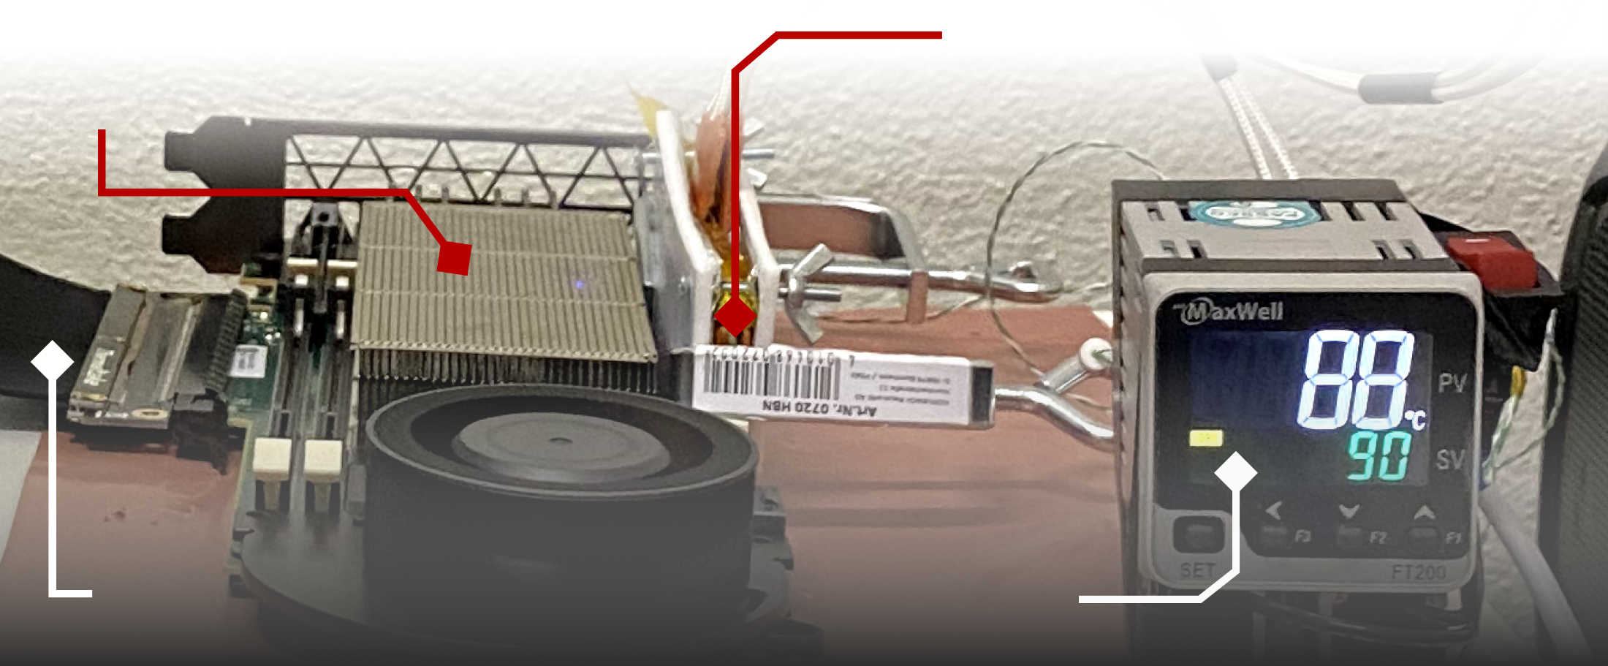
DDR4 DRAM Testing Infrastructure
DRAM Bender on a Xilinx Virtex UltraScale+ XCU200
Xilinx Alveo U200 FPGA Board (programmed with DRAM Bender*)
DRAM Module with Heaters
PCIe
Host Interface
MaxWell FT200 Temperature Controller
Fine-grained control over DRAM commands,
timing parameters (±1.5ns), and temperature (±0.5°C )
*Olgun et al., "DRAM Bender: An Extensible and Versatile FPGA-Based Infrastructure to Easily Test State-of-the-Art DRAM Chips,” TCAD, 2023. [GitHub: https://github.com/CMU-SAFARI/DRAM-Bender]
Notes:
I wanted to very briefly talk about DRAM Bender as it relates to our work as an enabler for discovering DRAM techniques and can be used for understanding DRAM failure modes (e.g., read disturbance, like RowHammer or RowPress)

Slide 42
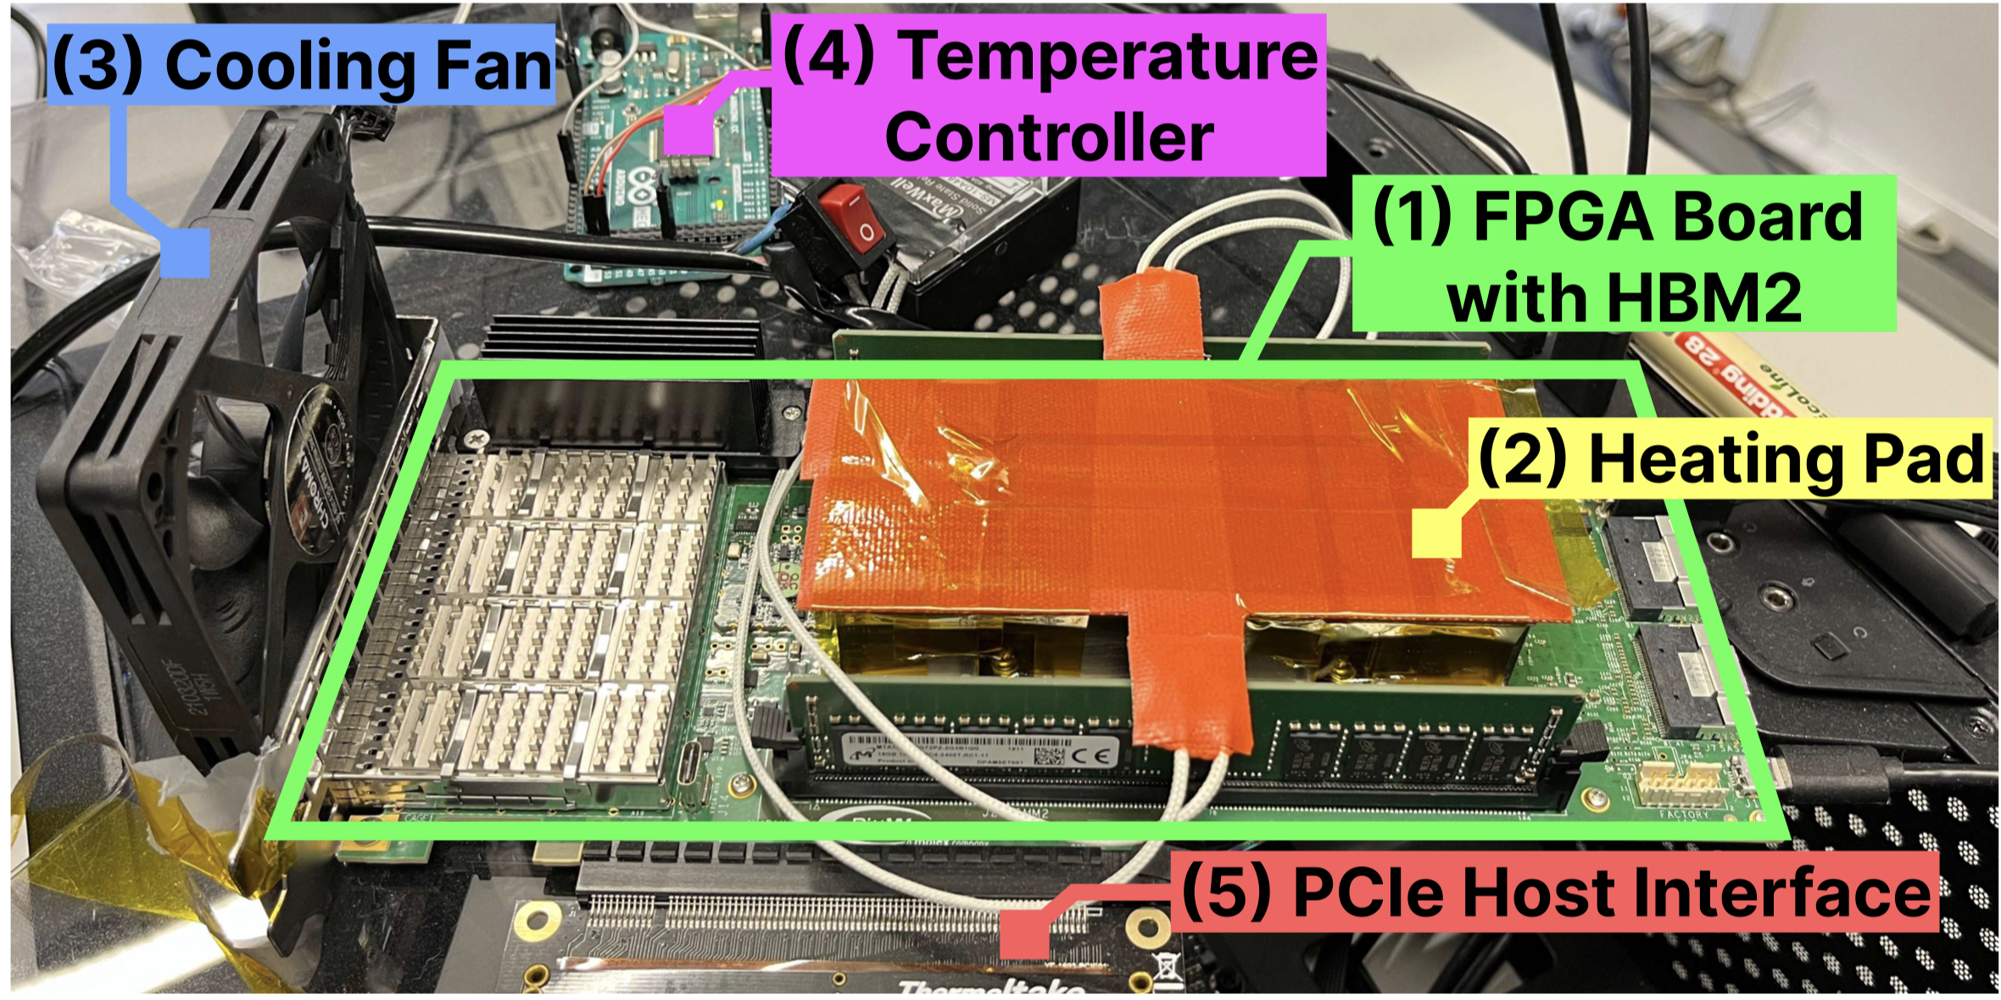
HBM2 DRAM Testing Infrastructure
DRAM Bender on a Bittware XUPVVH
Fine-grained control over DRAM commands,
timing parameters (±1.67ns), and temperature (±0.5°C )
*Olgun et al., "DRAM Bender: An Extensible and Versatile FPGA-Based Infrastructure to Easily Test State-of-the-Art DRAM Chips,” TCAD, 2023. [GitHub: https://github.com/CMU-SAFARI/DRAM-Bender]
Notes:
This is another version of the same infrastructure that we use to test HBM2 DRAM chips and we presented the first experimental study of Read Disturbance last year in DSN where we built and used this version of the infrastructure.

Slide 43
Another View of EasyDRAM
Memory Controller Clock Frequency
0.1~1 MHz
50~200 MHz
1~4 GHz
EasyDRAM
Programmable Memory Controller
data
1
Processing System (cores, caches, etc.)
DRAM interface
Time Scaling
clock control
2
2
The processor experiences lengthier stalls waiting for memory than in a real system
Notes:
and that’s it for DRAM Bender and how we issue DRAM commands at nanosecond granularity.
[CLICK] We also look at the processing system side of the clock discrepancy issue.

Slide 44
Another View of EasyDRAM
Memory Controller Clock Frequency
0.1~1 MHz
50~200 MHz
1~4 GHz
EasyDRAM
Programmable Memory Controller
data
1
Processing System (cores, caches, etc.)
DRAM interface
Time Scaling
clock control
2
2
The processor experiences lengthier stalls waiting for memory than in a real system
Notes:
… which brings me to the Time Scaling technique

Slide 45
EasyDRAM without Time Scaling
Programmable Mem. Ctrl.
Request Q.
CPU Core
R1
Scheduler
Request1
time
Notes:
I’ll first describe two issues that Time Scaling sets to fix over an example system that does not have time scaling.
[CLICK] We have the memory controller on the right and the cpu core on the left
[CLICK] The memory controller has a scheduler that picks the best request to schedulein [CLICK] its request queue and processes it.
[CLICK] We have time on the bottom, [CLICK] and one memory request on the timeline, created by the cpu core and issued to main memory.

Slide 46
EasyDRAM without Time Scaling
Programmable Mem. Ctrl.
Request Q.
CPU Core
Scheduler
R1
Request1
time
Notes:
The request arrives at the memory controller request queue…

Slide 47

EasyDRAM without Time Scaling
Programmable Mem. Ctrl.
Request Q.
CPU Core
R1
R2
Scheduler
Request1
Request2
time
Notes:
… and the scheduler starts processing this request
[CLICK] The cpu core generates another request

Slide 48
EasyDRAM without Time Scaling
Programmable Mem. Ctrl.
Request Q.
CPU Core
R1
R3
Scheduler
R2
Request1
Request2
Request3
time
Notes:
And issues that request and so on so forth

Slide 49
EasyDRAM without Time Scaling
Programmable Mem. Ctrl.
Request Q.
CPU Core
R1
Scheduler
R3
R2
Request1
Request2
Request3
time

Slide 50
EasyDRAM without Time Scaling
Programmable Mem. Ctrl.
Request Q.
CPU Core
R1
R4
Scheduler
R3
R2
Request1
Request2
Request3
Request4
time

Slide 51
EasyDRAM without Time Scaling
Programmable Mem. Ctrl.
Request Q.
CPU Core
R1
Scheduler
R4
R3
R2
Memory controller responds to Request1
1
long latency
Request1
Request2
Request3
Request4
time
Notes:
[CLICK] at this point in time indicated by the red dashed line, [CLICK] the memory controller completes the request and responds to the CPU core
[CLICK] first this is a very long latency request from the perspective of the CPU because it took many hundreds of cycles to complete

Slide 52
EasyDRAM without Time Scaling
Programmable Mem. Ctrl.
Request Q.
CPU Core
Scheduler
R4
R3
R2
2
additional memory requests arrive to change subsequent scheduling decisions
Request1
Request2
Request3
Request4
time
1
long latency
Notes:
And second, [CLICK] additional memory requests that would not have arrived were the memory controller to be fast have arrived at the memory controller and they will affect subsequent scheduling decisions
[CLICK] The two issues yield inaccuracies in performance evaluation

Slide 53
Time Scaling Key Ideas
CPU Core
Programmable Memory Controller
Request1
clock cycle
clock domain 1
clock domain 2
1
Split clock signal into emulation domains
“pause” CPU core during long latency memory requests
2
Tag memory requests with a clock cycle stamp
“ignore” the additional memory requests
Notes:
And we use two key ideas to solve them with Time Scaling
[CLICK] First we split the cpu core and the programmalbe memory controller to two clock domains
[CLICK] This allows us to pause the CPU core and stop it from experiencing time during long-latency memory requests
[CLICK] Second we tag memory requests with a [CLICK] clock cycle stamp and and ignore the memory requests that arrive ahead of time at the memory controller
====
The second component here is more conceptual than what is really implemented

Slide 54

EasyDRAM with Time Scaling
Programmable Mem. Ctrl.
Request Q.
CPU Core
R1
Scheduler
Request1
time (cpu clock cycles)
Notes:
Let’s see how the execution flow I previously showed you looks like with time scaling

Slide 55

EasyDRAM with Time Scaling
Programmable Mem. Ctrl.
Request Q.
CPU Core
Scheduler
R1
pause core clock
Request1
time (cpu clock cycles)
Notes:
When the first request arrives, EasyDRAM pauses the core

Slide 56
EasyDRAM with Time Scaling
Programmable Mem. Ctrl.
Request Q.
CPU Core
R1
Scheduler
simulate scheduler latency (timing model)
Request1
time (cpu clock cycles)
Notes:
The programmable memory controller simulates the scheduler latency for processing that request…

Slide 57
EasyDRAM with Time Scaling
Programmable Mem. Ctrl.
Request Q.
CPU Core
R1
Scheduler
allow core clock to advance
simulate scheduler latency (timing model)
Request1
time (cpu clock cycles)
Notes:
[CLICK] And allows the core to proceed a little

Slide 58
EasyDRAM with Time Scaling
Programmable Mem. Ctrl.
Request Q.
CPU Core
R1
R2
Scheduler
Request1
Request2
time (cpu clock cycles)
Notes:
Now the cpu core…

Slide 59
EasyDRAM with Time Scaling
Programmable Mem. Ctrl.
Request Q.
CPU Core
R1
Scheduler
R2
Memory controller responds to Request1
1
short latency
Request1
Request2
time (cpu clock cycles)
Notes:
… sends the second request and is then paused again.
[CLICK] The memory controller responds to the first request
[CLICK] and from the CPU core’s perspective, this is a much shorter latency request than what it previously looked like without time scaling

Slide 60
EasyDRAM with Time Scaling
Programmable Mem. Ctrl.
Request Q.
CPU Core
Scheduler
R2
2
additional memory requests do not change scheduling decisions
Request1
Request2
time (cpu clock cycles)
Notes:
AND [CLICK] Many additional requests also did not pile up in the request buffer to change subsequent scheduling decisions.

Slide 61
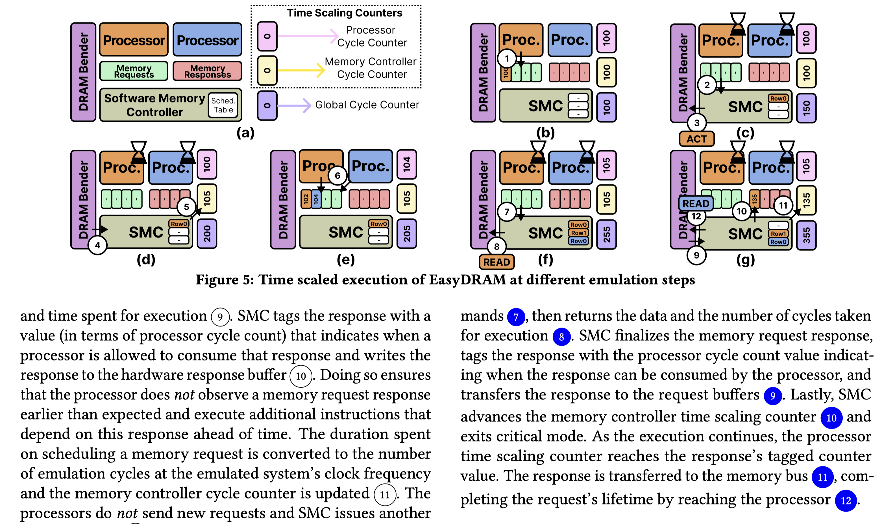
EasyDRAM with Time Scaling
https://arxiv.org/pdf/2506.10441
Programmable Mem. Ctrl.
Request Q.
CPU Core
Scheduler
R2
2
additional memory requests do not change scheduling decisions
Request1
Request2
time (cpu clock cycles)
Notes:
I have to leave you with this much about Time Scaling. A more detailed example that accurately describes Time Scaling is in the paper.

Slide 62
Time Scaling is Validated (I)
Use a two-level approach
1
RTL simulation of EasyDRAM
2
Memory latency profile comparison to a real system
Notes:
I’ll say that we validated Time Scaling using a two level approach whereby we perform RTL simulations and also compare EasyDRAM’s memory latency profile to a real system

Slide 63
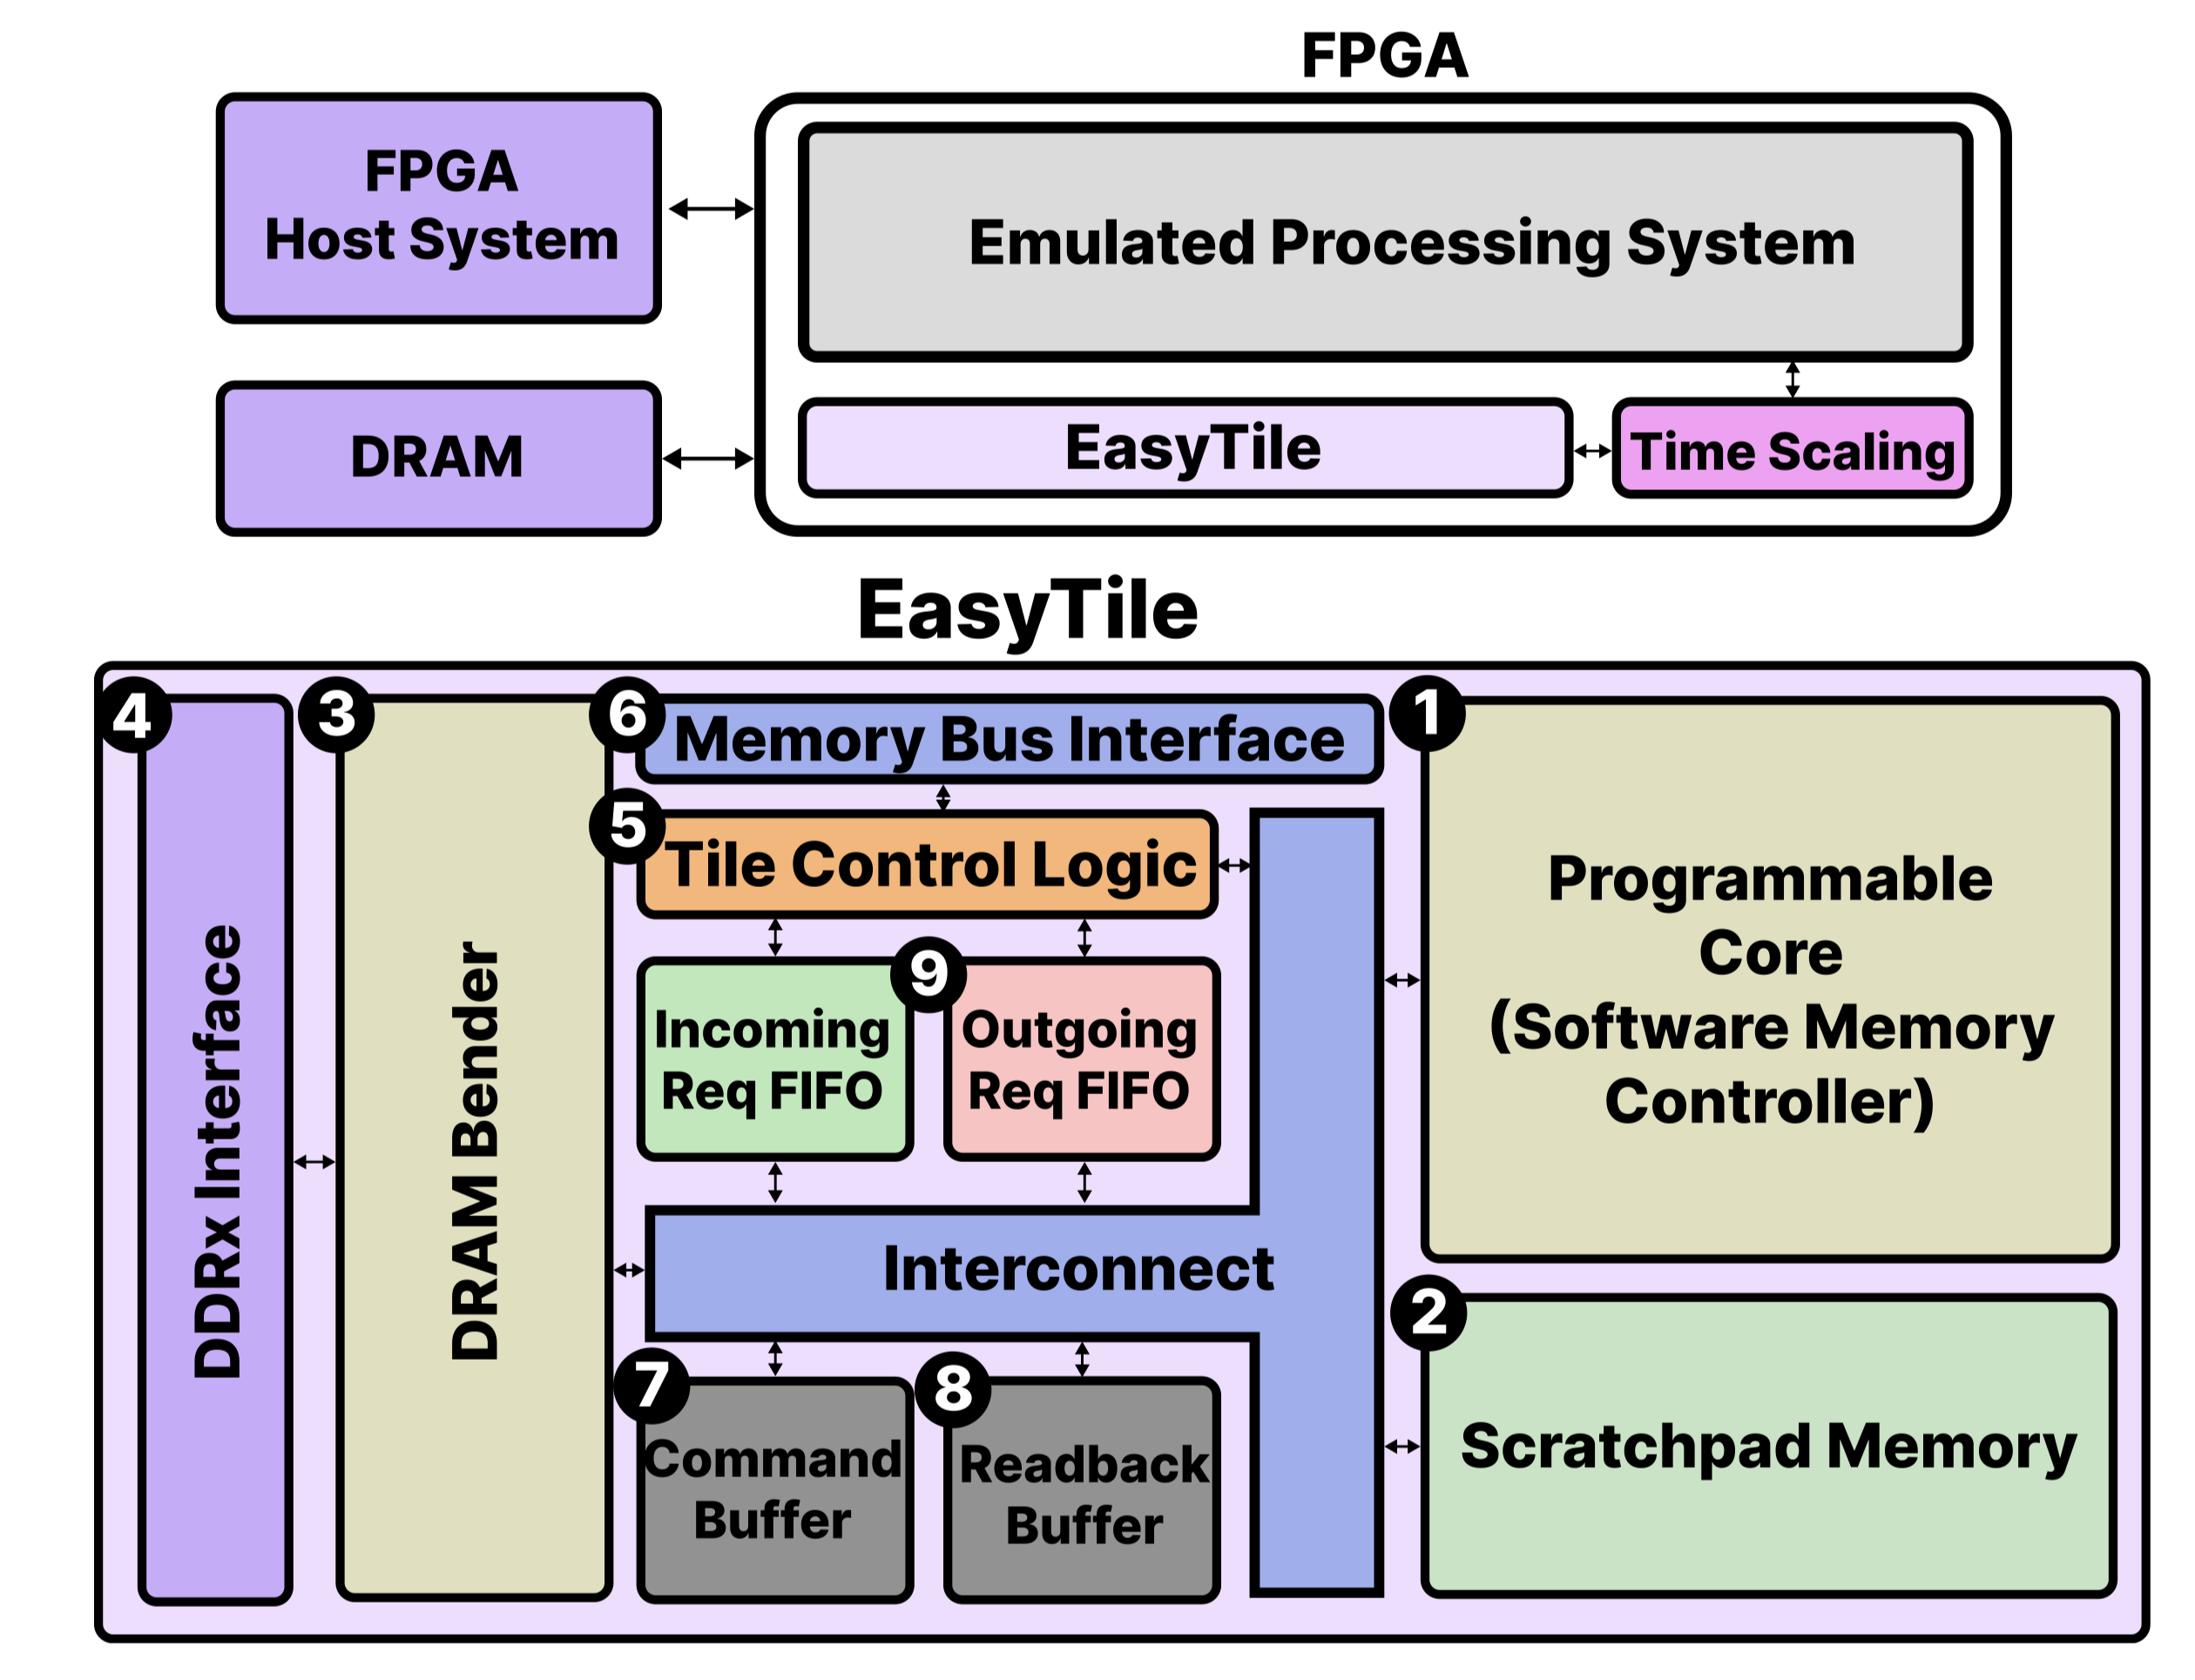
EasyDRAM Implementation
https://arxiv.org/pdf/2506.10441
Notes:
But before then, I’ll quickly show this. This is EasyDRAM’s system diagram.
[Point to EasyTile] this EasyTile is what encompasses all key ideas that I described so far. It is integrated into a RISC-V based processing system in the FPGA.
[CLICK] Please find the detailed descriptions of these components in the paper if you are interested.

Slide 64
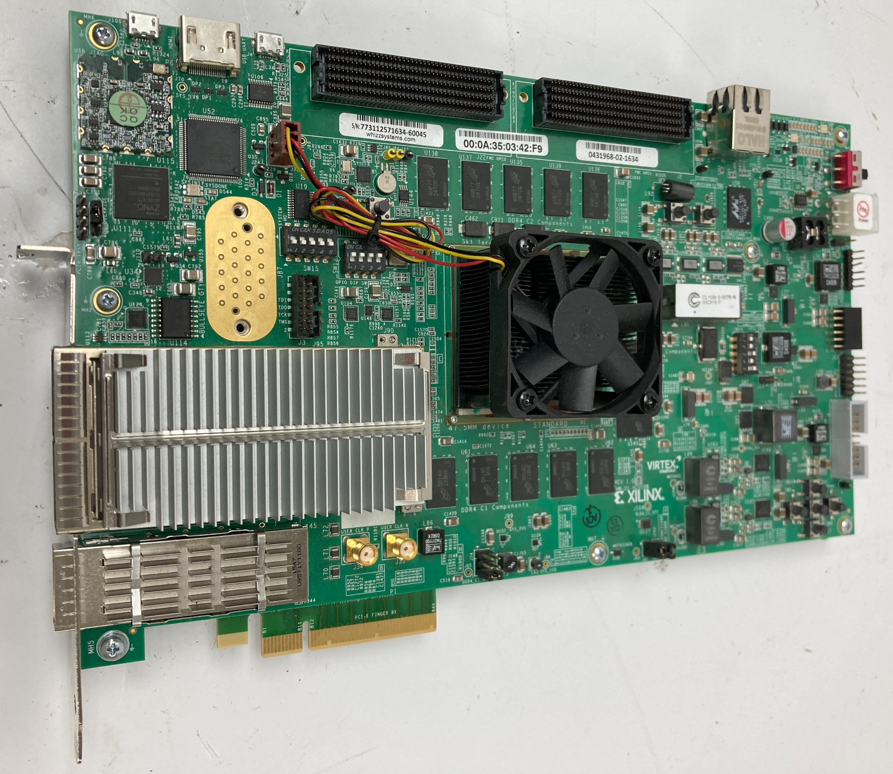
EasyDRAM’s FPGA Prototype
Full system prototype on Xilinx VCU108 FPGA board
RISC-V System: Out-of-order Boom Core in Rocket Chip with 512 KiB L2 cache
Real DDR4 DRAM: Micron EDY4016AABG-DR-F-D, 4 GiB, 1,333 MT/s
Notes:
The EasyDRAM system is prototyped on the Xilinx VCU108 FPGA board
[CLICK] It has an out-of-order core with 512 kilobytes of L2 cache
[CLICK] and a rank of DDR4 chips that we perform DRAM techniques on

Slide 65
Time Scaling is Validated (II)
Use a two-level approach
1
RTL simulation of EasyDRAM
RTL simulation: core clocked at 1 GHz + No Time Scaling
EasyDRAM: core clocked at 100 MHz + Time Scaling
EasyDRAM’s w/ Time Scaling execution time
within 0.1% of that of RTL simulation average across 29 microbenchmarks
Notes:
OK now I can go back to time scaling validation. [CLICK] We look at two systems:
First, we cycle-accurately simulate EasyDRAM’s RTL (it’s hardware design) that implements a 1 GHz processor.
Second, using the FPGA board I showed in the previous slide we implement an EasyDRAM design with a 100 MHz processor Time Scaled to simulate a 1 GHz processor.
[CLICK] We execute 29 polybench and lmbench workloads in both systems and see that their execution time deviate on average by 0.1% across all workloads.
====
Why 1 GHz? Just an arbitrary choice. You can use the open source repo to confirm that not much changes at higher clock frequencies (that’s what we expect).

Slide 66
Time Scaling is Validated (III)
2
NVIDIA Jetson Nano SoC (ARM Cortex A57 CPU)
Configure EasyDRAM to match the SoC system
Compare memory latency profile to EasyDRAM
Notes:
We also configure an EasyDRAM [CLICK] system to mimic this Nvidia Jetson Nano SoC [CLICK] and compare EasyDRAM’s memory latency profile to the Jetson Nano SoC.

Slide 67
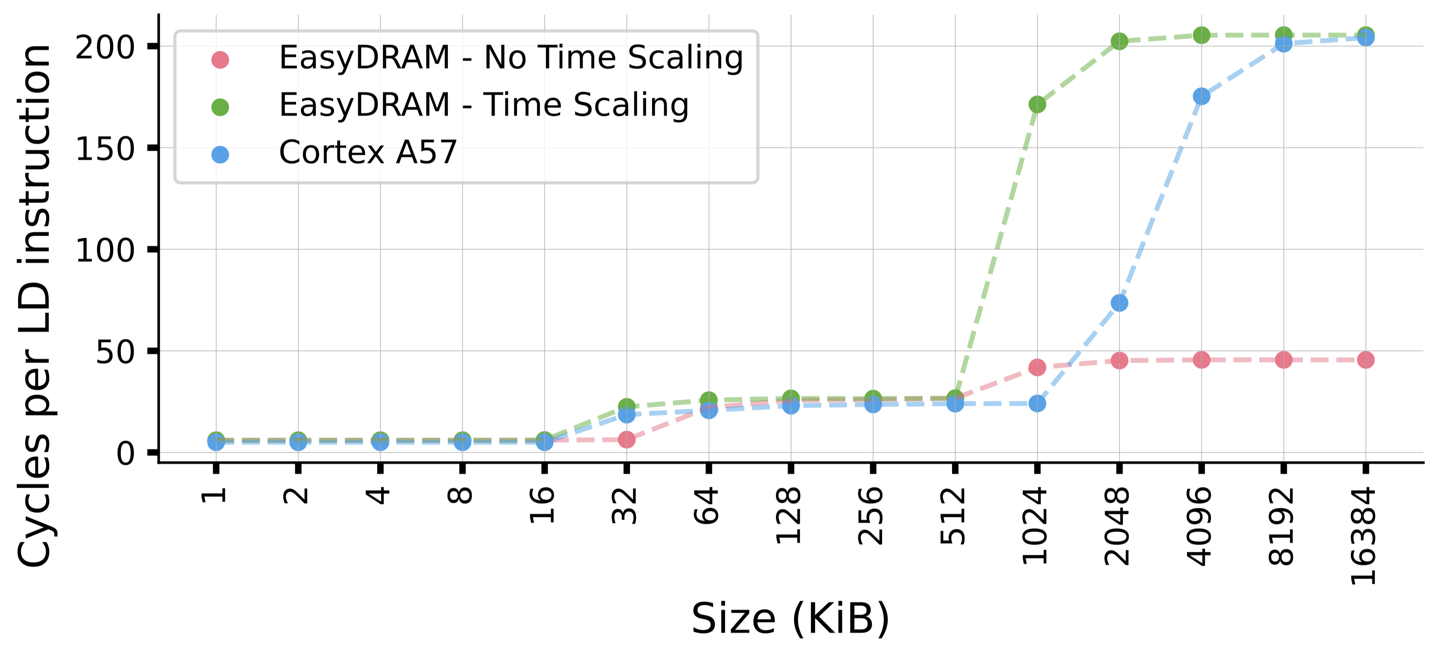
Time Scaling is Validated (III)
2
NVIDIA Jetson Nano SoC (ARM Cortex A57 CPU)
Configure EasyDRAM to match the SoC system
Compare memory latency profile to EasyDRAM
Notes:
Here the y-axis shows the average cycles it takes to execute a load instruction for a streaming memory access pattern to an array with size depicted on the x-axis

Slide 68
Time Scaling is Validated (III)
2
NVIDIA Jetson Nano SoC (ARM Cortex A57 CPU)
Configure EasyDRAM to match the SoC system
Compare memory latency profile to EasyDRAM
EasyDRAM with Time Scaling exhibits similar latency profile to the Cortex A57 system
Notes:
This is what memory access latency curves look like for EasyDRAM with no time scaling, EasyDRAM with Time Scaling and the Cortex A57 (that is the Nvidia Jetson) system.
[CLICK] We observe that EasyDRAM with Time Scaling exhibits a similar latency profile to the Cortex system, as opposed to EasyDRAM with no Time Scaling.

Slide 69
Talk Outline
Background
Motivation
EasyDRAM
Case Studies
Conclusion
Notes:
That’s it for EasyDRAM design. Now I’ll talk about the two case studies we conducted.

Slide 70
Two Case Studies
Realistic performance evaluations of
1
In-DRAM Row Copy (RowClone)
2
DRAM Access Latency Reduction
Notes:
These are realistic performance evaluations of in-DRAM row copy and [CLICK] DRAM access latency reduction

Slide 71
Two Case Studies
Realistic performance evaluations of
1
In-DRAM Row Copy (RowClone)
2
DRAM Access Latency Reduction
Notes:
I’ll start with the first one

Slide 72
Recall: RowClone Key Idea
s
r
c
r
o
w
s
d
s
r
c
t
r
r
o
o
w
w
s
r
c
r
o
w
Sense Amplifiers

1. Source row to sense amplifiers
?
2. Sense amplifiers to destination row
[Seshadri+ MICRO’13]
Notes:
Recall that the key idea of RowClone is to move data between DRAM rows without taking the data outside the subarray it belongs to

Slide 73
RowClone in Real DRAM Chips
Key Idea: Use carefully created DRAM command sequences
ComputeDRAM [Gao+, MICRO’19] demonstrates in-DRAM copy operations in real DDR3 chips
ACT → PRE → ACT command sequence with greatly reduced DRAM timing parameters
ACT S
PRE
ACT D
Standard DRAM Timings
“activate row S, precharge, then activate row D”
ACT S
PRE
ACT D
Violated DRAM Timings
“activate row S, then activate row D”
Notes:
We can perform RowClone in real DRAM chips. We rely on carefully constructed DRAM command sequences demonstrated first by
[CLICK] the ComputeDRAM paper in real DDR3 chips.
[CLICK] We send an <ACTivate precharge activate> command sequence with greatly violated DRAM timing parameters
[Animate and describe the rest]

Slide 74
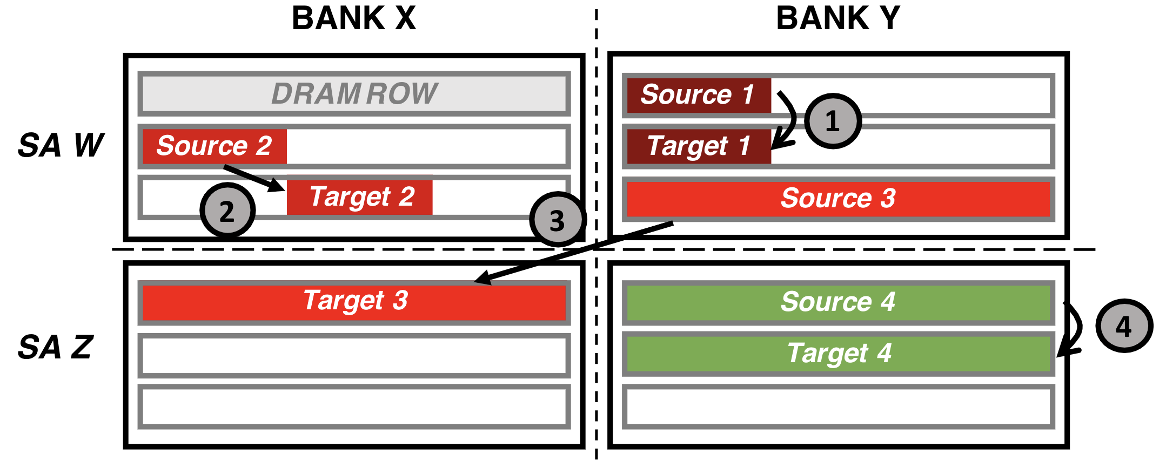
RowClone Memory Allocation Constraints
Notes:
RowClone has some memory allocation constraints that has implications for software.
Here we show a sketch of two DRAM banks X and Y and subarrays W and Z .

Slide 75
RowClone Memory Allocation Constraints
Notes:
This is one source target operand combination that cannot be RowClone’d

Slide 76
RowClone Memory Allocation Constraints
Notes:
Here are two others

Slide 77
RowClone Memory Allocation Constraints
Memory allocation that works for RowClone
4
Notes:
And finally this fourth allocation works for RowClone. That is to say that the source and target operands each occupy a DRAM row in the same subarray in the same bank.

Slide 78
RowClone Implementation
Initialization/one-time cost to find reliable source-target row pairs for RowClone
Source Row Address
Target Row Address
Increment Target Row Address
x1000
RowClone Source → Target
Failure
Success
Fail if any of 1,000 repetitions incorrectly copy source to target
Store address pair in a table
Repeated for all source row addresses in the DRAM bank
Notes:
To identify row address pairs that can reliably perform RowClone operations, we use a simple one-time characterization step
[CLICK] We have the source and target row address initially set to 0
[CLICK] we perform a rowclone operation from the source to target 1K times
[CLCIK] if any attempt fails, we increment the target row address and try again
[CLICK] if all attempts succeed, this is a reliable source-target row pair
[CLICK] we repeat this for all source row addresses in the DRAM bank. There are methods to reduce this one-time overhead, I’ll be happy to take questions about them.

Slide 79
RowClone Evaluation
Evaluated system configurations
EasyDRAM – No Time Scaling
EasyDRAM – Time Scaling
Ramulator 2.0 (configured to model EasyDRAM’s system)
Workloads
Copy: Copy N-bytes from source array to target array
Init: Initialize an N-byte array with data
CPU version: Use load/store instructions
RowClone version: Use in-DRAM row copy
RowClone – No Flush: Data is up to date in DRAM (no cached copies)
RowClone – CLFLUSH: Cached data must be flushed/invalidated to DRAM
Notes:
We evaluate RowClone using EasyDRAM with and without Time Scaling.
[CLICK] We also use Ramulator 2 to faithfully model EasyDRAM’s system.
[CLICK] We use two microbenchmarks that copy and [CLICK] initialize N-byte arrays
[CLICK] The CPU version uses load/store instructions and RowClone version uses in-DRAM row copy operations
[CLICK] and we evaluate two RowClone variants

Slide 80
RowClone Evaluation
Evaluated system configurations
EasyDRAM – No Time Scaling
EasyDRAM – Time Scaling
Ramulator 2.0 (configured to model EasyDRAM’s system)
Workloads
Copy: Copy N-bytes from source array to target array
Init: Initialize an N-byte array with data
CPU version: Use load/store instructions
RowClone version: Use in-DRAM row copy
RowClone – No Flush: Data is up to date in DRAM (no cached copies)
RowClone – CLFLUSH: Cached data must be flushed/invalidated to DRAM
Notes:
We’ll see results for Copy using No Flush where we assume data is up to date in DRAM.

Slide 81
RowClone Evaluation
Evaluated system configurations
EasyDRAM – No Time Scaling
EasyDRAM – Time Scaling
Ramulator 2.0 (configured to model EasyDRAM’s system)
Workloads
Copy: Copy N-bytes from source array to target array
Init: Initialize an N-byte array with data
CPU version: Use load/store instructions
RowClone version: Use in-DRAM row copy
RowClone – No Flush: Data is up to date in DRAM (no cached copies)
RowClone – CLFLUSH: Cached data must be flushed/invalidated to DRAM
https://arxiv.org/pdf/2506.10441
Notes:
For bulk data initialization and RowClone with CLFLUSH, I refer you to our paper.

Slide 82
Key Takeaways
Takeaway 1
DRAM technique evaluation platforms that do not faithfully model a modern processor report high benefits in favor of DRAM techniques
Takeaway 2
RowClone (still) significantly improves performance when compared to a modern CPU baseline
Notes:
We have two key takeaways from this study.
First is that DRAM technique evaluation platforms who do not faithfully model a modern processor report high benefits in favor of DRAM techniques
[CLICK] and RowClone still significantly improves performance when compared to a modern CPU baseline

Slide 83
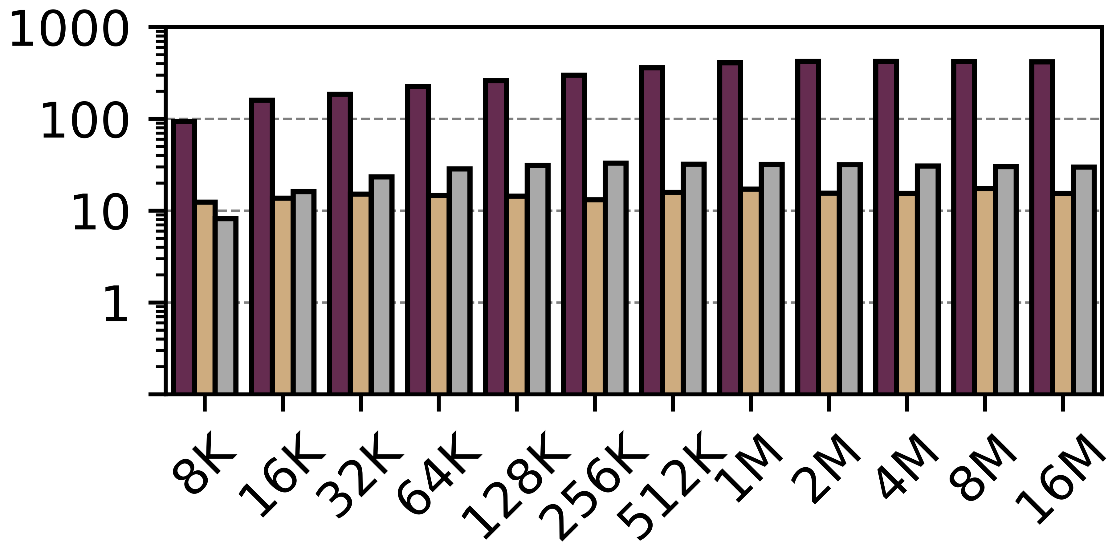
Execution Time (RowClone – No Flush)
RowClone-Copy Speedup Normalized to CPU-Copy
Notes:
This figure shows RowClone-Copy speedup normalized to CPU-Copy over…

Slide 84
Execution Time (RowClone – No Flush)
RowClone-Copy Speedup Normalized to CPU-Copy
Notes:
Varying copied array sizes on the x-axis

Slide 85
Execution Time (RowClone – No Flush)
RowClone-Copy Speedup Normalized to CPU-Copy
Notes:
We show three bars, from left to right EasyDRAM without time scaling, EasyDRAM with time scaling, and Ramulator 2.0.

Slide 86
Execution Time (RowClone – No Flush)
RowClone-Copy Speedup Normalized to CPU-Copy
Notes:
This is the full plot.

Slide 87
Execution Time (RowClone – No Flush)
RowClone-Copy Speedup Normalized to CPU-Copy
EasyDRAM – No Time Scaling demonstrates 307x (423x) average (maximum) speedup across tested array sizes
Notes:
EasyDRAM without time scaling demonstrates a very high speedup for RowClone over CPU copy.
This is in line with the results of a state-of-the-art DRAM technique evaluation platform, PiDRAM.

Slide 88
Execution Time (RowClone – No Flush)
RowClone-Copy Speedup Normalized to CPU-Copy
EasyDRAM –Time Scaling demonstrates 15.0x (17.4x) average (maximum) speedup across tested array sizes
Notes:
EasyDRAM **with** Time Scaling, demonstrates a smaller but still significantly high speedup: 15.0x across all tested array sizes.

Slide 89
Execution Time (RowClone – No Flush)
RowClone-Copy Speedup Normalized to CPU-Copy
Ramulator 2.0 demonstrates 27.2x (33.0x) average (maximum) speedup across tested array sizes
Notes:
Ramulator2.0 shows results more similar to EasyDRAM with time scaling. We attribute the difference between Ramulator 2.0 and EasyDRAM to differences in their system configurations. Please read the paper if you are interested and I’d be happy to answer any questions you have on this.
===
Say that you compare to ramulator in simulation speed as well

Slide 90
Key Takeaways
Takeaway 1
DRAM technique evaluation platforms that do not faithfully model a modern processor report high benefits in favor of DRAM techniques
Takeaway 2
RowClone (still) significantly improves performance when compared to a modern CPU baseline
Notes:
Our major results yield these two takeaways.

Slide 91
Two Case Studies
Realistic performance evaluations of
1
In-DRAM Row Copy (RowClone)
2
DRAM Access Latency Reduction
Notes:
That’s it for RowClone

Slide 92
Two Case Studies
Realistic performance evaluations of
1
In-DRAM Row Copy (RowClone)
2
DRAM Access Latency Reduction
Notes:
Now we move onto DRAM Access Latency Reduction

Slide 93
DRAM Access Latency Reduction: Key Idea
Stronger cells can be reliably accessed with a reduced t_{RCD}
wordline
Strong
(fast)
V_{dd}
access
transistor
V_{min}
Weak
(slow)
Ready to Access
Voltage Level
bitline
Bitline Voltage
capacitor
SA
0.5 V_{dd}
Time
ACTIVATE
SA Enable
READ
t_{RCD}
[Kim+ HPCA’18]
Notes:
You remember from this figure I showed earlier that we can reduce tRCD and reliably access strong cells.

Slide 94
Solar-DRAM: Variable Latency Cache Lines (VLC)
Weak bitline
Strong bitline
Cache line
…
Row Decoder
…
…
…
…
Strong subarray
column
Local Row Buffer
Identifies subarray columns comprised of strong bitlines
Access cache lines in strong subarray columns with a reduced t_{RCD}
[Kim+ ICCD’18]
Notes:
We implement Solar-DRAM’s variable latency cache lines in EasyDRAM.
[CLICK] For each subarray, we identify local bitlines as [CLICK] weak or [CLICK] strong. VLC [CLICK] identifies cache lines fully comprised of strong bitlines and [CLICK] accesses such cache lines with a reduced tRCD.

Slide 95
SolarDRAM VLC Implementation
Storing the minimum t_{RCD} value of all cache lines is not scalable
64M such cache lines in a 4 GiB module
Reduce storage overhead
Use t_{RCD} of weakest cache line in a row for that row
Factor of 128 storage reduction
Use storage-efficient Bloom filter to store weak row IDs
not found
Use low tRCD
Bloom Filter
Row address
contains
Use high tRCD
Notes:
Storing the minimum tRCD value of all cache lines in a DRAM module is not scalable because there are so many of those.
[CLICK] To reduce storage overhead, we use the tRCD of the weakest cache line in a row to identify the tRCD for all cache lines in that row
[CLICK] and use storage-efficient bloom filters to store weak row IDs
[CLICK] the memory controller looks up the row id in the bloom filter [CLICK] if the row is not in the bloom filter we use a low tRCD,
If [CLICK] the row is in the bloom filter, we use a higher tRCD value
====
How big is the Bloom filter?

Slide 96
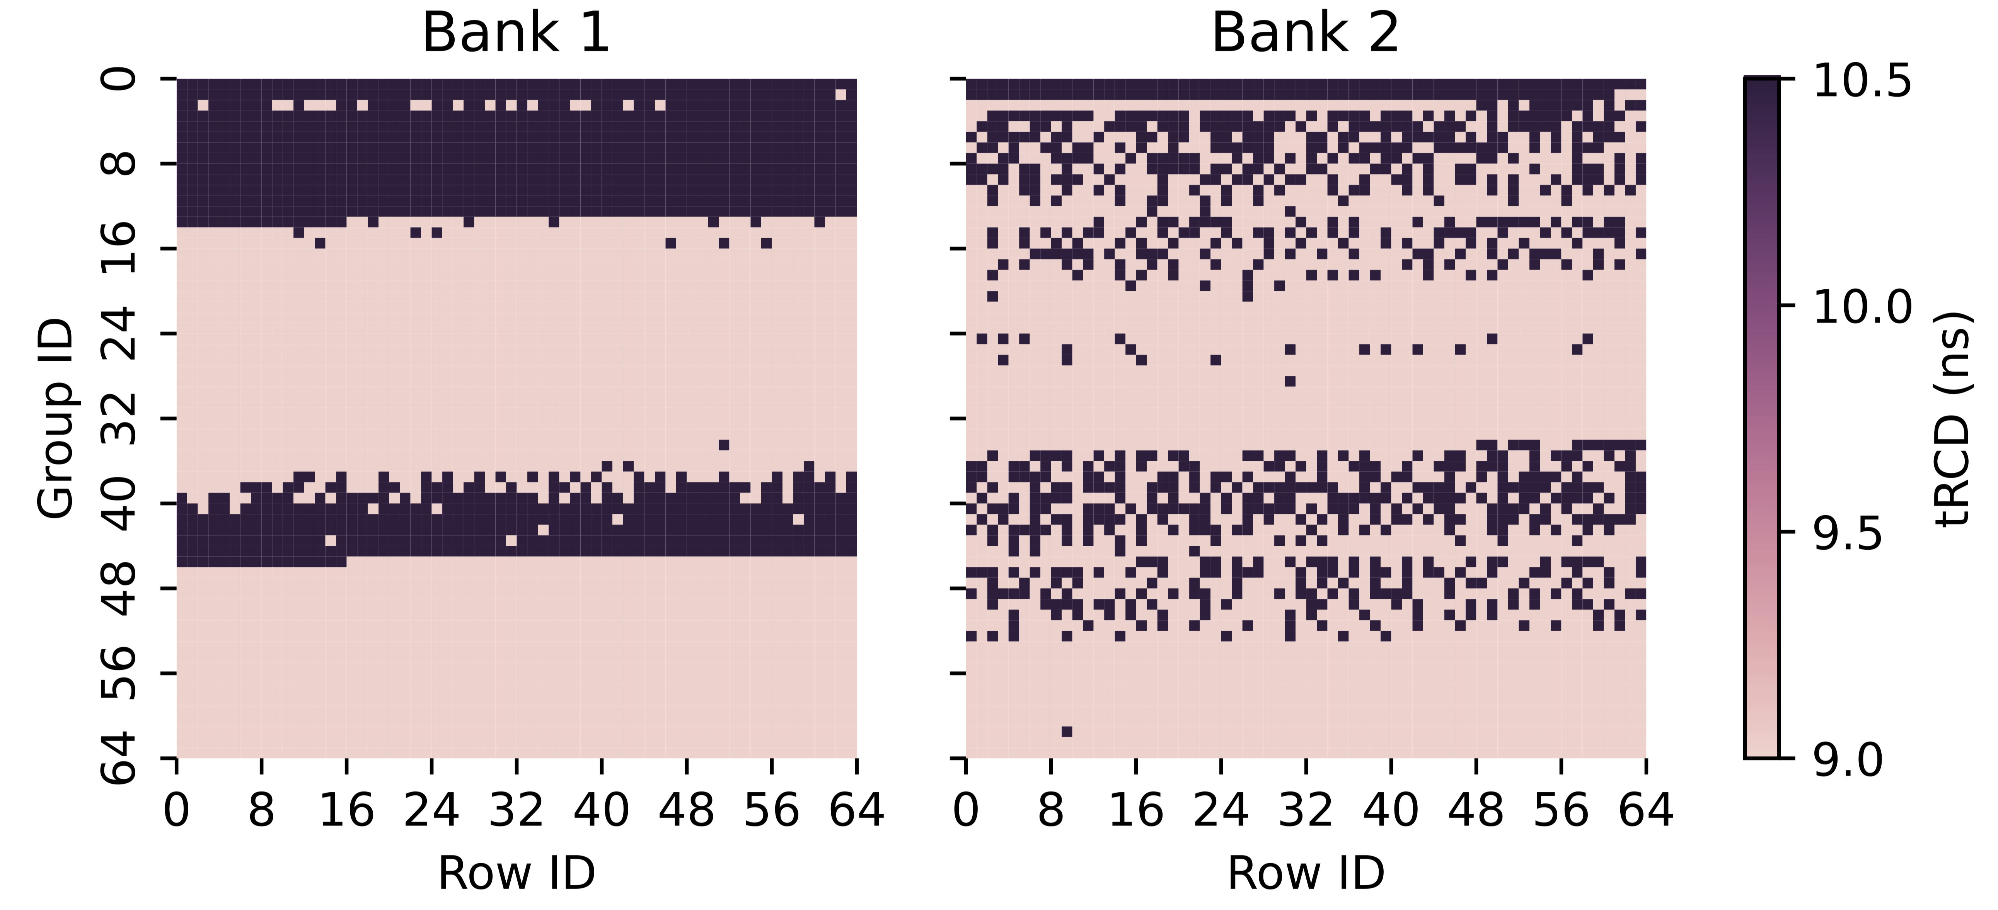
EasyDRAM VLC Profile
Characterize 4K DRAM rows in 2 banks for access latency failures
Nominal t_{RCD} for our module is 13.5 ns
Notes:
Let’s now see what is low and what is high tRCD.
We identify the minimum reliable tRCD for each row in the first 4K rows of two banks in DDR4 rank of chips (this slide refers to it as a module). The tRCD for this module is 13.5 nanoseconds.
[CLICK] We show the distribution of tRCD values across rows on both y and x-axes here. Group ID determines the group of 64 rows, so as we move right and down in each figure the row IDs increase.

Slide 97
EasyDRAM VLC Profile
Characterize 4K DRAM rows in 2 banks for access latency failures
Nominal t_{RCD} for our module is 13.5 ns
Notes:
This is the full plot

Slide 98
EasyDRAM VLC Profile
All cache lines reliably operate at < nominal tRCD
The fraction (84.5%) of “stronger” cache lines (t_{RCD} = 9.0 ns) far exceed that of “weaker” cache lines (t_{RCD} = 10.5 ns)
Notes:
We observe that [CLICK] all cache lines reliably operate at a tRCD value smaller than nominal tRCD
[CLICK] and we see that a large fraction of the rows have “stronger” cache lines (those that we can reliably access in 9 nanoseconds) than “weaker” cache lines (and those that take 10.5 nanoseconds to access reliably).

Slide 99
SolarDRAM Evaluation
Evaluated system configurations
EasyDRAM – Time Scaling
Ramulator 2.0 (configured to model EasyDRAM’s system)
PolyBench workload suite
Executed end-to-end in EasyDRAM
First 500M instructions executed for Ramulator 2.0
Notes:
We use EasyDRAM with Time Scaling and Ramulator 2 that models EasyDRAM’s system.
[CLICK] We evaluate workloads from the PolyBench suit end to end in EasyDRAM and the first 500M instructions of them in Ramulator 2.

Slide 100
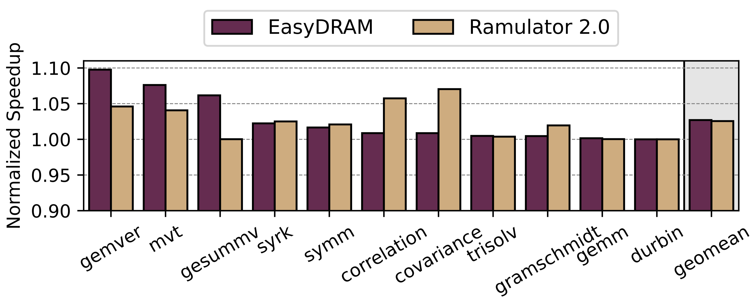
SolarDRAM Results
Notes:
Here we show the speedup of SolarDRAM normalized to a system that use the nominal 13.5 nanosecond tRCD over various workloads on x-axis.
Say what this is normalized to: respective baseline systems that use just nominal tRCD

Slide 101
SolarDRAM Results
Notes:
The bar on the left shows the end-to-end speedup we measure on EasyDRAM and the bar on the right shows the one we measure for Ramulator 2 using the first 500 M instructions.

Slide 102
SolarDRAM Execution Time
SolarDRAM improves system performance by 2.8% (9.8%) on average (maximum) across tested workloads
Benefits expected to increase with memory intensity
Notes:
This is the full plot.
[CLICK] We observe that SolarDRAM improves performance by 2.8% on average across all tested workloads. We see that the improvement reported by EasyDRAM and Ramulator2 is within the same range of values across all workloads and similar on average.
[CLICK] These benefits are reasonable given the memory intensity of the evaluated workloads. We expect the benefits to increase with memory intensity and latency-sensitivity.

Slide 103
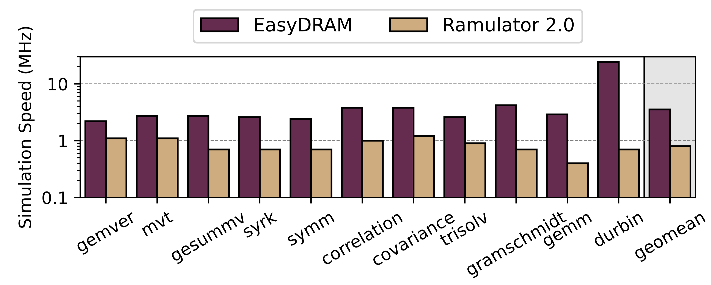
SolarDRAM Simulation Time
Average (maximum) simulation speed 5.9x (20.3x) faster than Ramulator 2.0
Notes:
We also look at how fast EasyDRAM and Ramulator takes to evaluate their portions of the workloads.
[CLICK] We observe that EasyDRAM is considerably faster than Ramulator 2.
====
EasyDRAM has additional benefits: And say that EasyDRAM evaluates a real system and a real DRAM chip

Slide 104
Talk Outline
Background
Motivation
EasyDRAM
Case Studies
Conclusion
Notes:
I’ll conclude my talk with a brief summary

Slide 105
EasyDRAM Conclusion
EasyDRAM
Easy to use FPGA-based infrastructure to accurately evaluate DRAM techniques
Easy to use (C++) programmable memory controller
Time Scaling for accurate evaluation
We conduct two case studies to showcase EasyDRAM’s ease of use and ability to accurately evaluate DRAM techniques
In-DRAM row copy (RowClone)
DRAM access latency reduction (SolarDRAM)
We hope EasyDRAM enables innovative ideas in memory system design to rapidly come to fruition
Notes:
We developed an easy to use FPGA-based infrastructure to accurately evaluate DRAM techniques
[CLICK] EasyDRAM relies on a C++ programmable memory controller and the time scaling technique to provide its goals.
[CLICK] We showcased EasyDRAM’s abilities using in-DRAM row copy and DRAM access latency reduction case studies
[CLICK] Moving forward, we hope that EasyDRAM enables innovative ideas in memory system design to rapidly come to fruition.

Slide 106
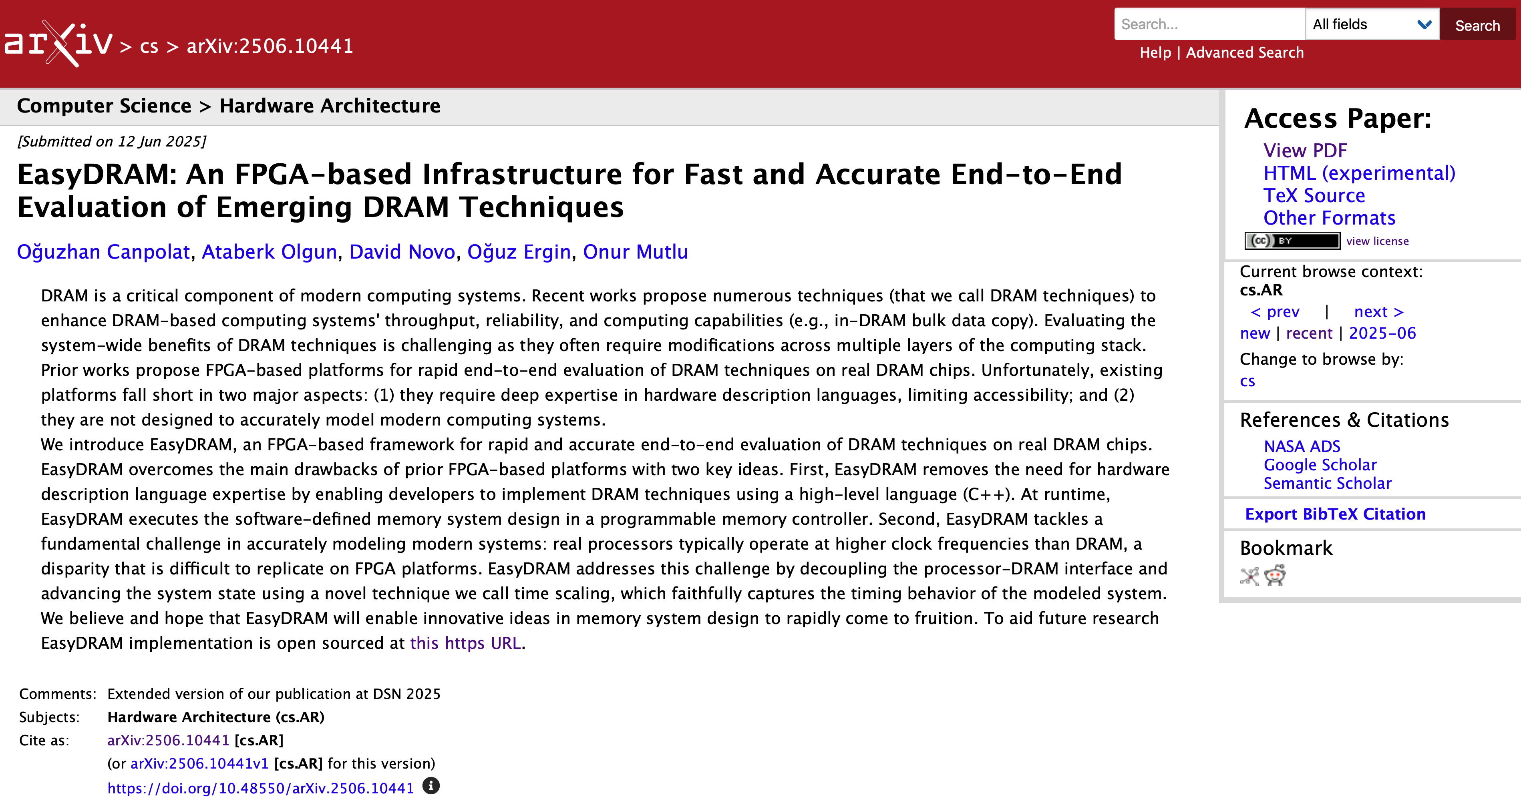
Extended Version on arXiv
https://arxiv.org/pdf/2506.10441
Notes:
An extended version of our conference paper is on arXiv.

Slide 107
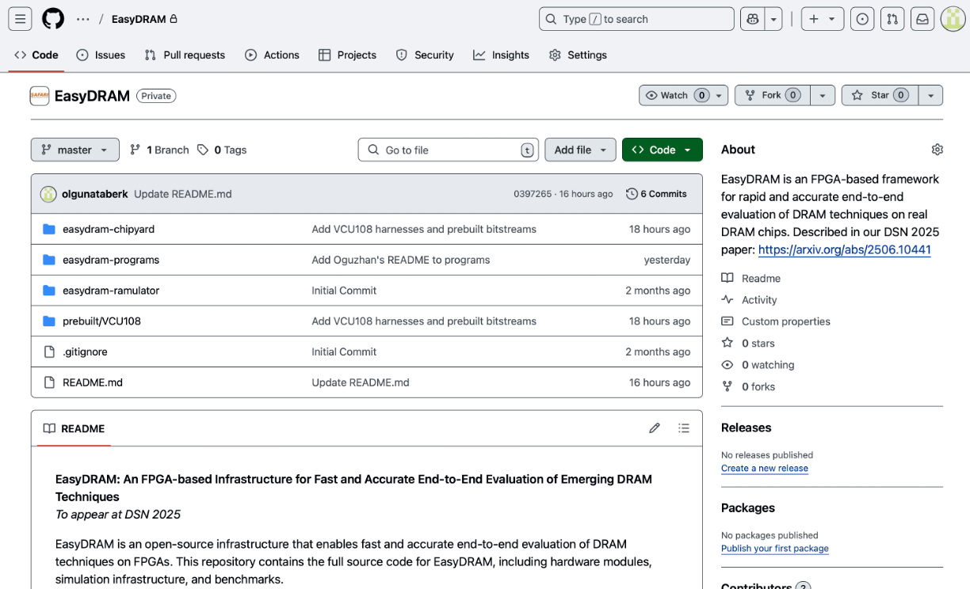
EasyDRAM is Open Source
https://github.com/CMU-SAFARI/EasyDRAM
Notes:
EasyDRAM is completely open sourced and you can find it at this link

Slide 108
EasyDRAM An FPGA-based Infrastructure for Fast and Accurate End-to-End Evaluation of Emerging DRAM Techniques
Oğuzhan Canpolat Ataberk Olgun David Novo Oğuz Ergin Onur Mutlu
https://arxiv.org/abs/2506.10441
Notes:
Thank you for listening. I’ll be happy to take any questions now.

Slide 109
EasyDRAM Backup Slides

Slide 110
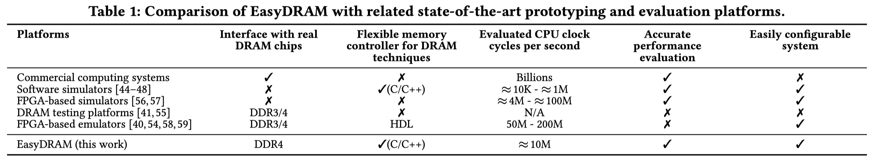
EasyDRAM vs. Other Platforms

Slide 111
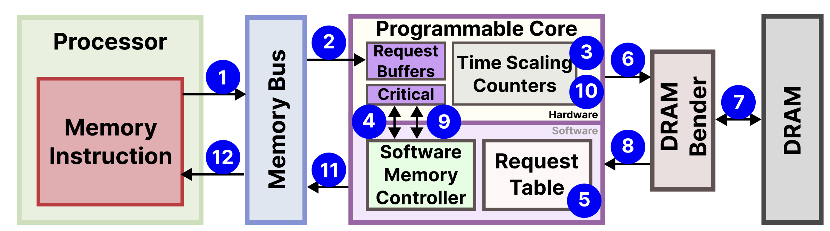
Lifetime of a Memory Request

Slide 112
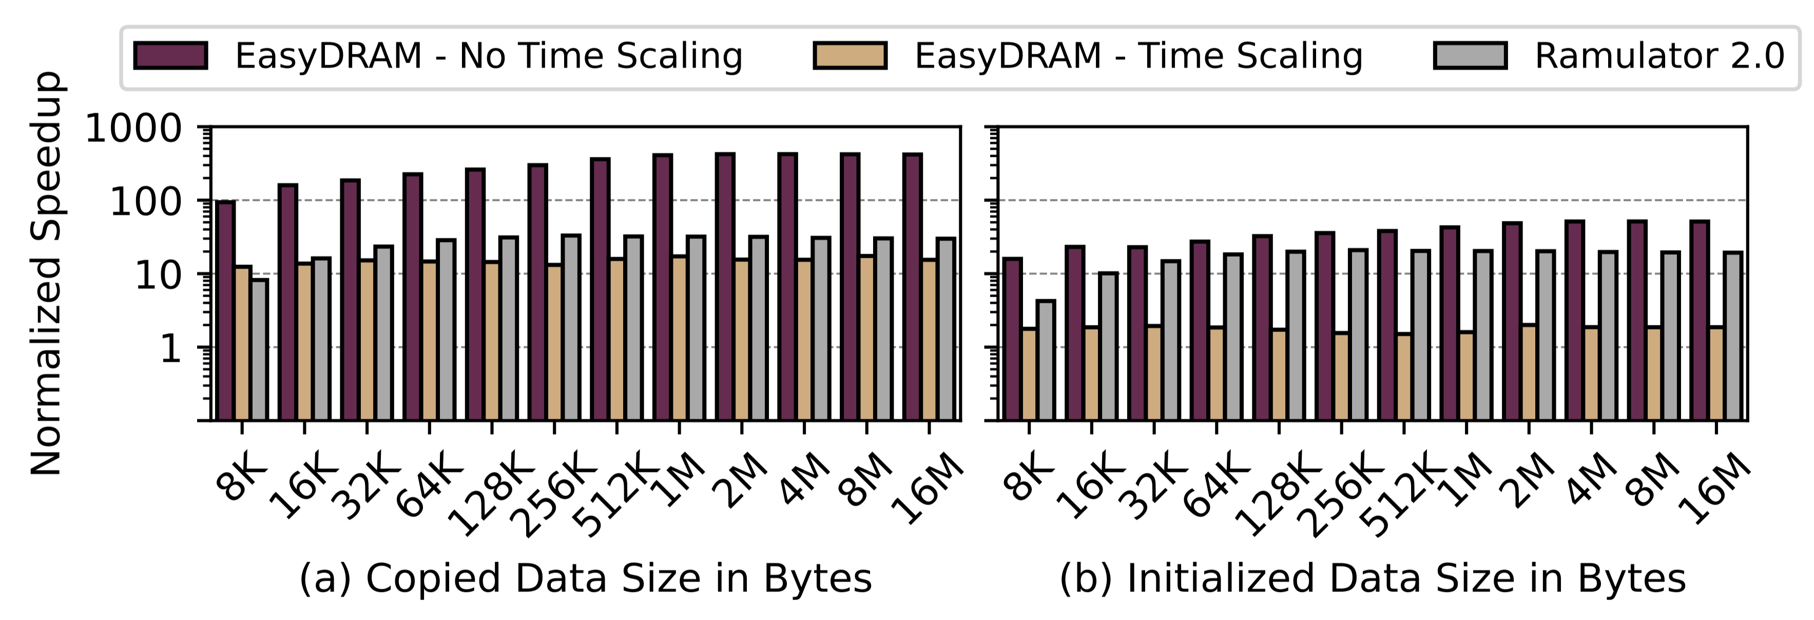
RowClone and Init – No Flush

Slide 113
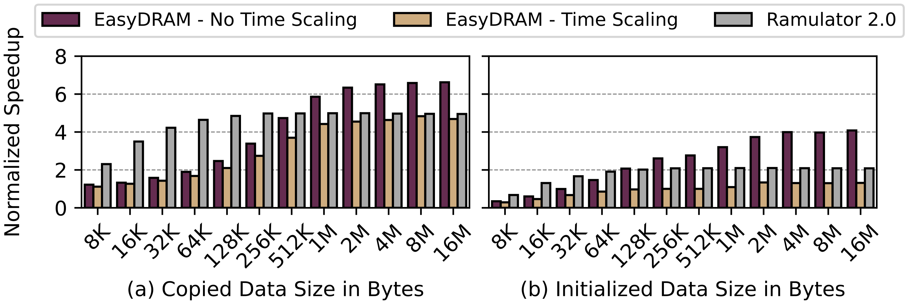
RowClone and Init – CLFLUSH

Slide 114
How Does a Program Issue RowClone Operations?
We use memory-mapped registers and an internal DRAM technique instruction encoding

Slide 115
HLS vs. EasyDRAM Programmable Memory Controller
HLS still defines hardware
There will come a time for you to reason about hardware design
You can still build the programmable memory ctrl. using HLS
Not a replacement for the programmable memory controller

Slide 116
Why not use the hard ARM core in the FPGA?
Good idea
Does not complement EasyDRAM as a whole
+ Higher performance core
Not in every FPGA

Slide 117
What is new?
EasyDRAM as a tool is new
Reproduction of prior results
This platform allows users to easily prototype fault tolerant DRAM technique implementations
Reliability – performance tradeoff for DRAM
Typically abstracted away by the DRAM standard
System designers can make conscious design decisions to extract the most performance out of their memory systems

