Slide 1




Revisiting Main Memory-Based Covert and Side Channel Attacks in the Context of Processing-in-Memory
F. Nisa Bostancı K. Kanellopoulos
A. Olgun A. G. Yaglikci I. E. Yuksel
N. Mansouri Ghiasi Z. Bingol M. Sadrosadati O. Mutlu

Slide 2
Executive Summary
Motivation: Processing-in-Memory (PIM) architectures alleviate data movement bottleneck by bringing computation closer to where data resides and are being adopted in real products
Problem: No prior work analyzes and evaluates the security of PIM architectures against timing side and covert channel attacks
Key Observation: PIM architectures create opportunities for critical main memory-based timing attacks due to two reasons:
PIM provides direct main memory access, a key building block for high-throughput attacks
Defenses against these attacks are highly costly or inapplicable to PIM architectures
IMPACT: a set of high-throughput In-Memory Processing-based timing Attacks that leverage direct and fast main memory accesses enabled by PiM architectures. IMPACT:
eliminates expensive cache bypassing steps used in main memory-based timing attacks
leverages the intrinsic parallelism of PIM operations
Case Studies:
Two high-throughput covert channel attacks leveraging different PIM architectures
A side-channel attack that leaks private information of concurrently running victim applications with low error rate
Mitigating IMPACT: We discuss and evaluate four different countermeasures against IMPACT, eventually concluding that mitigating IMPACT incurs high performance overheads
https://github.com/CMU-SAFARI/IMPACT
Notes:
This highlights the need for low-cost mitigations against IMPACT for robust future systems

Slide 3
Outline
Motivation and Problem
Key Observation
IMPACT
Mitigating IMPACT
Conclusion

Slide 4

Data Movement Bottleneck
Today’s computing systems are processor centric
All data is processed in the processor → at great system cost
Computing Unit
(CPU, GPU, FPGA, Accelerators)
Main Memory
(DRAM)
Memory
Channel
More than 60% of the total system energy is spent on data movement¹
¹ A. Boroumand et al., “Google Workloads for Consumer Devices: Mitigating Data Movement Bottlenecks,” ASPLOS'18
Notes:
Today's computing systems are processor centric,
Which means that all data is processed in the processor at great system cost
by first fetching the data to the computing unit,
then doing the computation to get the results, finally writing back the results to the main memory
This leads to spending more than 60% of the total system energy on data movement

Slide 5
Processing-In-Memory (PIM)
Two main approaches for Processing-In-Memory:
1
Processing-Near-Memory: PIM logic is added near the memory arrays or to the logic layer of 3D-stacked memory
2
Processing-Using-Memory: uses the analog operational principles of memory cells to perform computation
DRAM (e.g., 3D-Stacked Memory)
DRAM Bank
Vault
Controller
Processing-
Using-DRAM
DRAM Vault
…
PHY
Processing-Near-Vault
…
Processing-Near-Bank
Notes:
Processing-in-Memory architectures alleviate data movement bottlenecks by moving computation to where the data resides. Such architectures can be implemented
[CLICK] by adding logic near the memory arrays, in what is called processing-near-memory or
[CLICK] by using the analog operating principles of the memory cells to perform computation, in what is called processing-using-memory

Slide 6
Problem
A set of PIM techniques are already implemented in real products
and many more are expected to be adopted
No prior work analyzes and evaluates the security of emerging PIM architectures against timing covert- and side-channel attacks
Notes:
A set of PIM techniques are already implemented in real products
Some of which are shown here
And many more are expected to be adopted in the near future
Therefore, it is important to investigate the security aspects of such techniques and implement countermeasures to avoid potential widespread security vulnerabilities that their deployment can cause.
However, no prior work analyzes and evaluates the security of emerging PIM architectures
Against timing covert- and side-channel attacks.

Slide 7
Main Memory-Based Timing Channels
The attacker exploits the shared main memory states
An example: DRAM row buffer-based attacks [Pessl+, USENIX Sec'14]
DRAM Bank
close
R
O
W
A
open
open
R
O
W
B
R
R
O
O
W
W
A
B
Row Buffer
An access to an open row is served from the row buffer with lower latency
An access to any other row is served with higher latency
Notes:
Changing the memory system architecture requires revisiting the main memory-based timing channels that exploit shared main memory states
A prominent example of this is DRAM row buffer-based timing channels
A DRAM bank consists of multiple DRAM rows that share a row buffer
Which acts as an in-DRAM cache
To access a data in a DRAM row, we first need to open the DRAM row, which copies the content of the row to the row buffer and then perform read and write operations
The memory controller serves the next accesses to the same row with lower latency because the content is already in the row buffer
However, to access a different DRAM row, the memory controller first needs to close the open row and then open the target row, which is much slower.

Slide 8



Main Memory-Based Timing Channels
The attacker exploits the shared main memory states
An example: DRAM row buffer-based attacks [Pessl+, USENIX Sec'14]
DRAM Bank
close
R
O
W
A
Victim
open
R
O
W
B
e.g., cross-CPU attacks
R
R
O
O
W
W
A
B
Row Buffer
Attacker
An access to an open row is served from the row buffer with lower latency
Observable from userspace applications
Send message:
10010100
An access to any other row is served with higher latency

Slide 9
Outline
Motivation and Problem
Key Observation
IMPACT
Mitigating IMPACT
Conclusion

Slide 10
Key Observation
PIM architectures create opportunities for critical main memory-based timing attacks due to two reasons:
PIM architectures provide direct access to main memory, a key building block for high-throughput main memory-based timing attacks
1
Defenses against these attacks either incur high performance overheads or are not applicable to PIM architectures
2

Slide 11

1. Direct Access to Main Memory - (I)
Attacker leaks information by timing a memory access
Core
Read A
Attacker
Data A
Main Memory
leaks information (i.e., 1-bit)

Slide 12
1. Direct Access to Main Memory - (I)
Attacker leaks information by timing a memory access
High throughput attacks require reliable and fast access to main memory
Core
Attacker
Main Memory
…

Slide 13
1. Direct Access to Main Memory - (II)
High throughput attacks are difficult in compute-centric architectures
Deep cache hierarchies
filter memory accesses and
incur additional latency
Core
Cache Hierarchy
Attacker
Main Memory
Compute-Centric Architectures

Slide 14
1. Direct Access to Main Memory - (II)
Attackers manipulate the caches to access main memory (with a higher probability)
at the cost of a higher access latency
e.g., eviction sets (creating many accesses), cache flush instructions
Core
Cache Hierarchy
Attacker
Main Memory
Compute-Centric Architectures

Slide 15
1. Direct Access to Main Memory - (III)
PIM architectures provide userspace applications with fast and reliable direct main memory access
Main Memory
Cache Hierarchy
Core
Cache Hierarchy
Processing-
Using-DRAM
bypass caches completely
…
Attacker
…
Processing-Near-Bank
Processing-in-Memory Architectures
Small or no caches due to thermal dissipation limitations

Slide 16
Impact of Direct Memory Access on Leakage Throughput
Baseline Attack: State-of-the-art row buffer-based covert channel attack [1] with cache eviction sets [2]
Direct Memory Access Attack: Row buffer-based covert channel attack bypassing the cache hierarchy
11.27 Mbps
Intel i9-9900K
AMD Ryzen 95900
AMD EPYC 7513
Direct Memory Access Attack maintains its leakage throughput regardless of the LLC size, in contrast to the baseline attack
eviction latency increases

Slide 17
Key Observation
PIM architectures create opportunities for critical main memory-based timing attacks due to two reasons:
PiM architectures provide direct access to main memory, a key building block for high-throughput main memory-based timing attacks
1
Defenses against these attacks either incur high performance overheads or are not applicable to PIM architectures
2

Slide 18


2. Hard-to-Mitigate with Practical Defenses
Defenses have two options:
1
Fundamentally eliminating the channel
e.g., closed-row policy, constant time memory
Core
Cache Hierarchy
Attacker
Main Memory
Compute-Centric Architectures
all requests have the worst-case latency
Defense
Defenses that eliminate the timing channel induce high performance overheads due to the increased memory access latency

Slide 19
2. Hard-to-Mitigate with Practical Defenses
Defenses have two options:
2
Restrict the use of the timing channel
Core
Cache Hierarchy
Attacker
Main Memory
Compute-Centric Architectures
Defense
e.g., restrict cache flush instructions,
detect attacks based on cache statistics

Slide 20
2. Hard-to-Mitigate with Practical Defenses
Defenses have two options:
2
Restrict the use of the timing channel
Main Memory
Core
Cache Hierarchy
bypass caches completely
…
Attacker
Main Memory
…
Processing-Near-Bank
Defense
Defenses that restrict the use of the timing channel with cache management methods are inapplicable to PIM architectures

Slide 21
Outline
Motivation and Problem
Key Observation
IMPACT
Mitigating IMPACT
Conclusion

Slide 22
IMPACT
a set of high-throughput In-Memory Processing-based timing Attacks that leverage direct and fast main memory accesses enabled by PIM architectures
Memory
Core
Cache Hierarchy
Memory
Core
Bank 0
Bank 0
Bank 0
Bank 1
eliminate expensive cache bypassing steps
leverage intrinsic parallelism of PIM operations

Slide 23
IMPACT Case Studies
1. IMPACT-PNM Covert Channel
2. IMPACT-PUM Covert Channel
3. PNM-Based Genomic Privacy Attack

Slide 24
Evaluation Methodology
Environment: System simulation using Sniper [Carlson+, SC'11]
PNM architecture: PIM-Enabled Instructions [Ahn+,ISCA'15]
PUM architecture: RowClone [Seshadri+,MICRO'13]
System Configuration:
Processor Out-of-order, 2.6GHz clock frequency
DRAM DDR4, 1 channel, 1 rank/channel, 4 bank groups,
4 banks/bank group, 128K rows/bank
Mem Ctrl. Open Row Policy, Row Timeout = 100 ns
MMU L1 DTLB (4KB): 64-entry, 4-way, 1-cycle, L1 DTLB (2MB): 32-entry, 4-way, 1-cycle, L2 TLB: 1536-entry, 12-way, 12-cycle
LLC 2 MB/core, 16-way, 50-cycle access latency
Comparison Points:
DRAMA-clflush, DRAMA-eviction, DMA-Engine
https://github.com/CMU-SAFARI/IMPACT

Slide 25
IMPACT Case Studies
1. IMPACT-PNM Covert Channel
2. IMPACT-PUM Covert Channel
3. PNM-Based Genomic Privacy Attack

Slide 26
PNM Architecture: PIM-Enabled Instructions (PEI)
We assume PIM-Enabled Instructions [Ahn+, ISCA'15] as our PNM architecture
Memory
Core
Cache Hierarchy
PCU
DRAM Bank
PCU
DRAM Bank
PCU
…
Host-side PEI compute unit (PCU)
Locality Monitor
PCU
DRAM Bank
PCU
DRAM Bank
Benefitting from the cache
PEI Management Unit
Memory-side PCUs
Benefitting from reduced latency
"pim_add y, &x"
Notes:
We assume PIM-Enabled instructions as our PNM architecture
Which introduces compute units, called PCUs, on the host side and on the memory side
A management unit manages PCUs
And decides where to execute an operation based on its locality characteristics
If the operation benefits from the cache hierarchy it is executed on the host side
If it benefits from reduced latency, it is executed on the memory side

Slide 27
IMPACT-PNM: Key Mechanism
Offloads attack instructions to a memory-side PCU to eliminate expensive cache bypassing steps
Memory
Core
Cache Hierarchy
PCU
DRAM Bank
PCU
DRAM Bank
PCU
…
Host-side PEI compute unit (PCU)
Locality Monitor
PCU
DRAM Bank
PCU
DRAM Bank
PEI Management Unit
Memory-side PCUs
"pim_add y, &x"

Slide 28

IMPACT-PNM Overview
Bank 0
Memory
R0
R0
S0
PCU
DRAM Bank
Sender
Row Buffer
PCU
DRAM Bank
R0
Colocate data in the same set of banks
…
0
PCU
DRAM Bank
Bank M - 1
RM-1
PCU
DRAM Bank
RM-1
SM-1
Memory-side PCUs
Row Buffer
RM-1
Receiver
pim_add(x, R0)
initialize row buffer states
…
Init
1
pim_add(x, RM-1)

Slide 29
IMPACT-PNM Overview
10…10
Bank 0
split into M-bit batches
Memory
R0
S0
R0
1
PCU
DRAM Bank
S0
Sender
Row Buffer
0
PCU
DRAM Bank
transmit M bits at once
S0
R0
2
…
…
1
PCU
DRAM Bank
Bank M - 1
RM-1
SM-1
0
PCU
DRAM Bank
RM-1
Memory-side PCUs
Row Buffer
RM-1
Receiver
pim_add(y, S0)
no change
…
…
1
0
NOP

Slide 30
IMPACT-PNM Overview
10…10
Bank 0
split into M-bit batches
Memory
R0
S0
R0
1
PCU
DRAM Bank
S0
Sender
Row Buffer
0
PCU
DRAM Bank
S0
R0
…
…
10…10
1
PCU
DRAM Bank
Bank M-1
RM-1
SM-1
0
PCU
DRAM Bank
RM-1
Memory-side PCUs
Row Buffer
RM-1
Receiver
pim_add(x, R0)
Measure access latency
TIME
…
3
pim_add(x, RM-1)

Slide 31
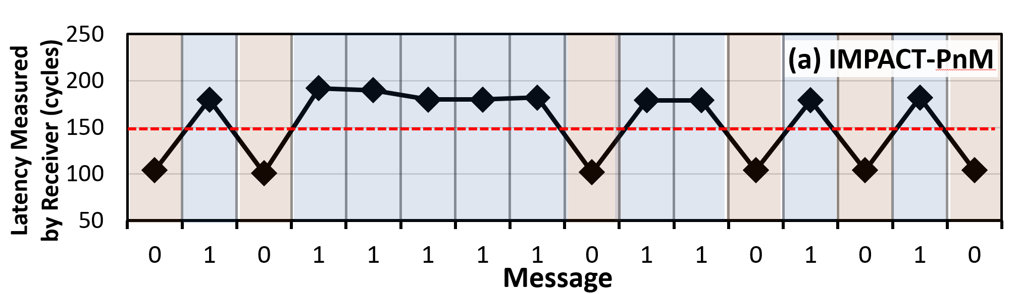
IMPACT-PNM: Proof-of-Concept Validation
Sending a 16-bit message using 16 DRAM banks
The receiver successfully determines the transmitted bit values by detecting the row buffer conflicts

Slide 32
IMPACT-PNM: Communication Throughput
One sender and one receiver process using 16 DRAM banks across increasing LLC sizes:
IMPACT-PNM provides a high communication throughput of 8.2 Mbps by eliminating expensive cache bypassing steps
(irrespective of the LLC size)

Slide 33
IMPACT Case Studies
1. IMPACT-PNM Covert Channel
2. IMPACT-PUM Covert Channel
3. PNM-Based Genomic Privacy Attack

Slide 34
PUM Architecture: RowClone
We assume a PUM architecture that provides userspace applications with RowClone [Seshadri+, MICRO'13]:
enables bulk data copy and initialization operations
DRAM
s
r
c
d
s
t
Bank 0
s
r
c
Core
Bank 1
…
d
s
t
Bank M - 2
Bank M - 1
s
r
c

Slide 35
Recall: DRAM operation
ACT src
PRE src
ACT dst
S
R
C
Write back to cells
Copy to row buffer
D
S
T
D
S
T
S
R
C
[Seshadri+ MICRO’13]

Slide 36
In-DRAM Row-Copy (RowClone)
ACT src
ACT dst
S
R
C
Copy to row buffer
D
S
T
Write back to cells
D
S
T
S
R
C
Copies the source (src) row's content to the destination (dst) row in-DRAM
[Seshadri+ MICRO’13]

Slide 37
Supporting RowClone
We assume two copy operations that exploit parallelism:
copying ranges across all banks
cp
Bank 0
Core
cp
Bank 1
cp
…
cp
Bank M - 2
"cp Range_A, Range_B"
cp
Bank M - 1
DRAM

Slide 38
Supporting RowClone
We assume two copy operations that exploit parallelism:
copying ranges across all banks
selective copying with a mask operation
cp
Bank 0
Core
Bank 1
cp
…
Bank M - 2
"cp Range_A, Range_B
mask"
cp
Bank M - 1
DRAM
(10...01)

Slide 39
IMPACT-PUM Overview
Bank Group 0
Bank Group 1
Bank 0
Bank 1
Bank 0
Bank 1
s
r
c
s
r
c
R
s
r
c
R
s
r
c
s
r
c
s
r
c
R
R
R
s
r
c
R
s
r
c
R
R
d
s
t
d
s
t
R
d
s
t
R
d
s
t
d
s
t
d
s
t
R
R
R
d
s
t
R
d
s
t
R
R
DRAM
S
s
r
c
S
s
r
c
S
s
r
c
S
s
r
c
S
d
s
t
S
d
s
t
S
d
s
t
S
d
s
t
RowClone
RowClone
RowClone
RowClone
1
Receiver

Slide 40


IMPACT-PUM Overview
Sender (Message: 1000)
2
RowClone (S_src, S_dst, mask)
RowClone (S_src, S_dst, 1 0)
RowClone (S_src, S_dst, 0 0)
Bank Group 0
Bank Group 1
3
4
Bank 0
Bank 1
Bank 0
Bank 1
R
s
r
c
R
s
r
c
R
s
r
c
R
s
r
c
R
d
s
t
R
d
s
t
R
d
s
t
R
d
s
t
DRAM
s
r
c
s
r
c
S
s
r
c
S
S
S
s
r
c
S
s
r
c
d
s
t
d
s
t
S
d
s
t
S
S
S
d
s
t
S
d
s
t
5
6
RowClone
RowClone
RowClone
RowClone
1
0
0
0
1
Receiver

Slide 41
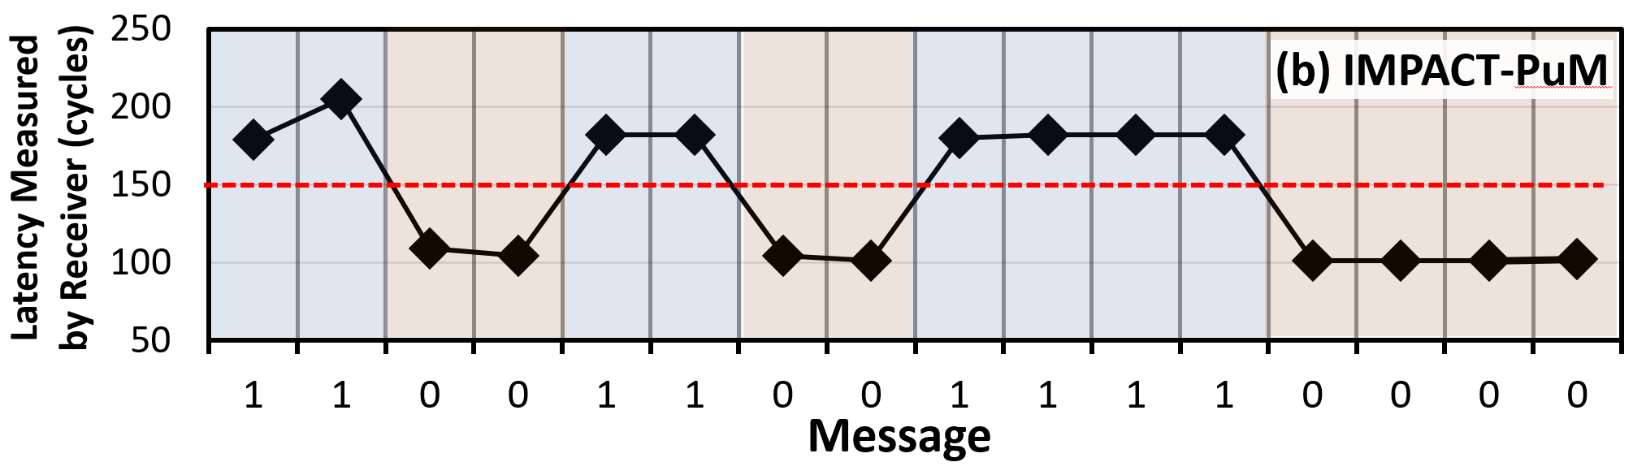
IMPACT-PUM: Proof-of-Concept Validation
Sending 16-bit messages using 16 DRAM banks
The receiver successfully determines the transmitted bit values by detecting the row buffer conflicts

Slide 42
IMPACT-PUM: Communication Throughput
One sender and one receiver process using 16 DRAM banks across increasing LLC sizes:
IMPACT-PUM provides a high communication throughput of 14.8 Mbps by exploiting intrinsic parallelism of processing-using-memory operations
(irrespective of the LLC size)

Slide 43
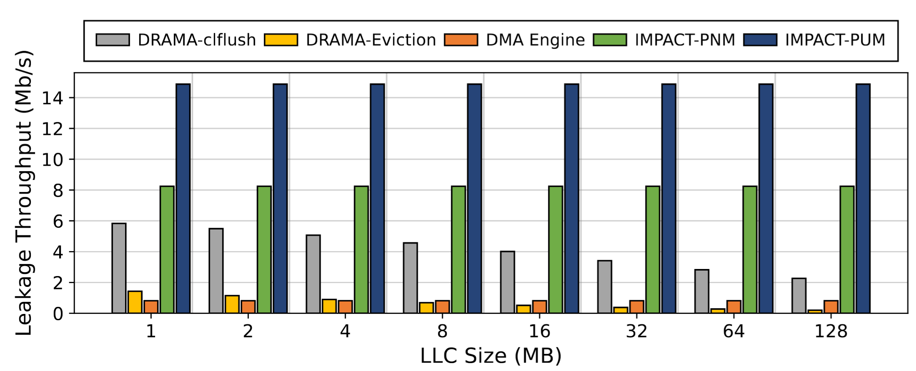
Covert Channel Throughput Comparison
Notes:
OS-related overheads

Slide 44
Covert Channel Throughput Comparison
14.8
Mbps
6.5x
8.2
Mbps
3.6x
IMPACT-PNM and IMPACT-PUM achieve 8.2 and 14.8 Mbps leakage throughput, respectively, across all LLC sizes
IMPACT-PNM and IMPACT-PUM outperform all state-of-the-art main memory-based attacks across all LLC sizes

Slide 45
IMPACT-PNM and IMPACT-PUM Comparison
IMPACT-PUM's sender routine takes 11.1x less time compared to IMPACT-PNM due to exploiting parallelism of PUM operations and results in higher throughput

Slide 46
IMPACT Case Studies
1. IMPACT-PNM Covert Channel
2. IMPACT-PUM Covert Channel
3. PNM-Based Genomic Privacy Attack

Slide 47

PNM-Based Genomics Attack Summary
DNA read mapping: a fundamental task in genomics
e.g., Biological research, forensics, diagnostics, drug development, personalized medicine, and agriculture
DNA → Privacy sensitive data
DNA
DNA fragments
Genome

Slide 48
PNM-Based Genomics Attack Summary
DNA read mapping: a fundamental task in genomics
DNA
Uses hash-table based methods
DNA fragments
Genome
Distributed across DRAM banks
and
accelerated with processing-near-memory architectures

Slide 49
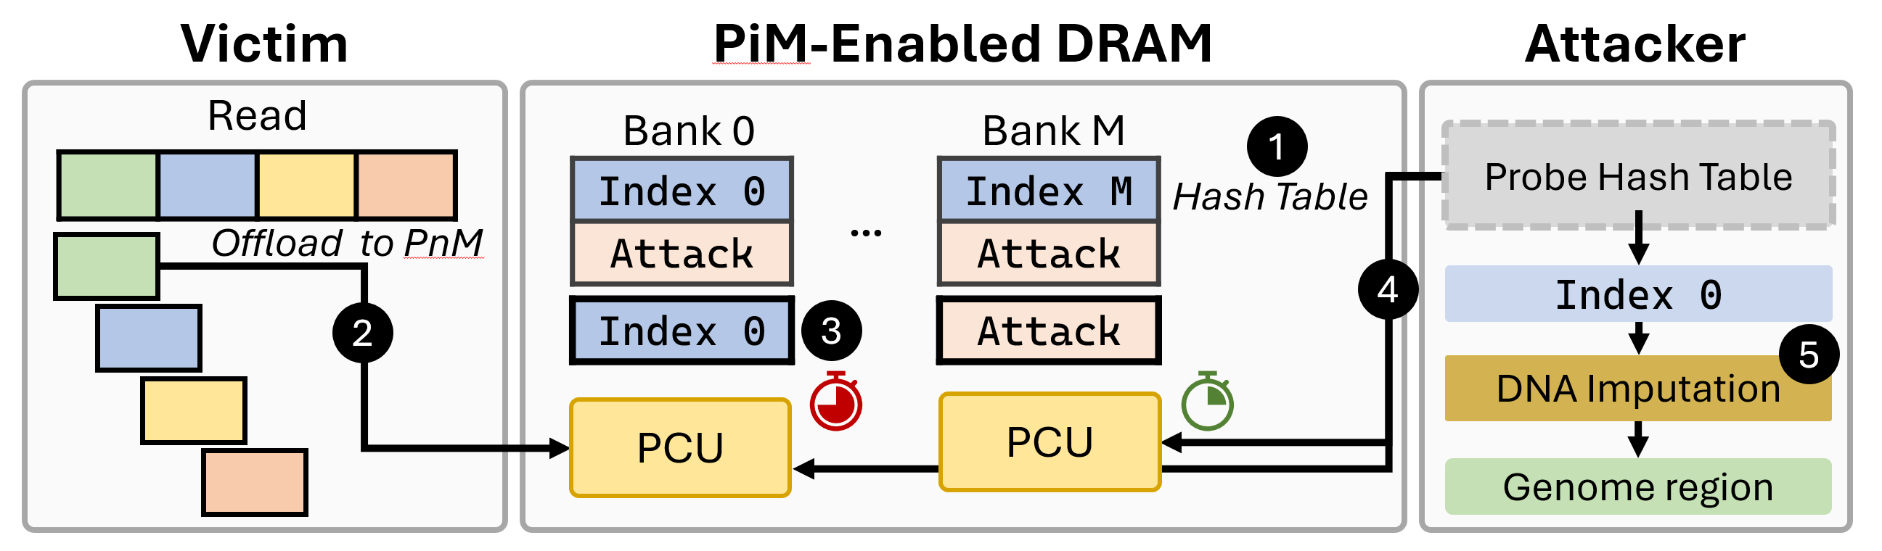
PNM-Based Genomics Attack Summary
DNA read mapping: a fundamental task in genomics
DNA
Uses hash-table based methods
DNA fragments
Genome
Notes:
This creates an opportunity for an IMPACT attack

Slide 50
PNM-Based Genomics Attack Summary
DNA read mapping: a fundamental task in genomics
An attacker can successfully leak characteristics of the DNA sample with low error rate by leveraging PiM operations
DNA
Uses hash-table based methods
DNA fragments
Genome

Slide 51
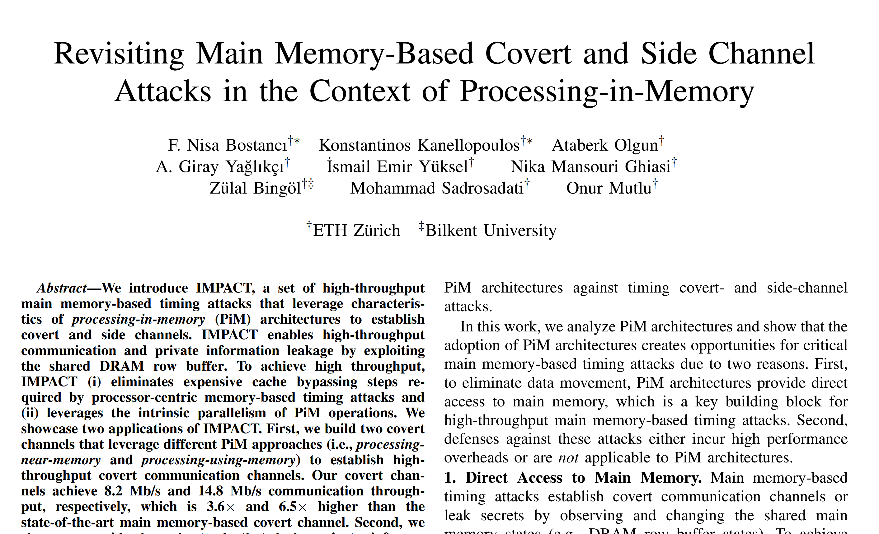
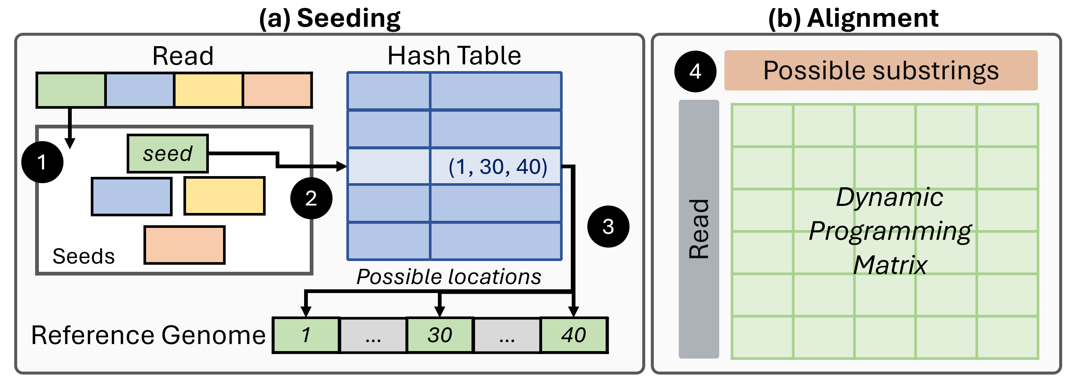
More details in the Paper
DNA read mapping: a fundamental task in genomics
Attacking DNA read mapping in a PIM architecture:
Benefits from PIM architectures
https://arxiv.org/abs/2404.11284

Slide 52
IMPACT Case Studies
1. IMPACT-PNM Covert Channel
2. IMPACT-PUM Covert Channel
3. PNM-Based Genomic Privacy Attack

Slide 53
Outline
Motivation and Problem
Key Observation
IMPACT
Mitigating IMPACT
Conclusion

Slide 54
Defenses Against IMPACT
Bank-level partitioning, closed row policy, constant time memory: restrictive and highly costly
Adaptive Constant-Time DRAM (ACT):
Key Idea: Only employ constant time memory when there is high interference in a DRAM bank
ACT reduces channel capacity but does not mitigate IMPACT completely
Reducing the channel capacity (to be comparable to the state-of-the-art attack) still induces a high performance overhead
Count row buffer conflicts within an epoch
Enforce constant access latency in the next epoch
Conflicts > threshold

Slide 55
Defenses Against IMPACT
Bank-level partitioning, closed row policy, constant time memory: restrictive and highly costly
Adaptive Constant-Time DRAM (ACT):
Key Idea: Only employ constant time memory when there is high interference in a DRAM bank
ACT reduces channel capacity but does not mitigate IMPACT completely
Reducing the channel capacity (to be comparable to the state-of-the-art attack) still induces a high performance overhead
Mitigating IMPACT incurs high performance overhead and more research is needed to find low-cost solutions
Count row buffer conflicts within an epoch
Enforce constant access latency in the next epoch
Conflicts > threshold

Slide 56
More in the Paper
PNM-based genomics side channel attack
Operational details
Throughput and accuracy analysis
Mitigations for IMPACT
Discussing and evaluating 4 countermeasures
Discussion
Other potential PIM-based attack vectors
Applicability of IMPACT to complex PIM architectures and future DRAM devices
Restricting access to PIM operations

Slide 57
More in the Paper
Breakdown of Throughput Improvements of PIM-based attacks
PNM-based genomics side channel attack
Operational details
Throughput and accuracy analysis
Mitigations for IMPACT
Discussing and evaluating 4 countermeasures
Discussion
Other potential PIM-based attack vectors
Applicability of IMPACT to complex PIM architectures and future DRAM devices
Restricting access to PIM operations
https://arxiv.org/abs/2404.11284

Slide 58
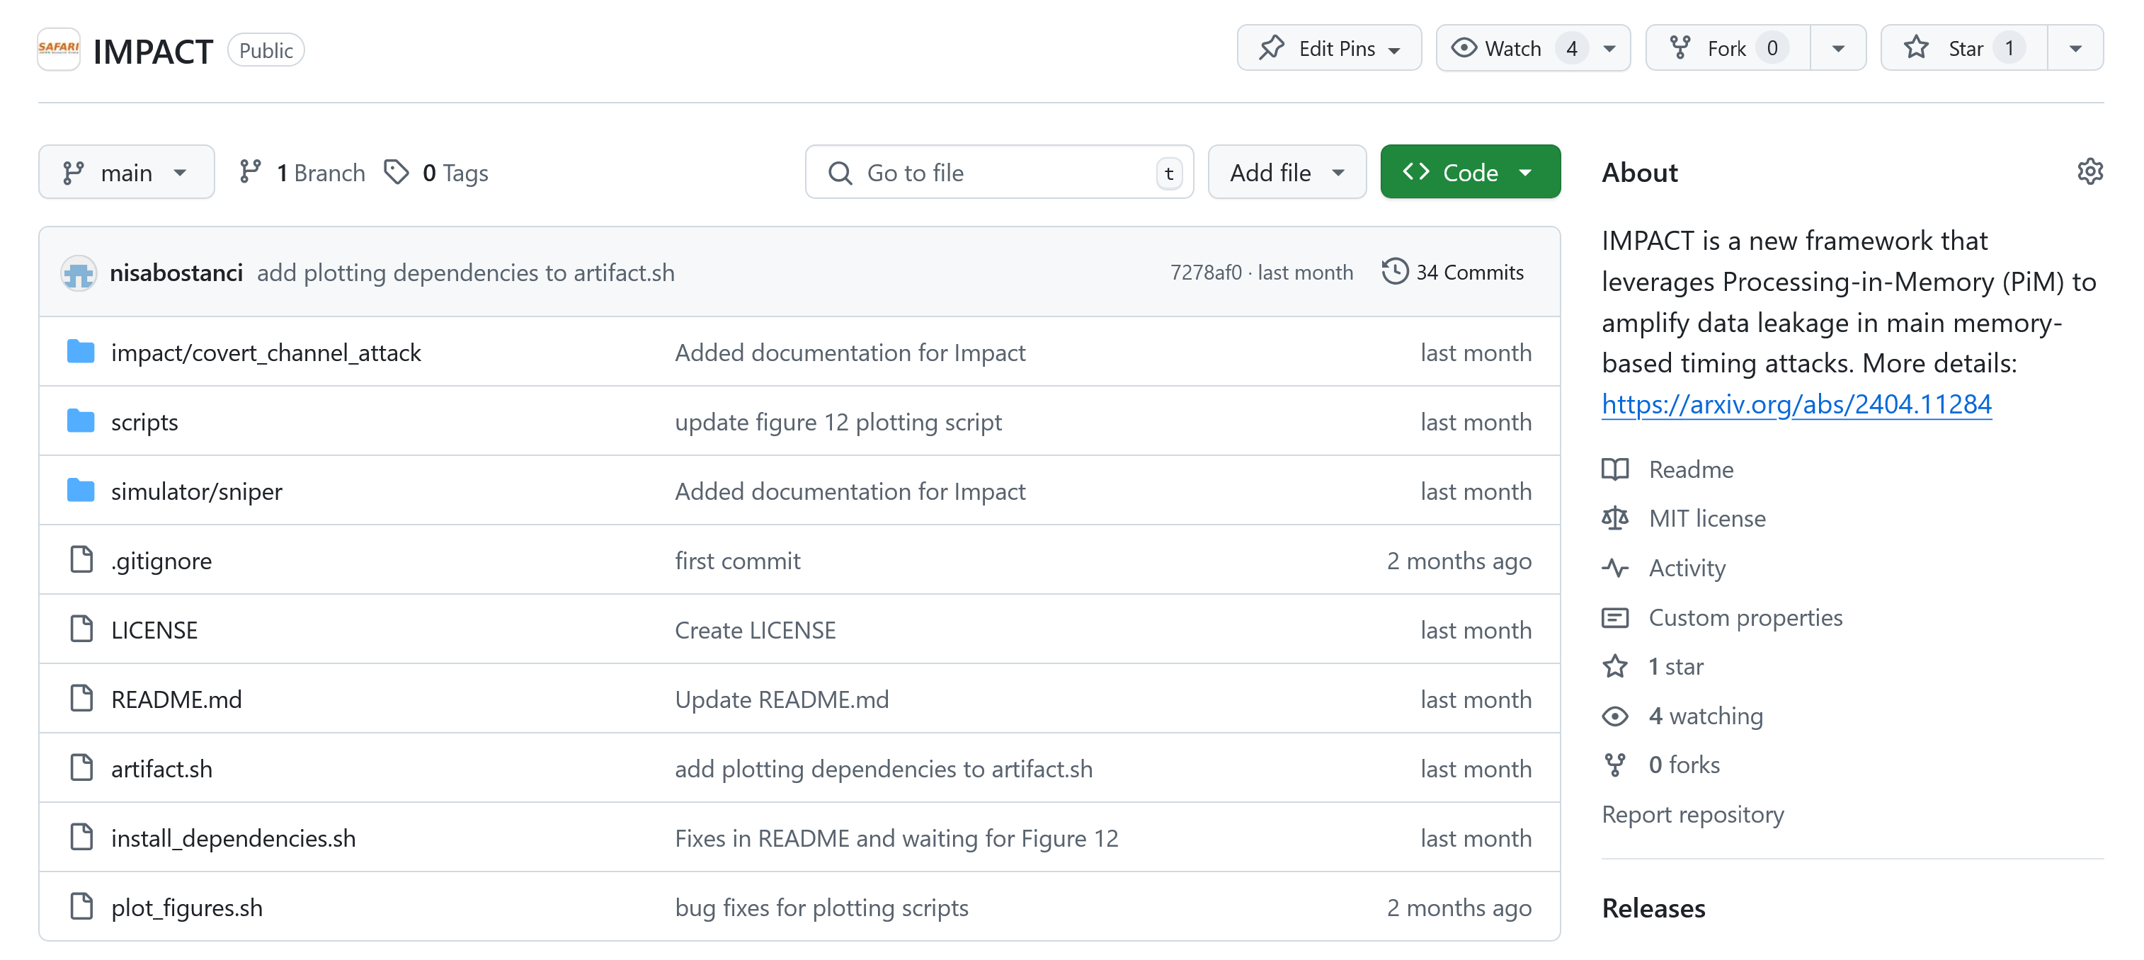
IMPACT is Open Source and Artifact Evaluated
https://github.com/CMU-SAFARI/IMPACT

Slide 59
Outline
Motivation and Problem
Key Observation
IMPACT
Mitigating IMPACT
Conclusion

Slide 60
Conclusion
Key Observation: PIM architectures create opportunities for critical main memory-based timing attacks due to two reasons :
PIM architectures provide direct access to main memory, which is a key building block for high-throughput main memory-based timing attacks
Defenses against these attacks are highly costly or are not applicable to PIM architectures
IMPACT: a set of high-throughput In-Memory Processing-based timing Attacks that leverage direct and fast main memory accesses enabled by PiM architectures
IMPACT achieves high throughput by:
eliminating expensive cache bypassing steps used in main memory-based timing attacks
leveraging the intrinsic parallelism of PIM operations
Case Studies:
Demonstrate two covert channel attacks leveraging different PIM architectures, achieving high throughput communication
Showcase a side-channel attack that leaks private information of concurrently running victim applications with low error rate
Mitigating IMPACT: We discuss and evaluate four different countermeasures against IMPACT, eventually concluding that mitigating IMPACT incurs high performance overheads
https://github.com/CMU-SAFARI/IMPACT

Slide 61


Revisiting Main Memory-Based Covert and Side Channel Attacks in the Context of Processing-in-Memory
F. Nisa Bostancı K. Kanellopoulos
A. Olgun A. G. Yaglikci I. E. Yuksel
N. Mansouri Ghiasi Z. Bingol M. Sadrosadati O. Mutlu
Paper Link
GitHub Repo

