Slide 1
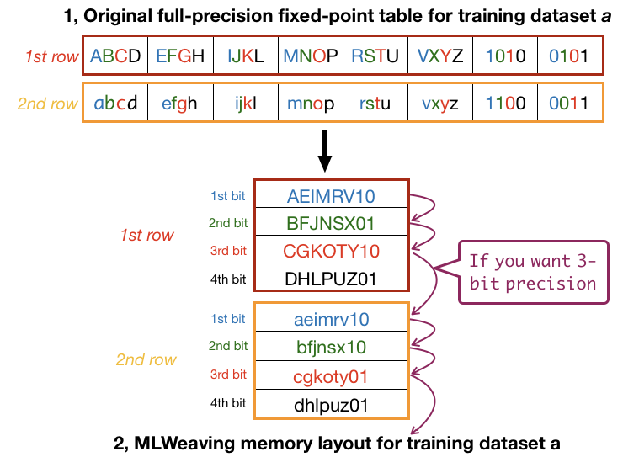
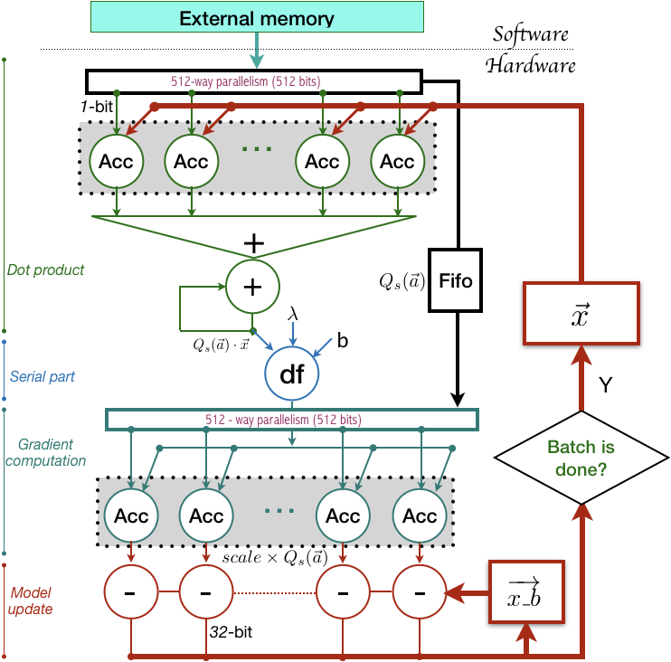
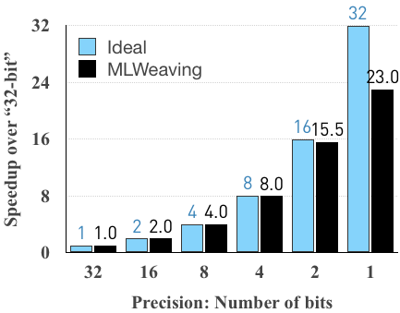
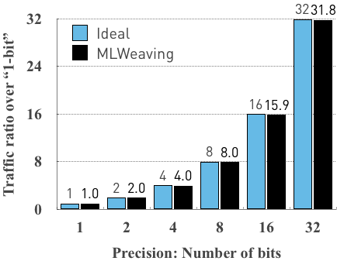
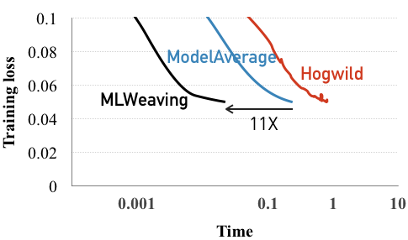
MLWeaving:A One-Size-Fits-All
System for Any-precision Learning
Zeke Wang, Kaan Kara, Hantian Zhang, Gustavo Alonso, Onur Mutlu, Ce Zhang
Problem:
Linear model training using low-precision SGD.
Stochastic Gradient Decent (SGD):
For e = 1 to E do /*E epochs*/
For i = 1 to N do /*N samples ($\overset{⃑}{a}$_{i},b_{i})*/
ax = Q_{s}($\overset{⃑}{a}$_{i})* $\overset{⃑}{x}$; /*dot product*/
scale = γ*df(ax, b_{i}); /*serial part*/
$\overset{⃑}{g}$ = scale*Q_{s}($\overset{⃑}{a}$_{i}); /*gradient comp*/
$\overset{⃑}{x}$ = $\overset{⃑}{x}$ - $\overset{⃑}{g}$; /*model update*/
Existing Approach:
$\overset{⃑}{x}$: model,
$\overset{⃑}{g}$: gradient,
Γ: learning rate,
df: derivative of loss function
1, One hardware design for each precision.
2, One quantized dataset for each precision.
Our Approach (MLWwaving):
One hardware design and one memory layout for any precision.
MLWeaving: Software/Hardware Co-design
MLWeaving memory layout (software)
MLWeaving arithmetic (hardware)
A~Z (a~z ) is binary, 0 or 1.
Bit-level flexibility of precision from software side
Directly consume the data from MLWeaving memory layout with bit-serial multipliers.
Experiment
Findings:
Hardware: an Intel Broadwell CPU (14 cores, 35MB LLC, 60 GB/s memory bandwidth) and an Intel Arria 10 FPGA (directly access the CPU memory via one QPI and two PCIe, with memory bandwidth: 15GB/s.
Dataset: Epsilon (40,000 samples, 2000 features).
Hogwild (ModelAverage): state-of-the-art parallel implementations of SGD on CPUs, using 14 cores, AVX2 and 8-bit dataset.
1, MLWeaving can roughly achieve linear speedup (time or memory traffic), when a lower number of bits is used, as shown in Figures a, b.
2, MLWeaving on an FPGA can achieve 11X speedup over its CPU rivals in Figure c.
(a) Time vs. Precision
(b) Memory traffic vs. Precision
(c) MLWeaving vs. CPU rivals

