Slide 1
What Your DRAM Power Models
Are Not Telling You:
Lessons from a Detailed Experimental Study
Saugata Ghose, A. Giray Yağlıkçı, Raghav Gupta, Donghyuk Lee,
Kais Kudrolli, William X. Liu, Hasan Hassan, Kevin K. Chang,
Niladrish Chatterjee, Aditya Agrawal, Mike O’Connor, Onur Mutlu
June 21, 2018

Slide 2
DRAM Power Is Becoming a Major Design Concern
Main memory in computers
consists of DRAM modules
DRAM consumes up to half
of total system power
State-of-the-art DRAM power models are not adequate
  Based on IDD values: standard current measurements provided by vendors
  Often have a high mean absolute percentage error
    32% for DRAMPower
    161% for Micron power model
Fraction of
Total System Energy
OUR GOAL
Measure and analyze the power used by real DRAM, and build an accurate DRAM power model

Slide 3
Background: DRAM Organization & Operation
Characterization Methodology
New Findings on DRAM Power Consumption
VAMPIRE: A Variation-Aware DRAM Power Model
Conclusion
Outline

Slide 4
Simplified DRAM Organization and Operation
DRAM Chip
Bank 0
. . .
Bank 7
Processor Chip
DRAM
Cell Array
Core
Core
. . .
activation
Row Buffer
Shared Last-Level Cache
Column Select
. . .
Memory Controller
Bank Select
I/O Drivers
I/O Drivers
memory channel
Fundamental DRAM commands: activate, read, write, precharge
One row of DRAM: 8 kB
One cache line of data: 64 B

Slide 5
Background: DRAM Organization & Operation
Characterization Methodology
New Findings on DRAM Power Consumption
VAMPIRE: A Variation-Aware DRAM Power Model
Conclusion
Outline

Slide 6
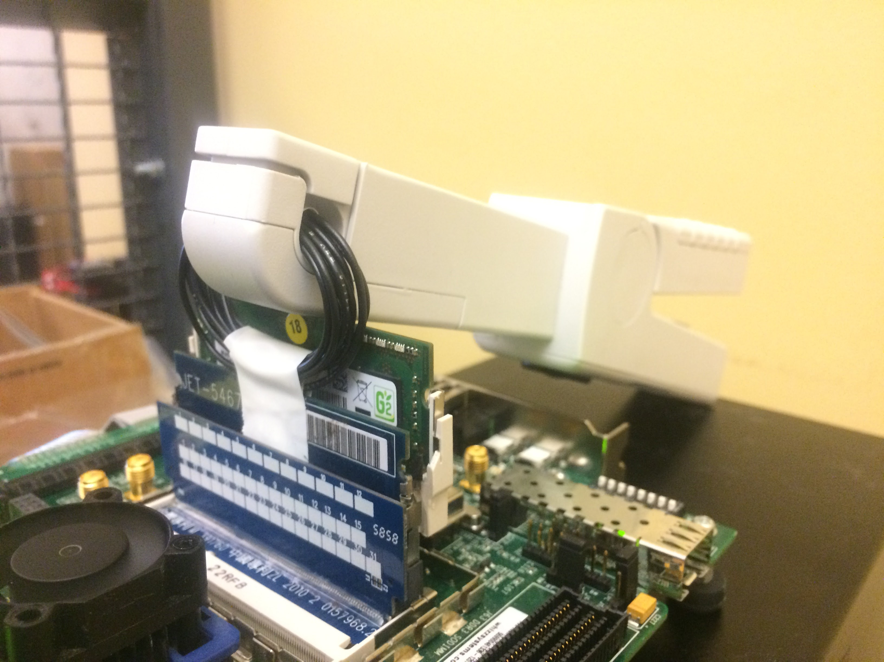

Power Measurement Platform
Keysight 34134A
DC Current Probe
DDR3L
SO-DIMM
Virtex 6
FPGA
JET-5467A Riser Board
Notes:
50 SO-DIMMs -> 200 DRAM chips

Slide 7
Methodology Details
SoftMC: an FPGA-based memory controller [Hassan+ HPCA ’17]
  Modified to repeatedly loop commands
  Open-source: https://github.com/CMU-SAFARI/SoftMC
Measure current consumed by a module during a SoftMC test
Tested 50 DDR3L DRAM modules (200 DRAM chips)
  Supply voltage: 1.35 V
  Three major vendors: A, B, C
  Manufactured between 2014 and 2016
For each experimental test that we perform
  10 runs of each test per module
  At least 10 current samples per run

Slide 8
Background: DRAM Organization & Operation
Characterization Methodology
New Findings on DRAM Power Consumption
VAMPIRE: A Variation-Aware DRAM Power Model
Conclusion
Outline

Slide 9
1. Real DRAM Power Varies Widely from IDD Values
IDD2N
Idle
IDD0
Activate–Precharge
IDD4R
Read
Different vendors have very different margins (i.e., guardbands)
Low variance among different modules from same vendor
Current consumed by real DRAM modules
varies significantly for all IDD values that we measure
Notes:
Replace IDD4R with corrected data

Slide 10
2. DRAM Power is Dependent on Data Values
Some variation due to infrastructure – can be subtracted
Without infrastructure variation: up to 230 mA of change
Toggle affects power consumption, but < 0.15 mA per bit
DRAM power consumption depends strongly
on the data value, but not on bit toggling
Notes:
Replace graphs

Slide 11
3. Structural Variation Affects DRAM Power Usage
Vendor C: variation in idle current across banks
All vendors: variation in read current across banks
All vendors: variation in activation based on
row address
1.20
1.15
1.10
1.05
1.00
0.95
Significant structural variation:
DRAM power varies systematically by bank and row
Notes:
Fix bank number alignment

Slide 12
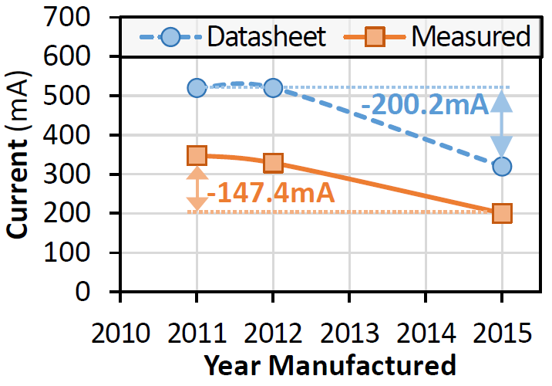
4. Generational Savings Are Smaller Than Expected
IDD0
Activate–Precharge
IDD4W
Write
Similar trends for idle and read currents
Actual power savings of newer DRAM is much lower
than the savings indicated in the datasheets
Notes:
Find sources and fix

Slide 13
Summary of New Observations on DRAM Power
Real DRAM modules often consume less power
than vendor-provided IDD values state
DRAM power consumption is dependent on the data value that is read/written
Across banks and rows, structural variation affects power consumption of DRAM
Newer DRAM modules save less power than indicated in datasheets by vendors
Detailed observations and analyses in the paper

Slide 14
Background: DRAM Organization & Operation
Characterization Methodology
New Findings on DRAM Power Consumption
VAMPIRE: A Variation-Aware DRAM Power Model
Conclusion
Outline

Slide 15
A New Variation-Aware DRAM Power Model
VAMPIRE: Variation-Aware model of Memory Power
Informed by Real Experiments
VAMPIRE and raw characterization data will be open-source:
https://github.com/CMU-SAFARI/VAMPIRE (August 2018)
Inputs
(from memory system simulator)
Trace of DRAM commands, timing
Data that is
being written
VAMPIRE
Outputs
Per-vendor
power consumption
Range for
each vendor
(optional)
Read/Write and
Data-Dependent
Power Modeling
Idle/Activate/Precharge
Power Modeling
Structural Variation Aware
Power Modeling

Slide 16
VAMPIRE Has Lower Error Than Existing Models
Validated using new power measurements: details in the paper
VAMPIRE has very low error for all vendors: 6.8%
Much more accurate than prior models

Slide 17
VAMPIRE Enables Several New Studies
Taking advantage of structural variation to perform
variation-aware physical page allocation to reduce power
Smarter DRAM power-down scheduling
Reducing DRAM energy with data-dependency-aware
cache line encodings
  23 applications from
  the SPEC 2006
  benchmark suite
  Traces collected using
  Pin and Ramulator
We expect there to be many other new studies in the future

Slide 18
Background: DRAM Organization & Operation
Characterization Methodology
New Findings on DRAM Power Consumption
VAMPIRE: A Variation-Aware DRAM Power Model
Conclusion
Outline

Slide 19
Conclusion
DRAM consumes up to half of total system power:
need to develop new low-power solutions
State-of-the-art DRAM power models are based only on
IDD values, and have a high error
We make four new observations on DRAM power consumption using 50 real DRAM modules from three major vendors
  Real DRAM modules often consume less power than IDD values state
  Power consumption is dependent on the data value being read/written
  Across banks and rows, structural variation affects power consumption
  Newer DRAM modules save less power than indicated in datasheets
VAMPIRE: a new DRAM power model built on our observations
  Mean absolute percentage error of only 6.8%
  Case study: dependency-aware data encoding reduces DRAM power by 12%
More information: https://github.com/CMU-SAFARI/VAMPIRE

Slide 20
What Your DRAM Power Models
Are Not Telling You:
Lessons from a Detailed Experimental Study
Saugata Ghose, A. Giray Yağlıkçı, Raghav Gupta, Donghyuk Lee,
Kais Kudrolli, William X. Liu, Hasan Hassan, Kevin K. Chang,
Niladrish Chatterjee, Aditya Agrawal, Mike O’Connor, Onur Mutlu
More information: https://github.com/CMU-SAFARI/VAMPIRE

Slide 21
Backup Slides

Slide 22
More Information in the Paper…
Full characterization analysis
Application-level comparison to existing power models
Case study: dependency-aware data encoding
Paper available at https://github.com/CMU-SAFARI/VAMPIRE

Slide 23
Today’s Models Leave a Lot to Be Desired
Most models reliant on JEDEC-based IDD values
  Micron power calculator
  DRAMPower
  gem5/GPGPU-Sim
Some rely on circuit-level models
  Vogelsang model for memory scaling
  CACTI
None are all that accurate
  One value for each DRAM
  Does not capture any inherent variation (e.g., data, structure)

Slide 24
How Do We Measure Current?
VDD
Host
PC
USB
Probe
PCI-e
FPGA
DRAM Module
PCI-e IF
Cmd Buffer
Rank
. . .
SoftMC [1]
Chip
Chip
memory
channel
[1]
Hassan et al. “SoftMC: A Flexible and Practical Open-Source Infrastructure
for Enabling Experimental DRAM Studies,” HPCA, 2017.

Slide 25
Foundation of Current Power Models
Just how bad are current models?
JEDEC defines a set of IDD values
IDD0 | Activation and Precharge
IDD1 | Activation – 1 Column Read – Precharge
IDD2N | Precharge Standby (all banks are precharged/closed) | ✔ clk enabled
IDD3N | Active Standby (all banks are active/opened) | ✔ clk enabled
IDD2P | Precharge Power-Down (all banks are precharged/closed) | ✘clk disabled
IDD3P | Active Power-Down (all banks are active/opened) | ✘clk disabled
IDD4R/W | Burst mode Read/Write
IDD5B | Burst mode Refresh
IDD7 | Activate – Column Read w/ Auto Precharge

Slide 26
What’s So Bad About That?
JEDEC defined IDD measurement loops cover:
  Average power consumption of all banks
    missing variation across banks
  Average power consumption of only two rows: 00 and F0
    missing variation across rows in a subarray
    missing variation across subarrays
  Average power consumption of only two data patterns: 00 and 33
    missing effect of number of ones/zeros in data
    missing effect of toggling bits

Slide 27
IDD0: Activation and Precharge Energy
DRAM Array
ACT
tRAS
PRE
tRP
ACT
tRAS
PRE
0xF0
time
0x00
Row Buffer

Slide 28
IDD1: Activation, Read, and Precharge Energy
DRAM Array
tRCD
tRP
0xF0
ACT
RD
PRE
ACT
tRAS
0x00
time
Row Buffer

Slide 29
IDD2N: Precharged Standby
Bank 0
Bank 1
Bank 7
DRAM Array
DRAM Array
DRAM Array
(1) Precharge All Banks
(Close Row Buffers)
(2) Wait
Row Buffer
Row Buffer
Row Buffer

Slide 30
IDD3N: Active Standby
Bank 0
Bank 1
Bank 7
DRAM Array
DRAM Array
DRAM Array
Activate All Banks
(Open Row Buffers)
(2) Wait
Row Buffer
Row Buffer
Row Buffer

Slide 31
IDD2P: Precharged Power Down
Bank 0
Bank 1
Bank 7
DRAM Array
DRAM Array
DRAM Array
(1) Precharge All Banks
(Close Row Buffers)
(2) Wait
CLK is Disabled
Row Buffer
Row Buffer
Row Buffer

Slide 32
IDD4R: Burst Read Current
Bank 0
Bank 1
Bank 7
Activate All Banks
(Open Row Buffers)
(2) Read one column
at a time
(3) Interleave across
banks after each read
DRAM Array
DRAM Array
DRAM Array
Row Buffer
Row Buffer
Row Buffer
0
8
1
9
7
15
0x00 0x33
0x00 0x33
0x00 0x33

Slide 33
IDD4W: Burst Write Current
Bank 0
Bank 1
Bank 7
Activate All Banks
(Open Row Buffers)
(2) Write one column
at a time
(3) Interleave across
banks after each read
DRAM Array
DRAM Array
DRAM Array
Row Buffer
Row Buffer
Row Buffer
0
8
1
9
7
15
0x00 0x33
0x00 0x33
0x00 0x33

Slide 34
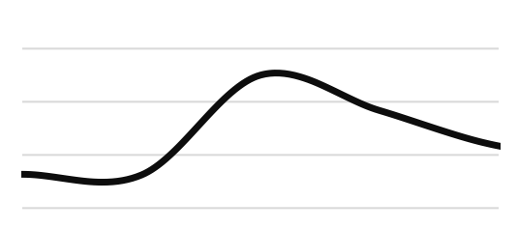
IDD5B: Refresh in Burst Mode
Burst Mode:
t_{REFI}
_{(64ms)}
t_{RFC}
t_{RFC}
REF
REF
REF
time
t_{RFC}

Slide 35
IDD7: Read, Auto-Precharge
ACT-RDA
t_{RRD}
ACT-RDA
t_{RRD}
ACT-RDA
t_{RRD}
time

Slide 36
Impact of Bit Toggling on DRAM Power
Bank 0 Row Buffer
Bank 1 Row Buffer
. . .
Bank 7 Row Buffer
column
number
0
1
2
c – 1
0
1
2
c – 1
0
1
2
c – 1
0000 1010 1111 … 0011
1011 0010 1011 … 0110
. . .
1011 0010 1011 … 0110
. . .
. . .
. . .
1
Column Select
Column Select
. . .
Column Select
. . .
global bitlines
global bitlines
2
Bank Select
peripheral bus
to I/O drivers
Notes:
Replace toggle figure

Slide 37
Data Dependency Model
 | Read |  |  | Write
 | F (mA) | G (mA) | H (mA) | F (mA) | G (mA) | H (mA)
Vendor A | 246.44 | 0.433 | 0.0515 | 531.18 | -0.246 | 0.0461
Vendor B | 217.42 | 0.157 | 0.0947 | 466.84 | -0.215 | 0.0166
Vendor C | 234.42 | 0.154 | 0.0856 | 368.29 | -0.116 | 0.0229
y = F + Gn + Ht
Additional current per logic-1
Additional current per bit toggle

Slide 38
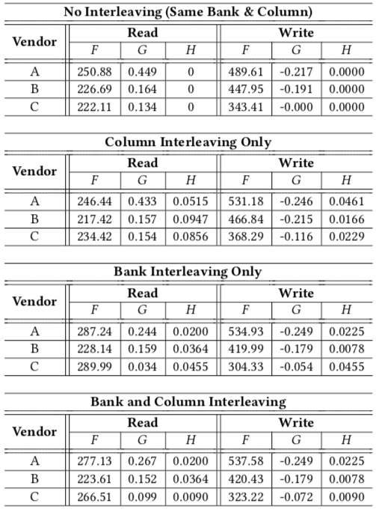

Models
https://github.com/CMU-SAFARI/VAMPIRE
Notes:
Update tables

Slide 39
Structural Variation
Normalized
Active Standby Energy
across Banks
Normalized
Read Burst Energy
across Banks
Normalized
Write Burst Energy
across Banks
Notes:
Standby is upto 23%

Slide 40
Evaluated System Configuration
Processor | x86-64 ISA, one core 3.2 GHz, 128-entry instruction window
Cache | L1: 64 kB, 4-way associative; L2: 2 MB, 16-way associative
Memory Controller | 64/64-entry read/write request queues, FR-FCFS [119, 149]
DRAM | DDR3L-800 [57], 1 channel, 1 rank/8 banks per channel
Application traces collected using Pin
DRAM command timings generated using Ramulator:
https://github.com/CMU-SAFARI/ramulator
Notes:
Make bigger

Slide 41
Trends Across Generations
Basically, if you’re building a system, you aren’t getting the kinds of savings you were promised
Activation Energy
Precharge Standby Energy
Read Energy
Write Energy

Slide 42
Data Encoding
Baseline: No coding
BDI: Base Delta Immediate
Optimized: Minimize the number of ones
OWI: Minimize ones for reads, maximize ones for writes
12.5%
Energy
Reduction
Notes:
Update graph

Slide 43
Validating Our DRAM Power Models
New tests run on 22 of our DDR3L DRAM SO-DIMMs
Validation command sequence
  Activate
  n reads
    Sweep n from 0 to 764
    All reads contain data value 0xAA
    All reads to Bank 0, Row 128
    Column interleaved
  Precharge
Error metric: mean absolute percentage error (MAPE)
Best prior model (DRAMPower): 32.4% MAPE
VAMPIRE: 6.8% MAPE

