Slide 1




Venice
Improving Solid-State Drive Parallelism at Low Cost via Conflict-Free Accesses
Rakesh Nadig*, Mohammad Sadrosadati*, Haiyu Mao,
Nika Mansouri Ghiasi, Arash Tavakkol, Jisung Park,
Hamid Sarbazi-Azad, Juan Gómez Luna, and Onur Mutlu

Slide 2
Talk Outline
Motivation
Venice
Evaluation
Summary
2

Slide 3
Overview of a Modern Solid-State Drive
SSD Controller
SSD
Shared Channel
Host Interface Layer
Flash Controller
Flash Chip
Flash Chip
…
Flash Chip
Flash Controller
Flash
Translation
Layer
Flash Chip
Flash Chip
…
Flash Chip
…
Flash Controller
…
…
…
Flash Chip
Flash Chip
…
Flash Chip
DRAM
3

Slide 4
Key Problem: Path Conflicts in Modern SSDs
Multiple flash memory chips are connected to the
SSD Controller using a shared channel
I/O requests attempt to simultaneously access the flash chips using a single path Path Conflict
Path Conflicts cause I/O requests to be
transferred serially on the shared channel
Limits SSD parallelism and reduces performance
4

Slide 5
Delay Caused by Path Conflicts
Path conflict!
Case 1: Same Channel
Case 2: Different Channels
FC0
Channel 0
Read Request 1
Read Request 2
F0
F1
F2
F3
Flash chip 0
time
Channel 0:
CMD
RD Operation
Data Transfer
Flash chip 1
CMD
RD Operation
Data Transfer
Served serially
Channel 0
FC0
Read Request 1
F0
F1
F2
F3
Channel 1
FC1
Read Request 2
F4
F5
F6
F7
Saved Cycles
Served in parallel
Channel 0:
Flash chip 0
CMD
RD Operation
Data Transfer
time
Channel 1:
Flash chip 4
CMD
RD Operation
Data Transfer
5

Slide 6
Performance Impact of Path Conflicts
Path conflicts increase the average I/O latency by 57% in our experiments
on a performance-optimized SSD
The performance overhead of path conflicts increases by 1.6x in our experiments
for high-I/O-intensity workloads
6

Slide 7
Prior Approaches
Baseline SSD
Packetized SSD (pSSD) [1]
Shared Channel
2x Wider Shared Channel
FC
FC
FC
FC
Flash
Chip
Flash
Chip
FC
FC
FC
FC
[1] Kim+, “Networked SSD: Flash Memory Interconnection Network for High-Bandwidth SSD”, MICRO 2022
[2] Tavakkol+, “Network-on-SSD: A Scalable and High-Performance Communication Design Paradigm for SSDs”, IEEE CAL 2012
7

Slide 8
Prior Approaches
Baseline SSD
Packetized SSD (pSSD) [1]
Shared Channel
2x Wider Shared Channel
FC
FC
Baseline SSD and Packetized SSD
do not provide path diversity to flash chips
FC
FC
Flash
Chip
Flash
Chip
FC
FC
FC
FC
[1] Kim+, “Networked SSD: Flash Memory Interconnection Network for High-Bandwidth SSD”, MICRO 2022
[2] Tavakkol+, “Network-on-SSD: A Scalable and High-Performance Communication Design Paradigm for SSDs”, IEEE CAL 2012
8

Slide 9
Prior Approaches
Baseline SSD
Packetized SSD (pSSD) [1]
Shared Channel
2x Wider Shared Channel
FC
FC
Baseline SSD and Packetized SSD
do not provide path diversity to flash chips
FC
FC
Flash
Chip
Flash
Chip
FC
FC
FC
FC
Packetized Network SSD (pnSSD) [1]
Network-on-SSD (NoSSD) [2]
FC
Horizontal Channel
FC
FC
Flash
Chip
FC
FC
Vertical Channel
FC
FC
FC
Link
[1] Kim+, “Networked SSD: Flash Memory Interconnection Network for High-Bandwidth SSD”, MICRO 2022
[2] Tavakkol+, “Network-on-SSD: A Scalable and High-Performance Communication Design Paradigm for SSDs”, IEEE CAL 2012
9

Slide 10
Prior Approaches
Baseline SSD
Packetized SSD (pSSD) [1]
Shared Channel
2x Wider Shared Channel
FC
FC
Baseline SSD and Packetized SSD
do not provide path diversity to flash chips
FC
FC
Flash
Chip
Flash
Chip
FC
FC
FC
FC
Packetized Network SSD (pnSSD) [1]
Network-on-SSD (NoSSD) [2]
FC
Horizontal Channel
Packetized Network SSD and Network-on-SSD
do not effectively utilize the path diversity
incur large area & cost overheads
FC
FC
Flash
Chip
FC
FC
Vertical Channel
FC
FC
FC
Link
[1] Kim+, “Networked SSD: Flash Memory Interconnection Network for High-Bandwidth SSD”, MICRO 2022
[2] Tavakkol+, “Network-on-SSD: A Scalable and High-Performance Communication Design Paradigm for SSDs”, IEEE CAL 2012
10

Slide 11
Our Goal
To fundamentally address the
path conflict problem in SSDs by
increasing the number of paths to each flash chip (i.e., path diversity) at low cost
effectively utilizing the increased path diversity for communication between the SSD controller and flash chips
11

Slide 12
Talk Outline
Motivation
Venice
Evaluation
Summary
12

Slide 13
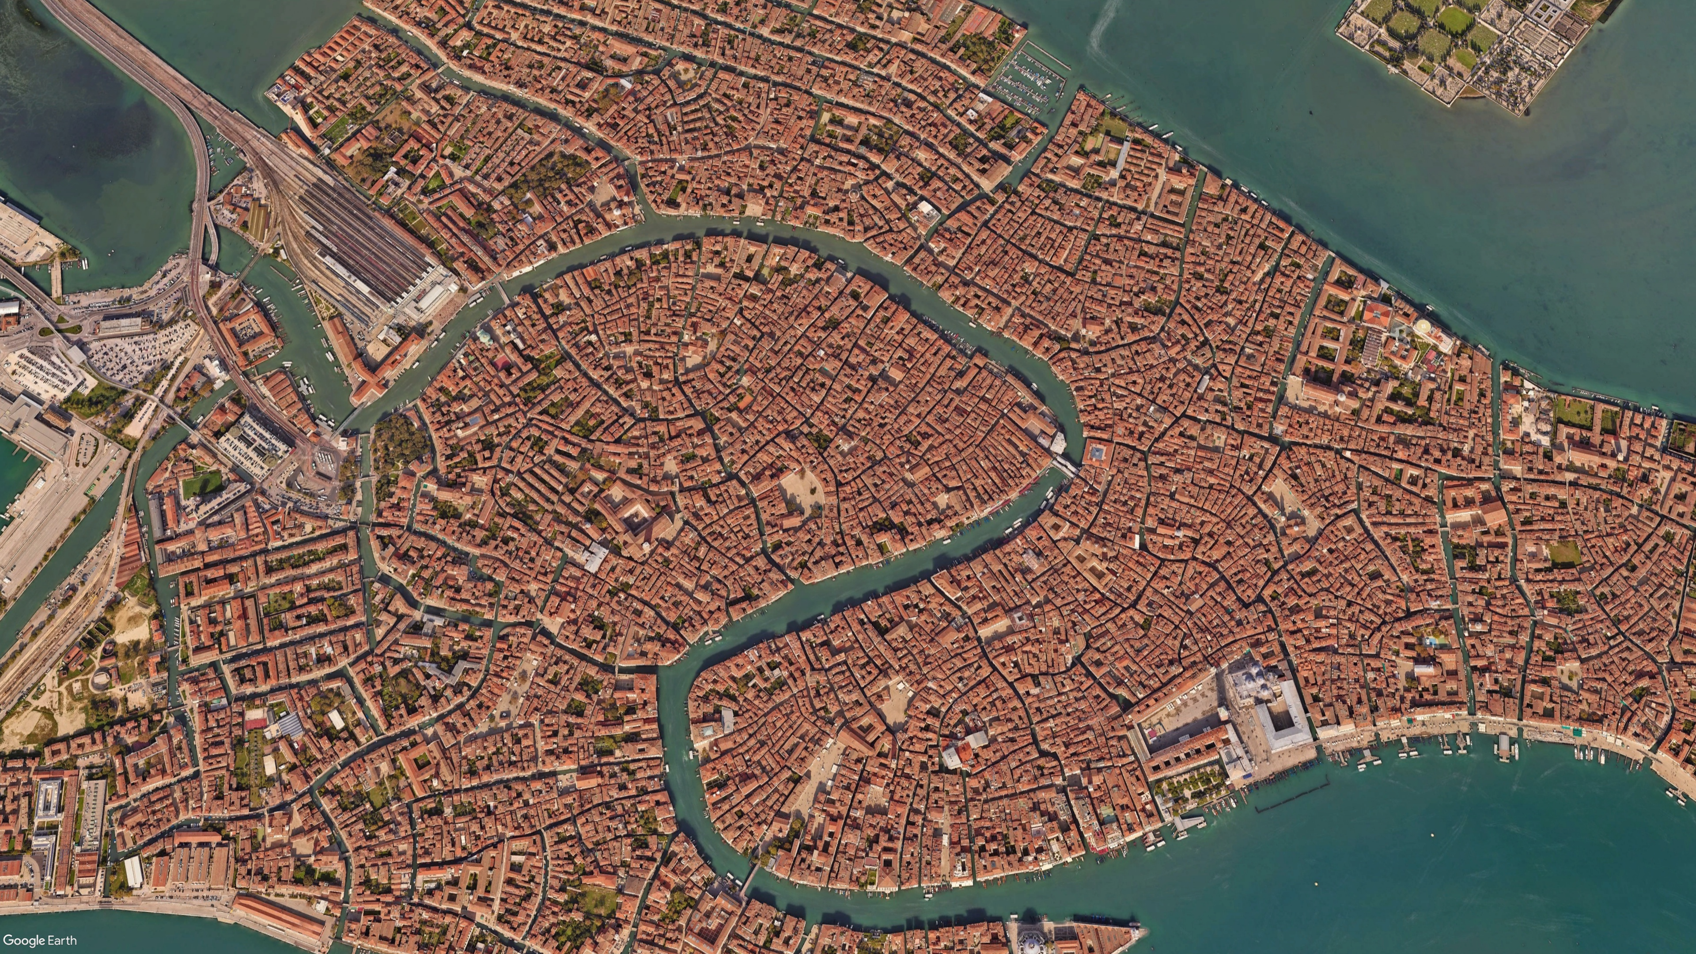



Our Proposal
Venice
A low-cost interconnection network of flash chips in the SSD
Conflict-free path reservation for each I/O request
A non-minimal fully-adaptive routing algorithm for path identification
Named after the network of canals in the city of Venice
https://en.wikipedia.org/wiki/Venice
13

Slide 14
Our Proposal
Venice
A low-cost interconnection network of flash chips in the SSD
Conflict-free path reservation for each I/O request
A non-minimal fully-adaptive routing algorithm for path identification
Named after the network of canals in the city of Venice
https://en.wikipedia.org/wiki/Venice
14

Slide 15
Venice: Architecture
Flash Node
Bi-directional Link
Flash
Chip
FC
…
FC
…
FC
…
…
…
…
…
…
I/O bus
Router
Chip
FC
…
Links
Venice provides increased path diversity at low cost
No modifications to existing flash chips in Venice
15

Slide 16
Our Proposal
Venice
A low-cost interconnection network of flash chips in the SSD
Conflict-free path reservation for each I/O request
A non-minimal fully-adaptive routing algorithm for path identification
Named after the network of canals in the city of Venice
https://en.wikipedia.org/wiki/Venice
16

Slide 17
Venice: Path Reservation (I)
Venice uses a small scout packet to reserve a
conflict-free path for each I/O request
Reserved Path
Target Flash Node
Router of F5
FC₀
F₀
F₁
F₂
F₃
F₄
FC₁
F₅
F₆
F₇
F₈
F₉
Crossbar
Scout
Packet
FC₂
F₁₀
F₁₁
F₁₂
F₁₃
F₁₄
Router Reservation Table
FC₃
F₁₅
F₁₆
F₁₇
F₁₈
F₁₉
Packet ID | Entry Port | Exit Port | Valid bit
1
Left
Right
Valid
17

Slide 18
Venice: Path Reservation (II)
Venice uses a small scout packet to reserve a
conflict-free path for each I/O request
Reserved Path
Target Flash Node
FC₀
F₀
F₁
F₂
F₃
F₄
FC₁
F₅
F₆
F₇
F₈
F₉
Reserved Path
FC₂
F₁₀
F₁₂
F₁₃
F₁₄
Scout
Packet
F₁₁
FC₃
F₁₅
F₁₆
F₁₇
F₁₈
F₁₉
18

Slide 19
Venice: Path Reservation
Venice uses a small scout packet to reserve a
conflict-free path for each I/O request
Path reservation eliminates path conflicts
by enabling conflict-free I/O transfer
Reserved Path
FC₀
F₀
F₁
F₂
F₃
F₄
FC₁
F₅
F₆
F₇
F₈
F₉
Reserved Path
FC₂
F₁₀
F₁₁
F₁₂
F₁₃
F₁₄
The overhead of path reservation is negligible
due to the small size of the scout packet
FC₃
F₁₅
F₁₆
F₁₇
F₁₈
F₁₉
19
Notes:
We look at another request whose target flash node is F9.
[click] in a shared bus SSD architecture, this request would face path conflict due to ongoing transfer of the previous request in the same channel. In Venice's interconnection network, the target flash node can be reached using a different path.
[click] Flash controller FC2 initiates the path reservation process by sending the scout packet
[click] the router of each flash node updates its router reservation table as the scout packet traverses the network
[click] a path is reserved for the second request now.

Slide 20
Our Proposal
Venice
A low-cost interconnection network of flash chips in the SSD
Conflict-free path reservation for each I/O request
A non-minimal fully-adaptive routing algorithm for path identification
Named after the network of canals in the city of Venice
https://en.wikipedia.org/wiki/Venice
20

Slide 21
Venice: Non-Minimal Fully Adaptive Routing
Venice uses a non-minimal fully-adaptive routing algorithm to route scout packets when a minimal path is unavailable
Effectively utilizes the idle links in the interconnection network to find a conflict-free path
Target Flash Node
Reserved Minimal Paths
Non-minimal Path
Req to F6
FC₀
F₀
F₁
F₂
F₃
F₄
Req to F8
FC₁
F₅
F₆
F₇
F₈
F₉
Req to F7
FC₂
F₁₀
F₁₁
F₁₂
F₁₃
F₁₄
Req to F2
FC₃
F₁₅
F₁₆
F₁₇
F₁₈
F₁₉
21

Slide 22
More in the Paper
Venice’s non-minimal fully-adaptive routing algorithm
Handling deadlock and livelock scenarios
Overhead of exercising a non-minimal path
Analysis of prior architectures proposed to mitigate
the path conflict problem
Detailed background on modern SSD architecture
22

Slide 23
Talk Outline
Motivation
Venice
Evaluation
Summary
23

Slide 24
Evaluation Methodology
Using MQSim [Tavakkol+, FAST’18], a state-of-the-art SSD simulator
Two SSD configurations
  Performance-Optimized (Samsung Z-NAND SSD)
  Cost-Optimized (Samsung PM9A3)
Nineteen data-intensive workloads from
  MSR Cambridge, YCSB, Slacker, SYSTOR ‘17 and RocksDB
Prior Approaches
  Baseline SSD: A typical multi-channel shared bus SSD
  Packetized SSD (pSSD) [Kim+, MICRO’22]: Uses packetization to double the flash channel bandwidth
  Packetized Network SSD (pnSSD) [Kim+, MICRO’22]: Increases path diversity by introducing vertical channels
  Network-on-SSD (NoSSD) [Tavakkol+, CAL 2012]: Proposes an interconnection network of flash chips with simple deterministic routing
  Path-conflict-free SSD: An ideal SSD with no path conflicts
24

Slide 25
Results: Performance Analysis (I)
Performance-Optimized SSD
45%
2.1x
1.9x
Speedup over Baseline SSD
2.0x
2.7x
Baseline SSD
Venice improves SSD performance by 1.9x
on average over the best-performing prior work
Venice’s performance is within 45%
of the performance of a Path-conflict-free SSD
25

Slide 26
Results: Performance Analysis (II)
Cost-Optimized SSD
25%
1.6x
1.5x
1.5x
1.7x
Speedup over Baseline SSD
Baseline SSD
Venice improves SSD performance by 1.5x
on average over the best-performing prior work
Venice’s performance is within 25%
of the performance of a Path-conflict-free SSD
26

Slide 27
Results: Performance Analysis (III)
Performance-Optimized SSD
Cost-Optimized SSD
Speedup over Baseline SSD
Venice provides significant improvement in performance over all prior approaches
Speedup over Baseline SSD
27

Slide 28
Results: Reduction in Path Conflicts
99.98% of I/O requests
do not experience path conflicts
% of I/O Requests
Venice mitigates path conflicts
by using path reservation and
effective utilization of path diversity
28

Slide 29
Results: SSD Energy Consumption
Baseline SSD
61%
46%
Energy Consumption (Norm. to Baseline SSD)
Venice reduces the SSD energy consumption
by 46% on average
over the most efficient prior work
29

Slide 30
More in the Paper
Power and area overhead analysis
Tail latency analysis
Sensitivity to interconnection network configurations
Performance on mixed workloads
Detailed evaluation methodology
30

Slide 31
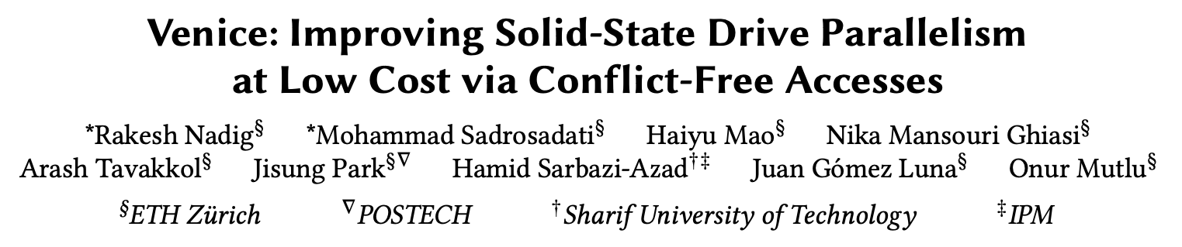

More in the Paper
https://arxiv.org/abs/2305.07768
31

Slide 32
Talk Outline
Motivation
Venice
Evaluation
Summary
32

Slide 33




Venice: Summary
Mitigates path conflicts by efficiently utilizing the
path diversity of the SSD interconnection network
Improves performance
by 1.9x/1.5x over the best-performing prior work
on performance-optimized/cost-optimized SSD
Reduces energy consumption
by 46% on average over the most efficient prior work
Low-cost and requires
no changes to commodity flash chips
33

Slide 34
Venice
Improving Solid-State Drive Parallelism at Low Cost via Conflict-Free Accesses
Rakesh Nadig*, Mohammad Sadrosadati*, Haiyu Mao,
Nika Mansouri Ghiasi, Arash Tavakkol, Jisung Park,
Hamid Sarbazi-Azad, Juan Gómez Luna, and Onur Mutlu
https://arxiv.org/abs/2305.07768

Slide 35
FAQ
Scout Packet Structure
Power Overhead
Area Overhead
Evaluated Configurations
Workload Characteristics
Mixed Workloads
Results
  Throughput Analysis
  Tail Latency
  Power Consumption
  Performance on Mixed Workloads
  Sensitivity to Interconnection Network Configuration

Slide 36

Structure of a Scout Packet
A scout packet consists of two 8 bit flits, a header flit and a tail flit
The flash controller sends a scout packet to identify a conflict-free path for the I/O request
8 bits
Scout Packet
2-bit Type Info
2 bits
6 bits
Header
Flit
Type
Destination Flash Chip ID
1st
Bit
0: Header Flit
1
1: Tail Flit
Tail
Flit
Type
Source Flash
Controller ID
Unused Bits
2
0: Cancel
2nd
Bit
2 bits
3 bits
3 bits
1: Reserve

Slide 37
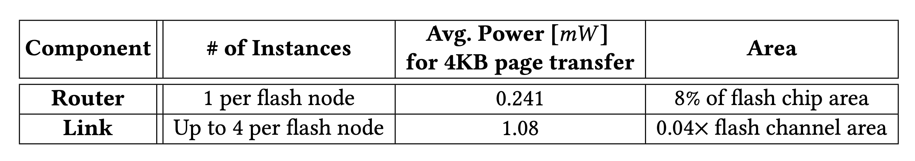
Power Consumption (I)
Router
  We implement the HDL and synthesize it using UMC 65nm technology node
  Router consumes 0.241mW for a 4KB page transfer
Network Link
  ORION 3.0 power model tool
  Each network link consumes about 1.08mW for a 4KB page transfer
  Link capacitance is lower than bus capacitance -> 90% less power than that of the shared channel bus
    Links are shorter and thinner than a shared bus
    Two drivers in links compared to several drivers in a bus

Slide 38
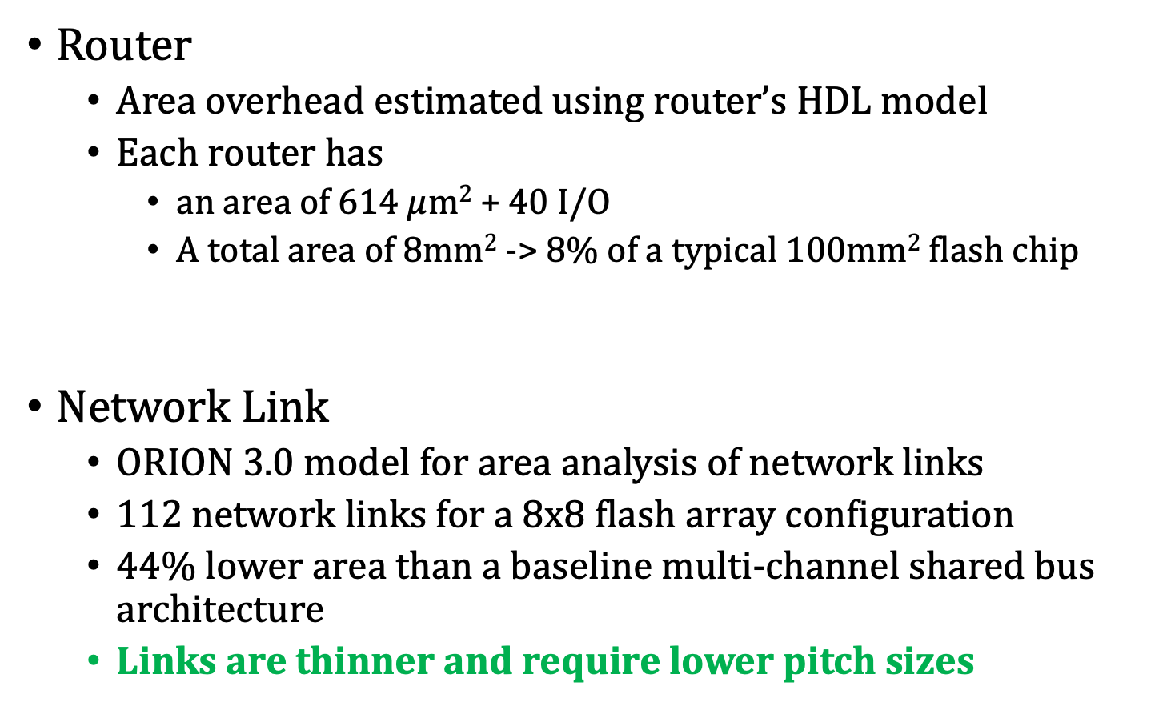
Area Overhead
Router
  Area overhead estimated using router’s HDL model
  Each router has
    an area of 614 $μ$m² + 40 I/O
    A total area of 8mm² -> 8% of a typical 100mm² flash chip
Network Link
  ORION 3.0 model for area analysis of network links
  112 network links for a 8x8 flash array configuration
  44% lower area than a baseline multi-channel shared bus architecture
  Links are thinner and require lower pitch sizes

Slide 39
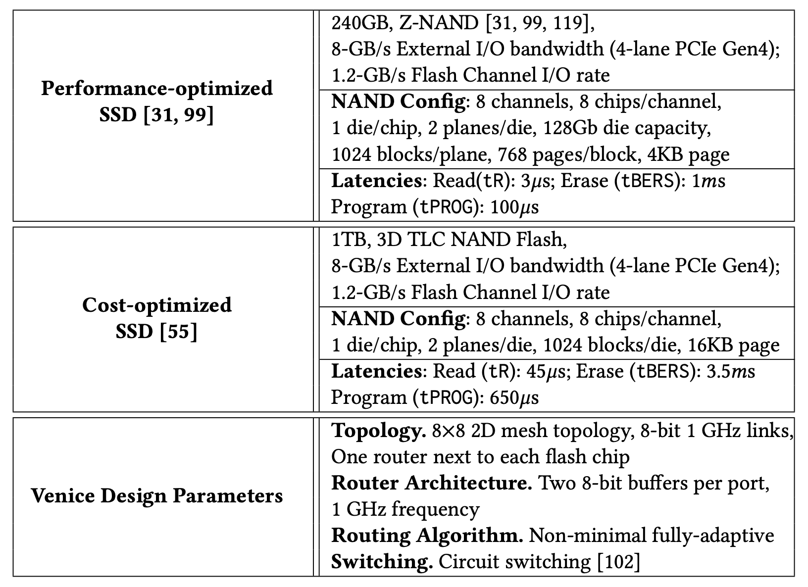
Evaluated Configurations

Slide 40
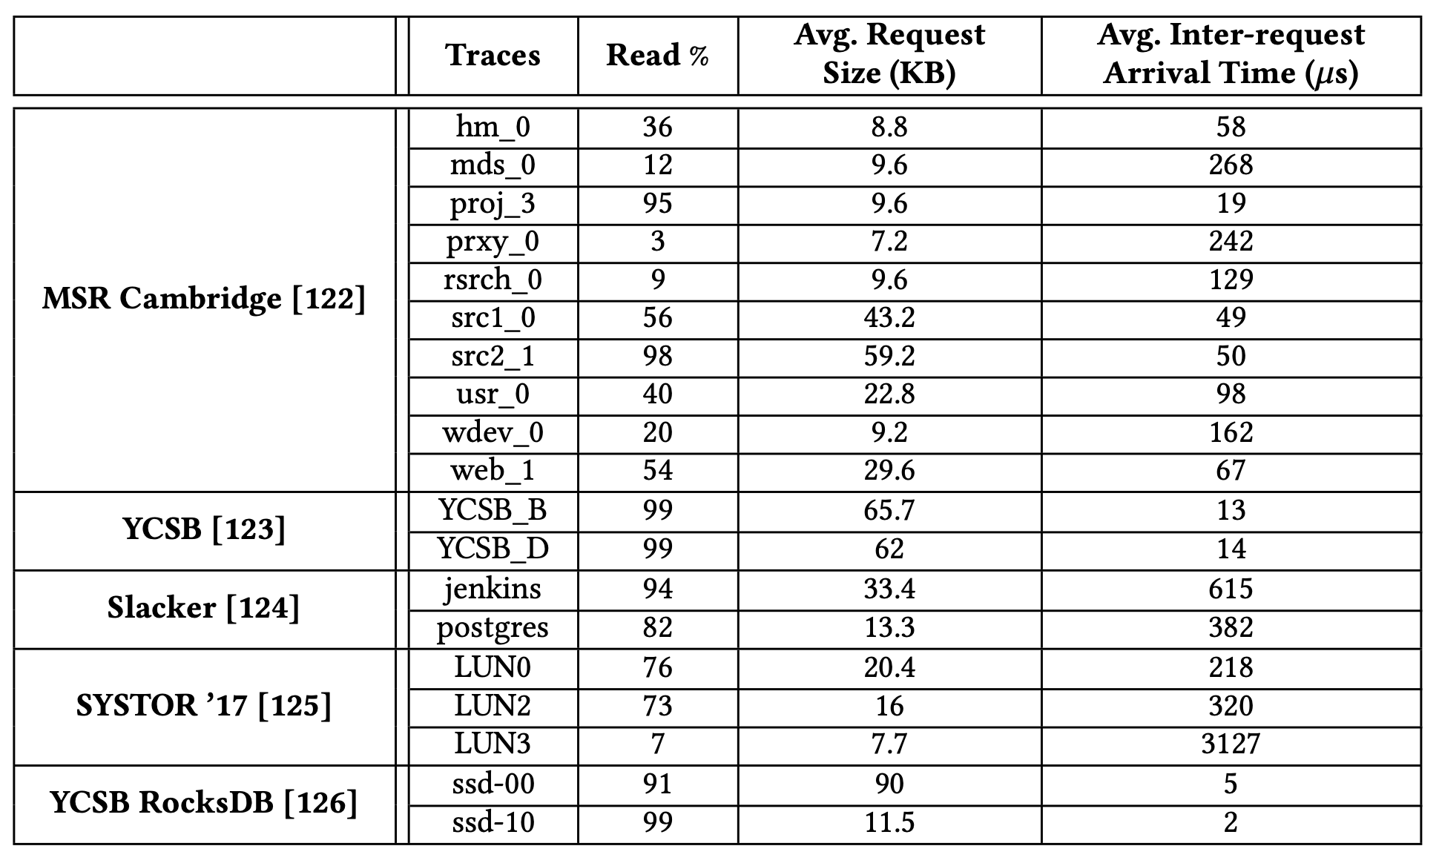
Workload Characteristics

Slide 41
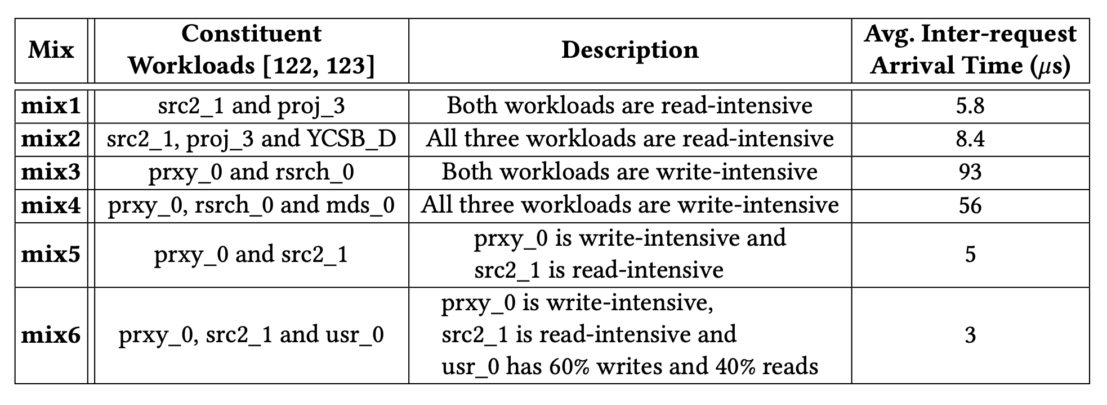
Mixed Workloads

Slide 42
SSD Throughput Analysis
Performance-Optimized SSD
Cost-Optimized SSD
176%
102%
120%
113%
SSD Throughput
(Norm. to
Path-conflict-free SSD)
76%
51%
58%
61%
SSD Throughput
(Norm. to
Path-conflict-free SSD)

Slide 43
SSD Throughput Analysis
Performance-Optimized SSD
Cost-Optimized SSD
176%
102%
120%
113%
SSD Throughput
(Norm. to
Path-conflict-free SSD)
Venice improves SSD throughput over prior approaches by effectively mitigating
path conflicts
76%
51%
58%
61%
SSD Throughput
(Norm. to
Path-conflict-free SSD)

Slide 44
Tail Latency
Comparison of tail latencies in the 99th percentile of
I/O requests
32% reduction
22% reduction

Slide 45
Tail Latency
Comparison of tail latencies in the 99th percentile of
I/O requests
Venice reduces tail latencies
by effectively mitigating path conflicts
32% reduction
22% reduction

Slide 46
Power Consumption (II)
1.07x
1.06x
0.96x
Power Consumption (Norm. to Baseline SSD)
0.95x
Baseline SSD
Venice reduces the average power consumption by 4% over Baseline SSD

Slide 47
Performance on Mixed Workloads
Speedup over Baseline SSD
2.47x
1.83x
1.01x
1.12x
1.01x
Baseline SSD
Venice outperforms prior approaches
on high-intensity mixed workloads
by effectively mitigating path conflicts

Slide 48
Sensitivity to Network Configurations
5.22x
3.81x
Speedup over Baseline SSD
2.56x
2.14x
2.03x
1.90x
1.22x
1.34x
1.27x
1.33x
1.05x
1.11x
Baseline SSD
Venice provides higher performance improvement
for 8x8 compared to 4x16 and 16x4

Slide 49
Prior Approaches to Address Path Conflicts
Network-On-SSD [2]
  Replaces a multi-channel shared bus architecture with an interconnection network of flash chips
  Significantly increases path diversity than a typical SSD
FC0
F0
F1
F2
F3
FC1
F4
F5
Links
F6
F7
FC2
F8
F9
F10
F11
FC3
F12
F13
F14
F15
[2] Tavakkol+, “Network-on-SSD: A Scalable and High-Performance Communication Design Paradigm for SSDs”, IEEE CAL 2012
5

Slide 50

Prior Approaches to Address Path Conflicts
Network-On-SSD [2]
  Replaces a multi-channel shared bus architecture with an interconnection network of flash chips
  Significantly increases path diversity than a typical SSD
Target Chip
Network-On-SSD’s simple routing algorithm fails to mitigate path conflicts in SSDs
FC0
F0
F1
F2
F3
Ongoing I/O request
FC1
F4
F5
F6
F7
Path Conflict
FC2
F8
F9
F10
F11
FC3
F12
F13
F14
F15
I/O Request to F2
[2] Tavakkol+, “Network-on-SSD: A Scalable and High-Performance Communication Design Paradigm for SSDs”, IEEE CAL 2012

