Slide 1
Efficient Document Analytics on Compressed Data: Method, Challenges, Algorithms, Insights
Feng Zhang †⋄, Jidong Zhai ⋄, Xipeng Shen #, Onur Mutlu ⋆, Wenguang Chen ⋄
†Renmin University of China ⋄Tsinghua University #North Carolina State University ⋆ETH Zürich

Slide 2
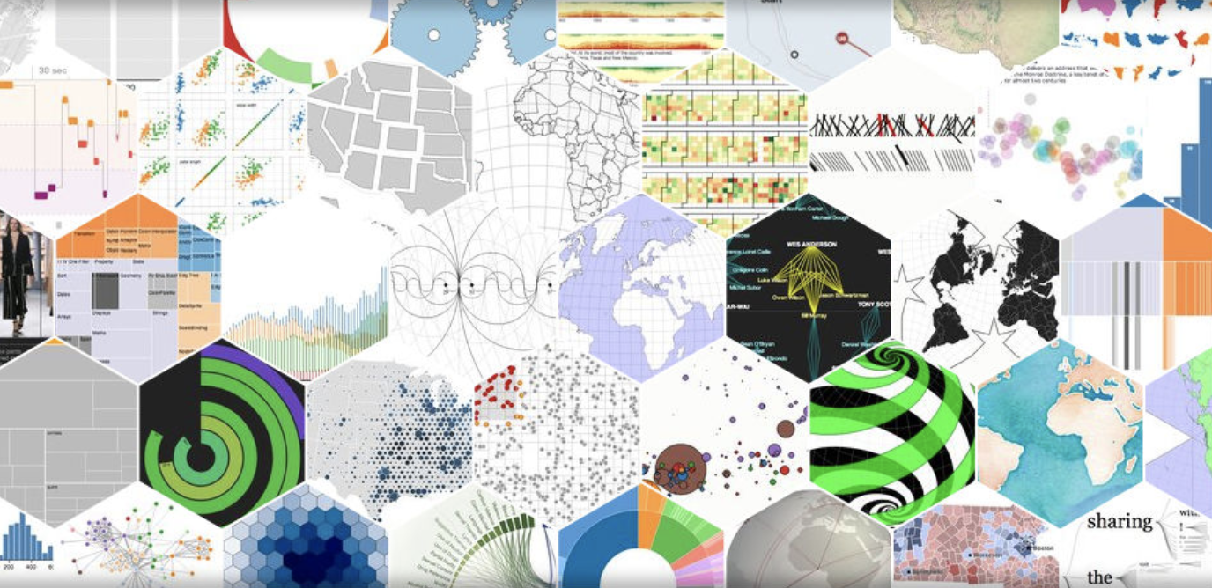
Motivation
Every day, 2.5 quintillion bytes of data created – 90% data in the world today has been created in the last two years alone[1].
How to perform efficient document analytics
when data are extremely large?
[1] What is Big Data?
https://www-01.ibm.com/software/data/bigdata/what-is-big-data.html

Slide 3
Outline
Introduction
Motivation & Example
Compression-Based Direct Processing
Challenges
Guidelines and Techniques
Solution Overview
Guidelines
Evaluation
Benchmarks
Results
Conclusion

Slide 4
Motivation
How to perform efficient document analytics when data are extremely large?
Challenge 1:
SPACE: Large Space Requirement
Challenge 2:
TIME: Long Processing Time

Slide 5
Motivation
Observation
Using Hash Table to check redundant content for Wikipedia dataset
REUSE
Whether we can perform
analytics directly on compressed data?

Slide 6
Our Idea
Compression-based direct processing
Sequitur algorithm meets our requirement
Input:
Rules:
R0:
R1
R1
R2
a
a b c a b d a b c a b d a b a
R0 → R1 R1 R2 a
R1 → R2 c R2 d
R2 → a b
edge
R1:
R2
c
R2
d
R2:
a
b
(a) Original data
(b) Sequitur compressed data
(c) DAG Representation
a: 0 b: 1 c: 2 d: 3
R0: 4 R1: 5 R2: 6
4 → 5 5 6 0
5 → 6 2 6 3
6 → 0 1
(d) Numerical representation
(e) Compressed data in numerical ID

Slide 7
Double benefits
R0:
R1
R1
R2
a
Appear more than once, but only store once!
Challenge 1:
Space
R1:
R2
c
R2
d
R2:
a
b
Appear more than once, but only compute once!
Challenge 2:
Time

Slide 8
Optimization
We can make it more compact.
R0:
R1
x2
a
x1
R2
x1
R0:
R1
R1
R2
a
R0:
R1
R1
R2
a
2
2
R1:
R2
c
R2
d
R1:
R2
x2
c
x1
1
R1:
R2
c
R2
d
1
d
x1
R2:
a
b
2
2
R2:
a
x1
R2:
a
b
b
x1
Some applications do not need to keep the sequence.
i
weight
Further saves storage space and computation time.
In each rule, we may remove sequence info too.

Slide 9
Example
i
Step #
<w,i>
Word table
Word Count
CFG Relation
Information Propagation
3
<a,6>, <b,5>
<c,2>, <d,2>
<a, 2×2 + 1 +1> = <a, 6>
<b, 2×2 + 1> = <b, 5>
<c, 1×2 > = <c, 2>
<d, 1×2 > = <d, 2>
R0:
R1
R1
R2
a
2
<a,2>, <b,2>
<c,1>, <d,1>
R1:
R2
c
R2
d
<a, 1×2> = <a, 2>
<b, 1×2> = <b, 2>
<c, 1>
<d, 1>
1
R2:
a
b
<a,1>, <b,1>

Slide 10
Challenges
How to organize data.
How to perform parallelism on large datasets.
CHALLENGES
Unit
sensitivity
Parallelism
barriers
Reuse
of results across nodes
Overhead
in saving and propagating
Order
sensitivity
Data
attributes
How to utilize the attributes of datasets.
How to accommodate the order for applications that are sensitive to the order.

Slide 11
Outline
Introduction
Motivation & Example
Compression-Based Direct Processing
Challenges
Guidelines and Techniques
Solution Overview
Guidelines
Evaluation
Benchmarks
Results
Conclusion

Slide 12
Solution Overview
SOLUTION TECHNIQUES
Adaptive
traversal order and
information to propagation
Double-layered
bit vector for
footprint minimization
CHALLENGES
Unit
sensitivity
Parallelism
barriers
Reuse
of results across nodes
Overhead
in saving and propagating
Coarse-grained
parallel algorithm and
automatic data partition
Order
sensitivity
Data
attributes
Compression-time
indexing
Double
compression
Two-level table with
depth-first traversal
Load-time
coarsening

Slide 13
Data Attributes Problem: How to utilize the attributes of datasets
Traversal Order
Average Size
or
or
?
≤2860
>2860
Postorder
Files #
≤800
>800
Preorder using regular BitMap
Preorder using 2levBitMap
The best traversal order may depend on the data attributes of input.
Guideline I: minimize the footprint size
Guideline II: Traversal order is essential for the efficiency

Slide 14
Parallelism Barriers Problem: How to perform parallelism on large datasets
Input files
f1
f2
f3
f4
f5
f6
…
SparkContext
RDD 1
RDD 2
RDD 3
…
Partition 1
Partition 2
Partition 1
Partition 2
Partition 1
Partition 2
f1
f2
f3
f4
f5:part1
f5:part2
f5:part3
f6
pipe()
pipe()
pipe()
pipe()
C++ Program
C++ Program
C++ Program
C++ Program
Final Results
Guideline III: Coarse-grained distributed implementation is preferred

Slide 15
Order Sensitivity (detailed in paper) Problem: Some applications are sensitive to the order
root node
Global Sequence Table
file0
file1
file2
R1
R2
w1
spt1
R2
w2
…
w4
spt2
R3
…
Local Sequence Table
R1:
w5
R4
R2:
R4
w5
R3:
R4
R5
…
Local Sequence Table
…
R4:
w6
w7
w8
R5:
w9
w6
w8
…
Guideline IV: depth-first traversal and a two-level table design

Slide 16
Unit Sensitivity (detailed in paper) Problem: How to organize data
root node
Level 1:
file0
file1
file2
Bit array
bit0
bit1
bit2
bit3
…
R1
R2
w1
spt1
R2
w2
…
w4
spt2
R3
…
Pointer array
P0
P1
NULL
P3
…
R1:
R2:
R3:
Level 2:
w5
R4
R4
w5
R4
R5
…
bit0
bit0
bit0
bit1
bit1
bit1
N bits
…
…
…
…
…
R4:
w6
R6
R7
R5:
w9
R8
w8
…
bit N-1
bit N-1
bit N-1
Guideline V: use of double-layered bitmap if unit information needs to be passed across the CFG

Slide 17
Short Summary for Six Guidelines
Data Attributes Challenge
Guideline II
Parallelism Barriers
Guideline III
Order Sensitivity
Guideline IV
Unit Sensitivity
Guideline V
General insights and common techniques
Guideline I and Guideline VI

Slide 18
Outline
Introduction
Motivation & Example
Compression-Based Direct Processing
Challenges
Guidelines and Techniques
Solution Overview
Guidelines
Evaluation
Benchmarks
Results
Conclusion

Slide 19
Benchmarks
Six benchmarks
Word Count, Inverted Index, Sequence Count, Ranked Inverted Index, Sort, Term Vector
Five datasets
580 MB ~ 300 GB
Two platforms
Single node
Spark cluster (10 nodes on Amazon EC2)

Slide 20
Time Savings
CompressDirect yields 2X speedup, on average, over direct processing.

Slide 21
Space Savings
CompressDirect achieves 11.8X compression ratio, even more than gzip does.
compression ratio = original size / compressed data size

Slide 22
Conclusion
Our method, compression-based direct processing.
How the concept can be materialized on Sequitur.
Major challenges.
Guidelines.
Our library, CompressDirect, to help further ease the required development efforts.

Slide 23
Thanks!
Any questions?
Feng Zhang †⋄, Jidong Zhai ⋄, Xipeng Shen #, Onur Mutlu ⋆, Wenguang Chen ⋄
†Renmin University of China ⋄Tsinghua University #North Carolina State University ⋆ETH Zürich

