Slide 1
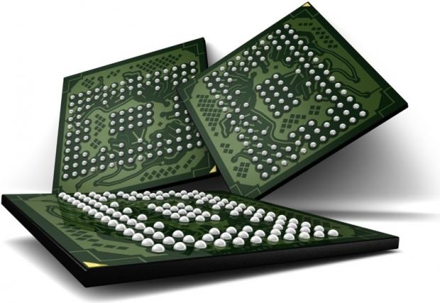


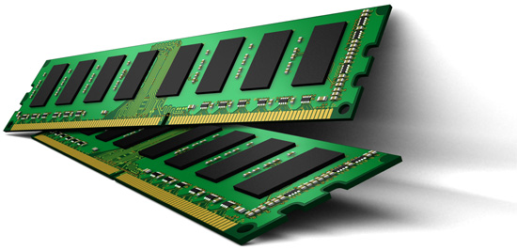

The Efficacy of Error Mitigation Techniques for DRAM Retention Failures
Samira Khan*$, Donghyuk Lee*, Yoongu Kim*, Alaa R. Alameldeen$, Chris Wilkerson$, and Onur Mutlu*
*Carnegie Mellon University $Intel Labs
DRAM Scaling Problem
DRAM is critical for performance
Demand for high capacity
Scaling enabled higher capacity
Scaling of DRAM results in failures
Intermittent failures are hard to detect
Manufacturing Time Testing
PASS
Manufacturing Time Testing
PASS
FAIL
FAIL
Longer manufacture-time tests, Lower yield, Higher cost
Vision: Online Profiling
Detect and mitigate errors runtime
  After the system has become operational
Reduces cost of testing, increases yield, enables scaling
We analyze the efficacy of system-level techniques
  Using experimental data from real DIMMs
Not fully tested during
manufacture-time
1
Ship modules
with possible failures
2
Detect and mitigate
failures online
PASS
3
FAIL
DRAM Intermittent Failures
Switch
1
Data Pattern Sensitivity
2
Variable Retention Time
Refreshed
Every 64 ms
Leakage
0
0
0
0
0
0
Capacitor
0
1
0
0
1
Efficacy of System-level Detection and Mitigation
1
Testing
2
Guardbanding
3
Error Correcting Code
Write some pattern
in the module
Adding a safety-margin on the refresh interval
Additional information to detect error and correct data
1
Read
and verify
3
Wait until
refresh interval
2
4X Guardband
ECC
2X Guardband
Even after hundreds of rounds, a small number of new cells keep failing
Refresh Interval
SECDED code reduces error rate by 100 times
Most of the cells exhibit closeby retention times
Only a few rounds can discover most of the failures
There are few cells with large differences in retention times
Combination of techniques
reduces error rate by 10⁷ times
Testing alone cannot detect
all possible failures
Even a large guardband (5X) cannot detect 5-15% of the intermittently failing cells
A combination of mitigation techniques is much more effective
Towards an Online Profiling System
Key Observations so far:
1. Testing alone cannot detect all possible failures
2. Combination of ECC and other mitigation techniques is much more effective
- But degrades performance
3. Testing can help to reduce the ECC strength
- Even if we start with a higher strength ECC
Initially Protect DRAM
with Strong ECC
2
Periodically Test
Parts of DRAM
Mitigate errors and
reduce ECC
1
3
Test
ECC
ECC
Run tests periodically after a short interval at smaller regions of memory

