Slide 1
Gaia: Geo-Distributed Machine Learning
Approaching LAN Speeds
Kevin Hsieh
Aaron Harlap, Nandita Vijaykumar, Dimitris Konomis,
Gregory R. Ganger, Phillip B. Gibbons, Onur Mutlu†
†

Slide 2



Machine Learning and Big Data
Machine learning is widely used to derive useful information from large-scale data
Pictures
Videos
User Activities
……
Image
Classification
Video
Analytics
Preference
Prediction

Slide 3
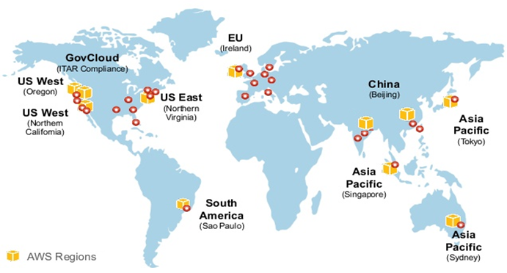
Big Data is Geo-Distributed
A large amount of data is generated rapidly, all over the world

Slide 4
Centralizing Data is Infeasible [1, 2, 3]
Moving data over wide-area networks (WANs) can be extremely slow
It is also subject to data sovereignty laws
1. Vulimiri et al., NSDI’15
2. Pu et al., SIGCOMM’15
3. Viswanathan et al., OSDI’16

Slide 5
Geo-distributed ML is Challenging
No ML system is designed to run across data centers (up to 53X slowdown in our study)

Slide 6
Our Goal
Develop a geo-distributed ML system
  Minimize communication over wide-area networks
  Retain the accuracy and correctness of ML algorithms
  Without requiring changes to the algorithms
Key Result: 1.8-53.5X speedup over state-of-the-art ML systems on WANs

Slide 7
Outline
Problem & Goal
Background & Motivation
Gaia System Overview
Approximate Synchronous Parallel
System Implementation
Evaluation
Conclusion

Slide 8

Background: Parameter Server Architecture
The parameter server architecture has been widely adopted in many ML systems
Training Data
Data 1
…
Data N
…
Worker Machine 1
Worker Machine N
Update
Update
Update
Update
ML Model
Synchronization is critical to the accuracy and correctness of ML algorithms
…
Parameter
Server
Parameter
Server
Read
Read
Read
Read

Slide 9
Deploy Parameter Servers on WANs
Deploying parameter servers across data centers requires a lot of communication over WANs
Data Center 1
Data Center 2
…
Worker Machine 1
Worker Machine N
ML Model
…
Parameter
Server
Parameter
Server

Slide 10
WAN: Low Bandwidth and High Cost
WAN bandwidth is 15X smaller than LAN bandwidth on average, and up to 60X smaller
In Amazon EC2, the monetary cost of WAN communication is up to 38X the cost of renting machines
11 Amazon EC2 Regions
11 Amazon EC2 Regions

Slide 11
ML System Performance on WANs
Matrix Factorization
Running ML systems on WANs can seriously slow down ML applications
11 EC2 Regions
Cui et al., “Exploiting Iterative-ness for Parallel ML Computations”, SoCC’14
Wei et al., “Managed Communication and Consistency for Fast Data-Parallel Iterative Analytics”, SoCC’15
Singapore / São Paulo
Virginia / California

Slide 12
Outline
Problem & Goal
Background & Motivation
Gaia System Overview
Approximate Synchronous Parallel
System Implementation
Evaluation
Conclusion

Slide 13

Gaia System Overview
Key idea: Decouple the synchronization model within the data center from the synchronization model between data centers
Data Center 1
Data Center 2
Remote Sync
Worker Machine
…
Parameter
Server
Parameter
Server
Communicate over WANs
only significant updates
Worker Machine
Parameter
Server
Parameter
Server
…
Worker Machine
Local Sync
Approximately Correct Model Copy
Approximately Correct Model Copy

Slide 14
Key Finding: Study of Update Significance
The vast majority of updates are insignificant

Slide 15
Outline
Problem & Goal
Background & Motivation
Gaia System Overview
Approximate Synchronous Parallel
System Implementation
Evaluation
Conclusion

Slide 16
Approximate Synchronous Parallel
The significance filter
Filter updates based on their significance
ASP selective barrier
Ensure significant updates are read in time
Mirror clock
Safe guard for pathological cases

Slide 17


The Significance Filter
Worker Machine
Parameter
Server
Update (Δ₂) on X
Update (Δ₁) on X
Value
Aggregated Update
Parameter X
Δ₁
Δ₁+Δ₂
0
Other
Parameters
Significance Function
>?
Significance Threshold
1%
$$\left\|\frac{Agg. Update}{Value}\right\|$$
$$\frac{1\%}{\sqrt{T}}$$

Slide 18
Approximate Synchronous Parallel
The significance filter
Filter updates based on their significance
ASP selective barrier
Ensure significant updates are read in time
Mirror clock
Safeguard for pathological cases

Slide 19

ASP Selective Barrier
Data Center 1
Data Center 2
Significant Update
Significant Update
Significant Update
Significant Update
Parameter Server
Parameter Server
Only workers that depend on these parameters are blocked
Arrive too late!
Data Center 1
Data Center 2
SelectiveBarrier
Significant Update
Significant Update
Significant Update
Significant Update
Parameter Server
Parameter Server

Slide 20
Outline
Problem & Goal
Background & Motivation
Gaia System Overview
Approximate Synchronous Parallel
System Implementation
Evaluation
Conclusion

Slide 21
Put it All Together: The Gaia System
Data Center Boundary
Control messages (barriers, etc.) are always prioritized
Gaia Parameter Server
Gaia Parameter Server
Worker Machine
Parameter Store
Update
Local Server
Aggregated Update
…
Worker Machine
Mirror Server
Control Queue
No change is required for ML algorithms and ML programs
Significance Filter
Mirror Client
SelectiveBarrier
Worker Machine
Data Queue

Slide 22
Problem: Broadcast Significant Updates
Communication overhead is proportional to the number of data centers

Slide 23
Mitigation: Overlay Networks and Hubs
Data Center Group
Data Center Group
Data Center Group
Hub
Hub
Hub
Hub
Data Center Group
Save communication on WANs by aggregating the updates at hubs

Slide 24
Outline
Problem & Goal
Background & Motivation
Gaia System Overview
Approximate Synchronous Parallel
System Implementation
Evaluation
Conclusion

Slide 25
Methodology
Applications
  Matrix Factorization with the Netflix dataset
  Topic Modeling with the Nytimes dataset
  Image Classification with the ILSVRC12 dataset
Hardware platform
  22 machines with emulated EC2 WAN bandwidth
  We validated the performance with a real EC2 deployment
Baseline
  IterStore (Cui et al., SoCC’14) and GeePS (Cui et al., EuroSys’16) on WAN
Performance metrics
  Execution time until algorithm convergence
  Monetary cost of algorithm convergence

Slide 26
Performance – 11 EC2 Data Centers
Gaia achieves 3.7-6.0X speedup over Baseline
Gaia is at most 1.40X of LAN speeds

Slide 27
Performance and WAN Bandwidth
Gaia achieves 3.7-53.5X speedup over Baseline
Gaia is at most 1.23X of LAN speeds
V/C WAN
(Virginia/California)
S/S WAN
(Singapore/São Paulo)

Slide 28
Results – EC2 Monetary Cost
Gaia is 2.6-59.0X cheaper than Baseline
Matrix Factorization
Topic Modeling
Image Classification

Slide 29
More in the Paper
Convergence proof of Approximate Synchronous Parallel (ASP)
ASP vs. fully asynchronous
Gaia vs. centralizing data approach

Slide 30
Key Takeaways
The Problem: How to perform ML on geo-distributed data?
  Centralizing data is infeasible. Geo-distributed ML is very slow
Our Gaia Approach
  Decouple the synchronization model within the data center from that across data centers
    Eliminate insignificant updates across data centers
  A new synchronization model: Approximate Synchronous Parallel
    Retain the correctness and accuracy of ML algorithms
Key Results:
  1.8-53.5X speedup over state-of-the-art ML systems on WANs
  at most 1.40X of LAN speeds
  without requiring changes to algorithms

Slide 31
Gaia: Geo-Distributed Machine Learning
Approaching LAN Speeds
Kevin Hsieh
Aaron Harlap, Nandita Vijaykumar, Dimitris Konomis,
Gregory R. Ganger, Phillip B. Gibbons, Onur Mutlu†
†

Slide 32
Executive Summary
The Problem: How to perform ML on geo-distributed data?
  Centralizing data is infeasible. Geo-distributed ML is very slow
Our Goal
  Minimize communication over WANs
  Retain the correctness and accuracy of ML algorithms
  Without requiring changes to ML algorithms
Our Gaia Approach
  Decouple the synchronization model within the data center from that across data centers: Eliminate insignificant updates on WANs
  A new synchronization model: Approximate Synchronous Parallel
Key Results:
  1.8-53.5X speedup over state-of-the-art ML systems on WANs
  within 1.40X of LAN speeds

Slide 33
Approximate Synchronous Parallel
The significance filter
Filter updates based their significance
ASP selective barrier
Ensure significant updates are read in time
Mirror clock
Safeguard for pathological cases

Slide 34
Mirror Clock
Data Center 1
Data Center 2
No guarantee under extreme network conditions
Barrier
Parameter Server
Parameter Server
Data Center 1
Data Center 2
Clock N
Clock N + DS
d
Guarantees all significant updates are seen after DS clocks
Clock N
Parameter Server
Parameter Server

Slide 35
Effect of Synchronization Mechanisms
Matrix Factorization
Topic Modeling

Slide 36
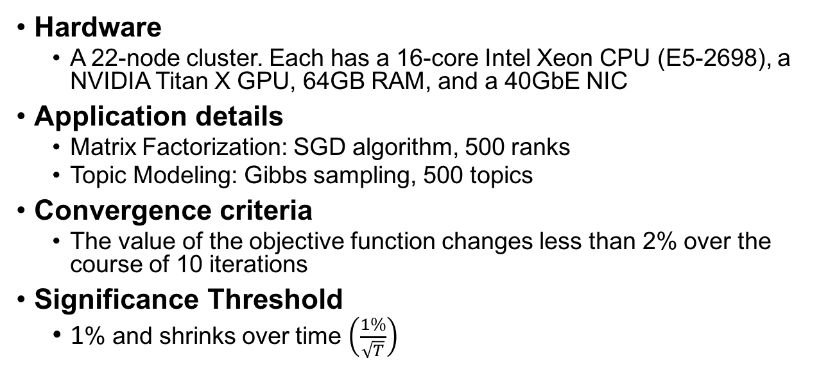
Methodology Details
Hardware
  A 22-node cluster. Each has a 16-core Intel Xeon CPU (E5-2698), a NVIDIA Titan X GPU, 64GB RAM, and a 40GbE NIC
Application details
  Matrix Factorization: SGD algorithm, 500 ranks
  Topic Modeling: Gibbs sampling, 500 topics
Convergence criteria
  The value of the objective function changes less than 2% over the course of 10 iterations
Significance Threshold
  1% and shrinks over time $\left(\frac{1\%}{\sqrt{T}}\right)$

Slide 37
ML System Performance Comparison
IterStore [Cui et al. SoCC’15] shows 10X performance improvement over PowerGraph [Gonzalez et al., OSDI’12] for Matrix Factorization
PowerGraph matches the performance of GraphX [Gonzalez et al., OSDI’14], a Spark-based system

Slide 38
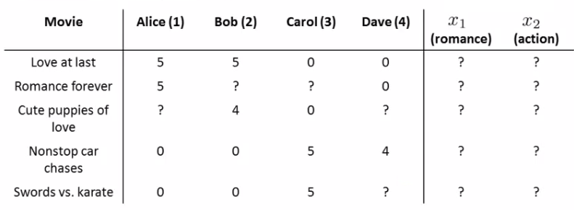
Matrix Factorization (1/3)
Matrix factorization (also known as collaborative filtering) is a technique commonly used in recommender systems

Slide 39


Matrix Factorization (2/3)
Movie
Rank (User Preference Parameters) (θ)
Rank (Movie Parameters) (x)
$$≅$$
$$∙$$
User

Slide 40
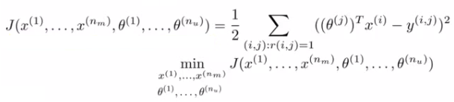
Matrix Factorization (3/3)
Objective function (L2 regularization)
Solve with stochastic gradient decent (SGD)

Slide 41
Background – BSP
BSP (Bulk Synchronous Parallel)
  All machines need to receive all updates before proceeding to the next iteration
Always sends and reads all updates
Accurate but slow
Worker 1
Worker 2
Worker 3
Clock
0
1
2
3

Slide 42
Background – SSP
SSP (Stale Synchronous Parallel)
  Allows the fastest worker ahead of the slowest worker by a bounded number of iterations
Alleviates the network bandwidth requirement, but still sends all updates
Worker 1
Worker 2
Worker 3
Clock
0
1
2
3
Staleness = 1

Slide 43
Compare Against Centralizing Approach
 |  | Gaia Speedup over Centralize | Gaia to Centralize Cost Ratio
Matrix Factorization | EC2-ALL | 1.11 | 3.54
 | V/C WAN | 1.22 | 1.00
 | S/S WAN | 2.13 | 1.17
Topic Modeling | EC2-ALL | 0.80 | 6.14
 | V/C WAN | 1.02 | 1.26
 | S/S WAN | 1.25 | 1.92
Image Classification | EC2-ALL | 0.76 | 3.33
 | V/C WAN | 1.12 | 1.07
 | S/S WAN | 1.86 | 1.08

Slide 44
SSP Performance – 11 Data Centers
Matrix Factorization

Slide 45
SSP Performance – 11 Data Centers
Topic Modeling

Slide 46
SSP Performance – V/C WAN
Matrix Factorization
Topic Modeling

Slide 47
SSP Performance – S/S WAN
Matrix Factorization
Topic Modeling

