Slide 1
Scalable Many-Core Memory Systems Lecture 3, Topic 2: Emerging Technologies and Hybrid Memories
Prof. Onur Mutlu
http://www.ece.cmu.edu/~omutlu
onur@cmu.edu
HiPEAC ACACES Summer School 2013
July 17, 2013

Slide 2
What Will You Learn in This Course?
Scalable Many-Core Memory Systems
July 15-19, 2013
Topic 1: Main memory basics, DRAM scaling
Topic 2: Emerging memory technologies and hybrid memories
Topic 3: Main memory interference and QoS
Topic 4 (unlikely): Cache management
Topic 5 (unlikely): Interconnects
Major Overview Reading:
Mutlu, “Memory Scaling: A Systems Architecture Perspective,” IMW 2013.

Slide 3
Readings and Videos

Slide 4
Course Information
Website for Course Slides and Papers
http://users.ece.cmu.edu/~omutlu/acaces2013-memory.html
http://users.ece.cmu.edu/~omutlu
Lecture notes and readings are uploaded
My Contact Information
Onur Mutlu
onur@cmu.edu
http://users.ece.cmu.edu/~omutlu
+1-512-658-0891 (my cell phone)
Find me during breaks and/or email any time.

Slide 5
Memory Lecture Videos
Memory Hierarchy (and Introduction to Caches)
http://www.youtube.com/watch?v=JBdfZ5i21cs&list=PL5PHm2jkkXmidJOd59REog9jDnPDTG6IJ&index=22
Main Memory
http://www.youtube.com/watch?v=ZLCy3pG7Rc0&list=PL5PHm2jkkXmidJOd59REog9jDnPDTG6IJ&index=25
Memory Controllers, Memory Scheduling, Memory QoS
http://www.youtube.com/watch?v=ZSotvL3WXmA&list=PL5PHm2jkkXmidJOd59REog9jDnPDTG6IJ&index=26
http://www.youtube.com/watch?v=1xe2w3_NzmI&list=PL5PHm2jkkXmidJOd59REog9jDnPDTG6IJ&index=27
Emerging Memory Technologies
http://www.youtube.com/watch?v=LzfOghMKyA0&list=PL5PHm2jkkXmidJOd59REog9jDnPDTG6IJ&index=35
Multiprocessor Correctness and Cache Coherence
http://www.youtube.com/watch?v=U-VZKMgItDM&list=PL5PHm2jkkXmidJOd59REog9jDnPDTG6IJ&index=32

Slide 6
Readings for Topic 1 (DRAM Scaling)
Lee et al., “Tiered-Latency DRAM: A Low Latency and Low Cost DRAM Architecture,” HPCA 2013.
Liu et al., “RAIDR: Retention-Aware Intelligent DRAM Refresh,” ISCA 2012.
Kim et al., “A Case for Exploiting Subarray-Level Parallelism in DRAM,” ISCA 2012.
Liu et al., “An Experimental Study of Data Retention Behavior in Modern DRAM Devices,” ISCA 2013.
Seshadri et al., “RowClone: Fast and Efficient In-DRAM Copy and Initialization of Bulk Data,” CMU CS Tech Report 2013.
David et al., “Memory Power Management via Dynamic Voltage/Frequency Scaling,” ICAC 2011.
Ipek et al., “Self Optimizing Memory Controllers: A Reinforcement Learning Approach,” ISCA 2008.

Slide 7
Readings for Topic 2 (Emerging Technologies)
Lee, Ipek, Mutlu, Burger, “Architecting Phase Change Memory as a Scalable DRAM Alternative,” ISCA 2009, CACM 2010, Top Picks 2010.
Qureshi et al., “Scalable high performance main memory system using phase-change memory technology,” ISCA 2009.
Meza et al., “Enabling Efficient and Scalable Hybrid Memories,” IEEE Comp. Arch. Letters 2012.
Yoon et al., “Row Buffer Locality Aware Caching Policies for Hybrid Memories,” ICCD 2012 Best Paper Award.
Meza et al., “A Case for Efficient Hardware-Software Cooperative Management of Storage and Memory,” WEED 2013.
Kultursay et al., “Evaluating STT-RAM as an Energy-Efficient Main Memory Alternative,” ISPASS 2013.

Slide 8
Readings for Topic 3 (Memory QoS)
Moscibroda and Mutlu, “Memory Performance Attacks,” USENIX Security 2007.
Mutlu and Moscibroda, “Stall-Time Fair Memory Access Scheduling,” MICRO 2007.
Mutlu and Moscibroda, “Parallelism-Aware Batch Scheduling,” ISCA 2008, IEEE Micro 2009.
Kim et al., “ATLAS: A Scalable and High-Performance Scheduling Algorithm for Multiple Memory Controllers,” HPCA 2010.
Kim et al., “Thread Cluster Memory Scheduling,” MICRO 2010, IEEE Micro 2011.
Muralidhara et al., “Memory Channel Partitioning,” MICRO 2011.
Ausavarungnirun et al., “Staged Memory Scheduling,” ISCA 2012.
Subramanian et al., “MISE: Providing Performance Predictability and Improving Fairness in Shared Main Memory Systems,” HPCA 2013.
Das et al., “Application-to-Core Mapping Policies to Reduce Memory System Interference in Multi-Core Systems,” HPCA 2013.

Slide 9
Readings for Topic 3 (Memory QoS)
Ebrahimi et al., “Fairness via Source Throttling,” ASPLOS 2010, ACM TOCS 2012.
Lee et al., “Prefetch-Aware DRAM Controllers,” MICRO 2008, IEEE TC 2011.
Ebrahimi et al., “Parallel Application Memory Scheduling,” MICRO 2011.
Ebrahimi et al., “Prefetch-Aware Shared Resource Management for Multi-Core Systems,” ISCA 2011.

Slide 10
Readings in Flash Memory
Yu Cai, Gulay Yalcin, Onur Mutlu, Erich F. Haratsch, Adrian Cristal, Osman Unsal, and Ken Mai, "Error Analysis and Retention-Aware Error Management for NAND Flash Memory" Intel Technology Journal (ITJ) Special Issue on Memory Resiliency, Vol. 17, No. 1, May 2013.
Yu Cai, Erich F. Haratsch, Onur Mutlu, and Ken Mai, "Threshold Voltage Distribution in MLC NAND Flash Memory: Characterization, Analysis and Modeling" Proceedings of the Design, Automation, and Test in Europe Conference (DATE), Grenoble, France, March 2013. Slides (ppt)
Yu Cai, Gulay Yalcin, Onur Mutlu, Erich F. Haratsch, Adrian Cristal, Osman Unsal, and Ken Mai, "Flash Correct-and-Refresh: Retention-Aware Error Management for Increased Flash Memory Lifetime" Proceedings of the 30th IEEE International Conference on Computer Design (ICCD), Montreal, Quebec, Canada, September 2012. Slides (ppt) (pdf)
Yu Cai, Erich F. Haratsch, Onur Mutlu, and Ken Mai, "Error Patterns in MLC NAND Flash Memory: Measurement, Characterization, and Analysis" Proceedings of the Design, Automation, and Test in Europe Conference (DATE), Dresden, Germany, March 2012. Slides (ppt)

Slide 11
Online Lectures and More Information
Online Computer Architecture Lectures
http://www.youtube.com/playlist?list=PL5PHm2jkkXmidJOd59REog9jDnPDTG6IJ
Online Computer Architecture Courses
Intro: http://www.ece.cmu.edu/~ece447/s13/doku.php
Advanced: http://www.ece.cmu.edu/~ece740/f11/doku.php
Advanced: http://www.ece.cmu.edu/~ece742/doku.php
Recent Research Papers
http://users.ece.cmu.edu/~omutlu/projects.htm
http://scholar.google.com/citations?user=7XyGUGkAAAAJ&hl=en

Slide 12
Emerging Memory Technologies

Slide 13
Agenda
Major Trends Affecting Main Memory
Requirements from an Ideal Main Memory System
Opportunity: Emerging Memory Technologies
Conclusions
Discussion

Slide 14
Major Trends Affecting Main Memory (I)
Need for main memory capacity and bandwidth increasing
Main memory energy/power is a key system design concern
DRAM technology scaling is ending

Slide 15
Trends: Problems with DRAM as Main Memory
Need for main memory capacity and bandwidth increasing
DRAM capacity hard to scale
Main memory energy/power is a key system design concern
DRAM consumes high power due to leakage and refresh
DRAM technology scaling is ending
DRAM capacity, cost, and energy/power hard to scale

Slide 16
Agenda
Major Trends Affecting Main Memory
Requirements from an Ideal Main Memory System
Opportunity: Emerging Memory Technologies
Conclusions
Discussion

Slide 17
Requirements from an Ideal Memory System
Traditional
Enough capacity
Low cost
High system performance (high bandwidth, low latency)
New
Technology scalability: lower cost, higher capacity, lower energy
Energy (and power) efficiency
QoS support and configurability (for consolidation)

Slide 18
Requirements from an Ideal Memory System
Traditional
Higher capacity
Continuous low cost
High system performance (higher bandwidth, low latency)
New
Technology scalability: lower cost, higher capacity, lower energy
Energy (and power) efficiency
QoS support and configurability (for consolidation)
Emerging, resistive memory technologies (NVM) can help

Slide 19
Review: Solutions to the DRAM Scaling Problem
Two potential solutions
Tolerate DRAM (by taking a fresh look at it)
Enable emerging memory technologies to eliminate/minimize DRAM
Do both
Hybrid memory systems

Slide 20
Solution 1: Tolerate DRAM
Overcome DRAM shortcomings with
System-DRAM co-design
Novel DRAM architectures, interface, functions
Better waste management (efficient utilization)
Key issues to tackle
Reduce refresh energy
Improve bandwidth and latency
Reduce waste
Enable reliability at low cost
Liu, Jaiyen, Veras, Mutlu, “RAIDR: Retention-Aware Intelligent DRAM Refresh,” ISCA 2012.
Kim, Seshadri, Lee+, “A Case for Exploiting Subarray-Level Parallelism in DRAM,” ISCA 2012.
Lee+, “Tiered-Latency DRAM: A Low Latency and Low Cost DRAM Architecture,” HPCA 2013.
Liu+, “An Experimental Study of Data Retention Behavior in Modern DRAM Devices” ISCA’13.
Seshadri+, “RowClone: Fast and Efficient In-DRAM Copy and Initialization of Bulk Data,” 2013.

Slide 21
Solution 2: Emerging Memory Technologies
Some emerging resistive memory technologies seem more scalable than DRAM (and they are non-volatile)
Example: Phase Change Memory
Expected to scale to 9nm (2022 [ITRS])
Expected to be denser than DRAM: can store multiple bits/cell
But, emerging technologies have shortcomings as well
Can they be enabled to replace/augment/surpass DRAM?
Lee, Ipek, Mutlu, Burger, “Architecting Phase Change Memory as a Scalable DRAM Alternative,” ISCA 2009, CACM 2010, Top Picks 2010.
Meza, Chang, Yoon, Mutlu, Ranganathan, “Enabling Efficient and Scalable Hybrid Memories,” IEEE Comp. Arch. Letters 2012.
Yoon, Meza et al., “Row Buffer Locality Aware Caching Policies for Hybrid Memories,” ICCD 2012 Best Paper Award.
Notes:
Even if DRAM continues to scale there could be benefits to examining and enabling these new technologies.

Slide 22
Hybrid Memory Systems
CPU
Meza+, “Enabling Efficient and Scalable Hybrid Memories,” IEEE Comp. Arch. Letters, 2012.
Yoon, Meza et al., “Row Buffer Locality Aware Caching Policies for Hybrid Memories,” ICCD 2012 Best Paper Award.
DRAMCtrl
PCM Ctrl
DRAM
Phase Change Memory (or Tech. X)
Fast, durable
Small,
leaky, volatile,
high-cost
Large, non-volatile, low-cost
Slow, wears out, high active energy
Hardware/software manage data allocation and movement
to achieve the best of multiple technologies

Slide 23
Agenda
Major Trends Affecting Main Memory
Requirements from an Ideal Main Memory System
Opportunity: Emerging Memory Technologies
Conclusions
Discussion

Slide 24
The Promise of Emerging Technologies
Likely need to replace/augment DRAM with a technology that is
Technology scalable
And at least similarly efficient, high performance, and fault-tolerant
or can be architected to be so
Some emerging resistive memory technologies appear promising
Phase Change Memory (PCM)?
Spin Torque Transfer Magnetic Memory (STT-MRAM)?
Memristors?
And, maybe there are other ones
Can they be enabled to replace/augment/surpass DRAM?

Slide 25
Agenda
Major Trends Affecting Main Memory
Requirements from an Ideal Main Memory System
Opportunity: Emerging Memory Technologies
Background
PCM (or Technology X) as DRAM Replacement
Hybrid Memory Systems
Conclusions
Discussion

Slide 26
Charge vs. Resistive Memories
Charge Memory (e.g., DRAM, Flash)
Write data by capturing charge Q
Read data by detecting voltage V
Resistive Memory (e.g., PCM, STT-MRAM, memristors)
Write data by pulsing current dQ/dt
Read data by detecting resistance R

Slide 27
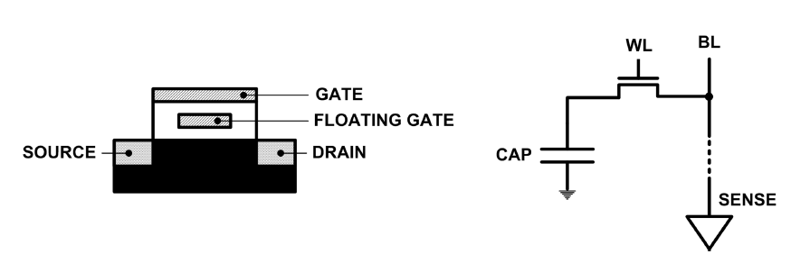
Limits of Charge Memory
Difficult charge placement and control
Flash: floating gate charge
DRAM: capacitor charge, transistor leakage
Reliable sensing becomes difficult as charge storage unit size reduces

Slide 28
Emerging Resistive Memory Technologies
PCM
Inject current to change material phase
Resistance determined by phase
STT-MRAM
Inject current to change magnet polarity
Resistance determined by polarity
Memristors
Inject current to change atomic structure
Resistance determined by atom distance

Slide 29
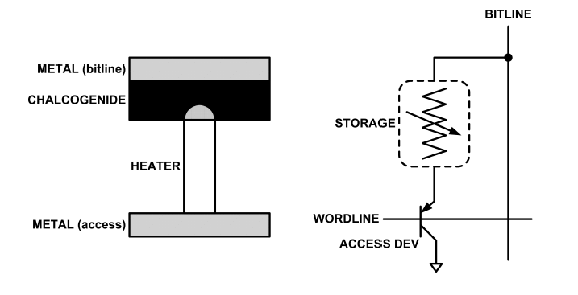
What is Phase Change Memory?
Phase change material (chalcogenide glass) exists in two states:
Amorphous: Low optical reflexivity and high electrical resistivity
Crystalline: High optical reflexivity and low electrical resistivity
PCM is resistive memory: High resistance (0), Low resistance (1)
PCM cell can be switched between states reliably and quickly

Slide 30
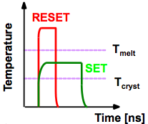
How Does PCM Work?
Write: change phase via current injection
SET: sustained current to heat cell above Tcryst
RESET: cell heated above Tmelt and quenched
Read: detect phase via material resistance
amorphous/crystalline
Large
Current
Small
Current
Memory
Element
SET (cryst)
Low resistance
Access
Device
RESET (amorph)
High resistance
10³-10⁴ Ω
10⁶-10⁷ Ω
Photo Courtesy: Bipin Rajendran, IBM
Slide Courtesy: Moinuddin Qureshi, IBM

Slide 31
Opportunity: PCM Advantages
Scales better than DRAM, Flash
Requires current pulses, which scale linearly with feature size
Expected to scale to 9nm (2022 [ITRS])
Prototyped at 20nm (Raoux+, IBM JRD 2008)
Can be denser than DRAM
Can store multiple bits per cell due to large resistance range
Prototypes with 2 bits/cell in ISSCC’08, 4 bits/cell by 2012
Non-volatile
Retain data for >10 years at 85C
No refresh needed, low idle power

Slide 32
Phase Change Memory Properties
Surveyed prototypes from 2003-2008 (ITRS, IEDM, VLSI, ISSCC)
Derived PCM parameters for F=90nm
Lee, Ipek, Mutlu, Burger, “Architecting Phase Change Memory as a Scalable DRAM Alternative,” ISCA 2009.

Slide 33
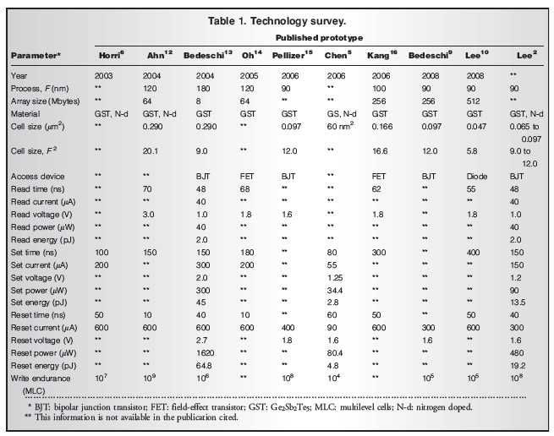

Slide 34
Phase Change Memory Properties: Latency
Latency comparable to, but slower than DRAM
Read Latency
50ns: 4x DRAM, 10⁻³x NAND Flash
Write Latency
150ns: 12x DRAM
Write Bandwidth
5-10 MB/s: 0.1x DRAM, 1x NAND Flash

Slide 35
Phase Change Memory Properties
Dynamic Energy
40 uA Rd, 150 uA Wr
2-43x DRAM, 1x NAND Flash
Endurance
Writes induce phase change at 650C
Contacts degrade from thermal expansion/contraction
10⁸ writes per cell
10⁻⁸x DRAM, 10³x NAND Flash
Cell Size
9-12F² using BJT, single-level cells
1.5x DRAM, 2-3x NAND (will scale with feature size, MLC)

Slide 36
Phase Change Memory: Pros and Cons
Pros over DRAM
Better technology scaling
Non volatility
Low idle power (no refresh)
Cons
Higher latencies: ~4-15x DRAM (especially write)
Higher active energy: ~2-50x DRAM (especially write)
Lower endurance (a cell dies after ~10⁸ writes)
Challenges in enabling PCM as DRAM replacement/helper:
Mitigate PCM shortcomings
Find the right way to place PCM in the system
Ensure secure and fault-tolerant PCM operation

Slide 37
PCM-based Main Memory: Research Challenges
Where to place PCM in the memory hierarchy?
Hybrid OS controlled PCM-DRAM
Hybrid OS controlled PCM and hardware-controlled DRAM
Pure PCM main memory
How to mitigate shortcomings of PCM?
How to minimize amount of DRAM in the system?
How to take advantage of (byte-addressable and fast) non-volatile main memory?
Can we design specific-NVM-technology-agnostic techniques?

Slide 38
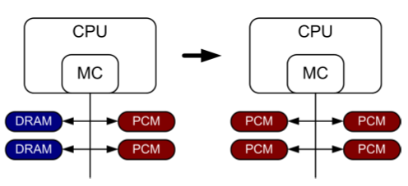
PCM-based Main Memory (I)
How should PCM-based (main) memory be organized?
Hybrid PCM+DRAM [Qureshi+ ISCA’09, Dhiman+ DAC’09, Meza+ IEEE CAL’12]:
How to partition/migrate data between PCM and DRAM

Slide 39
Hybrid Memory Systems: Challenges
Partitioning
Should DRAM be a cache or main memory, or configurable?
What fraction? How many controllers?
Data allocation/movement (energy, performance, lifetime)
Who manages allocation/movement?
What are good control algorithms?
How do we prevent degradation of service due to wearout?
Design of cache hierarchy, memory controllers, OS
Mitigate PCM shortcomings, exploit PCM advantages
Design of PCM/DRAM chips and modules
Rethink the design of PCM/DRAM with new requirements

Slide 40
PCM-based Main Memory (II)
How should PCM-based (main) memory be organized?
Pure PCM main memory [Lee et al., ISCA’09, Top Picks’10]:
How to redesign entire hierarchy (and cores) to overcome PCM shortcomings

Slide 41
Aside: STT-RAM Basics
Magnetic Tunnel Junction (MTJ)
Reference layer: Fixed
Free layer: Parallel or anti-parallel
Cell
Access transistor, bit/sense lines
Read and Write
Read: Apply a small voltage across bitline and senseline; read the current.
Write: Push large current through MTJ. Direction of current determines new orientation of the free layer.
Kultursay et al., “Evaluating STT-RAM as an Energy-Efficient Main Memory Alternative,” ISPASS 2013
Logical 0
Reference Layer
Barrier
Free Layer
Logical 1
Reference Layer
Barrier
Free Layer
Word Line
MTJ
Access
Transistor
Bit Line
Sense Line
Notes:
Moving from DRAM to STT-RAM, instead of a capacitor that stores charge, now we have a magnetic tunnel junction that has one reference layer with a fixed magnetic orientation, and a free layer that can be parallel or anti parallel to the reference layer; which determines the resistance, and in turn, the data stored in the MTJ. In addition to the MTJ, the cell, again, has an access transistor.
Reading requires a small voltage to be applied across the bitline and sense line; and the current is sensed. This current varies depending on the resistance of MTJ. To write data, we push a large current into the MTJ, which re-aligns the free layer. The direction of the current determines whether it becomes parallel or anti-parallel; i.e. logical 0 or 1.

Slide 42
Aside: STT MRAM: Pros and Cons
Pros over DRAM
Better technology scaling
Non volatility
Low idle power (no refresh)
Cons
Higher write latency
Higher write energy
Reliability?
Another level of freedom
Can trade off non-volatility for lower write latency/energy (by reducing the size of the MTJ)

Slide 43
Agenda
Major Trends Affecting Main Memory
Requirements from an Ideal Main Memory System
Opportunity: Emerging Memory Technologies
Background
PCM (or Technology X) as DRAM Replacement
Hybrid Memory Systems
Conclusions
Discussion

Slide 44
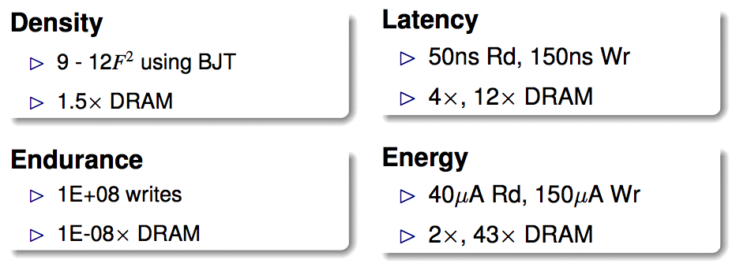
An Initial Study: Replace DRAM with PCM
Lee, Ipek, Mutlu, Burger, “Architecting Phase Change Memory as a Scalable DRAM Alternative,” ISCA 2009.
Surveyed prototypes from 2003-2008 (e.g. IEDM, VLSI, ISSCC)
Derived “average” PCM parameters for F=90nm

Slide 45
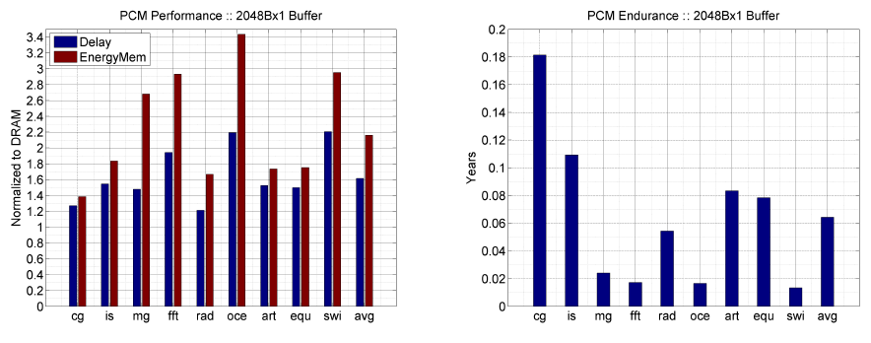
Results: Naïve Replacement of DRAM with PCM
Replace DRAM with PCM in a 4-core, 4MB L2 system
PCM organized the same as DRAM: row buffers, banks, peripherals
1.6x delay, 2.2x energy, 500-hour average lifetime
Lee, Ipek, Mutlu, Burger, “Architecting Phase Change Memory as a Scalable DRAM Alternative,” ISCA 2009.

Slide 46
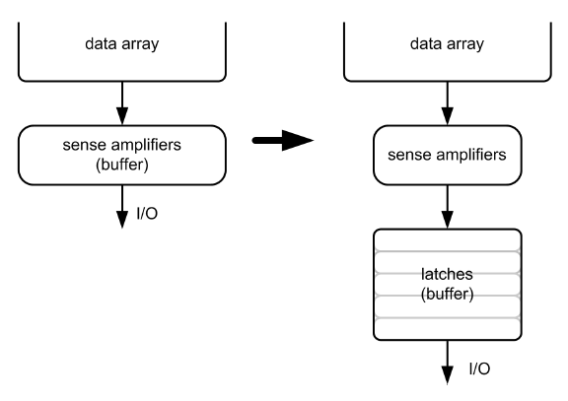
Architecting PCM to Mitigate Shortcomings
Idea 1: Use multiple narrow row buffers in each PCM chip
→ Reduces array reads/writes → better endurance, latency, energy
Idea 2: Write into array at
cache block or word
granularity
→ Reduces unnecessary wear
DRAM
PCM

Slide 47
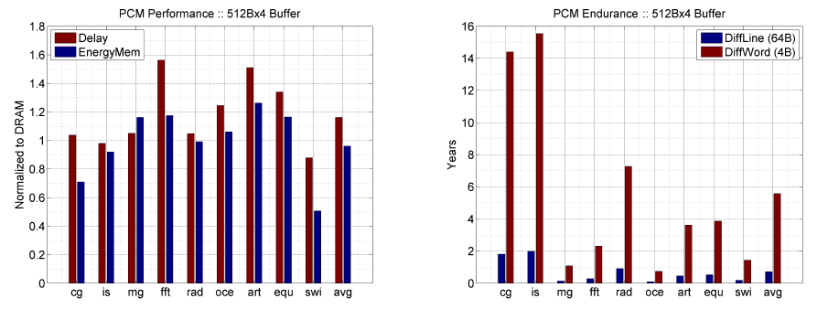
Results: Architected PCM as Main Memory
1.2x delay, 1.0x energy, 5.6-year average lifetime
Scaling improves energy, endurance, density
Caveat 1: Worst-case lifetime is much shorter (no guarantees)
Caveat 2: Intensive applications see large performance and energy hits
Caveat 3: Optimistic PCM parameters?

Slide 48
Agenda
Major Trends Affecting Main Memory
Requirements from an Ideal Main Memory System
Opportunity: Emerging Memory Technologies
Background
PCM (or Technology X) as DRAM Replacement
Hybrid Memory Systems
Conclusions
Discussion

Slide 49
Hybrid Memory Systems
CPU
Meza, Chang, Yoon, Mutlu, Ranganathan, “Enabling Efficient and Scalable Hybrid Memories,” IEEE Comp. Arch. Letters, 2012.
DRAMCtrl
PCM Ctrl
DRAM
Phase Change Memory (or Tech. X)
Fast, durable
Small,
leaky, volatile,
high-cost
Large, non-volatile, low-cost
Slow, wears out, high active energy
Hardware/software manage data allocation and movement
to achieve the best of multiple technologies

Slide 50
One Option: DRAM as a Cache for PCM
PCM is main memory; DRAM caches memory rows/blocks
Benefits: Reduced latency on DRAM cache hit; write filtering
Memory controller hardware manages the DRAM cache
Benefit: Eliminates system software overhead
Three issues:
What data should be placed in DRAM versus kept in PCM?
What is the granularity of data movement?
How to design a low-cost hardware-managed DRAM cache?
Two idea directions:
Locality-aware data placement [Yoon+ , ICCD 2012]
Cheap tag stores and dynamic granularity [Meza+, IEEE CAL 2012]

