Slide 1
Memory-Centric Computing
Onur Mutlu
omutlu@gmail.com
https://people.inf.ethz.ch/omutlu
13 July 2023
Lightning Talk @ DAC

Slide 2
The Problem
Computing
is Bottlenecked by Data

Slide 3
Data is Key for AI, ML, Genomics, …
Important workloads are all data intensive
They require rapid and efficient processing of large amounts of data
Data is increasing
We can generate more than we can process
We need to perform more sophisticated analyses on more data

Slide 4
Huge Demand for Performance & Efficiency
Source: https://youtu.be/Bh13Idwcb0Q?t=283

Slide 5
Data is Key for Future Workloads
In-memory Databases
[Mao+, EuroSys’12; Clapp+ (Intel), IISWC’15]
Graph/Tree Processing
[Xu+, IISWC’12; Umuroglu+, FPL’15]
In-Memory Data Analytics
[Clapp+ (Intel), IISWC’15;
Awan+, BDCloud’15]
Datacenter Workloads [Kanev+ (Google), ISCA’15]

Slide 6
Data Overwhelms Modern Machines
In-memory Databases
[Mao+, EuroSys’12; Clapp+ (Intel), IISWC’15]
Graph/Tree Processing
[Xu+, IISWC’12; Umuroglu+, FPL’15]
Data → performance & energy bottleneck
In-Memory Data Analytics
[Clapp+ (Intel), IISWC’15;
Awan+, BDCloud’15]
Datacenter Workloads [Kanev+ (Google), ISCA’15]

Slide 7
Data is Key for Future Workloads
Chrome
TensorFlow Mobile
Google’s web browser
Google’s machine learning framework
Video Playback
Video Capture
Google’s video codec
Google’s video codec
Notes:
In this work, we take a look at widely-used google consumer workloads, to figure out the major sources of energy consumption.
We look at Google Chrome web brower. We take a look at Tensorflow, Google’s machine learning framework, and we also take a look at two important video related workloads, video playback and video capture, both rely on Google’s vp9 codec technology.

Slide 8
Data Overwhelms Modern Machines
Chrome
TensorFlow Mobile
Google’s web browser
Google’s machine learning framework
Data → performance & energy bottleneck
Video Playback
Video Capture
Google’s video codec
Google’s video codec
Notes:
In this work, we take a look at widely-used google consumer workloads, to figure out the major sources of energy consumption.
We look at Google Chrome web brower. We take a look at Tensorflow, Google’s machine learning framework, and we also take a look at two important video related workloads, video playback and video capture, both rely on Google’s vp9 codec technology.

Slide 9
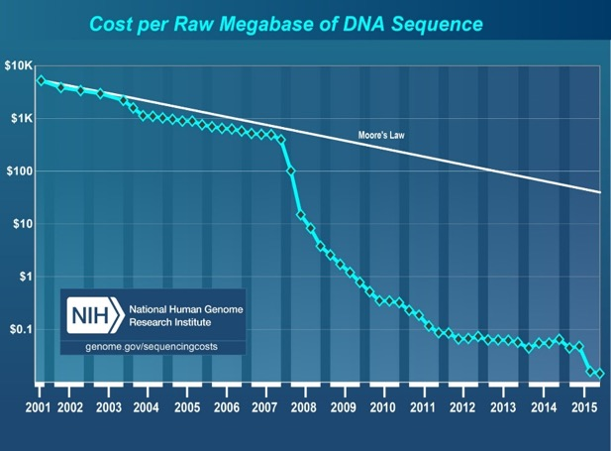
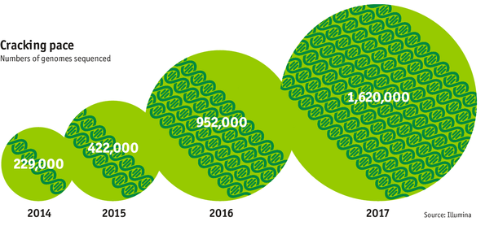
Data is Key for Future Workloads
development of high-throughput sequencing (HTS) technologies
Number of Genomes Sequenced
http://www.economist.com/news/21631808-so-much-genetic-data-so-many-uses-genes-unzipped
Notes:
However, since the development of high throughput sequencing (HTS) technologies, the cost of genome sequencing has fallen off a cliff (<< 1,000$) making it viable for almost everyone's use.

Slide 10
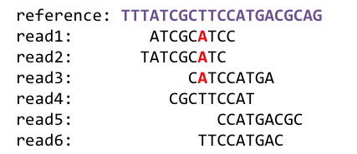
1
Sequencing
Genome Analysis
Read Mapping
2
Data → performance & energy bottleneck
Variant Calling
Scientific Discovery
3
4
Notes:
Genome analysis starts with sequencing random short DNA fragments of copies of the original molecule.
Unfortunately, these reads lack information about their order and which part of genome they are originated from.
Hence the second step is to map these reads to a long reference genome.

Slide 11
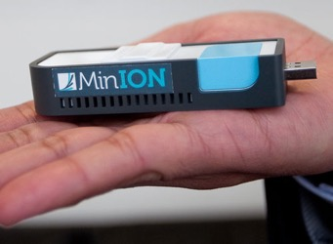
New Genome Sequencing Technologies
Oxford Nanopore MinION
Senol Cali+, “Nanopore Sequencing Technology and Tools for Genome
Assembly: Computational Analysis of the Current State, Bottlenecks
and Future Directions,” Briefings in Bioinformatics, 2018.
[Open arxiv.org version]

Slide 12
New Genome Sequencing Technologies
Oxford Nanopore MinION
Senol Cali+, “Nanopore Sequencing Technology and Tools for Genome
Assembly: Computational Analysis of the Current State, Bottlenecks
and Future Directions,” Briefings in Bioinformatics, 2018.
[Preliminary arxiv.org version]
Data → performance & energy bottleneck

Slide 13
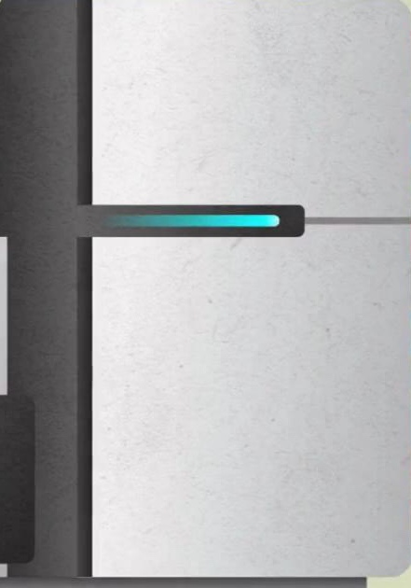
Problems with Data Analysis Today
Special-Purpose Machine
for Data Generation
General-Purpose Machine
for Data Analysis
FAST SLOW
Slow and inefficient processing capability
Large amounts of data movement
This picture is similar for many “data generators & analyzers” today

Slide 14
Accelerating Genome Analysis [DAC 2023]
Onur Mutlu and Can Firtina, "Accelerating Genome Analysis via Algorithm-Architecture Co-Design" Invited Special Session Paper in Proceedings of the 60th Design Automation Conference (DAC), San Francisco, CA, USA, July 2023. [arXiv version]
https://arxiv.org/pdf/2305.00492.pdf

Slide 15
Data Overwhelms Modern Machines …
Storage/memory capability
Communication capability
Computation capability
Greatly impacts robustness, energy, performance, cost

Slide 16
A Computing System
Three key components
Computation
Communication
Storage/memory
Burks, Goldstein, von Neumann, “Preliminary discussion of the
logical design of an electronic computing instrument,” 1946.
Image source: https://lbsitbytes2010.wordpress.com/2013/03/29/john-von-neumann-roll-no-15/

Slide 17
Today’s Computing Systems
Processor centric
All data processed in the processor → at great system cost

Slide 18
The Problem
Data access is the major performance and energy bottleneck
Our current
design principles
cause great energy waste
(and great performance loss)

Slide 19
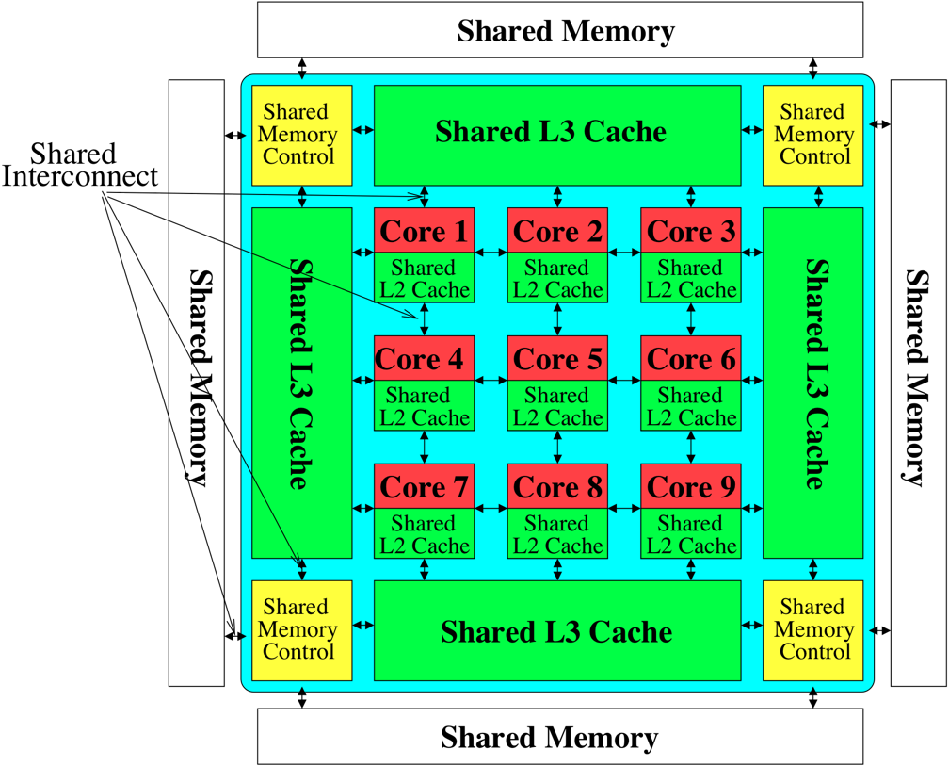
Perils of Processor-Centric Design
Most of the system is dedicated to storing and moving data
Yet, system is still bottlenecked by memory & storage

Slide 20
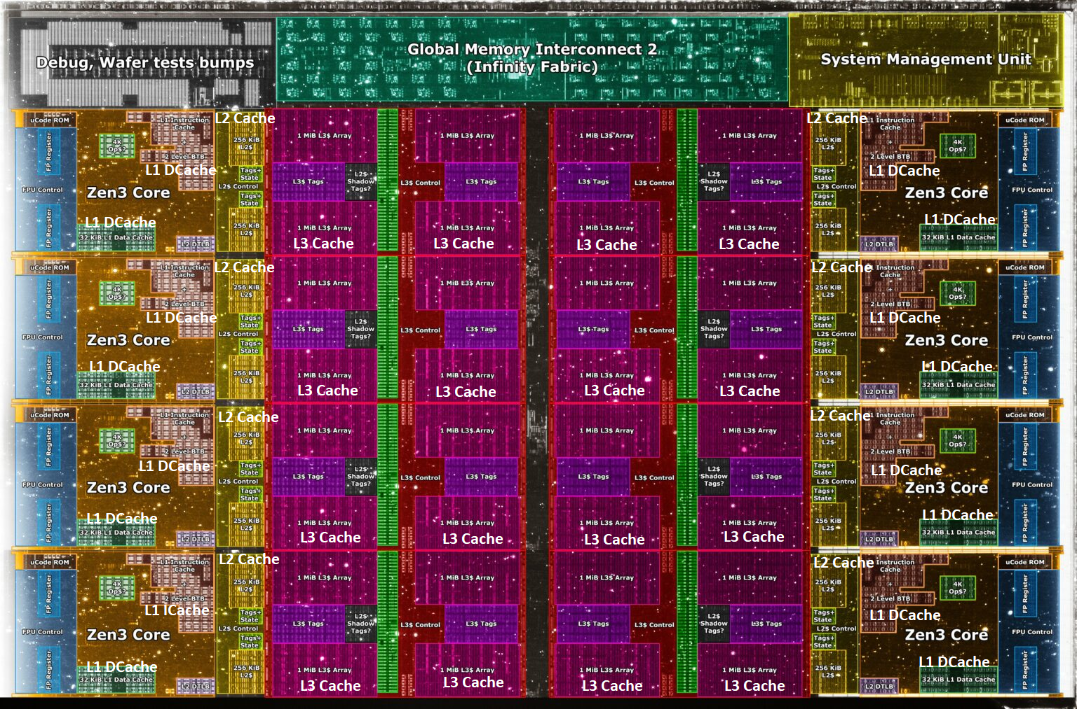
Deeper and Larger Memory Hierarchies
Core Count:
8 cores/16 threads
L1 Caches:
32 KB per core
L2 Caches:
512 KB per core
L3 Cache:
32 MB shared
AMD Ryzen 5000, 2020
https://wccftech.com/amd-ryzen-5000-zen-3-vermeer-undressed-high-res-die-shots-close-ups-pictured-detailed/

Slide 21
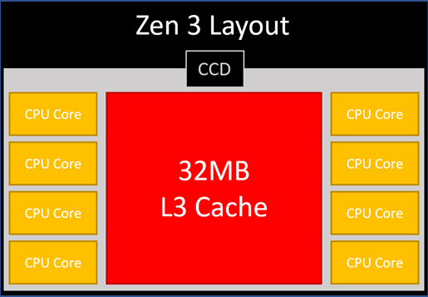
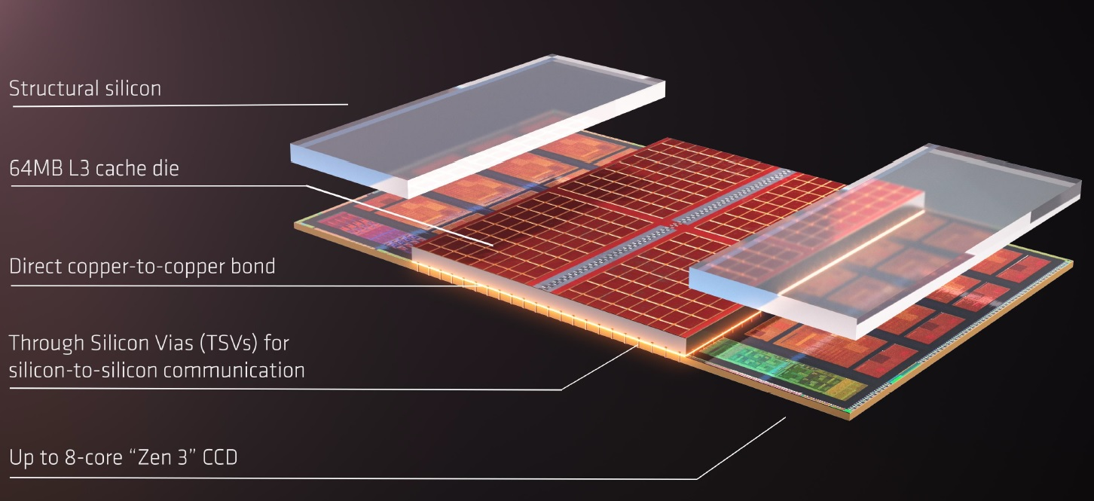
AMD’s 3D Last Level Cache (2021)
AMD increases the L3 size of their 8-core Zen 3 processors from 32 MB to 96 MB
Additional 64 MB L3 cache die stacked on top of the processor die
- Connected using Through Silicon Vias (TSVs)
- Total of 96 MB L3 cache
https://community.microcenter.com/discussion/5134/comparing-zen-3-to-zen-2
https://youtu.be/gqAYMx34euU
https://www.tech-critter.com/amd-keynote-computex-2021/
Notes:
CCD = Core Chiplet Die
Structural silicon is used to equalize the height and facilitate heat dissipation from the cores.

Slide 22
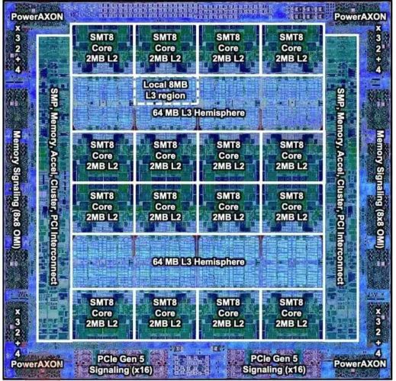
Deeper and Larger Memory Hierarchies
IBM POWER10,
2020
Cores:
15-16 cores,
8 threads/core
L2 Caches:
2 MB per core
L3 Cache:
120 MB shared
https://www.it-techblog.de/ibm-power10-prozessor-mehr-speicher-mehr-tempo-mehr-sicherheit/09/2020/

Slide 23
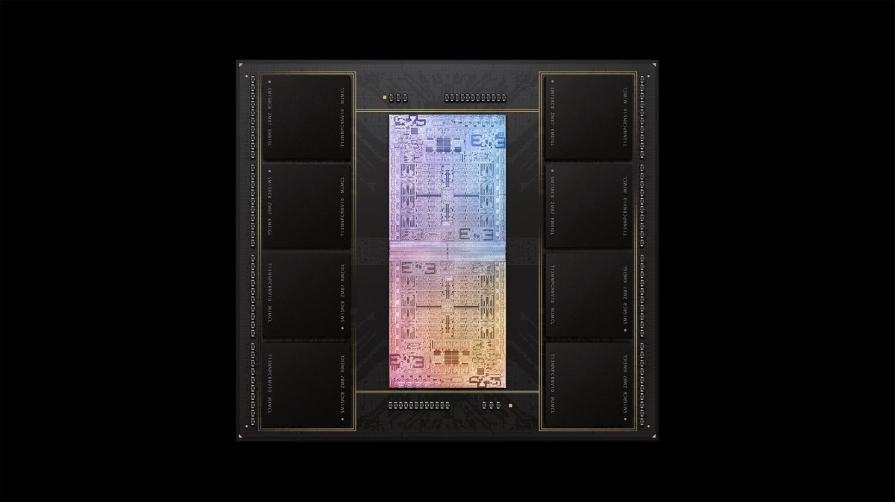
Deeper and Larger Memory Hierarchies
A lot of
SRAM
Storage
DRAM
DRAM
Storage
Apple M1 Ultra System (2022)
https://www.gsmarena.com/apple_announces_m1_ultra_with_20core_cpu_and_64core_gpu-news-53481.php

Slide 24
Data Overwhelms Modern Machines
Chrome
TensorFlow Mobile
Google’s web browser
Google’s machine learning framework
Data → performance & energy bottleneck
Video Playback
Video Capture
Google’s video codec
Google’s video codec
Notes:
In this work, we take a look at widely-used google consumer workloads, to figure out the major sources of energy consumption.
We look at Google Chrome web brower. We take a look at Tensorflow, Google’s machine learning framework, and we also take a look at two important video related workloads, video playback and video capture, both rely on Google’s vp9 codec technology.

Slide 25
Data Movement Overwhelms Modern Machines
Amirali Boroumand, Saugata Ghose, Youngsok Kim, Rachata Ausavarungnirun, Eric Shiu, Rahul Thakur, Daehyun Kim, Aki Kuusela, Allan Knies, Parthasarathy Ranganathan, and Onur Mutlu, "Google Workloads for Consumer Devices: Mitigating Data Movement Bottlenecks" Proceedings of the 23rd International Conference on Architectural Support for Programming Languages and Operating Systems (ASPLOS), Williamsburg, VA, USA, March 2018.
62.7% of the total system energy
is spent on data movement

Slide 26
Data Movement Overwhelms Accelerators
Amirali Boroumand, Saugata Ghose, Berkin Akin, Ravi Narayanaswami, Geraldo F. Oliveira, Xiaoyu Ma, Eric Shiu, and Onur Mutlu, "Google Neural Network Models for Edge Devices: Analyzing and Mitigating Machine Learning Inference Bottlenecks" Proceedings of the 30th International Conference on Parallel Architectures and Compilation Techniques (PACT), Virtual, September 2021. [Slides (pptx) (pdf)] [Talk Video (14 minutes)]
> 90% of the total system energy
is spent on memory in large ML models

Slide 27
Data Movement vs. Computation Energy
Dally, HiPEAC 2015
A memory access consumes ~100-1000X
the energy of a complex addition

Slide 28
Data Movement vs. Computation Energy
Han+, “EIE: Efficient Inference Engine on Compressed Deep Neural Network,” ISCA 2016.

Slide 29
Data Movement vs. Computation Energy
6400X
A memory access consumes 6400X
the energy of a simple integer addition
Han+, “EIE: Efficient Inference Engine on Compressed Deep Neural Network,” ISCA 2016.

Slide 30
Powerful Processors Mostly Wait for Data
All of Google’s Data Center Workloads (2015):
Kanev+, “Profiling a Warehouse-Scale Computer,” ISCA 2015.

Slide 31
The Problem
Processing of data
is performed
far away from the data

Slide 32
We Do Not Want to Move Data!
Dally, HiPEAC 2015
A memory access consumes ~100-1000X
the energy of a complex addition

Slide 33
We Need A Paradigm Shift To …
Enable computation with minimal data movement
Compute where it makes sense (where data resides)
Make computing architectures more data-centric

Slide 34
Processing Data Where It Makes Sense

Slide 35
Process Data Where It Makes Sense
Sensors
A lot of
SRAM
Storage
DRAM
DRAM
Storage
Apple M1 Ultra System (2022)
https://www.gsmarena.com/apple_announces_m1_ultra_with_20core_cpu_and_64core_gpu-news-53481.php

Slide 36
Goal: Processing in Memory/Storage
Many questions … How do we design the:
compute-capable memory & controllers?
processors & communication units?
software & hardware interfaces?
system software, compilers, languages?
algorithms & theoretical foundations?
Memory/Storage
Database
Graphs
Media
Processor
Core
Cache
Query
Interconnect
Problem
Results
Algorithm
Program/Language
System Software
SW/HW Interface
Micro-architecture
Logic
Devices
Electrons

Slide 37
Mindset: Memory as an Accelerator
CPU
core
CPU
core
mini-CPU
core
GPU
(throughput)
core
GPU
(throughput)
core
video
core
GPU
(throughput)
core
GPU
(throughput)
core
CPU
core
CPU
core
Memory
imaging
core
LLC
Specialized
compute-capability
in memory
Memory Controller
Memory Bus
Memory similar to a “conventional” accelerator

Slide 38
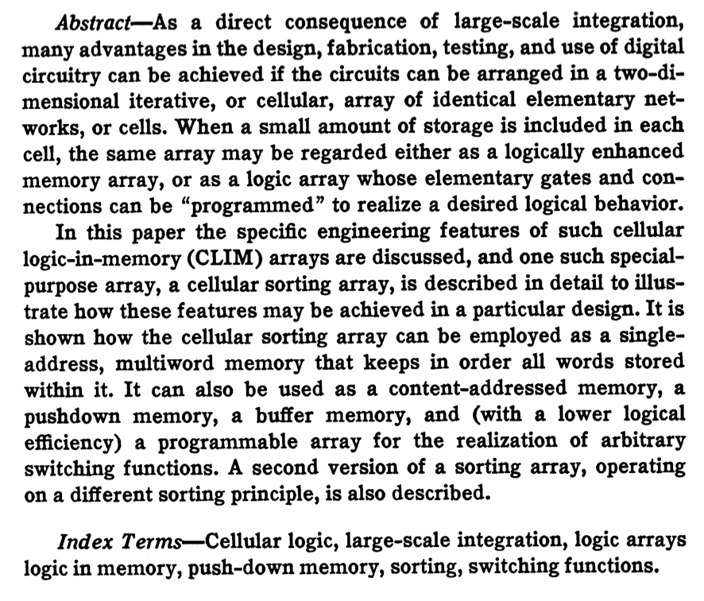
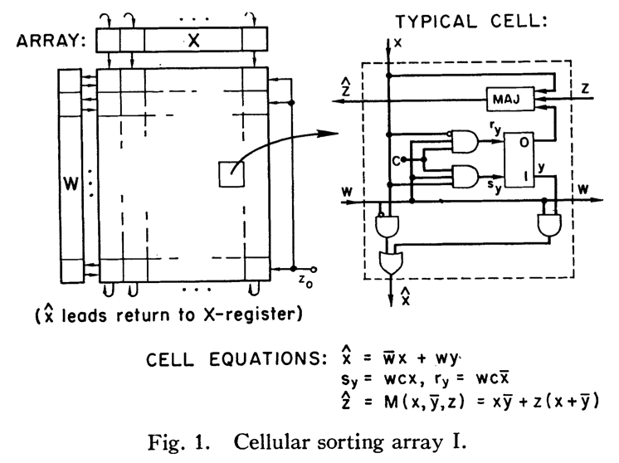
Processing in/near Memory: An Old Idea
Kautz, “Cellular Logic-in-Memory Arrays”, IEEE TC 1969.
https://doi.org/10.1109/T-C.1969.222754

Slide 39
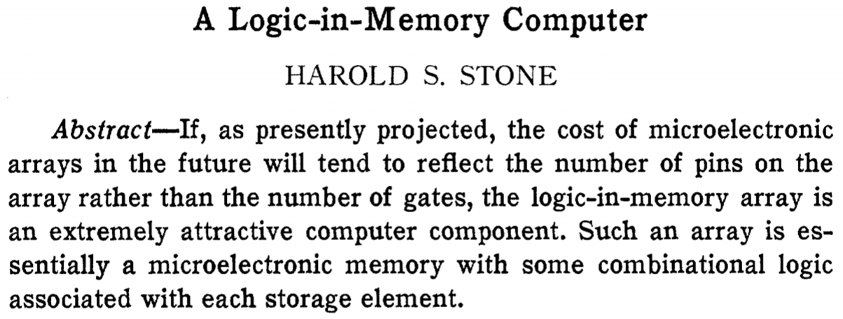
Processing in/near Memory: An Old Idea
Stone, “A Logic-in-Memory Computer,” IEEE TC 1970.
https://safari.ethz.ch/architecture/fall2020/lib/exe/fetch.php?media=stone_logic_in_memory_1970.pdf

Slide 40
Why Today?
Huge problems with Memory Technology
Memory technology scaling is not going well (e.g., RowHammer)
Many scaling issues demand intelligence in memory
Huge demand from Applications & Systems
Data access bottleneck
Energy & power bottlenecks
Data movement energy dominates computation energy
Need all at the same time: performance, energy, sustainability
We can improve all metrics by minimizing data movement
Designs are squeezed in the middle

Slide 41
The Push From the Bottom (Technology)
Intelligent
Memory Controllers
Can Avoid Many Failures
& Enable Better Scaling

Slide 42
The Pull From the Top (Systems & Apps)
High Performance,
Energy Efficient,
Sustainable
(All at the Same Time)

Slide 43
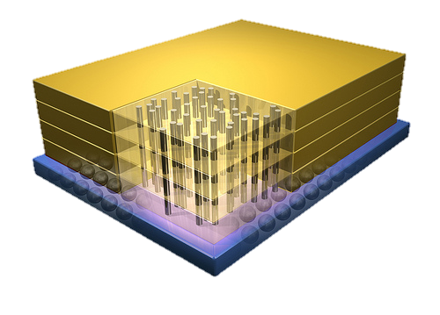
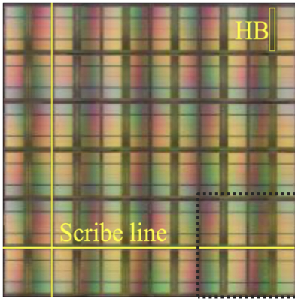
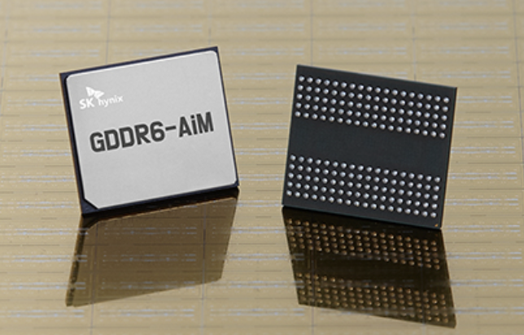
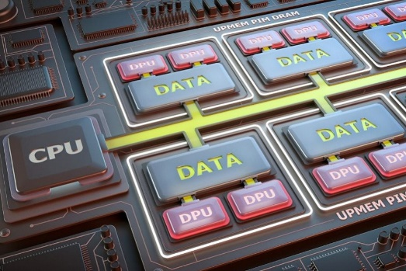
Processing-in-Memory Landscape Today
[Samsung 2021]
[Alibaba 2022]
[SK Hynix 2022]
[Samsung 2021]
[UPMEM 2019]
And, many other experimental chips and startups

Slide 44
PIM Review and Open Problems
Onur Mutlu, Saugata Ghose, Juan Gomez-Luna, and Rachata Ausavarungnirun, "A Modern Primer on Processing in Memory" Invited Book Chapter in Emerging Computing: From Devices to Systems - Looking Beyond Moore and Von Neumann, Springer, to be published in 2021.
https://arxiv.org/pdf/2012.03112.pdf

Slide 45
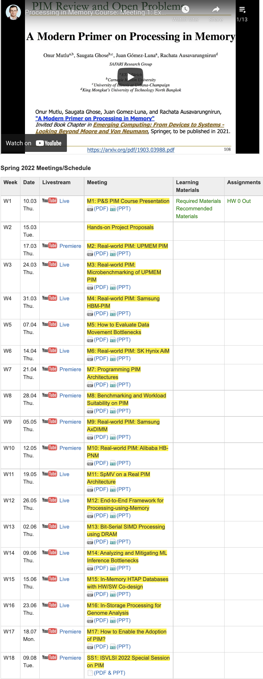
PIM Course (Fall 2022)
Fall 2022 Edition:
https://safari.ethz.ch/projects_and_seminars/fall2022/doku.php?id=processing_in_memory
Spring 2022 Edition:
https://safari.ethz.ch/projects_and_seminars/spring2022/doku.php?id=processing_in_memory
Youtube Livestream (Fall 2022):
https://www.youtube.com/watch?v=QLL0wQ9I4Dw&list=PL5Q2soXY2Zi8KzG2CQYRNQOVD0GOBrnKy
Youtube Livestream (Spring 2022):
https://www.youtube.com/watch?v=9e4Chnwdovo&list=PL5Q2soXY2Zi-841fUYYUK9EsXKhQKRPyX
Project course
Taken by Bachelor’s/Master’s students
Processing-in-Memory lectures
Hands-on research exploration
Many research readings
https://www.youtube.com/onurmutlulectures

Slide 46
Real PIM Tutorials [ISCA’23, ASPLOS’23, HPCA’23]
June, March, Feb : Lectures + Hands-on labs + Invited talks
https://events.safari.ethz.ch/isca-pim-tutorial/

Slide 47
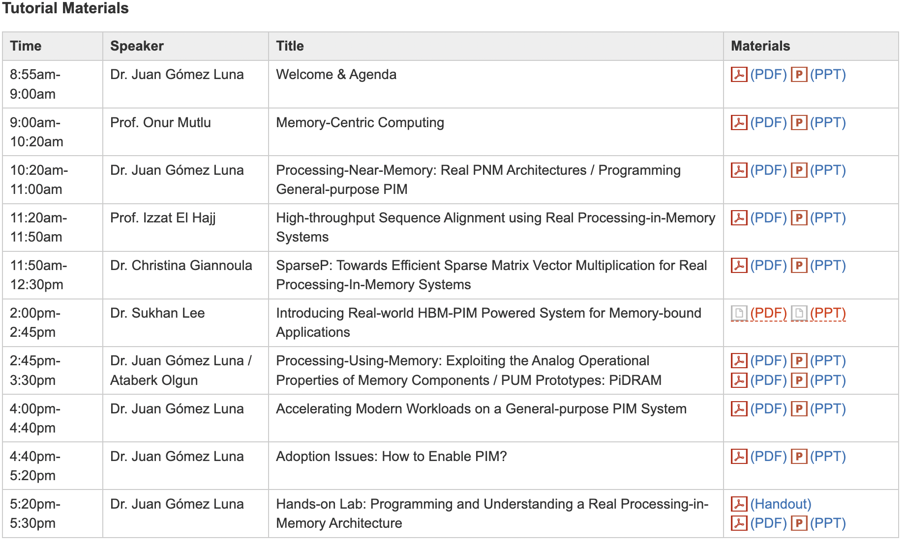
Real PIM Tutorial [ISCA 2023]
June 18: Lectures + Hands-on labs + Invited talks
https://www.youtube.com/live/GIb5EgSrWk0
https://events.safari.ethz.ch/isca-pim-tutorial/

Slide 48
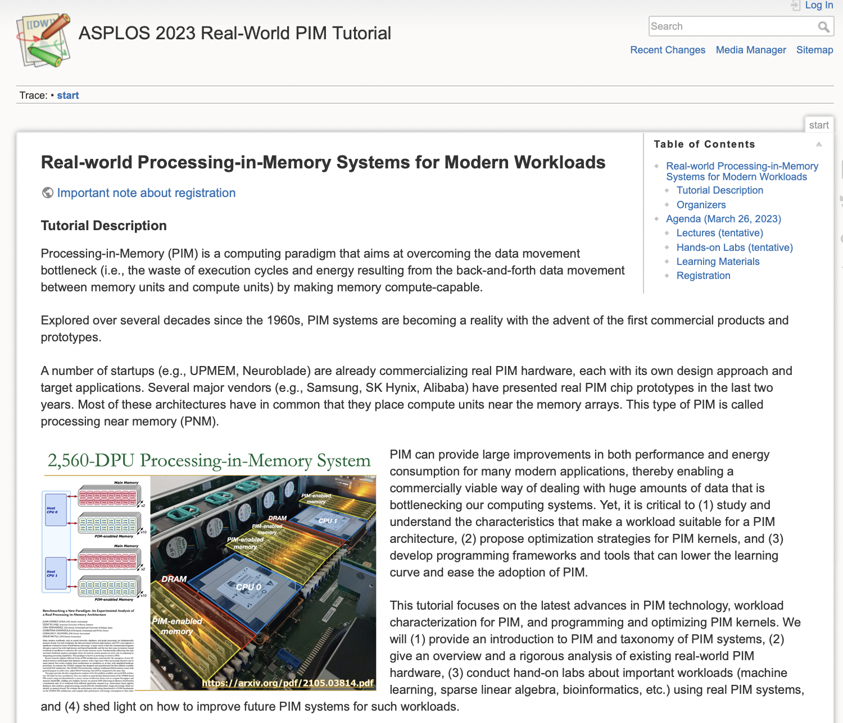
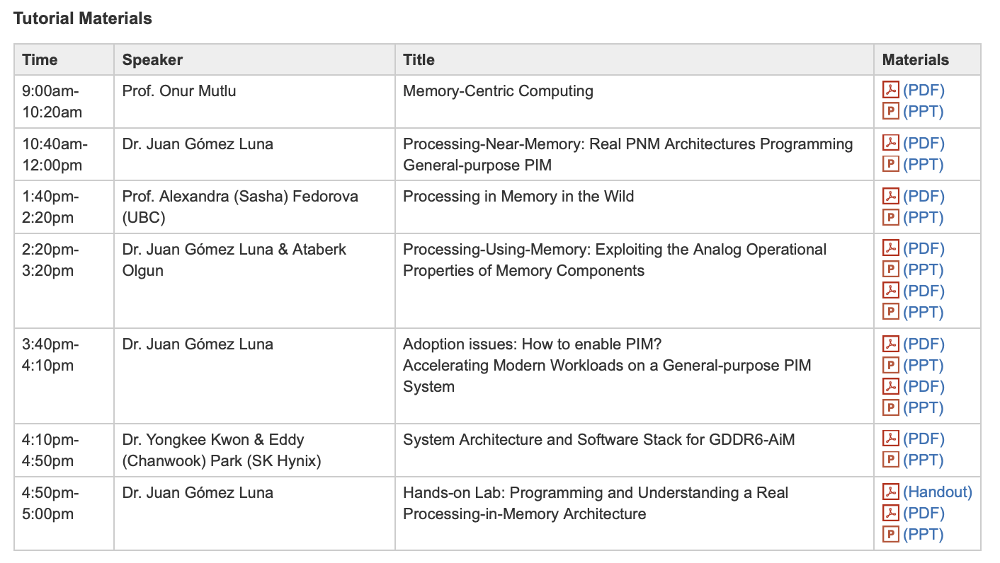
Real PIM Tutorial [ASPLOS 2023]
March 26: Lectures + Hands-on labs + Invited talks
https://www.youtube.com/watch?v=oYCaLcT0Kmo
https://events.safari.ethz.ch/asplos-pim-tutorial/

Slide 49
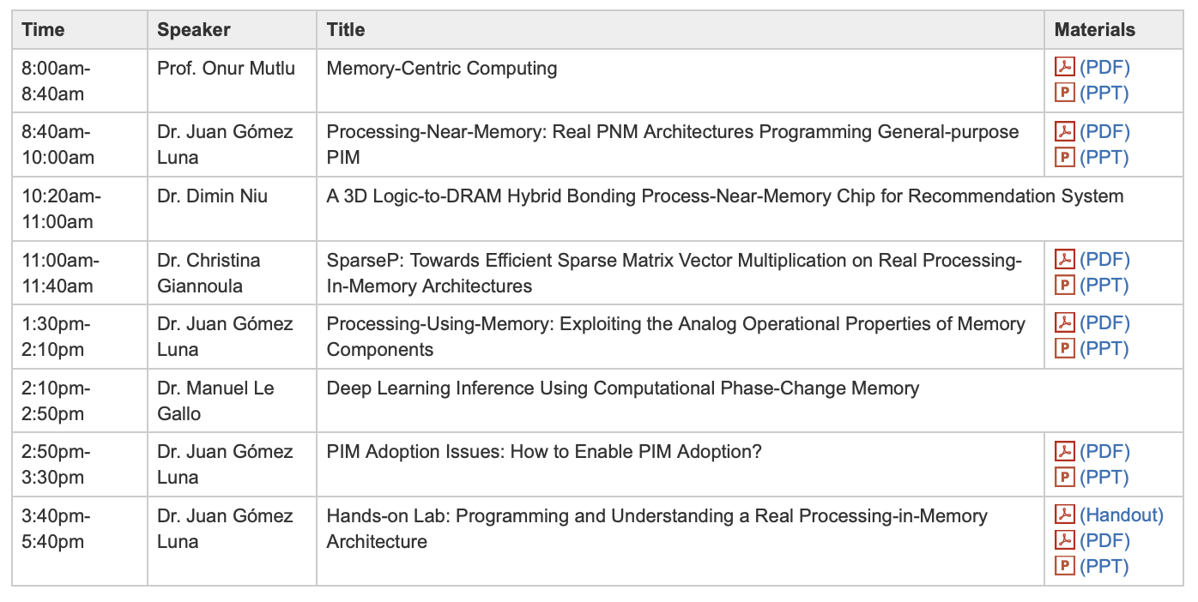
Real PIM Tutorial [HPCA 2023]
February 26: Lectures + Hands-on labs + Invited Talks
https://www.youtube.com/watch?v=f5-nT1tbz5w
https://events.safari.ethz.ch/real-pim-tutorial/

Slide 50
We Need to Think Differently from the Past Approaches

Slide 51
Processing in Memory: Two Approaches
1. Processing using Memory
2. Processing near Memory

Slide 52
A PIM Taxonomy
Nature (of computation)
Using: Use operational properties of memory structures
Near: Add logic close to memory structures
Technology
Flash, DRAM, SRAM, RRAM, MRAM, FeRAM, PCM, 3D, …
Location
Sensor, Cold Storage, Hard Disk, SSD, Main Memory, Cache, Register File, Memory Controller, Interconnect, …
A tuple of the three determines “PIM type”
One can combine multiple “PIM types” in a system

Slide 53
An Example PIM Type
Nature: Using
Technology: DRAM
Location: Main Memory
Processing using DRAM in Main Memory
Seshadri+, “Fast Bulk Bitwise AND and OR in DRAM”, IEEE CAL 2015.
Seshadri+, “Ambit: In-Memory Accelerator for Bulk Bitwise Operations Using Commodity DRAM Technology,” MICRO 2017.

Slide 54
Processing using DRAM
We can support
Bulk bitwise AND, OR, NOT, MAJ
Bulk bitwise COPY and INIT/ZERO
True Random Number Generation
At low cost
Using analog computation capability of DRAM
Idea: activating (multiple) rows performs computation
30-77X performance and energy improvement
Seshadri+, “Ambit: In-Memory Accelerator for Bulk Bitwise Operations Using Commodity DRAM Technology,” MICRO 2017.
Seshadri+“RowClone: Fast and Efficient In-DRAM Copy and Initialization of Bulk Data,” MICRO 2013.

Slide 55
In-DRAM Bulk Bitwise MAJ/AND/OR + NOT
½V_{DD}
½V_{DD}+δ
V_{DD}
A
Final State
AB + BC + AC
B
C
C(A + B) + ~C(AB)
dis
en
0
½V_{DD}
Seshadri+, “Fast Bulk Bitwise AND and OR in DRAM”, IEEE CAL 2015.

Slide 56
Bulk Bitwise Operations in Workloads
[1] Li and Patel, BitWeaving, SIGMOD 2013
[2] Goodwin+, BitFunnel, SIGIR 2017

Slide 57
In-DRAM Acceleration of Database Queries
>4-12X Performance Improvement
Seshadri+, “Ambit: In-Memory Accelerator for Bulk Bitwise Operations using Commodity DRAM Technology,” MICRO 2017.

Slide 58
More on Ambit
Vivek Seshadri, Donghyuk Lee, Thomas Mullins, Hasan Hassan, Amirali Boroumand, Jeremie Kim, Michael A. Kozuch, Onur Mutlu, Phillip B. Gibbons, and Todd C. Mowry, "Ambit: In-Memory Accelerator for Bulk Bitwise Operations Using Commodity DRAM Technology" Proceedings of the 50th International Symposium on Microarchitecture (MICRO), Boston, MA, USA, October 2017. [Slides (pptx) (pdf)] [Lightning Session Slides (pptx) (pdf)] [Poster (pptx) (pdf)]

Slide 59
In-DRAM Bulk Bitwise Execution
Vivek Seshadri and Onur Mutlu, "In-DRAM Bulk Bitwise Execution Engine" Invited Book Chapter in Advances in Computers, to appear in 2020. [Preliminary arXiv version]

Slide 60
SIMDRAM: Programmability
Nastaran Hajinazar, Geraldo F. Oliveira, Sven Gregorio, Joao Dinis Ferreira, Nika Mansouri Ghiasi, Minesh Patel, Mohammed Alser, Saugata Ghose, Juan Gomez-Luna, and Onur Mutlu, "SIMDRAM: An End-to-End Framework for Bit-Serial SIMD Computing in DRAM" Proceedings of the 26th International Conference on Architectural Support for Programming Languages and Operating Systems (ASPLOS), Virtual, March-April 2021. [2-page Extended Abstract] [Short Talk Slides (pptx) (pdf)] [Talk Slides (pptx) (pdf)] [Short Talk Video (5 mins)] [Full Talk Video (27 mins)]

Slide 61
In-DRAM Lookup-Table Based Execution
João Dinis Ferreira, Gabriel Falcao, Juan Gómez-Luna, Mohammed Alser, Lois Orosa, Mohammad Sadrosadati, Jeremie S. Kim, Geraldo F. Oliveira, Taha Shahroodi, Anant Nori, and Onur Mutlu, "pLUTo: Enabling Massively Parallel Computation in DRAM via Lookup Tables" Proceedings of the 55th International Symposium on Microarchitecture (MICRO), Chicago, IL, USA, October 2022. [Slides (pptx) (pdf)] [Longer Lecture Slides (pptx) (pdf)] [Lecture Video (26 minutes)] [arXiv version] [Source Code (Officially Artifact Evaluated with All Badges)] Officially artifact evaluated as available, reusable and reproducible.
https://arxiv.org/pdf/2104.07699.pdf

Slide 62
In-DRAM True Random Number Generation
Jeremie S. Kim, Minesh Patel, Hasan Hassan, Lois Orosa, and Onur Mutlu, "D-RaNGe: Using Commodity DRAM Devices to Generate True Random Numbers with Low Latency and High Throughput" Proceedings of the 25th International Symposium on High-Performance Computer Architecture (HPCA), Washington, DC, USA, February 2019. [Slides (pptx) (pdf)] [Full Talk Video (21 minutes)] [Full Talk Lecture Video (27 minutes)] Top Picks Honorable Mention by IEEE Micro.

Slide 63
In-DRAM True Random Number Generation
Ataberk Olgun, Minesh Patel, A. Giray Yaglikci, Haocong Luo, Jeremie S. Kim, F. Nisa Bostanci, Nandita Vijaykumar, Oguz Ergin, and Onur Mutlu, "QUAC-TRNG: High-Throughput True Random Number Generation Using Quadruple Row Activation in Commodity DRAM Chips" Proceedings of the 48th International Symposium on Computer Architecture (ISCA), Virtual, June 2021. [Slides (pptx) (pdf)] [Short Talk Slides (pptx) (pdf)] [Talk Video (25 minutes)] [SAFARI Live Seminar Video (1 hr 26 mins)]

Slide 64
In-Flash Bulk Bitwise Execution
Jisung Park, Roknoddin Azizi, Geraldo F. Oliveira, Mohammad Sadrosadati, Rakesh Nadig, David Novo, Juan Gómez-Luna, Myungsuk Kim, and Onur Mutlu, "Flash-Cosmos: In-Flash Bulk Bitwise Operations Using Inherent Computation Capability of NAND Flash Memory" Proceedings of the 55th International Symposium on Microarchitecture (MICRO), Chicago, IL, USA, October 2022. [Slides (pptx) (pdf)] [Longer Lecture Slides (pptx) (pdf)] [Lecture Video (44 minutes)] [arXiv version]
https://arxiv.org/pdf/2209.05566.pdf

Slide 65
Real Processing Using Memory Prototype
End-to-end RowClone & TRNG using off-the-shelf DRAM chips
Idea: Violate DRAM timing parameters to mimic RowClone
https://arxiv.org/pdf/2111.00082.pdf
https://github.com/cmu-safari/pidram
https://www.youtube.com/watch?v=qeukNs5XI3g&t=4192s

Slide 66
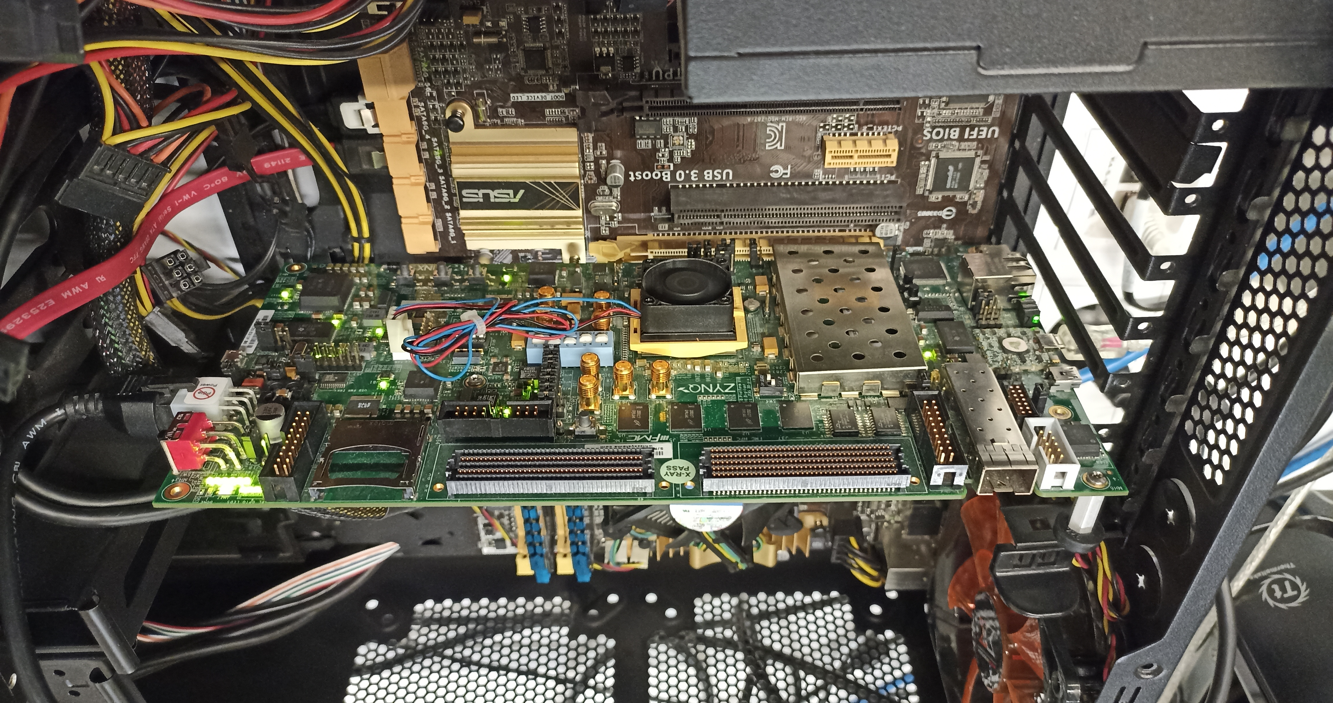
Real Processing-using-Memory Prototype
https://arxiv.org/pdf/2111.00082.pdf
https://github.com/cmu-safari/pidram
https://www.youtube.com/watch?v=qeukNs5XI3g&t=4192s
Host Machine
FPGA Board
RISC-V System
PiM-Enabled DIMM

Slide 67
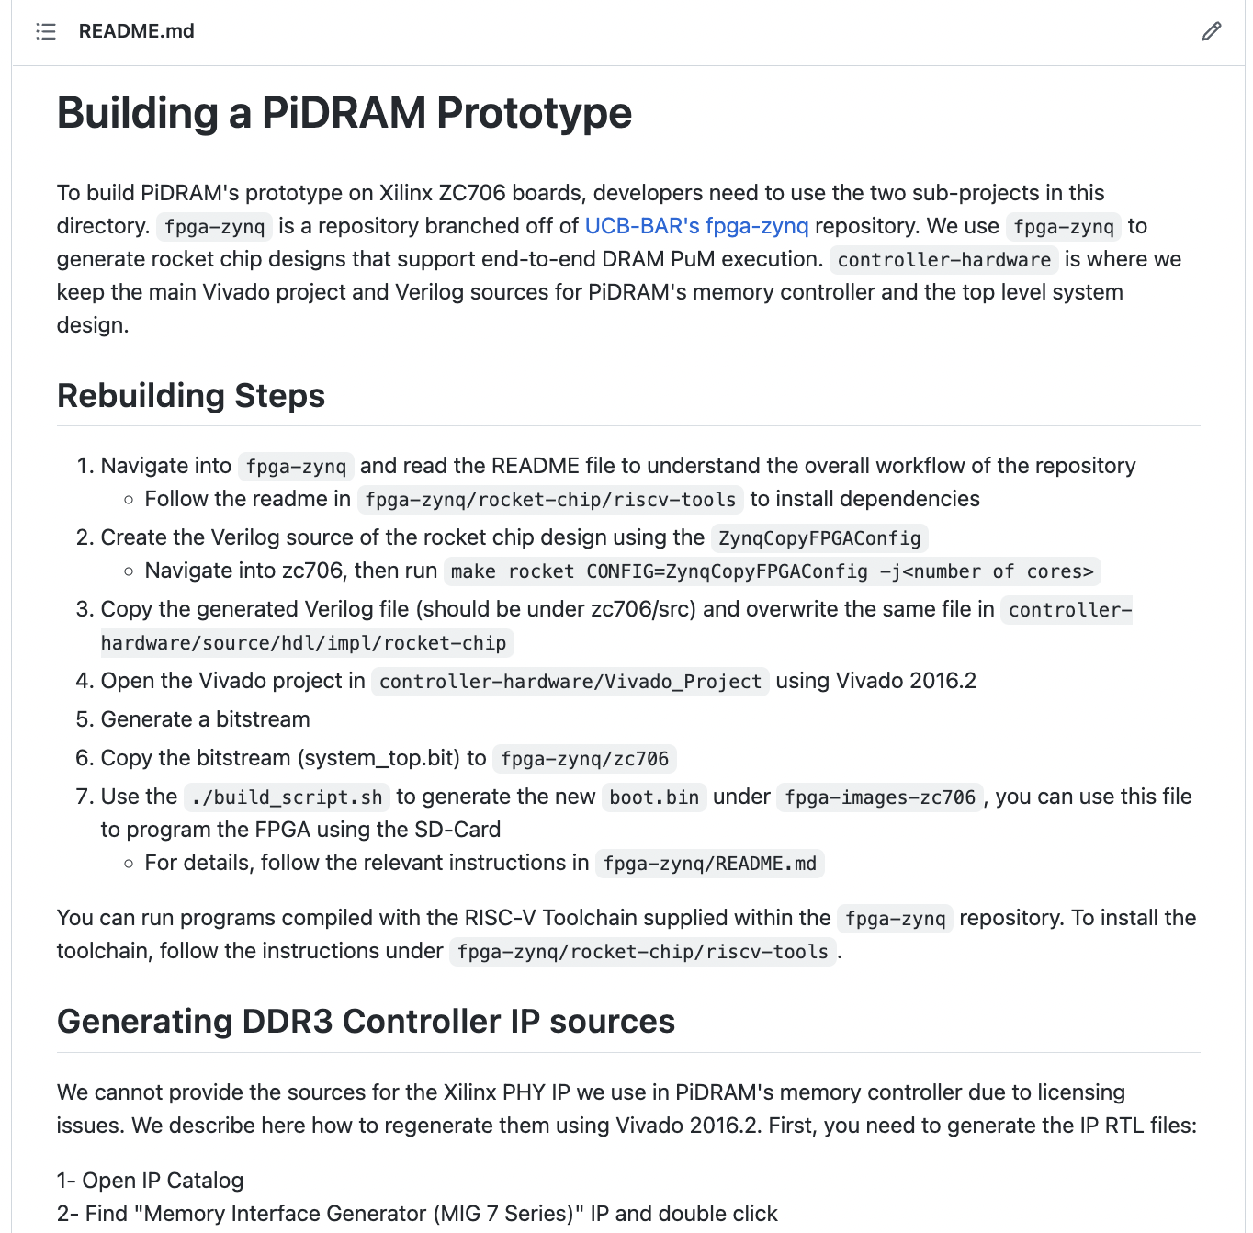
Real Processing-using-Memory Prototype
https://arxiv.org/pdf/2111.00082.pdf
https://github.com/cmu-safari/pidram
https://www.youtube.com/watch?v=qeukNs5XI3g&t=4192s

Slide 68
More on PiDRAM
Ataberk Olgun, Juan Gomez Luna, Konstantinos Kanellopoulos, Behzad Salami, Hasan Hassan, Oguz Ergin, and Onur Mutlu, "PiDRAM: A Holistic End-to-end FPGA-based Framework for Processing-in-DRAM" ACM Transactions on Architecture and Code Optimization (TACO), March 2023. [arXiv version] Presented at the 18th HiPEAC Conference, Toulouse, France, January 2023. [Slides (pptx) (pdf)] [Longer Lecture Slides (pptx) (pdf)] [Lecture Video (40 minutes)] [PiDRAM Source Code]

Slide 69
Eliminating the Adoption Barriers
How to Enable Adoption of Processing in Memory

Slide 70
Potential Barriers to Adoption of PIM
1. Applications, systems & software for PIM
2. Ease of programming (interfaces and compiler/HW support)
3. System and security support: coherence, synchronization, virtual memory, isolation, communication interfaces, …
4. Runtime and compilation systems for adaptive scheduling, data mapping, access/sharing control, …
5. Infrastructures to assess benefits and feasibility
All can be solved with change of mindset

Slide 71
We Need to Revisit the Entire Stack
Problem
Algorithm
Program/Language
System Software
SW/HW Interface
Micro-architecture
Logic
Devices
Electrons
We can get there step by step

Slide 72
PIM Review and Open Problems
Onur Mutlu, Saugata Ghose, Juan Gomez-Luna, and Rachata Ausavarungnirun, "A Modern Primer on Processing in Memory" Invited Book Chapter in Emerging Computing: From Devices to Systems - Looking Beyond Moore and Von Neumann, Springer, to be published in 2021.
https://arxiv.org/pdf/2012.03112.pdf

Slide 73
PIM Course (Fall 2022)
Fall 2022 Edition:
https://safari.ethz.ch/projects_and_seminars/fall2022/doku.php?id=processing_in_memory
Spring 2022 Edition:
https://safari.ethz.ch/projects_and_seminars/spring2022/doku.php?id=processing_in_memory
Youtube Livestream (Fall 2022):
https://www.youtube.com/watch?v=QLL0wQ9I4Dw&list=PL5Q2soXY2Zi8KzG2CQYRNQOVD0GOBrnKy
Youtube Livestream (Spring 2022):
https://www.youtube.com/watch?v=9e4Chnwdovo&list=PL5Q2soXY2Zi-841fUYYUK9EsXKhQKRPyX
Project course
Taken by Bachelor’s/Master’s students
Processing-in-Memory lectures
Hands-on research exploration
Many research readings
https://www.youtube.com/onurmutlulectures

Slide 74
Memory-Centric Computing
Onur Mutlu
omutlu@gmail.com
https://people.inf.ethz.ch/omutlu
13 July 2023
Lightning Talk @ DAC

Slide 75
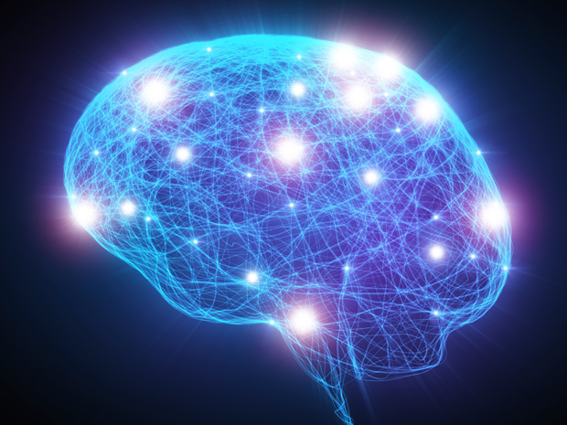
Source: http://spectrum.ieee.org/image/MjYzMzAyMg.jpeg

Slide 76
PIM Review and Open Problems (II)
Saugata Ghose, Amirali Boroumand, Jeremie S. Kim, Juan Gomez-Luna, and Onur Mutlu, "Processing-in-Memory: A Workload-Driven Perspective" Invited Article in IBM Journal of Research & Development, Special Issue on Hardware for Artificial Intelligence, to appear in November 2019. [Preliminary arXiv version]
https://arxiv.org/pdf/1907.12947.pdf

