Slide 1
Assignment 1 - Requirements Elicitation and Documentation
Shuai Wang
shuai.wang@inf.ethz.ch

Slide 2
Schedule
Three hours session (tentatively decide in this way):
Some tutorial and Q&A on the first assignment
Q&A (if needed) for the second assignment
Q&A (if needed) for the group project.
Can we put all the team members into one exercise session?
Not possible for the whole class, sorry.
Contact TAs in case you have any questions or want to make any changes to the grouping and exercise session ASAP.
We are collecting and maintaining an internal list of all the grouping info. And will update online late this week, after finishing all the exercise sessions.
Anyone knows the following students?
Manuela Fischer
Hao Wu

Slide 3
Exercise 1 - Design and Documentation
public class Node{
public Node () {...}
...
}
public class Edge{
...
}
public class STGraph{
List <Edge> edges;
Node source; Node target;
public STGraph(Node source, Node target){
this.source = source;
this.target = target;
this.edges = new ArrayList <Edge>();
}
public void setST(Node source , Node target){
this.source = source;
this.target = target;
}
public void addEdge(Edge e){
edges.add(e);
}
public List <Node> shortestPath ()
{...}
}
Passing the source and the target as arguments
Question: why this design decision makes sense?
Using a setter method for modifying them afterwards
But no free lunch!
Is this thread-safe?
Answer: only if we would rarely modify source and the target
Notes:
Undirected graphs
WeightsTime complexityAuthorℝ₊O(V²)
Dijkstra 1959ℝ₊O((E + V) log V)
Johnson 1977 (binary heap)ℝ₊O(E + V log V)
Fredman & Tarjan 1984 (Fibonacci heap)ℕO(E)
Thorup 1999 (requires constant-time multiplication).
Unweighted graphs
AlgorithmTime complexityAuthorBreadth-first searchO(E + V)
Directed acyclic graphs (DAGs)

Slide 4
Exercise 1 - Design and Documentation
public class Node{
public Node () {...}
...
}
public class Edge{
...
}
public class STGraph{
List <Edge> edges;
Node source; Node target;
public STGraph(Node source, Node target){
this.source = source;
this.target = target;
this.edges = new ArrayList <Edge>();
}
public void setST(Node source , Node target){
this.source = source;
this.target = target;
}
public void addEdge(Edge e){
edges.add(e);
}
public List <Node> shortestPath ()
{...}
}
Question: does the shortest path always exist?
Answer: of course no; only if the source and target are connected.
Question: what information should be documented for this function?
Answer: specify return values regarding different cases.
What if they are not connected?
What if source is identical to target?
Exception or null?
Algorithm?
...

Slide 5
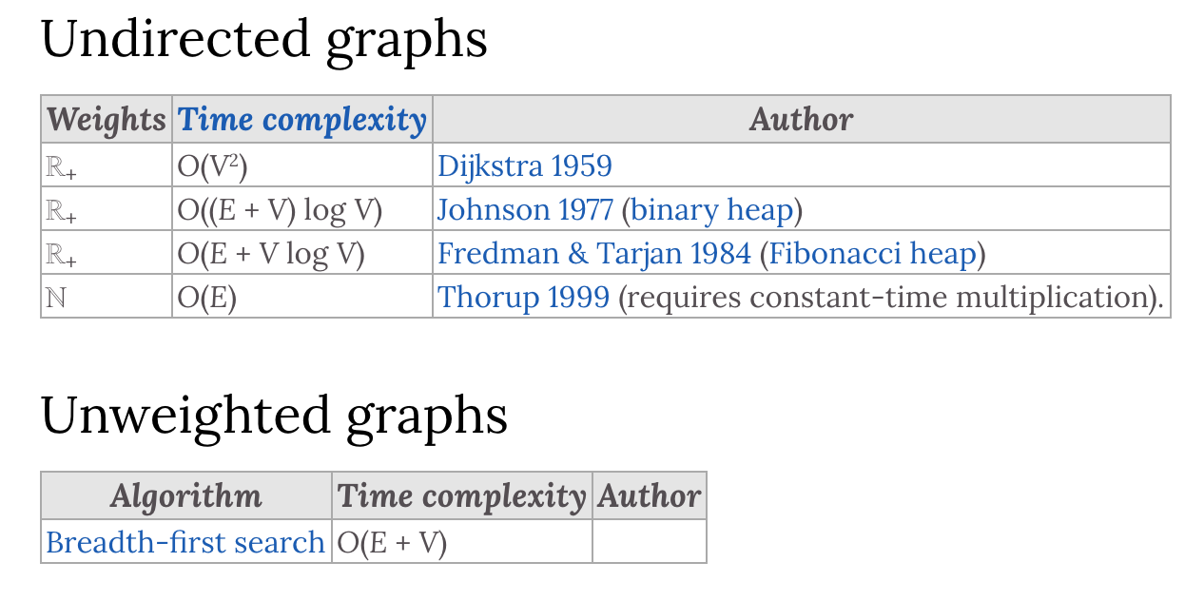
Exercise 1 - Design and Documentation
public class Node{
public Node () {...}
...
}
public class Edge{
...
}
public class STGraph{
List <Edge> edges;
Node source; Node target;
public STGraph(Node source, Node target){
this.source = source;
this.target = target;
this.edges = new ArrayList <Edge>();
}
public void setST(Node source , Node target){
this.source = source;
this.target = target;
}
public void addEdge(Edge e){
edges.add(e);
}
public List <Node> shortestPath ()
{...}
}
Question: how to make this function more efficient?
Answer: cache the results.
List <Node> shortestPath (){
if(sp == null && areConnectedST()){
sp = computeShortestPath();
}
return sp;
}
areConnectedST: BFS
shortestPath: much more complicated? Dijkstra algo.?

Slide 6
Exercise 1 - Design and Documentation
public class Node{
public Node () {...}
...
}
public class Edge{
...
}
public class STGraph{
List <Edge> edges;
Node source; Node target;
public STGraph(Node source, Node target){
this.source = source;
this.target = target;
this.edges = new ArrayList <Edge>();
}
public void setST(Node source , Node target){
this.source = source;
this.target = target;
}
public void addEdge(Edge e){
edges.add(e);
}
public List <Node> shortestPath ()
{...}
}
Question: How does this design influence the client-visible documentation?
Answer: no, OO design usually treats methods as black boxs.
Question: Are there alternative designs that achieve comparable results?
Answer: a more “eager” way of doing so.
Any fundamental difference?
Extension: cache the intermediate computation results?

Slide 7
Exercise 2 - Design
class List <E>{
E[] elems;
int len;
boolean shared;
List(int l){
elems = (E[]) new Object[l];
len = l;
shared = false;
}
void set(int index , E e){
if(shared){
elems = elems.clone();
shared = false;
}
elems[index] = e;
}
List <E> take (){
shared = true;
List<E> t = new List <E>(elems, len-1);
t.shared = true;
return t;
}
}
Question: a scenario in which this implementation performs unnecessary cloning operations, when the set method is called.
Answer:
List <Integer > A = new List <Integer>(3);
List <Integer > B = A.take();
b.set(0, -5);
a.set(1, 40);
A and B are not “synchronized”.

Slide 8
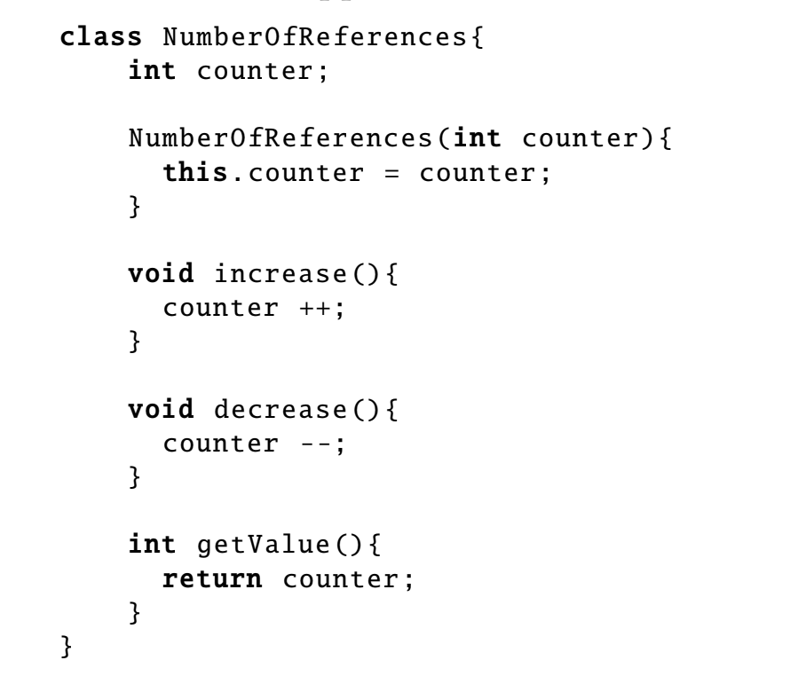
Exercise 2 - Design
class List <E>{
E[] elems;
int len;
boolean shared;
List(int l){
elems = (E[]) new Object[l];
len = l;
shared = false;
}
void set(int index , E e){
if(shared){
elems = elems.clone();
shared = false;
}
elems[index] = e;
}
List <E> take (){
shared = true;
List<E> t = new List <E>(elems, len-1);
t.shared = true;
return t;
}
}
Question: How could you modify the implementation to eliminate this inefficiency?
Answer: sync A and B with an object on heap.
Extension: learn how “smart-pointer” works in C++ 11g.

Slide 9
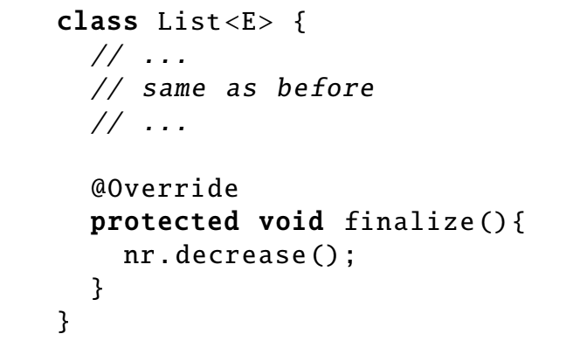
Exercise 2 - Design
Question: Is your proposed solution efficient in the case in which unused objects are removed by the garbage collector?
Answer: the previous implementation cannot “decrease” the counter.

Slide 10
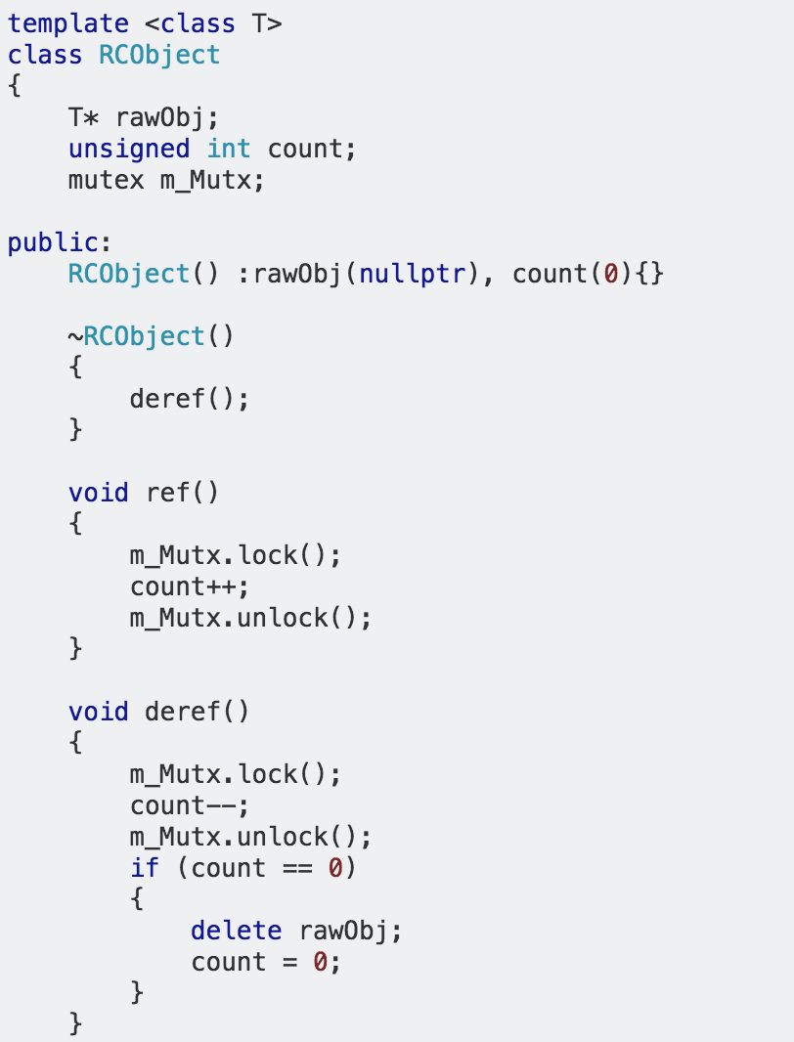
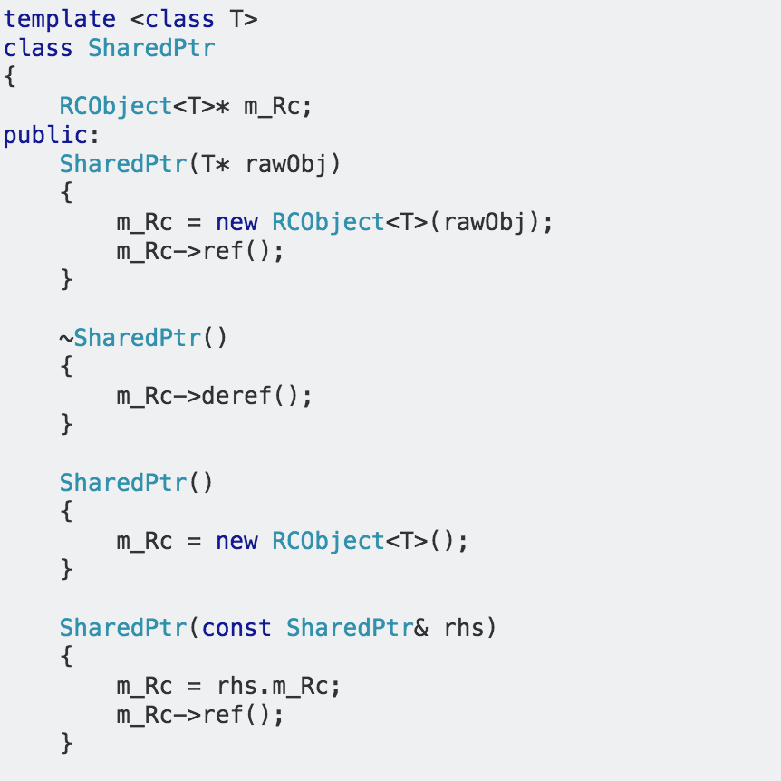
Exercise 2 – Design: A Simple Implementation of Modern C++ Smart Pointers
https://codereview.stackexchange.com/questions/159804/c-smart-pointer-implementation

Slide 11
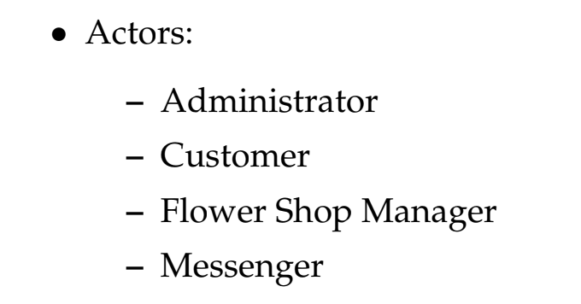
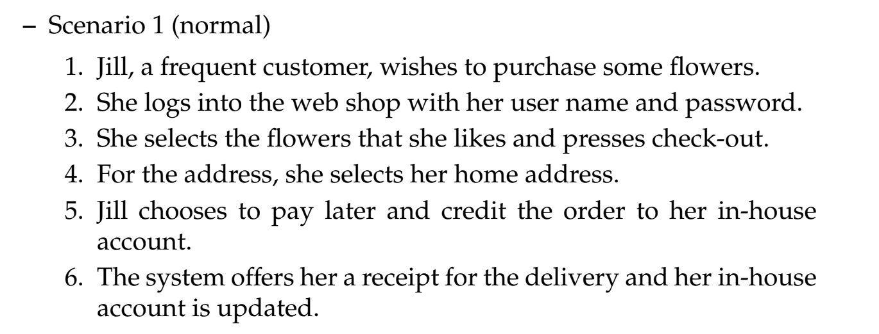
Exercise 3 - Requirements Elicitation
No authoritative solution to this exercise, but hope it helps for you to get some senses and think further on how to effectively gather requirements.
role playing
Scenarios
Notes:
Requirements Elicitation → gathering results

Slide 12
Exercise 3 - Requirements Elicitation: Corner Cases
Q: is an online customer logged out from the system automatically when inactive? If so, after what time?
A: Yes. When the customer is inactive for 5 minutes, he/she is logged out automatically.
Q: When a new customer creates an online account, can he place his first order to a different address than to which the credit card he is paying with is registered?
A: No. This is a security measure placed in order to prevent frauds.
A: However, after the first order was placed and the flowers were delivered, the customer can change the delivery address in subsequent orders.
Q: Is there any limit on the number of orders that can be taken per day?
A: Yes. This number depends on the number of messengers the owner currently has.
Q: Is it possible to cancel an order once it has been placed?
What’s your idea?

Slide 13
Let us know if you have any questions or would like to discuss
Contact TAs in case you have any questions or want to make any changes to the grouping and exercise session ASAP.
We are collecting and maintaining an internal list of all the grouping info. And will update online late this week, after finishing all the exercise sessions.

