Slide 1
Assignment 4 - Alloy
Shuai Wang
shuai.wang@inf.ethz.ch

Slide 2
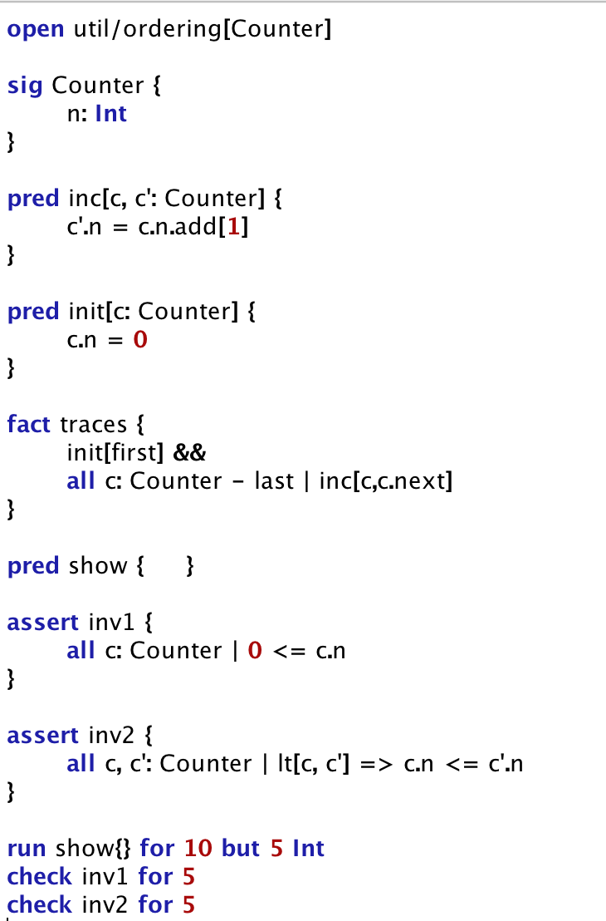
Exercise 1 – Counter Model
Define the init function and set n as 0.
Increment counter other than last
Always greater than or equal to zero.
Counter’s value never decreases.
Notes:
Undirected graphs
WeightsTime complexityAuthorℝ₊O(V²)
Dijkstra 1959ℝ₊O((E + V) log V)
Johnson 1977 (binary heap)ℝ₊O(E + V log V)
Fredman & Tarjan 1984 (Fibonacci heap)ℕO(E)
Thorup 1999 (requires constant-time multiplication).
Unweighted graphs
AlgorithmTime complexityAuthorBreadth-first searchO(E + V)
Directed acyclic graphs (DAGs)

Slide 3
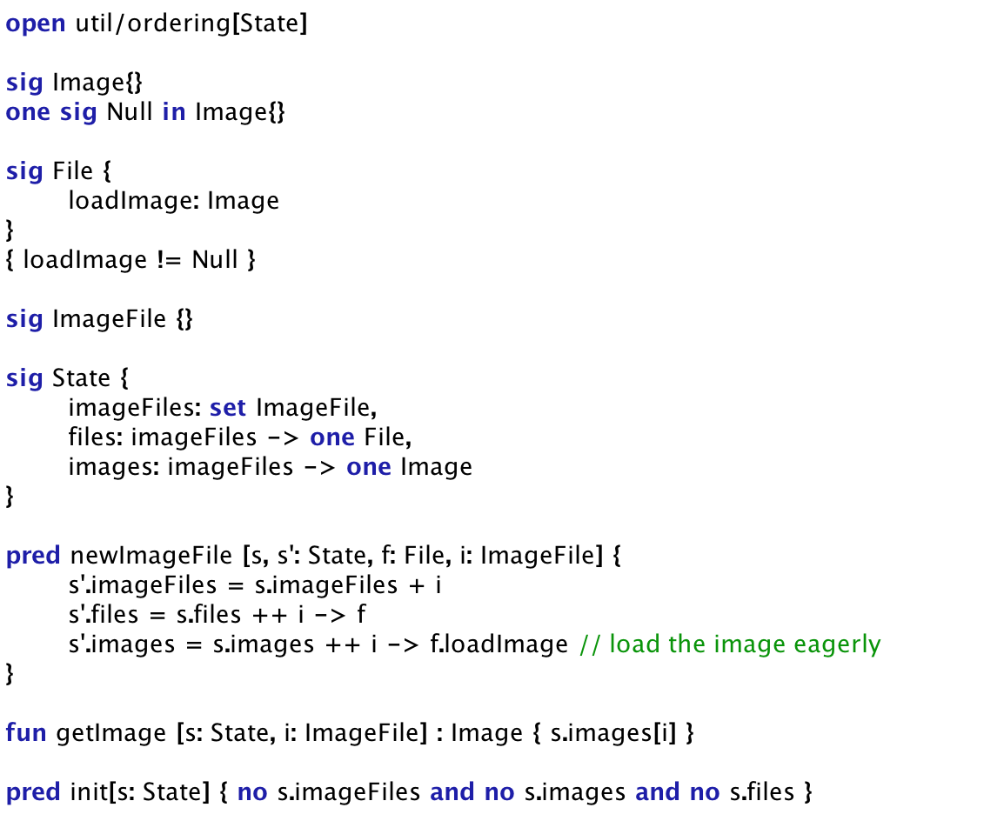
Exercise 2 – ImageFile (eager initialization)
Except File/ImageFile already stored in the state
Notes:
Undirected graphs
WeightsTime complexityAuthorℝ₊O(V²)
Dijkstra 1959ℝ₊O((E + V) log V)
Johnson 1977 (binary heap)ℝ₊O(E + V log V)
Fredman & Tarjan 1984 (Fibonacci heap)ℕO(E)
Thorup 1999 (requires constant-time multiplication).
Unweighted graphs
AlgorithmTime complexityAuthorBreadth-first searchO(E + V)
Directed acyclic graphs (DAGs)

Slide 4
Exercise 2 – ImageFile (eager initialization)
Inv1: getImage always return non-null.
Inv2: getImage always returns the same value.
Always return non-null.
Always return the same value, for a particular image.
Notes:
Undirected graphs
WeightsTime complexityAuthorℝ₊O(V²)
Dijkstra 1959ℝ₊O((E + V) log V)
Johnson 1977 (binary heap)ℝ₊O(E + V log V)
Fredman & Tarjan 1984 (Fibonacci heap)ℕO(E)
Thorup 1999 (requires constant-time multiplication).
Unweighted graphs
AlgorithmTime complexityAuthorBreadth-first searchO(E + V)
Directed acyclic graphs (DAGs)

Slide 5
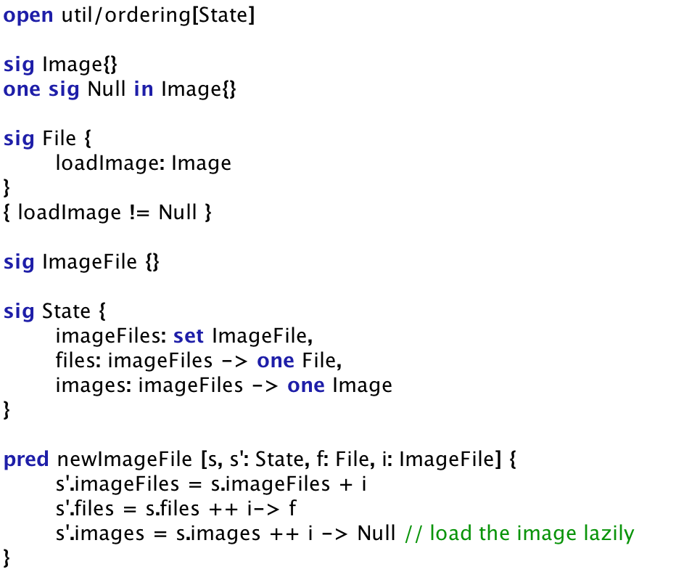
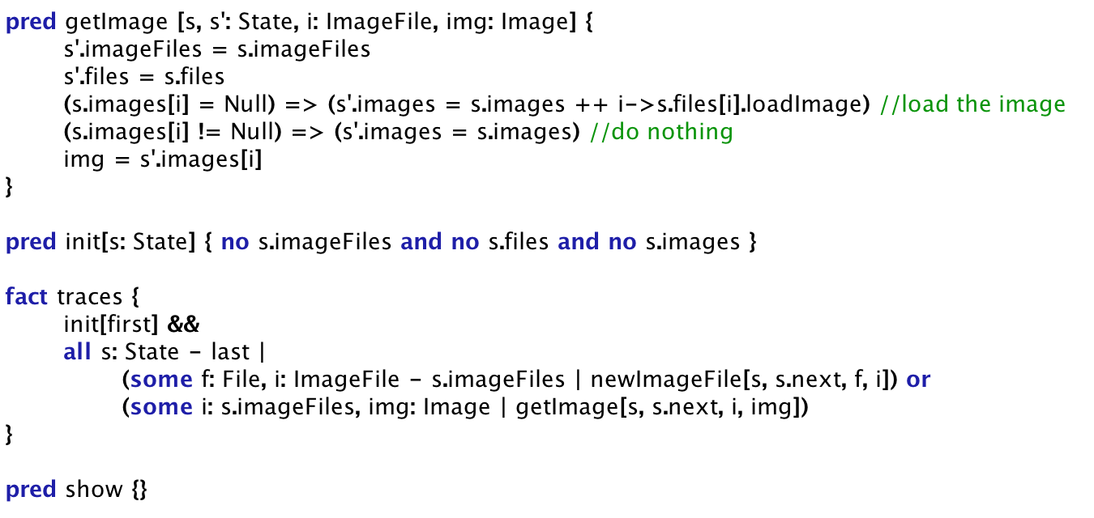
Exercise 2 – ImageFile (lazy initialization)
Check if already loaded
Two cases to proceed the state from s -> s’
Lazy initialization
Notes:
Undirected graphs
WeightsTime complexityAuthorℝ₊O(V²)
Dijkstra 1959ℝ₊O((E + V) log V)
Johnson 1977 (binary heap)ℝ₊O(E + V log V)
Fredman & Tarjan 1984 (Fibonacci heap)ℕO(E)
Thorup 1999 (requires constant-time multiplication).
Unweighted graphs
AlgorithmTime complexityAuthorBreadth-first searchO(E + V)
Directed acyclic graphs (DAGs)

Slide 6
Exercise 2 – ImageFile (lazy initialization)
Inv1: getImage always return non-null.
Inv2: getImage always returns the same value.
Shouldn’t be null.
Always return the same value, for a particular image.
Notes:
Undirected graphs
WeightsTime complexityAuthorℝ₊O(V²)
Dijkstra 1959ℝ₊O((E + V) log V)
Johnson 1977 (binary heap)ℝ₊O(E + V log V)
Fredman & Tarjan 1984 (Fibonacci heap)ℕO(E)
Thorup 1999 (requires constant-time multiplication).
Unweighted graphs
AlgorithmTime complexityAuthorBreadth-first searchO(E + V)
Directed acyclic graphs (DAGs)

Slide 7
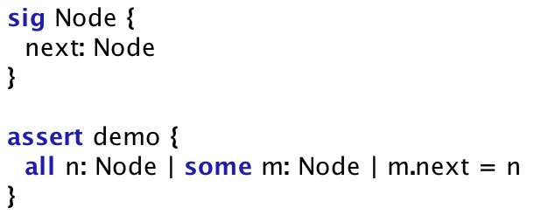
Exercise 3 – Assertion and Counterexamples
Define constraint and assertions for only one node.
Every node must point to one and only one node.
Then whether for every node, it is pointed by one and only one node?
X_{0,0} is a Boolean variable.
Given constraint, can we violate the assertion?
Solving Boolean constraints are usually super efficient.
Notes:
Undirected graphs
WeightsTime complexityAuthorℝ₊O(V²)
Dijkstra 1959ℝ₊O((E + V) log V)
Johnson 1977 (binary heap)ℝ₊O(E + V log V)
Fredman & Tarjan 1984 (Fibonacci heap)ℕO(E)
Thorup 1999 (requires constant-time multiplication).
Unweighted graphs
AlgorithmTime complexityAuthorBreadth-first searchO(E + V)
Directed acyclic graphs (DAGs)

Slide 8
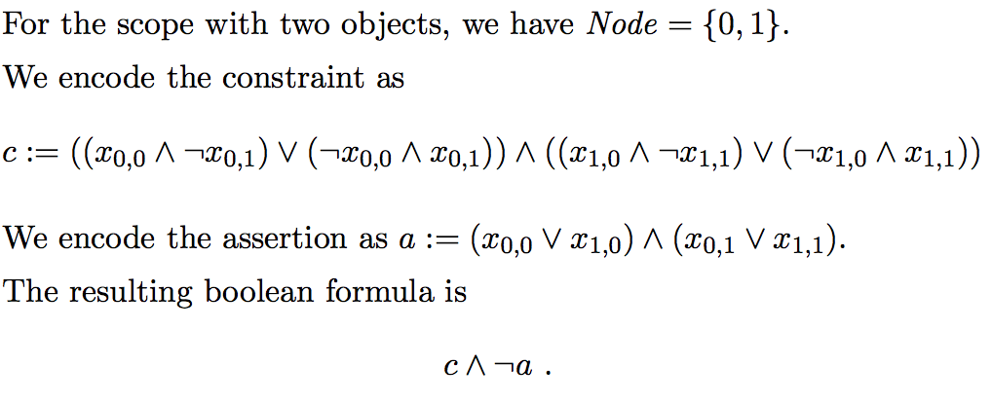
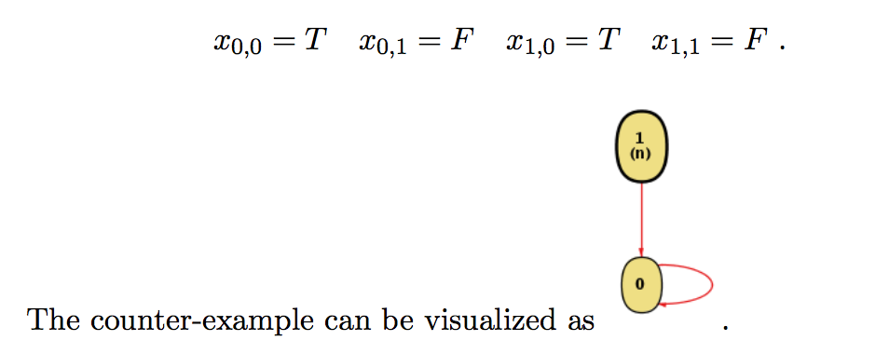
Exercise 3 – Assertion and Counterexamples
Definition constraint and assertions for two nodes.
All the possibilities.
Assertion.
Counter example!
Notes:
Undirected graphs
WeightsTime complexityAuthorℝ₊O(V²)
Dijkstra 1959ℝ₊O((E + V) log V)
Johnson 1977 (binary heap)ℝ₊O(E + V log V)
Fredman & Tarjan 1984 (Fibonacci heap)ℕO(E)
Thorup 1999 (requires constant-time multiplication).
Unweighted graphs
AlgorithmTime complexityAuthorBreadth-first searchO(E + V)
Directed acyclic graphs (DAGs)

Slide 9
Exercise 3 – Add a “prev” edge
A new fact:
Enhancement:
Every node is pointed by no more than one node.
Notes:
Undirected graphs
WeightsTime complexityAuthorℝ₊O(V²)
Dijkstra 1959ℝ₊O((E + V) log V)
Johnson 1977 (binary heap)ℝ₊O(E + V log V)
Fredman & Tarjan 1984 (Fibonacci heap)ℕO(E)
Thorup 1999 (requires constant-time multiplication).
Unweighted graphs
AlgorithmTime complexityAuthorBreadth-first searchO(E + V)
Directed acyclic graphs (DAGs)

Slide 10
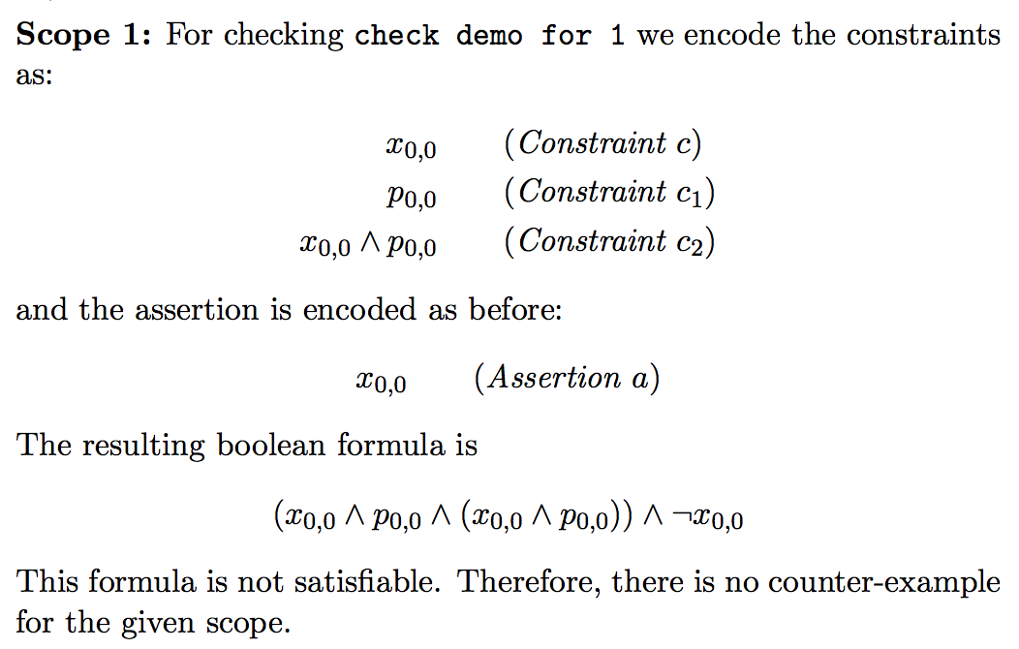
Exercise 3 – Add a “prev” edge
Define constraint and assertions for only one node.
Constraint.
Assertion.
Given constraint, can we violate the assertion?
Notes:
Undirected graphs
WeightsTime complexityAuthorℝ₊O(V²)
Dijkstra 1959ℝ₊O((E + V) log V)
Johnson 1977 (binary heap)ℝ₊O(E + V log V)
Fredman & Tarjan 1984 (Fibonacci heap)ℕO(E)
Thorup 1999 (requires constant-time multiplication).
Unweighted graphs
AlgorithmTime complexityAuthorBreadth-first searchO(E + V)
Directed acyclic graphs (DAGs)

Slide 11
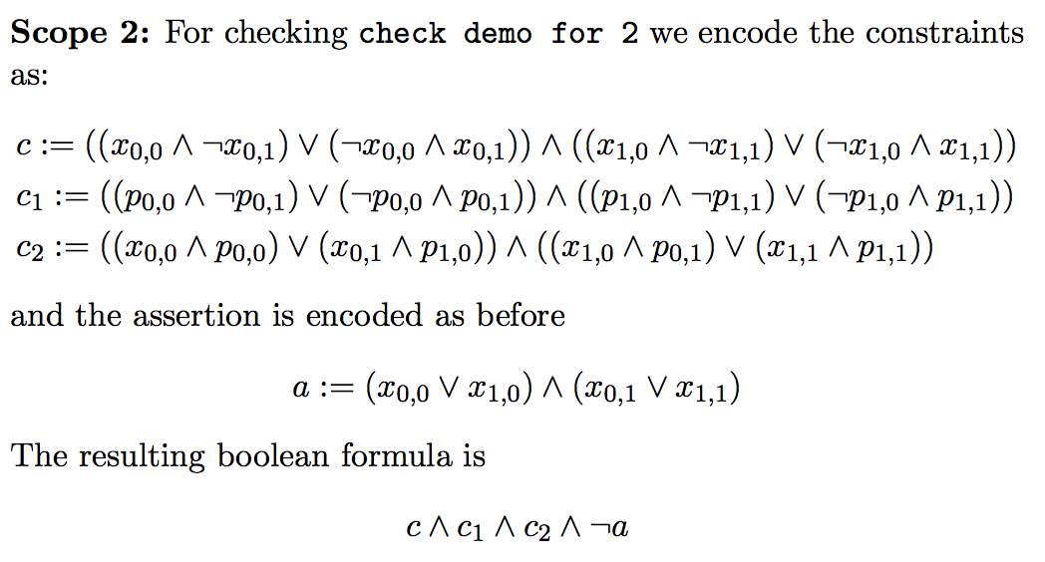
Exercise 3 – Add a “prev” edge
Definition constraint and assertions for two nodes.
Constraint.
Assertion.
Given constraint, can we violate the assertion?
Notes:
Undirected graphs
WeightsTime complexityAuthorℝ₊O(V²)
Dijkstra 1959ℝ₊O((E + V) log V)
Johnson 1977 (binary heap)ℝ₊O(E + V log V)
Fredman & Tarjan 1984 (Fibonacci heap)ℕO(E)
Thorup 1999 (requires constant-time multiplication).
Unweighted graphs
AlgorithmTime complexityAuthorBreadth-first searchO(E + V)
Directed acyclic graphs (DAGs)

Slide 12
Exercise 3 – a larger scope?
Every node must point to one and only one node.
Every node is pointed by no more than one node.
Then whether for every node, it is pointed by one and only one node? Sure.
Every node must point to one and only one node.
Then whether for every node, it is pointed by one and only one node?
Q: solve this with math induction?
Notes:
Undirected graphs
WeightsTime complexityAuthorℝ₊O(V²)
Dijkstra 1959ℝ₊O((E + V) log V)
Johnson 1977 (binary heap)ℝ₊O(E + V log V)
Fredman & Tarjan 1984 (Fibonacci heap)ℕO(E)
Thorup 1999 (requires constant-time multiplication).
Unweighted graphs
AlgorithmTime complexityAuthorBreadth-first searchO(E + V)
Directed acyclic graphs (DAGs)

