Slide 1
Teaching Physics by Modeling
Prof. Dr. François E. Cellier
Computer Science Department
ETH Zurich
Switzerland

Slide 2


Acknowledgments
Dr. Jürgen Greifeneder (ABB Research Center) helped me in fundamental ways with the conceptualization of models of thermodynamic systems
Dr. Dirk Zimmer (German Aerospace Research DLR) helped me with creating Modelica model libraries for two- and three-dimensional mechanical multi-body systems

Slide 3
Experiencing Physics
The key to understanding the physical world around us is to design interesting real-world experiments and see what happens.
In order to be able to make sense out of observations obtained from running these experiments, it is important to isolate individual effects as much as possible.
The key to successful experimentation is thus to find ways that enable us to observe individual effects in isolation.
For this reason, physicists are phenomenologists.
They understand each individual phenomenon in its finest details, but sometimes fail to take into account interactions between different phenomena.
Their world is one of a thousand intricate and beautiful puzzle stones … that unfortunately don’t always fit together very well.

Slide 4
Manufacturing Systems
The job of engineers is to create systems that are capable of performing useful tasks.
They take individual components and fit them together in new and interesting ways.
They focus on the interactions between system components much more than on the components themselves.
For this reason, engineers are systemists.
They understand the overall system very well, often at the expense of possessing only a limited knowledge of its parts.
Components are often used as black boxes, and therefore, engineers sometimes overlook limitations that invalidate assumptions made when the system is used in ways that had not been foreseen. This can lead to catastrophic failures.

Slide 5
Modeling Means Understanding
Making sense of observations means to create a mathematical description of the underlying system that explains these observations.
We claim to understand a phenomenon only when we are able to describe it in mathematical terms.
Modeling is thus central to the tasks that a physicist is supposed to perform.
Models should be encoded in such a way that they can be easily reused and safely connected to other models that interact with them.
For this to work, we need to design not only “correct” (within a given context) models, but at least as important, design model interfaces that are general and are based on sound physical principles, such as power flows.
The design of clean model interfaces is as important as if not more important than the design of “correct” models.

Slide 6
Simulation Fosters Understanding
Complex systems can be exerted in many different ways.
It is often impossible (too time consuming; too dangerous; too costly) to experiment with a real system in all possible ways.
Simulation makes it possible to expose complex system models to a much wider range of experimental conditions.
Therefore, simulation fosters understanding of system interactions that may otherwise remain hidden.
This deeper understanding of how a system will behave in all possible situations may prevent disasters.
For this reason, being able to design simulation experiments on models is central to the life of an engineer.
Physicists and engineers need to work closely together, and a robust physical system modeling and simulation environment, such as Modelica, forms the interface between them.

Slide 7
Modeling Using Energy Flows
In all physical systems, energy flows can be written as products of two different physical variables, one of which is extensive (i.e., proportional to the amount), whereas the other is intensive (i.e., independent of the amount).
In the case of coupled energy flows, it may be necessary to describe a single energy flow as the sum of products of such adjugate variables.
Examples:
P_{el} = u · i
P_{mech} = f · v
[W] = [V] · [A]
= [N] · [m/s]
= [kg · m² · s⁻³]

Slide 8
Bond Graphs
The modeling of physical systems by means of bond graphs operates on a graphical description of energy flows.
The energy flows are represented as directed harpoons. The two adjugate variables, which are responsible for the energy flow, are annotated above (intensive: potential variable, “e”) and below (extensive: flow variable, “f”) the harpoon.
The hook of the harpoon always points to the left, and the term “above” refers to the side with the hook.
e
e: Effort
f: Flow
P = e · f
f

Slide 9
A-causal Bond Graphs
U
0
i
⇔
U
v
+
v
Se
0
a
b
i
U
0
Energy is being added to the system
Voltage and current have opposite directions
I
0
I
u
v
0
v
⇔
Sf
a
b
I
0
u

Slide 10
Passive Electrical Elements in Bond Graph Representation
i
R
u
v
v
⇔
R
a
b
i
u
Voltage and current have same directions
i
C
u
v
v
⇔
C
a
b
i
u
Energy is being taken out off to the system
i
L
u
v
v
⇔
I
a
b
u
i

Slide 11
Junctions
e₂
e₁ = e₂
e₂ = e₃
f₁ – f₂ – f₃ = 0
e₁
f₂
⇔
0
f₁
e₃
f₃
e₂
f₂
f₁ = f₂
f₂ = f₃
e₁ – e₂ – e₃ = 0
e₁
⇔
1
f₁
e₃
f₃

Slide 12
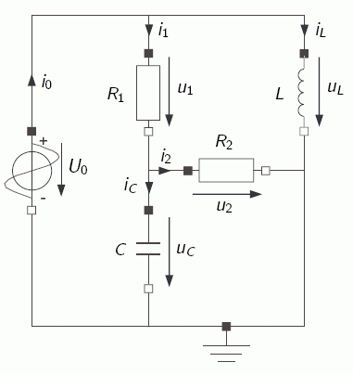
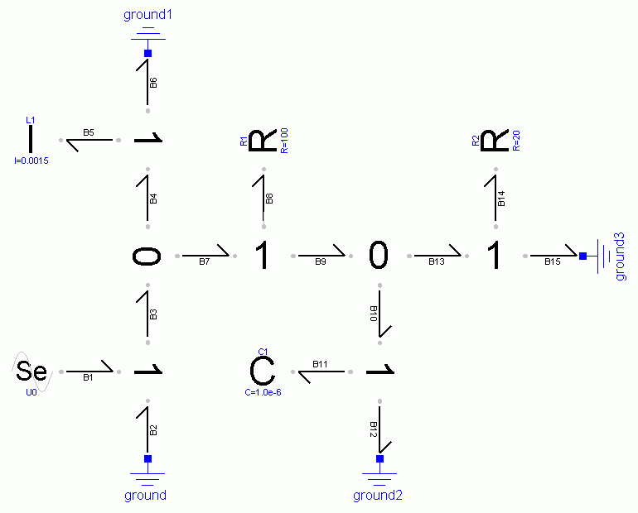
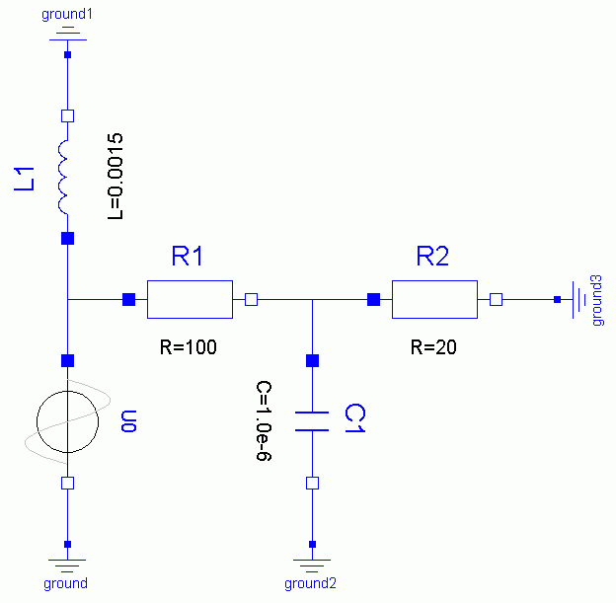
An Example I
v₁
v₂
v₀
i_{L}
i_{L}
u_{L}
v₀
v₁
i_{L}
u₁
i₁
u₂
i₂
v₁
v₂
v₂
v₀
i₁
i₁
i₂
i₂
v₁
i₀
i_{C}
v₂
i_{C}
i_{L}
v₂
U₀
v₁
u_{C}
i₀
i₁
i₂
i₀
v₀
i₀
i_{C}
v₀
i_{C}

Slide 13
An Example II
v₀
i_{L}
i_{L}
u_{L}
v₁
i_{L}
u₁
i₁
u₂
i₂
v₁
v₂
v₂
v₀
i₁
i₁
i₂
i₂
v₁
i₀
i_{C}
v₂
U₀
i_{C}
i₀
u_{C}
v₀
i₀
i_{C}
v₀
v₀ = 0
⇒
P = v₀ · i₀ = 0

Slide 14
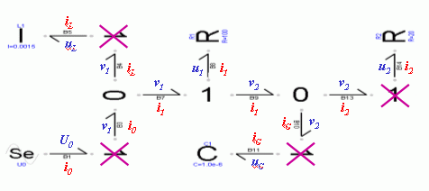
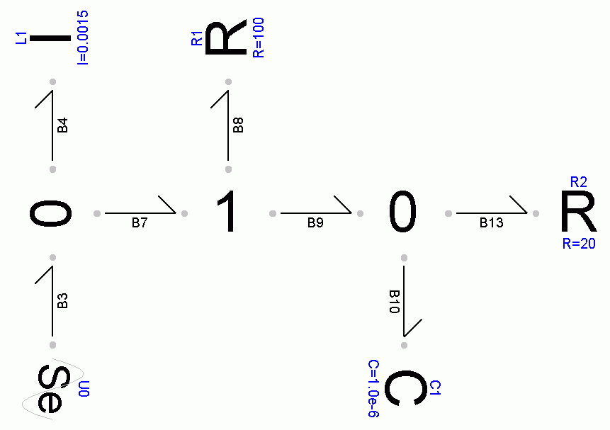
An Example III
u_{L}
i_{L}
u₁
i₁
v₁
v₂
u₂
i₁
i₁
i₂
U₀
i₀
i_{C}
u_{C}

Slide 15
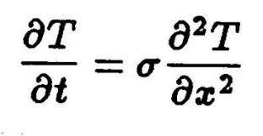
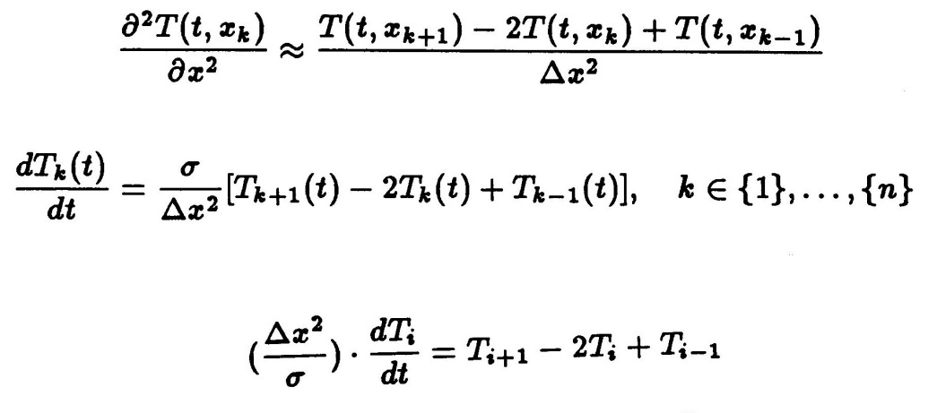
1st Learning Experience: Thermodynamics
We wish to model heat dissipation along a well insulated thin copper rod.
My physics text instructs me that this phenomenon is governed by the partial differential equation:
Discretization in space leads to:

Slide 16
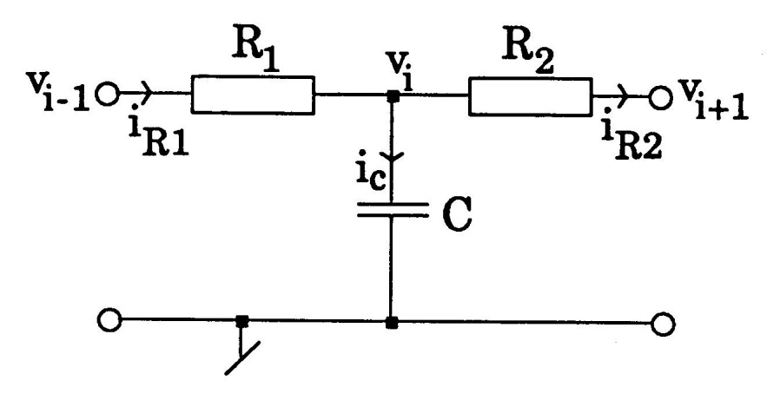
Thermodynamics II
Consequently, the following electrical equivalence circuit may be considered:
dv_{i} /dt = i_{C} /C
i_{C} = i_{R1} – i_{R2}
v_{i-1} – v_{i} = R· i_{R1}
v_{i} – v_{i+1} = R· i_{R2}
⇒
dv_{i} /dt = (i_{R1} – i_{R2} ) /C
= (v_{i+1} – 2·v_{i} + v_{i-1} ) /(R · C)
⇒
dv_{i}
(R · C)·
= v_{i+1} – 2·v_{i} + v_{i-1}
dt

Slide 17
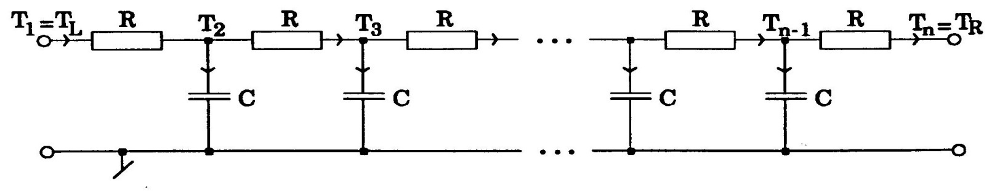
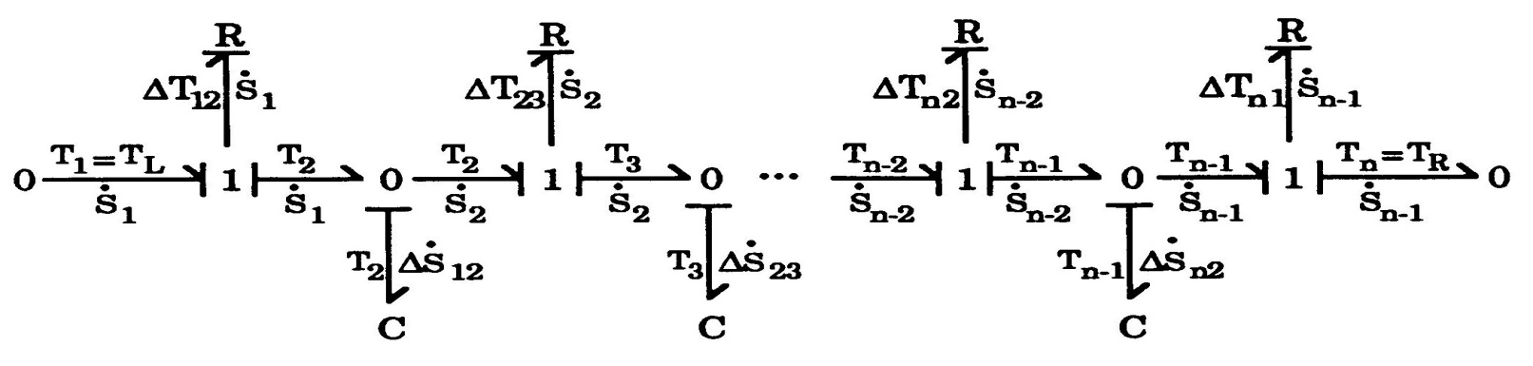
Thermodynamics III
As a consequence, heat conduction can be described by a series of such T-circuits:
In bond graph representation:

Slide 18
Thermodynamics IV
This bond graph is exceedingly beautiful ...
It only has one drawback ...
It is most certainly incorrect!
.
There are no energy sinks!
A resistor may make sense in an electrical circuit, if the heating of the circuit is not of interest, but it is most certainly not meaningful, when the system to be described is itself in the thermal domain.

Slide 19
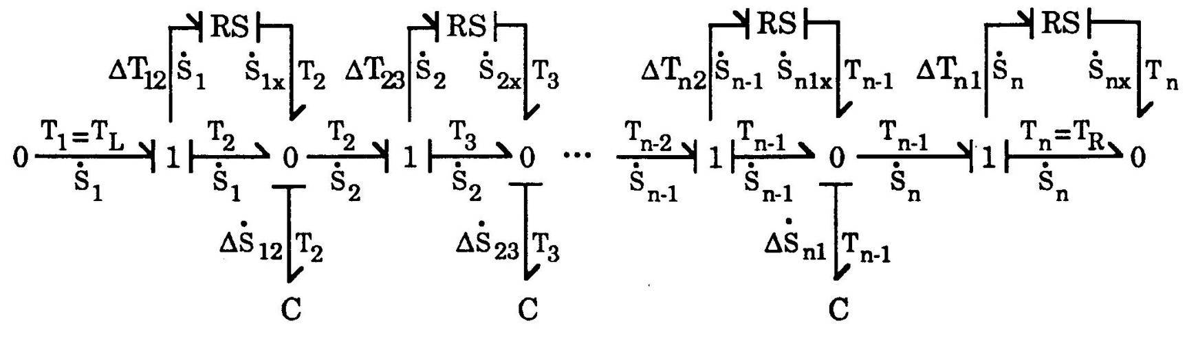
Thermodynamics V
The problem can be corrected easily by replacing each resistor by a resistive source.
The temperature gradient leads to additional entropy, which is re-introduced at the nearest 0-junction.

Slide 20
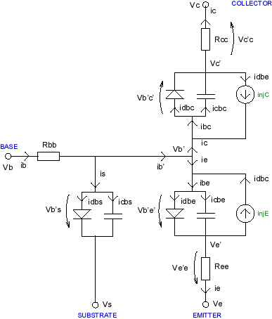
2nd Learning Experience: Electronics
We wish to model a bipolar junction transistor.
The SPICE manual offers us an equivalent circuit.

Slide 21
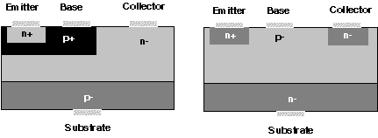
Vertical and Lateral npn-Transistors
vertical
lateral
The pn junction diodes connect positively doped regions with negatively doped regions.
In the laterally diffused npn transistor, all three junction diodes have their anodes in the base.
Dopants:
for p-region (acceptors): boron or aluminum
for n-region (donors): phosphorus or arsenic

Slide 22
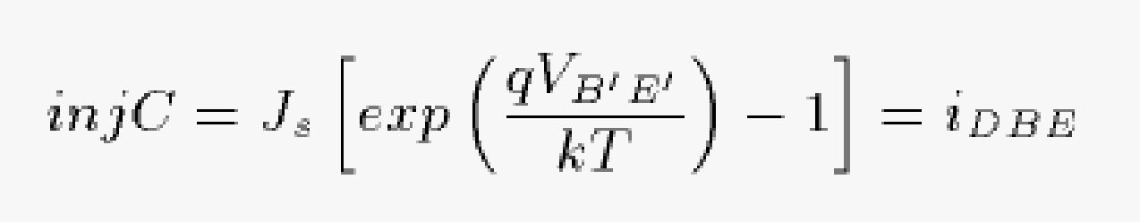
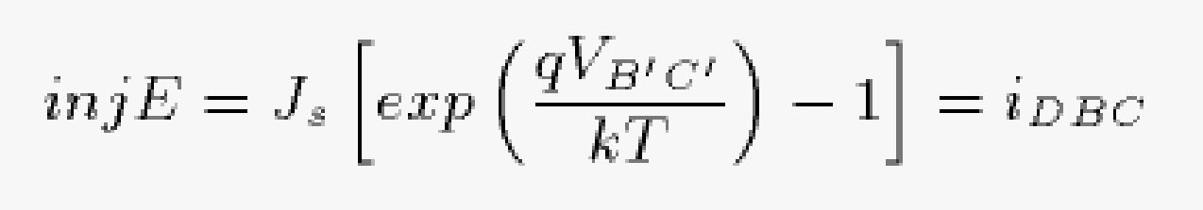
Non-linear Current Sources
The model contains two non-linear current sources that inject currents into the circuit:
The current injected into the collector is a function of the base-emitter Voltage, and the current injected into the emitter is a function of the base-collector Voltage.

Slide 23
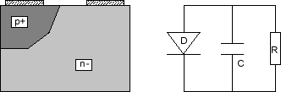
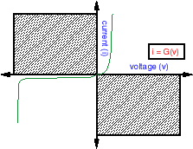
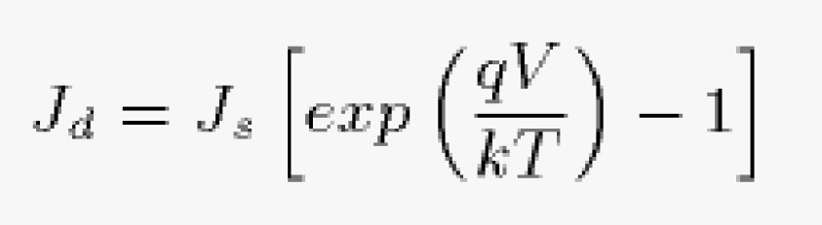
The Junction Diode Model
The pn junction diode is modeled as follows:
J_{d}

Slide 24
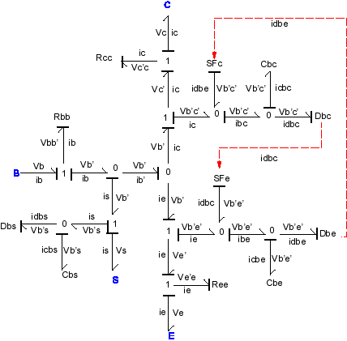
The BJT Bond Graph
⇒
Converted using the diamond property

Slide 25
Problems With BJT Bond Graph
Where does the power for these current sources come from?
The sources are internal to the model. Hence there is no place where these sources could possibly draw power from.

Slide 26
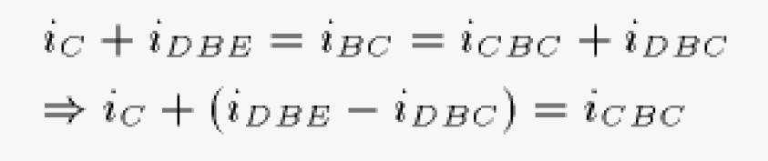
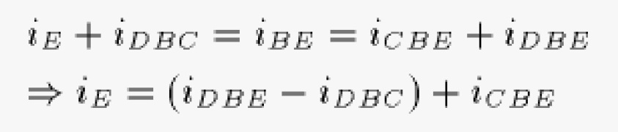
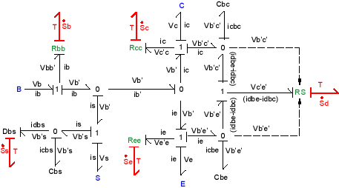
Conversion of the BJT Bond Graph

Slide 27
The Non-linear Resistor
The two current sources are really a power sink, rather than a power source. They can be interpreted as a single non-linear resistor.

Slide 28
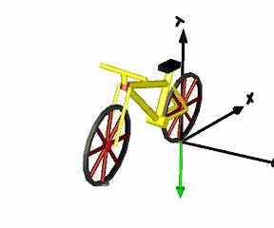
3rd Learning Experience: Mechanics
We wish to model a bicycle traveling along a road.
The model of the bicycle is to be built up modularly from its parts, i.e., wheels, frame, and handlebar.

Slide 29
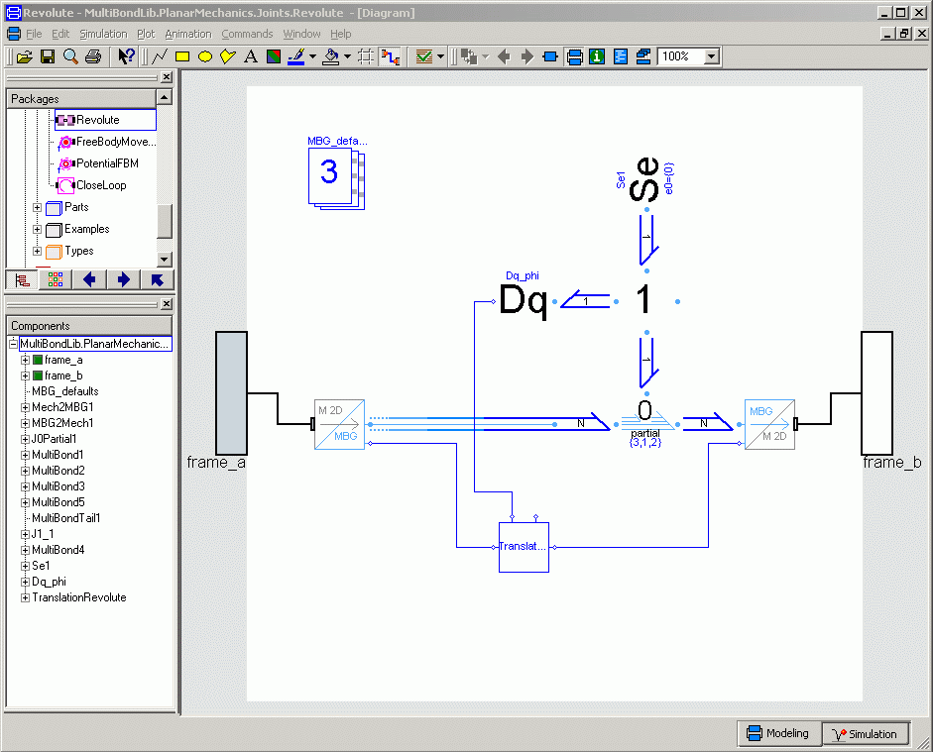
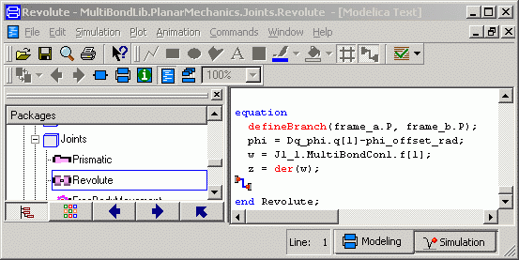
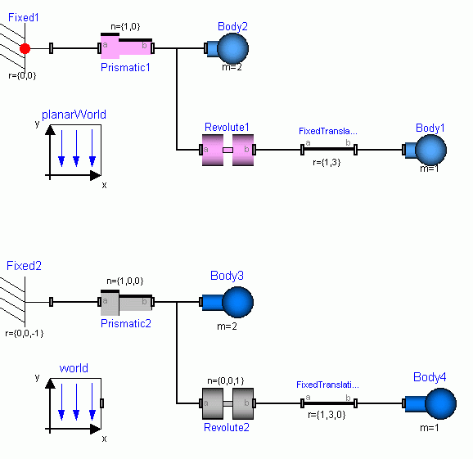
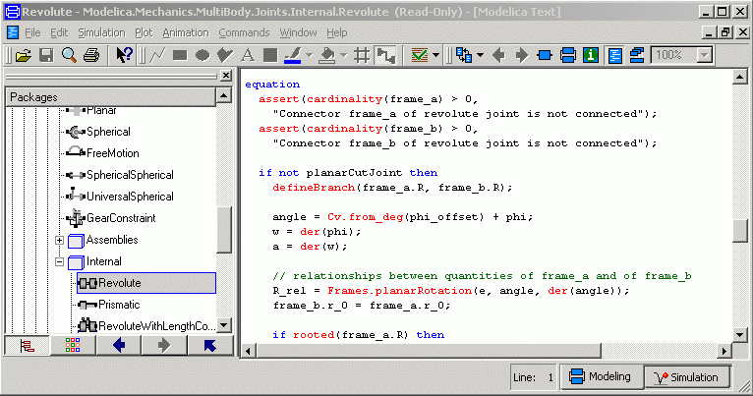
Revolute Joints

Slide 30
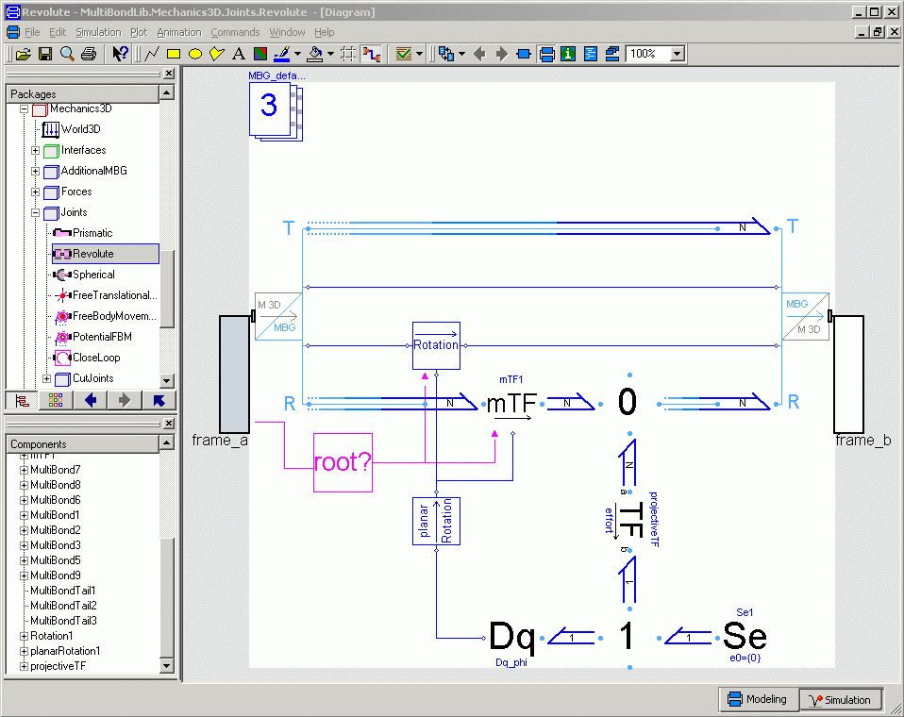
The 3D Revolute Joint
Coordinate transformation from frame_a to frame_b
Relative velocity and position of joint are computed here
The orientation matrix is computed from the relative angle φ by the planar rotation method.

Slide 31
The 3D Revolute Joint II
Additional rotational velocity is added here, in case the joint is being used as a drive, i.e., if external torque is being introduced at the effort source.

Slide 32
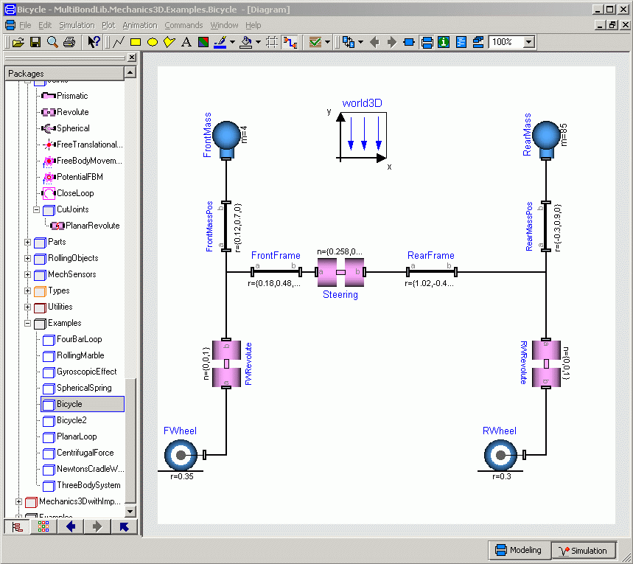
A Bicycle Model

Slide 33
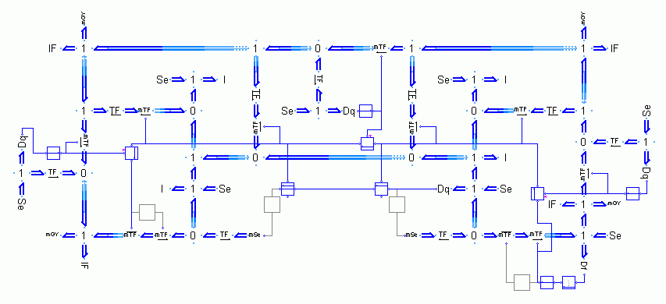
A Bicycle Model II
A multi-bond graph represents rarely the most suitable user interface. However, this is precisely the model that gets simulated. The multi-bond graph sits underneath the multi-body system description shown previously.

Slide 34
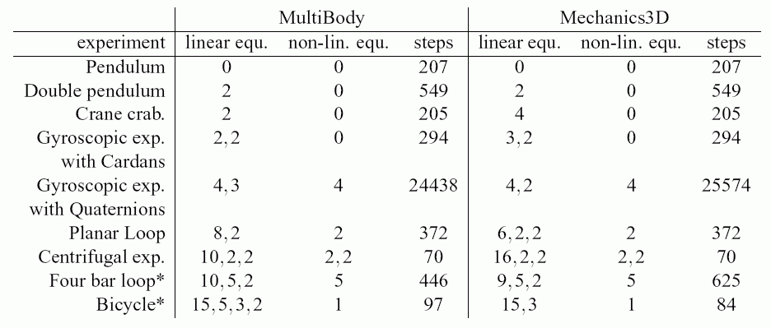
Efficiency of Simulation Runs
The following table compares the efficiency of the simulation code obtained using the multi-body library contained as part of the MSL with that obtained using the 3D mechanics sub-library of the MultiBondGraph library.
MSL
MultiBondGraph

Slide 35
Conclusions
Modeling and simulation are central both to system analysis and design.
The interfaces of component models are just as important as if not more important than the model structure itself.
Model interfaces need to be designed around sound physical quantities, such as power flows, to make the models truly modular and reusable in many different contexts.
Bond graphs support modeling by power flows in optimal ways.
An object-oriented modeling environment, such as Modelica, is paramount to convenient and safe manipulation of models of large-scale systems.
Bond graphs offer rarely the most convenient user interface; yet the object-oriented modeling paradigm enables us to wrap bond graphs into higher-level model architectures in a fully transparent fashion.

