Slide 1







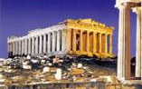
ECO-BOND GRAPHS
An Energy-Based Modeling and Simulation Framework
for Complex Dynamic Systems
with a focus on Sustainability and Embodied Energy Flows
Dr. Rodrigo Castro
ETH Zürich, Switzerland.
University of Buenos Aires & CONICET, Argentina.
Sept. 27, 2013, Athens, Greece
The 10th
International
Multidisciplinary
Modelling & Simulation
Multiconference
The 1st Int’l. Workshop on
Simulation for Energy, Sustainable
Development & Environment

Slide 2
Agenda
Problem formulation
  Emergy tracking & Complex Dynamics Systems
Possible approaches
Our approach
  Networked Complex Processes
  3-faceted representation of energy flows
The Bond Graph formalism
The new Eco Bond Graphs
  Definition
  Examples
  Simulation results
Conclusions

Slide 3
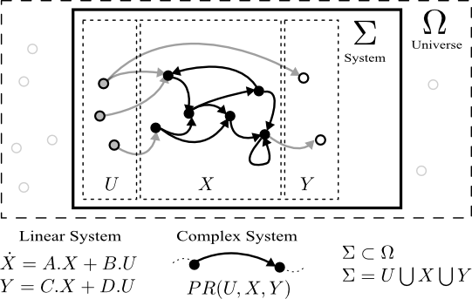
System Theoretic Approach
Problem formulation
Complex Dynamics Systems
  Global scale socio-natural processes
    We live in a nonlinear world, mostly away from equilibrium
×

Slide 4

Storages and Processes
Problem formulation
Flows of Mass and Energy
  Each process can abstract several internal sub processes
  We want to model systematically this type of systems
  Structural approach  Sustainability properties
“Grey Energy”
Notes:
KM:

Slide 5
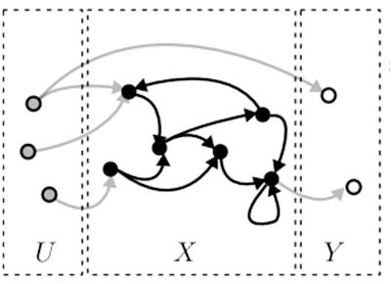
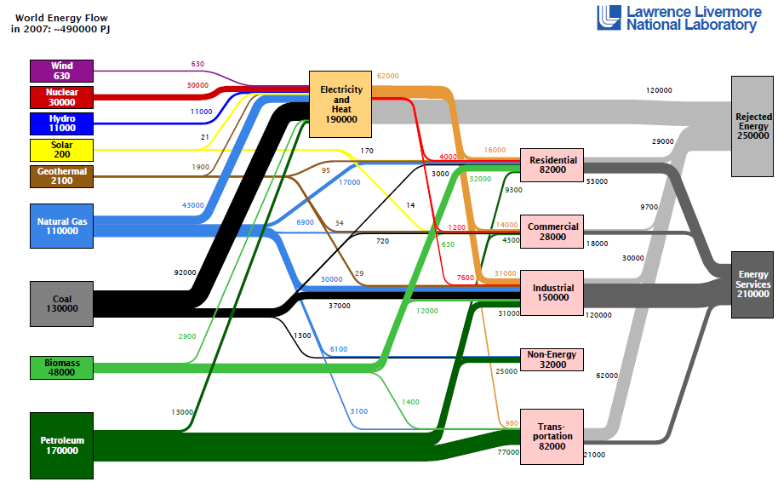
Considering energy losses
Possible approaches
Sankey Diagrams
  Static (snapshot-like) World Energy Flow.

Slide 6
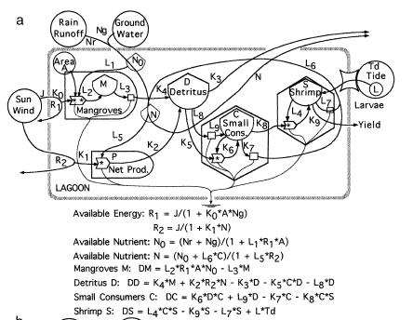
Considering energy losses
Possible approaches
Energy System Language (H.T. Odum)
  Account for dynamicsDifferential Eqns.

Slide 7
Networked processes
Our approach
Multi Input/Multi Output Processes
  Including recycling paths

Slide 8
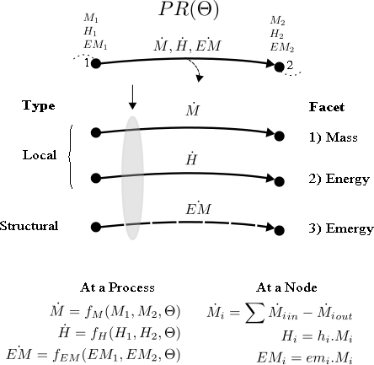
Focus on mass flows
Our approach
3-Faceted representation
Balance: Mass and Energy
Tracking: Emergy

Slide 9
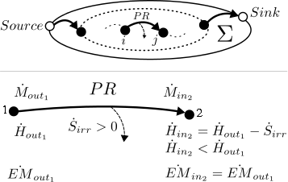
Basic formulation
Our approach
Minimum required formulation
  To achieve the modeling
  goal systematically
How do we formalize and generalize this structure ?

Slide 10
Bondgraphic approach
The Bond Graph Formalism
Bondgraph is a graphical modeling technique
  Rooted in the tracking of power [Joules/sec=Watt]
  Represented by effort variables (e) and flow variables (f)
Goal:
  Sound physical modeling of generalized flows of energy
  Self checking capabilities for thermodynamic feasibility
Strategy:
  Bondgraphic modeling of phenomenological processes
  Including emergy tracking capabilities
e
e: Effort
f: Flow
Power = e · f
f

Slide 11
Energy domains
The Bond Graph Formalism
e
Bondgraph is
multi-energy domain
f
Energy Domain | e Effort variable | f Flow variable
Mechanical, translation | Force | Linear velocity
Mechanical, rotation | Torque | Angular velocity
Electrical | Electromotive force | Current
Magnetic | Magnetomotive force | Flux rate
Hydraulic | Pressure | Volumetric flow rate
Thermal | temperature | entropy flow rate

Slide 12
Causal Bonds
The Bond Graph Formalism
As every bond defines two separate variables
  The effort e and the flow f
  We need two equations to compute values for these two variables
It is always possible to compute one of the two variables at each side of the bond.
A vertical bar symbolizes the side where the flow is being computed.
e
f

Slide 13
Junctions
The Bond Graph Formalism
Local balances of energy
e₂
e₂ = e₁
e₃ = e₁
f₁ = f₂ + f₃
e₁
f₂
⇔
0
f₁
e₃
f₃
Junctions of type 0 have only one flow equation, and therefore, they must have exactly one causality bar.
e₂
f₂
f₂ = f₁
f₃ = f₁
e₁ = e₂+ e₃
e₁
1
⇔
f₁
e₃
f₃
Junctions of type 1 have only one effort equation, and therefore, they must have exactly (n-1) causality bars.

Slide 14
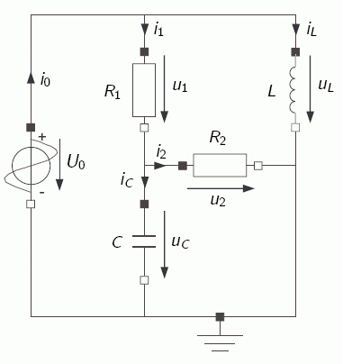
Example I
The Bond Graph Formalism
An electrical energy domain model
Bondgraphic equivalent
Electrical Circuit
Resistor
Inductor
Resistor
Voltage
Source
Capacitor

Slide 15
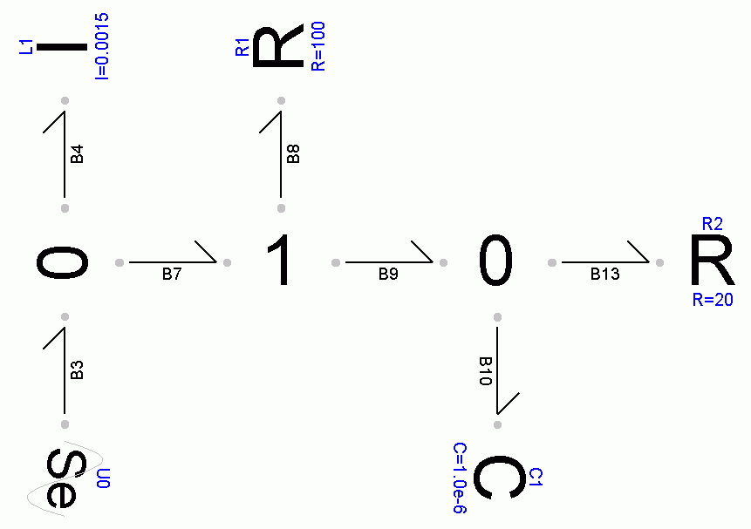
Example I
The Bond Graph Formalism
Systematic derivation
of equations
Bondgraphic model
U0 .e = f(t)
U0 .f = L1 .f + R1 .f
d/dt L1.f = U0 .e / L1
L1.f
R1 .e = U0 .e – C1 .e
U0.e
R1.f
R1.e
R1 .f = R1 .e / R1
U0.e
C1.e
C1.e
C1 .f = R1 .f – R2 .f
R1.f
R1.f
R2.f
d/dt C1.e = C1 .f / C1
R2 .f = C1 .e / R2
C1.f
C1.e
U0.e
U0.f

Slide 16
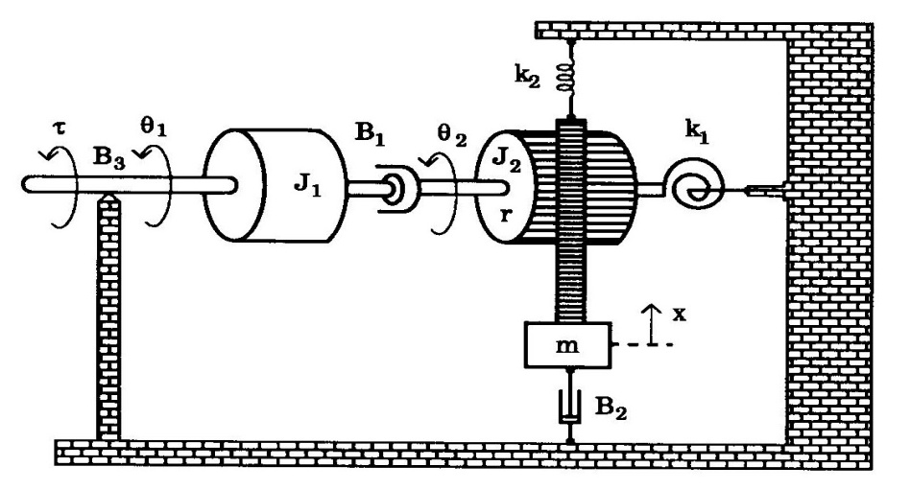
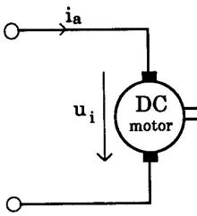
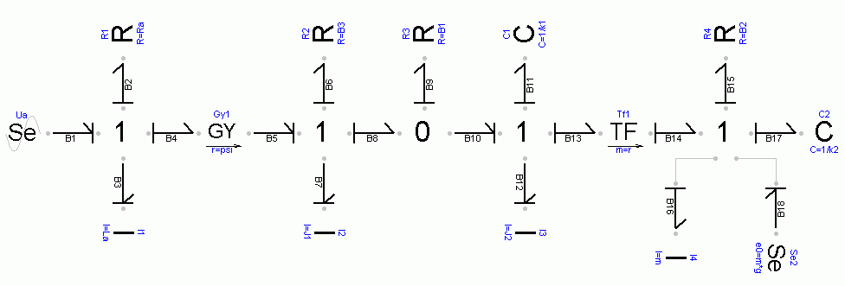
Example II
The Bond Graph Formalism
A multi-energy domain model
  Electricity
  Mechanical rotational
  Mechanical translational
Special elements such as
Gyrator and Transformer
convert energy flows across diff. physical domains
u_{Ra}
i_{a}
τ_{B3}
ω₁
τ_{B1}
ω₁₂
τ_{k1}
ω₂
F_{B2}
v
u_{a}
u_{i}
τ
τ_{B1}
τ_{B1}
τ_{G}
F_{G}
F_{k2}
i_{a}
i_{a}
ω₁
ω₁
ω₂
ω₂
v
v
i_{a}
u_{La}
ω₁
τ_{J1}
ω₂
τ_{J2}
v
F_{m}
-m·g
v

Slide 17

Facets and Bonds
Eco Bond Graphs
Bond Graph variables for Complex Systems
  Facets 1 and 2
    Power variables:
      Specific Enthalpy [J/kg] (an effort variable)
      Mass Flow [kg/sec] (a flow variable).
      [J/sec] = [J/kg] · [kg/sec] represents power
    Information variable
      Mass [Kg] (a state variable)
  Facet 3 (the emergy facet)
    Information variable
      Specific Emergy [J/kg] (a structural variable)
      [J/sec] = [J/kg] · [kg/sec] also denotes power
EcoBG

Slide 18
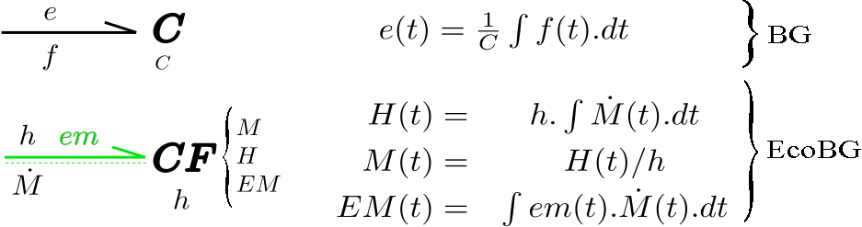
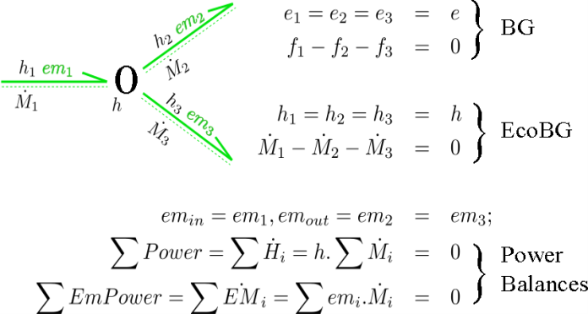
Accumulators
Eco Bond Graphs
The EcoBG Storage element
  A Capacitive Field (CF) accumulates more than one quantity: Enthalpy, Mass and Emergy
q
The specific enthalpy is
a property of the accumulated mass
Known in advance -> A parameter

Slide 19
Junctions
Eco Bond Graphs
The EcoBG 0-Junction
M₂
M₁
M₃

Slide 20
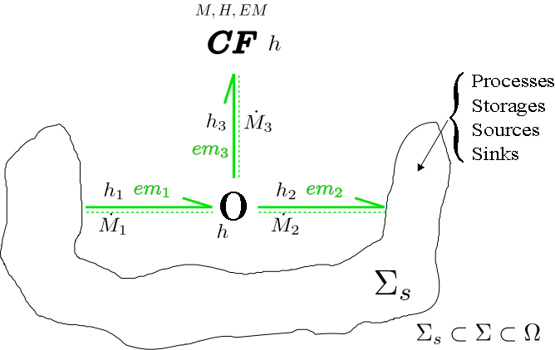
Reusable structures
Eco Bond Graphs
Basic unit based on EcoBG elements
  An important “building block”
Storage of mass and energy adhering to
the proposed
3-Faceted approach:
M₃
M₁
M₂

Slide 21
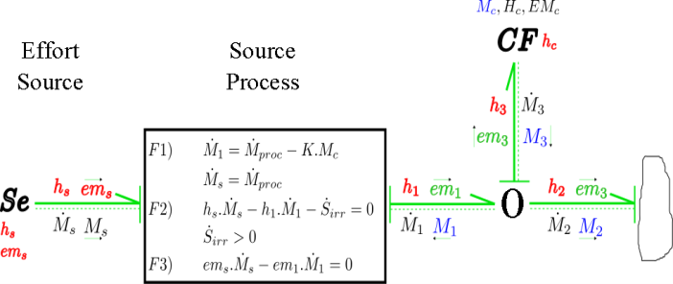
Modeling processes
Eco Bond Graphs
EcoBG Process elements
PR()

Slide 22
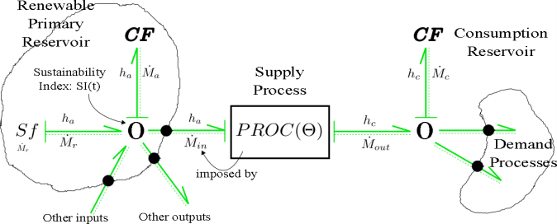
Example
Eco Bond Graphs
Extraction of renewable resources for consumption
Natural Renewable
Primary
Reservoir
Consumption
Secondary
Reservoir
Supply
Process
Demand
Process

Slide 23
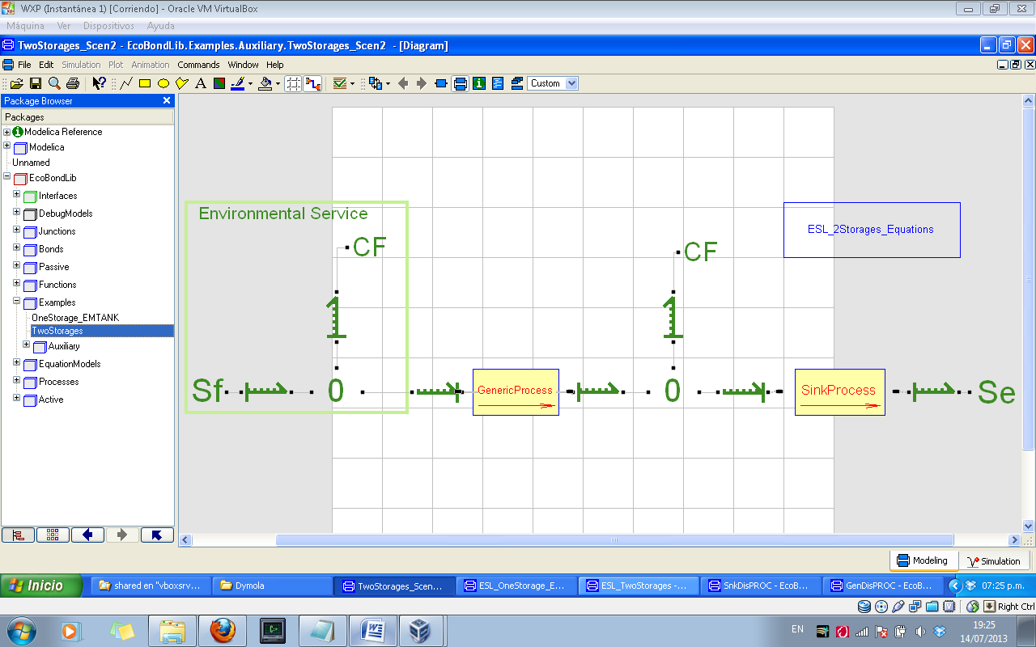
Software tools
Eco Bond Graphs
EcoBG library implemented in the Dymola® tool.
Natural Renewable
Primary
Reservoir
Consumption
Secondary
Reservoir
Supply
Process
Demand
Process

Slide 24
The Mass Layer
Eco Bond Graphs
Accumulated
Deposit (M_{a})
Consumption
Reservoir (M_{c})
Human
Demand
Rain

Slide 25
Energy and Emergy Layers
Eco Bond Graphs
Accumulated
Deposit (M_{a})
Consumption
Reservoir (M_{c})
Human
Demand
Rain
Notes:
Ks_irr does not play a role here

Slide 26
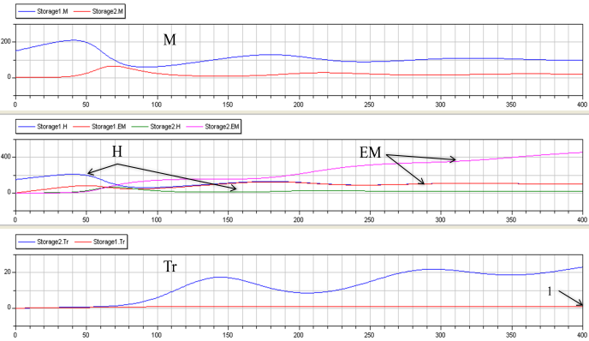
Simulation results
Eco Bond Graphs
Accumulated quantities (Deposit and Reservoir)
eq.
eq.
Energy
Emergy
Transformity
eq.

Slide 27
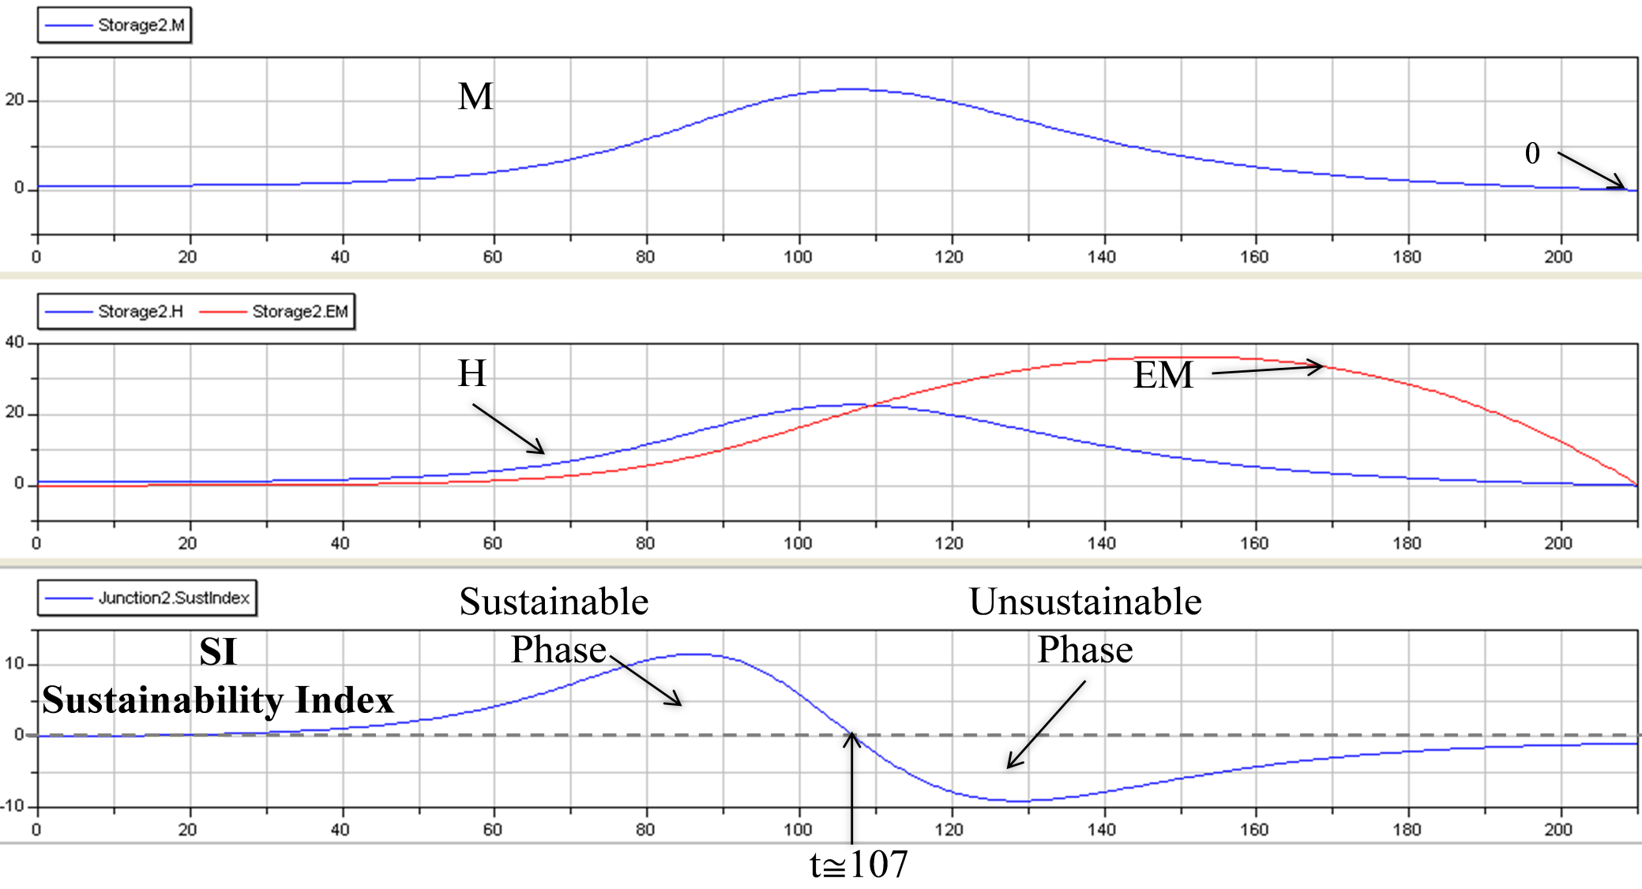
Simulation results
Eco Bond Graphs
Experiment: Rain flow reduced 4x. Results for Reservoir.
Mass
Energy
Emergy

Slide 28
Conclusions
Eco Bond Graphs
  A new “Plumbing Technology” for modeling Complex Dynamics Systems
  A low-level tool to equip other higher-level modeling formalisms
    with the ability to track emergy flows
Hierarchical interconnection of EcoBG subsystems
  Automatic and systematic evaluation of sustainability:
    global tracking of emergy and
    local checking of energy balances
M&S practice
  The laws of thermodynamics are not an opinable subject
    Every sustainability-oriented effort should -at some point- consider emergy
We should become able to inform both:
    decision makers (experts, politicians, corporations) and
    people who express their wishes (democratic societies)
  about which are the feasible physical boundaries
    within which their -largely opinable- desires and/or plans can
    be possibly implemented in a sustainable fashion.

Slide 29

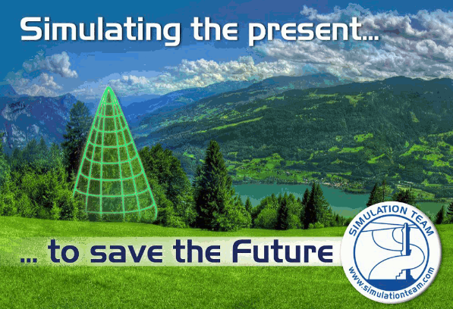
Q&A
Thanks for your attention !
rodrigo.castro@usys.ethz.ch
rcastro@dc.uba.ar

