Slide 1
Discretizing Time or States? A Comparative Study between DASSL and QSS
Xenofon Floros¹ Francois E. Cellier¹ Ernesto Kofman²
¹ Department of Computer Science, ETH Zurich, Switzerland
{xenofon.floros, francois.cellier}@inf.ethz.ch
² Laboratorio de Sistemas Dinámicos, FCEIA, Universidad Nacional de Rosario, Argentina
kofman@fceia.unr.edu.ar
EOOLT workshop – October 3, 2010

Slide 2
Outline
Modelica Language
QSS methods and PowerDEVS
Non-Discontinuous Modelica Models Simulation with QSS and DEVS
OpenModelica to PowerDEVS (OMPD) Interface
Simulation Results

Slide 3
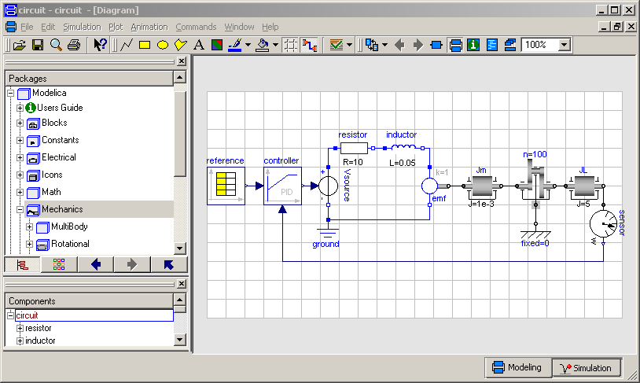
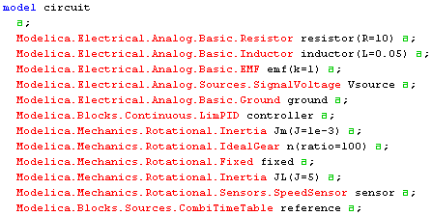
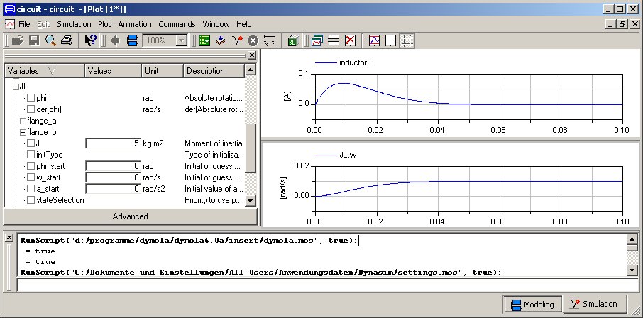
Modelica – The next generation modeling language
Modelica modeling environment (free or commercial)
Graphical editor for Modelica models
Free Modelica language
Textual description
Modelica simulation environment (free or commercial)
Translation of Modelica models in C-Code and Simulation

Slide 4
QSS methods
Simulation of continuous systems by a digital computer requires discretization.
Classical methods (e.g. Euler, Runge-Kutta etc.), that are implemented in Modelica environments, are based on discretization of time.
On the other hand, the Discrete Event System Specification (DEVS) formalism, introduced by Zeigler in the 90s, enables the discretization of states.
The Quantized-State Systems (QSS) methods, introduced by Kofman in 2001, improved the original quantized-state approach of Zeigler.
PowerDEVS is the environment where QSS methods have been implemented for the simulation of systems described in DEVS.

Slide 5
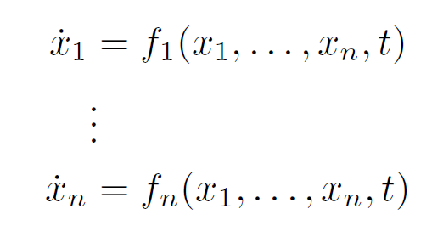
QSS methods
Let’s assume that the OpenModelica compiler has performed all the preprocessing
steps and reached a reduced ODE of the form:
or
Then the simulation environments (usually) provide solvers that evaluate the right-
hand side of the above equation at discrete time steps in order to compute the
next value of the state variable .

Slide 6
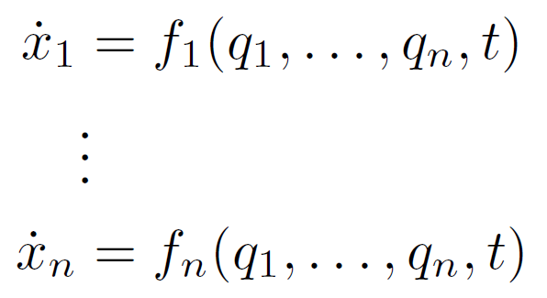
QSS methods
Contrary, in QSS methods the state variables have to be quantized in order to obtain
piecewise constant trajectories. Let be piecewise constant approximations of . Then, we can write:
and considering a single component we can define the “simple” DEVS models:
Quantized Integrator
Static Function

Slide 7
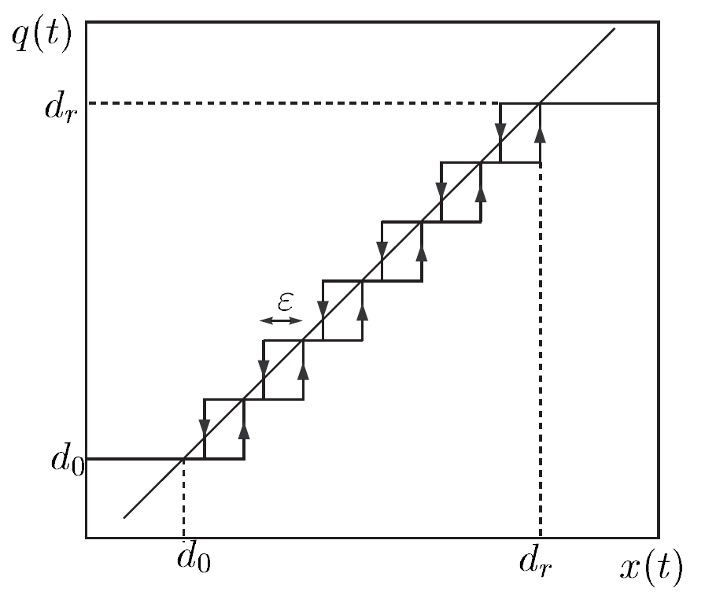
QSS methods
In QSS methods function Q has been chosen to be a Quantization Function with Hysteresis.
Usually the discrete values are equidistant and is called quantum.
At each step only one (quantized) state variable that changes more than the quantum value ΔQ is updated producing a discrete event.
Notes:
In principle one can use a simple quantization function like q = floor(x)
Unfortunately the transformation of a continuous system into its discrete counterpart can result into illegitimate models
( performing an infinite time of transitions into a finite time interval )

Slide 8
QSS higher order methods
QSS is a first-order approximation of the real system trajectory.
(In QSS quantized variables and state derivatives are piecewise constant, thus state variables piecewise linear).
The problem is that both the approximation error and the time interval between successive events grows linearly with the quantum . Thus reducing the error will cause a proportional increase of the computational time.
There are also available higher-order approximations (QSS2, QSS3) that reduce the computation time.

Slide 9
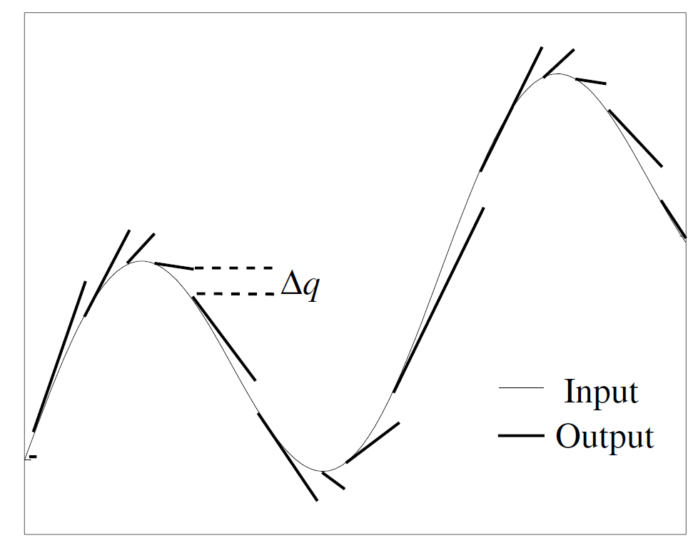
QSS higher order methods
For example, in QSS2 the quantized variables have piecewise linear trajectories thus (in the linear case) the state derivatives are also piecewise linear and the state variables piecewise parabolic
QSS2 approximation

Slide 10
PowerDEVS
Specify system structure
(using DEVS formalism)
Block implementation hidden
(C++ code)
Integrators implement the QSS
methods
Simulation using hierarchical
master-slave structure and
message passing
Allows for real-time simulation
http://sourceforge.net/projects/powerdevs/

Slide 11
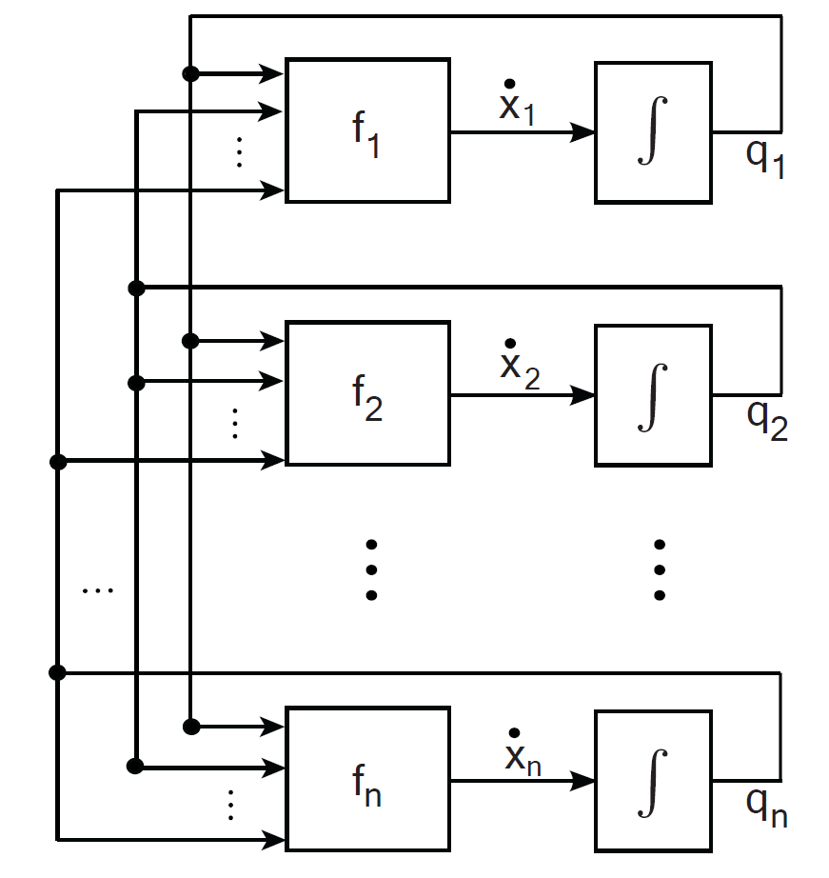
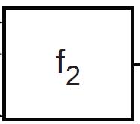
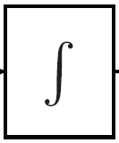
Simulate Modelica Models with QSS and DEVS
Thus, in absence of discontinuities, we can simulate our Modelica model using a coupled
DEVS model consisting of coupling, n Quantized Integrators and n Static Functions, e.g.

Slide 12
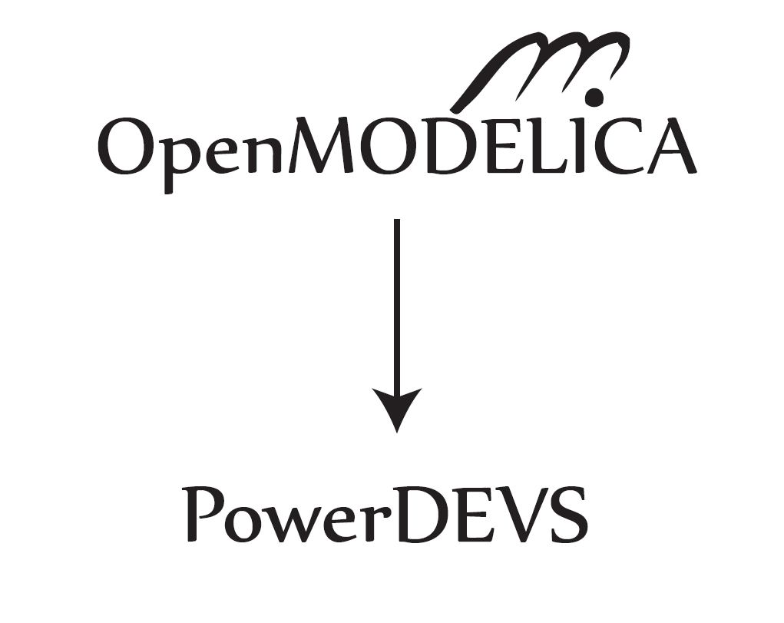
Goal
Design and implement an interface between OpenModelica and PowerDEVS

Slide 13
Goal
Interfacing OpenModelica and PowerDEVS we take advantage of
The powerful modeling tools and market share offered by Modelica
Users can still define their models using the Modelica language or their favorite graphical interface.
No prior knowledge of DEVS and QSS methods is needed.
The superior performance of quantization-based techniques in some particular problem instances
QSS methods allow for asynchronous variable updates, which potentially speeds up the computations for real-world sparse systems.
QSS methods do not need to iterate backwards to handle discontinuities, they rather predict them, enabling real-time simulation.

Slide 14
Interfacing OpenModelica and PowerDEVS (OMPD interface)

Slide 15
OMPD Interface (I)
Equation splitting
The interface extracts the indices of the equations needed in order to compute the derivative of each state variable.
Mapping split equations to BLT blocks
The splitted equations are mapped back to BLT blocks of equations. This is needed in order to pass this information to the OMC module that is responsible for solving algebraic loops.
Mapping split equations to DEVS blocks
Since the state variables and the equations needed to compute them have been identified, they are assigned sequentially to static blocks in the DEVS structure.
Generating DEVS structure
In order to correctly identify the DEVS structure of the model, the dependencies between the state variables that are computed in each static block have to be resolved. This is achieved employing the incidence matrix and the mapping of equations to DEVS blocks.
Discretizing Time or States? A Comparative Study between DASSL and QSS (EOOLT 2010)

Slide 16
OMPD Interface (II)
Generating the .pds structure file
Based on the DEVS structure it is straightforward to generate the .pds structure file.
Generating static blocks code
In this step the functionality of each static block is defined. Each static block needs to know its inputs and outputs, supplied by the DEVS structure, as well as the BLT blocks needed to compute the corresponding state derivatives. Then the existing code generation OMC module is employed to provide the actual simulation code for each static block.
Generating the .cpp code file
The code for the static blocks is ouput in the .cpp code file along with other information needed by PowerDEVS.

Slide 17
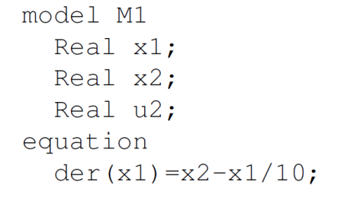
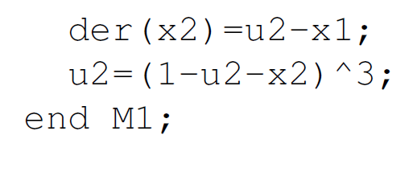
OMPD Interface - Example Model
Various tests have been performed to ensure that the implemented OMPD interface is working correctly.
Here we present the results of processing the following second-order model through the implemented interface:

Slide 18
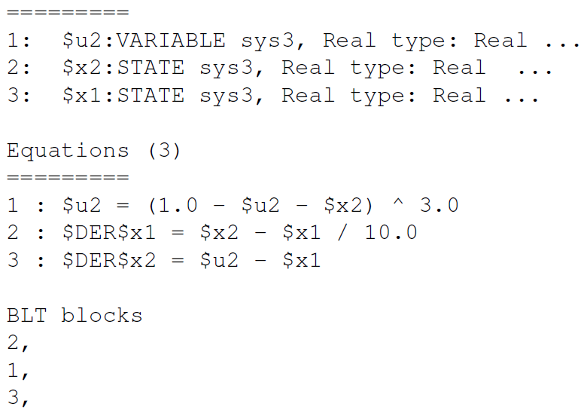
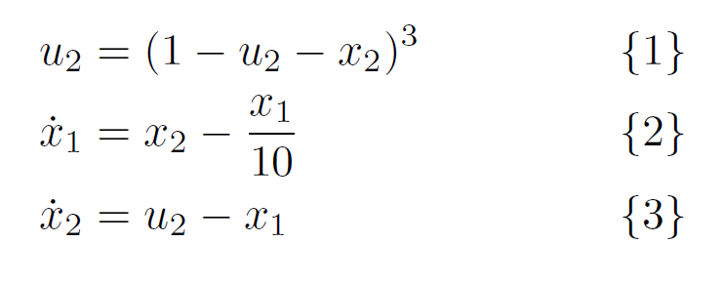
OMPD Interface - Example Model
In other words OMC has identified that
model M1 has:
2 state variables
1 algebraic variable
and 3 equations:
organized in 3 BLT blocks.
Information extracted by OMC compiler :

Slide 19
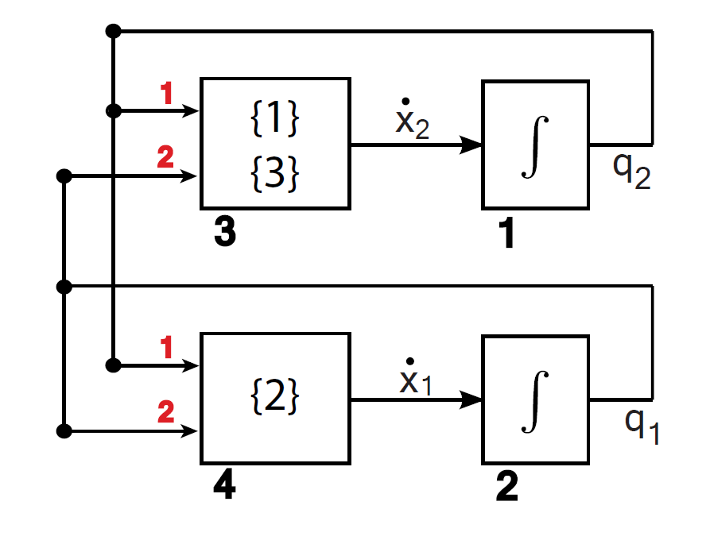
OMPD Interface - Example Model
Automatically generated DEVS structure

Slide 20
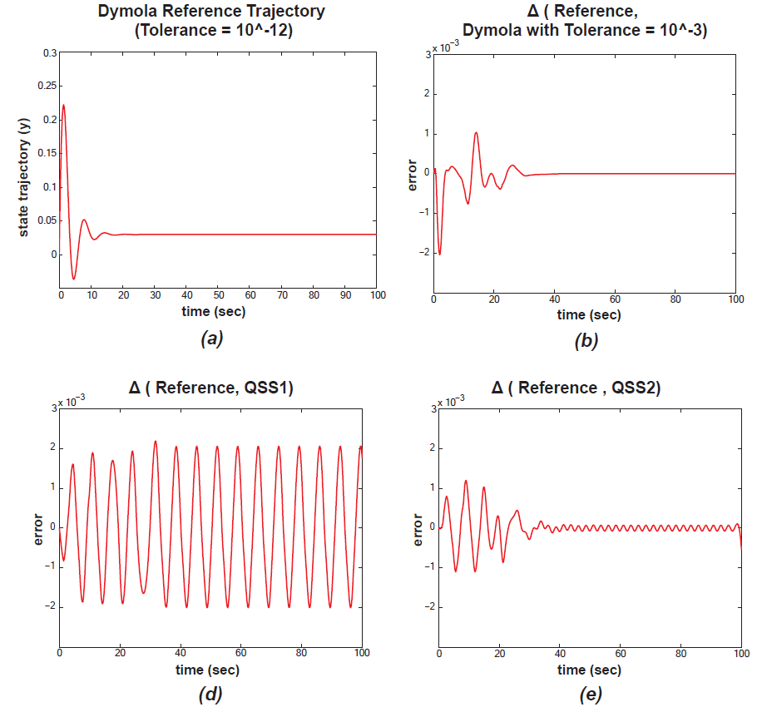
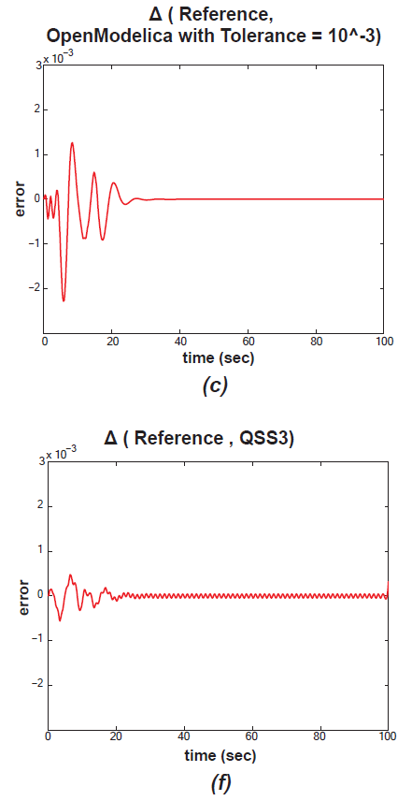
OMPD Interface - Example Model
Simulation Results for model M1.

Slide 21
Simulation Results – Benchmark Framework
We want to compare the performance of the standard DASSL solver of OpenModelica with the QSS3 method implemented in PowerDEVS.
More specifically we would like to investigate the performance of both algorithms for non-stiff models of different size and sparsity without discontinuities.
To achieve that we generate linear test models of the form:
In order to control the eigenvalues of the system matrix A is constructed as follows:
Generate real-valued random eigenvalues drawn from a Gaussian distribution :
Create a diagonal matrix
Create a random orthogonal matrix
Then, matrix has the desired eigenvalues .
Sparsity s is defined as the number of connections to each state variable.
To achieve a certain sparsity level s, we set the n-s absolute smallest elements of each row of
A to zero.

Slide 22
Simulation Results – Benchmark Framework
For the comparison simulations the following settings were used:
OpenModelica 1.5.0 with DASSL as the standard solver
PowerDEVS with QSS3
Tolerance was set to 10⁻³ for both environments.
Simulation End-Time was set to 3 sec.
The output file generation was disabled.
For each parameter configuration (n,s)
100 Modelica models were randomly generated and given as input to the standard OMC and via the OMPD interface to PowerDEVS.
The CPU time needed for the simulation was measured for each generated executable.
To obtain more reliable results, each simulation was repeated 10 times and the median was considered as the measured CPU time.
Finally, the mean of the measurements is reported along with +/- 1 standard deviation.

Slide 23
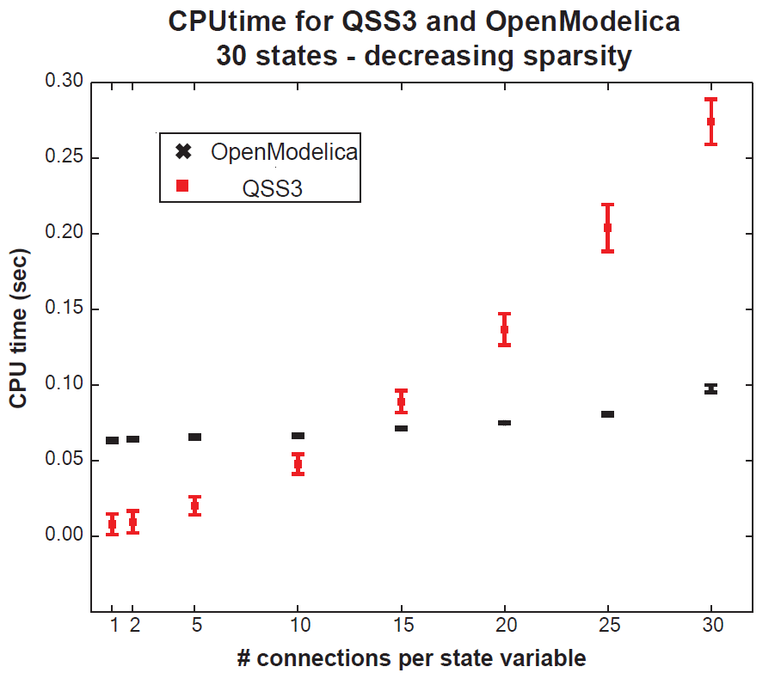
Simulation Results – Fixed Number of States

Slide 24
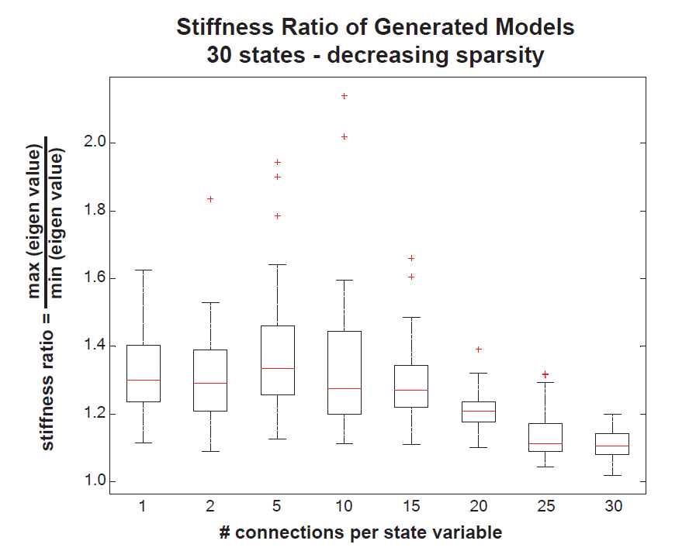
Simulation Results – Fixed Number of States

Slide 25
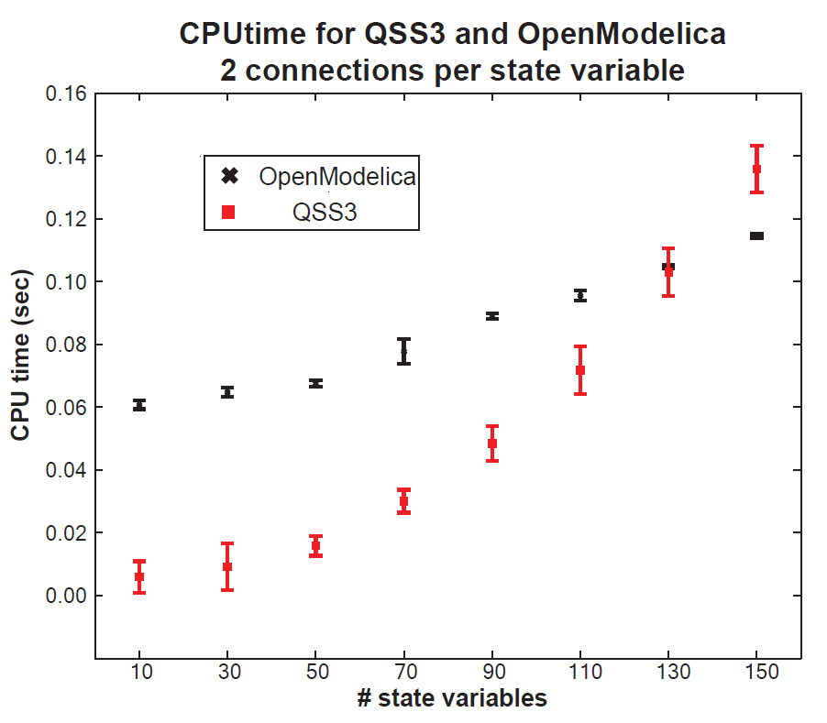
Simulation Results – Fixed Sparsity

Slide 26
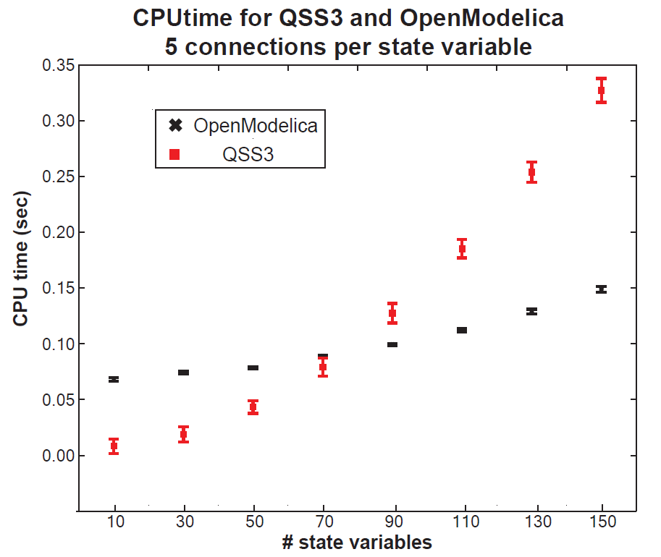
Simulation Results – Fixed Sparsity

Slide 27
Summary
Goal: Interface OpenModelica and PowerDEVS
Motivation:
Established and easy model definition in Modelica.
Exploit the superiority of QSS methods in certain classes of problems
without the overhead of a manual conversion.
Give the user the freedom to simulate either in a discretized-time or discretized-state world.
Current status:
All models without discontinuities
Manual application of the designed algorithm on 3 examples.
Future work:
Extend the interface to cover cases with discontinuities.
Further investigate the performance of QSS methods compared to DASSL for various classes of large-scale, real-world problems.

Slide 28
QUESTIONS ?

