Slide 1



A presentation by Daniel Huguenin on the paper
Fast and Effective Orchestration of Compiler Optimizations for Automatic Performance Tuning
written in 2006 at Purdue University by
Zhelong Pan^{[1]}
Rudolf Eigenmann^{[2]}
This presentation as .pptx: http://tinyurl.com/6y7gy8x (or scan QR code)
The paper: http://dl.acm.org/citation.cfm?id=1122414
[1] http://www.nic.uoregon.edu/iwomp2005/IWOMP_Photos_Day1/IWOMP_Photos-Images/7.jpg
[2] https://engineering.purdue.edu/ResourceDB/ResourceFiles/image3424

Slide 2
AVAILABILITY
As .pptx: http://tinyurl.com/6y7gy8x

Slide 3
« This is a cite from the paper. Note the dedicated quotation marks. »
Any references are listed here.
The paper: http://dl.acm.org/citation.cfm?id=1122414

Slide 4
THE PROBLEM

Slide 5
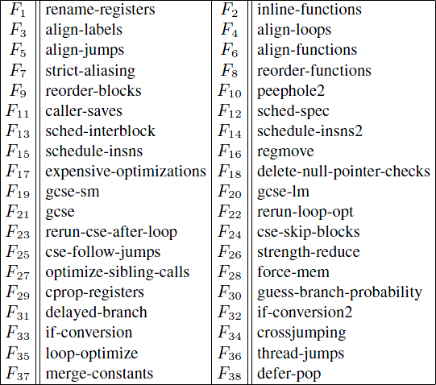
YOUR TASK!
?
?
?
?
?
?
?
?
?
?
?
?
?
?
?
?
?
?
?
?
?
?
Choose optimization options from above to maximize program performance. Good luck.
The table is taken from page 5 of the original paper.

Slide 6
Optimization
orchestration
« Given a set of compiler optimization options {F₁, F₂, ..., F_{n}}, find the combination that minimizes the program execution time. Do this efficiently, without the use of a priori knowledge of the optimizations and their interactions. »

Slide 7
GOAL

Slide 8
« We present […] Combined Elimination (CE), which aims at picking the best set of compiler optimizations for a program. […] this algorithm takes the shortest tuning time, while achieving comparable or better performance than other algorithms. »

Slide 9
ALGORITHMS

Slide 10
Exhaustive Search (ES)*
Batch Elimination (BE)
Iterative Elimination (IE)
Combined Elimination (CE)
Optimization Space Exploration (OSE)
Statistical Selection (SS)*
* Not covered in detail
Notes:
The described algorithms are formulated independently of the compiler used. The options used are simple ON/OFF options.

Slide 11
EXHAUSTIVE SEARCH
«
  Get all 2^{n} combinations of n options F₁, F₂, ..., F_{n}.
  Measure application execution time of the optimized version compiled under every possible combination.
  The best version is the one with the least execution time.
»
COMPLEXITY: O(2^{n})
« For 38 optimizations: It would take up to 2³⁸ program runs – a million years for a program that runs in two minutes. »

Slide 12
RELATIVE IMPROVEMENT
PERFORMANCE (RIP*)
A measure for the usefulness of an optimization.
RIP(F_{i}) > 0%: F_{i} is actually useful
RIP(F_{i}) < 0%: F_{i} causes the program execution time to increase
Not applying F_{i} increases the runtime by RIP(F_{i})
→ RIP(F_{i}) = 100% means the program runs twice as long without F_{i}
* Not to be confused with Rest In Peace

Slide 13
RELATIVE IMPROVEMENT
PERFORMANCE (RIP*)
= A measure for the usefulness of an optimization.
B: The baseline; a configuration of optimization options
F_{i}: An optimization option
T_{B}: Execution time when compiled under B
T(F_{i}=0): Execution time when compiled under B but with F_{i} off
* Not to be confused with Rest In Peace
Notes:
RIP(F_{i}) < 0%: Applying F_{i} has a negative effect!
RIP(F_{i}) > 0%: F_{i} is a useful optimization
Not applying F_{i} increases the runtime by RIP(F_{i}) → RIP(F_{i}) = 100% means the program runs twice as long without F_{i}

Slide 14
EXAMPLE
Baseline B: F₁ = 1, F₂ = 1, F₃ = 1
T_{B}: 80ms
T(F₁ = 0): 100ms (F₁ = 0, F₂ = 1, F₃ = 1)

Slide 15
BATCH ELIMINATION
«
  Compile the application under the baseline B = {F₁ = 1, F₂ = 1, ..., F_{n} = 1}. Execute the generated code version to get the baseline execution time T_{B}.
  For each optimization F_{i}, switch it off from B and compile the application. Execute the generated version to get T(F_{i} = 0), and compute the RIP_{B}(F_{i} = 0).
  Disable all optimizations with negative RIPs to generate the final, tuned version.
»
COMPLEXITY: O(n)
Would be good if the optimizations did not affect each other.

Slide 16
BATCH ELIMINATION
F₁, F₂, ..., F_{n}
Compile w/ all-on
Execute
T_{B}
COMPLEXITY: O(n)
For each F_{i}
Compile with all-on except F_{i}
Would be good if the optimizations did not affect each other.
Execute
T(F_{i} = 0)
RIP_{B}(F_{i} = 0)
RIP_{B}(F_{i} = 0) < 0?
Yes:
Don’t use F_{i}
No:
Use F_{i}

Slide 17
NO!
EXAMPLE
Combination | F₁ | F₂ | Runtime | RIP_{B}
1 | OFF | OFF | 320 ms | 60%
2 | ON | OFF | 160 ms | -20%
3 | OFF | ON | 180 ms | -10%
4 | ON | ON | 200 ms | (0%)
T_{B}

Slide 18
ITERATIVE ELIMINATION
  Initialize S = {F₁, F₂, ..., F_{n}} and B = {F₁ = 1, F₂ = 1, ..., F_{n} = 1}
  Determine the baseline T_{B}: Compile the program with the options in B and measure its runtime.
  For each optimization F_{i} in S, compute RIP_{B}(F_{i}) by compiling the program with the options in B, except F_{i} which is turned off, and measuring its runtime.
  Find the optimization F_{j} with the most negative RIP_{b}, remove it from S and set F_{j} = 0 in B (The baseline changes!)
  Repeat 2 - 4 until all remaining optimizations have a positive RIP_{b}. B now contains the "optimal" options.
COMPLEXITY: O(n²)
« [...] IE achieves better program performance than BE, since it considers the interaction of optimizations. However, when the interactions have only small effects, BE may perform close to IE in a faster way. »

Slide 19
ITERATIVE ELIMINATION
F₁, F₂, ..., F_{n}
S = {F₁, F₂, ..., F_{n}}
Compile w/ B
B = {F₁ = 1, ..., F_{n} = 1}
T_{B}
Execute
For each F_{i} in S
Compile under B, but F_{i} = 0
COMPLEXITY: O(n²)
RIP_{B}(F_{i} = 0)
T(F_{i} = 0)
Execute
« [...] IE achieves better program performance than BE, since it considers the interaction of optimizations. However, when the interactions have only small effects, BE may perform close to IE in a faster way. »
Exists F_{k}: RIP_{B}(F_{k} = 0) < 0?
No:
Result in B
Yes:
Find F_{k} with minimal RIP_{B}
B.F_{k} = 0
S = S \ {F_{k}}
T_{B} = T(F_{k} = 0)

Slide 20
EXAMPLE
YES!
Combination | F₁ | F₂ | Runtime | RIP_{B}
1 | OFF | OFF | 320 ms | 100%
2 | ON | OFF | 160 ms | (0%)
3 | OFF | ON | 180 ms
4 | ON | ON | 200 ms
Combination | F₁ | F₂ | Runtime | RIP_{B}
1 | OFF | OFF | 320 ms | 60%
2 | ON | OFF | 160 ms | -20%
3 | OFF | ON | 180 ms | -10%
4 | ON | ON | 200 ms | (0%)
T_{B}
T_{B}

Slide 21
COMBINED ELIMINATION
  Initialize S = {F₁, F₂, ..., F_{n}} and B = {F₁ = 1, F₂ = 1, ..., F_{n} = 1}
  Determine the baseline T_{B}: Compile the program with the options in B and measure its runtime.
  For each optimization F_{i} in S, compute RIP_{B}(F_{i}) by compiling the program with the options in B, except F_{i} which is turned off, and measuring its runtime.
  Find the optimization F_{j} with the most negative RIP_{b}, remove it from S and set F_{j} = 0 in B (The baseline changes!)
  For all remaining F_{k} with negative RIP_{b} from step 4, recompute the RIP_{B}(F_{k}) relative to the changed B. If still negative, remove F_{k} from S and set it to 0 in B.
  Repeat 2 - 5 until all remaining optimizations have a positive RIP_{b}. B now contains the "optimal" options.
COMPLEXITY: O(n²)
« CE takes the advantages of both BE and IE. When the optimizations interact weakly, CE eliminates the optimizations with negative effects in one iteration, just like BE. Otherwise, CE eliminates them iteratively, like IE. »

Slide 22
COMBINED ELIMINATION
F₁, F₂, ..., F_{n}
S = {F₁, F₂, ..., F_{n}}
Compile w/ B
B = {F₁ = 1, ..., F_{n} = 1}
T_{B}
Execute
For each F_{i} in S
Compile under B, but F_{i} = 0
COMPLEXITY: O(n²)
RIP_{B}(F_{i} = 0)
T(F_{i} = 0)
Execute
« CE takes the advantages of both BE and IE. When the optimizations interact weakly, CE eliminates the optimizations with negative effects in one iteration, just like BE. Otherwise, CE eliminates them iteratively, like IE. »
Exists F_{k}: RIP_{B}(F_{k} = 0) < 0?
No:
Result in B
Yes:
Find F_{k} with minimal RIP_{B}
For all remaining F_{j} with negative RIP_{B}, check if the RIP_{B} is still negative under the changed B. If so, remove F_{j} directly.
B.F_{k} = 0
S = S \ {F_{k}}
T_{B} = T(F_{k} = 0)
CE

Slide 23
Optimization SPACE
EXPLORATION
  Construct a set Ω which consists of a default optimization combination (Here: All on), and n combinations that each switch a single optimization off.
  Measure the execution time under each combination in Ω. Keep only the m fastest combinations in Ω.
  Construct a new Ω set consisting of all unions of two optimization combinations in the old Ω set.
  Repeat 2 and 3 until no new combinations can be generated or the performance gain becomes insignificant.
  The fastest version in the final Ω is the result.
COMPLEXITY: O(nm²) ~ O(n³)
Idea from S. Triantafyllis, M. Vachharajani, N. Vachharajani, and D. I. August. Compiler optimization-space exploration. In Proceedings of the international symposium on Code generation and optimization, pages 204–215, 2003.
Notes:
The “union” operation takes non-default values of the options in both combinations.

Slide 24
STATISTICAL SELECTION
 | F₁ | F₂ | ... | F_{n}
Combination 1 | 0 | 1 | 0 | 1
Combination 2 | 1 | 0 | 1 | 0
Combination 3 | 1 | 1 | 0 | 0
...
Combination k | 0 | 0 | 1 | 0
COMPLEXITY: O(n²)
You wouldn’t appreciate an in-depth explanation.
Shown in R. P. J. Pinkers, P. M. W. Knijnenburg, M. Haneda, and H. A. G. Wijshoff. Statistical selection of compiler options. In The IEEE Computer Societys 12th Annual International Symposium on Modeling, Analysis, and Simulation of Computer and Telecommunications Systems (MASCOTS’ 04), pages 494–501, Volendam, The Netherlands, October 2004.

Slide 25
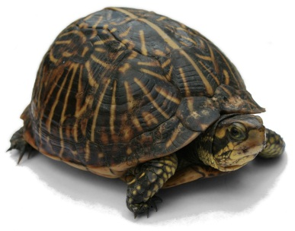

Complexity OVERVIEW
From
Algorithm | Complexity
Exhaustive Search | O(2^{n})
Optimization Space Exploration | O(nm²) ~ O(n³)
Statistical Selection | O(n²)
Iterative Elimination | O(n²)
Combined Elimination | O(n²)
Batch Elimination | O(n)
to
Turtle: http://upload.wikimedia.org/wikipedia/commons/f/f4/Florida_Box_Turtle_Digon3_re-edited.jpg
Rabbit: http://upload.wikimedia.org/wikipedia/commons/5/59/JumpingRabbit.JPG

Slide 26
PERFORMANCE ANALYSIS

Slide 27

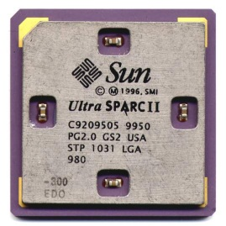


TESTING Environment
CPUs
Pentium 4
SPARC II
CPU2000
Benchmark
Ver. 3.3.3
Compiler
Pentium IV: http://www.esaitech.com/objects/catalog/product/image/thb51752.jpg
SPARC II: http://upload.wikimedia.org/wikipedia/commons/1/1c/Sun_UltraSPARCII.jpg
SPEC Logo: http://www.spec.org/images/SPECsmalllogoreg.png
GCC Logo: http://upload.wikimedia.org/wikipedia/commons/a/a9/Gccegg.svg
Notes:
The algorithms deal with a set of 38 O3 optimization options.
23 of the 28 SPEC CPU2000 benchmark programs are used and tuned with CE.
The remaining 5 programs are written in F90 or C++; the performance evaluation relies on the C programming language and F77 only.

Slide 28




Training
Set
Reference
Set
#include <stdio.h>
#include <stdio.h>
#include <stdio.h>
Executable icon:
http://fromthegut.org/gwen/peachtree/Windows%20XP.pvm/Windows%20Applications/NTVDM.EXE.app/Contents/Resources/AppBigIcon.png
All other illustrations except GCC logo are from Office.com.

Slide 29
SPEC CPU2000 INTEGER CODE
Compression (2x)
Game Playing: Chess
Group Theory, Interpreter
C Programming Language Compiler
Combinatorial Optimization
Word Processing
PERL Programming Language
Place and Route Simulator
Object-oriented Database
FPGA Circuit Placement and Routing

Slide 30
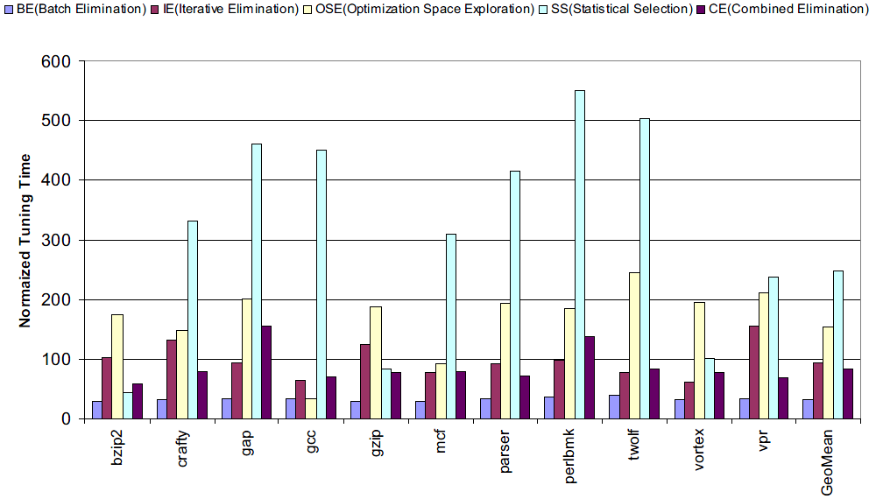
Tuning time (INT, P4)
Notes:
Normalized tuning time of five optimization orchestration algorithms for SPEC CPU2000 on Pentium 4.
Lower is better. CE has the shortest tuning time in all except a few cases. In all those cases, the extended tuning time leads to significantly higher performance.
Among the four algorithms (excluding BE), CE has the fastest average tuning speed. The faster algorithms achieve their speed at significant expense of program performance.

Slide 31
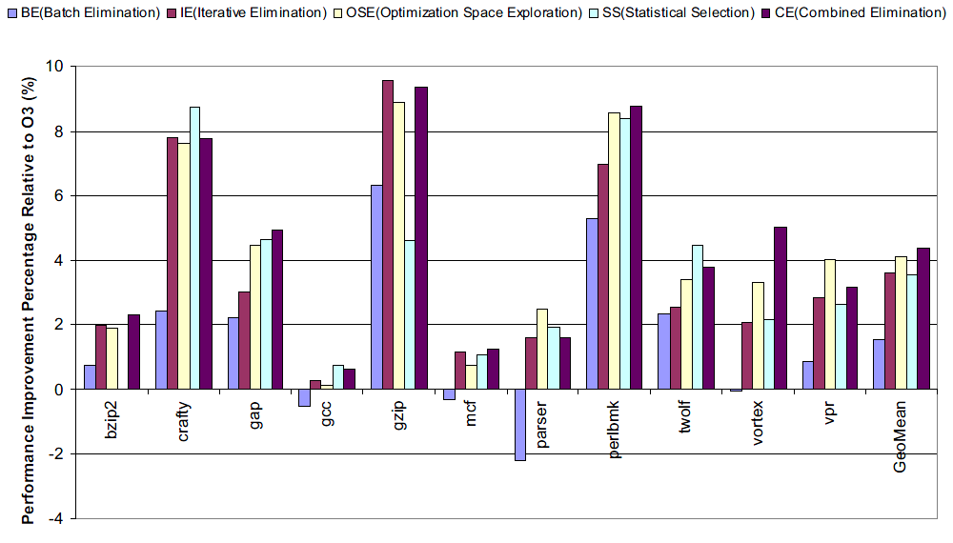
PERFORMANCE (INT, P4)
Notes:
Program performance of five optimization orchestration algorithms for SPEC CPU2000
benchmarks on Pentium 4. Higher is better. In all cases, CE performs the best or within 1% of the
best.

Slide 32
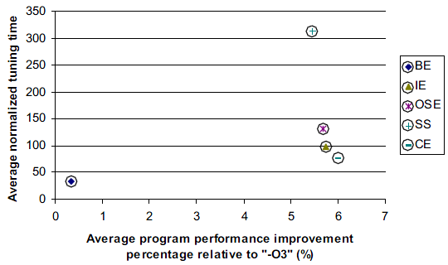
Comparison
Notes:
Bottom right is best, top left is worst

Slide 33
THE DOWNSIDE
Effective average tuning time on P4 @ 2.8 GHz (To scale)
CE: 2.96h
OSE: 4.51h
SS: 11.96h
Notes:
Applicability depends on development schedule, the sizes of real programs will be a lot bigger.
This is certainly NOT for nightly builds...

Slide 34

THE FUTURE
for(i = 0; i < 10; ++i)
{
//...
}
#include <stdio.h>
while(true)
{
printf("%d", ++j);
if(j > 2 * i)
break;
}
if(!over)
{
//...
}
iOS-style on/off switch: http://www.tobypitman.com/wp-content/uploads/2010/06/iphone-checkboxes.png

