Slide 1
Offline Adaptation Using Automatically Generated Heuristics
Frédéric de Mesmay, Yevgen Voronenko, and Markus Püschel
Department of Electrical and Computer Engineering, Carnegie Mellon University, Pittsburgh, USA
Marius Fehr, December 7th 2011

Slide 2
Online vs. Offline Adaptive Libraries
Online Adaptive
Offline Adaptive
Machine Learning
d = dft(n)
d = dft(n)
Search
generated at Installation
d(X,Y)
d(X,Y)
possibly unbounded initialization time
impractical for constantly changing problem specifications
bounded initialization time
no search if input specifications change
Notes:
differentiates between
what is … ?
what difference to user?
example dft
same interface
search best solution w. rsp. to hardware, problem size
lookup in a heuristic
use d
unbounded initialization time
search if problem changes
bounded
no search
paper , convert, machine learning technique

Slide 3
Motivation
Background
Adaptation Process
Results
Notes:
need background information
machine learning technique used
how a dft is optimized

Slide 4
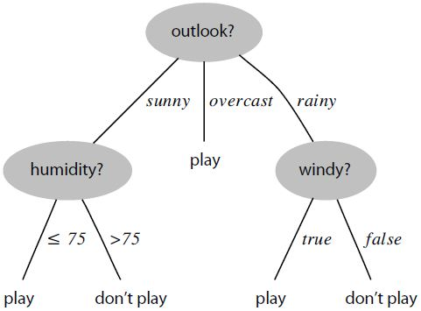
Statistical Classifier – C4.5
features
Based on entropy, the measure of uncertainty
Feature with smallest entropy becomes root
Source: Offline Adaptation Using Automatically Generated Heuristics, CMU
Notes:
use a statistical classifier
what does … ?
trainings set -> statistic of behaviour -> decision tree
concrete example
manager wants to predict
features -> nodes, decisions -> leafs
how does it work … ? No detail
entropy
entropy: measure of uncertainty
determines nodes
aim: choose feature, separates best
Outlook
sunny -> uncertain (3np:2p) -> high entropy
rain -> uncertain (2np:3p) -> high entropy
overcast -> certain (0np:4p) -> entropy low (zero)
overall entropy of outlook: low
best suited for root
apply recursively

Slide 5
DFT – Discrete Fourier Transforms
The Fourier Transform is a Linear Transform:
Y
DFT_{n}
X
=
*
${DFT}_{n}= {[e^{−2πikl/n}] }_{0≤k,l≤n} , i= \sqrt{−1}$
Notes:
paper based example transformation online dft offline dft
what is.. ? How can it be optimized and adapted?
Linear transform
transform x by multiplying with matrix
entries calculated

Slide 6
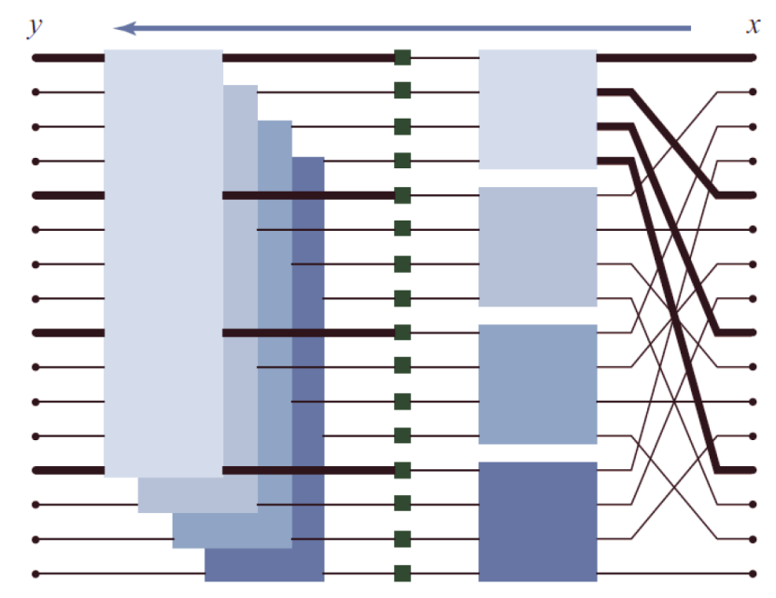
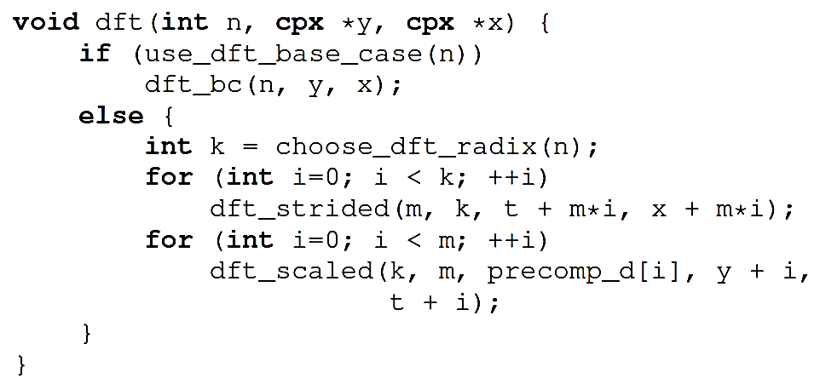
FFT – Fast Fourier Transforms
Divide and Conquer Algorithms
Source: Lecture Slides :“How to Write Fast Numerical Code “ 263-2300 (ETH, CS) , Markus Püschel
Notes:
one fast algorithm to compute dft
divide and conquer approach
example dft 16
divide into smaller dft’s
graphic left
see how entries
example
recursive in code
two parts that can be adapted
*read*
whether use base case on a size
base case means use optimized piece of code
other choose radix, how to split up
degrees of freedom, this version fft
note: not a recursive call to dft() but strided, scaled
additional input k, the stride
what … ?
dft, choice based only on size n
dft strided choice based size n and stride k

Slide 7
FFTW – Search space
dft ( 128 )
No
Radix 8
dft_scaled (8, 16)
Radix 4
dft_strided (16, 8)
These decisions can be optimized!
Features : Problem size and stride
Decisions: Use of base cases and choice of radix
Source: Offline Adaptation Using Automatically Generated Heuristics, CMU
Notes:
graph represents flow of fft, white boxes decisions, grey boxes recursive call
example dft(128)
*example*
see: algorithm runs has to decide again and again
recap: features, decisions

Slide 8
FFTW – Advanced Implementations
Lots of decisions!
Source: Offline Adaptation Using Automatically Generated Heuristics, CMU
Notes:
simple implementation
state of the art libraries
includes threading
search space is huge, lots of decisions

Slide 9
Motivation
Background
Adaptation Process
Results
Notes:
putting everything togeher

Slide 10
Offline Adaptation Process
Trainings Set
features |  | decisions
size | stride | use base case | radix
128 | - | no | 8
16 | - | no | 4
4 | - | yes | -
16 | 8 | no | 4
… | … | … | …
Heuristic
x
x
x
x
x
x
x
Search
C4.5
Notes:
### training set explanation
how combine, learned
choose training set
choose well, strong impact performance
feed set, search online adaptive library, write choices into table
features size stride, decisions, use base case, radix
seen table
know C4.5 creates heuristic
nice way, created heuristic, replace online search

Slide 11
Offline Adaptation Process
Online Adaptive Library
Exploration
Statistical Classification
Verification
Combination
Offline Adaptive Library
Source: Offline Adaptation Using Automatically Generated Heuristics, CMU
Notes:
some difficulties
4 steps
let’s…
one by one

Slide 12
Exploration
Exploration
Statistical Classification
Verification
Combination
“Creates a table for the statistical classifier to work with”
Trainings Set
features |  | decisions
Size | Stride | Use Base case | Radix
128 | - | No | 8
16 | - | No | 4
4 | - | Yes | -
16 | 8 | No | 4
… | … | … | …
x
x
x
x
x
x
x
Search
Notes:
exploration
easy step
create table
search of online adaptive lib.

Slide 13
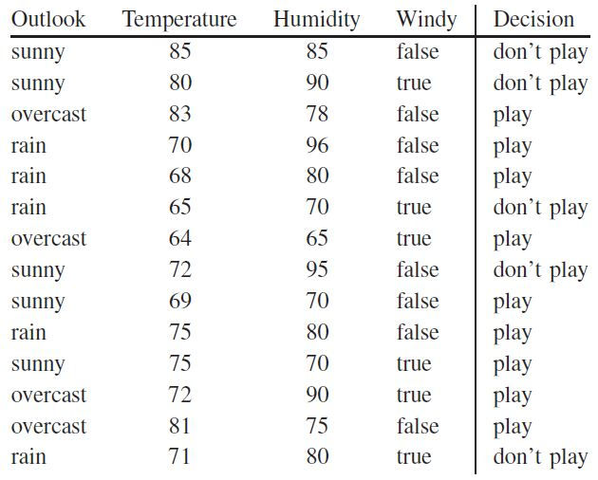
Statistical Classification
Exploration
Statistical Classification
Verification
Combination
Computes decision trees
Uses a modified version of C4.5
Provides “hints” based on library functionality
Source: Offline Adaptation Using Automatically Generated Heuristics, CMU
Notes:
Statistical Classification
decision trees from table
modified version c4.5
some tables performance bad
needs hints

Slide 14
Hinting
Exploration
Statistical Classification
Verification
Combination
Problem: Sometimes C4.5 has not enough information to make wise decisions
Choice of radix:
Performance depends strongly on the prime factorization
Multiple of 2 and 3 show very different behavior but are heavily interleaved
Solution: Provide additional features to C4.5
12 | 16 | 27 | 32 | 48 | 56 | 64 | 66 | 72 | 81 | 90 | 99
n
< 20
20 … 24
25 … 48
49 … 58
> 59
Radix ?
Radix ?
Radix ?
Radix ?
Radix ?
Notes:
how can table be bad
not enough info
example
radix
performance
one example
multiple 2,3 , different behavior, interleaved
C4.5,array into sub-array, same behavior
impossible efficient split up
solution?
provide add. feature

Slide 15
Hinting
Exploration
Statistical Classification
Verification
nfactor( 2 , n )
nfactor( 3, n )
n
2 | 4 | 0 | 5 | 4 | 3 | 6 | 1 | 3 | 0 | 1 | 0
1 | 0 | 3 | 0 | 1 | 0 | 0 | 1 | 2 | 4 | 2 | 2
12 | 16 | 27 | 32 | 48 | 56 | 64 | 66 | 72 | 81 | 90 | 99
Combination
4
1
48
3 | 1
2 | 2
72 | 90
Radix 12
Radix 18
4 | 5 | 3 | 6
0 | 0 | 0 | 0
16 | 32 | 56 | 64
Radix 4
0 | 0 | 0
3 | 4 | 2
27 | 81 | 99
2 | 1
1 | 1
12 | 66
Radix 3
Radix 6

Slide 16
Exploration
Statistical Classification
Verification
Combination
Source: Offline Adaptation Using Automatically Generated Heuristics, CMU
Notes:
see: code example, decide radix
feature in form of function nfactor(a, n)
knows
distinguish multiples
wise choices

Slide 17
Verification
Exploration
Statistical Classification
Verification
Combination
24 = 2 * 2 * 2* 3
Source: Offline Adaptation Using Automatically Generated Heuristics, CMU
Notes:
step verification
incorrect choices
incorrect?
constraint?
radix divides size
example 24 = 2*2*2*3
*example*
how could this happen?
testing set every size with 3 time fac 2 had 2 or more times fac 3, not case in reality
verification corrects

Slide 18
Combination
Exploration
Statistical Classification
Verification
Combination
Inserts decision trees into the library as heuristics
Offline Adaptive
Online Adaptive
d = dft(n)
Search
d(X,Y)
Notes:
combination
does what it named for
combines online adaptive library code with heuristic code
replace online by heuristic
completes transformation of library

Slide 19
Motivation
Background
Adaptation Process
Results
Notes:
results

Slide 20
2-Powers – Competitiveness
Platform:
2 x dual core 3GHz Intel Xeon 5160
Source: Offline Adaptation Using Automatically Generated Heuristics, CMU
Notes:
axes
lines
platform
powers of two
competing libs
NOT perf of offline lib
ONLINE
Why?
show source has good performance
see: pretty good

Slide 21
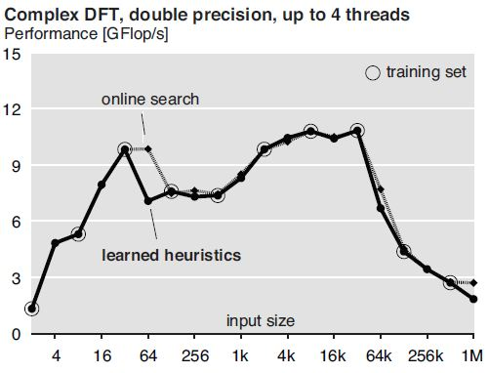
Learning and Generating Heuristics
Source: Offline Adaptation Using Automatically Generated Heuristics, CMU
Notes:
axes
lines
same platform
see same libs , different training set for offline lib
gap caused bad choice t s
t r without multithreading
heuristic will never choose m t
better
better
conclusion: choice of trainings set very important, should cover a broad variety of vectors

Slide 22
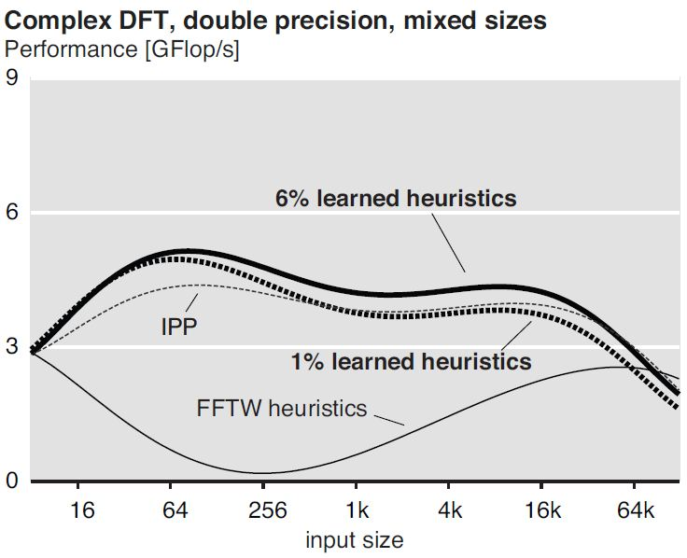
Mixed Sizes - Competitiveness
Source: Offline Adaptation Using Automatically Generated Heuristics, CMU
Notes:
axes
lines/dots
left
mixed sizes
6% size of training set
competes with IPP
points interpolated logarithmic 6 grade function
beats IPP
FFTW
not online search mode
handwritten heuristics
shows: writing good heuristics is very hard

Slide 23
Pro vs. Contra
Pro
Improvement of usability
Only small performance penalty (for DFT)
Entirely automatic method
Applicable to other problem domains / libraries
Computer generation of offline adaptive library, directly from algorithm specification (together with Spiral)
Contra
Performance depends strongly on choice of training set
Algorithm Specification
SPIRAL
this paper
Adaptive Offline Library

Slide 24
Questions
?

Slide 25
Questions
?

Slide 26
Online vs. Offline Adaptive Libraries 3
Library Type | Non – adaptive | Online adaptive | Offline adaptive
Prototype | IPP | FFTW | this paper
Interface | $$\left\{\begin{aligned}d=dft(n) \\ d(X,Y)\end{aligned}\right.$$ | $$\left\{\begin{aligned}d=dft(n) \\ d(X,Y)\end{aligned}\right.$$ | $$\left\{\begin{aligned}d=dft(n) \\ d(X,Y)\end{aligned}\right.$$
Initialization cost | $$O(n)$$ | $$>O(n log⁡(n))$$ | $$O(n)$$
Computation cost | $$O(n log⁡(n))$$ | $$O(n log⁡(n))$$ | $$O(n log⁡(n))$$
Adaptation mechanism | - | online (planer at runtime) | offline (at installation time)
problem changes | - | rerun planer | -
platform changes | rebuy | rerun planer | reinstall
Source: Offline Adaptation Using Automatically Generated Heuristics, CMU

Slide 27
Math behind C4.5
Entropy of event:
$$H\left(a= a_{j}\right)=−\sum_{i=1}^{n}{P\left(d_{i}\right|a= a_{j})\log_{2}P\left(d_{i}\right|a= a_{j})}$$
Entropy of feature:
$$H\left(a\right)=\sum_{j=1}^{m}{P\left(a= a_{j}\right)H(a= a_{j})}$$
Choose feature with smallest entropy

