Slide 1





Improving 3D NAND
Flash Memory Lifetime by
Tolerating Early Retention Loss and Process Variation
Yixin Luo Saugata Ghose Yu Cai Erich F. Haratsch Onur Mutlu
Notes:
Thank you for the introduction. Today, I will present our work about …

Slide 2
NAND Flash Memory Lifetime Problem
Gen N+1
ECC Limit
Gen N
ECC Limit
Raw Bit Error Rate (RBER)
Lifetime
Flash lifetime decreases in each generation
despite increased ECC strength
Lifetime
Wearout (Program/Erase Cycles, or PEC)
Notes:
NAND flash memory is a type of storage media widely used in today’s SSDs.
NAND flash memory wears out as we write more data to it.
This means that the raw bit error rate (on the y-axis) increases as the program/erase cycle (on the x-axis) increases, as we show on this figure.
These errors are tolerated by ECC code, which can correct raw bit errors up to a certain limit. When RBER goes beyond this limit, flash lifetime end.
In each new generation, we trade off reliability for higher storage density. So flash lifetime decreases despite the increased ECC strength and ECC limit.

Slide 3
Planar vs. 3D NAND Flash Memory
Planar NAND Flash Memory
3D NAND Flash Memory
Reduce flash cell size,
Reduce distance b/w cells
Scaling
Increase # of layers
Reliability
Scaling hurts reliability
Not well studied!
Notes:
To further increase storage density, manufacturers developed 3D NAND technology, which stacks dozens of layers of flash memory on top of each other.
This new technology changes a lot of designs inside flash memory, from circuit-level design to flash cell organization.
But at this point, due to its recent development, the implication of 3D NAND technology on flash reliability is not well studied.

Slide 4
Executive Summary
Problem: 3D NAND error characteristics are not well studied
Goal: Understand & mitigate 3D NAND errors to improve lifetime
Contribution 1: Characterize real 3D NAND flash chips
  Process variation: 21× error rate difference across layers
  Early retention loss: Error rate increases by 10× after 3 hours
  Retention interference: Not observed before in planar NAND
Contribution 2: Model RBER and threshold voltage
  RBER (raw bit error rate) variation model
  Retention loss model
Contribution 3: Mitigate 3D NAND flash errors
  LaVAR: Layer Variation Aware Reading
  LI-RAID: Layer-Interleaved RAID
  ReMAR: Retention Model Aware Reading
  Improve flash lifetime by 1.85× or reduce ECC overhead by 78.9%
Notes:
In this work, our goal is to …
In the xth contribution, we …

Slide 5
Agenda
Background & Introduction
Contribution 1: Characterize real 3D NAND flash chips
Contribution 2: Model RBER and threshold voltage
Contribution 3: Mitigate 3D NAND flash errors
Conclusion

Slide 6
Agenda
Background & Introduction
Contribution 1: Characterize real 3D NAND flash chips
  Process variation
  Early retention loss
  Retention interference
Contribution 2: Model RBER and threshold voltage
Contribution 3: Mitigate 3D NAND flash errors
Conclusion

Slide 7
Process Variation Across Layers
Flash Cell
…
Layer M
Flash cells on different layers may
have different error characteristics
…
…
…
…
…
…
…
…
Layer 1
…
Layer 0
BL N
…
BL 1
BL 0
Notes:
This figure shows how flash cells are organized in a 3-dimensional manner, with M+1 layers.
Each layer of a vertical bitline is a flash cell.
The key takeaway is the flash cells on different layers may have different error characteristics, because of the systematic process variation caused by the way how these vertical bitlines are manufactured.
So our goal is to experimentally characterize this phenomenon using real chips.

Slide 8

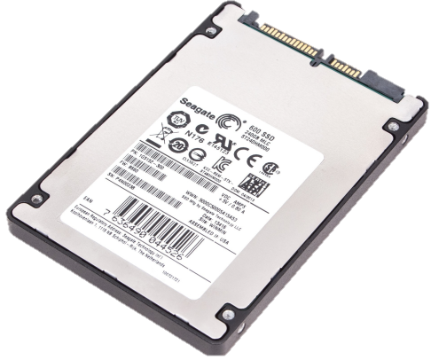
Characterization Methodology
Modified firmware version in the flash controller
  Controls the read reference voltage of the flash chip
  Bypasses ECC to get raw data (with raw bit errors)
Analysis and post-processing of the data on the server
Server
SSD
Notes:
Here is the methodology we use.
Our characterization platform consists of a form-factor SSD connected to a server machine.
We use a modified firmware version in the flash controller, which allows us to control the read reference voltage of the flash chip,
and to bypass error correction to get raw NAND data.

Slide 9
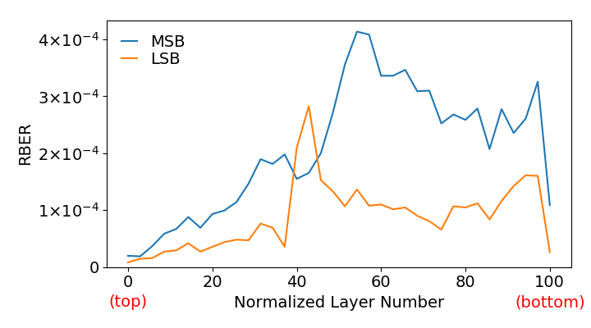
Layer-to-Layer Process Variation
Max RBER
21×
2.4×
Notes:
Here is the characterization result. X-axis shows …, y-axis shows …
We make several observations from the data.
Large variation in RBER across different layers, this phenomenon is called layer-to-layer
RBER variation caused by LSB-MSB page, we call this LSB-MSB RBER variation
Max RBER in middle layers
Consistent across chips

Slide 10
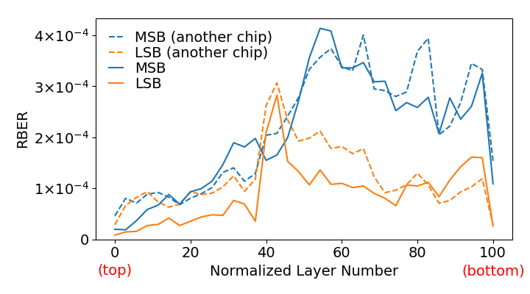
Layer-to-Layer Process Variation
Large RBER variation
across layers and LSB-MSB pages
Notes:
Here is the characterization result. X-axis shows …, y-axis shows …
We make several observations from the data.
Large variation in RBER caused by layers
RBER variation caused by LSB-MSB page
Max RBER in middle layers
Consistent across chips
The key takeaway is that due to layer-to-layer process variation, there are large RBER variations.

Slide 11

Retention Loss Phenomenon
Planar NAND Cell
3D NAND Cell
Control Gate
Substrate
Source
Charge Trap
(Insulator)
Gate Oxide
Floating Gate
(Conductor)
Control Gate
Tunnel Oxide
Gate Oxide
Source
Drain
Substrate
Drain
Tunnel Oxide
Most dominant type of error in planar NAND.
Is this true for 3D NAND as well?
Notes:
The second phenomenon we characterize is retention loss.
NAND flash cell stores data in the form of electric charges.
Retention loss refers to the phenomenon that charge leaks away over time, leading to retention errors.
Prior work has shown that retention error is the most dominant type of error in planar NAND flash memory.
So how about 3D NAND, which uses a new cell design?
Will this change the behavior of retention loss? That’s what we are about to find out.

Slide 12
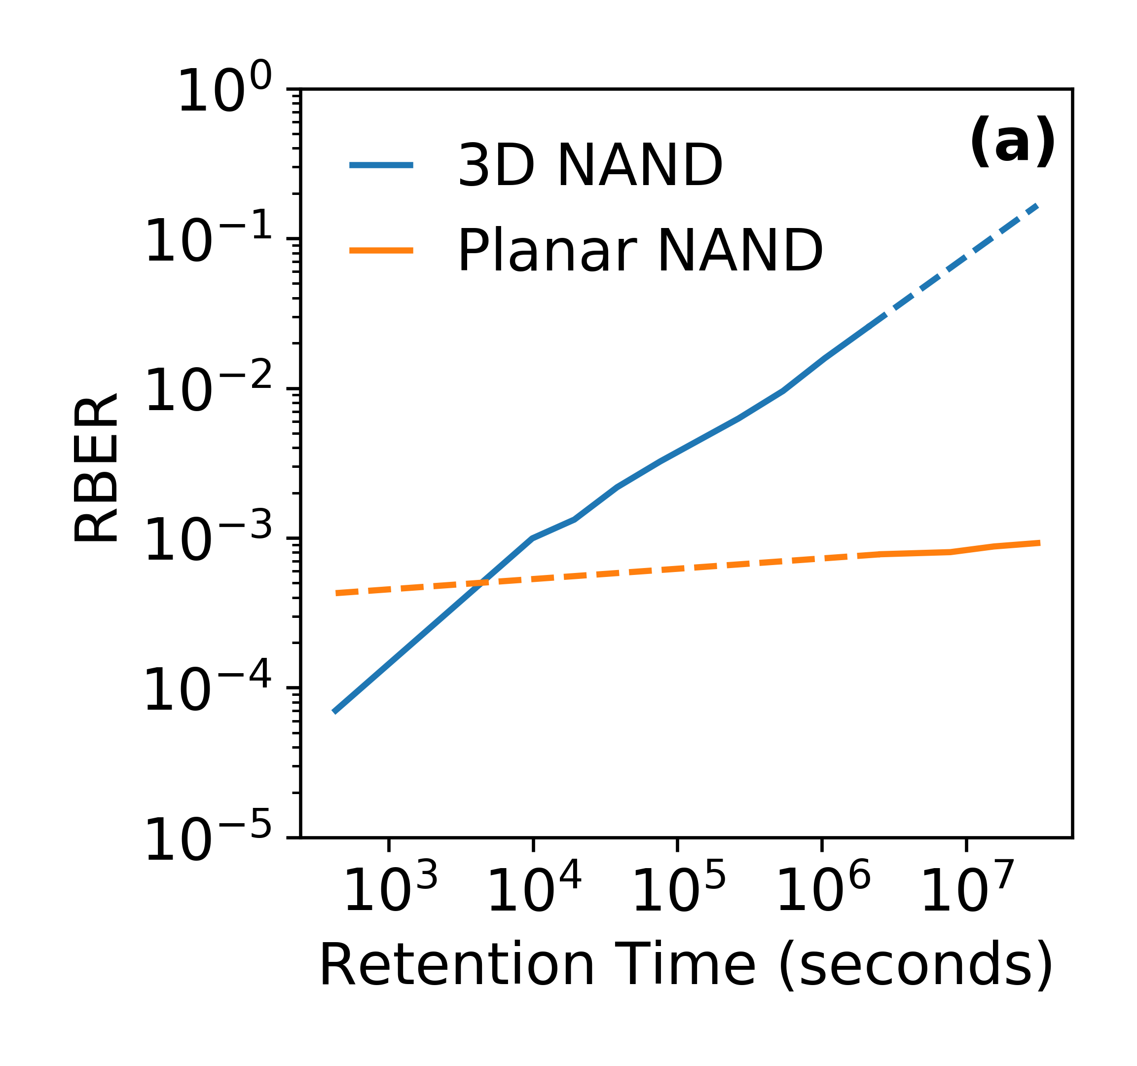
Early Retention Loss
11 days
10x
10x
3 years
10x
3 hours
Retention errors increase quickly
immediately after programming
Notes:
Here is the characterization result. X-axis shows …, y-axis shows … blue curve … orange curve ….
We make several observations from the data.
1. Retention errors increase much faster in 3D NAND than planar NAND
2. Retention errors increase quickly immediately after programming

Slide 13
Characterization Summary
Layer-to-layer process variation
  Large RBER variation across layers and LSB-MSB pages
  → Need new mechanisms to tolerate RBER variation!
Early retention loss
  RBER increases quickly after programming
  → Need new mechanisms to tolerate retention errors!
Retention interference
  Amount of retention loss correlated with neighbor cells’ states
  → Need new mechanisms to tolerate retention interference!
More threshold voltage and RBER results in the paper:
3D NAND P/E cycling, program interference, read disturb, read variation, bitline-to-bitline process variation
Our approach based on insights developed via our experimental characterization: Develop error models, and build online
error mitigation mechanisms using the models
Notes:
As a summary, we have discussed layer-to-layer process variation and early retention loss. Both are new and different in 3D NAND.
In our paper, we also show retention interference phenomenon where the amount of …, which is also new in 3D NAND.
So these three new phenomena in 3D NAND motivate us to design new mechanisms to tolerate 3D NAND errors.
We have many other results regarding threshold voltage and RBER, which we don’t have time to talk about.
Next, we will discuss our approach to model and mitigate these new 3D NAND errors characteristics.

Slide 14
Agenda
Background & Introduction
Contribution 1: Characterize real 3D NAND flash chips
Contribution 2: Model RBER and threshold voltage
  Retention loss model
  RBER variation model
Contribution 3: Mitigate 3D NAND flash errors
Conclusion

Slide 15
What Do We Model?
Read Reference Voltages
Threshold Voltage Distribution
V_{a}
V_{b}
V_{c}
MSB
LSB
Probability
11
01
00
10
Threshold Voltage (V_{th})
Raw Bit Errors
Notes:
First, let’s look at what are the things that we modeled.
NAND flash memory stores data as the threshold voltage of a flash cell.
The flash chips that we study in this work utilizes the multi-level cell technology, which divides the threshold voltage range into 4 possible states, so that each cell can store a 2-bit value, consisting of MSB and LSB.
We model the threshold voltage distribution of each state as a Gaussian distribution, with mean and variance.
The bit values stored in flash memory can be read by applying three read reference voltages at the boundary of the 4 states, Va Vb and Vc.
The cells in each distribution that goes across these reference voltages will cause raw bit errors, which changes over time.

Slide 16
Optimal Read Reference Voltage
V_{a}
V_{b}
V_{c}
Probability
Threshold Voltage (V_{th})
Raw Bit Errors
Notes:
Raw bit errors are decided by two things.
First is the distribution shifts quickly due to retention loss. If we keep the read reference voltage same, raw bit errors will increase.
Read reference voltage also affects raw bit errors. If we shift the read reference voltage accordingly, we can minimize raw bit errors.
We call this the optimal read reference voltage. Our goal is to model the shift accurately to reduce raw bit errors.

Slide 17
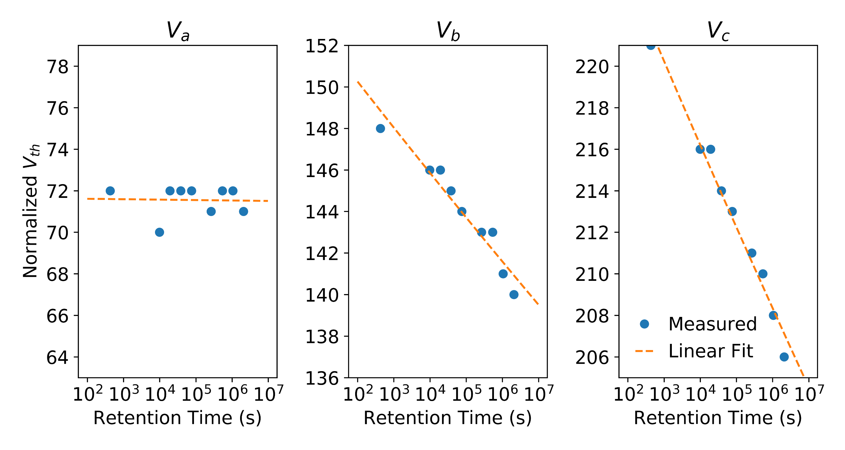
Retention Loss Model
Early retention loss can be modeled as
a simple linear function of log(retention time)
Notes:
This figure shows a part of our retention model. X-axis shows …, y-axis shows the optimal read reference voltage, each subfigure shows Va Vb Vc respectively
Blue dots are the actual optimal read reference voltages from measured data.
We find that the voltage shift due to retention loss fits a linear trend of the logarithm of retention time.
In fact, we find that other parameters also follows a linear function.

Slide 18
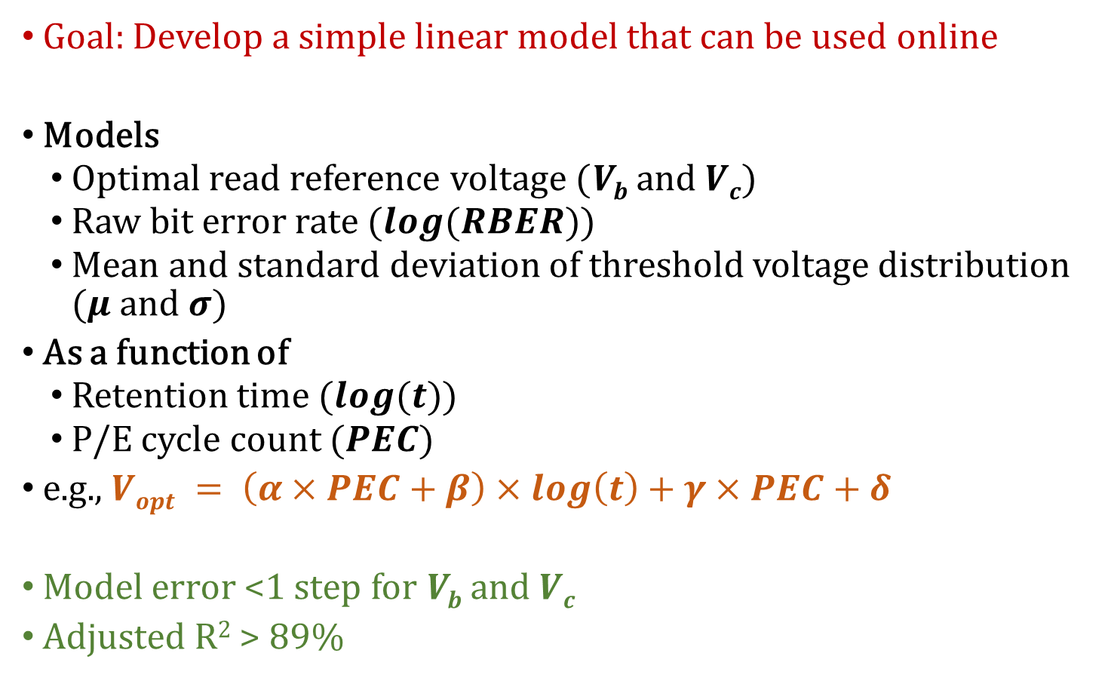
Retention Loss Model
Goal: Develop a simple linear model that can be used online
Models
  Optimal read reference voltage (V_{b} and $Vc$)
  Raw bit error rate ($log⁡(RBER)$)
  Mean and standard deviation of threshold voltage distribution ($μ$ and $σ$)
As a function of
  Retention time ($log⁡(t)$)
  P/E cycle count $(PEC)$
e.g., $Vopt = \left(α×PEC+β\right)×log\left(t\right)+γ×PEC+δ$
Model error <1 step for V_{b} and $Vc$
Adjusted R² > 89%
Notes:
Here is an overview of our full model. We refer to our paper for more detailed information.
Our retention loss model predicts …
And it models these variables as a function of …
Here is an example of how simple our model is to predict the optimal read reference voltage
Our model is highly accurate, …

Slide 19
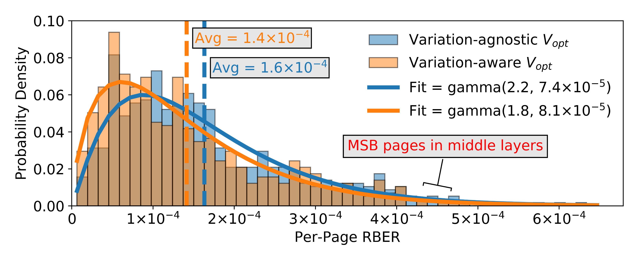
RBER Variation Model
Variation-agnostic V_{opt}
Same V_{ref} for all layers optimized for the entire block
Variation-aware V_{opt}
Different V_{ref} optimized for each layer
KL-divergence error = 0.09
RBER distribution follows gamma distribution
Notes:
This figure shows the distribution of per-page RBER within a flash block. X-axis shows …, y-axis shows …. The bars show the actual RBER distribution.
We find that this variation can be accurately modeled by a gamma distribution, regardless of which read reference voltage is used.
Variation-aware V_{opt} improves both average and worst-case RBER
RBER distribution follows gamma distribution: KL-divergence error = 0.09
Large gap between worst-case RBER and average RBER
→ Need new mechanisms to narrow the RBER distribution!

Slide 20
Agenda
Background & Introduction
Contribution 1: Characterize real 3D NAND flash chips
Contribution 2: Model RBER and threshold voltage
Contribution 3: Mitigate 3D NAND flash errors
  LaVAR: Layer Variation Aware Reading
  LI-RAID: Layer-Interleaved RAID
  ReMAR: Retention Model Aware Reading
Conclusion

Slide 21
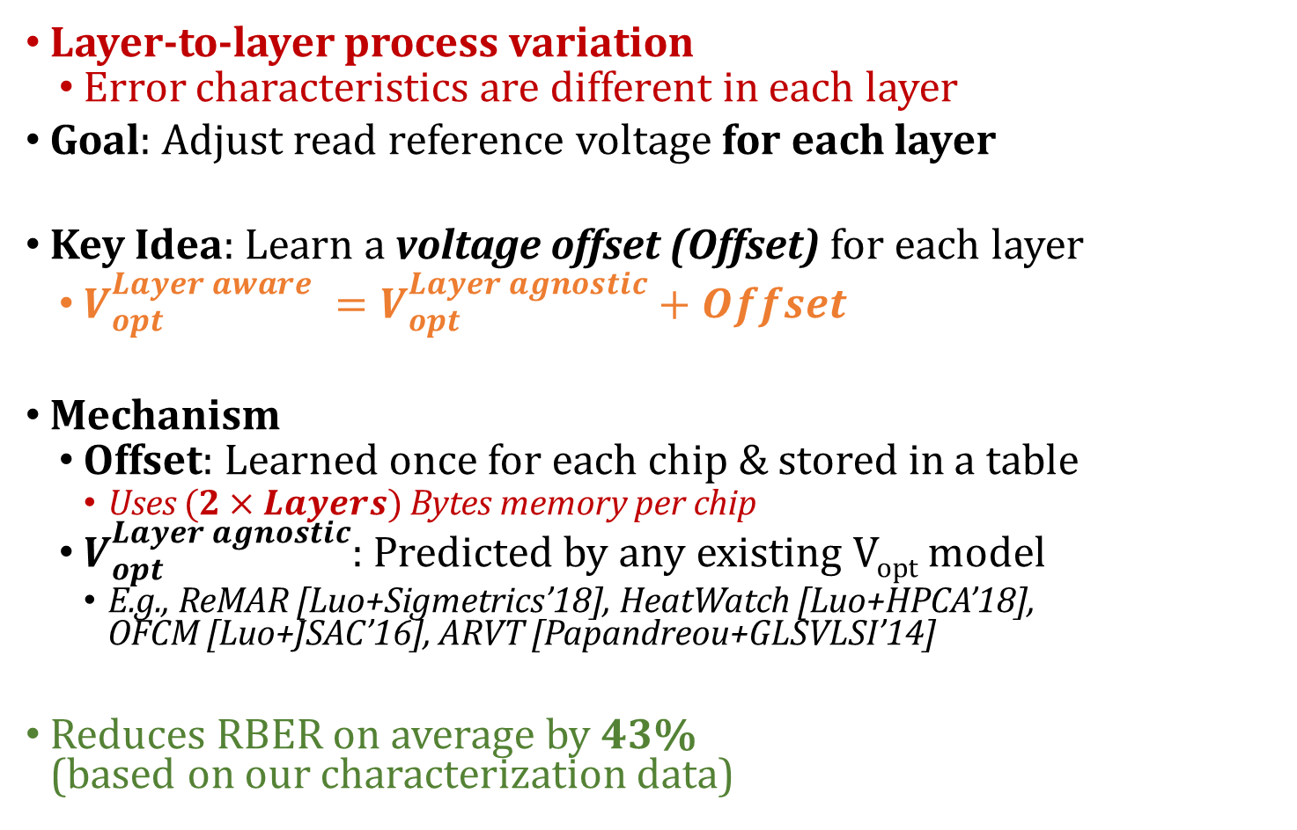
LaVAR: Layer Variation Aware Reading
Layer-to-layer process variation
  Error characteristics are different in each layer
Goal: Adjust read reference voltage for each layer
Key Idea: Learn a voltage offset (Offset) for each layer
  $V_{opt}^{Layer aware} =V_{opt}^{Layer agnostic}+Offset$
Mechanism
  Offset: Learned once for each chip & stored in a table
    Uses $(2×Layers)$ Bytes memory per chip
  $V_{opt}^{Layer agnostic}$: Predicted by any existing V_{opt} model
    E.g., ReMAR [Luo+Sigmetrics’18], HeatWatch [Luo+HPCA’18],
    OFCM [Luo+JSAC’16], ARVT [Papandreou+GLSVLSI’14]
Reduces RBER on average by 43%
(based on our characterization data)

Slide 22
LI-RAID: Layer-Interleaved RAID
Layer-to-layer process variation
  Worst-case RBER much higher than average RBER
Goal: Significantly reduce worst-case RBER
Key Idea
  Group flash pages on less reliable layers
  with pages on more reliable layers
  Group MSB pages with LSB pages
Mechanism
  Reorganize RAID layout to eliminate worst-case RBER
  <0.4% storage overhead

Slide 23
Conventional RAID
Wordline # | Layer # | Page | Chip 0 | Chip 1 | Chip 2 | Chip 3
0 | 0 | MSB | Group 0 | Group 0 | Group 0 | Group 0
0 | 0 | LSB | Group 1 | Group 1 | Group 1 | Group 1
1 | 1 | MSB | Group 2 | Group 2 | Group 2 | Group 2
1 | 1 | LSB | Group 3 | Group 3 | Group 3 | Group 3
2 | 2 | MSB | Group 4 | Group 4 | Group 4 | Group 4
2 | 2 | LSB | Group 5 | Group 5 | Group 5 | Group 5
3 | 3 | MSB | Group 6 | Group 6 | Group 6 | Group 6
3 | 3 | LSB | Group 7 | Group 7 | Group 7 | Group 7
Worst-case RBER in any layer
limits the lifetime of conventional RAID

Slide 24
LI-RAID: Layer-Interleaved RAID
Wordline # | Layer # | Page | Chip 0 | Chip 1 | Chip 2 | Chip 3
0 | 0 | MSB | Group 0 | Blank | Group 4 | Group 3
0 | 0 | LSB | Group 1 | Blank | Group 5 | Group 2
1 | 1 | MSB | Group 2 | Group 1 | Blank | Group 5
1 | 1 | LSB | Group 3 | Group 0 | Blank | Group 4
2 | 2 | MSB | Group 4 | Group 3 | Group 0 | Blank
2 | 2 | LSB | Group 5 | Group 2 | Group 1 | Blank
3 | 3 | MSB | Blank | Group 5 | Group 2 | Group 1
3 | 3 | LSB | Blank | Group 4 | Group 3 | Group 0
Any page with worst-case RBER can be corrected by other reliable pages in the RAID group

Slide 25
LI-RAID: Layer-Interleaved RAID
Layer-to-layer process variation
  Worst-case RBER much higher than average RBER
Goal: Significantly reduce worst-case RBER
Key Idea
  Group flash pages on less reliable layers
  with pages on more reliable layers
  Group MSB pages with LSB pages
Mechanism
  Reorganize RAID layout to eliminate worst-case RBER
  <0.8% storage overhead
Reduces worst-case RBER by 66.9%
(based on our characterization data)

Slide 26
ReMAR: Retention Model Aware Reading
Early retention loss
  Threshold voltage shifts quickly after programming
Goal: Adjust read reference voltages based on retention loss
Key Idea: Learn and use a retention loss model online
Mechanism
  Periodically characterize and learn retention loss model online
  Retention time = Read timestamp - Write timestamp
    Uses 800 KB memory to store program time of each block
  Predict retention-aware V_{opt} using the model
Reduces RBER on average by 51.9%
(based on our characterization data)

Slide 27
Impact on System Reliability
ECC Limit
85% longer flash lifetime
79% lower ECC storage overhead
LaVAR, LI-RAID, and ReMAR improve flash lifetime or reduce ECC overhead significantly

Slide 28
Error Mitigation Techniques Summary
LaVAR: Layer Variation Aware Reading
  Learn a V_{opt} offset for each layer and apply layer-aware V_{opt}
LI-RAID: Layer-Interleaved RAID
  Group flash pages on less reliable layers
  with pages on more reliable layers
  Group MSB pages with LSB pages
ReMAR: Retention Model Aware Reading
  Learn retention loss model and apply retention-aware V_{opt}
Benefits:
Improve flash lifetime by 1.85× or reduce ECC overhead by 78.9%
ReNAC (in paper): Reread a failed page using V_{opt} based on the
retention interference induced by neighbor cell

Slide 29
Agenda
Background & Introduction
Contribution 1: Characterize real 3D NAND flash chips
Contribution 2: Model RBER and threshold voltage
Contribution 3: Mitigate 3D NAND flash errors
Conclusion

Slide 30
Conclusion
Problem: 3D NAND error characteristics are not well studied
Goal: Understand & mitigate 3D NAND errors to improve lifetime
Contribution 1: Characterize real 3D NAND flash chips
  Process variation: 21× error rate difference across layers
  Early retention loss: Error rate increases by 10× after 3 hours
  Retention interference: Not observed before in planar NAND
Contribution 2: Model RBER and threshold voltage
  RBER (raw bit error rate) variation model
  Retention loss model
Contribution 3: Mitigate 3D NAND flash errors
  LaVAR: Layer Variation Aware Reading
  LI-RAID: Layer-Interleaved RAID
  ReMAR: Retention Model Aware Reading
  Improve flash lifetime by 1.85× or reduce ECC overhead by 78.9%
Notes:
In this work, our goal is to …
In the xth contribution, we …

Slide 31
Improving 3D NAND
Flash Memory Lifetime by Tolerating Early Retention Loss and Process Variation
Yixin Luo Saugata Ghose Yu Cai Erich F. Haratsch Onur Mutlu
Notes:
Thank you for the introduction. Today, I will present our work about …

Slide 32
Backup Slides

Slide 33
LI-RAID: Layer-Interleaved RAID
Wordline # | Layer # | Page | Chip 0 | Chip 1 | Chip 2 | Chip 3
0 | 0 | MSB | Group 0 | (Group 6) | Group 4 | Group 3
0 | 0 | LSB | Group 1 | (Group 7) | Group 5 | Group 2
1 | 1 | MSB | Group 2 | Group 1 | Blank | Group 5
1 | 1 | LSB | Group 3 | Group 0 | Blank | Group 4
2 | 2 | MSB | Group 4 | Group 3 | Group 0 | Blank
2 | 2 | LSB | Group 5 | Group 2 | Group 1 | Blank
3 | 3 | MSB | Blank | Group 5 | Group 2 | Group 1
3 | 3 | LSB | Blank | Group 4 | Group 3 | Group 0
Violating program sequence (in-order from top to bottom)
Groups 0&1 vulnerable to program interference by Groups 2&3

Slide 34
How Does NAND Flash Memory Work?
Charge = Threshold Voltage
NAND Flash Memory
Higher Voltage State
–
–
–
Data Value = 0
Flash Cell
Read Reference Voltage
Lower Voltage State
Data Value = 1
Notes:
3D NAND flash memory consists of flash cells, each of which holds different amount of charge which determines the threshold voltage of the cell.
And the threshold voltage determines the data value stored in that cell.
For example, for a cell that stores one bit of data, 0 can be assigned to higher voltage state, and 1 assigned to lower voltage state.
We can sense the data value by applying a read reference voltage to the cell that can distinguish between these two states.

Slide 35
MLC Threshold Voltage Distribution
–
–
–
–
–
–
Lowest Voltage State
Highest Voltage State
MSB Read Reference Voltage
LSB Read Reference Voltage
MSB
LSB
MSB Read Reference Voltage
Probability
11
01
00
10
Threshold Voltage
Threshold Voltage Distribution
Notes:
Each MLC cell has 4 threshold voltage states. We assign a different 2-bit value to each state..
And they are read by three read reference voltages instead of one.
To better understand the reliability of the cell, we typically model the probability distribution (point) of the threshold voltage (point) of each state as a probability density function. We call this the threshold voltage distribution.

Slide 36
3D NAND Flash Cell
Floating Gate Cell
3D Charge Trap Cell
Control Gate
Gate Oxide
Substrate
Charge Trap
(Insulator)
Floating Gate
(Conductor)
Source
Tunnel Oxide
Control Gate
Source
Drain
Substrate
Gate Oxide
Drain
Tunnel Oxide
Notes:
The 3D NAND chips that we studied use 3D charge-trap cell, and here is how it compares with a floating gate cell used in planar NAND.

Slide 37
3D NAND Organization
Block K+2
Block K+1
…
Block K
BL N
BL 1
BL 0
…
Layer M
Wordline M
…
…
…
…
…
…
…
…
Layer 1
Wordline 1
…
Layer 0
Wordline 0

Slide 38
MLC NAND Page Organization
Block K+2
Block K+1
…
Block K
BL N
BL 1
BL 0
…
Layer M
MSB page
Wordline M
LSB page
…
…
…
…
…
…
…
…
Layer 1
MSB page
Wordline 1
LSB page
…
Layer 0
MSB page
Wordline 0
LSB page

Slide 39
Root Cause of Early Retention Loss
Floating Gate Cell
3D Charge Trap Cell
Control Gate
Gate Oxide
Substrate
Charge Trap
(Insulator)
Floating Gate
(Conductor)
Source
Tunnel Oxide
Control Gate
Source
Drain
Substrate
Gate Oxide
Drain
Tunnel Oxide
Oxide layers are designed to be thinner in 3D NAND
[Samsung WhitePaper’14]
→ Charges near the surface of charge trap layer leaks faster
Notes:
The 3D NAND chips that we studied use 3D charge-trap cell, and here is how it compares with a floating gate cell used in planar NAND.

Slide 40
Retention Interference
V: Victim
N: Neighbor
Neighbor
< 2
steps
Victim
Neighbor
Retention loss speed correlated with
neighbor cells’ state
Notes:
The retention loss speed of a victim cell depends on
the threshold voltage of its directly-connect neighboring cell
Retention interference is small in current generation 3D NAND, but it will increase in future generations as layer numbers increase and distance between layers decrease → Need new mechanisms!

Slide 41
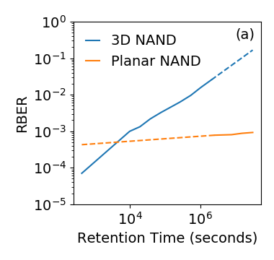
Retention Loss Model
Because of early retention loss, V_{opt} shifts quickly after programming
Linear correlation between V_{opt} and log(t : retention time)
Linear correlation between log(RBER) and log(t)
→ Develop a simple linear model that can be used online

Slide 42
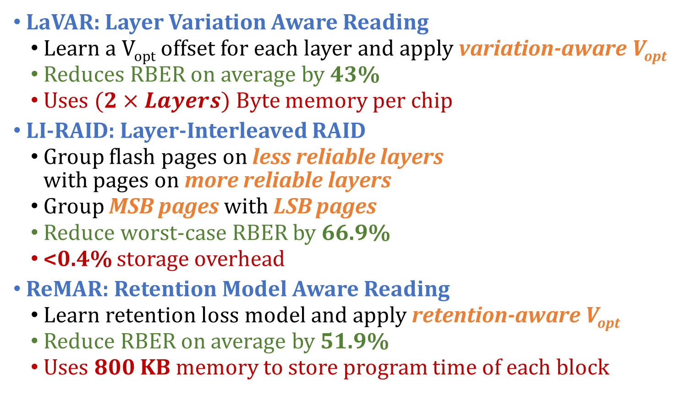
Error Mitigation Techniques
LaVAR: Layer Variation Aware Reading
  Learn a V_{opt} offset for each layer and apply variation-aware V_{opt}
  Reduces RBER on average by 43%
  Uses $(2×Layers)$ Byte memory per chip
LI-RAID: Layer-Interleaved RAID
  Group flash pages on less reliable layers
  with pages on more reliable layers
  Group MSB pages with LSB pages
  Reduce worst-case RBER by 66.9%
  <0.4% storage overhead
ReMAR: Retention Model Aware Reading
  Learn retention loss model and apply retention-aware V_{opt}
  Reduce RBER on average by 51.9%
  Uses 800 KB memory to store program time of each block

Slide 43
LI-RAID Data Layout
Page/Wordline #/Layer # | Chip 0 | Chip 1 | Chip 2 | Chip 3
MSB/Wordline 0/Layer 0 | Group 0 | Blank | Group 4 | Group 3
LSB/Wordline 0/Layer 0 | Group 1 | Blank | Group 5 | Group 2
MSB/Wordline 1/Layer 1 | Group 2 | Group 1 | Blank | Group 5
LSB/Wordline 1/Layer 1 | Group 3 | Group 0 | Blank | Group 4
MSB/Wordline 2/Layer 2 | Group 4 | Group 3 | Group 0 | Blank
LSB/Wordline 2/Layer 2 | Group 5 | Group 2 | Group 1 | Blank
MSB/Wordline 3/Layer 3 | Blank | Group 5 | Group 2 | Group 1
LSB/Wordline 3/Layer 3 | Blank | Group 4 | Group 3 | Group 0

Slide 44
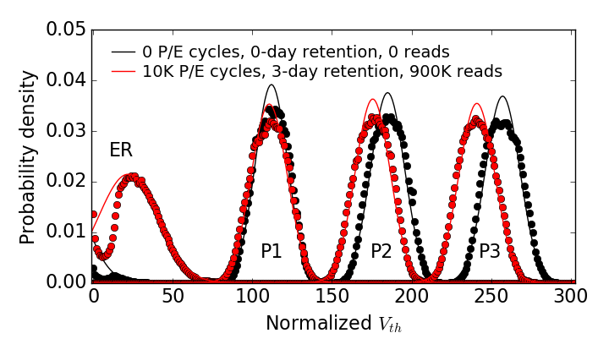
Threshold Voltage Shift

Slide 45
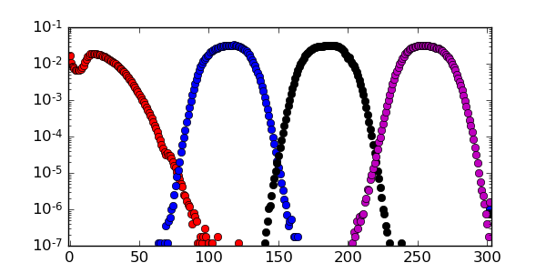
No Programming Errors

Slide 46
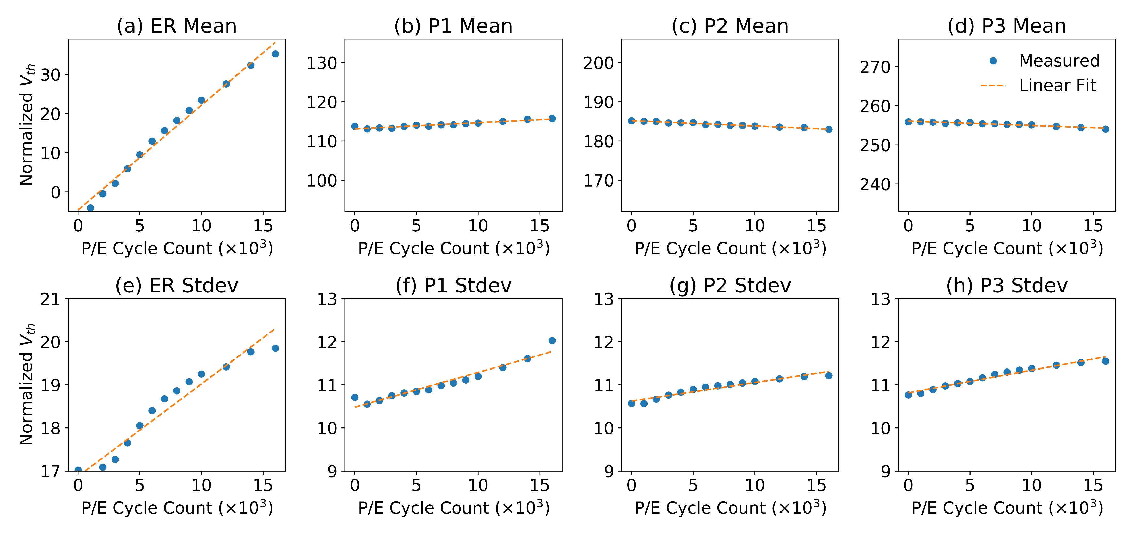
P/E Cycling Effect on Threshold Voltage

Slide 47
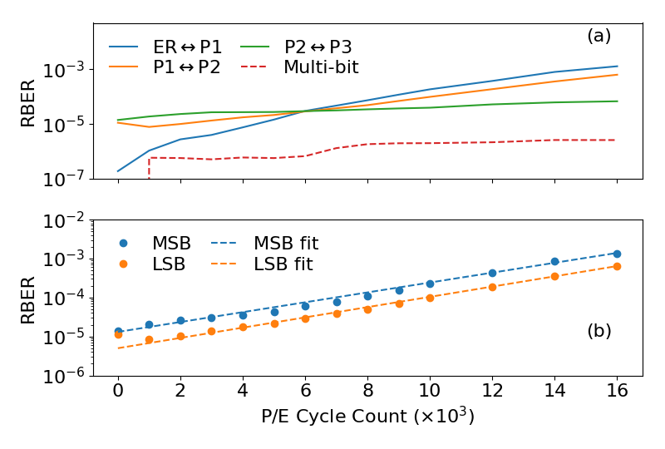
P/E Cycling Errors

Slide 48
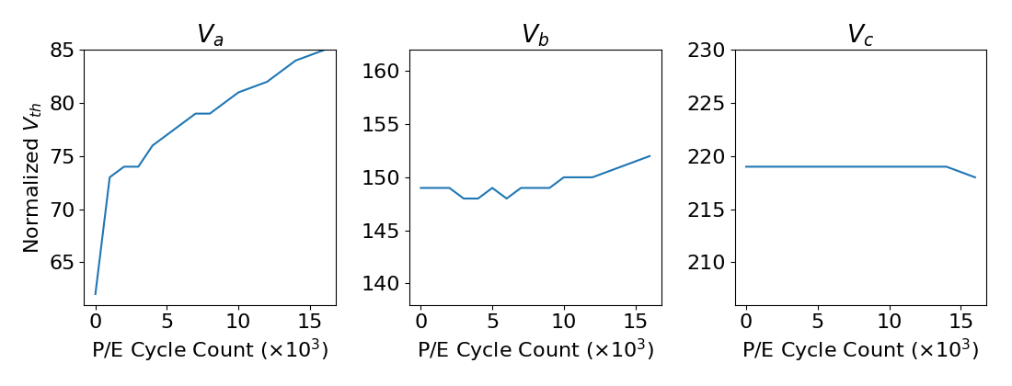
P/E Cycling Effect on
Optimal Read Reference Voltages

Slide 49
Program Interference Effect
& Interference Correlation
Block K+1
Block K
BL M-1
BL M
BL M+1
Previous wordline
WL N-1
.080%
Next bitline
WL N
-.040%
Victim
-.040%
Next wordline+bitline
WL N+1
.014%
2.7%
.014%
Next wordline
WL N+2
.057%
z
x
y

Slide 50
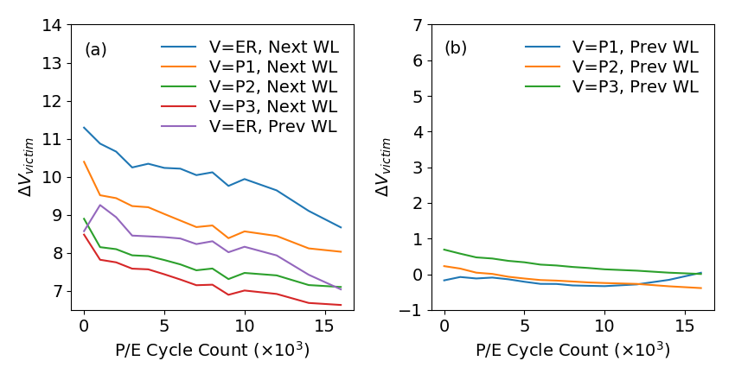
Program Interference vs. PEC

Slide 51
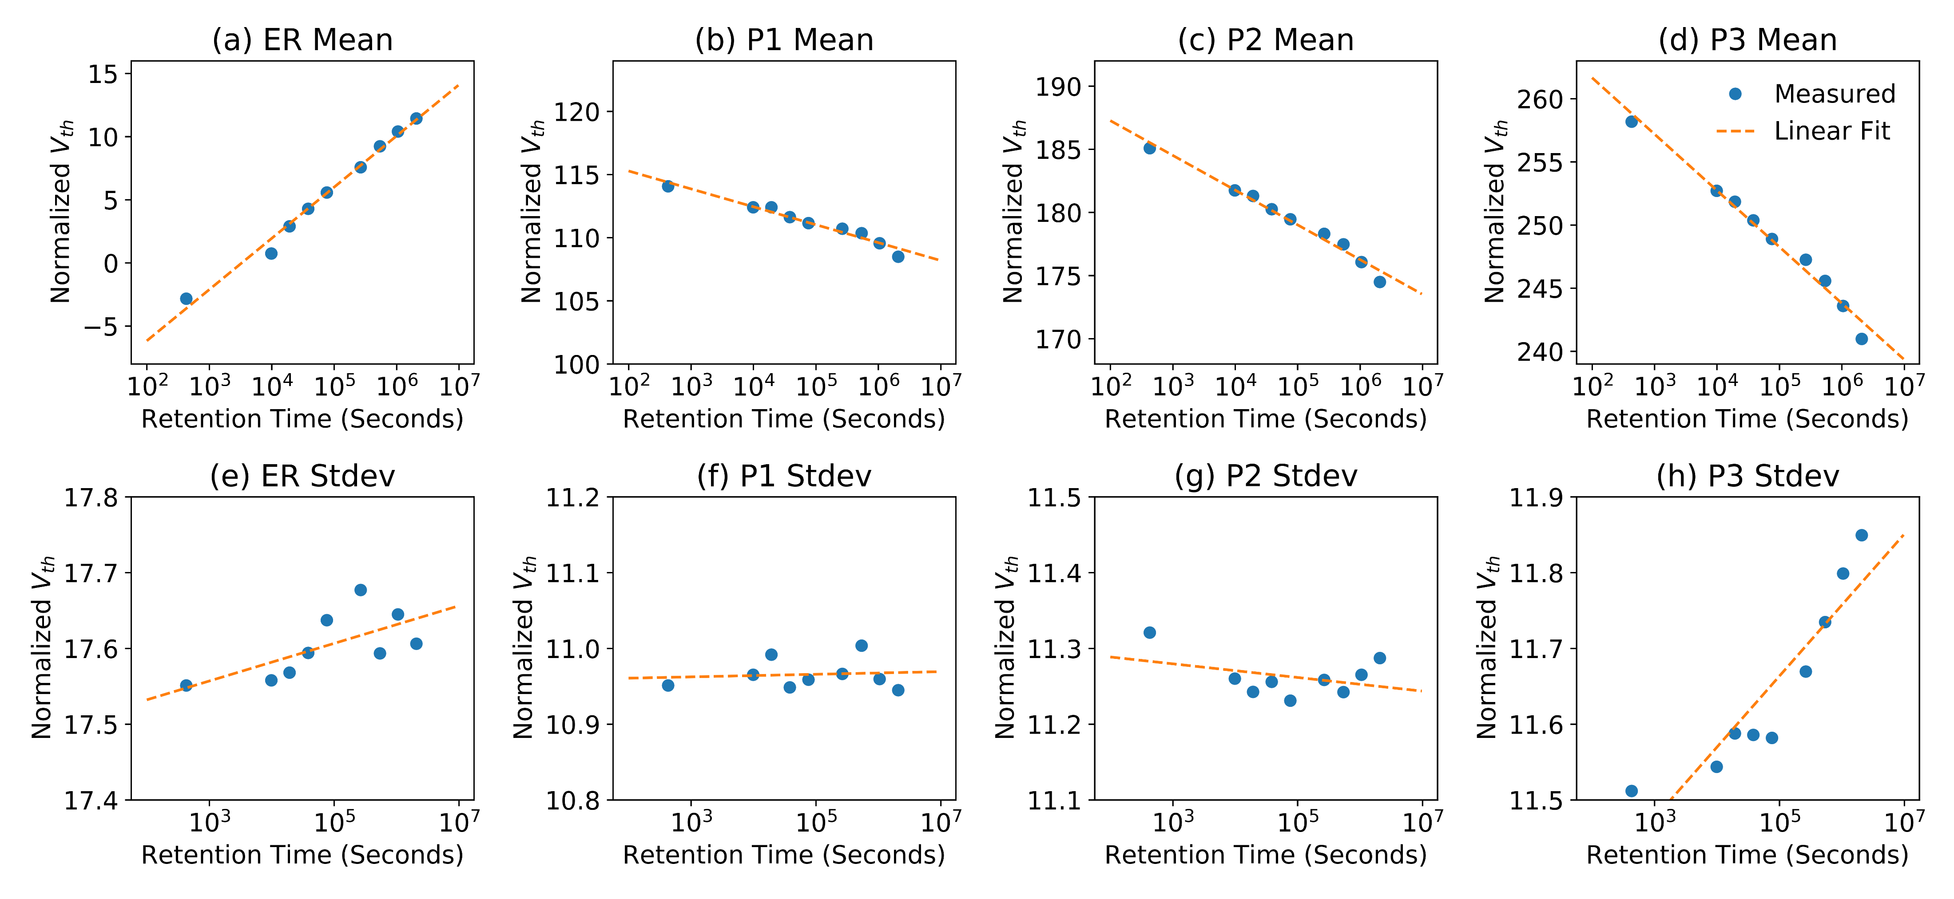
Early Retention Loss Effect on Threshold Voltage

Slide 52
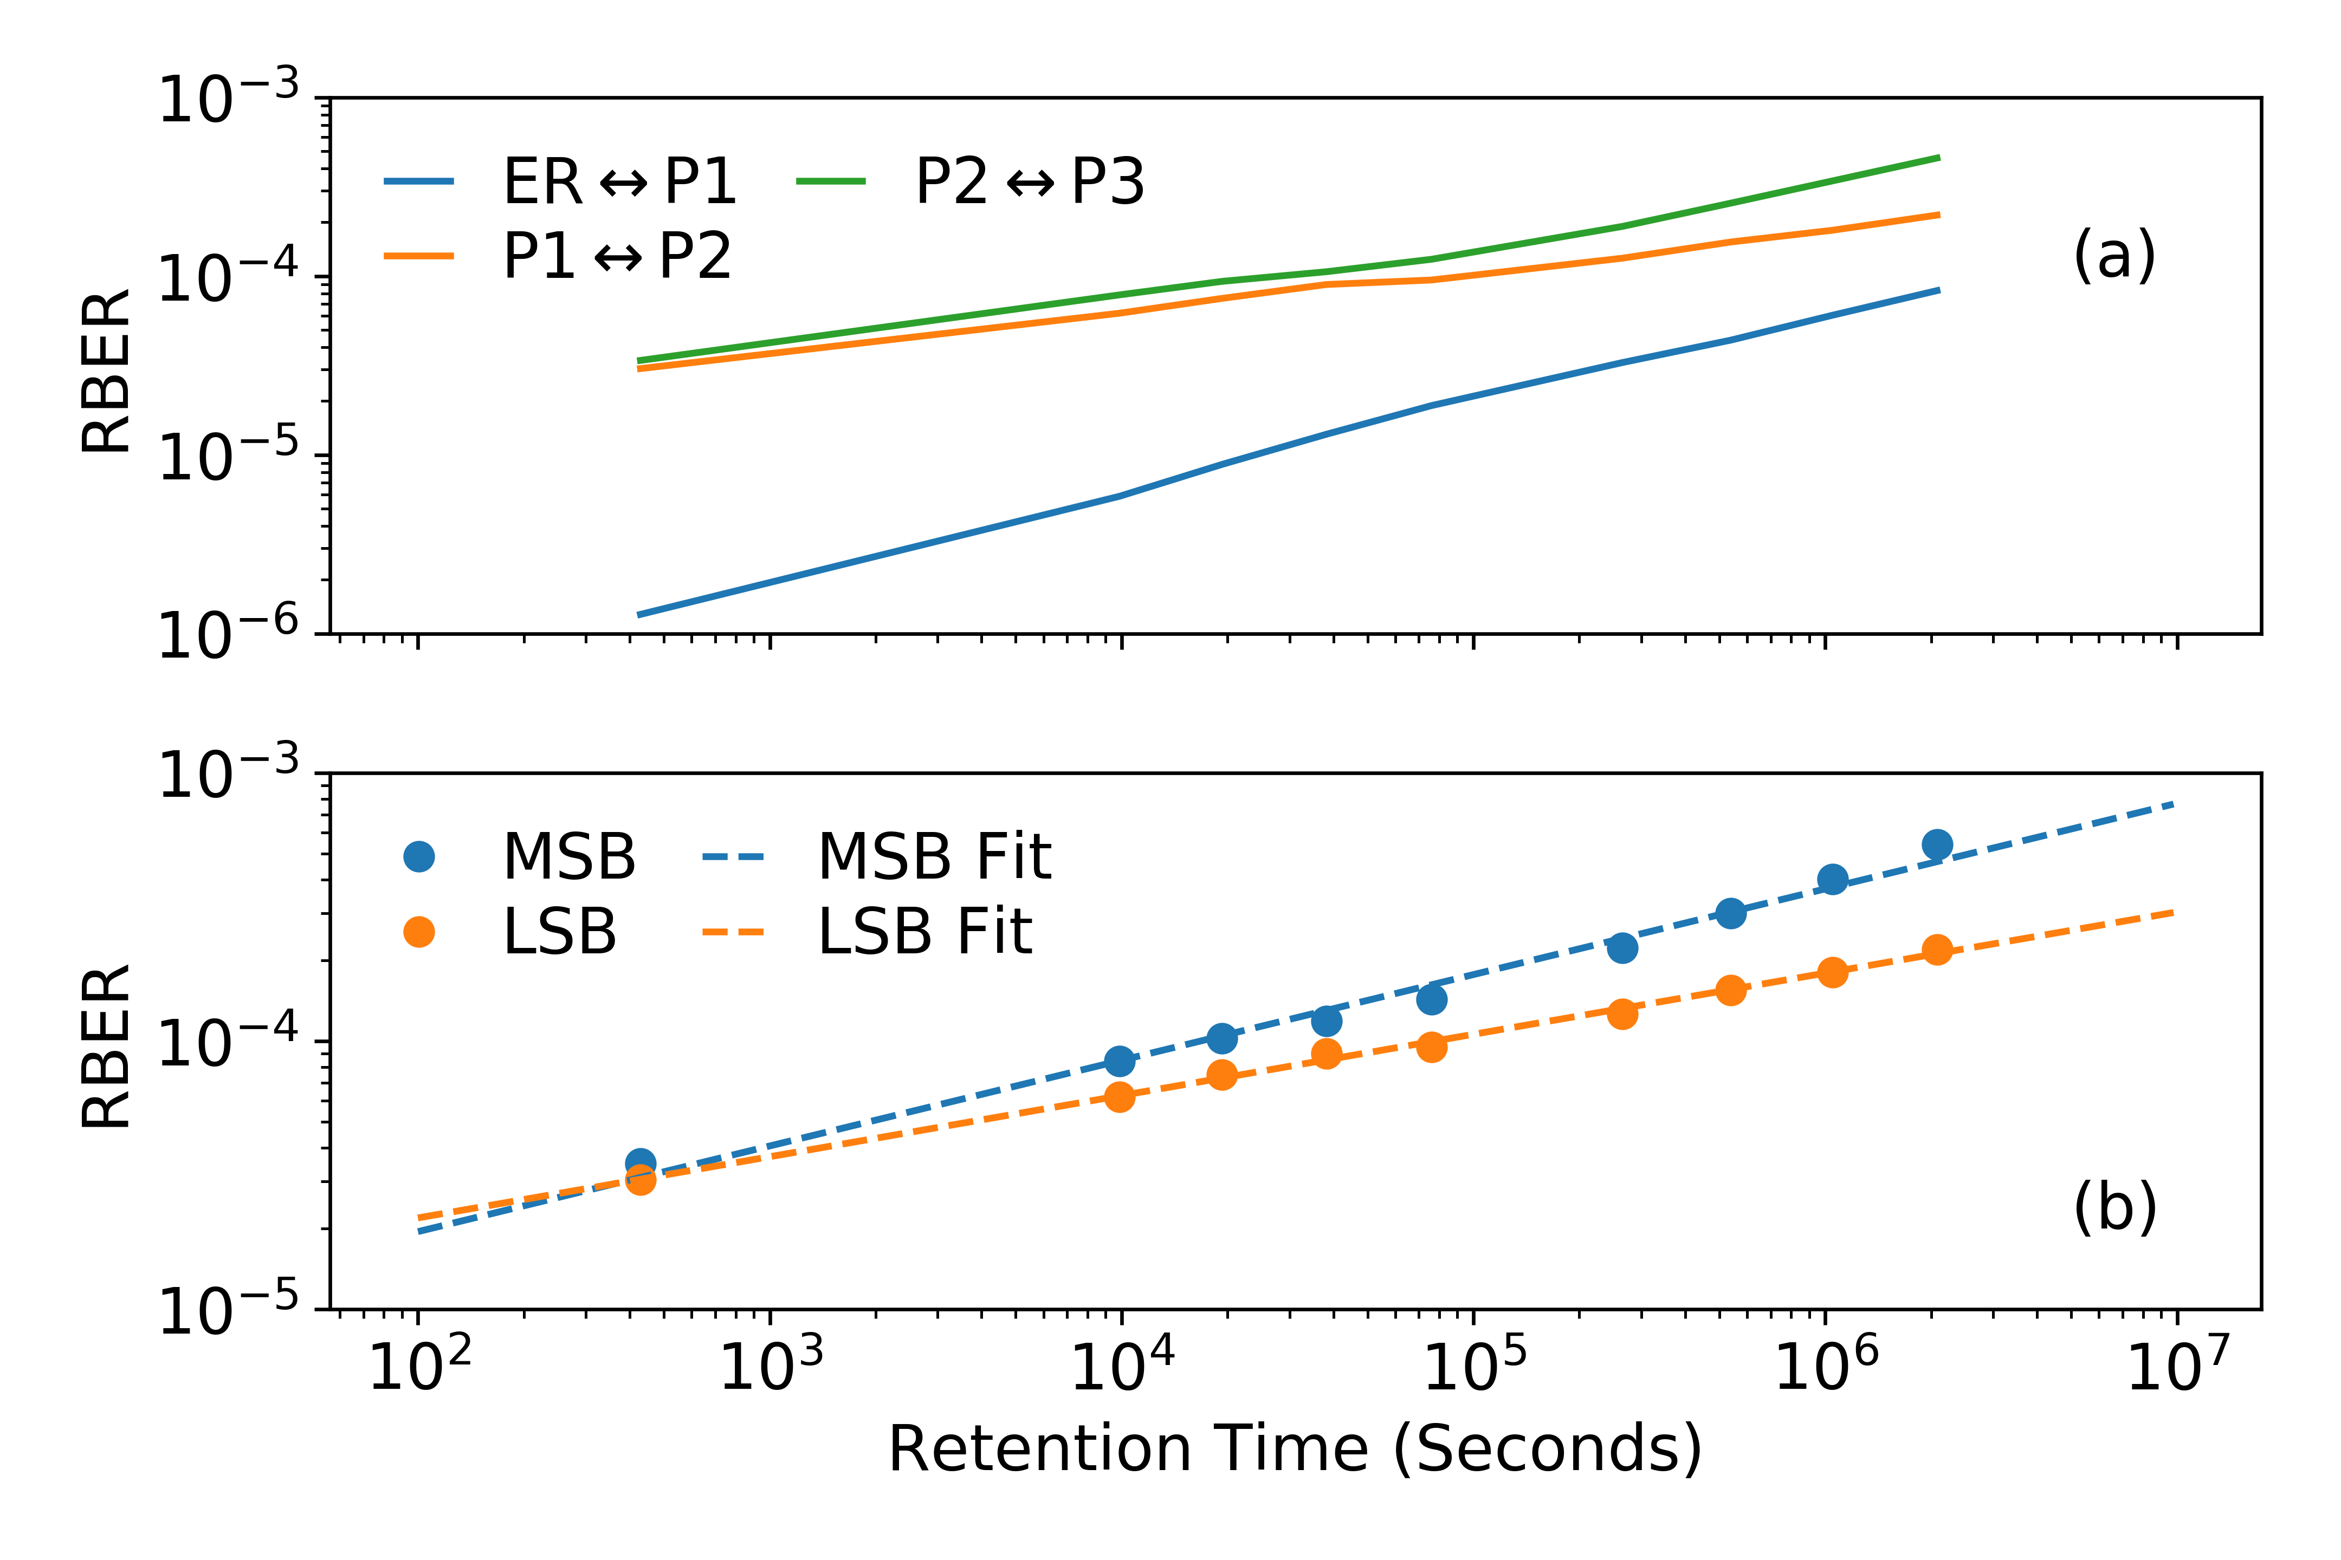
Early Retention Loss Errors

Slide 53

Early Retention Loss Effect on
Optimal Read Reference Voltages

Slide 54
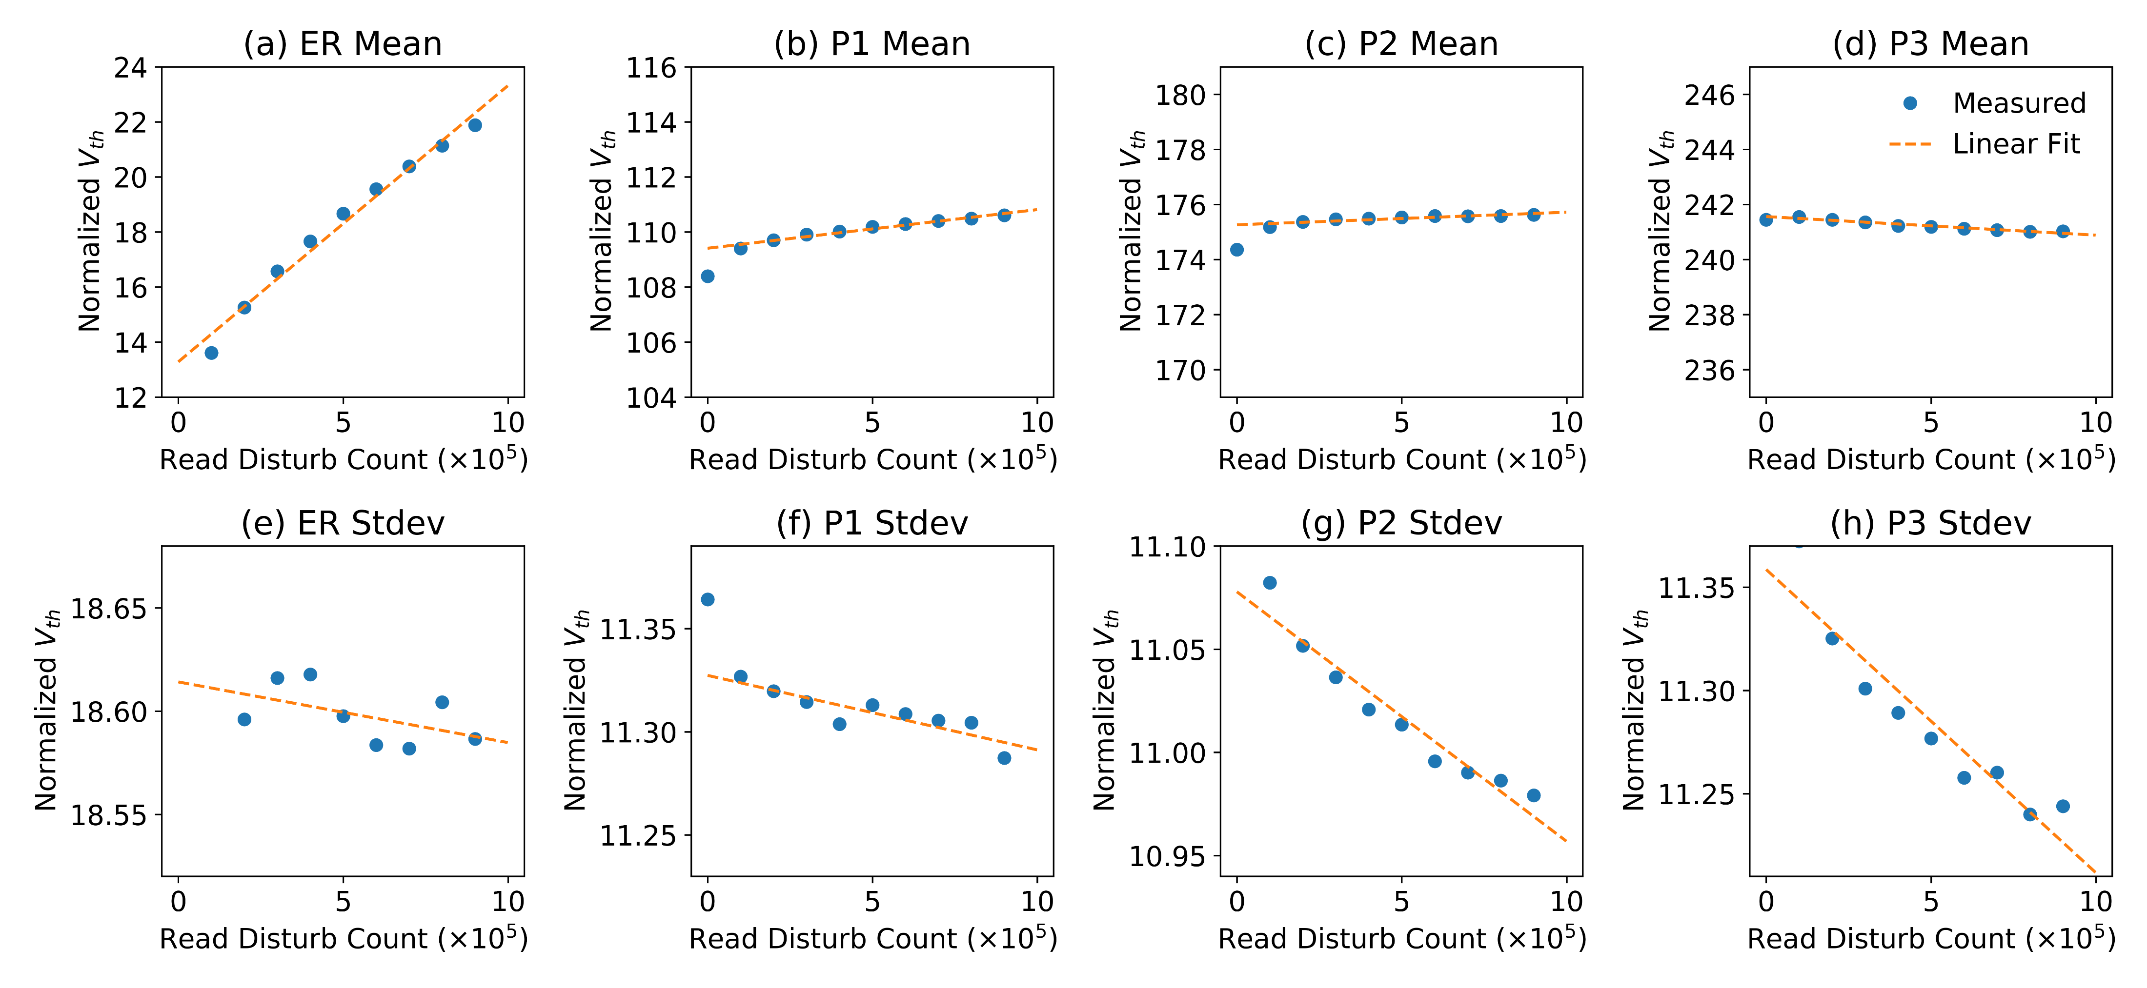
Read Disturb Effect on Threshold Voltage

Slide 55
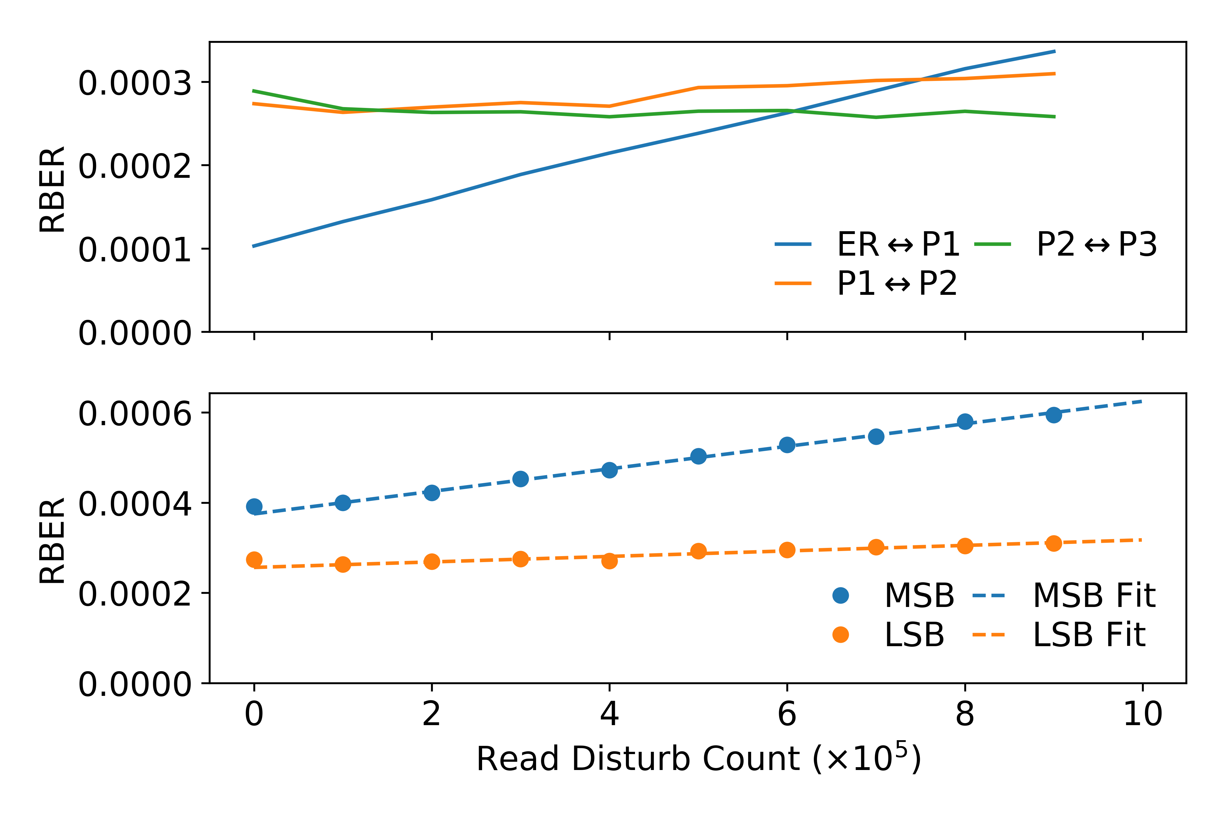
Read Disturb Errors

Slide 56
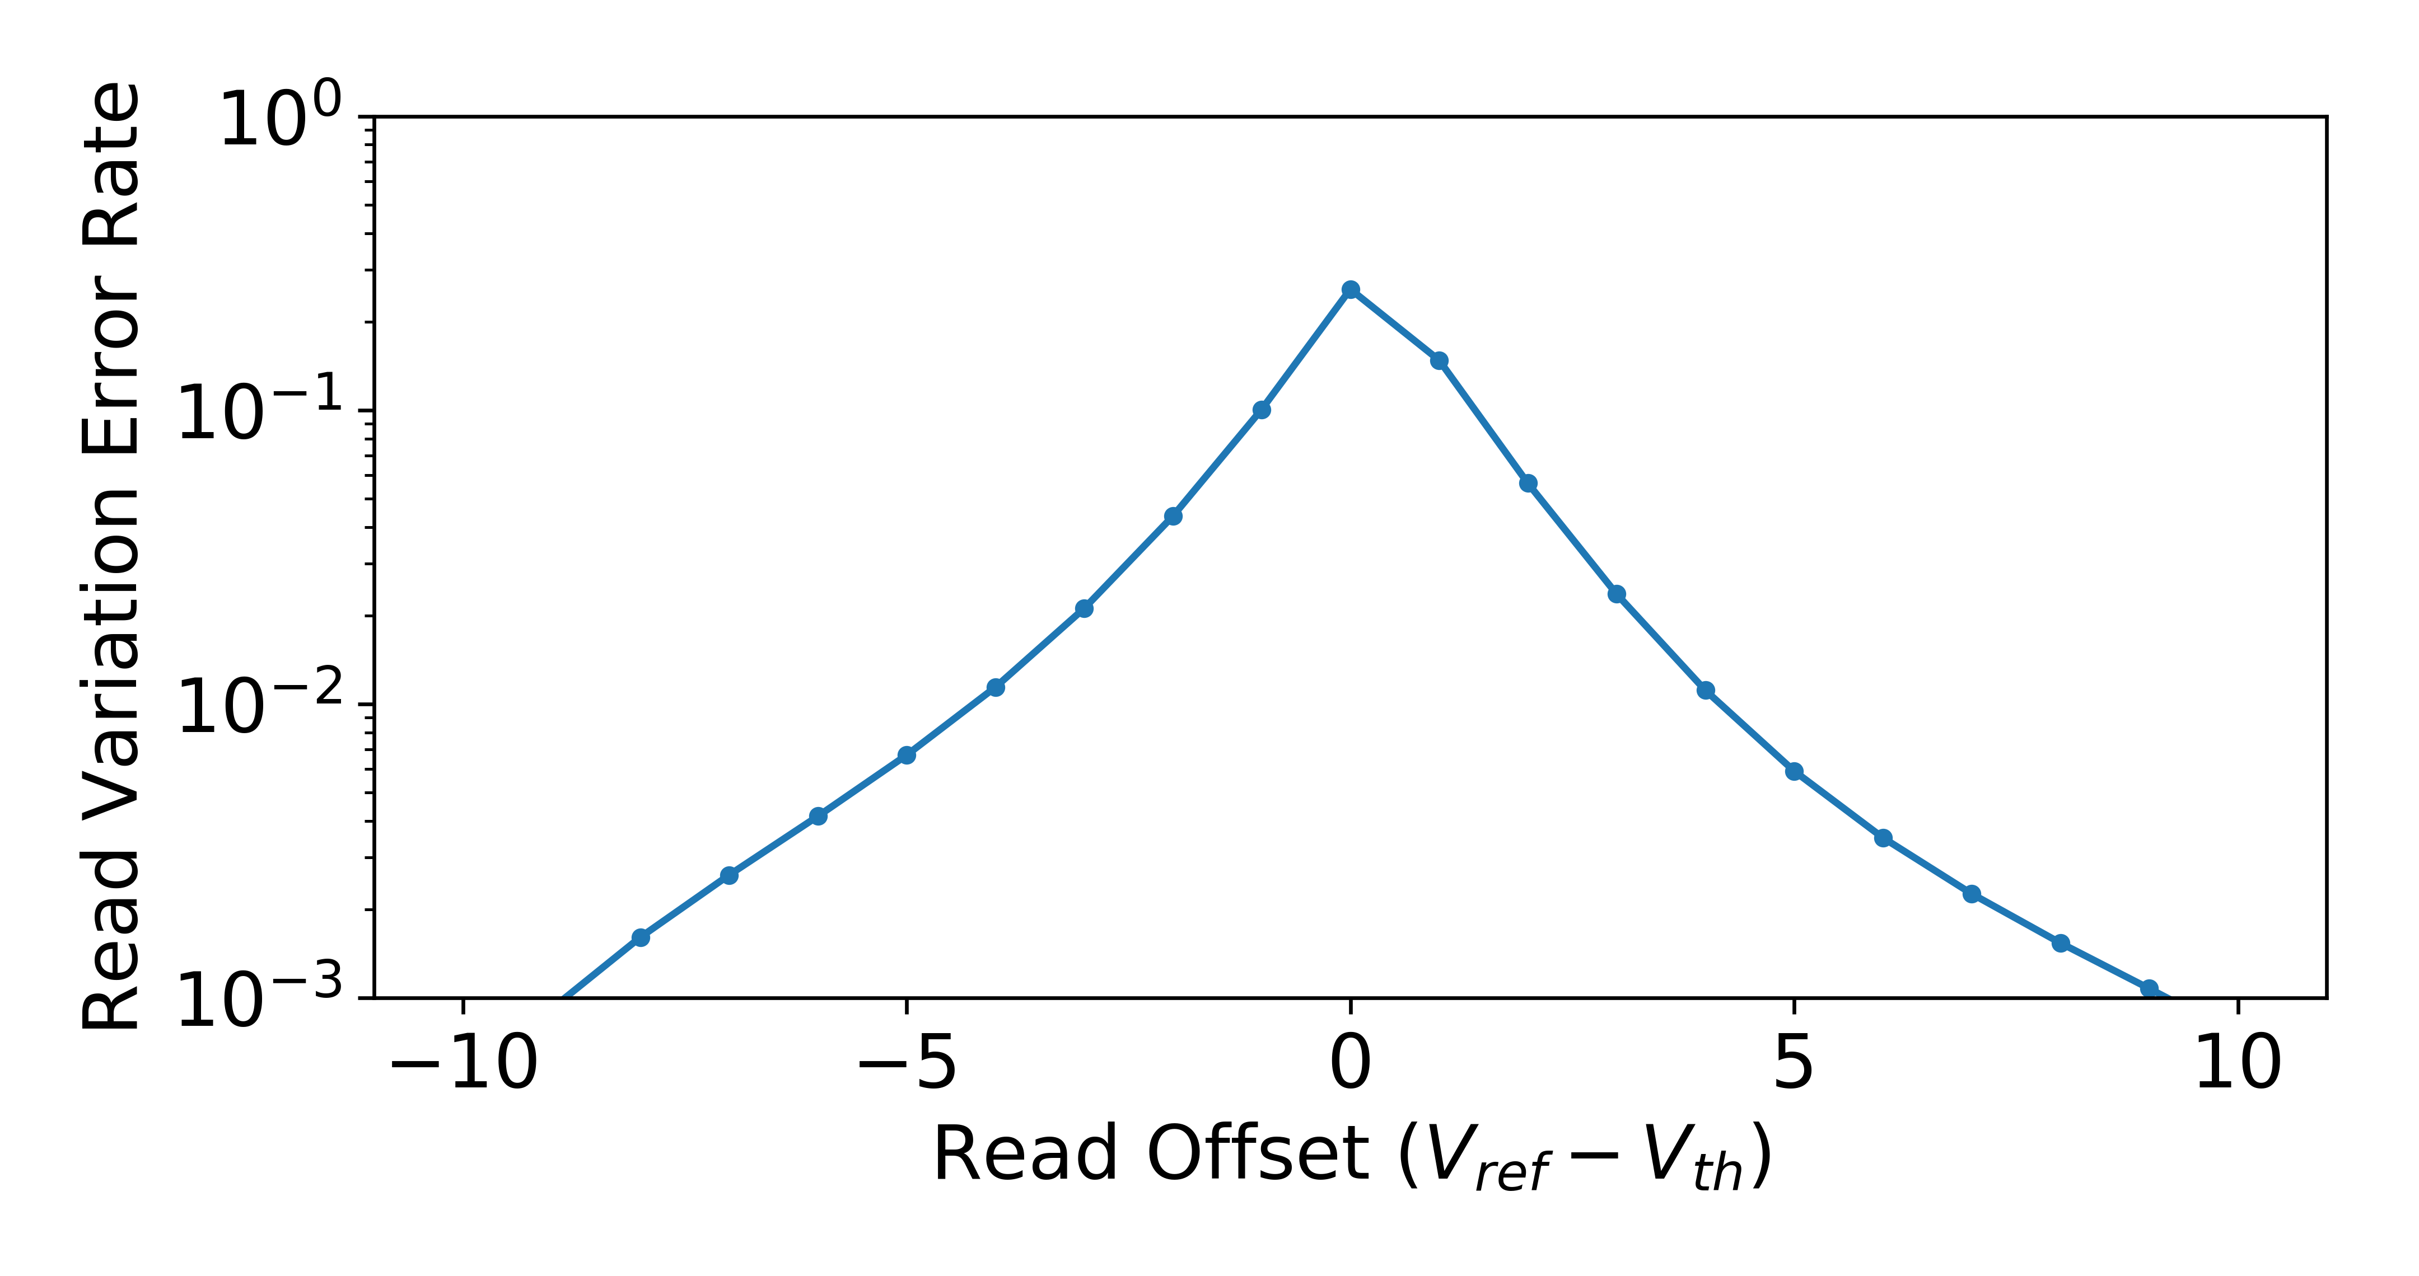
Read Variation Errors

Slide 57
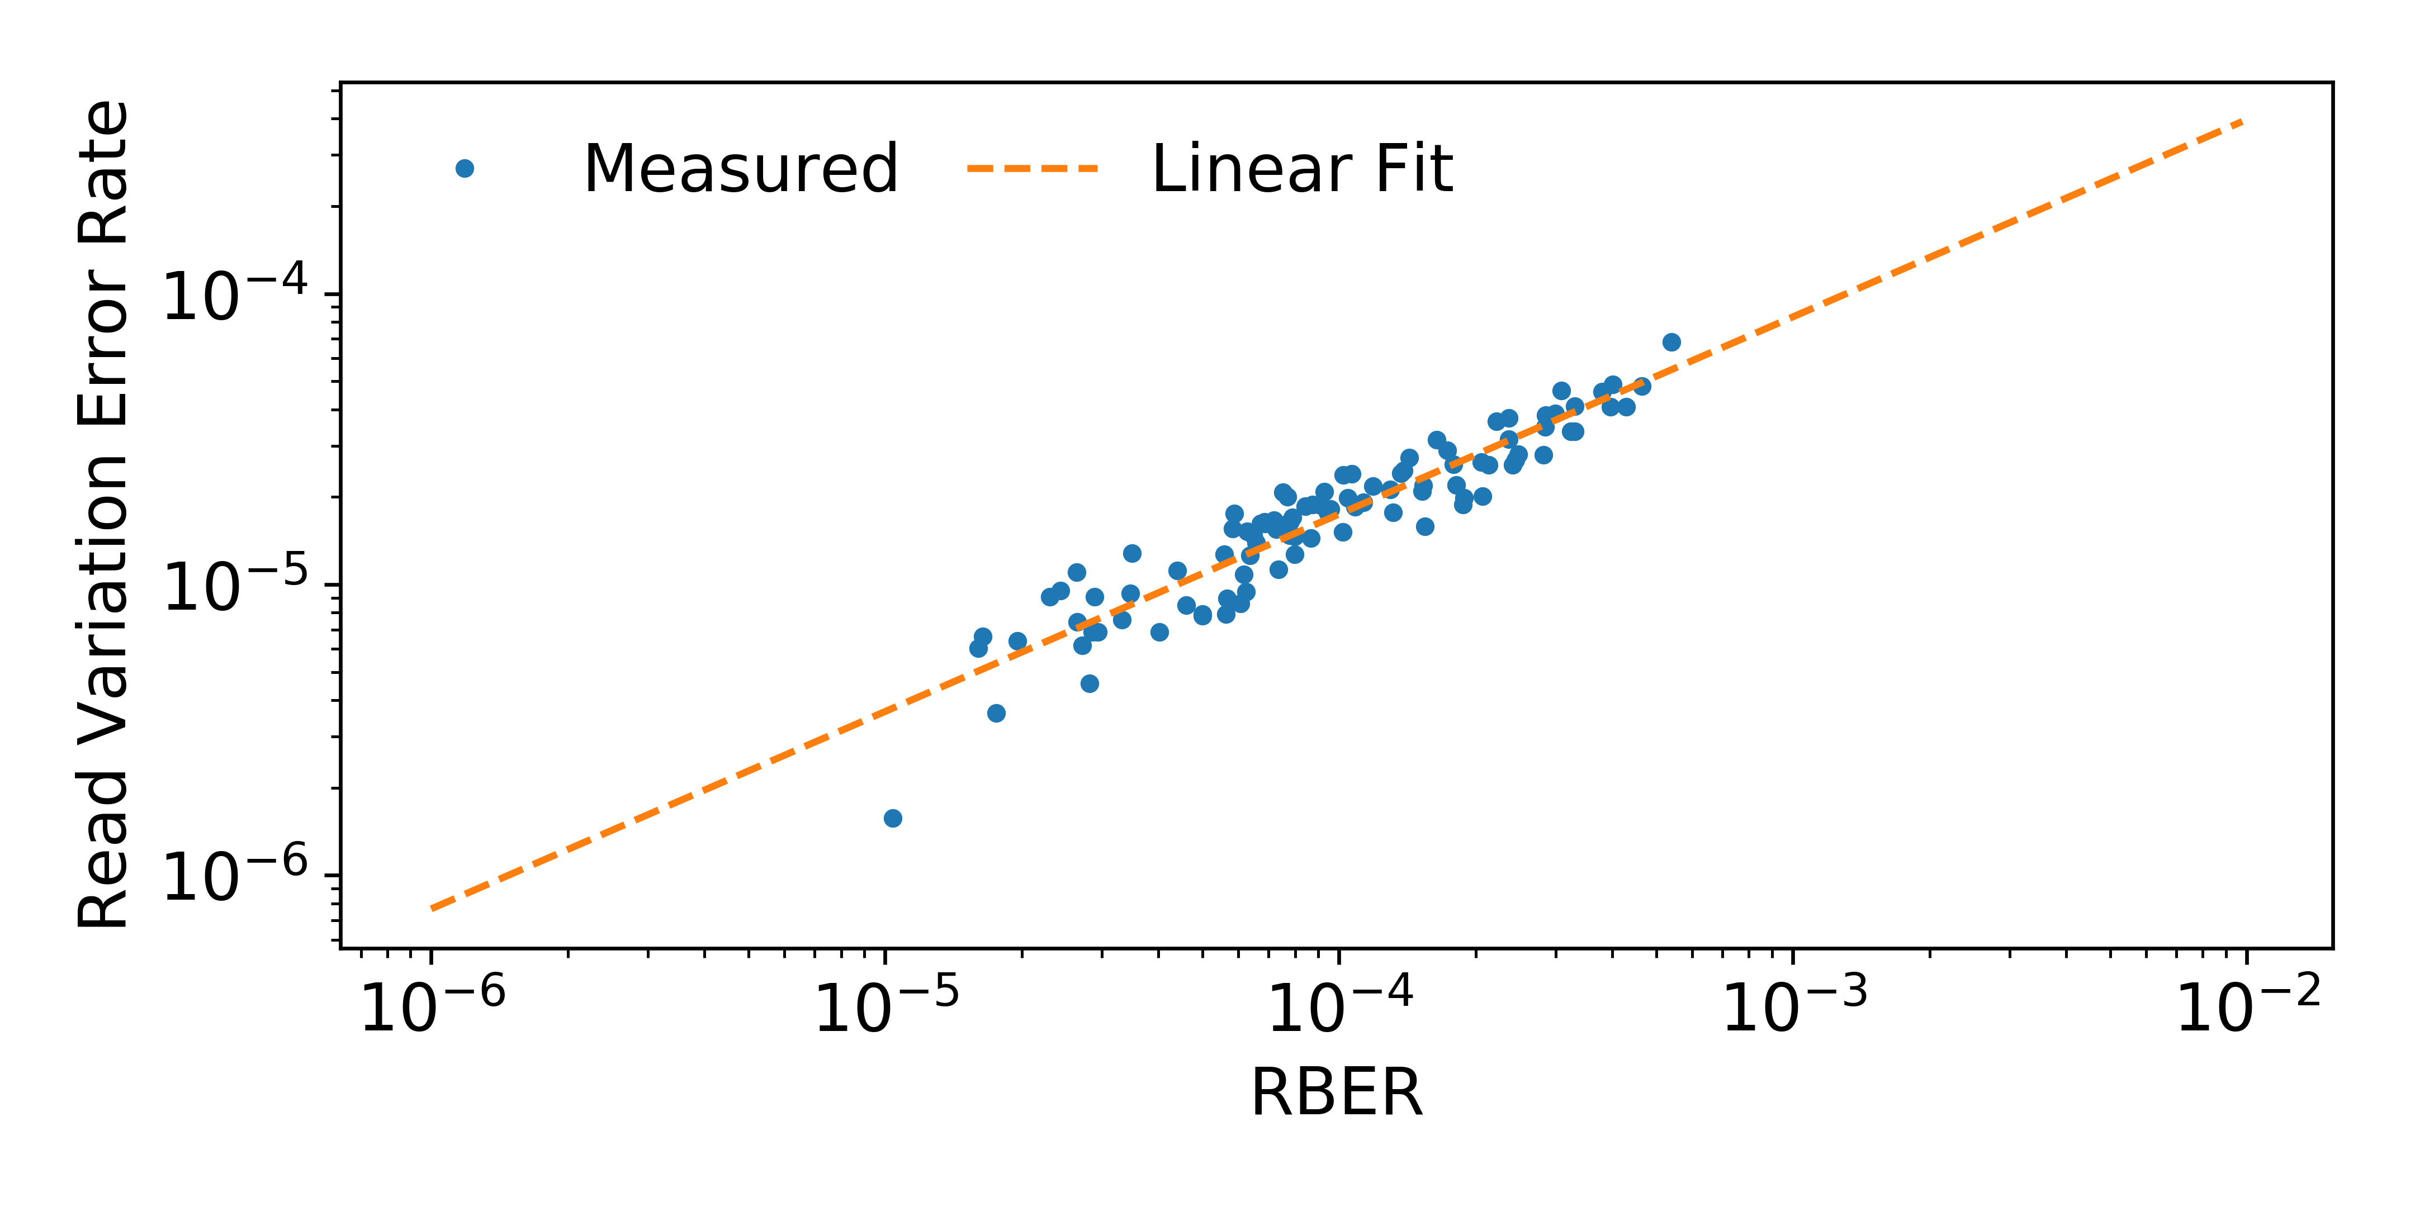
Read Variation Errors vs. RBER

Slide 58
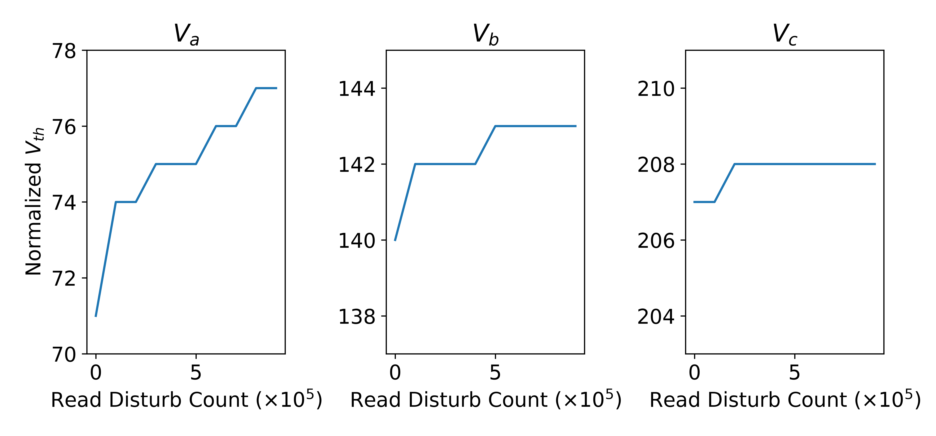
Read Disturb Effect on
Optimal Read Reference Voltages

Slide 59
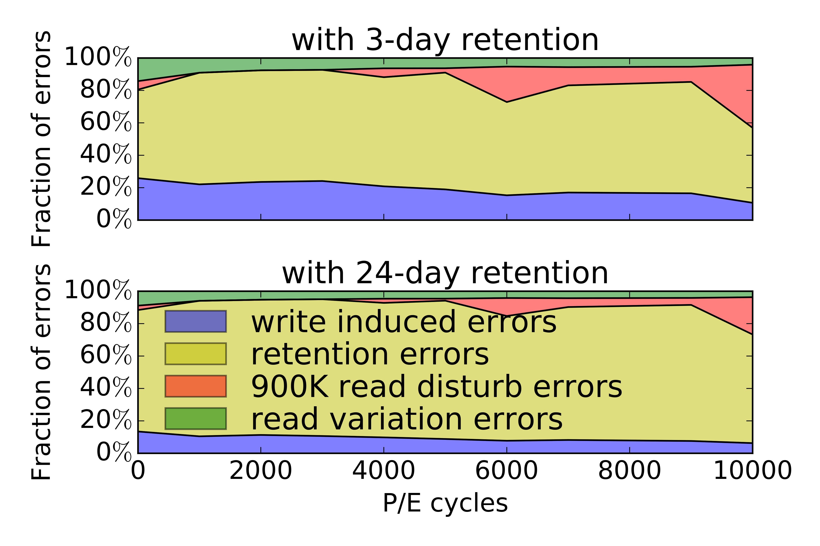
RBER Breakdown

