Slide 1

ABACuS
All-Bank Activation Counters for Scalable and Low Overhead RowHammer Mitigation
Ataberk Olgun
Yahya Can Tuğrul
F. Nisa Bostancı
İsmail Emir Yüksel
Haocong Luo
Steve Rhyner
A. Giray Yağlıkçı
Geraldo F. Oliveira
Onur Mutlu
Notes:
Hello everyone. My name is Ataberk Olgun, and I am excited to present our work ABACuS, which stands for All-Bank Activation Counters for Scalable and Low Overhead RowHammer Mitigation.

Slide 2
Outline
1. Background & Motivation
2. ABACuS: Key Idea and Mechanism
3. Evaluation
4. Conclusion
Notes:
Here is the outline of my talk

Slide 3
Outline
1. Background & Motivation
2. ABACuS: Key Idea and Mechanism
3. Evaluation
4. Conclusion
Notes:
I will start with a brief background on DRAM and RowHammer

Slide 4
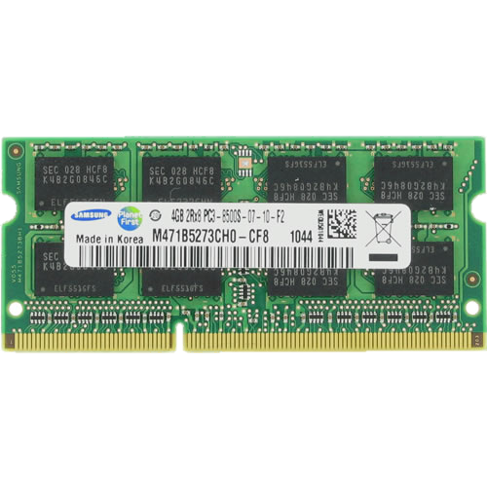
DRAM Organization
Subarray
Bitline
DRAM Cell
Bank
Wordline
…
Chip I/O
DRAM Row
. . .
…
…
…
…
…
Row Buffer
DRAM Chip
DRAM Bank
DRAM Subarray
Cache block (e.g., 512 bits)
Notes:
This is a DRAM module, used as the main memory on many systems. [CLICK]
A DRAM module consists of multiple chips each of which contains multiple banks [CLICK]
Each bank is composed of multiple subarrays [CLICK]
And within each subarray, there is a two dimensional array of DRAM cells. [CLICK]
These cells are organized into rows that are activated using wordlines [CLICK]
And the cells are connected to a row buffer via bitlines [CLICK].
Once the data is in the row buffer the DRAM chip serves read or write requests in cache block granularity.

Slide 5
DRAM Read Disturbance
Read disturbance in DRAM breaks memory isolation
Prominent example: RowHammer
DRAM Subarray
Row 1
Row 1
Row 1
Victim Row
Row 2
Row 2
Row 2
Row 2
Row 2
Row 2
open
open
Aggressor Row
closed
open
closed
Row 3
Row 3
Row 3
Victim Row
Repeatedly opening (activating) and closing a DRAM row
many times causes RowHammer bitflips in adjacent rows
[Kim+, ISCA’14]
Notes:
This is a different view of a DRAM subarray that we’ll look at to better understand RowHammer.
More generally, read disturbance has significant system-level implications because it breaks memory isolation.
[CLICK] and RowHammer is a prominent example of read disturbance.
[CLICK] [CLICKx8] Repeatedly activating and closing a DRAM row many times causes RowHammer bitflips in adjacent rows
We call the repeatedly activated row the aggressor row and the rows that have bitflips victim rows

Slide 6
Read Disturbance Worsens
Read disturbance bitflips occur
at much smaller row activation counts
  More than 100x decrease in less than a decade
139K
[Kim+, ISCA’14]
9.6K
[Kim+, ISCA’20]
<1K
[Luo+, ISCA’23]
Mitigation techniques against read disturbance attacks
need to be effective and efficient for highly vulnerable systems
[Bostanci+, HPCA’24]
Notes:
This phenomenon is getting worse
[CLICK] We can induce bitflips with around 100 times fewer hammers compared to 10 years ago. In other words, the RowHammer thresholds of DRAM chips are reducing.
[CLICK] Thus, we need effective and efficient read disturbance (or RowHammer) mitigations for highly vulnerable systems where only a few hundreds of hammers are enough to induce a bitflip

Slide 7
Read Disturbance Mitigation Approaches
There are many ways to mitigate RowHammer bitflips
More robust DRAM chips and/or error-correcting codes
Increased refresh rate
Physical isolation
Row remapping
Preventive refresh
Proactive throttling
Generally more resource-efficient
and lower overhead
than other approaches
Notes:
[CLICKx6] There are multiple ways to mitigate RowHammer bitflips each offering a different system
design point in the performance, energy, area tradeoff space
[CLICK] Preventive refresh-based ones are promising because they tend to make more efficient use of resources and induce smaller performance and energy overheads

Slide 8

Preventive Refresh
DRAM Chip
Row 1
Row 1
Row 1
Row 0
Victim Row
Row 2
Row 2
Row 2
Row 2
Row 2
Row 1
open
open
open
closed
Aggressor Row
Aggressor Row
Row 3
Row 3
Row 3
Row 2
Victim Row
Refreshing potential victim rows
mitigates read disturbance bitflips
Requires aggressor row activation count
estimation or tracking
[Kim+, ISCA’20]
Notes:
The idea of preventive refresh is to [CLICK]
refresh a victim row before bitflips from a RowHammer attack can manifest in that row.
That is, preventive refresh `resets’ the disturbance effect.
[CLICK] Doing so requires what’s called aggressor row activation count estimation or tracking.
Activation count tracking gives us a way of determining when to refresh a victim row.

Slide 9
Problem & Goal
Problem
No existing mitigation technique prevents RowHammer bitflips
at low area, performance and energy costs
Goal
Prevent RowHammer bitflips
at low performance, energy, and area cost
especially at very low RowHammer thresholds
(e.g., 125 aggressor row activations induce a bitflip)
Notes:
We find that no existing preventive refresh based mitigation
prevents RowHammer bitflips at low area, performance, and energy costs
[CLICK] Therefore our goal is to enable low area, performance, and energy RowHammer mitigation
Especially at very low RowHammer threshold where activating a row 125 induces a bitflip

Slide 10
Outline
1. Background & Motivation
2. ABACuS: Key Idea and Mechanism
3. Evaluation
4. Conclusion
Notes:
To that end, we develop ABACuS.

Slide 11
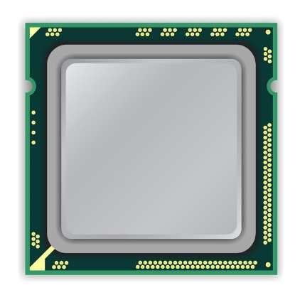
Key Observation
Many workloads access the same row address
in different banks at around the same time
CPU
Bank 0
Bank 1
Row X
Row X
Bank 2
Bank 3
LD (3,X)
Row X
Row X
LD (3,Y)
LD (0,X)
LD (1,X)
LD (2,X)
Load request targeting
bank 0 row X
Sibling rows
Time
LD (0,X)
LD (1,X)
LD (3,Y)
LD (3,X)
LD (2,X)
Notes:
ABACuS’s key idea, which I will talk about in the next slides, is based on this key observation that we make on how workloads interact with main memory.
We will show what we observe over an example.
[CLICK] Here is a system with a CPU and four DRAM banks. Each DRAM bank has a DRAM Row at the same row address highlighted with label Row X
[CLICK] A workload running on the CPU generates this load request targeting bank 0 and row x [CLICK] in the beginning of this timeline.
[CLICK] The CPU issues this request to its target bank and row, and it repeats this access pattern for other banks.
[CLICK] There might be other requests targeting different row addresses, [CLICK] but this does not contradict our observation
Eventually the CPU accesses the same row address across all banks
[CLICK] We call the rows with the same address sibling rows

Slide 12
Explanation for the Key Observation
1
Spatial locality in memory accesses
(e.g., [Smith+, ACM CSUR 1982])
A program tends to access neighboring
cache blocks at around the same time
e.g., a streaming access to an array
2
Modern physical → DRAM address mappings
(e.g., [Pessl+, USENIX Security 2016 and Kaseridis+, MICRO 2011])
Place neighboring cache blocks
into different banks, but into the same row
Leverage DRAM bank-level parallelism
for higher-throughput DRAM access
Notes:
There are two causes for our key observation
First one is the intrinsic spatial locality in workloads’ memory access patterns
[CLICK] A program usually accesses neighboring cache blocks at around the same time [CLICK] and a prominent access pattern that leads to this sort of behavior is streaming through the elements of an array.
[CLICK] The second cause is modern physical address to DRAM address mappings that [CLICK] place neighboring cache blocks into different banks, but into the same DRAM row.
[CLICK] They do this to leverage bank-level parallelism to get the most out of the available DRAM data transfer bandwidth.

Slide 13
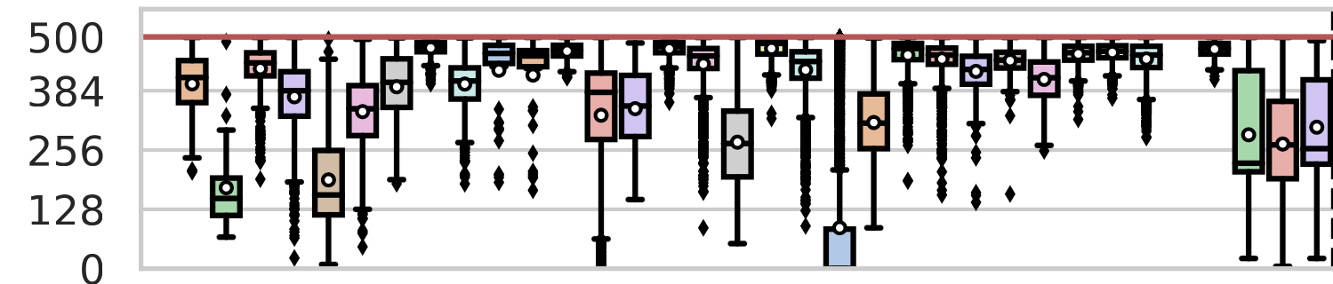
Sibling Row Activation Count for RowHammer Threshold = 500
RowHammer Threshold = 500
Sibling Row
Activation Count
  Memory Intensive SPEC06/17, TPC, MediaBench, YCSB Workloads
If a row is activated 500 times
its siblings are likely activated more than 250 times
The sibling row with the highest activation count
yields a good estimate for the activation count of all siblings
Notes:
This plot pictorially depicts our key observation across many tested [CLICK] workloads. I will not explain this in detail in the interest of time.
[CLICK] When a row gets activated RowHammer threshold times, which is 500 for this figure, we record the activation counts of that DRAM row’s siblings.
Each box in this plot shows the distribution of sibling rows’ activation counts for a tested workload.
[CLICK] Above this horizontal green line in the figure shows that [CLICK] if a row is activated RowHammer threshold times, its siblings are activated more than half the RowHammer threshold times.
[CLICK] Therefore, if we can track the sibling rows that is activated the most, it could give us a good estimate for the activation count of all its siblings.

Slide 14
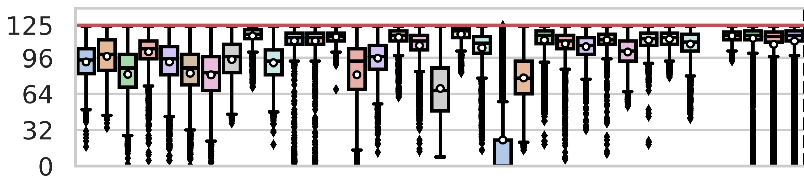
Sibling Row Activation Count for RowHammer Threshold = 125
RowHammer Threshold = 125
Sibling Row
Activation Count
  Memory Intensive SPEC06/17, TPC, MediaBench, YCSB Workloads
The sibling row with the highest activation count
yields an even better estimate for the activation count
of all sibling rows
Notes:
We repeat the analysis for a smaller RowHammer threshold of 125 activations.
[CLICK] We find the key observation to be more prominent at this smaller RowHammer threshold.

Slide 15
Existing Per-Bank Activation Counters
Induce High Storage Overhead
There are many (e.g., 16) banks in a DRAM chip
  Newer DRAM standards (DDR5) have more (32) banks
  # of activation counters linearly increases with # of banks
Bank 0
Bank 1
…
Bank 15
…
Need twice as many
counters for DDR5
Counter X
Counter X
…
Counter X
Existing Row Activation Tracker
Notes:
Let me quickly introduce an important problem of existing per-bank activation counter-based mitigation techniques.
There are many banks in a DRAM chip.
[CLICK] The number of banks and thereby the number of activation counters increase with newer DRAM generations

Slide 16
ABACuS: Key Idea
There are many (e.g., 16) banks in a DRAM chip
  Newer DRAM standards (DDR5) have more (32) banks
  # of activation counters linearly increases with # of banks
Sibling rows have similar activation counts
Have one counter for all siblings
  Reduce the number of counters by a factor of the number of banks
Bank 0
Bank 1
…
Bank 15
Bank 0-15
…
Counter X
Counter X
…
Counter X
Counter X
Existing Row Activation Tracker
ABACuS-Based Tracker
16x reduction in number of counters
Notes:
We have seen that sibling rows have similar activation counts
[CLICK] Our key idea is quite simple. It is to use one activation counter for all sibling rows [CLICK] and reduce the number of counters by a factor of the number of banks

Slide 17
Maximum Activation Count
Track the maximum (worst) activation count
across all sibling rows using one counter
Bank 0
Bank 1
…
Bank 15
Bank 0-15
…
32
14
…
97 (max.)
≥97
Existing Row Activation Tracker
ABACuS-Based Tracker
ABACuS counter value vs. maximum activation count
If ABACuS counter is smaller
If ABACuS counter is larger
Cannot preventively refresh on time
Cannot mitigate bitflips
Not secure
Unnecessary preventive refreshes
Higher perf. and energy overheads
Lower performance
Our design goal
ABACuS counter value == maximum activation count
Notes:
ABACuS’s objective is to track the maximum activation count across all sibling rows using one counter
[CLICK] If, for example the activation count of sibling rows look like this, [CLICK] then ABACuS’s counter value for the sibling rows will equal or be larger than 97
Why? because [CLICKx3] If the ABACuS counter is smaller than the maximum activation count, we cannot mitigate bitflips
[CLICKx2] and if it is larger, we will have increased performance and energy overheads from unnecessary preventive refreshes
[CLICK] And because of these two reasons, our key design goal for ABACuS is to keep its counter value equal to the maximum activation count

Slide 18
ABACuS Counting Algorithm
Intuition behind the counting algorithm
ABACuS “remembers” the sibling row whose activation increased the counter value to 97
  The row in bank 15 in this example
Need one bit per bank to store additional state
The ABACuS counter’s state
Activation count of sibling rows
Bank 0
Bank 1
Bank 15
Bank 0-15
…
32
14
…
97 (max.)
97
Increment ABACuS counter if
1) bank 15 is activated again OR 2) any other bank is activated twice
https://arxiv.org/pdf/2310.09977.pdf
Notes:
I will quickly explain the intuition behind ABACuS’s counting algorithm.
[CLICK] This diagram depicts an example system state where sibling rows have different activation counts from each other and the maximum activation count is in bank 15.
[CLICK] We will assume that ABACuS currently stores this maximum activation count.
[CLICK] ABACuS remembers the sibling row that last got activated and increased the counter value to 97, [CLICK] which is bank 15 in this example.
[CLICK] At this point, two different “actions” can increase ABACuS counter value to 98. First, when bank 15 gets activated again OR second, if any other bank gets activated twice.
I will leave you with this much detail about how ABACuS operates in the interest of time
[CLICK] ABACuS needs small additional state of one bit per bank to operate as such.
[CLICK] And we prove in our paper that ABACuS correctly maintains the maximum activation count using one counter.

Slide 19
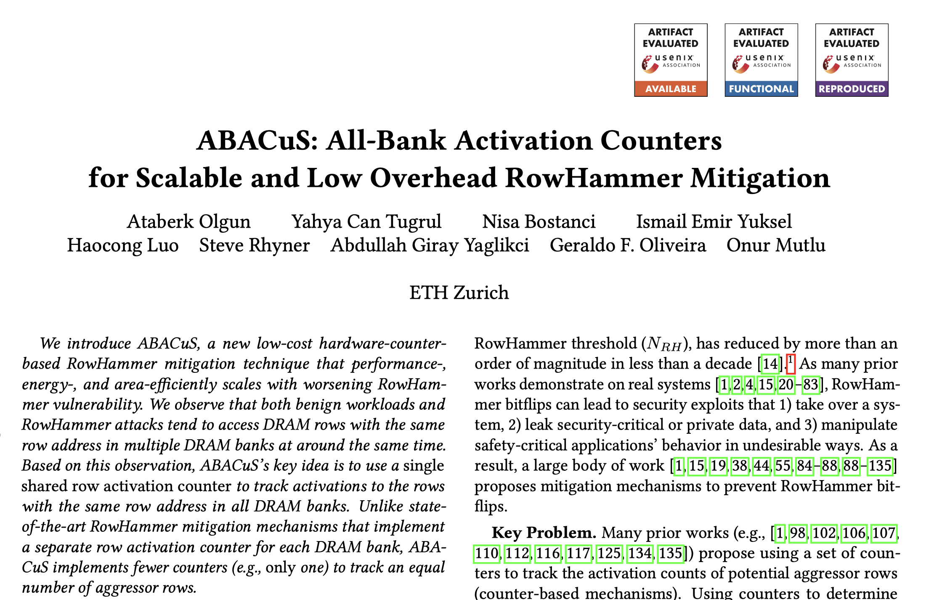
ABACuS: Implementation
Adopt a frequent item counting algorithm
  Area-efficient, fewer counters to track more DRAM rows
  ABACuS is compatible with other counter-based mitigations
ABACuS Counter Table
RowID
ABACuS Counter
Row Activation Counter (RAC)
Sibling Activation Vector (SAV)
N_{entries}
RowID
ABACuS Counter
…
…
…
…
…
…
…
RowID
ABACuS Counter
Spillover Counter
https://arxiv.org/pdf/2310.09977.pdf
Notes:
Our implementation of ABACuS leverages a prior work’s, namely Graphene’s, activation count tracking algorithm
[CLICK] For more details on how we implement ABACuS, please check the paper.

Slide 20
Outline
1. Background & Motivation
2. ABACuS: Key Idea and Mechanism
3. Evaluation
4. Conclusion
Notes:
Now let’s see how ABACuS performs.

Slide 21
Evaluation Methodology
Performance and energy consumption evaluation:
Cycle-level simulations using Ramulator [Kim+, CAL 2015]
and DRAMPower [Chandrasekar+, DATE 2013]
System Configuration:
  Processor 1 or 8 cores, 3.6GHz clock frequency,
  4-wide issue, 128-entry instruction window
  DRAM DDR4, 1 channel, 2 rank/channel, 4 bank groups,
  4 banks/bank group, 128K rows/bank, 3200 MT/s
  Memory Ctrl. 64-entry read and write requests queues,
  Scheduling policy: FR-FCFS with a column cap of 16 Last-Level Cache 2 MiB (single-core), 16 MiB (8-core)
Comparison Points: 4 state-of-the-art RowHammer mitigations
  Graphene (best performing), Hydra (area-optimized best performing),
  Low Processor Chip Area Cost: REGA, PARA
Workloads: 62 1- & 8-core (multiprogrammed) workloads
  SPEC CPU2006, SPEC CPU2017, TPC, MediaBench, YCSB
Notes:
We use a cycle-level memory system simulator
[click] configured in the way I show you here
[CLICK] And we compare ABACuS to 4 state-of-the-art preventive refresh based RowHammer mitigations, these are namely Graphene, Hydra, REGA, and PARA. Graphene is the highest-performance mechanism, PARA is the lowest-area-overhead mechanism and Hydra and REGA offer interesting tradeoffs between area and performance.
[CLICK] We simulate 62 single and 8-core multiprogrammed workloads from major benchmark suites.

Slide 22
Single-Core Performance and Energy
ABACuS prevents bitflips with very small
average performance and DRAM energy overheads
compared to a baseline system with no RowHammer mitigation
Notes:
We show [CLICK] the system throughput on the y-axis across all single-core workloads for the RowHammer threshold values displayed on the x-axis. The higher the bar, the better the performance.
[CLICK] This is the DRAM energy overhead. A smaller value is better.
[CLICK] We conclude that ABACuS prevents bitflips with very small performance and DRAM energy overheads compared to a baseline system with no RowHammer mitigation

Slide 23
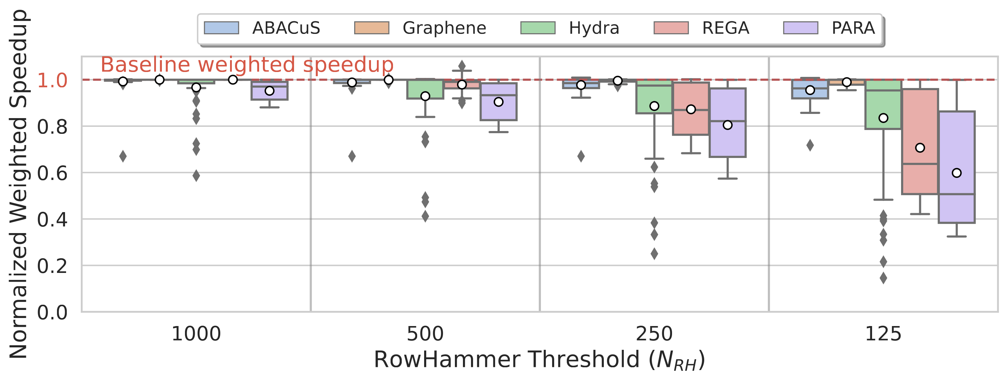
8-Core Performance Comparison
14.4%
2.6%
59.6%
ABACuS outperforms Hydra and PARA at all RowHammer thresholds
Notes:
This plot will show the 8-core multiprogrammed performance distribution across all workloads on the y-axis for ABACuS and the 4 state-of-the-art mitigation techniques. Higher values indicate better performance.
[CLICK] This is the full plot.
[CLICK] Here are the boxes for ABACuS showing the distribution of performance across all tested workloads.
[CLICK] And the red boxes show the mitigation AND rowhammer threshold configurations which ABACuS outperforms.
[CLICK] (slowly) We observe that ABACuS outperforms Hydra and PARA at all RowHammer thresholds on average across all workloads.

Slide 24
8-Core Performance Comparison
1.7%
1.9%
2.6%
4.4%
ABACuS outperforms Hydra and PARA at all RowHammer thresholds
ABACuS incurs a small performance overhead over Graphene
Notes:
We also see that ABACuS incurs a small performance overhead over Graphene, which we attribute to ABACuS’s unnecessary preventive refresh operations due to its low-cost aggressor row activation tracking scheme.

Slide 25
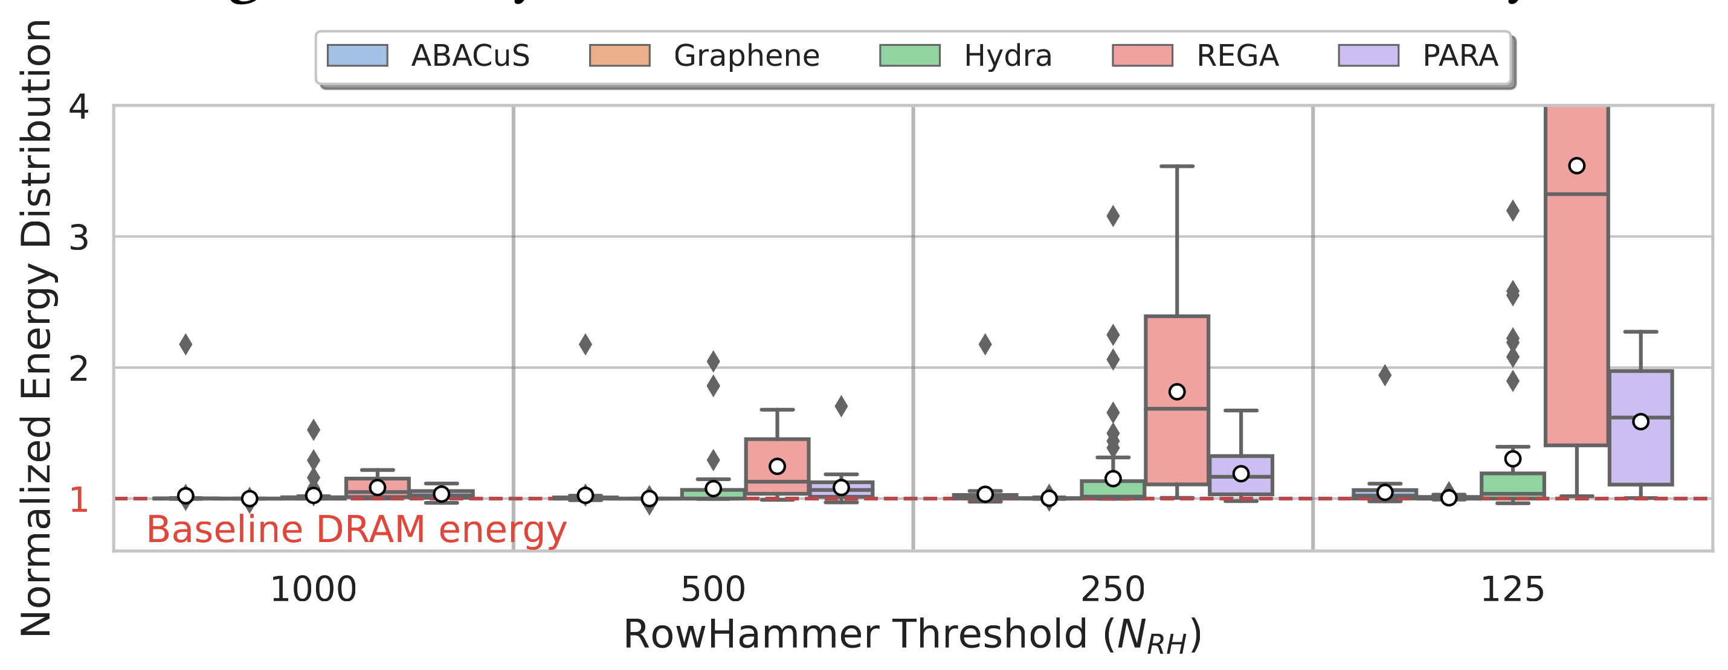
8-Core DRAM Energy Comparison
70.4%
19.6%
4.0%
34.0%
ABACuS consumes less energy than Hydra, REGA, and PARA
for RowHammer thresholds smaller than 1000
ABACuS incurs a small DRAM energy over Graphene
Notes:
Here is the same plot but for DRAM energy.
[CLICK] We observe that ABACuS consumes less energy than Hydra, REGA, and PARA at the tested RowHammer thresholds smaller than 1000. For example, ABACuS consumes approximately [CLICK] 20%, [CLICK] 70%, and [CLICK] 34% less energy than Hydra, REGA, and PARA at a very low RowHammer threshold of 125.
[CLICK] ABACuS performs similarly to Graphene in terms of DRAM energy, that is only 4% higher at the same very low RowHammer threshold.

Slide 26
Area Overhead
Area overhead analysis using
CACTI [Balasubramonian+, ACM TACO 2017]
Area overhead for a dual-rank system
22.7x
20.3x
*REGA modifies DRAM chips
2.5x
*PARA needs
a secure random number generator
Notes:
[CLICK] We analyze ABACuS’s area overhead
[CLICK] and we observe that at a RowHammer threshold of 1K, ABACuS induces a [click] significantly smaller area overhead
than Graphene and it [click] takes up smaller area than Hydra.
At a smaller RowHammer threshold of 125, ABACuS takes up significantly smaller area [CLICK] than Graphene.
Hydra’s area overhead at the 125 RowHammer threshold is relatively smaller
Compared to ABACuS, however it comes at a significant performance overhead that I showed you earlier.
[CLICK] We excluded REGA and PARA from this analysis because they do not incur processor chip area overheads.
However, REGA requires intrusive DRAM chip modifications and PARA needs a secure random number generator.

Slide 27
More in the Paper
Security analysis of ABACuS:
  Inductive proof for maximum activation count tracking
Single-core performance and energy comparison
Verilog-level circuit area, latency, energy, and power
  E.g., ABACuS takes 1.2 ns to update one counter
Performance under adversarial workloads
  Alternative ABACuS design
Performance & energy sensitivity analysis
  Number of ABACuS counters
  Number of banks
  DRAM address mapping functions…
Discussion on accounting for RowPress
Notes:
We have more details and analyses in our paper.
The paper presents a security analysis of ABACuS which shows that it guarantees to track the maximum activation count among all sibling rows and securely mitigate RowHammer bitflips
[CLICK] Performance and energy comparison for less memory intensive single-core workloads
[CLICK] Circuit-level performance, latency, energy, and power estimation based on a functional hardware Verilog model of ABACuS. For example, we show that ABACuS’s circuit latency is approximately 1.2 nanoseconds, which is significantly smaller than the minimum allowed delay of 2.5 nanoseconds between two ACT commands.
[CLICK] ABACuS’ performance under adversarial workloads that aim to exacerbate preventive refreshes by rapidly incrementing ABACuS counters AND our alternative ABACuS design that defeats these workloads
[CLICK] ABACuS’ performance and energy sensitivity to important system variables
[CLICK] And finally, discussion on how to account for RowPress which induces bitflips by keeping a DRAM row open rather than repeatedly activating it.

Slide 28
The Paper
https://arxiv.org/pdf/2310.09977.pdf
Notes:
I invite you, again, to read our paper for these details.

Slide 29
Outline
1. Background & Motivation
2. ABACuS: Key Idea and Mechanism
3. Evaluation
4. Conclusion
Notes:
I will quickly conclude my talk

Slide 30
ABACuS Summary
Key Observation: Many workloads access the same row address in different DRAM banks at around the same time
Key Idea: Use one counter to track the activation count of
many rows with the same address across all DRAM banks
Key Results: At very low RowHammer thresholds (e.g., 125), ABACuS:
Induces small system performance and DRAM energy overhead
Outperforms the state-of-the-art mitigations Hydra, REGA, and PARA
except the highly area costly Graphene
Induces 22.7X smaller chip area than Graphene
https://github.com/CMU-SAFARI/ABACuS
Notes:
Based on the key observation that…
[CLICK] We develop ABACuS, which uses one counter to track…
[CLICK] We show that ABACuS induces small performance and DRAM energy overheads at very low RowHammer thresholds, such as 125, and it outperforms state-of-the-art mitigation techniques

Slide 31
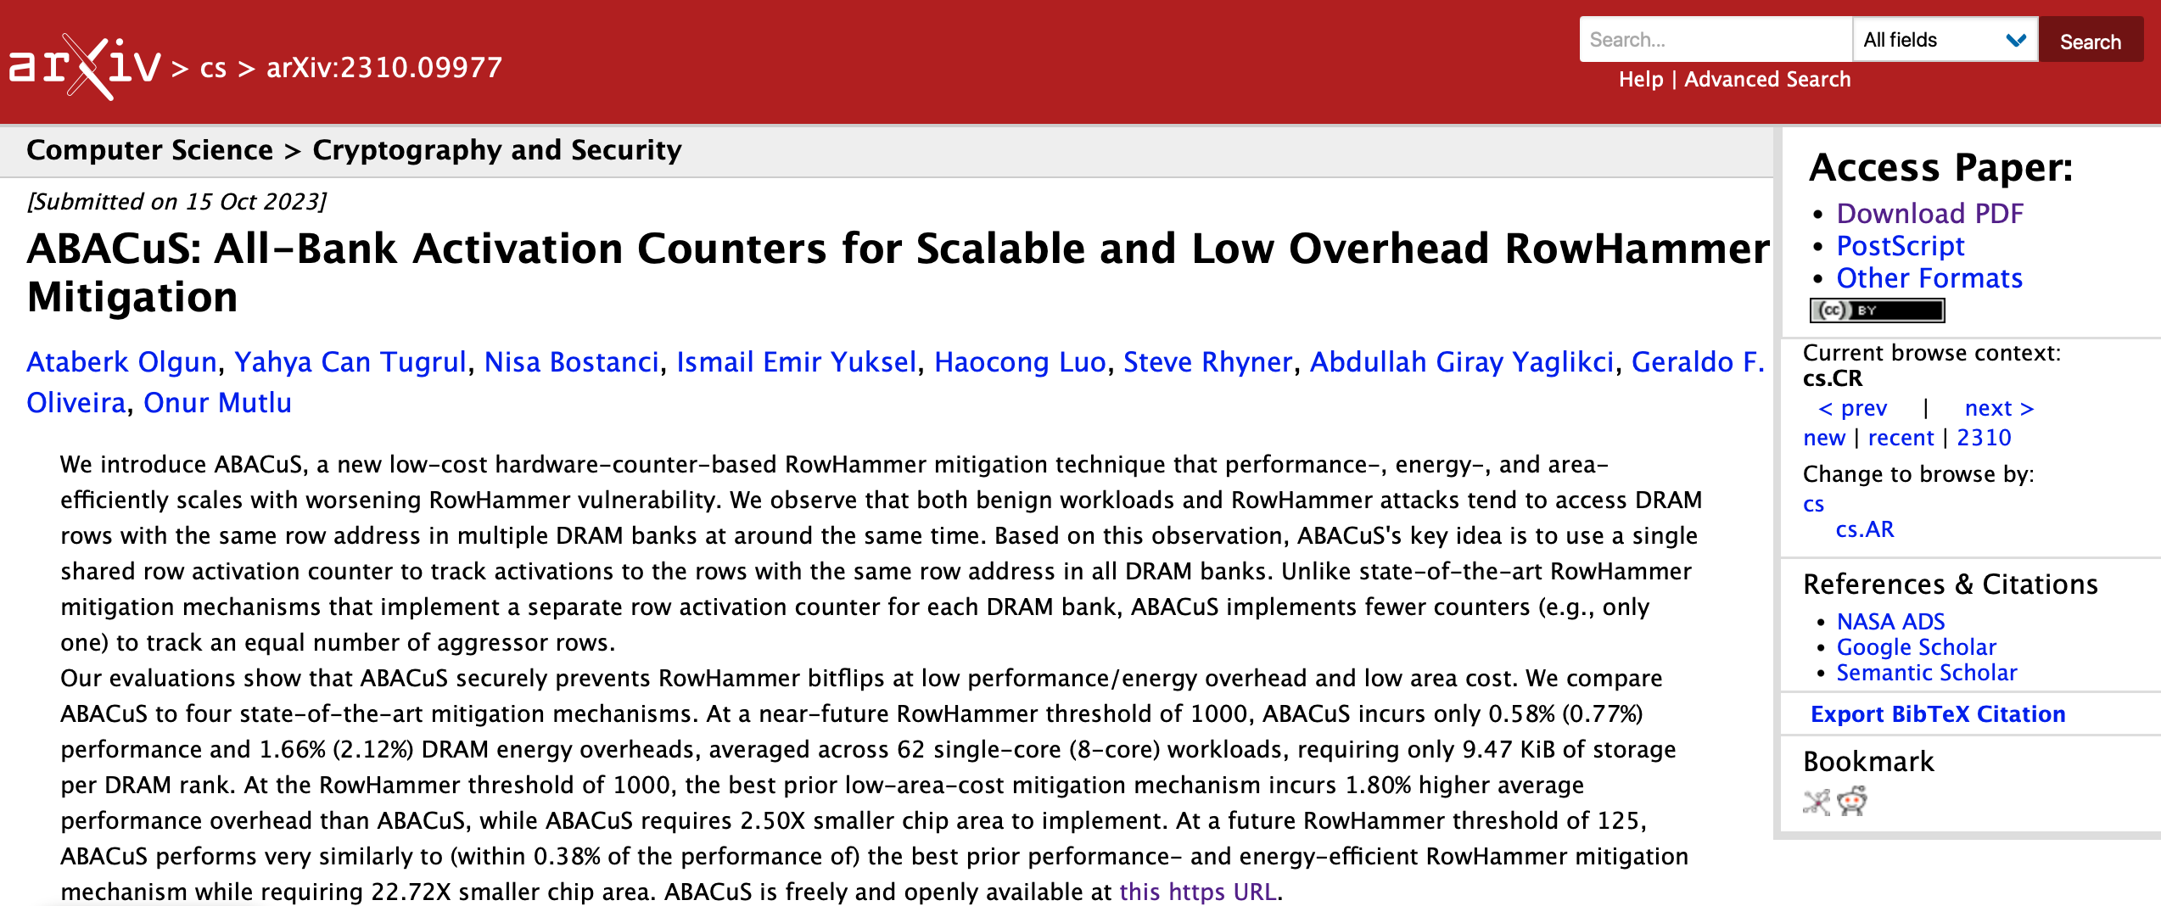
Extended Version on arXiv
https://arxiv.org/pdf/2310.09977.pdf

Slide 32
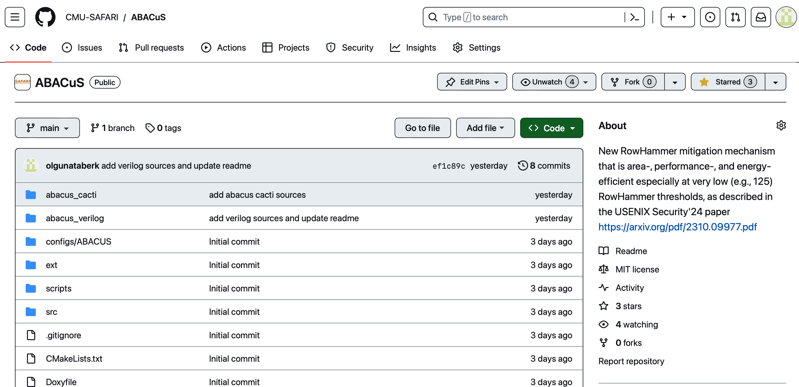
ABACuS is Open Source and Artifact Evaluated
https://github.com/CMU-SAFARI/ABACuS
Notes:
All our data and sources are open source and artifact evaluated

Slide 33
ABACuS
All-Bank Activation Counters for Scalable and Low Overhead RowHammer Mitigation
Ataberk Olgun
Yahya Can Tuğrul
F. Nisa Bostancı
İsmail Emir Yüksel
Haocong Luo
Steve Rhyner
A. Giray Yağlıkçı
Geraldo F. Oliveira
Onur Mutlu
Notes:
That will be all, thank you very much. I will be happy to take your questions.

Slide 34
Backup Slides

Slide 35
ABACuS Summary
Problem: As DRAM becomes more vulnerable to read disturbance, existing RowHammer mitigation techniques either prevent bitflips
at high area overheads or
with prohibitively large performance and energy overheads
Goal: Prevent RowHammer bitflips at low performance, energy,
and area cost especially at very low RowHammer thresholds
(e.g., 125 aggressor row activations induce a bitflip)
Key Observation: Many workloads access the same row address in different DRAM banks at around the same time
Key Idea: Use one counter to track the activation count of
many rows with the same address across all DRAM banks
Key Results: At very low RowHammer thresholds, ABACuS:
Induces small system performance and DRAM energy overhead
Outperforms the state-of-the-art mitigation (Hydra)
Takes up 22.7X smaller chip area than state-of-the-art (Graphene)
https://github.com/CMU-SAFARI/ABACuS

Slide 36
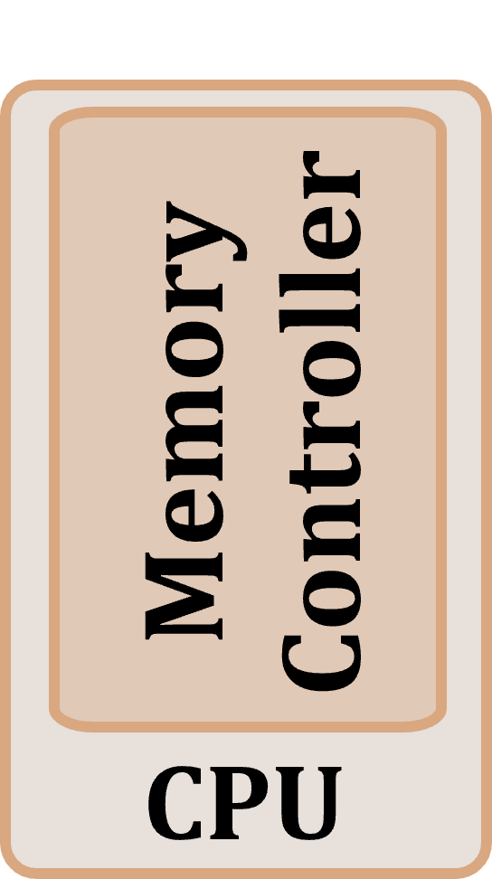
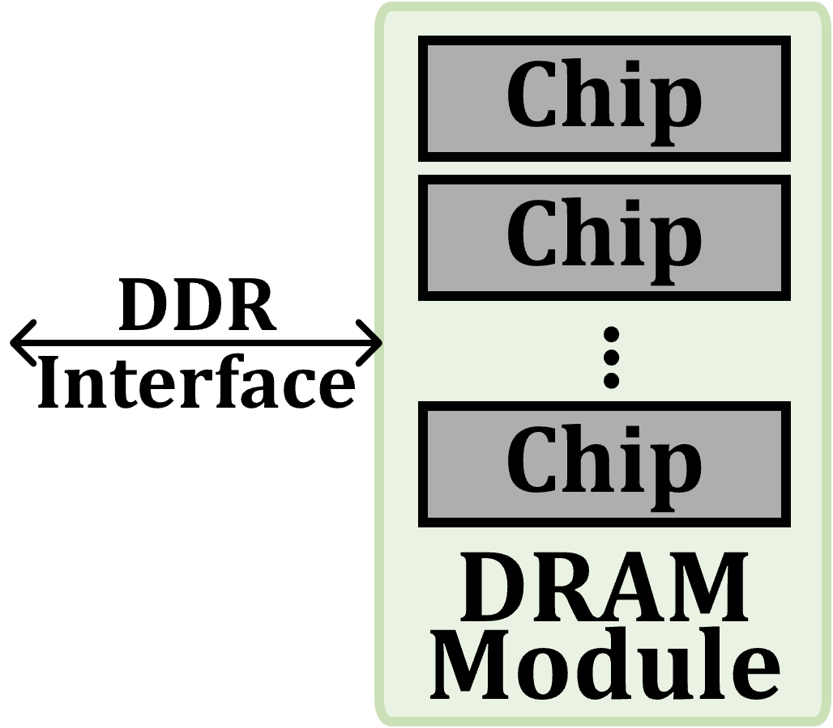
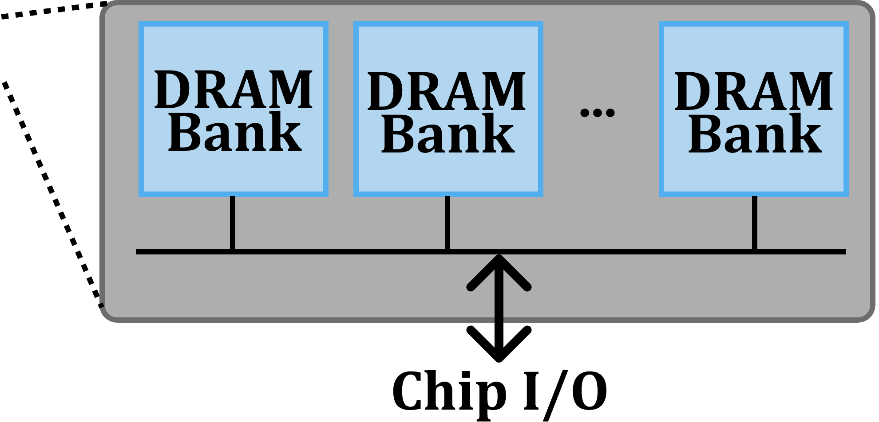
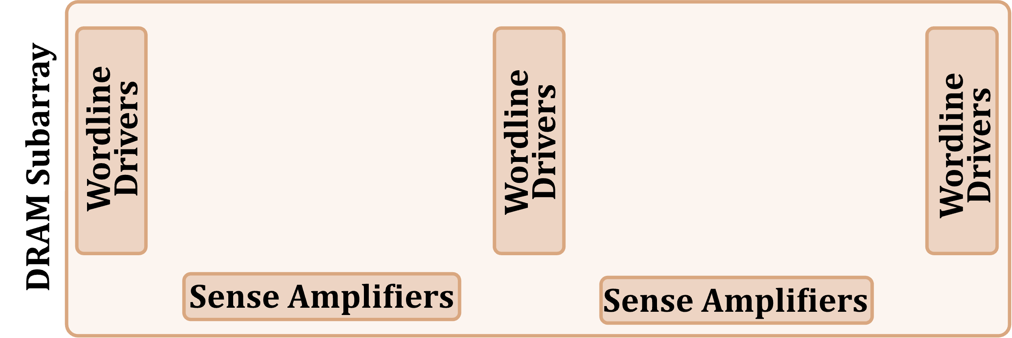
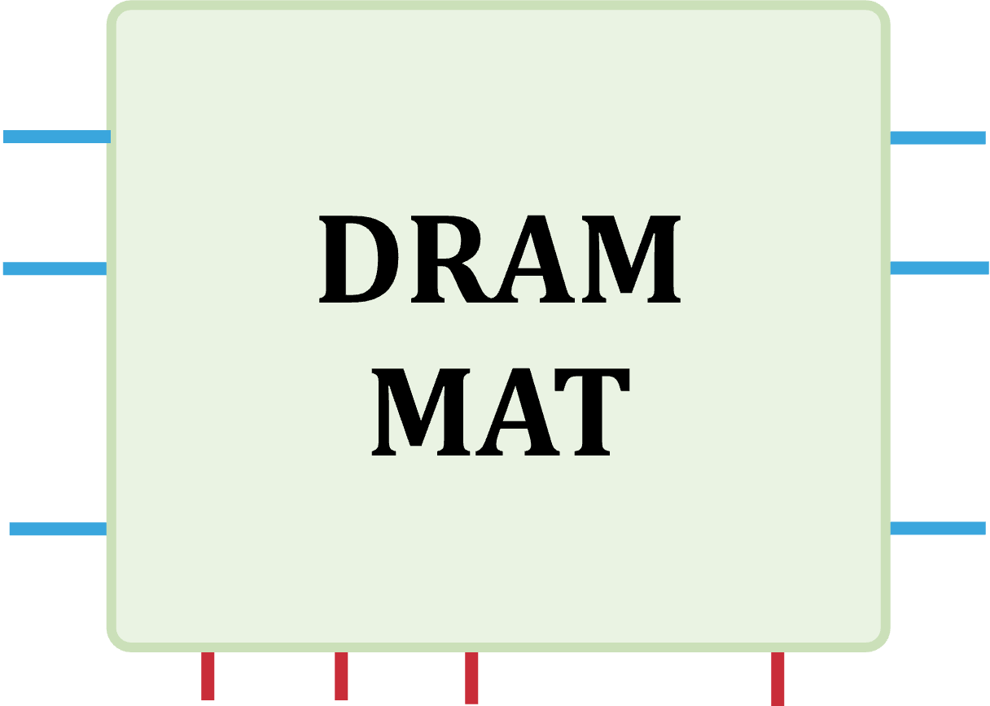
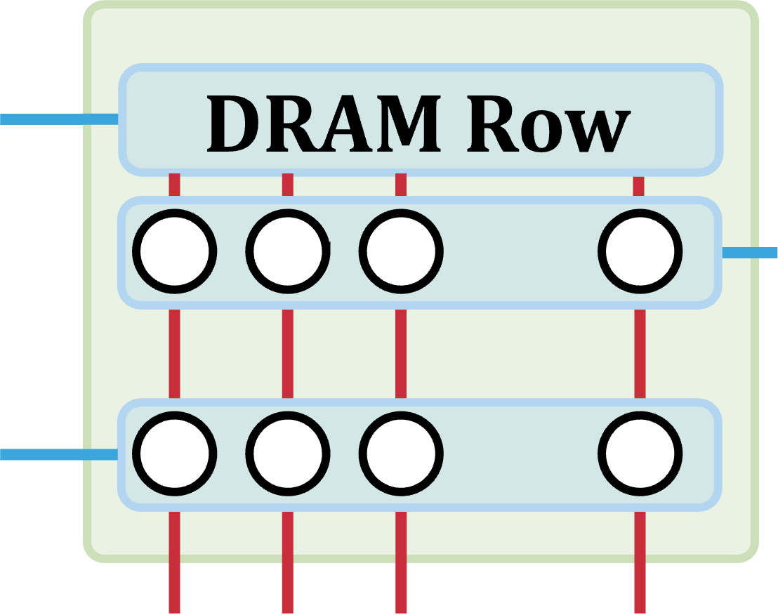
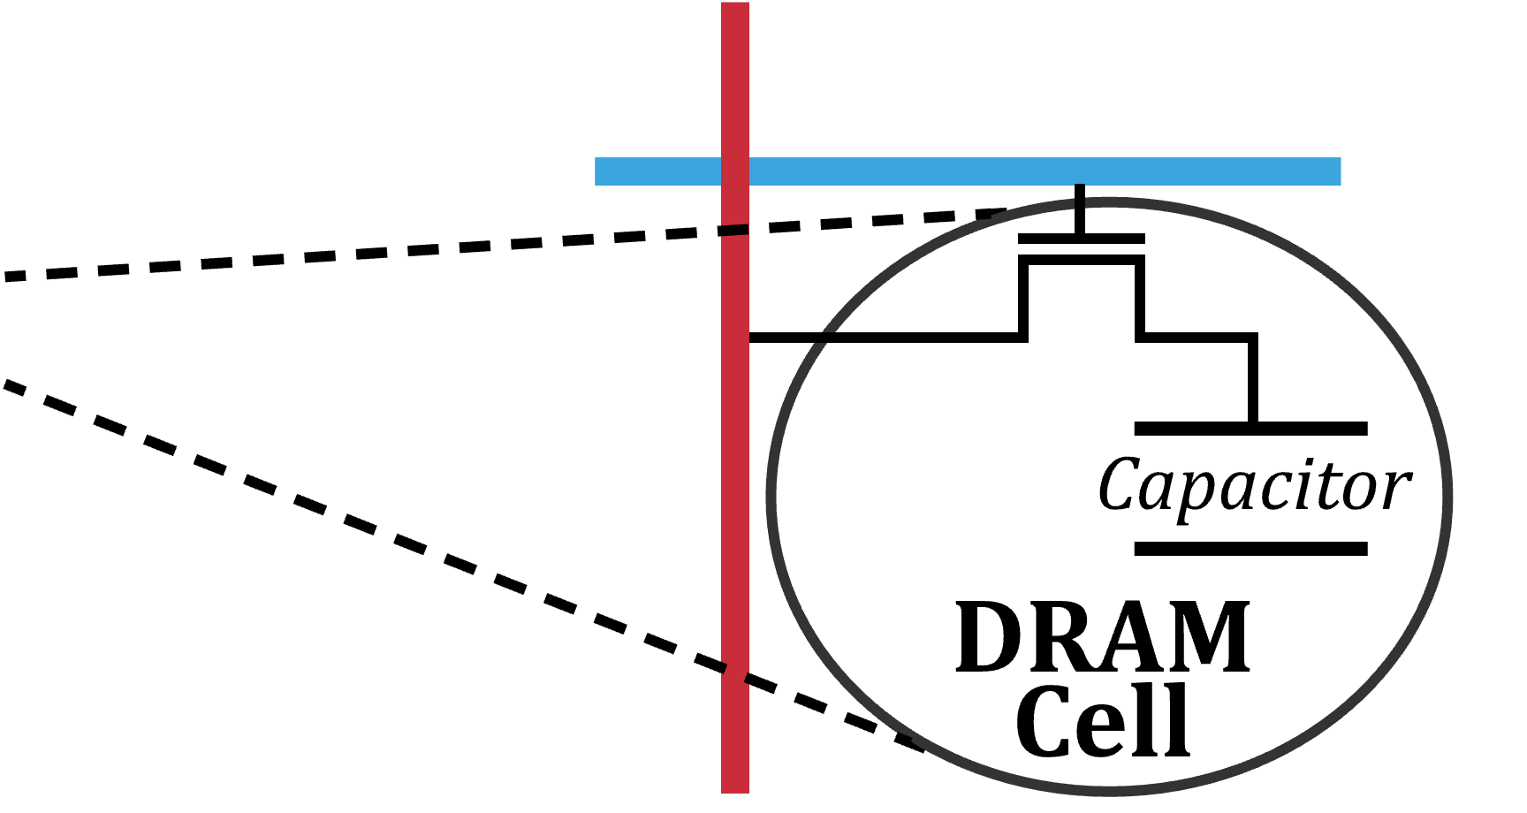
DRAM Organization
…
…
…
[Olgun+, ISCA’21]
Notes:
A processor’s memory controller
[CLICK] communicates with a set of DRAM chips within a DRAM module through a memory channel.
[CLICK] Each DRAM chip contains multiple banks that share a common chip I/O interface.
[CLICK] DRAM banks are organized into subarrays that consists of a set of wordline drivers and sense amplifiers
[CLICK] Subarrays are partitioned into DRAM MATs which are collections of DRAM cells that are separated from each other by wordline drivers.
[CLICK] DRAM cells are laid out onto a two-dimensional array of wordlines and bitlines within
a DRAM MAT. A row of DRAM cells is a DRAM row.
[CLICK] Here is a simplified diagram of a DRAM cell.

Slide 37


Preventive-Refresh-Based Mitigations
DRAM
Processor Chip
Processor
Chip
Processor Chip
Shared Counters
Row A
Counter A
Tag A
Counter A
Tag A
Counter A
Row B
Counter B
Tag B
Counter B
Tag B
Counter B
Row C
Counter C
Tag C
Counter C
Row D
Counter D
One ACT counter
per DRAM row
One ACT counter
per aggressor row
<1 counter
per DRAM row
VERY LOW
LOW
HIGH
Performance
& Energy Costs
Many DRAM rows
(e.g., >1M)
High DRAM bandwidth consumption
Area
Cost
VERY HIGH
HIGH
LOW
[Bostanci+, HPCA’24]
Notes:
If we look at how prior works estimate or track the activation count of DRAM rows, we see three main design choices.
[CLICK] One activation counter for each DRAM row allows us to [CLICK] precisely track each DRAM row’s activation count and refresh victim rows only when necessary, which induces the smallest performance overhead possible.
[CLICK] This comes at a very large area cost [CLICK] because there are millions of DRAM rows in a modern DRAM-based system.
[CLICK] Some prior works implement only as many counters as needed to track all possible aggressor DRAM rows, which is fewer than all DRAM rows in the chip, [CLICKx2] to reduce the area cost in exchange for performance and energy overheads.
[CLICK] Other techniques use one activation counter to estimate the activation counts of multiple rows, or use no activation counters at all and randomly determine potential aggressor rows [CLICKx3] These induce smaller area overheads at the cost of prohibitively high performance and energy overheads

Slide 38
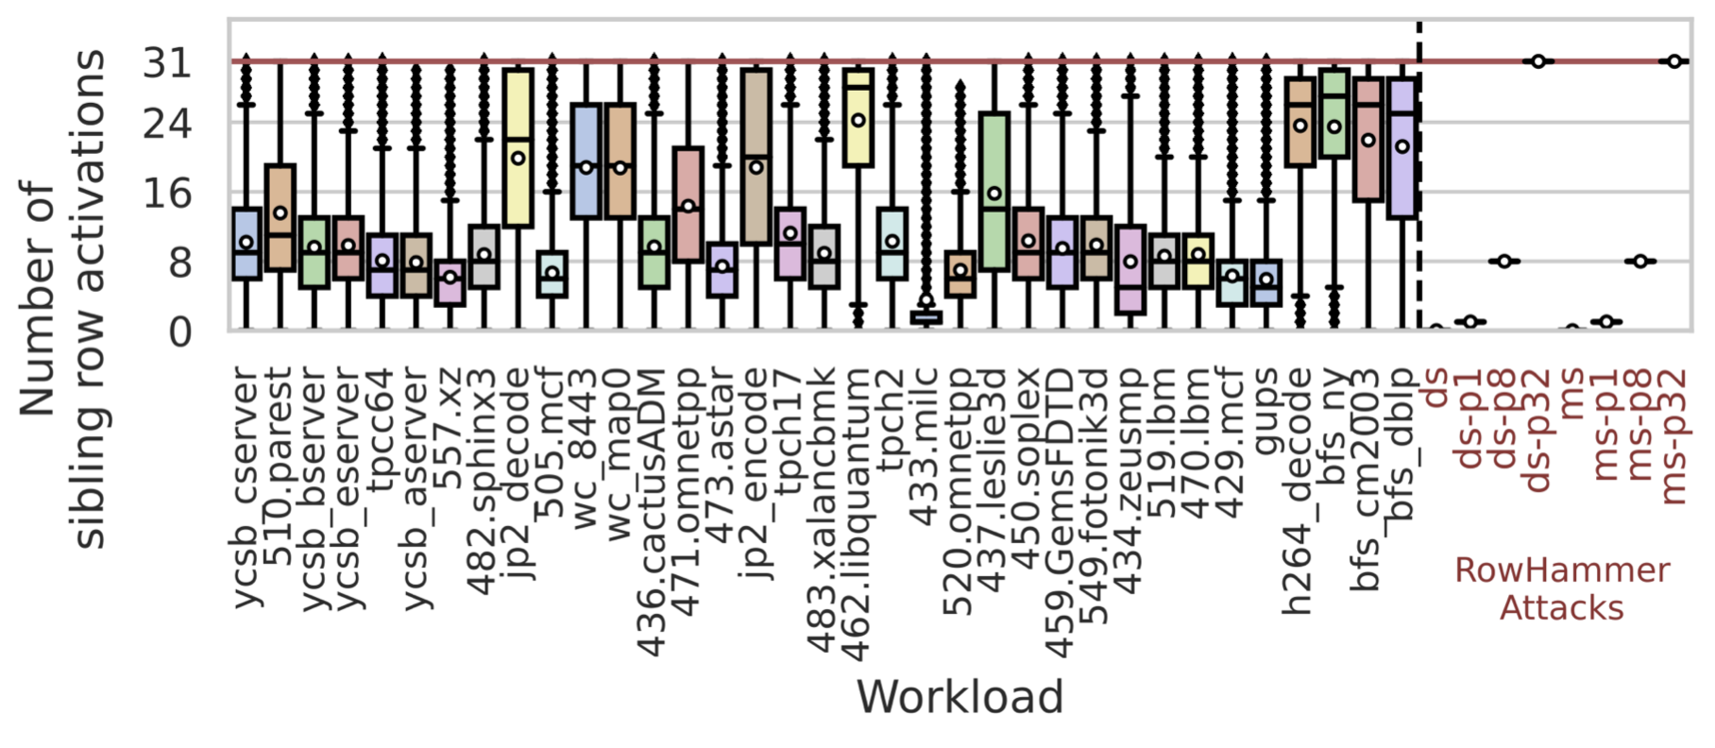
Number of sibling rows activated before one sibling row is activated again

Slide 39
ABACuS: Key Components
Adopt a frequent item counting algorithm
  Area-efficient, fewer counters to track more DRAM rows
  ABACuS is compatible with other counter-based mitigations
ABACuS Counter Table
RowID
ABACuS Counter
Row Activation Counter (RAC)
Sibling Activation Vector (SAV)
N_{entries}
RowID
ABACuS Counter
…
…
…
…
…
…
…
RowID
ABACuS Counter
Spillover Counter
Notes:
Before I show you how ABACuS achieves that objective, I will describe ABACuS’s key components.
ABACuS adopts a frequent item counting algorithm called Misra-gries, which allows us to use few counters to track all potential aggressor DRAM rows instead of having one counter per DRAM row.
[CLICK] ABACuS is implemented as a table of counters.
[CLICK] Each abacus counter has a row activation counter and a sibling activation bit vector
[CLICK] Only one Row address or RowID at a time can be ``mapped’’ to one counter.
[CLICK] There is a varying number of counters in a counter table [CLICK] based on the rowhammer threshold value, which we do not describe in detail interest of time.
[CLICK] Finally the spillover counter draws an upper bound for the activation count of any DRAM row that is *not* mapped to any abacus counter.

Slide 40
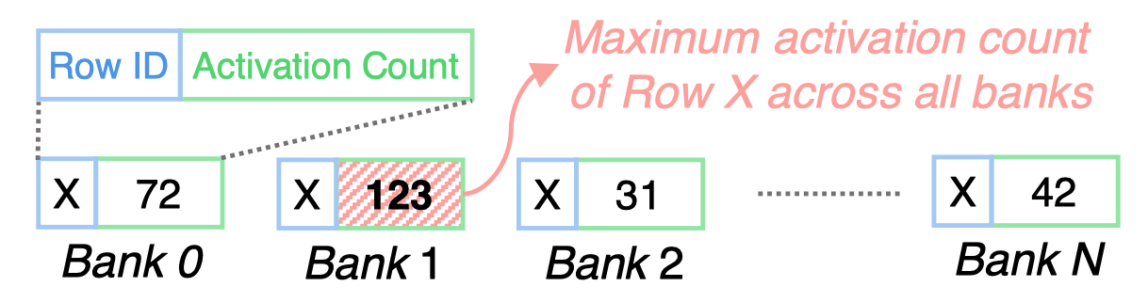
ABACuS: Operation
The RAC always stores the maximum activation count
  Store small additional information in SAV
“Which siblings were activated
since RAC was last incremented?”
One bit per bank
ABACuS Counter
Row Activation Counter (RAC)
Sibling Activation Vector (SAV)
Increment only when a sibling is activated “again”
(i.e., activate targets a set SAV bit)
https://arxiv.org/pdf/2310.09977.pdf
Notes:
Recall that we want to keep track of the maximum activation count across sibling rows.
[CLICK] I will make this claim that the row activation counter always stores the maximum activation count for the row address its mapped to, and
[CLICK] for this we store some additional information in the sibling activation vector.
We have a proof in the paper.
[CLICK] I will only briefly describe the intuition behind the proof. There is one bit for each bank in the sibling activation vector, so for a DRAM chip with 16 banks there will be 16 bits in the activation vector. If a bit is set it means that the sibling row in that bank was activated once since row activation counter was last incremented.
[CLICK] We only increment the row activation counter when a sibling row corresponding to a set sibling activation vector bit is activated and this way we store the maximum activation count in the row activation counter. For details of the proof, please read our paper.

Slide 41
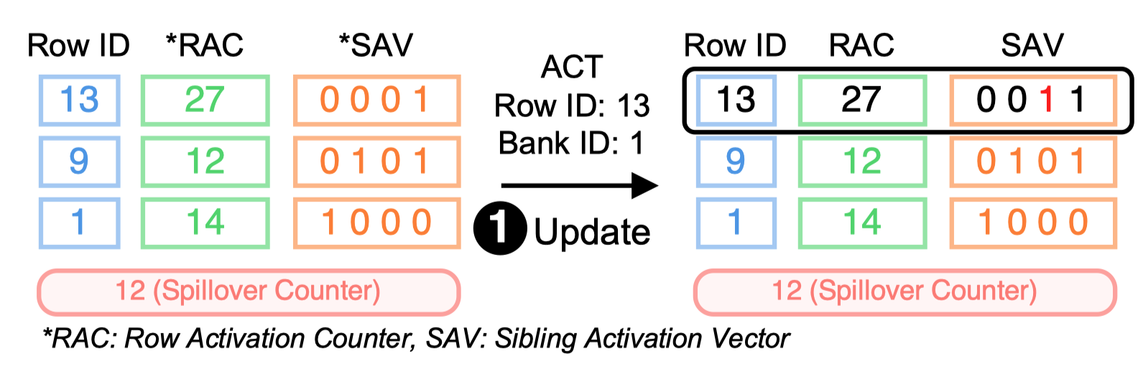
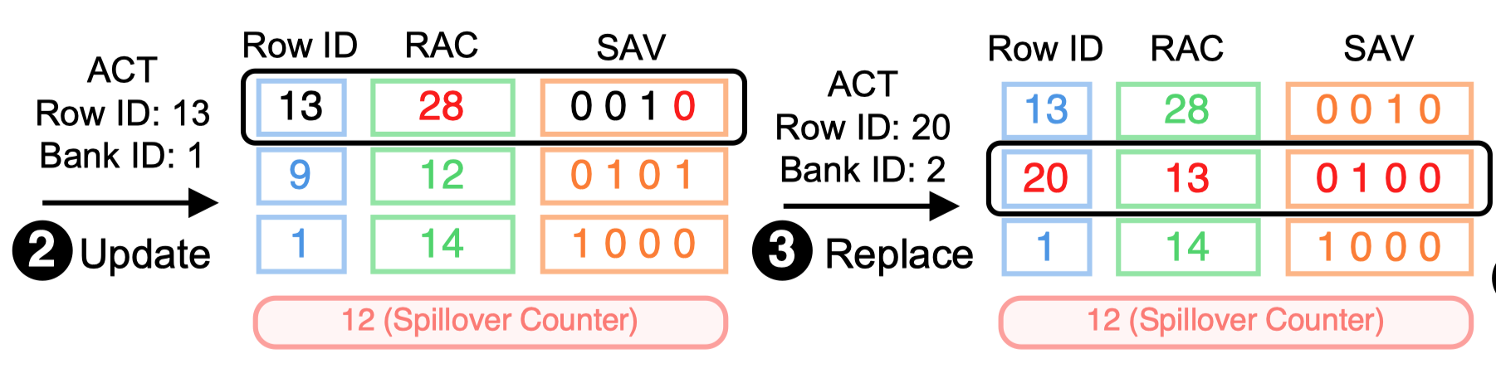
ABACuS: Operation (I)

Slide 42
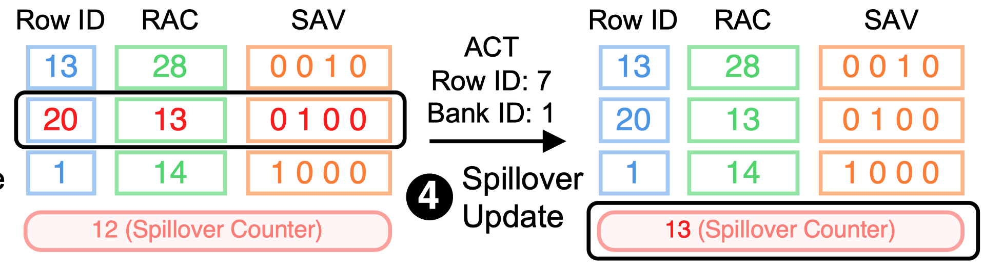
ABACuS: Operation (II)

Slide 43
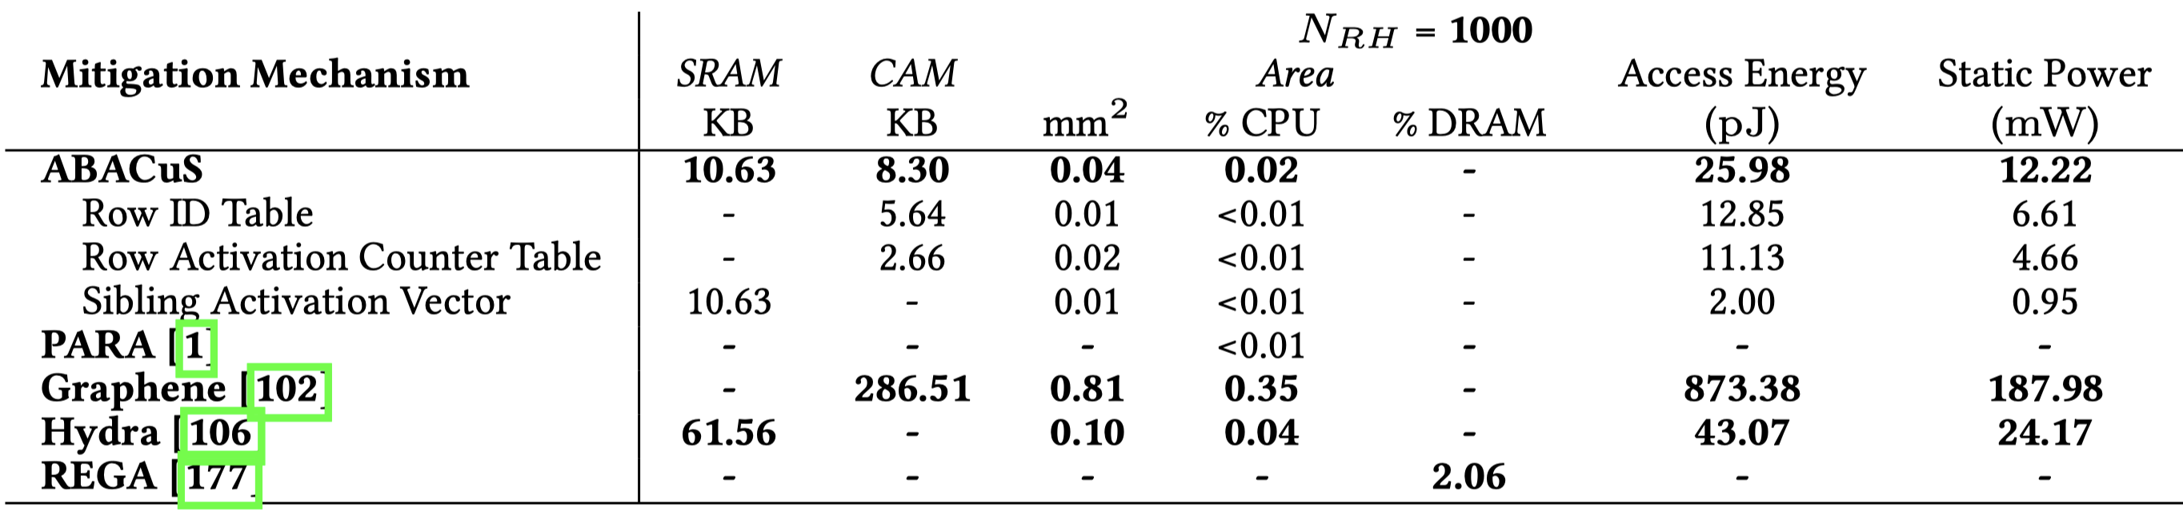
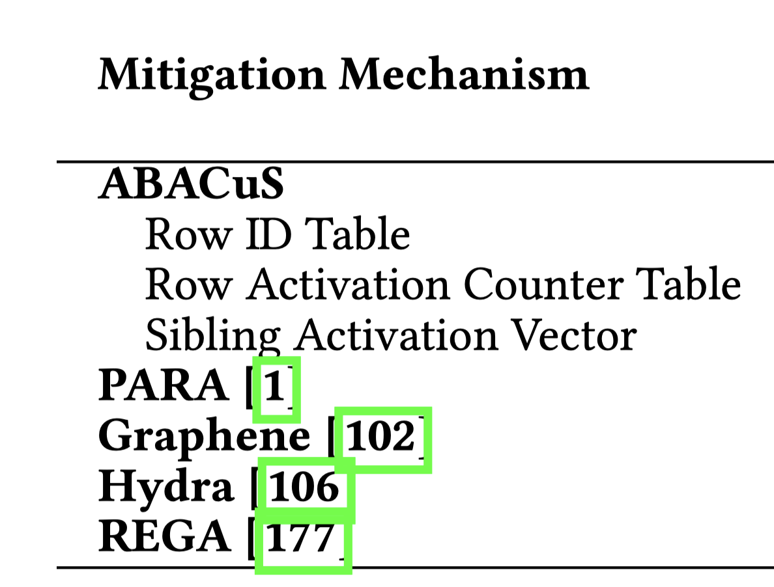
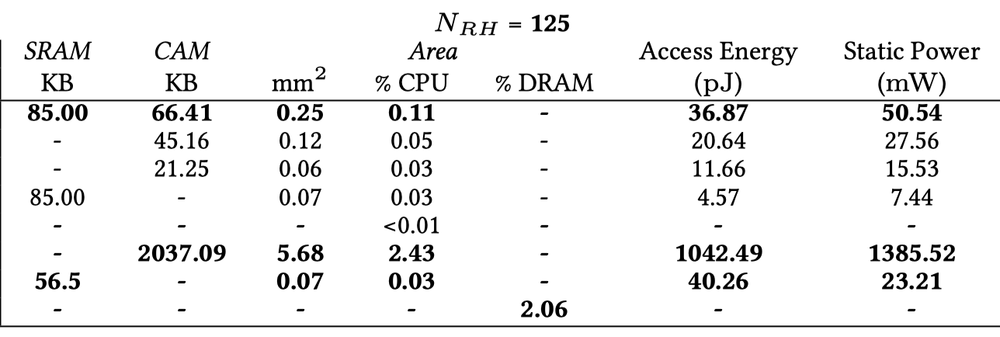
Area, Energy, and Power

Slide 44
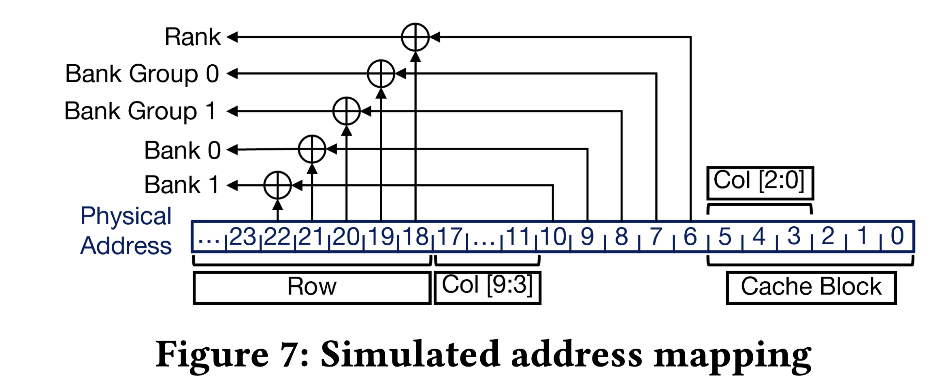
DRAM Address Mapping Function

Slide 45
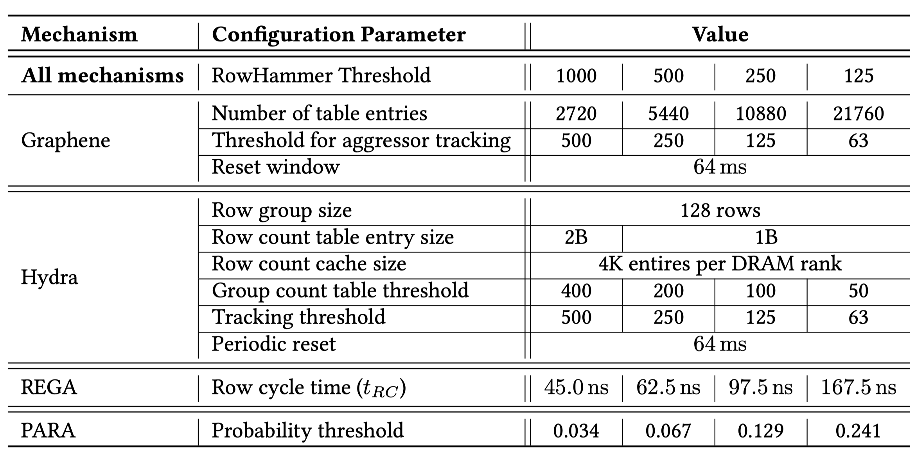
Key Configuration Parameters of RowHammer Mitigations

Slide 46
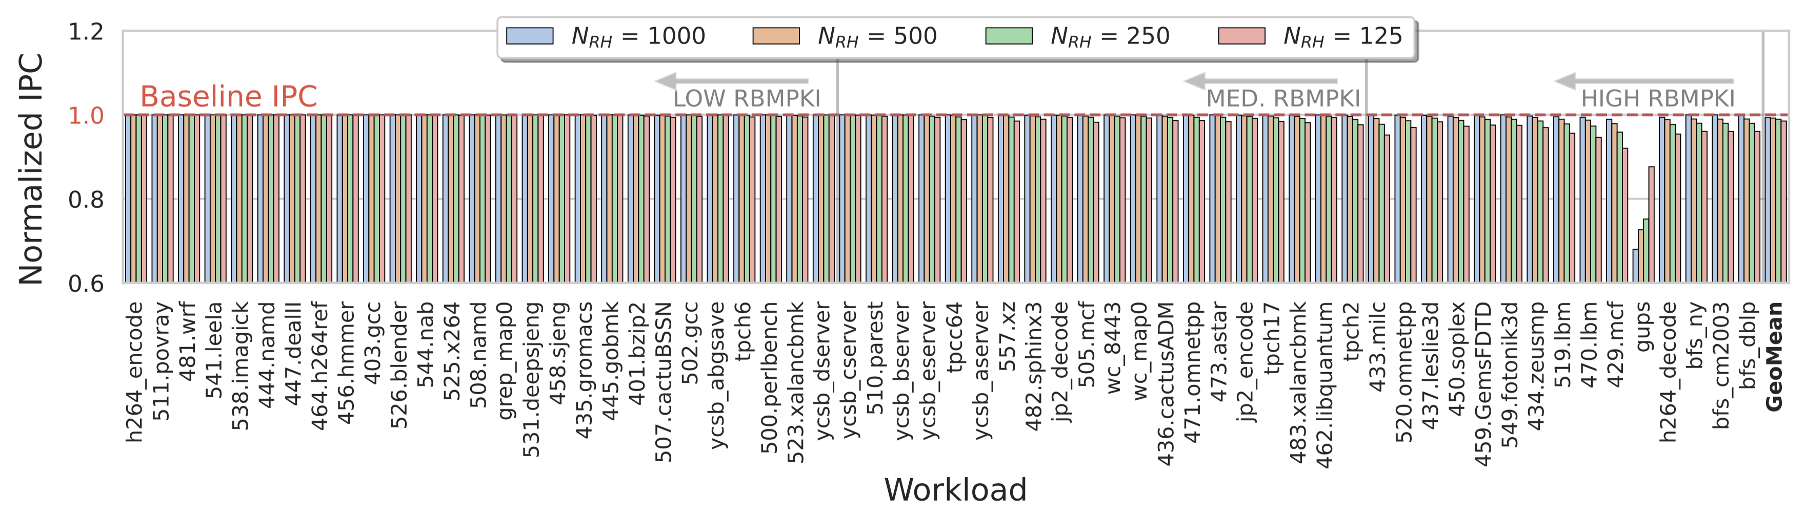
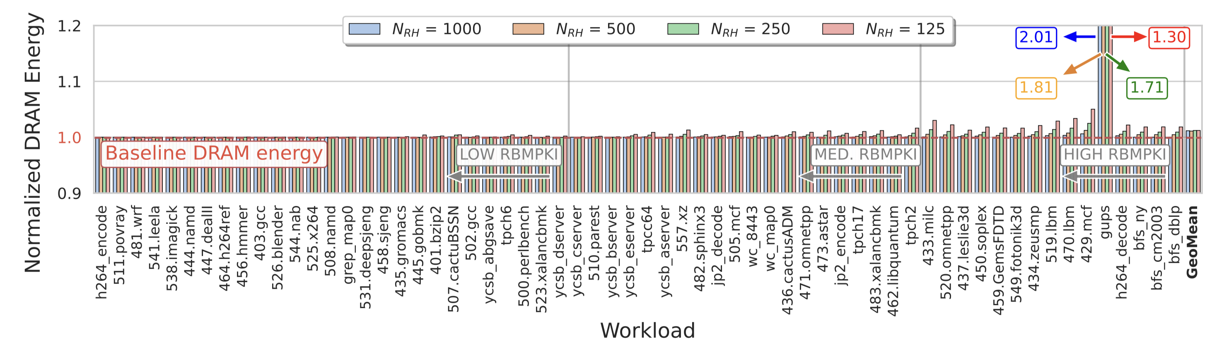
Single Core Performance and DRAM Energy
Notes:
0.6% to 1.5% average performance overhead as RowHammer threshold reduces from 1000 to 125.
Similar observations for DRAM energy.

Slide 47
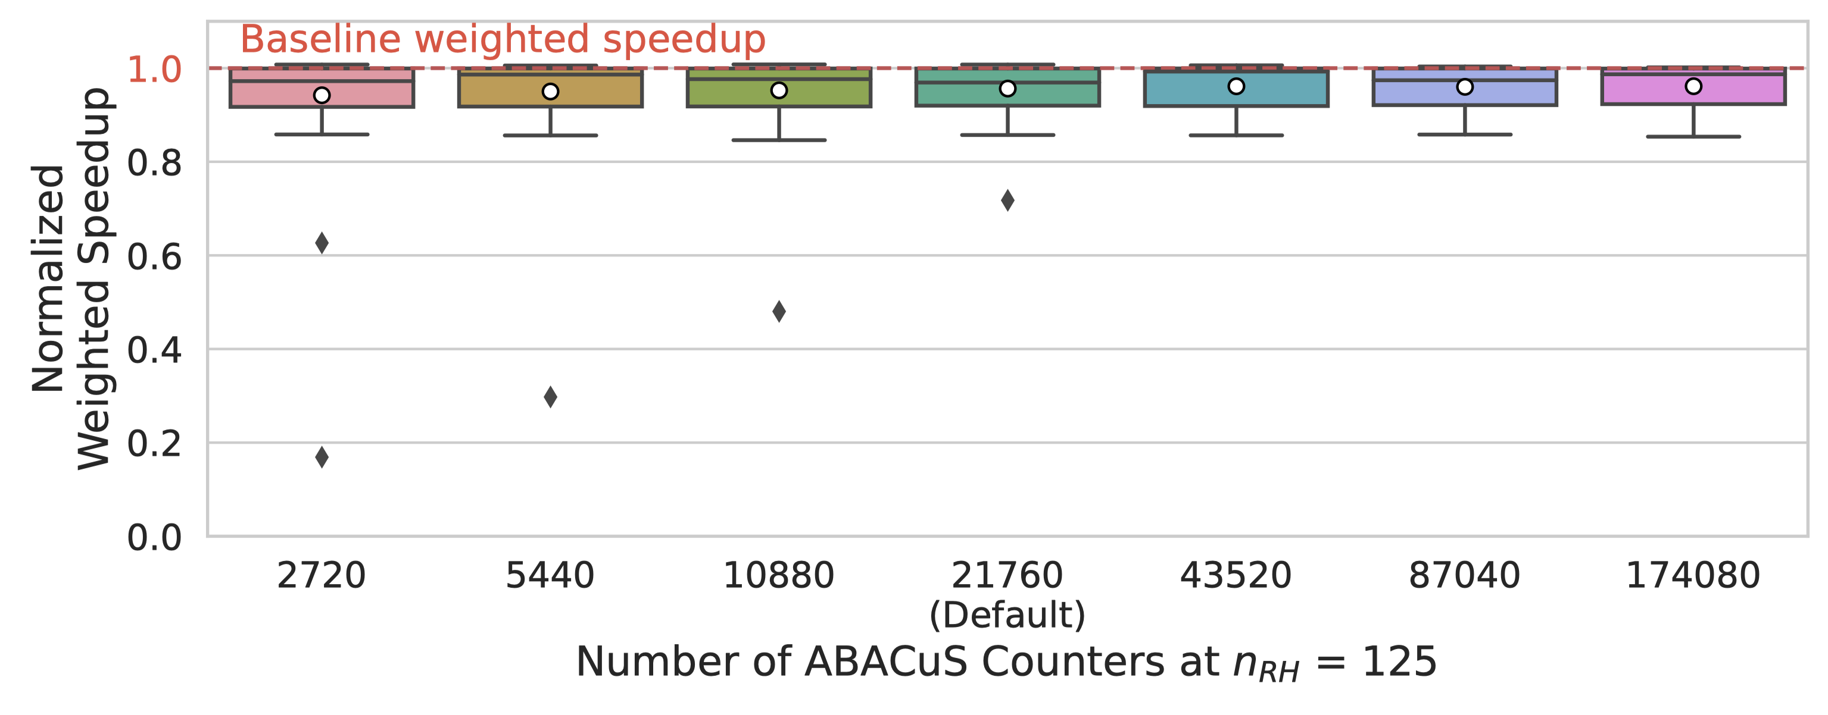
Sensitivity to
Number of ABACuS Counters
Notes:
Implementing fewer than the default number of entries marginally increases the average slowdown and significantly increases the maximum slowdown (across all workloads)
Implementing more counters reduces overheads. Increasing counters beyond 43520 provides diminishing returns.
62 8-core workloads

Slide 48
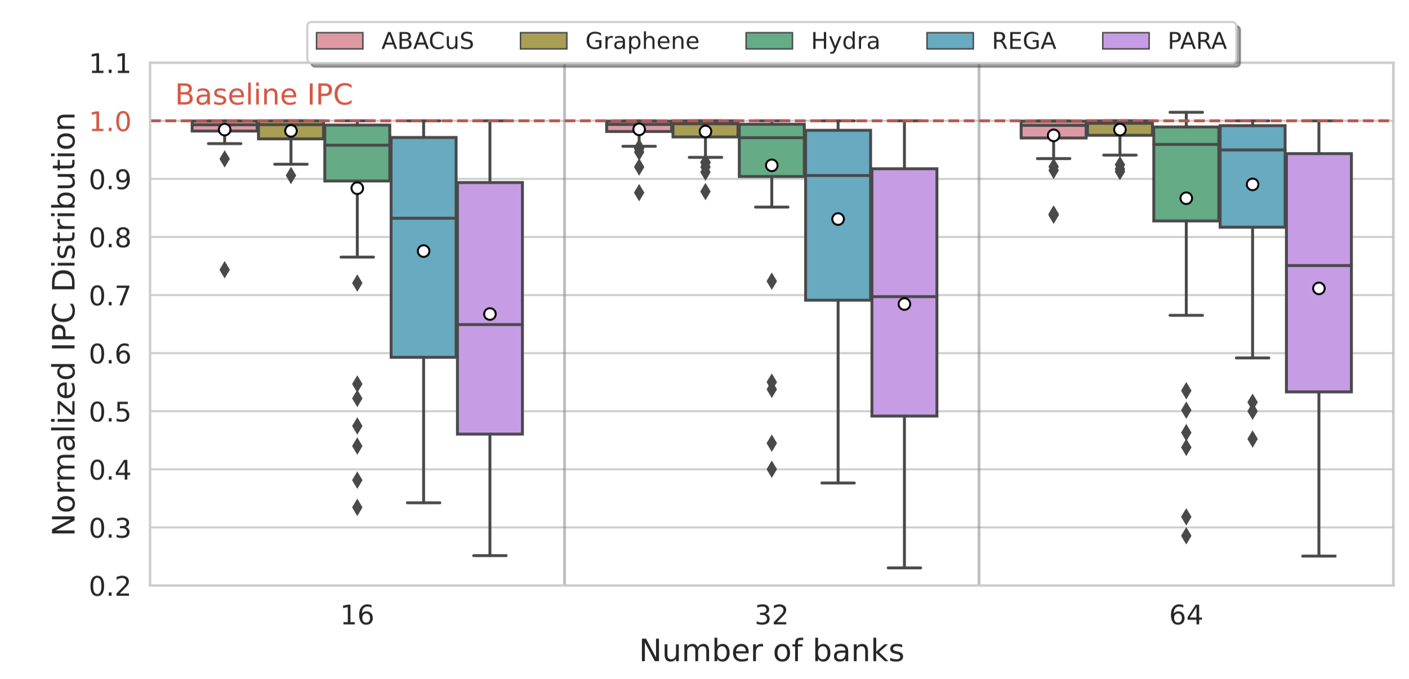
Sensitivity to Number of Banks
Notes:
ABACuS’s performance does not strongly correlate with the number of banks: Average overhead decreases as number of banks goes from 16 to 32, and then increases as the number of banks goes from 32 to 64.
The explanation of this observation has to do with workload access patterns changing in a way that reduces the number of preventive refresh operations.
ABACuS outperforms all mechanisms at number of banks = 16 and 32, it outperforms all but Graphene for # of banks = 64 (on average).
62 single core workloads

Slide 49
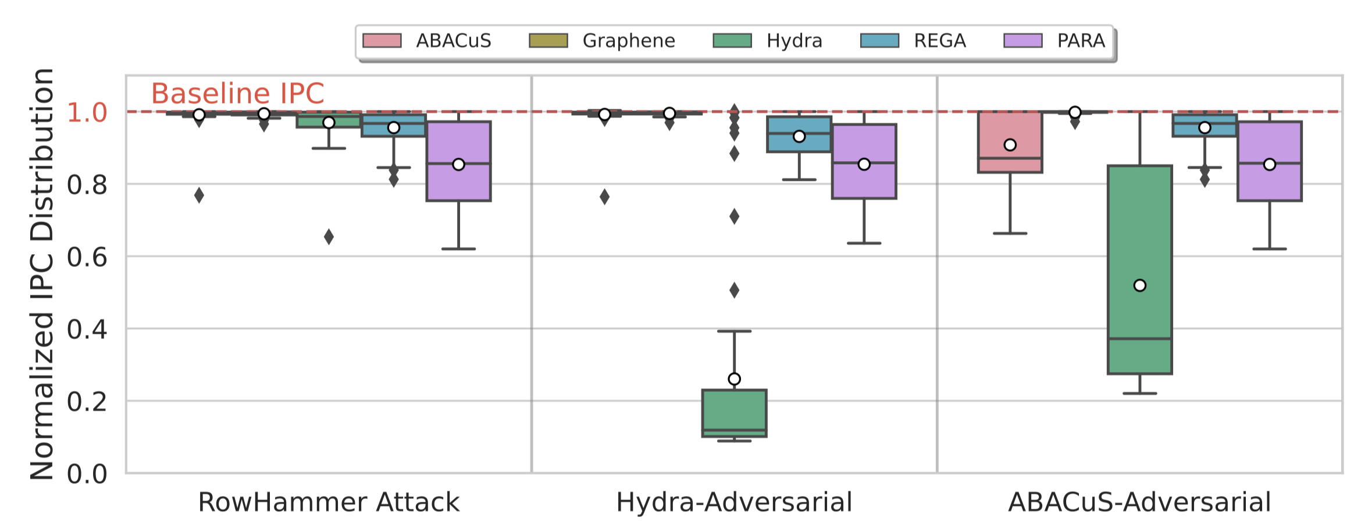
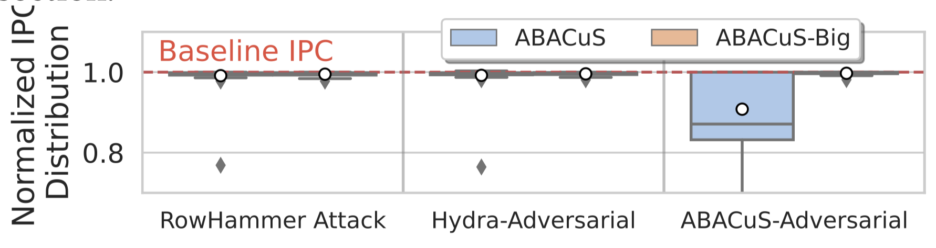
Performance Under Adversarial Workloads
Notes:
1 core executes adversarial attack on x-axis, other core executes one of the 62 workloads. NRH = 500.
9.20% performance overhead for ABACuS-Adversarial. [CLICK] If you have one counter per row (in all banks), this attack induces no additional overhead.

Slide 50
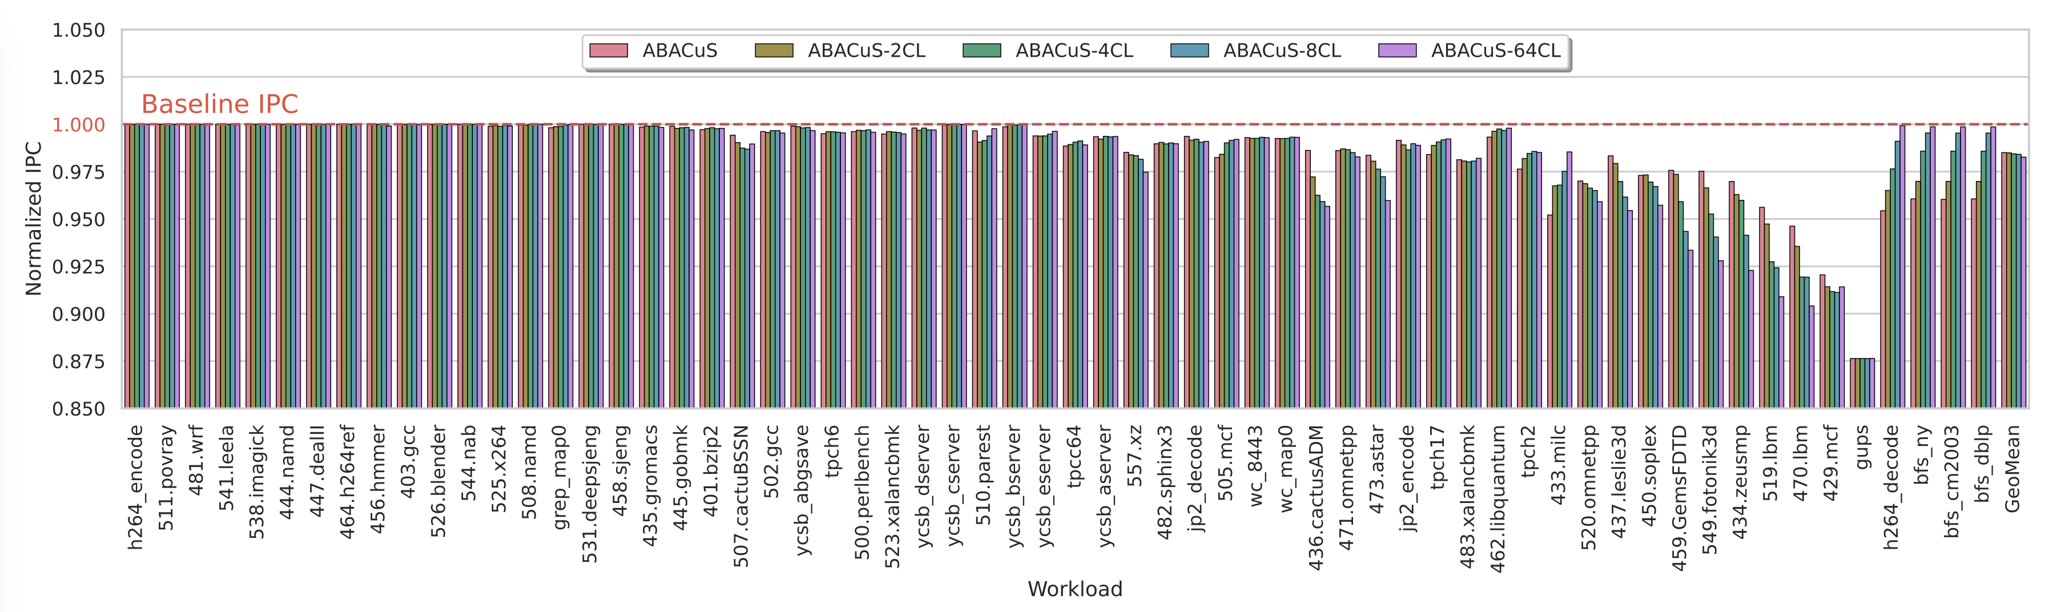
Sensitivity to Address Mapping
Notes:
Tested address mappings that differ by the number of cache lines they put in a row before switching to another bank. E.g., 2CL maps 2 consecutive cache blocks into the same row.
On average across all workloads, address mappings do not affect performance significantly.
However, no best address mapping that maximizes ABACuS’s performance across all workloads.

Slide 51
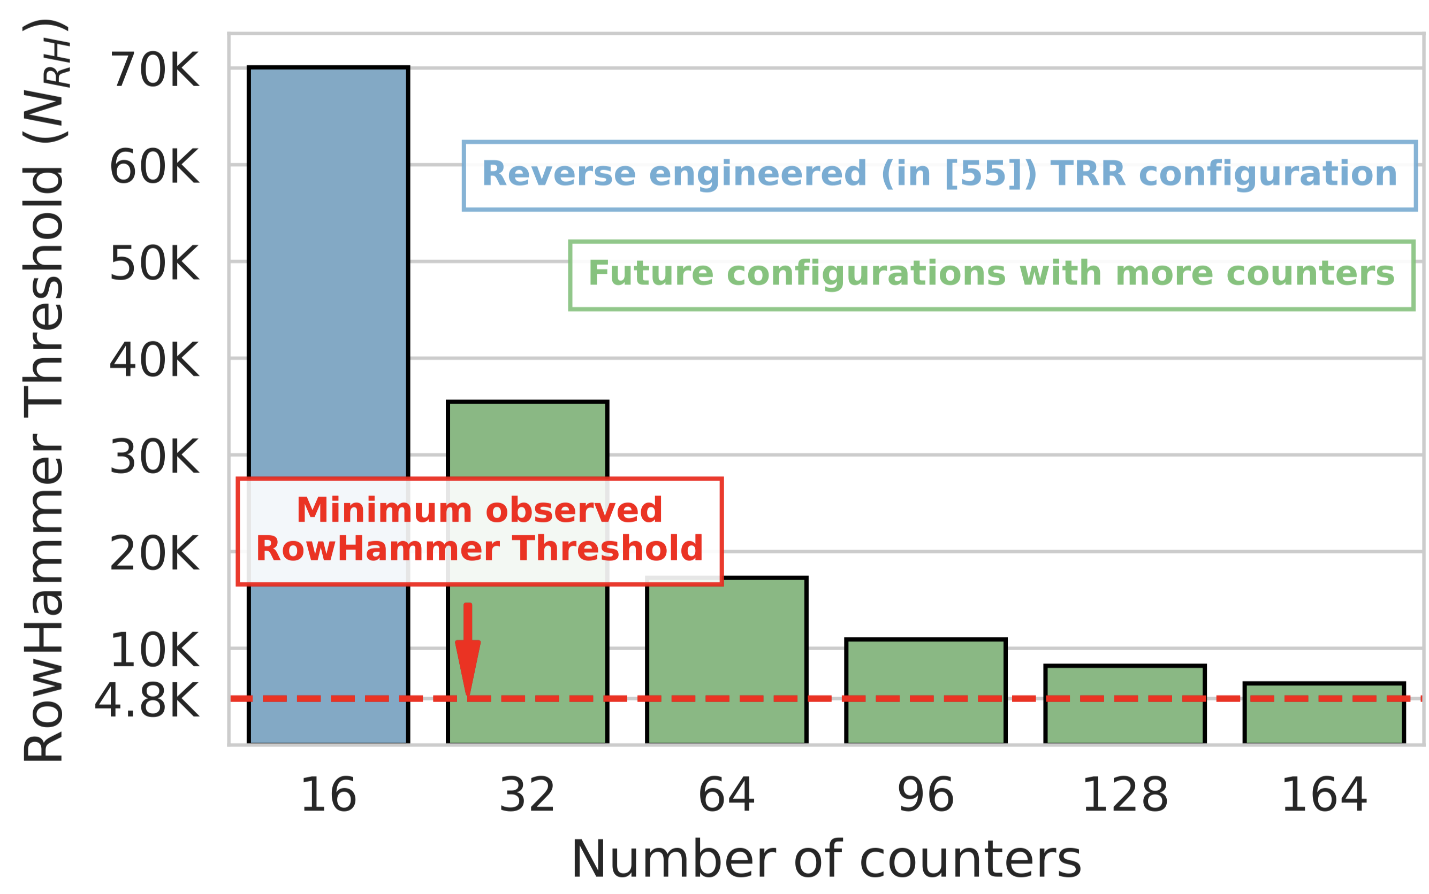
Limitations of Target Row Refresh
Notes:
Target Row Refresh (TRR) is a proprietary RowHammer mitigation introduced in DDR4. No one exactly knows what TRR is but some works reverse engineer its implementations in DDR4 chips. Based on the reverse engineered version, this is what we had come up with to show the lowest threshold values supported by the reverse engineered TRR mechanism.
Short story is the minimum observed RH threshold, which was 4.8K back then, is way below the minimum RH threshold supported by a future configuration of the reverse engineered TRR.

Slide 52
Applicability to Other Mitigations
Many workloads access the same row address
in different banks at around the same time
This observation can be leveraged by many other RowHammer mitigations
  Hydra, Graphene (what we showcase),
  Per Row Activation Counting (PRAC),
  ProTRR, …

Slide 53
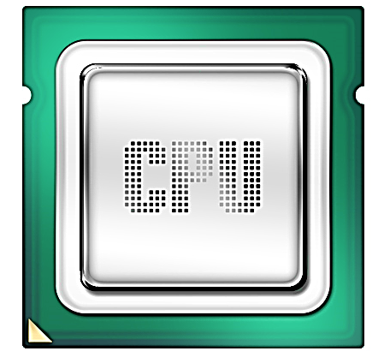
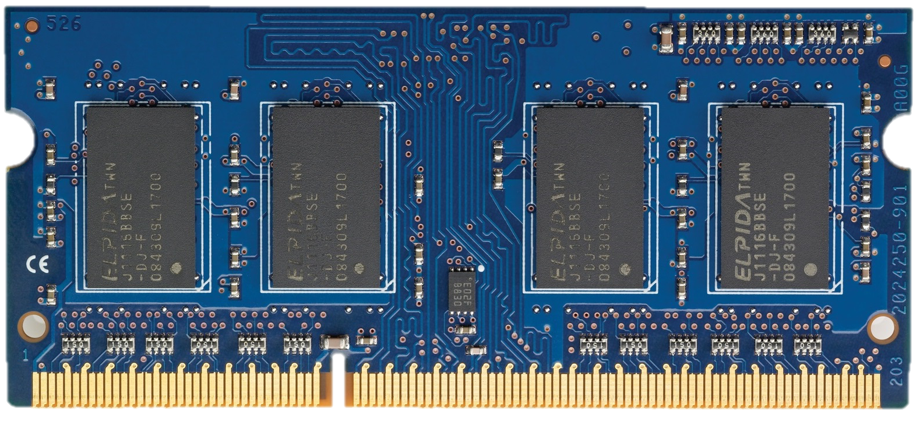
Industry Solutions to Read Disturbance:
Per Row Activation Counting (PRAC)
RFM
Back-Off
ACT
Row Counters
0
Back-Off Threshold
0
1
2
3
4
0
0
normal traffic
(180 ns)
recovery
(N RFMs)
PRAC-N
ACT
ACT
ACT
ACT
RFM
RFM
DRAM Commands
[Canpolat+, DRAMSec 2024]

Slide 54
PRAC is NOT the Silver Bullet
Goal: Rigorously analyze and characterize the security and performance implications of the DDR5 standard PRAC mechanism
Mathematical analysis & extensive simulations show that PRAC:
provides security as long as no bitflip occurs below 10 activations
has non-negligible performance (10%) and energy (18%) overheads
poorly scales for future DRAM chips, leading to significant overheads on performance (49%) and energy (136%)
allows memory performance attacks to hog significant amount of DRAM throughput (up to 79% throughput loss)
Future work: More research is needed to improve PRAC by
reducing the overheads due to increased DRAM timing parameters
solving the exacerbated performance impact as N_{RH} decreases
stopping preventive refreshes from being exploited by memory performance attacks
[Canpolat+, DRAMSec 2024]

