Slide 1



AgileWatts
An Energy-Efficient CPU Core Idle-State Architecture for Latency-Sensitive Server Applications
Jawad Haj-Yahya⁴
Haris Volos² Davide B. Bartolini¹ Georgia Antoniou²
Jeremie S. Kim³ Zhe Wang¹ Kleovoulos Kalaitzidis¹ Tom Rollet¹
Zhirui Chen¹ Ye Geng¹ Onur Mutlu³ Yiannakis Sazeides²
¹
²
³
⁴
Notes:
Thanks for the introduction.
Good morning, everyone.
I will present our work AgileWatts. This work focuses on improving Core Idle Power States,
In the next talk, Georgia will present our additional work
that improves System Level Idle Power states [END]

Slide 2
Motivation
Baseline = only C1 is enabled
The load of user-facing applications is unpredictable and bursty
  with microsecond-scale idleness – as known as the “Killer microseconds” idleness
This load behavior prevents CPU cores from entering deep idle states during idle periods, limiting power savings when the CPU core is idle
  A CPU core running Memcached never enters Deep idle state when running at ≥20% load
Idle states transition times can increase tail latency significantly
  The tail latency of Memcached increases by up to 37% when enabling Medium and Deep idle states
Notes:
[CLICK]
The load of user-facing applications is unpredictable and bursty with microsecond-scale idleness –
as known as the “Killer microseconds” idleness [CLICK]
This load behavior prevents CPU cores from entering deep idle states during idle periods,
limiting power savings when the CPU core is idle [CLICK]
A CPU core running Memcached never enters Deep idle state when running at 20% or higher load [CLICK]
Idle states transition times can increase tail latency significantly [CLICK]
The tail latency of Memcached increases by up to 37% when enabling Medium and Deep idle states [END]

Slide 3
Our Goal
~130us
~1.4W
~0.9W
HW Transition
Latency (us)
Power (W)
~8us
~0.1W
~0.3W
~0.01us
~0.1us
Shallow
Medium
Deep
Deep
& Agile
Shallow
Medium
Deep
Deep
& Agile
To eliminate the killer microseconds effect that prevent servers running latency critical application from entering deep energy saving states, we propose AgileWatts:
  A Deep & Agile low power state with
  Nanosecond-scale transition latency
We design AgileWatts with two design goals in mind:
  Drastically reducing the transition latency of deep core idle power states, making deep C-states usable
  Retaining most of the power savings of deep idle states
Notes:
[CLICK]
To eliminate the killer microseconds effect that prevent servers running latency critical application from entering deep energy saving states, we propose AgileWatts: [CLICK]
A Deep and Agile low power state [CLICK]
With Nanosecond-scale transition latency [CLICK]
We design AgileWatts with two design goals in mind: [CLICK]
Drastically reducing the transition latency of deep core idle power states, making deep C-states usable [CLICK]
And Retaining most of the power savings of deep idle states [END]

Slide 4
Core Idle Power State – Core C-states
Core C-states are power saving states enable the core to reduce its power consumption during idle periods
Intel’s Skylake architecture offers four main Core C-state:
  C0 - Active
  C1 – Shallow
  C1E – Medium
  C6 - Deep
Notes:
[CLICK]
Core C-states are power saving states enable the core to reduce its power consumption during idle periods [CLICK]
Intel’s Skylake architecture offers four main Core C-state:
C0
C1
C1E
C6 [END]

Slide 5
C0 (Active) Core C-state
Voltage
Clock Generator
Voltage Regulator
Voltage Level
C-State | Clocks | ADPLL | L1/L2 Cache | Voltage | Context
C0 | Running | On | Coherent | Nominal | Maintained
Notes:
The die photo shows an Intel Skylake server core tile.
The CPU core area is bordered with gray [CLICK]
The table shows core components’ states in core C-states [CLICK]
In C0 C-state - The All-Digital PLL clock generator is On [CLICK]
The Clocks are running [CLICK]
L1/L2 caches are coherence [CLICK]
And Voltage level is nominal [END]

Slide 6
C1 (Shallow) Core C-states
Voltage
C-State | Clocks | ADPLL | L1/L2 Cache | Voltage | Context
C1 | Most Stopped | On | Coherent | Nominal | Maintained
Notes:
In C1 C-state, most of the clocks are stopped [END]

Slide 7
C1E (Medium) Core C-state
Voltage
Transition to Minimum Voltage/
Frequency
C-State | Clocks | ADPLL | L1/L2 Cache | Voltage | Context
C1E | Most Stopped | On | Coherent | Min V/F | Maintained
Notes:
C1E C-state in similar to C1 while the voltage and frequency is reduced to minimum [END]

Slide 8
C6 (Deep) Core C-state
Voltage
Flush L1/L2
Caches
C-State | Clocks | ADPLL | L1/L2 Cache | Voltage | Context
C6 | Running | On | Flushed | Nominal | Maintained
Notes:
In C6 C-state, the L1 and L2 are flushed [END]

Slide 9
C6 (Deep) Core C-state
Voltage
Save Core’s
Context to
S/R SRAM
Save/
Restore SRAM
C-State | Clocks | ADPLL | L1/L2 Cache | Voltage | Context
C6 | Running | On | Flushed | Nominal | S/R SRAM
Notes:
Then, the core context is saved to an external save/restore SRAM [END]

Slide 10
C6 (Deep) Core C-state
Voltage
Turn-off the clocks and PLL
Save/
Restore SRAM
C-State | Clocks | ADPLL | L1/L2 Cache | Voltage | Context
C6 | Stopped | off | Flushed | Nominal | S/R SRAM
Notes:
Next, the clocks and PLL are turned off [END]

Slide 11
C6 (Deep) Core C-state
Voltage
Turn-off the voltage
Save/
Restore SRAM
C-State | Clocks | ADPLL | L1/L2 Cache | Voltage | Context
C6 | Stopped | off | Flushed | Shut-off | S/R SRAM
Notes:
And finally, the voltage is also turned-off [END]

Slide 12
C-states Power/Latency Tradeoff
~130us
~1.4W
~0.9W
HW Transition
Latency (us)
Power (W)
~8us
~0.1W
~0.3W
~0.01us
~0.1us
C1
C1E
C6
C6A
C1
C1E
C6
C6A
C-states provide power and performance tradeoff
The higher the C-state number
  The lower its power consumption
  But the longer the transition latency
During a C-state transition a core cannot be utilized
  Degrading the performance of latency-sensitive applications
AgileWatts tackles this problem with C6A (C6 Agile) C-state
  Deep idle C-state with a nanosecond-scale transition latency
Notes:
[CLICK]
C-states provide power and performance tradeoff [CLICK]
The higher the C-state number [CLICK]
The lower its power consumption [CLICK]
But the longer the transition latency [CLICK]
During a C-state transition a core cannot be utilized,
Degrading the performance of latency-sensitive applications [CLICK]
AgileWatts tackles this problem with C6A C-state
Deep idle C-state with a nanosecond-scale transition latency [END]

Slide 13
AgileWatts
We achieve AgileWatts goals with three key components:
  Units Fast Power-Gating
  Cache Coherence and Sleep Mode
  C6A Power Management Flow
Notes:
[CLICK]
We achieve AgileWatts goals with three key components: [CLICK]
Units Fast Power-Gating [CLICK]
Cache Coherence and Sleep Mode [CLICK]
And C6A Power Management Flow [END]

Slide 14
C6A (Deep & Agile) Core C-state
Voltage
C-State | Clocks | ADPLL | L1/L2 Cache | Voltage | Context
C6A | Running | On | Coherent | Nominal | Maintained
Notes:
We perform the following steps to achieve C6A [CLICK]

Slide 15
C6A (Deep & Agile) Core C-state
Voltage
Clock-gate most of the clock and keep the PLL On
C-State | Clocks | ADPLL | L1/L2 Cache | Voltage | Context
C6A | Most Stopped | On | Coherent | Nominal | Maintained
Notes:
C6A clock-gates most of the clocks and keeps the PLL On [CLICK]

Slide 16
C6A (Deep & Agile) Core C-state
Voltage
Power-gates most of the core units
Retaining the context in place
C-State | Clocks | ADPLL | L1/L2 Cache | Voltage | Context
C6A | Most Stopped | On | Coherent | Most PG | Maintained
Notes:
Next, it Power-gates most of the core units [CLICK]
And Retains the core context in place [END]

Slide 17
C6A (Deep & Agile) Core C-state
Voltage
Reduce the caches supply voltage using sleep transistors
Retain a logic active to wake-up the caches to respond to snoop requests
C-State | Clocks | ADPLL | L1/L2 Cache | Voltage | Context
C6A | Most Stopped | On | Coherent | PG/Ret/Nom | Maintained
Notes:
It reduces the caches supply voltage using sleep transistors [CLICK]
And retains a logic active to wake-up the caches to respond to snoop requests [END]

Slide 18
Evaluation Methodology
Power and Performance Model: to evaluate AgileWatts, we use an accurate analytical power model, calibrated against an Intel Skylake server and considering the performance penalty
Power and C-state Residency Measurements: We measure C-state residency and number of transitions using processor’s residency reporting counters
  We use the RAPL interface to measure power consumption
Workloads: We evaluate AgileWatts using three latency-critical workloads: Memcached, Apache Kafka, and MySQL
Notes:
[CLICK] to evaluate AgileWatts, we use an accurate analytical power model, calibrated against an Intel Skylake server and considering the performance penalty [CLICK]
We measure C-state residency and number of transitions using processor’s residency reporting counters.
We use the RAPL interface to measure power consumption [CLICK]
We evaluate AgileWatts using three latency-critical workloads: Memcached, Apache Kafka, and MySQL [CLICK]

Slide 19
Power Savings and Overhead at Varying Load Levels
AgileWatts reduces the average power consumption by up to 38% at low load
  At high load, AgileWatts still provides 10% power savings
AgileWatts has less than 1.3% impact on tail latency (server side)
Notes:
[CLICK]
AgileWatts reduces the average power consumption by up to 38% at low load
At high load, AgileWatts still provides 10% power savings [CLICK]
AgileWatts has less than 1.3 percent impact on tail latency [END]

Slide 20
Commonly used Configurations
Server vendors provide recommended system configurations, such as disabling certain C-states to increase system performance or disabling Turbo Boost to reduce power consumption
We analyze three common configurations that successively disable Turbo, C6, and C1E in the baseline configuration (P-states disabled and Turbo and C-states enabled)
  Turbo disabled (NT_Baseline),
  Turbo and C6 disabled (NT_No_C6), and
  Turbo, C6 and C1E disabled (NT_No_C6,No_C1E)
Notes:
[CLICK]
Server vendors provide recommended system configurations, such as disabling certain C-states to increase system performance
or disabling Turbo Boost to reduce power consumption [CLICK]
We analyze three common configurations that successively disable Turbo, C6, and C1E in the baseline configuration.
So, we analyze:
Turbo disabled,
Turbo and C6 disabled, and
Turbo, C6 and C1E disabled [CLICK] [END]

Slide 21
Commonly used Configurations
AgileWatts reduces average power consumption (AvgP) up to 71% against all three tuned configurations
The reason is that, in these workloads AgileWatts replaces the time that other configurations spend in C1 with C6A C-state, which has much lower power
Notes:
AgileWatts reduces average power consumption up to 71% against all three tuned configurations [CLICK]
The reason is that, in these workloads AgileWatts replaces the time that other configurations spend in C1 with C6A C-state, which has much lower power consumption[END]

Slide 22
Commonly used Configurations
AgileWatts improves the performance by up to 26.3% compared to NT_Baseline and NT_No_C6 configurations
AgileWatts only degrading the performance by up to 1% compared to NT_No_C6,No_C1E configuration
Notes:
[CLICK] AgileWatts improves the performance by up to 26.3% compared to NO_Turbo_Baseline and NO_Turbo_No_C6 configurations [CLICK]
AgileWatts only degrading the performance by up to 1% compared to No_Turbo_No_C6 and_No_C1E configuration [END]

Slide 23
Commonly used Configurations
AgileWatts provides average and tail latencies comparable
to the tuned configurations that disable some power
management features, while reducing power significantly
AgileWatts improves the performance by up to 26.3% compared to NT_Baseline and NT_No_C6
AgileWatts only degrading the performance by less than 1% compared to NT_No_C6,No_C1E
Notes:
AgileWatts provides average and tail latencies comparable to the tuned configurations that disable some power management features, while reducing power significantly

Slide 24
Other Details in the Paper
Implementation and hardware cost
Idle power analysis
C6A and C6AE latency
Performance penalty
Staggered unit wake-up
Design complexity and effort
Power savings and overhead at varying load levels
Analysis of turbo boost performance improvement
Notes:
There are other details in the paper [CLICK]

Slide 25
Conclusion
We introduced AgileWatts, a new deep C-state architecture that drastically reduces the transition latency, making deep C-states usable
We showed that AgileWatts architecture can be achieved by leveraging agile power management techniques while retaining most of the power savings of existing deep idle states
AgileWatts reduces the energy consumption of Memcached by up to 71% with up to 1% performance degradation
AgileWatts is an effective approach to improving energy consumption of servers running latency-critical applications by enabling the server’s processor to enter deep energy-saving states during short idle periods with negligible performance impact
We hope our work paves the way for improving the energy proportional of datacenter servers
Notes:
Let me conclude my talk
[CLICK]
We introduced AgileWatts, a new deep C-state architecture that drastically reduces the transition latency, making deep C-states usable [CLICK]
We showed that AgileWatts architecture can be achieved by leveraging agile power management techniques while retaining most of the power savings of existing deep idle states [CLICK]
AgileWatts reduces the energy consumption of Memcached by up to 71%
with up to 1% performance degradation [CLICK]
AgileWatts is an effective approach to improving energy consumption of servers running latency-critical applications by enabling the server’s processor to enter deep energy-saving states during short idle periods with negligible performance impact [CLICK]
We hope our work paves the way for improving the energy proportional of datacenter servers [END]

Slide 26
AgileWatts
An Energy-Efficient CPU Core Idle-State Architecture for Latency-Sensitive Server Applications
Jawad Haj-Yahya⁴
Haris Volos² Davide B. Bartolini¹ Georgia Antoniou²
Jeremie S. Kim³ Zhe Wang¹ Kleovoulos Kalaitzidis¹ Tom Rollet¹
Zhirui Chen¹ Ye Geng¹ Onur Mutlu³ Yiannakis Sazeides²
¹
²
³
⁴
Notes:
Thanks for your attention. I will be happy to take questions [END]

Slide 27
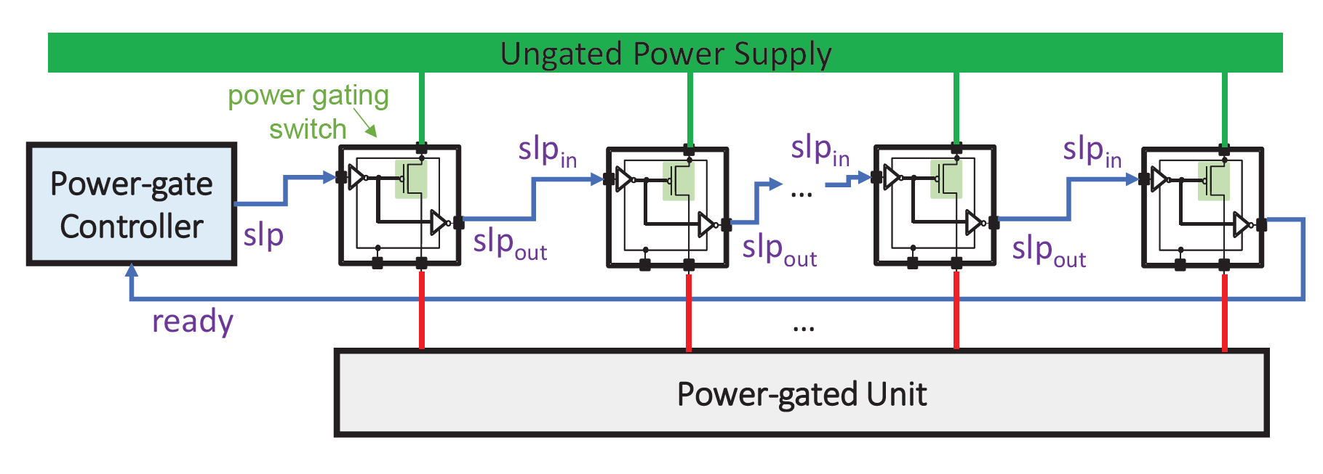
Power-gating
Power-gating is a technique that is used to eliminate leakage of idle circuits
Typically, the wake-up latency from a power-gated state requires a few to tens of cycles
To reduce the worst-case peak in-rush current when waking up a power-gate:
  A power-gate controller uses a staggered wake-up technique (shown in the figure)
  It turns on different power-gate switch cells in stages to limit the current spike
  To do so, the slp_{in} and slp_{out} of the switch cells are daisy-chained
  The controller issues a signal to the first slp_{in}, and it receives an acknowledgement (ready) from the last slp_{out} , indicating that the power-gate is fully conducting
Modern processors implement the staggering technique
  The Intel Skylake core staggers the wake up of the AVX power-gates over 15ns
Notes:
A high-end client processor is a system-on-chip that typically integrates three main domains into a single chip:
Compute (e.g., CPU cores and graphics engines)
IO
Memory system [CLICK]
We show the architecture used in recent Intel processors with a focus on CPU cores
Each CPU core has a power-gate for the entire core [CLICK]
Package layout showing
An ungated main voltage domain (V_{CU})
Four power-gated voltage domains (one for each CPU core, V_{C0G}, V_{C1G}, V_{C2G}, and V_{C3G}) [CLICK]
Side view of die and package showing
The ungated main voltage domain (VCU) and two cores’ voltage domains (V_{C0G} and V_{C1G})
The package’s decoupling capacitors [END]

Slide 28
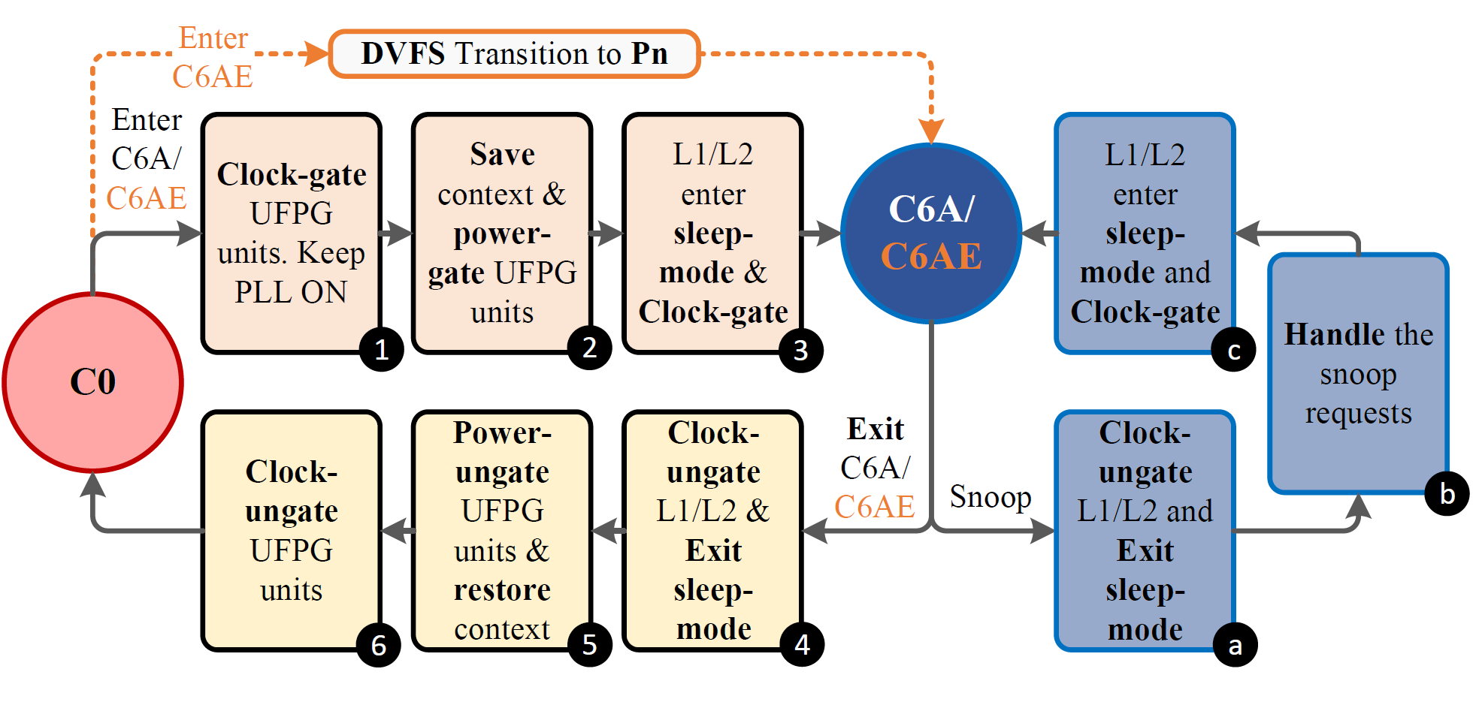
3. C6A Power Management Flow
AgileWatts flow orchestrates the transitioning between the C0 and C6A C-states and handles coherence traffic while in C6A state
The entry flow:
  Clock-gates the gated-domain (UFPG) and keeps the core phase-locked loop (PLL) powered-on
  When entering C6AE (C6A Enhanced), it initiates a non-blocking transition to Pn – the P-state with lowest frequency and voltage
  Saves (in place) the gated-domain’s context and shuts down its power
  Sets the private caches into sleep mode and shuts down their clock
When a snoop request arrives, the flow:
  Clock-ungates the private cache domain and contextually adjusts its supply voltage to exit sleep mode
  When all outstanding snoop requests are serviced, the flow rolls back the changes in reverse order and brings the core back into full C6A (or C6AE) state
Notes:
Intel desktop processors that are prior to Skylake (e.g., Haswell, Broadwell) support up to the package C7 state [CLICK]
Desktop’s energy efficiency benchmarks (ENERGY STAR & Intel Ready Mode Technology)
Have large phases in which the processor is fully idle
Their average power consumption needs can be met with package C7 state [CLICK]
The power consumption of package C7 is ~3× higher in DarkGates than in the baseline due to the additional cores leakage power
Since the voltage regulator is turned on in package C7 state and the power-gates are bypassed [CLICK]
To mitigate this issue, we extend the desktop systems with the package C8 state
A deeper package C-state in which the voltage regulator of the CPU cores is off [END]

Slide 29
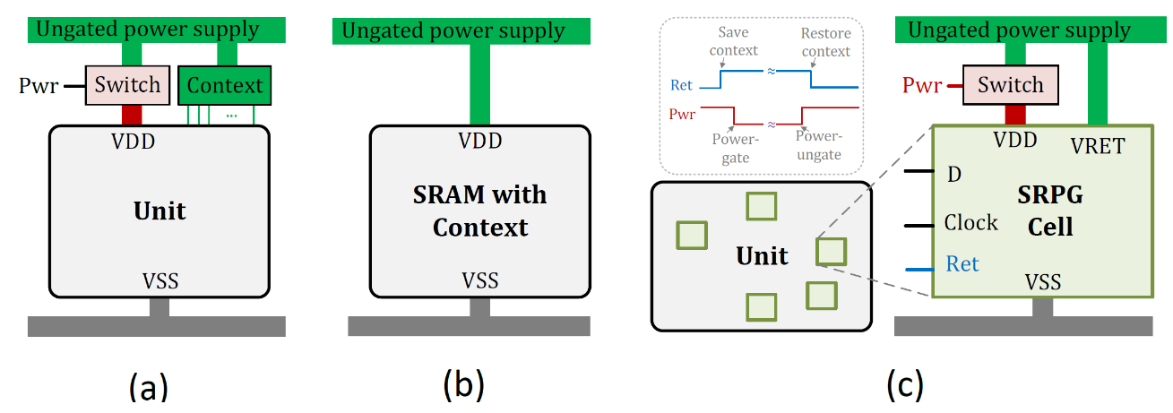
Retain the Context in Place
AgileWatts leverages three techniques to efficiently retain the context during C6A
  Placing Unit Context in the Ungated Domain
  Place SRAM Context in Ungated Power Supply
  State Retention Power Gates (SRPGs)
Notes:
Power-gate Bypassing technique is responsible for reducing CPU cores’ voltage drop in F_{max}-constrained systems by reducing system impedance [CLICK]
The technique uses the same Intel Skylake die to build: [CLICK]
A dedicated package for Skylake-H (high-end mobile) with the power-gates enabled and [CLICK]
A dedicated package for Skylake-S (high-end desktop) that bypasses the power-gates at the package level by shorting gated and un-gated CPU core power domains [CLICK]
This architecture is feasible since client processors typically share the same die between Skylake-H and Skylake-S [END]

Slide 30
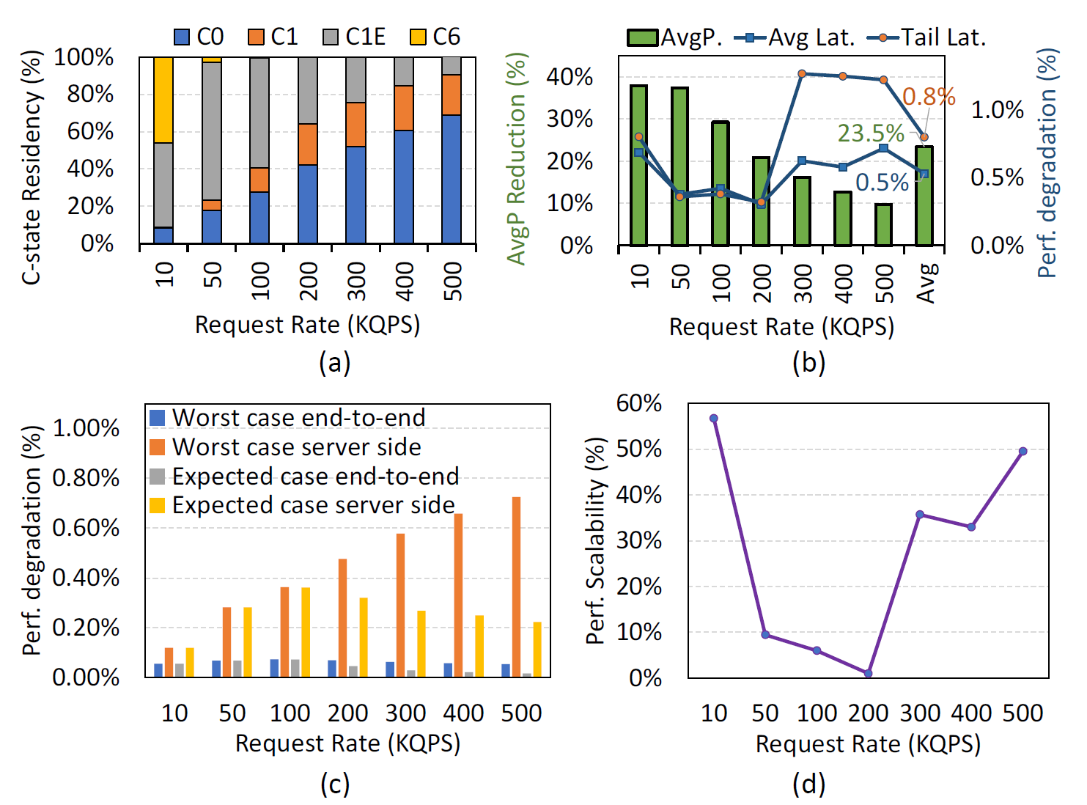
Power Savings and Overhead at Varying Load Levels
Further analyzes of AgileWatts impact on average response time is shown
We consider end-to-end (including network latency measured at 117us) and server-side response time for two cases:
  The worst case, where we assume a C-state transition for each query and
  the expected case, with the actual C-state transitions observed in the baseline
As expected, the gap between the worst and the expected case is larger at high load,
  since multiple queries are serviced within the same active period.
We observe that the degradation of the end-to-end response time (i.e., by client) is negligible because the (non-changing) network latency dominates the overall response time
Notes:
DarkGates improves real system performance by up to 8.1% (4.6% on average) [CLICK]
The performance benefit of DarkGates is positively correlated with the performance scalability of the running workload with CPU frequency [CLICK]
Highly-scalable workloads experience the highest performance gains
Workloads that are heavily bottlenecked by main memory, such as 410.bwaves and 433.milc, have almost no performance gain

Slide 31
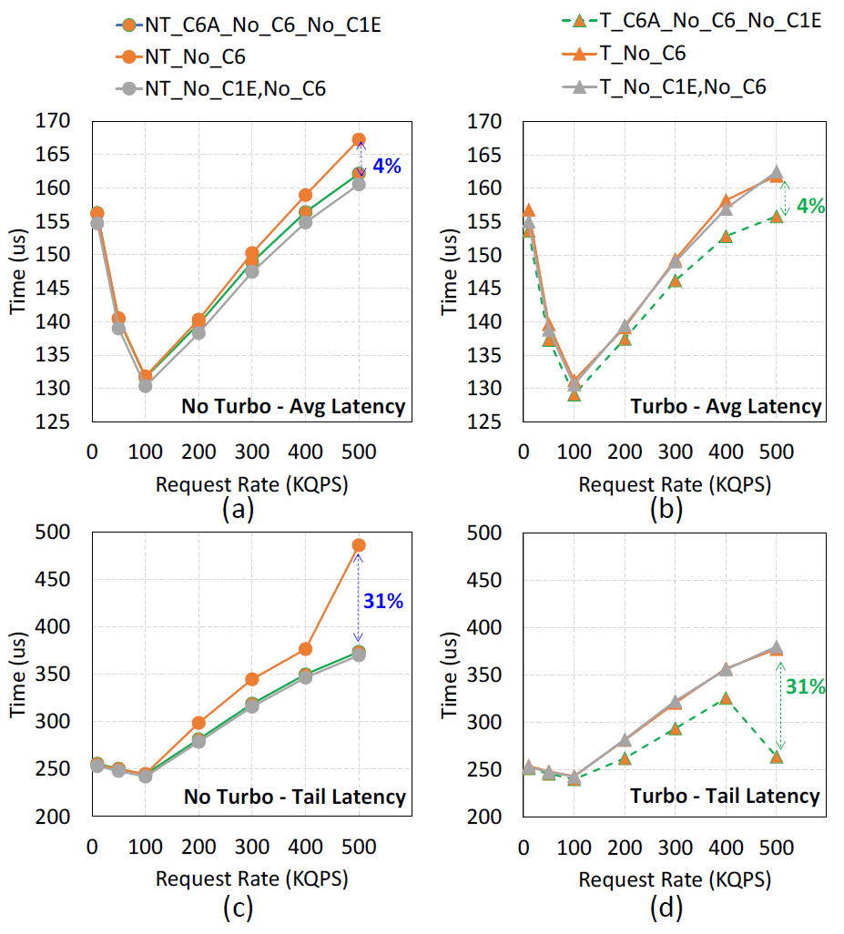
Analysis of Turbo Boost Performance Improvement
Average and tail latency at different request rates (QPS) for four configurations that show the effect of idle power state on Turbo performance:
  Turbo/No-Turbo & C6 disabled (T_No_C6/NT_No_C6),
  Turbo/No-Turbo & C6 & C1E disabled (T_No_C6,No_C1E/NT_No_C6,No_C1E), compared
With AgileWatts: Turbo/No-Turbo & C6A enabled & C6 & C1E disabled (T_C6A_No_C6_No_C1E/NT_C6A_No_C6_No_C1E)
Figures (a,c) show that the configuration with Turbo and C6 disabled (i.e., NT_No_C6) increases the average/tail latency performance by up to 4%/31% over the same configuration with C1E disabled (i.e., NT_No_C6,No_C1E)
Figures (c,d) show that enabling Turbo while disabling C1E (i.e., T_No_C6,No_C1E) does not improve performance over the same configuration with Turbo disabled (i.e., NT_No_C6,No_C1E)
Figures (b,d) show that with Turbo enabled, only disabling C6 (i.e., T_No_C6) has the same performance as additionally disabling C1E (i.e., T_No_C6,No_C1E)
  The reason is that in the T_No_C6 configuration, the transition overhead of C1E on average/tail latency offsets any thermal capacitance gains and ensuing performance gains from Turbo.
Notes:
ENERGY STAR and Intel Ready Mode Technology (RMT) efficiency workloads have fixed performance requirements and include long idle phases [CLICK]
DarkGates system reduces the average power consumption of ENERGY STAR and RMT by 33% and 68%, respectively, on the real Intel Skylake-S system
Compared to the baseline where we limit the deepest package C-state to C7 (DarkGates+C7) [CLICK]
The baseline system does not meet the target power limit for both workloads [CLICK]
The system without DarkGates at the deepest package C-state of C7 shows higher power reduction verses the system with DarkGates at the deepest package C-state of C8
When some of the cores are idle they consume leakage power in DarkGates+C8, but they are power-gated in Non-DarkGates+C7 [END]

Slide 32
Analysis of Turbo Boost Performance Improvement
Average and tail latency at different request rates (QPS) for four configurations that show the effect of idle power state on Turbo performance:
  Turbo/No-Turbo & C6 disabled (T_No_C6/NT_No_C6),
  Turbo/No-Turbo & C6 & C1E disabled (T_No_C6,No_C1E/NT_No_C6,No_C1E), compared
With AgileWatts: Turbo/No-Turbo & C6A enabled & C6 & C1E disabled (T_C6A_No_C6_No_C1E/NT_C6A_No_C6_No_C1E)
Figures (a,c) show that the configuration with Turbo and C6 disabled (i.e., NT_No_C6) increases the average/tail latency performance by up to 4%/31% over the same configuration with C1E disabled (i.e., NT_No_C6,No_C1E)
Figures (c,d) show that enabling Turbo while disabling C1E (i.e., T_No_C6,No_C1E) does not improve performance over the same configuration with Turbo disabled (i.e., NT_No_C6,No_C1E)
Figures (b,d) show that with Turbo enabled, only disabling C6 (i.e., T_No_C6) has the same performance as additionally disabling C1E (i.e., T_No_C6,No_C1E)
  The reason is that in the T_No_C6 configuration, the transition overhead of C1E on average/tail latency offsets any thermal capacitance gains and ensuing performance gains from Turbo.
In a configuration where both C6 and C1E are disabled while Turbo is enabled, AgileWatts can provide large performance benefits by enabling C6A instead of C1
Doing so provides larger thermal capacitance to Turbo compared to enabling C1E and reduces the long transition latency overhead of C6 and C1E C-states
Notes:
ENERGY STAR and Intel Ready Mode Technology (RMT) efficiency workloads have fixed performance requirements and include long idle phases [CLICK]
DarkGates system reduces the average power consumption of ENERGY STAR and RMT by 33% and 68%, respectively, on the real Intel Skylake-S system
Compared to the baseline where we limit the deepest package C-state to C7 (DarkGates+C7) [CLICK]
The baseline system does not meet the target power limit for both workloads [CLICK]
The system without DarkGates at the deepest package C-state of C7 shows higher power reduction verses the system with DarkGates at the deepest package C-state of C8
When some of the cores are idle they consume leakage power in DarkGates+C8, but they are power-gated in Non-DarkGates+C7 [END]

Slide 33
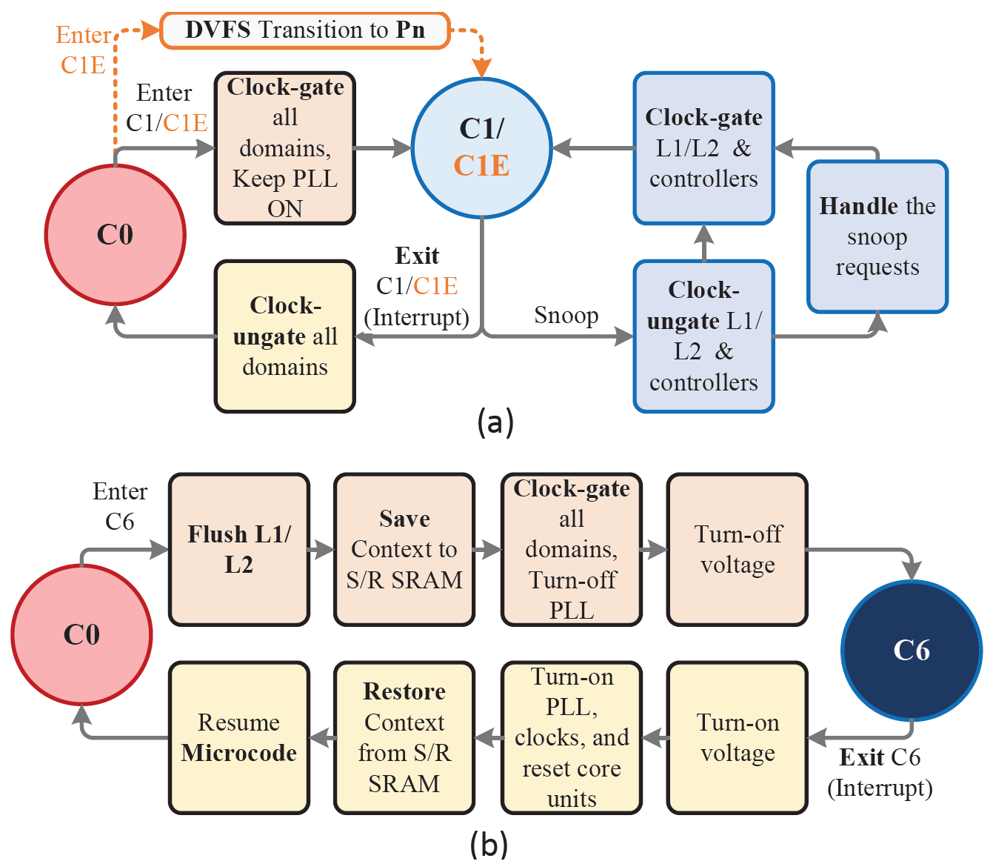
Core C6 C-state Entry and Exit Flow
C6 entry flushes privates caches, saves context, and turns off the PLL and voltage
  Entry latency is dominated by the L1/L2 cache flush
C6 exit is simply the reverse process of the entry flow
  Exit latency is dominated by the hardware wake-up and state restoration
Notes:
A high-end client processor is a system-on-chip that typically integrates three main domains into a single chip:
Compute (e.g., CPU cores and graphics engines)
IO
Memory system [CLICK]
We show the architecture used in recent Intel processors with a focus on CPU cores
Each CPU core has a power-gate for the entire core [CLICK]
Package layout showing
An ungated main voltage domain (V_{CU})
Four power-gated voltage domains (one for each CPU core, V_{C0G}, V_{C1G}, V_{C2G}, and V_{C3G}) [CLICK]
Side view of die and package showing
The ungated main voltage domain (VCU) and two cores’ voltage domains (V_{C0G} and V_{C1G})
The package’s decoupling capacitors [END]

Slide 34
Conclusion
Problem: the irregular request patterns and tight latency requirements of user-facing applications render ineffective existing energy-conserving techniques when the server processor is idle due to the long transition time from a deep idle power state
Goal: directly address the root cause of the inefficiency, namely the high transition latency, to mitigate the energy inefficiency of modern datacenter server processors
Mechanism: AgileWatts, a new deep C-state architecture that drastically reduces the transition latency by leveraging three key power management techniques
Uses medium-grained power-gates distributed across the core and maintains context in place
Keeps private caches (i.e., L1/L2) and minimal control logic for cache coherence power-ungated
Clock-gates the core components and clock distribution while keeping the clock generator on
Evaluation: we evaluate AgileWatts on the Intel Skylake server processor using variety of workloads, AgileWatts:
  Reduces the energy consumption of Memcached by up to 71% with up to 1% performance degradation
  Shows similar trends for other evaluated services such as MySQL and Kafka
  The new C-states, C6A is up to 900× faster than the deepest existing idle state C6
Conclusion: AgileWatts is an effective approach to improving energy consumption of servers running latency critical applications by enabling server’s processor to enter deep energy saving states during short idle periods with negligible performance impact
Notes:
First, I will give a high-level overview of the talk [CLICK]
Power-gates increase the system's power-delivery impedance and voltage guardband, limiting the system’s maximum attainable voltage and, thus, the CPU core’s maximum attainable frequency [CLICK]
Our goal is to mitigate the power-gates’ performance loss for systems that are performance constrained by the CPU frequency, such as high-end desktops [CLICK]
To this end we introduce DarkGates, a hybrid system architecture that is based on three key techniques [CLICK]
DarkGates Bypasses on-chip power-gates using package-level resources [CLICK]
Extends power management firmware to support operation in bypass- and normal-mode [CLICK]
Enables deeper idle power states [CLICK]
We implement DarkGates on the Intel Skylake microprocessor for client devices and evaluate it using a wide variety of workloads: [CLICK]
DarkGates Improves the average performance of SPEC CPU2006 workloads across all thermal design power levels by 4.2% to 5.3% on a real four-core Skylake system [CLICK]
Maintains the performance of 3DMark workloads for desktop systems with TDP greater than 45W. For a 35W-TDP desktop it experiences only a 2% degradation [CLICK]
Dark-Gates fulfills the requirements of the ENERGY STAR and the Intel Ready Mode energy efficiency benchmarks of desktop systems [CLICK]
We Conclude that DarkGates is an effective approach to improving energy consumption and performance demands across high-end heterogeneous client processors [END]

Slide 35
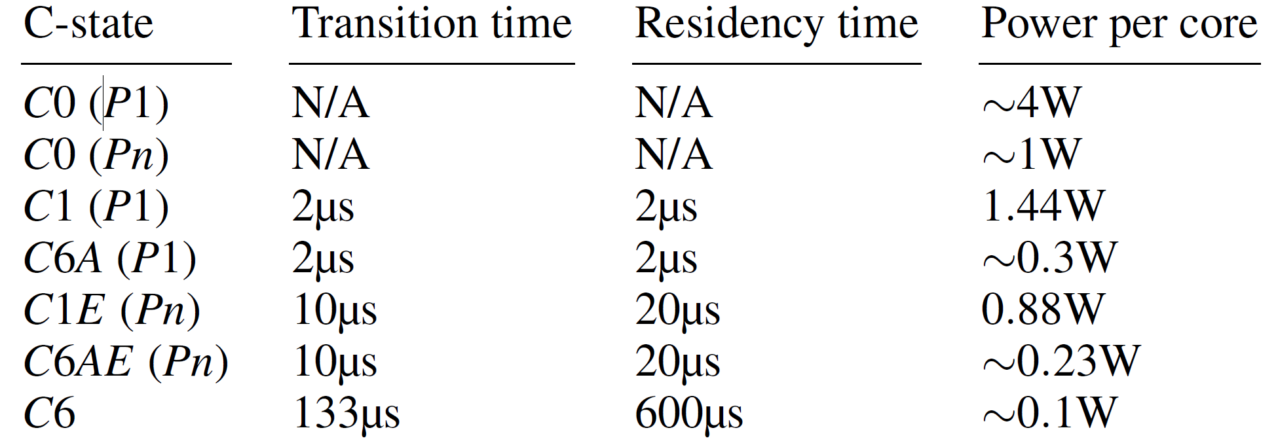
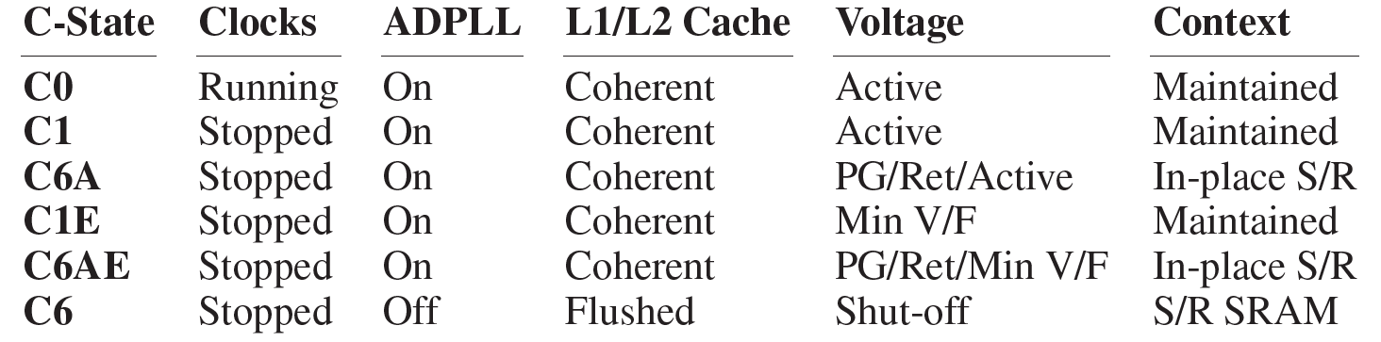
Core Idle Power State – Core C-states
Table 1
Table 2
Core C-states are power saving states enable cores to reduce their power consumption during idle periods
Modern processors support various C-states, for example, Intel’s Skylake architecture offers the following four: C0, C1, C1E, C6
  The higher the C-state number the lower its power consumption but the longer the transition time
Table 2 describes the microarchitectural state for each core C-state and our new proposed idle states
  C6A and C6AE (which replace C1 and C1E)
While C-states reduce power consumption, during the entry-to and exit-from a C-state a core cannot be utilized
  For example, it is estimated that C6 requires 133μs transition time
  As a result, entry-exit latencies can degrade the performance of services that have microseconds processing latency, such as in user-facing applications
Notes:
A high-end client processor is a system-on-chip that typically integrates three main domains into a single chip:
Compute (e.g., CPU cores and graphics engines)
IO
Memory system [CLICK]
We show the architecture used in recent Intel processors with a focus on CPU cores
Each CPU core has a power-gate for the entire core [CLICK]
Package layout showing
An ungated main voltage domain (V_{CU})
Four power-gated voltage domains (one for each CPU core, V_{C0G}, V_{C1G}, V_{C2G}, and V_{C3G}) [CLICK]
Side view of die and package showing
The ungated main voltage domain (VCU) and two cores’ voltage domains (V_{C0G} and V_{C1G})
The package’s decoupling capacitors [END]

Slide 36
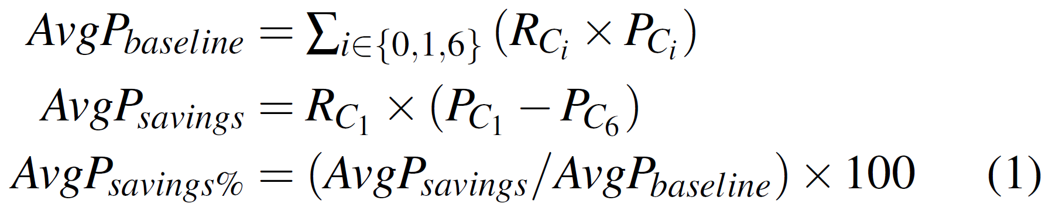
Motivation (II)
Since the deepest C-state is C6 (Table 1), we estimate an upper bound of the average power (AvgP) savings for the ideal case of a deep idle state using equation 1 with:
  The latency of C1 (2μs) and
  The power of C6 (0.1W) per core
R_{Ci} denotes the residency at power state Ci
  i.e., the fraction of time a core spends in state Ci
P_{Ci} denotes the average core power in state Ci
Referring to our workload examples and using C-states power from Table 1:
  Memcached at 20% load (i.e., RC0 = 20%, RC1 = 80%, RC6 = 0%) the potential power savings is 55%
Table 1
Equation 1
Notes:
A high-end client processor is a system-on-chip that typically integrates three main domains into a single chip:
Compute (e.g., CPU cores and graphics engines)
IO
Memory system [CLICK]
We show the architecture used in recent Intel processors with a focus on CPU cores
Each CPU core has a power-gate for the entire core [CLICK]
Package layout showing
An ungated main voltage domain (V_{CU})
Four power-gated voltage domains (one for each CPU core, V_{C0G}, V_{C1G}, V_{C2G}, and V_{C3G}) [CLICK]
Side view of die and package showing
The ungated main voltage domain (VCU) and two cores’ voltage domains (V_{C0G} and V_{C1G})
The package’s decoupling capacitors [END]

Slide 37
Core C1 C-state Entry and Exit Flow
C1 entry mainly clock-gates all core domains and keeps PLLs ON
C1E further reduces the voltage and frequency
C1 exit Clock-ungates all domains
During C1/C1E the core responses to snoop requests
Notes:
A high-end client processor is a system-on-chip that typically integrates three main domains into a single chip:
Compute (e.g., CPU cores and graphics engines)
IO
Memory system [CLICK]
We show the architecture used in recent Intel processors with a focus on CPU cores
Each CPU core has a power-gate for the entire core [CLICK]
Package layout showing
An ungated main voltage domain (V_{CU})
Four power-gated voltage domains (one for each CPU core, V_{C0G}, V_{C1G}, V_{C2G}, and V_{C3G}) [CLICK]
Side view of die and package showing
The ungated main voltage domain (VCU) and two cores’ voltage domains (V_{C0G} and V_{C1G})
The package’s decoupling capacitors [END]

Slide 38
Core C6 C-state Entry and Exit Flow
C6 entry flushes privates caches, saves context, and turns off the PLL and voltage
C6 exit is simply the reverse process of the entry flow
C6 entry latency is dominated by the L1/L2 cache flush
  This flush time varies depending on 1) the number of dirty lines and 2) the core frequency when entering C6
  Flushing a 50% dirty cache at 800MHz can take ∼75μs
C6 exit latency is significantly faster (∼30μs)
  ∼10μs for hardware wake-up (power-ungating, PLL relock, reset, and fuse propagation)
  State and microcode restoration take 20μs
Notes:
A high-end client processor is a system-on-chip that typically integrates three main domains into a single chip:
Compute (e.g., CPU cores and graphics engines)
IO
Memory system [CLICK]
We show the architecture used in recent Intel processors with a focus on CPU cores
Each CPU core has a power-gate for the entire core [CLICK]
Package layout showing
An ungated main voltage domain (V_{CU})
Four power-gated voltage domains (one for each CPU core, V_{C0G}, V_{C1G}, V_{C2G}, and V_{C3G}) [CLICK]
Side view of die and package showing
The ungated main voltage domain (VCU) and two cores’ voltage domains (V_{C0G} and V_{C1G})
The package’s decoupling capacitors [END]

Slide 39
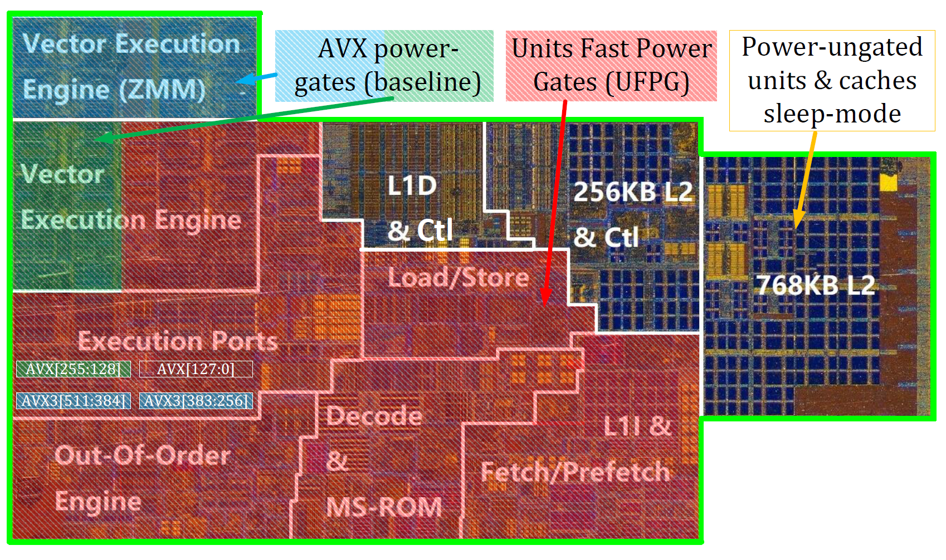
1. Units Fast Power-Gating
Units Fast Power-Gating is a low-latency power-gating (PG) architecture that
  Shuts off most of the core units while retaining the context in place
  thus, enabling a transition latency of tens of nanoseconds
Conventional context retention techniques sequentially save/restore the context to/from an external SRAM before/after power-gating/un-gating
  This process adds several microseconds to the entry/exit latency
  AgileWatts retains the context in place, completely removing save/restore latency overhead at a very small additional idle power cost
Notes:
Power-gate Bypassing technique is responsible for reducing CPU cores’ voltage drop in F_{max}-constrained systems by reducing system impedance [CLICK]
The technique uses the same Intel Skylake die to build: [CLICK]
A dedicated package for Skylake-H (high-end mobile) with the power-gates enabled and [CLICK]
A dedicated package for Skylake-S (high-end desktop) that bypasses the power-gates at the package level by shorting gated and un-gated CPU core power domains [CLICK]
This architecture is feasible since client processors typically share the same die between Skylake-H and Skylake-S [END]

Slide 40
1. Units Fast Power-Gating
Units Fast Power-Gating is a low-latency power-gating (PG) architecture that
  Shuts off most of the core units while retaining the context in place
  thus, enabling a transition latency of tens of nanoseconds
AgileWatts retains the CPU context in place, completely removing save/restore latency overhead at a very small additional idle power cost
Notes:
Power-gate Bypassing technique is responsible for reducing CPU cores’ voltage drop in F_{max}-constrained systems by reducing system impedance [CLICK]
The technique uses the same Intel Skylake die to build: [CLICK]
A dedicated package for Skylake-H (high-end mobile) with the power-gates enabled and [CLICK]
A dedicated package for Skylake-S (high-end desktop) that bypasses the power-gates at the package level by shorting gated and un-gated CPU core power domains [CLICK]
This architecture is feasible since client processors typically share the same die between Skylake-H and Skylake-S [END]

Slide 41
2. Caches Coherency and Sleep Mode (I)
To avoid the high latency to flush private caches to power-gate them, AgileWatts keeps them power-ungated when transitioning to C6A
This has two design implications:
  AgileWatts needs to employ other power-saving techniques to reduce the power of the caches
  A core in C6A state still needs to serve coherence requests (i.e., snoops)
Notes:
Power-gate Bypassing technique is responsible for reducing CPU cores’ voltage drop in F_{max}-constrained systems by reducing system impedance [CLICK]
The technique uses the same Intel Skylake die to build: [CLICK]
A dedicated package for Skylake-H (high-end mobile) with the power-gates enabled and [CLICK]
A dedicated package for Skylake-S (high-end desktop) that bypasses the power-gates at the package level by shorting gated and un-gated CPU core power domains [CLICK]
This architecture is feasible since client processors typically share the same die between Skylake-H and Skylake-S [END]

Slide 42
2. Cache Coherence and Sleep Mode (II)
AgileWatts employs two key techniques to reduce the power consumption of the power-ungated private cache domain:
  Unless a coherency request is being served, AgileWatts keeps this domain clock-gated to save its dynamic power
  AgileWatts leverages the cache sleep-mode technique, which adds sleep transistors to the SRAM array of private caches.
    These sleep transistors reduce the SRAM array’s supply voltage to the lowest level that can safely retain the SRAM content while significantly reducing leakage power
Notes:
Power-gate Bypassing technique is responsible for reducing CPU cores’ voltage drop in F_{max}-constrained systems by reducing system impedance [CLICK]
The technique uses the same Intel Skylake die to build: [CLICK]
A dedicated package for Skylake-H (high-end mobile) with the power-gates enabled and [CLICK]
A dedicated package for Skylake-S (high-end desktop) that bypasses the power-gates at the package level by shorting gated and un-gated CPU core power domains [CLICK]
This architecture is feasible since client processors typically share the same die between Skylake-H and Skylake-S [END]

Slide 43
2. Caches Coherency and Sleep Mode (III)
Since private caches are not flushed when a core enters C6A, AgileWatts must allow the core to respond to snoop requests
AgileWatts keeps the logic required to handle cache snoops in the power-ungated (but clock-gated) domain together with the private caches
As soon as this logic detects incoming snoop traffic
  it temporarily increases the SRAM array voltage through the sleep transistors and reactivates the clock of the private caches for the time required to respond to snoop requests
Notes:
Power-gate Bypassing technique is responsible for reducing CPU cores’ voltage drop in F_{max}-constrained systems by reducing system impedance [CLICK]
The technique uses the same Intel Skylake die to build: [CLICK]
A dedicated package for Skylake-H (high-end mobile) with the power-gates enabled and [CLICK]
A dedicated package for Skylake-S (high-end desktop) that bypasses the power-gates at the package level by shorting gated and un-gated CPU core power domains [CLICK]
This architecture is feasible since client processors typically share the same die between Skylake-H and Skylake-S [END]

Slide 44
Power Savings and Overhead at Varying Load Levels
AgileWatts reduces the average power consumption by up to 38% at low load, with less than 1% impact on both average and tail latency
At high load, AgileWatts still provides 10% power savings, with less than 1.3% impact on tail latency
Notes:
DarkGates improves real system performance by up to 8.1% (4.6% on average) [CLICK]
The performance benefit of DarkGates is positively correlated with the performance scalability of the running workload with CPU frequency [CLICK]
Highly-scalable workloads experience the highest performance gains
Workloads that are heavily bottlenecked by main memory, such as 410.bwaves and 433.milc, have almost no performance gain

Slide 45
Other Details in the Paper
Implementation and hardware cost
Idle Power Analysis
C6A and C6AE Latency
Performance Penalty
Staggered Unit Wake-up
Design Complexity and Effort
Power Savings and Overhead at Varying Load Levels
Analysis of Turbo Boost Performance Improvement
Notes:
There are other details in the paper, for example: [CLICK]
Implementation and hardware cost of:
Different processor chips’ packages
Power management flows in firmware
A deeper package C-states [CLICK]
DarkGates tradeoffs and drawbacks
Lifetime reliability effect
Performance of power-limited processor scenarios
Separate designs for different target segments [END]

Slide 46
Power Savings and Overhead at Varying Load Levels
AgileWatts significantly improves core average power consumption of the Memcached service across load levels with minimal performance overhead over the baseline
Further analyzes of AgileWatts impact on average response time is shown
We consider end-to-end (including network latency measured at 117us) and server-side response time for two cases:
  The worst case, where we assume a C-state transition for each query and
  the expected case, with the actual C-state transitions observed in the baseline
As expected, the gap between the worst and the expected case is larger at high load,
  since multiple queries are serviced within the same active period.
We observe that the degradation of the end-to-end response time (i.e., by client) is negligible because the (non-changing) network latency dominates the overall response time
Notes:
DarkGates improves real system performance by up to 8.1% (4.6% on average) [CLICK]
The performance benefit of DarkGates is positively correlated with the performance scalability of the running workload with CPU frequency [CLICK]
Highly-scalable workloads experience the highest performance gains
Workloads that are heavily bottlenecked by main memory, such as 410.bwaves and 433.milc, have almost no performance gain

