Slide 1






Ariadne: A Hotness-Aware and Size-Adaptive Compressed Swap Technique for Fast Application Relaunch and Reduced CPU Usage on Mobile Devices
Yu Liang, Aofeng Shen, Chun Jason Xue, Riwei Pan, Haiyu Mao
Nika Mansouri Ghiasi, Qingcai Jiang, Rakesh Nadig, Lei Li
Rachata Ausavarungnirun, Mohammad Sadrosadati, Onur Mutlu

Slide 2

Available Memory on Mobile Devices is Scarce
Memory demands of individual mobile applications increase
Number of concurrently running applications grows
DRAM capacity cannot be increased accordingly
  Due to constrained power budget of mobile devices
The available memory is usually insufficient to support multiple applications running concurrently
4GB of memory capacity
12GB of memory capacity
Notes:
Change the plot
Available memory on mobile devices is usually scarce
[Click]because both memory demands of individual mobile application and the number of concurrently running applications increase. However,
[Click] the DRAM capacity cannot be increased accordingly
[Click] due to limited power budget of mobile devices.
[Click] Thus, when running applications on mobile devices with 4GB of DRAM, the available DRAM decreases quickly as more applications are launched, and the system starts using swap space after launching three applications. With 12GB of DRAM, the system still consumes swap space when running few applications concurrently.
So, we conclude that the available memory is usually insufficient to support multiple applications running concurrently.
As the memory demands of individual mobile applications continue to grow and the number of concurrently running applications
increases, available memory on mobile devices is becoming increasingly scarce.
https://www.androidauthority.com/how-much-ram-do-i-need-phone-3086661/?utm_source=chatgpt.com

Slide 3
Memory Swap Schemes on Mobile Devices
When available memory is insufficient:
  SWAP: Swap data to secondary storage (i.e., flash memory)
Swap-in I/O
Prolong read latency
DRAM
Swap space
Flash memory
SWAP
Swap-out I/O
Reduce flash memory lifetime
Notes:
When memory is insufficient, the system usually swaps data to the flash memory of mobile devices.
However, swap-out I/O can reduce the lifetime of flash memory.
When the system reads data from flash memory, the data must be swapped in first, which increases read latency.

Slide 4
Memory Swap Schemes on Mobile Devices
When available memory is insufficient:
  SWAP: Swap data to secondary storage (i.e., flash memory)
  ZRAM: Compress data and store it in a specific area in DRAM (i.e., Zpool)
Swap-in I/O
Prolong read latency
DRAM
Swap space
Flash memory
SWAP
Swap-out I/O
Reduce flash memory lifetime
Compression
DRAM
Zpool
Swap space
Flash memory
ZRAM
Decompression
Increase flash memory lifetime
ZRAM increases flash memory lifetime and reduces read latency
since decompression latency is shorter than the data swap latency
LRU-based eviction policy
Default compression algorithm is lzo (Lz4)
Notes:
To reduce the overhead of the SWAP solution, state-of-the-art ZRAM compresses data and stores it in a specific area in DRAM, called zpool. When the system reads the data, it needs to be decompressed first.
ZRAM increases the lifetime of flash memory and reduces read latency because decompression latency is much shorter than the latency of swapping data.
Data selection for compression is based on the LRU policy. Mobile systems usually support LZO and LZ4 compression

Slide 5
Executive Summary
Problem: ZRAM prolongs application relaunch latency and wastes CPU usage because it does not differentiate data hotness levels or leverage different compression chunk sizes and data locality
Goal: To design a new compressed swap scheme for mobile devices that reduces application relaunch latency and CPU usage
Insights:
Hot data is similar between two consecutive relaunches
Small-size compression is fast, while large-size compression provides a better compression ratio
There is locality in data access during application relaunch
Ariadne:
  Leverages different compression chunk sizes based on data hotness level
  Performs speculative pre-decompression based on data locality
Key Results: Google Pixel 7 with Android 14. Compared to ZRAM, Ariadne
Reduces application relaunch latency by 50%
Decreases the CPU usage of compression and decompression procedures by 15%
Open source: https://github.com/CMU-SAFARI/Ariadne
Notes:
After a brief background introduction, I will start with an executive summary of our work:

Slide 6
Outline
Background
Problem and Motivation
New Insights into Mobile Workloads
Ariadne: Hotness-Aware and Size-Adaptive Compressed Swap
Evaluation
Conclusion
Notes:
I will first present problem and motivation.
[CLICK]

Slide 7
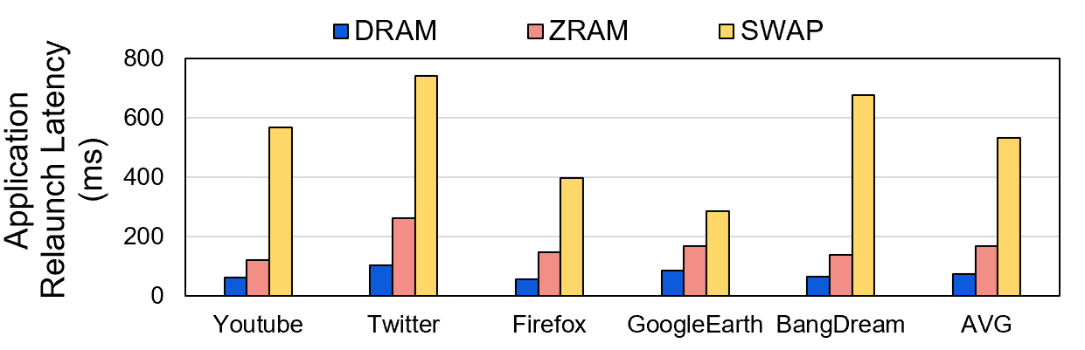


Problem 1: Delayed Application Relaunch
Application relaunch latency in three cases
ZRAM outperforms the traditional SWAP scheme
but increases relaunch latency 2.1× compared to NON-SWAP
NON-SWAP: The system reads all application data from DRAM during a relaunch
ZRAM: Most application data is read from zpool after being decompressed
SWAP: The system reads most data from the flash memory-based swap space
Notes:
We evaluated the performance of ZRAM on Google Pixel 7 with Android 14. you can find more detailed configurations in our peper.
We first collect the application relaunch latency in three cases: DRAM, ZRAM and SWAP.
In DRAM case, the system reads all application data directly from DRAM, there is no swapping.
In ZRAM case, most application data is read from DRAM after being decompressed as it is stored in compressed form in zpool.
In SWAP cases, the system reads most data from the flash memory-based swap space into main memory during a relaunch.
It does not involve compression or decompression.
We observe that ZRAM outperforms the traditional SWAP scheme but still prolongs relaunch latency compared to DRAM.

Slide 8
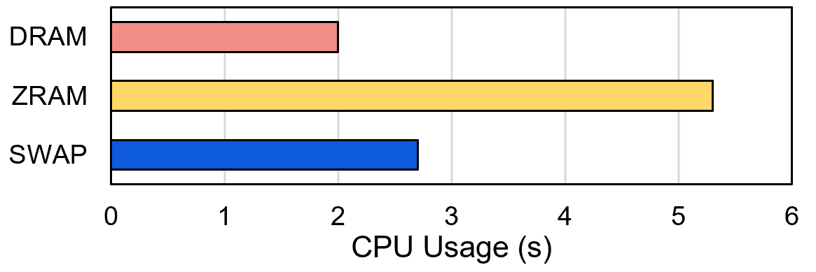
Problem 2: Higher CPU Usage
CPU usage of memory reclaim (i.e., freeing memory) in three cases
NON-SWAP: CPU usage of writing file-backed pages to flash memory
ZRAM: 1 + CPU usage for compressing data
SWAP: 1 + CPU usage for writing swapped data to flash memory
CPU is usually yielded to other processes
ZRAM has significant CPU usage
due to compression and decompression operations
Notes:
The name changes
We then collect the CPU usage in these three cases.
In DRAM case, the system reads all application data directly from DRAM, there is no swapping.
In ZRAM case, most application data is read from DRAM after being decompressed as it is stored in compressed form in zpool.
In SWAP cases, the system reads most data from the flash memory-based swap space into main memory during a relaunch.
It does not involve compression or decompression.
We observe that ZRAM outperforms the traditional SWAP scheme but still prolongs relaunch latency compared to DRAM.

Slide 9
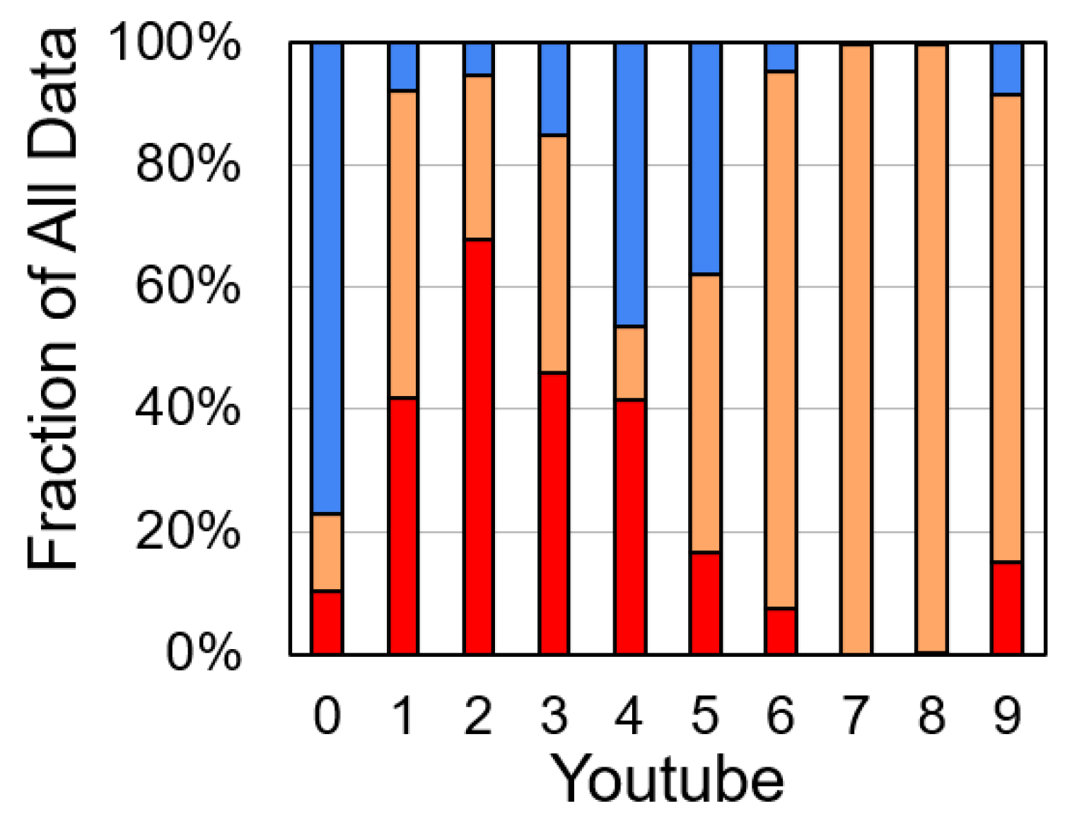
Motivation:
ZRAM Does NOT Consider Data Hotness
Sort all compressed data in the order of compression and then divide it into ten equal parts (X-axis)
The data in part 0 is the first to be compressed, that in part 9 is the last
To minimize compression operations, cold data should be compressed earlier (e.g., in parts 0 and 1) and hot data later (e.g., in parts 8 and 9)
We examine the fraction of hot, warm, and cold data in each part of compressed data
Optimal is all blue for parts 0 and 1
Notes:
Show one
X-axis and y-axis

Slide 10
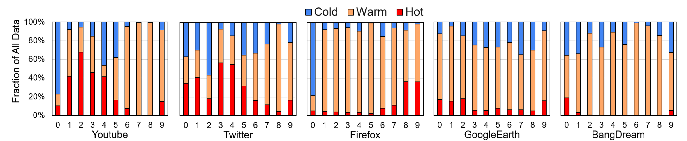
Motivation:
ZRAM Does NOT Consider Data Hotness
Sort all compressed data in the order of compression and then divide it into ten equal parts (X-axis)
The data in part 0 is the first to be compressed, that in part 9 is the last
To minimize compression operations, cold data should be compressed earlier (e.g., in parts 0 and 1) and hot data later (e.g., in parts 8 and 9)
We examine the fraction of hot, warm, and cold data in each part of compressed data
ZRAM does not differentiate between data hotness levels，
causing frequent compression and decompression
Notes:
Show one
X-axis and y-axis

Slide 11
Our Goal
To design a new compressed swap scheme
for mobile devices that reduces
application relaunch latency and CPU usage
Doing so requires reducing
the frequency and latency
of compression and decompression
Notes:
Our goal in this work
[CLICK] to design….
[CLICK] Doing so….
[CLICK]

Slide 12
Outline
Background
Problem and Motivation
New Insights into Mobile Workloads
Ariadne: Hotness-Aware and Size-Adaptive Compressed Swap
Evaluation
Conclusion

Slide 13
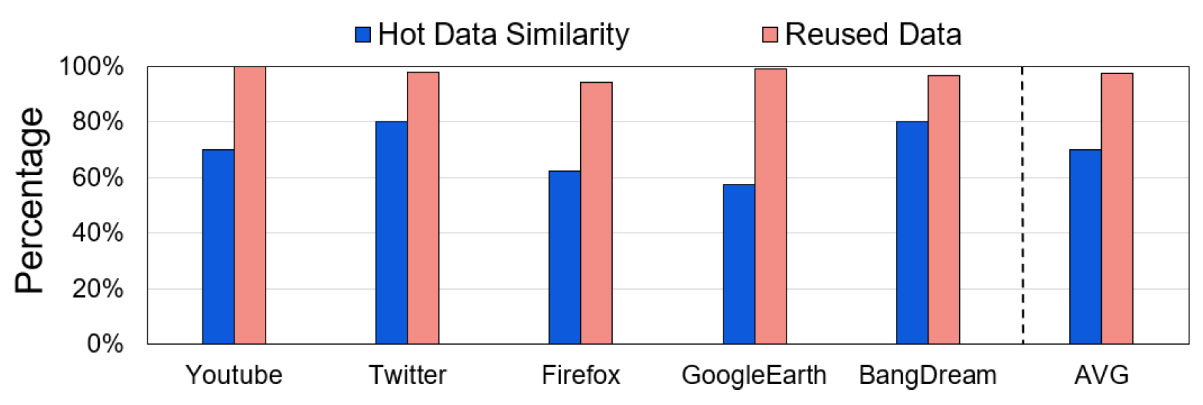
Insight 1: Data Reuse Across Relaunches
We examine data reuse between two consecutive relaunches of each application
70% data used in first relaunch will be reused in next relaunch
Hot data similarity: Percentage of identical hot data between two consecutive relaunches
Reused data: Percentage of hot data from the first relaunch that is reused in a later relaunch and execution
Relaunch the same application could trigger the same activities

Slide 14
Insight 1: Data Reuse Across Relaunches
We examine data reuse between two consecutive relaunches of each application
Insight 1: Hot data that is used during application relaunch is usually similar between two consecutive relaunches
Hot data similarity: Percentage of identical hot data between two consecutive relaunches
Reused data: Percentage of hot data from the first relaunch that is reused in a later relaunch and execution
Key idea 1: Identify hot data based only on the most recent relaunch to reduce the hotness identification overhead
Notes:
Hot data that is used during application relaunch \\
is usually similar between consecutive relaunches
Key idea 1: Identify hot data based only on the most recent relaunch \\
to reduce the hotness identification overhead

Slide 15

Insight 2: Compression Chunk Size
We examine compression performance with different compression chunk sizes
X-axis represents the compression chunk size

Slide 16
Insight 2: Compression Chunk Size
We examine compression performance with different compression chunk sizes
X-axis represents the compression chunk size
Large-size compression provides a higher compression ratio

Slide 17
Insight 2: Compression Chunk Size
We examine compression performance with different compression chunk sizes
X-axis represents the compression chunk size
Small-size compression provides short compression and decompression latencies

Slide 18
Insight 2: Compression Chunk Size
We examine compression performance with different compression chunk sizes
Insight 2: Small-size compression is much faster than large-size but has lower compression ratio
X-axis represents the compression chunk size
Key idea 2: Use small-size on hot data for low latency and large-size on cold data for high compression ratio

Slide 19
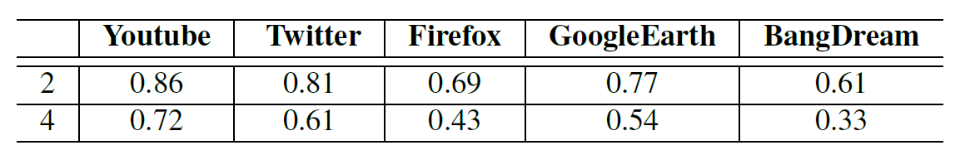
Insight 3: Data Locality in Zpool
The probability of accessing multiple consecutive pages in Zpool for each evaluated application
Probability of accessing two consecutive pages together
Insight 3: There is data use locality in Zpool when decompress data during application relaunch
Key idea 3: Pre-decompress the next compressed data
to hide decompression latency during application relaunch
Notes:
Need to give more details

Slide 20
Outline
Background
Problem and Motivation
New Insights into Mobile Workloads
Ariadne: Hotness-Aware and Size-Adaptive Compressed Swap
Evaluation
Conclusion

Slide 21
Ariadne: Hotness-Aware and Size-Adaptive Compressed Swap Scheme
Key Idea: Reduce the frequency and latency of compression and decompression by
  Leveraging different compression chunk sizes based on data hotness level
  Performing speculative pre-decompression based on data locality
Ariadne: Hotness-Aware and Size-Adaptive Compressed Swap Scheme
  HotnessOrg: Quickly identifies the hotness of data based on last relaunch
  AdaptiveComp: Uses different compression chunk sizes based on data hotness
      Small compression for hot and warm data, leading to fast decompression
      Large compression for cold data, leading to high compression ratio
  PreDecomp: pre-decompresses the next compressed data
Notes:
How to predicts
Compression chunk size

Slide 22
Ariadne: Hotness-Aware and Size-Adaptive Compressed Swap Scheme
Overview
DRAM
Flash memory
Main memory
Zpool
Swap space
A4
C2
B3
A5
A3
C4
A2
LRU list
HotnessOrg
AdaptiveComp
Swapping out
C2
A4
A6
C1
A5
A3
C
A
Swapping in (unlikely)
C3
C4
A2
A1
PreDecomp
Compressed pages
Notes:
Explain

Slide 23
Outline
Background
Problem and Motivation
New Insights into Mobile Workloads
Ariadne: Hotness-Aware and Size-Adaptive Compressed Swap
Evaluation
Conclusion

Slide 24

Evaluation Methodology
Platform: Google Pixel 7
  Eight core CPU
  12 GB DRAM LPDDR5
  128 GB SSD
  Android 14 with Linux 5.10.157
Evaluated Schemes:
  Baseline: state-of-the-art ZRAM
    LRU list data organization, page-size compression, no pre-decompression
  Ariadne: with different configurations
    HotnessOrg, AdaptiveComp, PreDecomp
Open Source: https://github.com/CMU-SAFARI/Ariadne

Slide 25
Effect on Application Relaunch Latency

Slide 26
Effect on Application Relaunch Latency
Ariadne reduces application relaunch latency by 50%
(over state-of-the-art ZRAM)

Slide 27
Effect on CPU Usage

Slide 28
Effect on CPU Usage
Hot data in the main memory
Ariadne reduces CPU usage of compression and decompression by 15% (over state-of-the-art ZRAM)

Slide 29
There is More in Our Paper
Design details of Ariadne
Ariadne implementation
Evaluation methodology details
More evaluation results
  Compression and decompression latency
  Compression ratio
  Prediction accuracy and coverage
  Sensitivity study with different parameters
Overhead analysis
  Small overhead in terms of computation and memory space
Notes:
I would like to also refer you to our paper for more details on:
[CLICK] more experimental characterizations on the effect of partial charge restoration
[CLICK] more details on PaCRAM
[CLICK] and a preliminary analysis for extending PaCRAM for other types of refreshes
[CLICK]

Slide 30
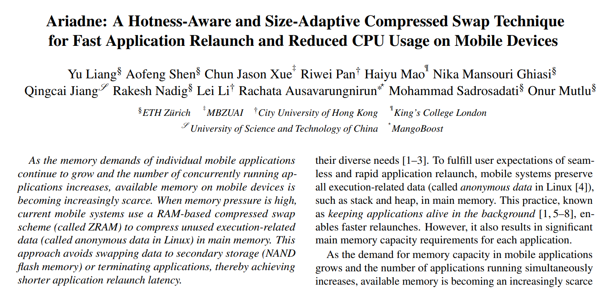

More in the Extended Version
https://arxiv.org/pdf/2502.12826
Notes:
Our paper is available on arXiv.
You can access it though the link or QR code.
[CLICK]

Slide 31
Outline
Background
Problem and Motivation
New Insights into Mobile Workloads
Ariadne: Hotness-Aware and Size-Adaptive Compressed Swap
Evaluation
Conclusion
Notes:
Finally we conclude this work.

Slide 32
Conclusion
Ariadne leverages different compression chunk sizes based on data hotness level and performs speculative pre-decompression based on data locality
Evaluation results on Google Pixel 7 with Android 14 show that Ariadne reduces both application relaunch latency and CPU usage, compared to ZRAM
Notes:
After a brief background introduction, I will start with an executive summary of our work:

Slide 33
Ariadne: A Hotness-Aware and Size-Adaptive Compressed Swap Technique for Fast Application Relaunch and Reduced CPU Usage on Mobile Devices
Yu Liang
Aofeng Shen Chun Jason Xue Riwei Pan Haiyu Mao
Nika Mansouri Ghiasi Qingcai Jiang Rakesh Nadig Lei Li
Rachata Ausavarungnirun Mohammad Sadrosadati Onur Mutlu
Notes:
Thank you for your listening. I am happy to take any questions.

Slide 34
Compression Ratio
Compression ratio under different settings
Notes:
Lets take a look at PaCRAM’s impact on the system performance for different three PaCRAM configurations
[CLICK] the x axis is the decreasing RowHammer threshold
[CLICK] and y axis is the system performance normalized to system performance when PaCRAM is not employed.
[CLICK] we observe that PaCRAM reduces the mitigation overhead induced by PARA
[CLICK] and improves the system performance by 25% on average
[CLICK]

Slide 35
Compression Ratio
Compression ratio under different settings
We can achieve better compression ratio by setting parameters
Notes:
Lets take a look at PaCRAM’s impact on the system performance for different three PaCRAM configurations
[CLICK] the x axis is the decreasing RowHammer threshold
[CLICK] and y axis is the system performance normalized to system performance when PaCRAM is not employed.
[CLICK] we observe that PaCRAM reduces the mitigation overhead induced by PARA
[CLICK] and improves the system performance by 25% on average
[CLICK]

Slide 36
Compression and Decompression Latency
Compression and decompression latency under different settings
Notes:
Lets take a look at PaCRAM’s impact on the system performance for different three PaCRAM configurations
[CLICK] the x axis is the decreasing RowHammer threshold
[CLICK] and y axis is the system performance normalized to system performance when PaCRAM is not employed.
[CLICK] we observe that PaCRAM reduces the mitigation overhead induced by PARA
[CLICK] and improves the system performance by 25% on average
[CLICK]

Slide 37
Prediction Accuray/Coverage
For hot data prediction
~70% Coverage
~97% Accuracy
Notes:
Lets take a look at PaCRAM’s impact on the system performance for different three PaCRAM configurations
[CLICK] the x axis is the decreasing RowHammer threshold
[CLICK] and y axis is the system performance normalized to system performance when PaCRAM is not employed.
[CLICK] we observe that PaCRAM reduces the mitigation overhead induced by PARA
[CLICK] and improves the system performance by 25% on average
[CLICK]

Slide 38
Overhead Analysis
HotnessOrg:
  Similar to existing LRU scheme, no overhead.
AdaptiveComp:
  Pages compressed together may used in different time, but locality shows impact is minimal.
PreDecomp:
  May predict data wrongly, so only predict one page based on locality.
Notes:
Lets take a look at PaCRAM’s impact on the system performance for different three PaCRAM configurations
[CLICK] the x axis is the decreasing RowHammer threshold
[CLICK] and y axis is the system performance normalized to system performance when PaCRAM is not employed.
[CLICK] we observe that PaCRAM reduces the mitigation overhead induced by PARA
[CLICK] and improves the system performance by 25% on average
[CLICK]

Slide 39
Implication on Application Relaunch Latency
EHL (excluding hot list) means hot list data is not compressed
Notes:
Lets take a look at PaCRAM’s impact on the system performance for different three PaCRAM configurations
[CLICK] the x axis is the decreasing RowHammer threshold
[CLICK] and y axis is the system performance normalized to system performance when PaCRAM is not employed.
[CLICK] we observe that PaCRAM reduces the mitigation overhead induced by PARA
[CLICK] and improves the system performance by 25% on average
[CLICK]

Slide 40
Implication on Application Relaunch Latency
AL (all) means all data including hot list data is compressed
Notes:
Lets take a look at PaCRAM’s impact on the system performance for different three PaCRAM configurations
[CLICK] the x axis is the decreasing RowHammer threshold
[CLICK] and y axis is the system performance normalized to system performance when PaCRAM is not employed.
[CLICK] we observe that PaCRAM reduces the mitigation overhead induced by PARA
[CLICK] and improves the system performance by 25% on average
[CLICK]

