Slide 1
Workshop on Computing with Unconventional Technologies (CUT 2021)
Benchmarking Memory-Centric Computing Systems:
Analysis of Real Processing-in-Memory Hardware
Juan Gómez Luna, Izzat El Hajj,
Ivan Fernandez, Christina Giannoula,
Geraldo F. Oliveira, Onur Mutlu
https://arxiv.org/pdf/2110.01709.pdf
https://arxiv.org/pdf/2105.03814.pdf
https://github.com/CMU-SAFARI/prim-benchmarks

Slide 2
Executive Summary
Data movement between memory/storage units and compute units is a major contributor to execution time and energy consumption
Processing-in-Memory (PIM) is a paradigm that can tackle the data movement bottleneck
  Though explored for +50 years, technology challenges prevented the successful materialization
UPMEM has designed and fabricated the first publicly-available real-world PIM architecture
  DDR4 chips embedding in-order multithreaded DRAM Processing Units (DPUs)
Our work:
  Introduction to UPMEM programming model and PIM architecture
  Microbenchmark-based characterization of the DPU
  Benchmarking and workload suitability study
Main contributions:
  Comprehensive characterization and analysis of the first commercially-available PIM architecture
  PrIM (Processing-In-Memory) benchmarks:
    16 workloads that are memory-bound in conventional processor-centric systems
    Strong and weak scaling characteristics
  Comparison to state-of-the-art CPU and GPU
Takeaways:
  Workload characteristics for PIM suitability
  Programming recommendations
  Suggestions and hints for hardware and architecture designers of future PIM systems
  PrIM: (a) programming samples, (b) evaluation and comparison of current and future PIM systems

Slide 3
Data Movement in Computing Systems
Data movement dominates performance and is a major system energy bottleneck
Total system energy: data movement accounts for
  62% in consumer applications✻,
  40% in scientific applications★,
  35% in mobile applications☆
Data Movement
SoC
DRAM
CPU
CPU
L2
GPU
Video Encoder
Video Decoder
Audio
Display Engine
✻ Boroumand et al., “Google Workloads for Consumer Devices: Mitigating Data Movement Bottlenecks,” ASPLOS 2018
★ Kestor et al., “Quantifying the Energy Cost of Data Movement in Scientific Applications,” IISWC 2013
☆ Pandiyan and Wu, “Quantifying the energy cost of data movement for emerging smart phone workloads on mobile platforms,” IISWC 2014

Slide 4
Data Movement in Computing Systems
Data movement dominates performance and is a major system energy bottleneck
Total system energy: data movement accounts for
  62% in consumer applications✻,
  40% in scientific applications★,
  35% in mobile applications☆
Compute systems should be more data-centric
Data Movement
SoC
CPU
Processing-In-Memory proposes
computing where it makes sense
(where data resides)
CPU
L2
DRAM
GPU
Video Encoder
Video Decoder
Audio
Display Engine
✻ Boroumand et al., “Google Workloads for Consumer Devices: Mitigating Data Movement Bottlenecks,” ASPLOS 2018
★ Kestor et al., “Quantifying the Energy Cost of Data Movement in Scientific Applications,” IISWC 2013
☆ Pandiyan and Wu, “Quantifying the energy cost of data movement for emerging smart phone workloads on mobile platforms,” IISWC 2014

Slide 5
UPMEM Processing-in-DRAM Engine (2019)
Processing in DRAM Engine
Includes standard DIMM modules, with a large number of DPU processors combined with DRAM chips.
Replaces standard DIMMs
  DDR4 R-DIMM modules
    8GB+128 DPUs (16 PIM chips)
    Standard 2x-nm DRAM process
  Large amounts of compute & memory bandwidth
CPU
(x86, ARM, RV…)
DDR
Data bus
https://www.anandtech.com/show/14750/hot-chips-31-analysis-inmemory-processing-by-upmem
https://www.upmem.com/video-upmem-presenting-its-true-processing-in-memory-solution-hot-chips-2019/

Slide 6
PIM Alleviates the Shortcomings of
Processor-Centric Systems
KEY TAKEAWAY 4
• UPMEM-based PIM systems outperform state-of-the-art CPUs in terms of performance (by 23.2× on 2,556 DPUs for 16 PrIM benchmarks) and energy efficiency on most of PrIM benchmarks.
• UPMEM-based PIM systems outperform state-of-the-art GPUs on a majority of PrIM benchmarks (by 2.54× on 2,556 DPUs for 10 PrIM benchmarks), and the outlook is even more positive for future PIM systems.
• UPMEM-based PIM systems are more energy-efficient than state-of-the-art CPUs and GPUs on workloads that they provide performance improvements over the CPUs and the GPUs.

Slide 7
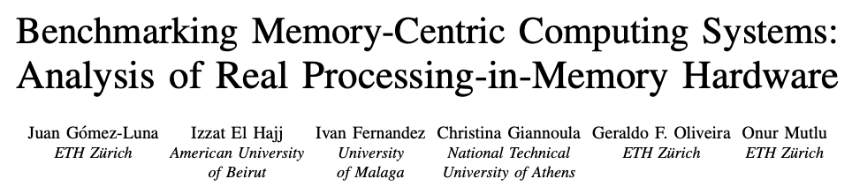
CUT 2021 Paper
https://arxiv.org/pdf/2110.01709.pdf
https://github.com/CMU-SAFARI/prim-benchmarks

Slide 8
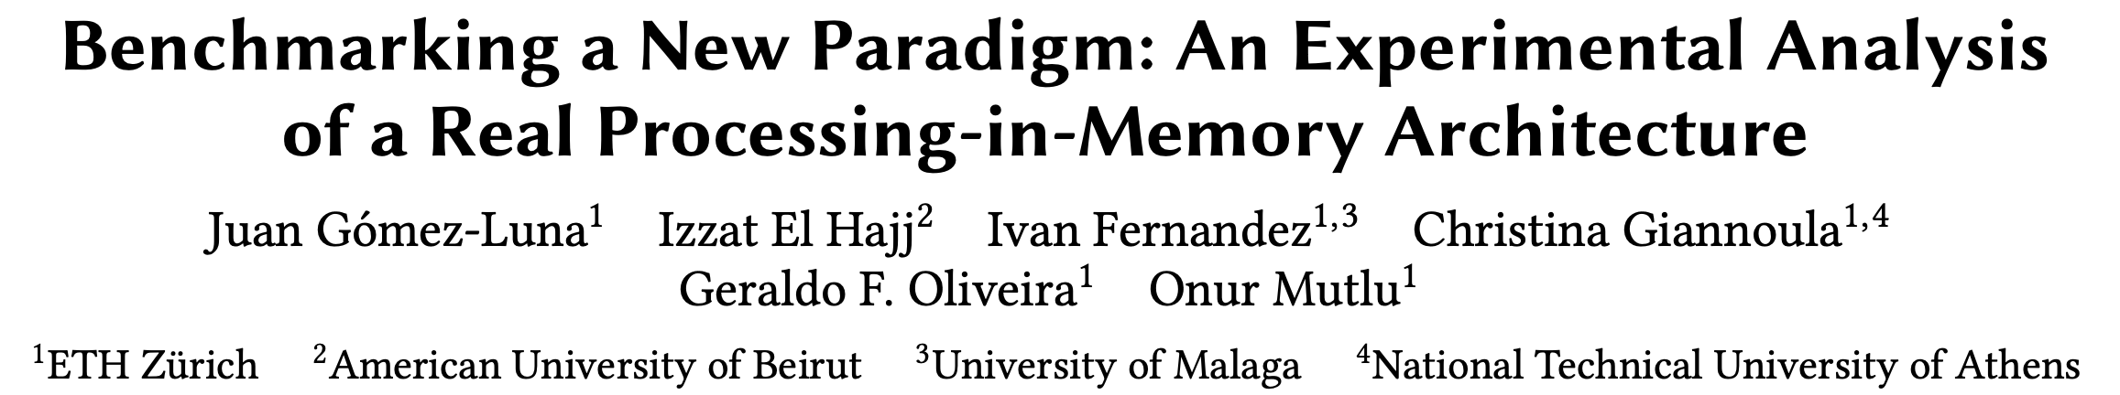
Long arXiv Version
https://arxiv.org/pdf/2105.03814.pdf
https://github.com/CMU-SAFARI/prim-benchmarks

Slide 9
Observations, Recommendations, Takeaways
GENERAL PROGRAMMING RECOMMENDATIONS
Execute on the DRAM Processing Units (DPUs) portions of parallel code that are as long as possible.
Split the workload into independent data blocks, which the DPUs operate on independently.
Use as many working DPUs in the system as possible.
Launch at least 11 tasklets (i.e., software threads) per DPU.
PROGRAMMING RECOMMENDATION 1
For data movement between the DPU’s MRAM bank and the WRAM, use large DMA transfer sizes when all the accessed data is going to be used.
KEY OBSERVATION 7
Larger CPU-DPU and DPU-CPU transfers between the host main memory and the DRAM Processing Unit’s Main memory (MRAM) banks result in higher sustained bandwidth.
KEY TAKEAWAY 1
The UPMEM PIM architecture is fundamentally compute bound. As a result, the most suitable work- loads are memory-bound.

Slide 10
Outline
Introduction
  Accelerator Model
  UPMEM-based PIM System Overview
UPMEM PIM Programming
  Vector Addition
  CPU-DPU Data Transfers
  Inter-DPU Communication
  CPU-DPU/DPU-CPU Transfer Bandwidth
DRAM Processing Unit
  Arithmetic Throughput
  WRAM and MRAM Bandwidth
PrIM Benchmarks
  Roofline Model
  Benchmark Diversity
Evaluation
  Strong and Weak Scaling
  Comparison to CPU and GPU
Key Takeaways

Slide 11
Accelerator Model
UPMEM DIMMs coexist with conventional DIMMs
Integration of UPMEM DIMMs in a system follows an accelerator model
UPMEM DIMMs can be seen as a loosely coupled accelerator
  Explicit data movement between the main processor (host CPU) and the accelerator (UPMEM)
  Explicit kernel launch onto the UPMEM processors
This resembles GPU computing

Slide 12
System Organization (I)
In a UPMEM-based PIM system UPMEM DIMMs coexist with regular DDR4 DIMMs
Notes:
P21 DIMMs.
DPUs cannot be shared. There is a large number of DPUs.
No need for OS.
This simplifies security implications. No side channels.

Slide 13
System Organization (II)
A UPMEM DIMM contains 8 or 16 chips
  Thus, 1 or 2 ranks of 8 chips each
Inside each PIM chip there are:
  8 64MB banks per chip: Main RAM (MRAM) banks
  8 DRAM Processing Units (DPUs) in each chip, 64 DPUs per rank

Slide 14
2,560-DPU System (I)
UPMEM-based PIM system with 20 UPMEM DIMMs of 16 chips each (40 ranks)
  P21 DIMMs
  Dual x86 socket
    UPMEM DIMMs coexist with regular DDR4 DIMMs
    2 memory controllers/socket (3 channels each)
    2 conventional DDR4 DIMMs on one channel of one controller
2560 DPUs*
160 GB
* There are 4 faulty DPUs in the system that we use in our experiments. Thus, the maximum number of DPUs we can use is 2,556.

Slide 15
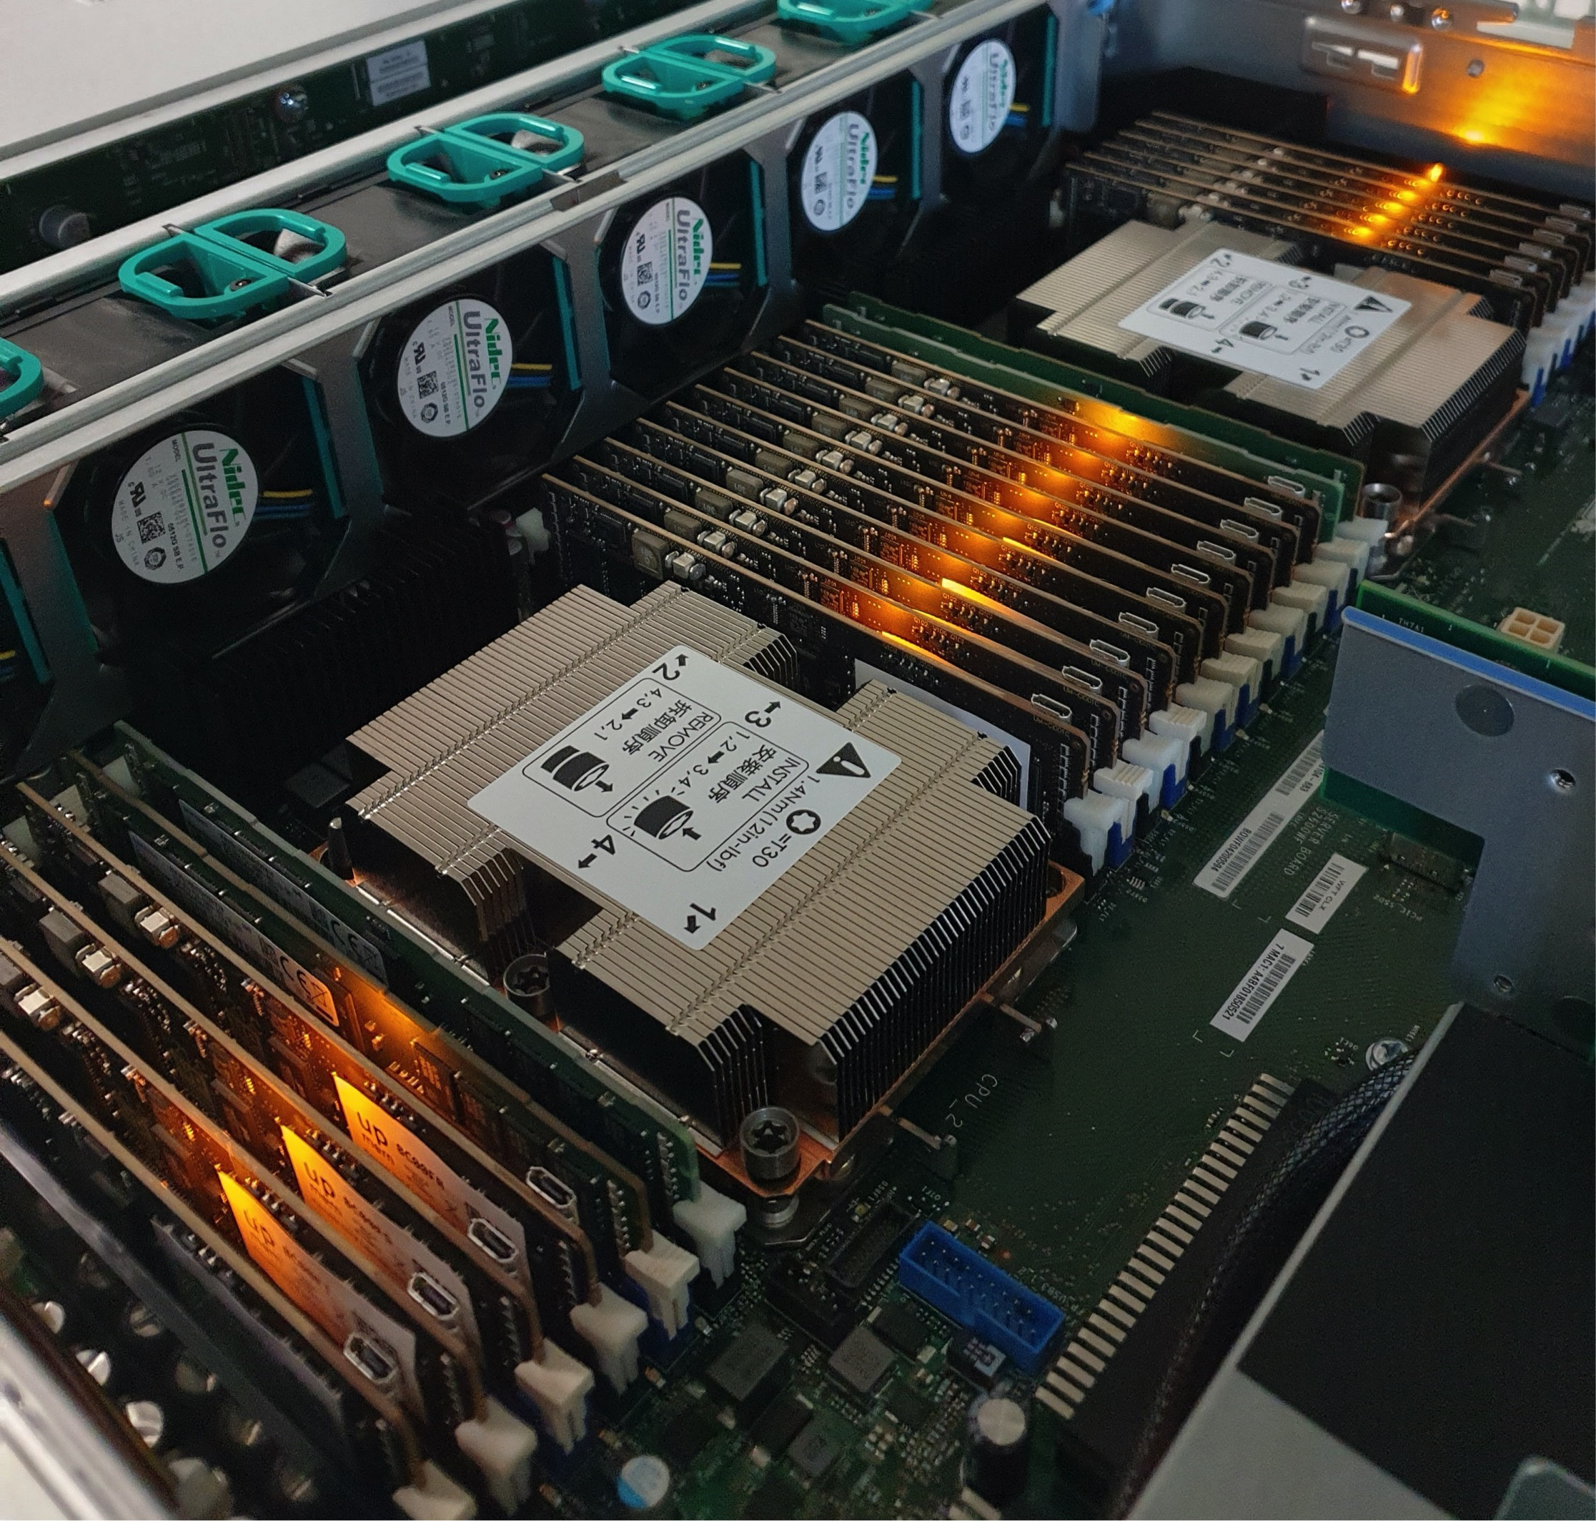
2,560-DPU System (II)

Slide 16
640-DPU System
UPMEM-based PIM system with 10 UPMEM DIMMs of 8 chips each (10 ranks)
  E19 DIMMs
  x86 socket
    2 memory controllers (3 channels each)
    2 conventional DDR4 DIMMs on one channel of one controller
640 DPUs
40 GB

Slide 17
Outline
Introduction
  Accelerator Model
  UPMEM-based PIM System Overview
UPMEM PIM Programming
  Vector Addition
  CPU-DPU Data Transfers
  Inter-DPU Communication
  CPU-DPU/DPU-CPU Transfer Bandwidth
DRAM Processing Unit
  Arithmetic Throughput
  WRAM and MRAM Bandwidth
PrIM Benchmarks
  Roofline Model
  Benchmark Diversity
Evaluation
  Strong and Weak Scaling
  Comparison to CPU and GPU
Key Takeaways

Slide 18
Vector Addition (VA)
Our first programming example
We partition the input arrays across:
  DPUs
  Tasklets, i.e., software threads running on a DPU
Tasklet 0
Tasklet 1
Tasklet 0
Tasklet 1
Tasklet 0
Tasklet 1
Tasklet 0
Tasklet 1
DPU 0
DPU 1
DPU 2
DPU 3

Slide 19
CPU-DPU/DPU-CPU Data Transfers
CPU-DPU and DPU-CPU transfers
  Between host CPU’s main memory and DPUs’ MRAM banks
Serial CPU-DPU/DPU-CPU transfers:
  A single DPU (i.e., 1 MRAM bank)
Parallel CPU-DPU/DPU-CPU transfers:
  Multiple DPUs (i.e., many MRAM banks)
Broadcast CPU-DPU transfers:
  Multiple DPUs with a single buffer

Slide 20
Inter-DPU Communication
There is no direct communication channel between DPUs
Inter-DPU communication takes places via the host CPU using CPU-DPU and DPU-CPU transfers
Example communication patterns:
  Merging of partial results to obtain the final result
    Only DPU-CPU transfers
  Redistribution of intermediate results for further computation
    DPU-CPU transfers and CPU-DPU transfers

Slide 21
How Fast are these Data Transfers?
With a microbenchmark, we obtain the sustained bandwidth of all types of CPU-DPU and DPU-CPU transfers
Two experiments:
  1 DPU: variable CPU-DPU and DPU-CPU transfer size (8 bytes to 32 MB)
  1 rank: 32 MB CPU-DPU and DPU-CPU transfers to/from a set of 1 to 64 MRAM banks within the same rank
Preliminary experiments with more than one rank
  Channel-level parallelism

Slide 22
CPU-DPU/DPU-CPU Transfers: 1 DPU
Data transfer size varies between 8 bytes and 32 MB
KEY OBSERVATION 7
Larger CPU-DPU and DPU-CPU transfers between the host main memory and the DRAM Processing Unit’s Main memory (MRAM) banks result in higher sustained bandwidth.

Slide 23
CPU-DPU/DPU-CPU Transfers: 1 Rank
CPU-DPU (serial/parallel/broadcast) and DPU-CPU (serial/parallel)
The number of DPUs varies between 1 and 64
KEY OBSERVATION 8
The sustained bandwidth of parallel CPU-DPU and DPU-CPU transfers between the host main memory and the DRAM Processing Unit’s Main memory (MRAM) banks increases with the number of DRAM Processing Units inside a rank.

Slide 24
Outline
Introduction
  Accelerator Model
  UPMEM-based PIM System Overview
UPMEM PIM Programming
  Vector Addition
  CPU-DPU Data Transfers
  Inter-DPU Communication
  CPU-DPU/DPU-CPU Transfer Bandwidth
DRAM Processing Unit
  Arithmetic Throughput
  WRAM and MRAM Bandwidth
PrIM Benchmarks
  Roofline Model
  Benchmark Diversity
Evaluation
  Strong and Weak Scaling
  Comparison to CPU and GPU
Key Takeaways

Slide 25
DRAM Processing Unit

Slide 26
DPU Pipeline
In-order pipeline
  Up to 350 MHz
Fine-grain multithreaded
  24 hardware threads
14 pipeline stages
  DISPATCH: Thread selection
  FETCH: Instruction fetch
  READOP: Register file
  FORMAT: Operand formatting
  ALU: Operation and WRAM
  MERGE: Result formatting
To the DMA engine

Slide 27
Arithmetic Throughput: Microbenchmark
Goal
  Measure the maximum arithmetic throughput for different datatypes and operations
Microbenchmark
  We stream over an array in WRAM and perform read-modify-write operations
  Experiments on one DPU
  We vary the number of tasklets from 1 to 24
  Arithmetic operations: add, subtract, multiply, divide
  Datatypes: int32, int64, float, double
We measure cycles with an accurate cycle counter that the SDK provides
  We include WRAM accesses (including address calculation) and arithmetic operation

Slide 28
Arithmetic Throughput: 11 Tasklets
KEY OBSERVATION 1
The arithmetic throughput of a DRAM Processing Unit saturates at 11 or more tasklets.
This observation is consistent for different datatypes (INT32, INT64, UINT32, UINT64, FLOAT, DOUBLE) and operations (ADD, SUB, MUL, DIV).

Slide 29
Arithmetic Throughput: Native Support
KEY OBSERVATION 2
DPUs provide native hardware support for 32- and 64-bit integer addition and subtraction, leading to high throughput for these operations.
DPUs do not natively support 32- and 64-bit multiplication and division, and floating point operations. These operations are emulated by the UPMEM runtime library, leading to much lower throughput.

Slide 30
DPU: WRAM Bandwidth

Slide 31
DPU: MRAM Latency and Bandwidth

Slide 32
MRAM Bandwidth
Goal
  Measure MRAM bandwidth for different access patterns
Microbenchmarks
  Latency of a single DMA transfer for different transfer sizes
    mram_read(); // MRAM-WRAM DMA transfer
    mram_write(); // WRAM-MRAM DMA transfer
  STREAM benchmark
    COPY, COPY-DMA
    ADD, SCALE, TRIAD
  Strided access pattern
    Coarse-grain strided access
    Fine-grain strided access
  Random access pattern (GUPS)
We do include accesses to MRAM

Slide 33

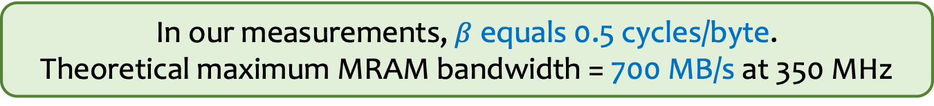
MRAM Read and Write Latency (I)
$$MRAM Bandwidth \left(in\frac{B}{S}\right)=\frac{size × frequencyDPU}{MRAM Latency}$$
We can model the MRAM latency with a linear expression
$$MRAM Latency \left(in cycles\right)=α+β×size$$
In our measurements, $β$ equals 0.5 cycles/byte.
Theoretical maximum MRAM bandwidth = 700 MB/s at 350 MHz

Slide 34
MRAM Read and Write Latency (II)
KEY OBSERVATION 4
The DPU’s Main memory (MRAM) bank access latency increases linearly with the transfer size.
The maximum theoretical MRAM bandwidth is 2 bytes per cycle.
$$MRAM Latency \left(in cycles\right)=α+β×size$$

Slide 35
MRAM Bandwidth
Goal
  Measure MRAM bandwidth for different access patterns
Microbenchmarks
  Latency of a single DMA transfer for different transfer sizes
    mram_read(); // MRAM-WRAM DMA transfer
    mram_write(); // WRAM-MRAM DMA transfer
  STREAM benchmark
    COPY, COPY-DMA
    ADD, SCALE, TRIAD
  Strided access pattern
    Coarse-grain strided access
    Fine-grain strided access
  Random access pattern (GUPS)
We do include accesses to MRAM

Slide 36
STREAM Benchmark: Bandwidth Saturation
KEY OBSERVATION 5
When the access latency to an MRAM bank for a streaming benchmark (COPY-DMA, COPY, ADD) is larger than the pipeline latency (i.e., execution latency of arithmetic operations and WRAM accesses), the performance of the DPU saturates at a number of tasklets smaller than 11. This is a memory-bound workload.
When the pipeline latency for a streaming benchmark (SCALE, TRIAD) is larger than the MRAM access latency, the performance of a DPU saturates at 11 tasklets. This is a compute-bound workload.

Slide 37
MRAM Bandwidth
Goal
  Measure MRAM bandwidth for different access patterns
Microbenchmarks
  Latency of a single DMA transfer for different transfer sizes
    mram_read(); // MRAM-WRAM DMA transfer
    mram_write(); // WRAM-MRAM DMA transfer
  STREAM benchmark
    COPY, COPY-DMA
    ADD, SCALE, TRIAD
  Strided access pattern
    Coarse-grain strided access
    Fine-grain strided access
  Random access pattern (GUPS)
We do include accesses to MRAM

Slide 38
DPU: Arithmetic Throughput vs. Operational Intensity

Slide 39
Arithmetic Throughput vs. Operational Intensity (I)
Goal
  Characterize memory-bound regions and compute-bound regions for different datatypes and operations
Microbenchmark
  We load one chunk of an MRAM array into WRAM
  Perform a variable number of operations on the data
  Write back to MRAM
The experiment is inspired by the Roofline model*
We define operational intensity (OI) as the number of arithmetic operations performed per byte accessed from MRAM (OP/B)
The pipeline latency changes with the operational intensity, but the MRAM access latency is fixed
*S. Williams et al., “Roofline: An Insightful Visual Performance Model for Multi-core Architectures,” CACM, 2009

Slide 40
Arithmetic Throughput vs. Operational Intensity (II)
In the memory-bound region, the arithmetic throughput increases with the operational intensity
Memory-bound region
Compute-bound region
In the compute-bound region, the arithmetic throughput is flat at its maximum
The throughput saturation point is the operational intensity
where the transition between
the memory-bound region and the compute-bound region happens
The throughput saturation point is as low as ¼ OP/B,
i.e., 1 integer addition per every 32-bit element fetched

Slide 41
Arithmetic Throughput vs. Operational Intensity (III)
KEY OBSERVATION 6
The arithmetic throughput of a DRAM Processing Unit (DPU) saturates at low or very low operational intensity (e.g., 1 integer addition per 32-bit element). Thus, the DPU is fundamentally a compute-bound processor.
We expect most real-world workloads be compute-bound in the UPMEM PIM architecture.

Slide 42
Outline
Introduction
  Accelerator Model
  UPMEM-based PIM System Overview
UPMEM PIM Programming
  Vector Addition
  CPU-DPU Data Transfers
  Inter-DPU Communication
  CPU-DPU/DPU-CPU Transfer Bandwidth
DRAM Processing Unit
  Arithmetic Throughput
  WRAM and MRAM Bandwidth
PrIM Benchmarks
  Roofline Model
  Benchmark Diversity
Evaluation
  Strong and Weak Scaling
  Comparison to CPU and GPU
Key Takeaways

Slide 43
PrIM Benchmarks
Goal
  A common set of workloads that can be used to
    evaluate the UPMEM PIM architecture,
    compare software improvements and compilers,
    compare future PIM architectures and hardware
Two key selection criteria:
  Selected workloads from different application domains
  Memory-bound workloads on processor-centric architectures
14 different workloads, 16 different benchmarks*
*There are two versions for two of the workloads (HST, SCAN).

Slide 44
PrIM Benchmarks: Application Domains
Domain | Benchmark | Short name
Dense linear algebra | Vector Addition | VA
 | Matrix-Vector Multiply | GEMV
Sparse linear algebra | Sparse Matrix-Vector Multiply | SpMV
Databases | Select | SEL
 | Unique | UNI
Data analytics | Binary Search | BS
 | Time Series Analysis | TS
Graph processing | Breadth-First Search | BFS
Neural networks | Multilayer Perceptron | MLP
Bioinformatics | Needleman-Wunsch | NW
Image processing | Image histogram (short) | HST-S
 | Image histogram (large) | HST-L
Parallel primitives | Reduction | RED
 | Prefix sum (scan-scan-add) | SCAN-SSA
 | Prefix sum (reduce-scan-scan) | SCAN-RSS
 | Matrix transposition | TRNS

Slide 45
Roofline Model
Intel Advisor on an Intel Xeon E3-1225 v6 CPU
Peak compute performance
L3
DRAM
All workloads fall in the memory-bound area of the Roofline

Slide 46
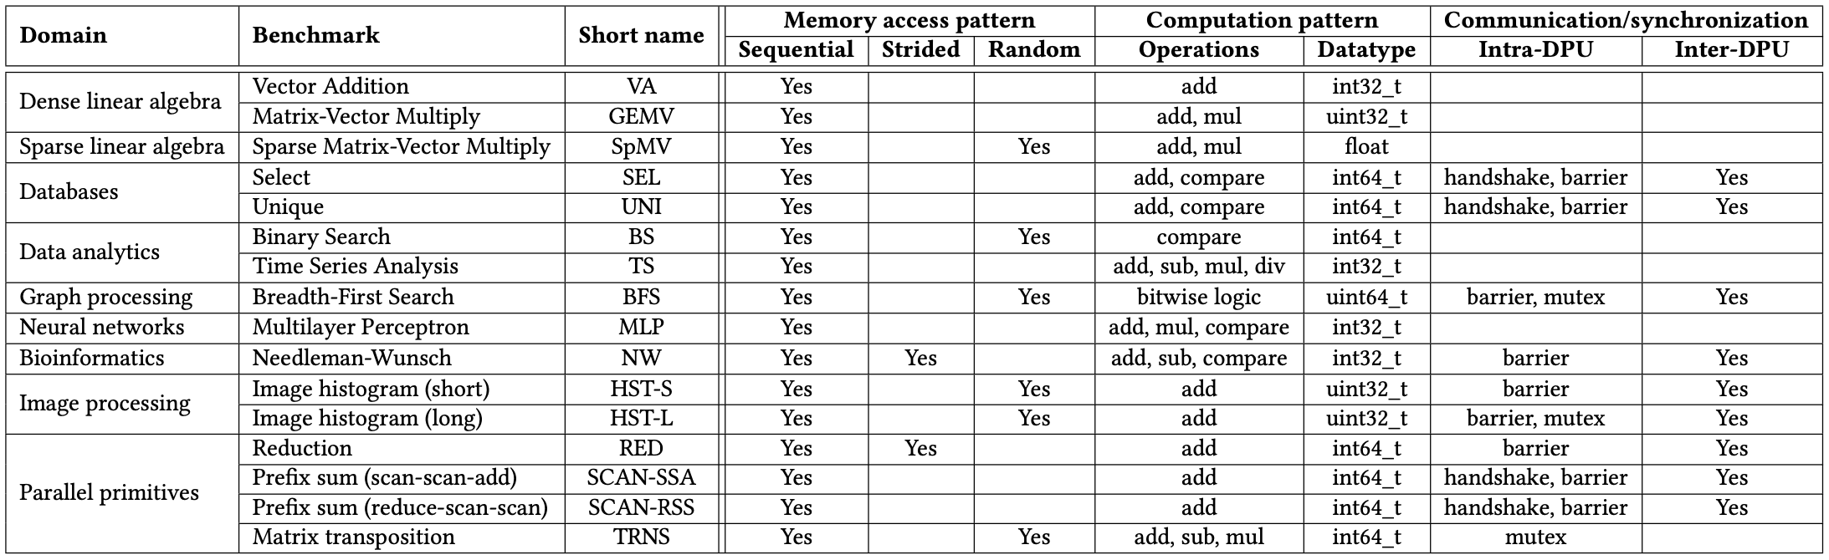
PrIM Benchmarks: Diversity
PrIM benchmarks are diverse:
  Memory access patterns
  Operations and datatypes
  Communication/synchronization

Slide 47
Outline
Introduction
  Accelerator Model
  UPMEM-based PIM System Overview
UPMEM PIM Programming
  Vector Addition
  CPU-DPU Data Transfers
  Inter-DPU Communication
  CPU-DPU/DPU-CPU Transfer Bandwidth
DRAM Processing Unit
  Arithmetic Throughput
  WRAM and MRAM Bandwidth
PrIM Benchmarks
  Roofline Model
  Benchmark Diversity
Evaluation
  Strong and Weak Scaling
  Comparison to CPU and GPU
Key Takeaways

Slide 48
Evaluation Methodology
We evaluate the 16 PrIM benchmarks on two UPMEM-based systems:
  2,556-DPU system
  640-DPU system
Strong and weak scaling experiments on the 2,556-DPU system
  1 DPU with different numbers of tasklets
  1 rank (strong and weak)
  Up to 32 ranks
Strong scaling refers to how the execution time of a program solving a particular problem varies with the number of processors for a fixed problem size
Weak scaling refers to how the execution time of a program solving a particular problem varies
with the number of processors for a fixed problem size per processor

Slide 49
Evaluation Methodology
We evaluate the 16 PrIM benchmarks on two UPMEM-based systems:
  2,556-DPU system
  640-DPU system
Strong and weak scaling experiments on the 2,556-DPU system
  1 DPU with different numbers of tasklets
  1 rank (strong and weak)
  Up to 32 ranks
Comparison of both UPMEM-based PIM systems to state-of-the-art CPU and GPU
  Intel Xeon E3-1240 CPU
  NVIDIA Titan V GPU

Slide 50
Strong Scaling: 1 DPU (I)
Strong scaling experiments on 1 DPU
  We set the number of tasklets to 1, 2, 4, 8, and 16
  We show the breakdown of execution time:
    DPU: Execution time on the DPU
    Inter-DPU: Time for inter-DPU communication via the host CPU
    CPU-DPU: Time for CPU to DPU transfer of input data
    DPU-CPU: Time for DPU to CPU transfer of final results
  Speedup over 1 tasklet

Slide 51
Strong Scaling: 1 DPU (II)
VA, GEMV, SpMV, SEL, UNI, TS, MLP, NW, HST-S, RED, SCAN-SSA (Scan kernel), SCAN-RSS (both kernels), and TRNS (Step 2 kernel), the best performing number of tasklets is 16
Speedups 1.5-2.0x as we double the number of tasklets from 1 to 8.
Speedups 1.2-1.5x from 8 to 16, since the pipeline throughput saturates at 11 tasklets
KEY OBSERVATION 10
A number of tasklets greater than 11 is a good choice for most real-world workloads we tested (16 kernels out of 19 kernels from 16 benchmarks), as it fully utilizes the DPU’s pipeline.

Slide 52
Strong Scaling: 1 DPU (III)
VA, GEMV, SpMV, BS, TS, MLP, HST-S do not use intra-DPU synchronization primitives
In SEL, UNI, NW, RED, SCAN-SSA (Scan kernel), SCAN-RSS (both kernels), synchronization is lightweight
BFS, HST-L, TRNS (Step 3) use mutexes, which cause contention when accessing shared data structures

Slide 53
Strong Scaling: 1 DPU (IV)
VA, GEMV, SpMV, BS, TS, MLP, HST-S do not use synchronization primitives
In SEL, UNI, NW, RED, SCAN-SSA (Scan kernel), SCAN-RSS (both kernels), synchronization is lightweight
BFS, HST-L, TRNS (Step 3) use mutexes, which cause contention when accessing shared data structures
KEY OBSERVATION 11
Intensive use of intra-DPU synchronization across tasklets (e.g., mutexes, barriers, handshakes) may limit scalability, sometimes causing the best performing number of tasklets to be lower than 11.

Slide 54
Strong Scaling: 1 Rank
Strong scaling experiments on 1 rank
  We set the number of tasklets to the best performing one
  The number of DPUs is 1, 4, 16, 64
  We show the breakdown of execution time:
    DPU: Execution time on the DPU
    Inter-DPU: Time for inter-DPU communication via the host CPU
    CPU-DPU: Time for CPU to DPU transfer of input data
    DPU-CPU: Time for DPU to CPU transfer of final results
  Speedup over 1 DPU

Slide 55
Strong Scaling: 32 Ranks
Strong scaling experiments on 32 rank
  We set the number of tasklets to the best performing one
  The number of DPUs is 256, 512, 1024, 2048
  We show the breakdown of execution time:
    DPU: Execution time on the DPU
    Inter-DPU: Time for inter-DPU communication via the host CPU
    We do not show CPU-DPU/DPU-CPU transfer times
  Speedup over 256 DPUs

Slide 56
Weak Scaling: 1 Rank
KEY OBSERVATION 17
Equally-sized problems assigned to different DPUs and little/no inter-DPU synchronization lead to linear weak scaling of the execution time spent on the DPUs (i.e., constant execution time when we increase the number of DPUs and the dataset size accordingly).
KEY OBSERVATION 18
Sustained bandwidth of parallel CPU-DPU/DPU-CPU transfers inside a rank of DPUs increases sublinearly with the number of DPUs.

Slide 57
CPU/GPU: Evaluation Methodology
Comparison of both UPMEM-based PIM systems to state-of-the-art CPU and GPU
  Intel Xeon E3-1240 CPU
  NVIDIA Titan V GPU
We use state-of-the-art CPU and GPU counterparts of PrIM benchmarks
  https://github.com/CMU-SAFARI/prim-benchmarks
We use the largest dataset that we can fit in the GPU memory
We show overall execution time, including DPU kernel time and inter DPU communication

Slide 58
CPU/GPU: Performance Comparison (I)
The 2,556-DPU and the 640-DPU systems outperform the CPU for all benchmarks except SpMV, BFS, and NW
The 2,556-DPU and the 640-DPU are, respectively, 93.0x and 27.9x faster than the CPU for 13 of the PrIM benchmarks

Slide 59
CPU/GPU: Performance Comparison (II)
The 2,556-DPU outperforms the GPU
for 10 PrIM benchmarks with an average of 2.54x
The performance of the 640-DPU is within 65%
the performance of the GPU for the same 10 PrIM benchmarks

Slide 60
CPU/GPU: Performance Comparison (III)
KEY OBSERVATION 19
The UPMEM-based PIM system can outperform a state-of-the-art GPU on workloads with three key characteristics:
Streaming memory accesses
No or little inter-DPU synchronization
No or little use of integer multiplication, integer division, or floating point operations
These three key characteristics make a workload potentially suitable to the UPMEM PIM architecture.

Slide 61
CPU/GPU: Energy Comparison
The 640-DPU system consumes on average 1.64x less energy than the CPU for all 16 PrIM benchmarks
For 12 benchmarks, the 640-DPU system provides energy savings
of 5.23x over the CPU

Slide 62
Outline
Introduction
  Accelerator Model
  UPMEM-based PIM System Overview
UPMEM PIM Programming
  Vector Addition
  CPU-DPU Data Transfers
  Inter-DPU Communication
  CPU-DPU/DPU-CPU Transfer Bandwidth
DRAM Processing Unit
  Arithmetic Throughput
  WRAM and MRAM Bandwidth
PrIM Benchmarks
  Roofline Model
  Benchmark Diversity
Evaluation
  Strong and Weak Scaling
  Comparison to CPU and GPU
Key Takeaways

Slide 63
Key Takeaway 1
The throughput saturation point is as low as ¼ OP/B,
i.e., 1 integer addition per every 32-bit element fetched
Memory-bound region
Compute-bound region
KEY TAKEAWAY 1
The UPMEM PIM architecture is fundamentally compute bound.
As a result, the most suitable workloads are memory-bound.

Slide 64
Key Takeaway 2
KEY TAKEAWAY 2
The most well-suited workloads for the UPMEM PIM architecture use no arithmetic operations or use only simple operations (e.g., bitwise operations and integer addition/subtraction).

Slide 65
Key Takeaway 3
KEY TAKEAWAY 3
The most well-suited workloads for the UPMEM PIM architecture require little or no communication across DPUs (inter-DPU communication).

Slide 66
Key Takeaway 4
KEY TAKEAWAY 4
• UPMEM-based PIM systems outperform state-of-the-art CPUs in terms of performance (by 23.2× on 2,556 DPUs for 16 PrIM benchmarks) and energy efficiency on most of PrIM benchmarks.
• UPMEM-based PIM systems outperform state-of-the-art GPUs on a majority of PrIM benchmarks (by 2.54× on 2,556 DPUs for 10 PrIM benchmarks), and the outlook is even more positive for future PIM systems.
• UPMEM-based PIM systems are more energy-efficient than state-of-the-art CPUs and GPUs on workloads that they provide performance improvements over the CPUs and the GPUs.

Slide 67
Executive Summary
Data movement between memory/storage units and compute units is a major contributor to execution time and energy consumption
Processing-in-Memory (PIM) is a paradigm that can tackle the data movement bottleneck
  Though explored for +50 years, technology challenges prevented the successful materialization
UPMEM has designed and fabricated the first publicly-available real-world PIM architecture
  DDR4 chips embedding in-order multithreaded DRAM Processing Units (DPUs)
Our work:
  Introduction to UPMEM programming model and PIM architecture
  Microbenchmark-based characterization of the DPU
  Benchmarking and workload suitability study
Main contributions:
  Comprehensive characterization and analysis of the first commercially-available PIM architecture
  PrIM (Processing-In-Memory) benchmarks:
    16 workloads that are memory-bound in conventional processor-centric systems
    Strong and weak scaling characteristics
  Comparison to state-of-the-art CPU and GPU
Takeaways:
  Workload characteristics for PIM suitability
  Programming recommendations
  Suggestions and hints for hardware and architecture designers of future PIM systems
  PrIM: (a) programming samples, (b) evaluation and comparison of current and future PIM systems

Slide 68
Long arXiv Version
https://arxiv.org/pdf/2105.03814.pdf
https://github.com/CMU-SAFARI/prim-benchmarks

Slide 69
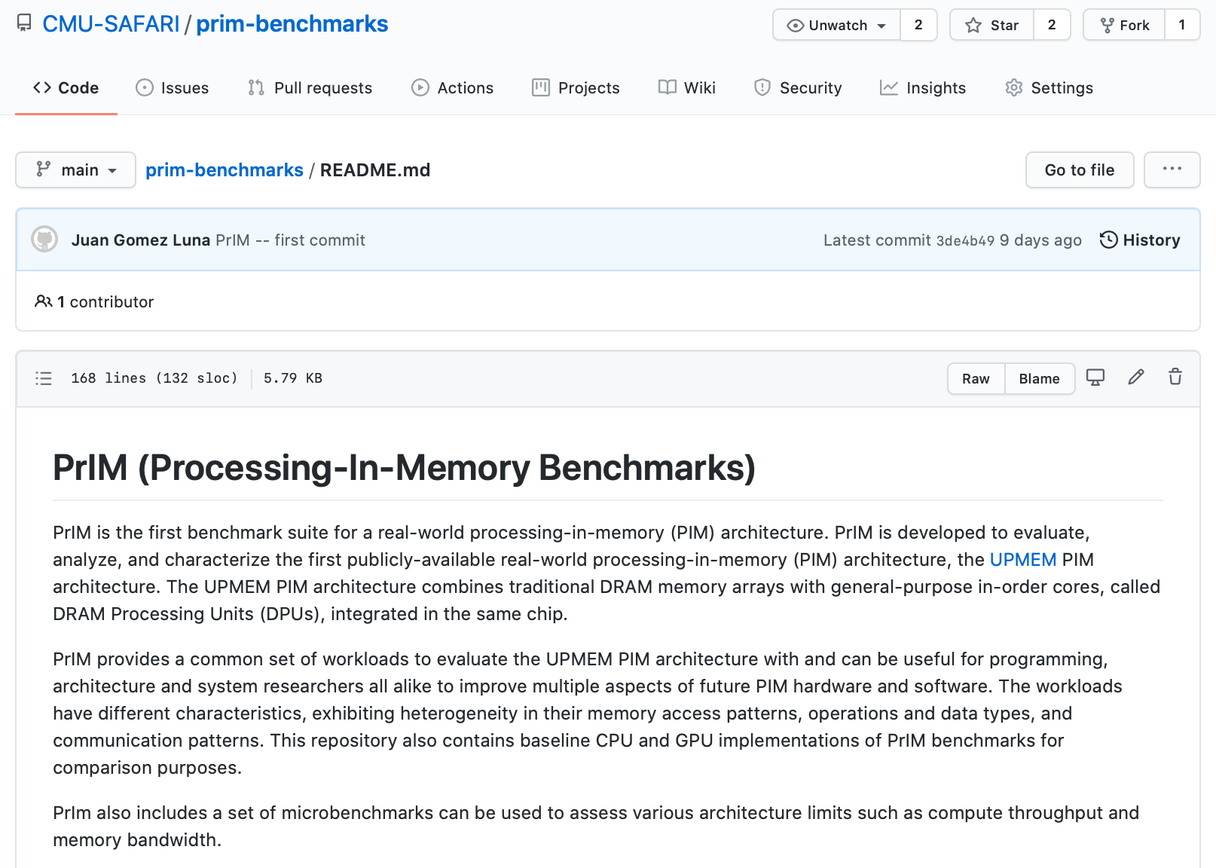
PrIM Repository
All microbenchmarks, benchmarks, and scripts
https://github.com/CMU-SAFARI/prim-benchmarks

Slide 70
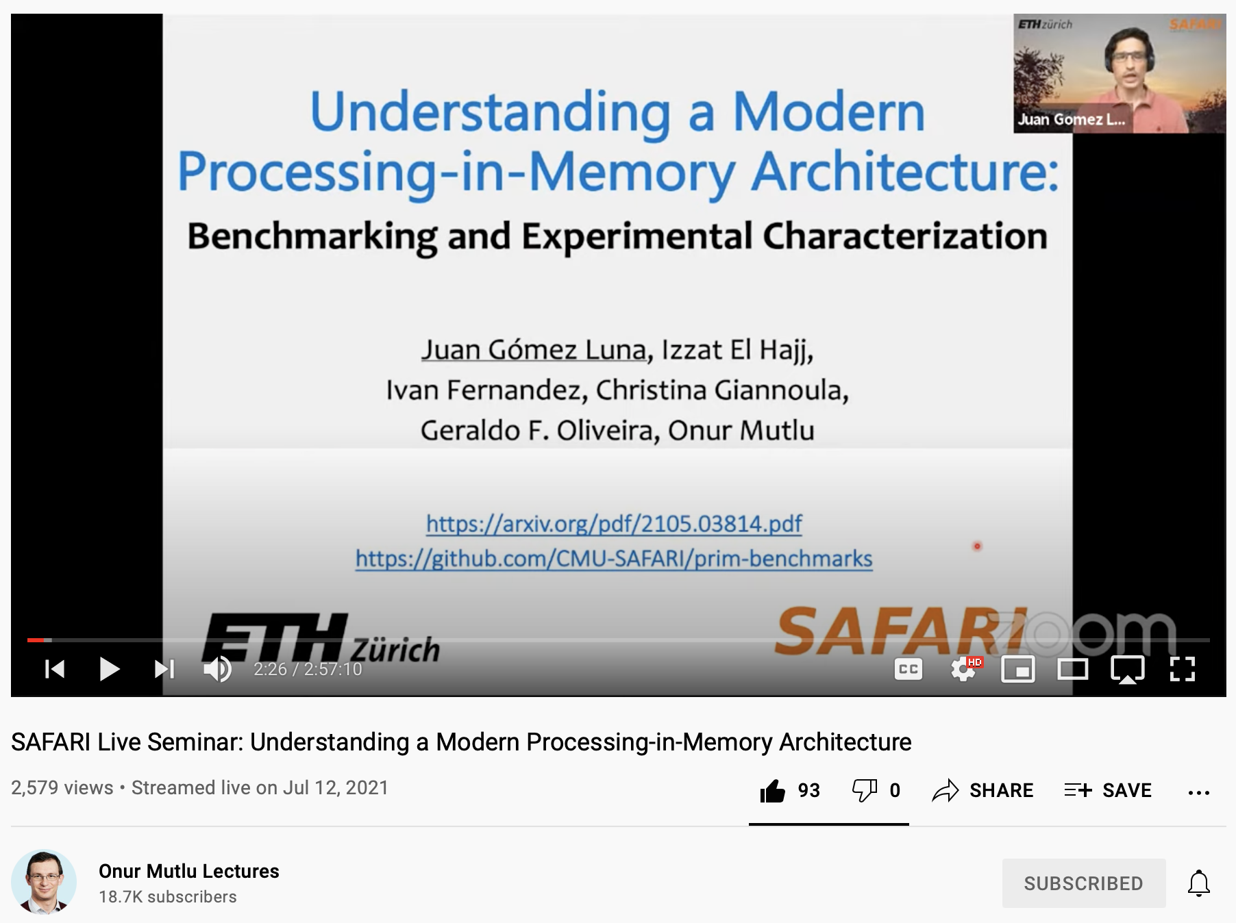
Understanding a Modern PIM Architecture
https://www.youtube.com/watch?v=D8Hjy2iU9l4&list=PL5Q2soXY2Zi_tOTAYm--dYByNPL7JhwR9

Slide 71
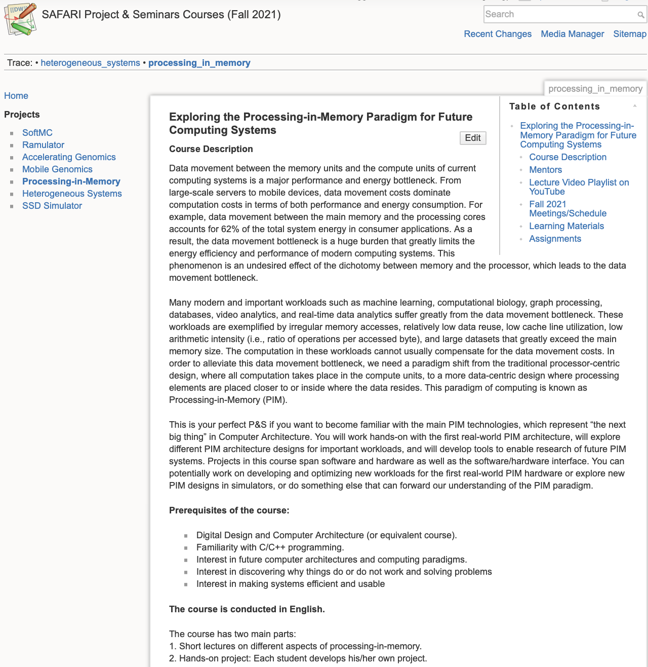
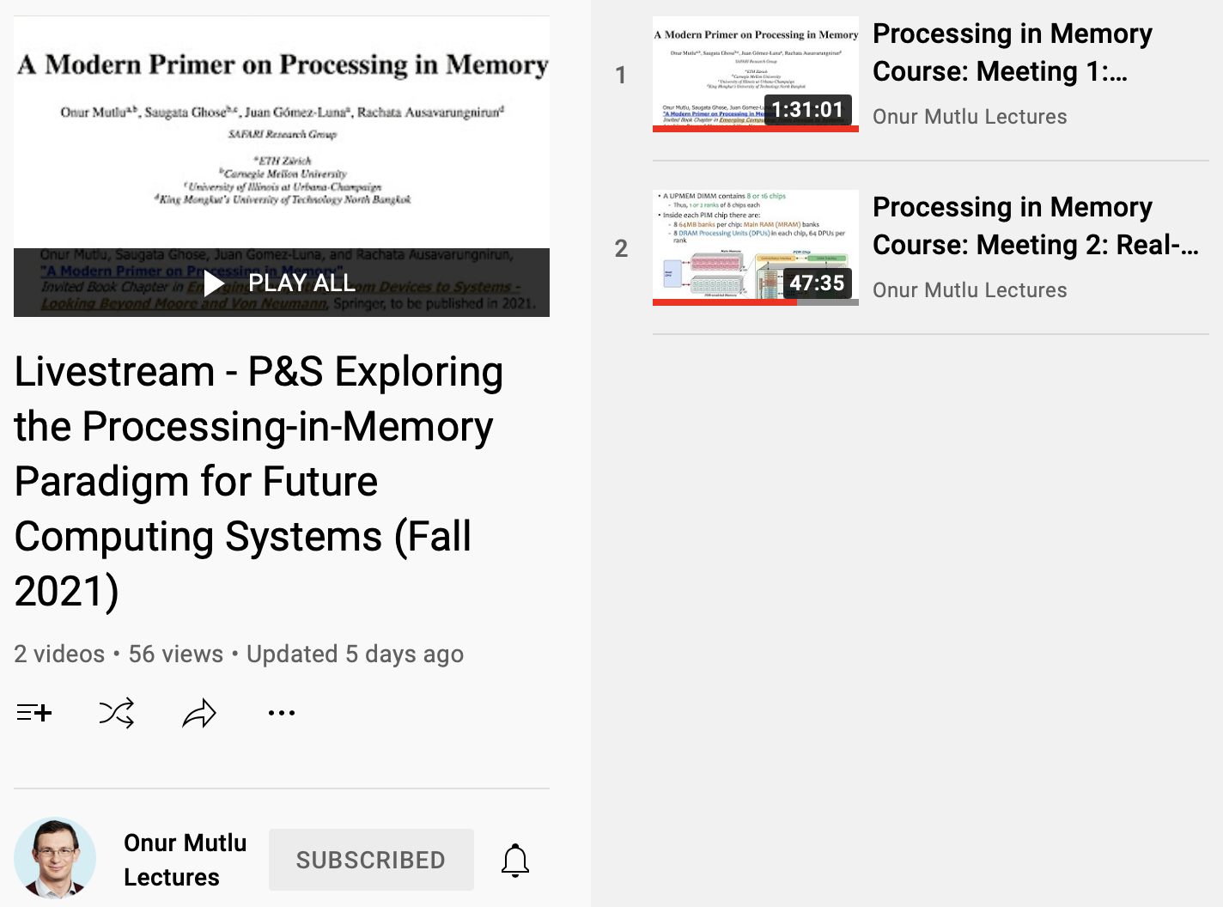
Processing-in-Memory Course (Fall 2021)
Short weekly lectures
Hands-on projects
https://youtube.com/playlist?list=PL5Q2soXY2Zi-841fUYYUK9EsXKhQKRPyX
https://safari.ethz.ch/projects_and_seminars/fall2021/doku.php?id=processing_in_memory

Slide 72
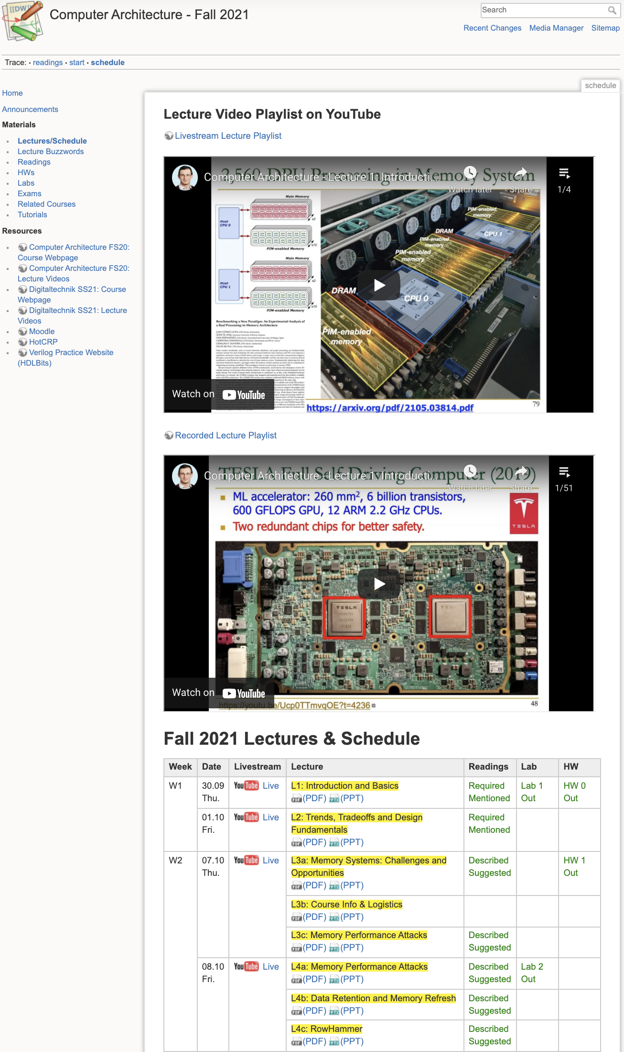
Comp Arch (Fall 2021)
https://safari.ethz.ch/architecture/fall2021/doku.php?id=schedule
Youtube Livestream:
  https://www.youtube.com/watch?v=4yfkM_5EFgo&list=PL5Q2soXY2Zi-Mnk1PxjEIG32HAGILkTOF
Master’s level course
  Taken by Bachelor’s/Masters/PhD students
  Cutting-edge research topics + fundamentals in Computer Architecture
  5 Simulator-based Lab Assignments
  Potential research exploration
  Many research readings

Slide 73
Workshop on Computing with Unconventional Technologies (CUT 2021)
Benchmarking Memory-Centric Computing Systems:
Analysis of Real Processing-in-Memory Hardware
Juan Gómez Luna, Izzat El Hajj,
Ivan Fernandez, Christina Giannoula,
Geraldo F. Oliveira, Onur Mutlu
https://arxiv.org/pdf/2110.01709.pdf
https://arxiv.org/pdf/2105.03814.pdf
https://github.com/CMU-SAFARI/prim-benchmarks

