Slide 1
Binary Star: Coordinated Reliability in Heterogeneous Memory Systems for High Performance and Scalability
Xiao Liu¹, David Roberts, Rachata Ausavarungnirun²
Onur Mutlu³, Jishen Zhao¹
¹UC San Diego, ²King Mongkut's University of Technology North Bangkok, ³ETH Zurich
52nd IEEE/ACM International Symposium on Microarchitecture®
October 12-16, 2019, Columbus, Ohio, USA
Notes:
Thanks for the introductions
Hybrid mem is a heterogeneous memory consists of 3D DRAM cache and main memory
This work collaborates with ETH Zurich and king mongkuts

Slide 2
Large memory capacity is in demand
S960
20TB
X1e
16TB
S192m
Scale-up Cloud Server
Memory Capacity (TB)
X1e
S192
X1
cr1.8x
r3.8x
G5
[Ogleari+, HPCA’ 2019]
Notes:
Application today
The major cloud service providers
The largest main memory capacity of a single node. Increase from less than 1 tb to more than 15 tb in less than three years.
[only talk about demand for memory capacity increases ]

Slide 3
Decreasing reliability in future DRAM
Scaling: decrease cell size to increase capacity.
Increasing error rate:
Vulnerability of ultra-thin dielectric material.
Increased variance between cells on retention time.
10⁻³
10⁻⁴
10⁻⁵
Bit Error Rate
10⁻⁵
10⁻⁶
10⁻⁷
10⁻⁸
Technology nodes (nm)
[Cha+, HPCA’17]

Slide 4
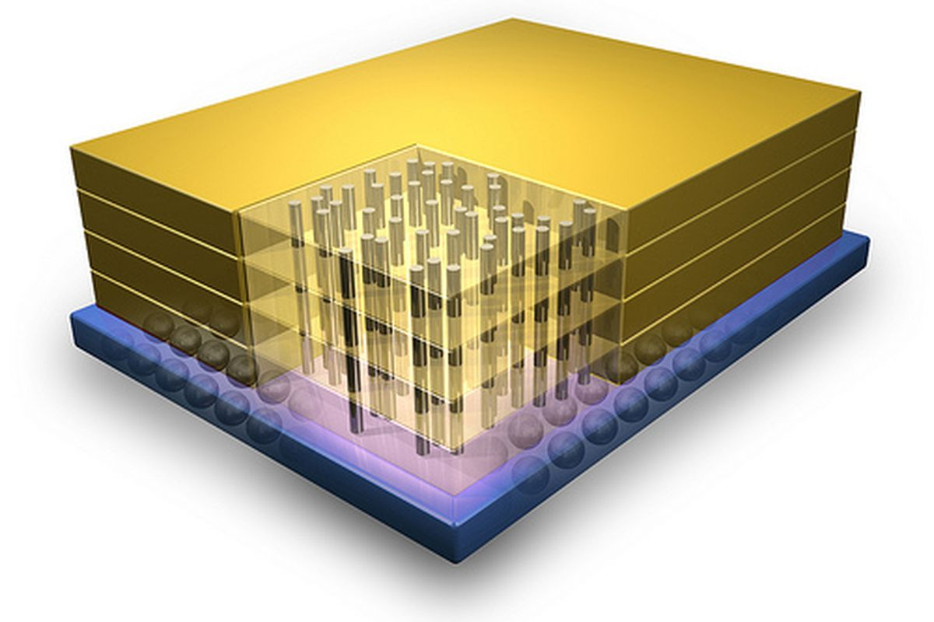
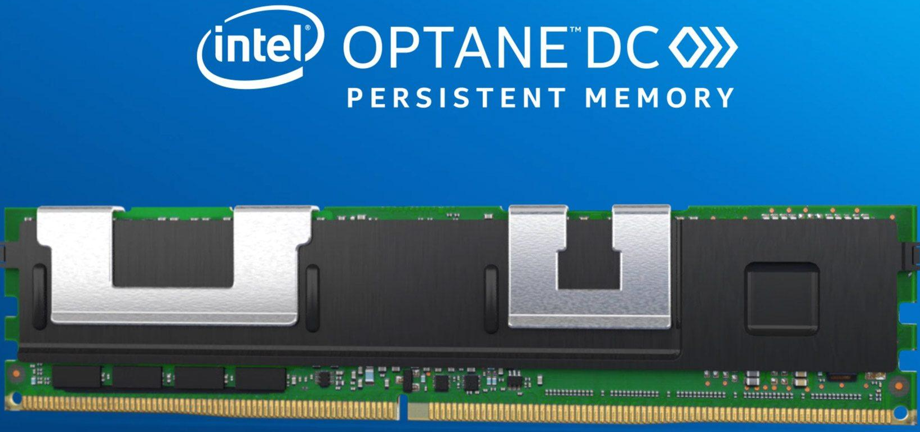
Benefit of hybrid memory
3D stacked DRAM
Processor
Core
Core
…
Core
L1 Cache
L1 Cache
…
L1 Cache
Shared SRAM Caches
3D DRAM LLC (Gigabytes)
Main Memory (Hundreds of GB ~ TB)
Izraelevitz, J., Yang, J., Zhang, L., Kim, J., Liu, X., Memaripour, A., Soh, Y.J., Wang, Z., Xu, Y., Dulloor, S.R., Zhao, J. and Swanson, S. 2019. Basic performance measurements of the intel optane DC persistent memory module. arXiv preprint arXiv:1903.05714.
Notes:
On the other hand, numerous emerging memory device shows up.
DRAM evolves by itself.
NVRAM
In this work we look into a combination of both.
Add non-volatile memory for example optane DC, change order of animation, arxiv paper

Slide 5
Reliability issues with traditional memory hierarchy scaling
28nm RECC DRAM
Better Reliability
Better Performance
Notes:
We statistically analyze the reliability and performance issue of traditional memory hierarchy.

Slide 6
Reliability issues with traditional memory hierarchy scaling
28nm RECC DRAM
Sub-20nm RECC+IECC DRAM
Better Reliability
Scales to <20nm
Better Performance

Slide 7
Reliability issues with traditional memory hierarchy scaling
28nm RECC DRAM
28nm RECC DRAM with 3D DRAM Cache
Sub-20nm RECC+IECC DRAM
Better Reliability
Add a 28nm
3D DRAM LLC
Sub-20nm RECC+IECC DRAM with 3D DRAM Cache
Add a sub-20nm 3D DRAM LLC
Better Performance

Slide 8
Opportunity #1
Inefficiency of decoupled reliability schemes
ECC
A_{c}
Error
On-chip 3D-stacked DRAM LLC
ECC
A_{m}
A_{p}
log
Off-chip Main Memory (Persistent)
Duplicated and unaware of each other

Slide 9
Opportunity #2
Most cache lines are clean
Fraction of
Clean LLC Blocks
0
5
10
Time (Seconds)
Errors on the clean cache line can be corrected by data in NVRAM
Notes:
Smooth talk

Slide 10
Binary Star: design overview
Core
Core
…
Core
…
L1 Cache
L1 Cache
L1 Cache
Shared SRAM Caches
On-chip 3D-stacked DRAM LLC (Gigabytes)
Last-level Cache
Off-chip NVRAM Main Memory
(Hundreds of Gigabytes ~ Terabytes)
Main
Memory
On-chip Components
On-chip Components
Off-chip Components
Notes:
Make all above 22

Slide 11
Binary Star: design overview
Core
Core
…
Core
…
L1 Cache
L1 Cache
L1 Cache
Shared SRAM Caches
On-chip 3D-stacked DRAM LLC (Gigabytes)
Coordinated Reliability Scheme Between 3D DRAM LLC and NVRAM
Off-chip NVRAM Main Memory
(Hundreds of Gigabytes ~ Terabytes)
On-chip Components
On-chip Components
Off-chip Components

Slide 12
Binary Star: design overview
Core
Core
…
Core
…
L1 Cache
L1 Cache
L1 Cache
Shared SRAM Caches
On-chip 3D-stacked DRAM LLC (Gigabytes)
Off-chip NVRAM Main Memory
(Hundreds of Gigabytes ~ Terabytes)
Coordinating Wear-Leveling with data consistency of the main memory
On-chip Components
On-chip Components
Off-chip Components

Slide 13
Periodic forced writeback
Binary Star Daemon: conducts periodic forced writebacks
Stalls the application
Saves process state
Issues cache-line writeback instructions
Observation 1: Errors in the LLC can be corrected by consistent data copies in NVRAM main memory.
All SRAM caches
a
On-chip 3D DRAM
LLC
CRC
b
ECC
Periodic forced writeback
(Infrequent, e.g., every 30 minutes)
a
b
Consistent
NVRAM block
a
c
b
Inconsistent
NVRAM block
Off-chip NVRAM
Notes:
About 30 minutes: we conduct sensity study and configure out. Trade-off

Slide 14
Consistent cache writeback
Observation 1: Errors in the LLC can be corrected by consistent data copies in NVRAM main memory.
Observation 2: NVRAM wear leveling naturally redirects and maintains the remapping of data updates to alternative memory locations.
On-chip 3D DRAM
LLC
CRC
a’
a’’
A
A’
Consistent
NVRAM block
a
a’
a’’
c
b
b
Inconsistent
NVRAM block
Off-chip NVRAM
Binary Star Triggered Wear-leveling
(once each periodic writeback interval)
Notes:
What if the cache line wants to evict a dirty cacheline?

Slide 15
LLC error correction and recovery
Error Recovery:
Application rolls back to execute from the last checkpoint
Error Correction:
Invalidate the Cache Line;
Serve a LLC Miss
No (Clean LLC Line)
Dirty?
Yes (Dirty LLC Line)
On-chip 3D DRAM
LLC
Error
CRC
a
a
a
A
A’
Consistent
NVRAM block
a
a’
a
c
Consistent Data
(A Checkpoint)
Inconsistent
NVRAM block
Off-chip NVRAM
Notes:
More smooth

Slide 16
Experiment setup
Simulators: McSimA+ (Performance), FaultSim (Reliability)
Baselines:
3D DRAM cache with DRAM main memory
DRAM main memory only
3D DRAM cache with NVRAM main memory (PCM)
NVRAM main memory only (PCM)
Notes:
Add animations for focus

Slide 17
Experiment setup
Simulators: McSimA+ (Performance), FaultSim (Reliability)
Baselines:
3D DRAM cache with DRAM main memory
DRAM main memory only
3D DRAM cache with NVRAM main memory (PCM)
NVRAM main memory only (PCM)
Notes:
Add animations for focus

Slide 18
Experiment setup
Resilience schemes:
Rank level ECC (RECC)
In-DRAM ECC (IECC)
Chipkill combined with IECC
Binary Star
Workloads:
In-memory/traditional databases workloads (Redis, Memcached, TPCC, YCSB, mysql)
Memory intensive workloads from PARSEC
Notes:
Add animations for focus

Slide 19
Experiment setup
Resilience schemes:
Rank level ECC (RECC)
In-DRAM ECC (IECC)
Chipkill combined with IECC
Binary Star
Workloads:
In-memory/traditional databases workloads (Redis, Memcached, TPCC, YCSB, mysql)
Memory intensive workloads from PARSEC
Notes:
Add animations for focus

Slide 20
Evaluation: system reliability
Better
System | FIT | Storage cost
 |  | DRAM LLC | Main memory
No-ECC 28nm DRAM | 44032-66150 | N/A | 0%
RECC 28nm DRAM | 8806-13230 | N/A | 12.50%
IECC+RECC sub-20nm 3D DRAM+DRAM | 78211-117912 | 18.75% | 18.75%
IECC+Chipkill sub-20nm 3D DRAM+DRAM | 37949-59518 | 18.75% | 18.75%
RECC sub-20nm 3D DRAM+PCM | 6352-9963 | 12.50% | 12.79%
Binary Star sub-20nm 3D DRAM+PCM
2637-3968
6.25%
12.79%
Notes:
Talk about the meaning of x/y axises
Add animations

Slide 21
Evaluation: devices’ reliability
3D-DRAM device error rate (for sub20 nm)
10¹⁶x reduction compares to RECC
10¹²x reduction compares to Chipkill+IECC
Number of writes to NVRAM
20% more writes when the periodic force writeback interval is 30 mins

Slide 22
Evaluation: performance
Better
3D DRAM+DRAM
Normalized Throughput
Within 1%
Notes:
Talk about the meaning of x/y axises
None of these baseline has any realibility
Animations

Slide 23
Other results
NVRAM latency sensitivity study
Effect on varying the periodic forced writeback interval
Performance
Rollback rate
Number of writes

Slide 24
Summary
Binary Star
Core
Core
…
Core
…
L1 Cache
L1 Cache
L1 Cache
Shared SRAM Caches
On-chip 3D-stacked DRAM LLC (Gigabytes)
Last-level Cache
Off-chip NVRAM Main Memory
(Hundreds of Gigabytes ~ Terabytes)
Main
Memory
On-chip Components

Slide 25
Summary
28nm RECC DRAM
28nm RECC DRAM with 3D DRAM Cache
Better Reliability
Sub-20nm RECC+IECC DRAM
Sub-20nm RECC+IECC DRAM with 3D DRAM Cache
Binary Star
Better Performance

Slide 26
Binary Star: Coordinated Reliability in Heterogeneous Memory Systems for High Performance and Scalability
Xiao Liu¹, David Roberts, Rachata Ausavarungnirun²
Onur Mutlu³, Jishen Zhao¹
¹UC San Diego, ²King Mongkut's University of Technology North Bangkok, ³ETH Zurich
52nd IEEE/ACM International Symposium on Microarchitecture®
October 12-16, 2019, Columbus, Ohio, USA

Slide 27
Summary
Binary Star utilizes state-of-art 3D DRAM and NVRAMs to provide large memory.
Binary coordinates resilience schemes to enable high reliability memory system.
Binary Star coordinates built in wear-leveling to enable high performance resilience guarantee.
Binary Star decreases the possibility of system failures by 92.9% compares to the state-of-the-art designs.
Binary Star achieves 99% performance of a conventional DRAM based system with no error correction.

Slide 28
Binary Star triggered Wear-leveling
Segment
number
A
A
A’
B
B’
Periodic forced
writeback
Consistent Cache
Writeback
A
A’
B
B
B’
Free Segment
Consistent Segment
Inconsistent Segment

Slide 29
Binary Star Daemon
Stall all
processes
Periodic forced writeback interval reached
Normal
application
execution
Memory error signal
Stall all
processes
Identify
erroneous
processes
2
1
6
7
Save all
processes’
PCB
Flush
all caches
with bclwb
Resume
all the
processes
Retrieve
data
with drst
Retrieve
the ckpted
PCBs
3
4
5
9
8
Periodic forced writeback
Rollback

Slide 30
NVRAM latency sensitivity study
Throughput

Slide 31
Effect on varying the periodic forced writeback interval
Normalized Throughput
Periodic Forced Writeback Interval (s)

Slide 32
Effect on varying the periodic forced writeback interval
8×10⁻⁹
6×10⁻⁹
Rollback rate
4×10⁻⁹
2×10⁻⁹
0
Periodic Forced Writeback Interval (s)

Slide 33
Evaluation: 3D-DRAM reliability
Better
10⁻³
10⁻⁷
10⁻¹¹
10⁻¹⁵
10¹⁶
Device Failure Rate
10⁻¹⁹
10¹²
28 nm
10⁻²³
Sub-20 nm
10⁻²⁷
10⁻³¹
10⁻³⁵
10⁻¹⁴
10⁻¹²
10⁻¹⁰
10⁻⁸
10⁻⁶
10⁻⁴
Single Cell BER
Notes:
Talk about the meaning of x/y axises
Add animation

Slide 34
Effect on varying the periodic forced writeback interval
Normalized writes
3D DRAM+PCM
17.2x
Periodic Forced Writeback Interval (s)

Slide 35
Backup
Notes:
Add results
1. Figure out question first, 2.hard question: do not had to , take offline,
3. Good question, 4. do not have strong jundgement

