Slide 1






BreakHammer
Enhancing RowHammer Mitigations by Carefully Throttling Suspect Threads
Oğuzhan Canpolat A. Giray Yağlıkçı
Ataberk Olgun İsmail E. Yüksel
Yahya C. Tuğrul Konstantinos Kanellopoulos
Oğuz Ergin Onur Mutlu
https://github.com/CMU-SAFARI/BreakHammer
Notes:
Hi all. I am Oğuzhan, very excited to be here and be able to present our work BreakHammer: Enhancing RowHammer Mitigations by Carefully Throttling Suspect Threads.

Slide 2
Executive Summary
Problem:
DRAM continues to become more vulnerable to RowHammer
Operations that prevent RowHammer (i.e., RowHammer-preventive actions) are time consuming and block access to memory
Key Exploit: Mount a memory performance attack by triggering
RowHammer-preventive actions to block memory access for long time periods
Goal: Reduce the performance overhead of RowHammer mitigation mechanisms by reducing the number of performed RowHammer-preventive actions
without compromising system robustness
Key Idea: Throttle threads that frequently trigger RowHammer solutions
Key Mechanism: BreakHammer
Observes triggered RowHammer-preventive actions
Identifies threads that trigger many preventive actions (i.e., suspect threads)
Reduces the memory bandwidth usage of the suspect threads
Key Results: BreakHammer significantly reduces the negative effects of RowHammer mitigation mechanisms on performance, energy, and fairness
https://github.com/CMU-SAFARI/BreakHammer
Notes:
Here is an executive summary of my talk:
[CLICK] DRAM continues to become more vulnerable to RowHammer…
Operations that prevent RowHammer, which we call…
[CLICK] We introduce a new exploit where one can mount a memory performance attack…
[CLICK] Our goal is to…
[CLICK] Our key idea is to throttle threads…
[CLICK] To this end, we propose a new mechanism, BreakHammer: which
[CLICK] Observes triggered RowHammer-preventive actions
[CLICK] Identifies threads that trigger many preventive actions (we call such threads suspect threads), and
[CLICK] Reduces the memory bandwidth usage of the suspect threads
[CLICK] Our rigorous evalutions show that BreakHammer significantly reduces the negative effects of RowHammer solutions on performance, energy, and fairness
[CLICK] BreakHammer and all of our datasets are fully open-sourced and available online
====
Don’t say unfairness

Slide 3
Outline
Background
Motivation
BreakHammer
Evaluation
Conclusion
Notes:
Here is the outline of my talk, I’ll continue with a brief background on DRAM and DRAM read disturbance

Slide 4
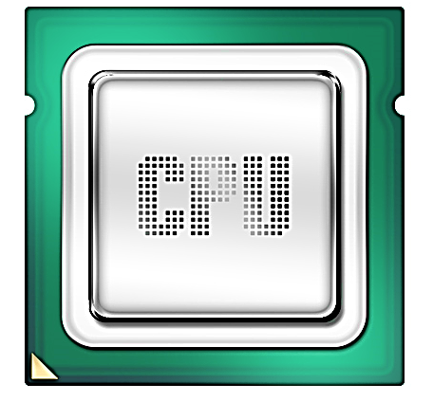
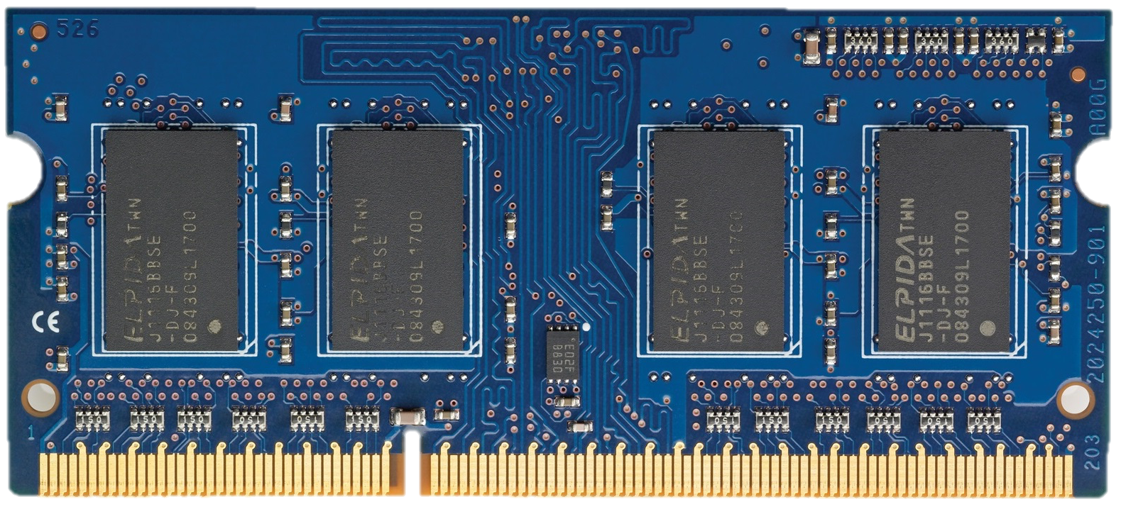
DRAM Organization
DRAM Chips
DRAM
Channel
DRAM Module
Notes:
Here I show a typical computing system with a processor and a DRAM module connected through the DRAM channel
[CLICK] A DRAM module contains multiple DRAM chips

Slide 5
DRAM Organization
DRAM Cell
Bitline
DRAM
Array
Wordline
Bank
S
S
S
S
Sense Amplifiers
(Row Buffer)
Off-Chip Channel
Notes:
and a DRAM chip [CLICK] contains several DRAM banks
[CLICK] inside each DRAM bank, we have a two dimensional array of DRAM cells
[CLICK] where a DRAM cell stores a single bit of information as electrical charge
[CLICK] DRAM cells are horizontally organized as DRAM rows and are connected via wordlines
[CLICK] and they are vertically connected to sense amplifiers via bitlines for DRAM accesses

Slide 6
RowHammer:
A Prime Example of Read Disturbance
DRAM Subarray
Row 0
Row 0
Victim Row
Row 1
Row 1
Row 1
Victim Row
Row 2
Row 2
Row 2
Row 2
Row 2
Row 2
open
open
open
closed
closed
Aggressor Row
Row 3
Row 3
Row 3
Victim Row
Row 4
Row 4
Victim Row
Repeatedly opening (activating) and closing (precharging)
a DRAM row causes read disturbance bitflips in nearby cells
Notes:
DRAM is accessed at a row granularity, however today, this access is not perfect
Where it is vulnerable to read disturbance, here I show a prime example of DRAM read disturbance, called RowHammer
Where repeatedly [CLICKx4] opening and closing a DRAM row induces bitflips in nearby unaccessed DRAM cells
[CLICK] in RowHammer terminology, we refer the repeatedly opened row as the aggressor row
and we refer the nearby unaccessed rows that experience bitflips as the victim rows
======
repeatedly?

Slide 7
Read Disturbance Vulnerabilities (I)
DRAM Subarray
Row 0
Row 0
Victim Row
Row 1
Row 1
Row 1
Victim Row
Row 2
Row 2
Row 2
Row 2
Row 2
open
open
open
closed
Aggressor Row
Row 3
Row 3
Row 3
Victim Row
Row 4
Row 4
Victim Row
The minimum number of activations that causes a bitflip is called the RowHammer threshold (N_{RH})
Notes:
We denote the minimum amount of activations to cause a bitflip as the RowHammer threshold, or NRH

Slide 8
Read Disturbance Vulnerabilities (II)
Technology Scaling
It is critical to prevent read disturbance bitflips
effectively and efficiently for highly vulnerable systems
Notes:
DRAM modules are continuously becoming more vulnerable to read disturbance over generations
[CLICK] over the last decade, we have seen more than two orders of magnitude decrease in the necessary activations to induce the first bitflip
[CLICK] therefore, it is critical to effectively and efficiently prevent these bitflips

Slide 9
Existing RowHammer Mitigations:
RowHammer-Preventive Actions
Many ways to prevent RowHammer via
RowHammer-preventive actions:
Preventive refresh
Row migration
Proactive throttling
…
State-of-the-art RowHammer mitigation mechanisms adopt these two approaches
Notes:
There are many ways proposed to prevent RowHammer with what we call RowHammer-preventive actions
[CLICK] Here I show a non exhaustive list of actions one can perform to mitigate RowHammer bitflips
[CLICK] In our talk, we will focus on these preventive refresh and row migration, as state-of-the-art solutions adopt these RowHammer-preventive actions
=====
Name them here

Slide 10
Preventive Refresh as a RowHammer-Preventive Actions
DRAM
Row 0
Row 0
Row 0
Victim Row
Row 1
Row 1
Row 1
Row 1
Victim Row
Row 2
Row 2
Row 2
Row 2
Row 2
Row 2
open
open
open
closed
Aggressor Row
Aggressor Row
Row 3
Row 3
Row 3
Row 3
Victim Row
Row 4
Row 4
Row 4
Victim Row
Refreshing potential victim rows
mitigates RowHammer bitflips
Notes:
One of these ways is to [CLICK] preventively refresh the potential victims of an aggressor row before they experience bitflips

Slide 11
Row Migration as a RowHammer-Preventive Action
DRAM
Row 0
Row 0
Victim Row
Row 1
Row 1
Row 1
Aggressor Row
Row 2
Row 2
Row 2
Row 2
Row 2
Row 2
open
open
open
closed
Aggressor Row
Victim Row
…
Row 4
Distant Row
Aggressor Row
Migrating potential aggressor rows
to a distant row mitigates RowHammer bitflips
Notes:
And another way is to [CLICK] move the contents of an aggressor row to a distant row away from its potential victims
before it has been activated enough times to induce a bitflip

Slide 12
Outline
Background
Motivation
BreakHammer
Evaluation
Conclusion
Notes:
I’ll continue with the motivation of our work

Slide 13

Root Cause of Performance Overhead
RowHammer-preventive actions are
blocking and time consuming operations
REF
ACT
DRAM
Channel
DRAM Module
Memory controller cannot access a memory bank
undergoing a RowHammer-preventive action
Refreshing KBs of data can block access to GBs of data
Notes:
One of the problem with RowHammer-preventive actions is that they are blocking operations
[CLICK] where the memory controller cannot access a memory bank undergoing a RowHammer-preventive action
[CLICK] As such, refreshing KBs of data can block access to GBs of data

Slide 14
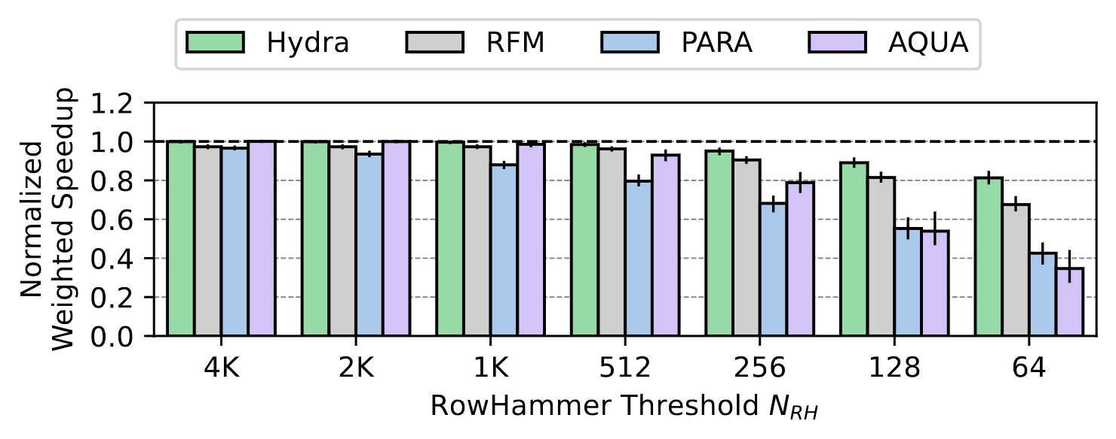
RowHammer Mitigation Performance Overhead
Preventive Refresh
Row Migration
Lower is worse
Lower is worse
Notes:
We analyze the system performance impact of blocking RowHammer-preventive actions by evaluating four state-of-the-art RowHammer solutions
[CLICK] Here, the X axis shows the decreasing RowHammer threshold
[CLICK] the Y axis shows the weighted speedup, normalized to a system with no RowHammer defense
[CLICK] and each bar identifies a different RowHammer mitigation mechanism
Hydra, RFM, and PARA use preventive refresh
And AQUA uses row migrations
[CLICK] From our analysis, we observe that RowHammer mitigation mechanisms incur significantly increasing performance overhead as the RowHammer threshold decreases

Slide 15
RowHammer Mitigation Performance Overhead
Preventive Refresh
Row Migration
19%
66%
RowHammer mitigation mechanisms incur
increasingly large performance overhead
as the RowHammer threshold decreases
Notes:
We analyze the system performance impact of blocking RowHammer-preventive actions by evaluating four state-of-the-art RowHammer solutions
[CLICK] Here, the X axis shows the decreasing RowHammer threshold
[CLICK] the Y axis shows the weighted speedup, normalized to a system with no RowHammer defense
[CLICK] and each bar identifies a different RowHammer mitigation mechanism
Hydra, RFM, and PARA use preventive refresh
And AQUA uses row migrations
[CLICK] From our analysis, we observe that RowHammer mitigation mechanisms incur significantly increasing performance overhead as the RowHammer threshold decreases

Slide 16





Memory Performance Attack
Attacker can trigger many preventive actions
to block access to main memory
Attacker
Core
Memory
Controller
User
Core
Preventive actions can be exploited
to reduce DRAM bandwidth availability
Notes:
Even worse, at these lower thresholds, RowHammer-preventive actions become a potential memory performance attack vector
[CLICK] where an attacker can intentionally trigger many of RowHammer-preventive actions
and cause a DRAM module to get blocked for extended periods of time, thereby reducing DRAM bandwidth availability
=====
Use whitespace, separate attacker and user
Maybe change the user icon
Use a sad icon

Slide 17
Problem & Goal
Problem
Operations that prevent RowHammer lead to
DRAM bandwidth availability issues
as they can frequently block access to memory
Goal
Reduce the performance overhead
of RowHammer mitigation mechanisms
by reducing the number of RowHammer-preventive actions
without compromising system robustness
Notes:
Therefore, the problem we tackle is [STOP] operations that prevent RowHammer become a system performance vulnerability as they can frequently block access to memory
[CLICK] and our goal is to reduce the performance overhead of RowHammer mitigation mechanisms by reducing the number of performed RowHammer-preventive actions without compromising system robustness

Slide 18
Outline
Background
Motivation
BreakHammer
Evaluation
Conclusion
Notes:
To this end, we propose a new mechanism, BreakHammer

Slide 19
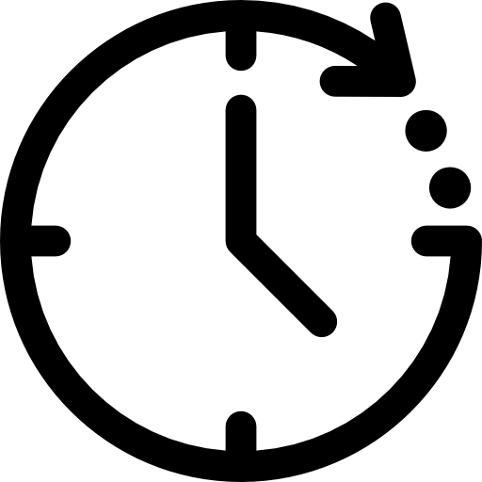
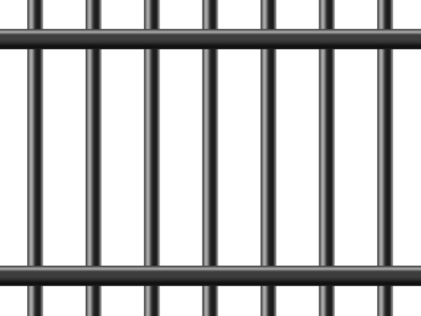

Key Idea
Detect and slow down the memory accesses of threads
that trigger many RowHammer-preventive actions
Suspect Thread
Attacker
Core
Memory
Controller
User
Core
Notes:
BreakHammer’s key idea is to detect and slow down the memory accesses of threads that trigger many RowHammer-preventive actions
[CLICK] We refer to these threads as suspect threads

Slide 20


BreakHammer: Overview
Execution Timeline
Throttling Window
Throttling Window
Throttling Window
RowHammer-Preventive Action
Thread 1’s Row Activations
REF_{P}
T1
T4
T2
T4
T1
T3
T4
REF_{P}
Time
1
2
3
Thread
Score
T1
10 ↑↑
T1
T2
T3
T4
T2
2 ↑
T3
3 ↑
LD
LD
LD
LD
T4
50 ↑↑↑
Suspect
Observing RowHammer-
Preventive Actions
Identifying Suspect Threads
Throttling Memory
Bandwidth Usage
Notes:
Here I show a cartoonish execution overview of BreakHammer.
[CLICK] BreakHammer divides the execution timeline into periods of equal length which we call Throttling Windows
[CLICK] and views the execution as a stream of row activations from different threads, and RowHammer-preventive actions
Whenever a RowHammer-preventive action is triggered, BreakHammer performs three key operations:
[CLICK] First, BreakHammer attributes what we call a RowHammer-preventive score to each thread proportional to their contribution to the given RowHammer-preventive action
[CLICK] Next, BreakHammer performs outlier analysis on the attributed scores
And detects suspect threads that unfairly reduce DRAM bandwidth availability
[CLICK] Lastly, BreakHammer slows down suspect threads by reducing their memory bandwidth usage
====
Try to say the section titles as well

Slide 21
BreakHammer: Overview
Execution Timeline
Throttling Window
Throttling Window
Throttling Window
RowHammer-Preventive Action
Thread 1’s Row Activations
REF_{P}
T1
T4
T2
T4
T1
T3
T4
REF_{P}
Time
1
2
3
Thread
Score
T1
10 ↑↑
T1
T2
T3
T4
T2
2 ↑
T3
3 ↑
LD
LD
LD
LD
T4
50 ↑↑↑
Suspect
Observing RowHammer-
Preventive Actions
Identifying Suspect Threads
Throttling Memory
Bandwidth Usage
Notes:
Now let’s take a deeper look on how BreakHammer attributes RowHammer-preventive scores
=====
Subscript p for REFs, they are not periodic refreshes

Slide 22
Observing RowHammer-Preventive Actions
BreakHammer tracks the number
of RowHammer-preventive actions each thread triggers
RowHammer-preventive score counter
Thread 1
Thread 2
Thread 3
Thread 4
Notes:
BreakHammer tracks the number of RowHammer-preventive actions each hardware thread triggers
[CLICK] To do so, BreakHammer implements a counter called RowHammer-preventive score for each hardware thread

Slide 23




Observing RowHammer-Preventive Actions:
Score Attribution Method
A RowHammer-preventive action is generally caused by
a stream of memory requests from many hardware threads
RH-Preventive Score
Thread 1
Thread 2
Thread 3
Thread 4
T1
T4
T2
T4
T4
T1
T3
T4
REF_{P}
Time
Thread 1’s Row Activations
RowHammer-Preventive Action
Notes:
The challenge with updating scores is that
one cannot directly attribute a RowHammer-preventive action to a single thread
because a RowHammer-preventive action is generally caused by a stream of memory requests contributed by many hardware threads
[CLICK] Here on the bottom I show a timeline of DRAM row activations and RowHammer-preventive actions
[CLICK] Where a stream of row activations from multiple threads trigger a preventive action
[CLICK] When a preventive action is triggered, BreakHammer attributes a score to each thread
PROPORTIONAL to the number of row activations the thread performed for the observed action

Slide 24
Observing RowHammer-Preventive Actions:
Integration Showcase
1)
Probabilistic Row Activation (PARA)
2)
Per Row Activation Counting (PRAC)
Notes:
BreakHammer cooperates with existing RowHammer solutions
Therefore, observed RowHammer-preventive actions change depending on the mechanism BreakHammer is integrated with
Here I show two examples on how BreakHammer can be integrated with existing solutions
====
Do not be Turkish on PARA

Slide 25
Observing RowHammer-Preventive Actions:
Integration Showcase
1)
Probabilistic Row Activation (PARA)
2)
Per Row Activation Counting (PRAC)
Notes:
Our first example is a memory-controller-based mechanism called Probabilistic Row Activation or PARA for short
====
Slide numbers missing on outlines

Slide 26

Observing RowHammer-Preventive Actions:
Integration Showcase with PARA (I)
BreakHammer cooperates with existing RowHammer solutions
Probabilistic Row Activation (PARA) [Kim+, ISCA 2024]:
Generates a random number
Compares the number with a threshold
If the random number exceeds the threshold performs a preventive refresh
>?
access
refresh_{P}
Notes:
In systems protected with PARA, whenever a DRAM row is activated
[CLICK] PARA generates a random number and compares it with a threshold
[CLICK] if the random number exceeds the threshold, PARA performs a preventive refresh

Slide 27

Observing RowHammer-Preventive Actions:
Integration Showcase with PARA (II)
Probabilistic Row Activation + BreakHammer (PARA+BH):
Track row activation count of each thread between preventive refreshes
Increment each thread’s score proportionally to its activations
RH-Preventive Score
Thread 1
Thread 2
Thread 3
access
refresh_{P}
T1
T3
T2
T3
T3
T1
T3
refresh_{P}
Time
Notes:
When we integrate BreakHammer with PARA:
[CLICK] BreakHammer tracks the row activation count of each thread between preventive refreshes
[CLICK] And whenever a preventive refresh is performed, increments each thread’s score proportionally to its activation count

Slide 28
Observing RowHammer-Preventive Actions:
Integration Showcase
1)
Probabilistic Row Activation (PARA)
2)
Per Row Activation Counting (PRAC)
Notes:
And our second example is an in-DRAM solution
Which the latest industry solution to DRAM read disturbance
Widely known as Per Row Activation Counting, or PRAC for short

Slide 29
Observing RowHammer-Preventive Actions:
Integration Showcase with PRAC (I)
BreakHammer cooperates with existing RowHammer solutions
Per Row Activation Counting (PRAC) [JEDEC, 2024]:
DRAM maintains an activation counter for each DRAM row
DRAM requests time by triggering a back-off
Memory controller provides time for
in-DRAM preventive refreshes
High Activation
Count Detected
Counter 0
back-off
Counter 1
RFM
...
Counter 3
Per Row
Activation Counters
Notes:
With PRAC
[CLICK] DRAM maintains an activation counter for each DRAM row
[CLICK] Whenever one of these counters reaches a critical value
For example close to RowHammer threshold
[CLICK] The DRAM module triggers whats called a back-off
[CLICK] After a back-off is received by the memory controller
It stops performing accesses to DRAM
And starts sending special commands that allow time for preventive refreshes
=====
Make the arrow shorter for high activation count
Refreshes should be refresh with subscript ps

Slide 30
Observing RowHammer-Preventive Actions:
Integration Showcase with PRAC (II)
Per Row Activation Counting + BreakHammer (PRAC+BH):
Track row activation count of each thread between back-offs
Increment each thread’s score proportionally to its activations
RH-Preventive Score
Thread 1
Thread 2
Thread 3
access
back-off
T1
T3
T2
T3
T3
T1
T3
back-off
Time
Notes:
When we integrate BreakHammer with PRAC:
[CLICK] BreakHammer tracks the row activation count of each thread between back-offs
[CLICK] And when a back-off is observed, BreakHammer increments each thread’s score proportionally to its activation count

Slide 31
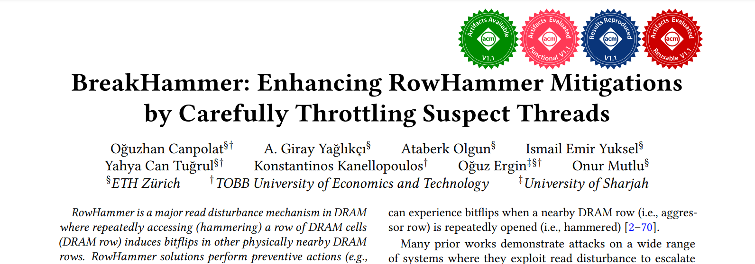
Observing RowHammer-Preventive Actions:
Integration with Other Mechanisms
We integrate BreakHammer with eight RowHammer solutions:
PARA [Kim+, ISCA 2014]
Graphene [Park+, MICRO 2020]
Hydra [Qureshi+, ISCA 2022]
TWiCe [Lee+, ISCA 2019]
AQUA [Saxena+, MICRO 2022]
REGA [Marazzi+, S&P 2023]
RFM [JEDEC 2020]
PRAC [JEDEC 2024]
https://arxiv.org/abs/2404.13477
https://github.com/CMU-SAFARI/BreakHammer
Notes:
BreakHammer is compatible with many types of RowHammer solutions including both in-memory controller and in-DRAM RowHammer mitigation mechanisms as we have seen.
In our paper, we integrate BreakHammer with eight state-of-the-art RowHammer solutions.
I would like to refer you to our paper or open-source repository for their integration.

Slide 32
BreakHammer: Overview
Execution Timeline
Throttling Window
Throttling Window
Throttling Window
RowHammer-Preventive Action
Thread 1’s Row Activations
REF_{P}
T1
T4
T2
T4
T1
T3
T4
REF_{P}
Time
1
2
3
Thread
Score
T1
10 ↑↑
T1
T2
T3
T4
T2
2 ↑
T3
3 ↑
LD
LD
LD
LD
T4
50 ↑↑↑
Suspect
Observing RowHammer-
Preventive Actions
Identifying Suspect Threads
Throttling Memory
Bandwidth Usage
Notes:
Let’s continue by looking at how BreakHammer identifies suspect threads

Slide 33

Identifying Suspect Threads:
An Example
BreakHammer detects threads that trigger too many RowHammer-preventive actions
Maximum Deviation
from the Average Score
Thread
Score
T1
10
T2
2
Score
>
Minimum Score
to Consider
T3
3
T4
50
…
…
Threads
Notes:
BreakHammer identifies suspect threads by detecting threads that trigger too many RowHammer-preventive actions
Here on the left, we have the RowHammer-preventive scores of threads in the system
[CLICK] We can visualize these scores as a distribution
Where the bars show different threads
And the height of the bars show the score of each thread
BreakHammer detects a suspect with two checks
[CLICK] First, BreakHammer checks if a thread’s score exceeds a minimum score to consider
This allows BreakHammer to protect threads with low memory intensity against suspect detection
[CLICK] Second, BreakHammer checks if a thread’s score largely exceeds the average score of all hardware threads
Doing so allows BreakHammer to detect suspect threads that unfairly reduce DRAM bandwidth availability
=====
Maximum deviation is not coming out
Do not waste white space
Add text about average score
Do not keep stuff close to each other use white space

Slide 34
BreakHammer: Overview
Execution Timeline
Throttling Window
Throttling Window
Throttling Window
RowHammer-Preventive Action
Thread 1’s Row Activations
REF_{P}
T1
T4
T2
T4
T1
T3
T4
REF_{P}
Time
1
2
3
Thread
Score
T1
10 ↑↑
T1
T2
T3
T4
T2
2 ↑
T3
3 ↑
LD
LD
LD
LD
T4
50 ↑↑↑
Suspect
Observing RowHammer-
Preventive Actions
Identifying Suspect Threads
Throttling Memory
Bandwidth Usage
Notes:
Lastly, let’s understand how BreakHammer throttles a suspect thread

Slide 35
Throttling Memory Bandwidth Usage of Suspect Threads
BreakHammer reduces the memory bandwidth usage
of each suspect thread
Cache-Miss Buffers*
Allocated
Maximum
User
0
3
∞
∞
0
1
∞
User
∞
Throttle
BreakHammer
0
2
∞
User
∞
Suspect
0
4
5
∞
∞
5
5
Last-Level Cache
Notes:
BreakHammer reduces the memory bandwidth usage of each suspect thread
There are many ways to reduce the memory bandwidth usage
[CLICK] For our implementation, we chose to limit the allocatable cache-miss buffers
Which track the requests that miss the last-level cache and are being served by the memory controller
[CLICK] At system boot, all threads have 0 allocated cache-miss buffers
and they are allowed to allocate all available cache-miss buffers in the system
[CLICK] As the threads execute and access main memory, they start allocating cache-miss buffers
[CLICK] When BreakHammer identifies a thread as suspect
It limits the number of cache-miss buffers the thread can allocate in the last-level cache
[CLICK] If a thread reaches their allocation limit
[CLICK] they can no longer make new request to main memory and must wait for their earlier requests to be resolved

Slide 36
Restoring Memory Bandwidth of Suspect Threads
BreakHammer
restores the memory bandwidth usage of a suspect thread
if the thread stays benign for the full duration of a throttling window
Memory Bandwidth
Usage Restored
Identified
This Window
Not
Identified
Still
Throttled
Suspect
Throttled
Benign
Benign
Throttling Window
Throttling Window
Throttling Window
Execution Timeline
Notes:
BreakHammer restores the memory bandwidth usage of a suspect thread back
If the thread stays benign for the full duration of a throttling window
Here on the bottom I show a execution timeline for an example
[CLICK] In the example, our thread is identified as a suspect in the first window, where BreakHammer immediately throttles their memory bandwidth usage
[CLICK] On the second window, the thread continues to execute with a reduced memory bandwidth
Where the thread stays benign and does not get identified as a suspect
[CLICK] At the end of this window, BreakHammer sees that the thread stayed benign and restores its memory bandwidth
[CLICK] Where in the last window, our thread continues to stay benign and uses its full memory bandwidth
=====
Have guides, rectangle without border can help
Bad whitespace usage
Check TCM, Atlas, BlockHammer again

Slide 37
Outline
Background
Motivation
BreakHammer
Evaluation
Conclusion
Notes:
I will continue with our evaluation of BreakHammer

Slide 38
Evaluation Methodology
Performance and energy consumption evaluation:
cycle-level simulations using Ramulator 2.0 [Luo+, CAL 2023]
and DRAMPower [Chandrasekar+, DATE 2013]
System Configuration:
  Processor 4 cores, 4.2GHz clock frequency,
  4-wide issue, 128-entry instruction window
  DRAM DDR5, 1 channel, 2 rank/channel, 8 bank groups,
  4 banks/bank group, 64K rows/bank
  Memory Ctrl. 64-entry read and write requests queues,
  Scheduling policy: FR-FCFS with a column cap of 4
  Last-Level Cache 8 MiB (4-core)
Notes:
We evaluate BreakHammer with cycle-level simulations using Ramulator 2.0 integrated with DRAMPower
[CLICK] We simulate a realistic four-core system with a DDR5 module that has 2 ranks and 64 banks in total

Slide 39
Evaluation Methodology
Comparison Points: Integrated with 8 state-of-the-art RowHammer mitigation mechanisms:
PARA [Kim+, ISCA 2014]
Graphene [Park+, MICRO 2020]
Hydra [Qureshi+, ISCA 2022]
TWiCe [Lee+, ISCA 2019]
AQUA [Saxena+, MICRO 2022]
REGA [Marazzi+, S&P 2023]
RFM [JEDEC 2020]
PRAC [JEDEC 2024]
Workloads: 4-core workload mixes from SPEC CPU2006,
SPEC CPU2017, TPC, MediaBench, YCSB
  90 mixes with one attacker
  90 mixes all benign
Notes:
We integrate BreakHammer with 8 state-of-the-art RowHammer mitigation mechanisms
And compare BreakHammer paired mechanisms against baseline solutions without BreakHammer
[CLICK] We evaluate a wide range of applications chosen from five major benchmark suites and create two type of workload mixes
[CLICK] We create 90 mixes where one core is mounting a memory performance attack by triggering many RowHammer-preventive actions
[CLICK] And 90 mixes where all applications are benign

Slide 40
Evaluation Results
1)
Under Attack
2)
No Attack
Notes:
Lets start by discussing systems [CLICK] that are under attack

Slide 41
Evaluation Results
1)
Under Attack
2)
No Attack
Notes:
Lets start by discussing systems [CLICK] that are under attack

Slide 42
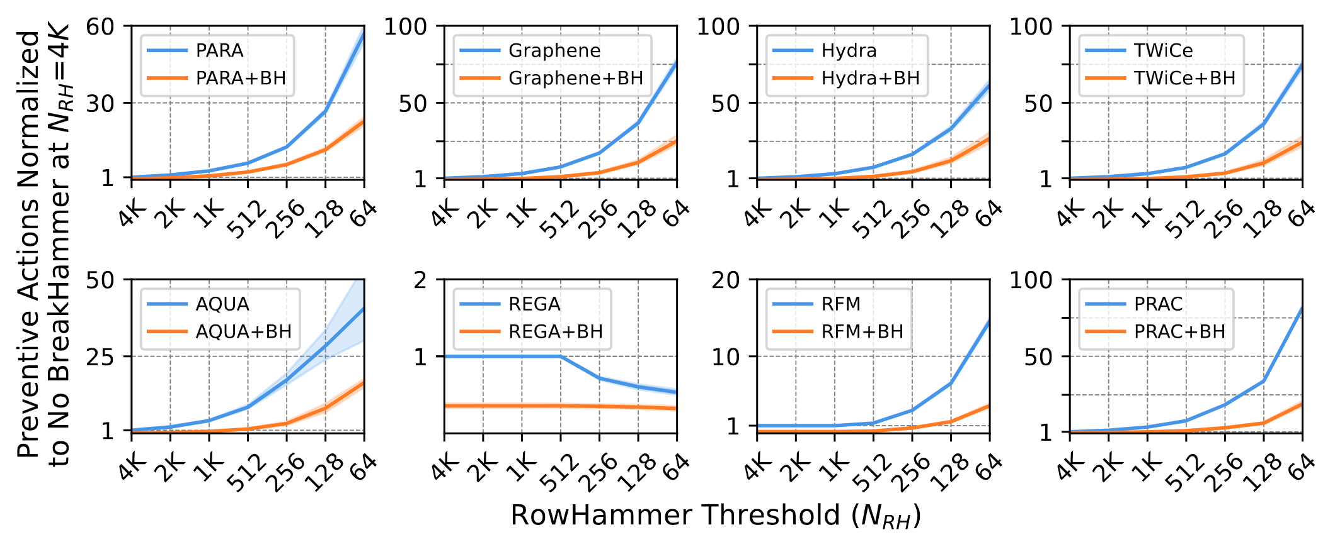
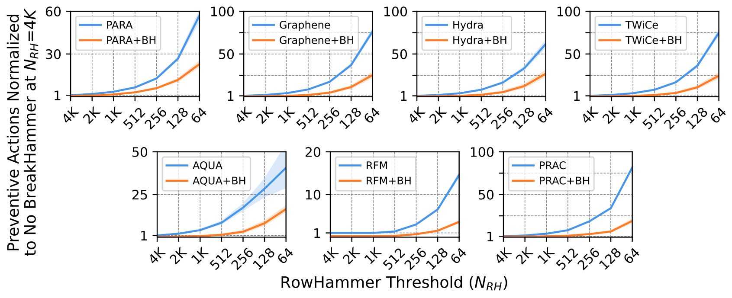
Preventive Action Count and Its Scaling
Higher is worse
No BreakHammer
With
BreakHammer
~34x
Lower is worse
Notes:
We first take a look at BreakHammer’s impact on the number of RowHammer preventive actions performed
[CLICK] Here, the X axis is the decreasing RowHammer threshold
[CLICK] the Y axis is the preventive action count normalized to the preventive count of the system without BreakHammer at a threshold of 4K
[CLICK] the blue line shows the system without BreakHammer
[CLICK] and the orange line shows the system with BreakHammer
[CLICK] As an example, this point on the figure depicts that PRAC performs approximately 30 times more preventive actions when the RowHammer threshold decreases from 4K to 128
[CLICK] and when PRAC is paired with BreakHammer at the same threshold, we observe 80% reduction in the number of preventive actions performed
[CLICK] When we look at all of our results
====
More than 30x
Approximately 34x
Just say significantly maybe

Slide 43
Preventive Action Count and Its Scaling
Higher is worse
No BreakHammer
With
BreakHammer
~80% reduction
with BreakHammer
Lower is worse
Notes:
We first take a look at BreakHammer’s impact on the number of RowHammer preventive actions performed
[CLICK] Here, the X axis is the decreasing RowHammer threshold
[CLICK] the Y axis is the preventive action count normalized to the preventive count of the mechanism without BreakHammer at a threshold of 4K
[CLICK] the blue line shows the system without BreakHammer
[CLICK] and the orange line shows the system with BreakHammer
[CLICK] As an example, this point on the figure depicts that PRAC performs approximately 30 times more preventive actions when the RowHammer threshold decreases from 4K to 128
[CLICK] and when PRAC is paired with BreakHammer at the same threshold, we observe 80% reduction in the number of preventive actions performed
[CLICK] When we look at all of our results

Slide 44
Preventive Action Count and Its Scaling
BreakHammer significantly reduces (72% on average) the number of preventive actions performed across all mechanisms
Notes:
We observe that BreakHammer significantly reduces the number of preventive actions performed across all mechanisms and all thresholds

Slide 45
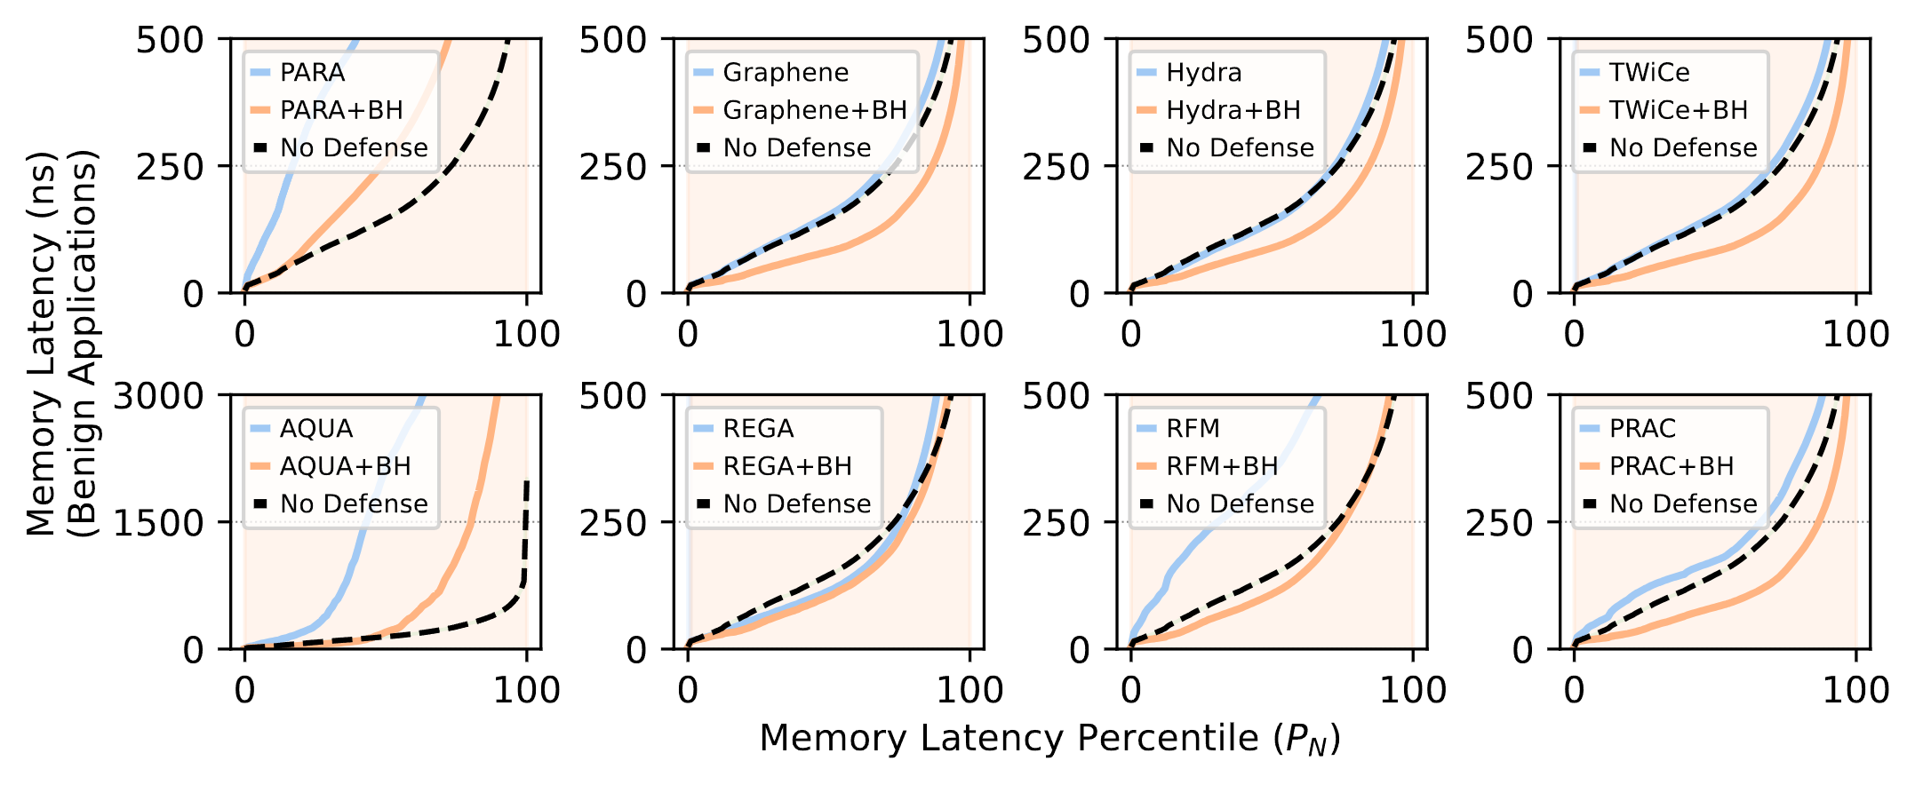
Memory Latency Impact at N_{RH}=64
No BreakHammer
Higher is worse
No Defense
With
BreakHammer
50% of requests are
served within 200ns
Notes:
We continue by evaluating BreakHammer’s effect on benign application memory latency at a RowHammer threshold of 64
[CLICK] the X axis is the memory latency percentiles
[CLICK] the Y axis is the memory latency of benign applications in nanoseconds
[CLICK] the blue line shows a system without BreakHammer
[CLICK] the orange line shows a system with BreakHammer
[CLICK] and the dashed dark line shows the system with no RowHammer defense
[CLICK] As an example, this point on the blue line means that 50% of all memory requests are served within 200ns
[CLICK] When we look at all of our results
====
Don’t mention the background color

Slide 46
Memory Latency Impact at N_{RH}=64
BreakHammer reduces memory latency across all mechanisms
Notes:
We observe that BreakHammer reduces the memory latency of all evaluated RowHammer solutions across all percentile values

Slide 47
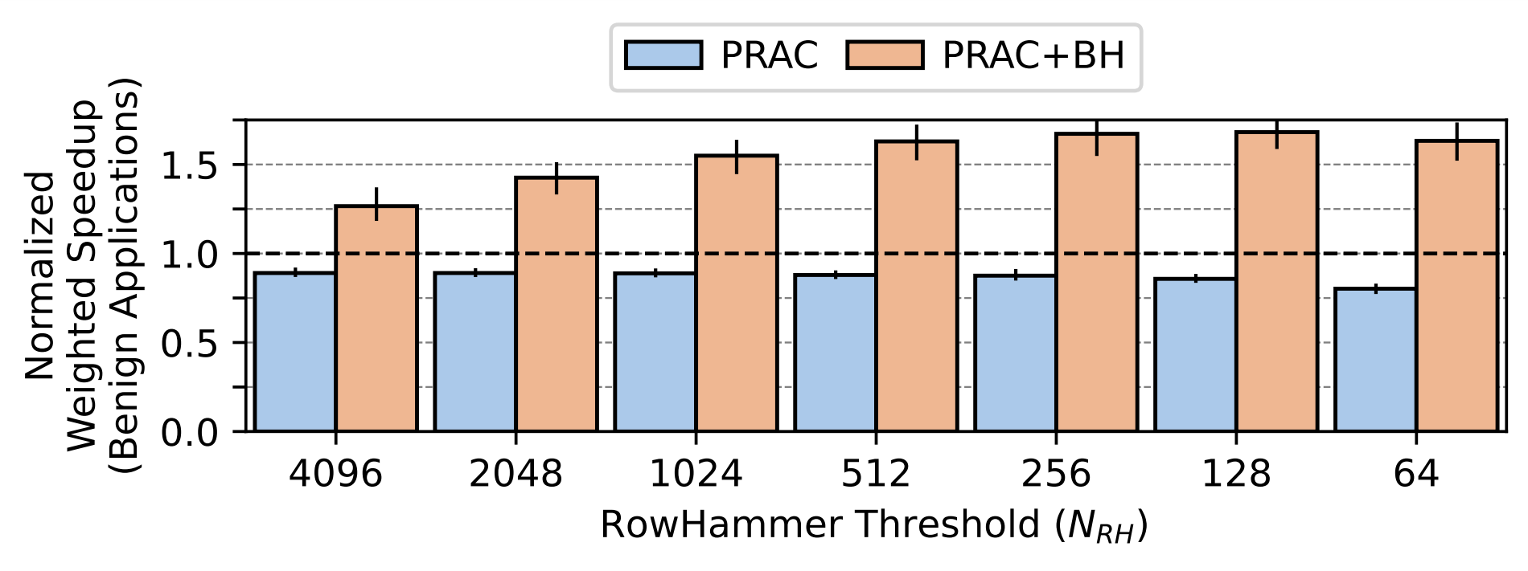
Performance Impact and Its Scaling
61%
76%
87%
93%
98%
105%
43%
Higher is better
Lower is worse
BreakHammer significantly increases (81% on average)
the performance of PRAC
Notes:
We analyze effect of reduced RowHammer-preventive action count and improved memory access latency on system performance
[CLICK] Here, the X axis is the decreasing RowHammer threshold
[CLICK] the Y axis is the system performance of benign applications normalized to a system with no RowHammer defense
[CLICK] Blue bars identify mechanisms without BreakHammer and orange bars present mechanisms with BreakHammer
[CLICK] For PRAC, we see that BreakHammer significantly increases the performance

Slide 48
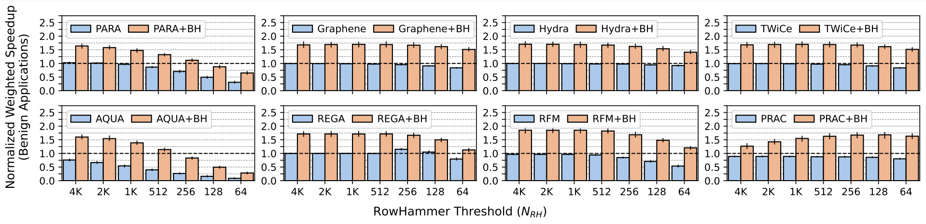
Performance Impact and Its Scaling
As RowHammer threshold decreases, RowHammer mitigation mechanisms incur increasing performance overhead
BreakHammer significantly increases system performance
(90% on average)
Notes:
When we look at the trends on other evaluated RowHammer mitigation mechanisms we see that
[CLICK] as RowHammer thresholds decreases, all evaluated RowHammer mitigation mechanisms incur increasing performance overhead
[CLICK] and BreakHammer greatly increases system performance for all evaluated solution

Slide 49
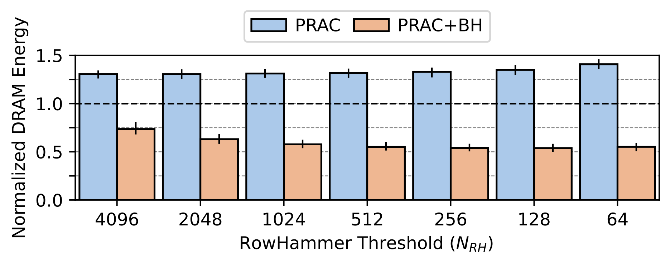
DRAM Energy Impact and Its Scaling
43%
51%
55%
57%
58%
59%
60%
Lower is better
Lower is worse
BreakHammer significantly reduces (by 55% on average)
the energy consumption of PRAC
Notes:
We also analyze BreakHammer’s impact on DRAM energy consumption
[CLICK] Here, the X axis is the decreasing RowHammer threshold
[CLICK] the Y axis is the DRAM energy consumption normalized to a system with no RowHammer defense
[CLICK] Bars identify mechanisms with and without BreakHammer
[CLICK] For PRAC, we see that BreakHammer significantly reduces the DRAM energy consumption

Slide 50
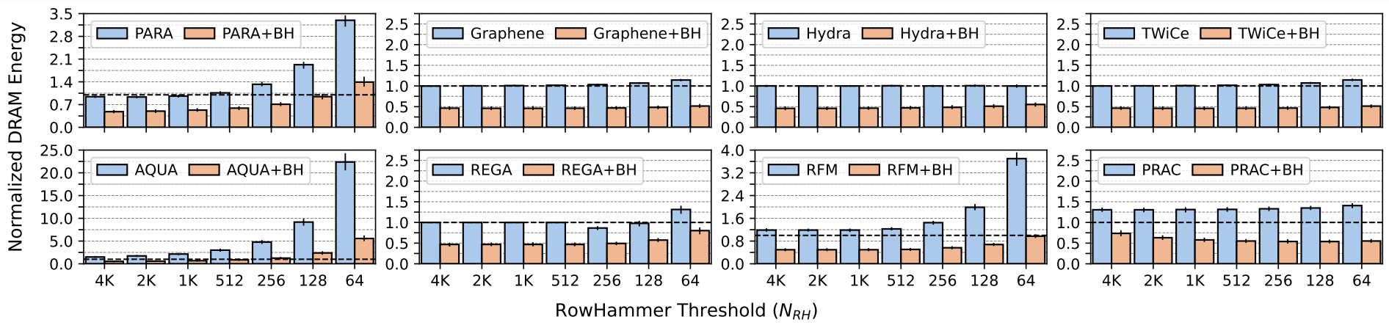
DRAM Energy Impact and Its Scaling
As RowHammer threshold decreases, RowHammer mitigation mechanisms consume significantly increasing DRAM energy
BreakHammer significantly decreases energy consumption (by 55% on average)
Notes:
When we look at the trends on other evaluated RowHammer mitigation mechanisms we see that
[CLICK] as RowHammer thresholds decreases, all evaluated RowHammer mitigation mechanisms consume increasingly more DRAM energy
[CLICK] and BreakHammer reduces DRAM energy consumption for all evaluated solution

Slide 51
Under Attack Summary
BreakHammer significantly reduces
the negative performance and energy overheads
of existing RowHammer mitigation mechanisms
when a memory performance attack is present
1)
BreakHammer accurately detects suspect threads
2)
BreakHammer effectively reduces
the memory interference caused by suspect threads
Notes:
To summarize
[CLICK] BreakHammer significantly reduces the negative performance and energy overheads of
existing RowHammer mitigation mechanisms when a memory performance attack is present
[CLICK] These benefits are because BreakHammer accurately detects suspect threads
[CLICK] and effectively reduces the memory interference caused by suspect threads

Slide 52
Evaluation Results
1)
Under Attack
2)
No Attack
Notes:
I will continue by summarizing our benign workload results

Slide 53
No Attack Summary
  Across 90 four-core benign workload mixes:
  BreakHammer slightly (<1%) improves
  memory access latency
  system performance
  DRAM energy efficiency
Notes:
Across 90 four-core benign workload mixes
Even though it is not our goal to improve the performance of benign systems
We observe that BreakHammer slightly improves
[CLICK] memory access latency
[CLICK] system performance
[CLICK] DRAM energy efficiency

Slide 54
More in the Paper
More implementation details
  Resetting BreakHammer counters
  Tracking software threads
  Throttling DMA and systems without caches
  Configuration parameters
Security analysis
  Upper bound on the overhead an attacker can cause
  Security against multi-threaded attackers
Performance evaluation
  Unfairness results
  Sensitivity to memory intensity of workloads
  Comparison to BlockHammer
  Sensitivity analysis of BreakHammer parameters
https://arxiv.org/abs/2404.13477
Notes:
I would like to also refer you to our paper for more details on:
BreakHammer’s implementation, such as resetting counters or tracking software threads
[CLICK] Our security analysis, where we present an upper bound for attacker activity
and discuss multi-threaded attackers that try to defeat BreakHammer
[CLICK] Also more evaluations on unfairness and sensitivity to memory intensity
With detailed results on all benign workloads and more
=====
Backup for BlockHammer and BLISS, maybe say throttling here

Slide 55

The Paper
https://arxiv.org/abs/2404.13477
Notes:
Our paper is available on arXiv, accessible through this link or QR code

Slide 56
Outline
Background
Motivation
BreakHammer
Evaluation
Conclusion
Notes:
Now I will conclude my talk

Slide 57
Conclusion
Key Exploit: Mount a memory performance attack by
triggering RowHammer-preventive actions to
block memory accesses for long periods of time
Key Mechanism: BreakHammer
Observes triggered RowHammer-preventive actions
Identifies threads that
trigger many preventive actions (i.e., suspect threads)
Reduces the memory bandwidth usage of the suspect threads
Key Results:
Under attack:
  Significantly improves system performance (by 90% on average)
  Significantly reduces energy consumption (by 55% on average)
No attack:
  Slightly (<1%) improves performance and energy consumption
https://github.com/CMU-SAFARI/BreakHammer
Notes:
We introduce the idea that it is possible to mount a memory performance attack by…
[CLICK] We propose BreakHammer: which
Observes triggered RowHammer-preventive actions
Identifies threads that trigger many of these actions
And reduces the memory bandwidth usage of suspect threads
[CLICK] Our evaluations show that:
When an attacker is present, BreakHammer accurately throttles the attacker which significantly improves performance and reduces energy
And when all applications are benign, BreakHammer slightly improves performance and reduces energy consumption

Slide 58

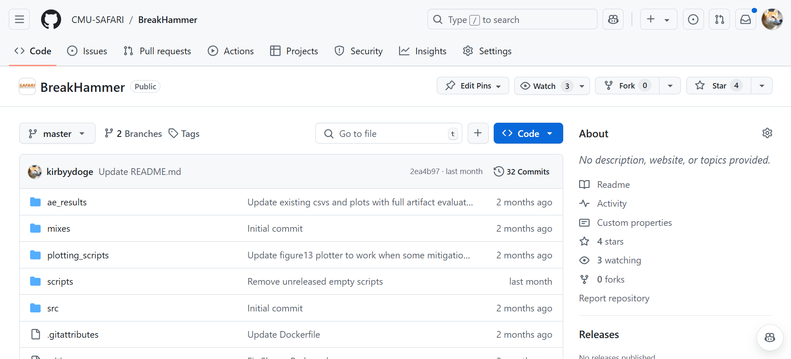
Open Source and Artifact Evaluated
https://github.com/CMU-SAFARI/BreakHammer
Notes:
Our BreakHammer implementation and all datasets are fully open-sourced and artifact evaluated

Slide 59
BreakHammer
Enhancing RowHammer Mitigations by Carefully Throttling Suspect Threads
Oğuzhan Canpolat A. Giray Yağlıkçı
Ataberk Olgun İsmail E. Yüksel
Yahya C. Tuğrul Konstantinos Kanellopoulos
Oğuz Ergin Onur Mutlu
https://github.com/CMU-SAFARI/BreakHammer
Notes:
Thank you for listening to my talk, I would be happy to answer any questions you may have
====
arXiv log is weird

Slide 60
BreakHammer
Enhancing RowHammer Mitigations by Carefully Throttling Suspect Threads
BACKUP SLIDES
Oğuzhan Canpolat A. Giray Yağlıkçı
Ataberk Olgun İsmail E. Yüksel
Yahya C. Tuğrul Konstantinos Kanellopoulos
Oğuz Ergin Onur Mutlu
https://github.com/CMU-SAFARI/BreakHammer

Slide 61
BreakHammer and RowPress
RowHammer
Aggressor Row
Open
Close
36ns, 47K activations to induce bitflips
RowPress
Aggressor Row
Open
Close
7.8µs, only 5K activations to induce bitflips
BreakHammer cooperates with a read disturbance solution
BreakHammer can become RowPress aware by:
1)
changing the score attribution to consider
row active time (e.g., Impress [Qureshi+, MICRO’24])
2)
conveying the type of action taken by the read disturbance solution and tracking them differently
(i.e., RowHammer or Rowpress-preventive action)

Slide 62
Throttling DMA and Systems without Caches
Processor Chip
BreakHammer
Core
Memory
Bandwidth
Usage
Throttler
Thread 1
Thread 2
Suspect
Identification
Core
Thread N
Observing Actions
Memory Controller
RowHammer
Mitigation Mechanism
Core
Memory Request Scheduler
Direct Memory Access (DMA)
Extend DMA and load-store units of cores
to track and limit the number of unresolved memory requests

Slide 63
BreakHammer vs BLISS
BLISS only tracks consecutive requests served
Thereby wrongly scores a benign thread with higher score
BLISS
Is Oblivious
To Action
One Request Served
Three Requests Served
One Request Served
ACT
RD
PRE
ACT
RD
RD
RD
PRE
ACT
RD
PRE
REF_{P}
Time
One Activation
One Activation
One Activation
BreakHammer is preventive action contribution aware
Thereby accurately scores the suspect thread with higher score
BreakHammer
Three Key
Operations
Take Place
T1
T2

Slide 64
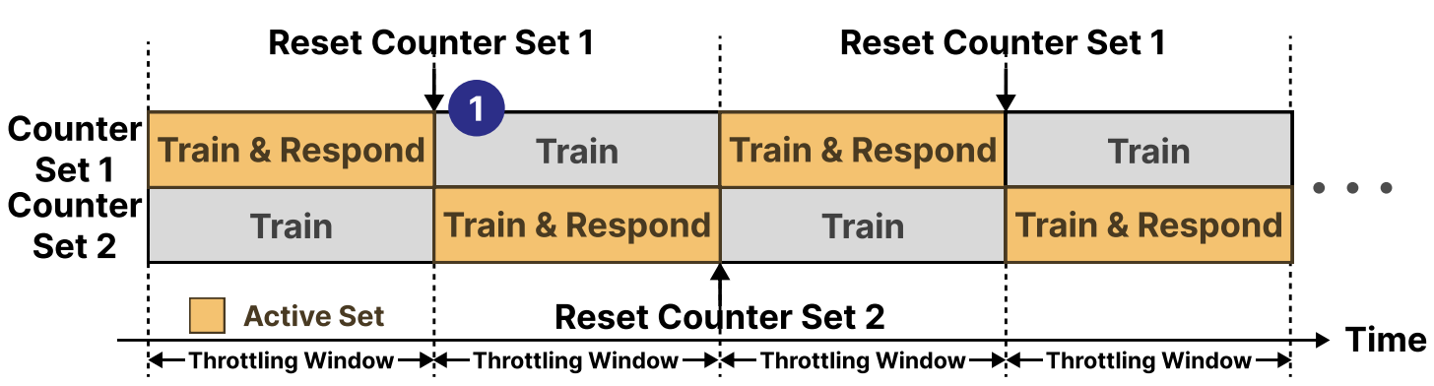
Resetting Counters

Slide 65
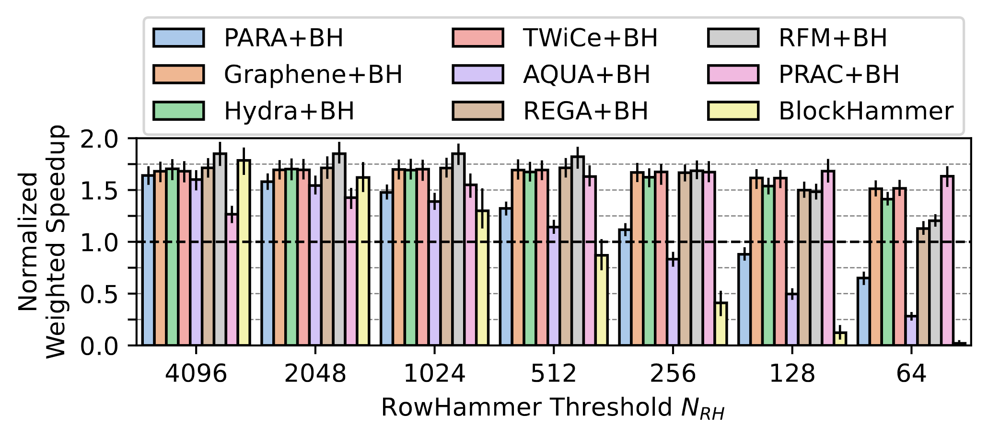
Comparison to BlockHammer
BreakHammer outperforms BlockHammer across
all evaluated RowHammer thresholds
Notes:
We also compare BreakHammer implemented RowHammer solutions to BlockHammer and observe that
[CLICK] BreakHammer outperforms BlockHammer across all evaluated RowHammer thresholds

Slide 66
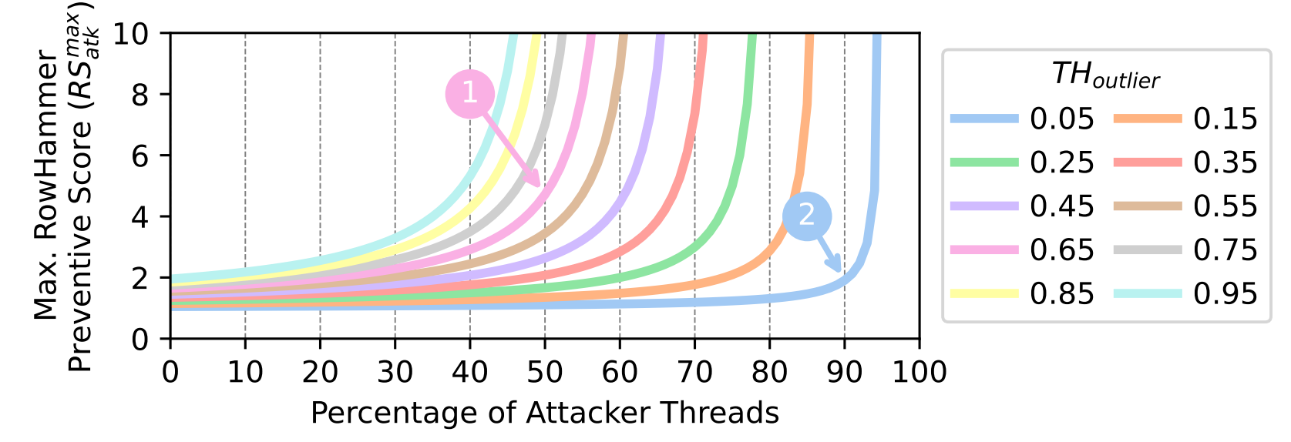
Upper Bound on the Overhead an Attacker Can Cause

Slide 67
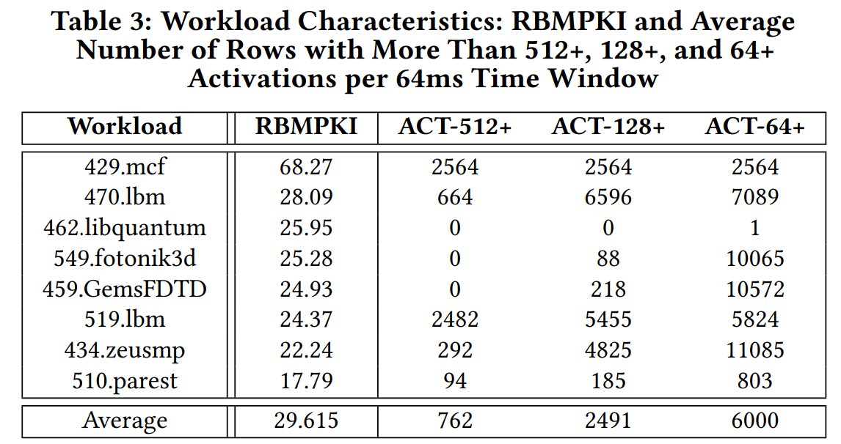
RBMPKI and Repeatedly Activated Row Count

Slide 68
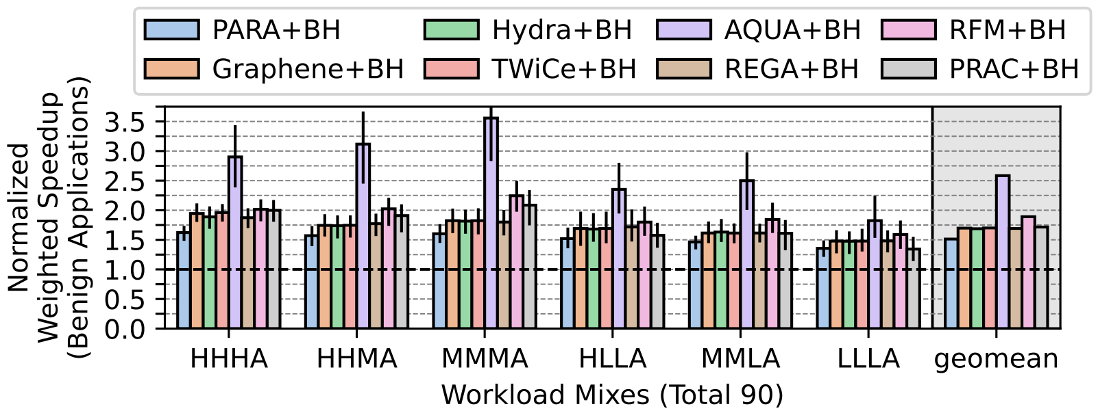
Under Attack Memory Intensity (N_{RH}=1K)

Slide 69
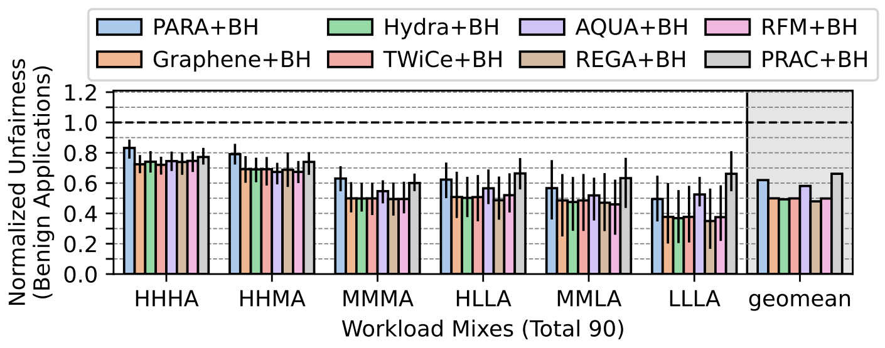
Under Attack Unfairness (N_{RH}=1K)

Slide 70
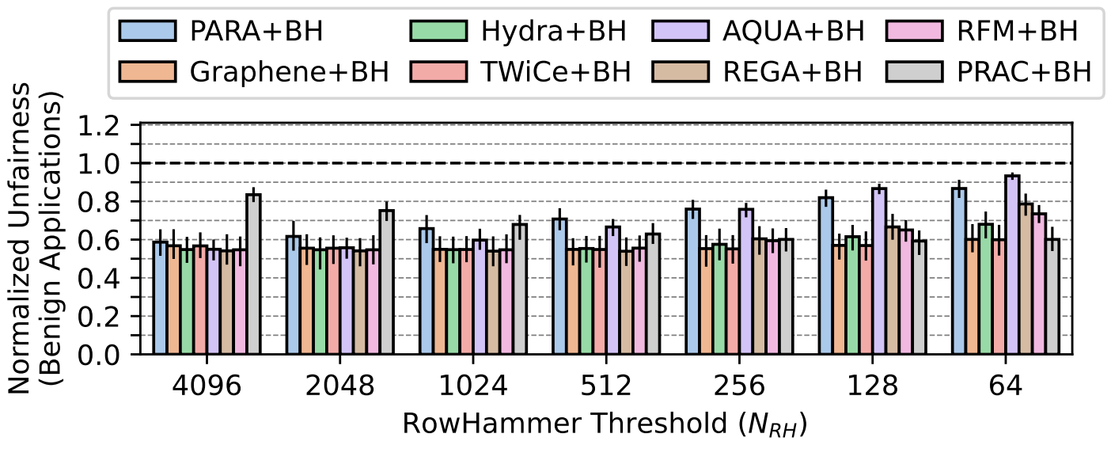
Under Attack Unfairness and Its Scaling

Slide 71
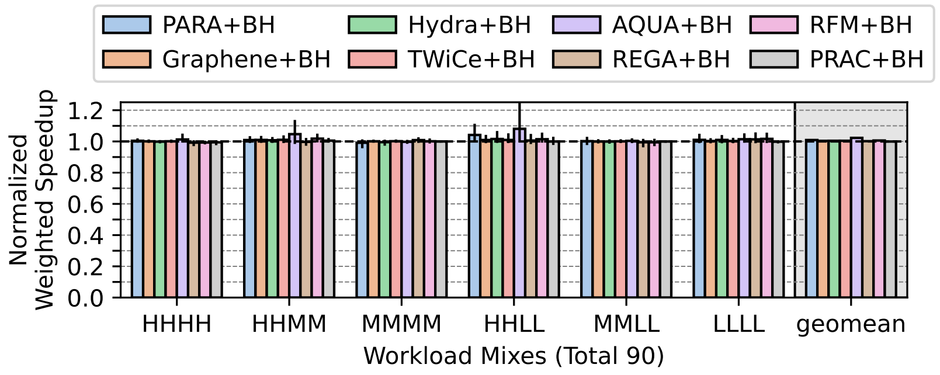
No Attack Memory Intensity (N_{RH}=1K)

Slide 72
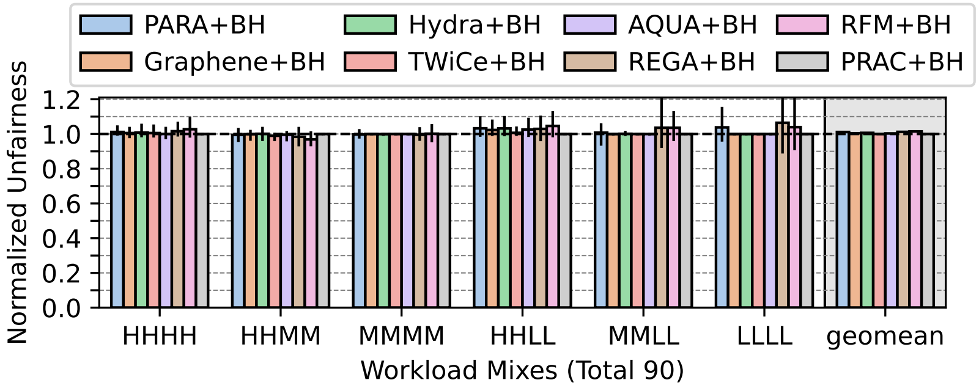
No Attack Unfairness (N_{RH}=1K)

Slide 73
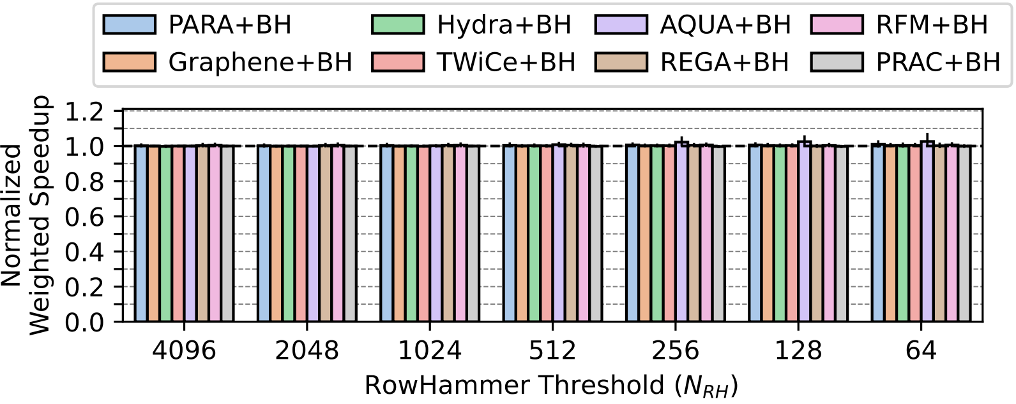
No Attack Performance and Its Scaling

Slide 74
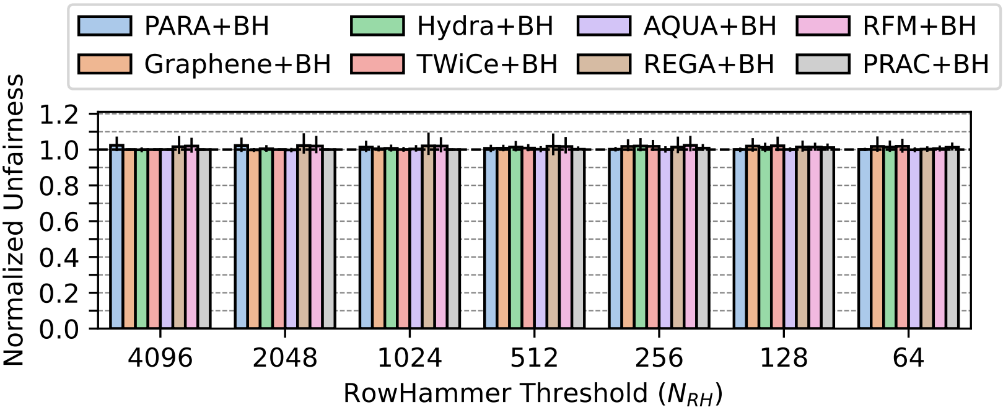
No Attack Unfairness and Its Scaling

Slide 75
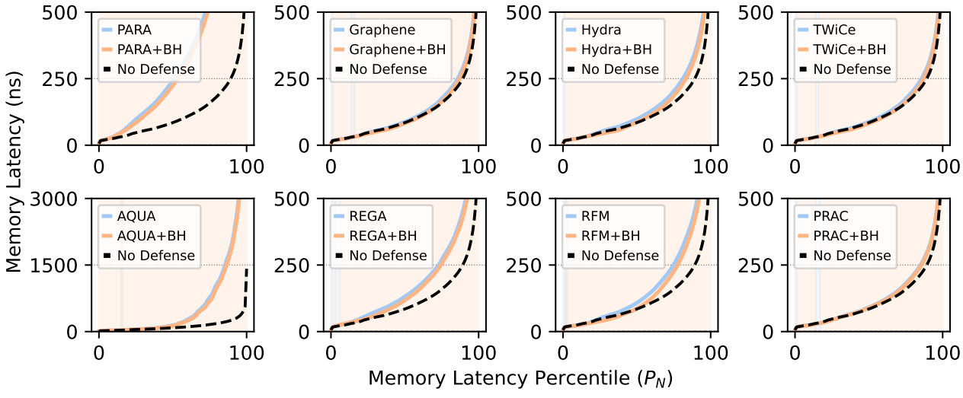
No Attack Memory Latency (N_{RH}=64)

Slide 76
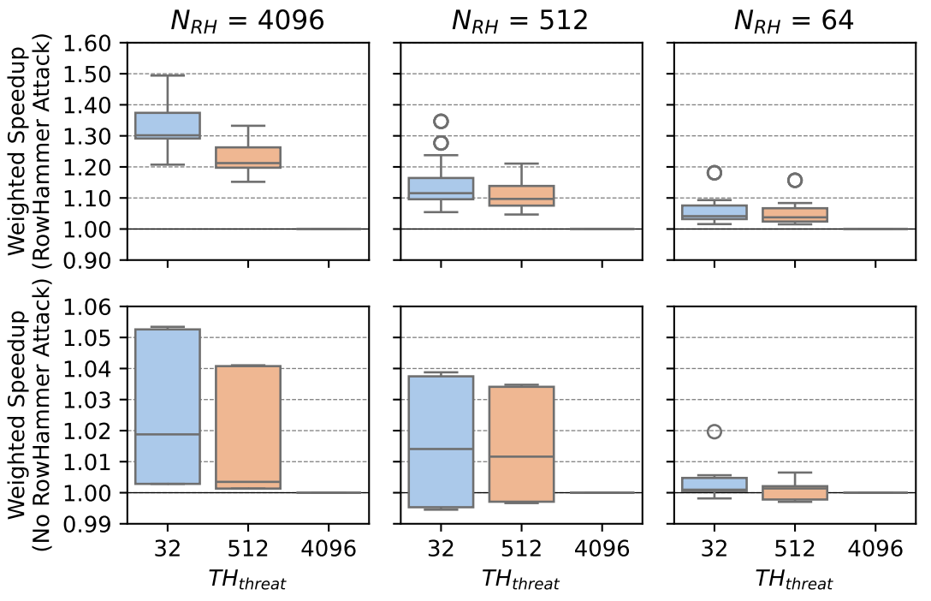
BreakHammer Sensitivity to Minimum Score

Slide 77
Organization
Processor Chip
BreakHammer
Core
Private
Caches
Shared
Caches
Memory
Bandwidth
Usage
Throttler
Thread 1
Thread 2
Suspect
Identification
Core
Private
Caches
Thread N
Observing Actions
Memory Controller
DRAM Chips
RowHammer
Mitigation Mechanism
Core
Private
Caches
Memory Request Scheduler
Direct Memory Access (DMA)

Slide 78
Identifying Suspect Threads:
An Example
BreakHammer detects threads that trigger too many RowHammer-preventive actions
T6: 90
T6: 90
T4: 30
T4: 30
T1: 25
T2: 3
T1: 25
T1: 25
T3: 11
T5: 20
T5: 20
T5: 20
T4: 30
T6: 90
T3: 11
T3: 11
T7: 5
T8: 0
T7: 5
T7: 5
T2: 3
T2: 3
T8: 0
T8: 0
>
Notes:
Here I show an hypothetical example with eight threads
[CLICK] After the first check: thread 7, 2, and 8, are considered safe because they do not exceed the minimum threshold of 10 in the example
[CLICK] and after the second check: thread 6 is considered as a suspect because it both exceeded the minimum score and largely deviates from the average off all thread scores

Slide 79
Identifying Suspect Threads:
High Level Algorithm
BreakHammer detects threads that trigger too many RowHammer-preventive actions
>
Minimum score to consider a thread as suspect
Maximum deviation
from the average score
>
>
Thread 1
Thread 2
Thread 3
Thread 4
Benign
Benign
Benign
Suspect
Notes:
BreakHammer identifies threads that cause too much overhead due to triggering RowHammer-preventive actions, we call such threads suspect threads.
BreakHammer performs two checks to determine a thread as suspect:
[CLICK] First, BreakHammer checks if a thread’s score exceeds a minimum threshold
[CLICK] Second, BreakHammer checks if a thread’s score largely deviates from the average score of all threads
[CLICK] A thread that satisfies both checks is identified as a suspect thread

