Slide 1
BurstLink
Techniques for Energy-Efficient Video Display
for Conventional and Virtual Reality Systems
Jawad Haj-Yahya¹ Jisung Park¹ Rahul Bera¹ Juan Gómez Luna¹
Taha Shahroodi¹ Jeremie S. Kim¹ Efraim Rotem² Onur Mutlu¹
1
1
2
Notes:
My name is Jawad Haj-Yahya and I will present our work BurstLink [END]

Slide 2
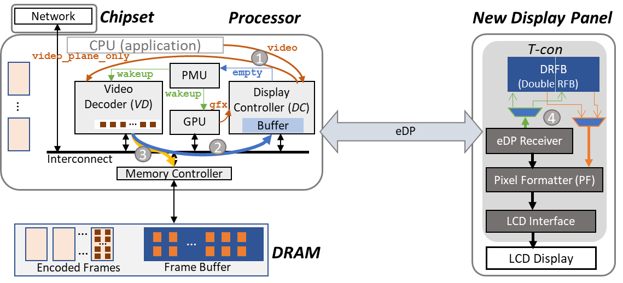
Our Goal: an Energy Efficient Video Streaming Scheme
Planar and virtual reality (VR) video streaming consumes significant system energy due to high power consumption of major system components (DRAM, display interfaces, and display panel)
We find two major inefficiencies in state-of-the-art video streaming schemes: 1) unnecessary data movement to/from DRAM, 2) underutilization of eDP interface bandwidth
Our Goal is to improve energy efficiency of planar and VR video streaming by leveraging display panel local memory to eliminate buffering frames in main memory
BurstLink Key idea: directly transfer a full decoded frame from the video-decoder (or GPU) to the display panel in a burst, exploiting the display interface’s maximum bandwidth
Notes:
[CLICK]
Planar and virtual reality video streaming consumes significant system energy due to high power consumption of major system components [CLICK]
We find two major inefficiencies in state-of-the-art video streaming schemes:
Firstly unnecessary data movement to/from DRAM, and secondly: underutilization of eDP interface bandwidth [CLICK]
Our Goal is to improve energy efficiency of planar and virtual reality video streaming by leveraging display panel local memory to eliminate buffering frames in main memory [CLICK]
BurstLink Key idea: directly transfer a full decoded frame from the video-decoder to the display panel in a burst, exploiting the display interface’s maximum bandwidth [END]

Slide 3
BurstLink: Key Results
BurstLink reduces the energy consumption of the host DRAM by eliminating data movement to/from the DRAM frame buffer
BurstLink increases the system’s idle-power state residency by reducing the usage of the processor and the display subsystem since they are active only during the burst period
We evaluate BurstLink using an analytical power model that we rigorously validate on an Intel Skylake mobile system. BurstLink:
Reduces system energy consumption for 4K planar/VR video streaming by 41%/33%
Provides an even higher energy reduction in future video streaming systems with higher display resolutions and/or display refresh rates
We show that using main memory (DRAM) as a communication hub between system components is energy-inefficient
BurstLink uses small remote memory near the data consumer to significantly reduce the number of costly main memory accesses in frame-based applications
Notes:
[CLICK]
BurstLink reduces the energy consumption of the host DRAM by eliminating data movement to/from the DRAM frame buffer [CLICK]
BurstLink increases the system’s idle-power state residency by reducing the usage of the processor and the display subsystem since they are active only during the burst period [CLICK]
We evaluate BurstLink using an analytical power model that we rigorously validate on an Intel Skylake mobile system. BurstLink: [CLICK]
Reduces system energy consumption for 4K planar/VR video streaming by 41%/33% [CLICK]
Provides an even higher energy reduction in future video streaming systems with higher display resolutions and/or display refresh rates [CLICK]
We show that using main memory (DRAM) as a communication hub between system components is energy-inefficient [CLICK]
BurstLink uses small remote memory near the data consumer to significantly reduce the number of costly main memory accesses in frame-based applications
[END]

Slide 4
BurstLink
Techniques for Energy-Efficient Video Display
for Conventional and Virtual Reality Systems
Jawad Haj-Yahya¹ Jisung Park¹ Rahul Bera¹ Juan Gómez Luna¹
Taha Shahroodi¹ Jeremie S. Kim¹ Efraim Rotem² Onur Mutlu¹
1
1
2
Notes:
[END]

