Slide 1
PIM Is All You Need: A CXL-Enabled GPU-Free System for Large Language Model Inference
Yufeng Gu*, Alireza Khadem*, Sumanth Umesh, Ning Liang, Xavier Servot, Onur Mutlu, Ravi Iyer, and Reetuparna Das
* Equal Contribution
April 2025
Open-source: https://github.com/Yufeng98/CENT
Notes:
Hi everyone, I am xxx, today I will present xxx. We open-sourced the artifact evaluation.

Slide 2
2x
Carbon Footprint
Training
Inference
[1] Meta AI, Sustainable AI: Environmental Implications, Challenges and Opportunities, MLSys’22
Notes:
Generative AI has reshaped people’s lives in various areas, such as text, image, video generation, coding assistance, intelligent agent and so on. The carbon footprint of the language model is dominated by the inference phase, which is twice as much as training. So, the scope of our work focuses on inference.

Slide 3
LLM Inference Cost Is Increasing
1M Output Token Cost ($)
Video
[1] https://openai.com/api/pricing/
Notes:
Large Language Model inference serving is very expensive. The API cost for 1M Output Token Cost increases with task complexity, from text to audio and reasoning. Video generation API is currently not available, but its price can be foreseen to be even higher.

Slide 4
Expensive GPU Server Is under Low Utilization
LLM Inference
GPU Server
Why is GPU underutilized on LLM inference?
Notes:
LLM inference is now deployed on GPU servers, which is expensive. However, the GPU utilization on LLM inference is lower than prior deep learning models. Why is GPU underutilized on LLM inference?
Note: GPU utilization uses the metric of SM active issue

Slide 5
How does LLM Inference work?
Which
number
Which number is larger, 9.11 or 9.8?
is
Prefill Stage
(Prompt Summarization)
larger
9.11
or
9.8
User
Prompt
Model Weights
X
Decoding Stage (Generate new tokens)
larger
than
9.11
is
9.8
.
Generate output tokens
❗️
X
X
X
X
Notes:
Let’s first understand how LLM inference works. User sends a prompt, where each token is converted to an embedding vector. These vectors are processed in parallel by GEMM operations. After understanding the prompt, in the decoding stage, the model generates output tokens one by one. This autoregressive execution cannot be processed in parallel and takes the majority of the runtime.

Slide 6
LLM Inference Decoding
Decoding Stage (Generate new tokens)
9.11
is
larger
than
9.8
.
Transformer Block
TB
TB
TB
TB
…
Fully Connection
Self-Attention
Fully Connection
X
X
X
Model Weights
KV Cache
Model Weights
Notes:
Let’s have a deep dive into the decoding stage. To generate one token, the model goes through a series of transformer blocks. Each transformer block is composed of fully connection operations, followed by self-attention and then fully connection. Fully connection operates on model weights, while self-attention operates in KV cache.

Slide 7
Llama 70B Inference Memory Requirement
4x A100 80GB
320GB Memory
140 GB
Notes:
To serve the inference task on Llama 70B, the model weights take around 140 GB of memory capacity. With batch size increasing, KV cache capacity scales linearly. 4xA100 GPUs can provide 320 GB memory capacity. With a 4K context length, the memory requirement starts exceeding GPU memory capacity at batch size of 128.

Slide 8
GPU Memory Capacity Limits LLM Inference Batch Size
4x A100 80GB
320GB Memory
Notes:
With context length increasing, the memory requirement starts exceeding GPU memory capacity at a lower batch size. The maximum supported batch size decreases from 128 at 4K context length to 16 at 32K context length. The reduced batch size reduces the GPU utilization.
Note: Prefill length = context length (4K~32K) - output length (3.5K)

Slide 9
Batch Queries in Decoding
Fully Connection
Self-Attention
Query 1
Model Weights
X
X
What’s the weather today?
Query 2
X
Model Weights
Which number is larger, 9.11 or 9.8?
X
Query 3
Model Weights
X
X
Translate the paragraph below.
User Specific KV Cache
Limited Batch Size
X
X
X
X
Notes:
When serving multiple queries concurrently, fully connection operations can be batched because each query shares the same model weights. On the other hand, self-attention operates on user-specific contexts, which cannot be batched and has to be processed in a sequential manner.

Slide 10
LLM Inference Has Low Operational Intensity
GEMM
LLM Inference
4K x 4K
4K x 4K
16 x 4K
4K x 4K
x
x
Input
Weight
Input
Weight
Operational Intensity = 2000 Ops/Byte
Operational Intensity = 16 Ops/Byte
A100 GPU Operational Intensity
= 156 Ops/Byte
H100 GPU Operational Intensity
= 295 Ops/Byte
Notes:
Deep learning models usually apply GEMM operations with high operational intensity. GPUs are well optimized for these operations by providing high compute throughput. However, due to the limited batch size and sequential attention operations, LLM inference tasks have low operational intensity.
Remove equations, put in appendix

Slide 11
LLM Inference Has Low Operational Intensity
GEMM
LLM Inference
How can we efficiently serve LLM Inference with
Low Operational Intensity
4K x 4K
4K x 4K
16 x 4K
4K x 4K
x
x
Input
Weight
Input
Weight
Compute Throughput
Operational Intensity = 2000 Ops/Byte
Operational Intensity = 16 Ops/Byte
Operational Intensity =
Memory Bandwidth
A100 GPU Operational Intensity
Memory Bandwidth
= 156 Ops/Byte
H100 GPU Operational Intensity
= 295 Ops/Byte
Notes:
How can we efficiently support this low operational intensity task? The operational intensity is determined by compute throughput and memory bandwidth. Increasing hardware’s memory bandwidth can solve this problem.

Slide 12
PIM Provides High Memory Bandwidth
GDDR6 PIM Chip
HBM
NVIDIA A100 GPU
HBM
HBM
HBM
DRAM Bank
DRAM Bank
HBM
HBM
PU
PU
…
DRAM Bank
DRAM Bank
2 TB/s Peak
Memory Bandwidth
PU
PU
32 TB/s Peak
Memory Bandwidth
Notes:
Advanced GPUs today have been equipped with high bandwidth memory, but they still have limited off-chip memory bandwidth. The Processing-In-Memory solution places processing units near DRAM banks. A single GDDR6 PIM chip can aggregate 32 TB/s peak memory bandwidth, 16x higher than GPU.

Slide 13
LLM Inference Requires Large Memory Capacity
Llama 70B
4K Context
Batch = 128
450 GB
140 GB
Model Weights
310 GB
KV Cache
 | Llama2 | Llama3 | DeepSeek R1 | OpenAI o1 | Gemini 1.5 Pro | Grok-3 | Claude 3.5
Model | 70 B | 405 B | 671 B | - | - | - | -
Contexts | 4K | 128 K | 128 K | 200 K | 2 M | 1 M | 200 K
https://platform.openai.com/docs/models#o1, https://developers.googleblog.com/en/new-features-for-the-gemini-api-and-google-ai-studio/, https://x.ai/blog/grok-3, https://docs.anthropic.com/en/docs/about-claude/models, The Llama 3 Herd of Models, DeepSeek-R1: Incentivizing Reasoning Capability in LLMs via Reinforcement Learning
Notes:
The inference task on Llama 70B model at 4K context and 128 Batch size requires 450 GB memory, where 140GB are used to store model weight, and 310GB are used for KV cache Meanwhile, recent LLM has increased model size and context length. For example, Llama3 mode size increases to 405B. Their context length also increases from 4K to 128K and further to 1M. Both Model weights and KV cache occupies larger and larger memory capacity.

Slide 14
CXL Interconnect Provides Substantial Memory Capacity
CXL Device
CXL Device
CXL Device
CXL Device
DRAM Bank
DRAM Bank
DRAM Bank
DRAM Bank
DRAM Bank
DRAM Bank
DRAM Bank
DRAM Bank
…
PU
PU
PU
PU
PU
PU
PU
PU
DRAM Bank
DRAM Bank
DRAM Bank
DRAM Bank
DRAM Bank
DRAM Bank
DRAM Bank
DRAM Bank
PU
PU
PU
PU
PU
PU
PU
PU
Scalable CXL Interconnect
CXL Device
CXL Device
CXL Device
CXL Device
DRAM Bank
DRAM Bank
DRAM Bank
DRAM Bank
DRAM Bank
DRAM Bank
32x
DRAM Bank
DRAM Bank
…
PU
PU
PU
PU
PU
PU
PU
PU
DRAM Bank
DRAM Bank
DRAM Bank
DRAM Bank
DRAM Bank
DRAM Bank
DRAM Bank
DRAM Bank
PU
PU
PU
PU
PU
PU
PU
PU
Notes:
To support the trend of increased memory capacity requirement, we apply the scalable CXL interconnect to provide substantial memory capacity. Each CXL device has 16 PIM chips, which provide 16 GB capacity. 32 CXL devices aggregate to half a terabyte of capacity. The CXL protocol can scale to even larger number of devices.

Slide 15
CENT Architecture
CENT
CXL Device
Host CPU
CXL Controller
CXL Switch
PNM Units
CXL Device
CXL Device
32x
CXL Device
…
16x
GDDR6-PIM
Notes:
In this work, we propose the CENT system. The host CPU drives 32 PIM devices through a CXL switch. Each device has a CXL controller, GDDR6-PIM chips and Processing-Near-Memory accelerators. Each CXL device has 16 GDDR6-PIM chips

Slide 16
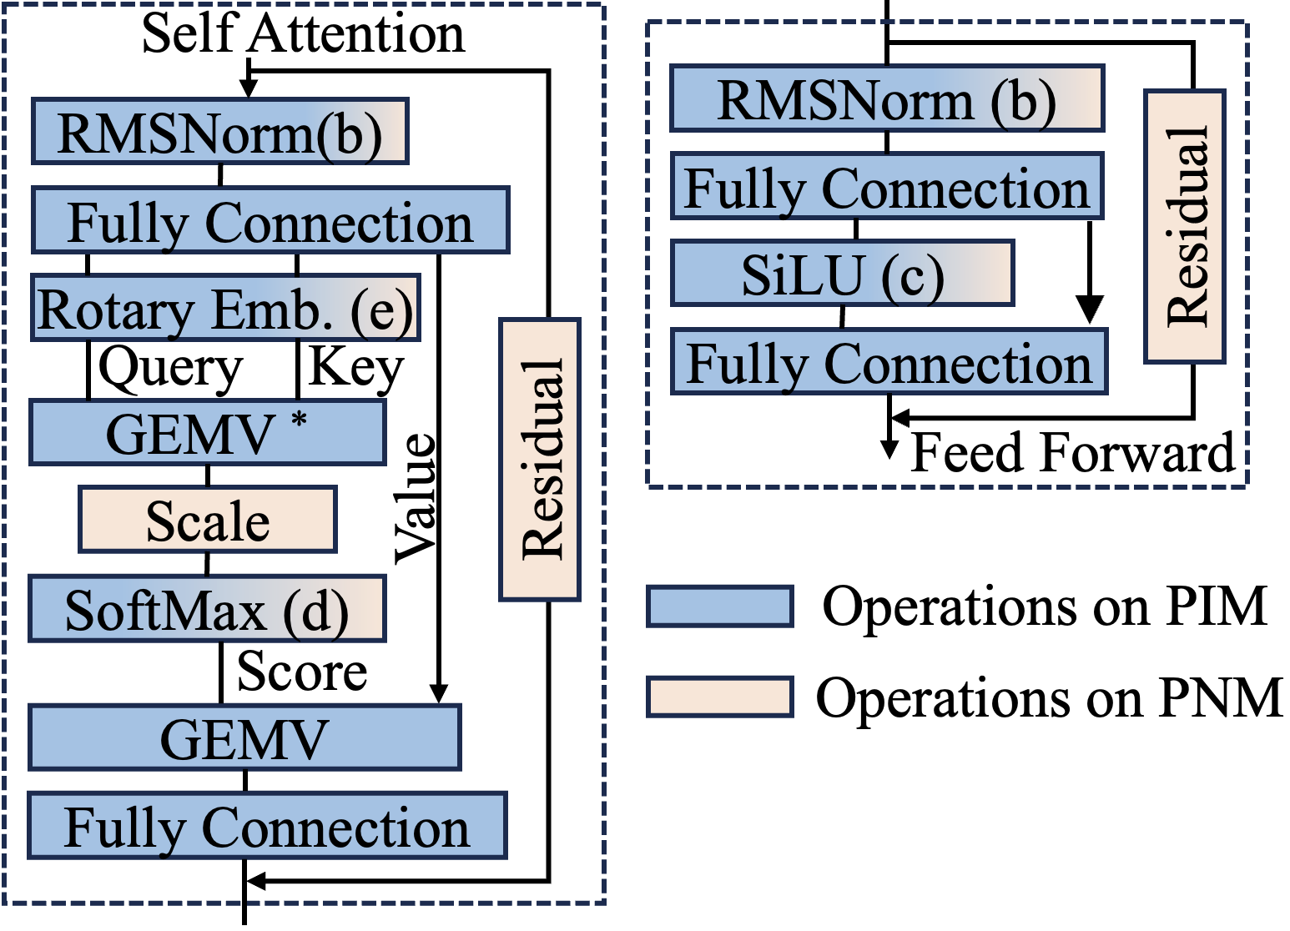
Full Transformer Block Execution on the CXL Device
PIM Module
99%
Vector Multiplication
Element-wise Multiplication
PNM Accelerator
Vector Addition Units
Reduction Trees
Exponent Processors
RISC-V cores for Special Functions
Notes:
Transformer block contains versatile operations. PIM module supports vector and element-wise multiplications, which accounts for 99% of total operations. Supporting remaining operations in the PIM module using DRAM process leads to high area overhead. To execute the full transformer block on the CXL device, we propose a hierarchical PIM-PNM design to support these operations outside the DRAM chip. The PNM accelerators have less compute throughput than PIM modules, but provides flexibility for versatile operations, including vector addition, reduction and exponent. We also apply RISC-V cores to support special functions, such as division.

Slide 17
CXL Device Architecture
CXL Port
Inter-device Communication Controller
Shared Buffer 64KB
Instruction Buffer 2MB
PC
PNM Units
Decoder
Legends
LD/ST
LD/ST
Inter-Device Data Flow
x16
Intra-Device Data Flow
PIM Ctrl
…
PIM Ctrl
Control Flow
GDDR6-PIM
GDDR6-PIM
Notes:
In each CXL device, the instructions are fetched from the instruction buffer and proceed into the decoder. The PIM instructions are directed into GDDR6-PIM chips. Other compute instructions are directed into the PNM accelerators. The intra-device communication is conducted through the shared buffer. The inter-device communication leverages the CXL Port.

Slide 18
Inter-Device CXL Communication
SEND
RECV
M_CAST
Multicast
Gather
CXL Switch
CXL Switch
Multicast
Receive
…
Receive
Receive
Send
…
Send
CXL Device 0
CXL Device 1
CXL Device 2
CXL Device 0
CXL Device 1
CXL Device 2
Notes:
The peer-to-peer communication between CXL devices is accomplished by Send and Receive instructions. On top of this, we propose multicast instruction and two new communication primitives - multicast and gather. In multicast, the source device sends data to destination devices. While in gather, the destination device receives data from all source devices sequentially. With these CXL communication primitives, we explored various parallel mapping strategies on the CENT architecture.

Slide 19
Parallel Model Mapping
Tensor Parallel Mapping
Pipeline Parallel Mapping
Host
Host
Multiple Prompts
CXL Switch
CXL Switch
P1
time
Transformer Decoder Blocks /
Pipeline Stages
T0
P2
T0
T4
T8
CXL Device
CXL Device
CXL Device
T1
T0
P3
…
T1
T5
T9
T2
T1
T0
T2
T6
T10
T3
T2
time
T1
Inter-Device Data Transfers
(16KB)
T3
T7
T11
…
T3
Decoder 0
T2
D0
D1
D2
…
Single Prompt
T3
Decoder 1
CXL Devices
…
Decoder 2
Peer-to-peer
Multicast-Gather
Notes:
In pipeline parallel mapping, certain transform blocks are mapped to a CXL device. The inter device communication only happens between two transformer blocks, using peer-to-peer communication primitive.. Multiple prompts are executed in a pipeline manner. In tensor parallel mapping, transformer blocks within a single prompt are executed sequentially and each of them is mapped across multiple CXL devices. Multicast and gather primitives are applied for these inter-device communications. Pipeline parallel mapping provides high serving throughputs, while tensor parallel mapping prioritizes the latency. A hybrid approach of both pipeline and tensor parallel mapping can strike a balance between serving latency and throughput.

Slide 20
Evaluation Methodology
Performance Model
Power Model
Cost Model
Workload Mapper
Trace Generator
PIM Cost
10x DRAM Cost [2]
Ramulator-based [1]
Cycle Accurate Simulator
Micron DRAM Power Model
Custom Design [3]
NRE Cost [4]
Die Cost
Packaging Cost
CXL Communication Analytical Model
Synthesis Results
[1] Ramulator 2.0: A Modern, Modular, and Extensible DRAM Simulator.
[2] UPMEM. Accelerating compute by cramming it into dram memory
[3] Supply chain aware computer architecture. In Proceedings of the 50th Annual International Symposium on Computer Architecture, pages 1–15, 2023.
[4] Moonwalk: Nre optimization in ASIC clouds. ACM SIGARCH Computer Architecture News, 45(1):511–526, 2017
Notes:
Our evaluation methodology includes the performance, power and cost model. The performance model starts from the workload mapper and trace generator. The PIM traces are fed into a Ramulator-based cycle accurate simulator. The results are combined with an analytical model for CXL communication. The power model is based on the Micron DRAM Power model and the synthesis results. The cost model includes the PIM model cost, which is estimated as 10x times of standard DRAM models, and the custom design cost is estimated through NRE cost, die cost and packaging cost.

Slide 21
CENT versus GPU Baseline
System | CENT | GPU
Hardware | 32 CXL Devices | 4 NVIDIA A100
Memory | 512 GB, GDDR6 | 320 GB, HBM2E
Notes:
We compare the CENT system with 32 CXL devices to the GPU system composed of 4 A100 GPUs for a power neutral comparison. We use the vLLM framework on the GPU baseline. The CENT system has half compute throughput but 64x peak memory bandwidth compared to the GPU system and has 2.4x lower owned TCO and even more saving on rental TCO.

Slide 22
CENT versus GPU Baseline
System | CENT | GPU
Hardware | 32 CXL Devices | 4 NVIDIA A100
Memory | 512 GB, GDDR6 | 320 GB, HBM2E
Compute Throughput | 608 TFLOPS | 1248 TFLOPS
Notes:
We make a power neutral comparison between the CENT system and GPU baseline. The CENT system has 32 CXL devices and 512 GB memory capacity. The GPU system is composed of 4 A100 GPUs and 320 GB memory capacity. We use the vLLM framework on the GPU baseline. The CENT system has half compute throughput but 64x peak memory bandwidth compared to the GPU system and has 2.4x lower owned TCO and even more saving on rental TCO.

Slide 23
CENT versus GPU Baseline
System | CENT | GPU
Hardware | 32 CXL Devices | 4 NVIDIA A100
Memory | 512 GB, GDDR6 | 320 GB, HBM2E
Compute Throughput | 608 TFLOPS | 1248 TFLOPS
Peak Bandwidth | 512 TB/s | 8 TB/s
Notes:
We make a power neutral comparison between the CENT system and GPU baseline. The CENT system has 32 CXL devices and 512 GB memory capacity. The GPU system composed of 4 A100 GPUs and 320 GB memory capacity. We use the vLLM framework on the GPU baseline. The CENT system has half compute throughput but 64x peak memory bandwidth compared to the GPU system and has 2.4x lower owned TCO and even more saving on rental TCO.

Slide 24
CENT versus GPU Baseline
System | CENT | GPU
Hardware | 32 CXL Devices | 4 NVIDIA A100
Memory | 512 GB, GDDR6 | 320 GB, HBM2E
Compute Throughput | 608 TFLOPS | 1248 TFLOPS
Peak Bandwidth | 512 TB/s | 8 TB/s
3-Year Owned Total Cost of Ownership | 0.73 $/hour | 1.76 $/hour
3-Year Rental Total Cost of Ownership | 1.05 $/hour | 5.45 $/hour
2.4x
Notes:
We compare the CENT system with 32 CXL devices to the GPU system composed of 4 A100 GPUs for a power neutral comparison. We use the vLLM framework on the GPU baseline. The CENT system has half compute throughput but 64x peak memory bandwidth compared to the GPU system. CENT also has a lower hardware cost, achieving 2.4x lower owned TCO and even more saving on rental TCO.

Slide 25
Cost Efficiency Comparison
Prefill Tokens = 512
Decoding Tokens = 3.5K
 | 3-Year Owned TCO
GPU | 1.76 $/hour
CENT | 0.73 $/hour
2.4x
Hardware Cost
2.3x
Throughput
5.2x
Tokens per $
Notes:
This chart shows the throughput comparison between CENT and GPU at Tokens / second, with 512 prefill tokens and 3.5K decoding tokens. CENT achieves an average of 2.3x higher end-to-end throughput than GPU baseline. CENT also has 2.4x lower Hardware cost, finally resulting in a more than 5 times of tokens per dollar, providing a more cost-efficient solution than GPUs.

Slide 26
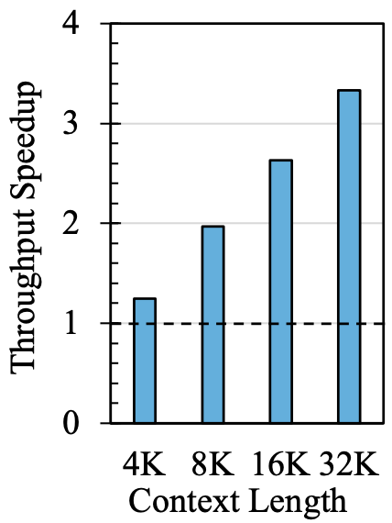
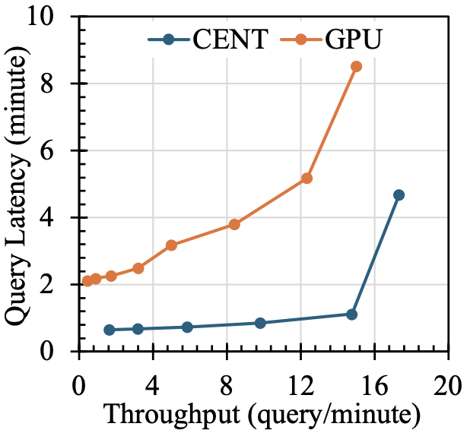
Long Context and QoS Analysis
Decoding Throughput
Comparison at 4K Context
Notes:
Here we can see more analysis on Llama 70B. CENT outperforms GPUs in the decoding stage, and this trend will be enhanced with the context length increasing, because GPUs can support less batch size at long context scenarios. Meanwhile, CENT also exhibits lower latency than GPUs at the same throughputs and can provide a better user experience.

Slide 27
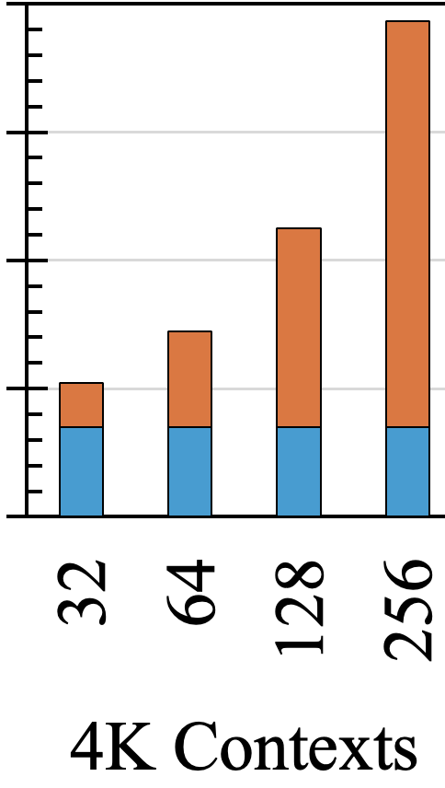
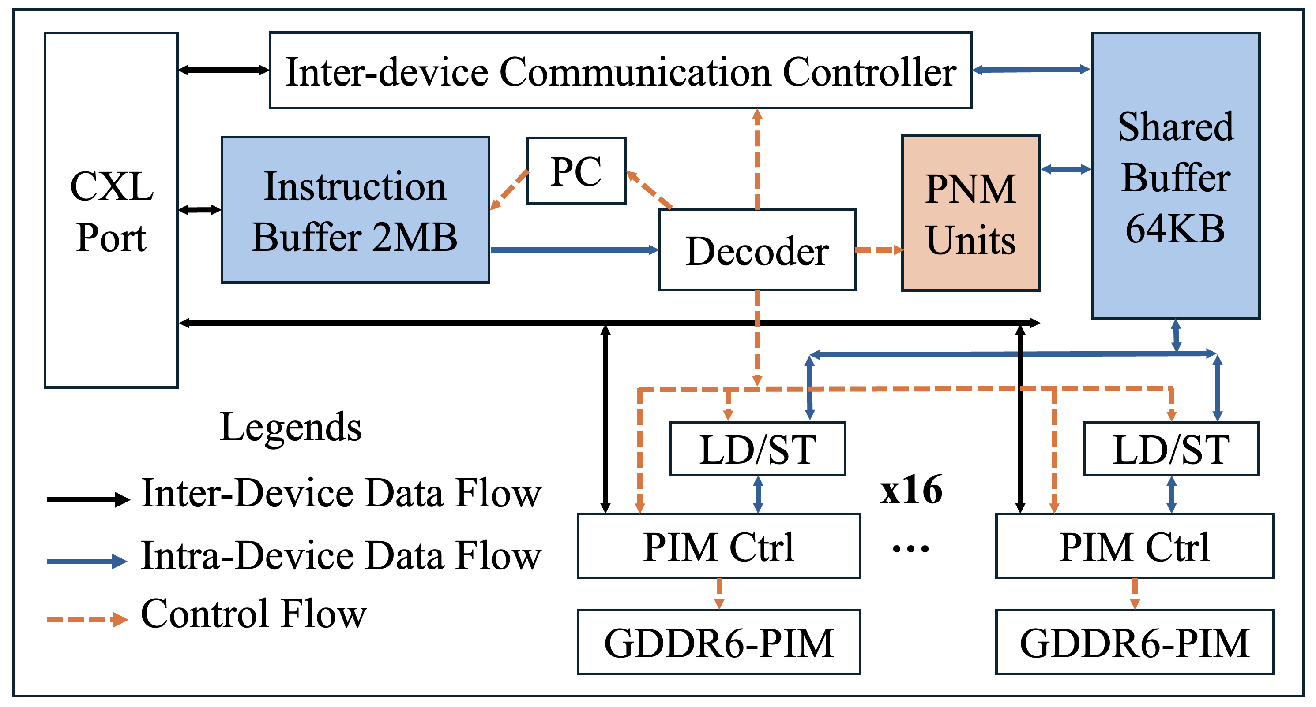
CENT: A CXL-Enabled PIM System
Low GPU Utilization
Limited Batch
4x A100 320 GB
Low Operational Intensity
Sequential
self-attention
execution
DRAM Bank
16 TB/s per GDDR6 channel
PU
Notes:
To conclude, we observe that LLM inference serving on the GPU system requires large memory capacity, which limits the batch size. Further, self-attention cannot even be batched. These factors result in a low GPU utilization This is due to the low operational intensity of this workload. To address this challenge, we use PIM to provide large internal bandwidth and propose the hierarchical PIM-PNM design to execute the entire transformer block on device. To support the large memory capacity requirement, we use the scalable CXL interconnect and propose new inter-device communication primitives, which enables various parallel workload mappings.

Slide 28
CENT: A CXL-Enabled PIM System
2.3x
Throughput
5.2x
Tokens per $
2.4x
Hardware Cost
Notes:
The CENT system has lower hardware cost and better energy efficiency, finally achieving more than 5 times of Token per Dollar.

Slide 29
PIM Is All You Need: A CXL-Enabled GPU-Free System for Large Language Model Inference
CENT Paper
CENT Artifact
Notes:
Thanks for listening and welcome any question

Slide 30
GPU Memory Capacity Limits LLM Inference Batch Size
4x A100 80GB
320GB Memory
Context
Length
Maximum Batch Size
GPU Utilization
Notes:
Although vLLM framework supports large batch size by swapping out KV cache to CPU, the serving throughput starts saturation at these points.
Note: Prefill length = context length (4K~32K) - output length (3.5K)
X-axis batch size above, explain more x and y-axis

Slide 31
GPU Memory Capacity Limits LLM Inference Batch Size
4x A100 80GB
320GB Memory
Notes:
With context length increasing, the memory requirement starts exceeding GPU memory capacity at a lower batch size. The maximum supported batch size decreases from 128 at 4K context length to 16 at 32K context length. The reduced batch size reduces the GPU utilization.
Note: Prefill length = context length (4K~32K) - output length (3.5K)

Slide 32
LLM Inference Has Low Operational Intensity
GEMM
LLM Inference
4K x 4K
4K x 4K
16 x 4K
4K x 4K
x
x
Input
Weight
Input
Weight
Operational Intensity = 2000 Ops/Byte
Operational Intensity = 16 Ops/Byte
4K * 4K * 4K * 2 Operations
16 * 4K * 4K * 2 Operations
(4K * 4K + 4K * 4K) * 2 Byte
(16 * 4K + 4K * 4K) * 2 Byte
312 TFLOPS (BF16)
A100 GPU Operational Intensity =
= 156 Ops/Byte
2.0 TB/s Bandwidth
Notes:
Deep learning models usually apply GEMM operations with high operational intensity. GPUs are well optimized for these operations by providing high compute throughput. However, due to the limited batch size and sequential attention operations, LLM inference tasks have low operational intensity.
Remove equations, put in appendix

Slide 33
Individual PIM Device Has Reduced Memory Density
DRAM Bank
DRAM Bank
PU
 | UPMEM [1] | AiM [2] | FIMDRAM [3]
Memory Density | 25% - 50% | 75% | 75%
[1] The true processing in memory accelerator. In 2019 IEEE Hot Chips 31 Symposium (HCS), pages 1–24. IEEE Computer Society, 2019
[2] System architecture and software stack for GDDR6-AiM. In 2022 IEEE Hot Chips 34 Symposium (HCS), pages 1–25. IEEE, 2022.
[3] 25.4 a 20nm 6gb function-in-memory DRAM, based on HBM2 with a 1.2 tflops programmable computing unit using bank-level parallelism, for machine learning applications. In 2021 IEEE International Solid-State Circuits Conference (ISSCC), volume 64, pages 350–352. IEEE, 2021.
Notes:
individual PIM, LLM needs capacity, CXL Network, low latency

Slide 34
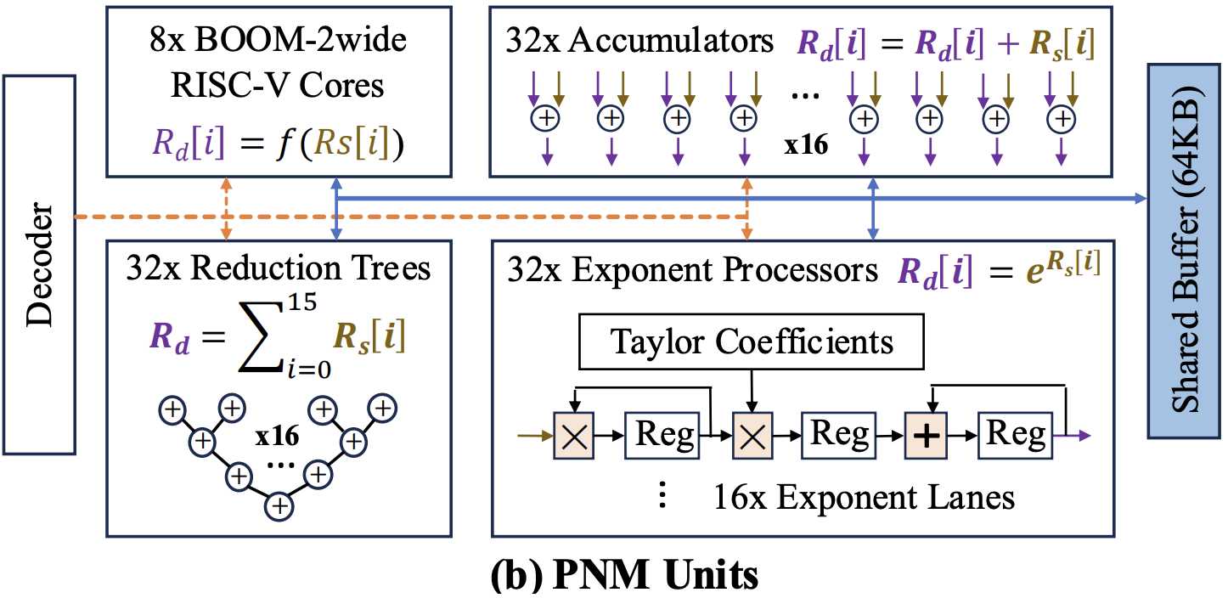
Hierarchical PIM-PNM Design
Vector Multiplication
Element-wise Multiplication
Vector Addition Units
Reduction Trees
Exponent Processors
RISC-V cores for Special Functions
Notes:
The PIM module is composed of near-bank MAC reduction, and PNM accelerators are shown in this figure. The fundamental difference between these two architecture is that, PIM module locates within the DRAM chip and uses the DRAM manufactural process, while PNM accelerators are placed outside DRAM chips, using logic manufactural process.

Slide 35
Inter-Device CXL Communication
Peer-to-peer
Send
Receive
CXL Switch
Send
Receive
Multicast
CXL Device 0
CXL Device 1
Multicast
Gather
CXL Switch
CXL Switch
Multicast
Receive
Receive
Receive
Send
Send
CXL Device 0
CXL Device 1
CXL Device 2
CXL Device 0
CXL Device 1
CXL Device 2
Notes:
The peer-to-peer communication between CXL devices is accomplished by Send and Receive instructions. On top of this, we propose multicast instruction and two new communication primitives - multicast and gather. In multicast, the source device sends data to destination devices. While in gather, the destination device receives data from all source devices sequentially. With these CXL communication primitives, we explored various parallel mapping strategies on the CENT architecture.
add ... for receive
M_CAST remove peer-to-peer

Slide 36
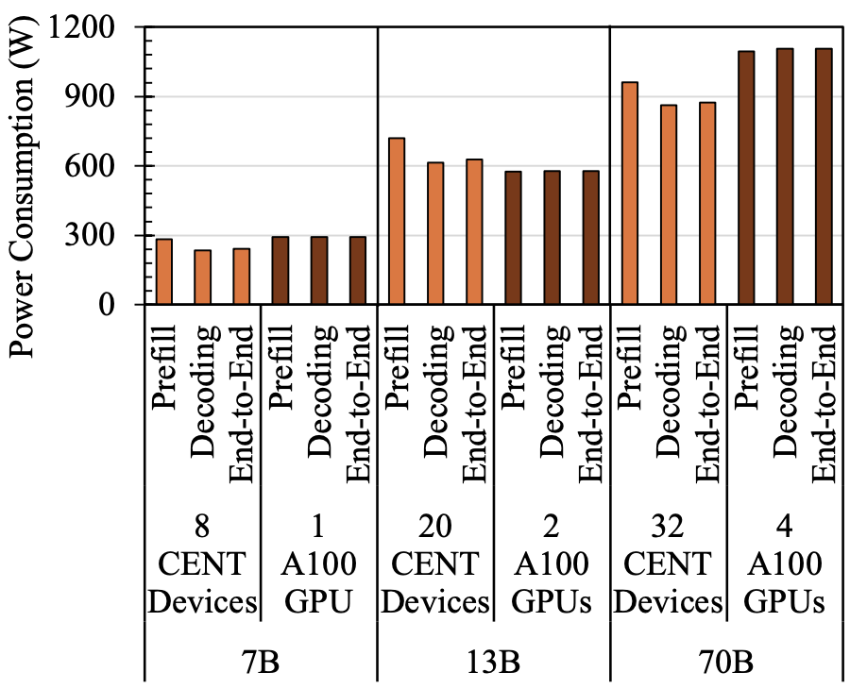
Energy Efficiency Comparison
CENT
GPU
Notes:
The CENT and GPU system operate at a similar power. We assign different numbers of devices to server models with different sizes and use the vLLM framework on the GPU baseline. This is the every efficiency comparison at Tokens / Joules, with 512 prefill tokens and 3.5K decoding tokens. In the prefill stage, tokens are processed in parallel and form a high operational intensity. CENT has lower energy efficiency than GPU. The decoding phase operates in an autoregressive manner, where CENT outperforms GPU. CENT achieves a 2.3x higher end-to-end energy efficiency than GPU.
No need to show this slide

Slide 37
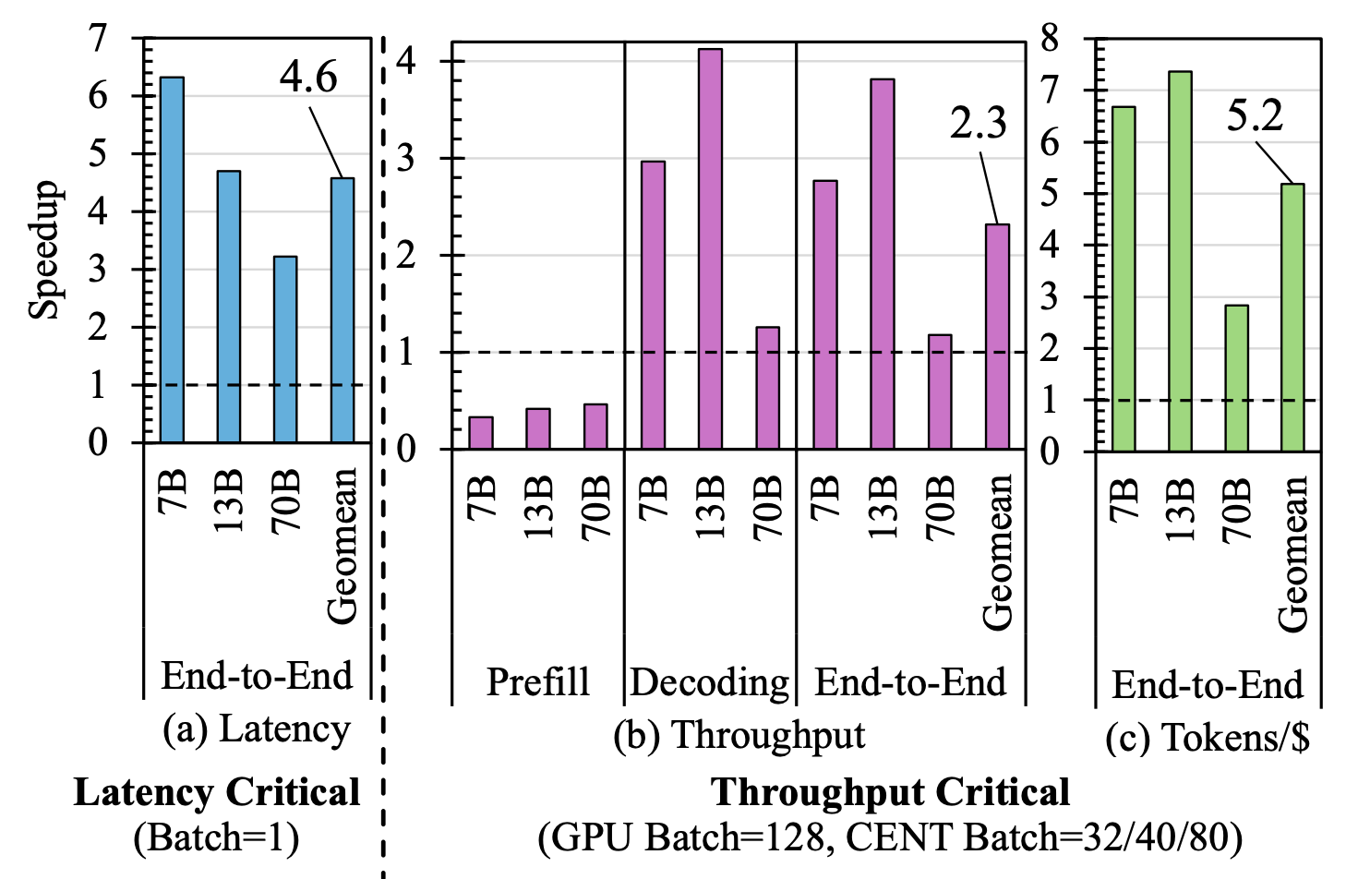
Row Throughput Speedup

Slide 38
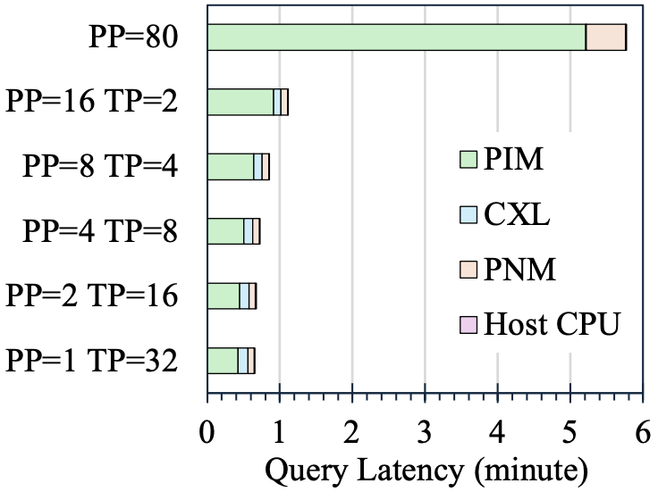
CENT Latency Breakdown

Slide 39
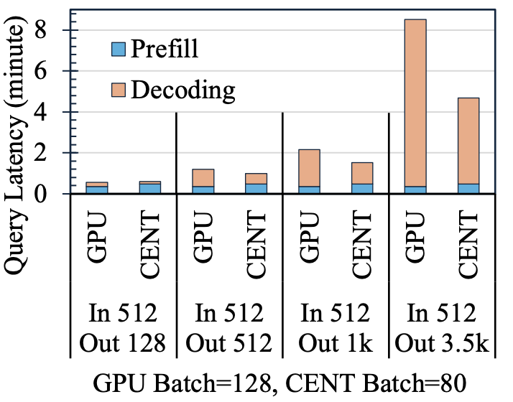
Latency Breakdown on Various Sequence Length

Slide 40
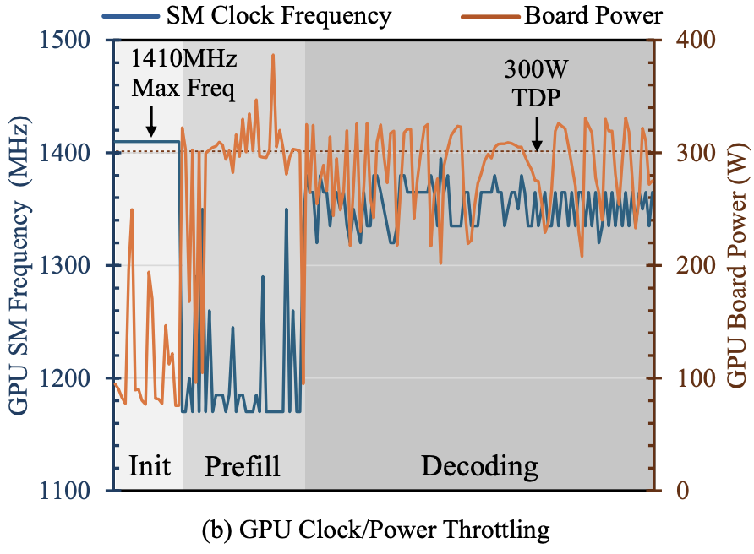
GPU Power Profile

Slide 41
Comparison with Related Works

Slide 42
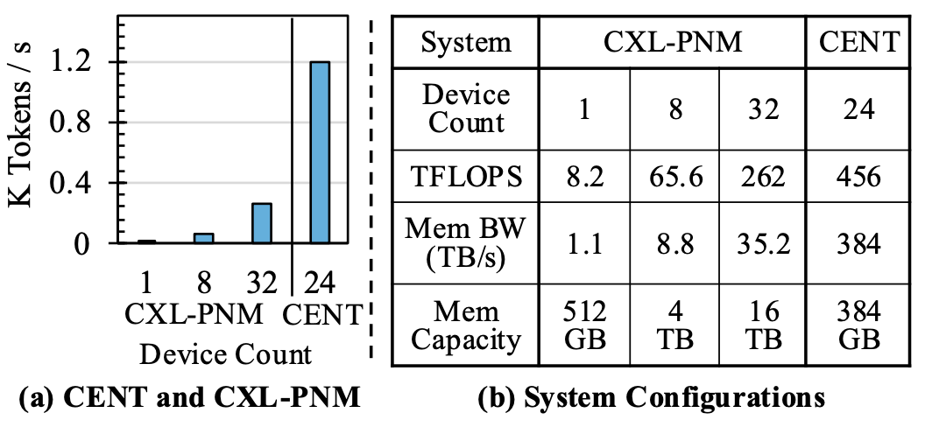
Comparison with CXL-PNM

Slide 43
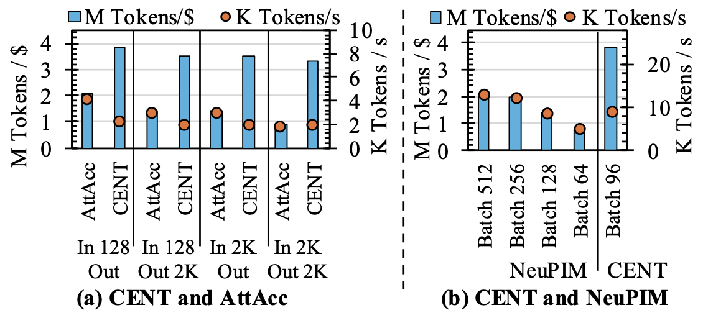
Comparison with HBM-PIM

Slide 44
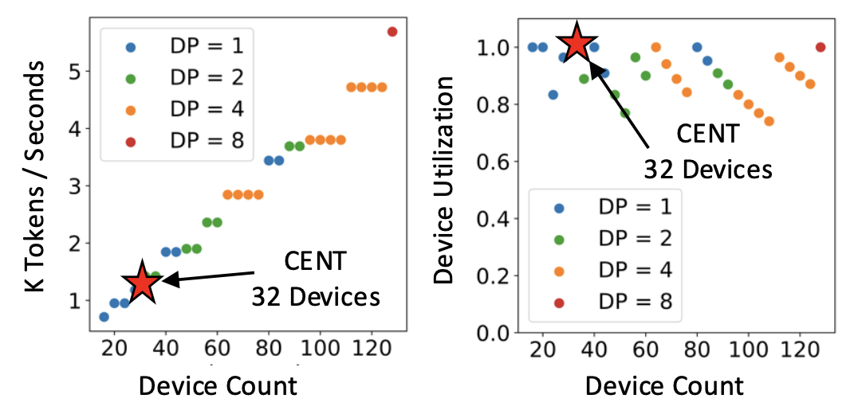
Scalability Study

