Slide 1


CIPHERMATCH
Accelerating Homomorphic Encryption-Based
String Matching via Memory-Efficient Data Packing
and In-Flash Processing
Mayank Kabra
Rakesh Nadig, Harshita Gupta, Rahul Bera, Manos Frouzakis,
Vamanan Arulchelvan, Yu Liang, Haiyu Mao,
Mohammad Sadrosadati, and Onur Mutlu
Notes:
Hello, everyone. I am Mayank Kabra and today I will be presenting our work ciphermatch, accelerating homomorphic encryption based string matching via efficient data packing and in flash processing

Slide 2

Executive Summary
Problem: Secure exact string matching using homomorphic encryption (HE) lacks scalability
due to performance bottlenecks in two key areas:
a) Use of complex homomorphic multiplication resulting in high computation cost
b) Data movement bottleneck from large encrypted database stored in solid-state drive (SSD)
Goal: Develop an algorithm-hardware co-design to provide scalable, parallelizable
and efficient HE-based secure exact string-matching
Key Idea: Use (a) only homomorphic addition and (b) perform in-flash processing by exploiting the operational principles of NAND-flash memory to accelerate secure exact string matching
CIPHERMATCH: A new algorithm-hardware co-design
that significantly improves the performance of HE-based secure exact string matching by
a) using only homomorphic addition to reduce the high computation cost
b) optimizing the data packing scheme to reduce memory footprint
c) designing a new in-flash-processing (IFP) architecture to reduce data movement
Key Results:
CIPHERMATCH algorithm: 42.9x speedup & 39.4x energy savings than best software
CIPHERMATCH with IFP: 136.9x speedup & 256.4x energy savings over CM-SW
Notes:
Let's 1st go into brief executive summary. So a secure string, matching, using homomorphic encryption face performance bottleneck in 2 key areas. 1st is the use of complex homomorphic multiplication operation, and second, the data movement bottleneck, which occurs from the because large encrypted databases are usually stored in ssds.
Our goal is to develop an algorithm hardware code design to provide scalable, parallelizable and efficient. He based secure exact string matching.
Our key idea is to use only homomorphic addition, operation and perform in flash processing by exploiting the operational principles of nand flash memory.
So to this end we propose cipher match and algorithm hardware code design that significantly improve the performance of he based secure exact string, matching
by using only homomorphic addition operation
by optimizing the existing data packing scheme and
by designing a new in flash processing architecture.
We observe that our cipher match algorithm provides 42.9 times speed up over state of the art and cipher match, when integrated within flash processing further provides 1 36.9 times speed up, and 256.4 times energy savings.

Slide 3
Talk Outline
Background, Problem & Goal
Key Idea
CIPHERMATCH System: Overview
CIPHERMATCH: Algorithm
CIPHERMATCH: Hardware
Evaluation Results
Notes:
This is my talk outine for today.

Slide 4
Talk Outline
Background, Problem & Goal
Key Idea
CIPHERMATCH System: Overview
CIPHERMATCH: Algorithm
CIPHERMATCH: Hardware
Evaluation Results
Notes:
so let's briefly go into background key problem and our goal.

Slide 5


Exact String Matching
Exact string matching is used
in many security critical applications, such as
Databases
Bioinformatics
e.g., searching a query in sensitive databases
e.g., identifying similarities in DNA sequences
[Koudas+, VLDB 2003]
[Chen+, TIP 2013]
[Bhukya+, IJCA 2011]
[Cali+, MICRO 2020]
Notes:
Exact string matching is used in many security critical applications, such as databases, for example, searching a query in sensitive databases or bioinformatics, for example, identifying variations in DNA sequences.

Slide 6

Exact String Matching
Server
Storage
(SSD)
Query
Database
User
Notes:
Let’s take a look, an example, assume a user has a query, and in a server with the database is stored in SSD.

Slide 7
Exact String Matching
Server
10010
Database
Storage
(SSD)
Query
010011100010101
10010
010110100101010
10010
User
Notes:
The user will send the query to the server and server will perform the string matches, and when the final match has happened the server will send the result back to user.

Slide 8



Exact String Matching
Server
Database
Storage
(SSD)
Query
010011100010101
Result
010110100101010
10010
User
Performing computation on plaintext
can lead to data leakage
Notes:
However, performing computations on this plain text data can lead to data leakage where the outsider can see the computation and can retrieve back the data.

Slide 9

Exact String Matching
Server
Database
Storage
(SSD)
Query
010011100010101
Result
010110100101010
10010
User
Homomorphic encryption (HE) can be leveraged
to perform secure exact string matching
Notes:
Now, homomorphic encryption can be leveraged to perform secure exact string matching.

Slide 10
Secure Exact String Matching
Server
Encrypt
Query
Storage
(SSD)
Query
Database
Enc(0100110101)
010011100010101
Homomorphic Operations
Result
Enc(0101101001)
Decrypt
010110100101010
Result
User
Allows users to compute on encrypted data without decrypting it
Notes:
Let's look at how secure exact string matching will work. So, 1st the user will encrypt the query, Send this encrypted query, and that the server will store the encrypted database. Now this we perform homomorphic operations, which allows users to compute on encrypted data without decrypting it on the server, and then we send the result back which is encrypted. Result where the user will decrypt these results so that he can see the final result.

Slide 11
Approaches to HE-based String Matching
Secure string matching using HE can be performed using two key approaches
Boolean Approach
Arithmetic Approach
Encrypt individual bits and use
homomorphic XOR and AND operations
Encrypt multiple packed bits and use
homomorphic MUL and ADD operations
1) High memory footprint
1) Low memory footprint
More detailed analysis in the paper
2) High computation cost
2) Low computation cost
3) Supports flexible query size
3) Supports limited query size
Notes:
Now secure string, matching, using homomorphic encryption can be used, performed using 2 key approaches. 1st is by Boolean approach, second is by arithmetic approach. In Boolean approach. We encrypt individual bits and use homomorphic ignore and and operation, whereas in arithmetic approach we encrypt multiple bits and use homomorphic multiplication and addition operations.
We analyzed these approaches and found some common characteristics. Boolean approach have high memory, footprint, and high computation cost, whereas arithmetic approach has lower memory, footprint, and lower computation cause as compared to Boolean approach.
However, there exist a tradeoff in these two approaches as Boolean approach provides more flexibility in query size whereas arithmetic approach supports only limited query sizes because of the use of limited computation and noise margin challenges due to the use of homomorphic multiplication. WE provide more detailed analysis in our paper.

Slide 12
Prior Works on HE-based String Matching
Arithmetic Approach [Yasuda+, CCSW 2013 ; Kim+, TDSC 2017 ; Bonte+, CCS 2020 ]
Boolean Approach [Pradel+, TrustCom 2021 ; Aziz+, Information 2024]
Notes:
Now there are prior works in both arithmetic approach and Boolean approach. But we'll focus more into arithmetic approach

Slide 13
Approaches to HE-based String Matching
Secure string matching using HE can be performed using two key approaches
Boolean Approach
Arithmetic Approach
Encrypt individual bits and use
homomorphic XOR and AND operations
Encrypt multiple packed bits and use
homomorphic MUL and ADD operations
1) High memory footprint
1) Low memory footprint
2) High computation cost
2) Low computation cost
3) Supports flexible query size
3) Supports limited query size
Notes:
Now secure string, matching, using homomorphic encryption can be used, performed using 2 key approaches. 1st is by Boolean approach, second is by arithmetic approach. In Boolean approach. We encrypt individual bits and use homomorphic ignore and and operation, whereas in arithmetic approach we encrypt multiple bits and use homomorphic multiplication and addition operations.
We analyzed these approaches and found some common characteristics. Boolean approach have high memory, footprint, and high computation cost, whereas arithmetic approach has lower memory, footprint, and lower computation cause as compared to Boolean approach.
However, there exist a tradeoff in these two approaches as Boolean approach provides more flexibility in query size whereas arithmetic approach supports only limited query sizes because of the use of limited computation and noise margin challenges due to the use of homomorphic multiplication. WE provide more detailed analysis in our paper.

Slide 14
Arithmetic Approach
Arithmetic Approach
Encrypt multiple packed bits
Database = 1 1 … 0 1 0 … 1 . . . 1 1 … 0
1024 elements
…
…
…
…
1
1
0
1
0
1
1
1
0
1 bit
32 bits
…
…
…
…
32
21
67
44
97
68
41
52
94
2048 elements
Yasuda et al. “Secure Pattern Matching Using Somewhat Homomorphic Encryption,” in CCSW, 2013
Notes:
Now we'll look more into details about arithmetic approach. So, let's assume a database in arithmetic approach. We take multiple bits of the data, and we place it into in each of the bits is placed into the elements of the plain text, vector and then we encrypt it to generate the encrypted data. For an example purpose, each plaintext element has 1 bit and 1024 elements and in encrypted ciphertext, each element can be of 32 bits with 2018 elements.

Slide 15
Arithmetic Approach
Arithmetic Approach
Encrypt multiple packed bits
Database = 1 1 … 0 1 0 … 1 . . . 1 1 … 0
…
…
…
…
1
1
0
1
0
1
1
1
0
…
…
…
…
32
21
67
44
97
68
41
52
94
128 bytes
Conventional database size
8 Kilobytes
Encrypted database size
64x
Yasuda et al. “Secure Pattern Matching Using Somewhat Homomorphic Encryption,” in CCSW, 2013
Notes:
Now assume a conventional database size of 128 bytes. We will pack this accordingly, and then generate an encrypted database with these approaches, and the database size will be 8 kB, which is 64 times increase in the database size.

Slide 16
Arithmetic Approach
Arithmetic Approach
Encrypt multiple packed bits
Perform homomorphic MUL and ADD operations
Database = 1 1 … 0 1 0 … 1 . . . 1 1 … 0
…
…
…
…
1
1
0
1
0
1
1
1
0
Encrypted Database
…
…
…
…
32
21
67
44
97
68
41
52
94
Encrypted Query
…
…
…
…
21
23
57
21
23
57
21
23
57
Yasuda et al. “Secure Pattern Matching Using Somewhat Homomorphic Encryption,” in CCSW, 2013
Notes:
Now we perform homomorphic multiplication and addition. Operation. Assume this has an encrypted database, as similarly, we will have an encrypted query. We'll perform homomorphic multiplication and addition operation to generate our final encrypted result

Slide 17
Arithmetic Approach
Arithmetic Approach
Encrypt multiple packed bits
Perform homomorphic MUL and ADD operations
…
…
…
…
32
21
67
44
97
68
41
52
94
…
Hom. Op.
Hom. Op.
Hom. Op.
…
…
…
…
21
23
57
21
23
57
21
23
57
Encrypted Result
…
…
...
…
49
51
49
32
65
28
81
56
63
Yasuda et al. “Secure Pattern Matching Using Somewhat Homomorphic Encryption,” in CCSW, 2013

Slide 18
Execution Time of Arithmetic Approach
Arithmetic Approach [Yasuda+, CCSW 2013 ; Kim+, TDSC 2017 ; Bonte+, CCS 2020 ]
Total execution time of [Yasuda+, CCSW 2013]
to perform secure string matching
0%
100%
98% of total time = homomorphic multiplication
98%
Homomorphic multiplication is 100x slower than homomorphic addition
on a CPU-system
Notes:
We analyze total execution time of one of the prior arithmetic approach best in terms of performance that perform secure string, matching, and observe that 98% of the total time constitutes from homomorphic multiplication operation.
And this is because homomorphic multiplication is 100 times slower than homomorphic addition operation

Slide 19
Key Problem (I): Homomorphic multiplication
Arithmetic Approach [Yasuda+, CCSW 2013 ; Kim+, TDSC 2017 ; Bonte+, CCS 2020 ]
Homomorphic multiplication limits scalability
of HE-based string matching algorithm
Total execution time of [Yasuda+, CCSW 2013]
to perform secure string matching
0%
100%
98% of total time = homomorphic multiplication
98%
Homomorphic multiplication is 100x slower than homomorphic addition
Notes:
zthis brings us to our key problem, one that homomorphic multiplication limits the scalability of these achieve based string matching algorithm.

Slide 20
Databases are Stored in Storage (SSD)
Databases are large and stored in SSDs
Homomorphic encryption
further increases the database size
Solid-State Drive (SSD)
Solid-State Drive (SSD)
Encrypted
Database
Database
Notes:
Now, databases are large and they are stored in SSD. When you encrypt, they further increase the database size.

Slide 21
Key Problem (II): Data Movement Bottleneck
Databases are large and stored in SSDs
External I/O bandwidth of SSD
is the main bottleneck for reading large encrypted database
Homomorphic encryption
further increases the database size
Solid-State Drive
(SSD)
Main
Memory
(DRAM)
Encrypted
Database
CPU/GPU
Notes:
Now, this brings us to our second key problem of data movement bottleneck, because the external I/O bandwidth of these Ssds is limited. We need to read this data from the SSD to perform computations which which leads to a large data movement.

Slide 22
Prior Works on Reducing Data Movement
Solid-State Drive
(SSD)
Encrypted
Database
Notes:
However, HE significantly increases the database size after encryption and store them in SSDs.
[CLICK] Hence, our key problem two is the data movement because the external I/O bandwidth of SSD is the main bottleneck to read the encrypted database is limited.

Slide 23
Prior Works on Reducing Data Movement
Solid-State Drive
(SSD)
SSD
Controller
Flash
Chip
…
Flash
Chip
Flash
Chip
…
Flash
Chip
Notes:
Essentially data is stored in NAND-flash chips

Slide 24
Prior Works on Reducing Data Movement
In-Flash Processing (IFP) [Park+, MICRO 2022 ; Gao+, MICRO 2021]
enables computation inside SSD by exploiting
the operational principles of NAND-flash memory
Solid-State Drive
(SSD)
SSD
Controller
Flash
Chip
…
Flash
Chip
Flash
Chip
…
Flash
Chip
Notes:
Now prior works has shown that we can reduce the data movement by exploiting some techniques like in flash processing, which enables computations inside the SSD by exploiting the operational principles of 9 flash memory.

Slide 25
Our Goal
Develop an
IFP-based algorithm-hardware co-designed system
that can perform scalable, parallelizable and efficient
secure exact string matching
Notes:
And with this our goal is to develop an in- flash processing based algorithm hardware, co-design system that can perform scalable, parallelizable and efficient, secure, exact string matching.

Slide 26
Talk Outline
Background, Problem & Goal
Key Idea
CIPHERMATCH: System Overview
CIPHERMATCH: Algorithm
CIPHERMATCH: Hardware
Evaluation Results
Notes:
This is my talk outine for today.

Slide 27
Key Observation
Database
In a conventional database,
we perform only addition to get a string match
10010
0100111000101010101101
Query
01101
~
01101
0101101001010101100010
01101
01101
This observation can be extended to perform
secure exact string matching
using only homomorphic addition
11111
Perform addition
Observe a string of 1111’s, if query matches
Encrypted
Database
10010
Enc(01001110001001…101)
Enc(Query)
Enc(01101)
~
01101
Enc(01101)
Enc(01011010010100…010)
Enc(01101)
Enc(01101)
Enc(11111)
Perform homomorphic addition
Observe Enc(1111’s), if Enc(query) matches
Notes:
Let's move into our key idea. We make a key observation, assume a database and a query. First, st we if we negate the query and send this query to the database and perform addition operation. We'll observe that if the query matches we'll observe a string of ones. Now this observation can be extended to homomorphic encryption. Also, where you have encrypted database and encrypted query.
Now assume, let's take us again a query, and negate it, and then generate an encrypted query, and when we send this encrypted query and perform homomorphic addition, operation, if the encrypted query matches, we will observe an encrypted string of ones.

Slide 28
Key Idea (1/2)
Database
10010
0100111000101010101101
Query
01101
~
01101
0101101001010101100010
01101
01101
11111
Use only homomorphic addition to perform
secure exact string matching
Perform addition
Observe a string of 1111’s
Encrypted
Database
10010
Enc(01001110001001…101)
Query
Enc(01101)
~
01101
Enc(01101)
Enc(01011010010100…010)
01101
Enc(01101)
Enc(11111)
Perform homomorphic addition
Observe a string of Enc(1111’s)
Notes:
we can use only homomorphic addition to perform secure exact string matching.

Slide 29
Key Observation
Homomorphic addition is highly parallelizable
Exploit inherent parallelism of NAND-flash memory
Improves the performance of secure string matching
Reduces data movement
Notes:
we also observe that homomorphic addition is highly parallelizable. And for this we can exploit the inherent parallelism of Nand flash memory which can improve the performance and reduce the data movement. We'll discuss about this in later, when we present our cipher match algorithm.

Slide 30
Key Idea (2/2)
In-Flash Processing (IFP) [Park+, MICRO 2022 ; Gao+, MICRO 2021]
enables computation inside SSD by exploiting
the operational principles of NAND-flash memory
Use only homomorphic addition to perform
secure exact string matching
Solid-State Drive (SSD)
Use in-flash processing (IFP) to reduce data movement
and accelerate secure exact string matching
Performs computation
Encrypted
Database
Main
Memory
(DRAM)
CPU/GPU
Notes:
However, this gives a second key idea that we can use in flash processing to reduce data movement and accelerate secure exact string matching.

Slide 31
CIPHERMATCH
An algorithm-hardware co-design
Improves the performance of
HE-based secure exact string matching
Reduces memory footprint
- by optimizing the data packing scheme used before encryption
Eliminates costly homomorphic multiplication
- by designing secure string-matching algorithm using only homomorphic addition
Reduces data movement
and leverages massive bit and array-level parallelism
by designing an in-flash processing architecture
Notes:
With this we propose cipher match, an algorithm hardware code design that improves the performance of he based secure exact string matching cipher match reduces memory footprint by optimizing the data. Packing scheme eliminates costly homomorphic multiplication by using only homomorphic addition operation and reduces data movement and leverage parallelism by designing and in flash processing architecture.

Slide 32
Talk Outline
Background, Problem & Goal
Key Idea
CIPHERMATCH: System Overview
CIPHERMATCH: Algorithm
CIPHERMATCH: Hardware
Evaluation Results
Notes:
Let's move on into Ciphermatch system overview.

Slide 33
CIPHERMATCH: System Overview
Client
Server
Storage
(SSD)
Database
Data Packing & Encryption
CPU
DRAM
Storage
(SSD)
Encrypted Database
Encrypted Database
Efficiently pack the database
to reduce the memory footprint after encryption
Notes:
So assume you have a client and a server. 1st client has a database and wants to store in the server client will efficiently pack this database to reduce the memory footprint and send it and store it into the servers. Database. Now, client has a query which he wants to perform. A string match client will again efficiently pack the query and send it to the server. Now, at server. We load the data, encrypted database and then perform string matching operation and get the final result. Using only homomorphic addition operation
to accelerate this overall process we can perform string matching inside the inside. The SSD. By performing computations by exploiting the operational principles of Nand flash memory.

Slide 34
CIPHERMATCH: System Overview
Client
Server
Storage
(SSD)
Query
Data Packing & Encryption
CPU
DRAM
Storage
(SSD)
Encrypted Query
Encrypted Database
Efficiently pack the database
to reduce the memory footprint after encryption
Efficiently pack the query
to perform parallel secure string matching on encrypted database

Slide 35
CIPHERMATCH: System Overview
Client
Server
Storage
(SSD)
CPU
Storage
(SSD)
Query
Data Packing & Encryption
CPU
DRAM
Encrypted Query
Performs String Matching
Encrypted Database
Result
Matched Index
Efficiently pack the database
to reduce the memory footprint after encryption
Efficiently pack the query
to perform parallel secure string matching on encrypted database
Perform secure exact string matching
using only homomorphic addition

Slide 36
CIPHERMATCH: System Overview
Client
Server
DRAM
Storage
(SSD)
Query
Data Packing & Encryption
CPU
Storage
(SSD)
Encrypted Query
Perform String Matching
Encrypted Database
Result
Matched Index
Efficiently pack the database
to reduce the memory footprint after encryption
Efficiently pack the query
to perform parallel secure string matching on encrypted database
Perform secure exact string matching
using only homomorphic addition
Accelerate secure exact string matching by performing computations inside SSD
by exploiting operational principles of NAND-flash memory

Slide 37
CIPHERMATCH: Key Steps
Memory-Efficient Data Packing Scheme
1
Secure Exact String-Matching Algorithm
2
In-Flash Processing
3
Notes:
Now, with this cipher match have 3 key steps. First, st to have a memory, efficient data packing scheme, second, to perform secure exact string, matching, algorithm, and 3, rd to use an in flash processing.

Slide 38
Talk Outline
Background, Problem & Goal
Key Idea
CIPHERMATCH: System Overview
CIPHERMATCH: Algorithm
CIPHERMATCH: Hardware
Evaluation Results
Notes:
This is my talk outine for today.

Slide 39
CIPHERMATCH: Key Steps
Memory-Efficient Data Packing Scheme
Memory-Efficient Data Packing Scheme
- Efficiently pack the query and database
to reduce the memory footprint and enable parallel string matching
1
Secure Exact String-Matching Algorithm
2
In-Flash Processing
3
Notes:
CIPHERMATCH algorithm consist of first two key steps and lets discuss them one by one.

Slide 40
Memory-Efficient Data Packing Scheme
1
01001110001001…101
Query (10010)
01011010010100…010
Database
01011
00101
00010
01001
Database = 010110010100010…01001
Notes:
1st is the memory efficient data packing scheme. Now assume you have a database and a query in a conventional database, a conventional domain. Let's look at how we will encrypt it. 1st for database, we will take multiple bits and place it into the elements of the plain text, vector. And then we encrypt it to generate the encrypted database.

Slide 41
Memory-Efficient Data Packing Scheme
1
01001110001001…101
Encode database
by packing multiple bits
into a single plaintext vector
Increase in encrypted database size is only 4x (2KB -> 8KB)
Query (10010)
01011010010100…010
Database
Database = 010110010100010…01001
16 bits
Encode
…
01011
00101
00010
01001
Encrypt
1024 elements
32 bits
Enc(Database)
…
32
21
48
67
2048 elements
Notes:
Now we encoded databases encode our database by packing multiple bits into the single plain text, vector
and we observe that the increase in database size is only 4 times, so that you can take 2 kB of database and can pack it into and generate an encrypted database size of 8 kB. Only.

Slide 42
Memory-Efficient Data Packing Scheme
1
Query (10010)
Enc(Database)
…
32
21
48
67
01101
01101
01101
01101
~Query (01101)
Notes:
Now for query, we 1st negate the query. we replicate the query into the elements of this plain text vector and then encrypt it.

Slide 43
Memory-Efficient Data Packing Scheme
1
Encode query
by negating and replicating
into a single plaintext vector
Query (10010)
Enc(Database)
…
32
21
48
67
~Query (01101)
Encode
…
01101
01101
01101
01101
Encrypt
Enc(~Query)
…
22
17
5
11
Notes:
So essentially, we encode the query by negating and replicating it into the plain text vector which is used to perform parallel string matches. We will look at which we will look at in the next slide.

Slide 44
Memory-Efficient Data Packing Scheme
1
Enc(Database)
…
32
21
48
67
Enc(~Query)
…
22
17
5
11
Notes:
So, with this encrypted database and encrypted query, we want to perform string matches, and with this we let's look at our second key step of performing secure exact string matching.

Slide 45
CIPHERMATCH: Key Steps
Memory-Efficient Data Packing Scheme
- Efficiently pack the query and database
to reduce the memory footprint and enable parallel string matching
1
Secure Exact String-Matching Algorithm
- Uses only homomorphic addition and identifies the match
to eliminate costly homomomorphic multiplication
2
In-Flash Processing
3

Slide 46
Secure Exact String-Matching Algorithm
2
Enc(Database)
…
32
21
48
67
+
+
+
+
Enc(~Query)
…
22
17
5
11
Homomorphic addition
is inherently element-wise addition
Notes:
Now we want to perform homomorphic addition between these 2. Now, homomorphic addition is inherently an element, wise addition, operation. So we perform an event wise addition and generate the final encrypted result.

Slide 47
Secure Exact String-Matching Algorithm
2
Enc(Database)
…
32
21
48
67
+
+
+
+
Enc(~Query)
…
22
17
5
11
Enc(Result)
…
54
38
53
78
Notes:
[CLICK] HE-based string matching can be performed using two key approaches:
[CLICK] By Boolean approach and an arithmetic approach.
[CLICK] In Boolean aproach,we encrypt individual bits
[CLICK] whereas in arithmetic approach, we take multiple bits,pack them together and generate polynomials
[CLICK] These polynomials are then encrypted to generate encrypted data

Slide 48
Secure Exact String-Matching Algorithm
2
Enc(Result)
…
54
38
53
78
Decrypt
…
10110
11010
11111
10100
Match Found !!
However, we want to find the match
using Enc(Result) on the server
Notes:
If we decrypt this result, we will observe that in one of the coefficient, we will find a string of one and with this the match is found. However, we want to find the match on the encrypted result on the server.

Slide 49
Identify the Match
2
Enc(Result)
…
54
38
53
78
Decrypt
…
10110
11010
11111
10100
Match Found !!
Match Value
…
11111
11111
11111
11111
Encrypt
Enc(Match value)
…
35
64
53
29
Notes:
So for this, what we want to do is to generate a new match value, which is basically it's every element contains a string of ones, we encrypt it, we generate an encrypted match value, and then, finally, we compare this encrypted result and encrypted match value to generate the index and send it back to the client.

Slide 50
Identify the Match
2
Enc(Result)
…
54
38
53
78
Compare
Generate Index
Enc(Match value)
…
35
64
53
29
Compare and send the final index back to client

Slide 51
CIPHERMATCH: Algorithm (Summary)
Negated, Replicated and Packed Encrypted Query
with an Encrypted Match Value
Client
Server
Encrypted Query
Storage
(SSD)
CPU
Storage
(SSD)
Query
Data Packing & Encryption
CPU
DRAM
1111..1
Encrypted Match Value
Encrypted Database
Perform String Matching
Result
Matched Index
String Matching using
only Homomorphic Addition
Efficiently Packed Encrypted Database
using our Memory-Efficient Data Packing
Notes:
So, to summarize, we have an efficiently pack encrypted database using our data packing scheme. We negate the rep negate, replicate, and pack the encrypted query, and then we send it with an encrypted match value using the same encryption parameters to find that find us find the index, and then we perform string matching, using homomorphic addition operation.
This algorithm can be employed in software in real system and we will look at it later in the evaluation section.

Slide 52
Talk Outline
Background, Problem & Goal
Key Idea
CIPHERMATCH: System Overview
CIPHERMATCH: Algorithm
CIPHERMATCH: Hardware
Evaluation Results

Slide 53
CIPHERMATCH: Hardware Overview
Client
Server
Query
Data Packing & Encryption
Encrypted Query
DRAM
Storage
(SSD)
CPU
Storage
(SSD)
1111..1
Encrypted Match Value
Perform String Matching
Encrypted Database
Result
Matched Index
Perform secure exact string matching
inside SSD using in-flash processing (IFP)
Notes:
Now with this, let's move on into our cipher match hardware design. So, we want to perform secure exact string matching inside our SSD using in-flash processing

Slide 54
Overview of a Modern Solid State Drive (SSD)
Storage
(SSD)
Solid-State Drive (SSD)
(NAND Flash-Based SSD)

Slide 55
Overview of a Modern Solid State Drive (SSD)
Solid-State Drive (SSD)
(NAND Flash-Based SSD)
SSD
Controller
(General-Purpose Core)
Flash
Chip
…
Flash
Chip
Internal DRAM
Flash
Chip
…
Flash
Chip
Notes:
so let's look into more detail of our SSD, so SSD consists of an SSD controller running on a general purpose code and connected with the Nand flash chip so that we can communicate with them, and contains an internal dram with with which we can buffer the intermediate data.

Slide 56
Overview of a Modern Solid State Drive (SSD)
Solid-State Drive (SSD)
(NAND Flash-Based SSD)
NAND Flash Memory
Data (A₁)
Latching circuit
Data (A₂)
SSD
Controller
(General-Purpose Core)
…
Sensing Latch
Flash
Chip
…
Flash
Chip
Data (A_{n})
Bitlines (BLs)
Data Latch 0
Latching circuit
Data Latch 1
Data Latch 2
Internal DRAM
Flash
Chip
…
Flash
Chip
Die#0
Die#1
…
Notes:
Now each flash chip, contain multiple dice, and then in each dice we have Nand Flash cell, which stores our data and consists of a latching circuit which which is used to perform, read and write operation. Now, this latching circuit consists of multiple data latches and sensing latches.

Slide 57
Limitations of Prior Work
Prior work [Gao+, MICRO 2021] uses latching circuit
to perform only bitwise operations
Solid-State Drive (SSD)
(NAND Flash-Based SSD)
NAND Flash Memory
Data (A₁)
Latching circuit
Data (A₂)
SSD
Controller
…
Sensing Latch
Data (A_{n})
Flash
Chip
…
Flash
Chip
Data Latch 0
Bitlines (BLs)
Latching circuit
Data Latch 1
Data Latch 2
Internal DRAM
Flash
Chip
…
Flash
Chip
Die#0
Die#1
…
Notes:
however, prior works has shown that we can use this latching circuitry to perform competition, but are only restricted to perform bit wise operations.

Slide 58
Advantages of Secure String Matching in SSD
Client
Server
Query
Data Packing & Encryption
Encrypted Query
DRAM
Storage
(SSD)
CPU
Storage
(SSD)
1111..1
Encrypted Match Value
Perform String Matching
Encrypted Database
Result
Matched Index
Homomorphic addition can be parallelized
Exploit bit-level and array-level parallelism
of NAND-flash memory
Notes:
Now, there are advantages of performing this secure string matching inside SSD homomorphic addition can be parallelized, as we saw in our cipher match algorithm. And we can exploit the bit level and array level parallelism of Nand flash memory to perform the string matches.

Slide 59
CIPHERMATCH: Hardware Overview
Server
Encrypted Query
Storage (SSD)
Encrypted Match Value
Index Generation
NAND Flash Memory
(Encrypted Data)
Matched Index
II
I
Perform homomorphic additions
inside NAND-flash memory
I
Generate the final index
by comparing it with match value
II
Notes:
Now, essentially, let's look into more detail of how the how our hardware is designed. So we want to perform homomorphic addition inside the nand flash memory, and we want to generate the final index by comparing it with the match value.

Slide 60
CIPHERMATCH: Hardware Overview
Server
Encrypted Query
Storage (SSD)
Encrypted Match Value
Index Generation
NAND Flash Memory
(Encrypted Data)
Matched Index
I
Perform homomorphic additions
inside NAND-flash memory
I
Perform element-wise addition inside NAND-flash memory
Notes:
Now let's look at how can we perform homomorphic addition for this, we want to perform element wise addition inside the nand flash memory,

Slide 61
CIPHERMATCH: Key Steps
Memory-Efficient Data Packing Scheme
- Efficiently pack the query and database
to reduce the memory footprint and enable parallel string matching
1
Secure Exact String-Matching Algorithm
- Uses only homomorphic addition and identifies the match
to eliminate costly homomomorphic multiplication
2
In-Flash Processing
-Exploit the operational principles of NAND-flash memory
to perform homomorphic addition
3
Notes:
CIPHERMATCH algorithm consist of first two key steps and lets discuss them one by one.

Slide 62
CIPHERMATCH: Element-Wise Addition
3
We use bit-serial addition
to avoid carry propagation across different bitlines
NAND Flash Memory
Solid-State Drive (SSD)
(NAND Flash-Based SSD)
Latching circuit
SSD
Controller
…
Sensing Latch
Flash
Chip
…
Flash
Chip
Data Latch 0
Bitlines (BLs)
Data Latch 1
Latching circuit
Data Latch 2
Internal DRAM
Flash
Chip
…
Flash
Chip
Die#0
Die#1
…
Notes:
Now, with this, we want to, we use bit serial addition. So to avoid carry propagation across different bit lines.

Slide 63
CIPHERMATCH: Bit-Serial Addition
3
NAND Flash Memory
…
Bitlines (BLs)
Latching circuit
Lay out the data vertically in NAND-flash memory
Enc(Database)
…
Y_{n}
Y_{n}
Y₁
Y₁
Y₂
Y₂
…
Y₀
A_{n}
Y₀
A_{n}
A₁
A₁
A₂
A₂
A₀
X_{n}
…
A₀
X_{n}
X₁
X₁
X₂
X₂
…
X₀
Notes:
Now let's look at in more details. How this how the bit serial addition is looks like assume as we have an encrypted database, and each element we have different bits of the data. we take these bits and we vertically lay out the data in the Nand flash memory, and in each bit line we perform a sequence of steps to perform bit serial addition.

Slide 64
CIPHERMATCH: Bit-Serial Addition
3
NAND Flash Memory
Y₀
X₀
A₀
Y₁
X₁
A₁
A_{i}
Y₂
X₂
A₂
A_{i}
A_{i}
A_{i}
A_{i}
A_{i}
A_{i}
…
…
B_{i}
Carry
…
B_{i}
B_{i}.C_{i}
A_{i}
(B_{i}⊕C_{i}).A_{i}
Sum
…
Y_{n}
X_{n}
A_{n}
C_{i}
C_{i}
C_{i}
A_{i}
A_{i}
(B_{i}⊕C_{i}).A_{i}
Carry
Bitlines (BLs)
B_{i}
B_{i}
B_{i}⊕C_{i}
B_{i}⊕C_{i}
A_{i}⊕B_{i}⊕C_{i}
Sum
Sum
B_{i}.C_{i}
B_{i}.C_{i}
B_{i}.C_{i}
B_{i}.C_{i}
Latching circuit
Latching circuit
Lay out the data vertically in NAND-flash memory
Notes:
Now, just to remind back in each latching circuit, we have multiple data latches and sensing latch so that we can store the intermediary data

Slide 65
CIPHERMATCH: Bit-Serial Addition
3
NAND Flash Memory
SSD Controller
Input Query Transferred from SSD Controller
Accumulated Bit Transferred to SSD Controller
Y₀
X₀
A₀
Y₁
X₁
A₁
Y₂
X₂
A₂
A_{i}
A_{i}
A_{i}
A_{i}
A_{i}
A_{i}
…
…
…
B_{i}
B_{i}.C_{i}
A_{i}
(B_{i}⊕C_{i}).A_{i}
Carry
Sum
…
Y_{n}
X_{n}
A_{n}
C_{i}
C_{i}
A_{i}
A_{i}
(B_{i}⊕C_{i}).A_{i}
Carry
Bitlines (BLs)
B_{i}
B_{i}⊕C_{i}
B_{i}⊕C_{i}
A_{i}⊕B_{i}⊕C_{i}
Sum
Sum
B_{i}.C_{i}
B_{i}.C_{i}
B_{i}.C_{i}
B_{i}.C_{i}
Latching circuit
Step 1
Step 2
Step 5
Step 3
Step 4
Step 6
Lay out the data vertically in NAND-flash memory
Send the query from SSD controller to the latches
Perform Steps 1-6 to perform bit-serial addition
Accumulate the sum bit and send the accumulated bit to the SSD controller
Sum = A_{i}⊕B_{i}⊕C_{i} and Carry = (B_{i}⊕C_{i}).A_{i} + B_{i}.C_{i}
Notes:
. First, we send the query which is from the SSD Controller to these latches we perform a sequence of steps from step one to 6, which constitute of bitwise Xor and An, or operation, and the data transfer between these latches to generate the final sum and carry bit.
Now we accumulate this sum bit and send the final accumulated bit back to the SSD controller.

Slide 66

CIPHERMATCH: Hardware (Summary)
Server
Encrypted Query
Storage (SSD)
Encrypted Static Value
Index Generation
NAND Flash Memory
(Encrypted Data)
Matched Index
II
I
Perform homomorphic additions
inside NAND-flash memory
I
Generate the final index
by comparing it with match value
II
Notes:
Now, with this we have performed homomorphic addition inside the land, flash memory. Finally, once the result is sent out, we want to generate the final index by comparing it with the match value, and with for this we use the general purpose course in a pipeline fashion to identify the final match.

Slide 67
CIPHERMATCH: Hardware (Summary)
Server
Encrypted Query
Storage (SSD)
General Purpose Core
NAND Flash Memory
(Encrypted Data)
Encrypted Static Value
Index Generation
Index Generation
Matched Index
II
I
Generate the final index
by comparing it with match value
II
Use general purpose cores to identify the final match

Slide 68
Talk Outline
Background, Problem & Goal
Key Idea
CIPHERMATCH: System Overview
CIPHERMATCH: Algorithm
CIPHERMATCH: Hardware
Evaluation Results

Slide 69
Evaluation Methodology (1/2): Real System
Our Implementation
Intel Xeon, 6 cores, 3.2 GHz 32GB DDR4 DRAM 2TB PCIe 4.0 SSD
We evaluate software-based CIPHERMATCH implementation (CM-SW)
by modifying the Microsoft SEAL library
Baselines
Arithmetic (using SEAL): State-of-the-art arithmetic approach [Yasuda+, CCSW 2013]
Boolean (using TFHE-rs): State-of-the-art Boolean approach [Aziz+, Information 2024]
Workloads
Varying query size (16-256 bits)* for encrypted database size of 128 GB
Varying encrypted database size (8-128 GB)* for 16-bit query and 1000 queries
* including all circular shifted queries
Notes:
Now let's move on into our evaluation result. We evaluate our software based cipher match implementation by modifying the Microsoft C library, and we evaluate against 2 baseline. 1st is the arithmetic approach, and second is the Boolean approach, and we evaluate for varying query, sizes for a fixed database size, and varying encrypted sizes, and we include all the circular shifted queries to find different variants of the queries.

Slide 70
Speedup for Different Query Sizes
Boolean
10⁶
10⁴
Speedup
10²
10⁰
16 32 64 128 256 Avg
Query Size (in bits)
Notes:
Let's look at the speed up for different query sizes where X-axis is the query size and Boolean approach is set at y equal to one.

Slide 71
Speedup for Different Query Sizes (1/3)
Boolean
Arithmetic
10⁶
10⁴
Speedup
10²
9.9x10³x
10⁰
16 32 64 128 256 Avg
Query Size (in bits)
Arithmetic technique outperforms Boolean technique
by orders of magnitude
Notes:
We make 3 key observation. First, Arithmetic approaches outperform Boolean approaches by significant margins because they pack multiple bits and reduce the memory footprint and perform the faster operations.

Slide 72
Speedup for Different Query Sizes (2/3)
Boolean
Arithmetic
CM-SW
10⁶
42.9x
10⁴
Speedup
10²
9.9x10³x
10⁰
16 32 64 128 256 Avg
Query Size (in bits)
CM-SW outperforms the best prior arithmetic technique
by 42.9x
Notes:
Second, ciphermatch software approach is further reduces outperforms. Arithmetic approaches by 42.9 times.

Slide 73
Speedup for Different Query Sizes (3/3)
Boolean
Arithmetic
CM-SW
10⁶
30.7x
44.1x
54.7x
62.2x
42.9x
20.7x
10⁴
Speedup
10²
9.9x10³x
10⁰
16 32 64 128 256 Avg
Query Size (in bits)
CM-SW speedup increases with query size
(due to the elimination of homomorphic multiplication)
Notes:
Third, cipher match software speed up increases with the increasing query sizes. This is because we have eliminated the use of homomorphic multiplication, and with this increasing query, sizes, homomorphic additions are much more scalable.

Slide 74
Evaluation Methodology (2/2): Simulation
Our Implementation
We evaluate IFP-based CIPHERMATCH implementation (CM-IFP)
by modeling the characteristics of the NAND-flash memory
Baselines
CM-SW: CIPHERMATCH on compute-centric system [same as real system]
CM-PuM: CIPHERMATCH on memory-centric system [*, 32GB DDR4-2400]
CM-PuM-SSD: CIPHERMATCH on storage-centric system [*, SSD DRAM - 2GB LPDDR4-1866]
[*] - SIMDRAM framework [Hajinazar+ , ASPLOS 2021]
Workloads
Varying query size (16-256 bits)* for encrypted database size of 128 GB
Varying encrypted database size (8-128 GB)* for 16-bit query and 1000 queries
* including all circular shifted queries

Slide 75
Speedup for Different Query Sizes
CM-SW
10⁶
10⁴
Speedup
10²
10⁰
16 32 64 128 256 Avg
Query Size (in bits)

Slide 76
Speedup for Different Query Sizes (1/3)
CM-SW
CM-PuM
CM-PuM-SSD
CM-IFP
10⁶
10⁴
Speedup
10²
10⁰
16 32 64 128 256 Avg
Query Size (in bits)
All three near-data processing systems
improve performance by reducing data movement

Slide 77
Speedup for Different Query Sizes (2/3)
CM-SW
CM-PuM
CM-PuM-SSD
CM-IFP
10⁶
136.9x
10⁴
Speedup
10²
10⁰
16 32 64 128 256 Avg
Query Size (in bits)
CM-IFP outperforms CM-SW by 136.9x
CM-IFP outperforms other near-data processing systems

Slide 78
Speedup for Different Query Sizes (3/3)
CM-SW
CM-PuM
CM-PuM-SSD
CM-IFP
10⁶
216.0x
168.9x
122.7x
100.2x
76.6x
136.9x
10⁴
Speedup
10²
10⁰
16 32 64 128 256 Avg
Query Size (in bits)
CM-IFP speedup decreases with query sizes
due to repeated flash read operations on same data
for circularly shifted queries

Slide 79
Energy Consumption for Different Query Sizes
CM-SW
10⁰
10⁻²
Norm. Energy Consumption
10⁻⁴
10⁻⁶
16 32 64 128 256 Avg
Query Size (in bits)

Slide 80
Energy Consumption for Different Query Sizes
CM-SW
CM-PuM
CM-PuM-SSD
CM-IFP
10⁰
256.4x
10⁻²
Norm. Energy Consumption
10⁻⁴
10⁻⁶
16 32 64 128 256 Avg
Query Size (in bits)
CM-IFP provides 256.4x energy savings over CM-SW
by largely reducing data movement
All three near-data processing systems
provide large energy savings over CM-SW

Slide 81
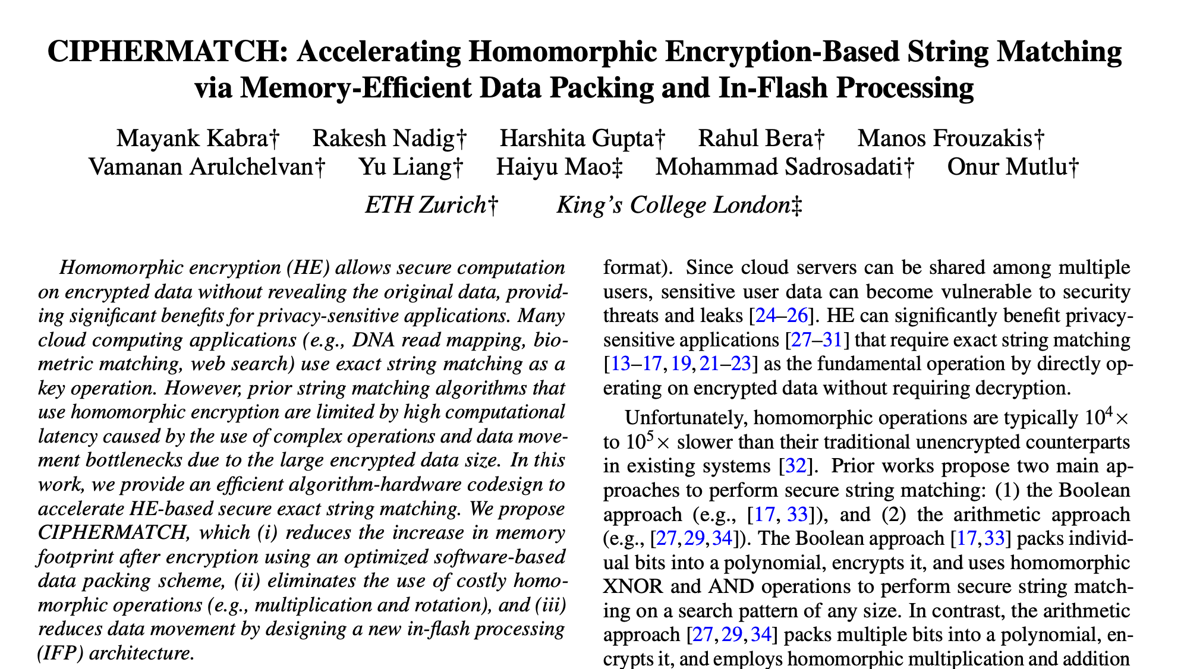
More Details in Our Paper
More detailed observations from our evaluation
  Comparison between CM-PuM and CM-PuM-SSD
  Comparison with the Boolean approach
End-to-end system design
  Operations in vertical data layout
  Enabling CIPHERMATCH in commodity SSDs
Overhead analysis of CIPHERMATCH hardware
  Storage overhead (from end-to-end system design)
  Area overhead (~0.6% of baseline NAND-flash memory)
Bitwise operations using NAND-flash memory
  Enabling bitwise operations using latching circuitry
  Exploiting bit-level and array-level parallelism
https://arxiv.org/pdf/2503.08968

Slide 82
To Summarize …

Slide 83
Conclusion
CIPHERMATCH
A new algorithm-hardware codesign that significantly improves the performance of secure exact string matching algorithm
Pack multiple bits of database
and thus eliminate the use of
homomorphic multiplication
+ Reduces memory footprint
+ Provides scalable
secure exact string-matching
1
Use in-flash processing (IFP)
to accelerate secure exact
string-matching
+ Reduces data movement
+ Leverages bit-level
and array-level parallelism
2
Key Results
CIPHERMATCH-SW: 42.9x speedup & 39.4x lower energy than best software
CIPHERMATCH-IFP: 136.9x speedup & 256.4x lower energy than CM-SW

Slide 84

CIPHERMATCH
Accelerating Homomorphic Encryption-Based
String Matching via Memory-Efficient Data Packing
and In-Flash Processing
arXiv
Mayank Kabra
Rakesh Nadig, Harshita Gupta, Rahul Bera, Manos Frouzakis,
Vamanan Arulchelvan, Yu Liang, Haiyu Mao,
Mohammad Sadrosadati, and Onur Mutlu

Slide 85
Backup slides

Slide 86
Summary
CM-SW provides 42.9x speedup
over the state-of-the-art approach in real systems
Due to our new memory-efficient data packing scheme
and use of only homomorphic additions
CM-IFP provides 136.9x speedup over CM-SW
and outperforms three near-data processing systems
Due to our new IFP design to perform in-flash operations
and exploiting large-scale bit-level parallelism

Slide 87
Executive Summary
Problem: Secure exact string matching using homomorphic encryption (HE) operations face performance bottlenecks in two key areas:
High computation cost due to use of complex homomorphic operations (e.g., multiplication)
data movement bottleneck due to large homomorphically encrypted data
Motivation: Reducing memory expansion from HE and performing computation where the database resides can improve the performance of secure exact string matching algorithm
Opportunity: (a) Perform memory-efficient packing of the database to reduce the increase in memory footprint after encryption and (b) perform simple computations (e.g., HE addition) inside solid state drives (SSDs – i.e., where the database is stored) to reduce data movement
CIPHERMATCH: A novel algorithm-hardware co-design that significantly improves the performance of HE-based secure string matching by using only homomorphic addition and leveraging the operational principles of NAND-flash memory.
Key Idea:
To pack multiple bits of data in the each coefficient of ciphertext
Use in-flash processing (IFP) to perform string matching inside NAND-flash memory
Key Benefits:
+ Reduce memory expansion after encryption
+ Eliminates the use of complex HE operations
+ Reduces data movement bottleneck
Key Results: (i) Software-based CIPHERMATCH implementation (CM-SW) achieves 42.9x speedup over state-of-the-art software approaches
(ii) CIPHERMATCH IFP implementation futher improves upon CM-SW, achieving 136.9x better performance and 256.4x lower energy consumption

Slide 88
Executive Summary
Problem: Secure exact string matching using homomorphic encryption (HE) operations face performance bottlenecks in two key areas:
High computation cost due to use of complex homomorphic operations (e.g., multiplication)
Data movement bottleneck due to large homomorphically encrypted data size
Motivation: Reducing memory expansion from HE and performing computation where the database resides can improve the performance of secure exact string matching algorithm
Opportunity: (a) Optimize memory usage by packing encrypted data efficiently and (b) perform secure string matching using simple HE operations (addition) inside SSDs, reducing data movement.
CIPHERMATCH: A novel algorithm-hardware co-design that significantly improves the performance of HE-based secure exact string matching (a) by using only homomorphic addition and (b) leveraging the operational principles of NAND-flash memory to perform secure exact string matching
Key Idea:
Pack multiple bits of data in the each coefficient of ciphertext
Use in-flash processing (IFP) to perform string matching inside NAND-flash memory
Key Benefits:
+ Reduce memory expansion after encryption
+ Eliminates the use of complex HE operations
+ Reduces data movement bottleneck
Key Results:
(i) Software-based CIPHERMATCH (CM-SW): 42.9× speedup over existing state-of-the-art approaches
(ii) CIPHERMATCH with IFP: 136.9× faster and 256.4× lower energy consumption than CM-SW
Notes:
We will discuss with a brief executive summary
[CLICK]
Background is way too much and can be cut down.
Color coordination (Wierd colors)
Make the 1 and 2 and (a) and (b) consistent.
COlor code Key idea and key benefits to show more benefits

Slide 89
NAND Flash Basics: A Flash Cell
A flash cell stores data by adjusting the amount of charge in the cell
1
0
Erased Cell
(Low Charge Level)
Programmed Cell
(High Charge Level)
Activation
Operates as a resistor
Operates as an open switch

Slide 90
NAND Flash Basics: A NAND String
A set of flash cells are serially connected to form a NAND String
Bitline (BL)
1
0
0
1
…
0
NAND String

Slide 91
NAND Flash Basics: A NAND Block
NAND strings connected to different bitlines comprise a NAND block
BL₁
BL₂
BL₃
BL₄
BL₅
BL_{N}
Block
WL₁
1
1
1
1
1
…
1
A single wordline (WL) controls a large number of flash cells: High bit-level parallelism
WL₂
0
0
0
0
0
…
0
WL₃
0
0
0
0
0
…
0
WL₄
1
1
1
1
1
…
1
…
…
…
…
…
…
WL_{M}
0
0
0
0
0
…
0

Slide 92
NAND Flash Basics: A NAND Plane
A large number of blocks share the same bitlines
Latches to store flash read data
…
Block₁
…
…
…
…
…
…
…
…
…
Block₂
…
…
…
…
…
…
…
…
…
…
…
…
…
…
…
Block_{K}
…
…
…
…
…
…
…
…
BL₁
BL₂
BL₃
BL₄
BL₅
BL_{N}

Slide 93
Speedup for Different Database Size
10⁶
72.1x
72.1x
72.1x
62.2x
62.2x
68.1x
10⁴
Speedup
10²
1.2x10³x
10⁰
8GB 16GB 32GB 64GB 128GB Avg
Encrypted Database Size (in GB)
CM-SW shows average speedup of 68.1x over prior arithmetic approach
CM-SW speedup decreases as data size exceeds DRAM capacity, primarily due to increased data movement between storage and DRAM.
Query Size of 16 bits

Slide 94
Speedup for Different Database Size
10⁶
250.1x
250.1x
250.1x
295.1x
295.1x
268.3x
226.3x
66.5x
10⁴
Speedup
10²
10⁰
8GB 16GB 32GB 64GB 128GB Avg
Encrypted Database Size (in GB)
CM-IFP shows highest average speedup of 268.3x over CM-SW
CM-SW speedup decreases when data size goes beyond DRAM size due to frequent data movement between storage and DRAM
Query Size of 16 bits

Slide 95
Energy Consumption for Different Query Size
10⁰
76.9x
156.2x
83.3x
454.5x
370.3x
294.1x
227.2x
256.4x
10⁻²
Norm. Energy
Consumption
10⁻⁴
10⁻⁶
16 32 64 128 256 Avg
Query Size (in bits)
CM-IFP shows highest average energy savings of 256.4x over CM-SW
CM-IFP energy efficiency decreases with increasing query sizes due to expensive flash reads
Database Size of 128 GB

Slide 96
CIPHERMATCH: NAND-Flash Bitwise Operations
NAND Flash Read Circuitry
NAND Flash Chip
Peripheral Circuitry
D-Latch
D-Latch
S-Latch
S-Latch
Plane#0
Plane#1
..
..
Blk#2
Blk#2
Blk#1
Blk#1
Die#0
Die#1
…
Storage (SSD)
SSD Controller
(General Purpose Core)
Flash Controller
Flash Chip
Flash Chip
Flash Chip
Flash Controller
Flash Chip
Flash Chip
Flash Chip
Internal DRAM
Flash Controller
Flash Chip
Flash Chip
Flash Chip
Notes:
We can provide it later. Lets breiefly discuss and provide background.

Slide 97
CIPHERMATCH: NAND-Flash Bitwise Operations
Design proposed by prior work [Cho+, Patent 2022]
Notes:
Show the tree structure why people should listen to NAND flash operations.

Slide 98
CIPHERMATCH: NAND-Flash Bitwise Operations
Bitwise AND of A and B
Data (A) is read and stored in S- latch
Data (A) is transferred from S-latch to D-latch
Similarly data (B) is read and stored in S-latch
OUT_D
OUT_D
RST_D
1
2
SET_D
2
OUT_S
OUT_S
3
3
SET_S
1
SO

Slide 99
CIPHERMATCH: NAND-Flash Bitwise Operations
1
1->0
1
EN
EN
OUT_D
OUT_D
Bitwise AND of A and B
1
0
RST_D
D-latch (A) | S-latch (B) | Z
SET_D
0 | 0
0
0 | 1
0
OUT_S
OUT_S
1 | 0
0
Retains Value
1 | 1
1
0
SET_S
Precharge the bitline to logical 1
SO
Precharge the bitline to logical 1
Notes:
Show the tree structure why people should listen to NAND flash operations.

Slide 100
Data Movement Bottleneck
Compute-centric systems: Move entire data from storage to CPU/GPU
Memory bandwidth:
~ 40 GB/s
Storage
(NAND Flash-Based SSD)
Main
Memory
(DRAM)
CPU/GPU
Storage I/O bandwidth:
~ 8 GB/s
Notes:
EXplain this better.
Explain the legends.
Too much gap
Write DRAM size 32GB on top.
Remove the DRAM size.
Remove the (can)

Slide 101
Motivation (II) – Data Movement Bottleneck
2
Compute-centric systems: Move entire data from storage to CPU/GPU
Memory-centric systems: Perform computations in main memory
Memory bandwidth:
~ 40 GB/s
Storage
(NAND Flash-Based SSD)
Storage
(NAND Flash-Based SSD)
Main
Memory
(DRAM)
Main
Memory
(DRAM)
CPU/GPU
CPU/GPU
External I/O bandwidth of storage systems
is the main bottleneck for memory intensive application
Storage I/O bandwidth:
~ 8 GB/s
Storage I/O bandwidth:
~ 8 GB/s
Notes:
EXplain this better.
Explain the legends.
Too much gap
Write DRAM size 32GB on top.
Remove the DRAM size.
Remove the (can)

Slide 102
Motivation (II) – Data Movement Bottleneck
2
Compute-centric systems: Perform computations in CPU/GPU
Memory-centric systems: Perform computations in main memory
Storage-centric systems: Perform computations inside storage system
Storage
(NAND Flash-Based SSD)
Main
Memory
(DRAM)
CPU/GPU
In-Storage
Compute
Units
NAND
Chip#1
…
NAND
Chip#4
NAND
Chip#31
…
NAND
Chip#32
Notes:
EXplain this better.
Explain the legends.
Too much gap
Write DRAM size 32GB on top.
Remove the DRAM size.
Remove the (can)

Slide 103
Motivation (II) – Data Movement Bottleneck
2
Compute-centric systems: Perform computations in CPU/GPU
Memory-centric systems: Perform computations in main memory
Storage-centric systems: Perform computations inside storage system
Storage
(NAND Flash-Based SSD)
Main
Memory
(DRAM)
CPU/GPU
In-Storage
Compute
Units
NAND
Chip#1
…
NAND
Chip#4
SSD-internal bandwidth
becomes the new bottleneck for computations
NAND
Chip#31
…
NAND
Chip#32
Notes:
EXplain this better.
Explain the legends.
Too much gap
Write DRAM size 32GB on top.
Remove the DRAM size.
Remove the (can)

Slide 104
In-Flash Processing (IFP)
Perform computations inside NAND-flash chips
by using operational principles of NAND-flash memory
Storage
(NAND Flash-Based SSD)
Main
Memory
(DRAM)
CPU/GPU
In-Storage
Compute
Units
NAND
Chip#1
…
NAND
Chip#4
NAND
Chip#31
…
NAND
Chip#32
Notes:
EXplain this better.
Explain the legends.
Too much gap
Write DRAM size 32GB on top.
Remove the DRAM size.
Remove the (can)

Slide 105
In-Flash Processing (IFP)
Prior Works ([Gao+, MICRO 2021] , [Park+, MICRO 2022])
perform bitwise operations using the latching circuit
NAND Flash Chip
Operand O₁
Operand O₁
Operand O₂
Operand O₂
Operand O₃
…
Operand O₃₂
Bitlines (BLs)
O₁ & O₂
Latching circuit
O₁
Notes:
EXplain this better.
Explain the legends.
Too much gap
Write DRAM size 32GB on top.
Remove the DRAM size.
Remove the (can)

Slide 106
Limitations of Prior Works
Boolean Approach [Pradel+, TrustCom 2021 ; Aziz+, Information 2024]
Arithmetic Approach [Yasuda+, CCSW 2013 ; Kim+, TDSC 2017 ; Bonte+, CCS 2020 ]
Boolean
Approach
Arithmetic
Approach
High memory footprint due to encryption of individual bits
Low memory footprint due to data packing mechanism
m = 1 1 0 1 0 1 1 . . . 1 1 0
m = 1 1 0 1 0 1 1 . . . 1 1 0
Enc(b₀) Enc(b₁) … Enc(b_{n})
Enc(P₁(x)) Enc(P₂(x)) … Enc(P_{n}(x))
Notes:
[CLICK] Many prior works exist for performing secure string matching using both Boolean and arithmetic approaches
[CLICK] However, we analyze different characteristics of these prior works and observe that
[CLICK] Boolean approaches have high memory footprint because we need to encrypt individual bits, [CLICK] whereas in arithmetic approaches,we have lower memory footprint due to the use of data packing mechanisms.

Slide 107
Limitations of Prior Works
Boolean Approach [Pradel+, TrustCom 2021 ; Aziz+, Information 2024]
Arithmetic Approach [Yasuda+, CCSW 2013 ; Kim+, TDSC 2017 ; Bonte+, CCS 2020 ]
Boolean
Approach
Arithmetic
Approach
High memory footprint due to encryption of individual bits
Low memory footprint due to data packing mechanism
High computation cost due to large number of HE operations
Low computation cost due to small number of HE operations
Enc(b₀) ⊕ Enc(b₁) ⊕ Enc(b₂) .…. 1000x
Enc(P₁(x)) Enc(P₂(x)) .…. 10x
✖️ ✖️
Notes:
[CLICK] Boolean approaches have overall high computation cost due to more number of HE operations required to perform string matching
[CLICK] Whereas in Boolean approaches, we perform lessnumber of HE operations and achieve lower computation cost as compared to Boolean appraoches

Slide 108
Limitations of Prior Works
Boolean Approach [Pradel+, TrustCom 2021 ; Aziz+, Information 2024]
Arithmetic Approach [Yasuda+, CCSW 2013 ; Kim+, TDSC 2017 ; Bonte+, CCS 2020 ]
Boolean
Approach
Arithmetic
Approach
High memory footprint due to encryption of individual bits
Low memory footprint due to data packing mechanism
High computation cost due to large number of HE operations
Low computation cost due to small number of HE operations
Support flexible query sizes due to unlimited computations
Support limited query sizes due to limited computations
Notes:
[CLICK] However, Boolean approaches support flexible query sizes because we can perform unlimited computations
[CLICK] Whereas arithmetic approaches can only support limited query sizes because these approaches can perform only limited computations which is defined by multiplicative depth of the algorithm as these algorithms use homomorphic multiplication operations.

Slide 109
Approaches for HE-based String Matching
Secure string matching using HE can be performed using two key approaches
Boolean Approach
Arithmetic Approach
Encrypt individual bits
Encrypt individual bits
e.g., m = 1 1 0 1 0 1 1 . . . 1 1 0
Encrypt multiple packed bits
e.g., m = 1 1 0 1 0 1 1 . . . 1 1 0
1
Encrypt multiple packed bits
1
Enc(b₀) Enc(b₁) … Enc(b_{n})
P₁= b₂x²+b₁x¹+b₀ P₂(x)= b₅x²+b₄x¹+b₃ … P_{n}(x)
Enc(P₁(x)) Enc(P₂(x)) … Enc(P_{n}(x))

Slide 110
Approaches for HE-based String Matching
Secure string matching using HE can be performed using two key approaches
Boolean Approach
Arithmetic Approach
Encrypt individual bits
Encrypt multiple packed bits
1
1
Perform homomorphic
XOR and AND operation
Perform homomorphic
multiplication and addition operation
2
2
Enc(b₀) Enc(b₁) … Enc(b_{n})
Enc(P₁(x)) Enc(P₂(x)) … Enc(P_{n}(x))
⊕ ⊕ … ⊕
✖️ ✖️ … ✖️
Enc(q₀) Enc(q₁) … Enc(q_{n})
Enc(Q₁(x)) Enc(Q₂(x)) … Enc(Q_{n}(x))
Enc(r₀) & Enc(r₁) & … & Enc(r_{n})
Enc(R₁(x)) + Enc(R₂(x)) +… + Enc(R_{n}(x))
Result
Result
Notes:
[CLICK] In Boolean Approach, [CLICK] we perform homomorphic XOR and [CLICK] AND operation and generate the final result
[CLICK] In arithmetic approach,[CLICK] we perform homomomorphic multiplication and addition operation.

Slide 111
Prior Works on HE-based String Matching
Boolean Approach [Pradel+, TrustCom 2021 ; Aziz+, Information 2024]
Arithmetic Approach [Yasuda+, CCSW 2013 ; Kim+, TDSC 2017 ; Bonte+, CCS 2020 ]
Boolean
Approach
Arithmetic
Approach
High memory footprint due to encryption of individual bits
Low memory footprint due to data packing mechanism
m = 1 1 0 1 0 1 1 . . . 1 1 0
m = 1 1 0 1 0 1 1 . . . 1 1 0
Enc(b₀) Enc(b₁) … Enc(b_{n})
Enc(P₁(x)) Enc(P₂(x)) … Enc(P_{n}(x))
Notes:
[CLICK] Many prior works exist for performing secure string matching using both Boolean and arithmetic approaches
[CLICK] However, we analyze different characteristics of these prior works and observe that
[CLICK] Boolean approaches have high memory footprint because we need to encrypt individual bits, [CLICK] whereas in arithmetic approaches,we have lower memory footprint due to the use of data packing mechanisms.

Slide 112
Prior Works on HE-based String Matching
Boolean Approach [Pradel+, TrustCom 2021 ; Aziz+, Information 2024]
Arithmetic Approach [Yasuda+, CCSW 2013 ; Kim+, TDSC 2017 ; Bonte+, CCS 2020 ]
Boolean
Approach
Arithmetic
Approach
High memory footprint due to encryption of individual bits
Low memory footprint due to data packing mechanism
Support flexible query sizes due to unlimited computations
Support limited query sizes due to limited computations
Notes:
[CLICK] However, Boolean approaches support flexible query sizes because we can perform unlimited computations
[CLICK] Whereas arithmetic approaches can only support limited query sizes because these approaches can perform only limited computations which is defined by multiplicative depth of the algorithm as these algorithms use homomorphic multiplication operations.

Slide 113
Arithmetic Approach Performs Better
(Aziz +, Information 2024) (Yasuda+, CCSW 2013)
Execution Time (in s)
Database Size
(64 bytes)
Database Size
(128 bytes)
Database Size
(256 bytes)
Query Size (in Bits)
Arithmetic approach performs better
with larger database sizes due to fewer HE operations
Notes:
Hence, arithmetic approaches scales better with larger database sizes because they use fewer HE operations.

Slide 114
Latency Breakdown of Arithmetic Approach
(Aziz +, Information 2024) (Yasuda+, CCSW 2013)
Hom.
Add.
(1.8%)
Execution Time (in s)
Hom. Mult. (98.2%)
Latency
Breakdown (%)
Database Size
(64 bytes)
Database Size
(128 bytes)
Database Size
(256 bytes)
Query Size (in Bits)
Notes:
We analyze the latency breakdown of arithmetic approach and found that most of the time is spent on performing homomorphic multiplications.

Slide 115
Key Problem (I): Complex HE Operations
(Aziz +, Information 2024) (Yasuda+, CCSW 2013)
Hom.
Add.
(1.8%)
Execution Time (in s)
Hom. Mult. (98.2%)
Latency
Breakdown (%)
Database Size
(64 bytes)
Database Size
(128 bytes)
Database Size
(256 bytes)
Query Size (in Bits)
Prior arithmetic approaches
use costly homomorphic multiplication operations
which limits the scalabilty of HE-based string matching
Notes:
[CLICK] Hence, key problem one is that prior arithmetic approaches use costly homomorphic multiplication operations which incur high computation cost and [CLICK] mitgating homomorphic operations can significanly improves the performance.

Slide 116
Key Observation
String matching can be performed using addition operation
If we negate the data, add it to the original data,
we get a string of 1 1 1 1’s
m = 0 1 0 1 0 0 1 0 1 0 0 1 0 1
+ ~m = 1 0 1 0 1 1 0 1 0 1 1 0 1 0
1 1 1 1 1 1 1 1 1 1 1 1 1 1
Value which can be checked
Notes:
Conventional string matching can be performed using addition operation
[CLICK] e.g., if we negate the data and [CLICK] add it to the original data we receive a static value which can be checked

Slide 117
Key Observation
String matching can be performed using addition operation
m = 0 1 0 1 0 0 1 0 1 0 0 1 0 1
+ ~m = 1 0 1 0 1 1 0 1 0 1 1 0 1 0
1 1 1 1 1 1 1 1 1 1 1 1 1 1
Value which can be checked
Secure string matching can be performed using HE addition operation
Enc( m ) = (5 x¹⁰²⁴ + 10 x¹⁰²³ + …. + 19 , …)
+ Enc(~m ) = (6 x¹⁰²⁴ + 11 x¹⁰²³ + …. + 3 , …)
(11 x¹⁰²⁴ + 21 x¹⁰²³ + …. + 22 , …)
(1111…1x¹⁰²⁴ + 1111…1 x¹⁰²³ + …. + 1111…1)
Decrypt
Notes:
Now this observation can be extended by using HE addition [CLICK], where the data is encrypted and we perform homomorphic addition. Once we decrypt the result we see that final result after decryption contains the static value of 1111

Slide 118
Key Observation
String matching can be performed using addition operation
m = 0 1 0 1 0 0 1 0 1 0 0 1 0 1
+ ~m = 1 0 1 0 1 1 0 1 0 1 1 0 1 0
1 1 1 1 1 1 1 1 1 1 1 1 1 1
Value which can be checked
This output after homomorphic addition
is an encrypted value of 1111’s
that can be used for matching
Secure string matching can be performed using HE addition operation
Enc( m ) = (5 x¹⁰²⁴ + 10 x¹⁰²³ + …. + 19 , …)
+ Enc(~m ) = (6 x¹⁰²⁴ + 11 x¹⁰²³ + …. + 3 , …)
(11 x¹⁰²⁴ + 21 x¹⁰²³ + …. + 22 , …)
(1111…1x¹⁰²⁴ + 1111…1 x¹⁰²³ + …. + 1111…1)
Decrypt
Notes:
Now this observation can be extended by using HE addition [CLICK], where the data is encrypted and we perform homomorphic addition. Once we decrypt the result we see that final result after decryption contains the static value of 1111

Slide 119
Memory-Efficient Data Packing Scheme
1
Client Machine
Server Machine
Query
Data Packing & Encryption
Encrypted Query
DRAM
Storage
(SSD)
CPU
Perform String Matching
Encrypted Database
Result
Matched Index
Assume, Database (d) =
1 0 1 0 1 1 1
1 0 0 1 0 1 1
1 0 1 0 1 1 1
1 0 0 1 0 1 1
1 1 ... 1 0 1 0 1
1 1 ... 1 0 1 0 1
Encode database into multiple plaintext polynomials (P(x))
by packing multiple bits into a single polynomial coefficient
e.g., P(x) = 1 0 1 0 1…1 x¹⁰²⁴ + 1 0 0 1 0…1 x¹⁰²³ + …. + 1 1...1 0 1 0 1
Encrypted Database
Notes:
First, lets assume database d as string of binary values.
[CLICK] We distribute the database and place them into the multiple coefficients of the polynomial. Then we perform encryption to generate the encrypted database and store it in the SSD of server machine.

Slide 120
CIPHERMATCH: Data Packing Scheme
1
Client Machine
Server Machine
Query
Data Packing & Encryption
CPU
DRAM
Storage
(SSD)
Perform String Matching
Encrypted Database
Result
Matched Index
Assume, Query (q) =
0 0 0 1 1 0 0
1 1 1 0 0 1 1
0 0 0 1 1 0 0
0 0 0 1 1 0 0
0 0 0 1 1 0 0
The query (q) is negated, replicated
and encoded into the plaintext polynomials (Q(x))
e.g., Q(x) = 0 0 0 1 1…0 x¹⁰²⁴ + 0 0 0 1 1…0 x¹⁰²³ + …. + 0 0 0 1 1…0
Encrypted
Query
Notes:
Second, we assume a query (q). For query, we negate the query and replicate this query in coefficients of the polynomial. Then we encrypt this query and send this query from client to the server machine.

Slide 121
CIPHERMATCH: Identify the Match
2
String matching can be performed using addition operation
m = 0 1 0 1 0 0 1 0 1 0 0 1 0 1
+ ~m = 1 0 1 0 1 1 0 1 0 1 1 0 1 0
1 1 1 1 1 1 1 1 1 1 1 1 1 1
Value which can be checked
This output after homomorphic addition
is an encrypted value of 1111’s
that can be used for matching
Secure string matching can be performed using HE addition operation
Enc( m ) = (5 x¹⁰²⁴ + 10 x¹⁰²³ + …. + 19 , …)
+ Enc(~m ) = (6 x¹⁰²⁴ + 11 x¹⁰²³ + …. + 3 , …)
(11 x¹⁰²⁴ + 21 x¹⁰²³ + …. + 22 , …)
(1111…1x¹⁰²⁴ + 1111…1 x¹⁰²³ + …. + 1111…1)
Decrypt
Notes:
Now this observation can be extended by using HE addition [CLICK], where the data is encrypted and we perform homomorphic addition. Once we decrypt the result we see that final result after decryption contains the static value of 1111

Slide 122
CIPHERMATCH: Identify the Match
2
String matching can be performed using addition operation
m = 0 1 0 1 0 0 1 0 1 0 0 1 0 1
+ ~m = 1 0 1 0 1 1 0 1 0 1 1 0 1 0
1 1 1 1 1 1 1 1 1 1 1 1 1 1
Value which can be checked
Secure String matching can be performed using HE addition operation
Enc( m ) = (5 x¹⁰²⁴ + 10 x¹⁰²³ + …. + 19 , …)
+ Enc(~m ) = (6 x¹⁰²⁴ + 11 x¹⁰²³ + …. + 3 , …)
(11 x¹⁰²⁴ + 21 x¹⁰²³ + …. + 22 , …)
(1010…1x¹⁰²⁴ + 1111…1 x¹⁰²³ + …. + 1001…0)
Decrypt
Notes:
It should be observation
Say it in simple way ..
Too much text.
Rounded edges , fix the gaps
make it bold.
Entire slide think about it.
Key Observation

Slide 123
CIPHERMATCH: Identify the Match
2
Enc( m ) = (5 x¹⁰²⁴ + 10 x¹⁰²³ + …. + 19 , …)
+Enc(~q ) = (2 x¹⁰²⁴ + 14 x¹⁰²³ + …. + 3 , …)
(1010…1x¹⁰²⁴ + 1111…1 x¹⁰²³ + …. + 1001…0)
Encrypted Database
Encrypted Query
Result = (7 x¹⁰²⁴ + 24 x¹⁰²³ + …. + 22 , …)
Decrypt
Match polynomial = 111…11 x¹⁰²⁴ + 111…11 x¹⁰²³ + …. + 111…11
Encrypt
Match value = (91 x¹⁰²⁴ + 24 x¹⁰²³+ …. + 32 , …)
Notes:
It should be observation
Say it in simple way ..
Too much text.
Rounded edges , fix the gaps
make it bold.
Entire slide think about it.
Key Observation

Slide 124
CIPHERMATCH: Identify the Match
2
Enc( m ) = (5 x¹⁰²⁴ + 10 x¹⁰²³ + …. + 19 , …)
+Enc(~q ) = (2 x¹⁰²⁴ + 14 x¹⁰²³ + …. + 3 , …)
(1010…1x¹⁰²⁴ + 1111…1 x¹⁰²³ + …. + 1001…0)
Encrypted Database
Encrypted Query
Result = (7 x¹⁰²⁴ + 24 x¹⁰²³ + …. + 22 , …)
Result = (7 x¹⁰²⁴ + 24 x¹⁰²³ + …. + 22 , …)
Decrypt
Match polynomial = 111…11 x¹⁰²⁴ + 111…11 x¹⁰²³ + …. + 111…11
Encrypt
Match value = (91 x¹⁰²⁴ + 24 x¹⁰²³+ …. + 32 , …)
Notes:
It should be observation
Say it in simple way ..
Too much text.
Rounded edges , fix the gaps
make it bold.
Entire slide think about it.
Key Observation

Slide 125
CIPHERMATCH: Identify the Match
2
Result = (7 x¹⁰²⁴ + 24 x¹⁰²³ + …. + 22 , …)
Compare
Generate Index
Match value = (91 x¹⁰²⁴ + 24 x¹⁰²³+ …. + 32 , …)
Compare the match value
Notes:
It should be observation
Say it in simple way ..
Too much text.
Rounded edges , fix the gaps
make it bold.
Entire slide think about it.
Key Observation

Slide 126
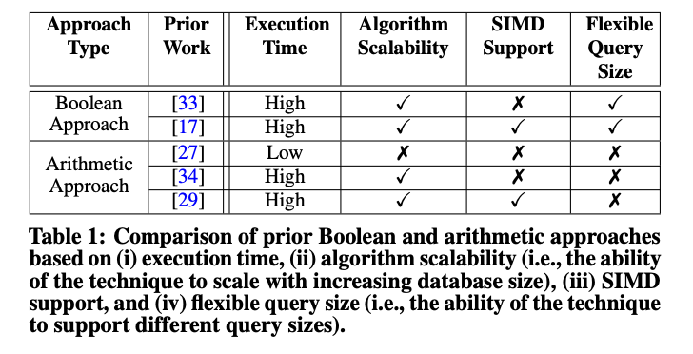
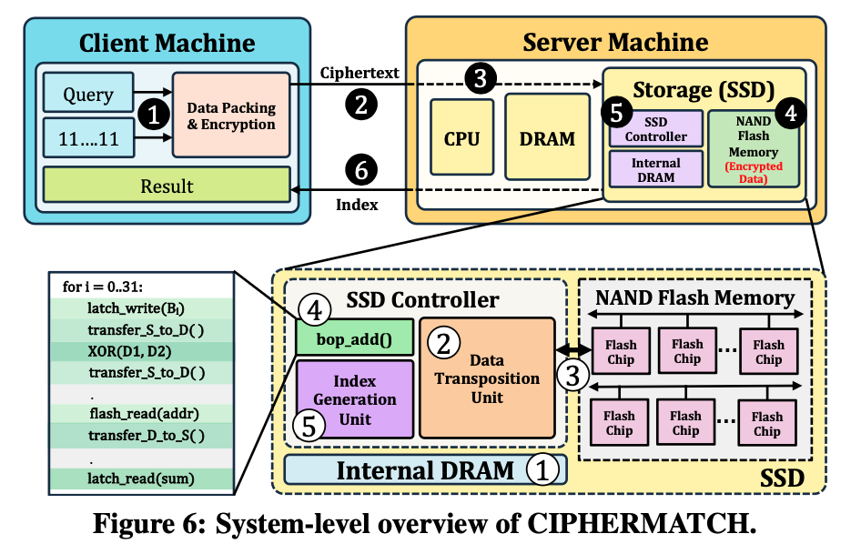
Qualitative Analysis of Prior Work
Notes:
It should be observation
Say it in simple way ..
Too much text.
Rounded edges , fix the gaps
make it bold.
Entire slide think about it.
Key Observation

Slide 127
System-Level Overview of CIPHERMATCH
Notes:
It should be observation
Say it in simple way ..
Too much text.
Rounded edges , fix the gaps
make it bold.
Entire slide think about it.
Key Observation

Slide 128
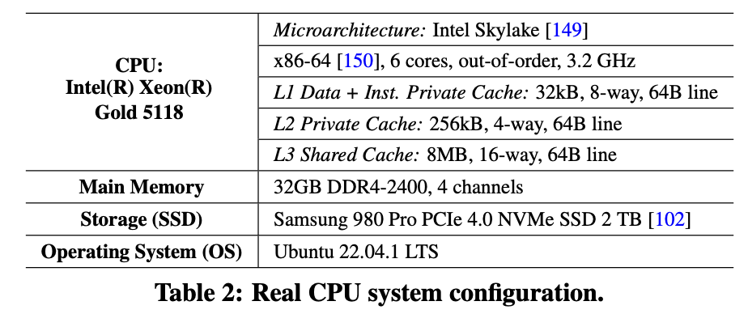
Evaluation Configuration
Notes:
It should be observation
Say it in simple way ..
Too much text.
Rounded edges , fix the gaps
make it bold.
Entire slide think about it.
Key Observation

Slide 129
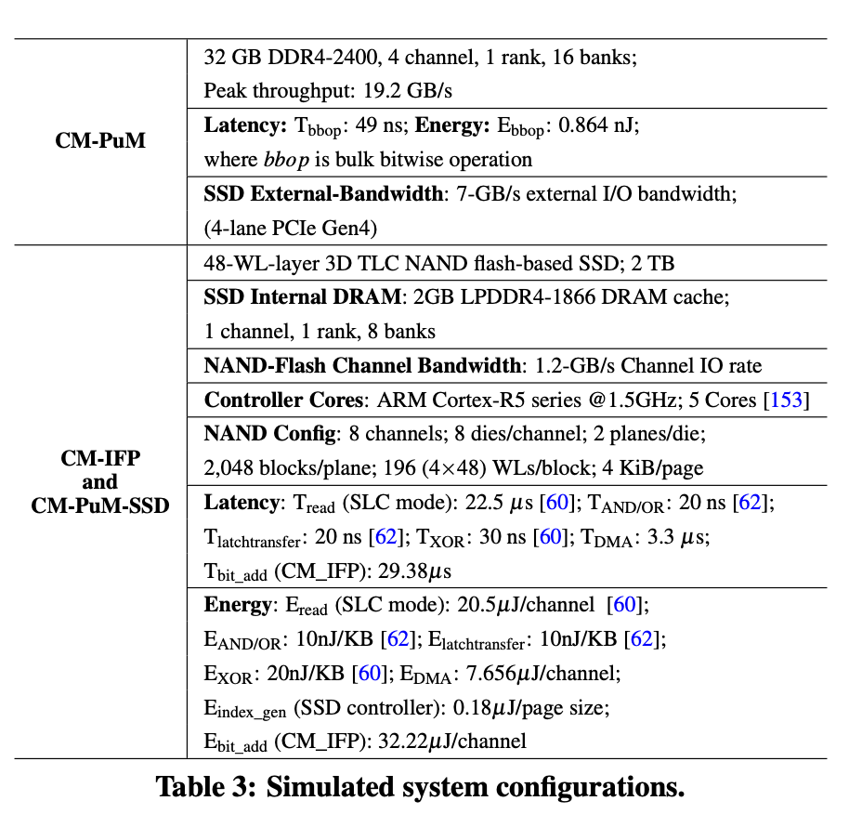
Evaluation Configuration
Notes:
It should be observation
Say it in simple way ..
Too much text.
Rounded edges , fix the gaps
make it bold.
Entire slide think about it.
Key Observation

