Slide 1
COVIDHunter: An Accurate, Flexible, and Environment-Aware Open-Source COVID-19 Outbreak Simulation Model
Mohammed Alser
Jeremie S. Kim, Nour Almadhoun Alserr, Stefan W. Tell, Onur Mutlu
alserm@ethz.ch
Presented at ISMB/ECCB 2021
Notes:
Hello, My name is Mohammed Alser, and I will be presenting COVIDHunter

Slide 2
Executive Summary
Problem: No model is capable of accurately simulating the epidemiological situation while accounting for the effects of environmental conditions and considering a reasonably low number of assumptions and model parameters.
No future prediction: Accounting for reporting delays and under-reporting due to inefficiencies such as low number of COVID-19 tests.
Inaccurate prediction: Don’t rely on the observed (laboratory-confirmed) number of cases, lack environment-awareness, and require a large number of assumptions and various input parameters.
Goal: Develop such a COVID-19 outbreak simulation model.
COVIDHunter:
Key ideas: Quantifies the spread of COVID-19 in a geographical region by calculating the daily reproduction number, R, based on 1) mitigation measures, 2) environmental conditions, 3) population clustering (HEALTHY, INFECTED, CONTAGIOUS, and IMMUNE), and 4) infected travelers.
Uses historical COVID-19 hospitalizations-to-cases and deaths-to-cases ratios for calculating the number of hospitalizations and deaths.
Key results:
Compared to prominent policy-making models (IBZ, LSHTM, ICL, and IHME), COVIDHunter achieves more accurate estimation and provides no prediction delay.
For each 1◦C rise in daytime temperature, there is a 3.67% decrease in the daily number of confirmed cases.
COVIDHunter is easy to use and flexible to configure due to the simple modeling approach that uses a small number of parameters.
Notes:
No model is capable of simulating the pandemic while accounting for environmental conditions and considering a low number of assumptions.
== click == Our goal is to develop such a simulation model, and we call it COVIDHunter
== click == Existing models either don’t provide future prediction and try to account for reporting delay or under-reporting.
== click == Some other models provide inaccurate predictions and require large number of assumptions and parameters.
== click == To improve this, we propose COVIDHunter: The Key idea is to quantify the spread of COVID-19 by calculating the daily reproduction number based on 1) mitigation measures, 2) environmental conditions, 3) population clustering (HEALTHY, INFECTED, CONTAGIOUS, and IMMUNE), and 4) infected travelers.
== click == We also use historical COVID-19 hospitalizations-to-cases and deaths-to-cases ratios for calculating the number of hospitalizations and deaths.
Key results:
== click == COVIDHunter provides more accurate estimation with no prediction delay, compared to prominent policy-making models (IBZ, LSHTM, ICL, and IHME).
== click == For each 1◦C rise in daytime temperature, there is a 3.67% decrease in the daily number of confirmed cases.
== click == Easy to use and flexible to configure due to the simple modeling approach that uses a small number of parameters.

Slide 3
How Does COVIDHunter Work?
HEALTHY
Predict the daily R value
Label
each individual
INFECTED
CONTAGIOUS
HOSPITALIZED
IMMUNE
Mitigation measures
& environmental conditions
DEAD
Population statistics and number of infected travelers
Predict the daily number of hospitalizations and deaths
Predict the daily number of cases
R describes the average number of new infections caused by each infected person
Notes:
COVIDHunter includes four main steps
== click == First, it predicts the daily reproduction number using input information about the mitigation measures and environmental conditions
== click == Second, it labels each individual in a population according to different stages of the COVID-19 infection timeline. This step uses input information about the population and infected travelers (such as cross-boarder travelers)
== click == Third, it predicts the daily number of cases
== click == Fourth, it predicts the daily number of hospitalizations and deaths

Slide 4
Epidemiological Situation in Switzerland
We use Switzerland as a use-case for all the experiments.
COVIDHunter is completely configurable for other countries:
https://github.com/CMU-SAFARI/COVIDHunter/tree/main/Reproduce-Switzerland-Case-Study-Results
Workloads
Data and source code: https://github.com/CMU-SAFARI/COVIDHunter
Simulation runs and visualization: https://mealser.github.io/COVIDHunter/
Comparison points
Prominent simulation models used to assist in decision-making for policy-makers in countries:
United Kingdom, ICL [Flaxman+, Nature 2020].
United States, IHME [Reiner+, Nature Medicine 2020].
Switzerland, IBZ [Huisman+, medRxiv 2020]
LSHTM [Russell+, BMC Medicine 2020].
Notes:
We use Switzerland as a use-case for all the experiments. However, our model is not limited to any specific region as the parameters it uses are completely configurable.
== click == All workloads and evaluation results are publicly available
== click == We compare the predictions of COVIDHunter with that of four prominent simulation models that are used to assist in decision-making such as: ICL, IHME, IBZ, and LSHTM.

Slide 5
Evaluating the Mitigation Measures
Without considering the effect of environmental conditions
0.73
0.6
0.5
0.4
0.35
Monitoring Predicting
considering the effect of environmental conditions
Mitigation measures applied during the summer of 2020 are only 14% more relaxed compared to the mitigation measures applied during the first wave, which is implausible.
Notes:
mitigation measures (only mandatory of wearing mask on public transport) applied during the summer of 2020 are only 14% more relaxed compared to the mitigation measures (e.g., closure of schools, restaurants, and borders, ban on small and large events) applied during the first wave, which is implausible.

Slide 6
Predicted Number of COVID-19 Cases
Simulation run: January 2021 Simulation run: April 2021
ICL model provides overestimated number of COVID-19 cases (3.8× compared to CTC_100%_M(t)=0.7) as demonstrated using two different simulation runs, January 2021 and April 2021.

Slide 7
Predicted Number of COVID-19 Hospitalizations
Simulation run: January 2021 Simulation run: April 2021
ICL model and IHME model overestimate the number of hospitalizations (18.6× and 10.6× higher than the observed number of hospitalizations), using January and April 2021 simulation runs, respectively, which is highly unlikely.

Slide 8
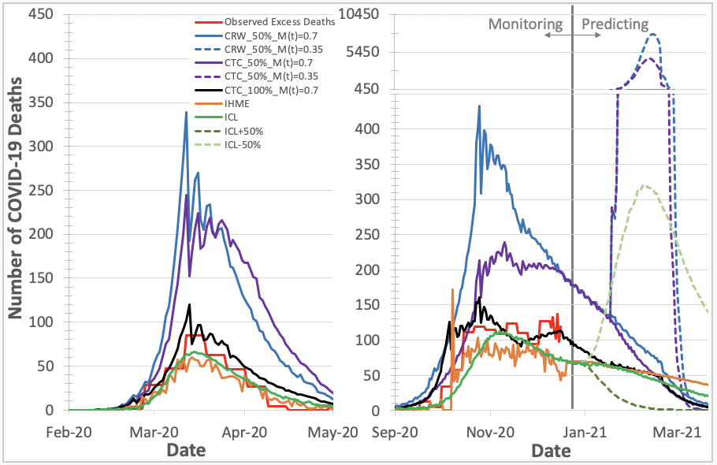
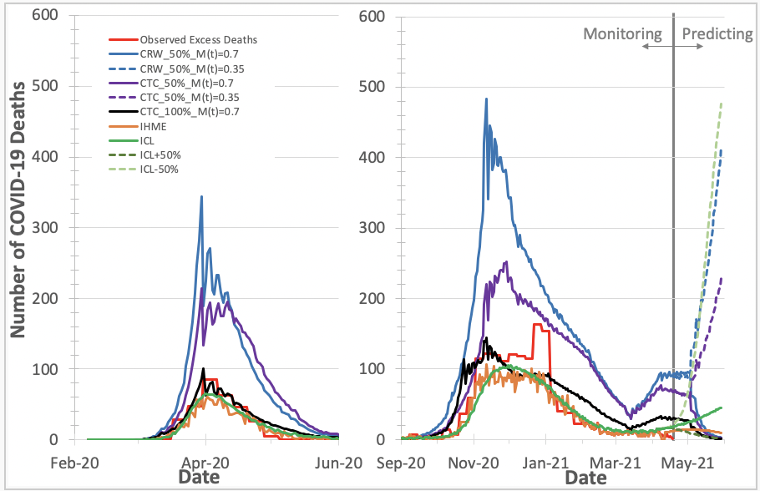
Predicted Number of COVID-19 Deaths
Simulation run: January 2021 Simulation run: April 2021
ICL and IHME models provide late prediction (their curves are shifted by 5-10 days from that of other models).

Slide 9
COVIDHunter 2.0
Support for a mutated virus with a different R0 value.
Support for asymptomatic cases.
Support for vaccinations.
Compatible with COVIDHunter 1.0
The reproduction number, R.
The number of infected persons.
The number of hospitalized persons.
The number of deaths.
The number of individuals at each stage of the COVID-19 infection (healthy, infected, contagious, and immune).
The strength and the duration of each mitigation measure.
https://github.com/CMU-SAFARI/COVIDHunter

Slide 10
COVIDHunter forecasts that further tightening of mitigation measures is needed before October 2021 to avoid overwhelming healthcare system in Switzerland.

Slide 11
https://github.com/CMU-SAFARI/COVIDHunter

Slide 12
Simulation runs and visualization: https://mealser.github.io/COVIDHunter/

Slide 13
Alser+, COVIDHunter: An Accurate, Flexible, and Environment-Aware Open-Source COVID-19 Outbreak Simulation Model, medRxiv, 2021
Source code: https://github.com/CMU-SAFARI/COVIDHunter
Simulation runs and visualization: https://mealser.github.io/COVIDHunter/
Notes:
I invite you to check our COVIDHunter webpage and read our full paper for more details

Slide 14
COVIDHunter: An Accurate, Flexible, and Environment-Aware Open-Source COVID-19 Outbreak Simulation Model
Mohammed Alser
Jeremie S. Kim, Nour Almadhoun Alserr, Stefan W. Tell, Onur Mutlu
alserm@ethz.ch
Presented at ISMB/ECCB 2021
Notes:
Thank you so much for your time and attention.

