Slide 1





Chronus
Understanding and Securing the Cutting-Edge Industry Solutions to DRAM Read Disturbance
Oğuzhan Canpolat
Giray Yağlıkçı Geraldo Oliveira Ataberk Olgun
Nisa Bostancı İsmail Emir Yüksel Haocong Luo
Oğuz Ergin Onur Mutlu
https://github.com/CMU-SAFARI/Chronus

Slide 2
Executive Summary
Problem:
DRAM continues to become more vulnerable to read disturbance
Latest update (April 2024) to DDR5 standard introduces Per Row Activation Counting (PRAC) to mitigate read disturbance
No prior work investigates PRAC’s security and performance
Goal: Rigorously analyze, characterize, and improve the security and performance of the DDR5 standard PRAC mechanism
Mathematical analysis & extensive simulations show that: PRAC
Has significant (10%) performance overhead for modern DRAM chips
because PRAC requires additional time to track read disturbance aggressors
Poorly scales to future DRAM chips that are more vulnerable to read disturbance because PRAC is vulnerable to an adversarial access pattern (i.e., the wave attack)
Chronus: Solves PRAC’s two major weaknesses by
Concurrently tracking read disturbance aggressors while serving accesses
Securing PRAC against a potential wave attack
Key Results: Chronus provides high performance and low energy at low hardware complexity overhead and outperforms five state-of-the-art solutions
https://github.com/CMU-SAFARI/Chronus

Slide 3
Outline
Background
Industry Solutions to Read Disturbance
Security Analysis of Industry Solutions
Performance Analysis of Industry Solutions
Chronus
Evaluation
Conclusion

Slide 4
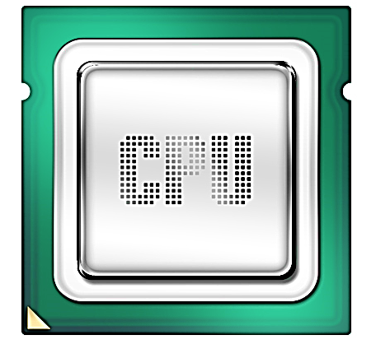
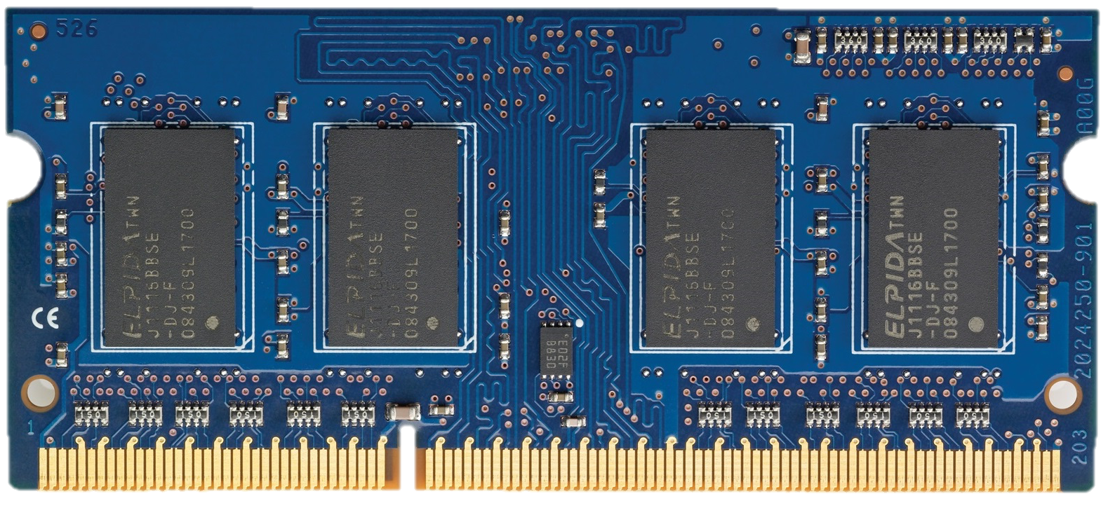
DRAM Organization
DRAM Chips
DRAM
Channel
Processor
DRAM Module
Notes:
Processor <> DRAM Module

Slide 5
DRAM Organization
DRAM Cell
Bitline
DRAM
Array
Wordline
Bank
S
S
S
S
Sense amplifiers
(row buffer)
Off-chip channel
Notes:
Several banks
2d grid
Dram cell
Rows
Row buffer

Slide 6
DRAM Operations
1
ACTIVATE: Fetch the row
into the row buffer
1
1
1
1
2
READ/WRITE: Retrieve or
update data
3
PRECHARGE: Prepare the bank for a new ACTIVATE
to I/O
ACTIVATION and PRECHARGE are time-consuming operations
Notes:
3 stages
Act, rd/wr/pre
Time consuming

Slide 7
DRAM Access Latency
Command
ACTIVATE
PRECHARGE
Data
Duration
t_{RAS}
t_{RP}
Next
ACT
row-cycle time (t_{RC})
Notes:
Predefined amount of time
To send a PRE after ACT we wait -> tRAS
To send an ACT after PRE we wait -> tRP

Slide 8
RowHammer: A Prime Example of Read Disturbance
DRAM Subarray
Row 0
Row 0
Victim Row
Row 1
Row 1
Row 1
Victim Row
Row 2
Row 2
Row 2
Row 2
Row 2
Row 2
open
open
open
closed
closed
Aggressor Row
Row 3
Row 3
Row 3
Victim Row
Row 4
Row 4
Victim Row
Repeatedly opening (activating) and closing (precharging)
a DRAM row causes read disturbance bitflips in nearby cells
Notes:
victims EXPERIENCE bitflips

Slide 9
Read Disturbance Vulnerabilities (I)
DRAM Subarray
Row 0
Row 0
Victim Row
Row 1
Row 1
Row 1
Victim Row
Row 2
Row 2
Row 2
Row 2
Row 2
open
open
open
closed
Aggressor Row
Row 3
Row 3
Row 3
Victim Row
Row 4
Row 4
Victim Row
The minimum number of activations that causes a bitflip is called the RowHammer threshold (N_{RH})

Slide 10
Read Disturbance Vulnerabilities (II)
DRAM chips are more vulnerable to read disturbance today
Read disturbance bitflips occur at much lower activation counts
(more than two orders of magnitude decrease in less than a decade):
139K
[Kim+, ISCA’14]
9.6K
[Kim+, ISCA’20]
<1K (RowPress)
[Luo+, ISCA’23]
It is critical to prevent read disturbance bitflips
effectively and efficiently for highly vulnerable systems

Slide 11
Existing RowHammer Mitigations (I):
Preventive Refresh
DRAM Subarray
Row 0
Row 0
Row 0
Victim Row
Row 1
Row 1
Row 1
Row 1
Victim Row
Row 2
Row 2
Row 2
Row 2
Row 2
Row 2
open
open
open
closed
Aggressor Row
Aggressor Row
Row 3
Row 3
Row 3
Row 3
Victim Row
Row 4
Row 4
Row 4
Victim Row
Refreshing potential victim rows
mitigates RowHammer bitflips

Slide 12

Existing RowHammer Mitigations (II):
DRAM Aggressor Row Tracking or Estimation
DRAM Subarray
Row 0
Row 0
Row 0
Victim Row
Row 1
Row 1
Row 1
Row 1
Victim Row
Row 2
Row 2
Row 2
Row 2
Row 2
Row 2
open
open
open
closed
Aggressor Row
Aggressor Row
Row 3
Row 3
Row 3
Row 3
Victim Row
Row 4
Row 4
Row 4
Victim Row
Necessary to accurately track or estimate aggressor DRAM row activation counts to preventively refresh potential victim rows

Slide 13
Outline
Background
Industry Solutions to Read Disturbance
Security Analysis of Industry Solutions
Overhead Analysis of Industry Solutions
Chronus
Evaluation
Conclusion

Slide 14

Industry Solutions to Read Disturbance:
When To Refresh? (I)
Preventive refresh operations are
blocking and time consuming operations
ACT
REF
DRAM
Channel
DRAM Module
Memory controller cannot access a memory bank
undergoing a preventive refresh
Notes:
One problem is finding time to refresh
DRAM module CANNOT decide on its own

Slide 15
Industry Solutions to Read Disturbance:
When To Refresh? (II)
Earlier JEDEC DDR5 specifications introduce
Refresh Management (RFM) commands
RFM
DRAM
Channel
DRAM Module
Memory controller sends an RFM command
to allow time for preventive refreshes

Slide 16
Industry Solutions to Read Disturbance
Periodic Refresh Management (PRFM)
Periodic Refresh Management (PRFM)
Memory controller periodically issues RFM commands
Memory controller periodically issues RFM commands
Per Row Activation Counting and Back-Off (PRAC)
DRAM chip tracks row activations and requests RFMs by sending a back-off
Notes:
Industry has two solutions that use PRFM

Slide 17
Industry Solutions to Read Disturbance:
Periodic Refresh Management (PRFM)
ACT
RFM
Bank Activation Counters
0
3
2
1
0
0
0
0
0
PRFM tracks activations with low accuracy,
causing a high number of preventive refreshes,
leading to large performance and energy overheads
RFM Threshold
ACT
ACT
ACT
RFM
DRAM Commands
Notes:
a counter PER DRAM bank

Slide 18
Industry Solutions to Read Disturbance
Periodic Refresh Management (PRFM)
Memory controller periodically issues RFM commands
Per Row Activation Counting and Back-Off (PRAC)
Per Row Activation Counting and Back-Off (PRAC)
DRAM chip tracks row activations and requests RFMs by sending a back-off
DRAM chip tracks row activations and requests RFMs by sending a back-off

Slide 19
Industry Solutions to Read Disturbance:
Per Row Activation Counting
Counters
DRAM Rows
0
101010101010101010101010
0
1
2
3
4
101010101010101010101010
…
…
PRAC allows accurate tracking of aggressor row activations
Notes:
Each row has a corresponding counter

Slide 20
Industry Solutions to Read Disturbance:
Per Row Activation Counting DRAM Timings
Counters
DRAM Rows
0
101010101010101010101010
0
101010101010101010101010
…
…
The activation counter of a row is updated
while the row is being closed
PRAC increases precharge duration (t_{RP}) by 140%
precharge duration (t_{RP})
PRE
ACT
Notes:
Be clear on what JEDEC published

Slide 21
Industry Solutions to Read Disturbance:
Per Row Activation Counting DRAM Timings
Timing parameter changes for DDR5-3200AN speed bin
[JEDEC JESD79-5C, April 2024]
t_{RP}
_{: +21ns}
_{(+140%)}
t_{RAS}
_{: -16ns}
_{(-50%)}
t_{RTP}
_{: -2.5ns}
_{(-33%)}
t_{WR}
_{: -20ns}
_{(-66%)}
t_{RC}
_{: +5ns}
_{(+10%)}
Notes:
The list of all affected timing parameters
Importantly, tRP and tRC increase

Slide 22
Industry Solutions to Read Disturbance:
Per Row Activation Counting (PRAC)
ACT
RFM
Back-Off
No Back-Off
Row Counters
0
Back-Off Threshold
0
1
2
3
4
0
…
normal traffic
(180 ns)
recovery
(N RFMs)
delay
(N ACTs)
PRAC-N
ACT
ACT
ACT
ACT
RFM
RFM
ACT
ACT
DRAM Commands
Notes:
An execution example
Recovery predefined #RFMs
mechanism named after the number of RFMs
Delay predefined #ACTs
Same number with RFMs in recovery

Slide 23
Outline
Background
Industry Solutions to Read Disturbance
Security Analysis of Industry Solutions
Performance Analysis of Industry Solutions
Chronus
Evaluation
Conclusion

Slide 24
Security Analysis of Industry Solutions:
Mathematical Security Analysis Methodology
Wave attack [Yağlıkçı+, 2021] : worst-case access pattern
  maximizes hammer count by using decoy rows
  on a system with PRFM
  on a system with PRAC
Parameters:
  Starting row set size: # of rows that the wave attack hammers
  RFM threshold (PRFM)
  Back-Off threshold (PRAC)
Result: Worst possible (highest) activation count
that an attacker can achieve to a row

Slide 25
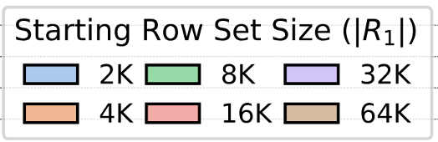
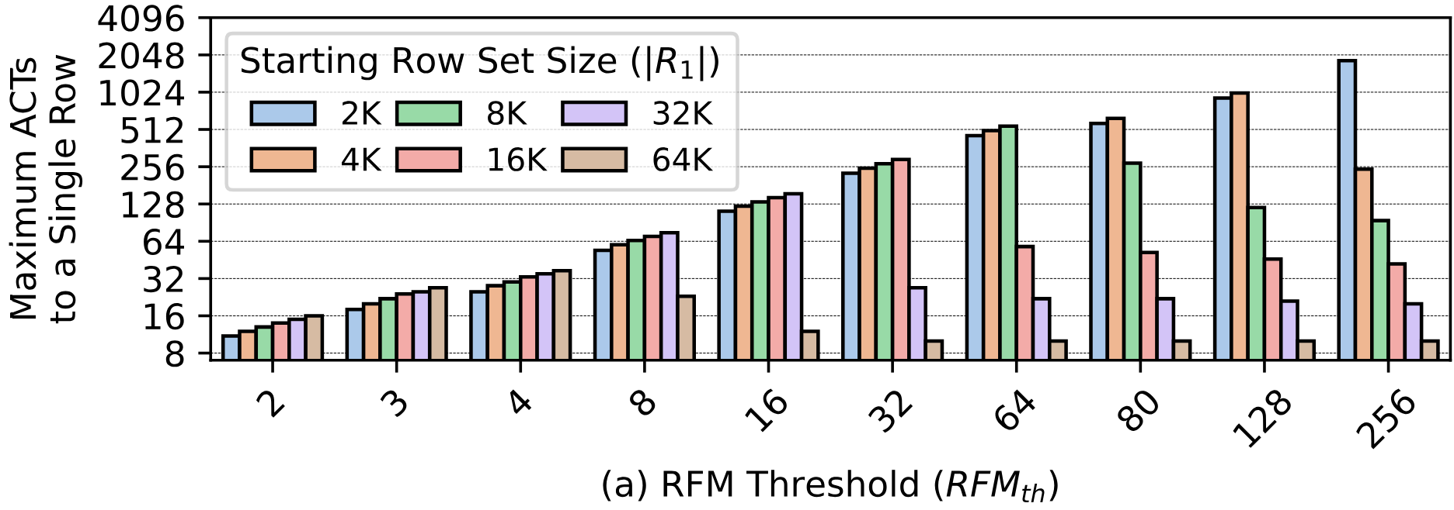
Security Analysis of Industry Solutions:
Secure PRFM Configurations
Wave Attack Parameter
Highest activation count
an attacker can achieve
Lower is better
Less frequent RFM commands

Slide 26
Security Analysis of Industry Solutions:
Secure PRFM Configurations
Wave Attack Parameter
RowHammer Threshold = 1024
Unsafe
Highest activation count
an attacker can achieve
Safe
Lower is better
Less frequent RFM commands
Notes:
We check by drawing a line
A system is secure if all attacker params are under the line
RFM 256 *not* safe against RH 1024

Slide 27
Security Analysis of Industry Solutions:
Secure PRFM Configurations
PRFM Security Analysis
Highest activation count
an attacker can achieve
Lower is better
Less frequent RFM commands

Slide 28
Security Analysis of Industry Solutions:
Secure PRFM Configurations
PRFM Security Analysis
Highest activation count
an attacker can achieve
Lower is better
Less frequent RFM commands
PRFM must send RFM commands very frequently (every ~8 ACTs) to prevent bitflips at low read disturbance thresholds (below 128)

Slide 29
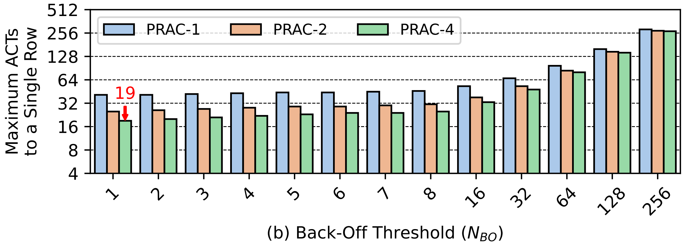
Security Analysis of Industry Solutions:
Secure PRAC Configurations
PRAC Security Analysis
Highest activation count
an attacker can achieve
Lower is better
Less frequent back-off signals

Slide 30
Security Analysis of Industry Solutions:
Secure PRAC Configurations
PRAC Security Analysis
Highest activation count
an attacker can achieve
Lower is better
Less frequent back-off signals
PRAC can be configured for secure operation
against RowHammer thresholds as low as 20

Slide 31
Outline
Background
Industry Solutions to Read Disturbance
Security Analysis of Industry Solutions
Performance Analysis of Industry Solutions
Chronus
Evaluation
Conclusion
Notes:
Using these secure configurations

Slide 32
Performance Analysis of Industry Solutions:
Evaluation Methodology
Performance evaluation:
cycle-level simulations using Ramulator 2.0 [Luo+, CAL 2023]
System Configuration:
  Processor 4 cores, 4.2GHz clock frequency,
  4-wide issue, 128-entry instruction window
  DRAM DDR5, 1 channel, 2 rank/channel, 8 bank groups,
  4 banks/bank group, 64K rows/bank
  Memory Ctrl. 64-entry read and write requests queues,
  Scheduling policy: FR-FCFS with a column cap of 4 Last-Level Cache 8 MiB (4-core)
Workloads: 60 4-core workload mixes
  SPEC CPU2006, SPEC CPU2017, TPC, MediaBench, YCSB

Slide 33
Performance Analysis of Industry Solutions:
Industry Solution Variants
1
PRFM
Memory controller periodically issues RFM
2
PRAC-N
Memory controller issues N RFMs each with back-off
3
PRAC+PRFM
Memory controller issues RFM periodically and with back-offs
Notes:
TAKE YOUR TIME

Slide 34
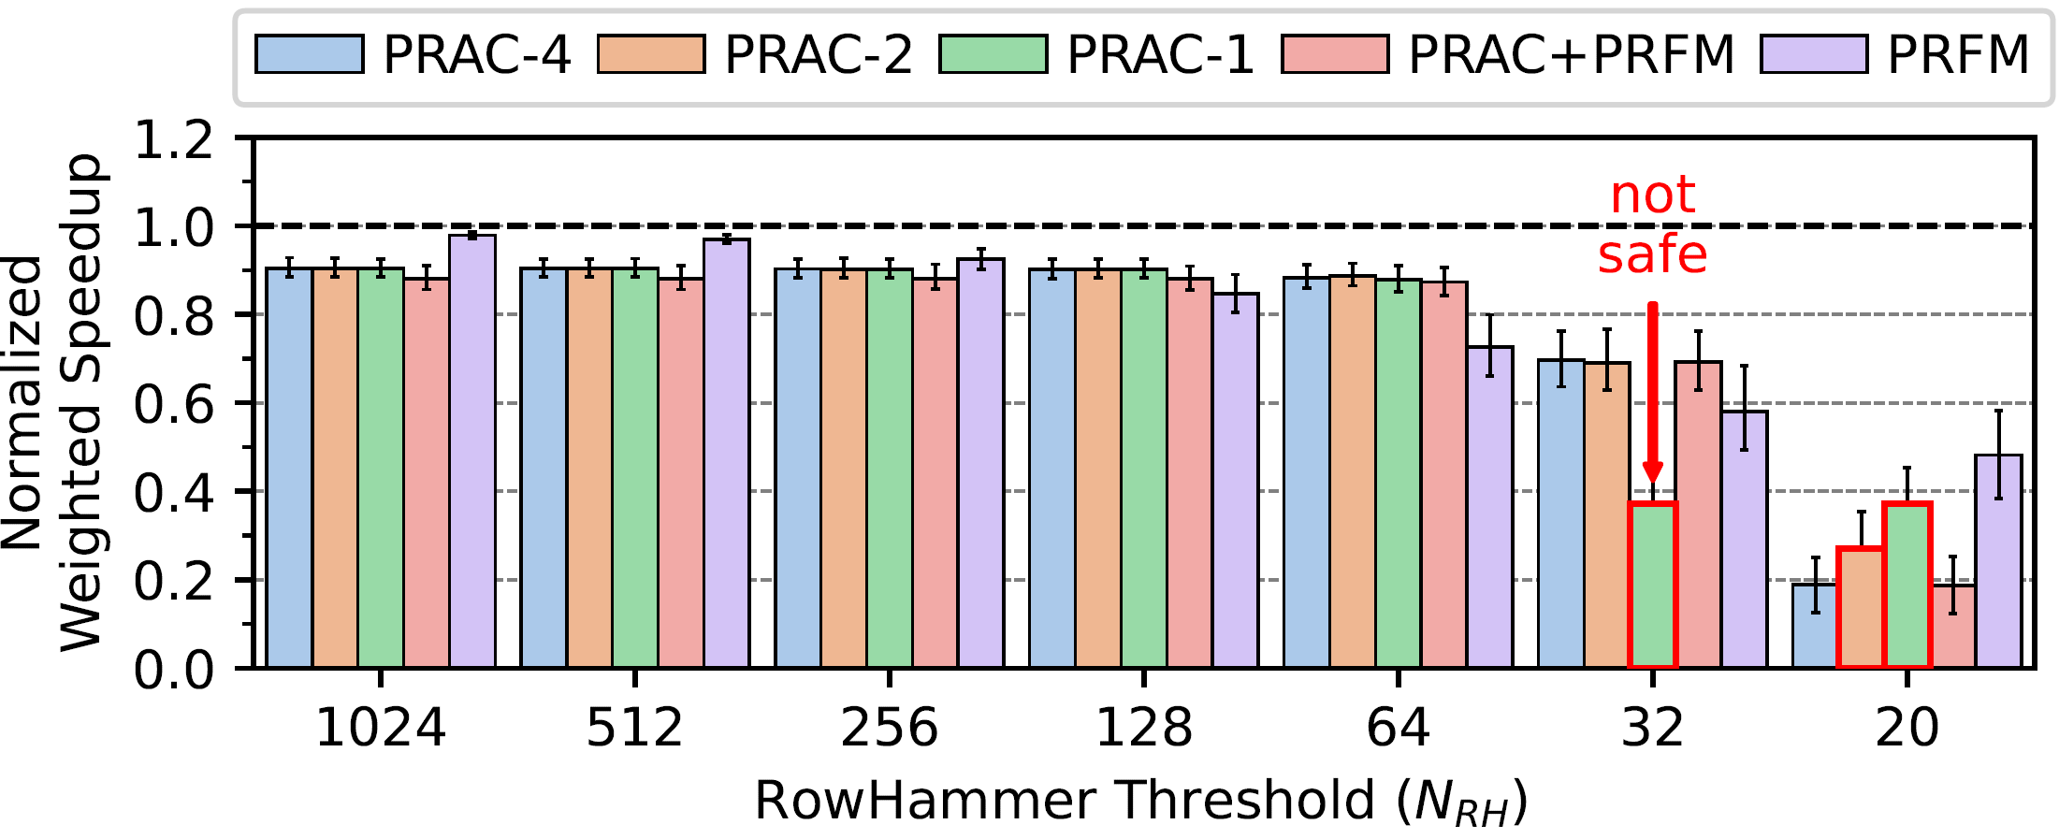
Experimental Results:
Performance Overhead and Its Scaling
Higher is better
Increasing RowHammer vulnerability

Slide 35
Experimental Results:
Performance Overhead and Its Scaling
10%
Higher is better
Increasing RowHammer vulnerability
At high N_{RH} values, PRAC has non-negligible (10%) performance overhead due to increased DRAM access latency

Slide 36
Experimental Results:
Performance Overhead and Its Scaling
Higher is better
Above N_{RH} of 64, PRAC overhead only
slightly increases due to timely preventive refreshes
Lower is worse
Below N_{RH} of 64, PRAC overhead significantly increases
due to conservative configuration against a potential wave attack

Slide 37
PRAC’s Two Major Outstanding Problems
1
2
Increased critical
DRAM timing parameters
Wave attack vulnerability requires aggressive configuration
Large performance overhead even at high read disturbance thresholds
Poor scaling to low read disturbance thresholds

Slide 38
Outline
Background
Industry Solutions to Read Disturbance
Security Analysis of Industry Solutions
Performance Analysis of Industry Solutions
Chronus
Evaluation
Conclusion

Slide 39
Chronus: Key Ideas
1
2
Concurrently update counters while serving
DRAM accesses
Prevent wave attacks by providing DRAM chip
more control over back-offs and preventive refreshes
No increase in critical
DRAM timing parameters
Better scaling to low read disturbance thresholds

Slide 40
Chronus: Overview
Concurrent Counter Update
Concurrently update counters while serving DRAM accesses
Chronus Back-Off
Dynamically control the number of refreshes as needed

Slide 41
Chronus: Concurrent Counter Update
Chronus concurrently updates counters while serving accesses
DRAM Bank
Row Decoder
Counter 0
Counter N-1
Counter
Subarray
Counter N+1
Counter 2N-1
Counter
Updates
Increment
Row Buffer
Row Decoder
Row 0
Subarray
Level
Parallelism
Regular
Subarray
Row N-1
Row Buffer
Regular
Accesses
Row Decoder
Row N
Regular
Subarray
Row 2N-1
Row Buffer
Notes:
Chronus concurrently updates counters with a small change to the bank
Alongside the regular DRAM subarrays that store data, Chronus adds an additional Counter subarray to store counters
DRAM -> access, Counter -> updates
SALP

Slide 42
Chronus: Concurrent Counter Update
Chronus concurrently updates counters while serving accesses
Row Decoder
Open Row
Counter 0
Counter N-1
Counter
Subarray
Row N
Row 0
Updates
Counter
Counter N+1
Counter 2N-1
Increment
Row Buffer
Counter 0
Counter N-1
Row Decoder
Open Row
Row 0
Row 0
Regular
Subarray
Serves
Regular
Accesses
Row N-1
Row Buffer
Row 0
Row Decoder
Row N
Row N
Regular
Subarray
Row 2N-1
Row Buffer
ACT 0
PRE
ACT N
Time

Slide 43
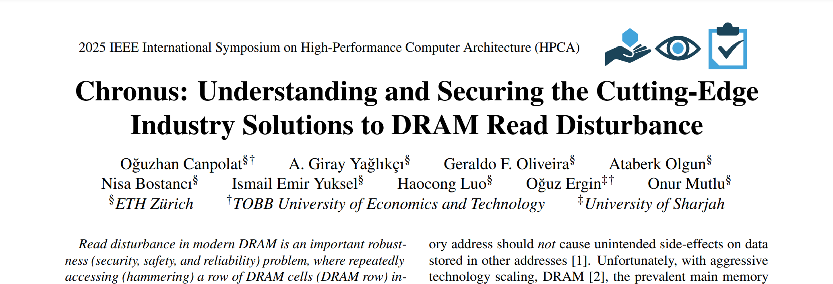
Chronus: Concurrent Counter Update
(More in the paper)
https://arxiv.org/abs/2502.12650
Counter Subarray
incurs 0.5% area overhead
per bank
Counter Subarray
induces 19% energy overhead
to opening and closing a row

Slide 44
Chronus: Overview
Concurrent Counter Update
Concurrently update counters while serving DRAM accesses
Chronus Back-Off
Dynamically control the number of refreshes as needed

Slide 45
Chronus: Chronus Back-Off
Chronus Back-Off prevents a potential wave attack
with two simple changes to PRAC Back-Off
1)
Chronus Back-Off dynamically controls
the number of refreshes as needed
2)
Chronus Back-Off does not have a delay period

Slide 46
Chronus: Chronus Back-Off
Chronus refreshes all rows that exceed the back-off threshold
Aggressor Tracking Table
Tracks row counters
with most activations
Row
Counter
R50
100
!
-
-
-
-
!
R0
100
-
-
!
R35
100
R60
99
!
R60
100
window of normal traffic
and refreshes continue
refresh needed
no critical rows
dynamic control of refreshes
no delay period
alert_n
RFM
RFM
RFM
ACT
RFM
Time
Notes:
Hypothetical scenario
Aggressor tracks counters with most activations, helps to know which rows to mitigate in RFM
When critical, assert alert_n
Memory controller sends RFMs as long as asserted
When done, deassert
If a new counter becomes critical, reassert without a delay
Execution continues…

Slide 47
Chronus: Chronus Back-Off
(More in the paper)
https://arxiv.org/abs/2502.12650
Aggressor Tracking Table
requires only 4 entries
Chronus Back-Off
security analysis
Notes:
More in the paper:
The tracking table
Configuring table size
Security proof of Chronus back-off

Slide 48
Outline
Background
Industry Solutions to Read Disturbance
Security Analysis of Industry Solutions
Performance Analysis of Industry Solutions
Chronus
Evaluation
Conclusion

Slide 49
Evaluation Methodology
Performance and energy consumption evaluation:
cycle-level simulations using Ramulator 2.0 [Luo+, CAL 2023]
and DRAMPower [Chandrasekar+, DATE 2013]
System Configuration:
  Processor 4 cores, 4.2GHz clock frequency,
  4-wide issue, 128-entry instruction window
  DRAM DDR5, 1 channel, 2 rank/channel, 8 bank groups,
  4 banks/bank group, 64K rows/bank
  Memory Ctrl. 64-entry read and write requests queues,
  Scheduling policy: FR-FCFS with a column cap of 4 Last-Level Cache 8 MiB (4-core)
Workloads: 60 4-core workload mixes
  SPEC CPU2006, SPEC CPU2017, TPC, MediaBench, YCSB

Slide 50
Evaluation Methodology: Chronus Variants
1
Chronus
Concurrently updates counters while serving accesses
and uses Chronus Back-Off
2
Chronus-PB
Concurrently updates counters while serving accesses
but uses PRAC Back-Off
Notes:
We only propose Chronus but evaluate Chronus-PB isolates the benefits of Chronus Back-Off

Slide 51
Evaluation Methodology
Comparison Points: Two Chronus variants are compared against 5 state-of-the-art DRAM read disturbance mitigation mechanisms:
PARA [Kim+, ISCA 2014]
Graphene [Park+, MICRO 2020]
Hydra [Qureshi+, ISCA 2022]
PRAC [JEDEC 2024]
PRFM [JEDEC 2020]

Slide 52
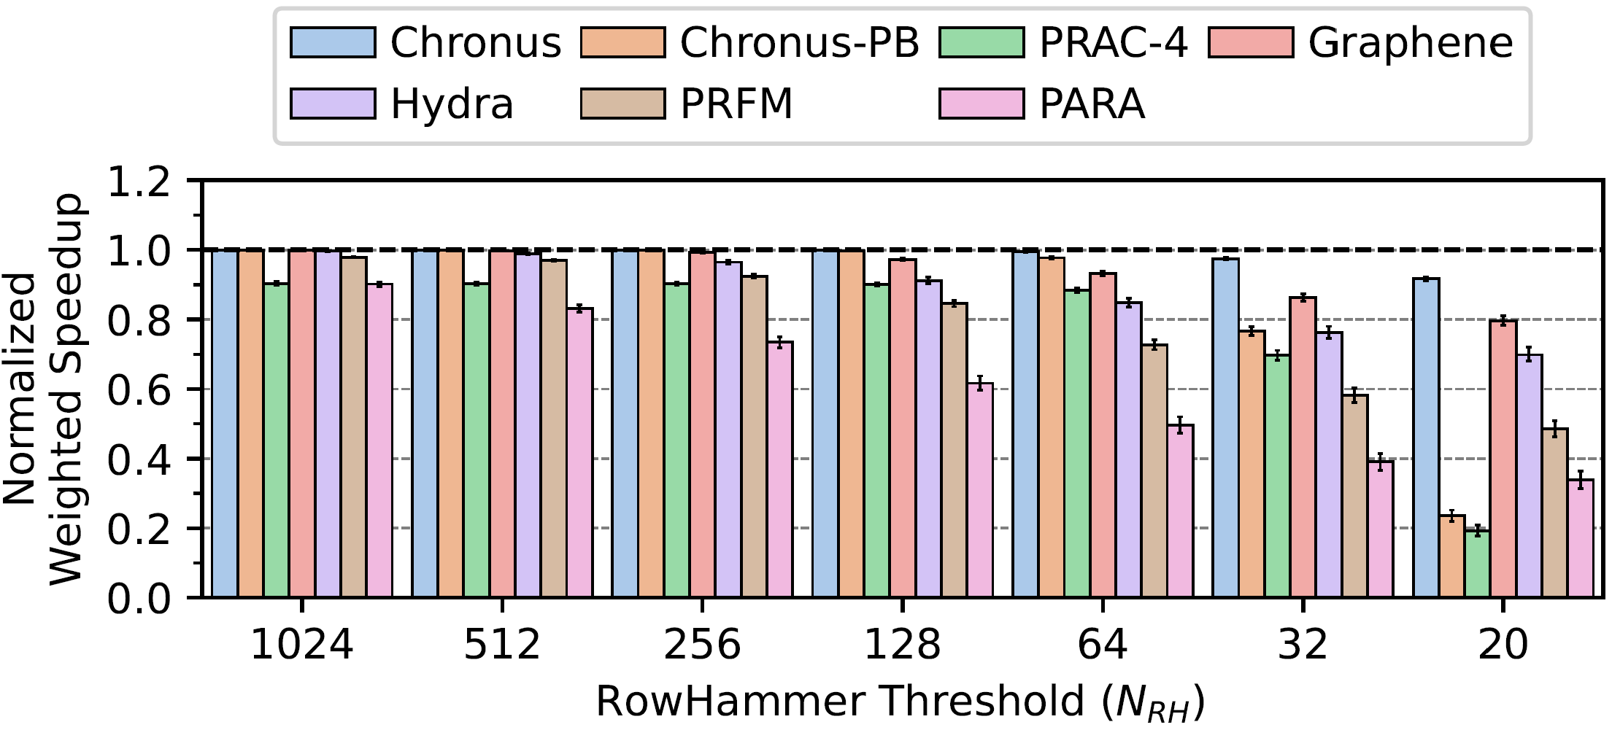
Evaluation:
System Performance and Its Scaling
Higher is better
Increasing RowHammer vulnerability

Slide 53
Evaluation:
System Performance and Its Scaling
<0.1%
10%
At high N_{RH} values, Chronus and Chronus-PB’s concurrent counter update mechanism prevents the high performance overhead of PRAC

Slide 54
Evaluation:
System Performance and Its Scaling
At low N_{RH} values, Chronus Back-Off prevents
the high performance overhead due to aggressive PRAC configuration

Slide 55
Evaluation:
System Performance and Its Scaling
Chronus outperforms all evaluated mitigation mechanisms
at all evaluated RowHammer thresholds

Slide 56
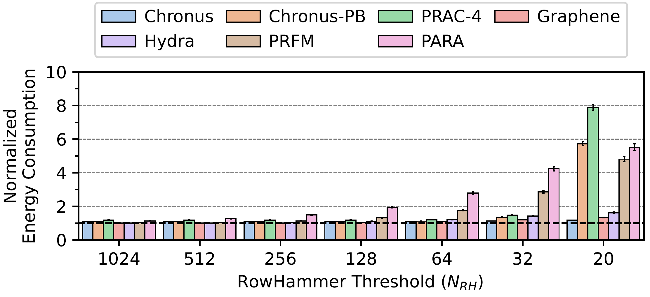
Evaluation:
DRAM Energy and Its Scaling
Lower is better
Increasing RowHammer vulnerability

Slide 57
Evaluation:
DRAM Energy and Its Scaling
10%
18%
At high N_{RH} values, Chronus reduces PRAC energy overhead by 44%

Slide 58
Evaluation:
DRAM Energy and Its Scaling
At low N_{RH} values, Chronus Back-Off prevents
the high energy overhead due to aggressive PRAC configuration

Slide 59
Evaluation Summary
Chronus significantly reduces
the negative performance and energy overheads of PRAC
1)
Chronus concurrently updates counters
while serving DRAM accesses
2)
Chronus dynamically controls
the number of refreshes as needed

Slide 60
More in the Paper
Detailed Background on PRAC
  More information on PRAC and RFM
  Determining which rows to refresh during a back-off
Security Analysis of PRAC
  Threat Model
  Secure Configurations
Details on Chronus
  Preventing bitflips in the counter subarray
  Security proof
  Hardware complexity
Evaluation
  Chronus outperforms all mechanisms in single-core workloads
  Effect of workload memory intensity on system performance
System Performance Adversarial Workloads
  Chronus reduces PRAC’s system performance overhead under a system performance adversarial workload by 66%
https://arxiv.org/abs/2502.12650

Slide 61

The Paper
https://arxiv.org/abs/2502.12650

Slide 62
Outline
Background
Industry Solutions to Read Disturbance
Security Analysis of Industry Solutions
Performance Analysis of Industry Solutions
Chronus
Evaluation
Conclusion

Slide 63
Conclusion
We rigorously analyzed and characterized the security and performance implications of recently introduced industry solutions to DRAM read disturbance
Mathematical analysis & extensive simulations show that: PRAC
Has significant (10%) performance overhead for modern DRAM chips
because PRAC requires additional time to update row activation counters
Poorly scales to future DRAM chips that are more vulnerable to read disturbance
because PRAC is vulnerable to an adversarial access pattern (i.e., the wave attack)
Chronus: Solves PRAC’s two major weaknesses by
Concurrently updating counters while serving accesses
Securing PRAC against a potential wave attack
Key Results: Chronus
Significantly reduces the negative performance and energy overheads of PRAC
for both modern and future DRAM chips that are more vulnerable to read disturbance
Outperforms five state-of-the-art academic and industry solutions
in terms of system performance and energy
https://github.com/CMU-SAFARI/Chronus

Slide 64

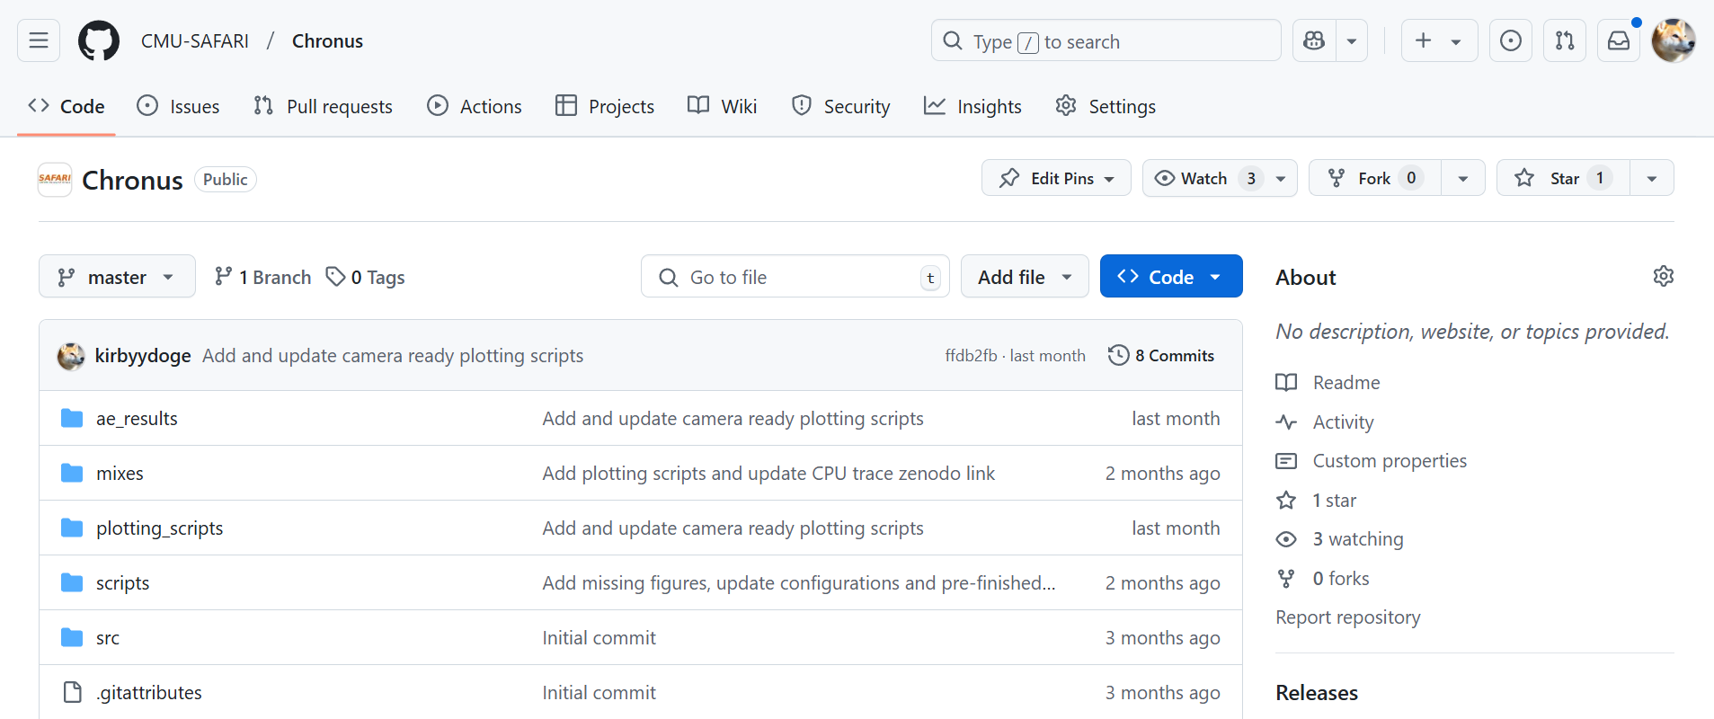
Open Source and Artifact Evaluated
https://github.com/CMU-SAFARI/Chronus

Slide 65
Chronus
Understanding and Securing the Cutting-Edge Industry Solutions to DRAM Read Disturbance
Oğuzhan Canpolat
Giray Yağlıkçı Geraldo Oliveira Ataberk Olgun
Nisa Bostancı İsmail Emir Yüksel Haocong Luo
Oğuz Ergin Onur Mutlu
https://github.com/CMU-SAFARI/Chronus

Slide 66
Chronus
Understanding and Securing the Cutting-Edge Industry Solutions to DRAM Read Disturbance
BACKUP SLIDES
Oğuzhan Canpolat
Giray Yağlıkçı Geraldo Oliveira Ataberk Olgun
Nisa Bostancı İsmail Emir Yüksel Haocong Luo
Oğuz Ergin Onur Mutlu
https://github.com/CMU-SAFARI/Chronus

Slide 67
PRAC Counter Update
Row Decoder
Row 0
Open Row
Row 0
Row N-1
Row Buffer
Row 0
ACT 0
PRE
Time
Open Row
Row Decoder
Row 0
Counter 0
Open Row
Row 0
Row N-1
Counter N-1
Row Buffer
Row Buffer
Row 0
Counter 0
ACT 0
PRE
iRD
iWR
iPRE
Time
start counter update
increment
close the row

Slide 68
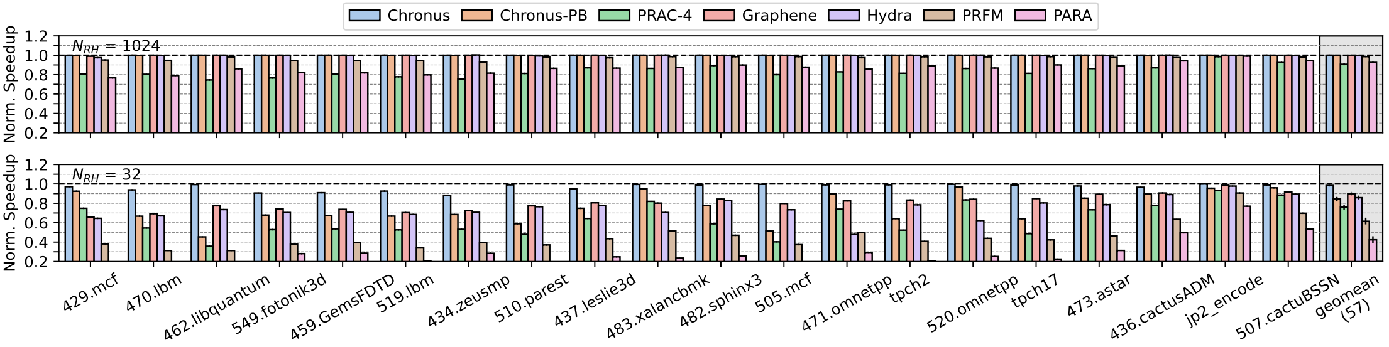
Evaluation:
Singe-core System Performance

Slide 69
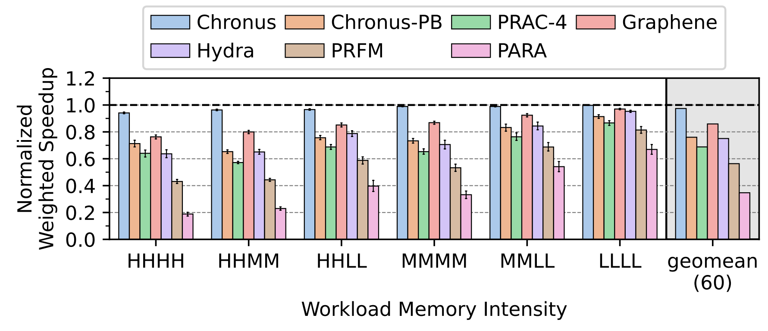
Evaluation:
Effect of Workload Memory Intensity (N_{RH}=32)

Slide 70
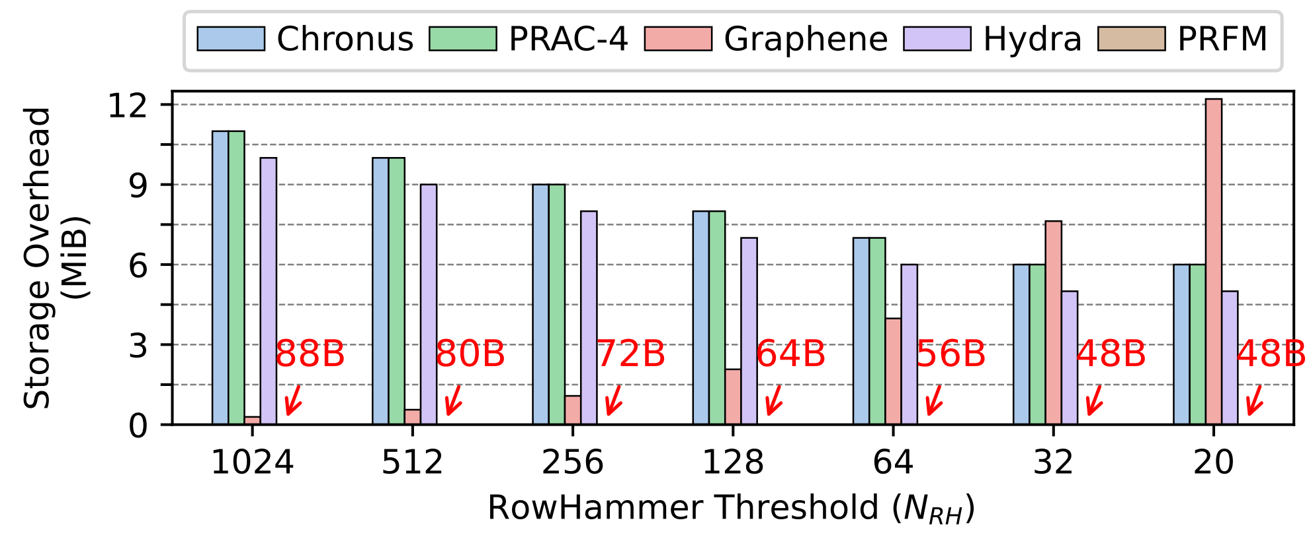
Evaluation:
Storage Overhead

Slide 71
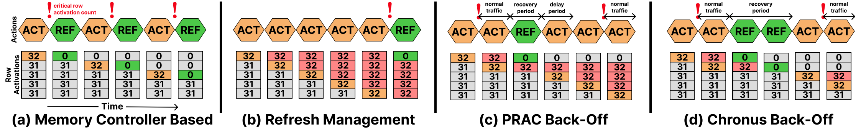
Wave Attack Visualization

Slide 72
Security Analysis:
Wave Attack (I)
0
101010101010101010101010
0
101010101010101010101010
0
101010101010101010101010
0
1
2
3
4
101010101010101010101010
0
0
101010101010101010101010
0
101010101010101010101010
0
101010101010101010101010

Slide 73
Security Analysis:
Wave Attack (II)
0
101010101010101010101010
0
1
101010101010101010101010
0
2
0
101010101010101010101010
0
100010101010101010001000
100010101010101010001010
100010100000101010001000
101010101010101010101010
2
3
0
101010101010101010101010
6
5
7
4
1
101010101010100010100010
101010101010100010101010
100010001010100010100010
0
101010101010101010101010
0
101010101010101010101010
1
0
0
101010101010101010101010
2
3
0
101010101010101010101010
Secure configuration is not trivial

