Slide 1
Computer Systems at CMU
As told by Onur Mutlu
(on behalf of many)
onur@cmu.edu
Carnegie Mellon University
ECE PhD Orientation 2013

Slide 2
An Exciting and Collaborative Place to Fundamentally Change the Way Future Computing Systems are Designed
Hopefully you are already excited!

Slide 3
Tons of Great People Doing Lots of Diverse, Evolving Work
Pick an Advisor (not a project)

Slide 4


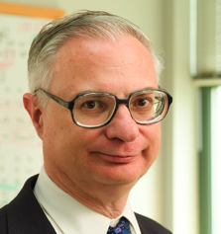
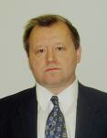


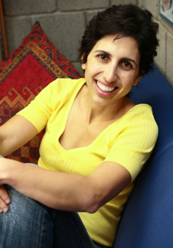
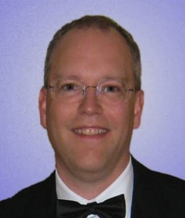

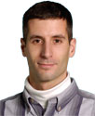


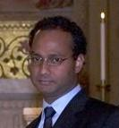

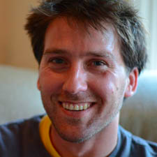
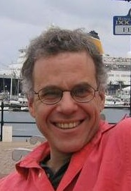
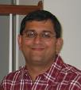
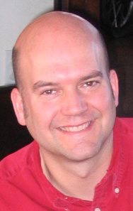

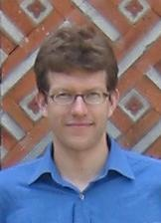
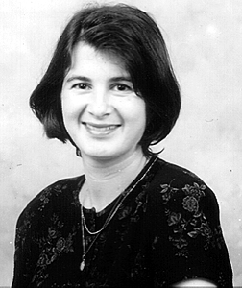


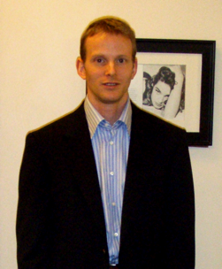



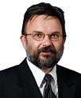
Notes:
Impossible to cover all research in this talk. You should talk with the faculty members you are interested in!

Slide 5


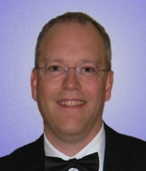





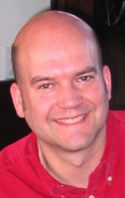
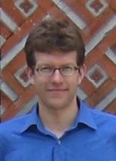
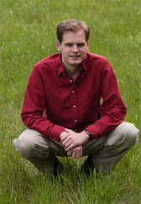
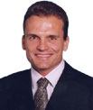

Computer Systems
Computer Architecture
  Seth Goldstein, James Hoe, Diana Marculescu, Todd Mowry, Onur Mutlu, David O’Hallaron
Security
  Lujo Bauer, David Brumley, Lorrie Cranor, Anupam Datta, Adrian Perrig, Virgil Gligor
Networks
  Hyong Kim, Srinivasan Seshan, Peter Steenkiste, Hui Zhang, Rohit Negi
Data Storage
  Greg Ganger, Garth Gibson
Embedded Systems
  Priya Narasimhan, Phil Koopman, Raj Rajkumar, Dan Siewiorek, Asim Smailagic
Fast Computing
  Franz Franchetti, Markus Püschel
Silicon Valley
  Martin Griss, Jason Lohn, Joy Zhang, Pei Zhang, Collin Jackson,
  Patrick Tague
And Others

Slide 6


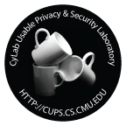
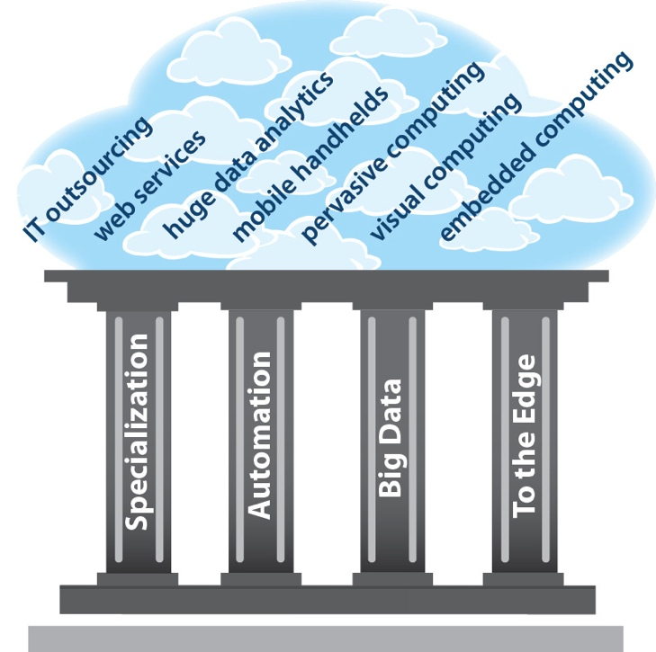

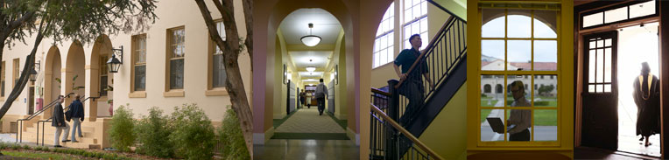

CMU Silicon Valley

Slide 7
Collaboration is Natural at CMU
Within the Systems Area: Parallel Data Lab, ISTC-CC, ISTC-EC, CSSI, …
Across Areas: Circuits, Architecture, Systems, Security, Programming Languages, Theory, …
Across Departments: ECE, CSD, RI, EPP, …
With Many Partners in Computing Industry
With Other Researchers outside CMU

Slide 8


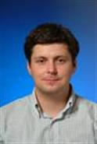
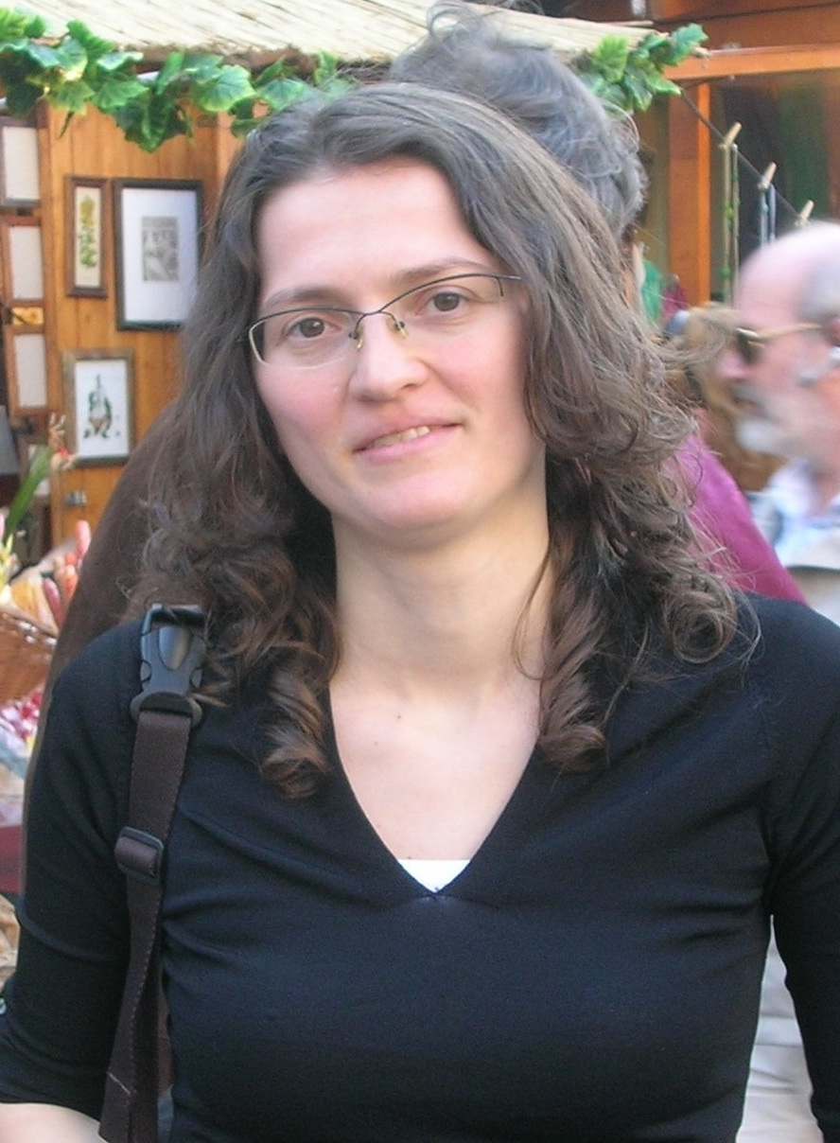

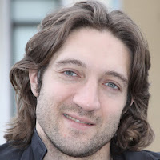
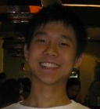
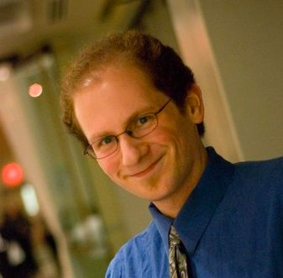
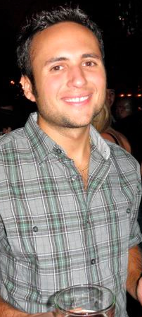

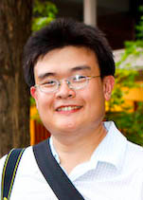
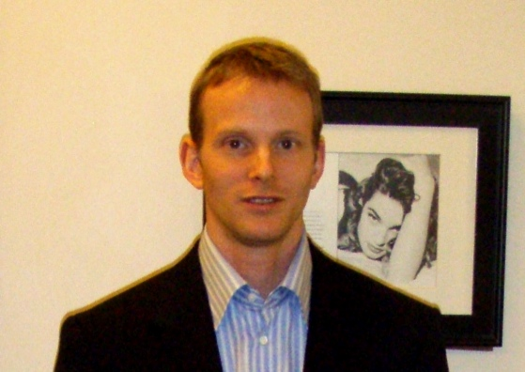
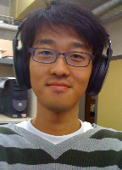
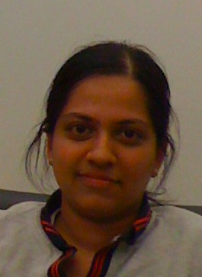


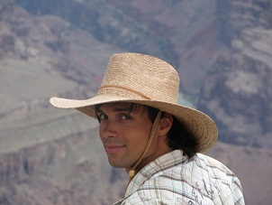
A Personal Example
Students Drive Research

Slide 9
Exciting Areas
Just a few I’ll mention:
Cloud Computing Research
Computer Architecture Research
Embedded Systems Research
Computer Security Research

Slide 10
Cloud Computing (+Big Data)
Cloud computing: use someone else’s computers instead of buying/maintaining your own
Promises huge benefits in…
  resource efficiency: consolidation
  agility and productivity of application development
  system and service robustness
  data sharing and end user access
Huge need for fundamental research and understanding at many levels
Notes:
Huge potential efficiency benefits
Consolidation
Higher server utilization (7-25% -> 70+%)
Economies of scale
E.g., HP went from 80+ data centers to 6
and saved $1B/year… over 60% of total annual expense
Aggregation
One set of experts doing it for many
Instead of each for themselves
Huge productivity benefits (Rapid deployment)
Rent when ready and scale as need
Rather than specify, buy, deploy, setup, then start

Slide 11
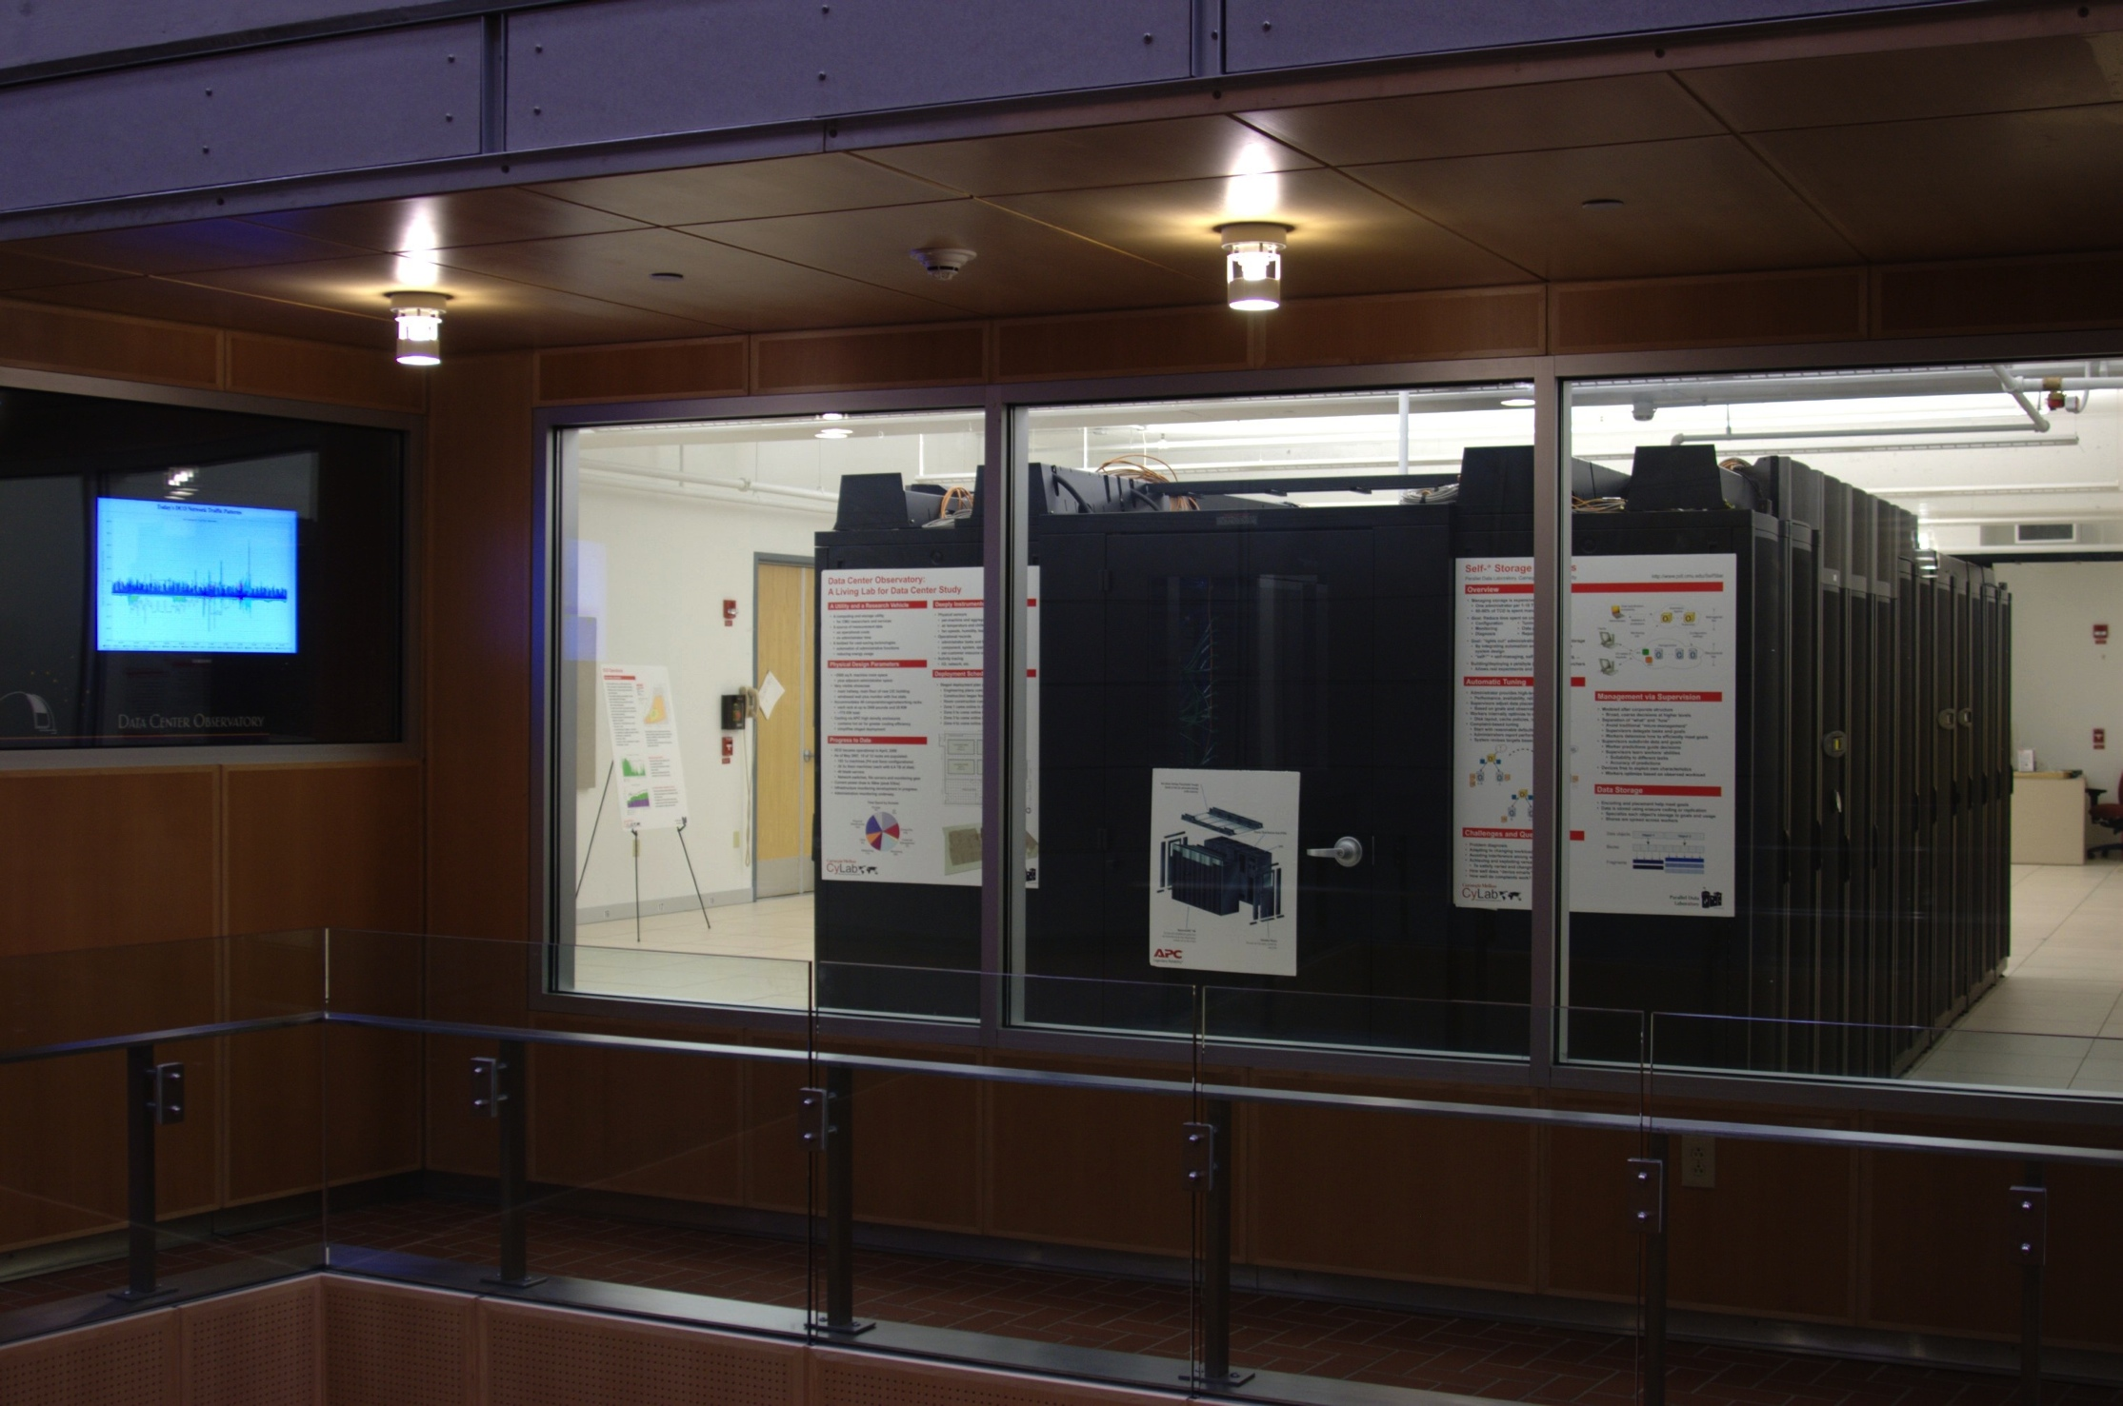
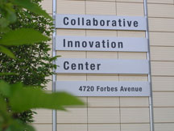
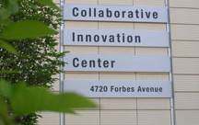
The Beginnings: PDL’s Data Center Observatory
PDL Consortium: $7M over last decade
APC, EMC, Facebook, Google, HP, Hitachi, Intel, Microsoft, NEC, NetApp, Oracle, Panasas, Riverbed, Samsung, Seagate, STEC, Symantec, VMware

Slide 12
The Parallel Data Lab
Academia’s Premier Storage Systems Lab!
Selected Research Topics
(Too many to list here!)
Very Successful History
New storage architectures
Distributed storage systems
File & database systems
Storage management
Secure storage systems
Home media systems
Data organization & search
Virtual machines
Applying new technologies
Founded in 1992
Numerous best paper awards
Excellent partnership with industry
Successful public code deployments
Significant Industry Involvement
17 member companies!
Two annual on-campus events
Access to the industry leaders
Check out www.pdl.cmu.edu for the whole story!

Slide 13
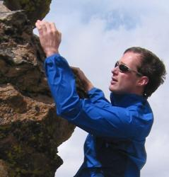
PDL Facts
Established: 1992
Faculty involved: 25
  Career pubs >1,800, citations ~30,000
PhD+MS graduated: 57+53
  Faculty at Berkeley, Stanford, MIT, Toronto, ...
  Key technical leaders at EMC, Seagate, Intel, …
Papers published: >200
  FAST 2011, 2010, 2009, 2008, 2007, 2005, 2004, 2003, 2002
  SOSP 2011, 2009, 2007, 2005; HotOS 2010, 2009, 2003
  NSDI 2011, 2007, 2006; SIGCOMM 2009
  ATC 2010, 2007, 2006, 2005, 2003, 2002
  SIGMETRICS 2008, 2007, 2006, 2004, 2002
  ICDE 2007, 2004, 2002; VLDB 2010, 2007, 2004, 2003, 2002; SIGMOD 2005, 2003
  SC 2011, 2009, 2005, 2004; HPDC 2010; SciDAC 2007; PDSW 2009, 2008, 2007
  ISCA 2011-2013; HPCA 2010-2013; MICRO 2010-2012; ISCA 2009; ASPLOS 2004; Computer 2010, 2006, DSN 2010, 2006, 2004; HotDep 2009, 2006
Awards: Last 5 years: 54; Prior 5 years: 32
  2011 SOSP Hall of Fame
  2011 IEEE Young Computer Architect
  2011 ACM Graduate Student Research
  …
Notes:
Stats from ACM DL
Stanford (Jure Leskovec), Berkeley (Ion Stoica, Dawn Song), MIT (Stavros Harizopoulos)
Toronto (Bianca Schroeder, Angela Demke Brown), Michigan (Shuheng Zhou), Tsinghua (Likun Liu), Northwestern (Nikos Hardavellas), Amherst (Kinman Au)

Slide 14
Faculty Associated with PDL
Greg Ganger, PDL Director
David Andersen
Lujo Bauer
Chuck Cranor
Lorrie Cranor
Christos Faloutsos
Eugene Fink
Rajeev Gandhi
Garth Gibson
Seth Copen Goldstein
Mor Harchol-Balter
Bruce Krogh
Todd Mowry
Onur Mutlu
Priya Narasimhan
David O'Hallaron
Andy Pavlo
Adrian Perrig
Mahadev Satyanarayanan
Srinivasan Seshan
Bruno Sinopoli
Hui Zhang

Slide 15
Cloud and Big Data Research Themes
Scalability
  Performance demand drives ever more devices
Manageability
  Human costs cannot grow with scale
Models of Computation: Data-Intensive Computing
  BigData needs simple tools for processing massive data
Anticipating & Exploiting New Technology
  Non-volatile memory devices & non-overwrite disks
  New hardware/software stacks, new failure modes, new efficiencies

Slide 16
Intel Science & Technology Center for Cloud Computing (ISTC-CC)
5-institution community
  led by Carnegie Mellon and Intel
  including Georgia Tech, Princeton, and UC-Berkeley
  homed at Carnegie Mellon; 4 Intel researchers onsite
Focus on critical enabling technologies
  foundations on which future clouds will be built
    complementing evolution of early cloud building blocks
  work with researchers exploring new cloud apps
    e.g., ISTCs on visual, pervasive, and embedded
Broad, aggressive 5-year research agenda

Slide 17
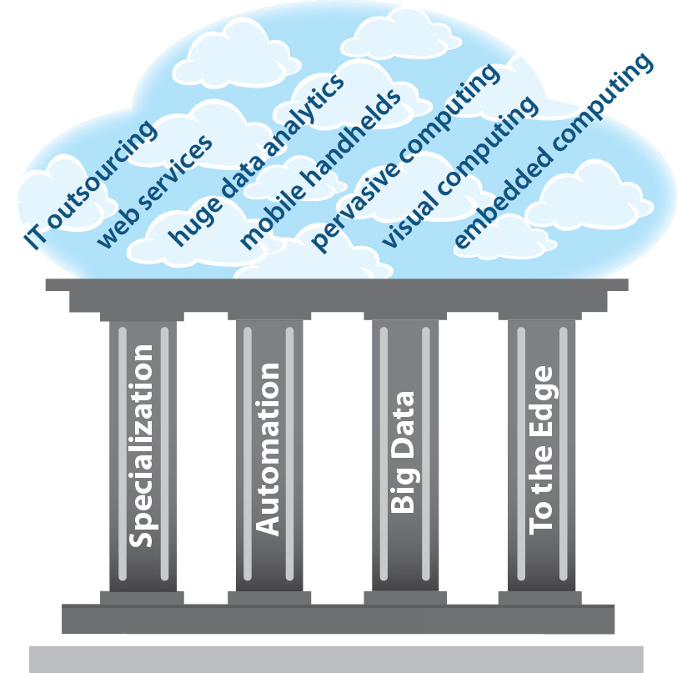
ISTC-CC Research Pillars Build Foundation

Slide 18
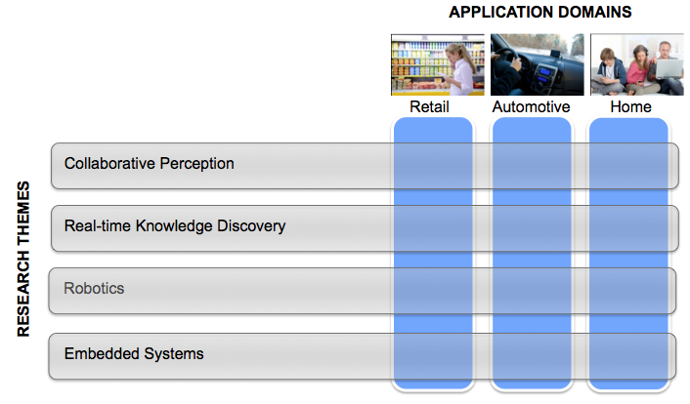
Intel Science & Technology Center for Embedded Computing (ISTC-EC)

Slide 19
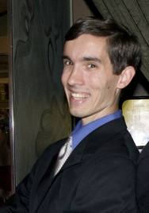
CyLab
World’s Premier Academic Research Center for Cyber Security
  One of largest U.S. university-based research & education programs for cyber security, dependability & privacy
  Nationally Recognized
    National Science Foundation (NSF) CyberTrust Center
    National Security Agency (NSA)
    Center of Academic Excellence in Information Assurance Education
  Many awards
    ACM Best Doctoral Dissertation Award 2011
  Cross-disciplinary, university-wide program
    Faculty and researchers from six colleges of Carnegie Mellon
    50+ faculty/researchers and
    130+ graduate students
  Funded by both private & public sectors
    Gov’t like NSA, DARPA, NSF
    Companies like Lockheed Martin, Booz Allen, Northrop Grumman, and others.

Slide 20
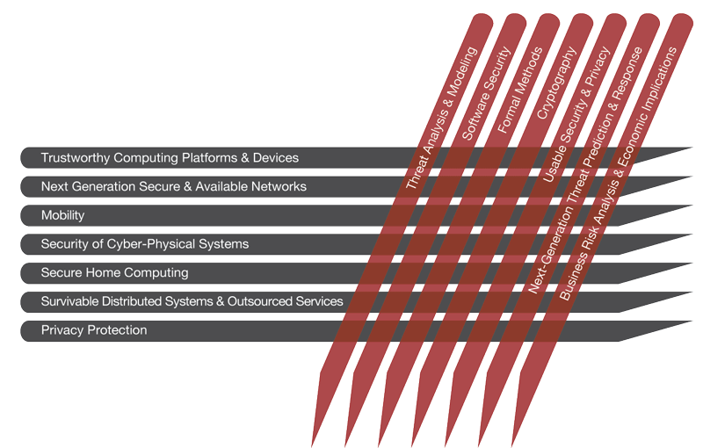
What Does CyLab Do?
Cross-Cutting CyLab Research Thrusts

Slide 21
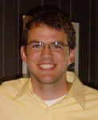
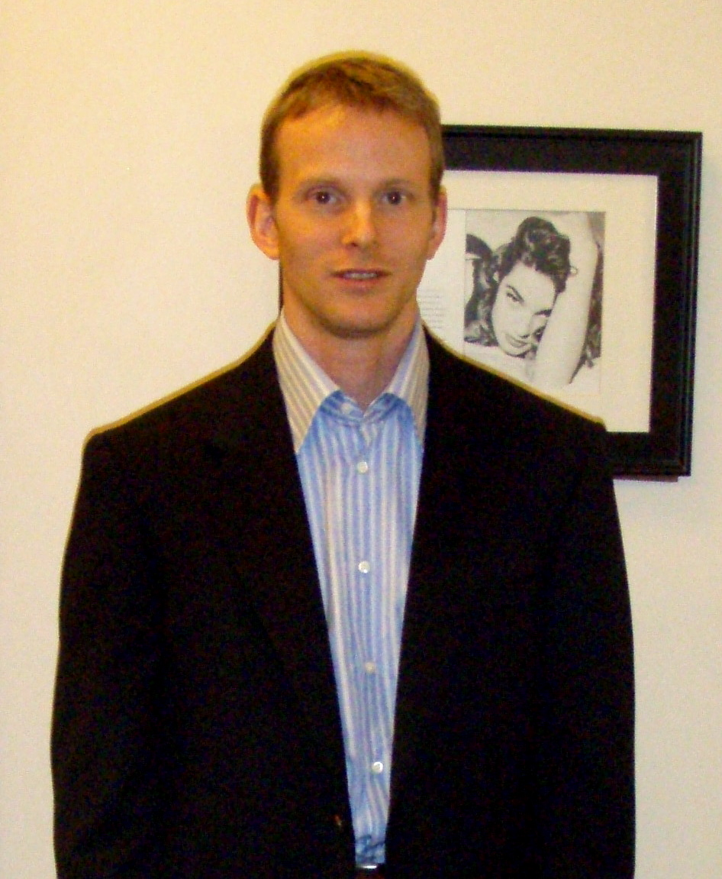
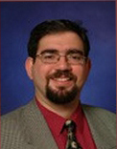
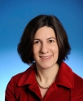

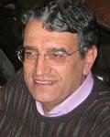
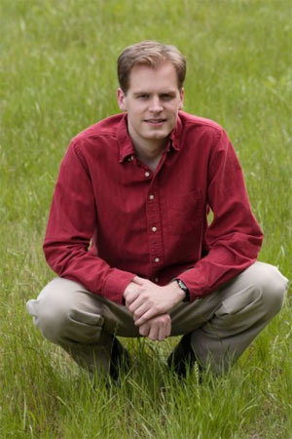
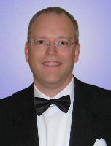
CyLab Researchers & Collaboration
Access Control
Availability
Lujo
Bauer
Network Security
Jon
McCune
David
Brumley
Crypto
Adrian
Perrig
Trusted Computing
Anupam
Datta
Marios Savvides
Usability & Privacy
Lorrie
Cranor
Bruno Sinopoli
Threat Analysis & Response
Virgil
Gligor
Software Security
Patrick
Tague
Collin
Jackson
Pei
Zhang
Philip Koopman
Average In Degree: > 2

Slide 22
Cross-cutting Centers and Research
Problem
Algorithm
Collaboration at CMU fosters cross-cutting, cross-layer research across the computing stack
Program/Language
User
Runtime System
(VM, OS, MM)
ISA
Microarchitecture
Logic
Circuits
Electrons

Slide 23
Computer Architecture Lab at Carnegie Mellon
10-20 years from now
  What are the computation models?
  How are computation, communication and memory designed and managed?
  What are the system software and HW/SW interface primitives?

Slide 24

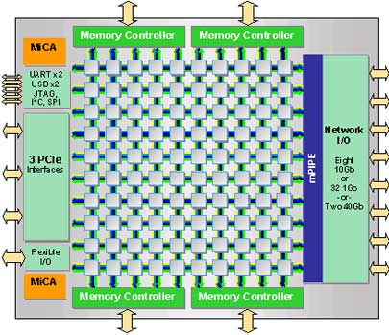
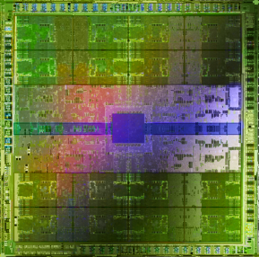




Onur Mutlu
Computer Architecture
and Systems
Research Focus: Computer architecture, HW/SW, bioinformatics
parallel architectures, many-core systems
memory systems, interconnects
hardware/software interaction, novel execution models
energy efficiency, fault tolerance, hardware security
Some Questions:
How do we design ultra-efficient systems?
Alternatives to multi-core and today’s memory?
Can we put the entire data center on a single chip?
What is the HW/SW interface and chip of 2030 AD?
Intel Core i7
8 cores
Tilera TILE Gx
100 cores
Nvidia Fermi
448 “cores”
IBM POWER7
8 cores
AMD Barcelona
4 cores
Sun Niagara II
8 cores
Notes:
Professor Mutlu’s research focus is all aspects of computer hardware architecture. Current projects are in many-core systems, memory systems, HW/SW interaction, fault tolerance, and hardware security.
The main theme of his research group is to devise scalable, efficient, high-performance hardware architectures that are 10-20 years out into the future.
Some big questions his research group is trying to answer are:
How do we design very efficient 1000-core systems?
Can we put the entire data center on a single chip?
Can we find alternatives to multi-core?
What is the HW/SW interface and chip of 2030 AD?
Mutlu is looking for bright students interested in the general area of computer architecture. Here is a sampling of some of the topic areas his group is currently investigating.

Slide 25
Heterogeneous parallel architectures
CPU
core
CPU
core
mini-CPU
core
GPU
(throughput)
core
GPU
(throughput)
core
video
core
GPU
(throughput)
core
GPU
(throughput)
core
CPU
core
CPU
core
Memory
imaging
core
LLC
Specialized
compute-capability
in memory
Memory Controller
Memory Bus
Onur Mutlu and Kayvon Fatahalian

Slide 26
Enabling Ultra-Efficient (Visual) Search
What is the right partitioning of computation capability?
What is the right low-cost memory substrate?
What memory technologies are the best enablers?
How do we rethink/ease (visual) search algorithms/applications?
Memory
Processor
Core
Database (of images)
Cache
Query vector
Interconnect
Results

Slide 27


CoRAM Memory Architecture
Can we make reconfigurable fabric a first-class computing device?
Memory and I/O is Hard on FPGA
Proposed Solution [Chung, FPGA’11]
  extend capability of FPGA SRAMs to act as universal portals to memory and I/O
  built-in NoC provides data transport
  replace rigid platform interfaces with
  portable software control threads
Channels
Software
Control Threads
Core Logic
CoRAM
Memory
User-Level Abstraction
Multiple Target Platforms
FPGA
Platform
(e.g., Altera)
James Hoe
Notes:
So let’s begin with a brief review of CoRAM. With today’s practices, FPGAs are known to have a lot of pain points, one of the major ones is how an application interacts with memory and I/O.
When an application needs to talk to memory, the user is often responsible for building a custom memory hierarchy from scratch. The application must conform to rigid, platform- and device-specific interfaces and gateware, some of which even the user designs himself. Furthermore, the user is responsible for efficiently distributing this data from the interfaces to the application, which often entails building an application-specific network-on-chip.
Last year, we presented a solution called the CoRAM memory architecture. The idea behind CoRAM is to present an abstracted view of the FPGA’s memory resources, that in itself can be re-targeted automatically to different devices, and platforms.
The CoRAM memory architecture restricts all communication between the application and DRAM and I/O using the FPGA’s built-in SRAMs. The distributed SRAMs are backed and interconnected by a built-in network-on-chip that automatically facilitates the on-chip data distribution required by the application.
Last but not least, a key feature of CoRAM is the idea of replacing the conventional, platform-specific control logic with a high-level, software control thread abstraction that can be made portable and easy-to-use for general-purpose applications.

Slide 28





Spiral: Computers Programming Computers
Programming
Synthesis
COTS
Intel
Special hardware
Cell blade
Result
Same performance, 1/10th human effort, non-expert user
Key ideas
restrict domain, use mathematics, performance portability
Franz
Franchetti
D. McFarlin, F. Franchetti, M. Püschel, and J. M. F. Moura: High Performance Synthetic Aperture Radar Image Formation On Commodity Multicore Architectures. in Proceedings SPIE, 2009.
Notes:
Spiral is an example of high-level domain-specific code generation or code synthesis. We input into Spiral algorithm knowledge and architecture knowledge as well as program transformations/optimizations. Once Spiral “knows” these things, it behaves like a human expert programmer talking to an expert algorithm designer, who jointly produce highly optimized software for a given functionality and platform.
One demonstration was to compare our tool against industry-written RADAR image formation code.
A defense contractor implemented a polar formatting SAR image formation algorithm (taking a photo with RADAR)0 for the Cell processor. The work is documented in a paper that won the best paper award (Rudin:2007). We then worked with them to formalize their algorithm in Spiral and had Spiral generate the SAR image formation algorithm instances according to the specification in their paper.
A non-expert then was using our tool to generate a SAR implementation according to the paper specs that was outperforming the expert implementation on a much weaker machine (Intel Quadcore vs. Cell blade).
This is an example of successfully converting a high-level algorithm description into extremely competitive code. The Spiral produced scary 13MB code from the algorithm specification, pulling all the tricks no human programmer would dare to try (but dream to do if only possible).

Slide 29








Franz Franchetti
Project 1: Extending Spiral to new algorithms and platforms
Project 2: domain-specific power efficient computing
Project 3: Code/proof co-synthesis for robotic vehicles
Notes:
I’m looking for masters students—my PhD admits do not attend the Open House
Project 1: Extending Spiral to new architectures and applications
In this project we extend the automatic performance tuning and program synthesis system Spiral. We will target the latest greatest parallel platforms including multicores, manycores, GPUs and FPGAs, and extend Spiral to new application domains. The project also touches hardware/software co-design and verification.
Project 2: in the context of the DARPA PERFECT program in collaboration with Profs. Hoe, Pileggi, Moura we are looking at ways to utilize domain and algorithm knowledge to push the power efficiency of UAV (unmanned aerial vehicles) computations to 75 GFLOPS/W, or about 15x from today
Project 3: We develop technology based on Spiral to automatically synthesize highly efficient control code and the proof that the code is correct. The code is deployed on robotic vehicles and high end cars. This is an interdisciplinary project involving people form robotics, formal methods, signal processing, compilers, and computer algebra.

Slide 30


Diana Marculescu: Resource Mgmt. for Many-Core
D. Marculescu
Holistic power & perf. mgmt. for many-core systems
10-20X lower power/delivered perf. by exploiting
  Workload variation
  Near-threshold computing
  Voltage/frequency overscaling
  Implicit and explicit resource heterogeneity
Challenge: determine best online policy for maximizing performance under TDP constraints
Notes:
TDP = thermal design power

Slide 31



P. Koopman
Courses:
Associate Professor
Department of ECE
& National Robotics Engineering Center
http://www.ece.cmu.edu/~koopman
18-348: Embedded System Engineering
18-649: Distributed Embedded Systems
18-849: Dependable Embedded Systems
Safety Critical Systems
Robot Robustness
Is this 5-ton robot acting in a safe way?
  (How can you be sure?)
Software stress testing
  Do bad inputs make it go crazy?
Run-time safety monitoring
  Needs to be safe even with bugs
Cars will be controlled via networks
  Steer-by-wire; Brake-by-wire; …
  Can we make them safe+affordable?
Safety even in the presence of bugs
General Motors Sponsorship
koopman@cmu.edu
Notes:
Notes: (That’s me at the terra cotta warriors in Xi’an china where I was doing a design review)
LEFT: GM is sponsoring us to do drive-by-wire safety. A computer network is (or will soon be) between your throttle pedal, brake pedal, and steering wheel.
Takes a lot to make sure that works even if parts break or there is a software bug.
RIGHT: That’s a picture of crusher, which is basically an automated tank with out the big gun on top (newer ones have a turret).
In this case it’s safe because it’s supposed to be doing an obstacle test. But how to you know it won’t randomly take off and run things over? (There is a reason it is called “crusher”). We’re doing Ballista-style software robustness testing on big automated vehicles at NREC and building add-on safety monitors that will ensure safety even if the primary autonomy software has bugs.

Slide 32

Radu Marculescu
Radu M.: Design of Highly Integrated Multicore Systems
Research Focus: Embedded Systems, Cyber Physical Systems
Vision: Demonstrate low-power and reliable approaches for multiprocessor communication at nanoscale (i.e., developing sort of internet-on-a-chip).
(collaboration w/ D. Marculescu, S. Blanton)
Multi-frequency/voltage NoC
Heterogeneous Network-on-Chip platform
Tasks: Develop distributed energy/performance optimization techniques for multicore systems; Develop on-chip fault-tolerant communication techniques
Notes:
Professor Marculescu is looking for a few students to work on developing a new class of multiprocessors systems-on-chip where communication happens via a network instead of a bus. Simply think of implementing sort of internet-on-a-chip type of platforms where various design methodologies and tools need to be developed from scratch w/ the primary objectives of making the communication as energy-efficient and as reliable as possible.
As shown in the left hand of this slides, for heterogeneous multiprocessor platforms of the future, there are many knobs that can be exploited to make such an endeavor possible. For instance, we can exploit the “power of many” (computing) nodes that exist on such a platform and define new techniques for efficient communication (e.g. low-power, fault-tolerance, etc.) This is a highly interdisciplinary type of work that involves concepts from design automation, VLSI, networking and control areas.
As shown in the right hand of this slide, as a first step, we plan to develop a set of techniques and prototypes for multi-voltage and multi-frequency platforms where we can dynamically control the power consumption and system resources (e.g. QoS), at run time, as a function of the workload of various embedded applications. We also plan to prototype this using real hardware and show the applicability of these ideas while running real applications.
Overall, this project is fits well ECE and CS type of backgrounds.

Slide 33
Radu Marculescu
Radu M.: Design of Cyber Physical Systems (CPS)
Research Focus: Embedded Systems, Cyber Physical Systems
CPS operation from physical processes (e.g., volcanic activity monitoring, traffic conditions, etc.) to workloads. This consists of data monitoring and compression/communication to data centers for further analysis.
Distributed controllers dynamically estimate the workload and decide on prioritizing data transmission or allocating more resources.
Examples include implantable devices like pacemakers, body-area-networks, nano/bio devices for health care applications
Notes:
Built to interact with the physical world, cyber physical systems (CPS) need to be efficient, reliable, dependable and safe. Consequently, a science of CPS design must be established to take into account the workload characteristics (e.g., self-similarity, non-stationarity) when optimizing such systems.
In this project, we are looking at developing design and optimization techniques of future Cyber Physical Systems. Typical examples include design of implantable devices like pacemakers, body-area-networks, nano-devices for drug delivery systems. Adopting a CPS approach has many implications in the design of control strategies, topology selection and resource allocation, scheduling, and routing algorithms.
The project is highly interdisciplinary and fits well ECE and CS type of backgrounds.

Slide 34


Radu Marcuescu
Radu M.: Social Networks Modeling and Analysis
Research Focus: Social Systems
Social networks involve both technology and human interaction and show remarkable dynamics in response to various real-world events. Our research targets new approaches for characterizing complex interactions and collective behaviors in bursty events in social media.
This can be used for real-time management of social networks in applications like micro-blogging, viral marketing, emergency response, and disaster management.
Notes:
Microblogging disseminates real-time information through dynamic user interactions. While it is intuitive that such interactions may generate patterns, it is difficult to identify and characterize them in satisfactory detail. In this project, we use dynamic graphs and time-series to study the dynamics and collective behaviors in micro-blogging. To enable automatic pattern identification, a distance metric is used to capture the heterogeneous aspects of the dynamical interactions.
The project is highly interdisciplinary and fits well ECE and CS type of backgrounds.

Slide 35


Peter Steenkiste
The eXpressive Internet Architecture
The Internet has been wildly successful, but the architecture faces several challenges
  Security should be built in, not layered on top of, the architecture
  Better support for content and service-oriented networking
  Mobile, wireless users should be first class citizens
XIA is a future Internet architecture proposal that radically improves trustworthiness and evolvability of the Internet
  Intrinsic security properties that are part of the architecture
  Communication between diverse principals: hosts, content, …
  Support for rich services, e.g. transcoding, mobility, DTN, …
This new interdisciplinary project is looking for students …
  … interested in networking, distributed systems, security, ..
  … with good system building skills and a sense of adventure!
Notes:
E.g. it is possible to send packets directly to “content” (e.g. to retrieve it) and “services” (to invoke them)

Slide 36






Dan Siewiorek and Asim Smailagic: Virtual Coaches
Vision: Use low cost sensors and machine learning to determine user context and respond proactively anticipating user needs
Dan Siewiorek and Asim Smailagic
Machine Learning on Embedded Platforms
Wheel Chair Propulsion Pattern to
Avoid Repetitive Use Damage to
Shoulders and Wrists
Wrist worn sensors
Observed propulsion
patterns
Feature space for accelerometers
Tasks: Develop machine learning models for multi-sensor systems; provide appropriate engaging guidance and encouragement in domains of health care, occupational therapy, and social networking; Cloudlet Architecture to provide mobile computational resources
Notes:
Building upon research in pervasive and context aware computing, Virtual Coaches are a whole new class of mobile applications that apply machine learning algorithms in real time to determine what a user is doing, infer user intent, and provide supportive information such as reminders to do a forgotten task, background on the current situation, encouragement, or detailed instructions. The feature space for accelerometers illustrates how machine learning can separate regions of feature space into activities such as running, walking, standing, sitting, etc. A simple example of a virtual coach is observing manual wheel chair propulsion patterns and encourage of the semicircular pattern which places the least stress on the shoulder rotator cup and wrist of the commonly observed propulsion techniques. The ultimate goal is to build an Autonomic Virtual Coach that is responsible for it’s own management and evolution, assess changes in user abilities, requests synthesis of new functionality for coach to adapt to changes, and automatic download of new capability. Our current focus is in the domain of assistive coaches for people with physical occupations, people with disabilities, and older adults.

Slide 37
David Brumley – Computer Security
Research Vision:
Develop techniques to Automatically Check the World’s Software for Exploitable Bugs
Example Current Projects
Vetting the
Security of Systems
Decompilation
Automatic Exploit Generation
Malware Analysis
Notes:
Prof Brumley is looking for new students in the area of computer security. His work focuses on checking the

Slide 38



Example Project: Automatic Exploit Generation
1. Formal Exploit Specifications
e.g., buffer overflow, information leaks
Example
Research
Challenges
2. Binary Program Verification
e.g., Symbolic Execution
3. Exploits against real code
We get a shell in seconds
Notes:
The goal of the project is given a program, automatically generate working exploits. We take a formal methods approach. There are three substantial challenges. First, how do we encode what it means to “exploit” a program in logic. Second, can we check off-the-shelf binary programs. Third, can we generate exploits against real code.

Slide 39







Lujo Bauer
Research interests: computer security
and privacy, usable security
Passwords
  What makes a password hard for an attacker to guess but easy
  for a user to remember?
  How to we induce users to create such passwords?
Access control over personal data (a.k.a. privacy)
  What kind of access-control / privacy policies do users
  want? What kind of policies are easy for users to understand?
  What kind of interfaces are best for creating and editing policies?
Application and system security
  How do we prevent apps and plugins from stealing our information?
  How do we build applications and systems that
  we can prove enforce users’ policies correctly?
Notes:
Themes:
Understanding users (what they want, what they can easily understand)
Building systems (that we can prove are secure)

Slide 40

Nicolas Christin
Research Focus: Information security and policy, including security economics, network security, and usable security.
Modeling behaviors and incentives in
information security
  Attackers
    Understanding financial incentives, underground economies
  Targets/Victims
    Understanding biases, incentives
  Combines network measurements, economics, psychology
Integrating human factors in secure system design
  Designing right set of incentives
  Designing usable and secure systems
    e.g., effect of password composition policies on security/usability
Notes:
I am mostly interested in integrating human factors (i.e., economics and psychology) with secure system design. My research is centered around two main axis: first, a modeling effort that aims to formally characterize both the decision process people go through when confronted to security attacks, as well as the motivations attackers have for undertaking these attacks in the first place. Second, once robust models are in place, we can use these as to guide system design – by considering technical as well as non-technical factors. As a practical example I have recently become very interested in online crime modeling: having an actual model of how the attackers operate leads us to better understand which methods or techniques can best disrupt their activities.

Slide 41

Nicolas Christin
Example focus area: Modeling Online Crime Supply Chains
Understanding the motivations of the attackers
  Increasing monetization of Internet security attacks
    Financial incentive dominating attackers’ motivations
  Attacks are nowadays the product of multiple interactions between various parties
    “Supply chains” of attacks
Overarching goal: Model these supply chains and understand them to better disrupt them
Example: Japanese One Click Frauds
  Gathered and analyzed 4 years worth of data
  Found that top eight groups responsible for >50% of all frauds
  Found they could make a lot ($100K/yr+) of money with little risk or investment needed
    Strong incentive to misbehave!
$$$
Vulnerability
$$$
enables
Malware
$$$
enables
Botnet control
enables
Botnet use
(e.g., spam)
Notes:
This is a large effort on trying to better understand the relationships between the different entities that conspire to make online crime prosper. At a high level I want to understand the business relationships between the different actors. Some people develop security vulnerabilities; some people commoditize the exploits into malware; some use the malware to run botnets; some use these botnets. Are all these miscreants the same people? If not, what are the monetary flows, the structure of the market?
To gain some insights, we are currently running a number of measurement campaigns on various criminal activities. For instance, a recent work provided a pretty comprehensive characterization of the Japanese “One Click Fraud” phenomenon (this is a cousin of the scareware frauds – basically a window pops up telling you you owe money to somebody because of some action you took online, and you are pressured into paying). By analyzing four years worth of data scattered on the web, we figured that the top eights perpetrators account for more than half of all frauds; and that they stand to make a lot of money for little risk. This success leads to a large number of aspiring crooks trying their luck, which multiplies the number of such frauds.

Slide 42
CMU is a Great Research Environment:
Collaborative, Open, Broad

Slide 43










Collaborative (and Social)

Slide 44

PDL Retreat 2011
Strong Industry Following, Collaboration, Feedback

Slide 45
Collaboration → High Impact →
More Collaboration

Slide 46
An Exciting and Collaborative Place to Fundamentally Change the Way Future Computer Systems are Designed
You can change the world!

Slide 47
Computer Systems at CMU
As told by Onur Mutlu
(on behalf of many)
onur@cmu.edu
Carnegie Mellon University
ECE PhD Orientation 2013

