Slide 1

Revisiting DRAM Read Disturbance
Identifying Inconsistencies Between
Experimental Characterization and
Device-Level Studies
Haocong Luo İsmail Emir Yüksel Ataberk Olgun
A. Giray Yağlıkçı Onur Mutlu
ETH Zurich
VTS’ 25
28 April 2025
Notes:
Hello everyone, I am Haocong, and I will be presenting our work revisiting…

Slide 2
Executive Summary
Goal: Align and cross-validate the experimental characterization of DRAM read disturbance (RowHammer and RowPress) with the error mechanisms modeled by device-level simulation
  Challenge: Gap between real-chip characterization and device-level mechanisms due to low-level DRAM array layout (i.e., true- and anti-cells)
Key Methodology:
  Extract key device-level read disturbance mechanisms from prior works
  Reverse-engineer the true- and anti-cells layout of real DRAM chips
  Perform real-chip characterization that directly match the access and data patterns studied in device-level works
Key Inconsistencies:
  For Double-Sided RowHammer, experimental characterization shows bitflips in both directions while device-level mechanisms suggest only 1→0 bitflips will happen
  For Single-Sided RowPress, experimental characterization shows overwhelmingly 1→0 bitflips while device-level mechanisms suggest both kinds of bitflips will happen
Notes:
Our goal is to align and cross validate…
The challenge here is the gap between real-chip characterization…
In this paper, we first extract …
And we find inconsistencies between real chip characterization and device-level studies in both RowHammer and RowPress

Slide 3
Outline
Background
  Key DRAM Organization & Operation
  DRAM Read Disturbance Phenomena: RowHammer & RowPress
Device-Level DRAM Read Disturbance Mechanisms
Real-Chip Characterization Methodology
  Reverse Engineering of True- and Anti-Cell Layout
Real-Chip Characterization Results
  Inconsistency I: Initial Bitflip Direction of Double-Sided RowHammer
  Inconsistency II: Bitflip Count of Double-Sided RowHammer
  Inconsistency III: Bitflip Direction of Single-Sided RowPress
Hypotheses
Conclusion

Slide 4
Outline
Background
  Key DRAM Organization & Operation
  DRAM Read Disturbance Phenomena: RowHammer & RowPress
Device-Level DRAM Read Disturbance Mechanisms
Real-Chip Characterization Methodology
  Reverse Engineering of True- and Anti-Cell Layout
Real-Chip Characterization Results
  Inconsistency I: Initial Bitflip Direction of Double-Sided RowHammer
  Inconsistency II: Bitflip Count of Double-Sided RowHammer
  Inconsistency III: Bitflip Direction of Single-Sided RowPress
Hypotheses
Conclusion

Slide 5
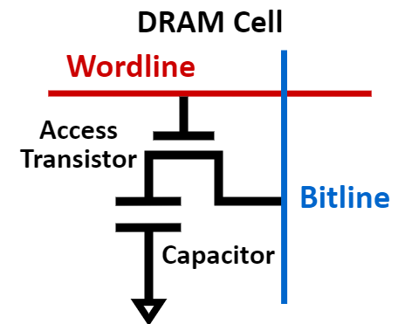
Background – DRAM Organization I
DRAM is the prevalent technology for main memory
  A DRAM cell stores one bit of information in a leaky capacitor
  DRAM cells are organized into DRAM rows
  Data are read from DRAM cells at row-granularity using Sense Amplifiers
DRAM Row
…
Wordline
…
DRAM Row
Sense Amplifiers

Slide 6


Background – DRAM Organization II
True-Cell and Anti-Cell
  The sense amplifier is a differential amplifier
  A DRAM cell can represent a logical 1 by storing either positive or negative charge depending on if it is connected to $\text{Bitline}$ or $\overline{\text{Bitline}}$
Bitline
True-cell: Represents a logical 1 by storing positive charge
(i.e., $V_{Capacitor} = V_{Core}$)
Anti-cell: Represents a logical 1 by storing negative charge
(i.e., $V_{Capacitor} = V_{SS}$)
True-Cell
Wordline
Sense
Amplifier
Anti-Cell
Wordline
Bitline
Notes:
Because the sense amplifier is a differential amplifier, a DRAM cell can represent a logical 1 by storing either positive or negative charge
We call a cell true-cell if represents a logical 1 by storing positive charge, and an anti-cell otherwise

Slide 7
Background – DRAM Read Disturbance I
Read disturbance in DRAM breaks memory isolation
  Accessing a DRAM row (aggressor row) disturbs the integrity of data stored in DRAM cells of other unaccessed rows (victim rows), causing bitflips
Prominent Example I: RowHammer
DRAM
Row 1
Row 1
Row 1
Victim Row
Row 2
Row 2
Row 2
Row 2
Row 2
Row 2
closed
open
open
Aggressor Row
closed
open
Row 3
Row 3
Row 3
Victim Row
Repeatedly opening (activating) and closing a DRAM row many times causes RowHammer bitflips in adjacent rows
[Kim et al., "Flipping Bits in Memory Without Accessing Them: An Experimental Study of DRAM Disturbance Errors,“ in ISCA’14]
Notes:
Read disturbance is a critical security vulnerability in DRAM because it breaks memory isolation: accessing a DRAM row, which we call aggressor row, disturbs the integrity of data stord in DRAM cells of other unacessed victim DRAM rows, causing bitflips
A

Slide 8
Background – DRAM Read Disturbance II
Read disturbance in DRAM breaks memory isolation
  Accessing a DRAM row (aggressor row) disturbs the integrity of data stored in DRAM cells of other unaccessed rows (victim rows), causing bitflips
Prominent Example II: RowPress
DRAM
Row 1
Row 1
Row 1
Victim Row
Row 2
Row 2
Row 2
Row 2
Row 2
Row 2
open
open
closed
Aggressor Row
closed
open
Aggressor Row
Row 3
Row 3
Row 3
Victim Row
Keeping a DRAM row open for a long time
causes bitflips in adjacent rows without requiring
as many row activations as RowHammer
[Luo et al., “RowPress: Amplifying Read Disturbance in Modern DRAM Chips,“ in ISCA’23]

Slide 9
Outline
Background
  Key DRAM Organization
  DRAM Read Disturbance Phenomena: RowHammer & RowPress
Device-Level DRAM Read Disturbance Mechanisms
Real-Chip Characterization Methodology
  Reverse Engineering of True- and Anti-Cell Layout
Real-Chip Characterization Results
  Inconsistency I: Initial Bitflip Direction of Double-Sided RowHammer
  Inconsistency II: Bitflip Count of Double-Sided RowHammer
  Inconsistency III: Bitflip Direction of Single-Sided RowPress
Hypotheses
Conclusion
Notes:
Next I will explain the key device-level mechanisms of read disturbance from prior works

Slide 10
Device-Level Read Disturbance Mechanisms
Key Device-Level Characteristic 1:
Double-Sided RowHammer should only induce 1→0 bitflips
Key Device-Level Characteristic 2:
Single-Sided RowPress should induce both
1→0 and 0→1 bitflips
Notes:
To summarize, according to device-level studies, Double-Sided RowHammer should only induce 1->0 bitflips, and single-sided rowpress should induce both bitflips. Now, let us take a deeper look at these device level mechanism from prior works

Slide 11
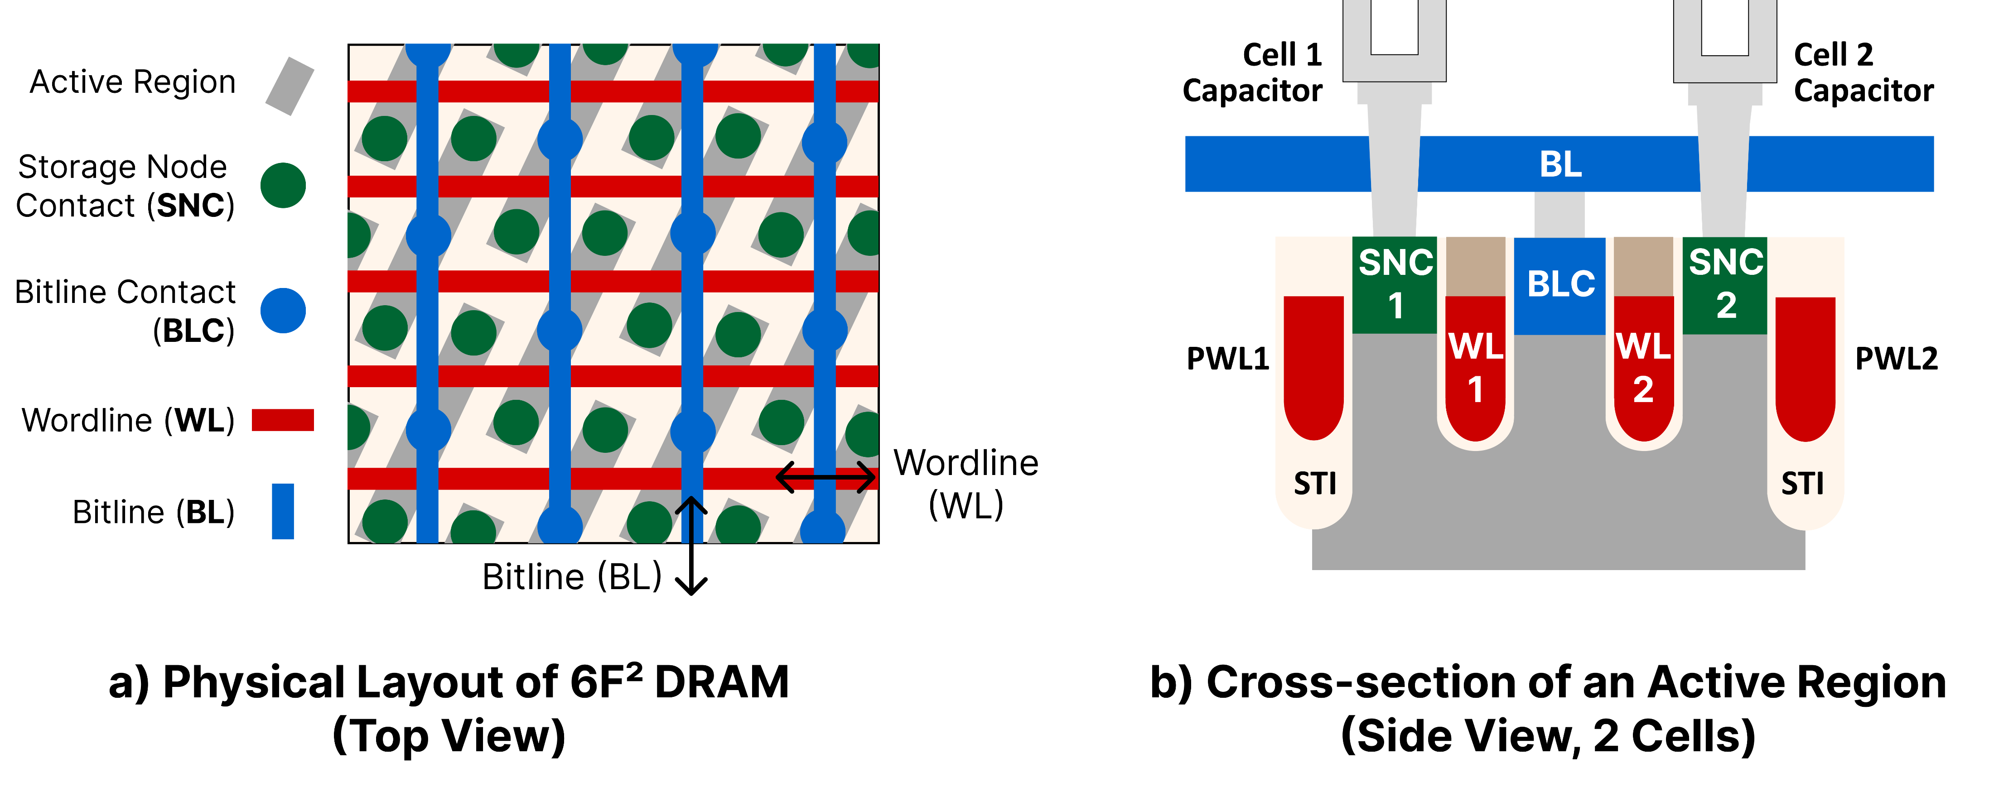
Device-Level Mechanisms – Physical Layout
Modern 6F² DRAM cell array layout
Passing
WL1
2
WL1
WL2
1
Passing
WL2
Notes:
Here is the actual physical layout of DRAM cells in modern DRAM array. Now, let us focus on two DRAM cells sharing the same active region. We focus on 1) the two respective wordlines of the two cells, and 2) the two passing wodlines that does not form an access transistor with the cell

Slide 12
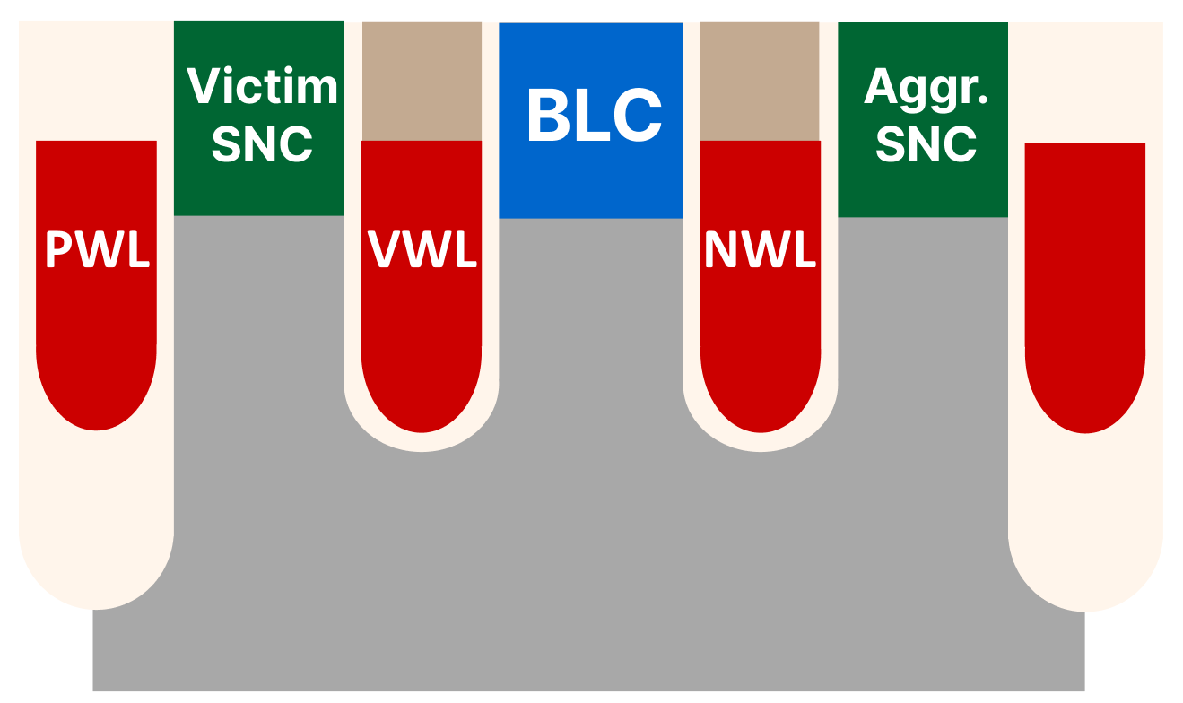
Device-Level Mechanism – RowHammer I
Key Error Mechanisms of RowHammer
  Trap-assisted Electron Migration [Yang+, EDL’19] [Walker+, TED’21] [Zhou+, IRPS’23]
PWL: Passing Wordline VWL: Victim Wordline
NWL: Neighboring Wordline (Aggressor)

Slide 13
Device-Level Mechanism – RowHammer I
Key Error Mechanisms of RowHammer
  Trap-assisted Electron Migration [Yang+, EDL’19] [Walker+, TED’21] [Zhou+, IRPS’23]
Acceptor-Like Trap
PWL: Passing Wordline VWL: Victim Wordline
NWL: Neighboring Wordline (Aggressor)

Slide 14
Device-Level Mechanism – RowHammer I
Key Error Mechanisms of RowHammer
  Trap-assisted Electron Migration [Yang+, EDL’19] [Walker+, TED’21] [Zhou+, IRPS’23]
    When NWL (aggressor) is open, acceptor-like traps are charged with electrons
Open
Trap Charged w/ Electron
e-
PWL: Passing Wordline VWL: Victim Wordline
NWL: Neighboring Wordline (Aggressor)
Notes:
Optimize lines to remove orphan

Slide 15
Device-Level Mechanism – RowHammer I
Key Error Mechanisms of RowHammer
  Trap-assisted Electron Migration [Yang+, EDL’19] [Walker+, TED’21] [Zhou+, IRPS’23]
    When NWL (aggressor) is open, acceptor-like traps are charged with electrons
    When NWL (aggressor) is closed, electrons are emitted from traps and
    migrate towards the victim cell
Closed
e-
Electron
Migration
PWL: Passing Wordline VWL: Victim Wordline
NWL: Neighboring Wordline (Aggressor)
Notes:
Kill orphans

Slide 16
Device-Level Mechanism – RowHammer II
Key Error Mechanisms of RowHammer (Cont’d)
  Double-Sided RowHammer is much more effective than Single-Sided
  at inducing bitflips (i.e., require much fewer aggressor row activations)
  Both NWL and PWL are aggressors, being opened and closed in an
  alternating manner, “sandwiching” the victim
Open
Closed
Closed
Open
PWL: Passing Wordline (Aggressor) VWL: Victim Wordline
NWL: Neighboring Wordline (Aggressor)
Notes:
RowHammer is the strongest when doing the double-sided access pattern, where both NWL and PWL serve as aggressors, being opened and closed in an alternating manner, sandwiching the victim

Slide 17
Device-Level Mechanism – RowHammer II
Key Error Mechanisms of RowHammer (Cont’d)
  Double-Sided RowHammer is much more effective than Single-Sided
  at inducing bitflips (i.e., require much fewer aggressor row activations)
  When NWL is closed, PWL is open: Enhancing electron migration
  NWL is closed for a longer period: More time for electron emission from traps
Open
Closed
+
+
e-
Enhanced
Electron Migration
PWL: Passing Wordline (Aggressor) VWL: Victim Wordline
NWL: Neighboring Wordline (Aggressor)

Slide 18
Device-Level Mechanism – RowHammer III
Key Error Mechanisms of RowHammer (Cont’d)
  Double-Sided RowHammer is much more effective than Single-Sided
  at inducing bitflips (i.e., require much fewer aggressor row activations)
  Electron migration is significantly enhanced by the alternating opening-closing of the NWL and the PWL -> Enhances 1→0 bitflips
    State-of-the-art device-level study claim 0→1 bitflips are
    “eliminated completely” [Zhou+, IRPS’23]
Key Device-Level Characteristic 1:
Double-Sided RowHammer should only induce 1→0 bitflips

Slide 19
Device-Level Mechanism – RowPress I
Key Error Mechanisms of RowPress
  NWL RowPress: When NWL is kept open for a long period, its strong electric field increases the leakage from the victim to the BLC,
  causing 0→1 bitflips [Zhou+, TED’24] [Zhou+, IRPS’24]
  PWL RowPress: When PWL is kept open for a long period, its strong electric field draws electrons towards the victim,
  causing 1→0 bitflips [Zhou+, TED’24] [Zhou+, IRPS’24]
Open
Open
+
+
+
+
e-
e-
Increased
Leakage
NWL RowPress
PWL RowPress
Notes:
Optimize, use colors

Slide 20
Device-Level Mechanism – RowPress II
Key Error Mechanisms of RowPress
  NWL RowPress: When NWL is kept open for a long period, its strong electric field increases the leakage from the victim to the BLC,
  causing 0→1 bitflips [Zhou+, TED’24] [Zhou+, IRPS’24]
  PWL RowPress: When PWL is kept open for a long period, its strong electric field draws electrons towards the victim,
  causing 1→0 bitflips [Zhou+, TED’24] [Zhou+, IRPS’24]
Key Device-Level Characteristic 2:
Single-Sided RowPress should induce both
1→0 and 0→1 bitflips

Slide 21
Outline
Background
  Key DRAM Organization
  DRAM Read Disturbance Phenomena: RowHammer & RowPress
Device-Level DRAM Read Disturbance Mechanisms
Real-Chip Characterization Methodology
  Reverse Engineering of True- and Anti-Cell Layout
Real-Chip Characterization Results
  Inconsistency I: Initial Bitflip Direction of Double-Sided RowHammer
  Inconsistency II: Bitflip Count of Double-Sided RowHammer
  Inconsistency III: Bitflip Direction of Single-Sided RowPress
Hypotheses
Conclusion

Slide 22
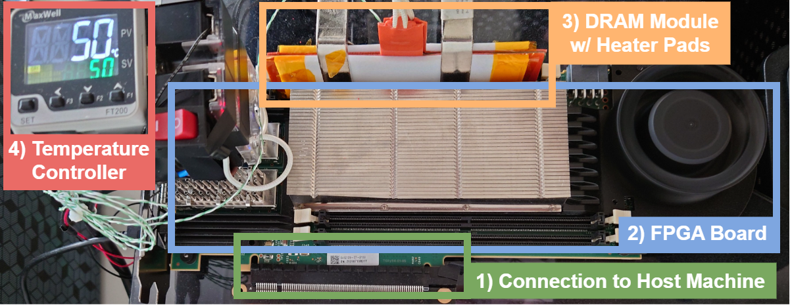
Real-Chip Characterization Methodology I
DRAM Bender
  Commodity-off-the-shelf (COTS) DDR4 DRAM testing infrastructure
Fine-grained control over
DRAM commands and timings (1.5ns granularity)
https://github.com/CMU-SAFARI/DRAM-Bender
Olgun et al., "DRAM Bender: An Extensible and Versatile FPGA-based Infrastructure
to Easily Test State-of-the-art DRAM Chips," in TCAD, 2023.

Slide 23
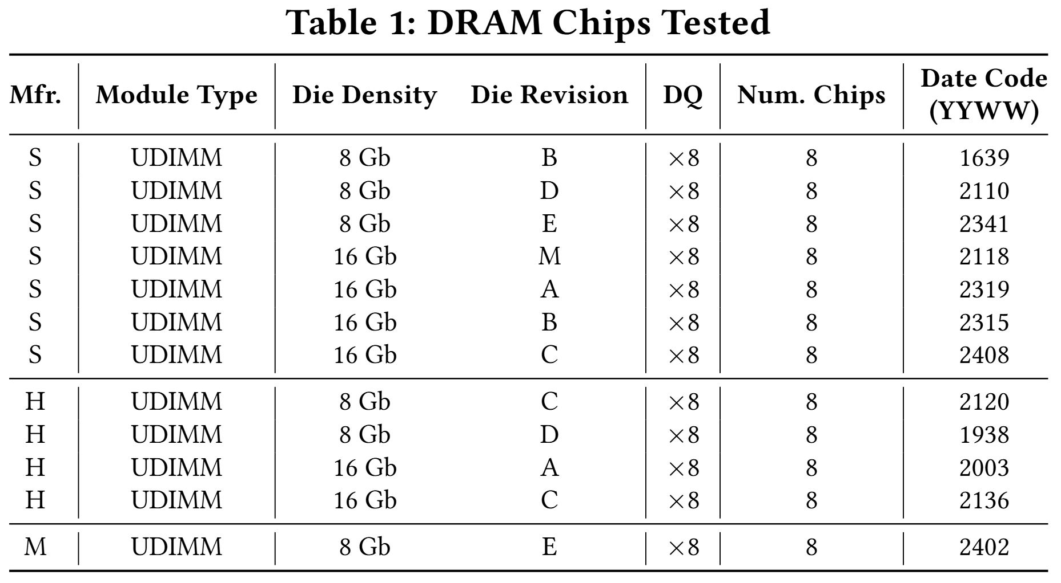
Real-Chip Characterization Methodology II
DRAM Chips Tested
  COTS DDR4 from all three major DRAM manufacturers
  12 different modules with different DRAM die revisions and densities
  96 DRAM chips in total
  We test 2048 randomly chosen victim rows from each module

Slide 24
Outline
Background
  Key DRAM Organization
  DRAM Read Disturbance Phenomena: RowHammer & RowPress
Device-Level DRAM Read Disturbance Mechanisms
Real-Chip Characterization Methodology
  Reverse Engineering of True- and Anti-Cell Layout
Real-Chip Characterization Results
  Inconsistency I: Initial Bitflip Direction of Double-Sided RowHammer
  Inconsistency II: Bitflip Count of Double-Sided RowHammer
  Inconsistency III: Bitflip Direction of Single-Sided RowPress
Hypotheses
Conclusion

Slide 25
True- and Anti-Cell Layout Reverse Engineering
Motivation
  DRAM internal architecture and layout is opaque to the memory controller
  The observed bitflip direction in real-chip characterization results does not always correspond to the real bitflip direction that happens in the DRAM cells (i.e., due to true- and anti-cells)
Retention Failure Based Reverse Engineering
  Major DRAM retention leakage paths (junction leakage and GIDL) are towards the access transistor substrate, which are usually negatively biased
  [Saino+, IEDM’00] [Yang+, EDL’13] [Park+, IMW’15] [Lee+, JSSC’11]
  Prior works on experimental characterization of DRAM retention failures assume DRAM retention failure only contain 1→0 bitflips, and leverages this to reverse engineer the true- and anti-cell layout of DRAM chips
  [Liu+, ISCA’13] [Nam+, ISCA’24]
We find consistent true- and anti-cell layouts as in prior works

Slide 26
Outline
Background
  Key DRAM Organization
  DRAM Read Disturbance Phenomena: RowHammer & RowPress
Device-Level DRAM Read Disturbance Mechanisms
Real-Chip Characterization Methodology
  Reverse Engineering of True- and Anti-Cell Layout
Real-Chip Characterization Results
  Inconsistency I: Initial Bitflip Direction of Double-Sided RowHammer
  Inconsistency II: Bitflip Count of Double-Sided RowHammer
  Inconsistency III: Bitflip Direction of Single-Sided RowPress
Hypotheses
Conclusion

Slide 27
Summary of Inconsistencies Found
Inconsistency I – Double-Sided RowHammer Bitflip Direction
  Real-Chip Characterization: Observed both 0→1 and 1→0 bitflips; 0→1 bitflips are initially easier to induce than 1→0 bitflips
  Device-Level Mechanism: Double-Sided RowHammer significantly enhances 1→0 leakage that it should only induce 1→0 bitflips
Inconsistency II – Double-Sided RowHammer Bitflip Count
  Real-Chip Characterization: Only with a sufficiently large hammer count does the number of 1→0 bitflips exceed that of 0→1 bitflips
  Device-Level Mechanism: Double-Sided RowHammer significantly enhances 1→0 leakage that it should only induce 1→0 bitflips
Inconsistency III – Single-Sided RowPress Bitflip Direction
  Real-Chip Characterization: Observed overwhelmingly 1→0 bitflips
  Device-Level Mechanism: Single-Sided RowPress should induce both 0→1 and 1→0 bitflips

Slide 28
Outline
Background
  Key DRAM Organization
  DRAM Read Disturbance Phenomena: RowHammer & RowPress
Device-Level DRAM Read Disturbance Mechanisms
Real-Chip Characterization Methodology
  Reverse Engineering of True- and Anti-Cell Layout
Real-Chip Characterization Results
  Inconsistency I: Initial Bitflip Direction of Double-Sided RowHammer
  Inconsistency II: Bitflip Count of Double-Sided RowHammer
  Inconsistency III: Bitflip Direction of Single-Sided RowPress
Hypotheses
Conclusion

Slide 29
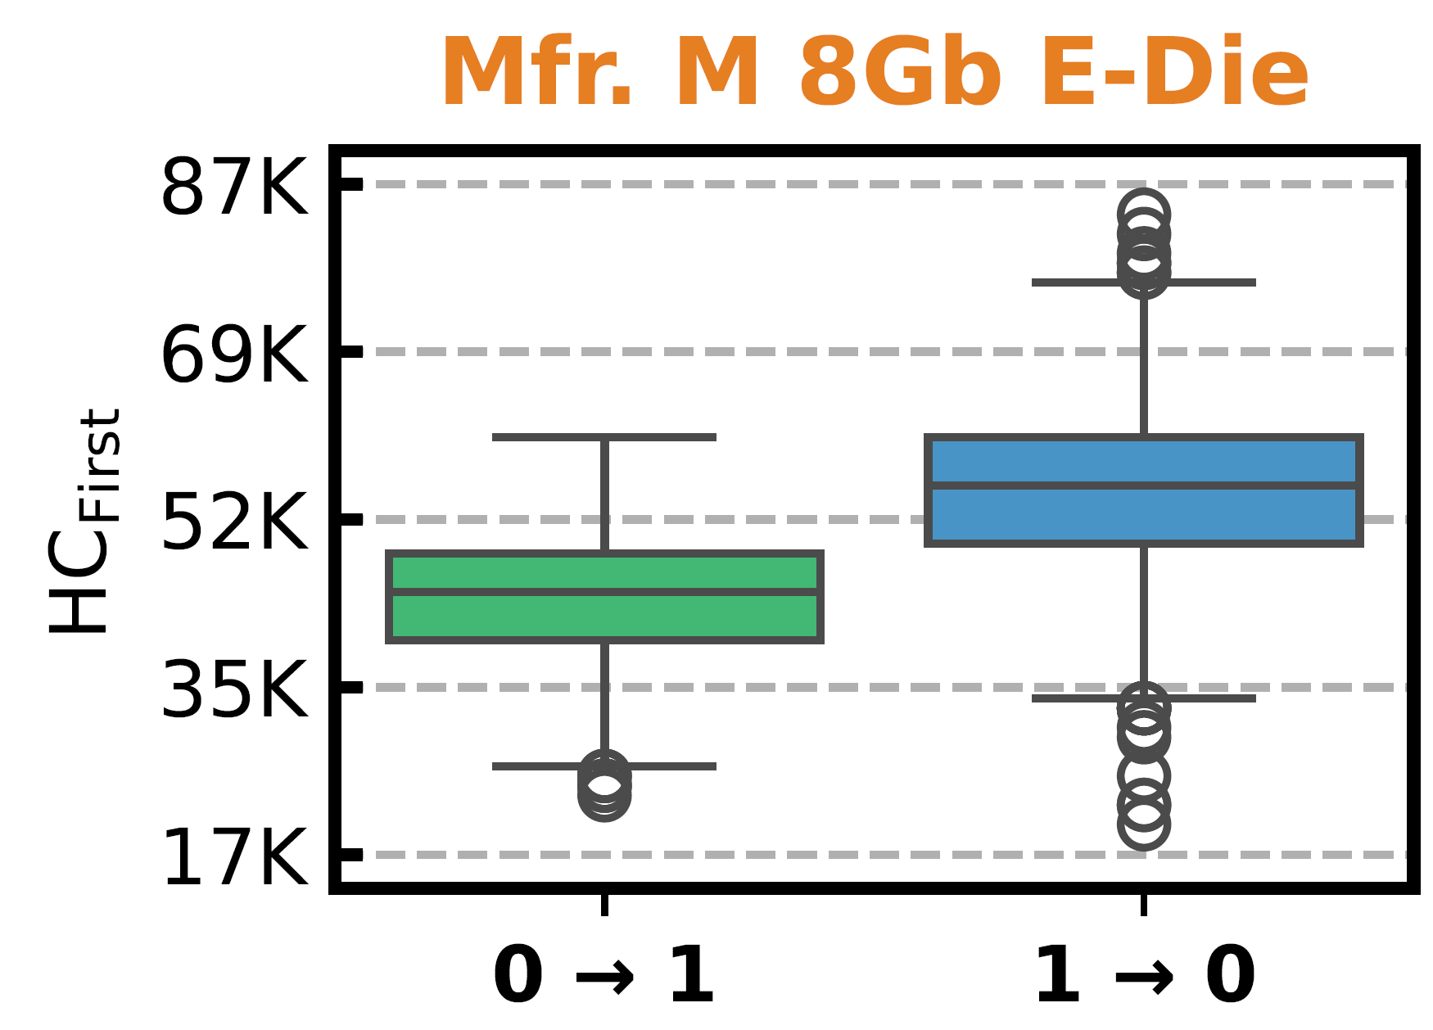
Initial Bitflip Direction of Double-Sided RowHammer I
Access Pattern: Double-Sided RowHammer
Data Pattern: All physical 1 (or 0) in the victim rows, All physical 0
(or 1) in the aggressor rows
Key Metric: HC_{First} , the minimum aggressor row activation (hammer) count to induce at least one bitflip in the victim row
Notes:
First show the small figure in a bigger version instead of censoring the rest

Slide 30
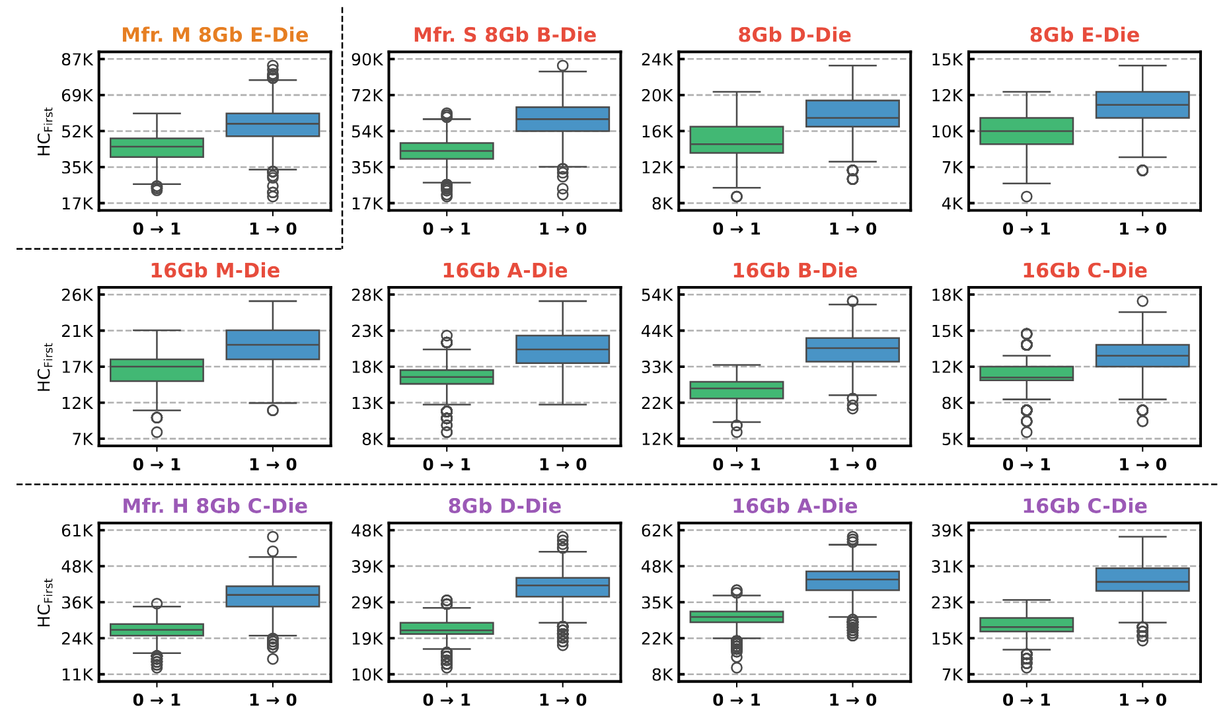
Initial Bitflip Direction of Double-Sided RowHammer I
Access Pattern: Double-Sided RowHammer
Data Pattern: All physical 1 (or 0) in the victim rows, All physical 0
(or 1) in the aggressor rows
Key Metric: HC_{First} , the minimum aggressor row activation (hammer) count to induce at least one bitflip in the victim row
Notes:
First show the small figure in a bigger version instead of censoring the rest

Slide 31
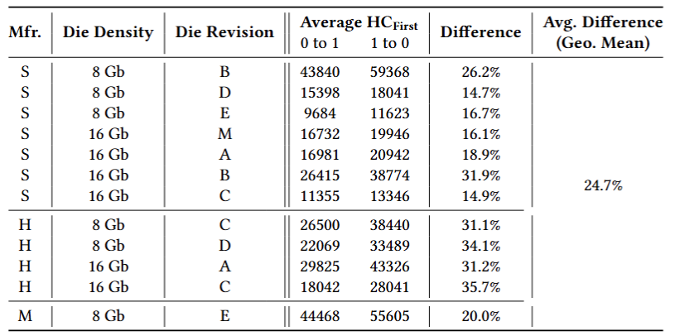
Initial Bitflip Direction of Double-Sided RowHammer II
Average HC_{First} of 0→1 and 1→0 bitflips
(Double-Sided RowHammer)
Real-Chip Obsv. 1: Double-Sided RowHammer induces
both 0→1 and 1→0 bitflips
Real-Chip Obsv. 2: For Double-Sided RowHammer, it is easier to induce 0→1 bitflips than 1→0 bitflips

Slide 32
Inconsistency I
Takeaways from Real-Chip Characterization Results
  Double-Sided RowHammer involves error mechanisms for inducing both 0→1 and 1→0 bitflips
  For Double-Sided RowHammer, the observed error mechanism for 0→1 bitflips is initially stronger than that of 1→0 bitflips in the most vulnerable DRAM cells (i.e., those requiring the least number of aggressor row activations to experience bitflips)
Characteristics from Device-Level Mechanisms
  Double-Sided RowHammer significantly enhances leakage that causes
  1→0 bitflips that it should only induce 1→0 bitflips

Slide 33
Outline
Background
  Key DRAM Organization
  DRAM Read Disturbance Phenomena: RowHammer & RowPress
Device-Level DRAM Read Disturbance Mechanisms
Real-Chip Characterization Methodology
  Reverse Engineering of True- and Anti-Cell Layout
Real-Chip Characterization Results
  Inconsistency I: Initial Bitflip Direction of Double-Sided RowHammer
  Inconsistency II: Bitflip Count of Double-Sided RowHammer
  Inconsistency III: Bitflip Direction of Single-Sided RowPress
Hypotheses
Conclusion

Slide 34
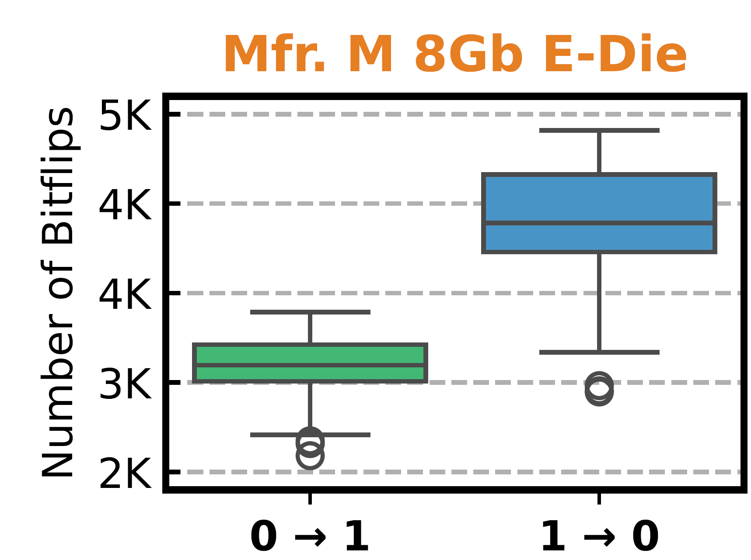
Bitflip Count of Double-Sided RowHammer I
Access Pattern: Double-Sided RowHammer
Data Pattern: All physical 1 (or 0) in the victim rows, All physical 0
(or 1) in the aggressor rows
Key Metric: Per-Row Bitflip Count, after hammering each aggressor row for a sufficiently high number of times (500K)

Slide 35
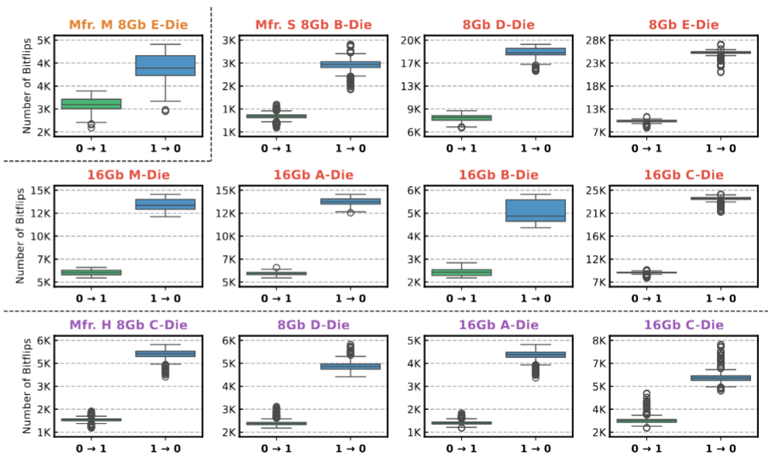
Bitflip Count of Double-Sided RowHammer I
Access Pattern: Double-Sided RowHammer
Data Pattern: All physical 1 (or 0) in the victim rows, All physical 0
(or 1) in the aggressor rows
Key Metric: Per-Row Bitflip Count, after hammering each aggressor row for a sufficiently high number of times (500K)

Slide 36
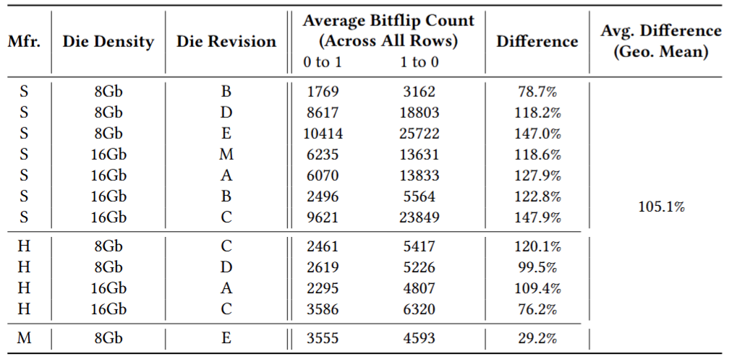
Bitflip Count of Double-Sided RowHammer II
Average bitflip count (across all victim rows) of 0→1 and 1→0 bitflips (Double-Sided RowHammer)
Real-Chip Obsv. 3: With sufficiently many hammers, Double-Sided RowHammer induces more 1→0 than 0→1 bitflips

Slide 37
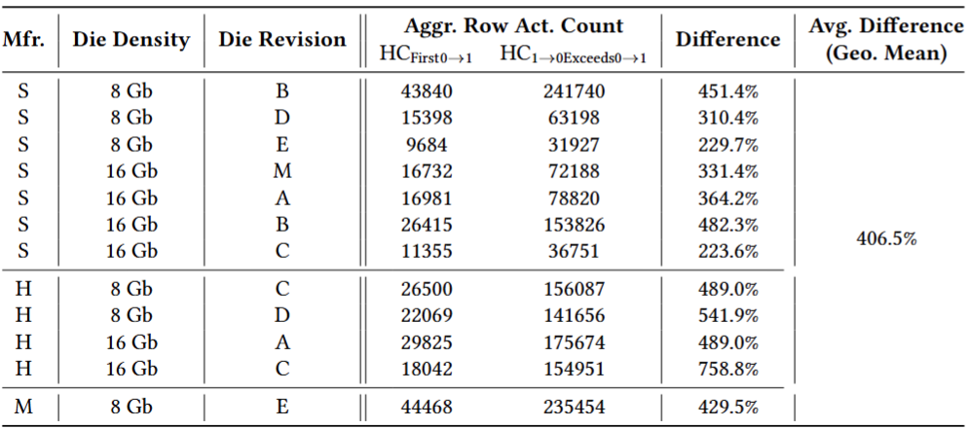
Bitflip Count of Double-Sided RowHammer III
When does the number of 1→0 bitflips start to exceed the number of 0→1 bitflips?
  HC_{1→0Exceeds0→1}: The minimum hammer count that the number of 1→0 bitflips exceed the number of 0→1 bitflips
Notes:
Up to about 7.5x more
On average about 4X more

Slide 38
Inconsistency II
Takeaways from Real-Chip Characterization Results
  For Double-Sided RowHammer, the observed error mechanism for 1→0 bitflips are only stronger than that of 0→1 bitflips with a sufficiently high hammer count
Characteristics from Device-Level Mechanisms
  Double-Sided RowHammer significantly enhances leakage that causes
  1→0 bitflips that it should only induce 1→0 bitflips

Slide 39
Outline
Background
  Key DRAM Organization
  DRAM Read Disturbance Phenomena: RowHammer & RowPress
Device-Level DRAM Read Disturbance Mechanisms
Real-Chip Characterization Methodology
  Reverse Engineering of True- and Anti-Cell Layout
Real-Chip Characterization Results
  Inconsistency I: Initial Bitflip Direction of Double-Sided RowHammer
  Inconsistency II: Bitflip Count of Double-Sided RowHammer
  Inconsistency III: Bitflip Direction of Single-Sided RowPress
Hypotheses
Conclusion

Slide 40
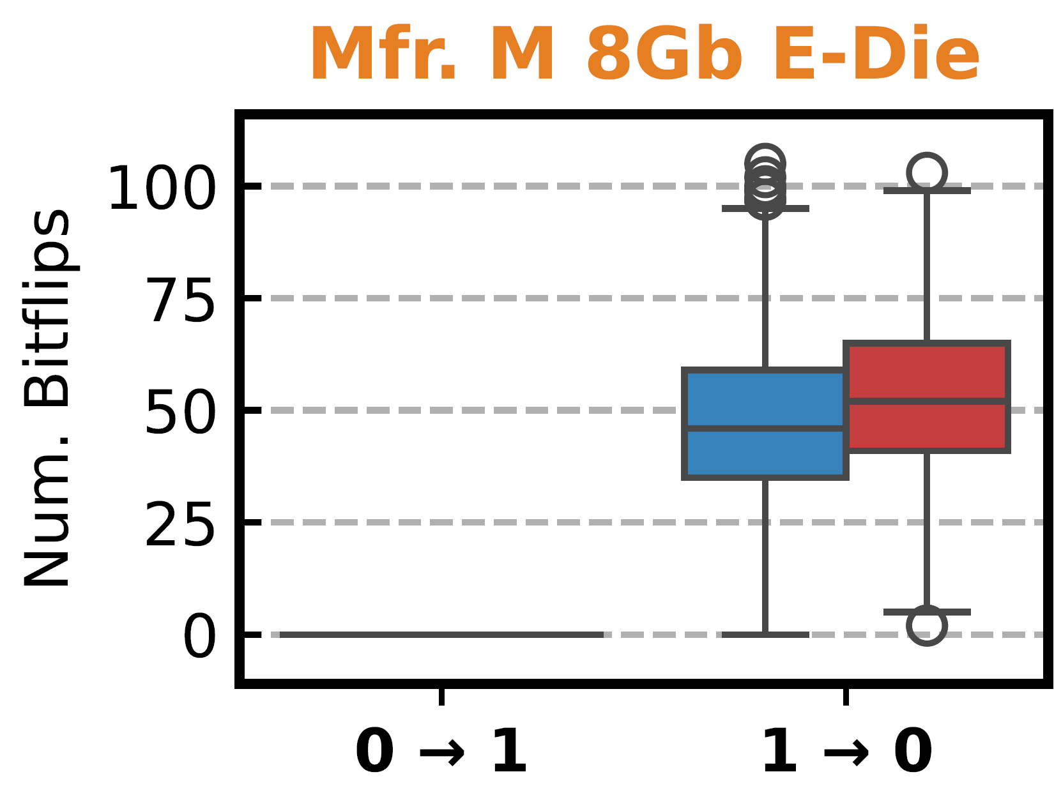
Bitflip Direction of Single-Sided RowPress
Access Pattern: Single-Sided RowPress at both the upper and lower aggressor row; kept open for 7.8µs per activation
Data Pattern: All physical 1 (or 0) in the victim rows, All physical 0
(or 1) in the aggressor rows
Key Metric: Per-Row Bitflip Count, after activating each aggressor row for a sufficiently high number of times (7500)

Slide 41
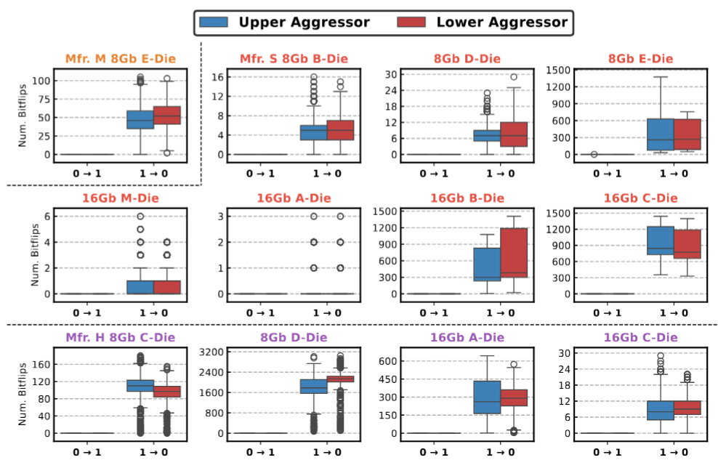
Bitflip Direction of Single-Sided RowPress
Access Pattern: Single-Sided RowPress at both the upper and lower aggressor row; kept open for 7.8µs per activation
Data Pattern: All physical 1 (or 0) in the victim rows, All physical 0
(or 1) in the aggressor rows
Key Metric: Per-Row Bitflip Count, after activating each aggressor row for a sufficiently high number of times (7500)
Only observed a
single 0→1 bitflip

Slide 42
Inconsistency III
Takeaways from Real-Chip Characterization Results
  For Single-sided RowPress, for both NWL and PWL, the observed error mechanism for inducing 1→0 bitflips is much stronger than that of 0→1 bitflips that we observe overwhelmingly 1→0 bitflips within
  the refresh window
Characteristics from Device-Level Mechanisms
  NWL Single-Sided RowPress should induce 0→1 bitflips
  PWL Single-Sided RowPress should induce 1→0 bitflips

Slide 43
Summary of Inconsistencies Found
Inconsistency I – Double-Sided RowHammer Bitflip Direction
  Real-Chip Characterization: Observed both 0→1 and 1→0 bitflips; 0→1 bitflips are initially easier to induce than 1→0 bitflips
  Device-Level Mechanism: Double-Sided RowHammer significantly enhances 1→0 leakage that it should only induce 1→0 bitflips
Inconsistency II – Double-Sided RowHammer Bitflip Count
  Real-Chip Characterization: Only with a sufficiently large hammer count does the number of 1→0 bitflips exceed that of 0→1 bitflips
  Device-Level Mechanism: Double-Sided RowHammer significantly enhances 1→0 leakage that it should only induce 1→0 bitflips
Inconsistency III – Single-Sided RowPress Bitflip Direction
  Real-Chip Characterization: Observed overwhelmingly 1→0 bitflips
  Device-Level Mechanism: Single-Sided RowPress should induce both 0→1 and 1→0 bitflips

Slide 44
Outline
Background
  Key DRAM Organization
  DRAM Read Disturbance Phenomena: RowHammer & RowPress
Device-Level DRAM Read Disturbance Mechanisms
Real-Chip Characterization Methodology
  Reverse Engineering of True- and Anti-Cell Layout
Real-Chip Characterization Results
  Inconsistency I: Initial Bitflip Direction of Double-Sided RowHammer
  Inconsistency II: Bitflip Count of Double-Sided RowHammer
  Inconsistency III: Bitflip Direction of Single-Sided RowPress
Hypotheses
Conclusion

Slide 45
Hypotheses I
Two Possibilities
  The retention failure based true- and anti-cell reverse engineering methodology is not always applicable in modern DRAM chips
  Current device-level explanations of DRAM read disturbance is not comprehensive enough
Other major retention leakage paths that does NOT leak towards the substrate
  Dielectric leakage that leaks towards BLC?
  More pronounced in modern DRAM as process keeps shrinking [Yu+, ICET’22]

Slide 46
Hypotheses II
Existing device-level works make oversimplified assumptions during simulation
  Prior works that study the trap-assisted electron migration leakage mechanism only focus on acceptor-like trap
  [Yang+, EDL’19] [Walker+, TED’21] [Zhou+, IRPS’23] [Zhou+, TED’24]
  Are donor-like traps really not causing any read disturbance leakage?
Device-level simulations focus on a few isolated structures and components
  Maybe the modeled read disturbance mechanisms are no longer first-order when put in the context of a full DRAM array
  Other coupling mechanisms between multiple devices and/or process variation might dominate real-chip characterization results
Real-chip characterization results are heavily skewed
  There could be asymmetry between the signal margins of reading a 1 and a 0, as a result of sense amplifier design and operation
Notes:
Maybe: Reduce text

Slide 47
Hypotheses III
There could be two different sets of read disturbance leakage mechanisms that affects different sets of DRAM cells
  For example, the error mechanism of 1→0 bitflips could be the major mechanism of Double-Sided RowHammer as prior works study for the majority of the cells
  However, the error mechanism behind the 0→1 bitflips determines the tail distribution of the HC_{First} (i.e., it affects the most vulnerable DRAM cells)

Slide 48
Outline
Background
  Key DRAM Organization & Operation
  DRAM Read Disturbance Phenomena: RowHammer & RowPress
Device-Level DRAM Read Disturbance Mechanisms
Real-Chip Characterization Methodology
  Reverse Engineering of True- and Anti-Cell Layout
Real-Chip Characterization Results
  Inconsistency I: Initial Bitflip Direction of Double-Sided RowHammer
  Inconsistency II: Bitflip Count of Double-Sided RowHammer
  Inconsistency III: Bitflip Direction of Single-Sided RowPress
Hypotheses
Conclusion

Slide 49
Conclusion
Goal: Align and cross-validate the experimental characterization of read disturbance (RowHammer and RowPress) with the error mechanisms modeled by device-level simulation
  Challenge: Gap between real-chip characterization and device-level mechanisms due to low-level DRAM array layout (i.e., true- and anti-cells)
Key Methodology:
  Extract key device-level read disturbance mechanisms from prior works
  Reverse-engineer the true- and anti-cells layout of real DRAM chips
  Perform real-chip characterization that directly match the access and data patterns studied in device-level works
Key Inconsistencies:
  For Double-Sided RowHammer, experimental characterization shows bitflips in both directions while device-level mechanisms suggest only 1→0 bitflips will happen
  For Single-Sided RowPress, experimental characterization shows overwhelmingly 1→0 bitflips while device-level mechanisms suggest both kinds of bitflips will happen
Notes:
Animate this

Slide 50


Revisiting DRAM Read Disturbance
Identifying Inconsistencies Between
Experimental Characterization and
Device-Level Studies
Haocong Luo İsmail Emir Yüksel Ataberk Olgun
A. Giray Yağlıkçı Onur Mutlu
ETH Zurich
VTS’ 25
28 April 2025
arXiv
Data & Code

