Slide 1
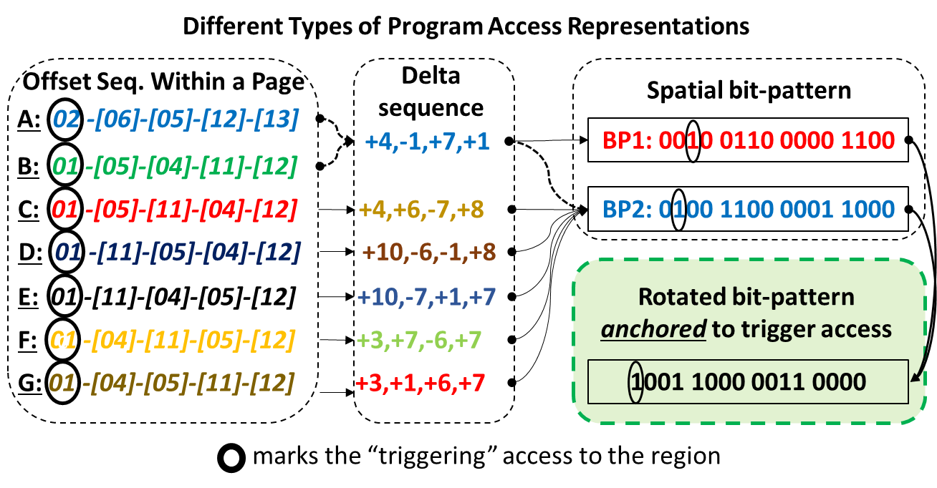
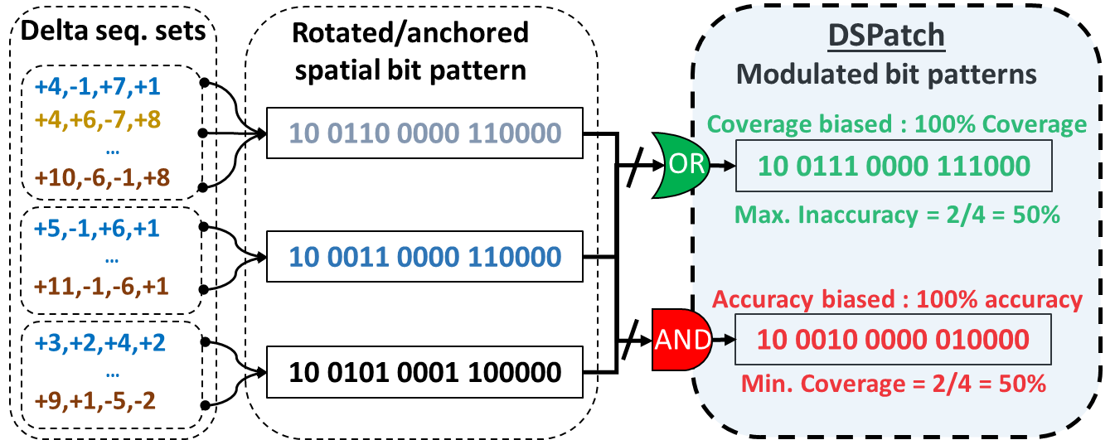
DSPatch: Dual Spatial Pattern Prefetcher
Rahul Bera* Anant V. Nori* Onur Mutlu⁺ Sreenivas Subramoney*
*Processor Architecture Research Lab (PARL), Labs
⁺ ETH Zürich
1. Motivation
2. Challenge
3. Goal
Current state-of-the-art spatial prefetcher performance plateaus despite increasing memory bandwidth
Need to boost speculation and coverage to maximize utilization of memory bandwidth resource
Fundamental tradeoff in traditional prefetcher design between Coverage versus Accuracy
Limits ability to dynamically adapt to memory bandwidth headroom and significantly boost Coverage
New prefetcher design should include:
Pattern representations best suited to capture spatially co-located program accesses and boost Coverage
Mechanisms to simultaneously optimize for both Coverage and Accuracy
Ability to dynamically adjust aggressiveness (Coverage vs. Accuracy) based on available DRAM bandwidth
C
A
4. DSPatch Key Insights
A bit-pattern representation, rotated and anchored to the first “triggering” access to a page, captures all spatially identical patterns subsuming any temporal variability.
Captures all “global deltas” from the trigger access
Bit-wise OR of rotated bit-patterns adds missing bits to the pattern, biasing it towards Coverage
Bit-wise AND of rotated bit-patterns keeps only repeating bits in the pattern, biasing it for Accuracy
Using dual modulated bit-patterns allows DSPatch to simultaneously optimize for both Coverage and Accuracy
C
A
5. DSPatch Design
DSPatch: Overall Flow
DSPatch: Pattern Update
DSPatch: Pattern Predict
Page Buffer (PB) [1.23 KB]
1
PC Signature | CovP | AccP
0x7ffecca | 1100011001111100 | 1000001000011000
BW>=75%?
Y
Measure_{AccP} saturated?
Y
5
Pattern Update
Program Access
Y
Signature Prediction Table
(SPT)
[2.375 KB]
2
Program
1001011100010001
N
No prediction
CovP
OR
AND
N
Predict AccP
Vulnerable Fill
3
AccP
4
PC Signature | CovP | AccP
0x7ffecca | 1101111101111101 | 1000001000010000
BW>=50%?
Y
Measure_{CovP} saturated?
Y
Bandwidth
utilization
Pattern
Predict
Predict CovP
Measure_{CovP} : Incr. if CovP Coverage < 50% || CovP Accuracy < 50%
Measure_{AccP} : Incr. if AccP Accuracy < 50%
N
N
5. DSPatch Results
DSPatch: Single Core Performance
DSPatch: Single Core DRAM B/W Scaling
DSPatch: Multi-Core Performance
6%
2ch-2400
15.1%
1ch-2133
6%
10%
7.4%

