Slide 1
DSPatch: Dual Spatial pattern prefetcher
Rahul Bera¹, Anant V. Nori¹, Onur Mutlu², Sreenivas Subramoney¹
¹Processor Architecture Research Lab, Intel Labs
²ETH Zürich

Slide 2
Summary
Motivation:
DRAM bandwidth increases with every generation
Prefetchers need to adapt to effectively utilize this resource
Challenge:
Significantly boost Coverage AND
Simultaneously optimize for Accuracy
Dual Spatial Pattern Prefetcher (DSPatch)
Simultaneously learn two spatial bit-pattern representations of program accesses per page
Coverage-biased (CovP)
Accuracy-biased (AccP)
Predict one of the patterns based on current DRAM bandwidth headroom
CovP
AccP
BW
utilization
6% average speedup over baseline with PC-stride @ L1 and SPP @ L2
10% average speedup when DRAM bandwidth is doubled
Only 3.6 KB of hardware storage

Slide 3
Outline
1. Motivation and Observations
2. Dual Spatial Pattern Prefetcher (DSPatch)
3. Evaluation
4. Conclusion

Slide 4
Motivation: Current prefetchers’ performance scales poorly with increasing DRAM bandwidth
C
A
Traditional prefetcher design tradeoff between Coverage and Accuracy
Limits ability to significantly boost Coverage when needed

Slide 5
Observation 1 Anchored spatial bit-patterns well suited to capture spatial access patterns
Cacheline offset seq.
within a page
Cacheline delta seq.
within a page
Spatial bit-pattern
Anchored spatial
bit-pattern
A: [02]-[06]-[05]-[12]-[13]
B: [01]-[05]-[04]-[11]-[12]
C: [01]-[05]-[11]-[04]-[12]
D: [01]-[11]-[05]-[04]-[12]
E: [01]-[11]-[04]-[05]-[12]
F: [01]-[04]-[11]-[05]-[12]
G: [01]-[04]-[05]-[11]-[12]
+4, -1,+7,+1
+4,+6,-7,+8
+10,-6,-1,+8
+10,-7,+1,+7
+3,+7,-6,+7
+3,+1,+6,+7
0010 0110 0000 1100
0100 1100 0001 1000
1001 1000 0011 0000
“_” marks the first (triggering) access to the page
Spatial bit-patterns subsume any small temporal variability in accesses
Anchored spatial bit-patterns capture all “global” deltas from the triggering access

Slide 6
Observation 2 Anchored spatial bit-patterns allow modulation for Coverage versus Accuracy
Cacheline delta seq. within a page
Anchored spatial bit-patterns
Modulated anchored spatial bit-patterns
+4,-1,+7,+1
+4,+6,-7,+8
…
+10,-6,-1,+8
1001 1000 0011 0000
OR
1001 1100 0011 1000
Coverage biased : 100% Coverage
+5,-1,+6,+1
…
+11,-1,-6,+1
1000 1100 0011 0000
AND
1000 1000 0001 0000
+3,+2,+4,+2
…
+9,+1,-5,-2
Accuracy biased : 100% accuracy
1001 0100 0110 0000
Bit-wise OR modulation ⇒ Biased towards Coverage
Bit-wise AND modulation ⇒ Biased towards Accuracy

Slide 7
Outline
1. Motivation and Observations
2. Dual Spatial Pattern Prefetcher (DSPatch)
3. Evaluation
4. Conclusion

Slide 8
DSPatch: Key Idea
Simultaneously learn two modulated spatial bit-pattern representations of program accesses
Coverage-Biased (CovP)
Accuracy-Biased (AccP)
Predict one of the patterns based on current DRAM bandwidth headroom
CovP
AccP
BW
utilization
C
A
Optimize simultaneously for both:
Significantly higher Coverage
High Accuracy

Slide 9
DSPatch: Overall Design
Page Buffer (PB)
Page | Trigger PC | Bit-pattern
0x65 | 0x7ffecca | 0010 1100 0001 0010
0x66 | 0x7ff8980 | 0001 0010 0011 0001
1
Program Access
5
.
.
.
.
.
.
.
.
.
Signature Prediction Table
(SPT)
2
CovP
4
PC Signature | CovP | AccP
0x7ffecca | 1011 0011 1110 0011 | 0001 0000 0011 0010
3
AccP
.
.
.
.
.
.
.
.
.
BW
utilization

Slide 10
DSPatch: Quantify Coverage, Accuracy and Bandwidth
Page Buffer (PB)
Quantifying Coverage and Accuracy
Identify good bits in SPT pattern(s)
PopCount compare to program pattern
Quantize to quartile buckets (25%,50,75%)
1
Program Access
5
Signature Prediction Table
(SPT)
Pattern | Value | PopCount
From Program | 1011 0100 0011 1100 | 8
From SPT | 1010 0110 0000 0001 | 5
Bitwise-AND | 1010 0100 0000 0000 | 3
Coverage
[25%-50%]
2
Accuracy
[50%-75%]
CovP
4
3
AccP
Quantifying DRAM bandwidth utilization
Count DRAM accesses in 4 x tRC window
Compare to peak possible access count
Quantize to quartile buckets (25%,50,75%)
BW
utilization

Slide 11
DSPatch: Pattern Update
PC Signature | CovP | AccP
0x7ffecca | 1100 0110 0111 1100 | 1000 0010 0001 1000
5
Program
1001 0111 0001 0001
OR
AND
OR_{count}
Limit number of modulation operations
Measure_{CovP}
Incr if CovP coverage < 50% || CovP accuracy < 50%
Measure_{AccP}
Incr if AccP accuracy < 50%
PC Signature | CovP | AccP
0x7ffecca | 1101 1111 0111 1101 | 1000 0010 0001 0000
2b
2b
2b

Slide 12
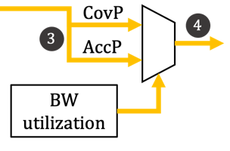
DSPatch: Pattern Predict
BW utilization >=75%?
Measure_{AccP} saturated?
Y
Y
No prefetch
N
N
BW utilization >=50%?
Measure_{CovP} saturated?
Prefetch using AccP
Vulnerable Fill
Y
Y
PC Signature | CovP | AccP
0x7ffecca | 1101111101111101 | 1000001000010000
N
N
Prefetch using CovP
2b
2b
2b
BW Utilization
< 50%
Y

Slide 13
Outline
1. Motivation and Observations
2. Dual Spatial Pattern Prefetcher (DSPatch)
3. Evaluation
4. Conclusion

Slide 14
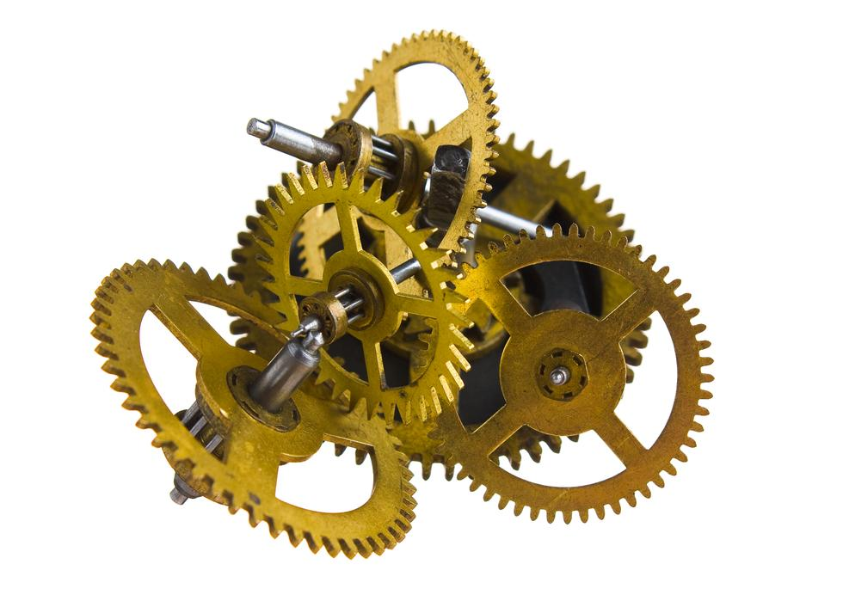
Evaluation Methodology
Configuration
4 x86 cores @ 4 GHz, 4 wide OoO, 224 deep ROB entries
32KB, 8 way Data and Code L1 caches
PC-stride prefetcher into Data L1
256 KB L2 Cache
BOP, SPP, SMS, DSPatch evaluated @ L2
2 MB LLC/Core
Memory Configuration
Single Core evaluations: 1Ch-DDR4-2133MHz
Multi Core evaluations: 2Ch-DDR4-2133MHz
Workloads
Single-Core: 75 workloads spanning Cloud, Client, Server, HPC, Sysmark, SPEC06 and SPEC17
Multi-Core: 42 high-MPKI homogeneous mixes, 75 heterogeneous mixes

Slide 15
DSPatch: Single-Core Performance
6%
Standalone DSPatch outperforms SPP and SMS by 1% and 3% respectively
DSPatch+SPP outperforms SPP by 6% on average

Slide 16
DSPatch: Performance Scaling With Bandwidth
1ch-2400
1ch-2133
10%
1ch-1600
6%
2ch-2133
2ch-2400
2ch-1600
DSPatch performance scales well with increase in memory bandwidth

Slide 17
DSPatch: Multi-Core Performance
15.1%
7.9%
5.9%
7.4%
DSPatch performs well in bandwidth-constrained multi-core scenarios

Slide 18
DSPatch: Hardware Storage
Structure | Size Per Entry (in bytes) | No. of Entries | Size (in KB)
PB | 19.75 B | 64 | 1.23 KB
SPT | 9.5 B | 256 | 2.375 KB
Total |  |  | 3.6 KB
DSPatch is an order of magnitude smaller than SMS
and takes only 2/3rd storage of SPP

Slide 19
More In Paper
Design optimizations
Bit-pattern compression (Reduce storage)
Multiple triggers per 4KB page (Increase coverage)
Results
Breakdown of coverage and accuracy of DSPatch
Performance comparison of ISO-sized adjunct prefetchers
Contribution of Coverage vs. Accuracy biased patterns

Slide 20
Outline
1. Motivation and Observations
2. Dual Spatial Pattern Prefetcher (DSPatch)
3. Evaluation
4. Conclusion

Slide 21
Summary
Motivation:
DRAM bandwidth increases with every generation
Prefetchers need to adapt to effectively utilize this resource
Challenge:
Significantly boost Coverage AND
Simultaneously optimize for Accuracy
Dual Spatial Pattern Prefetcher (DSPatch)
Simultaneously learn two spatial bit-pattern representations of program accesses per page
Coverage-biased (CovP)
Accuracy-biased (AccP)
Predict one of the patterns based on current DRAM bandwidth headroom
CovP
AccP
BW
utilization
6% average speedup over baseline with PC-stride @ L1 and SPP @ L2
10% average speedup when DRAM bandwidth is doubled
Only 3.6 KB of hardware storage

Slide 22
DSPatch: Dual Spatial pattern prefetcher
Rahul Bera¹, Anant V. Nori¹, Onur Mutlu², Sreenivas Subramoney¹
¹Processor Architecture Research Lab, Intel Labs
²ETH Zürich

Slide 23
BACKUP

Slide 24
Observation: Pollution

Slide 25
Coverage and Accuracy
Covered
Uncovered
Mispredicted
For DSPatch, every 2% increase in coverage comes at a cost of only 1% increase in misprediction

