Slide 1




DarkGates
A Hybrid Power-Gating Architecture to Mitigate the Performance Impact of Dark-Silicon
in High Performance Processors
Jawad Haj-Yahya
Jeremie S. Kim A. Giray Yağlıkçı Jisung Park
Efraim Rotem Yanos Sazeides Onur Mutlu
Notes:
My name is Jawad Haj-Yahya and I will present our work DarkGates [END]

Slide 2
Executive Summary
Problem: power-gates increase the system's power-delivery impedance and voltage guardband, limiting the system’s maximum attainable voltage (i.e., V_{max}) and, thus, the CPU core’s maximum attainable frequency (i.e., F_{max})
Goal: mitigate the power-gates’ performance loss for systems that are performance constrained by the CPU frequency (i.e., Fmax-constrained), such as high-end desktops
Mechanism: DarkGates, hybrid system architecture that is based on three key techniques
Bypasses on-chip power-gates using package-level resources (called bypass mode)
Extends power management firmware to support operation in bypass- and normal-mode
Enables deeper idle power states
Evaluation: we implement DarkGates on the Intel Skylake microprocessor for client devices and evaluate it using a wide variety of workloads, DarkGates:
  Improves the average performance of SPEC CPU2006 workloads across all thermal design power (TDP) levels (35W–91W) by 4.2%-5.3% on a real 4-core Skylake system
  Maintains the performance of 3DMark workloads for desktop systems with TDP greater than 45W. For a 35W-TDP (the lowest TDP) desktop it experiences only a 2% degradation
  Dark-Gates fulfills the requirements of the ENERGY STAR and the Intel Ready Mode energy efficiency benchmarks of desktop systems
  Conclusion: DarkGates is an effective approach to improving energy consumption and performance demands across high-end heterogeneous client processors
Notes:
First, I will give a high-level overview of the talk [CLICK]
Power-gates increase the system's power-delivery impedance and voltage guardband, limiting the system’s maximum attainable voltage and, thus, the CPU core’s maximum attainable frequency [CLICK]
Our goal is to mitigate the power-gates’ performance loss for systems that are performance constrained by the CPU frequency, such as high-end desktops [CLICK]
To this end we introduce DarkGates, a hybrid system architecture that is based on three key techniques [CLICK]
DarkGates Bypasses on-chip power-gates using package-level resources [CLICK]
Extends power management firmware to support operation in bypass- and normal-mode [CLICK]
Enables deeper idle power states [CLICK]
We implement DarkGates on the Intel Skylake microprocessor for client devices and evaluate it using a wide variety of workloads: [CLICK]
DarkGates Improves the average performance of SPEC CPU2006 workloads across all thermal design power levels by 4.2% to 5.3% on a real four-core Skylake system [CLICK]
Maintains the performance of 3DMark workloads for desktop systems with TDP greater than 45W. For a 35W-TDP desktop it experiences only a 2% degradation [CLICK]
Dark-Gates fulfills the requirements of the ENERGY STAR and the Intel Ready Mode energy efficiency benchmarks of desktop systems [CLICK]
We Conclude that DarkGates is an effective approach to improving energy consumption and performance demands across high-end heterogeneous client processors [END]

Slide 3
Presentation Outline
Overview of Client Processor Architecture
Motivation and Goal
DarkGates
  Power-gate Bypassing
  Improved Power Management Algorithms
  A New Package C-state for Desktops
Evaluation
Conclusion
Notes:
I will now give and Overview of Client Processor Architecture [END]

Slide 4
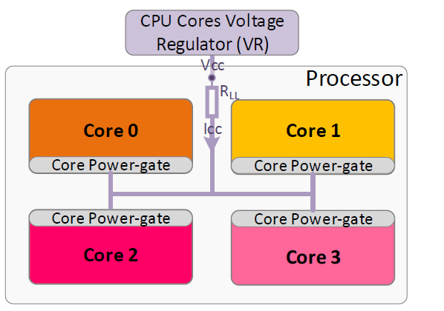
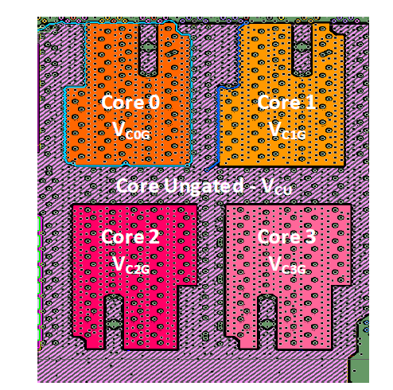
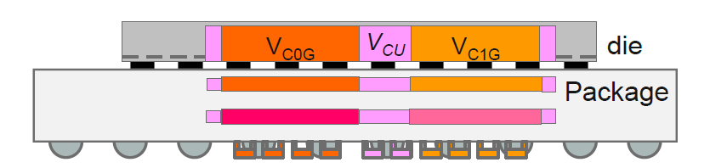
Client Processor Power Management Architecture
A high-end client processor is a system-on-chip that typically integrates three main domains into a single chip:
  Compute (e.g., CPU cores and graphics engines)
  IO
  Memory system
We show the architecture used in recent Intel processors with a focus on CPU cores
  Each CPU core has a power-gate for the entire core
Package layout showing
  An ungated main voltage domain (V_{CU})
  Four power-gated voltage domains (one for each CPU core, V_{C0G}, V_{C1G}, V_{C2G}, and V_{C3G})
Side view of die and package showing
  The ungated main voltage domain (VCU) and two cores’ voltage domains (V_{C0G} and V_{C1G})
  The package’s decoupling capacitors
Notes:
A high-end client processor is a system-on-chip that typically integrates three main domains into a single chip:
Compute (e.g., CPU cores and graphics engines)
IO
Memory system [CLICK]
We show the architecture used in recent Intel processors with a focus on CPU cores
Each CPU core has a power-gate for the entire core [CLICK]
Package layout showing
An ungated main voltage domain (V_{CU})
Four power-gated voltage domains (one for each CPU core, V_{C0G}, V_{C1G}, V_{C2G}, and V_{C3G}) [CLICK]
Side view of die and package showing
The ungated main voltage domain (VCU) and two cores’ voltage domains (V_{C0G} and V_{C1G})
The package’s decoupling capacitors [END]

Slide 5
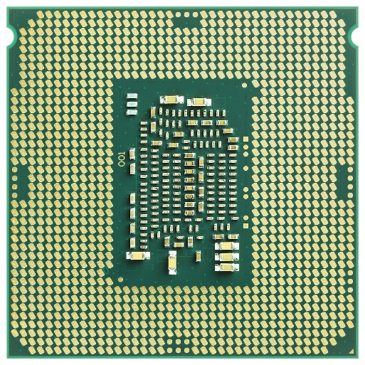
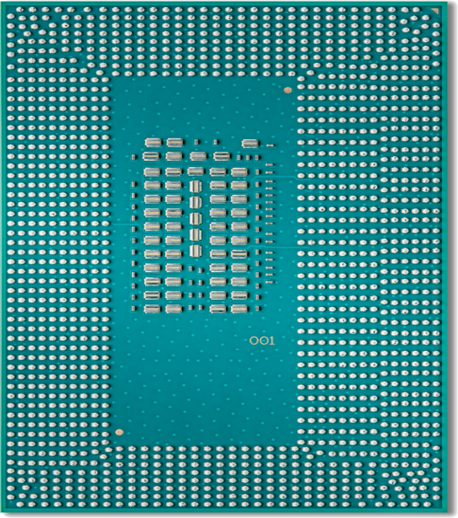
Client Processor Packages and Die Sharing
Architects of modern client processors typically build a single CPU core (with a built-in power-gate) architecture that supports all dies of a client processor family
Some of the dies are used to build different processor packages targeting different segments
  For example, the Intel Skylake uses a single processor die for all TDP ranges (from 35W to 91W) of
    High-end desktop (Skylake-S) processors
    High-end mobile (Skylake-H) processors
This design reuse is adopted for two major reasons
  Allows system manufacturers to configure a processor for a specific segment, For example,
    A land grid array (LGA) package is used for desktops (Skylake-S)
    A ball grid array (BGA) package is used for laptops (Skylake-H)
  It reduces non-recurring engineering (NRE) cost and design complexity
Skylake-S (LGA)
Skylake-H (BGA)
Notes:
Architects of modern client processors typically build a single CPU core architecture that supports all dies of a client processor family [CLICK]
Some of the dies are used to build different processor packages targeting different segments
For example, the Intel Skylake uses a single processor die for all TDP ranges of [CLICK]
High-end desktop processors [CLICK]
High-end mobile processors [CLICK]
This design reuse is adopted for two major reasons
Allows system manufacturers to configure a processor for a specific segment, For example,
A land grid array (LGA) package is used for desktops (Skylake-S)
A ball grid array (BGA) package is used for laptops (Skylake-H)
It reduces non-recurring engineering (NRE) cost and design complexity [END]

Slide 6
Presentation Outline
Overview of Client Processor Architecture
Motivation and Goal
DarkGates
  Power-gate Bypassing
  Improved Power Management Algorithms
  A New Package C-state for Desktops
Evaluation
Conclusion
Notes:
I will now discuss the motivation and the goal of our work [END]

Slide 7
Experiments on Two Different Systems
To show the potential performance benefits of increasing CPU core clock frequency as we increase the effective voltage
  We evaluate the performance impact when reducing the voltage guardband of a real Intel Broadwell processor
To show the impact of power-gates bypassing on reducing the voltage guardband of Skylake system
  We evaluate the maximum possible reduction in system impedance when we bypass the power-gates
Notes:
To show the potential performance benefits of increasing CPU core clock frequency as we increase the effective voltage
We evaluate the performance impact when reducing the voltage guardband of a real Intel Broadwell processor [CLICK]
To show the impact of power-gates bypassing on reducing the voltage guardband of Skylake system
We evaluate the maximum possible reduction in system impedance when we bypass the power-gates [END]

Slide 8
1. Performance Impact of Voltage Guardband
We configure the Intel Broadwell processor to four Thermal Design Power (TDP) levels using post-silicon configuration tools
We reduce the voltage guardband of the CPU cores by 100mV
  Allowing the power budget management algorithm (PBM) to increase the CPU cores’ frequency for a given voltage
  While keeping the system power consumption below TDP and the voltage below the maximum operating voltage limit (V_{max})
The goal of this experiment is to evaluate the potential performance benefits of increasing CPU core clock frequency as we increase the effective voltage by reducing the voltage guardband
We run the SPEC CPU2006 benchmarks, both floating-point (fp) and integer (int) with base (single-core) and rate (all cores) modes
Notes:
We configure the Intel Broadwell processor to four Thermal Design Power (TDP) levels using post-silicon configuration tools [CLICK]
We reduce the voltage guardband of the CPU cores by 100mV [CLICK]
Allowing the power budget management algorithm (PBM) to increase the CPU cores’ frequency for a given voltage [CLICK]
While keeping the system power consumption below TDP and the voltage below the maximum operating voltage limit (V_{max}) [CLICK]
The goal of this experiment is to evaluate the potential performance benefits of increasing CPU core clock frequency as we increase the effective voltage by reducing the voltage guardband [CLICK]
We run the SPEC CPU2006 benchmarks, both floating-point (fp) and integer (int) with base (single-core) and rate (all cores) modes [END]

Slide 9
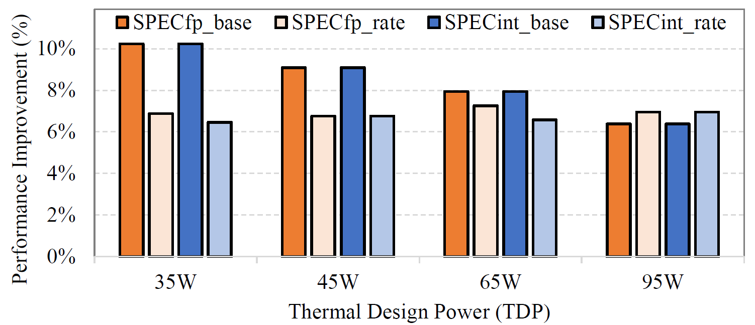
1. Performance Impact of Voltage Guardband
The average performance of SPECfp and SPECint benchmarks increases by 6-10% as the system’s frequency increases for each given TDP level
The system can run at a higher frequency with the same CPU core voltage level without exceeding the TDP limit since the effective voltage increases once we reduce the voltage guardband
Notes:
The average performance of SPECfp and SPECint benchmarks increases by 6-10% as the system’s frequency increases for each given TDP level [CLICK]
The system can run at a higher frequency with the same CPU core voltage level without exceeding the TDP limit since the effective voltage increases once we reduce the voltage guardband [END]

Slide 10
1. Performance Impact of Voltage Guardband
Reducing the voltage guardband can significantly improve the performance of both thermally-limited systems and F_{max}-constrained systems
The average performance of SPECfp and SPECint benchmarks increases by 6-10% as the system’s frequency increases for each given TDP level
The system can run at a higher frequency with the same CPU core voltage level without exceeding the TDP limit since the effective voltage increases once we reduce the voltage guardband
Notes:
Reducing the voltage guardband can significantly improve the performance of both thermally-limited systems and F_{max}-constrained systems

Slide 11
Experiments on Two Different Systems
To show the potential performance benefits of increasing CPU core clock frequency as we increase the effective voltage
  We evaluate the performance impact when reducing the voltage guardband of a real Intel Broadwell processor
To show the impact of power-gates bypassing on reducing the voltage guardband of Skylake system
  We evaluate the maximum possible reduction in system impedance when we bypass the power-gates
Notes:
I will now discuss the second experiment:
To show the impact of power-gates bypassing on reducing the voltage guardband of Skylake system
We evaluate the maximum possible reduction in system impedance when we bypass the power-gates [END]

Slide 12
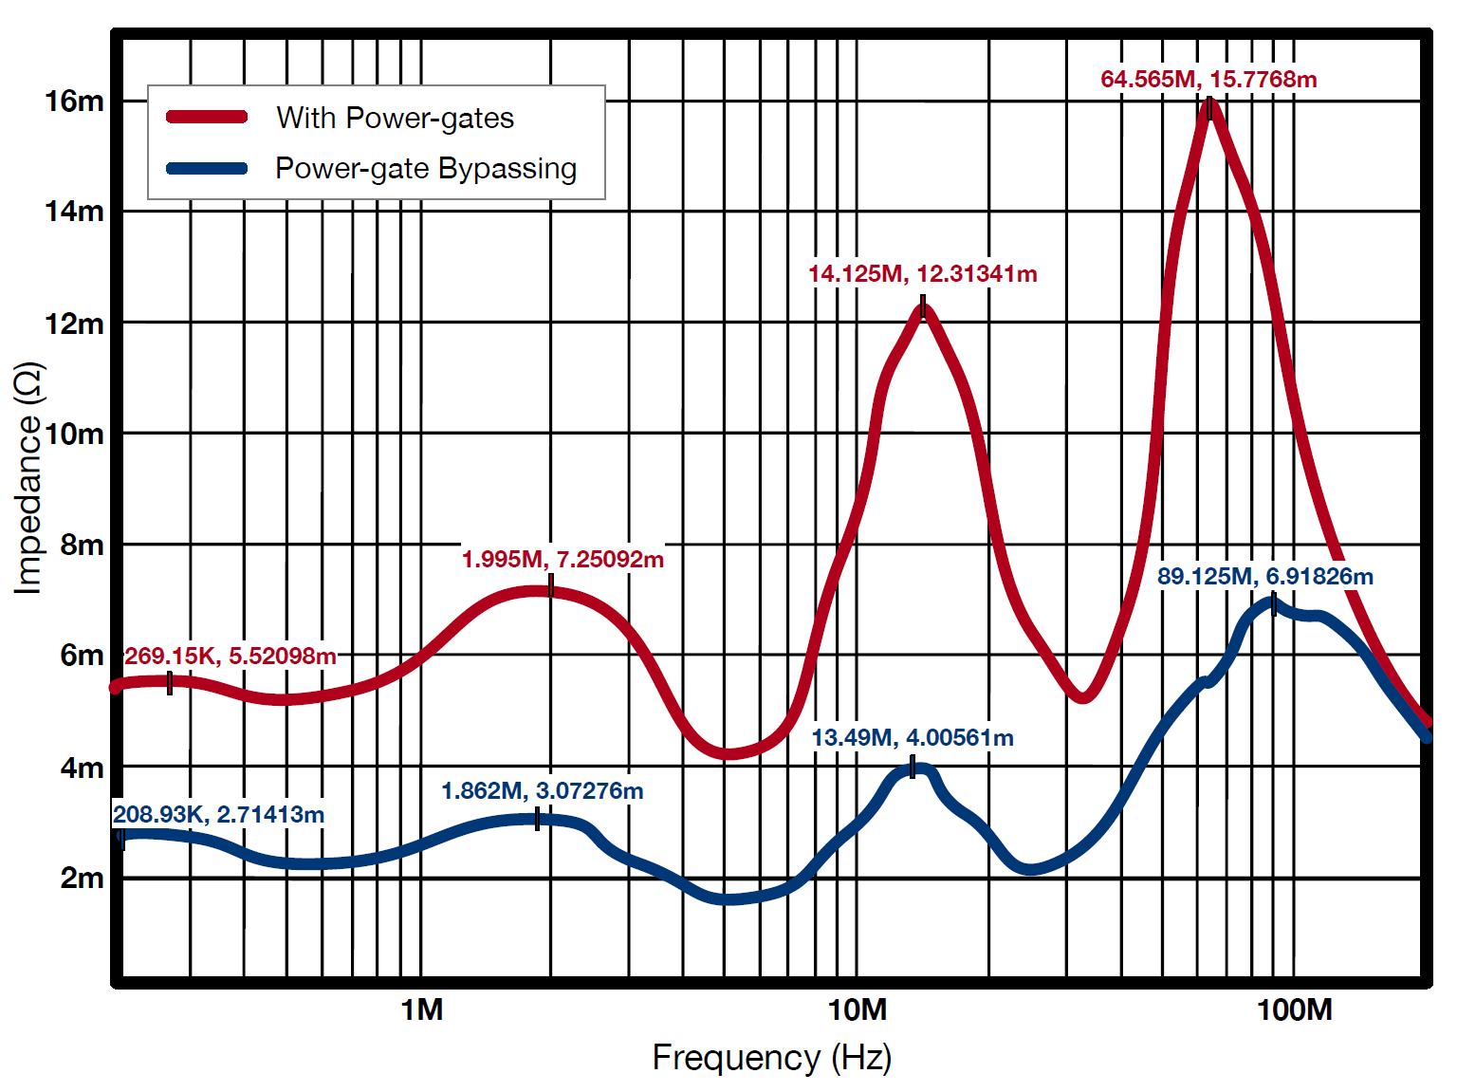
2. Voltage Guardband Impact of Power-gates Bypassing
We simulate the impedance-frequency profile of two Intel Skylake systems:
  Using power-gates (red)
  Bypassing the power-gates (blue)
The system that uses the power-gates has approximately 2× the impedance of a system that bypasses the power-gates
  A system that uses the power-gates requires approximately 2× the voltage guardband of a system that bypasses the power-gates
Notes:
We simulate the impedance-frequency profile of two Intel Skylake systems: [CLICK]
Using power-gates (red) [CLICK]
Bypassing the power-gates (blue) [CLICK]
The system that uses the power-gates has approximately 2× the impedance of a system that bypasses the power-gates [CLICK]
A system that uses the power-gates requires approximately 2× the voltage guardband of a system that bypasses the power-gates [END]

Slide 13
2. Voltage Guardband Impact of Power-gates Bypassing
We simulate the impedance-frequency profile of two Intel Skylake systems:
  Using power-gates (red)
  Bypassing the power-gates (blue)
The system that uses the power-gates has approximately 2× the impedance of a system that bypasses the power-gates
  A system that uses the power-gates requires approximately 2× the voltage guardband of a system that bypasses the power-gates
Bypassing the power-gates can reduce system impedance by ~2×,
which allows reducing the voltage guardband by ~ 2×
Notes:
We conclude that Bypassing the power-gates can reduce system impedance by ~2×,
which allows reducing the voltage guardband by ~ 2×

Slide 14
Our Goal
Based on our experimental analyses, we propose DarkGates, a hybrid system architecture that increases the performance of F_{max}-constrained systems while fulfilling their energy efficiency requirements
We design DarkGates with two design goals in mind:
  Reduce CPU cores’ power-delivery impedance to reduce voltage guardband, thereby improving the performance of high-end desktops
  Meet the energy efficiency requirements of desktop devices by enabling deeper package C-states
Notes:
Based on our experimental analyses, we propose DarkGates, a hybrid system architecture that increases the performance of F_{max}-constrained systems while fulfilling their energy efficiency requirements [CLICK]
We design DarkGates with two design goals in mind: [CLICK]
Reduce CPU cores’ power-delivery impedance to reduce voltage guardband, thereby improving the performance of high-end desktops [CLICK]
Meet the energy efficiency requirements of desktop devices by enabling deeper package C-states [END]

Slide 15
Presentation Outline
Overview of Client Processor Architecture
Motivation and Goal
DarkGates
  Power-gate Bypassing
  Improved Power Management Algorithms
  A New Package C-state for Desktops
Evaluation
Conclusion
Notes:
I will now present DarkGates [END]

Slide 16
DarkGates
We achieve DarkGates goals with three key components:
  A Power-gate Bypassing technique
  Improved power management firmware algorithms
  A new deep package C-state
Notes:
We achieve DarkGates goals with three key components: [CLICK]
A Power-gate Bypassing technique [CLICK]
Improved power management firmware algorithms [CLICK]
A new deep package C-state [END]

Slide 17
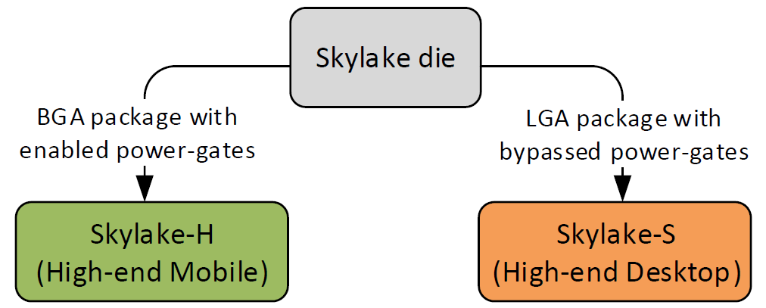
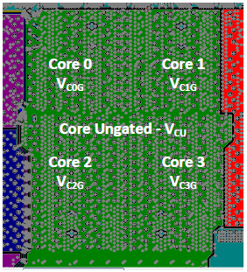
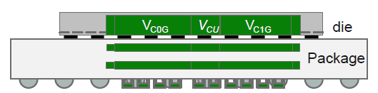
1. Power-gate Bypassing
Power-gate Bypassing technique is responsible for reducing CPU cores’ voltage drop in F_{max}-constrained systems by reducing system impedance
The technique uses the same Intel Skylake die to build:
  A dedicated package for Skylake-H (high-end mobile) with the power-gates enabled and
  A dedicated package for Skylake-S (high-end desktop) that bypasses the power-gates at the package level by shorting gated and un-gated CPU core power domains
This architecture is feasible since client processors typically share the same die between Skylake-H and Skylake-S
Notes:
Power-gate Bypassing technique is responsible for reducing CPU cores’ voltage drop in F_{max}-constrained systems by reducing system impedance [CLICK]
The technique uses the same Intel Skylake die to build: [CLICK]
A dedicated package for Skylake-H (high-end mobile) with the power-gates enabled and [CLICK]
A dedicated package for Skylake-S (high-end desktop) that bypasses the power-gates at the package level by shorting gated and un-gated CPU core power domains [CLICK]
This architecture is feasible since client processors typically share the same die between Skylake-H and Skylake-S [END]

Slide 18
2. Improved Power Management Algorithms
DarkGates architecture requires the adjustment of three main components of the power management unit:
  Adjustment of DVFS firmware power management algorithms (e.g., P-state, Turbo) to take into account the new V/F curves for the desktop system
  Adjustments of the power budget management algorithm (PBM) to take into account the additional power consumption due to the leakage of inactive cores
  Adjustment of the reliability voltage guardband since DarkGates can change the processor’s lifetime reliability due to powering-on cores more time compared to baseline
Notes:
DarkGates architecture requires the adjustment of three main components of the power management unit: [CLICK]
Adjustment of DVFS firmware power management algorithms (e.g., P-state, Turbo) to take into account the new V/F curves for the desktop system [CLICK]
Adjustments of the power budget management algorithm (PBM) to take into account the additional power consumption due to the leakage of inactive cores [CLICK]
Adjustment of the reliability voltage guardband since DarkGates can change the processor’s lifetime reliability due to powering-on cores more time compared to baseline [END]

Slide 19
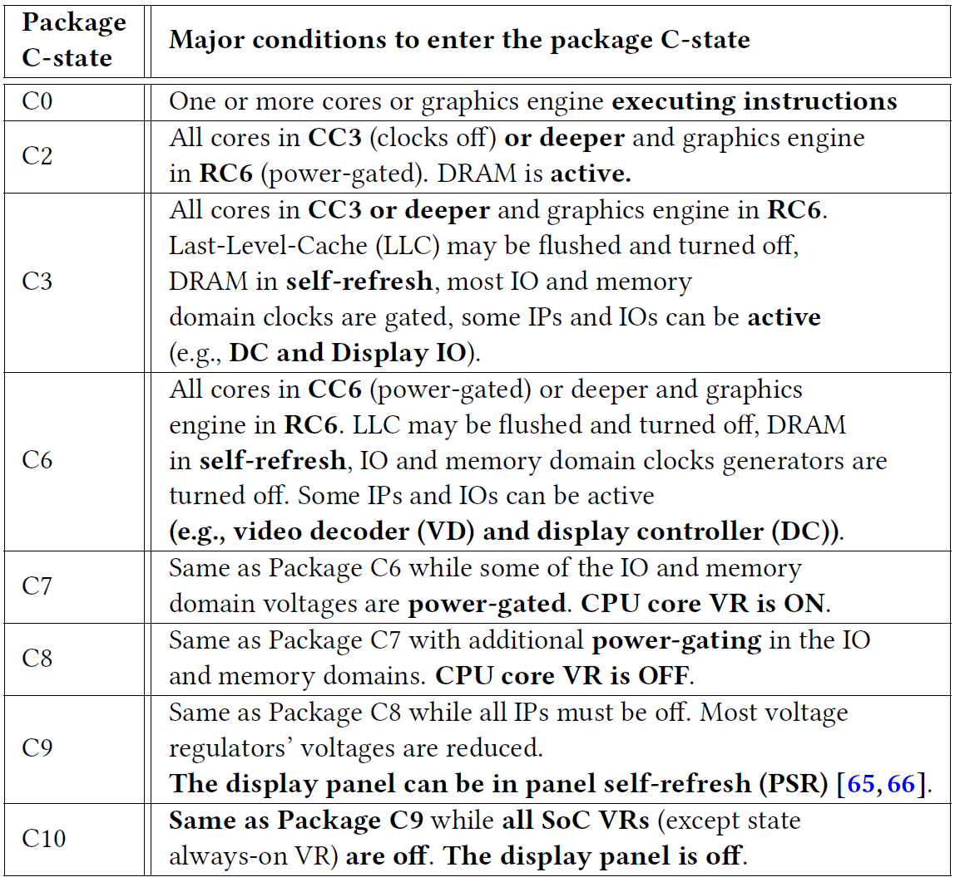
3. New Package C-state for Desktops
Intel desktop processors that are prior to Skylake (e.g., Haswell, Broadwell) support up to the package C7 state
Desktop’s energy efficiency benchmarks (ENERGY STAR & Intel Ready Mode Technology)
  Have large phases in which the processor is fully idle
  Their average power consumption needs can be met with package C7 state
The power consumption of package C7 is ~3× higher in DarkGates than in the baseline due to the additional cores leakage power
  Since the voltage regulator is turned on in package C7 state and the power-gates are bypassed
To mitigate this issue, we extend the desktop systems with the package C8 state
  A deeper package C-state in which the voltage regulator of the CPU cores is off
Notes:
Intel desktop processors that are prior to Skylake (e.g., Haswell, Broadwell) support up to the package C7 state [CLICK]
Desktop’s energy efficiency benchmarks (ENERGY STAR & Intel Ready Mode Technology)
Have large phases in which the processor is fully idle
Their average power consumption needs can be met with package C7 state [CLICK]
The power consumption of package C7 is ~3× higher in DarkGates than in the baseline due to the additional cores leakage power
Since the voltage regulator is turned on in package C7 state and the power-gates are bypassed [CLICK]
To mitigate this issue, we extend the desktop systems with the package C8 state
A deeper package C-state in which the voltage regulator of the CPU cores is off [END]

Slide 20
3. New Package C-state for Desktops
Intel desktop processors that are prior to Skylake (e.g., Haswell, Broadwell) support up to the package C7 state
Desktop’s energy efficiency benchmarks (ENERGY STAR & Intel Ready Mode Technology)
  Have large phases in which the processor is fully idle
  Their average power consumption needs can be met with package C7 state
The power consumption of package C7 is ~3× higher in DarkGates than in the baseline due to the additional cores leakage power
  Since the voltage regulator is turned on in package C7 state and the power-gates are bypassed
To mitigate this issue, we extend the desktop systems with the package C8 state
  A deeper package C-state in which the voltage regulator of the CPU cores is off
The new package C8 state reduces the CPU cores’ leakage power and saves even more power in the uncore compared to the package C7 state
Notes:
The new package C8 state reduces the CPU cores’ leakage power and saves even more power in the uncore compared to the package C7 state [END]

Slide 21
Other Details in the Paper
Implementation and hardware cost of:
  Different processor chips’ packages
  Power management flows in firmware
  A deeper package C-states
DarkGates tradeoffs and drawbacks
  Lifetime reliability effect
  Performance of power-limited processor scenarios
  Separate designs for different target segments
Notes:
There are other details in the paper, for example: [CLICK]
Implementation and hardware cost of:
Different processor chips’ packages
Power management flows in firmware
A deeper package C-states [CLICK]
DarkGates tradeoffs and drawbacks
Lifetime reliability effect
Performance of power-limited processor scenarios
Separate designs for different target segments [END]

Slide 22
Presentation Outline
Overview of Client Processor Architecture
Motivation and Goal
DarkGates
  Power-gate Bypassing
  Improved Power Management Algorithms
  A New Package C-state for Desktops
Evaluation
Conclusion
Notes:
I will now present DarkGates evaluation [END]

Slide 23
Methodology
Framework: We implement DarkGates on the Intel Skylake die that targets high-end desktop (Skylake-S) and high-end mobile (Skylake-H) processors
  For our baseline and DarkGates measurements, we use the Skylake-H (mobile) and Skylake-S (desktop), respectively
Configuring the Processor: We use Intel’s In-Target Probe (ITP) silicon debugger tool that connects to an Intel processor through the JTAG port
Power Measurements: We measure power consumption when running energy-efficiency benchmarks by using a National Instruments Data Acquisition (NI-DAQ) card
Workloads: We evaluate DarkGates with three classes of workloads
  SPEC CPU2006 benchmarks to evaluate CPU core performance
  3DMARK benchmarks to evaluate computer graphics performance
  ENERGY STAR and Ready Mode Technology (RMT) workloads to evaluate the effect of DarkGates on energy efficiency
Skylake-S
Skylake-H
Notes:
Framework: We implement DarkGates on the Intel Skylake die that targets high-end desktop (Skylake-S) and high-end mobile (Skylake-H) processors
For our baseline and DarkGates measurements, we use the Skylake-H (mobile) and Skylake-S (desktop), respectively [CLICK]
Configuring the Processor: We use Intel’s In-Target Probe (ITP) silicon debugger tool that connects to an Intel processor through the JTAG port [CLICK]
Power Measurements: We measure power consumption when running energy-efficiency benchmarks by using a National Instruments Data Acquisition (NI-DAQ) card [CLICK]
Workloads: We evaluate DarkGates with three classes of workloads
SPEC CPU2006 benchmarks to evaluate CPU core performance
3DMARK benchmarks to evaluate computer graphics performance
ENERGY STAR and Ready Mode Technology (RMT) workloads to evaluate the effect of DarkGates on energy efficiency [END]

Slide 24
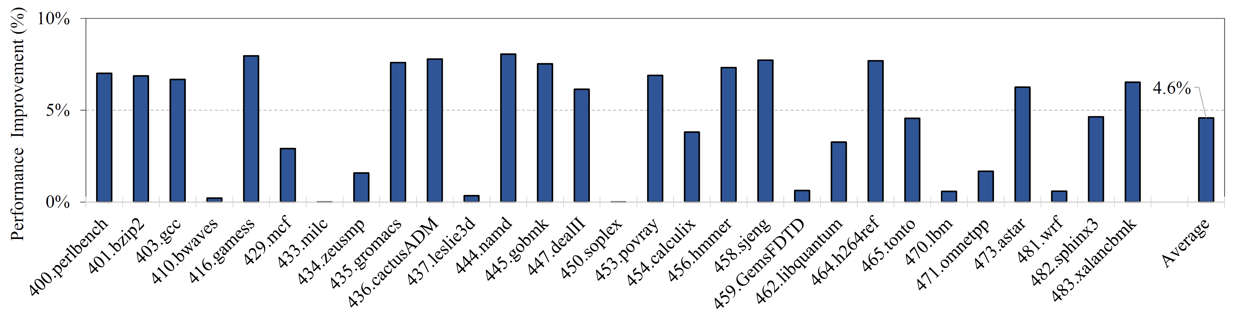
Evaluation of CPU Workloads
DarkGates improves real system performance by up to 8.1% (4.6% on average)
The performance benefit of DarkGates is positively correlated with the performance scalability of the running workload with CPU frequency
  Highly-scalable workloads (i.e., those bottlenecked by CPU core frequency, such as 416.games and 444.namd) experience the highest performance gains
  Workloads that are heavily bottlenecked by main memory, such as 410.bwaves and 433.milc, have almost no performance gain
Notes:
DarkGates improves real system performance by up to 8.1% (4.6% on average) [CLICK]
The performance benefit of DarkGates is positively correlated with the performance scalability of the running workload with CPU frequency [CLICK]
Highly-scalable workloads experience the highest performance gains
Workloads that are heavily bottlenecked by main memory, such as 410.bwaves and 433.milc, have almost no performance gain

Slide 25
Evaluation of CPU Workloads
DarkGates significantly improves CPU core performance by reducing the voltage guardband with Power-gate bypassing
Doing so improves the V/F curves and leads to higher CPU core frequency for both thermally-constrained and V_{max}-constrained systems
DarkGates improves real system performance by up to 8.1% (4.6% on average)
The performance benefit of DarkGates is positively correlated with the performance scalability of the running workload with CPU frequency
  Highly-scalable workloads (i.e., those bottlenecked by CPU core frequency, such as 416.games and 444.namd) experience the highest performance gains
  Workloads that are heavily bottlenecked by main memory, such as 410.bwaves and 433.milc, have almost no performance gain
Notes:
DarkGates significantly improves CPU core performance by reducing the voltage guardband with Power-gate bypassing
Doing so improves the V/F curves and leads to higher CPU core frequency for both thermally-constrained and V_{max}-constrained systems

Slide 26
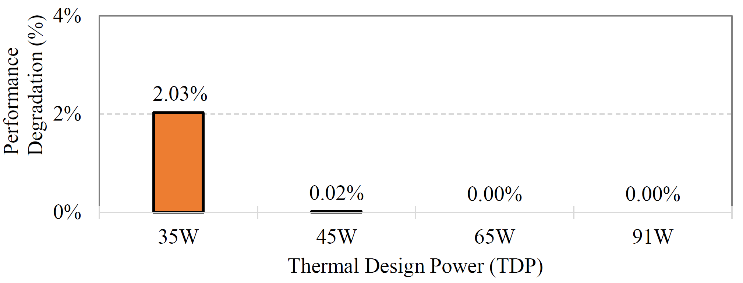
Evaluation of Graphics Workloads
DarkGates provides the same system performance for 3DMark for TDP levels ≥45W
  Since graphics workloads in these systems are not limited by thermal constraints
DarkGates leads to only 2% performance degradation for a TDP level of 35W
  The additional leakage power of the idle CPU cores forces the power budget management algorithm to reduce the frequency of the graphics engine to keep the system within the TDP limit
Notes:
DarkGates provides the same system performance for 3DMark for TDP levels equal or grater than 45W
Since graphics workloads in these systems are not limited by thermal constraints [CLICK]
DarkGates leads to only 2% performance degradation for a TDP level of 35W
The additional leakage power of the idle CPU cores forces the power budget management algorithm to reduce the frequency of the graphics engine to keep the system within the TDP limit [END]

Slide 27
Evaluation of Graphics Workloads
The reduced graphics engine power budget due to the additional leakage power of idle CPU cores can slightly degrade the performance of graphics workloads in thermally-limited systems
Not a main concern in many real systems that are not thermally-limited
DarkGates provides the same system performance for 3DMark for TDP levels ≥45W
  Since graphics workloads in these systems are not limited by thermal constraints
DarkGates leads to only 2% performance degradation for a TDP level of 35W
  The additional leakage power of the idle CPU cores forces the power budget management algorithm to reduce the frequency of the graphics engine to keep the system within the TDP limit
Notes:
The reduced graphics engine power budget due to the additional leakage power of idle CPU cores can slightly degrade the performance of graphics workloads in thermally-limited systems
Not a main concern in many real systems that are not thermally-limited

Slide 28
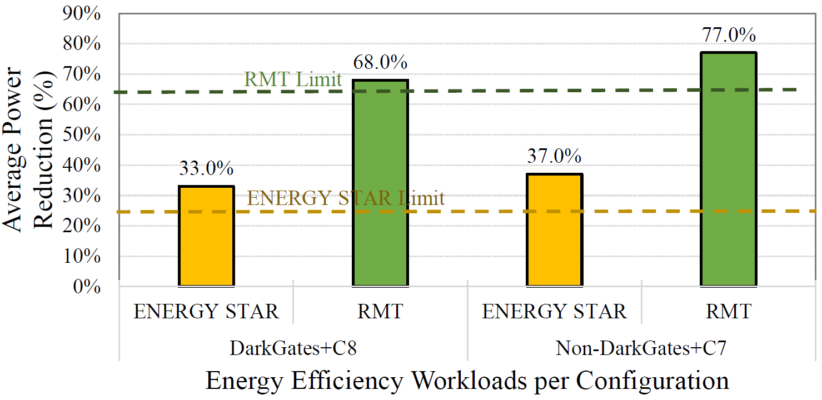
Evaluation of Energy Efficiency Workloads
DarkGates+C8
Non-DarkGates+C7
ENERGY STAR and Intel Ready Mode Technology (RMT) efficiency workloads have fixed performance requirements and include long idle phases
DarkGates system (DarkGates+C8) reduces the average power consumption of ENERGY STAR and RMT by 33% and 68%, respectively, on the real Intel Skylake-S system
  Compared to the baseline where we limit the deepest package C-state to C7 (DarkGates+C7)
The baseline system (DarkGates+C7) does not meet the target power limit for both workloads
The system without DarkGates at the deepest package C-state of C7 (Non-DarkGates+C7) shows higher power reduction verses the system with DarkGates at the deepest package C-state of C8 (DarkGates+C8)
  When some of the cores are idle they consume leakage power in DarkGates+C8, but they are power-gated in Non-DarkGates+C7
Notes:
ENERGY STAR and Intel Ready Mode Technology (RMT) efficiency workloads have fixed performance requirements and include long idle phases [CLICK]
DarkGates system reduces the average power consumption of ENERGY STAR and RMT by 33% and 68%, respectively, on the real Intel Skylake-S system
Compared to the baseline where we limit the deepest package C-state to C7 (DarkGates+C7) [CLICK]
The baseline system does not meet the target power limit for both workloads [CLICK]
The system without DarkGates at the deepest package C-state of C7 shows higher power reduction verses the system with DarkGates at the deepest package C-state of C8
When some of the cores are idle they consume leakage power in DarkGates+C8, but they are power-gated in Non-DarkGates+C7 [END]

Slide 29
Evaluation of Energy Efficiency Workloads
Applying DarkGates with package C8 state significantly reduces the average processor power consumption,
thereby meeting the target average power requirements of the energy efficiency standards
DarkGates+C8
Non-DarkGates+C7
ENERGY STAR and Intel Ready Mode Technology (RMT) efficiency workloads have fixed performance requirements and include long idle phases
DarkGates system (DarkGates+C8) reduces the average power consumption of ENERGY STAR and RMT by 33% and 68%, respectively, on the real Intel Skylake-S system
  Compared to the baseline where we limit the deepest package C-state to C7 (DarkGates+C7)
The baseline system (DarkGates+C7) does not meet the target power limit for both workloads
The system without DarkGates at the deepest package C-state of C7 (Non-DarkGates+C7) shows higher power reduction verses the system with DarkGates at the deepest package C-state of C8 (DarkGates+C8)
  When some of the cores are idle they consume leakage power DarkGates+C8, but they are power-gated in Non-DarkGates+C7
Notes:
Applying DarkGates with package C8 state significantly reduces the average processor power consumption,
thereby meeting the target average power requirements of the energy efficiency standards [END]

Slide 30
Presentation Outline
Overview of Client Processor Architecture
Motivation and Goal
DarkGates
  Power-gate Bypassing
  Improved Power Management Algorithms
  A New Package C-state for Desktops
Evaluation
Conclusion
Notes:
I will now conclude my talk [END]

Slide 31
Conclusion
Problem: power-gates increase the system's power-delivery impedance and voltage guardband, limiting the system’s maximum attainable voltage (i.e., V_{max}) and, thus, the CPU core’s maximum attainable frequency (i.e., F_{max})
Goal: mitigate the power-gates’ performance loss for systems that are performance constrained by the CPU frequency (i.e., Fmax-constrained), such as high-end desktops
Mechanism: DarkGates, hybrid system architecture that is based on three key techniques
Bypasses on-chip power-gates using package-level resources (called bypass mode)
Extends power management firmware to support operation in bypass- and normal-mode
Enables deeper idle power states
Evaluation: we implement DarkGates on the Intel Skylake microprocessor for client devices and evaluate it using a wide variety of workloads, DarkGates:
  Improves the average performance of SPEC CPU2006 workloads across all thermal design power (TDP) levels (35W–91W) by 4.2%-5.3% on a real 4-core Skylake system
  Maintains the performance of 3DMark workloads for desktop systems with TDP greater than 45W. For a 35W-TDP (the lowest TDP) desktop it experiences only a 2% degradation
  Dark-Gates fulfills the requirements of the ENERGY STAR and the Intel Ready Mode energy efficiency benchmarks of desktop systems
  Conclusion: DarkGates is an effective approach to improving energy consumption and performance demands across high-end heterogeneous client processors
Notes:
Power-gates increase the system's power-delivery impedance and voltage guardband, limiting the system’s maximum attainable voltage and, thus, the CPU core’s maximum attainable frequency [CLICK]
Our goal is to mitigate the power-gates’ performance loss for systems that are performance constrained by the CPU frequency, such as high-end desktops [CLICK]
To this end we introduce DarkGates, a hybrid system architecture that is based on three key techniques [CLICK]
DarkGates Bypasses on-chip power-gates using package-level resources [CLICK]
Extends power management firmware to support operation in bypass- and normal-mode [CLICK]
Enables deeper idle power states [CLICK]
We implement DarkGates on the Intel Skylake microprocessor for client devices and evaluate it using a wide variety of workloads: [CLICK]
DarkGates Improves the average performance of SPEC CPU2006 workloads across all thermal design power levels by 4.2% to 5.3% on a real four-core Skylake system [CLICK]
Maintains the performance of 3DMark workloads for desktop systems with TDP greater than 45W. For a 35W-TDP desktop it experiences only a 2% degradation [CLICK]
Dark-Gates fulfills the requirements of the ENERGY STAR and the Intel Ready Mode energy efficiency benchmarks of desktop systems [CLICK]
We Conclude that DarkGates is an effective approach to improving energy consumption and performance demands across high-end heterogeneous client processors [END]

Slide 32
DarkGates
A Hybrid Power-Gating Architecture to Mitigate the Performance Impact of Dark-Silicon
in High Performance Processors
Jawad Haj-Yahya
Jeremie S. Kim A. Giray Yağlıkçı Jisung Park
Efraim Rotem Yanos Sazeides Onur Mutlu
Notes:
Thanks for your attention, for more details please read our HPCA 2022 paper [END]

