Slide 1



ECI-Cache: A High-Endurance and Cost-Efficient I/O Caching Scheme for Virtualized Platforms
Saba Ahmadian^{1,2}, Onur Mutlu^{3,4}, Hossein Asadi^{1,2}
1
2
3
4
Presenter: Saugata Ghose (Carnegie Mellon University)

Slide 2
Introduction: Performance Gap Between CPUs and I/O Devices
Data centers run an increasing number of
data-intensive applications
  Facebook in 2014: 600TB data per day
Magnetic hard drive (HDD) latency not improving
Storage subsystem → performance bottleneck
IMCSummit 2015 - Day 1 Developer Track - Evolution of non-volatile memory express; IBM, FAST 2010

Slide 3
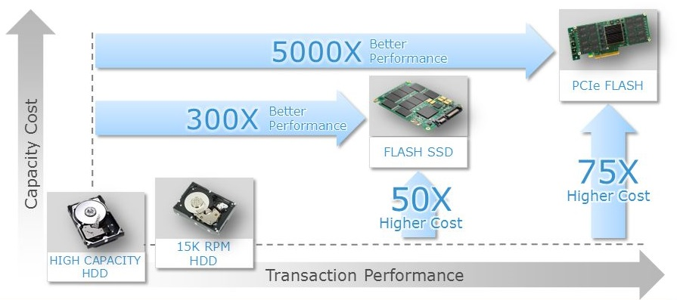
Trade-offs in Modern Storage Devices
EMC Corp., 2013
Magnetic HDDs:
Low Performance, Low Cost, Larger Capacity
Solid-State Drives (SSDs):
High Performance, High Cost, Smaller Capacity
Writes Slower than Reads, Limited Endurance

Slide 4
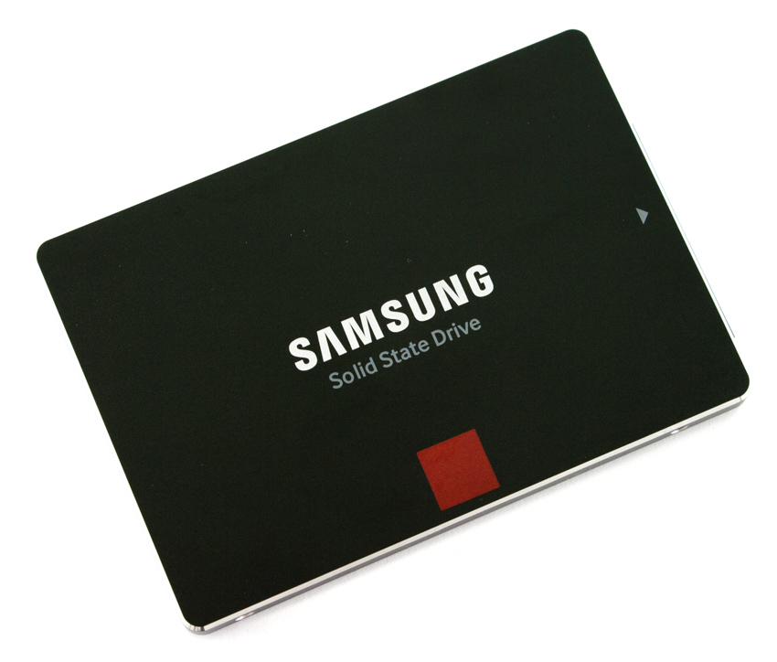
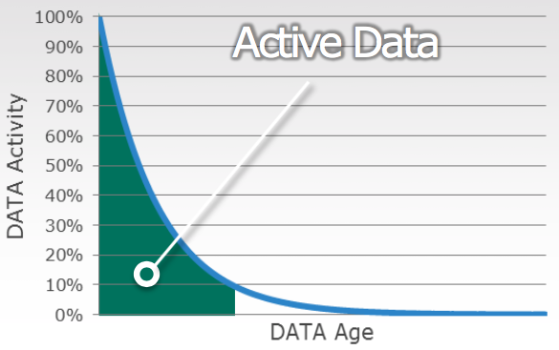
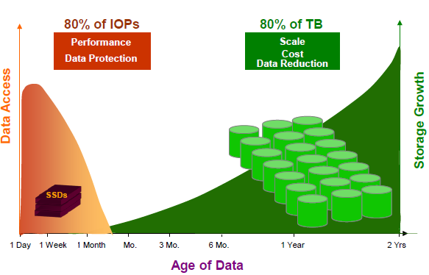
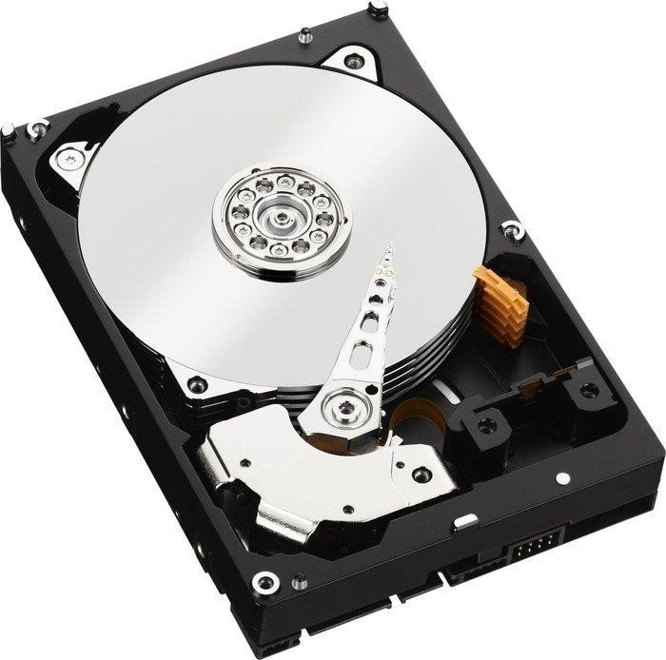
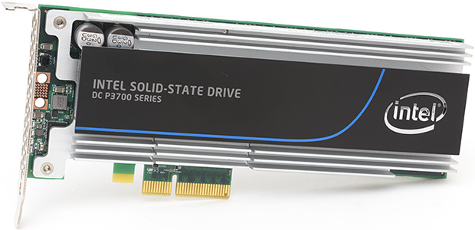
Hybrid Storage Systems:
Combine HDDs and SSDs for Best of Both Worlds
Data is Highly Skewed
At Any Given Time, Only a Small Percentage of Data is Active
Cache Hot (Active) Data on
High-Performance SSD
Store All Other Data in
Low Cost HDD
HOT
SSD
COLD
HDD
How much of the SSD cache should we allocate
to each application in a data center machine?

Slide 5
Calculating SSD Cache Size
Today: use reuse distance to determine
how much cache to allocate to each VM
  Time between two accesses to the same block
  Achieves a balance between allocated cache size and cache hit rate
  Used by state-of-the-art I/O cache managers
Challenge: SSD write behavior
  Much slower than reads
  More writes decrease the SSD lifetime

Slide 6
Traditional Reuse Distance (TRD)
Access
# of reqs
RD 0: 2
RD 2: 2
RD 3: 1
RD 7: 1
n
Reuse Distance (RD) n
W
W
A3
7
Address
W
R
A2
3
R
R
A1
2
W
R
W
W
A0
2
0
0
Time

Slide 7
The Problem with Reuse Distance
Write requests do not fall on the critical path
In SSDs, read requests (on the critical path)
can be delayed by long-latency write requests
TRD does not consider the request type
  Write After Write (WAW)
  first write not used, but incurs latency/endurance cost
  Write After Read (WAR)
  unclear if newly-written data will be reused later
  Read After Read (RAR)/Read After Write (RAW)
  data is needed by the application → useful
W
W
2
New Metric: Useful Reuse Distance
Consider only requests that we know will be reused

Slide 8
Useful Reuse Distance (URD)
# of reqs
RD 0: 2
RD 2: 2
RD 3: 1
RD 7: 1
Access
# of reqs
1 RD 0: 2 1
1 RD 2: 2 1
RD 3: 1
0 RD 7: 1 0
n
Reuse Distance (RD) n
W
W
A3
7
Address
W
R
A2
3
R
R
A1
2
W
R
W
W
A0
2
0
0
Time

Slide 9
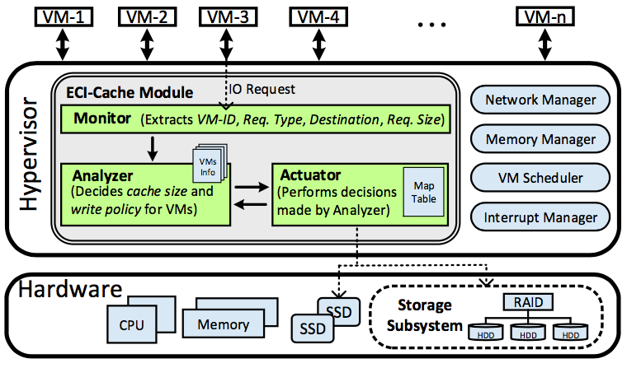
ECI-Cache
High-Endurance, Cost-Efficient I/O Cache
Hypervisor-based SSD cache manager
Implemented as a working QEMU module
Allocates per-VM
cache space
dynamically
using URD
Assigns per-VM
write policies
adaptively

Slide 10
ECI-Cache Management
For each VM
  Collect storage traces from prior interval
  Calculate fraction of reuse for each type: RAR, RAW, WAR, WAW
  Determine write policy
    If WAW + WAR > threshold, disable cache writes
    Otherwise, cache uses writebacks
  Calculate Useful Reuse Distance
Adjust cache sizes (see the paper)
Assign policies

Slide 11
Evaluation: Experimental Setup
All experiments run on a real platform
  HP Proliant DL380 Gen. 5, 8 Xeon CPUs, 16GB RAM
  4x HDD: 146GB SAS 10K HP → RAID5 (3+1)
  SSD: 128GB SATA Samsung 850 Pro
QEMU Hypervisor on Centos 7 (Kernel: 3.10.0-327)
  16 running VMs (OS: Ubuntu 15.04 and Centos 7)
  Applications: MSR traces from SNIA
Compare ECI-Cache to Centaur [Koller+ ICAC ’15], best prior I/O cache manager

Slide 12
Experiments:
Performance-Per-Cost Improvement
ECI-Cache improves perf-per-cost by more than 30%
Much smaller cache space allocation by ECI-Cache
Higher hit rate for ECI-Cache

Slide 13
Experiments:
Performance Improvement
ECI-Cache improves performance by 17%

Slide 14
Experiments:
Endurance (Lifetime) Improvement
ECI-Cache improves SSD lifetime by 65%

Slide 15
Conclusion
I/O is a performance bottleneck in virtualized platforms
Improve I/O performance using an SSD cache
SSD writes introduce long latencies, lower endurance
URD: Useful Reuse Distance
New metric: count reuse only when next access is read
ECI-Cache: Hypervisor-based I/O cache
- Per-VM URD-based cache sizing
- Per-VM write policy
Results on real system → Improved Performance (17%),
Performance-per-Cost (30%), and Endurance (65%)

Slide 16
ECI-Cache: A High-Endurance and Cost-Efficient I/O Caching Scheme for Virtualized Platforms
Saba Ahmadian^{1,2}, Onur Mutlu^{3,4}, Hossein Asadi^{1,2}
1
2
3
4
Presenter: Saugata Ghose (Carnegie Mellon University)

Slide 17
Backup Slides

Slide 18
Challenge for Hybrid Storage:
Closing the Performance Gap
Data is Highly Skewed
At Any Given Time, Only a Small Percentage of Data is Active
Active Data on
High Performance SSD
Hot Data
Cold Data
ACTIVE
Inactive Data on
Low Cost HDD
SSD
INACTIVE
HDD
Small Size Hot Data → SSD
Large Size Cold Data → HDD
EMC Corp., 2015.
IMEX Research Cloud Infrastructure Report 2009-2011.

Slide 19


Previous Cache Size Estimation Approaches
Reuse Intensity
  Mostly capable for CPU caches
WSS (Working Set Size)
  Doesn’t measure data reuse
  Indicates required space for acceptable performance
Reuse Distance Based
  Trade-off between allocated size and miss ratio
  Miss Ratio Curves (MRCs)
    Miss ratio as a function of cache size → Predict future Perf.
  Locality
    Spatial
    Temporal (in selected time intervals)
Compared to Previous Approaches, Reuse Distance Based Provides Most Effective Cache Size Estimation
Existing Reuse Distance Calculation Approaches Not Consider Request Type
Our Goal: Propose a Novel Reuse Distance Calculation Scheme that Considers: 1) Distance and 2) Type of Requests

Slide 20
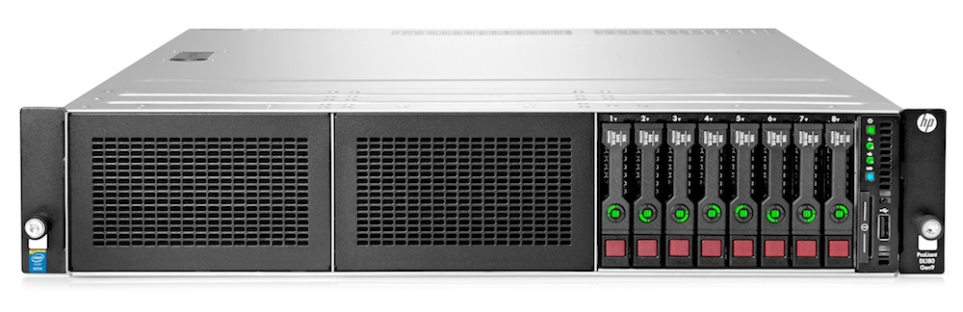
Introduction: Why Virtualization?
High Resource Utilization ☺
  Delivering high performance for each VM
Providing System Isolation ☺
  Each VM limited to its own resources
Providing Abstraction ☺
  Dynamically adjustable
    Storage
    Network
    Computing Resources
XEN
VMWare ESX
QEMU
VirtualBox
Hypervisor
Available in: http://www.arumtec.net/fr/outils-virtualisation/outils-de-virtualisation/vmware-esxi-5/presentation-de-vmware-esxi-5, Accessed: Oct, 2015.

Slide 21
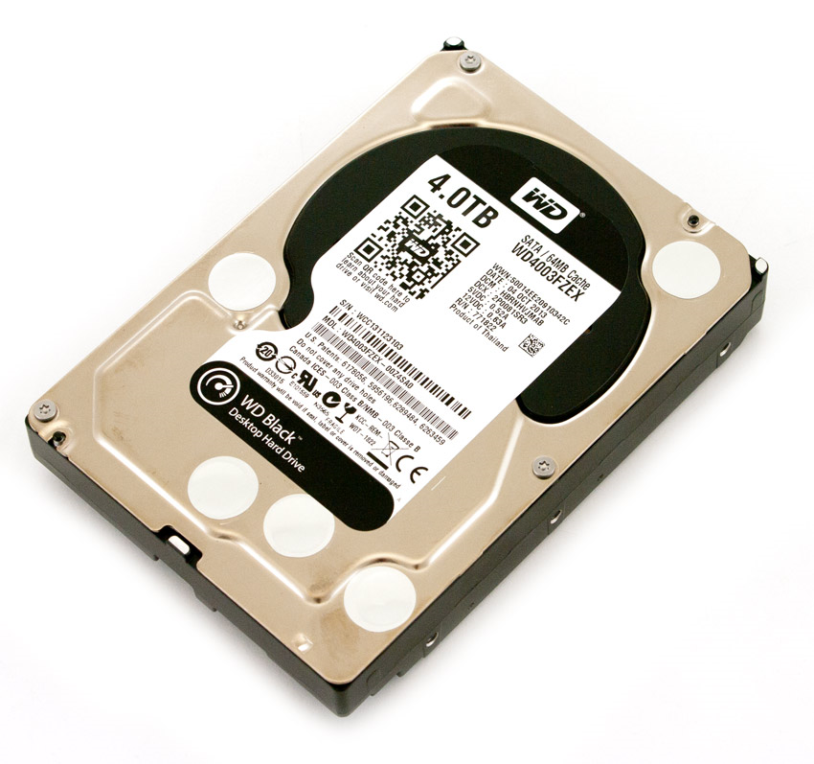
Motivation: HDDs vs. SSDs
Slow (180 MB/s, IOPS: 140) ☹
Power Hungry (Active: 9w, Idle: 8w) ☹
Heavy (780g) ☹
Noisy ☹
MTBF < 1 Mh ☹
Inexpensive (0.06 $/G) ☺
Unlimited Writes ☺
Fast (550 MB/s, IOPS > 50K) ☺
Low Power (Active: 3w, Idle: 60mw) ☺
Light (66g) ☺
Very Low Noise ☺
MTBF: 2 Mh ☺
Expensive (0.1 $/G) ☹
Limited Writes ☹
WD Black SATA HDD (4TB)
Samsung 850 PRO SATA SSD (2TB)
http://www.storagereview.com/, Accessed: Oct, 2015
Notes:
Enterprise SSD vs. Enterprise HDD
Storagereviewcom
Hitachi

Slide 22
Challenge for Hybrid Storages:
IO Caching
Active Data on
High Performance SSD
Balance Workload
Handle IO Bursts
ACTIVE
SSD
INACTIVE
HDD
Hot Data
Inactive Data on
Low Cost HDD
Cold Data

Slide 23

How URD based cache works? (cont.)
Example#3 (URD):
Access
Hit
1
2
3
5
6
Write 1
Write 2
Read 1
Read 3
Read 5
Read 6
Read 2
Max. URD = 4
Cache Size = 5blk
1
RD(WA*) < RD(RA*) → TRD 𝜶 RD(RA*), URD 𝜶 RD(RA*) ➔ TRD = URD
RD(WA*) > RD(RA*) → TRD 𝜶 RD(WA*), URD 𝜶 RD(RA*) ➔ TRD > URD
2

Slide 24
Architecture of ECI-Cache
Resides in Path of VMs IO Requests
As a Module of Hypervisor Kernel
Full Control on VMs IO Requests
Monitor
  Extracts IO traces
  Device block layer
  blktrace
Analyzer
  Estimates size (URD)
  Assigns write policy
Actuator
  Performs configs.

Slide 25
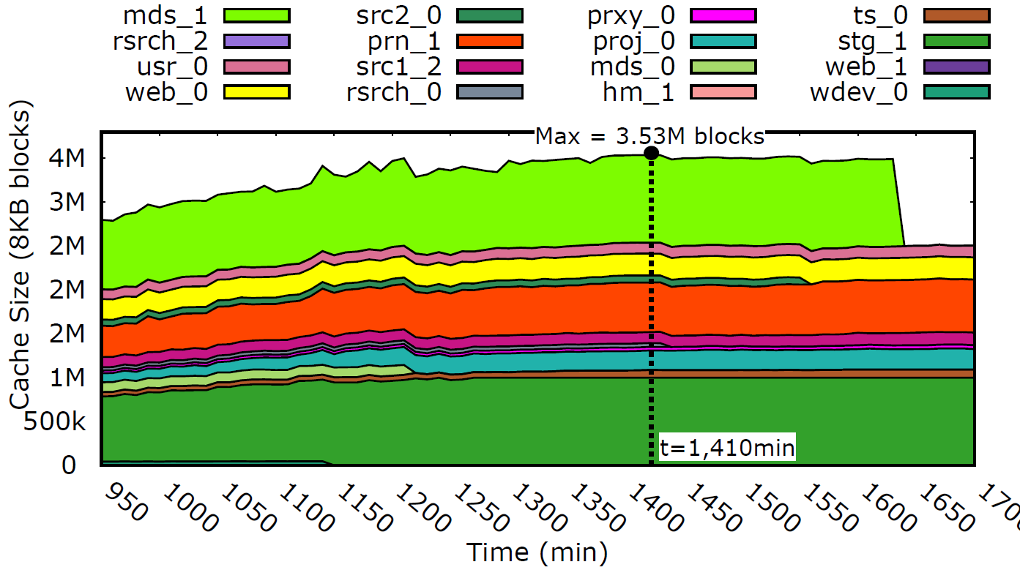
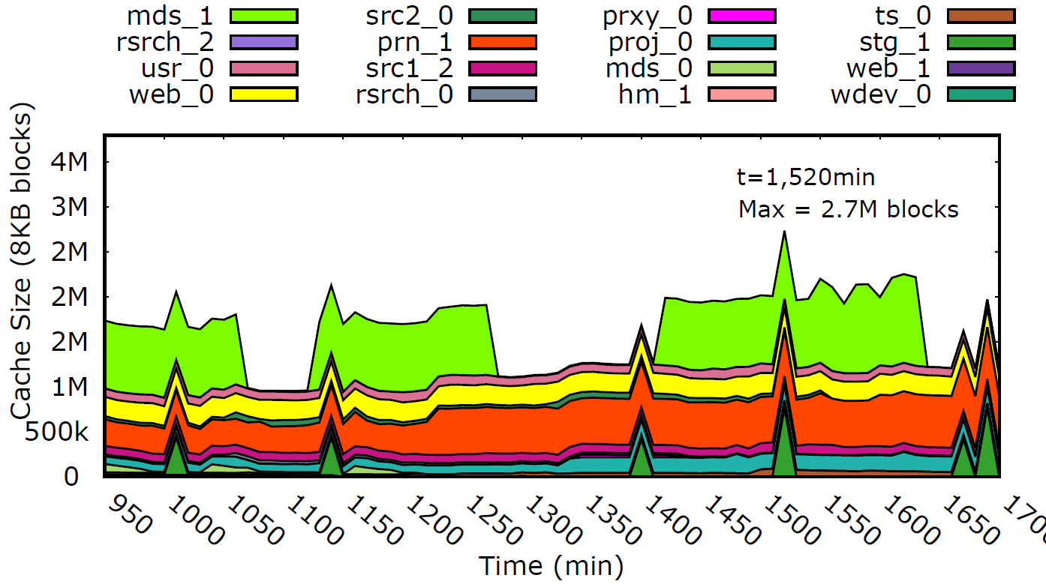
Experiments: Cache Allocation (Unlimited SSD Space)
Cache Allocation for VMs by Centaur (TRD)
Cache Allocation for VMs by ECI-Cache (URD)
Much Smaller Cache Space Allocation by ECI-Cache
Similar Hit Ratio by ECI-Cache
ECI-Cache Improves Perf-Per-Cost by 30%

Slide 26
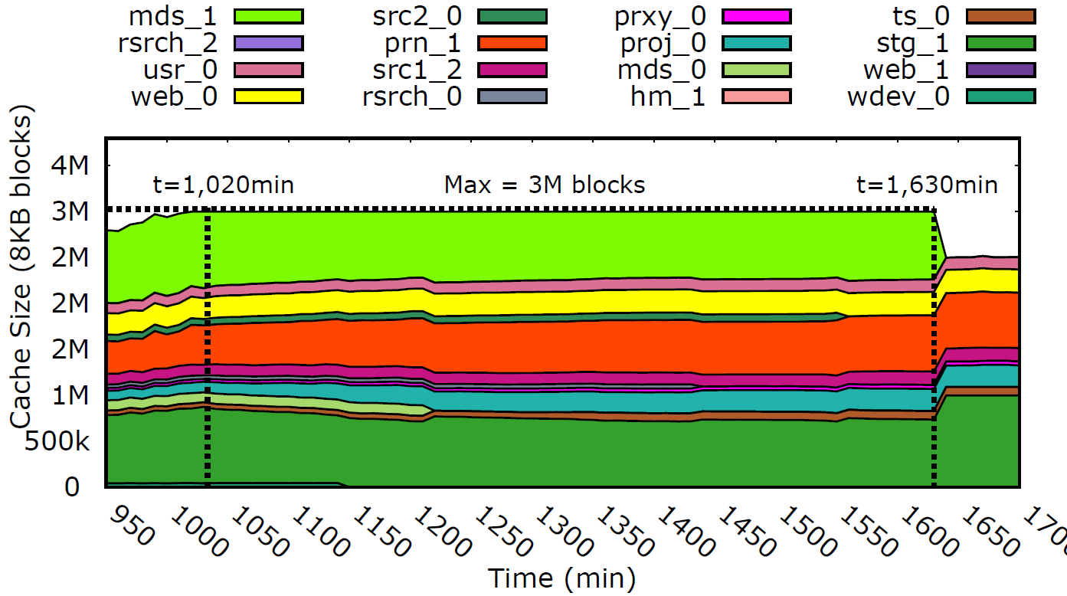
Experiments: Cache Allocation (Limited SSD Space → Infeasible)
Cache Allocation for VMs by Centaur (TRD)
Cache Allocation for VMs by ECI-Cache (URD)
Much Smaller Cache Space Allocation by ECI-Cache
Higher Hit Ratio by ECI-Cache
ECI-Cache Improves Perf-Per-Cost by More than 30%
ECI-Cache Improves Performance by 17%

Slide 27
Alternatives For SSD Caching
(cont.)
VM-Based SSD Caching
  VM has best knowledge and full control of Cache ☺
  Isolation ☺
  Guest OS should modify and create cache ☹
  Cache size not dynamically adjustable ☹
VM1
VM2
VMn
SSD
SSD
SSD
Hypervisor
HDD
HDD
HDD

Slide 28
Alternatives For SSD Caching (cont.)
Storage System-Level
SSD Caching
    Easy to use ☺
    Not transparent for VMs ☹
    Performance management cannot be guaranteed ☹
VM1
VM2
VMn
Hypervisor
SSD
HDD
HDD
HDD

Slide 29
Alternatives For SSD Caching
(cont.)
Hypervisor-Based
SSD Caching
    Transparent for VMs ☺
    Hypervisor full control ☺
    Hypervisor is aware of VMs workload ☺
VM1
VM2
VMn
Hypervisor
SSD
HDD
HDD
HDD

Slide 30
Previous Work: S-CAVE
Hypervisor-Based SSD Cache
Granularity: Fixed-Sized
Policy: Write Through
Dynamic Size Management
Estimate Cache Demand For Each VM:
  Working Set Size (WSS)
Luo, Tian, et al. "S-cave: Effective ssd caching to improve virtual machine storage performance." Proceedings of the 22nd international conference on Parallel Architectures and Compilation Techniques (PACT), 2013.

Slide 31
Executive Summary
Problem → I/O considered a performance bottleneck in virtualized platforms
Our goal → Improve I/O performance of virtualized platforms using an SSD cache
Key observations → 1) Impact of cache write policy on performance and SSD endurance,
2) Impact of request type on reuse distance
Key idea → URD: Useful Reuse Distance → Include the request type in reuse distance calculation
ECI-Cache → Hypervisor-based I/O cache → Per-VM URD-based cache size and effective write policy
Key results → Improved Performance (17%), Perf.-per-Cost (30%), and Endurance (65%)

Slide 32
Outline
Executive Summary
Motivation
Background
URD: Useful Reuse Distance
ECI-Cache: High Endurance & Cost Efficient I/O Cache
  Cache Size Estimation
  Cache Policy Assignment
Conclusion

Slide 33
Introduction
Virtual machines are widely used today in
data centers and cloud computing platforms
Virtual
Machine
Data Center Virtualization Market:
8% growth between 2017 and 2023 →$10 Billion by 2023
https://www.marketresearchfuture.com/reports/data-center-virtualization-market-3207, Accessed: July, 2017.

Slide 34
Outline
Executive Summary
Motivation
Background
URD: Useful Reuse Distance
ECI-Cache: High Endurance & Cost Efficient I/O Cache
  Cache Size Estimation
  Cache Policy Assignment
Conclusion

Slide 35
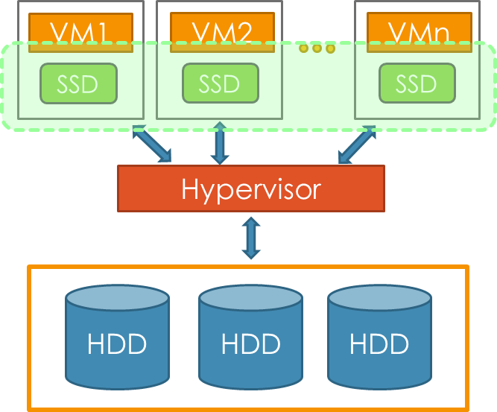
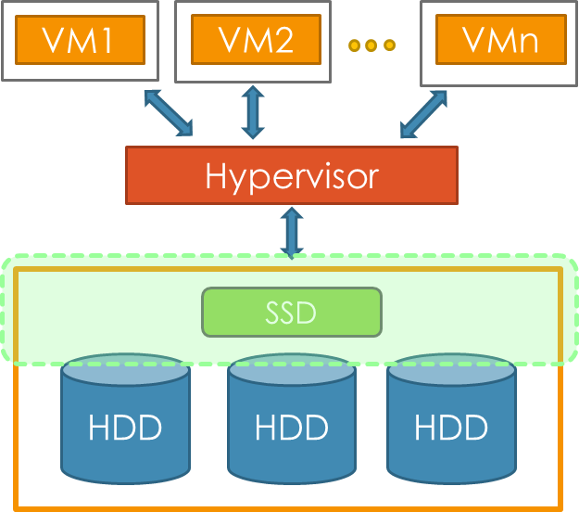
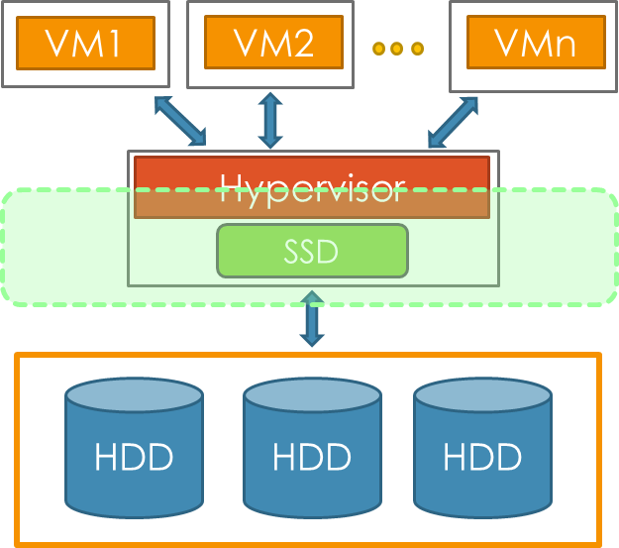
Managing Storage Caches in Data Centers
1
2
3
Storage System-Level
Hypervisor
Based
VM-Based
Hypervisor-Based SSD Cache Performs Efficient Cache Management and Space Partitioning
  VM has full control of cache ☺
  Isolation ☺
  Size not dynamically adjustable ☹
  Easy to use ☺
  Isolation ☺
  Not transparent for VMs ☹
  No performance management ☹
  Transparent for VMs ☺
  Hypervisor full control ☺
  Hypervisor is aware of VMs workload ☺

Slide 36
Previous Cache Size Estimation Approaches
Reuse Intensity
  Mostly capable for CPU caches
WSS (Working Set Size)
  Doesn’t measure data reuse
  Indicates required space for acceptable performance
Reuse Distance Based
  Trade-off between allocated size and miss ratio
  Miss Ratio Curves (MRCs)
    Miss ratio as a function of cache size → Predict future Perf.
  Locality
    Spatial
    Temporal (in selected time intervals)

Slide 37
Outline
Executive Summary
Motivation
Background
URD: Useful Reuse Distance
ECI-Cache: High Endurance & Cost Efficient I/O Cache
  Cache Size Estimation
  Cache Policy Assignment
Conclusion

Slide 38


I/O Classification
Read
Read
Write
WAR
RAR
Next
OP.
1 SSD Write + Perf. (HR) ↑
2 SSD Write + Perf. (HR) -
Write
Read
Write
WAW
RAW
Next
OP.
1 SSD Write + Perf. (HR) ↑
2 SSD Write + Perf. (HR) -

Slide 39
Useful Reuse Distance (URD)(Cont.)
Key idea: Only Considers RAR and RAW
Cache size estimation based on URD
  Key result#1: Much smaller size
  Key result#2: Never evicts referenced data from cache
  Key result#3: Improve performance and perf.-per-cost
Written data in cache by:
Read miss or
Write
Will be accessed by a READ request in future!

Slide 40
Using URD in a Cache
Example#1 (TRD):
1
2
3
5
6
Write 1
Write 2
Read 1
Read 3
Read 5
Read 6
Write 2
Max. RD = 4
Access
Hit
Cache Size = 5blk
1
Example#2 (URD):
RD(WA*) < RD(RA*) → TRD 𝜶 RD(RA*), URD 𝜶 RD(RA*) ➔ TRD = URD
RD(WA*) > RD(RA*) → TRD 𝜶 RD(WA*), URD 𝜶 RD(RA*) ➔ TRD > URD
1
1
2
Write 1
Write 2
Read 1
Read 3
Read 5
Read 6
Write 2
Max. URD = 1
2
1 5
2 3
Cache Size = 2blk
5 2
3 6
2
3

Slide 41
Outline
Executive Summary
Motivation
Background
URD: Useful Reuse Distance
ECI-Cache: High Endurance & Cost Efficient I/O Cache
  Cache Size Estimation
  Cache Policy Assignment
Conclusion

Slide 42
Outline
Executive Summary
Motivation
Background
URD: Useful Reuse Distance
ECI-Cache: High Endurance & Cost Efficient I/O Cache
  Cache Size Estimation
  Cache Policy Assignment
Conclusion

Slide 43
Cache Size and Policy Assignment
at intervals of Δt

Slide 44
Outline
Executive Summary
Motivation
Background
URD: Useful Reuse Distance
ECI-Cache: High Endurance & Cost Efficient I/O Cache
  Cache Size Estimation
  Cache Policy Assignment
Conclusion

Slide 45
Summary and Conclusion
Problem → I/O considered as performance bottleneck in virtualized platforms
Our goal → Improve I/O performance of virtualized platforms via SSD cache
Key observations → 1) Impact of cache write policy on performance and SSD endurance,
2) Impact of request type on reuse distance
Key idea → URD: Useful Reuse Distance → Considering request type in reuse distance calculation
ECI-Cache → Hypervisor based I/O cache → Per-VM URD-based cache size and effective write policy
Key results → Enhanced Performance (17%), Perf.-per-Cost (30%), and Endurance (65%)

Slide 46
Previous Work: vCacheShare
Hypervisor-Based SSD Cache
Granularity: Fixed-Sized
Policy: Write Around (RO)
Dynamic Cache Size Management
Estimate Cache Demand for each VM:
  Cache Utility
    CU = l × RR × (H(c) + αRI)
Meng, Fei, et al. "vCacheShare: automated server flash cache
space management in a virtualization environment.“
USENIX ATC. 2014.

Slide 47
Previous Work: Centaur
Hypervisor-Based SSD Cache
Granularity: Fixed-Sized
Policy: Write Back
Dynamic Cache Size Management
Estimate Cache Demand for each VM:
  Reuse Distance (RD)
  MRCs

Slide 48
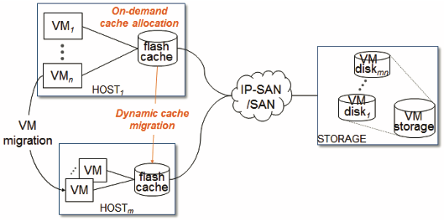
Previous Work: CloudCache
Hypervisor-Based SSD Cache
Policy: Write Back
VMs Migration
  Performance
  Endurance
Estimate Cache Demand for each VM:
  Reuse Working Set Size (RWSS)
    Temporal Locality
Arteaga, Dulcardo, et al. "CloudCache: On-demand Flash Cache Management for Cloud Computing." FAST. 2016.

Slide 49
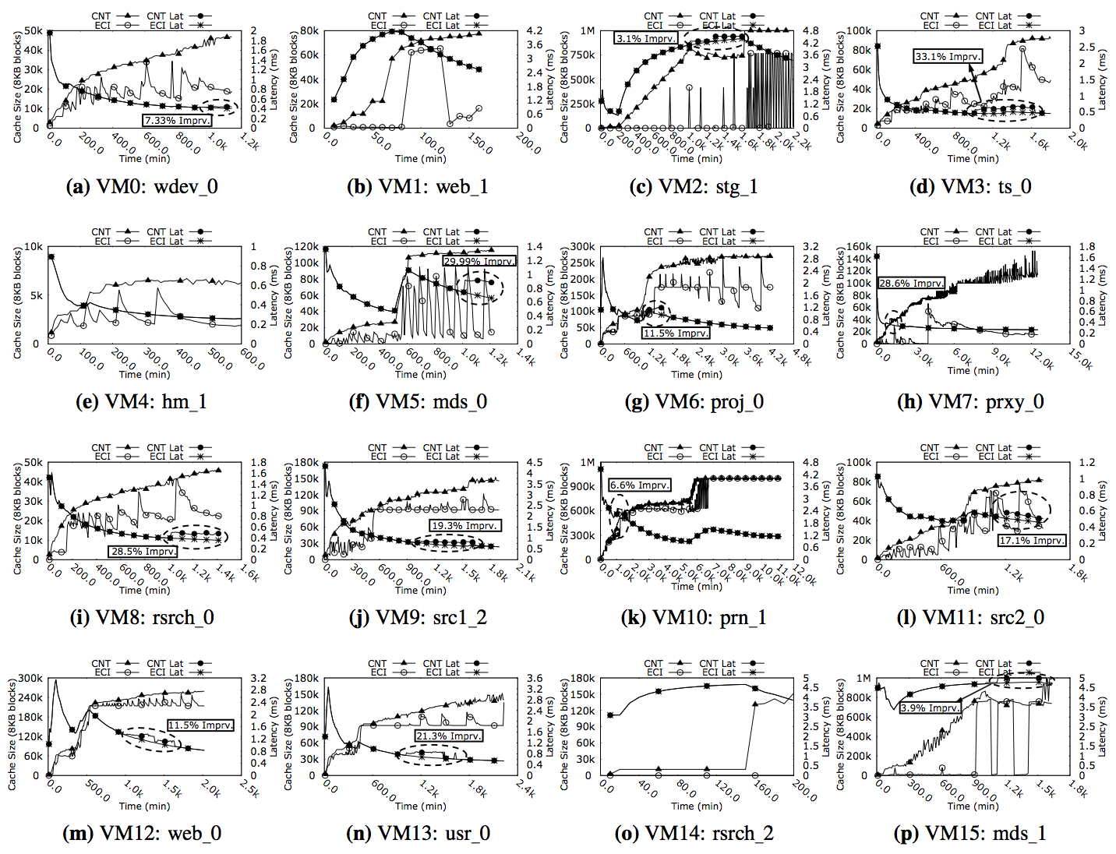
Latency Improvement

Slide 50
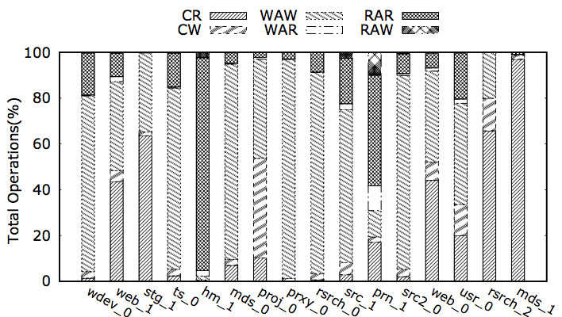
Operations on VMs Workload

Slide 51
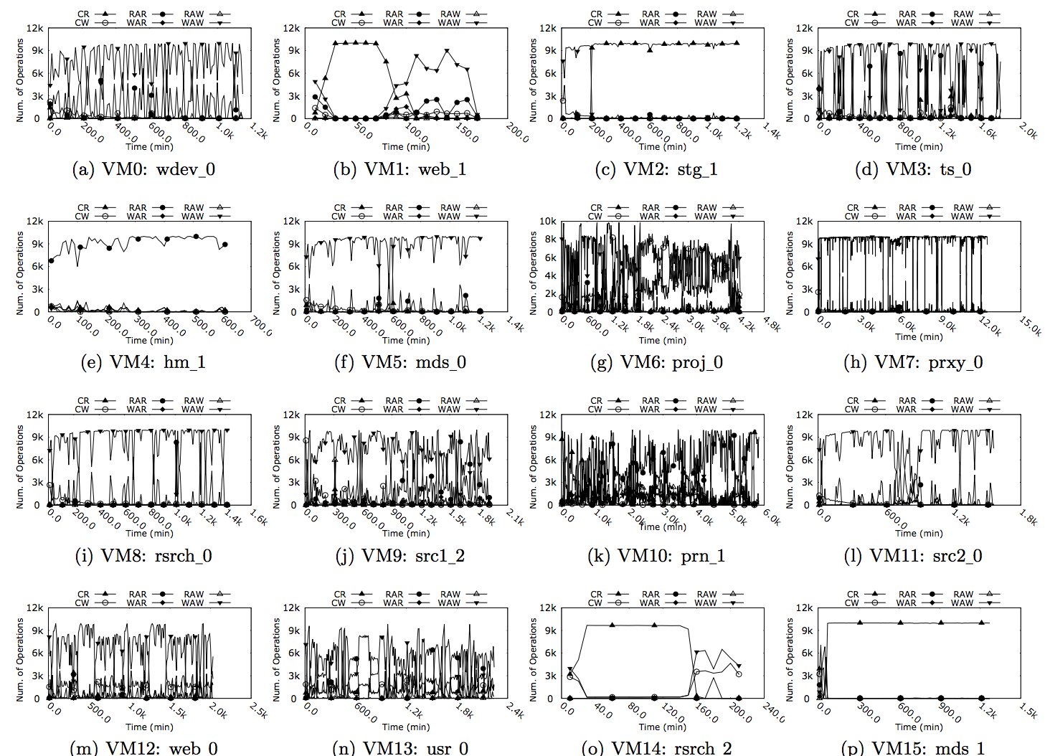
Operations on VMs Workload

Slide 52
Previous Work
SSD Caching
(in Virtualized Platforms)
EMC VFCache
NetApp Mercury
S-CAVE
vCache
Share
Fusion ioTurbine
vFRM
Centaur
Effective SSD Caching
XEN
ESX
ESX
ESX
KVM/QEMU
VMWare, ESX
VMWare, Linux, Windows
VMWare, ESX
Global
Host-side
Dynamic-Partitioned
Host-side
Dynamic-Partitioned
Host-side
Dynamic-Partitioned
Host-side
Global
Global
Host-side
Host-side
Global
Host-side
Global
Host-side
Cloud
Cache
ESX
Dynamic-Partitioned
Host-side
WSS
Reuse Intensity
Reuse Distance
Reuse WSS
commercial
commercial
commercial
commercial
EMC’12
MSST’12
Fusion-io’11
NOMS’14
TECS’14
PACT’13
ATC’14
ICAC’15
FAST’16
Dynamic - Partitioned
Static/Global

Slide 53
Previous Work:
Dynamic Cache Space Allocation
S-CAVE [PACT’13]
  Hypervisor-based SSD cache
  Policy: Write Through
  Size estimation:
    Working Set Size (WSS)
vCacheShare [ATC’14]
  Hypervisor-based SSD cache
  Policy: Write Around (RO)
  Size estimation:
    Reuse Intensity →CU = l × RR × (H(c) + αRI)
[1] Luo, Tian, et al. "S-cave: Effective ssd caching to improve virtual machine storage performance." Proceedings of the 22nd international conference on Parallel Architectures and Compilation Techniques (PACT), 2013.
[2] Meng, Fei, et al. "vCacheShare: automated server flash cache space management in a virtualization environment.“ USENIX ATC. 2014.

Slide 54
Previous Work (Cont.):
Dynamic Cache Space Allocation
Centaur [ICAC’15]
  Hypervisor-based SSD cache
  Policy: Write Back
  Size estimation:
    Reuse Distance (RD)
    MRCs
CloudCache [FAST’16]
  Hypervisor-based SSD cache
  Policy: Write Back
  VMs migration → Perf. + Endurance
  Size estimation:
    Reuse Working Set Size (RWSS)
      Temporal locality
Arteaga, Dulcardo, et al. "CloudCache: On-demand Flash Cache Management for Cloud Computing." FAST. 2016.

