Slide 1
A Framework for Memory Oversubscription Management in Graphics Processing Units
Session 2： DATA MOVEMENT 1 9:30AM-10:30AM，April 15th
Chen Li, Rachata Ausavarungnirun, Christopher J. Rossbach,
Youtao Zhang, Onur Mutlu, Yang Guo, Jun Yang

Slide 2
Problem
Limited memory capacity becomes a first-order design and performance bottleneck

Slide 3
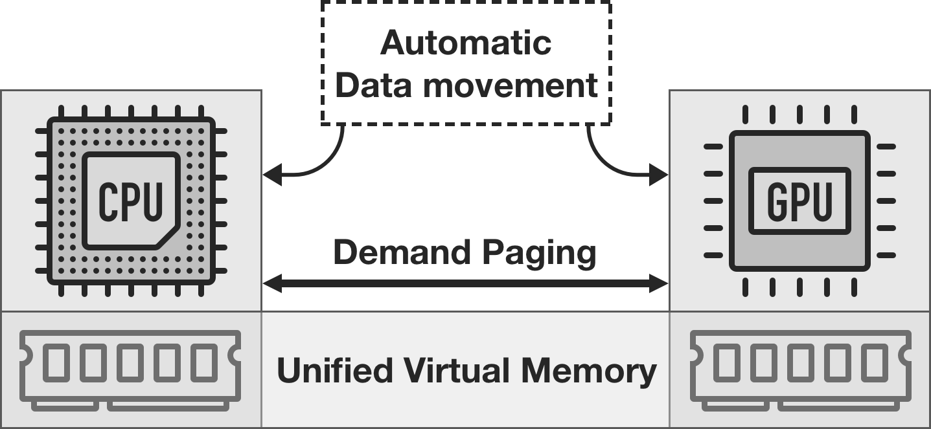
Problem
Limited memory capacity becomes a first-order design and performance bottleneck
Unified virtual memory and demand paging enable memory oversubscription support

Slide 4
Problem
Limited memory capacity becomes a first-order design and performance bottleneck
Unified virtual memory and demand paging enable memory oversubscription support
Memory oversubscription causes GPU performance degradation or, in several cases, crash

Slide 5
Motivation
Prior Hand-tuning Technique 1:
- Overlap prefetch with eviction requests
Hide eviction latency
Prefetch Requests
Eviction Requests

Slide 6
Motivation
Prior Hand-tuning Technique 2:
- Duplicate read-only data
Reduce the number of evictions
Duplicate read-only data instead of migration
No need to evict duplicated data

Slide 7
Motivation
Prior Hand-tuning Techniques:
- Overlap prefetch with eviction requests
- Duplicate read-only data
Manually managing data movement
No visibility into other VMs in cloud environment

Slide 8
Motivation
Prior Hand-tuning Techniques:
- Overlap prefetch with eviction requests
- Duplicate read-only data
Manually managing data movement
No visibility into other VMs in cloud environment
Application-transparent mechanisms are urgently needed

Slide 9
Our Proposal
Application-transparent Framework
ETC Framework

Slide 10
Our Proposal
Application-transparent Framework
ETC Framework
Proactive Eviction

Slide 11
Our Proposal
Application-transparent Framework
ETC Framework
Proactive Eviction
Memory-aware Throttling

Slide 12
Our Proposal
Application-transparent Framework
ETC Framework
Proactive Eviction
Memory-aware Throttling
Capacity Compression

Slide 13
Our Proposal
Regular Applications
With No Data Sharing
ETC Framework
Proactive Eviction
ETC fully mitigates the oversubscription overhead

Slide 14
Our Proposal
Regular Applications
With No Data Sharing
ETC Framework
Proactive Eviction
ETC Framework
Regular Applications With Data Sharing
Proactive Eviction
Capacity Compression
ETC improves the performance by 60.4%

Slide 15
Our Proposal
Regular Applications
With No Data Sharing
ETC Framework
Proactive Eviction
ETC Framework
Regular Applications With Data Sharing
Proactive Eviction
Capacity Compression
ETC improves the performance by 270%
ETC Framework
Irregular Applications
Memory-aware Throttling
Capacity Compression

Slide 16
A Framework for Memory Oversubscription Management in Graphics Processing Units
Session 2： DATA MOVEMENT 1 9:30AM-10:30AM，April 15th
Chen Li, Rachata Ausavarungnirun, Christopher J. Rossbach,
Youtao Zhang, Onur Mutlu, Yang Guo, Jun Yang

