Slide 1







A Framework for Memory Oversubscription Management in Graphics Processing Units
`
Chen Li, Rachata Ausavarungnirun, Christopher J. Rossbach,
Youtao Zhang, Onur Mutlu, Yang Guo, Jun Yang
Notes:
Hello, I am Chen Li from NUDT China. Today I am going to talk about how to reduce the overhead of memory oversubscription in Unified Virtual Memory. This work was done when I was visiting University of Pittsburgh, and in collaboration with CMU, UT Austin and ETH.

Slide 2
Executive Summary
Problem: Memory oversubscription causes GPU performance degradation or, in several cases, crash
Motivation: Prior hand tuning techniques require heavy loads on programmers and have no visibility into other VMs in the cloud
  Application-transparent mechanisms in GPU are needed
Observations: Different applications have different sources of memory oversubscription overhead
ETC: an application-transparent framework that applies Eviction, Throttling and Compression selectively for different applications
Conclusion: ETC outperforms the state-of-the-art baseline on all different applications
Notes:
Here is the high level overview of this talk.
In this work,[click] we focus on the performance degradation problem caused by memory oversubscription.
[click]
We found that previous hand tuning techniques all have shortcomings as they require heavy programming efforts. Moreover, hand-tuning cannot work in multi-tenants environments.
[click]
Thus, application-transparent mechanisms are needed.
[click]
We observe the memory access traces of different applications and found that memory oversubscription overheads are caused by different reasons.
[click]
In this work, we propose an application-transparent framework, called ETC, that uses the effective combinations of 3 techniques to overcome the memory oversubscription for different types of applications.
[click]
Experimental results show that ETC can outperform the state-of-the-art baseline on all different applications.

Slide 3
Outline
Executive Summary
Memory Oversubscription Problem
Demand for Application-transparent Mechanisms
Demand for Different Techniques
ETC: An Application-transparent Framework
Evaluation
Conclusion
Notes:
Let’s first go over the memory oversubscription problem.

Slide 4

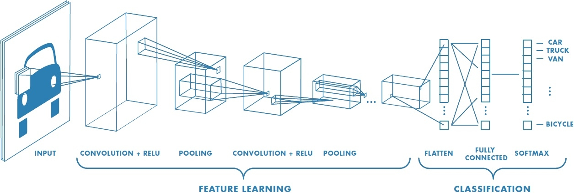
Memory Oversubscription Problem
Cloud providers oversubscribe resource for better utilization
Limited memory capacity becomes a first-order design and performance bottleneck
DNN training requires larger memory to train larger models
Notes:
[click]
In current datacenters, cloud servers tend to virtualize costly resources, such as GPUs, to increase their utilization. However, it may cause the memory space shortages for some memory-hungry users.
[click]
One typical example is prevailing machine learning applications that are mostly running on GPUs. They typically use large models for training, and so are often limited by the memory capacity.
[click]
Therefore, limited memory capacity becomes a first-order design and performance bottleneck.

Slide 5






Memory Oversubscription Problem
Unified virtual memory and demand paging enable memory oversubscription support
Memory oversubscription causes GPU performance degradation or, in several cases, crash
Notes:
[click]
In modern GPUs, the unified virtual memory[click] and demand paging capabilities[click] free developers from manually managing data movement between CPU memory and GPU memory. As a result, the allocated memory size can be larger than the GPU memory capacity, which means that memory can be oversubscribed.
[click]
However, moving data between CPU memory and GPU memory incurs a long latency, and our measurements on a real GPU system show that applications could experience severe performance degradation or, in several cases, crash.

Slide 6
Outline
Executive Summary
Memory Oversubscription Problem
Demand for Application-transparent Mechanisms
Demand for Different Techniques
ETC: An Application-transparent Framework
Evaluation
Conclusion
Notes:
And then let me show you the best way to address this issue

Slide 7
Demand for Application-transparent Framework
Prior Hand-tuning Technique 1:
- Overlap prefetch with eviction requests
Hide eviction latency
Prefetch
Eviction
Notes:
[click]
Some of the performance loss due to memory oversubscription can be reduced by more programming efforts.
[click]
For example, overlapping prefetch with eviction requests to hide eviction latency. When there is not enough memory space, it is not necessary to wait for the eviction at the occurrence of a page fault.

Slide 8
Demand for Application-transparent Framework
Prior Hand-tuning Technique 2:
- Duplicate read-only data
Reduce the number of evictions
Duplicate read-only data instead of migration
No need to evict
duplicated data
Drop duplicated data instead
Notes:
[click]
Another hand-tuning technique is duplicating read-only data instead of migration to reduce the number of evictions, since those duplicated data can be dropped instead of evicted.

Slide 9
Demand for Application-transparent Framework
Prior Hand-tuning Techniques:
- Overlap prefetch with eviction requests
- Duplicate read-only data
  Requires programmers to manage data movement manually
  No visibility into other VMs in cloud environment
Application-transparent mechanisms are urgently needed
Notes:
[click]
However, these hand-tuning techniques force programmers to manually manages data movement. It is exacerbated in the cloud environment where virtual machines may have no visibility into the working set of other tenants applications.
[click]
Therefore, more effective application transparent mechanisms to reduce memory oversubscription overhead are urgently needed.

Slide 10
Outline
Executive Summary
Memory Oversubscription Problem
Demand for Application-transparent Mechanisms
Demand for Different Techniques
ETC: An Application-transparent Framework
Evaluation
Conclusion
Notes:
Next, let me show you some observations for kernel’s memory oversubscription behaviors.

Slide 11
Demand for Different Techniques
Different Applications behave differently under oversubscription
>1000X
>1000X
Average 17% performance loss
Crashed
Collected from NVIDIA GTX1060 GPU
Notes:
We run 5 applications with memory oversubscription support in an NVIDIA GPU, and config the effective memory capacities to be 50% or 75% of the applications’ total footprint.
The x-axis is the applications’ name, and the y-axis represents the runtime normalized to 100% of applications’ footprint
[click]
From the plot we observed that the average performance degradation of the first 3 applications is 17%,
[click]
while ATAX and MVT keep running with huge amount of data movement to crash when the effective memory capacity can only fit 50% of the footprint. It means these applications behave much differently under memory oversubscription.

Slide 12
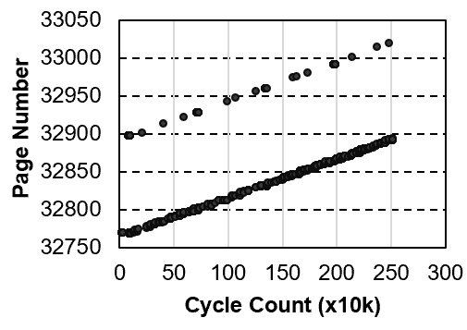
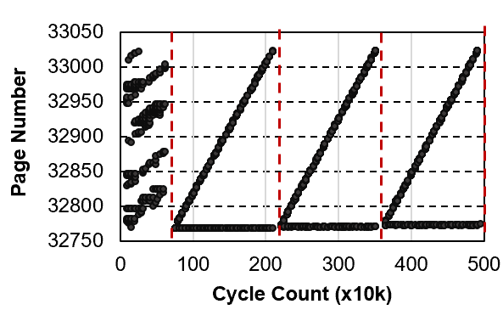
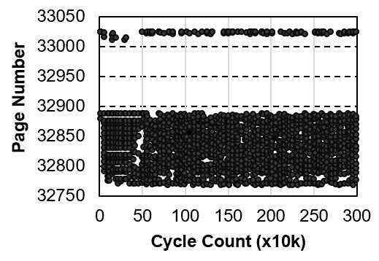
Demand for Different Techniques
Representative traces of 3 applications
Regular applications
with no data sharing
Regular applications
with data sharing
3DCONV
LUD
Irregular applications
ATAX
Hiding Eviction Latency
Hiding Eviction Latency;
Reducing data migration
Reducing working set size
Different techniques are needed to mitigate different sources of overhead
Streaming access
Small working set
Data reuse by kernels
Small working set
Random access
Large working set
Waiting for Eviction
Moving data back and forth for several times
Thrashing
Notes:
We collect the memory access traces for all those benchmarks and 3 representative traces can be observed.
[click]
In these figures, the x-axis represents the execution time in cycles; the y-axis shows the page ID in memory.
The first benchmark 3DCONV performs streaming access and the working set is small.
Due to streaming access, a page usually will not be accessed again after a period from the first access.
[click]
Waiting for the eviction at page faults is the only overhead for these type of applications.
[click]
The second benchmark LUD is similar to the first one, but the data is reused by different kernels. Each page is accessed for several times.
[click]
Although it is also streaming access at each phase, between different kernels there are synchronizations.
[click]
Therefore, each page has to be moved back and forth (between CPU and GPU?) for several times which cause large performance degradation.
[click]
The last benchmark ATAX performs much differently from the first two.
[click]
It is fairly randomly accessing the memory space. The working set of this type is very large and looks stable. When the working set is larger than the available memory space,
[click]
thrashing will occur which could lead to system crash.
According to these observations,
[click]
we classify the applications as regular application with no data sharing or data sharing, and irregular applications.
[click]
Therefore we need different techniques to overcome different bottlenecks which can mitigate different sources of overhead.

Slide 13
Outline
Executive Summary
Memory Oversubscription Problem
Demand for Application-transparent Mechanisms
Demand for Different Techniques
ETC: An Application-transparent Framework
Evaluation
Conclusion
Notes:
Based on these observations, we know that instead of a single technique, we need a framework to overcome the memory oversubscription.

Slide 14
Our Proposal
Application-transparent Framework
ETC Framework
Application Classification
Proactive Eviction
Memory-aware Throttling
Capacity Compression
Notes:
Our ETC framework consists of two parts.
[click]
The first part is application classification. It determines the type of the running application.
[click]
And then we have proactive eviction
[click]
Memory-aware Throttling
[click]
And capacity compression.
They focus on different bottlenecks and reduce the memory oversubscription overhead.

Slide 15
Application Classification
LD/ST Units
Sampled coalesced memory accesses per warp
< threshold
> threshold
Regular applications
Irregular applications
Compiler-information
No data sharing
Data sharing
Notes:
Firstly, we need to determine what’s the type of the running application.
[click]
We sampled the number of coalesced memory accesses per warp at LD/ST Unit.
[click]
If it is smaller than a threshold, the application should be regular type.
[click]
Otherwise, it is irregular.
[click]
If the application is regular type, we use compiler-information to determine if it has data sharing. ETC utilizes the compiler by marking kernels that contain the same pointer as shared.

Slide 16
Regular Applications with no data sharing
Proactive Eviction
Waiting for Eviction
Demand
Pages
Evicted
Pages
First page
fault detected
GPU runs
out of memory
(a)
Baseline
CPU-to-GPU
GPU-to-CPU
Page A
Page B
Page C
Page D
Page F
Page H
Page J
Page L
Page E
Page G
Page I
Page K
Key idea of proactive eviction: evict pages preemptively before GPU runs out of memory
time
Proactive
Eviction
CPU-to-GPU
GPU-to-CPU
Page A
Page B
Page C
Page D
Page F
Page H
Page J
Page L
(b)
Page E
Page G
Page I
Page K
Page M
Saved Cycles
Notes:
[click]
For regular application with no data sharing, current design for the eviction is when the GPU runs out of memory, new demand pages need to wait for evicting pages to make space. It will stall the page fault and decrease the performance.
[click]
In ETC, we proposed proactive eviction to make space preemptively for new pages before GPU runs out of memory which can save a large number of cycles.

Slide 17
Proactive Eviction
Not Enough Space
Evict a Chunk
Page Fault
Allocate a
New Page
Enough Space
Fetch a New Page
App Classification
App Type: Regular
Proactive Eviction
Evict A Chunk
Virtual Memory Manager
Memory Oversubscribed
Available Memory Size < 2MB
ETC Implementation
Notes:
We added a detection process to the default implementation to determine when proactive eviction can be triggered. There are three conditions to be detected, including application type, memory oversubscribed and available memory size. The proactive eviction is triggered when all these conditions are satisfied. It will evict a chunk of data at the same time of fetching a new page. As a result, the eviction of cold pages can be done proactively and its latency can be hidden.

Slide 18
Regular Applications with data sharing
Proactive Eviction
Waiting for Eviction
Key idea of capacity compression: Increase the effective capacity to reduce the oversubscription ratio
Implementation: transplants Linear Compressed Pages (LCP) framework [Pekhimenko et al., MCIRO’13] from a CPU system.
Capacity Compression
Moving data back and forth for several times
Notes:
For regular applications with data sharing, although proactive eviction is effective at hiding the eviction latency,
[click]
the major overhead comes from moving data back and forth for several times. Proactive eviction is not effective because shared pages are used again by other kernels. We still need new techniques.
[click]
In ETC, we proposed capacity compression to further reduce the oversubscription ratio.
[click]
To implement capacity compression, we transplant Linear compressed pages from a CPU system to GPU. Additional accesses to compression-related metadata lead to 13% of performance degradation in average. Thus, it is crucial to determine when the LCP framework is useful. Capacity compression can be effective only when the oversubscription overhead is large enough.

Slide 19
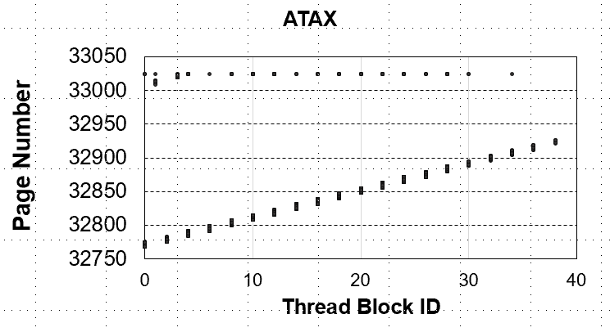
Irregular Applications
Key idea of memory-aware throttling : reduce the working set size to avoid thrashing
Memory-aware Throttling
Thrashing
Reduce concurrent running thread blocks
Fit the working set into the memory capacity
Notes:
[click]
For irregular applications, we propose memory-aware throttling.
[click]
Since the working set size is too large which may cause thrashing, our key idea is reducing the working set size. Observed from this plot, the x-axis is the thread block ID, while the y-axis is the page number. we find that different thread blocks of irregular applications access different regions of the data.
[click]
It is effective to reduce the working set size by throttling the concurrent running thread blocks.

Slide 20
Memory-aware Throttling
Throttle SM
4
Page eviction detected
1
5
Page fault detected
3
Detection Epoch
Execution Epoch
No page eviction
2
Release SM
Time expires with
no page fault
ETC Implementation （SM Throttling）
Notes:
GPU throttling is usually implemented in thread block level, but we found that it introduces an overly long adjustment period to reach the level with minimum thrashing.
Thus, we choose SM throttling for its quick converge.
We set two epochs at each throttling phase to adjust the approximate working set size.
At the execution epoch, no adjustment is allowed, while detection epoch is used to decide to throttle or release SM according to the information of page faults and evictions.

Slide 21
Irregular Applications
Memory-aware Throttling
Thrashing
Capacity Compression
Lower Thread Level Parallelism
Lower Thread Level Parallelism (TLP)
Notes:
[click]
Memory-aware Throttling lowers the TLP, which may reduce the performance even if the thrashing is removed.
[click]
Hence, capacity compression is combined to use in this case which can increase the TLP.

Slide 22
ETC Framework
Regular applications with no data sharing
Proactive Eviction
Memory-aware Throttling
Regular applications with data sharing
Capacity Compression
Irregular applications
No single technique can work for
all applications
Notes:
[click]
We found that no single techniques can work for all applications, ETC dynamically selects the most effective combinations of these techniques based on the type of application.

Slide 23
ETC Framework
Application-transparent Framework
App starts
Oversubscribing
memory
All Regular App
Compiler
Proactive Eviction
All Irregular App
GPU Runtime
APP Classification
Memory-Aware Throttling
GPU Hardware
Data Sharing Regular App
All Irregular App
Memory Coalescers
Capacity Compression
Notes:
This is the overview of our ETC framework.
When the GPU memory is oversubscribed, ETC becomes active and the application classification unit determines the type of running application, and related techniques can be triggered to overcome the oversubscription.

Slide 24
Outline
Executive Summary
Memory Oversubscription Problem
Demand for Application-transparent Mechanisms
Demand for Different Techniques
ETC: An Application-transparent Framework
Evaluation
Conclusion
Notes:
Now that I have explain how ETC works, I am going to discuss our simulation methodology as well as our evaluation

Slide 25
Methodology
Mosaic simulation platform [Ausavarungnirun et al., MICRO’17]
  Based on GPGPU-Sim and MAFIA [Jog et al., MEMSYS ’15]
  Models demand paging and memory oversubscription support
Real GPU evaluation
  NVIDIA GTX 1060 GPU with 3GB memory
Workloads
  CUDA SDK, Rodinia, Parboil, and Polybench benchmarks
Baseline
  BL: the state-of-the-art baseline with prefetching [Zheng et al., HPCA’16]
  An ideal baseline with unlimited memory
Notes:
[click]
We modified the Mosaic simulator to model demand paging and memory oversubscription.
[click]
The real GPU evaluation is done by an NVIDIA GTX 1060 GPU with 3GB memory.
[click]
All evaluated applications are from CUDA SDK, Rodinia, parboil and Polybench benchmarks.
[click]
The state-of-the-art baseline with prefetching and an ideal baseline with unlimited memory are implemented to compare with our ETC framework.

Slide 26
Performance
ETC performance normalized to a GPU with unlimited memory
Compared with the
state-of-the-art baseline,
Regular applications with no data sharing
3.1%
6.1%
59.2%
102%
Fully mitigates the overhead
436%
61.7%
Regular applications with data sharing
60.4% of performance improvement
Irregular applications
270% of performance improvement
Notes:
[click]
In terms of performance, I am going to show the ETC performance of these 3 types of applications normalized to a GPU with unlimited memory. The x-axis is the 3 types of applications with ETC or not, and the y-axis is the normalized performance to the baseline with unlimited memory.
[click]
We make 3 conclusions.
[click]
First, ETC is effective at recovering the performance loss from the memory oversubscription for regular applications with no data sharing, because the eviction latency can be fully hidden by our proactive eviction techniques.
[click]
Second, additional page migrations are incurred due to the synchronization for regular applications with data sharing, but we still improve the performance by an average of 60.4%
[click]
Third, ETC can also improve the performance of irregular applications by 2.7X compared to the baseline, as thrashing can be eliminated.

Slide 27
Other results
In-depth analysis of each technique
Classification accuracy results
  Cache-line level coalescing factors
  Page level coalescing factors
Hardware overhead
Sensitivity analysis results
  SM throttling aggressiveness
  Fault latency
  Compression ratio
Notes:
We also have other results in the paper
[click]
Including in-depth analysis of each technique
[click]
classification accuracy results of two different coalescing levels
[click]
And hardware overhead cost by ETC
[click]
We also perform Sensitivity analysis on SM throttling aggressiveness, fault latency and compression ratio.

Slide 28
Outline
Executive Summary
Memory Oversubscription Problem
Demand for Application-transparent Mechanisms
Demand for Different Techniques
ETC: An Application-transparent Framework
Evaluation
Conclusion
Notes:
Now I am going to conclude the work

Slide 29
Conclusion
Problem: Memory oversubscription causes GPU performance degradation or, in several cases, crash
Motivation: Prior hand tuning techniques require heavy loads on programmers and have no visibility into other VMs in the cloud
Application-transparent mechanisms in GPU are needed
Observations: Different applications have different sources of memory oversubscription overhead
ETC: an application-transparent framework that
  Proactive Eviction Overlaps eviction latency of GPU pages
  Memory-aware Throttling Reduces thrashing cost
  Capacity Compression Increases effective memory capacity
Conclusion: ETC outperforms the state-of-the-art baseline on all different applications
Notes:
[click]
In this work we take a look at the memory oversubscription overhead and proposed ETC Framework with 3 effective techniques
[click]
Experimental results shows that the overhead of regular applications with no data sharing can be fully mitigated, while the performance of regular applications with data sharing and irregular applications can be improved by 60.4% and 270% compared with the state-of-the-art baseline.

Slide 30
A Framework for Memory Oversubscription Management in Graphics Processing Units
Chen Li, Rachata Ausavarungnirun, Christopher J. Rossbach,
Youtao Zhang, Onur Mutlu, Yang Guo, Jun Yang

