Slide 1


Focus: Querying Large Video Datasets with Low Latency and Low Cost
Kevin Hsieh
Ganesh Ananthanarayanan, Peter Bodik, Shivaram Venkataraman,
Paramvir Bahl, Matthai Philipose, Phillip B. Gibbons, Onur Mutlu

Slide 2
Video Recordings are Ubiquitous
Massive video recordings are happening everywhere

Slide 3

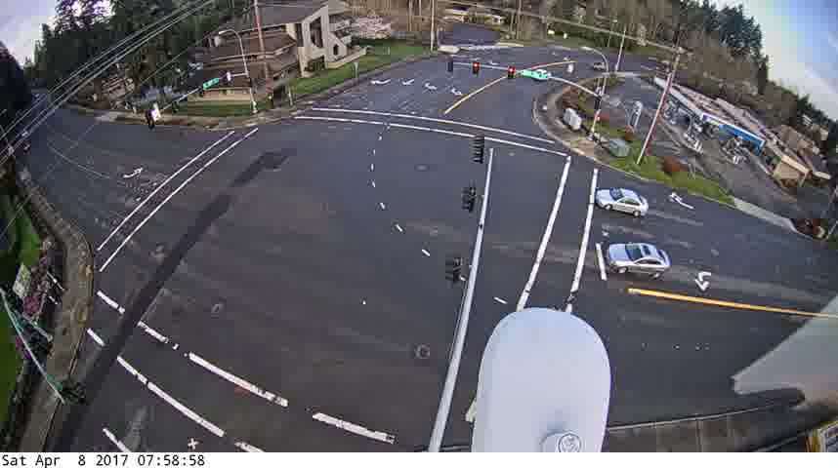
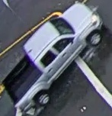

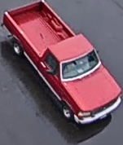
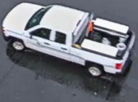
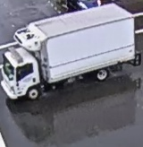
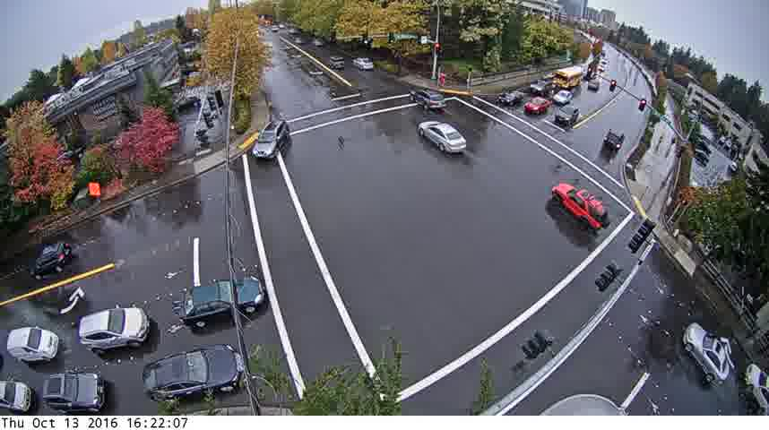
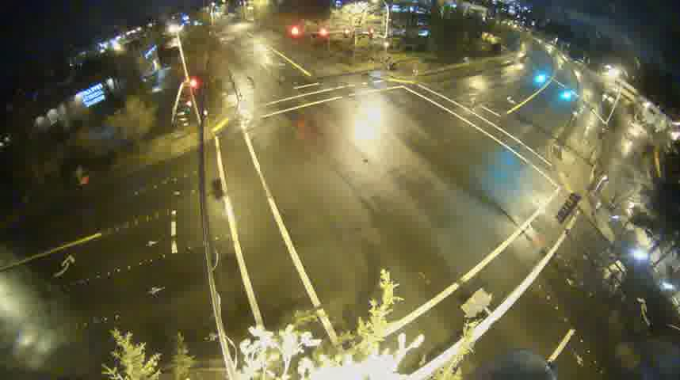
Key Application: Querying Objects in Videos
Find all trucks among traffic videos in a city last week
Find all people in garage videos in a company last night
→ Query execution requires running detector & classifier CNNs
→ It is slow and costly on massive videos

Slide 4



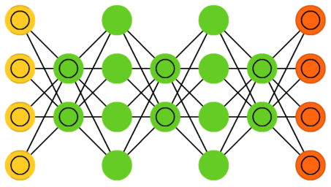


Ingest Time Analysis: Too Costly
Analyzing live videos at ingest time can make query fast
  But it is costly
  Potentially wasteful (ingest all garage cameras vs. query one)
Ingest
Query
$380/month/stream
Object Class → [Frames]

Slide 5



Query Time Analysis: Too Slow
Analyzing videos at query time can save cost
  Frame down-sampling / skipping
  CNN specialization / cascading
  But it still very slow (5 hr for a month-long video [1])
Ingest
Query
1. Kang et al., NoScope, PVLDB’17

Slide 6
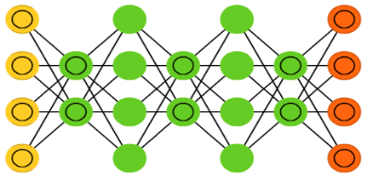

Our Goal
Enable low-latency and low-cost querying over large historical video datasets
CNN,
Accuracy target
Query object class
Low-Latency and Low-Cost
Video Querying System
Frames
Frames
Frames with trucks

Slide 7
Background: Convolutional Neural Networks
A Convolutional Neural Network (CNN) outputs the probability of each class
Based on the extracted features (high-level representation)
Pooling Layer
Fully-Connected Layer
Pr(Truck) ✓
Pr(Moving Van)
Pr(Bus)
Pr(Car)
…
Pr(Person)
.
.
.
.
.
.
Convolutional + Rectification Layer
Extracted Features

Slide 8
Focus System: Low-latency query with low-cost ingest
Approximate indexing via cheap ingest
Redundancy elimination for fast query
Trading off ingest cost vs. query latency

Slide 9
Focus System: Low-latency query with low-cost ingest
Approximate indexing via cheap ingest
Redundancy elimination for fast query
Trading off ingest cost vs. query latency

Slide 10

Low-Cost Ingestion: Cheaper CNNs
Process video frames with a cheap CNN at ingest time
  Compressed and Specialized CNN: fewer layers / weights and are specialized for each video stream
CNN
specialization
Frames
Frames
Frames
Objects
Expensive CNN
Index
Specialized, Compressed CNN
Notes:
To achieve low-cost ingestion, we need to process video frames with cheaper CNNs. We can leverage the well-studied compressed and specialized CNNs as our cheap CNNs......

Slide 11


Challenge: Cheap CNNs are Less Accurate
Cheaper CNNs are less accurate than the expensive CNNs
The best result from the expensive CNN is within the top-K results of the cheaper CNN
Rank | Expensive CNN | Cheap CNN
1 | Truck | Moving Van
2 | Moving Van | Airplane
3 | Passenger Car | Truck
4 | Recreational vehicle | Passenger Car
Notes:
Unfortunately, we cannot apply cheaper CNNs at ingest time directly because cheaper CNNs are less accurate than the expensive CNNs

Slide 12
Recall, Precision and Top-K Results
Recall: Fraction of relevant objects that are selected
Precision: Fraction of selected objects that are relevant
Ground-truth CNN: YOLOv2
>99% Recall
Cheaper CNN →Lower Recall
Cheap CNNs can achieve high recall with small top-K results

Slide 13
Solution: Split Ingest- and Query-time Work
Query-time work is done only on queried videos (reduce waste)
Ingest-time
Query-time
CNN
specialization
Frames
Frames
Frames
Querying for trucks
Frames with trucks
Objects
Specialized, Compressed CNN
Top-K Index
Expensive CNN
Object Class → [Objects]
Object → Frame
High Recall
High Precision

Slide 14
Focus System: Low-latency query with low-cost ingest
Approximate indexing via cheap ingest
Redundancy elimination for fast query
Trading off ingest cost vs. query latency

Slide 15






Low-Latency Query: Redundancy Elimination
Approximate indexing ➔ non-trivial work at query time
  A larger K ➔ more query-time work
Images with similar feature vectors are visually similar
Minimize the work at query time ➔ clustering similar objects based on the extracted features
……
Query-time work is done only once per cluster
Extracted Features

Slide 16
Adding Feature-based Clustering
Reduce redundant work at query time
Ingest-time
Query-time
CNN
specialization
Frames
Frames with trucks
Frames
Frames
Features
Clusters
Querying for trucks
Object clusters
Top-K results
Centroid
objects
Objects
Specialized, Compressed CNN
Top-K Index
Expensive CNN
Object Class → [Clusters]
Cluster → Centroid, [Objects], [Frames]

Slide 17
Focus System: Low-latency query with low-cost ingest
Approximate indexing via cheap ingest
Redundancy elimination for fast query
Trading off ingest cost vs. query latency

Slide 18
Ingest Cost vs. Query Latency
Parameter selection → trading off ingest cost vs. query latency
  The cheap CNN at ingest time
  K in the top-K approximate indexing
  Clustering threshold for feature-based clustering
  …
/
A set of configurations
Optimize for Ingest Cost
Balance
Low latency
Optimize for Query Latency
Enable trade-offs to meet application’s need
Rarely queried

Slide 19
Experimental Setup
Video Datasets
  11 live traffic and enterprise videos
  Each video stream is evaluated for 12 hours
Accuracy Targets
  99% recall and 99% precision w.r.t. YOLOv2
Baselines
  Ingest-heavy: Analyzes all frames with YOLOv2 at ingest time and stores the inverted index for query
  NoScope [VLDB’17]: A query-optimized system that analyzes frames only at query time

Slide 20
Average End-to-End Performance
NoScope (5 hours/month/stream)
162X Faster
(5 hours ➔ 2 mins/month/stream)
57X Cheaper
($380➔$7/month/stream)
Better
Focus
Ingest-heavy
($380/month/stream)
Focus achieves low-latency query with low-cost ingest
Better

Slide 21
Effect of Different Components
Both techniques are important to Focus

Slide 22
Demo
Available at: https://youtu.be/MNCspIm9U38

Slide 23
More in the Paper
Characterization of real-world videos
Implementation details
Other applications
  Process large and growing data with CNNs, such as audio, bioinformatics, geoinformatics
More results
  Trade-off alternatives
  Sensitivity studies

Slide 24
Key Takeaways
Problem: Querying objects in massive videos is challenging
Our Approach: Low-latency query with low-cost ingest
Key Results
  57X (up to 92X) cheaper than ingest-time-only solutions
  162X (up to 607X) faster than state-of-the-art, query-time-only solutions
Ingest-time
Query-time
CNN
specialization
Frames
Frames with trucks
Frames
Frames
Querying for trucks
Object clusters
Top-K results
Centroid
objects
Objects
Specialized, Compressed CNN
Top-K Index
Expensive CNN

Slide 25
Focus: Querying Large Video Datasets with Low Latency and Low Cost
Kevin Hsieh
Ganesh Ananthanarayanan, Peter Bodik, Shivaram Venkataraman,
Paramvir Bahl, Matthai Philipose, Phillip B. Gibbons, Onur Mutlu

Slide 26
Ingest Cost by Video

Slide 27
Query Latency by Video

Slide 28
Trade-off Alternatives

Slide 29
Sensitivity – Number of Classes
We study the sensitivity to the number of object class using 1,000 ImageNet classes
The results show that Focus is
  15× faster in query latency
  57× cheaper in ingest cost than the baseline systems

Slide 30
Implementation Architecture
GT-CNN,
Accuracy target
M2
Stream Tuner
Model and parameter selection
Trade-off policy
Frames
ST₁
Frames
Frame / object extraction
Specialized model training
ST₂
Query object class
Frames with queried object class
IP₁
Ingest CNN and parameters
Ingest CNN evaluation
Feature vector clustering
Centroid object selection
GT-CNN evaluation
Objects
IP₂
IP₃
QP₁
QP₂
Approximate index
M1
Ingest Processor
M3
Query Processor

