Slide 1



G-TADOC: Enabling Efficient GPU-Based Text Analytics without Decompression
Feng Zhang †, Jidong Zhai ⋄, Xipeng Shen #, Onur Mutlu ⋆, Xiaoyong Du †
†Renmin University of China
⋄Tsinghua University
#North Carolina State University
⋆ETH Zürich

Slide 2
Outline
Background
Motivation
Challenges
Our Solution
Evaluation
Conclusion

Slide 3
1. Background
TADOC: Text Analytics Directly on Compression
Input:
Rules:
file0
file1
file0: w1 w2 w3 w1 w2 w4
w1 w2 w3 w1 w2 w4
file1: w1 w2 w1
R0 → R1 R1 SPT1 R2 w1
R1 → R2 w3 R2 w4
R2 → w1 w2
R0:
R1
R1
SPT1
R2
w1
(b) TADOC compressed data
R1:
R2
w3
R2
w4
(a) Original data
w1: 0 w2: 1 w3: 2 w4: 3 R0: 4 R1: 5 R2: 6 SPT1: 7
4 → 5 5 7 6 0
5 → 6 2 6 3
6 → 0 1
R2:
w1
w2
(c) DAG Representation
(d) Numerical representation
(e) Compressed data in numerical form
[1] Zhang, F., Zhai, J., Shen, X., Mutlu, O., & Chen, W. (2018). Efficient document analytics on compressed data: Method, challenges, algorithms, insights. Proceedings of the VLDB Endowment, 11(11), 1522-1535.

Slide 4
1. Background
CFG Relation
Information Propagation
Example: word count
<w,i>
Word table
<w1,6>, <w2,5>, <w3,2>, <w4,2>
R0:
R1
R1
SPT1
R2
w1
Step 3
w1: 2×2 + 1 +1 = 6
w2: 2×2 + 1 = 5
w3: 1×2 = 2
w4: 1×2 = 2
<w1,2>, <w2,2>
<w3,1>, <w4,1>
R1:
R2
w3
R2
w4
Step 2
w1: 1×2 = 2
w2: 1×2 = 2
w3: 1
w4: 1
Step 1
R2:
w1
w2
<w1,1>, <w2,1>

Slide 5
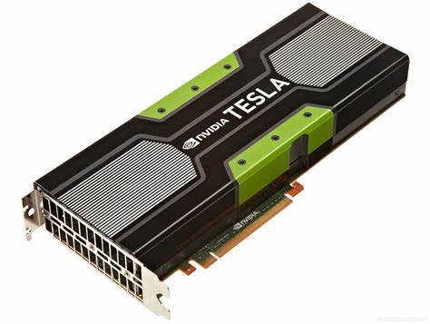
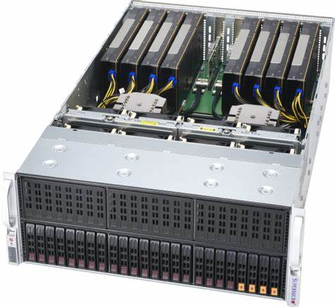
2. Motivation
GPU – popular in data science
limited GPU memory
different from CPUs
Previous GPU-based methods does not apply

Slide 6
3. Challenges
Challenge 1: GPU parallelism for TADOC
  Example: R2 depends on R0 and R1, and R1 depends on R0
dependencies
  Edges
file0
file1
R0:
R1
R1
SPT1
R2
w1
R1:
R2
w3
R2
w4
R2:
w1
w2

Slide 7
3. Challenges
Challenge 2: TADOC final result update conflict of massive GPU threads
  Example: writing to a global buffer
global buffer
file0
file1
thread
w1
R0:
R1
R1
SPT1
R2
w1
w2
…
thread
R1:
R2
w3
R2
w4
…
w_i
thread
R2:
w1
w2
write conflicts

Slide 8
3. Challenges
Challenge 3: sequence maintenance of TADOC com- pressed data on GPUs
  Example: cross-rule sequence
sequence:
  w1-w2-w3
    R1 and R2
file0
file1
R0:
R1
R1
SPT1
R2
w1
R1:
R2
w3
R2
w4
R2:
w1
w2

Slide 9
4. Our Solution
G-TADOC
modules
phases
TADOC compressed data
data structures
initialization
data structure preparation
parallel execution engine
light-weight scanning
TADOC program
graph traversal
top-down traversal /
bottom-up traversal
sequence support
results
result merging

Slide 10
4. Our Solution
Fine-Grained Thread-Level Execution Engine
Top-down / bottom-up traversal design
thread0
thread1
thread2
thread3
root
R1
R2
w1
spt1
R2
w2
…
w4
spt2
R3
…
R1:
w5
R4
R2:
R4
w5
R3:
w2
R5
…
thread4
thread5
thread6
…
R4:
w6
w7
w8
…
R5:
w9
w6
w8
thread7
thread8
Fine-grained thread-level partitioning design.

Slide 11
4. Our Solution
G-TADOC Data Structures
  G-TADOC maintained memory pool
  Thread-safe data structures
  Head and tail structures for sequence support
Locks
0 | 1 | 0 | 0 | 0
root
Entries
-1 | 0 | -1 | 1 | -1
…
w1
w2
w3
R1
w8
w9
w10
…
Keys
126 | 163 | 78
head
tail
Values
1 | 1 | 1 | 0 | 0
…
R1:
w4
w5
…
w6
w7
…
Next
2 | -1 | -1
(d) Add key = 78 (suppose hash to 1), and value = 1.

Slide 12
4. Our Solution
Sequence Support in G-TADOC
  Phase 1: initialization for head and tail buffers
  Phase 2: graph traversal with sequence support

Slide 13
5. Evaluation
Six benchmarks
  Word Count, Inverted Index, Sequence Count, Ranked Inverted Index, Sort, Term Vector from [1]
Five datasets
  62 MB ~ 50 GB
Four platforms
  three generations of Nvidia GPUs
    Pascal, Volta, and Turing micro-architectures
  Spark cluster (10 nodes on Amazon EC2)
[1] Zhang, F., Zhai, J., Shen, X., Mutlu, O., & Chen, W. (2018). Efficient document analytics on compressed data: Method, challenges, algorithms, insights. Proceedings of the VLDB Endowment, 11(11), 1522-1535.

Slide 14
5. Evaluation
On average, G-TADOC achieves 31.1× speedup over TADOC.
Turing (GeForce RTX 2080 Ti)

Slide 15
5. Evaluation
Speedups in different phases
(a) Phase 1: initialization.
(b) Phase 2: traversal.

Slide 16
5. Evaluation
Analysis of performance metrics
(a) DRAM throughput.
(b) Achieved occupancy.

Slide 17
6. Conclusion
G-TADOC, the first framework enabling efficient GPU-based text analytics directly on compressed data
Our work can help put much larger content directly in GPU memory.

Slide 18
Thanks!
Any questions?
Feng Zhang †, Jidong Zhai ⋄, Xipeng Shen #, Onur Mutlu ⋆, Xiaoyong Du †
†Renmin University of China
⋄Tsinghua University
#North Carolina State University
⋆ETH Zürich

