Slide 1
Algorithmic Improvement and GPU Acceleration of the GenASM Algorithm
Joël Lindegger
Damla Senol Cali, Mohammed Alser, Juan Gómez-Luna, Onur Mutlu
jmlindegger@gmail.com
30/05/2022
HiCOMB 2022
Notes:
Hi all, I’m Joel Lindegger, I’m a PhD student in the SAFARI research group at ETH Zurich. I will present to you “Algorithmic Improvement and GPU Acceleration of the GenASM Algorithm”. Let’s start with some background [Click]

Slide 2
Background
Pairwise sequence alignment is a common stage in genomic pipelines, such as read mapping
Pairwise sequence alignment is computationally expensive and often the pipeline’s bottleneck
GenASM is a state-of-the-art sequence aligner with high throughput and energy efficiency
[1] Senol Cali+, “GenASM: A High-Performance, Low-Power Approximate String Matching Acceleration Framework for Genome Sequence Analysis”, MICRO 2020
Notes:
Pairwise sequence alignment is a common stage in genomic pipelines, such as read mapping.
[Click] It is computationally expensive, and often the pipeline’s bottleneck.
[Click] GenASM is a state-of-the-art sequence aligner with high throughput and energy efficiency. We build on top of GenASM due to its several benefits [Click]

Slide 3
Benefits of GenASM
GenASM uses only cheap bitwise operations
GenASM has linear runtime complexity with respect to the sequence length, due to its windowing heuristic
GenASM supports traceback, thus it can report the CIGAR string
GenASM provides intra-task parallelism
[1] Senol Cali+, “GenASM: A High-Performance, Low-Power Approximate String Matching Acceleration Framework for Genome Sequence Analysis”, MICRO 2020
Notes:
In particular, GenASM uses only cheap bitwise operations
[Click] has linear runtime complexity
[Click] supports traceback and
[Click] provides intra-task parallelism.
However, we identify three inefficiencies in the GenASM algorithm [Click]

Slide 4
Problem – Inefficiencies in GenASM
GenASM has a large memory footprint
GenASM has a low operational intensity
GenASM does unnecessary work
Notes:
In particular, we observe that GenASM has a large memory footprint
[Click] a low operational intensity and
[Click] does some unnecessary work.
These inefficiencies limit GenASMs throughput and energy efficiency for several computing platforms, such as CPUs, GPUs and ASICs.
Thus, our goal [Click]

Slide 5
Our Goal
Our goal is to enable fast and efficient implementations of GenASM for CPUs, GPUs, and ASICs
To this end we propose Scrooge, which
Reduces the memory footprint
Reduces the number of bytes accessed
Eliminates unnecessary work
Notes:
… is to enable fast and efficiency implementations of GenASM for CPUs, GPU, and ASICs.
To this end we propose [Click] Scrooge, which reduces the memory footprint, number of bytes accessed, and unnecessary work. [Click]

Slide 6
Scrooge
Three novel algorithmic improvements to the GenASM algorithm
High-performance CPU and GPU implementations of the improved algorithm
Notes:
Scrooge consists of three novel algorithmic improvements to GenASM, and
[Click] high-performance CPU and GPU implementations of the improved algorithm.
Let me briefly recap the GenASM algorithm [Click]

Slide 7
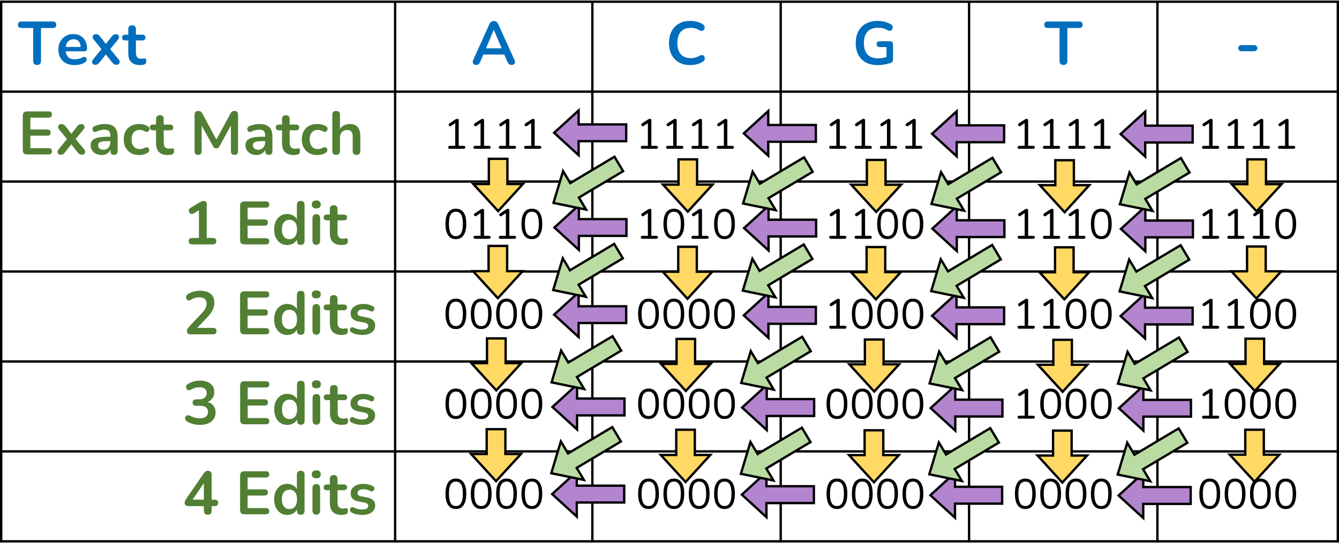
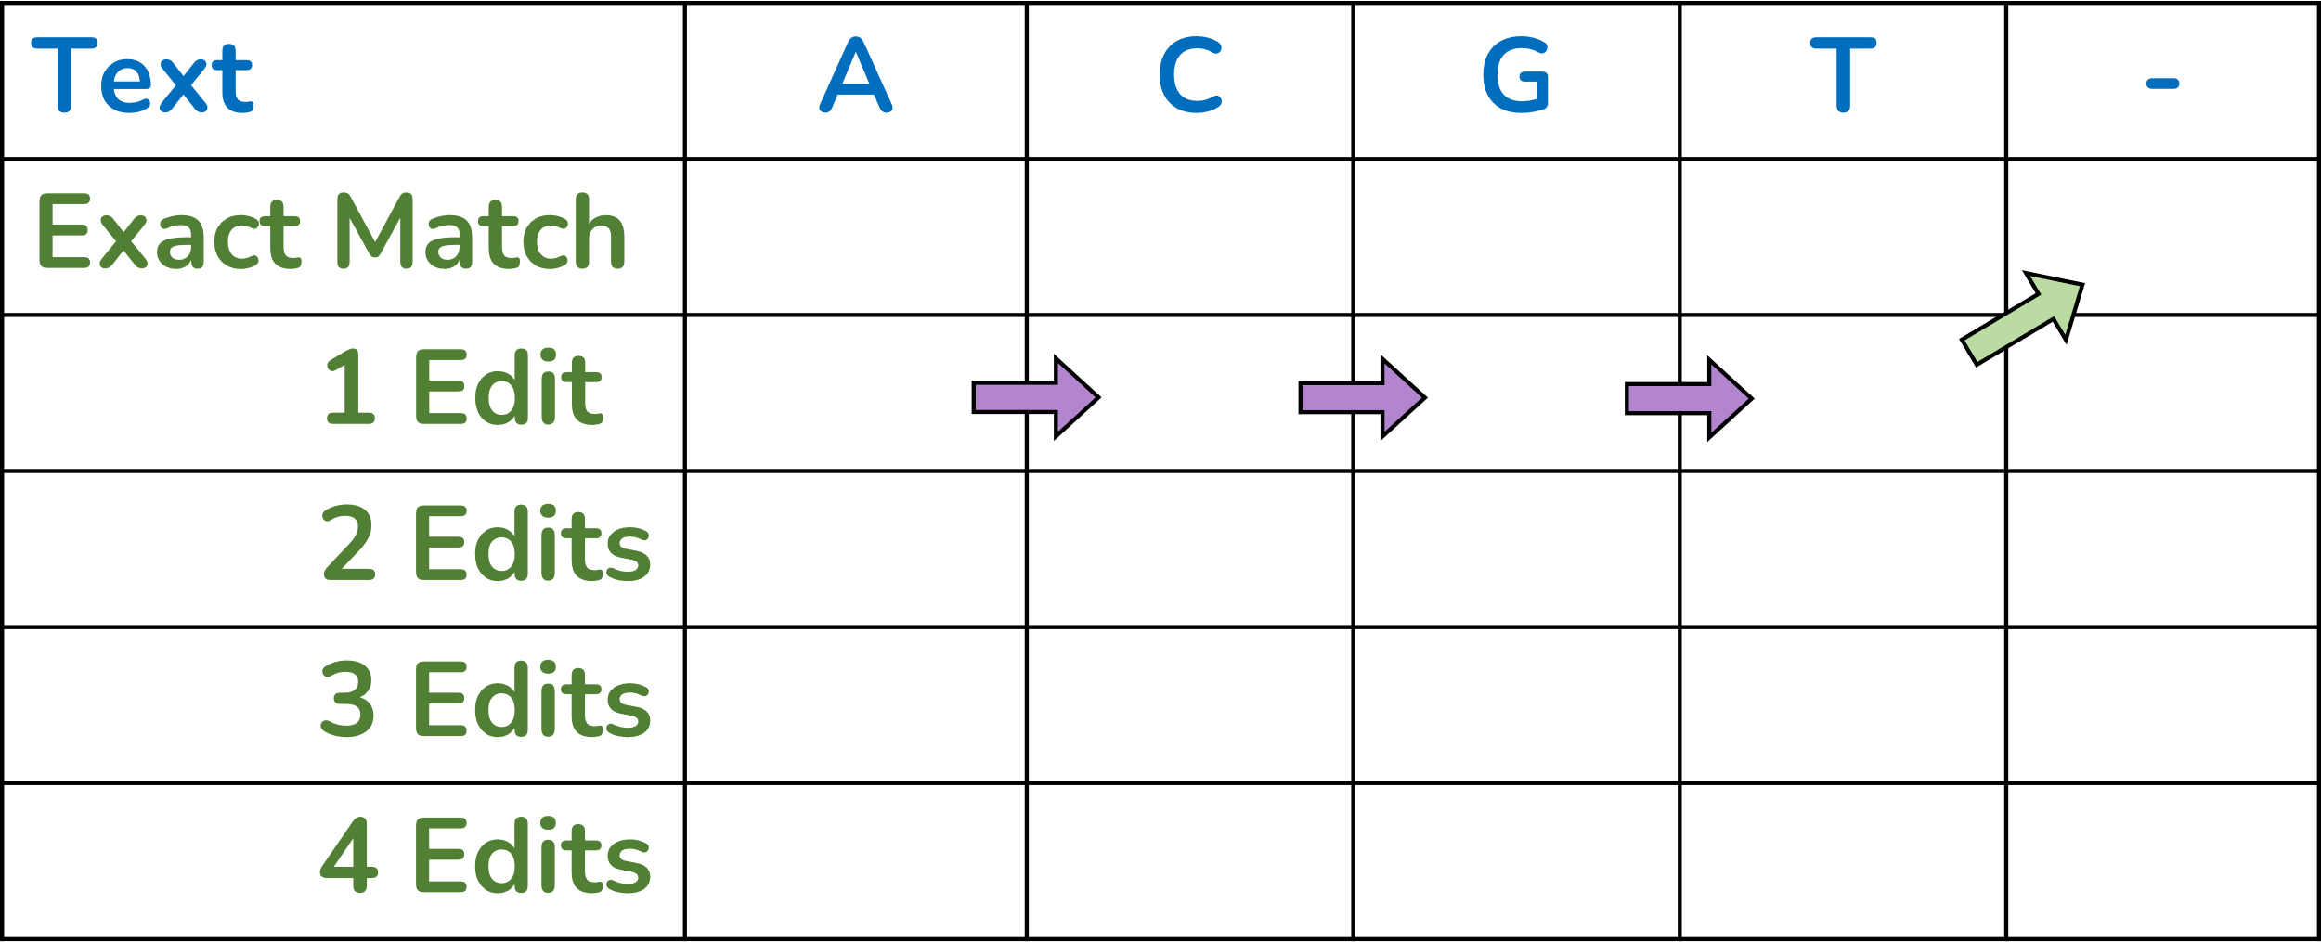
GenASM Algorithm
1
Distance Calculation
Builds table of bitvectors
Finds the edit distance
Edit Distance
2
Traceback
Requires table of bitvectors
Finds the CIGAR string
CIGAR String
Notes:
It consists of two steps, the first is called distance calculation and builds a table of bitvectors
[Click] The edit distance is then determined from the bitvectors.
[Click] The second step is called traceback, and requires the table of bitvectors as input. It then finds the CIGAR string by traversing a single path across the table of bitvectors.
Together, the edit distance and CIGAR string are the desired output of sequence alignment.
We develop three novel improvements to this algorithm [Click]

Slide 8
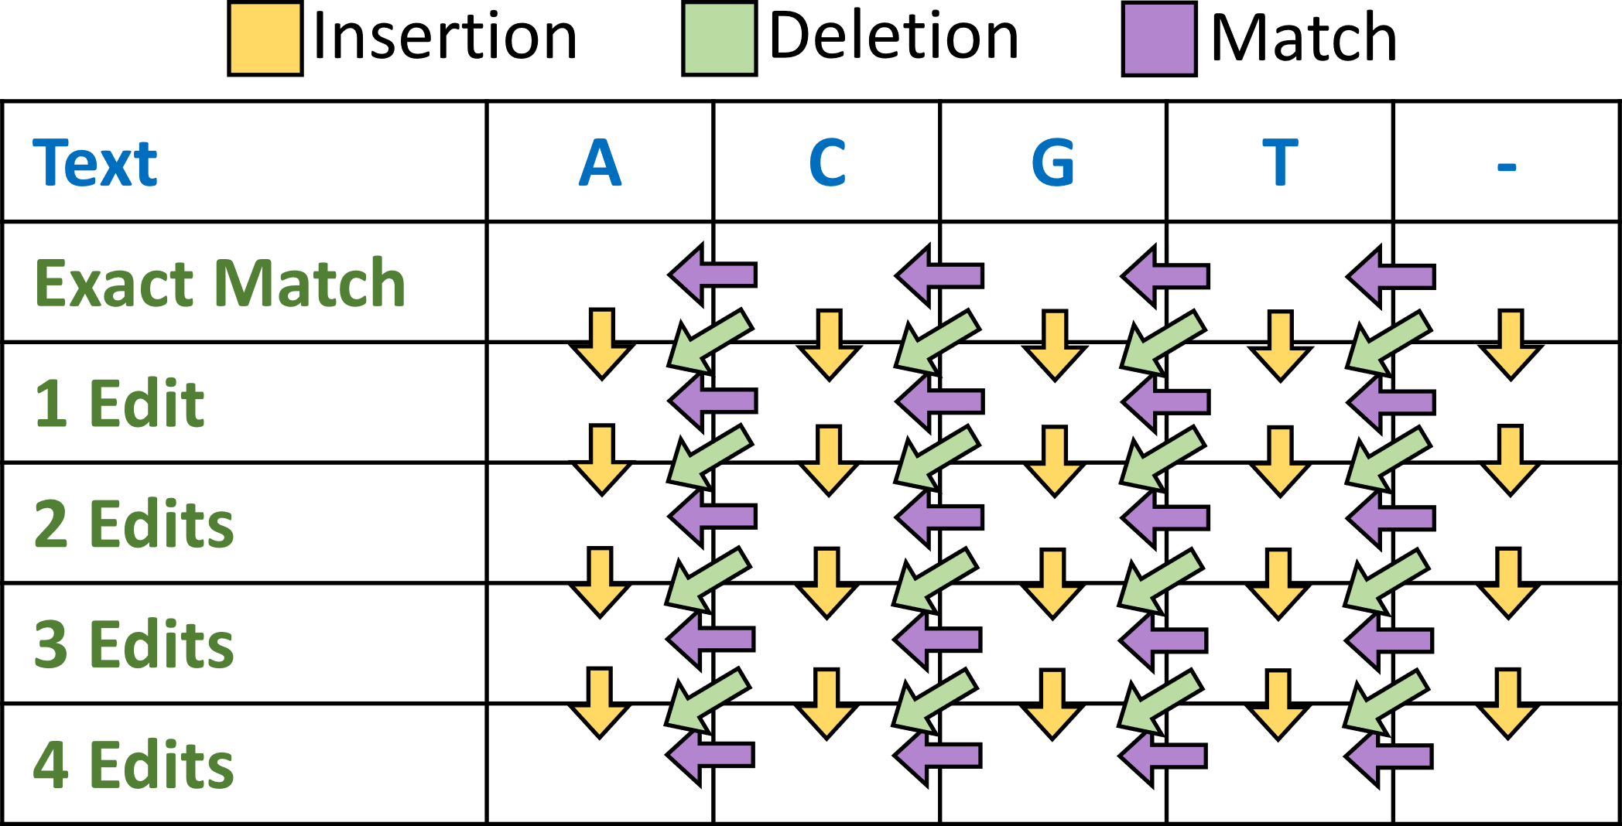
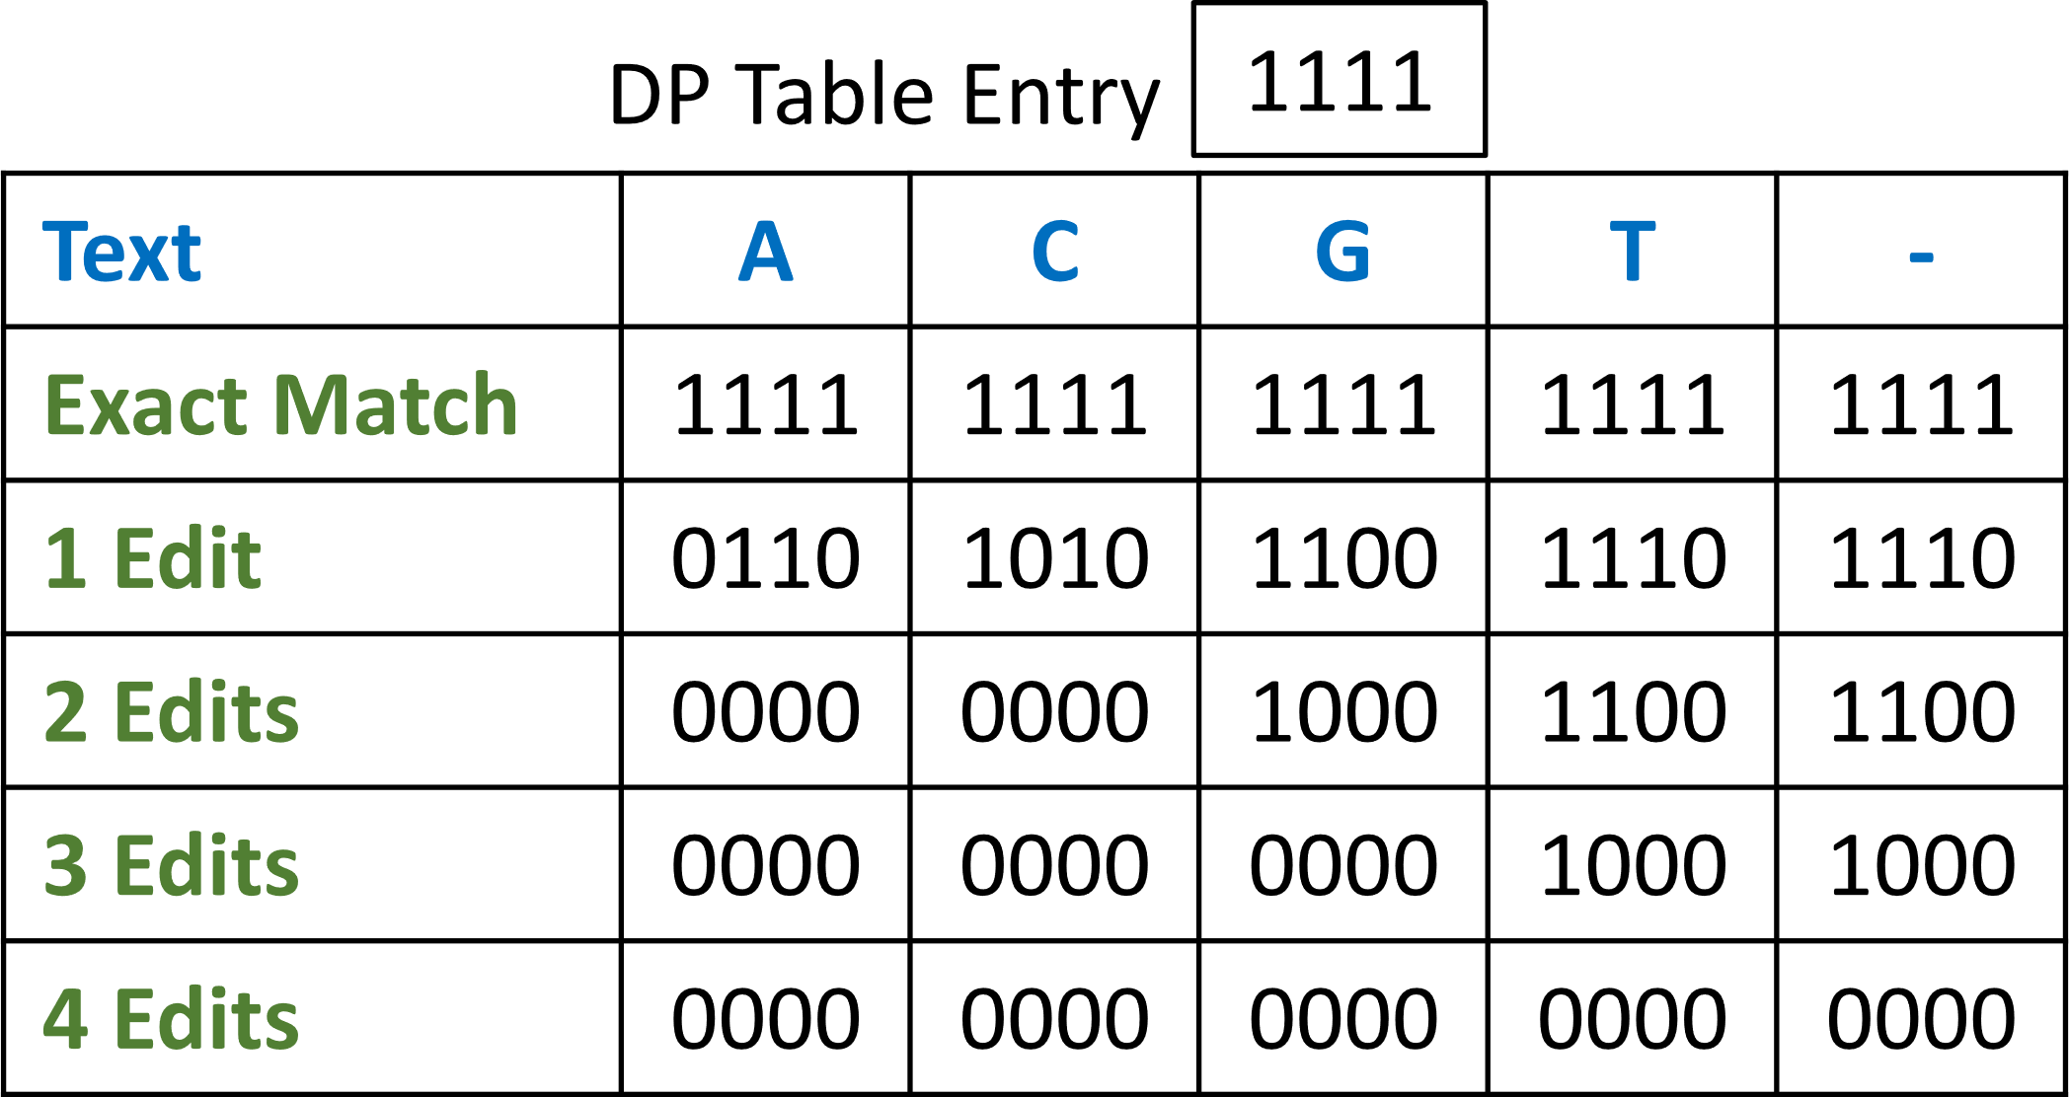
Scrooge Improvement 1: Store Entries, Not Edges (SENE)
GenASM
Scrooge
Stores 3 edges per table entry for traceback
Stores table entries directly, edges are regenerated
SENE Improvement
SENE results in a 3x reduction in memory footprint and data movement
Notes:
First, we observe that GenASM stores 3 edges per table entry for traceback.
[Click] We show it is sufficient to store the table entries directly, from which edges can then be regenerated during traceback as needed.
The overhead of regenerating edges is small, because traceback traverses only a single path across the table, thus few edges need to be regenerated.
We call this improvement Store Entries, Not Edges, SENE.
[Click] It results in a 3x reduction in memory footprint and data movement.

Slide 9
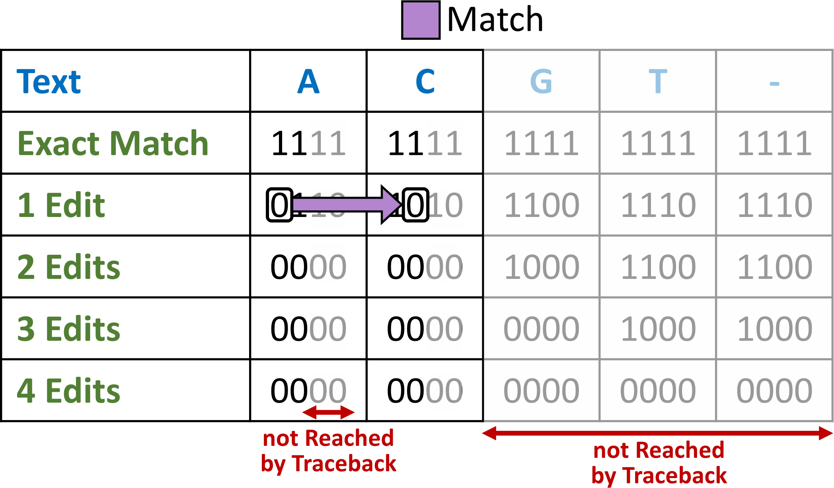
Scrooge Improvement 2: Discard Entries Not used by Traceback (DENT)
GenASM’s traceback does not cross the entire table
Scrooge discards entries that are never reached
DENT results in a 4x reduction in memory footprint and data movement
Notes:
Second, we observe that GenASM’s traceback does not cross the entire table.
[Click] Thus, Scrooge discards entries that are never reached.
[Click] This results in a 4x reduction in memory footprint and data movement.
We call this improvement DENT, Discard Entries Not used by Traceback.

Slide 10
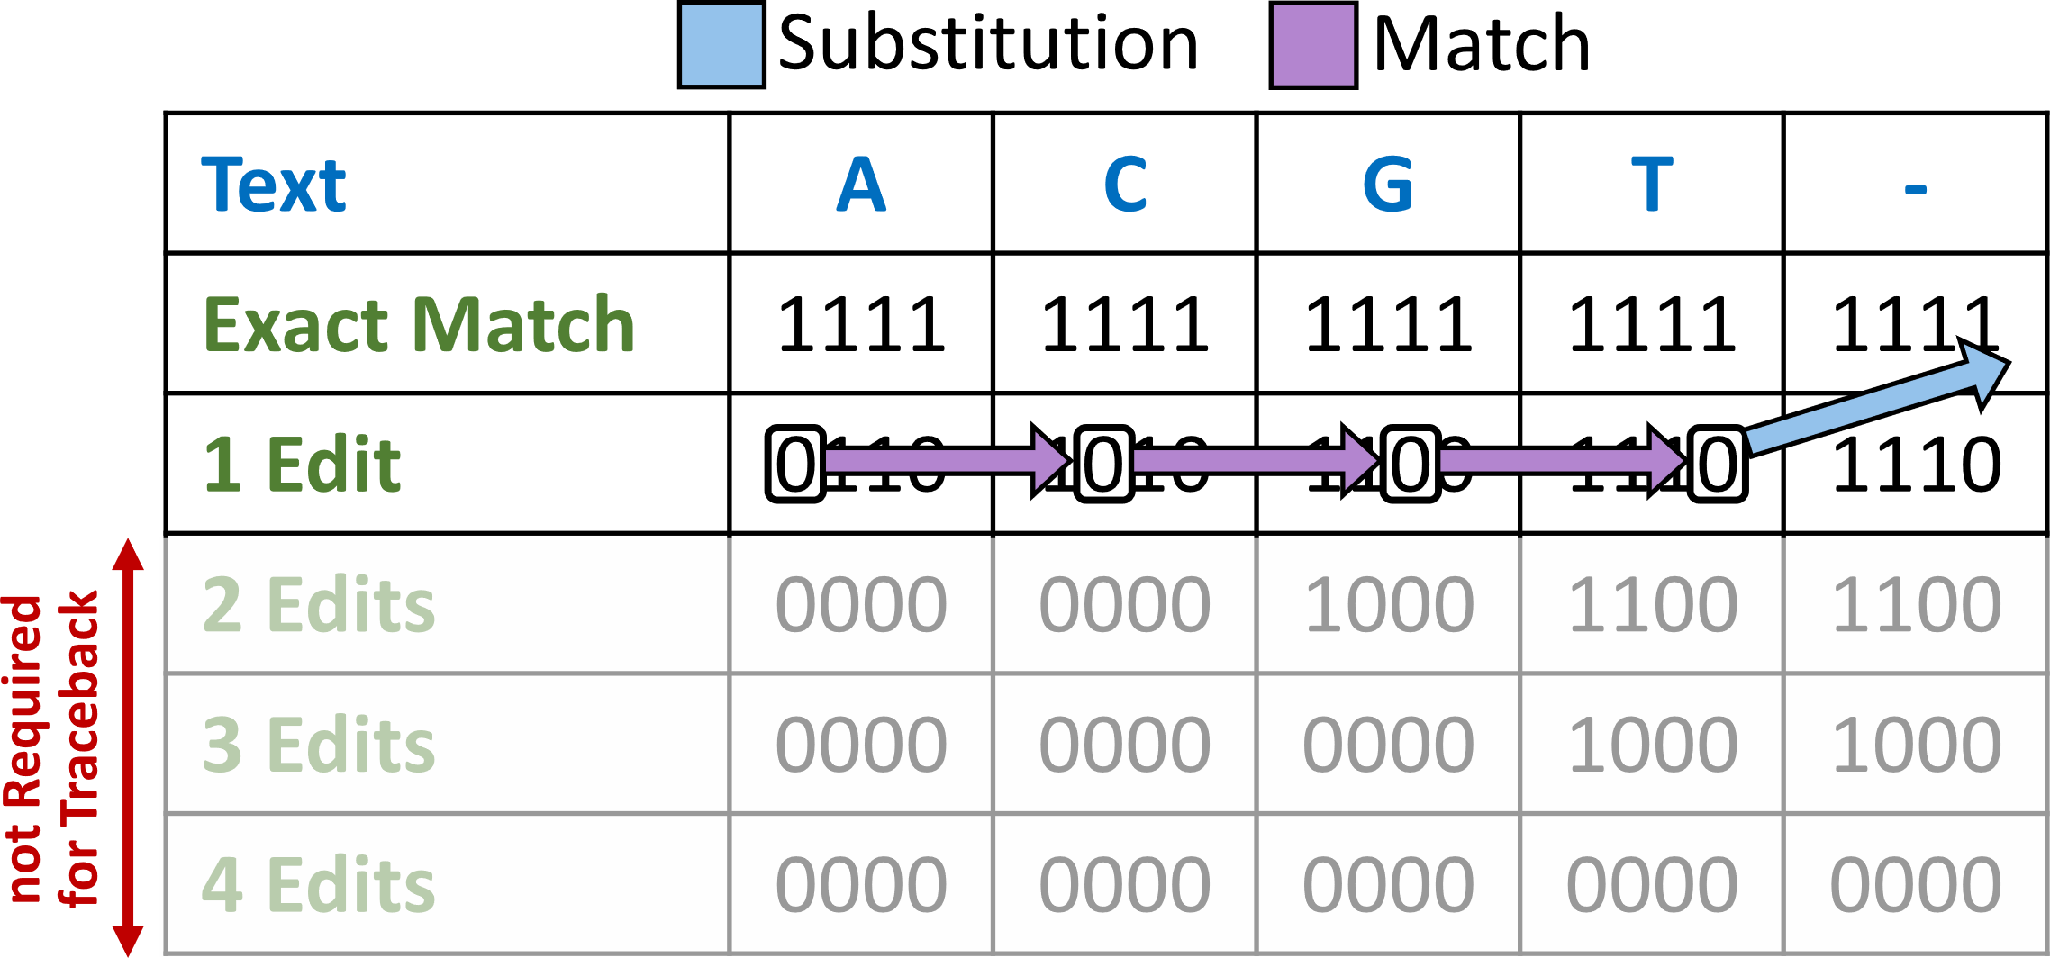
Scrooge Improvement 3: Early Termination (ET)
Rows below the edit distance do not contain useful information
Scrooge stops the computation when it finds the edit distance
ET eliminates unnecessary work and reduces data movement
Notes:
Third, we observe that rows below the edit distance do not contain useful information.
[Click] Thus, Scrooge stops the computation as soon as it finds the row with the edit distance
[Click] We call this improvement Early Termination, ET. It eliminates unnecessary work and reduces data movement.

Slide 11
Methodology
Platforms:
CPU: Dual Socket Intel Xeon Gold 5118 (2× 24 logical cores at 3.2GHz with 196GB DDR4)
GPU: NVIDIA A6000
Baseline Tools:
CPU: KSW2 [2,3], Edlib [4]
GPU: Darwin-GPU [5]
Dataset:
We simulate 500 PacBio reads from the human genome using PBSIM2 [6], each of length 10kb
We obtain 138,929 read/candidate location pairs from minimap2 [2]
Notes:
We experimentally evaluate our improvements through high-performance implementations for recent CPU and GPU platforms.
[Click] We compare to several baselines [Click] using a long read dataset.
Let’s look at some key results [Click]

Slide 12
Key Results
Scrooge is faster than all baselines
1.9x speedup over GenASM on a recent CPU
5.9x speedup over GenASM on a recent GPU
Notes:
We observe that Scrooge is faster than all baselines.
[Click] In particular, we observe a 1.9x speedup over GenASM on a recent CPU,
And [Click] a 5.9x speedup over GenASM on a recent GPU.

Slide 13
Discussion - ASIC
A prior ASIC implementation of GenASM [1] dedicates the majority of chip area and power to SRAM
[1] Senol Cali+, “GenASM: A High-Performance, Low-Power Approximate String Matching Acceleration Framework for Genome Sequence Analysis”, MICRO 2020
Our algorithmic improvements can reduce the SRAM size by 12x
Our algorithmic improvements could reduce GenASM’s total ASIC chip area and power by up to 2.5x and 2x
Notes:
Further, we observe that a prior ASIC implementation of GenASM dedicates the majority of chip area and power to SRAM.
[Click] Our algorithmic improvements can reduce the SRAM size by 12x.
[Click] Thus we calculate that our algorithmic improvements could reduce the total chip area and power by up to 2.5x and 2x respectively.

Slide 14
Conclusion
Motivation | Pairwise sequence alignment is a bottleneck in genomic pipelines (e.g., read mapping) GenASM is a state-of-the-art sequence aligner, its hardware implementation is up to 10,000x faster than prior software aligners and draws 500x less power
Problem | Three inefficiencies in the GenASM algorithm limit its throughput and energy efficiency: It has a large memory footprint It has a high bandwidth pressure It does some unnecessary work
Goal | Enable fast and efficient implementations of GenASM for CPUs, GPUs, and ASICs
Scrooge | Three novel algorithmic improvements to the GenASM algorithm: SENE and DENT reduce the memory footprint and data movement of GenASM Early Termination eliminates unnecessary work High-performance CPU and GPU implementations
Results | 1.9x speedup over GenASM on a recent CPU (Xeon Gold 5118) 5.9x speedup over GenASM on a recent GPU (NVIDIA A6000) Similar improvements to be expected for ASICs
Notes:
In conclusion, we advance the state of the art in pairwise sequence alignment by building on top of GenASM.
We have proposed Scrooge, which includes three novel algorithmic improvements, and high-performance CPU and GPU implementations of the improved algorithm.
We have experimentally demonstrated the benefits of our improvements for CPU and GPU implementations, and argue that similar benefits should be expected for ASICs.

Slide 15
Links
Source Code (Available Soon!)
Short Paper
Notes:
Scrooge’s source code will soon be available on github, and our short paper is available online.

Slide 16
Algorithmic Improvement and GPU Acceleration of the GenASM Algorithm
Joël Lindegger
Damla Senol Cali, Mohammed Alser, Juan Gómez-Luna, Onur Mutlu
jmlindegger@gmail.com
30/05/2022
HiCOMB 2022
Notes:
Thank your for your attention.

Slide 17
References
[1] Senol Cali+, “GenASM: A High-Performance, Low-Power Approximate String Matching Acceleration Framework for Genome Sequence Analysis”, MICRO 2020
[2] Li, “Minimap2: Pairwise Alignment for Nucleotide Sequences”, Bioinformatics 2018
[3] Suzuki+, “Introducing Difference Recurrence Relations for Faster Semi-Global Alignment of Long Sequences”, BMC Bioinformatics 2018
[4] Šošić+, “Edlib: A C/C++ Library for Fast, Exact Sequence Alignment Using Edit Distance”, Bioinformatics 2017
[5] Ahmed+, “GPU Acceleration of Darwin Read Overlapper for de Novo Assembly of Long DNA Reads”, BMC Bioinformatics 2020
[6] Ono+, “PBSIM2: A Simulator for Long-Read Sequencers With a Novel Generative Model of Quality Scores”, Bioinformatics 2020

Slide 18
Backup Slides

Slide 19
Why “Scrooge”?
Our algorithm has an extremely small memory footprint
In other words, it is extremely resource-saving, a common attribute of characters called “Scrooge” in pop culture

Slide 20
Speedup
Baseline Affine Gap Cost
Baseline Edit Distance
Scrooge
Edit Distance
Scrooge with the algorithmic improvements is significantly faster than GenASM on CPUs and GPUs.

Slide 21
Result - Parameter Sweeps are Necessary
The CPU version of Scrooge benefits most from ET and SENE, while DENT should not be used.
The GPU version of Scrooge benefits most from SENE and DENT, while ET only yields marginal speedups.
The best combination of improvements depends on the computing platform.

Slide 22
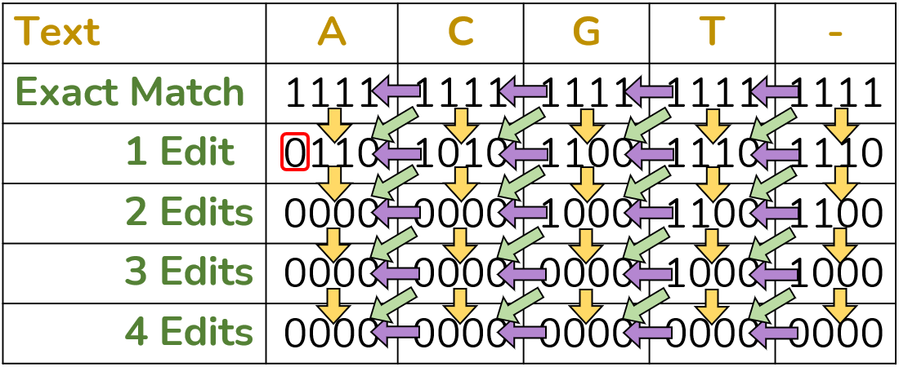
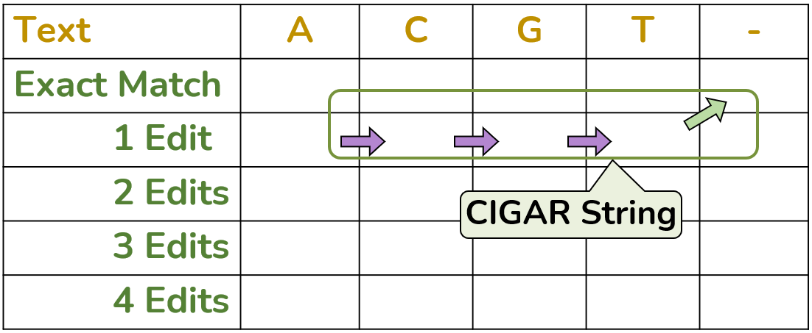
GenASM Algorithm
1.
Distance Calculation
Edit Distance
2.
Traceback

Slide 23
GenASM Distance Calculation
Input
Text | A | C | G | T | -
Exact Match
1 Edit
2 Edits
3 Edits
4 Edits
Edit Distance Limit
Pattern | A | C | G | A
Input
[1] Senol Cali+, “GenASM: A High-Performance, Low-Power Approximate String Matching Acceleration Framework for Genome Sequence Analysis”, MICRO 2020

Slide 24
GenASM Distance Calculation
Bitwise Update Rules
Substitution
Match
Input
Insertion
Deletion
Text | A | C | G | T | -
Exact Match | 1111 | 1111 | 1111 | 1111 | 1111
1 Edit | 0110 | 1010 | 1100 | 1110 | 1110
2 Edits | 0000 | 0000 | 1000 | 1100 | 1100
3 Edits | 0000 | 0000 | 0000 | 1000 | 1000
4 Edits | 0000 | 0000 | 0000 | 0000 | 0000
Edit Distance Limit
Pattern | A | C | G | A
Table of Bitvectors
Input
[1] Senol Cali+, “GenASM: A High-Performance, Low-Power Approximate String Matching Acceleration Framework for Genome Sequence Analysis”, MICRO 2020

Slide 25
GenASM Distance Calculation Output
Update Bitvectors
Match
Insertion
Deletion
Text | A | C | G | T | -
Exact Match
1 Edit
2 Edits
3 Edits
4 Edits
Edit Distance
[1] Senol Cali+, “GenASM: A High-Performance, Low-Power Approximate String Matching Acceleration Framework for Genome Sequence Analysis”, MICRO 2020

Slide 26
GenASM Traceback
Update Bitvectors
Match
Insertion
Deletion
Text | A | C | G | T | -
Exact Match
1 Edit
2 Edits
3 Edits
4 Edits
[1] Senol Cali+, “GenASM: A High-Performance, Low-Power Approximate String Matching Acceleration Framework for Genome Sequence Analysis”, MICRO 2020

Slide 27
GenASM Traceback
Update Bitvectors
Match
Insertion
Deletion
Text | A | C | G | T | -
Exact Match
1 Edit
2 Edits
3 Edits
4 Edits
[1] Senol Cali+, “GenASM: A High-Performance, Low-Power Approximate String Matching Acceleration Framework for Genome Sequence Analysis”, MICRO 2020

Slide 28
GenASM Traceback - Output
Update Bitvectors
Match
Insertion
Deletion
Text | A | C | G | T | -
Exact Match
1 Edit
2 Edits
3 Edits
4 Edits
CIGAR String
[1] Senol Cali+, “GenASM: A High-Performance, Low-Power Approximate String Matching Acceleration Framework for Genome Sequence Analysis”, MICRO 2020

