Slide 1




GenASM: A Low-Power, Memory-Efficient Approximate String Matching Acceleration Framework for Genome Sequence Analysis
Damla Senol Cali¹
Carnegie Mellon University
(dsenol@andrew.cmu.edu)
Gurpreet S. Kalsi², Zulal Bingol³, Lavanya Subramanian², Can Firtina⁴,
Jeremie Kim^{1,4}, Rachata Ausavarungnirun^{5,1}, Mohammed Alser⁴,
Anant Nori², Juan Gomez-Luna⁴, Amirali Boroumand¹, Allison Scibisz¹,
Sreenivas Subramoney², Can Alkan³, Saugata Ghose^{6,1}, and Onur Mutlu^{4,1,3}
To appear in MICRO 2020.
1 2 3 4
5 6
Notes:
Hello, I am Damla Senol Cali. Today, I'll be presenting our work "GenASM: A Low-Power, Memory-Efficient Approximate String Matching Acceleration Framework for Genome Sequence Analysis". This work will appear in MICRO 2020.

Slide 2

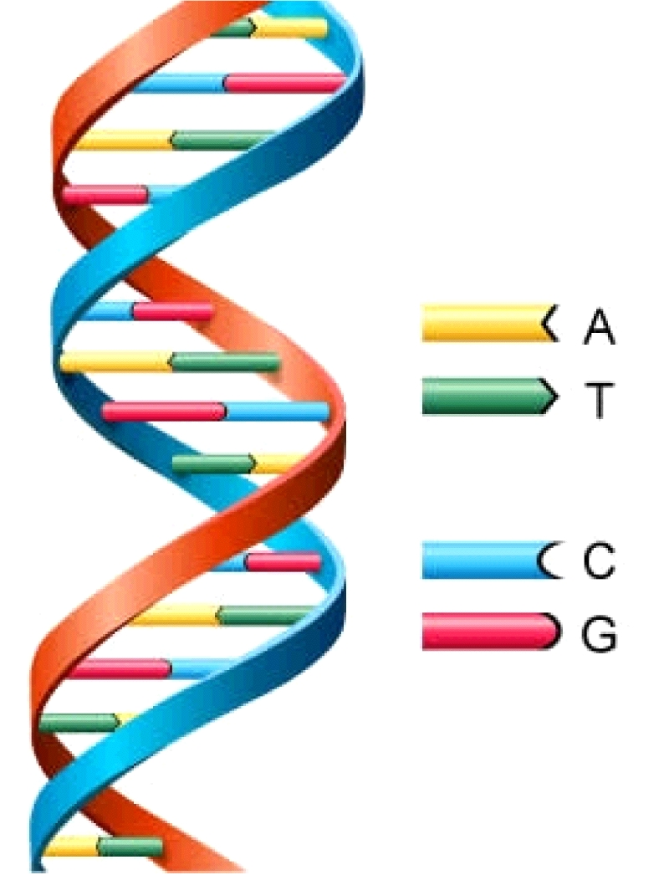
Genome Sequencing
Genome sequencing is the process of determining the order of the DNA sequence in an organism’s genome.
Genome sequencing is pivotal in:
  Personalized medicine
  Outbreak tracing
  Evolution
  Forensics
Genome
DNA
Notes:
The genetic material of an organism is called genome and each genome consists of DNA.
The information in DNA is encoded with a sequence of four different types of bases, A, C, G and T.
**COVID-19

Slide 3
Genome Sequencing (cont.)
Large DNA molecule
Small DNA fragments
ACGTACCCCGT
TTTTTTTAATT
ACGAGCGGGT
GATACACTGTG
AAAAAAAAAA
Reads
CTAGGGACCTT
ACGACGTAGCT
Notes:
As the whole genome of most organisms cannot be sequenced all at once, the genome is broken into smaller fragments.
After each fragment is sequenced, small pieces of DNA sequences (i.e. reads) are generated.

Slide 4
Genome Sequence Analysis
Genome sequence analysis requires:
Taking small DNA fragments from an organism
Reorganizing them into the entire genome
Success of all medical and genetic applications critically depends on:
  Existence of computational techniques that can process and analyze the enormous amount of sequence data quickly and accurately
Effectively leveraging genome sequencing as a tool:
  Requires very high computational power
  Requires processing a large amount of data
  Bottlenecked by the current capabilities of computer systems
Notes:
Since we lose the location information of these reads with respect to the original genome, ...

Slide 5
Read Mapping
Read mapping is the method of aligning reads against a reference genome to detect matches and variations.
One of the key components of genome sequence analysis.
Goal is to identify the original location of each read in the reference genome.
Sequenced genome may not exactly map to the reference genome
Reason: mutations, variations, sequencing errors
Multiple steps of read mapping must account for these errors.
Reference
Genome
Reference
Read
Notes:
A common approach to genome sequencing is to perform read mapping, where reads are assembled by finding their location in a reference genome.
Unfortunately, the bases in a read may not be identical to the bases in the reference genome at that original location for one of two reasons. First, the sequencing technologies introduce errors into the read fragments during extraction. Second, the read may contain mutations that are specific to the individual organism that the DNA was extracted from, which are not captured in the reference genome.
a base pair can be inserted, deleted, or substituted for another base pair

Slide 6
Problem & Our Goal
Multiple steps of read mapping are essentially a series of approximate (i.e., fuzzy) string matches
Approximate string matching makes up a significant portion of read mapping (i.e., more than 70%).
One of the key bottlenecks of the entire genome analysis pipeline.
Our Goal:
Accelerate approximate string matching by designing a fast and flexible framework,
which can be used to accelerate multiple steps of the genome sequence analysis pipeline
Notes:
Due to their need to account for edits, mutliple steps of read mapping are effectively a form of approximate (i.e., fuzzy) string matching (ASM), and can make use of existing ASM algorithms.
Typically, ASM uses an expensive quadratic-time dynamic programming algorithm.
This time-consuming algorithm accounts for over 70% of the execution time of read mapping [5], and acts as the bottleneck for the entire genome analysis pipeline.

Slide 7
Outline
Background
Motivation
ASM with Bitap Algorithm
GenASM: ASM Acceleration Framework
Use Cases of GenASM
Evaluation
Conclusion

Slide 8
Bitap Algorithm
We have focused on the Bitap algorithm^{1,2}
→ Reason: Bitap algorithm can perform ASM with fast and simple bitwise operations, which makes it amenable to acceleration
Step 1: Preprocessing
  For each character (A, C, G, T), generate a pattern bitmask
  Indicates if character exists at each position of the pattern.
Step 2: Searching (Edit Distance Calculation)
  Compare all characters of the text with the pattern by using:
    Pattern bitmasks
    Set of bitvectors that hold the status of the partial matches
    Bitwise operations
[1] R. A. Baeza-Yates and G. H. Gonnet. "A new approach to text searching." Communications of the ACM, 1992.
[2] S. Wu and U. Manber. "Fast text searching: allowing errors." Communications of the ACM, 1992.
Notes:
... to replace the dynamic programming algorithm ...
I won't go into the details of the algorithm due to time limit, please refer to our paper for the details of the algorithm and its limitations.

Slide 9
Outline
Background
Motivation
ASM with Bitap Algorithm
GenASM: ASM Acceleration Framework
Use Cases of GenASM
Evaluation
Conclusion

Slide 10
GenASM
Approximate string matching (ASM) acceleration framework based on the Bitap algorithm
Includes optimized ASM algorithm and new hardware
  Highly-parallel Bitap with small memory footprint
  Bitvector-based novel algorithm to perform traceback
    Finding the sequence of matches, substitutions, insertions and deletions, along with their positions
  Processing-in-Memory (PIM) accelerator for Bitap and traceback
Optimized for both 1) short yet accurate and 2) long but noisy reads
Notes:
In this work, we propose GenASM ...

Slide 11
GenASM Design
Memory
❷ reference
region and read
Logic Layer
GenASM-DC
Accelerator
❶ reference
and query
locations
DC-SRAM
Host CPU
❻ Find the traceback output
TB-SRAM for PE₁
GenASM-TB
Accelerator
TB-SRAM for PE₂
❸ Generate the bitvectors for the current window
❹ Write
bitvectors
.
.
❺ Read
bitvectors
TB-SRAM for PE_{n}
GenASM-DC:
generates bitvectors and performs edit
Distance Calculation
GenASM-TB: performs TraceBack and assembles the optimal alignment
Notes:
GenASM is composed of two main components: GenASM-DC and GenASM-TB.
DC-SRAM for writing the intermediate data required for DC execution.
TB-SRAMs for writing the bitvectors generated during DC execution, which are later used in the TB execution.
Although our accelerators can be ported anywhere in the system,
In order to achieve high parallelism and low power-consumption, we place GenASM-DC and GenASM-TB in the logic layer of 3D-stacked memory.
Our hardware is highly efficient in terms of area and power, which are within the budget limits of the logic layer.
Overall Mechanism:
When read mapping starts, the host CPU generates candidate locations in the reference genome for each read fragment ( 1 in Figure 2). For each candidate location, GenASM-DC reads the corresponding reference genome region and the read from the memory. GenASM-DC then writes these to its dedicated SRAM, which we call DC-SRAM ( 2 ). After that, GenASM-DC searches for the pattern within the text region using the modified Bitap algorithm and generates the bitvectors ( 3 ). Each processing element (PE) of GenASM-DC writes the generated bitvectors to its own dedicated SRAM, which we call TB-SRAM ( 4 ). Once GenASM-DC completes its search, GenASM-TB starts reading the stored bitvectors from TB-SRAMs ( 5 ) and generates the traceback output ( 6 ). Once GenASM-TB generates this output, it moves onto the next ref-read pair.

Slide 12
GenASM-DC: Hardware Design
GenASM-DC Hardware Accelerator (HWA) is implemented as a linear cyclic systolic array.
  Optimized to reduce memory bandwidth and memory footprint
Processing Core (PC)
Processing Element (PE)
PE-1
PE-2
PE-(p-1)
PE-p
Processing Block (PB)
Notes:
Processing Core (PC): Basic compute component which computes the intermediate bitvectors
Required logic is added around Processing Core to define PE:
Processing Element
Multiple Processing Elements are concatenated to define PB:
Processing Block

Slide 13
GenASM-TB: Hardware Design
Very simple logic:
  1) Reads the bitvectors from one of the TB-SRAMs using the computed address
  2) Performs the required computation and comparisons to find the traceback output for the current position
  3) Computes the next TB-SRAM address to read the new set of bitvectors

Slide 14
GenASM: Overall System
Notes:
We design our system around a 16GB 3D-stacked Hybrid Memory Cube (HMC) memory with 32 vaults (shown in Figure 8). Within each vault, the logic layer contains a GenASM-DC accelerator, its associated DC-SRAM (8KB), a GenASM-TB accelerator, and TB-SRAMs (64×1.5KB).
Each vault in 3D-stacked memory contains its own GenASM-DC and GenASM-TB hardware
→ vault-level parallelism

Slide 15
Outline
Background
Motivation
ASM with Bitap Algorithm
GenASM: ASM Acceleration Framework
Use Cases of GenASM
Evaluation
Conclusion

Slide 16
Use Cases of GenASM
Reference genome
Indexing
Hash-table based index
Seeding
Reads
Seeding
Potential mapping
locations
Reference
segment
Pre-Alignment Filtering
Query read
Non-filtered candidate mapping locations
Read Alignment
Optimal alignment
Notes:
In order to understand what are the use cases of GenASM, we need to look at the read mapping pipeline. Read mapping can be seen as a four-step process (i.e., seed-and- extend).
First, read mapping starts with indexing the reference genome. This index contains all possible fixed-length substrings as the keys, and the exact match locations of these substrings in the reference genome as values. Second, seeding queries the index structure for determining potential mapping locations of each read in the reference genome using substrings (i.e., seeds) from each read.
Third, pre-alignment filtering uses filtering heuristics to examine the similarity between every read and its potential matching segment on the reference genome that are identified in the second step. Goal is to eliminate most of the dissimilar sequences to decrease the number of required alignments. Fourth, for all of the non-filtered candidate mapping locations, read alignment (i.e., seed-extension) step performs a dynamic programming based alignment to determine the best location of the query read. As part of this step, traceback operation between the reference segment and the query is performed in order to find the optimal alignment.

Slide 17
Use Cases of GenASM (cont.)
Read Alignment Step of Read Mapping
  Also called verification or seed-extension
  GenASM can perform ASM between the query reads and the candidate regions and report the optimal alignment.
Pre-Alignment Filtering for Short Reads
  Filter out the dissimilar sequences
  GenASM can efficiently calculate the edit distance between the short read and the candidate text and decide whether it is above a user-defined threshold.
Edit Distance Calculation Between Any Two Sequences
  Fundamental operation in genomics
    Measure the similarity or distance between two sequences
  GenASM-DC is inherently an edit distance calculation accelerator
We also discuss other possible use cases of GenASM in our paper:
  Hash-table based indexing, whole genome alignment, generic text search

Slide 18
Outline
Background
Motivation
ASM with Bitap Algorithm
GenASM: ASM Acceleration Framework
Use Cases of GenASM
Evaluation
Conclusion

Slide 19
Evaluation Methodology
16GB HMC-like 3D-stacked DRAM architecture
  32 vaults
  256GB/s of internal bandwidth, and
  a clock frequency of 1.25GHz
Datasets:
  Simulated long read datasets (ONT and PacBio)
    10Kbp reads with 10-15% error rate
  Simulated short read datasets (Illumina)
    100-250bp reads with 5% error rate
Notes:
3D-stacked DRAM arch.
two different datasets to show our applicability for both short and long reads

Slide 20
Evaluation Methodology (cont.)
For Use Case 1: Read Alignment, we compare GenASM with:
  Two state-of-the-art read mappers: Minimap2¹ and BWA-MEM²
    Compare GenASM only with the alignment steps of these mappers
    Running on Intel® Xeon® Gold 6126 CPU (12-core) operating @ 2.60GHz with 64GB DDR4 memory
  Two state-of-the-art accelerators, Darwin³ and GenAx⁴
    Compare GenASM only with the alignment components of these accelerators (GACT for Darwin, SillaX for GenAx)
[1] H. Li. "Minimap2: pairwise alignment for nucleotide sequences." In Bioinformatics, 2018.
[2] H. Li. "Aligning sequence reads, clone sequences and assembly contigs with BWA-MEM." In arXiv, 2013.
[3] Y. Turakhia et al. "Darwin: A genomics co-processor provides up to 15,000 x acceleration on long read assembly." In ASPLOS, 2018.
[4] D. Fujiki et al. "GenAx: A genome sequencing accelerator." In ISCA, 2018.
Notes:
I will show the details of the evaluation of our first use case: alignment as part of this presentation due to time limitation.
We compared GenASM against state-of-the-art hardware and software

Slide 21
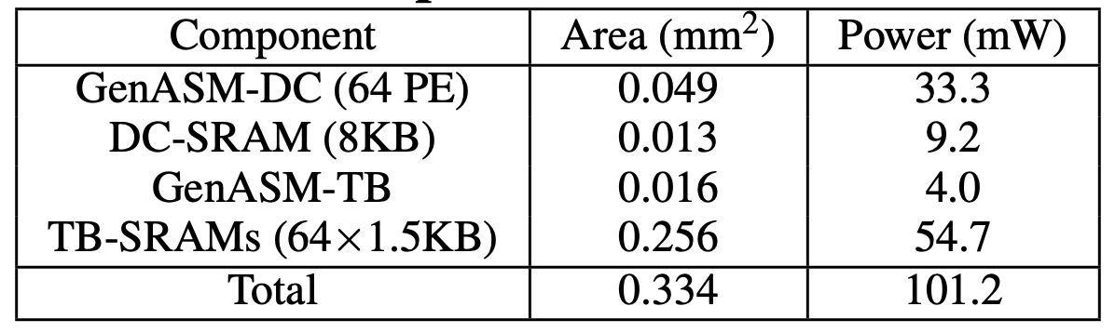
Key Results – Area and Power
Both GenASM-DC and GenASM-TB operates @ 1GHz
Based on our synthesis of the GenASM-DC and GenASM-TB accelerator datapath using Synopsys Design Compiler with a typical 28 nm LP process:
Total power consumption of all 32 vaults 3.24W
Total area overhead of all 32 vaults is 10.69 mm²

Slide 22
Key Results (Use Case 1) – Long Reads
Long Read Datasets:
  Compared to 12-thread runs of Minimap2 and BWA-MEM:
  Compared to Darwin-GACT:
    3.8× better throughput
    2.7× less power consumption
116× speedup
and
37× less power consumption
648× speedup
and
34× less power consumption

Slide 23
Key Results (Use Case 1) – Short Reads
Short Read Datasets:
  Compared to 12-thread runs of Minimap2 and BWA-MEM:
  Compared to GenAx-SillaX:
    1.9× better throughput
    Comparable area and power consumption
158× speedup
and
30× less power consumption
111× speedup
and
33× less power consumption

Slide 24
Key Results (Use Cases 2 & 3)
Pre-Alignment Filtering for Short Reads
  Use Case 2
  3.6× speedup vs. Shouji
  GenASM also significantly improves the filtering accuracy
Edit Distance Calculation
  Use Case 3
  246 – 5668× speedup vs. Edlib
See our MICRO 2020 paper for more details
Notes:
Please refer to our paper for the evaluation of other two use cases and for more details

Slide 25
Outline
Background
Motivation
ASM with Bitap Algorithm
GenASM: ASM Acceleration Framework
Use Cases of GenASM
Evaluation
Conclusion

Slide 26
Conclusion
Problem:
  Genome sequence analysis is bottlenecked by the computational power and memory bandwidth limitations of existing systems.
  This bottleneck is particularly an issue for approximate string matching.
Goal: Provide an approximate string matching (ASM) acceleration framework in order to accelerate multiple steps of genome sequence analysis
Key Contributions:
  First to enhance and accelerate Bitap for ASM with genomic sequences
  GenASM: approximate string matching (ASM) acceleration framework
    Co-design of our modified scalable and memory-efficient algorithms with low-power and area-efficient hardware accelerators
    Evaluation of three different use cases of ASM in genomics: read alignment, edit distance calculation, and pre-alignment filtering.
Key Results: GenASM is significantly more efficient for all the three use cases (in terms of throughput and throughput per unit power) than state-of-the-art software and hardware baselines.
Notes:
In this work, we focus on approximate string matching because it is one of the main bottlenecks of genome sequence analysis.
Our goal is to ....
We propose the first ...
GenASM is a novel ASM acceleration framework where we co-design ...
We have evaluated ...
And show that ...

Slide 27
GenASM: A Low-Power, Memory-Efficient Approximate String Matching Acceleration Framework for Genome Sequence Analysis
Damla Senol Cali¹
Carnegie Mellon University
(dsenol@andrew.cmu.edu)
Gurpreet S. Kalsi², Zulal Bingol³, Lavanya Subramanian², Can Firtina⁴,
Jeremie Kim^{1,4}, Rachata Ausavarungnirun^{5,1}, Mohammed Alser⁴,
Anant Nori², Juan Gomez-Luna⁴, Amirali Boroumand¹, Allison Scibisz¹,
Sreenivas Subramoney², Can Alkan³, Saugata Ghose^{6,1}, and Onur Mutlu^{4,1,3}
To appear in MICRO 2020.
1 2 3 4
5 6
Notes:
Thank you!

