Slide 1




GenASM: A High Performance, Low-Power Approximate String Matching Acceleration Framework for Genome Sequence Analysis
Damla Senol Cali
Carnegie Mellon University
(dsenol@andrew.cmu.edu)
Gurpreet S. Kalsi², Zulal Bingol³, Can Firtina⁴, Lavanya Subramanian⁵,
Jeremie Kim^{1,4}, Rachata Ausavarungnirun^{6,1}, Mohammed Alser⁴,
Juan Gomez-Luna⁴, Amirali Boroumand¹, Anant Nori², Allison Scibisz¹,
Sreenivas Subramoney², Can Alkan³, Saugata Ghose^{7,1}, and Onur Mutlu^{4,1,3}
1 2 3 4
5 6 7 1,4
Notes:
Hello, I am Damla Senol Cali. Today, I'll be presenting our work "GenASM: A High Performance, Low-Power Approximate String Matching Acceleration Framework for Genome Sequence Analysis".

Slide 2
Genome Sequencing
Genome sequencing: Enables us to determine the order of the DNA sequence in an organism’s genome
  Plays a pivotal role in:
    Personalized medicine
    Outbreak tracing
    Understanding of evolution
Modern genome sequencing machines extract smaller randomized fragments of the original DNA sequence, known as reads
  Short reads: a few hundred base pairs, error rate of ∼0.1%
  Long reads: thousands to millions of base pairs, error rate of 10–15%
Notes:
[CLICK] Genome sequencing, which enables us to determine the DNA sequence of an organism, [CLICK] plays a pivotal role in areas such as personalized medicine, outbreak tracing (like COVID-19), and the understanding of evolution.
[CLICK] Modern genome sequencing machines extract small randomized fragments of the original DNA sequence, which we call reads.
[CLICK] State-of-the-art sequencing machines produce either short reads or long reads

Slide 3
Genome Sequence Analysis
Read mapping: First key step in genome sequence analysis (GSA)
  Aligns reads to one or more possible locations within the reference genome, and
  Finds the matches and differences between the read and the reference genome segment at that location
Multiple steps of read mapping require approximate string matching
  Approximate string matching (ASM) enables read mapping to account for sequencing errors and genetic variations in the reads
Bottlenecked by the computational power and memory bandwidth limitations of existing systems
Notes:
[CLICK] Read mapping is the first key step in genome sequence analysis, [CLICK] where we take each read, align it to one or more possible locations within the reference genome, and find the matches and differences between the read and the reference genome segment at that location.
[CLICK] Multiple steps of read mapping must account for the sequencing errors, and for the differences caused by genetic variations. As a result, read mapping must perform approximate string matching (ASM).
[CLICK] However, it is currently bottlenecked by the computational power and memory bandwidth limitations of existing systems.

Slide 4
GenASM: ASM Framework for GSA
Our Goal:
Accelerate approximate string matching
by designing a fast and flexible framework,
which can accelerate multiple steps of genome sequence analysis
GenASM: First ASM acceleration framework for GSA
  Based upon the Bitap algorithm
    Uses fast and simple bitwise operations to perform ASM
  Modified and extended ASM algorithm
    Highly-parallel Bitap with long read support
    Novel bitvector-based algorithm to perform traceback
  Co-design of our modified scalable and memory-efficient algorithms with low-power and area-efficient hardware accelerators
Notes:
[CLICK] Our goal in this work is to design a fast and flexible framework for both short and long reads, which can accelerate multiple steps of genome sequence analysis (GSA).
[CLICK] To this end, we propose GenASM.
[CLICK] We base GenASM on Bitap, an ASM algorithm that uses only fast and simple bitwise operations, making it amenable to efficient hardware acceleration. To our knowledge, GenASM is the first work that enhances and accelerates Bitap.
[CLICK] We modify Bitap to support long reads and to enable parallelization.
We also develop a novel Bitap-compatible algorithm for traceback
[CLICK] And, we co-design specialized hardware for both algorithms.

Slide 5
Use Cases & Key Results
Read Alignment
116× speedup, 37× less power than Minimap2 (state-of-the-art SW)
111× speedup, 33× less power than BWA-MEM (state-of-the-art SW)
3.9× better throughput, 2.7× less power than Darwin (state-of-the-art HW)
1.9× better throughput, 82% less logic power than GenAx (state-of-the-art HW)
Pre-Alignment Filtering
3.7× speedup, 1.7× less power than Shouji (state-of-the-art HW)
Edit Distance Calculation
22–12501× speedup, 548–582× less power than Edlib (state-of-the-art SW)
9.3–400× speedup, 67× less power than ASAP (state-of-the-art HW)
Notes:
GenASM is flexible and can be used to accelerate multiple use cases.
In this work, we evaluate three use cases in detail: [CLICK] read alignment, [CLICK] pre-alignment filtering and [CLICK] edit distance calculation.
We find that, for all the three use cases [CLICK] [CLICK] [CLICK], GenASM is significantly more efficient in terms of both speed and power consumption than state-of-the-art software and hardware baselines

Slide 6
Outline
Introduction
Background
  Approximate String Matching (ASM)
  ASM with Bitap Algorithm
GenASM: ASM Acceleration Framework
  GenASM Algorithm
  GenASM Hardware Design
  Use Cases of GenASM
Evaluation
Conclusion
Notes:
Let’s look at approximate string matching and the bitap algorithm in detail.

Slide 7
Approximate String Matching
Sequenced genome may not exactly map to the reference genome due to genetic variations and sequencing errors
Approximate string matching (ASM):
  Detect the differences and similarities between two sequences
  In genomics, ASM is required to:
    Find the minimum edit distance (i.e., total number of edits)
    Find the optimal alignment with a traceback step
          Sequence of matches, substitutions, insertions and deletions, along with their positions
  Usually implemented as a dynamic programming (DP) based algorithm
Reference:
Read:
AAAATGTTTAGTGCTACTG
AAAATGTTTACTGCTACTTG
AAAATGTTTAGTGCTACTG
AAATGTTTACTGCTACTTG
AAAATGTTTAGTGCTACTTG
AAAATGTTTAGTGCTACTTG
AAAATGTTTAGTGCTACTG
AAAATGTTTAGTGCTACTTG
A
G
C
T
deletion
substitution
insertion
Notes:
As I introduced, read mapping is the first key step in genome sequence analysis.
[CLICK] When we are mapping the reads generated from the sequenced genome, they may not exactly map to the reference genome due to genetic variations and sequencing errors.
[CLICK] As we can see from this example, these errors and differences (which are also known as edits) can take the form of base [CLICK] deletions, [CLICK] substitutions and [CLICK] insertions.
[CLICK] Since multiple steps of read mapping must account for these errors, they must perform approximate string matching (ASM).
[CLICK] The goal of approximate string matching is to detect the differences and similarities between two sequences.
[CLICK] In genomics, ASM is required
[CLICK] (1) to determine the minimum number of edits between two genomic sequences (which is called edit distance), and also
[CLICK] (2) to find the optimal alignment with a traceback step., where we find the sequence of matches, substitutions, insertions and deletions, along with their positions.
[CLICK] Approximate string matching is typically implemented as a dynamic programming based algorithm, which has quadratic time and space complexity. Therefore, it is desirable to find lower-complexity algorithms for ASM.

Slide 8
Bitap Algorithm
Bitap^{1,2} performs ASM with fast and simple bitwise operations
  Amenable to efficient hardware acceleration
  Computes the minimum edit distance between a text (e.g., reference genome) and a pattern (e.g., read) with a maximum of k errors
Step 1: Pre-processing (per pattern)
  Generate a pattern bitmask (PM) for each character in the alphabet (A, C, G, T)
  Each PM indicates if character exists at each position of the pattern
Step 2: Searching (Edit Distance Calculation)
  Compare all characters of the text with the pattern by using:
    Pattern bitmasks
    Status bitvectors that hold the partial matches
    Bitwise operations
[1] R. A. Baeza-Yates and G. H. Gonnet. "A New Approach to Text Searching." CACM, 1992.
[2] S. Wu and U. Manber. "Fast Text Searching: Allowing Errors." CACM, 1992.
Notes:
[CLICK] One candidate to replace DP-based algorithms for ASM is the Bitap algorithm. Bitap uses only fast and simple bitwise operations to perform ASM, making it amenable to efficient hardware acceleration.
[CLICK] Bitap tackles the problem of computing the minimum edit distance between a reference text (e.g., reference genome) and a query pattern (e.g., read) with a maximum of k errors.
The algorithm has two steps. [CLICK]
Bitap starts with a pre-processing procedure
[CLICK] where we generate one pattern bitmask for each character in the alphabet. These pattern bitmasks help us to represent the query pattern in a binary format.
Second step (searching or edit distance calculation) is the main step of the algorithm. Here, [CLICK] we examine each text character one by one, by using
[CLICK] 1) the pre-processed pattern bitmasks,
[CLICK] 2) status bitvectors which are updated at each text iteration and hold the partial match information for the text characters examined so far, and
[CLICK] 3) the simple bitwise operations.

Slide 9
Bitap Algorithm (cont’d.)
Step 2: Edit Distance Calculation
For each character of the text (char):
    Copy previous R bitvectors as oldR
    R[0] = (oldR[0] << 1) | PM [char]
    For d = 1…k:
    deletion = oldR[d-1]
    substitution = oldR[d-1] << 1
    insertion = R[d-1] << 1
    match = (oldR[d] << 1) | PM [char]
    R[d] = deletion & mismatch & insertion & match
    Check MSB of R[d]:
    If 1, no match.
    If 0, match with d many errors.
Large number of iterations
Notes:
I won’t get into the details of the algorithm, but let me highlight the three key properties of it.
First, Bitap iterates over each text character as the outer loop and it iterates over each possible edit distance (1 to k) as the inner loop.
Thus, when we have long error-prone reads, both of these loops need to iterate over very large numbers.

Slide 10
Bitap Algorithm (cont’d.)
Step 2: Edit Distance Calculation
For each character of the text (char):
    Copy previous R bitvectors as oldR
    R[0] = (oldR[0] << 1) | PM [char]
    For d = 1…k:
    deletion = oldR[d-1]
    substitution = oldR[d-1] << 1
    insertion = R[d-1] << 1
    match = (oldR[d] << 1) | PM [char]
    R[d] = deletion & mismatch & insertion & match
    Check MSB of R[d]:
    If 1, no match.
    If 0, match with d many errors.
Data dependency between iterations (i.e., no parallelization)
Notes:
Second, There is two-level data dependency in Bitap.
[CLICK] There is an outer loop data dependency when computing deletion, substitution and match bitvectors as they require oldR bitvectors which are coming from previous text iteration.
[CLICK] Also, there is an inner loop data dependency when computing insertion bitvector as it requires R[d-1] which is coming from previous inner loop iteration.

Slide 11
Bitap Algorithm (cont’d.)
Step 2: Edit Distance Calculation
For each character of the text (char):
    Copy previous R bitvectors as oldR
    R[0] = (oldR[0] << 1) | PM [char]
    For d = 1…k:
    deletion = oldR[d-1]
    substitution = oldR[d-1] << 1
    insertion = R[d-1] << 1
    match = (oldR[d] << 1) | PM [char]
    R[d] = deletion & mismatch & insertion & match
    Check MSB of R[d]:
    If 1, no match.
    If 0, match with d many errors.
Does not store and process these intermediate bitvectors to find the optimal alignment (i.e., no traceback)
Notes:
And third, Bitap generates these four intermediate bitvectors but they are not stored and processed with a traceback step to find the optimal alignment

Slide 12
Limitations of Bitap
Algorithm
Data Dependency Between Iterations:
  Two-level data dependency forces the consecutive iterations to take place sequentially
No Support for Traceback:
  Bitap does not include any support for optimal alignment identification
No Support for Long Reads:
  Each bitvector has a length equal to the length of the pattern
  Bitwise operations are performed on these bitvectors
Limited Compute Parallelism:
  Text-level parallelism
  Limited by the number of compute units in existing systems
Limited Memory Bandwidth:
  High memory bandwidth required to read and write the computed bitvectors to memory
Hardware
Notes:
We find that Bitap has five limitations that hinder its applicability and efficient hardware acceleration for genome sequence analysis.
[CLICK] [CLICK] We have already covered the first two algorithmic limitations.
[CLICK] We find one more algorithmic limitation, which is no support for long reads. In Bitap, the query length so read length is limited by the word size of the machine running the algorithm because each bitvector has a length equal to the length of the pattern and we perform the bitwise operations on these bitvectors. Thus, the algorithm does not support long reads, whose lengths are on the order of thousands to millions of base pairs
[CLICK] These are the algorithmic limitations of the Bitap algorithm.
Even after we solve the algorithmic limitations of Bitap, we find that we cannot extract significant performance benefits with algorithmic enhancements alone.
[CLICK] 4) For example, while Bitap iterates over each character of the input text sequentially, we can enable text-level parallelism to improve its performance. However, the achievable level of parallelism is limited by the number of compute units in existing systems.
5) We would expect that a GPU, which has thousands of compute units, can overcome the limited compute parallelism issues that CPUs experience. [CLICK] However, we find that a GPU implementation of the Bitap algorithm suffers from the limited amount of memory bandwidth available for each GPU thread.
[CLICK] And these are the HW-related limitations.
In order to overcome these limitations and design an efficient accelerator, we find that we need to both (1) modify and extend the Bitap algorithm and (2) develop specialized hardware that can exploit the new opportunities that our algorithmic modifications provide.

Slide 13
Outline
Introduction
Background
  Approximate String Matching (ASM)
  ASM with Bitap Algorithm
GenASM: ASM Acceleration Framework
  GenASM Algorithm
  GenASM Hardware Design
  Use Cases of GenASM
Evaluation
Conclusion
Notes:
To this end, we propose GenASM, an ASM acceleration framework for genome sequence analysis.

Slide 14
GenASM: ASM Framework for GSA
Approximate string matching (ASM) acceleration framework based on the Bitap algorithm
First ASM acceleration framework for genome sequence analysis
We overcome the five limitations that hinder Bitap’s use in genome sequence analysis:
  Modified and extended ASM algorithm
    Highly-parallel Bitap with long read support
    Novel bitvector-based algorithm to perform traceback
  Specialized, low-power and area-efficient hardware for both modified Bitap and novel traceback algorithms
Notes:
[CLICK] To our knowledge, GenASM is the first ASM acceleration framework for GSA and it is also first that enhances and accelerates Bitap.
[CLICK] We make significant modifications to Bitap in order to overcome those five limitations.
[CLICK] First, we modify the Bitap algorithm, by extending it to support long reads and by eliminating loop-carried data dependencies to enable parallelization.
[CLICK] Second, we develop a novel Bitap-compatible algorithm for traceback, which uses information collected during ASM about the different types of errors to identify the optimal alignment of reads.
[CLICK] these cover the algorithmic contributions of GenASM
[CLICK] And third, we co-design specialized, low-power and area-efficient hardware for both algorithms.
[CLICK] and this covers the hardware-level contributions of GenASM

Slide 15
GenASM Algorithm
GenASM-DC Algorithm:
  Modified Bitap for Distance Calculation
  Extended for efficient long read support
  Besides bit-parallelism that Bitap has, extended for parallelism:
    Loop unrolling
    Text-level parallelism
GenASM-TB Algorithm:
  Novel Bitap-compatible TraceBack algorithm
  Walks through the intermediate bitvectors (match, deletion, substitution, insertion) generated by GenASM-DC
  Follows a divide-and-conquer approach to decrease the memory footprint
Notes:
[CLICK] Our first algorithm GenASM-DC
[CLICK] is the modified Bitap algorithm for distance calculation, where
[CLICK] we extend it to provide efficient support for long reads, and
[CLICK] we enable parallelism besides bit-parallelism that baseline Bitap provides by
[CLICK] performing loop unrolling and removing the loop dependencies and
[CLICK] exploiting text-level parallelism, where we divide the text into overlapping sub-texts and search the query in each of these sub-texts in parallel.
[CLICK] Our second algorithm, GenASM-TB, is a novel Bitap-compatible traceback algorithm,.
[CLICK] which walks through the intermediate bitvectors (match, deletion, substitution, insertion) generated by GenASM-DC and finds the optimal alignment.
[CLICK] In order to decrease the memory footprint of the algorithm, it follows a divide-and-conquer approach, where we divide the text and pattern into overlapping windows and perform the traceback computation for each window. After all of the windows’ partial traceback outputs are generated, we merge them to find the complete traceback output.

Slide 16
GenASM Hardware Design
Main Memory
GenASM-DC
GenASM-DC
GenASM-TB
GenASM-DC
Accelerator
GenASM-TB
GenASM-DC
Accelerator
DC-SRAM
DC-SRAM
TB-SRAM₁
TB-SRAM₁
GenASM-TB
Accelerator
GenASM-TB
Accelerator
TB-SRAM₂
Host CPU
TB-SRAM₂
.
.
.
TB-SRAM_{n}
TB-SRAM_{n}
GenASM-DC:
generates bitvectors
and performs edit
Distance Calculation
GenASM-TB: performs TraceBack and assembles the optimal alignment
Notes:
Let’s look at the HW design of GenASM.
Our co-designed hardware consists of two components:
[CLICK] (1) GenASM-DC, which provides hardware support to efficiently execute our GenASM-DC algorithm to perform distance calculation; and
[CLICK] (2) GenASM-TB, which provides hardware support to efficiently execute our novel GenASM-TB algorithm to find the optimal alignment.
GenASM also has two types of SRAM buffers: [CLICK] DC-SRAM and [CLICK] TB-SRAMs
Let’s look at the high-level overview of GenASM

Slide 17
GenASM Hardware Design
Main Memory
GenASM-DC
GenASM-DC
GenASM-TB
GenASM-DC
Accelerator
GenASM-TB
GenASM-DC
Accelerator
DC-SRAM
DC-SRAM
2
2
reference text
& query pattern
7
reference text
& query pattern
sub-text &
sub-pattern
Find the
traceback output
3
sub-text &
sub-pattern
3
TB-SRAM₁
TB-SRAM₁
GenASM-TB
Accelerator
GenASM-TB
Accelerator
6
5
6
5
TB-SRAM₂
Host CPU
TB-SRAM₂
Write
bitvectors
Write
bitvectors
Read
bitvectors
.
.
.
Read
bitvectors
1
1
TB-SRAM_{n}
reference & query locations
TB-SRAM_{n}
reference & query locations
Generate
bitvectors
Generate
bitvectors
4
4
GenASM-DC:
generates bitvectors
and performs edit
Distance Calculation
GenASM-TB: performs TraceBack and assembles the optimal alignment
Notes:
[CLICK] GenASM execution starts when the host CPU issues a task to GenASM with the reference and the query sequences’ locations.
[CLICK] GenASM-DC reads the corresponding reference text region and the query pattern from the memory, and then writes these to its dedicated SRAM, DC-SRAM.
[CLICK] After that, GenASM-DC divides the reference text and query pattern into multiple overlapping windows, and
[CLICK] for each sub-text and sub-pattern, GenASM-DC searches for the sub-pattern within the sub-text and generates the bitvectors.
[CLICK] GenASM-DC writes the generated bitvectors to TB-SRAMs. Once GenASM-DC completes its search for the current window,
[CLICK] GenASM-TB starts reading the stored bitvectors from TB-SRAMs and
[CLICK] generates the window’s traceback output.
Once GenASM-TB generates this output, GenASM computes the next window and repeats Steps 3–7 until all windows are completed.

Slide 18
GenASM Hardware Design
Main Memory
GenASM-DC
GenASM-DC
GenASM-TB
GenASM-DC
Accelerator
GenASM-TB
GenASM-DC
Accelerator
DC-SRAM
DC-SRAM
2
reference text
& query pattern
7
sub-text &
sub-pattern
Find the
traceback output
3
TB-SRAM₁
TB-SRAM₁
GenASM-TB
Accelerator
GenASM-TB
Accelerator
5
TB-SRAM₂
6
Host CPU
TB-SRAM₂
Write
bitvectors
.
.
.
Read
bitvectors
1
TB-SRAM_{n}
reference & query locations
TB-SRAM_{n}
Generate
bitvectors
4
GenASM-DC:
generates bitvectors
and performs edit
Distance Calculation
GenASM-TB: performs TraceBack and assembles the optimal alignment
Our specialized compute units and on-chip SRAMs help us to:
Match the rate of computation with memory capacity and bandwidth
Achieve high performance and power efficiency
Scale linearly in performance with the number of parallel compute units that we add to the system
Notes:
[CLICK] Our specialized compute units and on-chip SRAMs helps us to:
[CLICK] (1) Match the rate of computation with memory capacity and bandwidth
[CLICK] (2) Achieve high performance and power efficiency
[CLICK] (3) Scale linearly in performance with the number of parallel compute units that we add to the system

Slide 19
GenASM-DC: Hardware Design
Linear cyclic systolic array based accelerator
  Designed to maximize parallelism and minimize memory bandwidth and memory footprint
Processing Block (PB)
Processing Core (PC)
Notes:
Let's look at GenASM-DC's hardware design.
[CLICK] We implement GenASM-DC as a linear cyclic systolic array based accelerator, using small and very simple logic components.
[CLICK] This design helps us to maximize parallelism and minimize memory BW and footprint.
[CLICK] Processing Core is the basic compute component which computes the intermediate bitvectors
[CLICK] and when we add the flip-flop-based storage logic around Processing Core, we define a Processing Element (PE)
[CLICK] Multiple PEs are concatenated to define a Processing Block
[CLICK] We also have DC-SRAM, which stores the reference text, the pattern bitmasks for the query read, and the intermediate data generated from PEs, and we also have
[CLICK] TB-SRAMs, which store the intermediate bitvectors generated by each PE of GenASM-DC for later use by GenASM-TB.

Slide 20
GenASM-TB: Hardware Design
1
1
Last CIGAR
1
2
.
.
64
Last CIGAR
1
2
.
.
64
64
64
match
match
2
2
CIGAR string
CIGAR string
Bitwise Comparisons
64
Bitwise Comparisons
64
insertion
insertion
CIGAR
out
192
CIGAR
out
192
deletion
64
deletion
64
3
3
Next Rd Addr Compute
subs
Next Rd Addr Compute
64
subs
64
<<
<<
1.5KB
TB-SRAM₁
1.5KB
TB-SRAM₂
GenASM-TB
1.5KB
TB-SRAM₆₄
to main
memory
Very simple logic:
  ❶Reads the bitvectors from one of the TB-SRAMs using the computed address
  ❷Performs the required bitwise comparisons to find the traceback output for the current position
  ❸Computes the next TB-SRAM address to read the new set of bitvectors
1
2
3
Notes:
[CLICK] We implement GenASM-TB hardware using very simple logic, which
[CLICK] 1) reads the bitvectors from one of the TB-SRAMs using the computed address,
[CLICK] 2) performs the required bitwise comparisons to find the traceback output for the current position, and
[CLICK] 3) computes the next TB-SRAM address to read the new set of bitvectors.
After GenASM-TB finds the complete traceback output (which is also called CIGAR string), [CLICK] it writes the output to main memory and completes its execution.

Slide 21
Use Cases of GenASM
Read Alignment Step of Read Mapping
  Find the optimal alignment of how reads map to candidate reference regions
Pre-Alignment Filtering for Short Reads
  Quickly identify and filter out the unlikely candidate reference regions for each read
Edit Distance Calculation
  Measure the similarity or distance between two sequences
We also discuss other possible use cases of GenASM in our paper:
  Read-to-read overlap finding, hash-table based indexing, whole genome alignment, generic text search
Notes:
We demonstrate the efficiency and flexibility of the GenASM acceleration framework by describing three use cases of approximate string matching in genome sequence analysis:
[CLICK] (1) read alignment step of short and long read mapping,
Which is the most time consuming step of read mapping that we align each read to all of its candidate reference regions and then find the optimal alignment.
[CLICK] (2) pre-alignment filtering for short reads,
Where we aim to quickly identify and filter out the unlikely candidate reference regions of each read by approximating the edit distance between them and filter out if it is above a threshold.
[CLICK] (3) edit distance calculation between any two arbitrary-length sequences.
Which is one of the fundamental operations in genomics that measures the similarity or distance btw two sequences
[CLICK] We believe the GenASM framework can be useful for many other use cases, and we discuss some of them briefly in our paper.

Slide 22
Outline
Introduction
Background
  Approximate String Matching (ASM)
  ASM with Bitap Algorithm
GenASM: ASM Acceleration Framework
  GenASM Algorithm
  GenASM Hardware Design
  Use Cases of GenASM
Evaluation
Conclusion
Notes:
Let’s look at our evaluation of the GenASM design and framework.

Slide 23
Evaluation Methodology
We evaluate GenASM using:
  Synthesized SystemVerilog models of the GenASM-DC and GenASM-TB accelerator datapaths
  Detailed simulation-based performance modeling
16GB HMC-like 3D-stacked DRAM architecture
  32 vaults
  256GB/s of internal bandwidth, clock frequency of 1.25GHz
  In order to achieve high parallelism and low power-consumption
  Within each vault, the logic layer contains a GenASM-DC accelerator, its associated DC-SRAM, a GenASM-TB accelerator, and TB-SRAMs.
Notes:
[CLICK] We evaluate GenASM using a combination of
(1) synthesis of our DC and TB accelerator datapaths, and
(2) detailed simulation-based performance modeling
[CLICK] We evaluate a 16GB HMC-like 3D-stacked DRAM arch, with 32 vaults. Our accelerators can be ported anywhere in the system, but in order to achieve high parallelism and low power-consumption, we place GenASM-DC and GenASM-TB in the logic layer of 3D-stacked memory. As I will show next, our hardware is highly efficient in terms of both area and power, so they are within the budget limits of the logic layer.

Slide 24
Evaluation Methodology (cont’d.)
 | SW Baselines | HW Baselines
Read Alignment | Minimap2¹ BWA-MEM² | GACT (Darwin)³ SillaX (GenAx)⁴
Pre-Alignment Filtering | – | Shouji⁵
Edit Distance Calculation | Edlib⁶ | ASAP⁷
[1] H. Li. "Minimap2: Pairwise Alignment for Nucleotide Sequences." In Bioinformatics, 2018.
[2] H. Li. "Aligning sequence reads, clone sequences and assembly contigs with BWA-MEM." In arXiv, 2013.
[3] Y. Turakhia et al. "Darwin: A genomics co-processor provides up to 15,000 x acceleration on long read assembly." In ASPLOS, 2018.
[4] D. Fujiki et al. "GenAx: A genome sequencing accelerator." In ISCA, 2018.
[5] M. Alser. "Shouji: A fast and efficient pre-alignment filter for sequence alignment." In Bioinformatics, 2019.
[6] M. Šošić et al. "Edlib: A C/C++ library for fast, exact sequence alignment using edit distance." In Bioinformatics, 2017.
[7] S.S. Banerjee et al. ”ASAP: Accelerated short-read alignment on programmable hardware." In TC, 2018.
Notes:
[CLICK] For the use cases we evaluate, we compare GenASM with state-of-the-art HW and SW baselines.

Slide 25
Evaluation Methodology (cont’d.)
For Use Case 1: Read Alignment, we compare GenASM with:
  Minimap2 and BWA-MEM (state-of-the-art SW)
    Running on Intel® Xeon® Gold 6126 CPU (12-core) operating @2.60GHz with 64GB DDR4 memory
    Using two simulated datasets:
          Long ONT and PacBio reads: 10Kbp reads, 10-15% error rate
          Short Illumina reads: 100-250bp reads, 5% error rate
  GACT of Darwin and SillaX of GenAx (state-of-the-art HW)
    Open-source RTL for GACT
    Data reported by the original work for SillaX
    GACT is best for long reads, SillaX is best for short reads
Notes:
I won’t go into details, so you can refer to our paper for more details.

Slide 26
Evaluation Methodology (cont’d.)
For Use Case 2: Pre-Alignment Filtering, we compare GenASM with:
  Shouji (state-of-the-art HW – FPGA-based filter)
    Using two datasets provided as test cases:
      100bp reference-read pairs with an edit distance threshold of 5
      250bp reference-read pairs with an edit distance threshold of 15
For Use Case 3: Edit Distance Calculation, we compare GenASM with:
  Edlib (state-of-the-art SW)
    Using two 100Kbp and 1Mbp sequences with similarity ranging between 60%-99%
  ASAP (state-of-the-art HW – FPGA-based accelerator)
    Using data reported by the original work

Slide 27
Key Results – Area and Power
Based on our synthesis of GenASM-DC and GenASM-TB accelerator datapaths using the Synopsys Design Compiler with a 28nm LP process:
  Both GenASM-DC and GenASM-TB operate @ 1GHz
  Total (1 vault): 0.334 mm² 0.101 W
  Total (32 vaults): 10.69 mm² 3.23 W
  % of a Xeon CPU core: 1% 1%
Notes:
[CLICK] We synthesize our DC and TB accelerator datapaths with a typical 28nm low-power process:
[CLICK] Both accelerators operates at 1GHz.
[CLICK] We find that for 32 GenASM accelerator (one for each HMC vault), total area overhead is ten point sixty nine millimeter square and total power consumption is three point twenty-three watts.
We observe that both area and power consumption of GenASM (at 1 vault) is around 1% of the area and power consumption of a single Xeon CPU core.

Slide 28
Key Results – Area and Power
Based on our synthesis of GenASM-DC and GenASM-TB accelerator datapaths using the Synopsys Design Compiler with a 28nm LP process:
  Both GenASM-DC and GenASM-TB operate @ 1GHz
  GenASM has low area and power overheads
Notes:
Thus, GenASM has low area and power overheads.

Slide 29
Key Results – Use Case 1
Read Alignment Step of Read Mapping
  Find the optimal alignment of how reads map to candidate reference regions
Pre-Alignment Filtering for Short Reads
  Quickly identify and filter out the unlikely candidate reference regions for each read
Edit Distance Calculation
  Measure the similarity or distance between two sequences
Notes:
Let’s look at our results for the first use case: read alignment

Slide 30
Key Results – Use Case 1 (Long Reads)
116×
648×
  GenASM achieves 648× and 116× speedup over
  12-thread runs of BWA-MEM and Minimap2,
  while reducing power consumption by 34× and 37×
SW
Notes:
[CLICK] As software baselines, we compare GenASM with BWA-MEM (which is shown with red bars) and Minimap2 (which is shown with purple bars). Both are commonly used, state-of-the-art read mappers.
[CLICK] We find that GenASM achieves [CLICK] six hundred and forty eight times speedup over 12-thread run of BWA-MEM and [CLICK] a hundred and sixteen times speedup over 12-thread run of Minimap2 (SW), [CLICK] while reducing power consumption by thirty four times and thirty seven times.

Slide 31
Key Results – Use Case 1 (Long Reads)
3.9×
HW
  GenASM provides 3.9× better throughput,
  6.6× the throughput per unit area, and
  10.5× the throughput per unit power,
  compared to GACT of Darwin
Notes:
[CLICK] Compared to GACT of Darwin, which is a state-of-the-art long read alignment accelerator, [CLICK] GenASM provides 3.9 times better throughput, [CLICK] 6.6 times better throughput per unit area, and 10.5 times better throughput per unit power.

Slide 32
Key Results – Use Case 1 (Short Reads)
158×
111×
SW
  GenASM achieves 111× and 158× speedup over
  12-thread runs of BWA-MEM and Minimap2,
  while reducing power consumption by 33× and 31×
  GenASM provides 1.9× better throughput and
  uses 63% less logic area and 82% less logic power,
  compared to SillaX of GenAx
HW
Notes:
[CLICK] For short reads, compared to same SW baselines, [CLICK] [CLICK] [CLICK] GenASM provides significant speedup and reduction in power consumption, similar to long reads.
[CLICK] Compared to SillaX of GenAx, which is a state-of-the-art short read alignment accelerator, GenASM provides 1.9 times better throughput, while using 63% less logic area and 82% less logic power.

Slide 33
Key Results – Use Case 2
Read Alignment Step of Read Mapping
  Find the optimal alignment of how reads map to candidate reference regions
Pre-Alignment Filtering for Short Reads
  Quickly identify and filter out the unlikely candidate reference regions for each read
Edit Distance Calculation
  Measure the similarity or distance between two sequences
Notes:
Let’s look at our results for the second use case: pre-alignment filtering

Slide 34
Key Results – Use Case 2
Compared to Shouji:
  3.7× speedup
  1.7× less power consumption
  False accept rate of 0.02% for GenASM vs. 4% for Shouji
  False reject rate of 0% for both GenASM and Shouji
  GenASM is more efficient in terms of
  both speed and power consumption,
  while significantly improving the accuracy
  of pre-alignment filtering
HW
Notes:
[CLICK] I do not have time to cover this result in detail, but here is the key takeaway:
Compared to Shouji, which is a state-of-the-art FPGA-based filter, GenASM is more efficient in terms of both speed and power consumption, while significantly improving the accuracy of pre-alignment filtering

Slide 35
Key Results – Use Case 3
Read Alignment Step of Read Mapping
  Find the optimal alignment of how reads map to candidate reference regions
Pre-Alignment Filtering for Short Reads
  Quickly identify and filter out the unlikely candidate reference regions for each read
Edit Distance Calculation
  Measure the similarity or distance between two sequences
Notes:
Let’s look at our results for the third use case: edit distance calculation

Slide 36
Key Results – Use Case 3
12501×
627×
146×
1458×
  GenASM provides 146 – 1458× and 627 – 12501× speedup,
  while reducing power consumption by 548× and 582×
  for 100Kbp and 1Mbp sequences, respectively, compared to Edlib
SW
  GenASM provides 9.3 – 400× speedup over ASAP,
  while consuming 67× less power
HW
Notes:
Again, I won’t be able to cover these results in detail, but here are the key takeaways:
Compared to the SW baseline, Edlib, GenASM provides 2 to 4 orders of magnitude speedup, while reducing power consumption by 2 orders of magnitude.
And compared to the HW baseline, ASAP, GenASM provides 9.3 to 400 times speedup, while consuming 67 times less power

Slide 37
Outline
Introduction
Background
  Approximate String Matching (ASM)
  ASM with Bitap Algorithm
GenASM: ASM Acceleration Framework
  GenASM Algorithm
  GenASM Hardware Design
  Use Cases of GenASM
Evaluation
Conclusion
Notes:
Before I conclude,

Slide 38
Additional Details in the Paper
Details of the GenASM-DC and GenASM-TB algorithms
Big-O analysis of the algorithms
Detailed explanation of evaluated use cases
Evaluation methodology details (datasets, baselines, performance model)
Additional results for the three evaluated use cases
Sources of improvements in GenASM (algorithm-level, hardware-level, technology-level)
Discussion of four other potential use cases of GenASM
Notes:
Here is the list of additional details that you can find in our paper.

Slide 39
Conclusion
Problem:
  Genome sequence analysis is bottlenecked by the computational power and memory bandwidth limitations of existing systems
  This bottleneck is particularly an issue for approximate string matching
Key Contributions:
  GenASM: An approximate string matching (ASM) acceleration framework to accelerate multiple steps of genome sequence analysis
    First to enhance and accelerate Bitap for ASM with genomic sequences
    Co-design of our modified scalable and memory-efficient algorithms with low-power and area-efficient hardware accelerators
    Evaluation of three different use cases: read alignment, pre-alignment filtering, edit distance calculation
Key Results: GenASM is significantly more efficient for all the three use cases (in terms of throughput and throughput per unit power) than state-of-the-art software and hardware baselines
Notes:
[CLICK] To conclude, in this work, we focus on approximate string matching because it is one of the main bottlenecks of genome sequence analysis.
[CLICK] We propose GenASM, an approximate string matching (ASM) acceleration framework to accelerate multiple steps of genome sequence analysis
[CLICK] GenASM is the first work that enhances and accelerates Bitap for ASM with genomic sequences
[CLICK] In GenASM, we co-design our modified scalable and memory-efficient algorithms with low-power and area-efficient hardware accelerators
[CLICK] We evaluate three different use cases and
[CLICK] we show that GenASM is significantly more efficient for all the three use cases (in terms of throughput and throughput per unit power) than state-of-the-art software and hardware baselines

Slide 40
GenASM: A High Performance, Low-Power Approximate String Matching Acceleration Framework for Genome Sequence Analysis
Damla Senol Cali
Carnegie Mellon University
(dsenol@andrew.cmu.edu)
Gurpreet S. Kalsi², Zulal Bingol³, Can Firtina⁴, Lavanya Subramanian⁵,
Jeremie Kim^{1,4}, Rachata Ausavarungnirun^{6,1}, Mohammed Alser⁴,
Juan Gomez-Luna⁴, Amirali Boroumand¹, Anant Nori², Allison Scibisz¹,
Sreenivas Subramoney², Can Alkan³, Saugata Ghose^{7,1}, and Onur Mutlu^{4,1,3}
1 2 3 4
5 6 7 1,4
Notes:
Thank you!

Slide 41
Backup Slides

Slide 42
Genome Sequencing
Large DNA molecule
Small DNA fragments
ACGTACCCCGT
TTTTTTTAATT
ACGAGCGGGT
GATACACTGTG
AAAAAAAAAA
Reads
CTAGGGACCTT
ACGACGTAGCT
Notes:
As the whole genome of most organisms cannot be sequenced all at once, the genome is broken into smaller fragments.
After each fragment is sequenced, small pieces of DNA sequences (i.e. reads) are generated.

Slide 43
Read Mapping
Reference genome
Indexing
Hash-table based index
Reads
Seeding
Potential mapping
locations
Reference
segment
Pre-Alignment Filtering
Query read
Remaining potential mapping locations
Read Alignment
Optimal alignment
Notes:
In order to understand what are the use cases of GenASM, we need to look at the read mapping pipeline. Read mapping can be seen as a four-step process (i.e., seed-and- extend).
First, read mapping starts with indexing the reference genome. This index contains all possible fixed-length substrings as the keys, and the exact match locations of these substrings in the reference genome as values. Second, seeding queries the index structure for determining potential mapping locations of each read in the reference genome using substrings (i.e., seeds) from each read.
Third, pre-alignment filtering uses filtering heuristics to examine the similarity between every read and its potential matching segment on the reference genome that are identified in the second step. Goal is to eliminate most of the dissimilar sequences to decrease the number of required alignments. Fourth, for all of the non-filtered candidate mapping locations, read alignment (i.e., seed-extension) step performs a dynamic programming based alignment to determine the best location of the query read. As part of this step, traceback operation between the reference segment and the query is performed in order to find the optimal alignment.

Slide 44
Short Reads vs. Long Reads
Short Reads
Sequences with tens to hundreds of bases
Highly accurate sequences
Output of SRS technologies (e.g., Illumina, Ion Torrent)
Long reads
Sequences with thousands or millions of bases
Sequences with high error rates
Output of LRS technologies (e.g., Oxford Nanopore Technologies, PacBio)
Notes:
Genome sequence analysis pipeline takes small DNA fragments from an organism and reorganizes them into the entire genome.

Slide 45
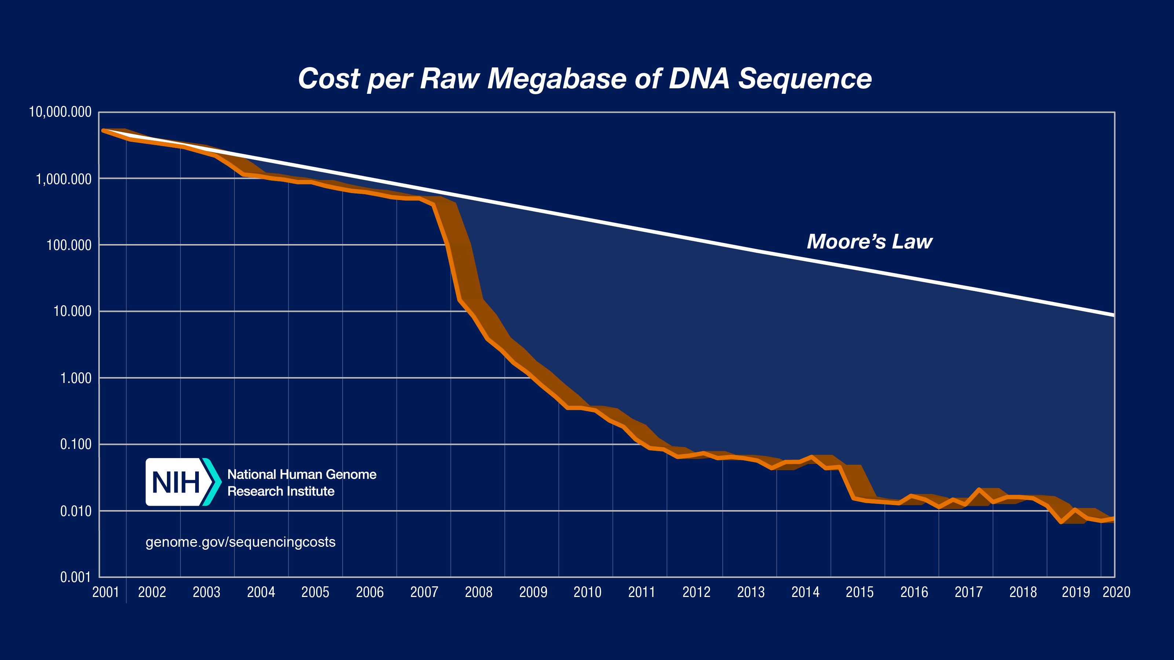
Cost of Sequencing
*From NIH (https://www.genome.gov/about-genomics/fact-sheets/DNA-Sequencing-Costs-Data)

Slide 46
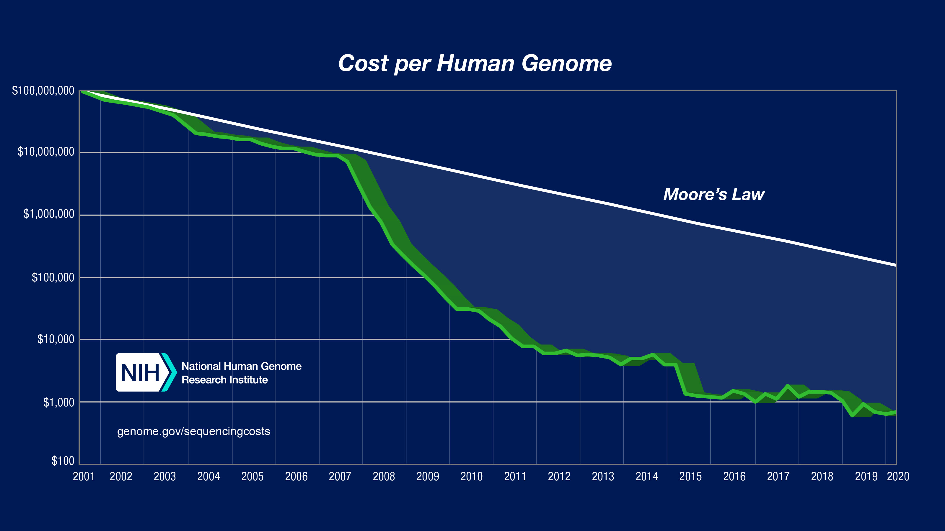
Cost of Sequencing (cont’d.)
*From NIH (https://www.genome.gov/about-genomics/fact-sheets/DNA-Sequencing-Costs-Data)

Slide 47
Sequencing of COVID-19
Why whole genome sequencing (WGS) and sequence data analysis are important:
  To detect the virus from a human sample such as saliva, Bronchoalveolar fluid etc.
  To understand the sources and modes of transmission of the virus
  To discover the genomic characteristics of the virus, and compare with the previous viruses (e.g., 02-03 SARS epidemic)
  To design and evaluate the diagnostic tests
Two key areas of COVID-19 genomic research:
  To sequence the genome of the virus itself, COVID-19, in order to track the mutations in the virus.
  To explore the genes of infected patients. This analysis can be used to understand why some people get more severe symptoms than others, as well as, help with the development of new treatments in the future.

Slide 48
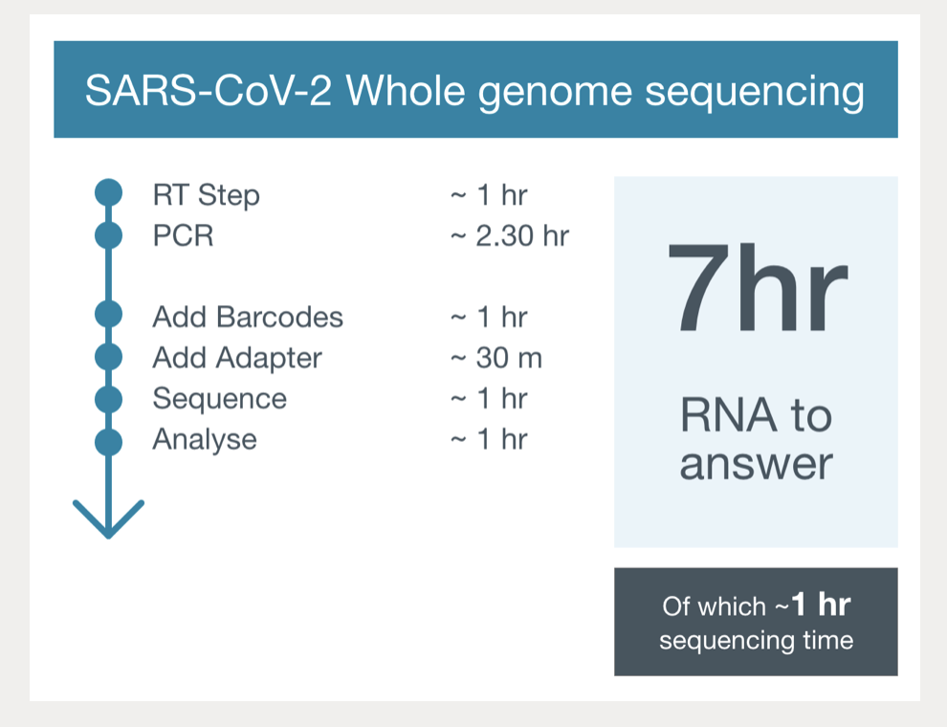
COVID-19 Sequencing with ONT
From ONT (https://nanoporetech.com/covid-19/overview)

Slide 49
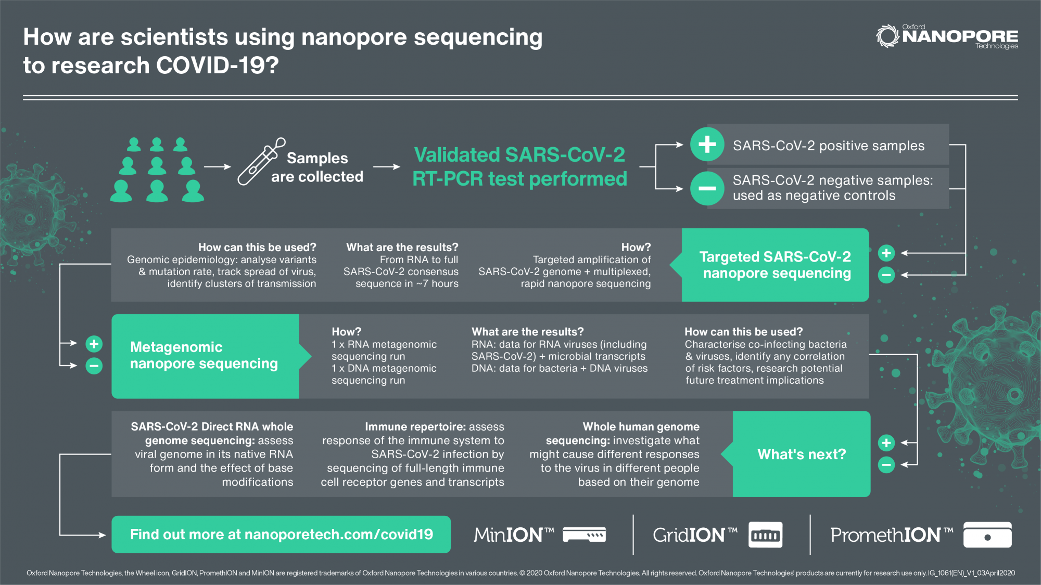
COVID-19 Sequencing with ONT (cont’d.)
From ONT (https://nanoporetech.com/covid-19/overview)

Slide 50
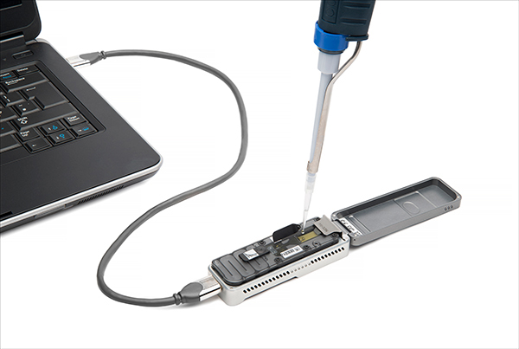

Future of Genome Sequencing & Analysis
MinION from ONT
SmidgION from ONT

Slide 51
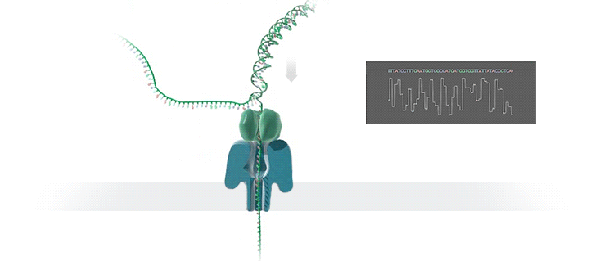
Nanopore Genome Assembly Pipeline
Raw signal data
Basecalling
DNA reads
Read-to-Read Overlap Finding
Overlaps
Assembly
Assembly
Draft assembly
Read Mapping (Optional)
Mappings of reads against draft assembly
Improved assembly
Polishing (Optional)
Notes:
The output of MinION is raw signal data that represents changes in electric current when a DNA strand passes through nanopore. Thus, the pipeline starts with the raw signal data. The first step, basecalling, translates this raw signal output of MinION into bases (A, C, G, T) to generate DNA reads. The second step computes all read-to-read overlaps. The third pipeline step, genome assembly, then constructs a draft assembly. To increase the accuracy of the assembly, further polishing, i.e. post-assembly error correction, may be required. The fourth step of the pipeline is mapping the original basecalled reads to the generated draft assembly from the previous step (i.e. read mapping). The fifth and final step of the pipeline is polishing the assembly with the help of mappings from the previous step.

Slide 52

Nanopore Sequencing & Tools
Damla Senol Cali, Jeremie S. Kim, Saugata Ghose, Can Alkan, and Onur Mutlu. "Nanopore Sequencing Technology and Tools for Genome Assembly: Computational Analysis of the Current State, Bottlenecks and Future Directions." Briefings in Bioinformatics (2018).
BiB Version arXiv Version
BiB version
arXiv version

