Slide 1

GenPIP
In-Memory Acceleration of Genome Analysis via
Tight Integration of Basecalling and Read Mapping
Haiyu Mao, Mohammed Alser, Mohammad Sadrosadati, Can Firtina,
Akanksha Baranwal, Damla Senol Cali, Aditya Manglik, Nour Almadhoun Alserr, Onur Mutlu
Notes:
Good Morning, everyone, I am Haiyu Mao, a postdoc researcher in SAFARI research group at ETH. Today, I am gonna present our work, GenPIP.

Slide 2


Overview: Genome Analysis
Genome analysis: Enables us to determine the order of the DNA sequence in an organism’s genome
  Plays an important role in
    Personalized medicine
    Outbreak tracing
    Understanding of evolution
    …
Modern genome sequencing machines extract smaller randomized fragments of the original DNA sequence, known as reads
  Oxford Nanopore Technologies (ONT):
  A widely-used sequencing technology
    Portable sequencing devices
    High-throughput
    Cheap
ONT sequencing device [forbes.com]
Notes:
[CLICK] Genome analysis enables us to determine the DNA sequence of an organism,
[CLICK] which plays an important role in
[CLICK] personalized medicine,
[CLICK] outbreak tracing (like COVID-19)
[CLICK] the understanding of evolution
[CLICK] and so on
[CLICK] Modern genome sequencing machines extract smaller randomized fragments of the original DNA sequence, which we call reads.
[CLICK] Oxford nanopore technologies is a widely-used sequencing technology
[CLICK] as it provides portable sequencing devices
[CLICK] it is high-throughput
[CLICK] and cheap

Slide 3

Overview: Two Limitations
Multiple steps in genome analysis
Large data movement between multiple steps
A lot of
wasted computation done on data that is later discovered to be useless
Notes:
[CLICK] There are multiple steps in the genome analysis
[CLICK] We observe there is large data movement between these steps
[CLICK] and a lot of wasted computation done on the data that later discovered to be useless

Slide 4
Overview: GenPIP
GenPIP: A fast and energy-efficient in-memory acceleration system for the Genome analysis PIPeline via tight integration of genome analysis steps
GenPIP has two key techniques
  Chunk-based pipeline (CP)
    Provides fine-grained collaboration of genome analysis steps
  Early rejection (ER)
    Timely stops the execution on useless data by predicting which reads will not be useful
GenPIP outperforms state-of-the-art software & hardware solutions using CPU, GPU, and optimistic PIM by 41.6×, 8.4x, and 1.4x, respectively.
Notes:
To overcome these two limitations, we propose GenPIP
[CLICK] GenPIP is A fast and energy-efficient in-memory acceleration system for the Genome analysis PIPeline via tight integration of genome analysis steps
[CLICK] GenPIP has two key techniques
A chunk-based pipeline that provides fine-grained collaboration of genome analysis steps
An early-rejection technique predicts which reads will not be useful and then stops the execution of basecalling and read mapping for such reads
[CLICK] GenPIP outperforms state-of-the-art software & hardware solutions.

Slide 5
Outline
Background and Motivation
GenPIP: Tight Integration of Genome Analysis Steps
  Chunk-based Pipeline (CP)
  Early Rejection (ER)
GenPIP Implementation
Evaluation
Conclusion
Notes:
Let’s have a look at the genome analysis pipeline and our motivation

Slide 6
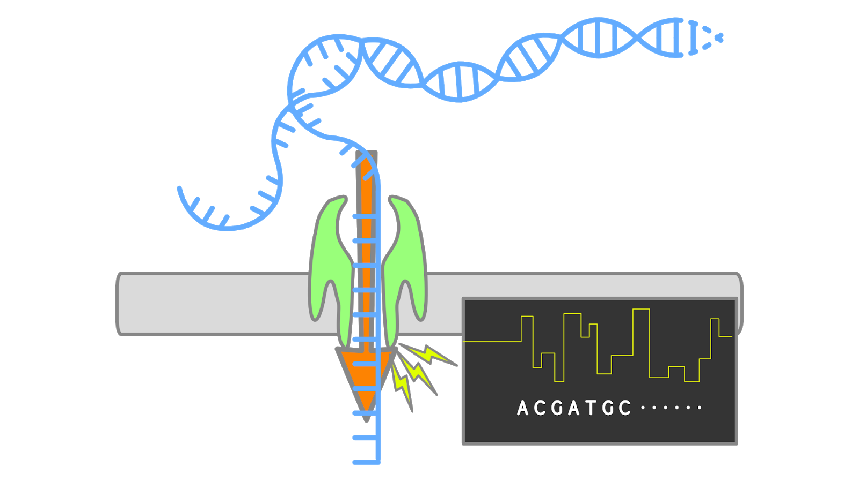


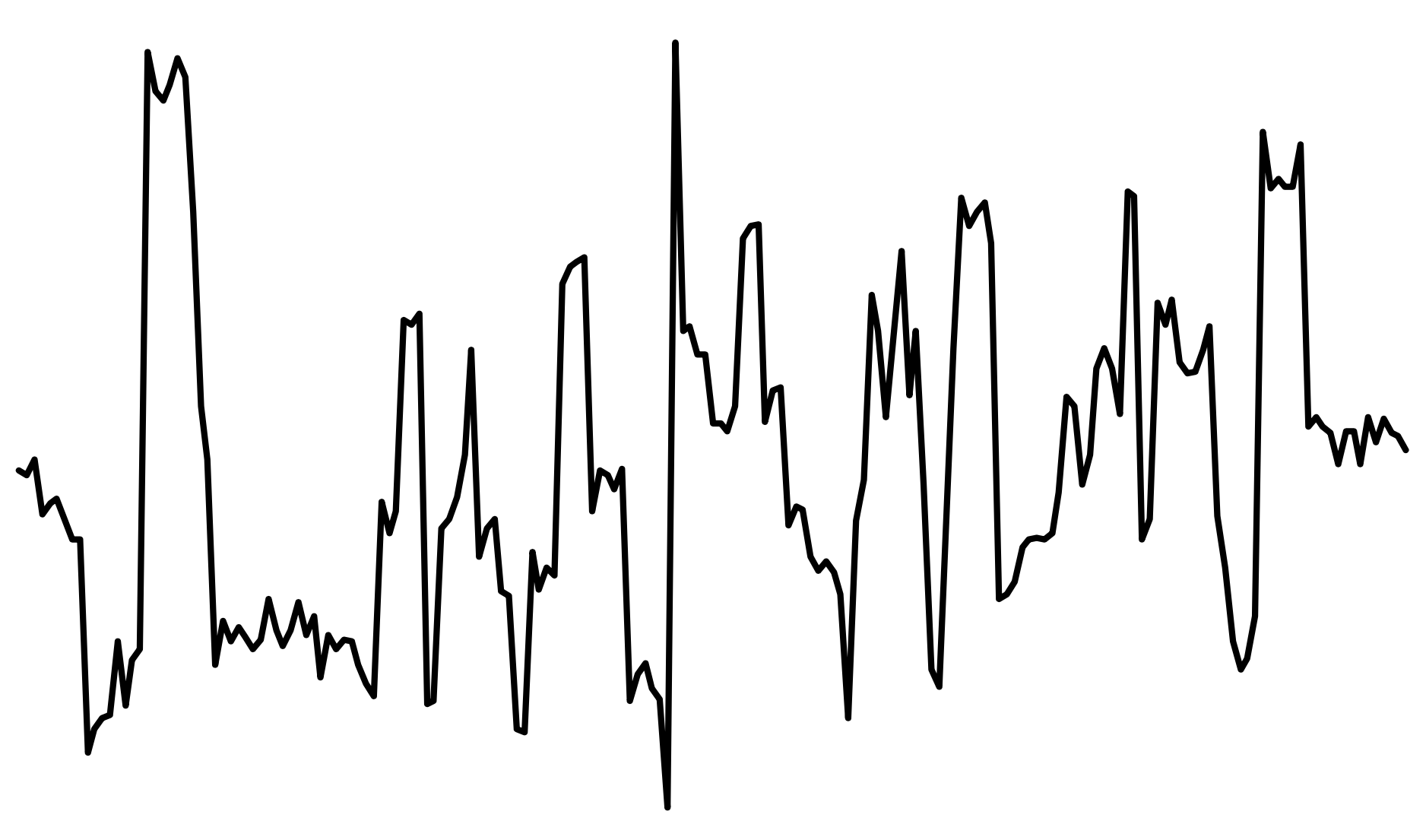


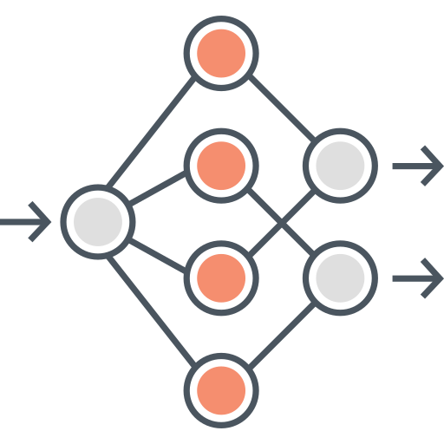
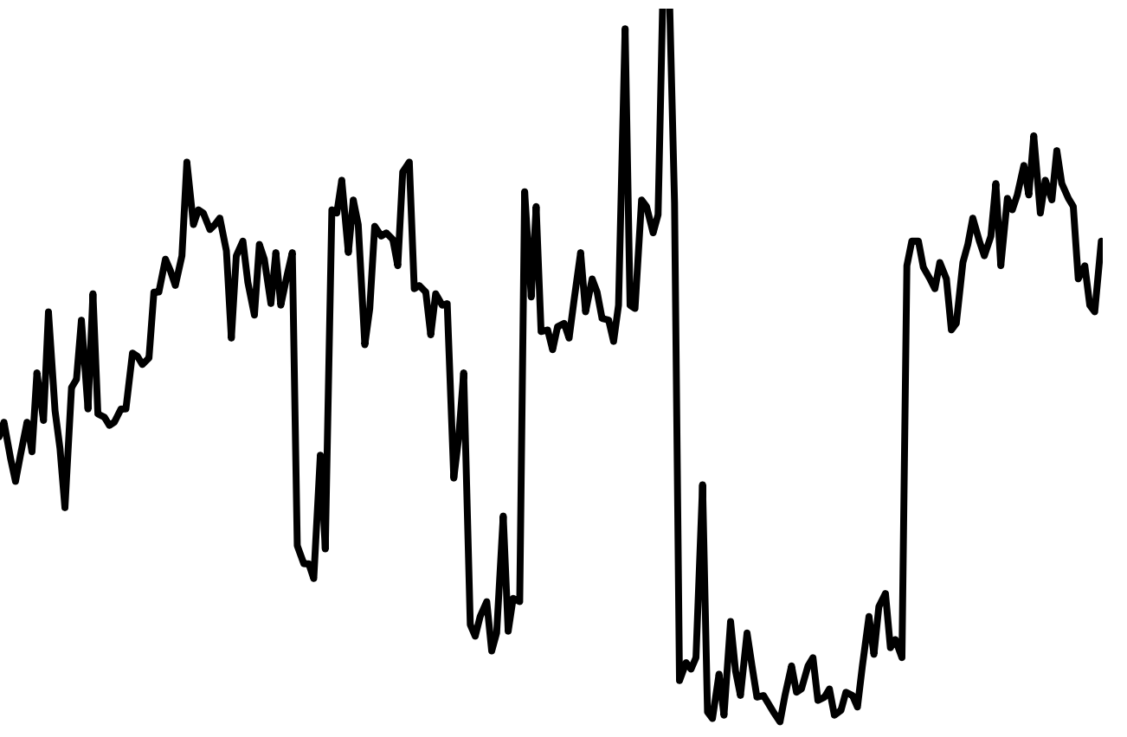
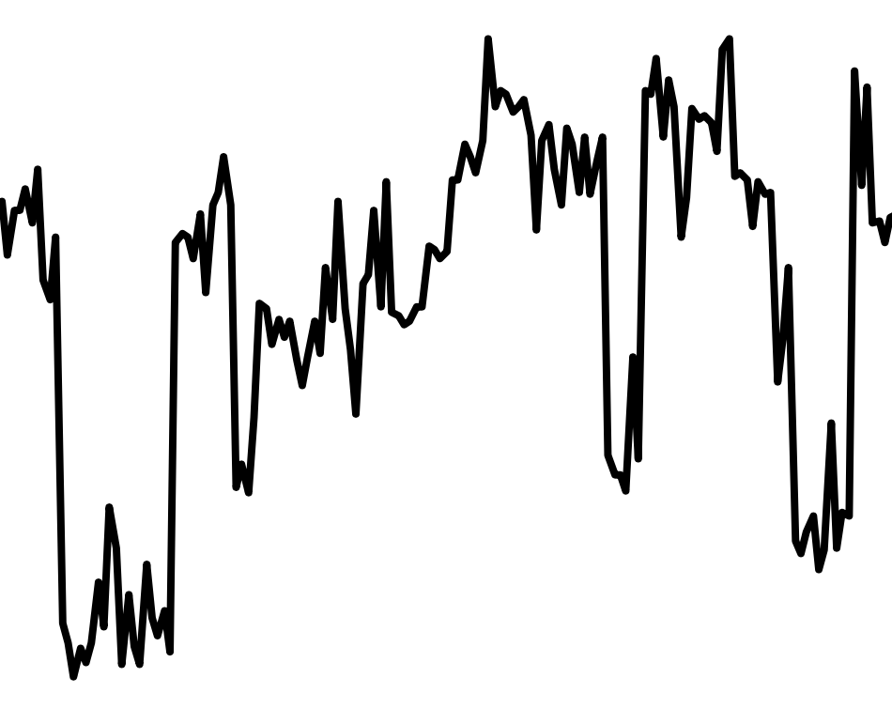
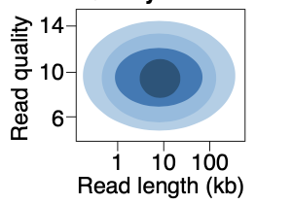
Genome Analysis Pipeline
Genome sequencing
Storage
Storage
Compute
Read
G
G
A
C
A
T
G
G
C
C
G
G
T
T
T
T
C
C
T
T
C
C
A
A
A
A
A
A
G
1. Basecalling
G
Low-quality
Compute
Compute
Store
mapping results
Reference genome
Storage
High-quality
T
A
T
G
G
A
C
T
T
T
A
G
C
A
A
A
C
G
C
G
T
T
C
Mapped
Unmapped
2. Read Quality Control
A
A
T
T
G
G
G
G
A
A
C
3. Read Mapping
C
Notes:
After we get the raw signals from the nanopore sequencing machine, we store them
Then we execute the first step, basecalling. we read the raw signals chunk by chunk from the storage and basecall them one by one into chunk of bases.
Here, red means the base quality is low and green means the base quality is high
After basecalling all chunks in a sequence, we assemble them into a read.
After basecalling all raw signal sequences into reads, we store them
Then execute the second step, read quality control.
Read quality control filters out the low-quality reads
And stores the high-quality reads
After that, we execute the read mapping step to map the read to the reference genome
If the read cannot be mapped to the reference genome, we discard it
For the read can be mapped to the reference genome, we store the mapping results.

Slide 7
Limitation 1: Large Data Movement
Using a human dataset in [NC’19] as an example:
Raw Signals
Basecalling
Reads
Read quality
control
High-quality
reads
Read
mapping
Mapped
reads
3913 GB
546 GB
437 GB
382 GB
Large data movement between genome analysis steps
[NC'19] Rory Bowden, Robert W Davies, Andreas Heger, Alistair T Pagnamenta, Mariateresa de Cesare, Laura E Oikkonen, Duncan Parkes, Colin Freeman, Fatima Dhalla, Smita Y Patel, et al. Sequencing of human genomes with nanopore technology. Nature Communications, 2019.
Notes:
The genome analysis pipeline has two main limitations
The first one is large data movement
We use a human dataset as an example
We move the raw signals to the basecalling
Then store the reads
And move the reads to the machine that executes read quality control
Then move the high quality reads to machines executes read mapping
In the end, only mapped reads are reviewed by bio analysts.
We conclude that there is large data movement between these steps

Slide 8
Limitation 2: Wasted Computation
Using a human dataset in [NC’19] as an example:
100%
79.5%
69.5%
Raw Signals
Basecalling
Reads
Read quality
control
High-quality
reads
Read
mapping
Mapped
reads
Low-quality
reads
Unmapped
reads
20.5%
10%
A considerable amount of computation on useless data due to
Low-quality reads
Unmapped reads
[NC'19] Rory Bowden, Robert W Davies, Andreas Heger, Alistair T Pagnamenta, Mariateresa de Cesare, Laura E Oikkonen, Duncan Parkes, Colin Freeman, Fatima Dhalla, Smita Y Patel, et al. Sequencing of human genomes with nanopore technology. Nature Communications, 2019.
Notes:
Second, 100% of reads are basecalled but 20.5% low-quality reads are filtered
And 10% of unmapped reads are discarded.
We conclude that there is a considerable amount of computation on useless data due to low quality reads and unmapped reads

Slide 9
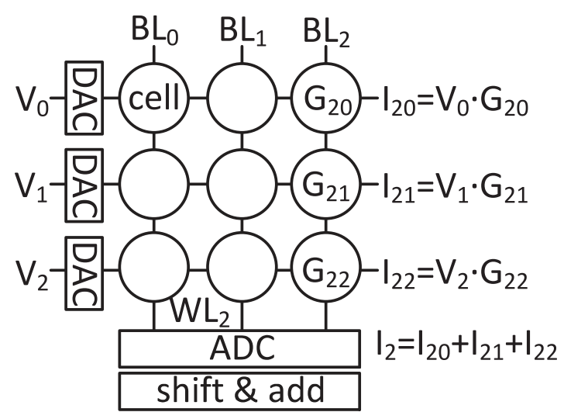
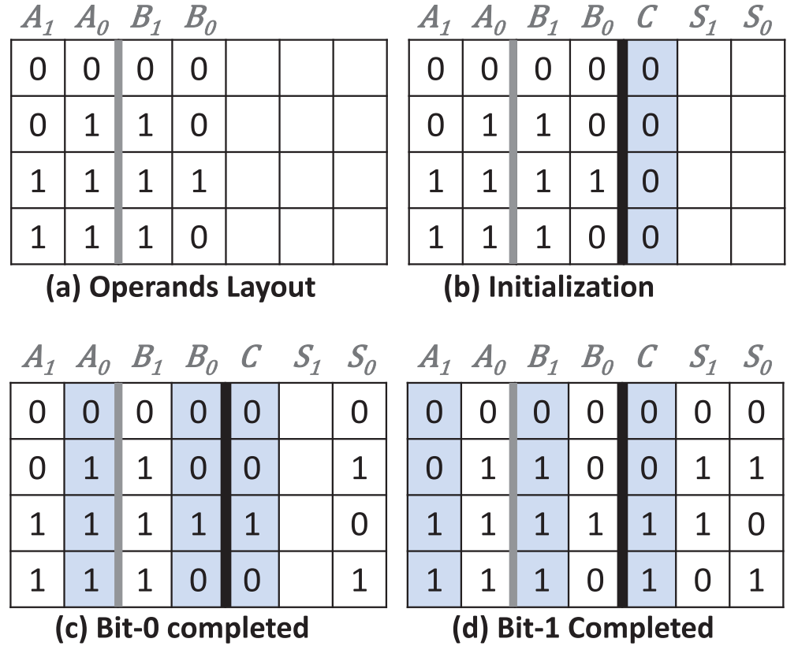
State-of-the-art Works
NVM-based PIM is an efficient technique to reduce data movement by processing data using or near memory
  Reduce the data movement in a single genome analysis step
  Exacerbate the data movement overhead between analysis steps
Raw Signals
Basecalling
Reads
Read quality
control
High-quality
reads
Read
mapping
Mapped
reads
NVM-based PIM for dot-product operation [Helix, PACT’20]
NVM-based PIM for search and addition
[PARC, ASPDAC’20]
No prior work tackles data movement between analysis steps and reduces useless computation
Notes:
Previous works accelerate either basecalling or read mapping using processing in memory
A prior work uses NVM-based PIM for dot-product calculation to accelerate basecalling since dot-product is the main operation in basecalling
A prior work uses NVM-based CAM for search and addition operation to accelerate read mapping since these two operations are the dominant operations in read mapping
These PIM accelerators reduce the data movement in a single step
But exacerbate the data movement overhead between analysis steps
And there is no prior work tackles data movement problem between the steps and reduce useless computation

Slide 10
Goal and Opportunities
Goal: Efficiently accelerate the entire genome analysis pipeline while minimizing data movement and useless computation
We perform a study to quantify potential performance benefits
  Results are normalized to the performance of GPU
NVM-based PIM accelerators for separate basecalling and read mapping
no data movement
between the accelerators of analysis steps
no data movement
and
no useless reads
(ideal case)
Notes:
Our goal in this work is to efficiently accelerate the entire genome analysis pipeline while minimizing data movement and useless computation
To quantify potential benefits of overcoming the two limitations, we compare performance of the three systems and results are normalized to the performance of GPU
First, Basecalling and read mapping are executed in two in-memory accelerators separately, which achieves 2.7 times speedup
Assume there is no data movement, which achieves 6.1 times speedup
Assume there is no data movement and no useless reads in the pipeline. Which achieves 9 times speedup

Slide 11
Outline
Background and Motivation
GenPIP: Tight Integration of Genome Analysis Steps
  Chunk-based Pipeline (CP)
  Early Rejection (ER)
GenPIP Implementation
Evaluation
Conclusion
Notes:
Let’s have a look at the detail of our proposal, GenPIP

Slide 12
GenPIP
First holistic in-memory accelerator for the genome analysis pipeline, including basecalling, read quality control, and read mapping steps
GenPIP has two key techniques
  Chunk-based Pipeline (CP)
    Enables fine-grained pipelining of genome analysis steps
    Processes reads at chunk granularity (i.e., a subsequence; 300 bases)
  Early Rejection (ER)
Notes:
GenPIP is the first holistic in-memory accelerator for the genome analysis pipeline, including basecalling, read quality control, and read mapping steps
[CLICK] GenPIP has two key techniques
[CLICK] Chunk-based pipeline (CP)
[CLICK] Early rejection (ER)
[CLICK] Enables fine-grained pipeline of genome analysis steps by processing reads at chunk granularity

Slide 13
Chunk-based Pipeline (CP)
CP increases parallelism by overlapping the execution of different steps at chuck granularity
CP reduces intermediate data by computing on data as soon as data is generated
CP provides opportunities for ER by analyzing a read at chunk granularity
A read consists of four chunks: C1, C2, C3, C4
Assemble
QC: Quality control
RM: Read mapping
Conventional Pipeline
Basecalling
C1
Basecalling
C2
Basecalling
C3
Basecalling
C4
QC
Read
Read Mapping
Read
Basecalling
C1
Basecalling
C2
Basecalling
C3
Basecalling
C4
QC
C3
QC
C4
Assemble
Chunk-based Pipeline
QC
C1
QC
C2
Saved cycles
RM
C1
RM
C2
RM
C3
RM
C4
RM
Read
Time
Notes:
CP increases parallelism by overlapping the execution of different steps at chuck granularity
CP reduces the intermediate data by computing on the data as soon as the data is generated
CP provides opportunities for ER by analyzing a read at chunk granularity
[CLICK] In the conventional pipeline, the basecaller basecalls chunks one by one and
[CLICK] assemble them into a read to
[CLICK] do quality check
[CLICK] and read mapping
[CLICK] in our chunk-based pipeline, once a chunk is basecalled, we do quality control and partial computation of read mapping on the basecalled chunk
[CLICK] in the end, we assemble the them and do the remaining computation on the read

Slide 14
GenPIP
First holistic in-memory accelerator for the genome analysis pipeline, including basecalling, read quality control, and read mapping steps
GenPIP has two key techniques
  Chunk-based Pipeline (CP)
    Enables fine-grained collaboration of genome analysis steps by processing reads at chunk granularity (i.e., a subsequence of a read, e.g., 300 bases)
  Early Rejection (ER)
    Stops the execution on useless reads as early as possible by using a small number of chunks to predict the usefulness of a read
Notes:
Another key technique of GenPIP is Early rejection (ER)
Which Timely stops the execution on useless reads by using a small number of chunks to predict the usefulness of a read

Slide 15
Early Rejection (ER)
Predict and eliminate low-quality and unmapped reads from the genome analysis pipeline as early as possible
Basecall a small number of chunks
Check the average quality of these chunks
Pass
Basecall more chunks
Map basecalled chunks so far
Basecall the remaining chunks
Execute the remaining computation in read mapping
Check the mapping score
Fail
Stop
analysis
Fail
Pass
Early-Rejection based on chunk quality scores (ER-QSR)
  Predict low-quality reads using chunk quality scores
Early-Rejection based on chunk mapping scores (ER-CMR)
  Predict unmapped reads using chunk mapping scores
Notes:
Our early rejection technique Predicts and eliminates low-quality and unmapped reads in the genome analysis pipeline as early as possible
[CLICK] First, it basecalls a small number of chunks,
[CLICK] then check the average quality score of these chunks.
[CLICK] if it fails, then it stops analysis;
[CLICK] if it passes, then it basecalls more chunks
[CLICK] and map the basecalled chunks to the reference genome
[CLICK] to check the mapping score
[CLICK] if it fails, then it stops analysis
[CLICK] otherwise, basecalling remaining chunks
[CLICK] and execute the remaining computation in read mapping
[CLICK] in conclusion, ER has two sub-techniques, ER based on chunk quality scores
[CLICK] and ER based on chunk mapping

Slide 16
Implementation of CP and ER
CP and ER can be applied on
different systems, e.g., CPU, GPU, and PIM
We implement CP and ER using PIM since PIM is more efficient to reduce the data movement between genome analysis steps
We also apply CP and ER on CPU and GPU baselines and observe speedup and energy savings
Notes:
It’s worth to mention that, CP and ER can be implemented in many systems, such as CPU and GPU
We implement CP and ER in the PIM system since it’s more efficient

Slide 17
Outline
Background and Motivation
GenPIP: Tight Integration of Genome Analysis Steps
  Chunk-based Pipeline (CP)
  Early Rejection (ER)
GenPIP Implementation
Evaluation
Conclusion
Notes:
Let’s look at GenPIP implementation

Slide 18
GenPIP Implementation
Raw signals from the sequencing machine
GenPIP
In-memory
Read Mapping
[PARC, ASPDAC’20]
+ Our design
In-memory
Basecaller
[Helix, PACT’20]
Signal
chunk
eDRAM
Basecalled
chunk
Chunk
Average Calculator
Read Mapping Controller
Base quality score
Chunk quality score
Quality score
PIM-CQS
PIM chunk quality score calculation
ER
Controller
Chunk mapping score
Read mapping result
To storage
Basecalling Module
ER
GenPIP Controller
ER
Read Mapping Module
https://arxiv.org/pdf/2209.08600.pdf
Notes:
GenPIP has three main modules, basecalling, read mapping and GenPIP controller
[CLICK]

Slide 19
GenPIP Implementation
Raw signals from the sequencing machine
GenPIP
In-memory
Read Mapping
Our design +
[PARC, ASPDAC’20]
In-memory
Basecaller
[Helix, PACT’20]
Signal
chunk
eDRAM
Basecalled
chunk
Tightly integrating the genome analysis steps
Reduces data movement
Eliminates useless computation
Chunk
Average Calculator
Read Mapping Controller
Base quality score
Chunk quality score
Quality score
PIM-CQS
PIM chunk quality score calculation
ER
Controller
Chunk mapping score
Read mapping result
To storage
Basecalling Module
ER
GenPIP Controller
ER
Read Mapping Module
Notes:
GenPIP has three main modules, basecalling, read mapping and GenPIP controller
[CLICK]

Slide 20
Outline
Background and Motivation
GenPIP: Tight Integration of Genome Analysis Steps
  Chunk-based Pipeline (CP)
  Early Rejection (ER)
GenPIP Implementation
Evaluation
Conclusion
Notes:
Let’s look at our evaluation

Slide 21
Evaluation Methodology
Performance, Area and Power Analysis:
  Simulation via Verilog HDL, NVSim [TCAD’12], and CACTI 6.5 [MICRO’07]
  See methodology in the paper for more
Baselines:
  CPU (Intel Xeon Gold 5118 CPU)
  GPU (NVIDIA GeForce RTX 2080 Ti GPU)
  Optimistic integration of two PIM accelerators (Helix [PACT’20] and PARC [ASP-DAC’20])
    Assumes no data movement between steps
    Assumes intermediate data causes no overhead
Datasets:
  E. coli (http://lab.loman.net/2016/07/30/nano pore- r9- data- release/)
  Human (https://www.ebi.ac.uk/ena/browser/view/PRJEB30620)
Notes:
We use several simulators for GenPIP and you can check the paper for more details
We compare GenPIP with cpu gpu and an optimistic integration of two PIM accelerators, where we assume there is no data movement between steps and enough on-chip memory for intermediate data
We evaluate on two datasets, Ecoli and human

Slide 22
Key Results – Performance
1.4x
8.4x
41.6x
GenPIP provides 41.6x, 8.4x, and 1.4x speedup over CPU, GPU, and optimistic PIM
Both CP and ER are critical to the speedup
Notes:
Here are the results of performance.
On average, GenPIP provides 41.6x over CPU, 8.4x over GPU, and 1.4x speedup over optimistic PIM, , which is an ideal integration
More evaluation details in the paper show both CP and ER are critical to the speedup

Slide 23
Key Results – Energy Efficiency
1.37x
20.8x
32.8x
GenPIP provides 32.8x, 20.8x, and 1.37x energy savings
over CPU, GPU, and optimistic PIM
ER is especially critical to the energy efficiency
Notes:
Here are the energy reduction results
On average, GenPIP provides 32.8, 20.8, and 1.37x energy savings compared to CPU, GPU, and optimistic PIM, which is an ideal integration
We also find that reducing data movement and useless data contribute a lot to the energy reduction

Slide 24
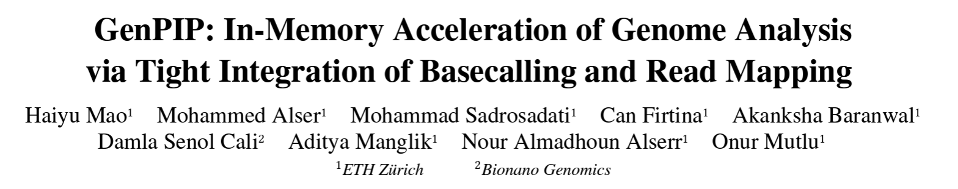

More in the Paper
https://arxiv.org/pdf/2209.08600.pdf
Details of CP and ER
Detailed GenPIP architecture and implementations
  GenPIP controller
  Timely early rejection implementation
  In-memory seeding accelerator
More comparison points
Sensitivity analysis of the chunks used for ER
Area and power analysis
Notes:
We have more details in the paper

Slide 25
More in the Paper
Details of CP and ER
Detailed GenPIP implementation
  GenPIP controller
  Early rejection implementation
  In-memory seeding accelerator
Results of applying CP and ER in CPU and GPU
Sensitivity analysis on the number of sampled chunks used for ER
Area and power analysis
Notes:
including
Details of cp and er
Detailed genpip implementation
Results of applying cp and er in cpu and gpu
Sensitivity analysis
Area and power analysis

Slide 26
Outline
Background and Motivation
GenPIP: Tight Integration of Genome Analysis Steps
  Chunk-based Pipeline (CP)
  Early Rejection (ER)
GenPIP Implementation
Evaluation
Conclusion
Notes:
To conclude our work

Slide 27
Conclusion
Problem: The genome analysis pipeline has large data movement between genome analysis steps and a significant amount of wasted computation on useless data
Goal: Tightly integrate genome analysis steps to reduce the data movement between steps and eliminate computation on useless data
GenPIP: The first in-memory genome analysis accelerator that tightly integrates genome analysis steps
GenPIP has two key techniques
  A chunk-based pipeline
  A new early-rejection technique
GenPIP outperforms state-of-the-art software & hardware solutions using CPU, GPU, and optimistic PIM by 41.6×, 8.4x, and 1.4x, respectively.
Notes:
we observe that the genome analysis pipeline has large data movement between steps and a significant amount of useless data
Our goal is to Tightly integrate genome analysis steps to reduce the data movement between steps and eliminate the computation on useless data
Therefore, we propose, GenPIP, the First in-memory genome analysis accelerator that tightly integrates basecalling and read mapping via two key techniques A chunk-based pipeline A new early-rejection technique
According to our evaluation, GenPIP outperforms state-of-the-art software & hardware solutions

Slide 28
GenPIP
In-Memory Acceleration of Genome Analysis via
Tight Integration of Basecalling and Read Mapping
Haiyu Mao, Mohammed Alser, Mohammad Sadrosadati, Can Firtina,
Akanksha Baranwal, Damla Senol Cali, Aditya Manglik, Nour Almadhoun Alserr, Onur Mutlu
Notes:
Thank you. I am happy to take any questions.

Slide 29
Backup Slides
Genome Sequencing
  Sequencing Technologies
  Current State of Sequencing
Genome Analysis Pipeline
  Basecalling
  Read Quality Control
  Read Mapping
Early Rejection
  ER based on Quality Scores
  ER based on Chunk Mapping
GenPIP Architecture
  In-memory seeding
Number of chunks for ER

Slide 30






Genome Sequencing
Chopped DNA
fragments
Sequenced reads
Sample Collection
Sequencing
Large DNA
molecule
Preparation
Genome Sequence Analysis

Slide 31
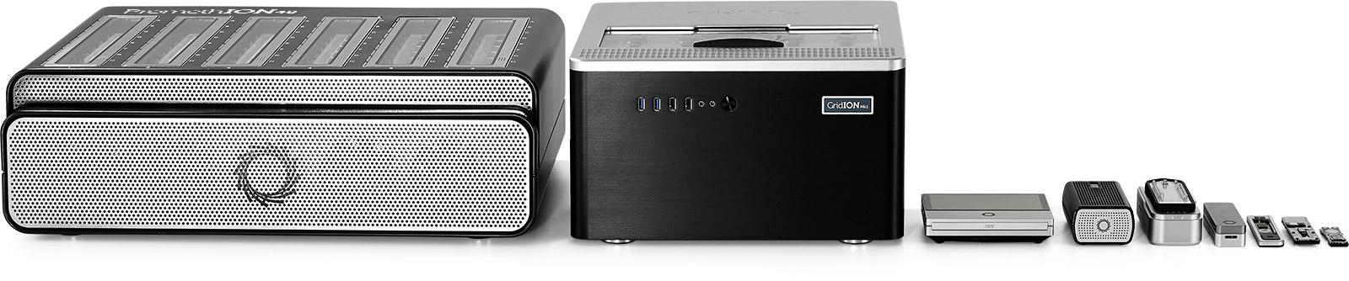

Sequencing Technologies
Oxford Nanopore (ONT)
PacBio
Illumina
Short reads: a few hundred base pairs and error rate of ∼0.1%
  Long reads: thousands to millions of base pairs and error rate of 5–10%
Notes:
ONT, PacBio, Illumina
[CLICK] Based on the sequencing device, we obtain either short reads or long reads.

Slide 32
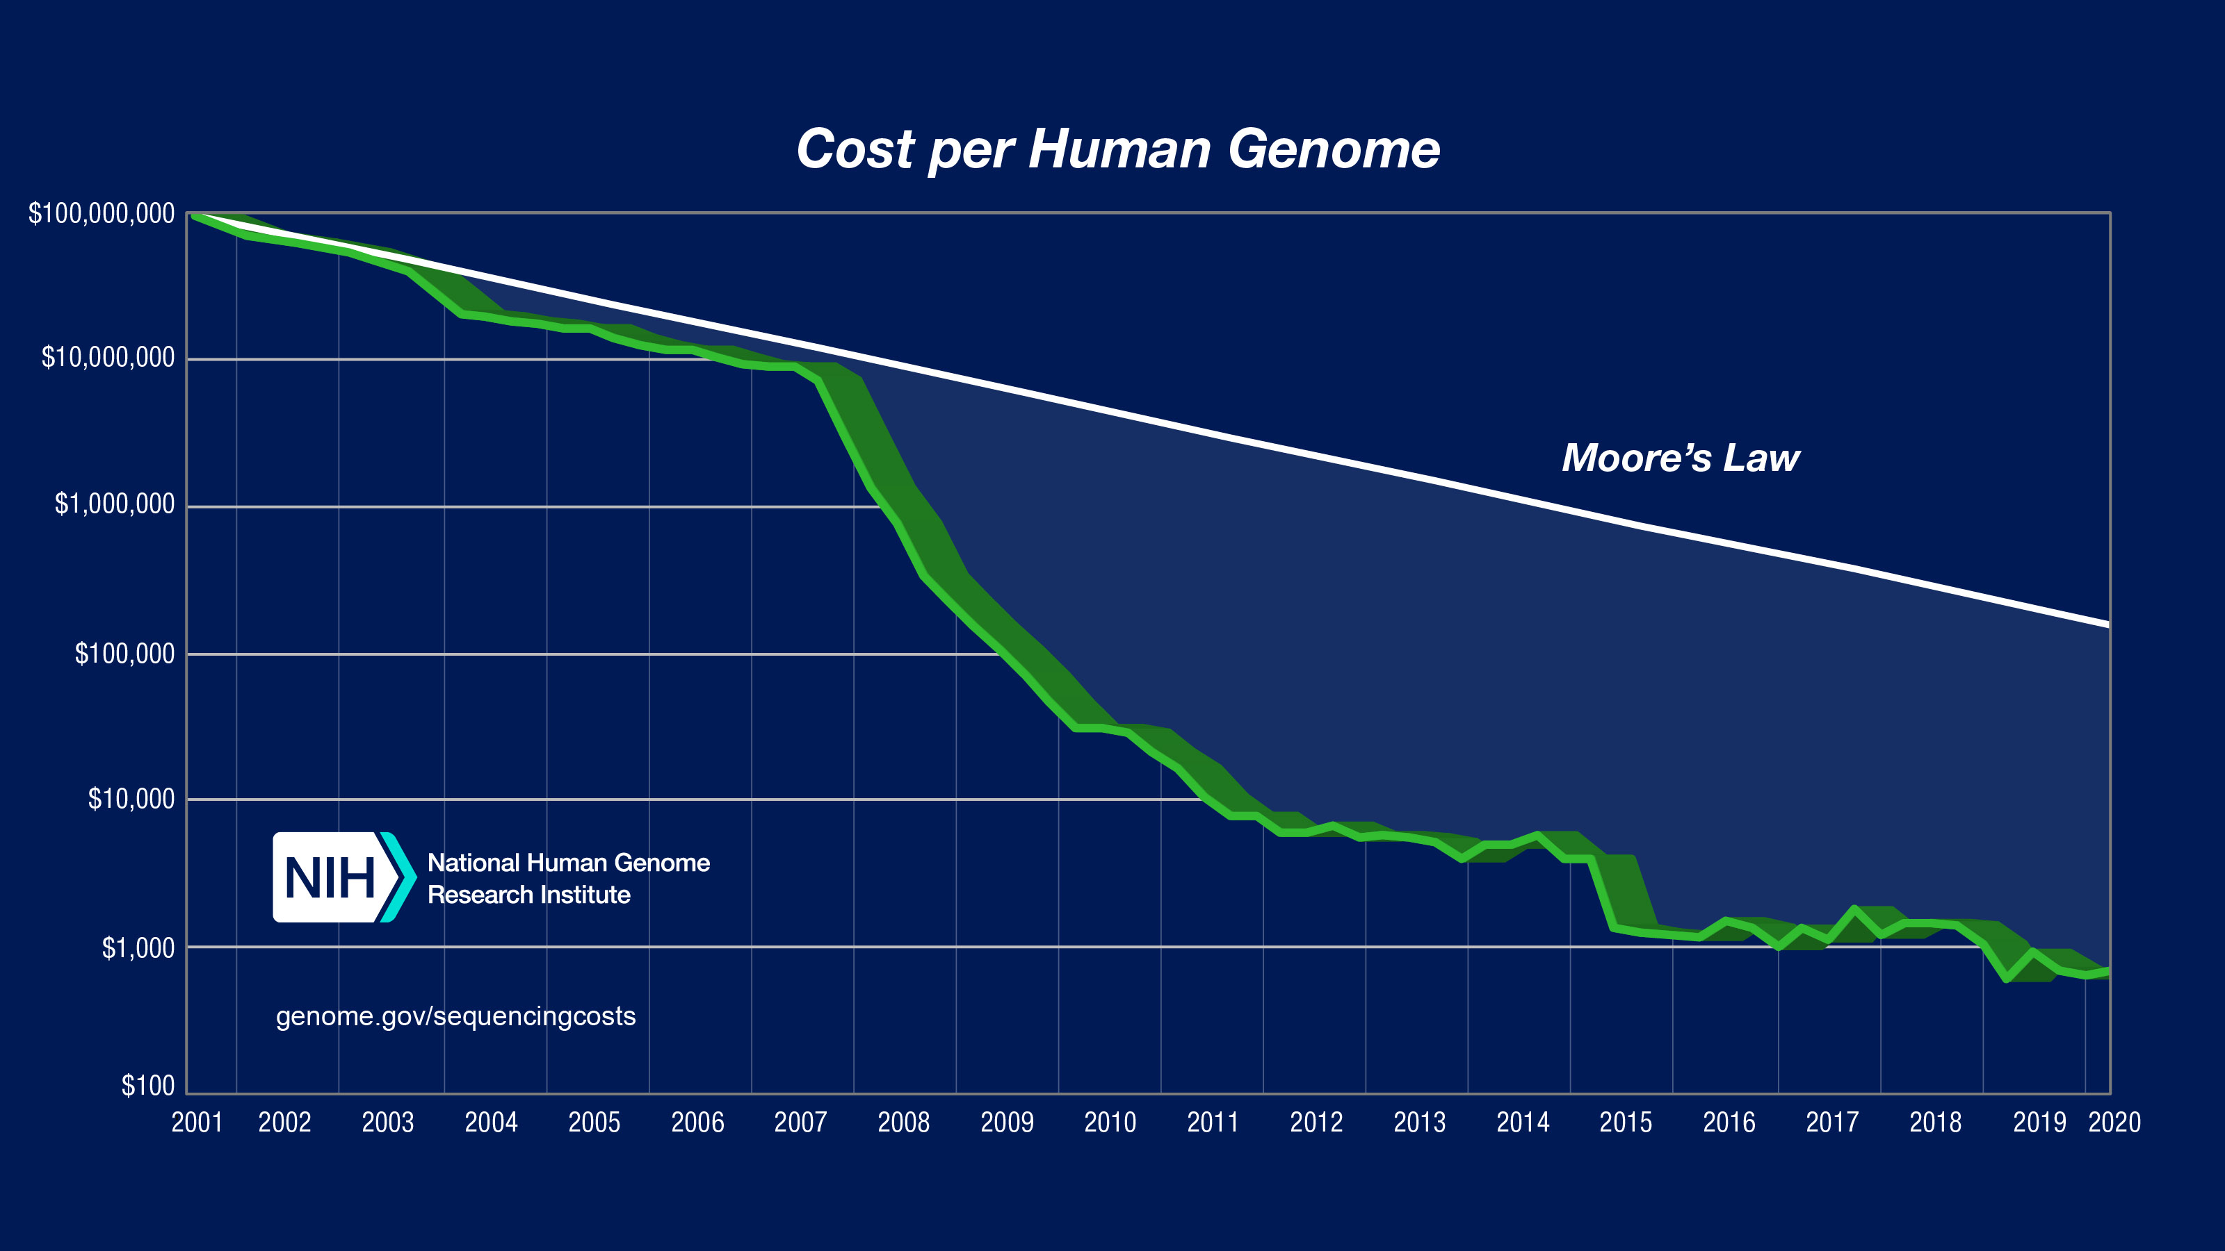
Current State of Sequencing
*From NIH (https://www.genome.gov/about-genomics/fact-sheets/DNA-Sequencing-Costs-Data)
Notes:
However, the compute power doesn’t match up with this trend.
Modern sequencing machines generate read fragments at an exponentially higher rate than prior sequencing technologies, with their growth far outpacing the growth in computational power in recent years
For example, the Illumina NovaSeq 6000 system can sequence about 48 human whole genomes at 30× genome coverage (the av- erage number of times a genomic base is sequenced) in about two days. However, analyzing (performing mapping and variant calling) the sequencing data of a single human genome requires over 32 CPU hours on a 48-core Intel Xeon processor, 23 of which are spent on read mapping

Slide 33
Current State of Sequencing
Computation is a bottleneck!
*From NIH (https://www.genome.gov/about-genomics/fact-sheets/DNA-Sequencing-Costs-Data)
Notes:
However, the compute power doesn’t match up with this trend.
Modern sequencing machines generate read fragments at an exponentially higher rate than prior sequencing technologies, with their growth far outpacing the growth in computational power in recent years
For example, the Illumina NovaSeq 6000 system can sequence about 48 human whole genomes at 30× genome coverage (the av- erage number of times a genomic base is sequenced) in about two days. However, analyzing (performing mapping and variant calling) the sequencing data of a single human genome requires over 32 CPU hours on a 48-core Intel Xeon processor, 23 of which are spent on read mapping

Slide 34
Basecalling
Basecaller
Input
raw
signal
chunks
A 0.1
C 0.6
G 0.2
T 0.1
Assemble
chunks of bases into a long read
Raw Signals
Long Reads
DNNs
Input: Raw signal chunks
Process: Translate raw signals to bases (i.e., A, C, G, T) and calculate each base quality
Output: Assemble chunks into a long read

Slide 35
Read Quality Control
Long read
Compare the read quality score with the threshold
higher
A
C
T
High-quality
A
G
Calculate the average
3
5
4
2
7
Base quality score
Low-quality
Discard
lower
Input: Base quality scores of a read from the basecalling step
Process: Calculate the average of all base quality scores in a read as the read quality score, and compare the read quality score to the threshold to decide whether this read is low-quality or high-quality
Output: High-quality reads (discard low-quality reads)
Notes:
[CLICK] The second step, read quality control, usually runs on the remote machines outside the lab
[CLICK] It receives the base quality scores of a read from the basecalling step
[CLICK] calculates the read quality score
[CLICK] compares the read quality score with the threshold
[CLICK] decides whether it’s low-quality or high-quality and
[CLICK] discards the low-quality reads

Slide 36
Read Mapping
High-quality Long Reads
(a) Indexing
(b) Seeding
(c) Chaining
a
b
c
(d) Alignment
Reference Genome
Read
d
Hash table
Possible substrings
Subsequence
Subsequence
Query
locations
Possible
locations
Read
DP
Input: High-quality read passes the read quality control step
Process:
  Use subsequence in a read to query the hash table to get possible match locations
  Identify the candidate regions and output the chaining score
  Execute the alignment step if there is a chain
Output: Mapping information
Notes:
[CLICK] The third step, read mapping.
[CLICK] It receives the high-quality long reads to execute the seeding step,
[CLICK] which uses the subsequences in the read to query the pre-created hash table of the reference genome and then gets the possible match locations
[CLICK] then it executes chaining to identify the candidate regions and output the chaining score
[CLICK] if the chaining score is acceptable, then it executes alignment to quantitatively identify the similarity between the read and each candidate region

Slide 37
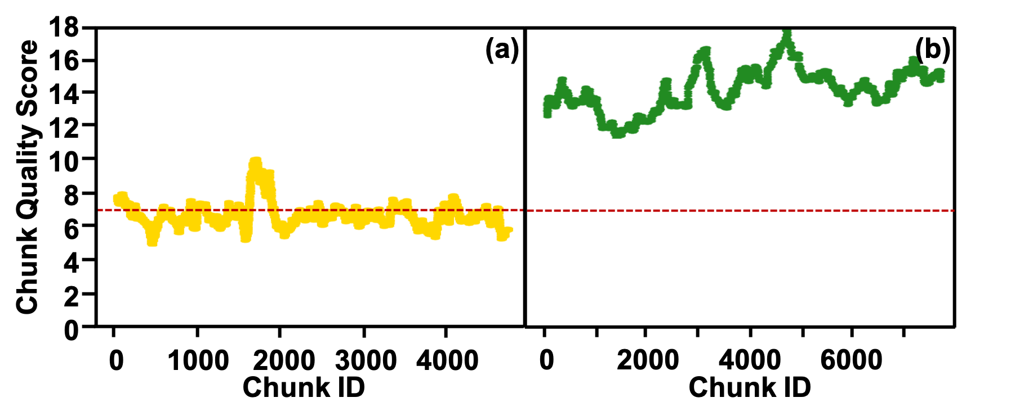
ER based on Chunk Quality Scores
Goal: Accurately estimate the quality of the entire read by checking the quality of a small number of sampled chunks
High-quality
Threshold: 7
Low-quality read
High-quality read
Low-quality
Observation 1: The range of quality scores for the chunks extracted from high-quality reads is greatly higher than that from low-quality reads
Observation 2: A single chunk’s quality score is not enough to predict the read quality score because there are many chunks whose quality scores are larger than 7
Observation 3: Consecutive chunks’ quality scores are usually close to each other, indicating that sampling consecutive chunks may not be representative enough to estimate the quality of an entire read
Sample a small number of non-consecutive chunks evenly in a read
to predict the read quality
Notes:
The goal of ER based on the chunk quality scores is to accurately estimate the quality of the entire read by checking the quality of a small number of sampled chunks
To achieve the goal, we study the chunk quality score in both low-quality read and high-quality read. 7 is the threshold
We have 3 main observations.
[CLICK] First, The range of quality scores for the chunks extracted from high-quality reads is greatly higher than that from low-quality reads
[CLICK] Second, A single chunk’s quality score is not enough to predict the read quality score because there are many chunks whose quality scores are larger than 7
[CLICK] Third, Consecutive chunks’ quality scores are usually close to each other, indicating that sampling consecutive chunks may not be representative enough to estimate the quality of an entire read
[CLICK] Therefore, we conclude that ER based on chunk quality scores needs to Sample a small number of non-consecutive chunks evenly in a read to predict the read quality

Slide 38
ER based on Chunk Mapping
Key insight of ER based on chunk mapping: A read probably cannot be mapped to the reference genome if enough consecutive chunks in this read cannot be mapped to the reference genome
Mapping a small chunk provides too many possible mapping locations
1. Sample a small number of consecutive chunks in a read
2. Merge these small consecutive chunks into a big chunk
3. Map this big chunk to the reference genome to predict whether the read can be mapped or not
Notes:
The key insight of ER based on chunk mapping is that A read probably cannot be mapped to the reference genome if enough consecutive chunks in this read cannot be mapped to the reference genome
[CLICK] However, Mapping a small chunk provides too many possible mapping locations
[CLICK] Therefore, ER based on chunk mapping needs to Sample a small number of consecutive chunks in a read
[CLICK] Merge these small consecutive chunks into a big chunk
[CLICK] Map this big chunk to the reference genome to predict whether the read can be mapped or not

Slide 39
Architecture of GenPIP
Raw signals from the sequencing machine
1
3
4
5
Read Queue
In-memory
seeding
Chunk/read
& locations
PIM Basecaller
Read Mapping Controller
DP Units
(Dynamic Programming)
Signal
chunk
Chunk
Chunk &
locations
Chunk Buffer
Quality Score Calculation
for Each Base
Basecalled
chunk
Average Quality Score Calculator
Global Buffer
Mapping
result
Buffer
Base quality
scores
CQS
Quality score
2
PIM-CQS
PIM chunk quality score calculation
ER-QSR
Controller
ER-QSR
signal
Chaining score
ER-CMR
Controller
To storage
ER-CMR
signal
Sequence alignment result
ER-CMR
signal
a
Basecalling Module
c
GenPIP Controller
b
Read Mapping Module
Notes:
GenPIP has three main modules, basecalling, read mapping and GenPIP controller
[CLICK]

Slide 40
In-memory Seeding
Basecalled
chunk from the GenPIP controller
A list of possible locations to the read mapping controller
Query String Generator (QSG)
Chunk
eDRAM Buffer
QSG
Query
ReRAM-based RAM
(stores the possible locations
i.e., values in the hash table)
A substring from a chunk
ReRAM
CAM
…
(key)
Possible locations
c
…
Addr.
a
b
…
d
…
h
g
f
e
QSG
Query
ReRAM-based RAM
(stores the possible locations
i.e., values in the hash table)
Generated query string
ReRAM
CAM
(key)
Addr.

Slide 41
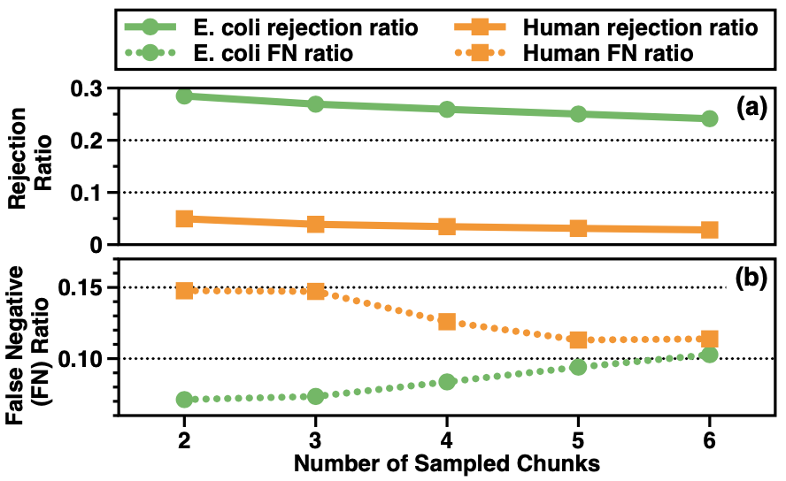
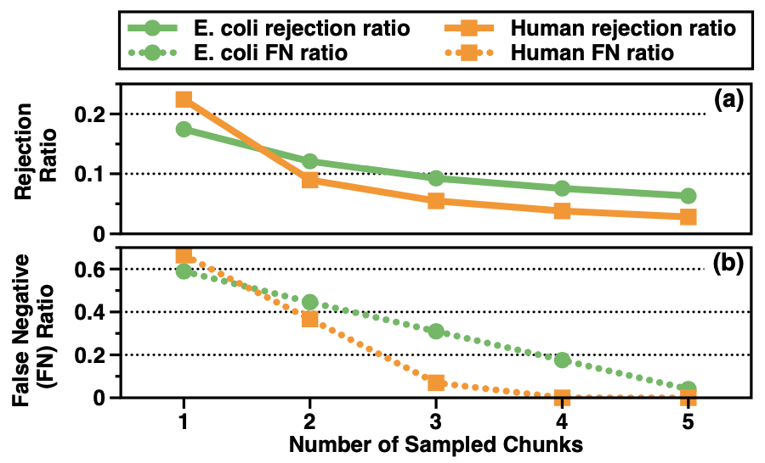
Key Results – Sensitivity Analysis
Early rejection based on the chunk quality scores
Early rejection based on the chunk mapping
Early rejection based on the chunk quality scores technique uses two and five sampled chunks for the E. coli and human datasets, respectively.
Early rejection based on the chunk mapping technique uses five and three sampled chunks for the E. coli and human datasets, respectively.
Notes:
Early rejection based on the chunk quality scores technique uses two sampled chunks for the E. coli and five chunks for human dataset
Early rejection based on the chunk mapping technique uses five and three sampled chunks for the E. coli and human datasets

